Slide 1
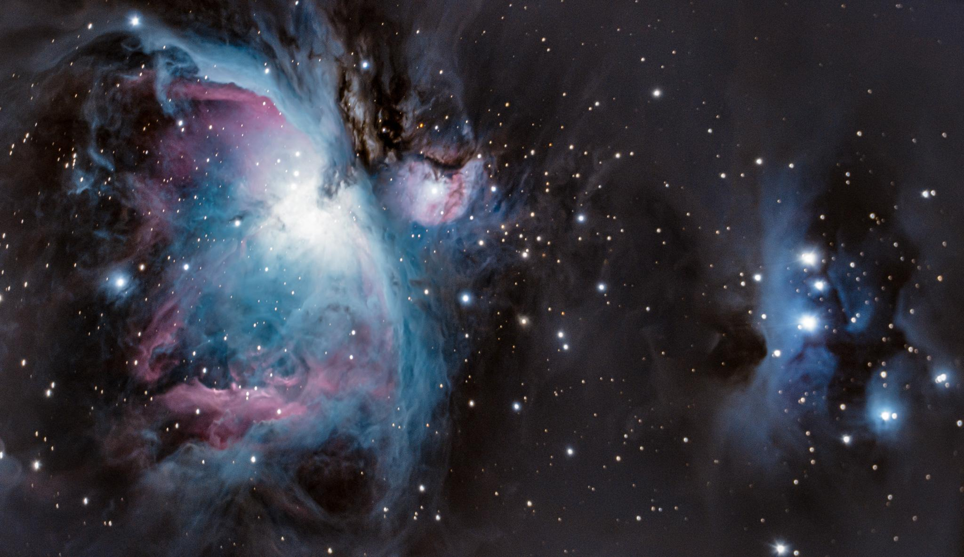
Spectral Telescope for Star Classification by Main Sequence (STSC-MS)
Notes:
Addison: I will speak here and introduce the group since I have the next slide

Slide 2
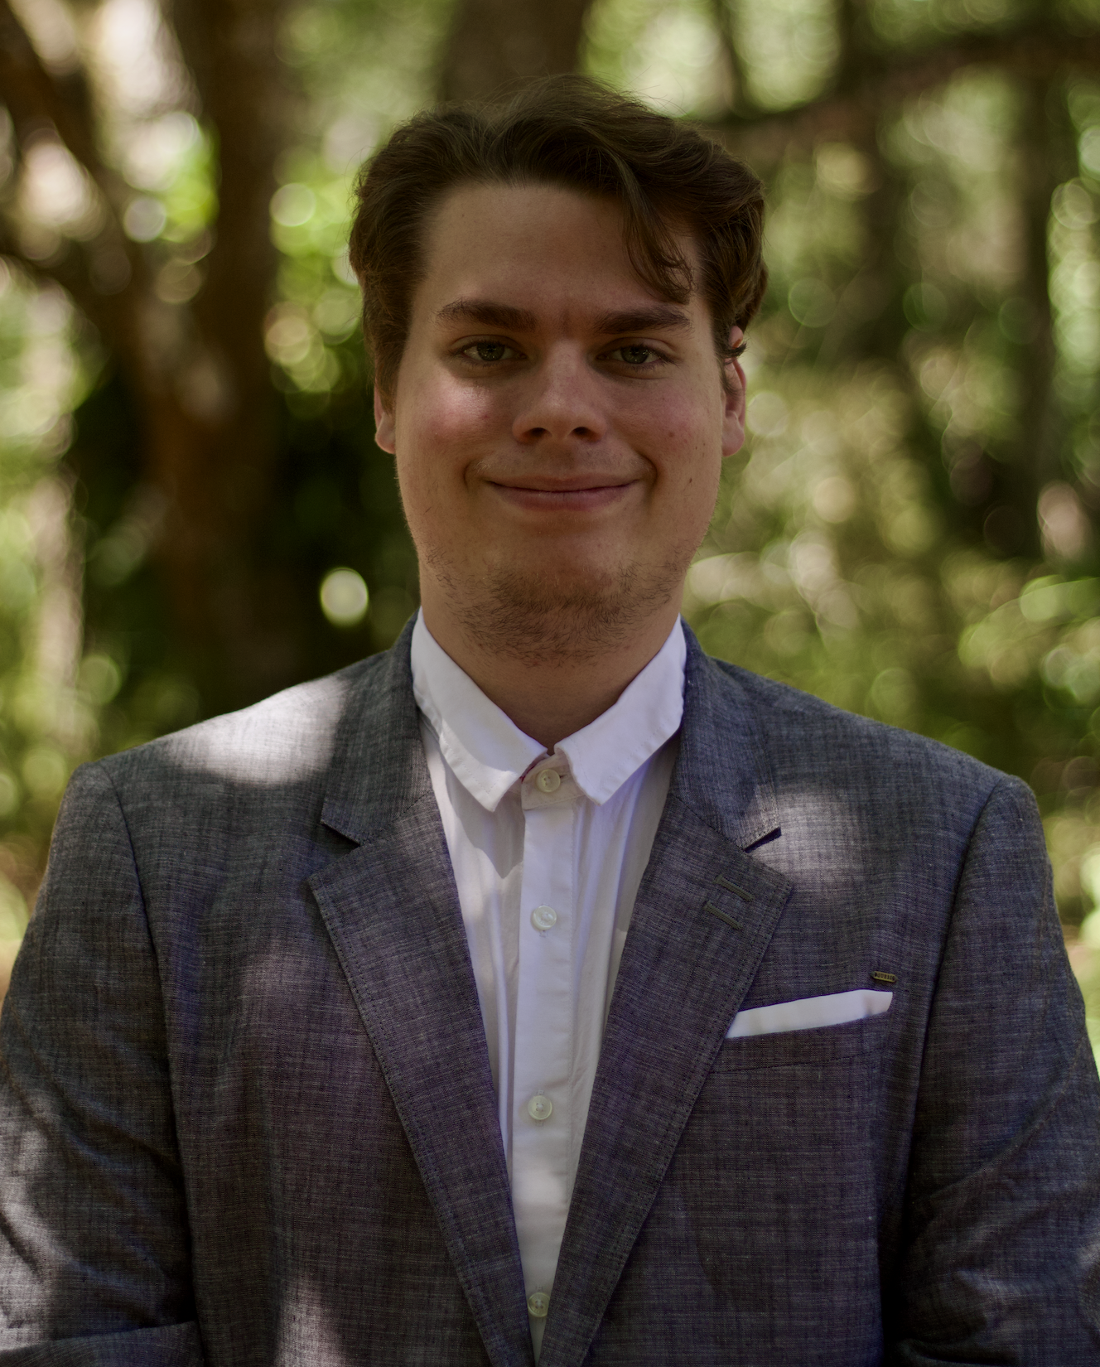
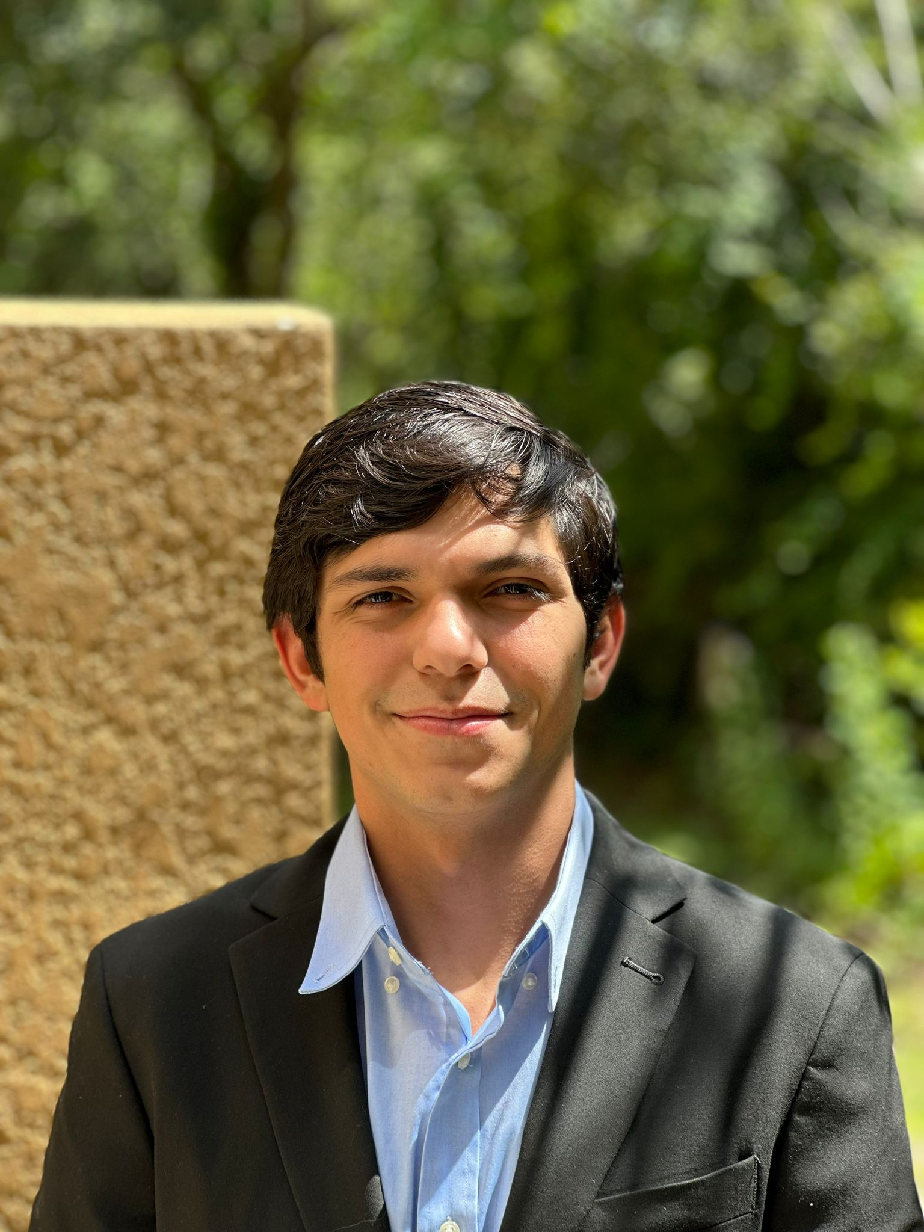
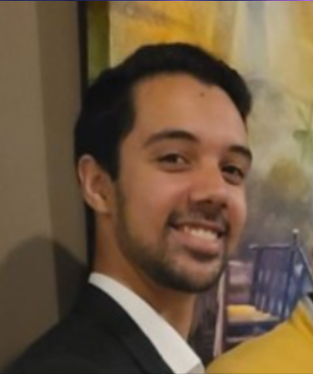
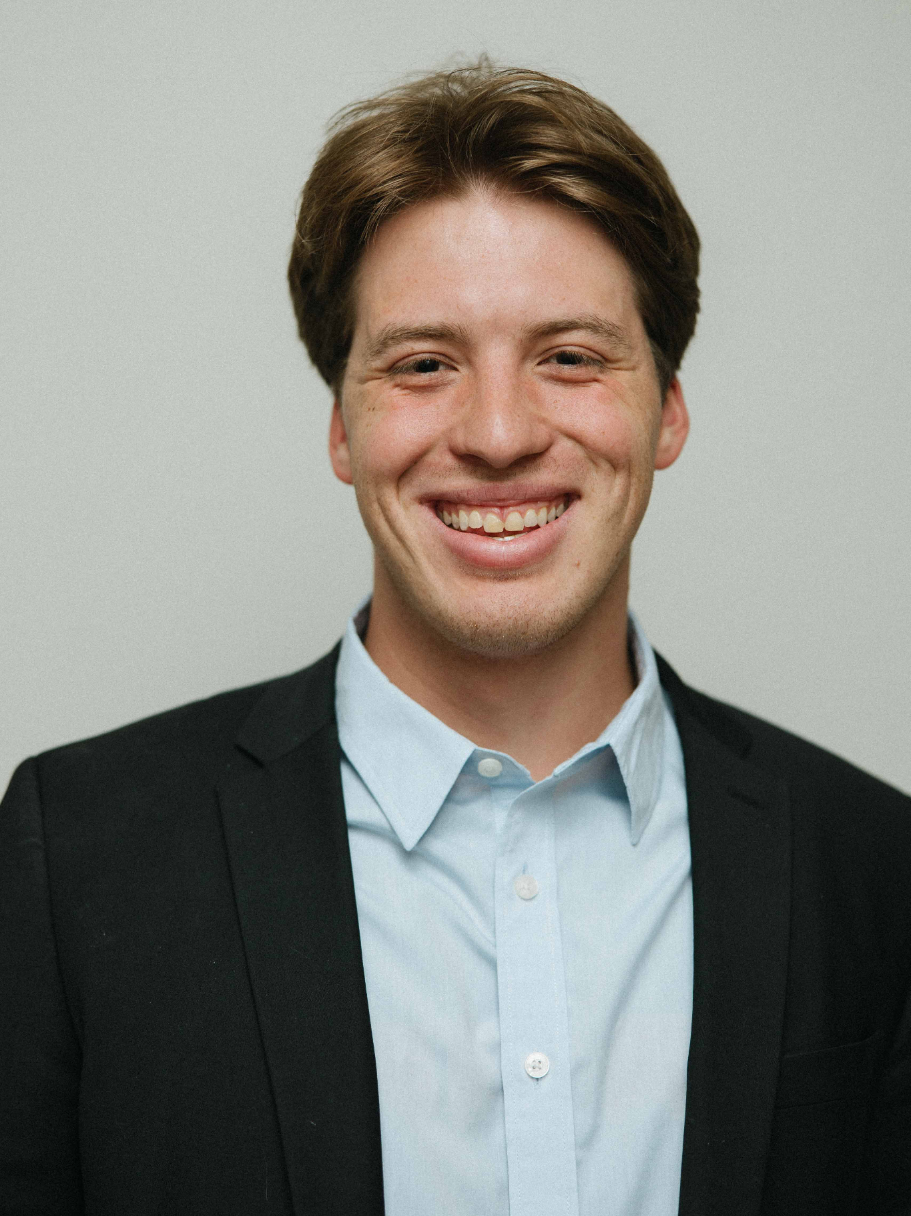
Meet Group 3!
Addison Long
Photonic Science and Engineering
Aaron Moreno
Computer Engineering
Alejandro Olivo
Computer Engineering
Sebastian Rowe
Electrical Engineering
Notes:
We will all present ourselves
(If you would like to use a script) Script: My name is [INSERT NAME HERE] and I am in the [INSERT COLLEGE HERE] program.
Ex: “My name is Alejandro Olivo and I am in the Computer Engineering program.”

Slide 3
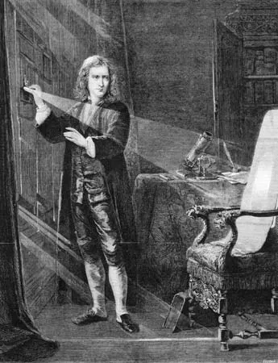
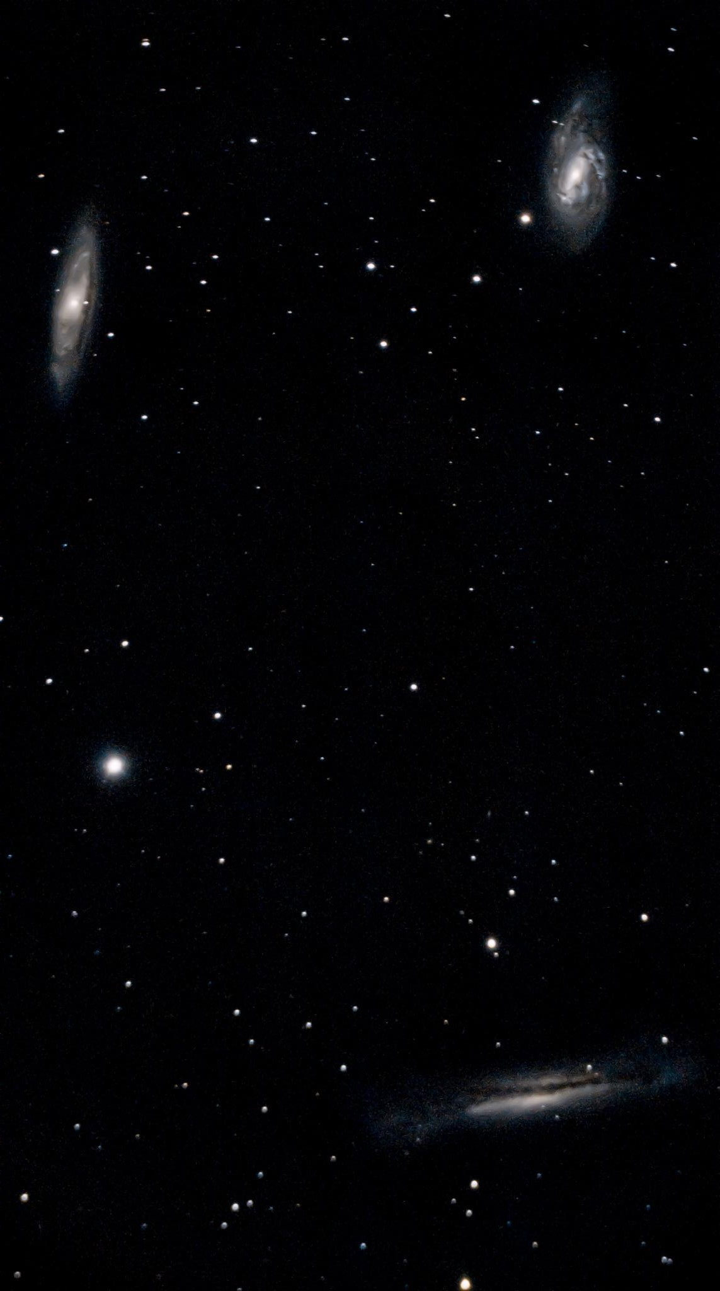
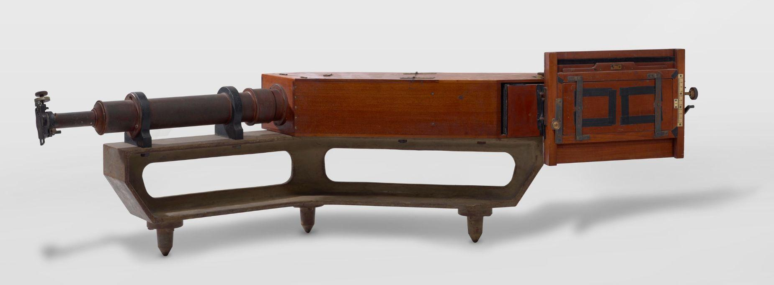
Motivation and Background
Addison Long
Photonic Science and Engineering
Curiosity
Market opportunity
Modern Resources
Notes:
Addison will speak
The night sky is home to many nebula, stars, and galaxies. In my time doing astrophotography, I have taken many photos of various deep sky objects, and the results are always fascinating, but the images I take lack information. I, like many other curious hobbyist astronomers, turn to spectroscopy. Spectroscopic methods enable us to thoroughly analyze the light from these deep-sky objects to infer their properties. The first spectrograms were initially gathered by Sir Isaac Newton of the Sun by simply placing a prism in the shutter of his window. Later, spectrograms were taken on film, but now, in the modern age, precisely machined ruled diffraction gratings are affordable, digital cameras are so sensitive to light that nearly every photon is captured, and auto-tracking and guiding are now reaching the mainstream. There is an emerging market of astrophotographers and hobbyist astronomers, and as a team, we aim to create a product that is affordable and adaptable to enable anyone to learn and explore the wonders of the cosmos.

Slide 4
Project Goals Met
Sebastian Rowe
Electrical Engineering
Basic Goals
Broad Spectrum survey capabilities
User Interface implementation
General Control PCB
Intermediate Goals
Temperature Classification
Interfacing SE mount for guiding and tracking
Imaging survey capabilities
Stretch Goals
Identification of spectroscopic binary star systems
Notes:
Record screen; Everyone present this part. Addison will edit the good parts

Slide 5
Objectives Met
Sebastian Rowe
Electrical Engineering
Basic Objectives
Spectrum acquisition
Raspberry pi Control circuit
Tracking with 20 seconds of exposure time with trailing not exceeding 2 seconds of arc
Intermediate Objectives
Implementation of PHD2
Stretch Goal Objectives
480mb/s file transfer rate to personal computer
Notes:
Record screen; Everyone present this part. Addison will edit the good parts

Slide 6
Specifications and Requirements
Component | Specification | Parameter
Tracking Mount | Position accuracy, weight, motor input power, PCB input power | <15 arcminutes, <5 lbs, 12 VDC, 5 VDC
Diffraction Grating | Grating period & Grating type | 600 lines/mm & Ruled
Concave Mirrors | Spectral range & Focal length | 450nm-20um & 50 mm
Spectrometer | Spectral range | 450-700+ nm
Guide Camera | Pixel size & exposure time | 3.72 𝜇m & 1 s
Spectrometer Imaging Camera | Pixel size & exposure time | 3.72 𝜇m & 18 s>
Raspberry Pi | Clock speed | ∼3 GHz
Addison Long
Photonic Science and Engineering
Notes:
Addison will speak
At a spectral resolution of around 1 nm, we can resolve spectral features such as absorptions and emissions; with these details, we can perform general stellar spectral classification. With auto tracking and guiding at a rate lower than 25 arc mins in altitude and azimuth, we can take long exposures and pull out faint details. We hope to surpass my current tracking rig accuracy and achieve a tracking error of less than 25 arc mins in altitude and azimuth. At nearly 1 full degree of error in both altitude and azimuth, I managed this image of the M3 globular cluster with nice round stars, none of them stretching more than a few arc seconds. At a full 60 seconds of exposure time per subframe, we can be sure that our mount tracks are accurate enough to gather plenty of photons from even the dimmest sources while preserving fine details of the spectrum.

Slide 7
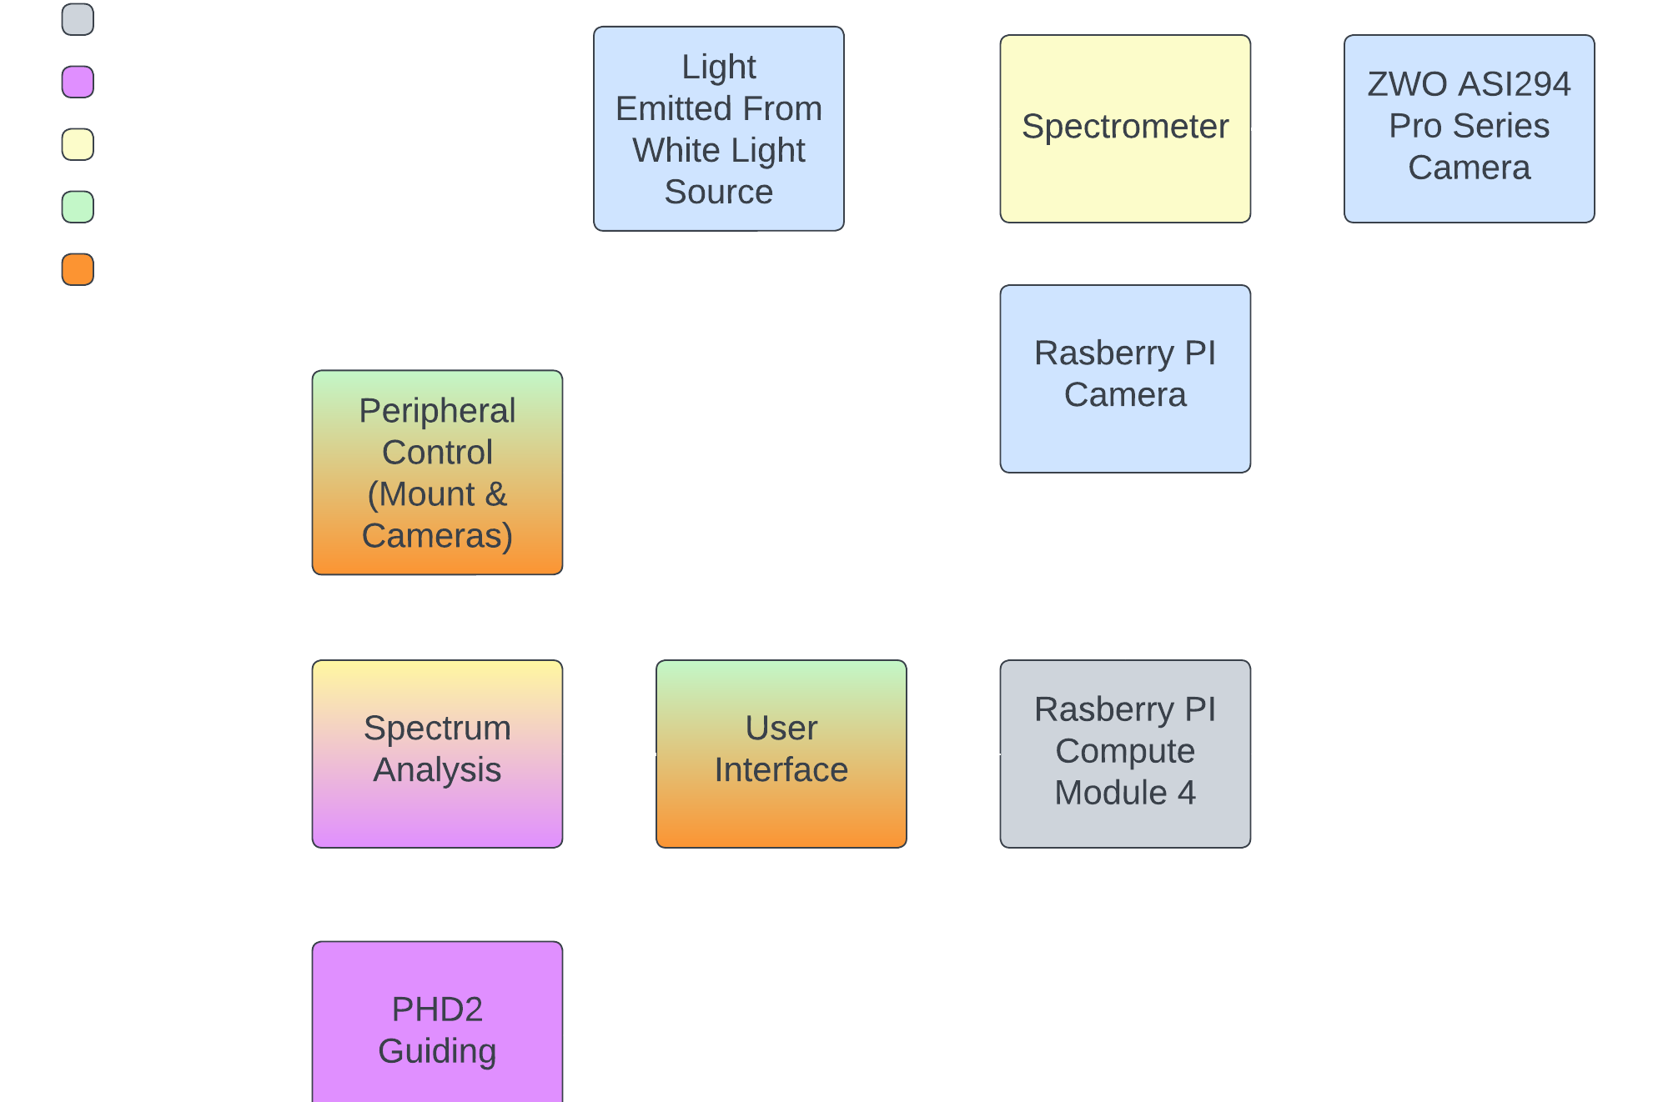
Overall Project Block Diagram
Aaron Moreno
Computer Engineering
Notes:
Aaron will speak

Slide 8
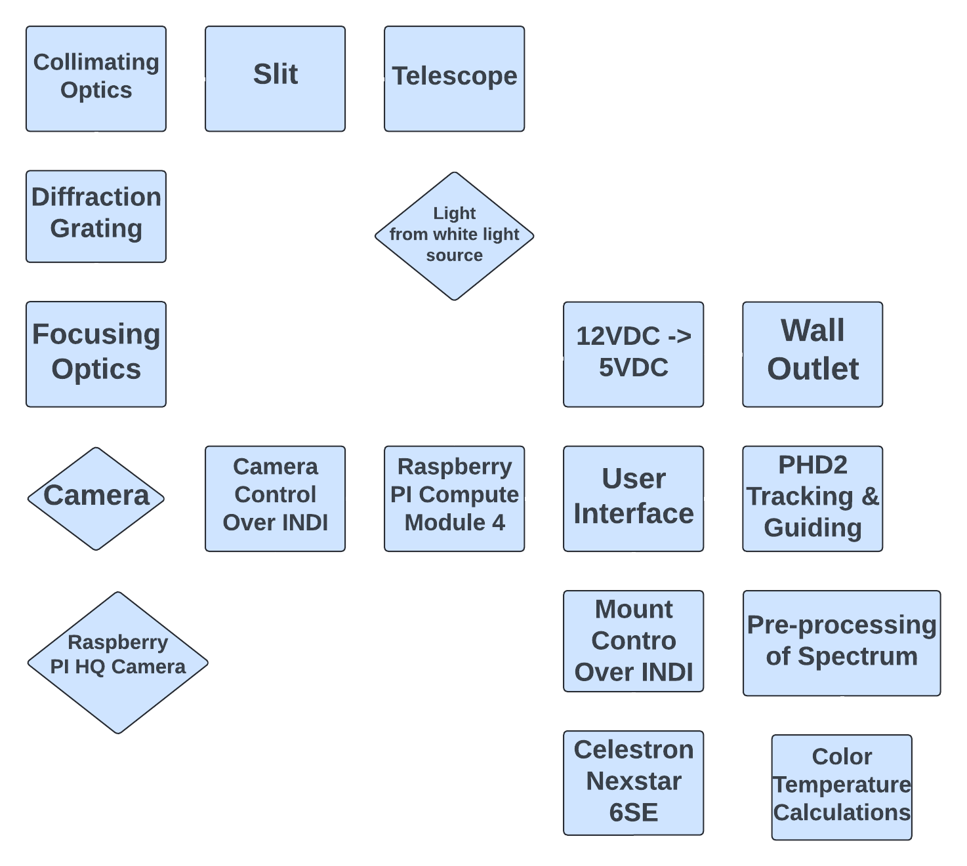
Operational Project Flow Diagram
Aaron Moreno
Computer Engineering
Notes:
Aaron will speak

Slide 9
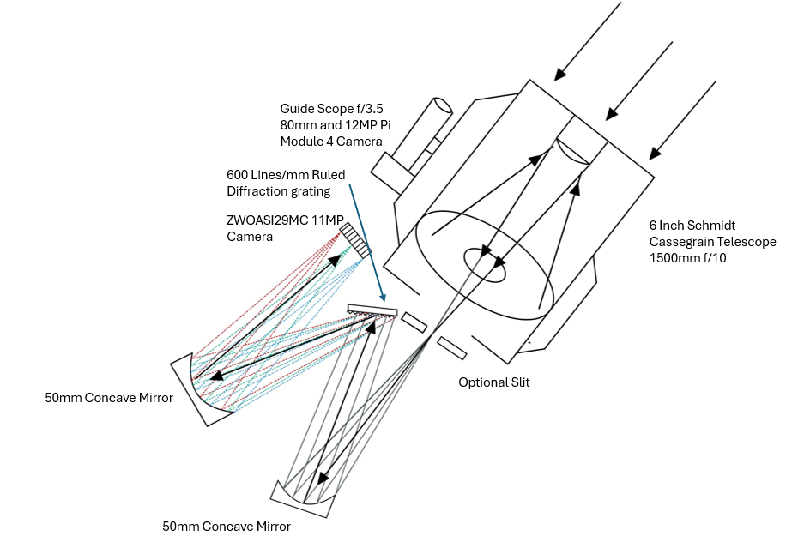
Project Design Approach
Addison Long
Photonic Science and Engineering
Notes:
Addison - Optics
When we decided to take on the challenge of capturing stellar spectra, we first had to identify all the complicating factors. First, individual stars are very dim, so gathering enough light for spectroscopy is difficult. We opted for a fully catoptric system to ensure we lose as little light as possible. However, that is only one piece of the puzzle. To maximize the signal, we need to take long exposures; star trails are evident because of the earth's rotation, even at short exposures. To combat earth's rotation, we need a tracking and guiding setup. I will now pass it on to Aaron to explain how we are going to approach the tracking and guiding problem
Aaron - CPE

Slide 10
Hardware Selection for the Spectrometer System
Addison Long
Photonic Science and Engineering
Component | Parameter | Purpose | Quantity | Cost
ZWOASI294MC Pro | 11MP Cooled Camera | Plenty of resolution and cooled camera give greater sensitivity to 700nm and longer wavelengths. | 1 | $999 (Already Owned)
Diffraction Grating | 600 Lines/mm | Spectrum fills camera sensor | 1 | $80
Concave Mirror | 12.7mm Diameter 50mm Focal Length | First mirror collimates the light second focuses the spectrum into the camera. | 2 | $43
Notes:
Addison will speak about cameras & optics
For the spectrometer diffraction Grating, I selected a 500line/mm ruled grating to ensure 1 nm wavelength separation while ensuring we can fit a spectrum from 400-700nm on the camera sensor. To prevent chromatic aberrations and signal loss, our system is catoptric with no transmissive elements other than the Schmidt Corrector plate for the telescope.
For the mirror choice, I decided to use silver-coated first surface mirrors for greater than 90% efficiency from 400nm-20um. For this project we will be using a Cooled Deep sky camera for its superior sensitivity. However, this system is not limited to a specific camera. It is adaptable to any camera given a 1.25 inch nosepiece adapter. Just like the camera, the telescope is also adaptable. The spectrometer is designed around the F/10 6 inch SCT from celestron. This telescope has a long focal length of around 1500mm, and the relatively slow f/# enables us to pick out stars easily, reducing spectrum contamination from background stars. However, this spectrometer can be easily adapted to any telescope, ensuring that it can cater to your specific equipment and needs.

Slide 11
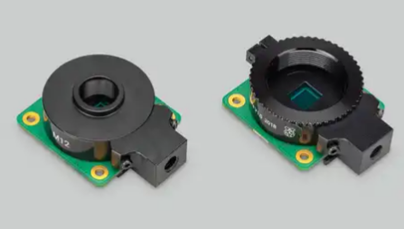
Guide Camera Selection
Aaron Moreno
Computer Engineering
Guide Camera | Sensor | Lens Mount | Resolution | Pixel Size | Cost
Camera Module 3 | Sony IMX708 | N/A | 11.9 Megapixels | 1.4 µm x 1.4 µm | $25
HQ Camera | Sony IMX477 | C/CS- or M12-mount | 12.3 Megapixels | 1.55 µm x 1.55 µm | $50
GS Camera | Sony IMX 296 | C/CS | 1.58 Megapixels | 3.45 µm x 3.45 µm | $50

Slide 12
Software Selection
Programming Language | Attributes
C | Low-level design
 | Portability
 | Extensibility
Python | Extensive library
 | Ability to analyze data
 | Support of programming paradigms
Alejandro Olivo
Computer Engineering
Notes:
Alejandro will speak

Slide 13
Onboard Computer Selection
Aaron Moreno
Computer Engineering
Onboard Computer | Processor | Max Ram | GPIO | Onboard GPU | Cost
Raspberry Pi Compute Module 4 | Broadcom BCM2711, Quad-core Cortex-A72 (ARM v8) 64-bit SoC @ 1.5GHz | 8 GB | I2C, SPI, UART, PWM, SDIO, PCIe 1x lane, USB 2.0, MIPI DSI display port, MIPI CSI camera port | Yes | 75.00 $
NVIDIA Jetson Nano | Quad-core ARM® Cortex®-A57 MPCore processor @ 1.43GHz | 4 GB | GPIO, I2C, I2S, SPI, UART, USB 3.0, USB 2.0, HDMI, MIPI CSI | Yes | 129.00 $
BeagleBone Black | AM335x 1GHz ARM® Cortex-A8 | 512 MB | GPIO, I2C, SPI, UART, ADC, PWM | Yes | 72.54 $
Notes:
Aaron will speak

Slide 14
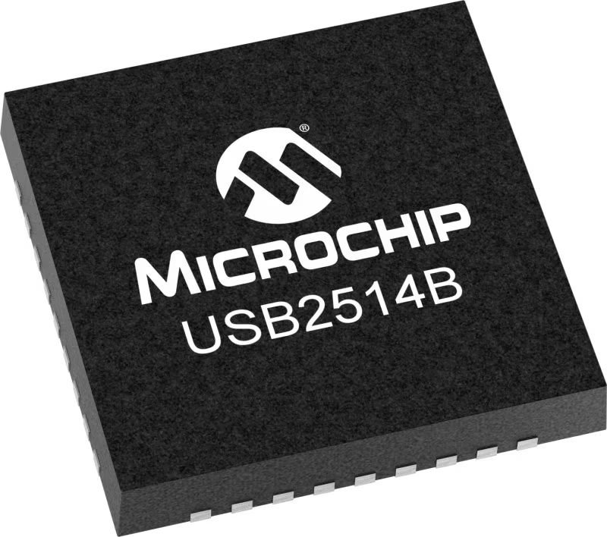
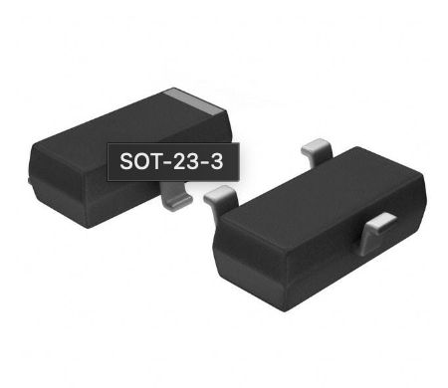
Peripheral I/O
Sebastian Rowe
Electrical Engineering
4x USB
To Support Keyboard, Mouse, Main Camera, Mount
MUX To support 4 USB Ports
Microchip USB2514B
1x HDMI
To Support External Display
Power Switch to ensure steady power flow through HDMI
Richtek Technology RT9742SNGV
2x CSI2
To Support Guide Camera and Stretch Board
Independent power line for Stretch Board
Notes:
SEBASTIAN

Slide 15
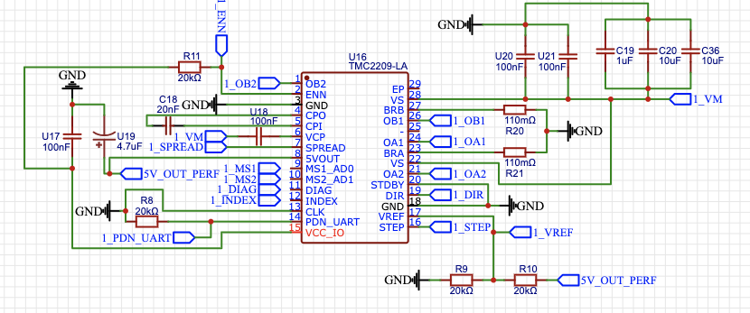
Stretch Board
Motor Control Board for Control of a custom mount
Communication over 12C from RPCM4 to PIC18 to Motor Drivers
Main PCB Built ready for addition of Stretch Board
Third Power Supply
2nd FPC Connector
Data lines to RPCP4
Motor | Step Angle | Torque | Cost
17HM19-1684S | .9 Degrees | .44 Ncm | $23.99
MIKROE-1530 | 5.625 Degrees | .03 Nm | $8.00
SF2421-10B11 | 1.8 Degrees | .29 Nm | $28.32
Sebastian Rowe
Electrical Engineering
Microcontroller | I/O | Vin | Cost
PIC18F26Q43 | 2x SPI, 1x 12C, 5x UART | 1.8-5.5V Vin | $2.23
ATMEGA328P (Arduino Mini Chip) | 23x GPIO, 1x USART, 1x SPI | 2.7-5.5V Vin | $1.52
ATMEGA328PB-AU (Arduino Uno R3 Chip) | 27x GPIO, 1x SPI, 1x UART | 2.5-5.5V Vin | $2.89
Driver | Microstepping | I-out | Cost
TMC2209 SILENTSTEPSTICK | 102,400 steps/rev | 1.4A-3A | $30.19
DRV8825 | 12,800 steps/rev | 2.5A-3A | $11.88
DM332T | 12,800 steps/rev | 1A-3.2A | $22.99
Notes:
Sebastian will speak
Taking this information into account and applying it to our use case, we believe it best to use a stepper motor as they provide a very high degree of accuracy and stability. Though it does not move very fast, it does not need to move very fast as the motions we will be making with the motor are very very small. Furthermore, our entire rig will not be that heavy (less than 10lbs) and therefore we can get away with not having a huge stepper motor to get enough torque to move our rig.
What kind of electromechanical motor?
DC Motors
Simple control
Good for continuous rotation
Limited precision
Servo Motors
High precision
Feedback control
More complex and expensive
Stepper Motors
High precision
Simple control for position
Suitable for incremental movements
Choice → StepperOnline 17HM19-1684S
0.9 degree Step Angle
44 Ncm Torque
Affordable

Slide 16
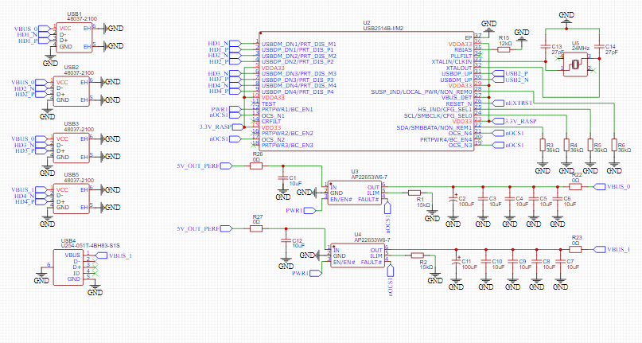
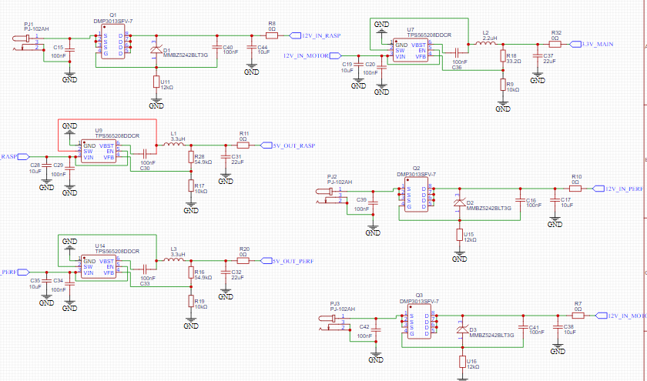
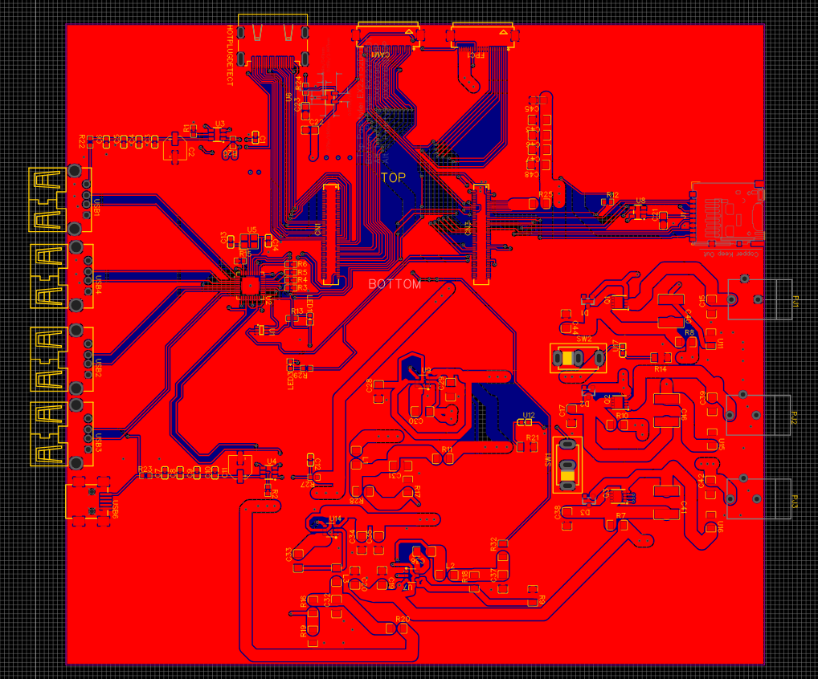
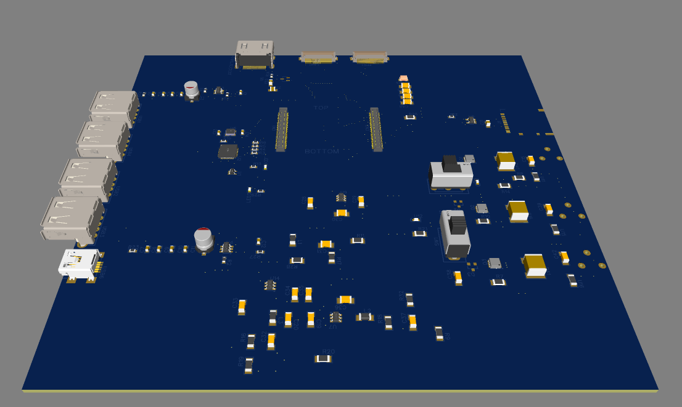
PCB Design
Key Features
Separate power line to reduce noise and voltage drop on raspberry pi VIN
2.64mm wide traces with 2 oz of copper to allow for up to 4 amps of current
Aaron Moreno
Computer Engineering
Notes:
Aaron will speak

Slide 17
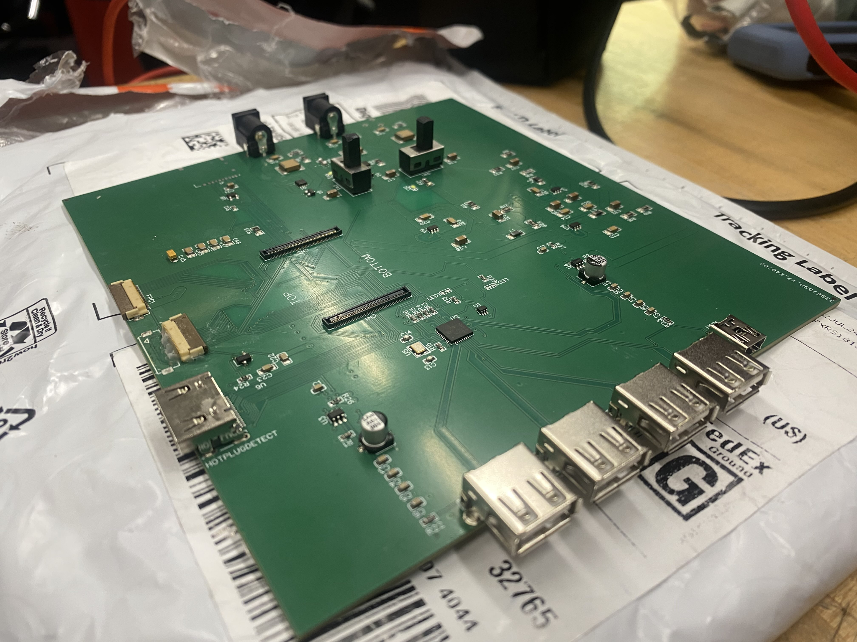
Main PCB v2
Sebastian Rowe
Electrical Engineering
Three Major Improvements
Male USB Ports swapped out for Female USB ports
Guide Scope CSI2 Data Line Polarity…
…and “Manual Adjustment” of the CSI2 Port orientation
Power Switches and LED Indicators
Notes:
Aaron will speak

Slide 18
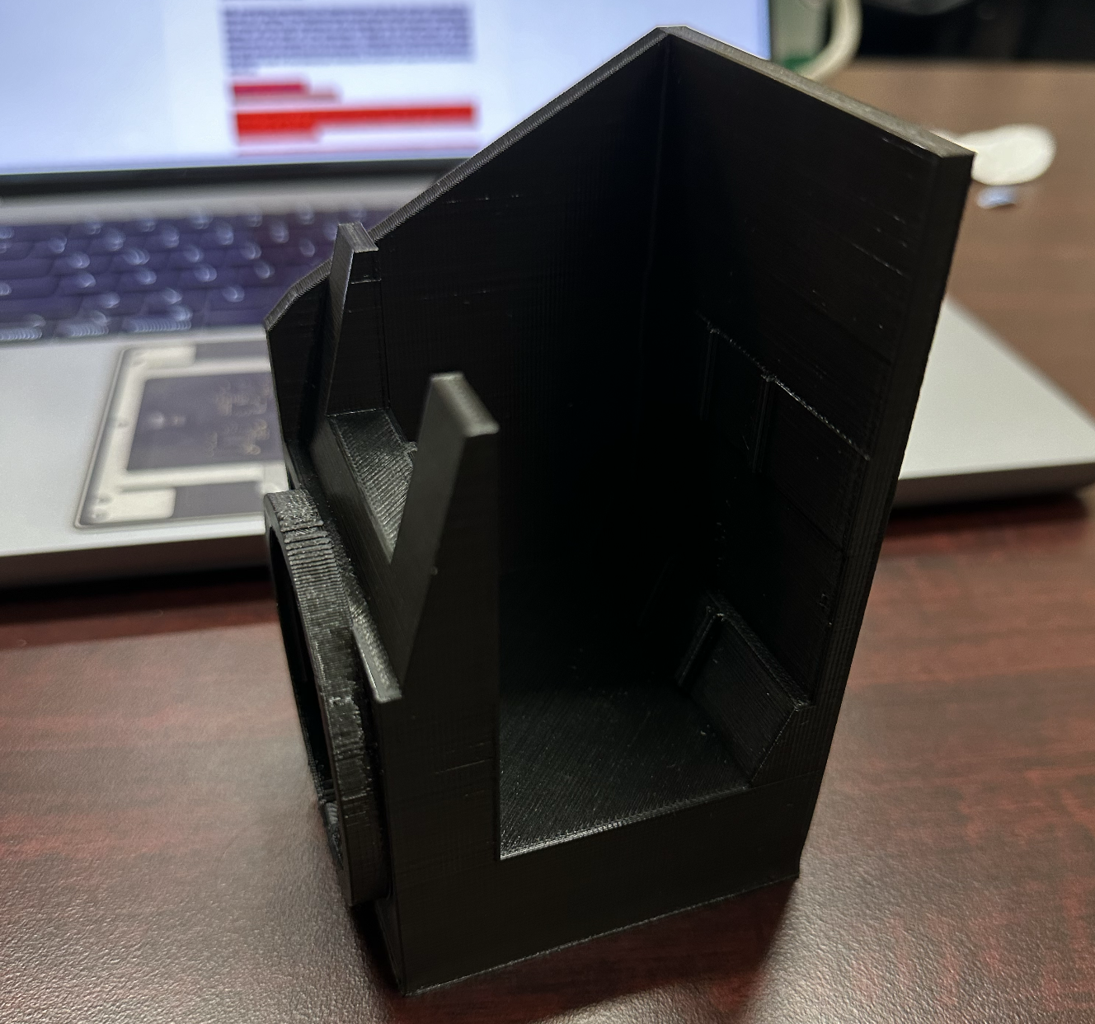
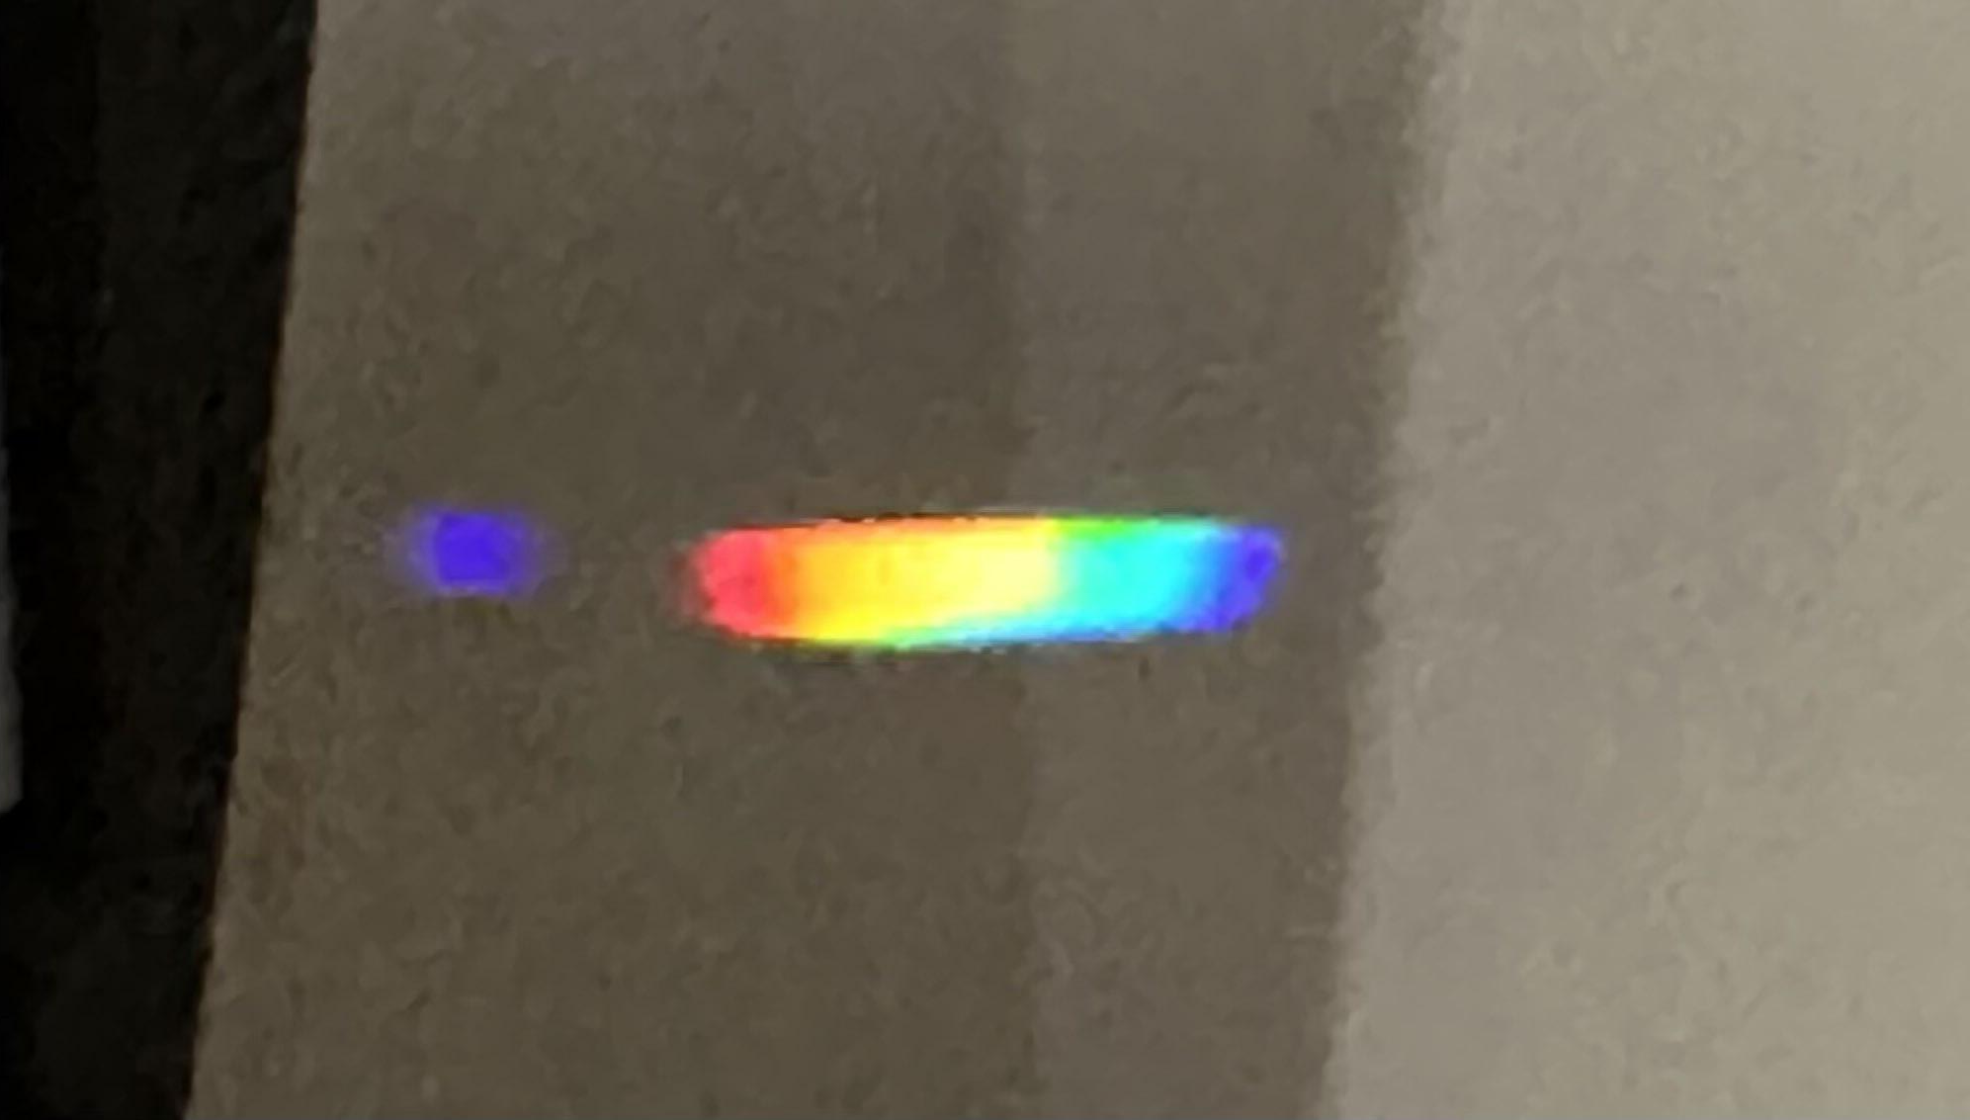
Spectrometer V1
Addison Long
Photonic Science and Engineering
Poor mirror mount method
No camera mount
No way to test on a star
Proof of concept
Notes:
Addison will speak
This is the first version of the spectrometer and it has many issues. First we mounted the mirrors using heavy duty double sided tape and because at this point in senior design we were not certain on what camera we wanted to use we just left a window that would allow us to project the spectrum onto a card. The tracking mount was not functional at this time so we had no way to test with a star but I was able to use a hand made cardboard slit and a camera lens I had to focus the light from my phone camera and create the spectrum you see on the card. We get a nice continuous spectrum but its sloppy since we are working in suboptimal conditions This was mostly a proof of concept and a confirmation of the simulation.

Slide 19
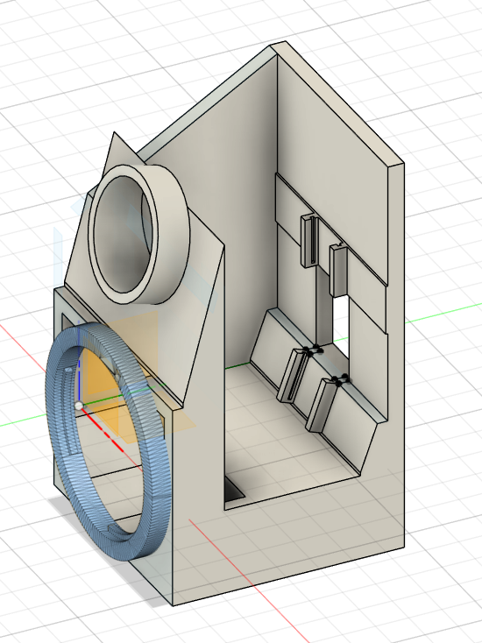
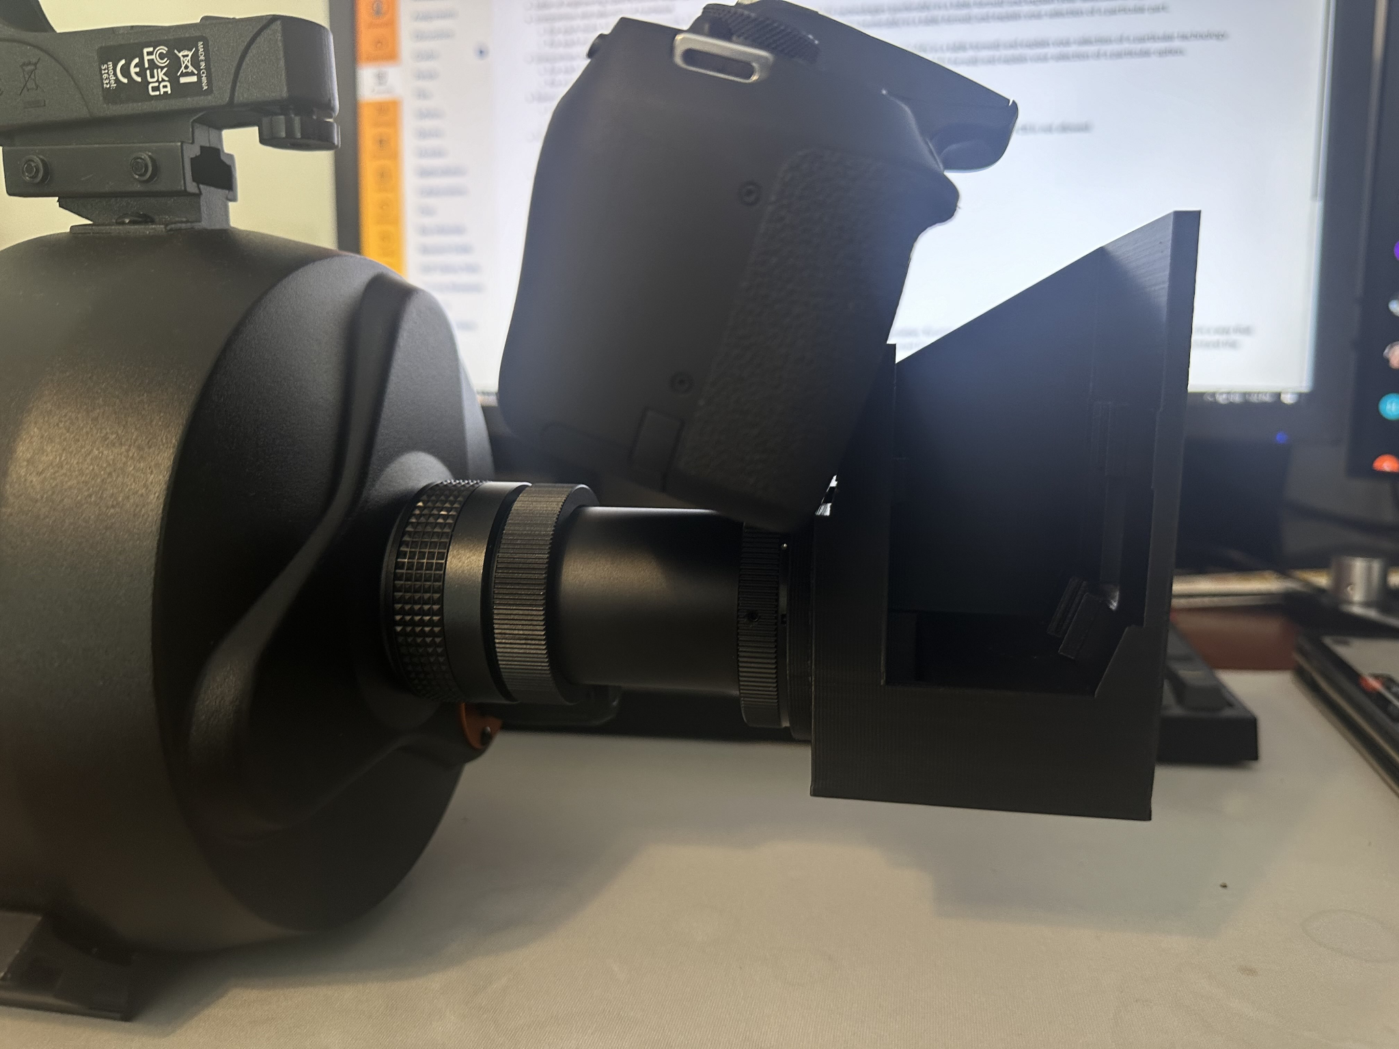
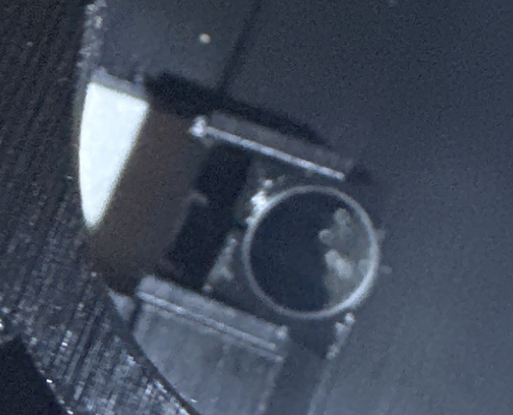
Early Design of Spectrometer
Addison Long
Photonic Science and Engineering
Unexpected print error
Sturdy
Telescope mount works
Fusion 360 model of V3
Notes:
Addison Speaks
Unfortunately, version 2 of the spectrometer is not usable. We needed to develop our own mirror mounting method for our product to work. Despite using proper dimensions in 3d cad, the actual 3d print was around .2mm too small, which prevented our mirror mount from working since we needed to be precise to properly tension the mirror to hold it in place. Despite being unable to test the spectrometer output on the camera, we could at least mount both the camera and telescope to verify that the print is sturdy and that the telescope's center of mass does not deviate too much. V3 is currently in the design stage our current 3d model has been adjusted for print error and the schematic was changed from Cannons EF mount to a 1.25inch nosepiece which is a more universal camera adapter

Slide 20
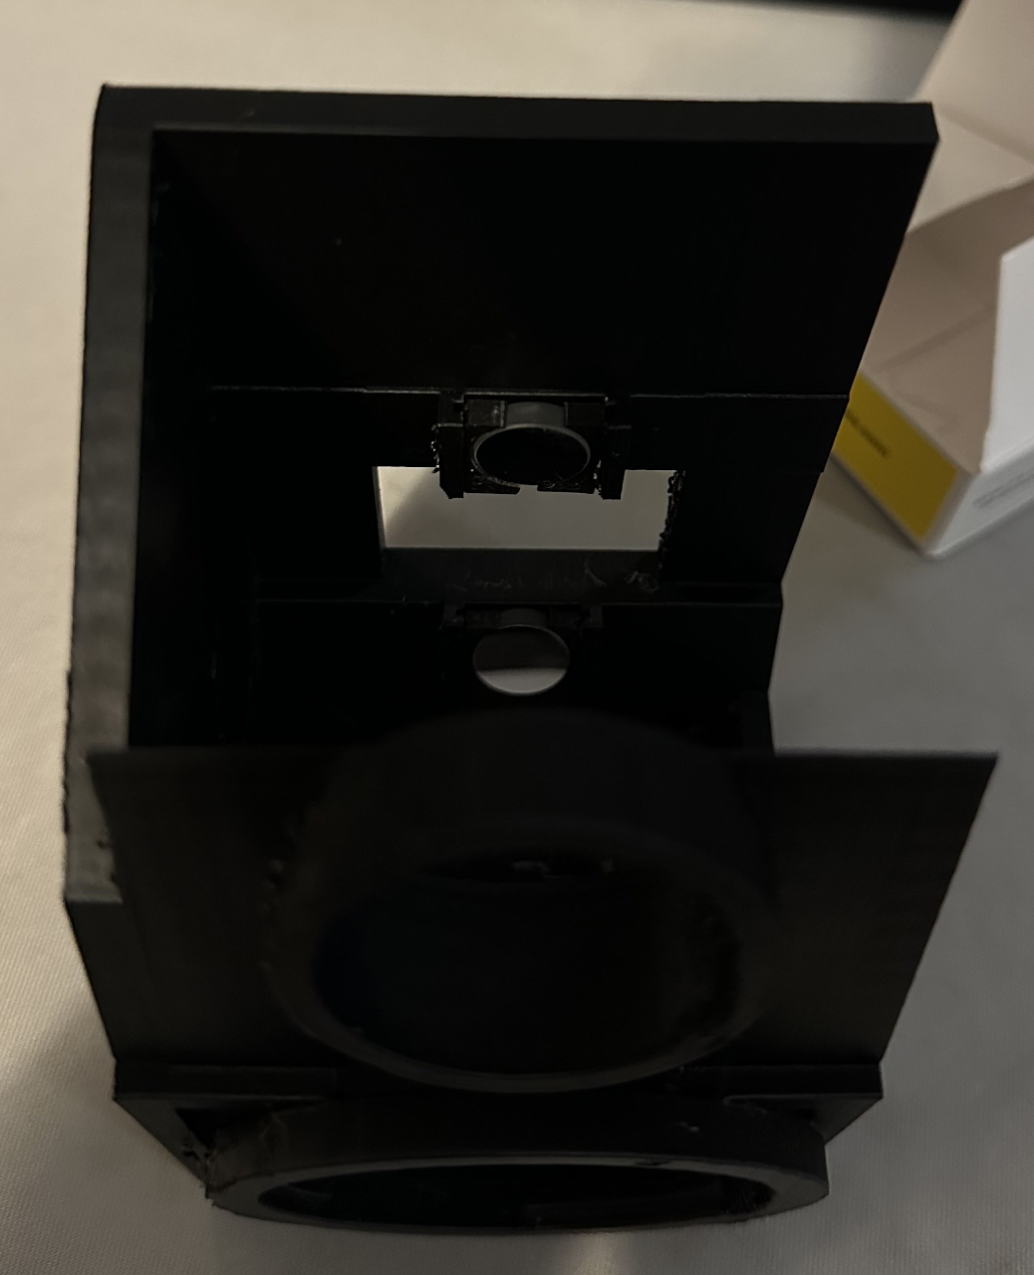
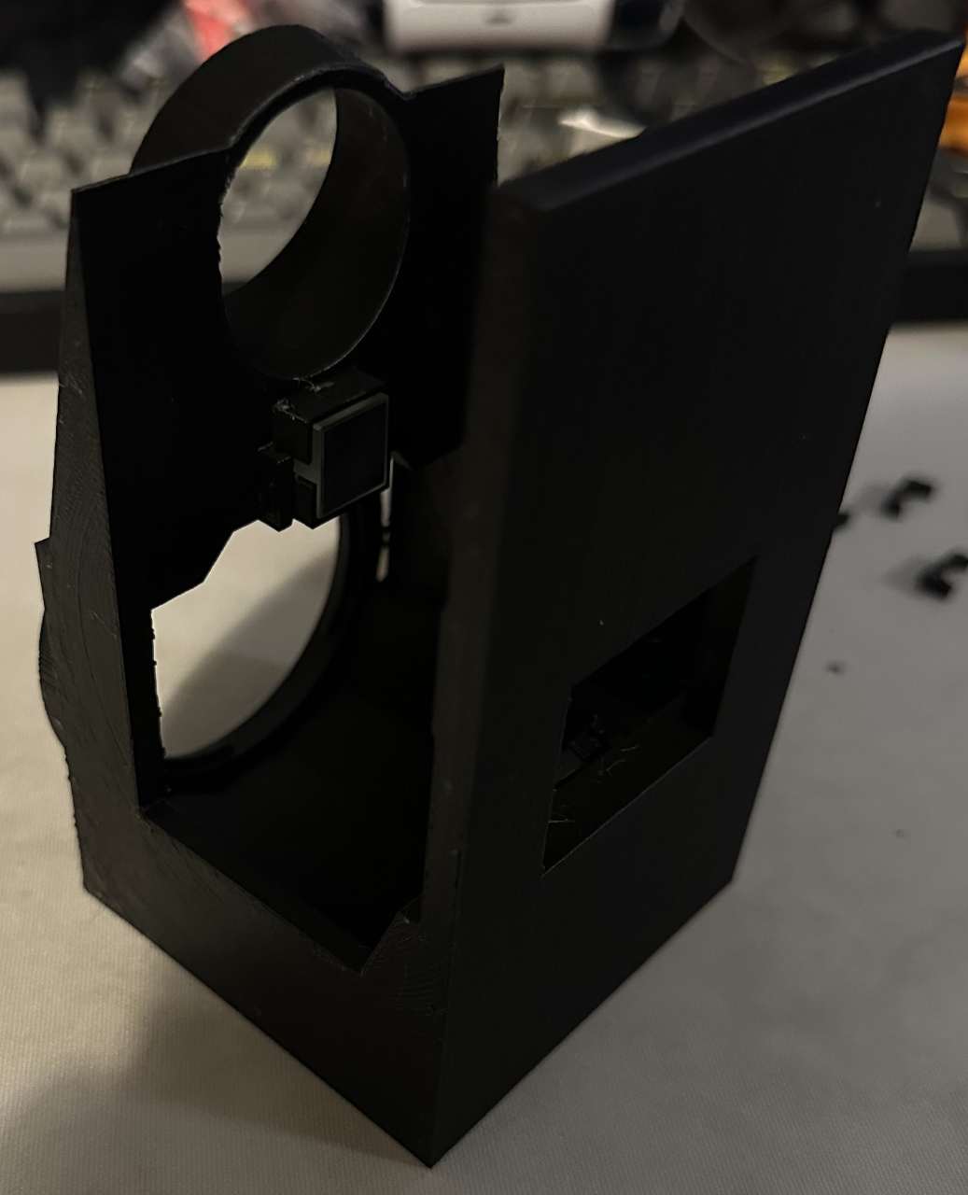
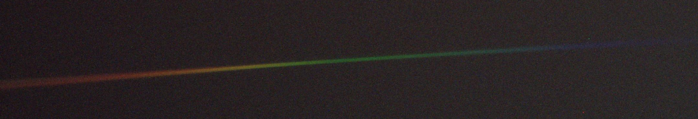
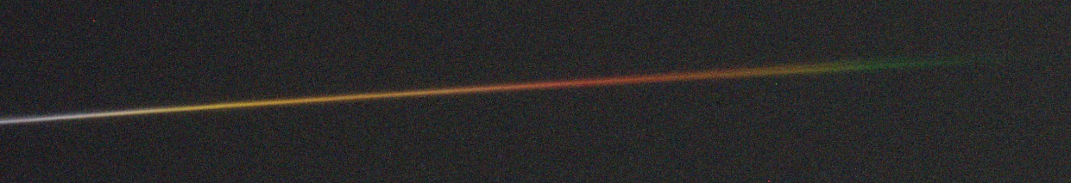
Final Spectrometer
Higher resolution print
Still has astigmatism
Full Spectral range
Adapter for ZWO camera
Addison Long
Photonic Science and Engineering
Rasalhague - Hot Spectroscopic binary temperature ~7500 kelvin
Arcturus - Cold star ~4300 kelvin

Slide 21
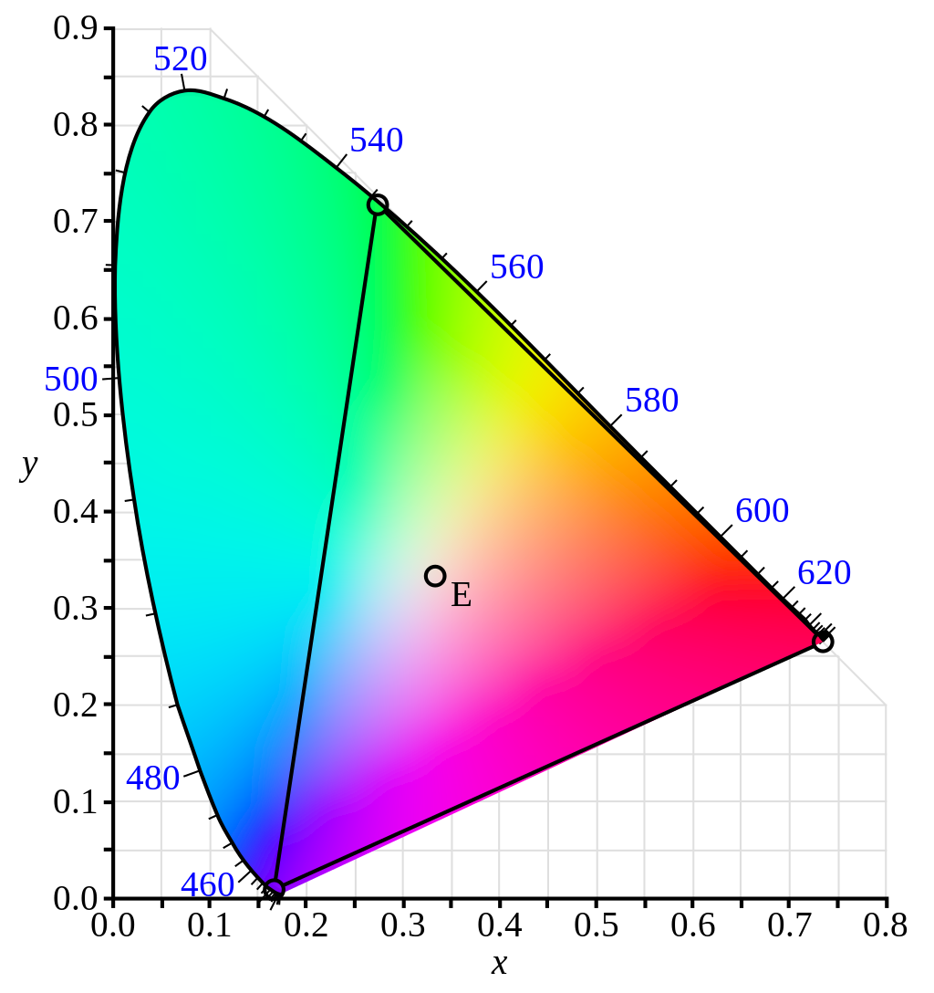
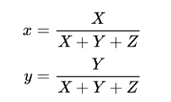
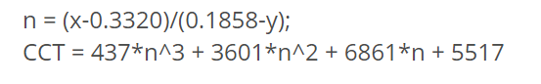
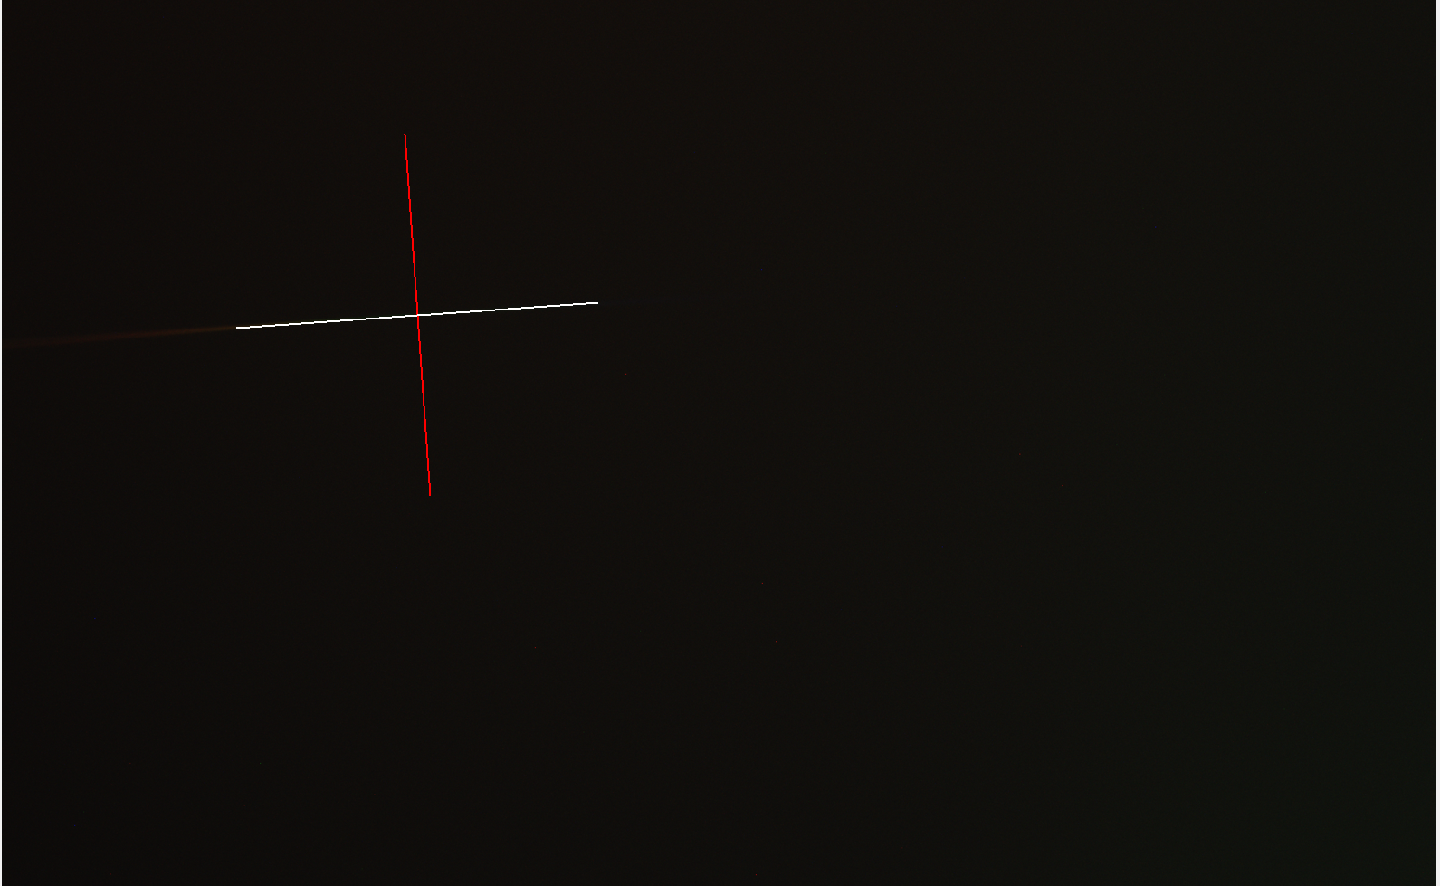
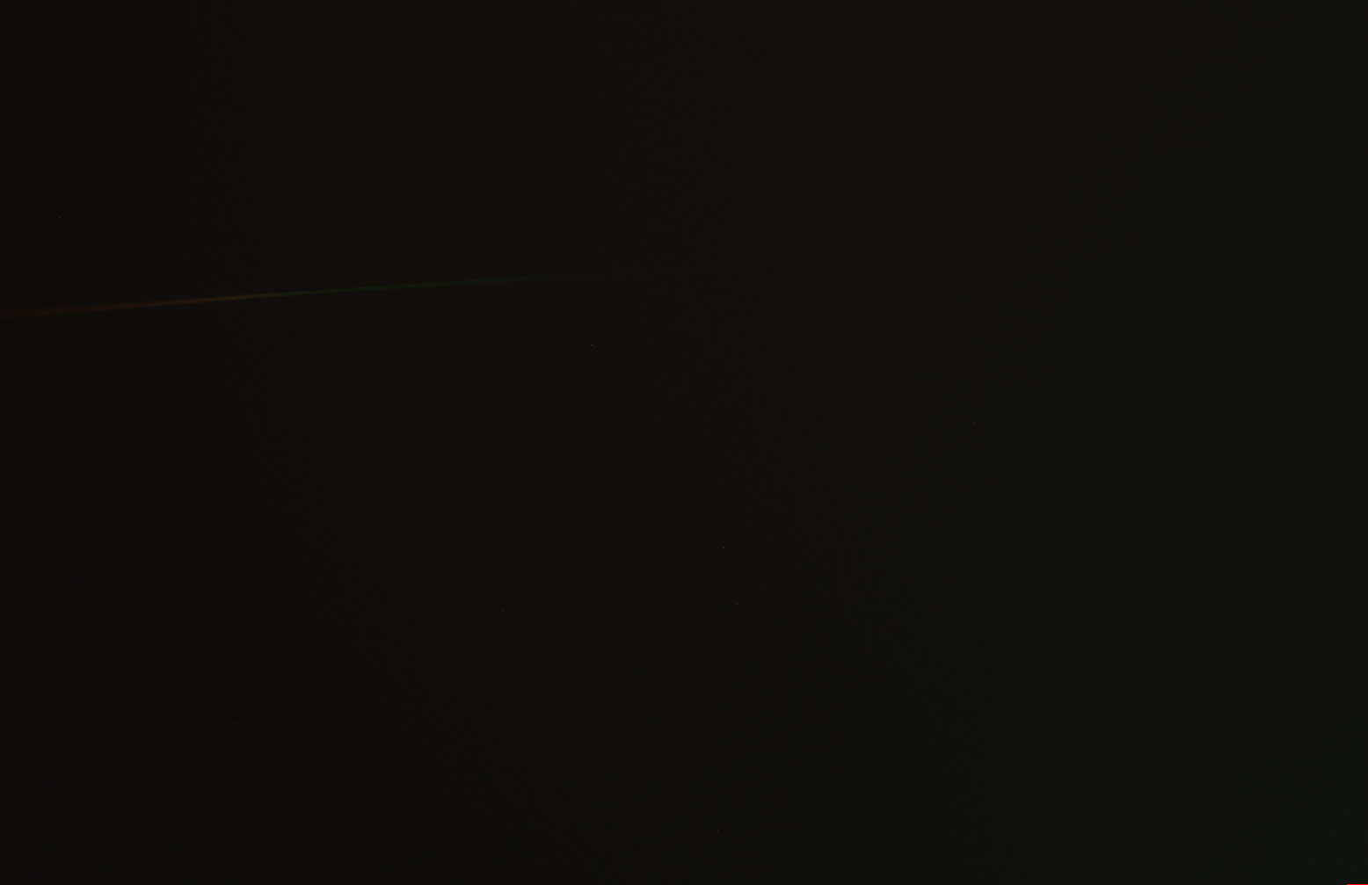
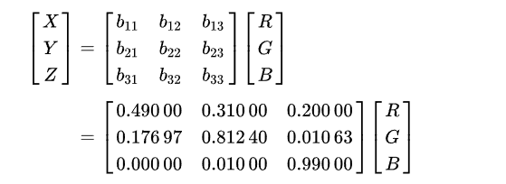
Spectrum Analysis Software
X-Y parameters for CCIE 1931
McCamy’s Approximation for Correlated color temperature
Aaron Moreno
Computer Engineering
Python Based
Supports Fits File type
Calculates Color Temperature based of CIE 1931 Color Space fundamentals
> 95% Color Temperature Accuracy
XYZ to RGB for CIE 1931
Expected Color Temperature of Rasalhague : 7880 K - 8050 K
Resulting Color Temperature of Rasalhague : 8323.107 K

Slide 22
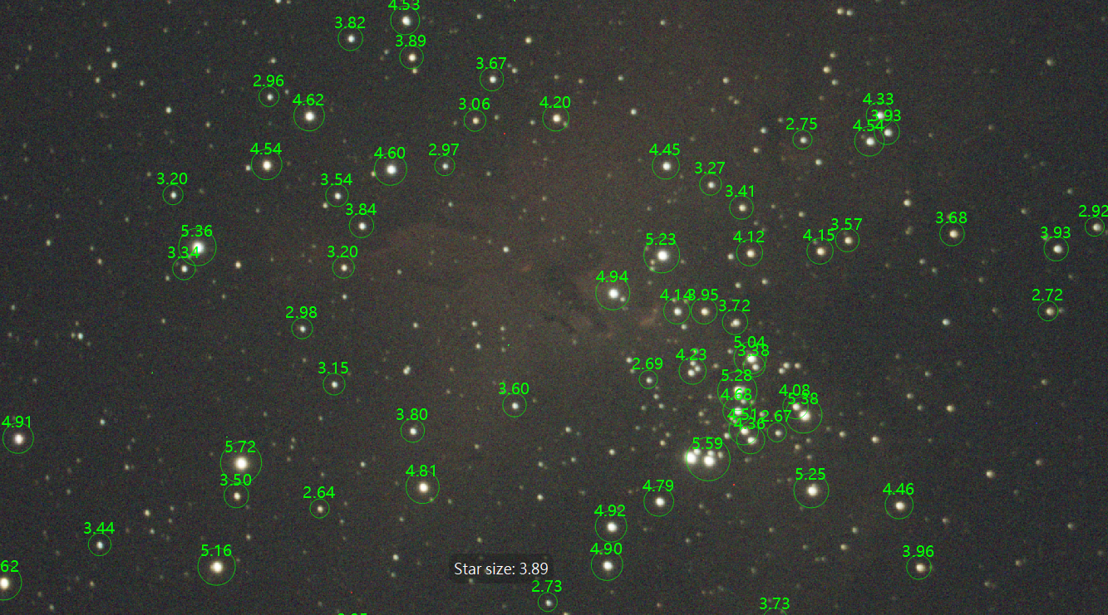
System Tracking Accuracy
Single 20 second exposure of the pillars of creation
Average star size of 3.89 arcseconds
Atmosphering distortion causes 2 seconds of arc bloating
Addison Long
Photonic Science and Engineering

Slide 23
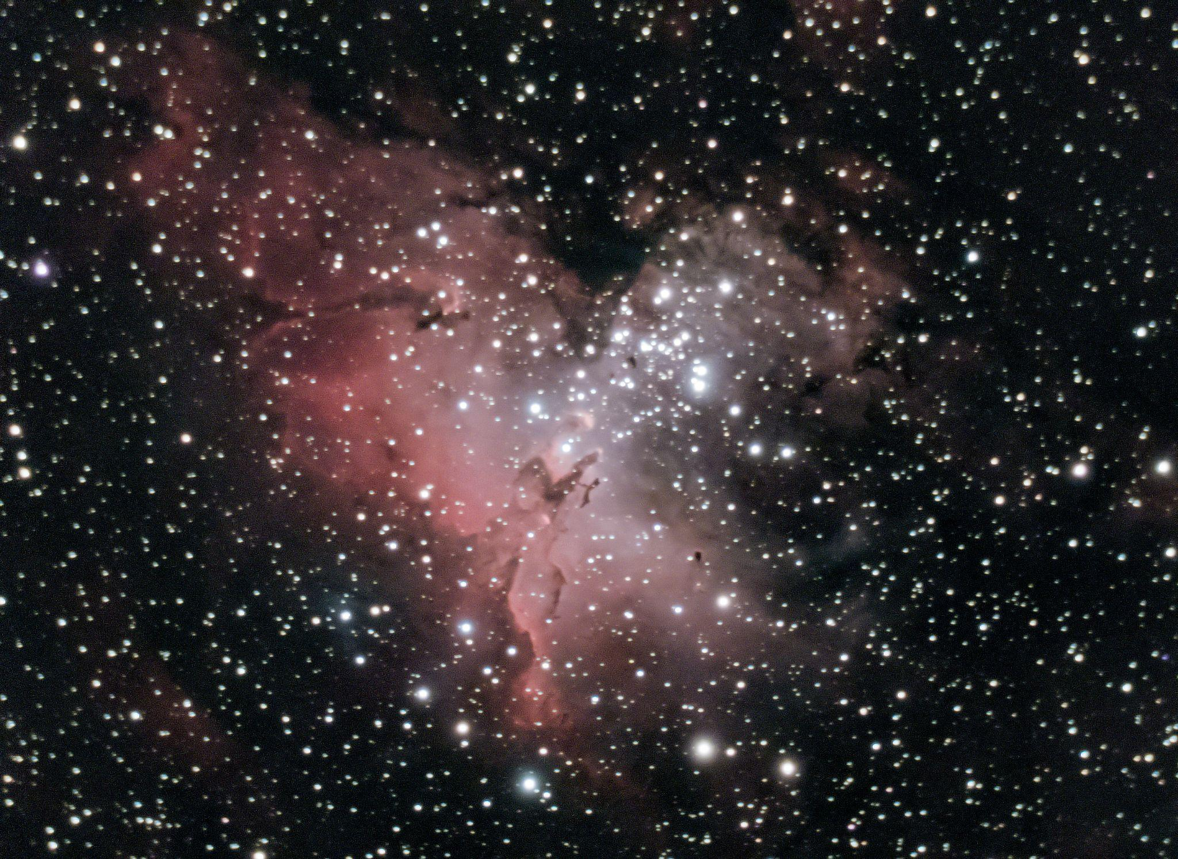
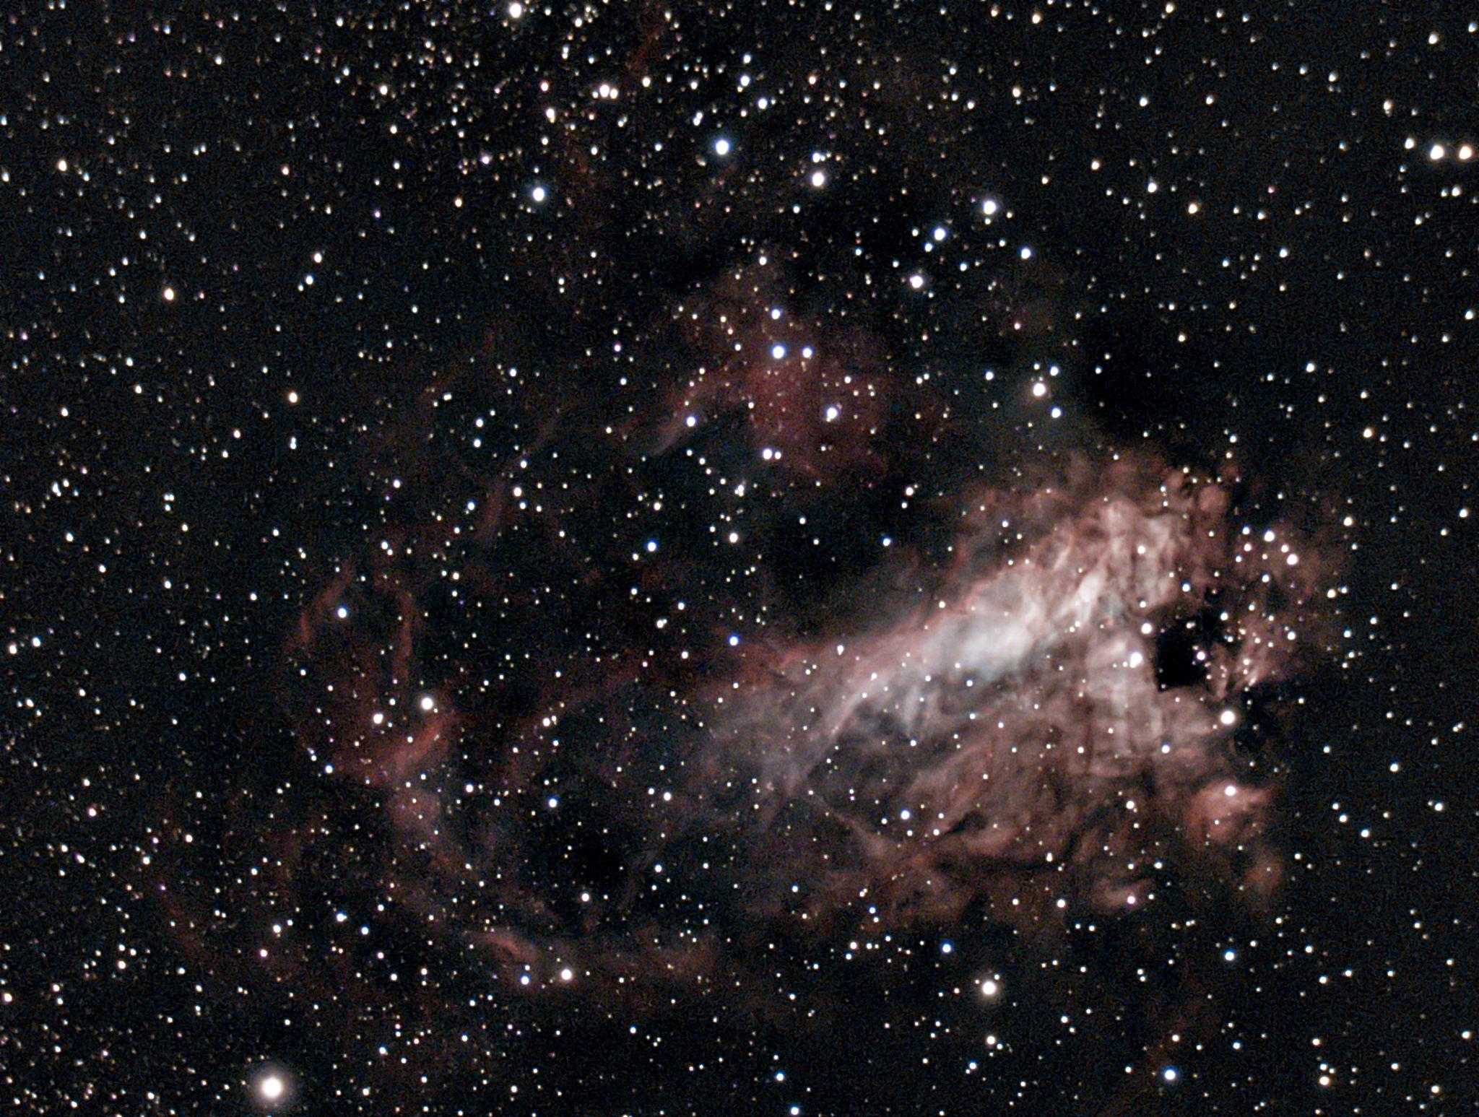
200 x 20 second exposures images stacked. Images were taken during our clear nights after testing. These nebula have their primary emission wavelengths at the hydrogen alpha line (656 nm)
Addison Long
Photonic Science and Engineering
Eagle Nebula & Pillars of Creation
Omega Nebula

Slide 24
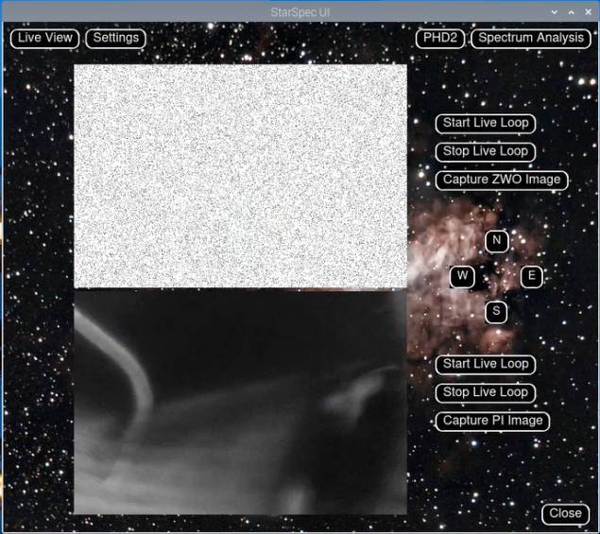
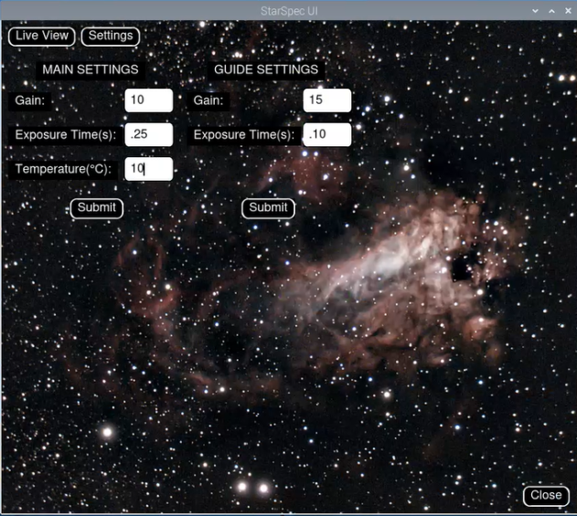
Software Design
Alejandro Olivo
Computer Engineering
Notes:
Alejandro will speak about UI stuff
Addison note: the nebula in the UI there is the veil nebula if you want to mention it.

Slide 25
Results
Alejandro Olivo
Computer Engineering
Reached desired spectral range 450 - 700
Calculated Color Temperature of Stars
Integrated Guiding (PHD2) into Celestron Mount
PCB able to interface and control all needed peripherals
Tracking with 20 Seconds Exposure with less than 2 seconds of arc (little to no star trails)

Slide 26
Improvements
Alejandro Olivo
Computer Engineering
Change camera type allowing for higher intensity blues
Calculate stars color temperature using blackbody curve
Make custom mount or change mount to further increase possible exposure times.
Build custom Raspberry PI Library to speed up image acquisition on live view.

Slide 27
Current Budget
Item | Quantity | Cost per Item
Diffraction Grating | 1 | $80
Protected Silver Coating Mirrors | 2 | $43
Guide Camera | 1 | $50
Main PCB | 1 | ∼$55
Total | 4 | ~$271
Sebastian Rowe
Electrical Engineering
Notes:
Sebastian will speak
Spectrometer 160$
1x Diffraction grating 600 lines/mm 12.7x12.7mm 80$
2x Protected silver coating mirrors 12.7mm diameter 95% reflective between 400-20um wavelengths $43 x2
Main PCB ~$35 ($30 is RPC4)
Stretch PCB ~$40 (2x $15 Motor Drivers)
Stepper Motor - $23.99

Slide 28
Components Already Owned
Stretch Board Budget
Sebastian Rowe
Electrical Engineering
Item | Quantity | Cost
Telescope & Mount | 1 | $1000
Main Camera | 1 | $999
HDMI Display | 1 | $80
Total | 3 | $2079
Item | Quantity | Cost
Secondary PCB | 1 | ∼$40
Stepper Motors | 2 | $23.99
Stretch Total | 3 | $87.98
Total w/ Main | 7 | $358.98
Notes:
Sebastian will speak

Slide 29
Work Distribution
Task | Primary | Secondary
3D Print & Design | Aaron | Addison
INDI Driver Integration | Sebastian | Alejandro
Drivers | Aaron | N/A
Frontend User Interface | Alejandro | Sebastian
Hardware & Software Integration | Alejandro | Sebastian
Task | Primary | Secondary
PCB Design | Aaron | Sebastian
Software for Spectrum Classification & Analysis | Addison | Aaron
Spectrometer | Addison | N/A
Stretch Board (Motor Control) | Sebastian | Aaron
Notes:
Sebastian will speak

Slide 30
Questions?

