Slide 1


PURRFECT CLEANER
Senior Design Project - Group 5
Notes:
Good Afternoon everyone, our team will be presenting our Senior Design Project, the Purrfect Cleaner

Slide 2




Team Introductions
Samuel Durkee
Computer Engineering - B.S
Junxu Zeng
Electrical Engineering - B.S
Eliezer Roman
Electrical Engineering - B.S
Kayla Funchess
Computer Engineering - B.S

Slide 3

Agenda
Components Selections
Hardware
Software
Standards and Constraints
Administrative Content
Notes:
Listed here are the topics we are going to discuss in our presentation. We will go over the components we selected, the hardware, software, standards and constrains, and lastly the administrative content.

Slide 4

Project Objectives
Enhancing the quality of life for cat owners
  A self-cleaning cycle that runs every 4 hours
  A mobile application with notifications and recorded data charts
Creating an automatic cat litter box with safety features
  Implementing motion sensors to detect if the cat is near
  Setting up weight sensors in the box to detect if the cat is relieving itself
  Activating a standby mode, in the case that the cat is near/in the box during the cleaning cycle
Notes:
Our main objectives for our senior Design project are about enhancing the quality of life for the owners and implementing safety features. So we decided to have a cleaning cycle that operates every four hours and a mobile application that alerts the owner when the waste bin is full or record information on the cat such as their weight. For the safety features we decided to have both motion sensors and weight sensors to ensure that the cleaning cycle would be in stand by mode and not start if the cat is near or inside the box

Slide 5
Engineering Requirements
Quality | Target Expectation
Summation parts cost | >= $150
Functionality | >= 2 functions
Dimensionality | Length <= 50 cm Width <= 40 cm Height <= 15 cm
Response Time | < 2 seconds
Clean Time | < 120 seconds
Power Consumption | clean cycle <= 3 watts
Notes:
Now we will discuss our group's engineering requirements. Firstly, our group has placed a paramount focus on affordability for the user. Likewise, we aim to produce an automatic litter box whose total cost in parts will not exceed $150. Next we have set our project to contain multifunctional features with a minimum requirement of 2 distinct functions. In terms of size parameters, our project is targeted to not exceed 50 cm X 40 cm X 15 cm in terms of length, width, and height. We expect to produce responsive and reliable products with no feature delaying more than 2 seconds to communicate with the user. In regards to the litterbox’s cleaning time we have a hard cap of 120 seconds for a complete cycle. Finally, we emphasize minimal power consumption with a maximum of 3 watts usage during 1 cycle.

Slide 6
Components Selection

Slide 7
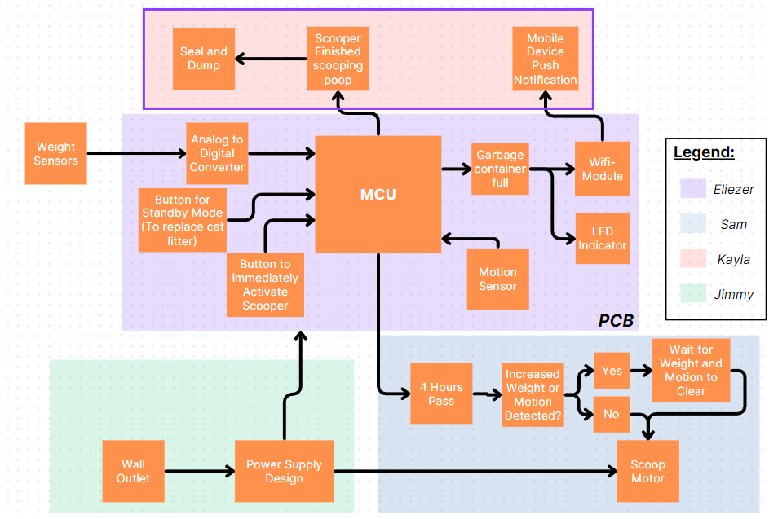
Hardware Block Diagram
Eliezer Roman
Electrical Engineer

Slide 8
Microcontroller
Eliezer Roman
Electrical Engineer
The microcontroller will need to support 5 peripherals in the system.
  2- Weight and Motion Sensor
  1- DC Motor via MOSFET
  2- Buttons
Low power options are viable in our system, as it will be idle for long periods.
We chose the ATMega328P for its support of many peripherals and native 5V compatibility to keep it aligned with all the other components.
MCU Name | Cost | Working Voltage | Operating Temperature | # Of I/O Support | Memory
MSP430FR6989 | ($6.50) | 1.8V - 3.6V | -40 - +85 °C | 12 | 128KB LPRAM
ATMega328P | ($1.63) | 1.8V - 5.5V | -40 - +105 °C | 27 | 1KB EEPROM, 2KB SRAM, 32KB Flash
RP2040 | ($5.99) | 1.8V - 3.3V | -40 - +85 °C | 30 | 264KB SRAM

Slide 9
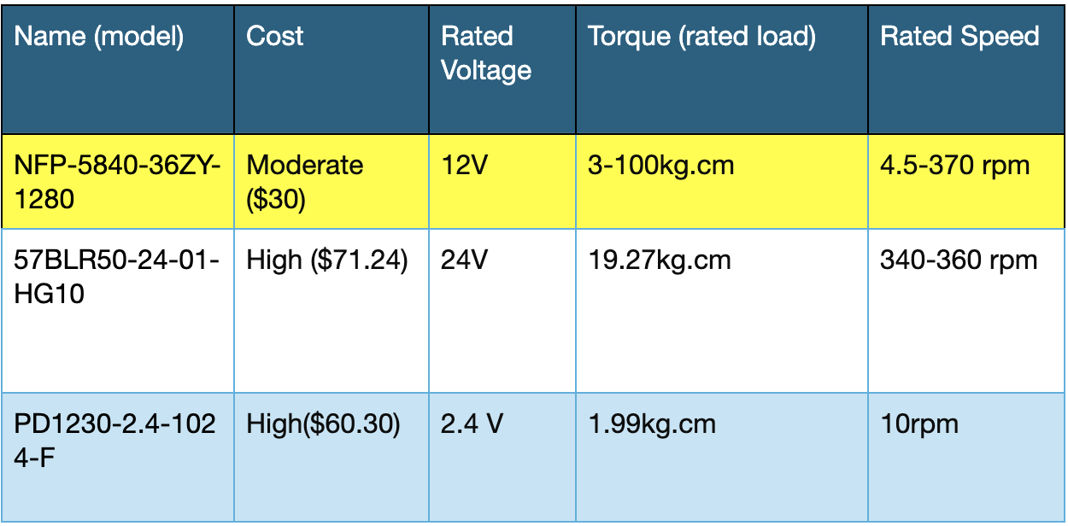
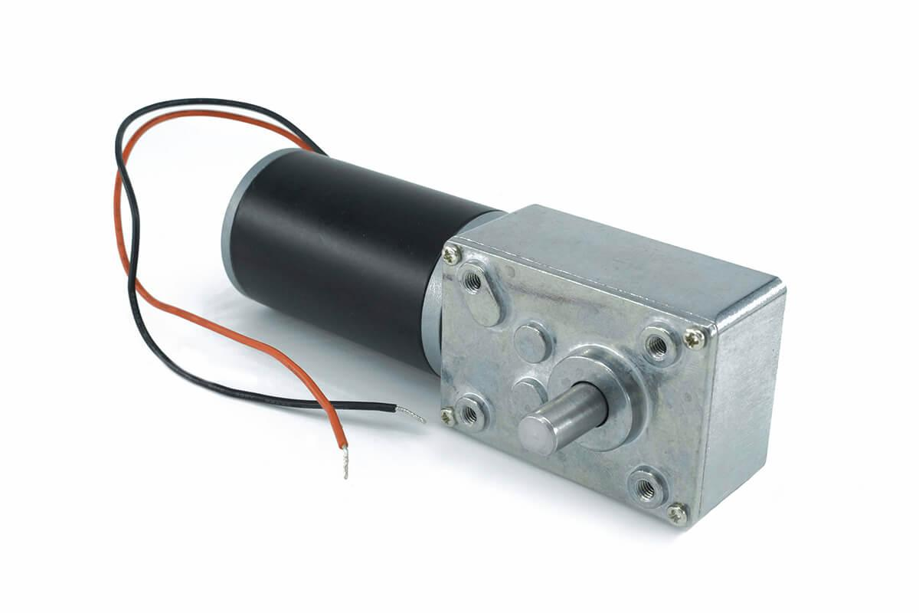
Worm Gear Motor
The Worm Gear motor will be implemented in the cat litter box to accomplish the chief goals: automatic functionality, safety, and ease of use. The Worm Gear will extend and retract a simple robotic arm with a fine comb attached to the end. The motor will be automatically powered during certain time intervals programmed in the MCU. The weight and motion sensors will communicate with the MCU upon triggering and stop the motor temporarily. Due to the Worm Gear Motor reversibility and self-locking mechanism, it ensures cat safety. The motor can be activated manually through a “Run Now” button or mobile application allowing remote access. Our group decided to choose the NFP-5840-36ZY-1280 model.
Notes:
Our next component is the worm gear motor. The Worm Gear motor will be implemented in the cat litter box to accomplish the chief goals of automatic functionality, safety, and ease of use for the user. The motor will function in the litterbox as the driving mechanism for the filtration comb that will periodically sift through the cat litter, picking up any excrement as it completes its cycle. The motor will automatically run every 4 hours as configured to receive power by the MCU. The motor can also be activated manually through a “Run Now” button or mobile application wifi signal. The weight and motion sensors will assist the motor by communicating with the MCU upon being triggered. Consequently, any detection from either sensor will temporarily stop the motor for a delayed time placing the device in standby mode. Eventually, the motor will attempt to run again after both sensors are inactive ensuring cat and user safety. Our group chose to implement a worm gear motor due to its structural self-locking mechanism and directional reversibility. Specifically, our group picked the NFP-5840-36ZY-1280 model due to its high customer ratings and affordability.

Slide 10
Power Supply
Name | Cost | Output Voltage | Output Current | Wattage
BSTOEM | $4.00 | 5 volts | 2.4 amps | 12 watts
AGTRAY | $4.25 | 5 volts | 2.4 amps | 12 watts
Ocupwei | $4.50 | 5 volts/ 9 volts | 1 amps/ 2.2 amps | 5 watts/ 20 watts
Outlet to USB-C Port
5 volts output
Notes:
Now moving on to the power supply, we decided to have the device plugged into the wall outlet considering that the customers are unlikely to move our product around frequently. The puerfect cleaner is going to consume power from the outlet and convert the 120 AC voltage to 5 volts DC output with an AC-DC converter. The reason we are choosing 5 volts output is that the microcontroller we are using is the atmega 328p that operates at 5 volts, and the most common AC-DC converter that are in the market has 5 volts output due to the demand of mobile device charging.

Slide 11
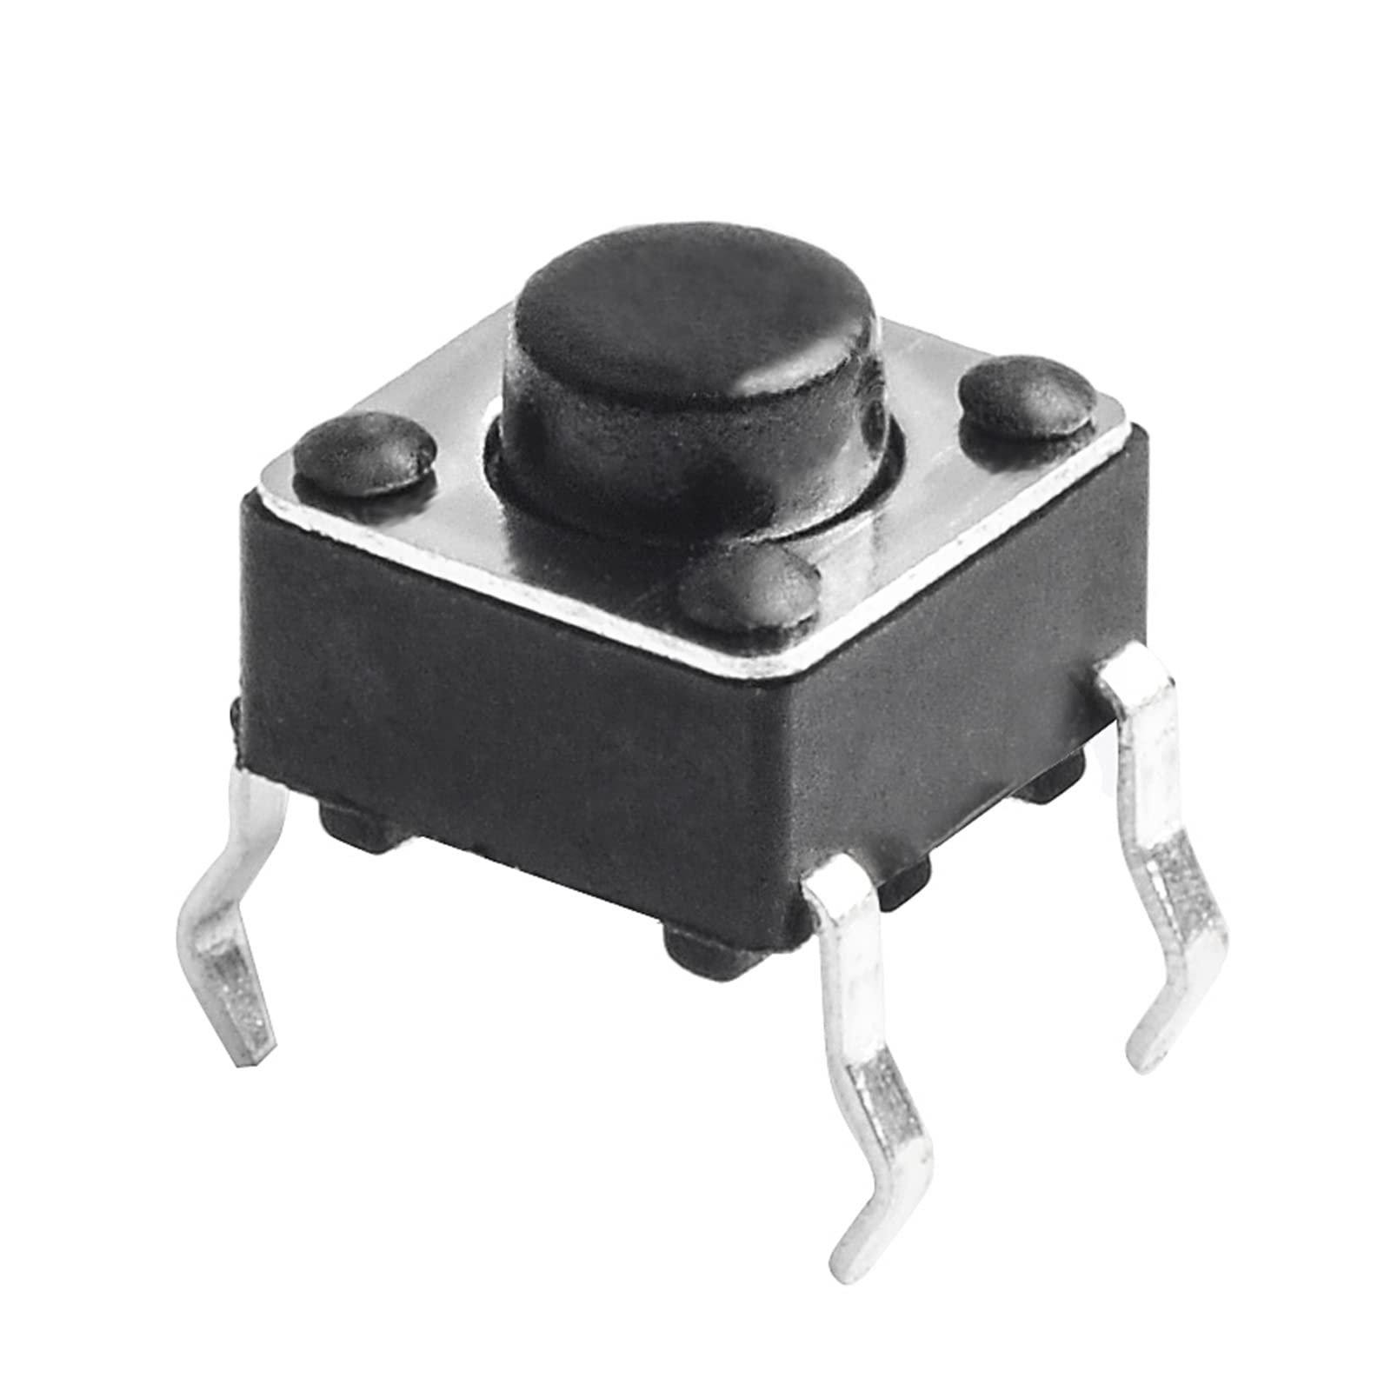
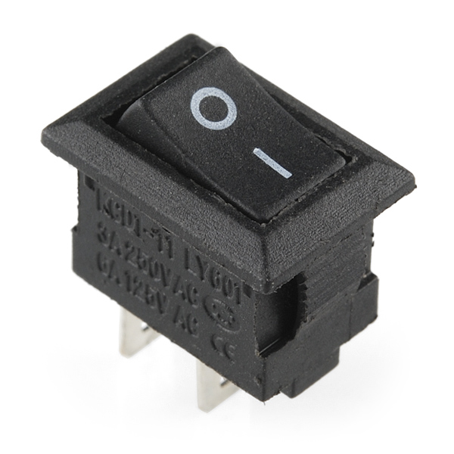
Switch and Push Button
Parameters | Conditions/Descriptions | Min | Max | Units
Rated Voltage |  | 1 | 12 | Vdc
Rate Current |  | 0.01 | 50 | mA
Withstand Voltage | For 1 min |  | 250 | Vac
Notes:
For the switch and push buttons, the switch will be used to control the power of the device, The buttons are designed to be used for user inputs, allowing us to implement different operating modes. we didn’t choose any specific models for these two components, because our primary requirement is to detect when the button is pushed or when the switch is flicked, and any models can achieve that.

Slide 12
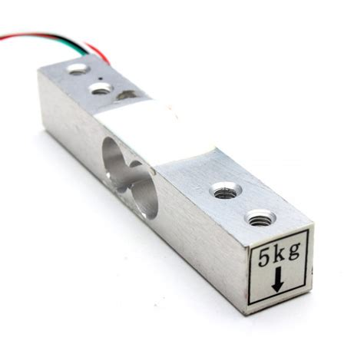
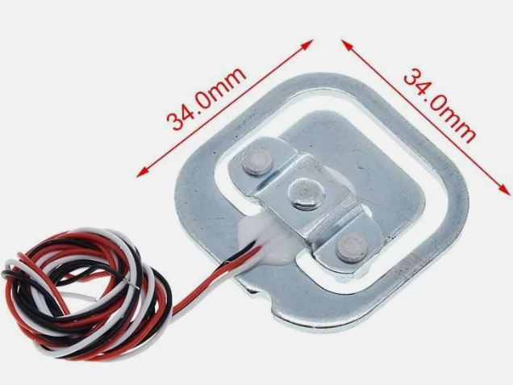
Weight Sensor
Eliezer Roman
Electrical Engineer
Name | Cost | Working Voltage | Sensing Range | Operating Temperature
NEXTION Strain Gauge Weight Sensor x4 | ($8.99) | 3.3V - 5V | <50kg | -10 - +50 °C
Seeed Tech Load Cell | ($9.95) | 10V - 15V | <50kg | -35 - +80 °C
ShangHJ Load Cell Weighing Sensor | ($12.99) | 5V - 10V | <50kg | -10 - +40 °C
The weight sensor will be used in conjunction with the motion sensor in order to achieve the same goal, safety. It will use the HX711 Analog to Digital converter to produce an input signal for the microcontroller to read and determine if the motor should be stopped. We chose the load cell from ShangHJ for its support of a 5V working voltage and being a block form factor.

Slide 13
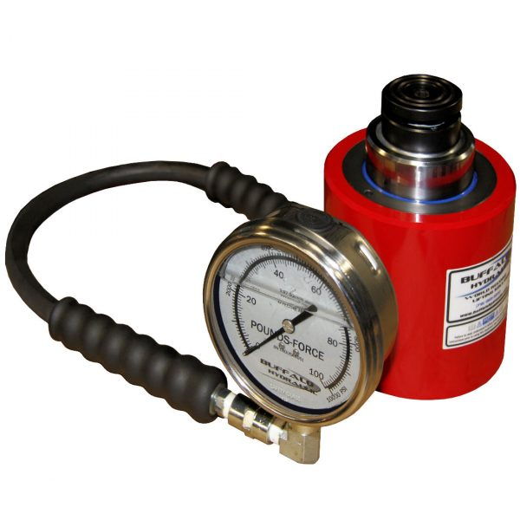
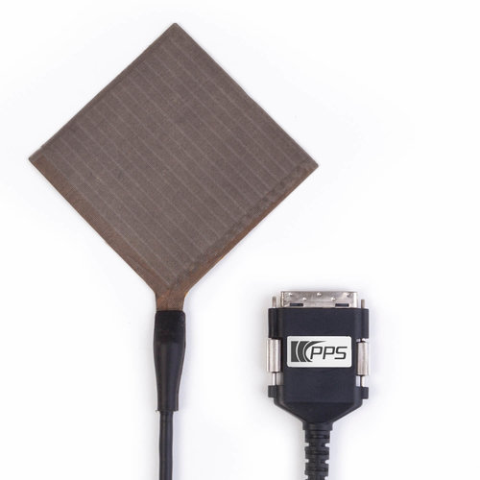
Weight Sensor
Eliezer Roman
Electrical Engineer
Name | Cost | Use case
Strain Gauge | Low ($5-10$) | Most common commercial weight sensor, usually found in household weight scales
Hydraulic | High ($60-$100) | Made for heavy duty industrial use, usually found in a hydraulic press machine or a forklift
Capacitive Based | Low ($5-$10) | Made for sensing small changes in weight pressure, usually found in touchscreens or touchpads

Slide 14
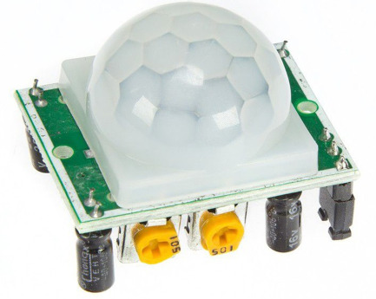
PIR Motion Sensor
Name | Cost | Working Voltage | Sensing Range | Operating Temperature
Miniature PIR Sensor | Low ($1.69) | 2.7V - 12V | ≤100 degree cone angle, 3-5 meters | -20 - +60 °C
HC-SR501 PIR Sensor | Low($1.8) | 4.5V - 12V | <110 ° cone angle | -15-+70 degrees
ZRE200GE | Moderate($2) | 3 V - 15 V | 138 degrees from center of element on axis X 125 degrees from center of element on axis Y | -20°C to +70°C
Notes:
As Eliezer was saying, the Motion sensor will be used for safety purposes. If the motion sensor detects any movements when the motor is operating. The motor will be put on hold. This sensor runs from 4.5 V to 12 volts with unknown current consumption. We chose this specific model because it allows us to set our desired configuration. like changing the sensitivity and the detecting range. With the HC-SR501 sensor, we can actively change the configurations according to different applications.

Slide 15
Hardware

Slide 16
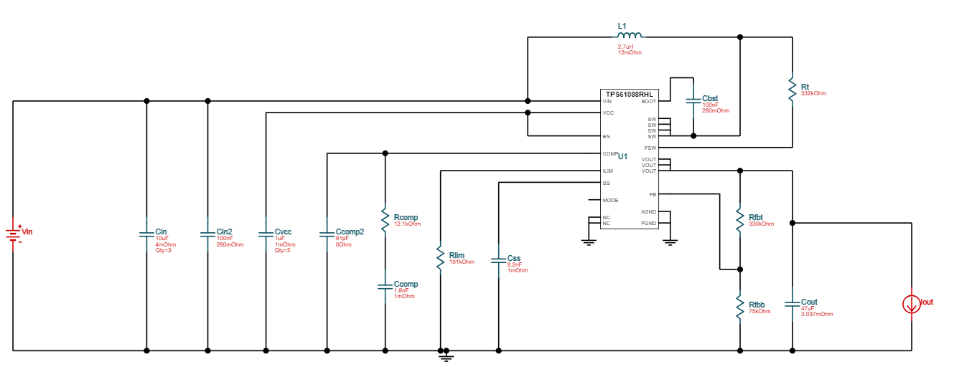
DC-DC Converter
5 volts to 6.5 volts to supply the motor
Name | Value | Category | Description
Efficiency | 96.70% | System Information | Steady state efficiency
IC Tj | 43.66 °C | IC | IC junction temperature
IC Pd | 352.11 mW | IC | IC power dissipation
Pout | 13 W | System Information | Total output power
Iin Avg | 2.69 A | IC | Average input current
IC Ipk | 3.1 A | IC | Peak switch current in IC
Notes:
The microcontroller chip we are using operates at 5 volts. According to the datasheet of the motor, the operating voltage of the motor should be around 6 volts. However, the voltage coming out from the power supply is only 5 voltage, therefore, we implemented a 5 volts to 6.5 volts DC-DC converter. We chose 6.5 volts as the output to consider power losses throughout the system. We designed this converter by using the TI webench circuit designer, with this DC-DC converter, there will now be sufficient voltage supply for the motor.

Slide 17
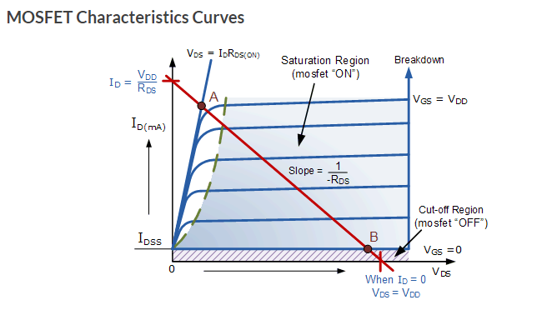
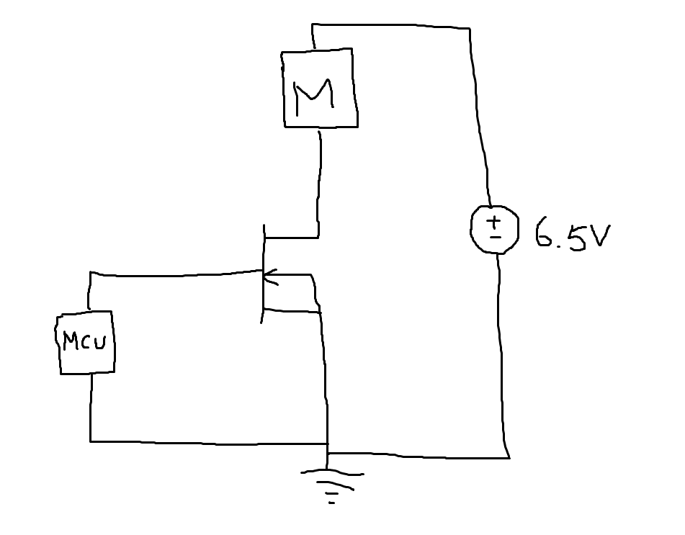
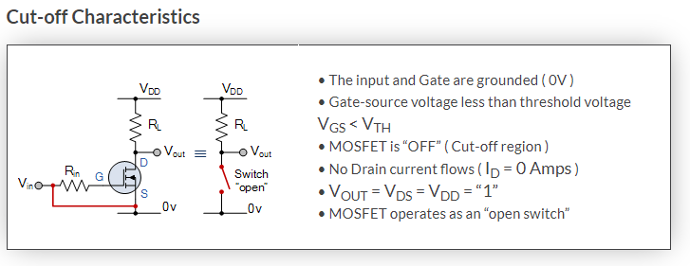
Motor Switch
Notes:
Since the motor operates at a different votlage from everything else on the device, we need a way to switch the motor on and off accordingly. After some research, we decided to use an enhancement NMOS to act as a switch for the motor. We have the output of the MCU connected to the gate pin of the NMOS and the motor with the supply connected to the drain pin. According to MOSFET characteristic. If the gate-source voltage is higher than the thermal voltage, the mosfect is going to turn on, which means it is operating in the saturation region. And when the gate-source voltage is less than the thermal voltage, the MOSFECT operates in the cut-off region, which opens the circuit. The down side of this setup is that when the mosfect is operatin, it will consume a portion of the power that are supplied to the motor.

Slide 18
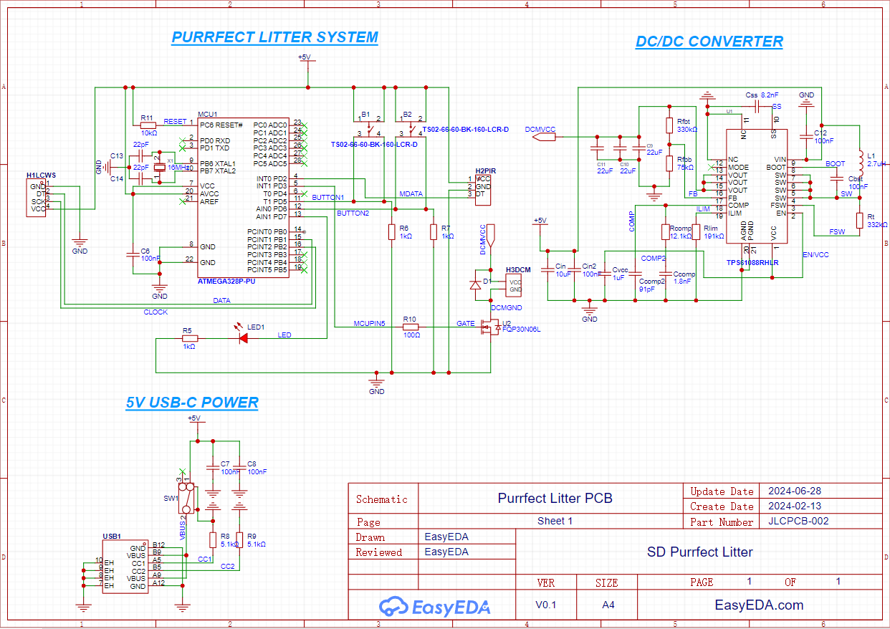
PCB
Schematic
Eliezer Roman
Electrical Engineer

Slide 19
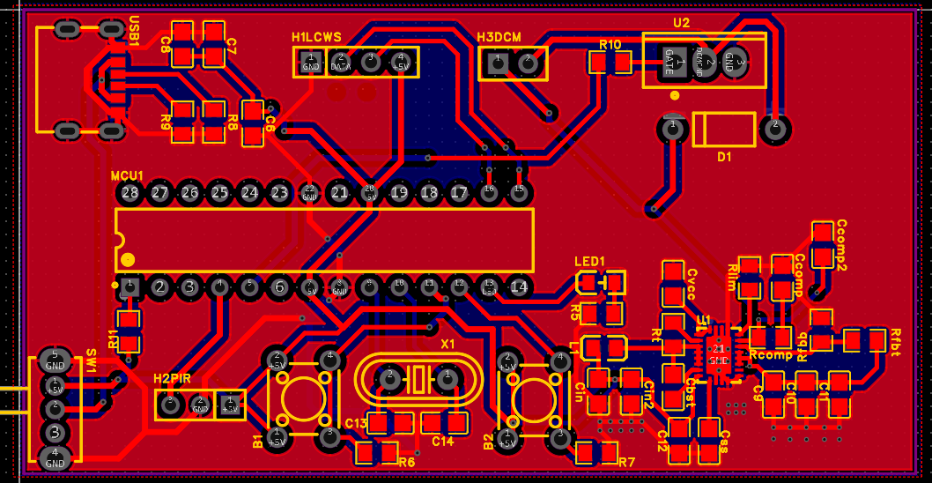
PCB
Layout
Eliezer Roman
Electrical Engineer

Slide 20
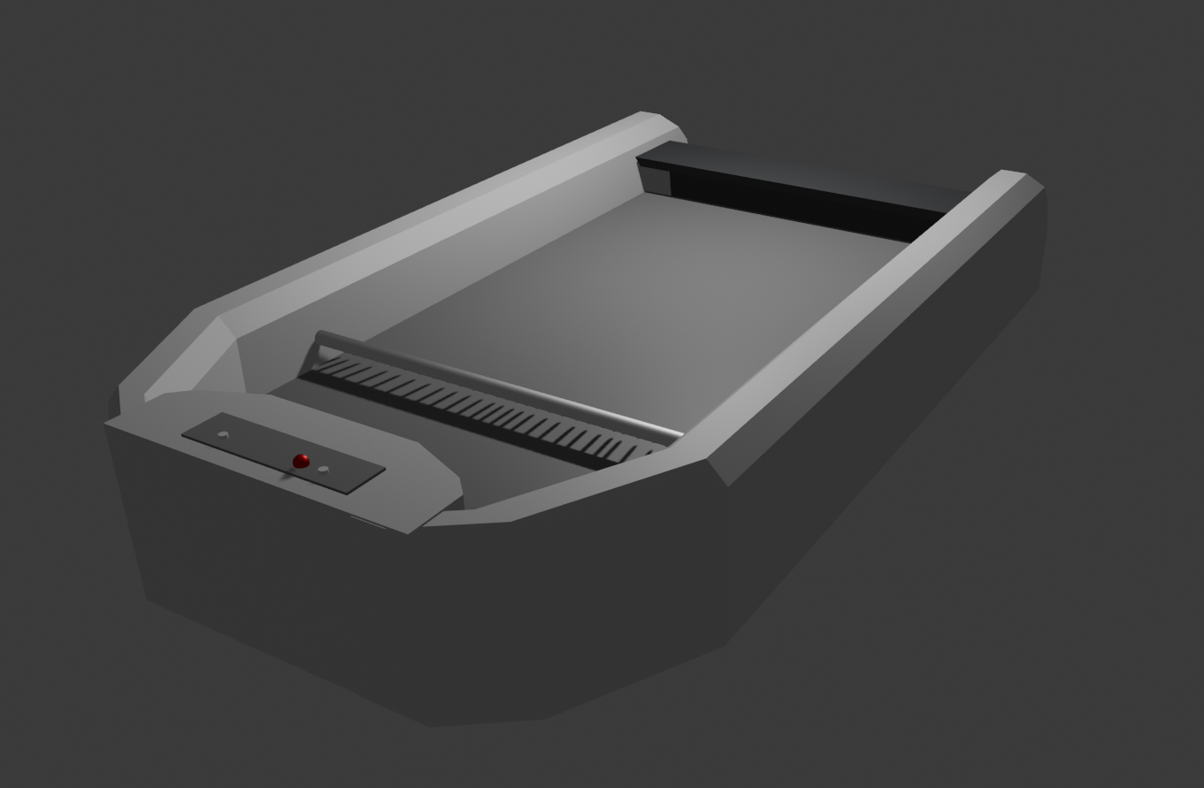
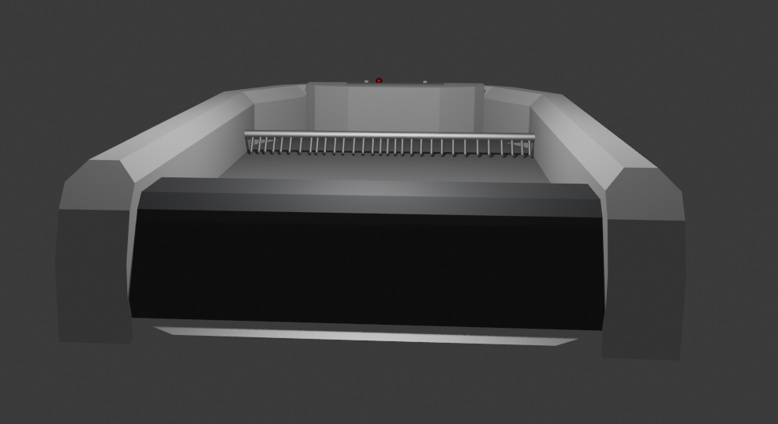
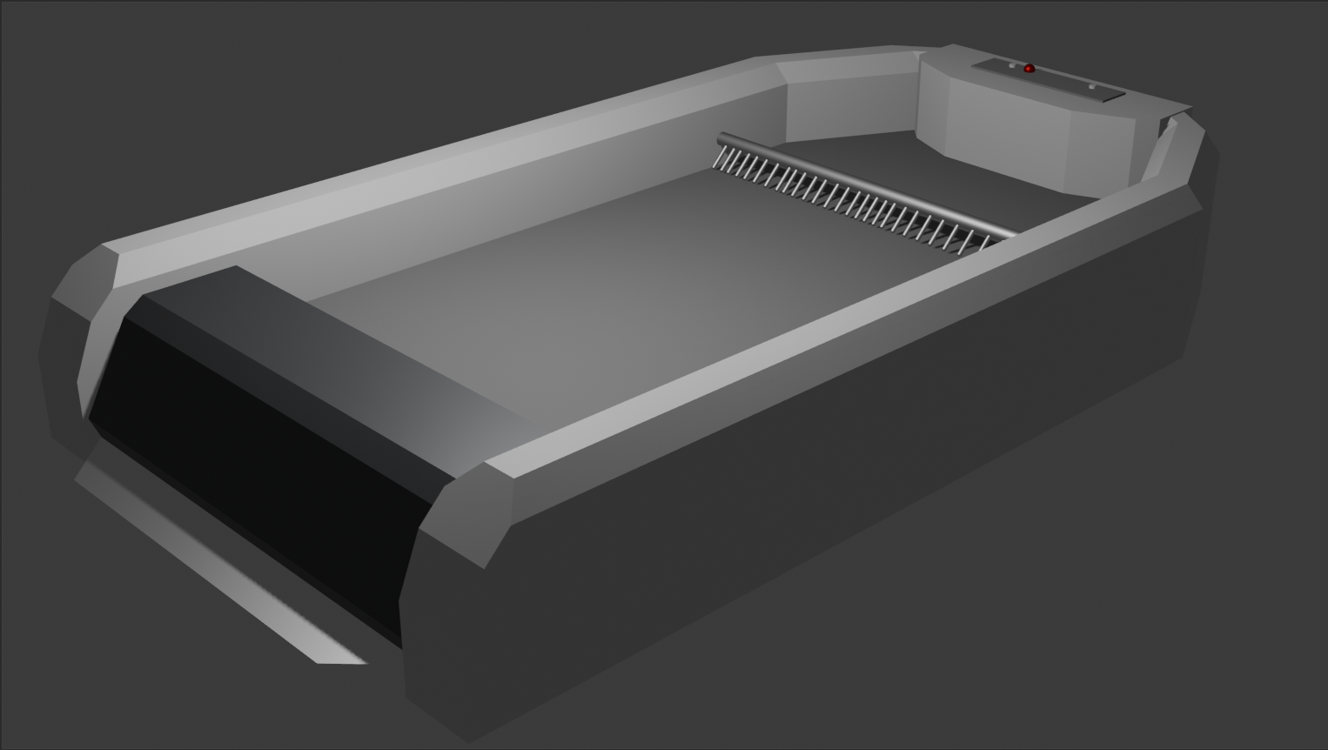
Structural Design
The Purrfect Cleaner Automatic litter box will consist of a plastic exterior designed with a rectangular based attached to a smoothened perimeter.
Notes:
The Purrfect cleaner litter box will consist of a polypropylene plastic exterior containing a base and smoothened perimeter. Our sifting comb will consist of stainless steel. Our box will contain a 2 layer tray system, both of which are PVC plastic. The front of the box will have a black detachable flap allowing for the two plastic base trays. The upper layer will hold the litter, while the lower layer is a removable plastic tray designed to catch the cat excrement during the cleaning cycle. The tray will be outfitted with a disposable mini trash bag allowing for easy cleaning with little to no leftover mess. Both trays are supported by groves along the interior of the box that hold them in place. The back of the litter box contains a control panel with the two buttons, including the on and off and run now/standby. Additionally, the control panel has a red led, which will flicker on and off during the cleaning cycle.

Slide 21
Software

Slide 22
Arduino Uno Software
Motion Sensor Code
  MCU reads the state of the motion sensors
  If a moving object is within 7 meters of one of the sensors, then a signal is sent to the motors to stop operating if the cleaning cycle was in motion
Weight Sensor Code
  MCU reads the values from the weight sensor
  If there is an additional weight detected, a signal will be sent to motors to pause the cleaning cycle
  The weight of the cat is recorded and sent to the database. It would be graphed on a weight chart for the owner to view
Timer Code
  The MCU’s timer would keep track every 4 hours to then activate the cleaning cycle
  If the motion or weight sensor detect anything, then the timer would turn off and restart once both of the sensors don’t detect anything
Notes:
For the software portion of our project, our main focus was to get the motion sensor, weight sensor, and timer working. The basic structure of the motion sensor code was to have the mcu constantly read the state of the motion sensor and if there was an object within 7 meters of one of the sensors then the motor would receive a signal to stop and pause the cleaning cycle. For the weight sensor code, the MCU would again constantly read the state of the sensor and would pause the cycle as well if additional weight is detected. It would also record the weight of the cat and send it to the database so that the owner can view it on a weight chart on the mobile application. Lastly the timer code is responsible for keeping track every 4 hours in order for the cleaning cycle to operate accordingly. In the case that the motion and/or weight sensor detect anything, the timer would shut of and restart once the sensors do not detect anything anymore.

Slide 23
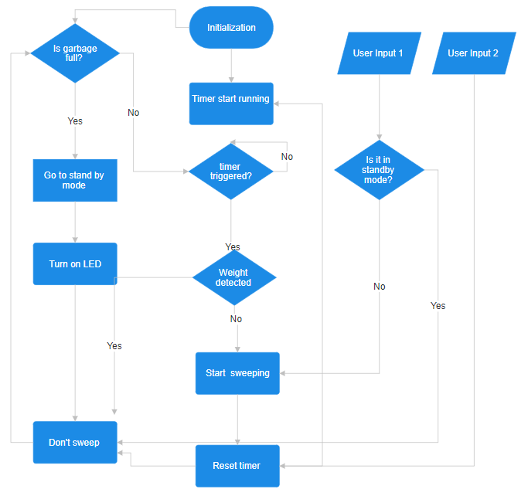
Software FlowChart
Notes:
The software flowchart shows that the users would have 2 inputs which are the Sanitary Mode which activates the manual cleaning and the start scooping mode that immediately starts the cleaning cycle. If the weight sensors detects additional weight the sweeping will stop and restarts the timer once the cat has left the box. If the waste bin is full, then an LED would light up and it would enter a standby mode until the waste is cleared.

Slide 24
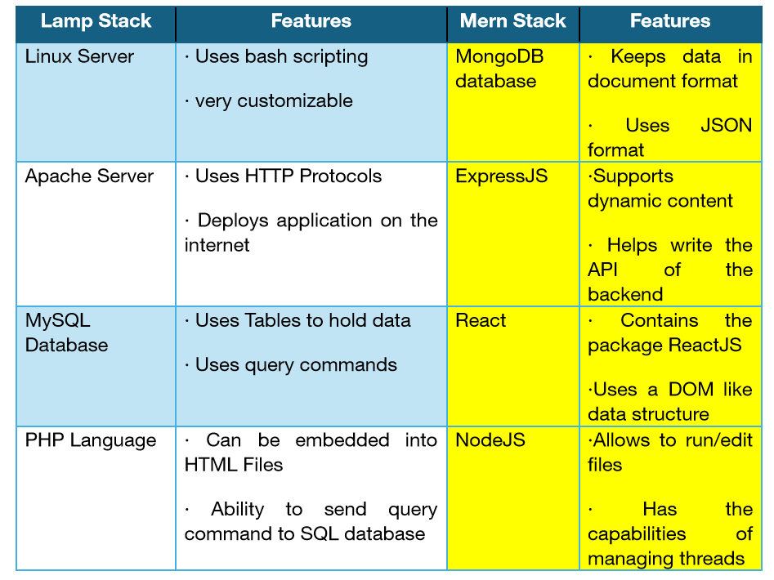
Stack Technology
The stack we are using is the MERN stack. It consists of 4 software-technologies which are MongoDB, ExpressJS, React, and NodeJS. We chose this stack because since we are planning to make a mobile application using for our Purrfect Cleaner and the software technologies mainly use Javascript which is used for most apps
Notes:
The stack we are using is the MERN stack. It consists of 4 software-technologies which are MongoDB(the database), ExpressJS(that helps with the backend development), React( the javascript library), and NodeJS( the JavaScript run environment). We chose this stack because since we are planning to make a mobile application for our Purrfect Cleaner, we have seen that most mobile applications' software technologies mainly use JavaScript which is used for most apps and is considered a standard. Mern Stack is also much more flexible in both the front and back end portions of an application than Lamp Stack.

Slide 25
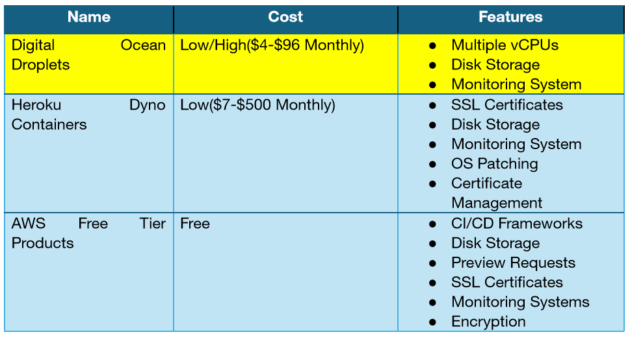
Cloud Service Selection
Notes:
The cloud service we plan on using is the Digital Ocean droplets. The reason why we chose this is because we previously had a positive experience and the features that it provides such as the amount of disk storage and the selection of multiple virtual CPUS come with an affordable price.

Slide 26
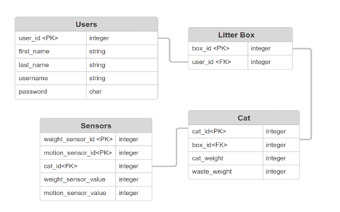
Entity Relationship Diagram
Notes:
The entity relationship diagram or ERD for short shows the structure of what our database on MongoDB would look like. It consists of 4 boxes which are the users, the litterbox, sensors, and the owners cat. Each box is connected by their own primary key or (PK) and foreign key or (FK) which are unique IDs to send/receive stored information contained in each box for a specific user with their very own unique ID.

Slide 27
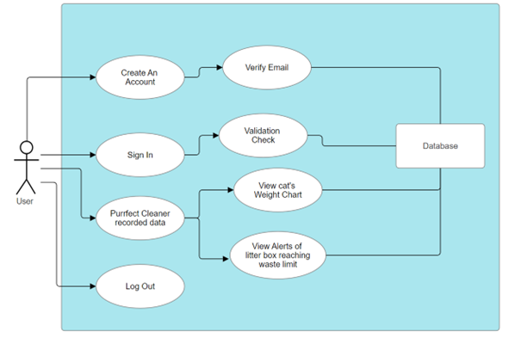
Use Case Diagram
Our mobile app will follow a similar structure to this use-case diagram
Users will be able to create an account with a valid email address and then sign in to store and view personal information about their cat and alerts
Notes:
The use case diagram illustrates how are app will work. Basically, the users would be able to create and account with a valid email address and login into said account to be able to view their cat’s weight chart and view past alerts sent to their email address. They would also be able to log out as well.

Slide 28
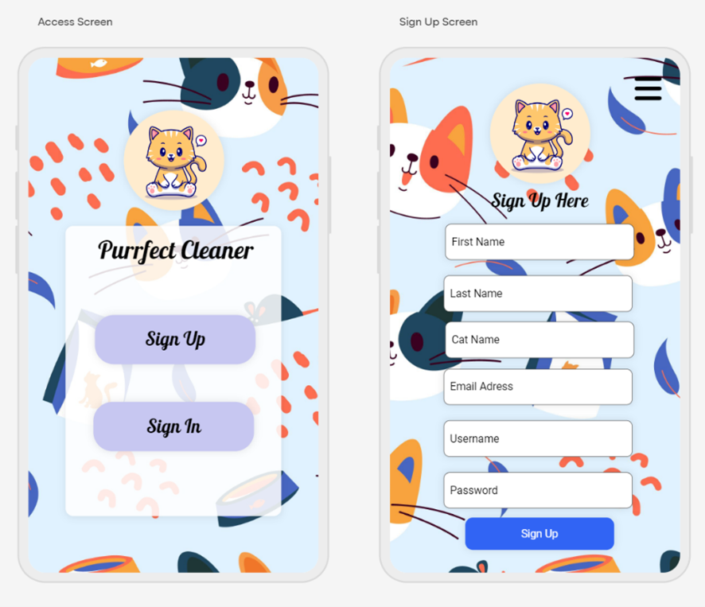
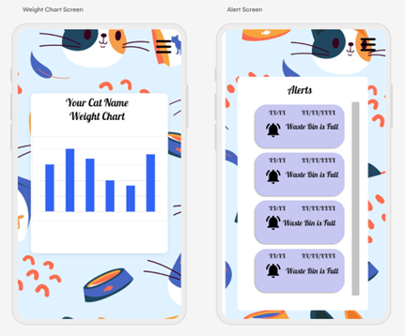
Mobile Application Design
We plan to have a total of 7 pages:
  The Access Page
  Sign Up Page
  Sign In Page
  Home Page
  Weight Chart Page
  Alert Page
  Settings Page
Notes:
We plan to have 7 pages in total for our mobile app. The Access page would be where users can choose to login or sign in to their account. The sign up and sign in pages would allow the user to create and sign into their accounts. The signup page would also include verification for the email address so that the user would be able to successfully receive alerts about when the waste bin is full. The home page would give the option to view the alerts page and the weight chart page. Lastly the settings page would allow the owner to input their cat’s name and the chance to be able to change their password. (REDo)

Slide 29
Standards & Design Constraints

Slide 30
Standards
USB-C
The USB-C is one of the many connecter designs that is considered an industry standard today. It’s design consists of a reversible connector to prevent wrongful insertion, supports fast transfer speeds up to 40 Gbps, and includes a feature called power delivery which allows for the ability to transfer higher power levels.
American Power Standard
The North American region has their own power standards which differ from other regions of the world. The power standard for the United States is a voltage of 120V and a frequency of 60 hertz. It’s purpose is to ensure electrical compatibility in the electrical infrastructure in the region.
IEEE 802.11
IEEE 802.11 is a wifi standard provided by the Institute of Electrical and Electronic Engineers to ensure stability, faster transmission rates, and longer connectivity ranges. There have been multiple versions of the IEEE 802.11 from 1997 to 2021 and we followed the most recent on which is IEEE 802.11ax^™ or Wi-Fi 6.
Simple Mail Transfer Protocol
This protocol regulates how emails are transferred across the internet. It uses headers for the mail being transferred which has the IP address of both the sender and receiver and uses the Transmission Control Protocol to open a connection between the two.
Notes:
For the standards we have chosen to look at standards in both the Electrical and Software portions of our project. Listed here we have standards regarding the USB-C port which mentions the design and capabilities of the port, the American power standard goes into detail about the power standards and requirements in the North American region, the I triple E standard for Wifi which mentions the standard transfer rates and ranges of wifi enabled devices, and lastly the simple Mail transfer protocol which is about how mail is transferred across the internet.

Slide 31

Design Constraints
User Safety
Cat Safety
Time
Security
Affordability
Intellectual Property
Notes:
Now we will discuss our project’s design constraints. Our first major constraint is User Safety. We had to make sure that our product would be suitable for a range of user factors including age and allergy conditions. The next constraint is cat safety. Our project is designed to not only serve cats of ranging ages and sizes, but also protect them and ensure their health. Our group has been limited by time constraints. Given that our project is due over the summer instead of in the fall we have had to allocate a greater percentage of our available time to the project. Another constraint is security. Any mobile based communication must be protected to avoid potential cyber attacks. Affordability is another great constraint our group has applied. We intend to create a well functioning product, whose net cost will be competitive to other potential products on the market. Our last major constraint is preserving intellectual property and ethical practices. Due to there being many other products on the market, our group has taken extra steps to ensure creative uniqueness and authenticity.

Slide 32
Administrative Content

Slide 33
Budget and Estimate
Eliezer Roman
Electrical Engineer
Component | Quantity | Vendor | Estimated Price
PCB Order | 1 | JLC | $45
Motion Sensor | 1 | Amazon | $5
Weight Sensor | 1 | Amazon | $9
MCU - ATMega328P | 1 | Amazon | $6
TPS61088 | 1 | TBD | $1.90
Bags | 1 | Amazon | $15
Motor | 1 | Micro DC Motors | $20
Casing | 1 | TBD | $20
Buttons | 2 | Amazon | $6
Scooper | 1 | Amazon | $20
Total | - | - | $146
Our goal to reach in terms of budgeting was to stay below a price of 200$ for our Purrfect Litter. This was to stay in competition with similar products that don’t offer as many features. The table on the right gives our estimated price that the Purrfect Litter would cost.
Estimated Price Table

Slide 34
Bill of Materials
Bill of Materials (Purchases made since the making of this presentation is displayed)
Eliezer Roman
Electrical Engineer
Part Numberth | Part Name | Quantity | Vendor | Price (Taxes & Quantity Included) | Date Purchased | Date Received
NFP-5840-36ZY-1280 | Worm Gear Motor Reversible High Torque | 1 | Amazon | $30.00 | April 12th, 2024 | April 17th, 2024
Y4-7188128A | PCB, 1st iteration | 5 | JLCpcb | $22.25 | June 18th, 2024 | June 20th, 2024
Y5-7188128A | PCB, 2nd iteration | 5 | JLCpcb | $12.67 | June 28th, 2024 | TBD
Part Number | Part Name | Quantity | Vendor | Price (Taxes & Quantity Included) | Date Purchased | Date Received
N/A | Miuzei Super Kit, Adruino Project | 1 | Amazon | $38.33 | Sep. 26th, 2022 | Oct. 2nd, 2022
HC-SR501 | Infrared Motion Sensor | 3 | Amazon | $7.76 | Feb. 14th, 2024 | Feb. 15th, 2024
B07B4DNJ2L | 50kg Strain Gauge Weight Sensor | 1 | Amazon | $9.57 | Feb. 15th, 2024 | Feb. 16th, 2024
S18X2+S19X2 | ShangHJ 2pc 20kg Load Cell Weighing Sensor | 1 | Amazon | $11.90 | April 10th, 2024 | April 11th, 2024

Slide 35
Division of Work
Eliezer Roman
Electrical Engineer
Project Task | Lead Person | Sub-Lead Person
Printed Circuit Board Design | Eliezer | Junxu
Power Supply Design | Junxu | Eliezer
Code Creation | Kayla | Sam
Printed Circuit Board Testing | Eliezer | Junxu
Power Supply Testing | Junxu | Eliezer
Code Testing | Kayla | Sam
Motion Sensor Implementation | Junxu | Eliezer
Mobile App Design | Kayla | Sam
Weight Sensor Implementation | Eliezer | Junxu
Motor Implementation | Sam | Junxu
Enclosure Design | Sam | Kayla

Slide 36

Current Progress
PCB design finalized
  With the DC-DC converter
  Without the DC-DC converter
Ordering litter box
Finding a possible mechanism that can move the filter
Weight Sensor reading invalid values
Notes:
I want to share with everyone our current progress on the project, we have finished designing and ordered the PCB not too long ago. The reason why we are having two designs is that we are not sure how fast the motor will spin when the load is applied.If the 6.5-volt power supply will cause the motor to spin to fast, we could go with the PCB design that doesn’t have the DC-DC converter, which runs at a lower voltage. And since we don’t decide to switch the polarity of the motor during operation we need to find a mechanism that can retract the position of the motor with the motor spinning in the same direction. With that be said, we also need to find a litter box that allows us to implement our periphals and physical design. And lastly, one problem we are running into is that the weight sensor was retuning invalid values when we were testing it, we need to figure it out since the weight sensing is a crucial element to the safety feature of our project.

Slide 37
Thank you!
Notes:
Thank you for watching our presentation. Before we go, are there any questions?

