Slide 1
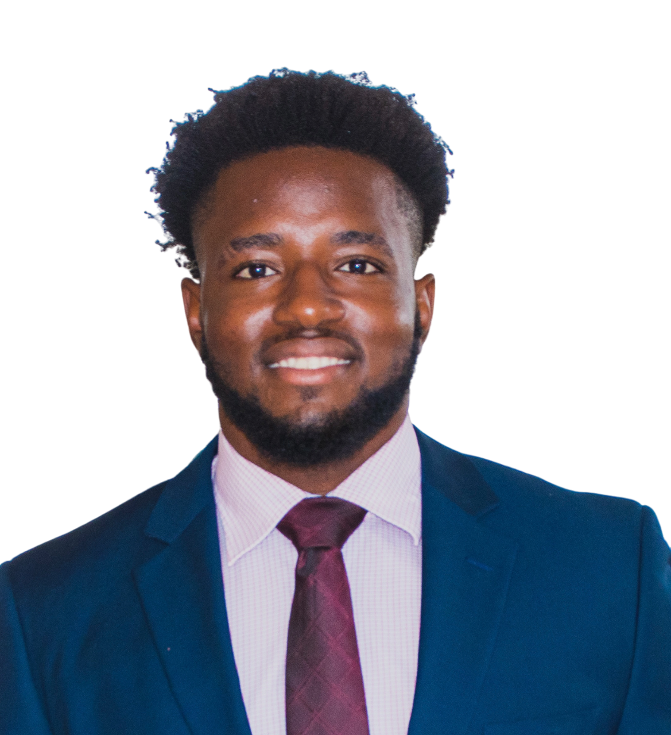

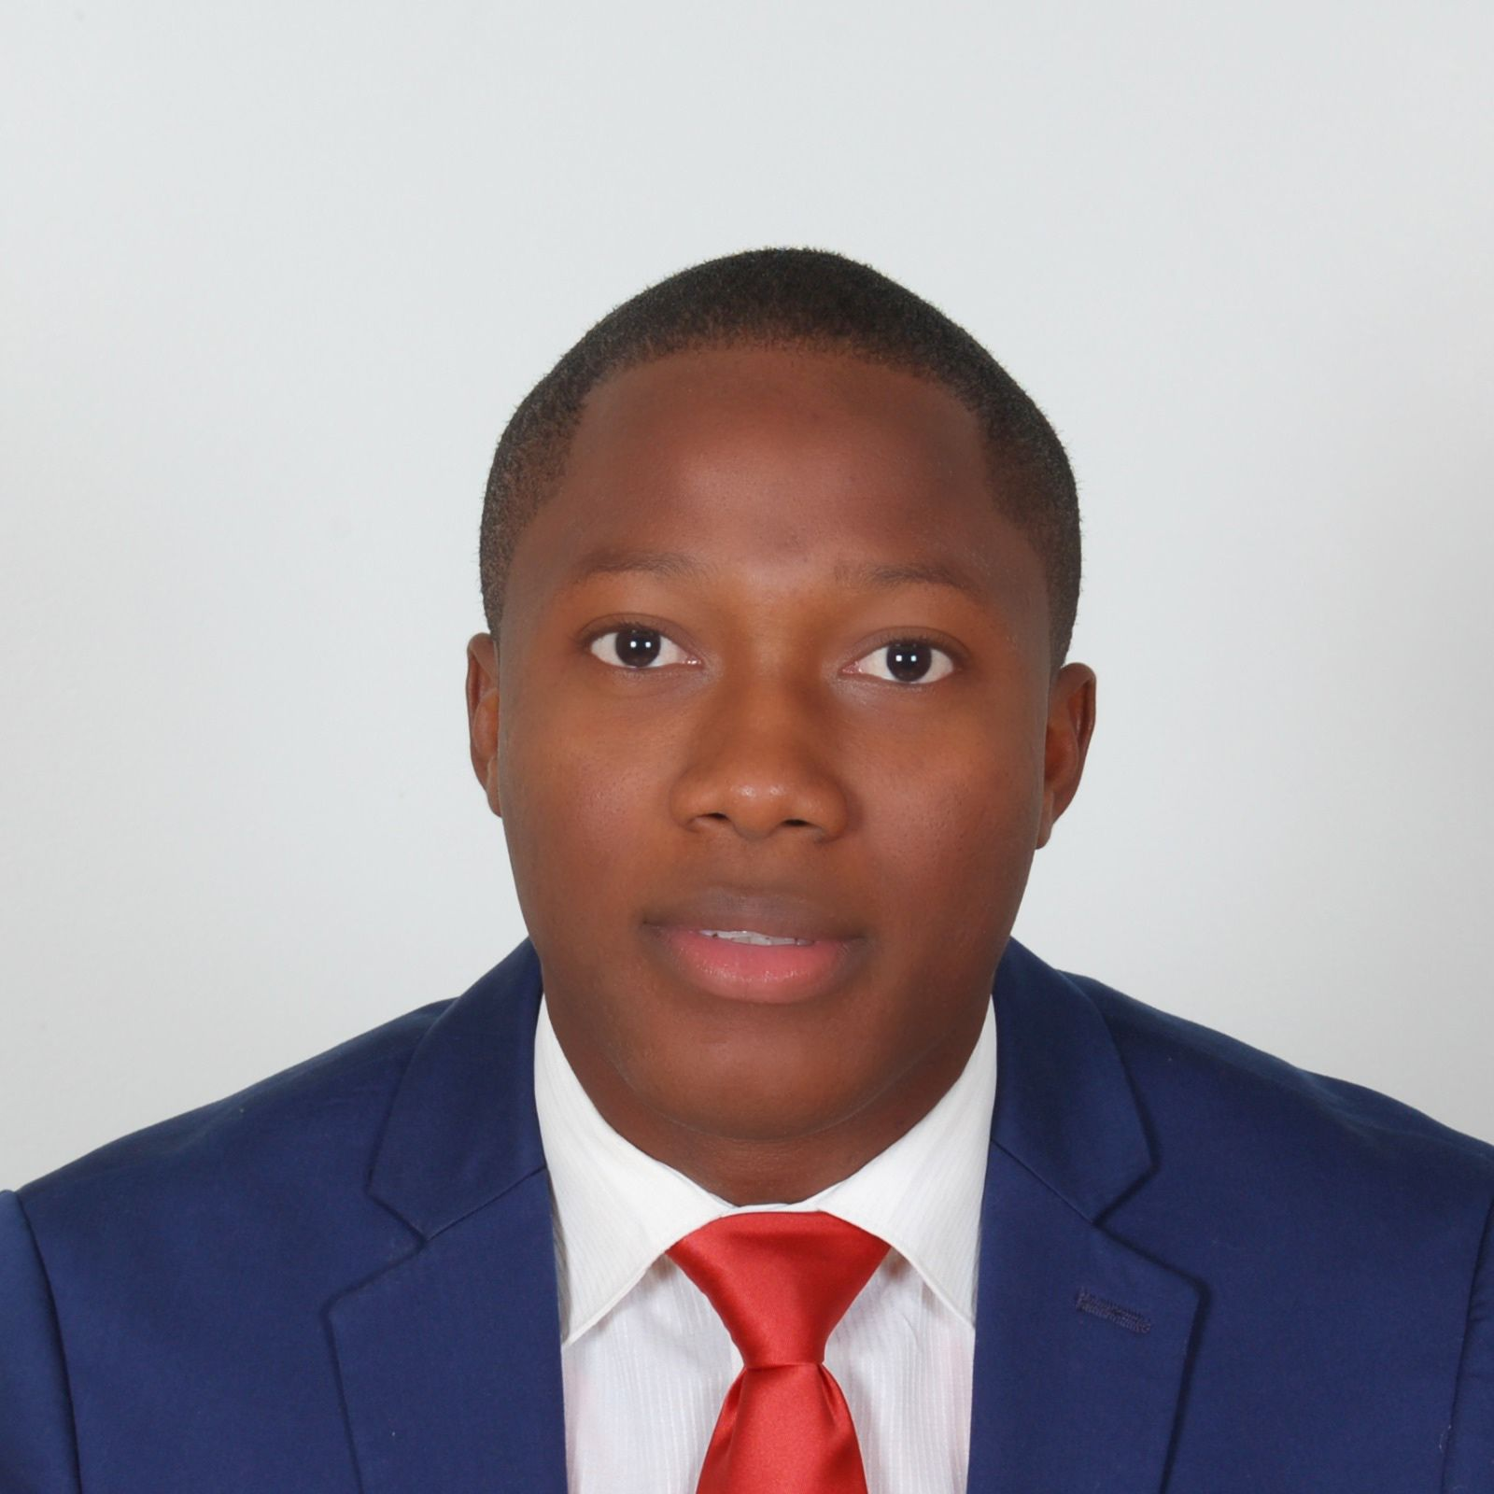
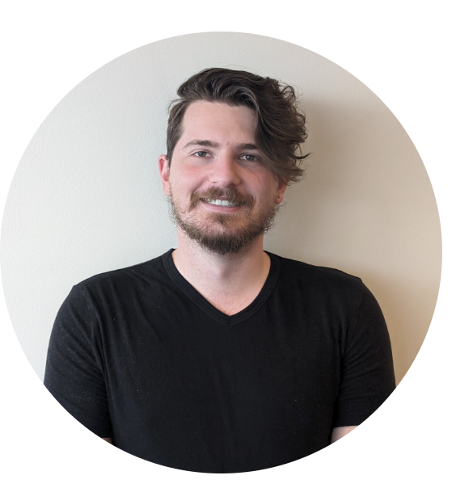
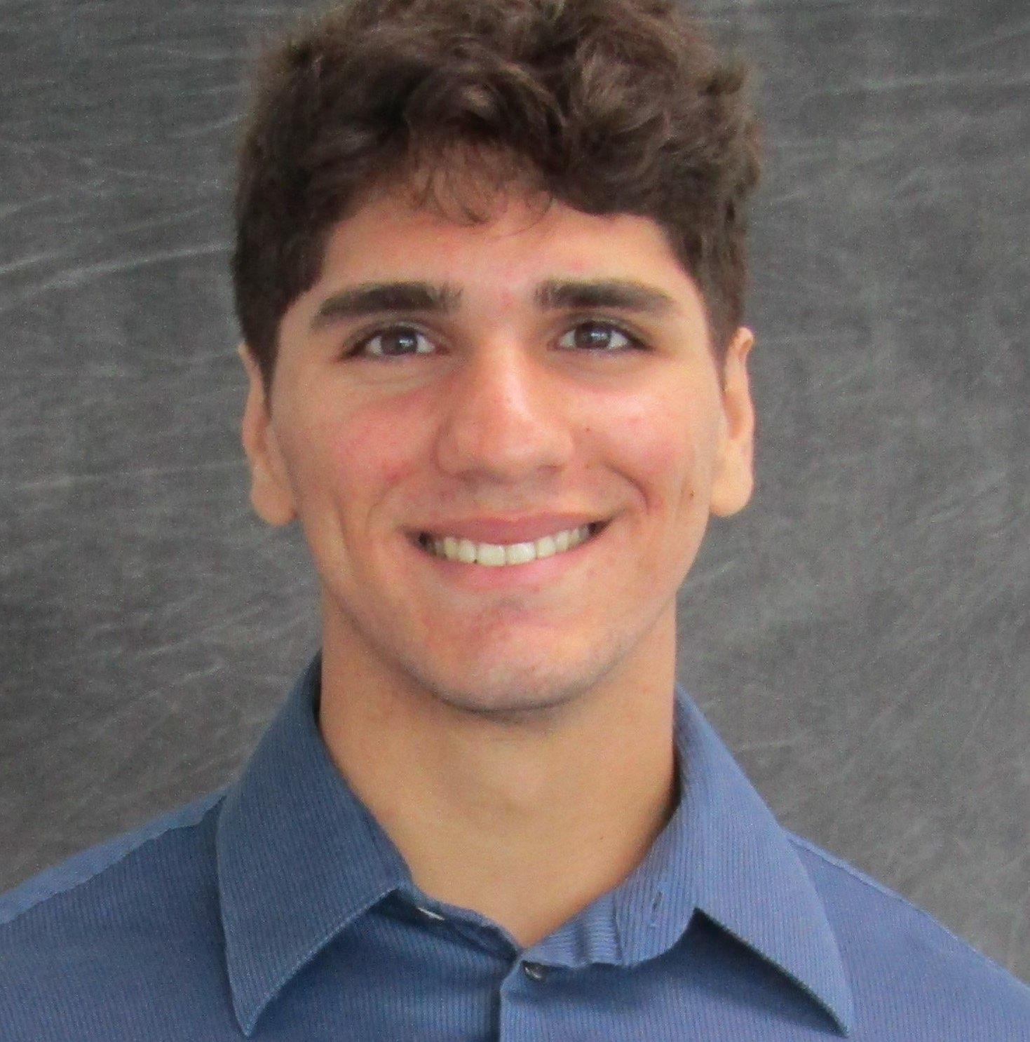
Emmanuel Levasseur
Luckner Ablard
Oren Muszkal
Stephen Polner
Group 8

Slide 2
Motivation & Background
World development and population growth leading to energy consumption concerns.
Need for energy-saving systems due to environmental impact and resource strain.
HVAC systems are major contributors to home energy usage.
Smart Film PDLC in residential settings to reduce solar heating.

Slide 3
Existing Product
Gauzy: Offers smart window film systems, primarily for privacy applications.
SmartGlass: Provides similar services to Gauzy but with a broader range, including an online-connected interface.
SmartTint: automotive

Slide 4
Goals
Primary Goals: Offer satisfaction and convenience of an automated window tinting system, maintain desired indoor temperature and light intensity, and save on electricity costs associated with indoor cooling.
Integration: Integrate existing smart glass technology with a uniquely designed control system.
Control System: Implement the control system in a model house to adjust the tint percentage of windows based on indoor temperature and sunlight intensity.

Slide 5
Goals cont'd
Advantage: The system can adapt to changing conditions and maximize outdoor visibility when tinting is not needed.
Software Goal: Design a mobile application that allows users to manually control the tinting system and customize its functionality.

Slide 6
Objective
Collect temperature and light intensity data using thermal and luminosity sensors.
Transmit data via wireless relays to and from a central microcontroller.
Program microcontroller logic to output voltages that act as a control signal.
Design a PCB and implement a controller to transform control signals into the proper voltages for the desired tinting percentages.
Implement an AC to DC converter to power the central control unit.
Incorporate a smartphone application into the logic of the microcontroller.

Slide 7
Specifications
A window tinting system that can be set up in different modes
Manual Control
Temperature and light sensors that take in the current environment reading
1 pair of windows connected and communicating
Integration of sensors and devices
App and UI integration

Slide 8
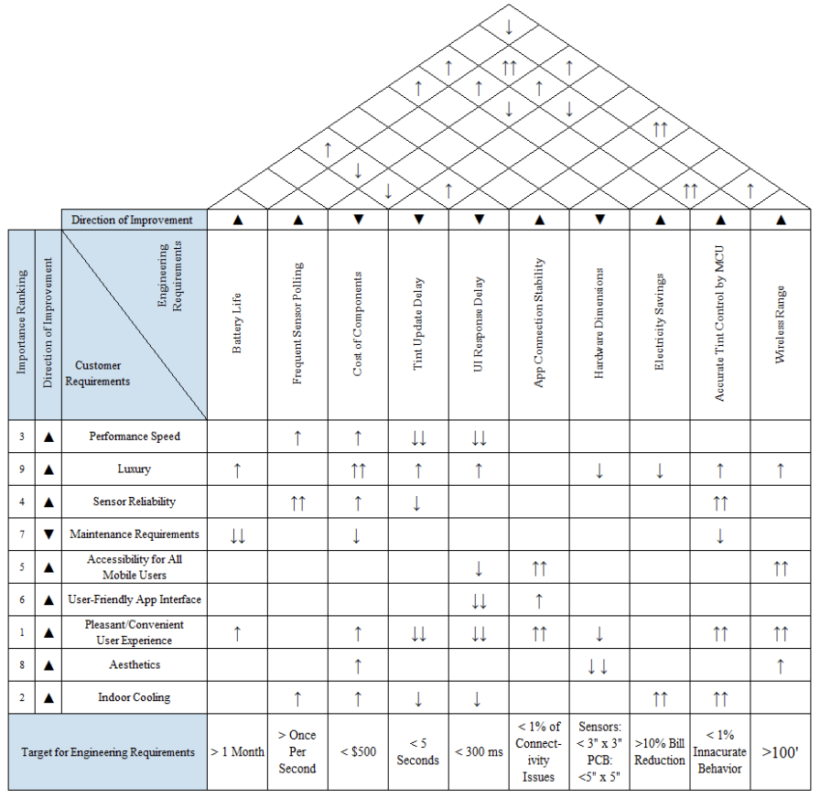
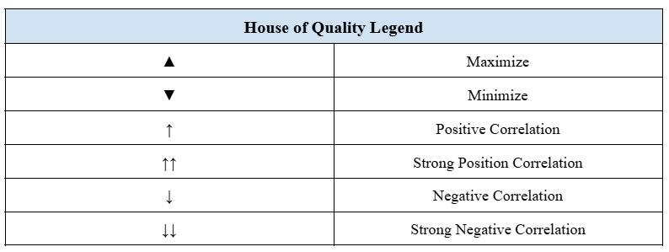
House of Quality

Slide 9
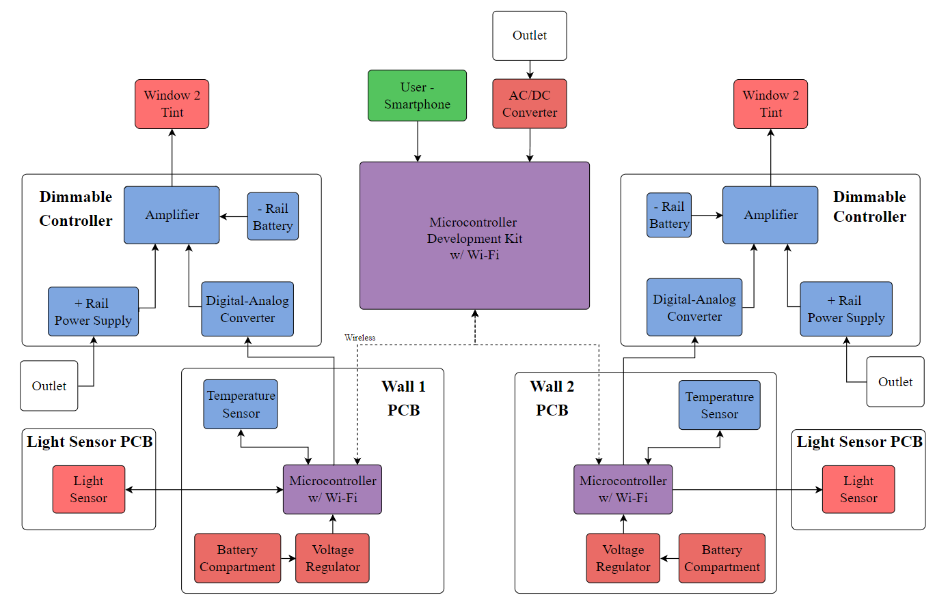
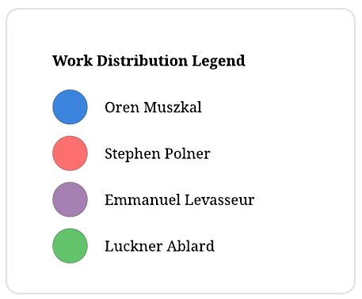
Hardware
Block Diagram

Slide 10
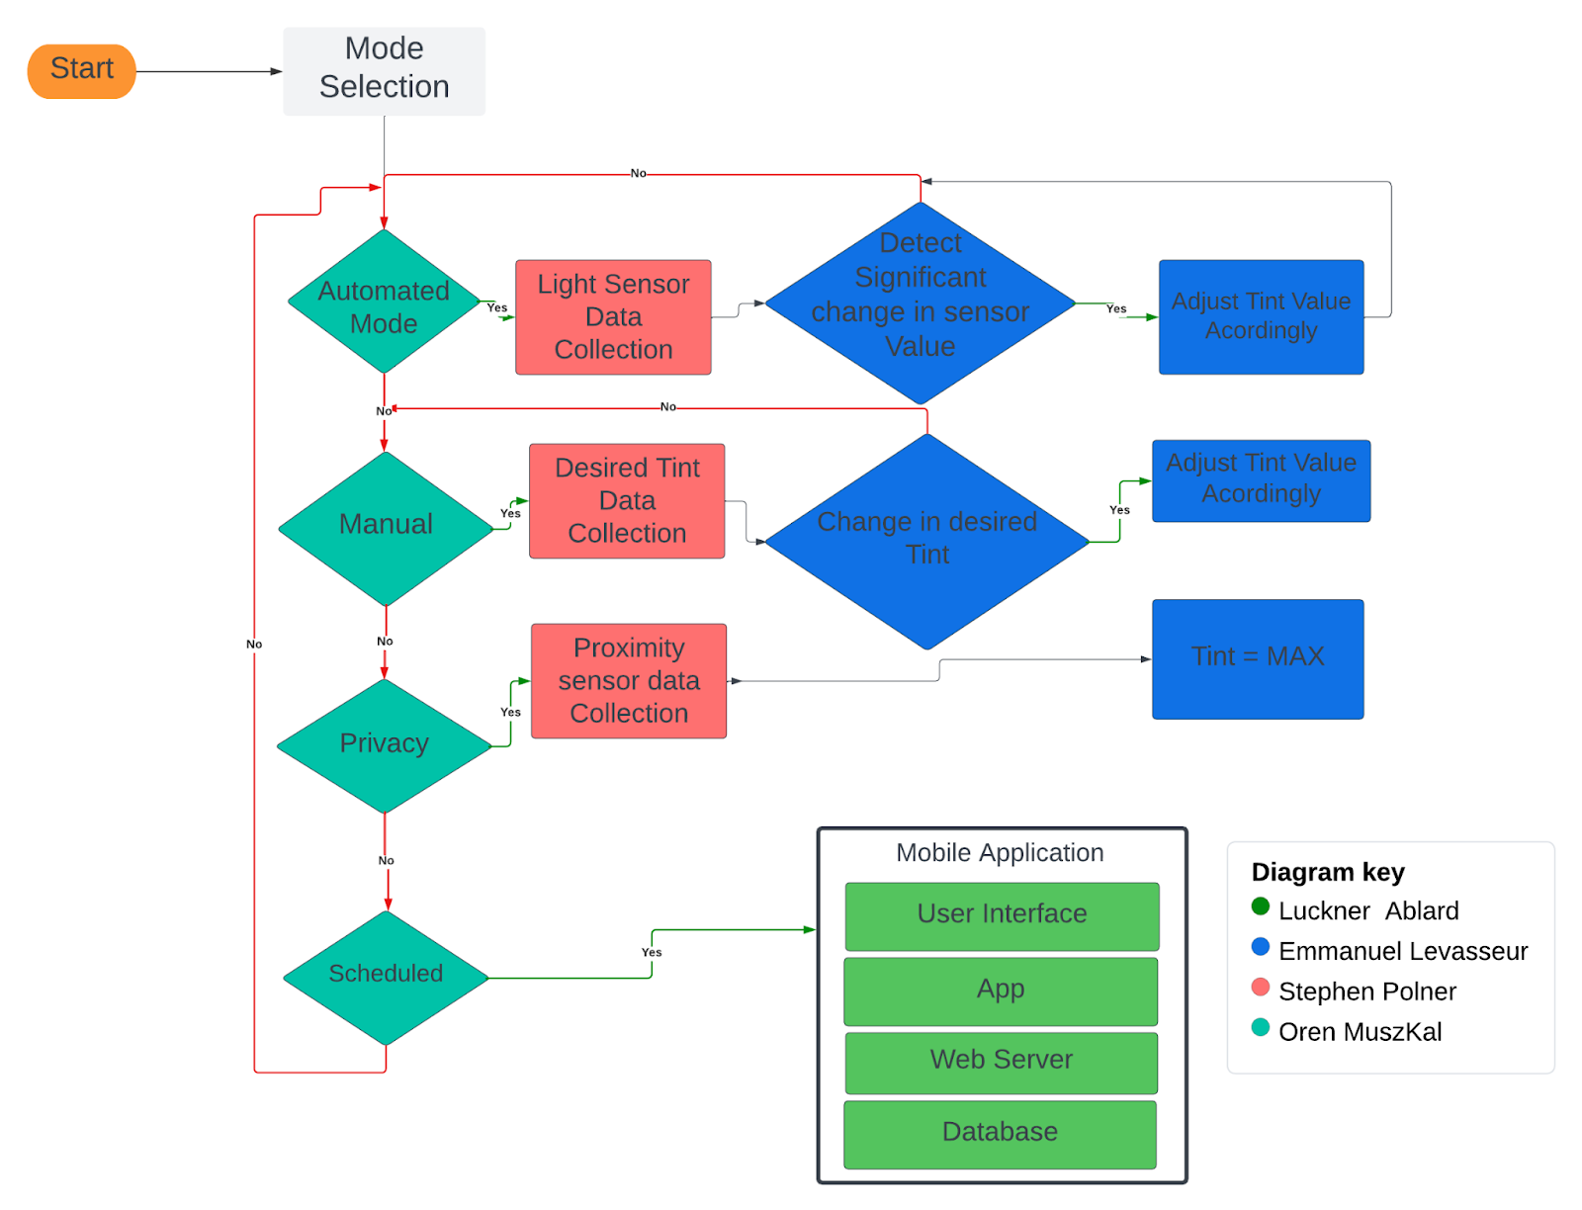
Software
Flow Chart

Slide 11
Hardware
Comparison and Selection
MCU
Smart Glass Technologies
Voltage regulation
Temperature Sensor
Light Sensor
Batteries
Power Supply

Slide 12
MCU
Microcontroller Family | Wi-Fi Support | I2C Support | Programming Language | Power Consumption
MSP430 | No (requires external module) | Yes | C | Moderate
AVR | Varies (check specific chip) | Yes | C | Low
PIC | No (requires external module) | Yes | C | Very Low
ARM Cortex | Varies (check specific chip) | Yes | C | Varies
ESP8266/ESP32 | Built-in | Yes | C | Moderate
FPGA | Complex (requires external components) | Can be implemented | Hardware Description Languages (Verilog) | Varies

Slide 13
Smart Glass Technologies
 | Thermo chromic | Photochromic | Electrochromic | Dimmable PDLC | SPD | Micro- Blinds
Electrically Controllable | No | No | Yes | Yes | Yes | Yes
Switching Time | Several Minutes | <1 minute | Several Minutes | Nearly Instantly | Several Seconds | Nearly Instantly
Powered Off State | N/A | N/A | Transparent | Opaque | Opaque | Transparent
Commercial Availability | High | High | Medium | High | Medium | Low
Available as Film | Yes | Yes | No | Yes | No | No
Light Transmittance | 5-90% | 10-90% | 5-80% | 40-90% | 1-55% | 0-100%

Slide 14
Temperature Sensor
 | Size | Cost | Power Draw | Response Time | Accuracy | Connectivity
Thermocouple | 3mm | $5-20 | 10mW | 100ms | 1C | Good
RTD | 1-5mm | $30-200 | 20mW | 2s | .1C | Good
Thermistor | 5mm | $2-15 | 15mW | 500ms | Varied | Good
IR | 20mm | $50-500 | 50mW-1W | 100ms | 1-2C | Good
Semiconductor | 3mm | $5-30 | 5mW-20mW | 200ms | .5-2C | Excellent
Gas | 1m | $200-1k | 20mW | 5s-2m | .0001C | Fair to Good
Bimetallic | 10mm | $1-20 | Passive | 5s | 2C | Fair
Fiber Optic | varies | $100-1k | 1-10mW | 2ms-2s | .01C | Fair to good

Slide 15
Light Sensor
 | Size | Cost | Current Draw | Response Time | Accuracy | Connectivity
Photodiode | 1mm | $5-20 | 1 μA - 100 μA | 100ns- 10μs | 1% - 5% | Good
Photo-transistor | 2mm | $30-200 | 1 μA - 100 μA | 10μs | 1% - 5% | Good
LDR | 5mm | $2-15 | 1 μA - 10 μA | 10ms | 5% - 10% | Good
CMOS | 2-10mm | $50-500 | 1 mA - 10 mA | 100μs- 1ms | <1% | Excellent
PICs | 1m | $50-500 | 1 μA - 10 mA | 100ns-10μs | <1% | Excellent

Slide 16
Batteries
 | Alkaline AA | Lithium AA | Zinc-Carbon AA | NiMH AA | Lithium-Ion 18650 | Lithium Polymer
Battery Life | 1000-3000 mAh | 1500-3500 mAh | 500-1500 mAh | 1300-3000 mAh | 1500-3600 mAh | Size- Dependent
Rechargeable | No | No | No | Yes | Yes | Yes
Cost per Battery | $0.80-2 | $2-4 | $0.50-1 | $1.50-3.50 | $5-10 | 3500 mAh Example: $13-14
Nominal Voltage | 1.5V | 1.5V | 1.5V | 1.3V | 3.7V | 3.7V
Dimensions L = Length D = Diameter | L: 50.5 mm D: 14.5 mm | L: 50.5 mm D: 14.5 mm | L: 50.5 mm D: 14.5 mm | L: 50.5 mm D: 14.5 mm | L: 65.2 mm D: 18.6 mm | 3500 mAh Example: 129L x 56W x 4H mm

Slide 17
Mobile App Stack
Mobile App Stacks | Framework | Components | Programming Languages | Database
LAMP | Linux | Linux Apache MySQL PHP | HTML CSS PHP | MySQL
MERN | React | MongoDB Express.JS React Node.JS | HTML CSS JavaScript | MongoDB
MEAN | Angular JS | MongoDB Express.JS Angular.JS Node.JS | HTML CSS JavaScript | MongoDB

Slide 18
Hosting Platform
Hosting Platforms | Advantages | Disadvantages
AWS Amplify | Affordable, scalable solutions with pay-as-you-go pricing, featuring data protection through encryption and IAM, without requiring upfront hardware investments. | Prone to occasional outages impacting accessibility and has vendor lock-in, making migration to other platforms difficult.
Heroku | Supports various programming languages, handles growing user bases effectively, and benefits from extensive community and documentation. | Limited control over server configurations, costly for large-scale or high-traffic apps, and may have lagging performance compared to other platforms.
Microsoft Azure | Offers a wide range of services including AI and analytics, scalability for growing user bases, support for multiple app development platforms, and a secure environment with authentication and encryption. | Requires expertise for complex setup and configuration, with vendor lock-in and potentially increasing costs.

Slide 19
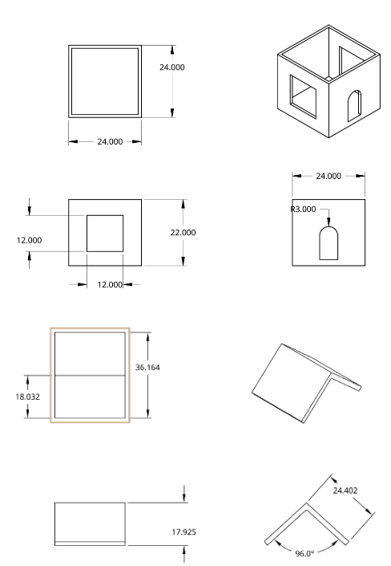
Hardware Design
Light Sensor Board
Regulator Breakout
MCU
Dimmable Controller
Communication Technologies

Slide 20
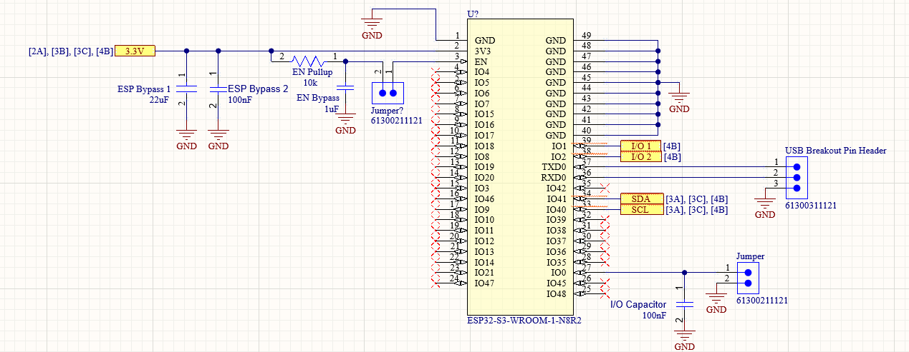
MCU PCB

Slide 21
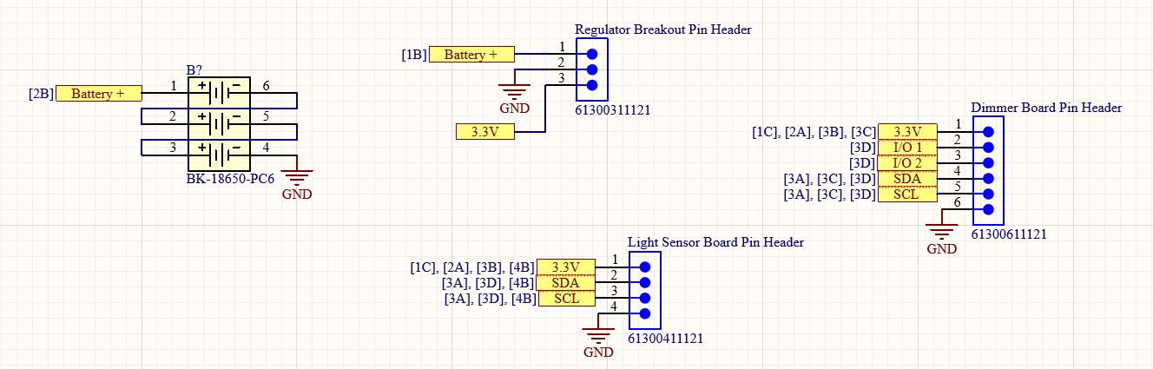
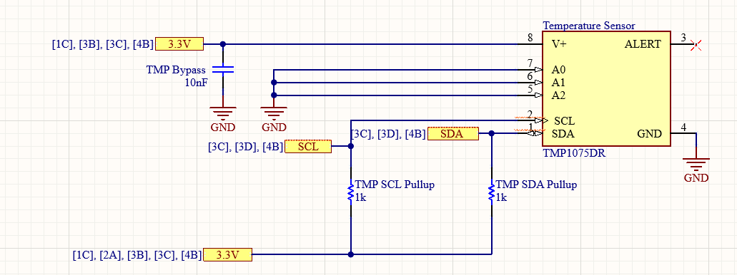
MCU PCB
cont'd

Slide 22
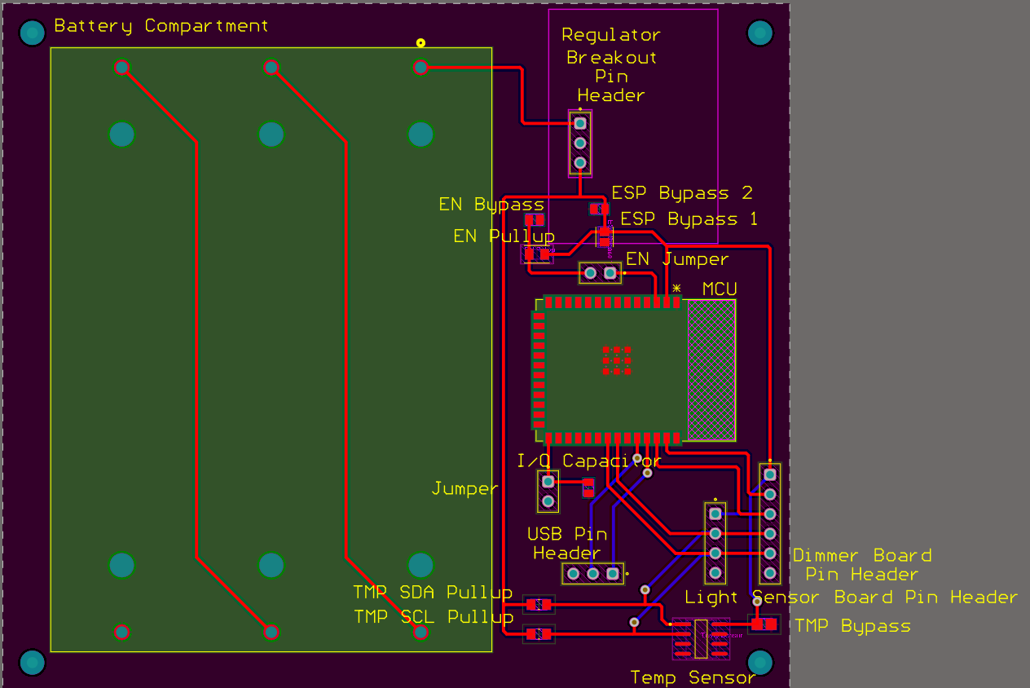
MCU PCB
cont'd

Slide 23
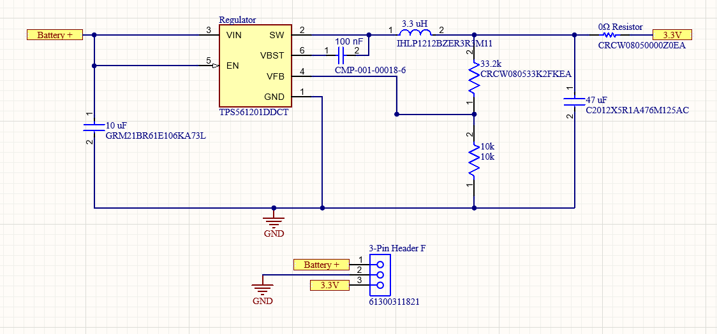
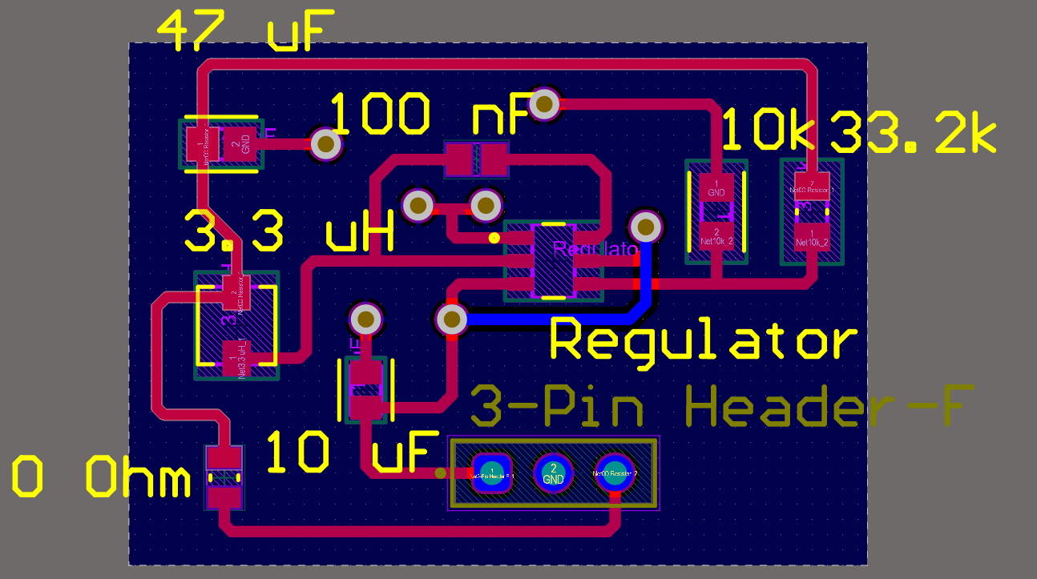
Regulator Breakout PCB

Slide 24
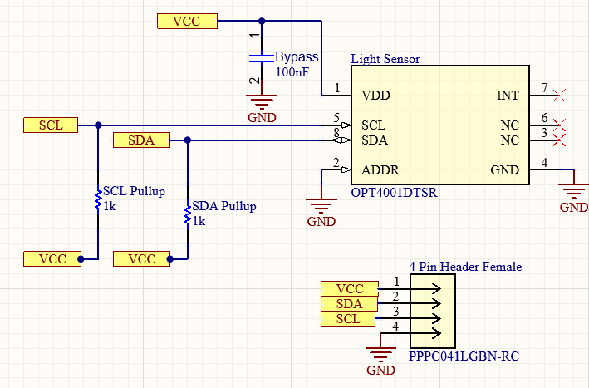
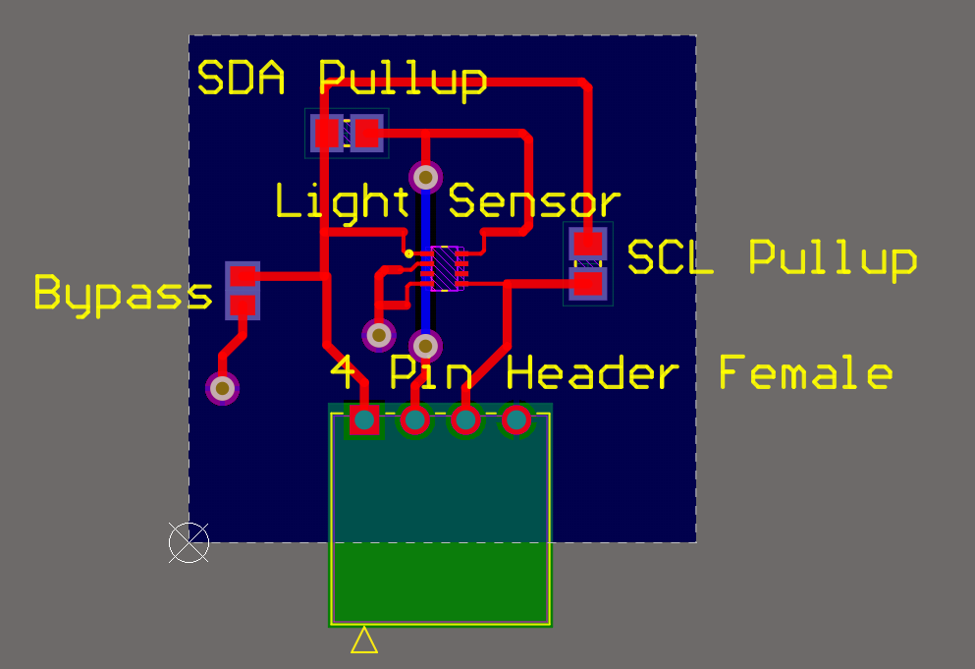
Light Sensor PCB

Slide 25
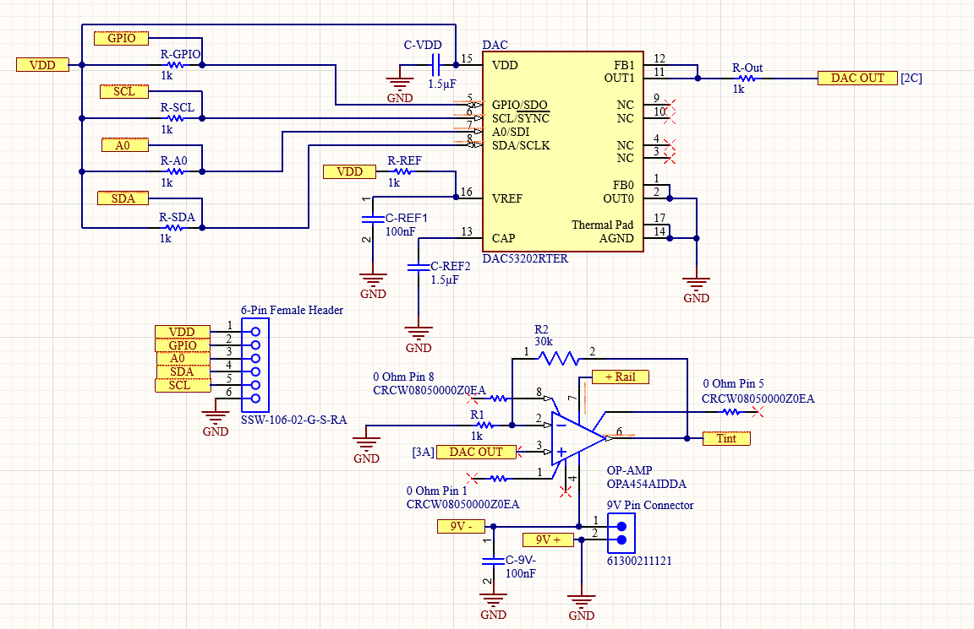
Dimmable
Controller

Slide 26
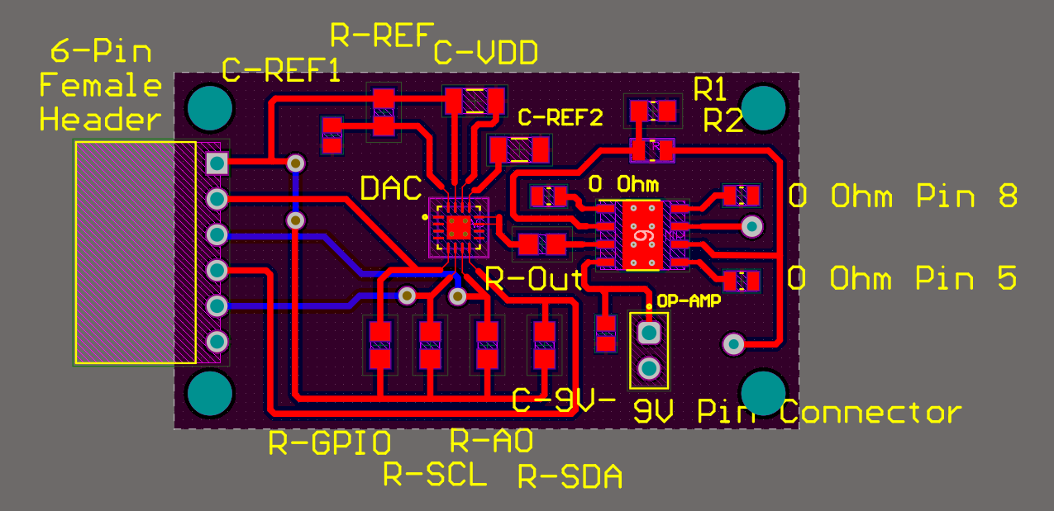
Dimmable
Controller
cont'd

Slide 27
Software Design
Case Diagram
Activity Diagram
Sensor and Tint Control
Automatic Tint Algorithm
User Interface
Backend(API)
Database
Development tools

Slide 28
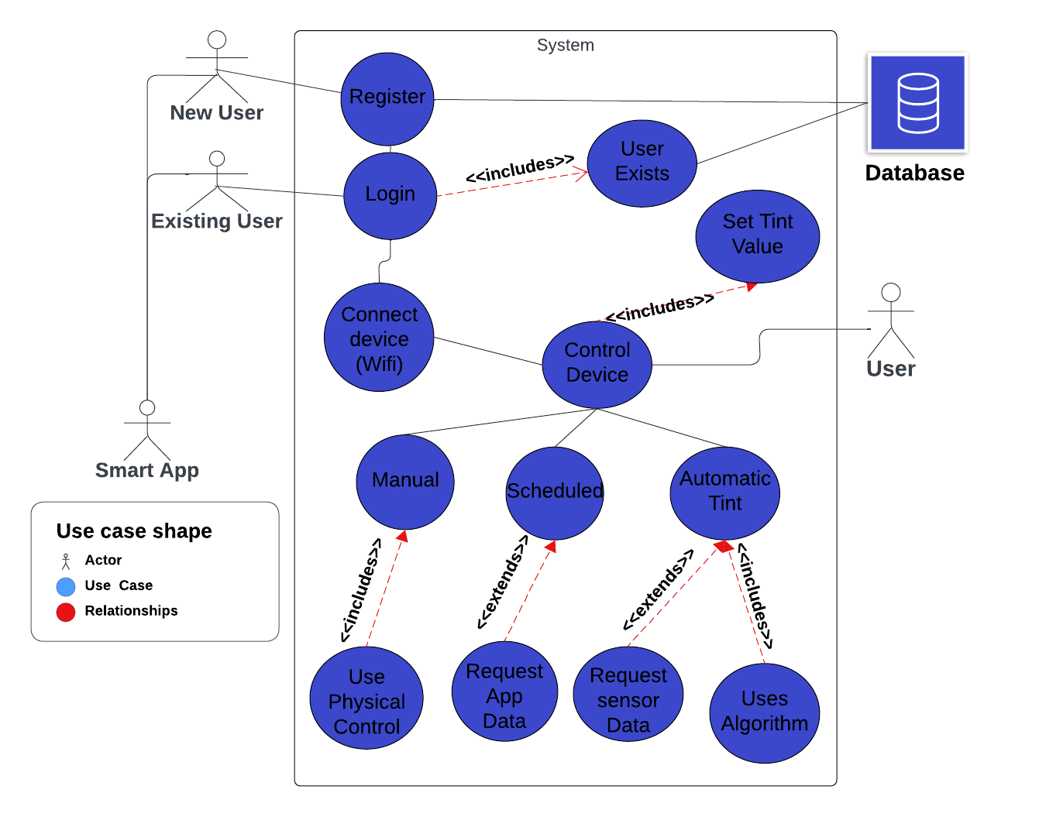
Case Diagram

Slide 29
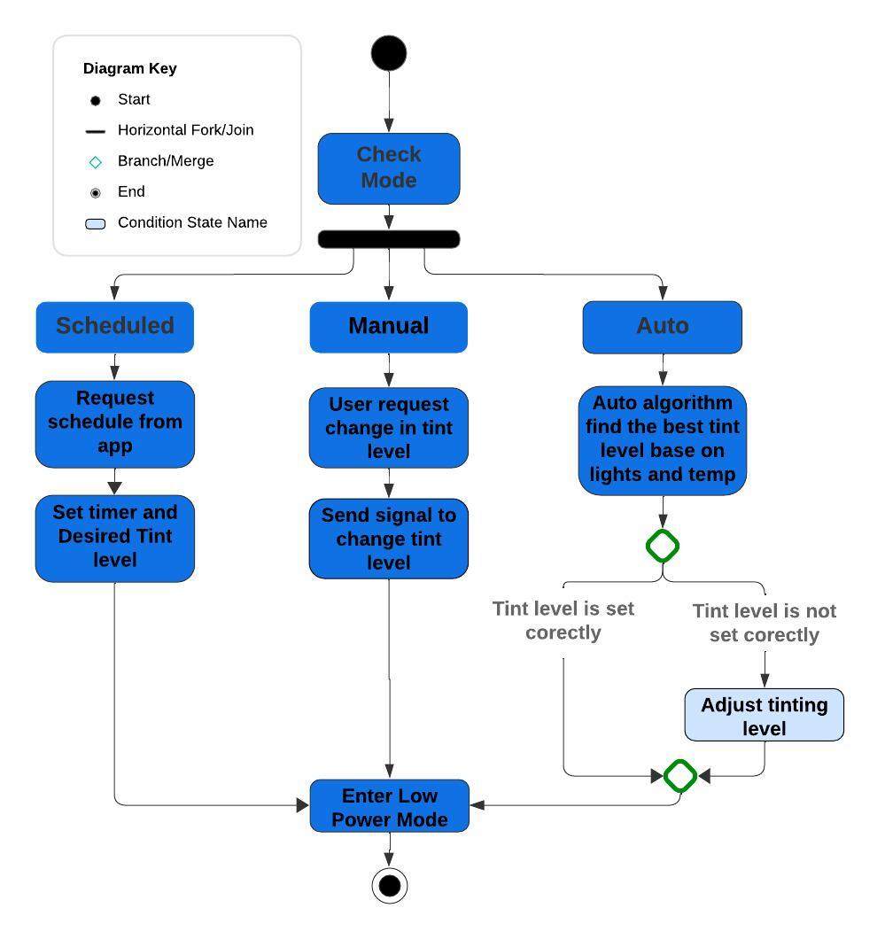
Activity Diagram

Slide 30
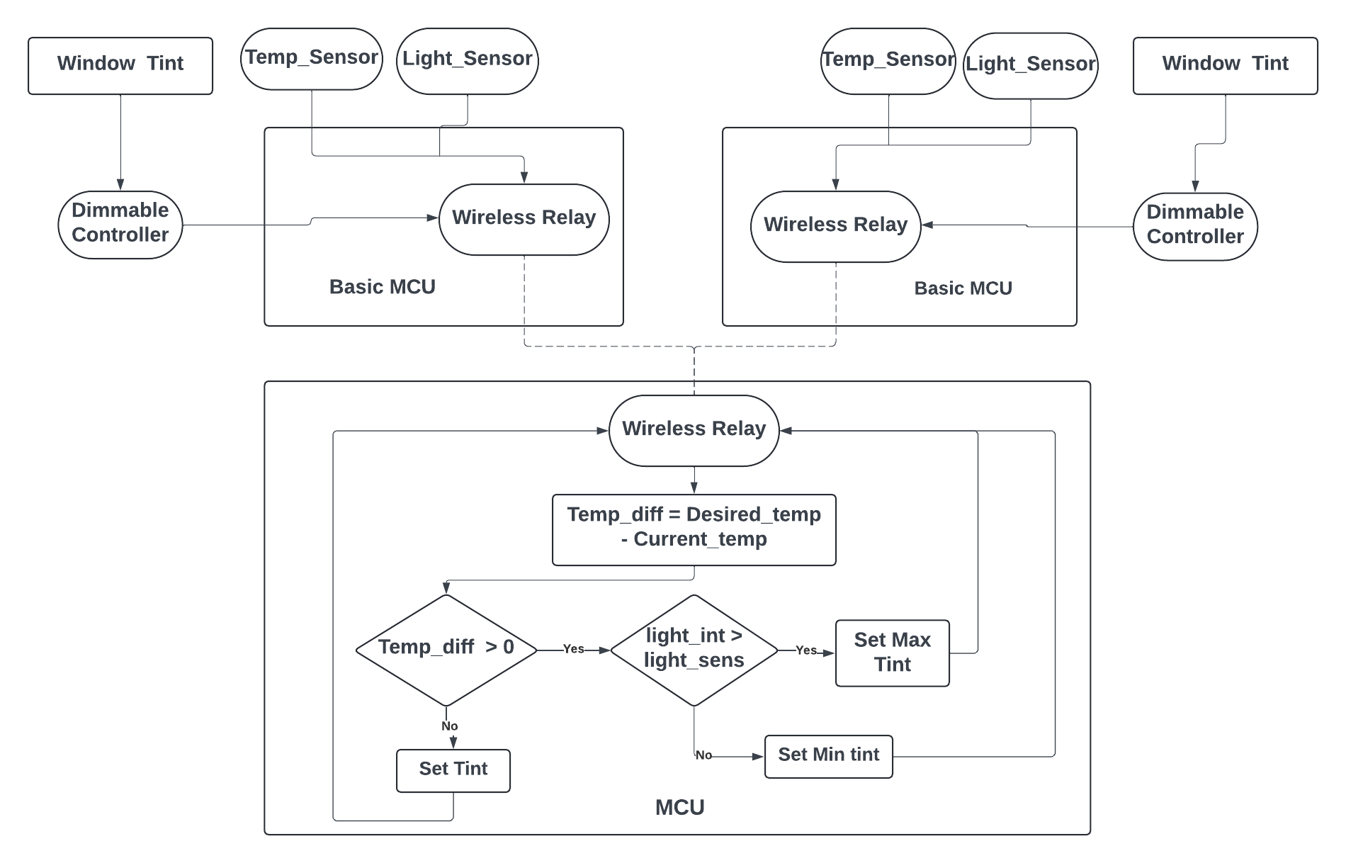
Sensor and Tint Control

Slide 31
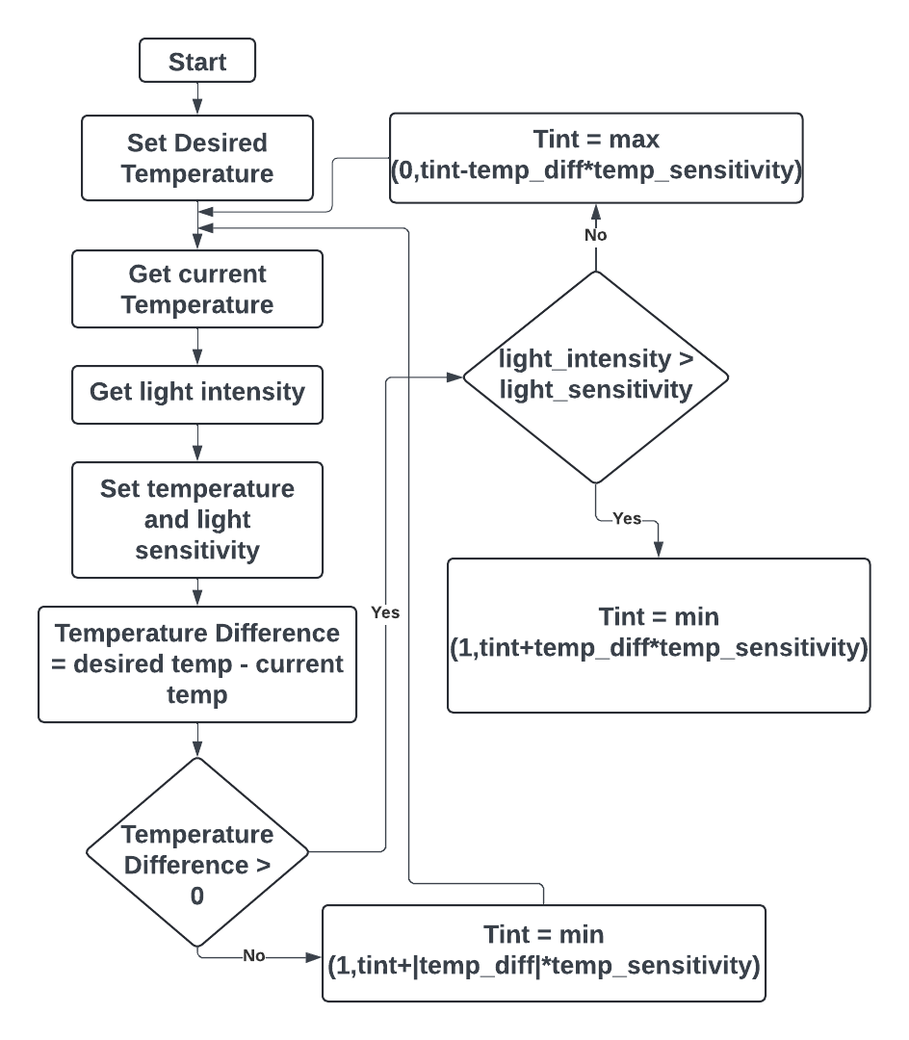
Automatic
Tint Algorithm

Slide 32
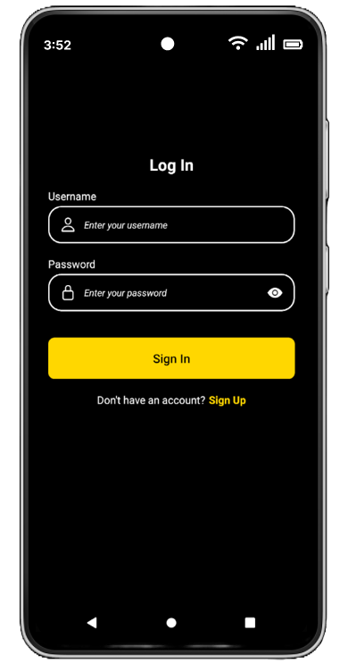
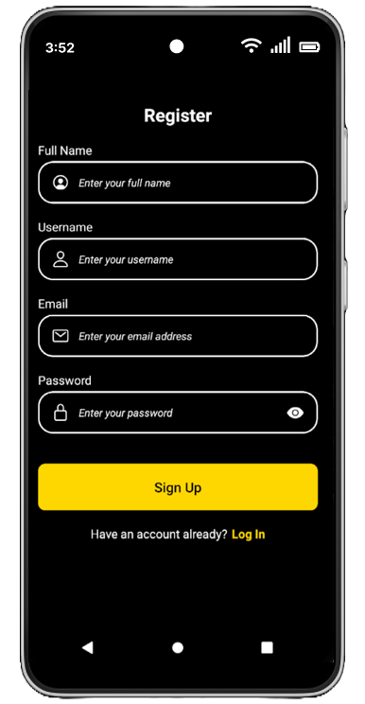
User Interface

Slide 33
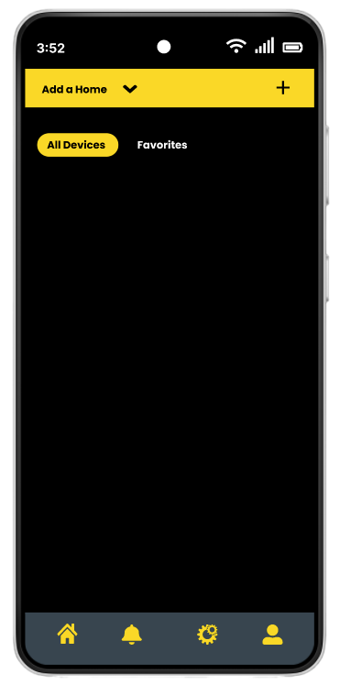
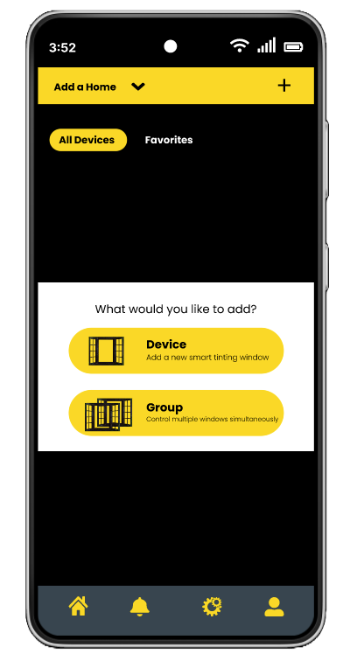
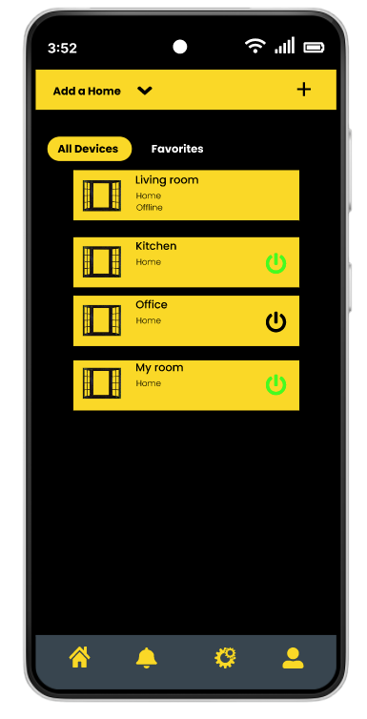
User Interface cont'd

Slide 34
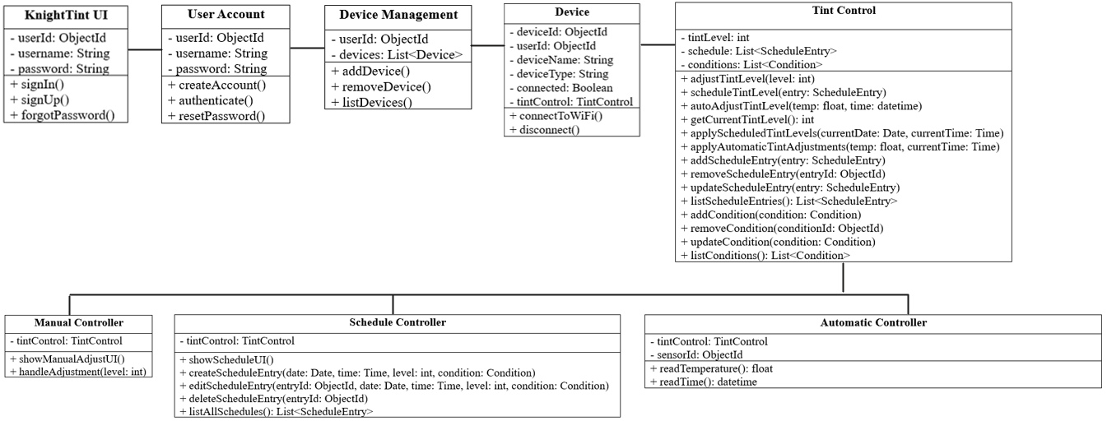
Backend (APIs)

Slide 35
Database
Real-time Data Collection
Centralized Data Storage in MongoDB
Handling Large Volumes of Data Efficiently
Real-time Sensor Data Recording
Automated Window Tint Adjustment
High Performance and Low Latency

Slide 36









Development tools
Github
Visual Studio Code Editor
Arduino IDE
Android Studio
Google Docs
MongoDB
Heroku
Discord
Altium Designer

Slide 37
Administrative Contents
Budget
Task Distribution
Miles Stones
Issues
Progress

Slide 38
Budget
Item | Total Price (USD) | Quantity
PCB | $140.00 | 4
Smart Glass | $80.00 | 2
Microcontroller | $30.00 | 3
Connectivity Devices (Wi-Fi/Bluetooth) | $20.00 | 3
Demo House | $50.00 | 1
Light Sensor | $5.00 | 10
Temperature Sensor | $1.00 | 10
Total | $326.00

Slide 39
Distribution of Tasks
Luckner Ablard- Mobile App Development, Task management
Oren Muszkal- Leader, PCB design, PCB development
Emmanuel Levasseur- Software development, 3D modeling, secretary
Stephen Polner- PCB design, PCB development

Slide 40
Milestones
Week # | Dates | Milestone Description
1 | 5/13/2024 - 5/20/2024 | Append to the 120-page document thing we've learned from the prototype.
2 | 5/20/2024 - 5/27/2024 | Individual System design (APP, MCU, PCB)
3 | 5/27/2024 - 6/3/2024 | Continue working on PCD MCU and APP (update 120-page paper)
4-9 | 6/3/2024 - 7/8/2024 | System integration (Make sure everything is working together and connected )
9-10 | 7/8/2024 - 7/22/2024 | Practice project demo (Go through a knock demonstration in front of our committee members)
11 | 7/22/2024 - 7/29/2024 | Finalize project demo and documentation
12 | TBD | Final Presentation

Slide 41
Issues
Time Management - Since we are on the Spring-Summer track, we have to deal with shortened deadlines
Cost - This project’s expenditures were higher than originally expected but through some clever tricks, we managed to stay near the original goal for spending
Changes - We have had to make numerous changes to our project with various major shifts in products

Slide 42
Progress
Used a clever solution for controlling voltages to the window tint
85% completion on Application
All 4 PCB’s completed and Dr.Weeks approved

Slide 43

Questions?

