Slide 1



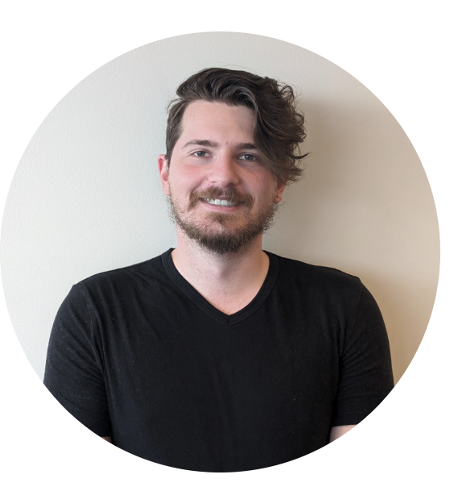
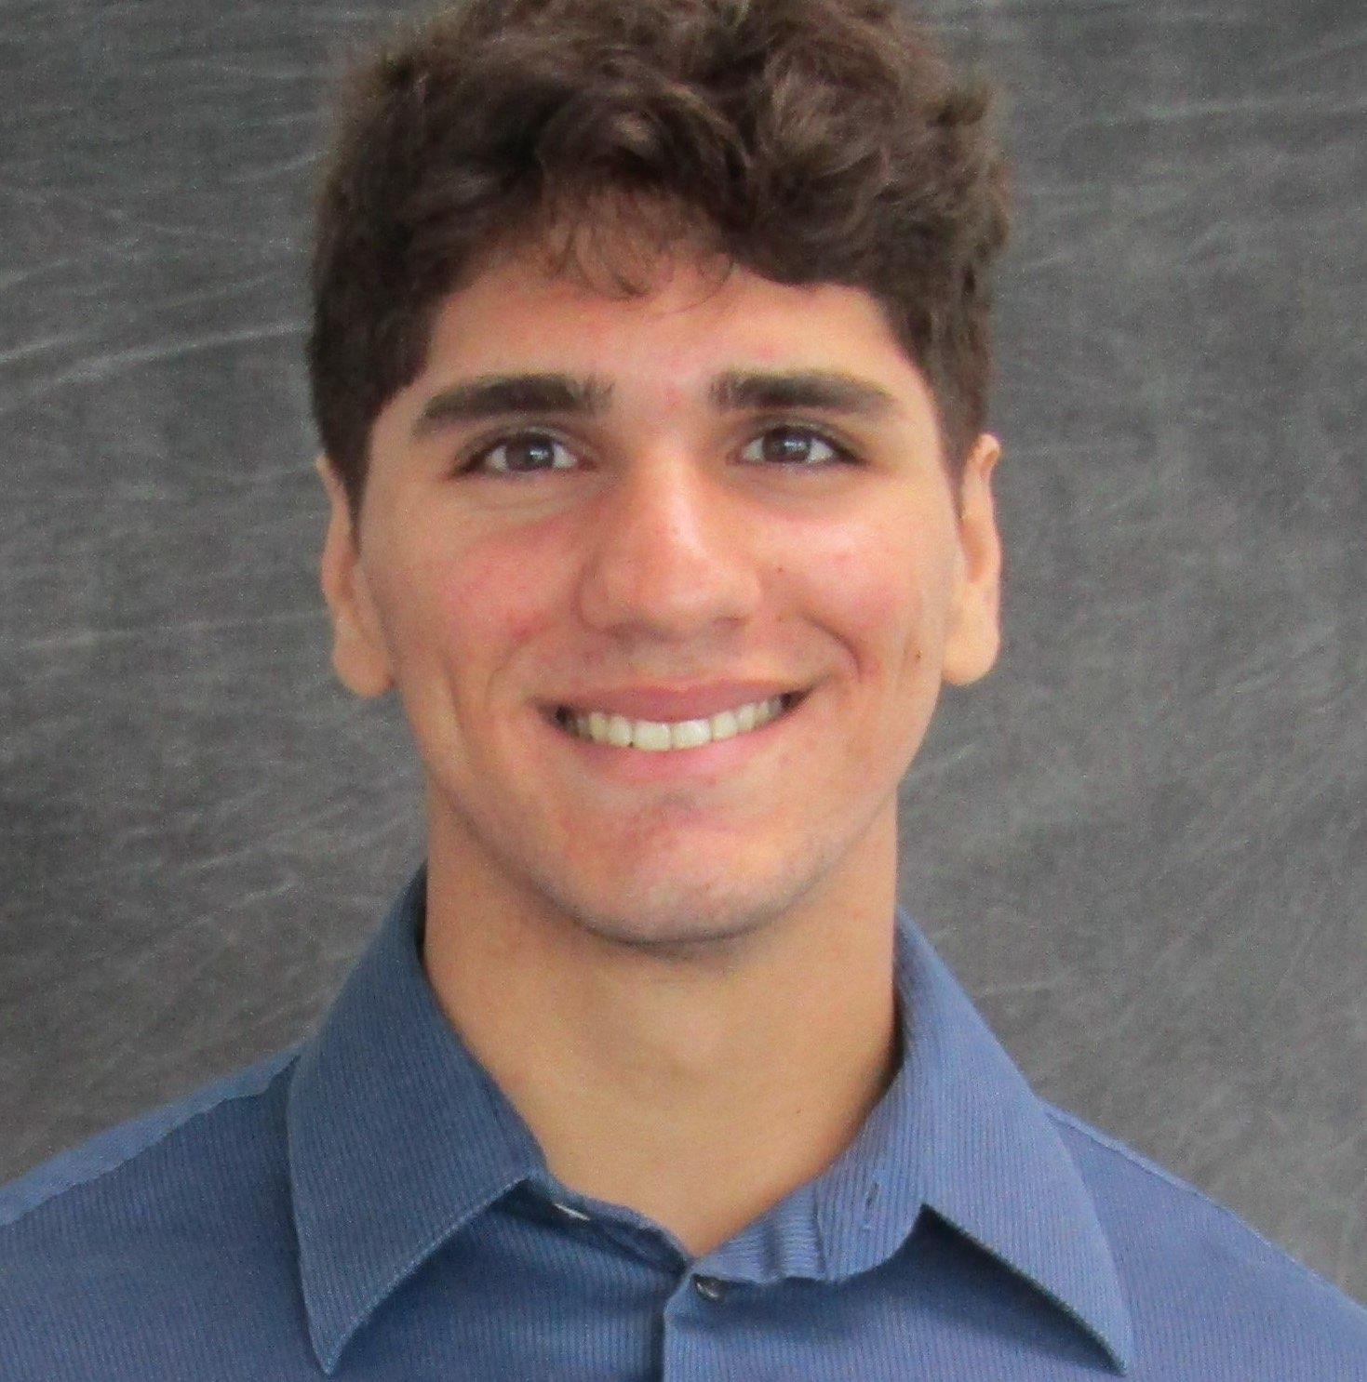
Emmanuel Levasseur Luckner Ablard Oren Muszkal Stephen Polner
Group 8

Slide 2
Motivation & Background
World development and population growth leading to energy consumption concerns.
Need for energy-saving systems due to environmental impact and resource strain.
HVAC systems are major contributors to home energy usage.
Smart Film PDLC in residential settings to reduce solar heating.

Slide 3
Existing Product
Gauzy: Offers smart window film systems, primarily for privacy applications.
SmartGlass: Provides similar services to Gauzy but with a broader range, including an online-connected interface.
SmartTint: automotive

Slide 4
Goals
Primary Goals: Offer satisfaction and convenience of an automated window tinting system, maintain desired indoor temperature and light intensity, and save on electricity costs associated with indoor cooling.
Integration: Integrate existing smart glass technology with a uniquely designed control system.
Control System: Implement the control system in a model house to adjust the tint percentage of windows based on indoor temperature and sunlight intensity.

Slide 5
Goals cont'd
Advantage: The system can adapt to changing conditions and maximize outdoor visibility when tinting is not needed.
Software Goal: Design a mobile application that allows users to manually control the tinting system and customize its functionality.

Slide 6
Objective
Collect temperature and light intensity data using thermal and luminosity sensors.
Transmit data via wireless relays to and from a central microcontroller.
Program microcontroller logic to output voltages that act as a control signal.
Design a PCB and implement a controller to transform control signals into the proper voltages for the desired tinting percentages.
Implement an AC to DC converter to power the central control unit.
Incorporate a smartphone application into the logic of the microcontroller.

Slide 7
Specifications
A window tinting system that can be set up in different modes
Manual Control
Temperature and light sensors that take in the current environment reading
1 pair of windows connected and communicating
Integration of sensors and devices
App and UI integration

Slide 8
Key Requirements
Marketing Requirements | Engineering Requirements | Justification
1, 3, 9 | The sensors should read the temperature and light at least once per second. | The system should be adaptive and respond to rapidly changing circumstances.
1, 7, 9 | Real-time Tinting Updates: Updates with < 3 seconds delay after user mobile application manual input. | Timely updates enhance user satisfaction by providing real-time information about window tinting.
9 | Tint should block up to 90% of income light without voltage, but transparent at the highest voltage. | The window tint implementation should accomplish the project goal of indoor cooling without sacrificing window functionality.
Marketing Requirements Key:
Performance speed
Quality/affordability balance
Sensor reliability
Maintenance minimization
Accessibility
User-friendliness
Convenience
Aesthetics
Indoor cooling efficacy
Notes:
Change to a spec table (re-record )

Slide 9
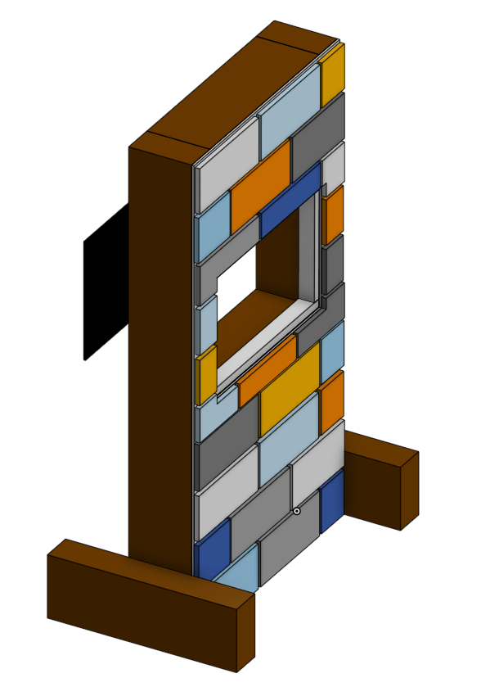
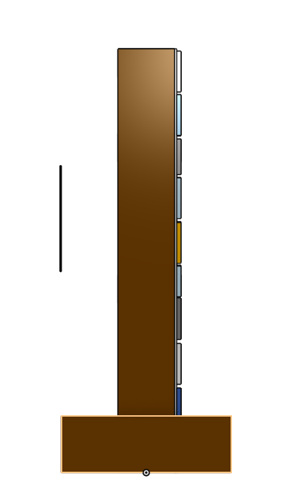
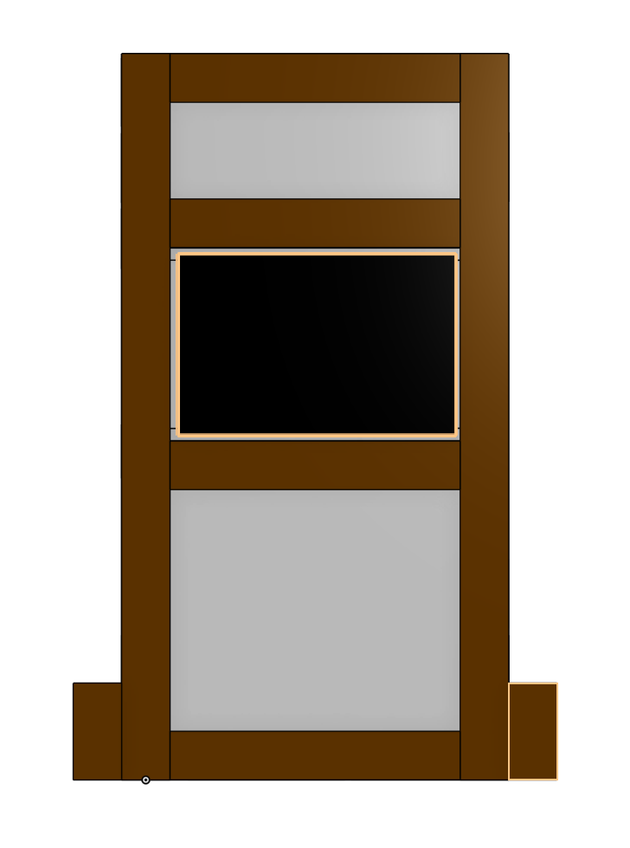
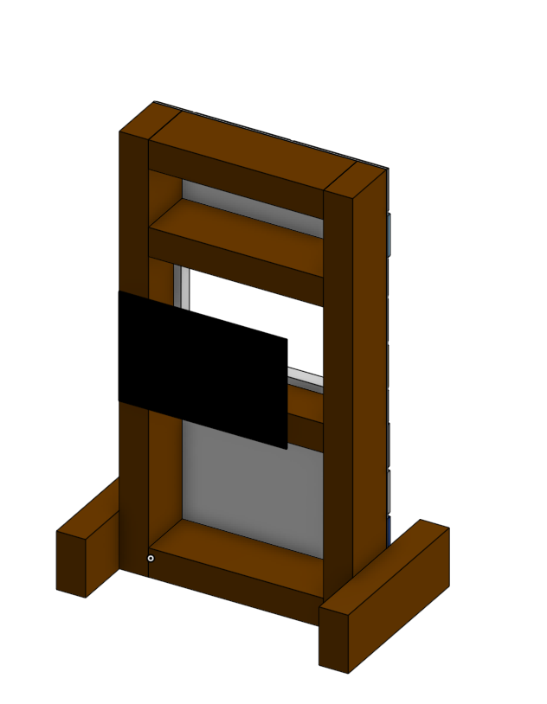
Physical Prototype
Notes:
3d model

Slide 10
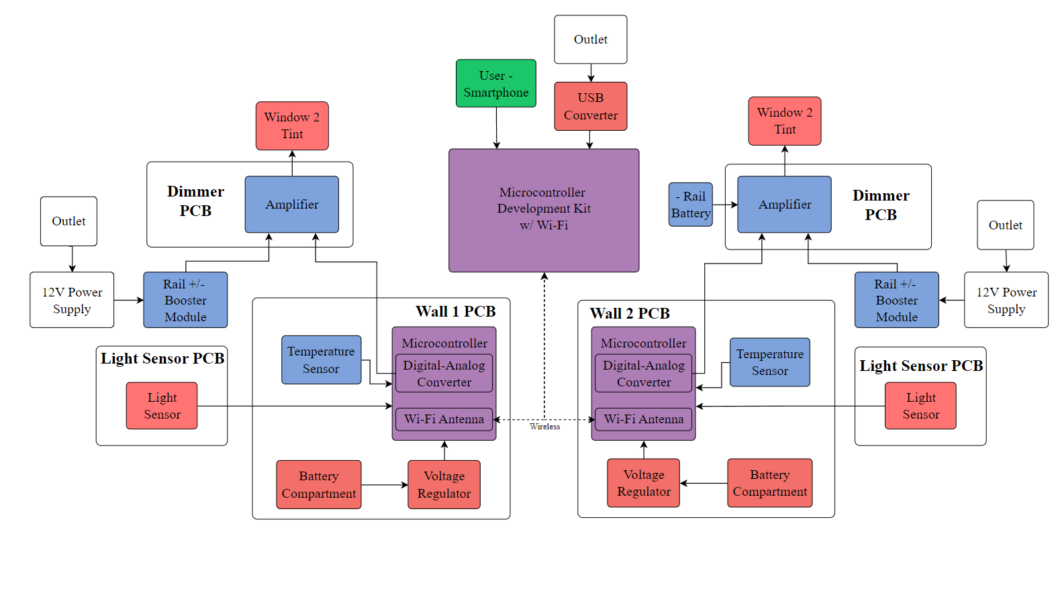
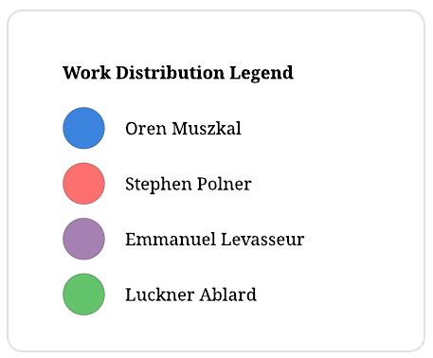
Hardware
Block Diagram

Slide 11
Hardware
Comparison and Selection
MCU
Smart Glass Technologies
Voltage regulation
Temperature Sensor
Light Sensor
Batteries
Power Supply

Slide 12
MCU
Microcontroller Family | Wi-Fi Support | I2C Support | Programming Language | Power Consumption
MSP430 | No (requires external module) | Yes | C | Moderate
AVR | Varies (check specific chip) | Yes | C | Low
PIC | No (requires external module) | Yes | C | Very Low
ARM Cortex | Varies (check specific chip) | Yes | C | Varies
ESP8266/ESP32 | Built-in | Yes | C | Moderate
FPGA | Complex (requires external components) | Can be implemented | Hardware Description Languages (Verilog) | Varies
The ESP32 is the optimal choice for IoT devices due to its combination of built-in Wi-Fi and Bluetooth capabilities, powerful dual-core processing, and affordability. This makes it ideal for a wide range of applications, from simple sensors to complex home automation systems, while remaining accessible to hobbyists and professionals alike.
Notes:
add text description to explain choice

Slide 13
Smart Glass Technologies
 | Thermo chromic | Photochromic | Electrochromic | Dimmable PDLC | SPD | Micro- Blinds
Electrically Controllable | No | No | Yes | Yes | Yes | Yes
Switching Time | Several Minutes | <1 minute | Several Minutes | Nearly Instantly | Several Seconds | Nearly Instantly
Powered Off State | N/A | N/A | Transparent | Opaque | Opaque | Transparent
Commercial Availability | High | High | Medium | High | Medium | Low
Available as Film | Yes | Yes | No | Yes | No | No
Light Transmittance | 5-90% | 10-90% | 5-80% | 40-90% | 1-55% | 0-100%
PDLC was chosen over SPD for the project due to budget constraints, as SPD proved to be too expensive. While PDLC lacks some of the light reduction capabilities of SPD, it still offers similar enough features to demonstrate the project's concept.

Slide 14
Temperature Sensor
 | Size | Cost | Power Draw | Response Time | Accuracy | Connectivity
Thermocouple | 3mm | $5-20 | 10mW | 100ms | 1C | Good
RTD | 1-5mm | $30-200 | 20mW | 2s | .1C | Good
Thermistor | 5mm | $2-15 | 15mW | 500ms | Varied | Good
IR | 20mm | $50-500 | 50mW-1W | 100ms | 1-2C | Good
Semiconductor | 3mm | $5-30 | 5mW-20mW | 200ms | .5-2C | Excellent
Gas | 1m | $200-1k | 20mW | 5s-2m | .0001C | Fair to Good
Bimetallic | 10mm | $1-20 | Passive | 5s | 2C | Fair
Fiber Optic | varies | $100-1k | 1-10mW | 2ms-2s | .01C | Fair to good
The semiconductor device was chosen for the project due to its fit within the group's parameters. Other options like RTD, IR sensing, gas, bimetallic, and fiber optic were eliminated due to cost, size, response time, accuracy, or a combination of these factors, while thermistor and thermocouple were considered but had potential drawbacks.

Slide 15
Light Sensor
 | Size | Cost | Current Draw | Response Time | Accuracy | Connectivity
Photodiode | 1mm | $5-20 | 1 μA - 100 μA | 100ns- 10μs | 1% - 5% | Good
Photo-transistor | 2mm | $30-200 | 1 μA - 100 μA | 10μs | 1% - 5% | Good
LDR | 5mm | $2-15 | 1 μA - 10 μA | 10ms | 5% - 10% | Good
CMOS | 2-10mm | $50-500 | 1 mA - 10 mA | 100μs- 1ms | <1% | Excellent
PICs | 1m | $50-500 | 1 μA - 10 mA | 100ns-10μs | <1% | Excellent
The TI OPT4001 photodiode was selected for the project due to its affordability, functionality, and suitability for the human-based system's requirements. Alternatives were dismissed based on cost, accuracy, size, power consumption, or unnecessary features, making the OPT4001 the optimal choice for integration due to its precision, response time, and low operation current.

Slide 16
Batteries
 | Alkaline AA | Lithium AA | Zinc-Carbon AA | NiMH AA | Lithium-Ion 18650 | Lithium Polymer
Battery Life | 1000-3000 mAh | 1500-3500 mAh | 500-1500 mAh | 1300-3000 mAh | 1500-3600 mAh | Size- Dependent
Rechargeable | No | No | No | Yes | Yes | Yes
Cost per Battery | $0.80-2 | $2-4 | $0.50-1 | $1.50-3.50 | $5-10 | 3500 mAh Example: $13-14
Nominal Voltage | 1.5V | 1.5V | 1.5V | 1.3V | 3.7V | 3.7V
Dimensions L = Length D = Diameter | L: 50.5 mm D: 14.5 mm | L: 50.5 mm D: 14.5 mm | L: 50.5 mm D: 14.5 mm | L: 50.5 mm D: 14.5 mm | L: 65.2 mm D: 18.6 mm | 3500 mAh Example: 129L x 56W x 4H mm
The 18650 lithium-ion batteries were chosen for the KnightTint system due to their replaceability, energy density, and voltage output, prioritizing user convenience and simplicity. The Samsung SDI 35E 18650 battery was specifically selected for its balance of performance, cost, and brand reputation, offering significant savings compared to alternatives like the Vapcell N40.

Slide 17
Hardware Design
Light Sensor Board
Regulator Breakout
MCU
Dimmable Controller
Communication Technologies
Notes:
Re Record with the new hardware

Slide 18
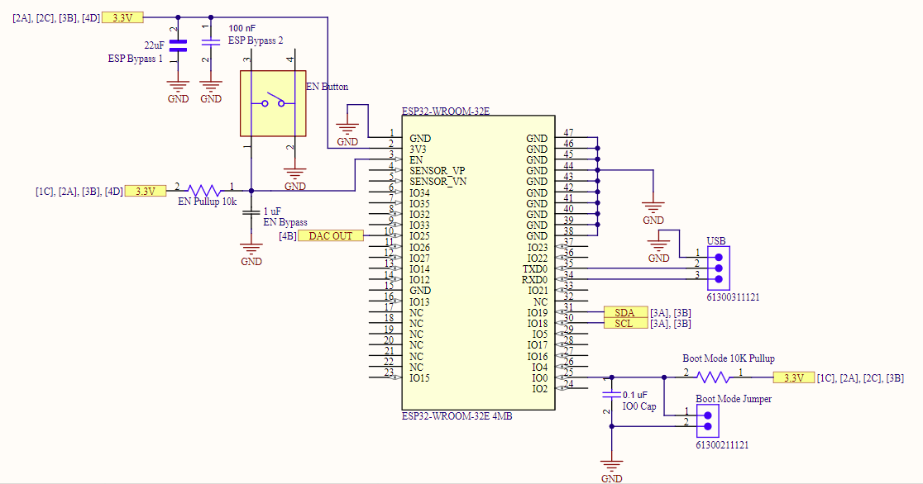
MCU PCB

Slide 19
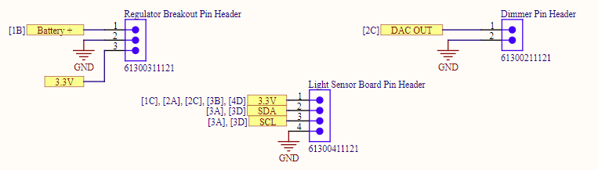
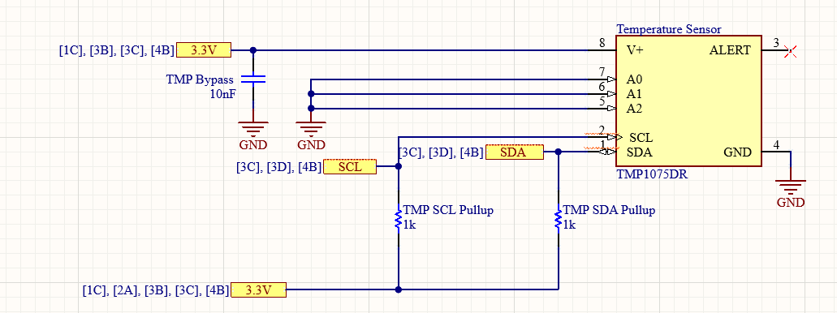
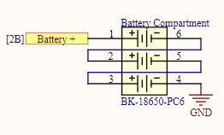
MCU PCB cont'd

Slide 20
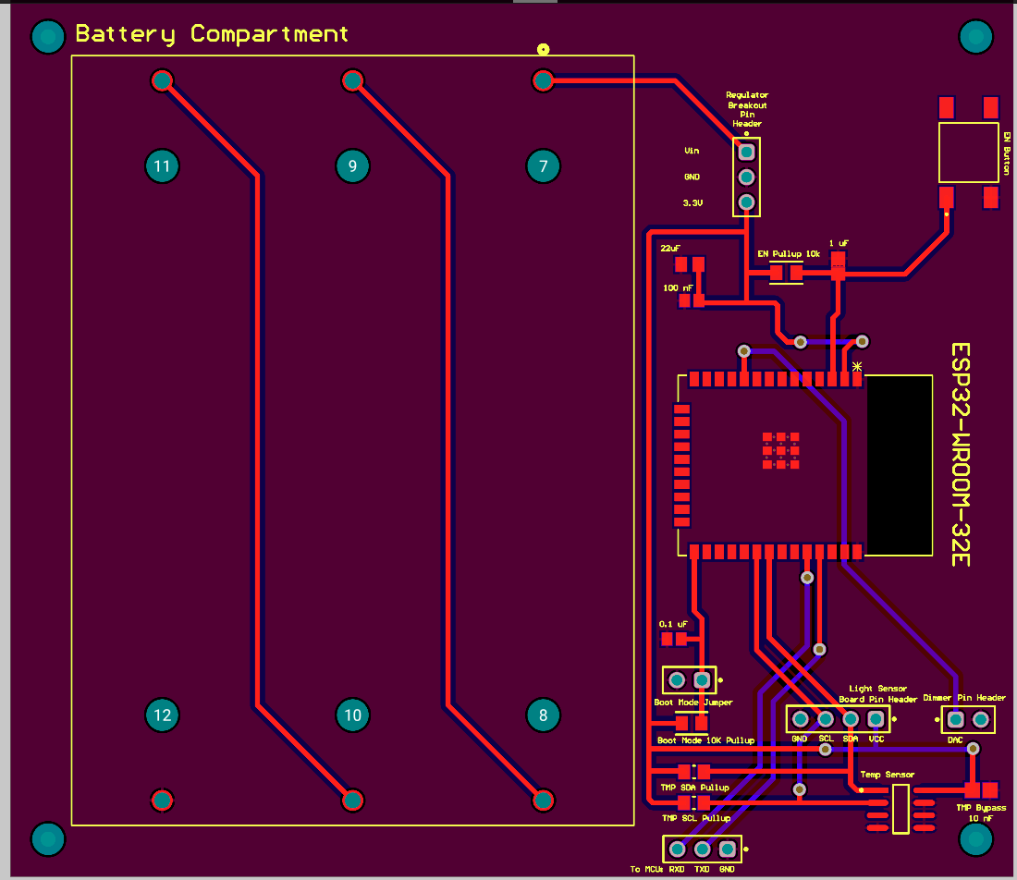
MCU PCB cont'd

Slide 21
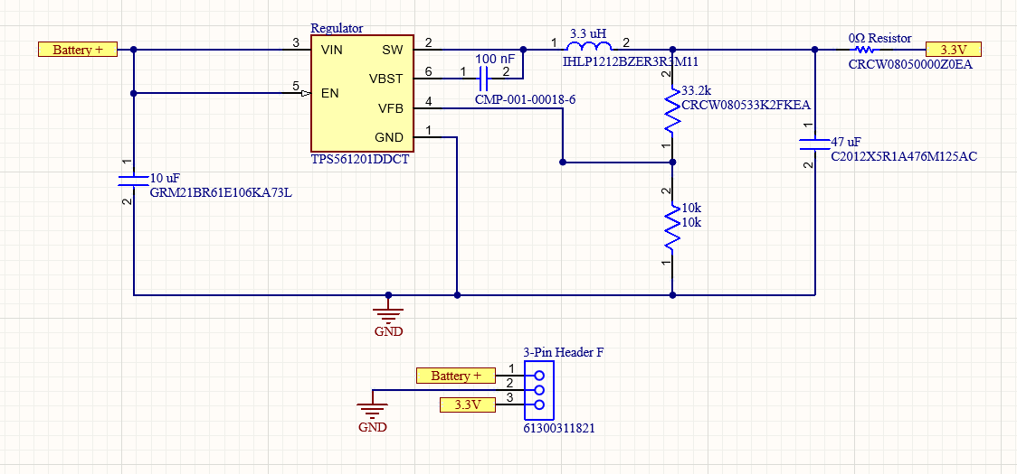
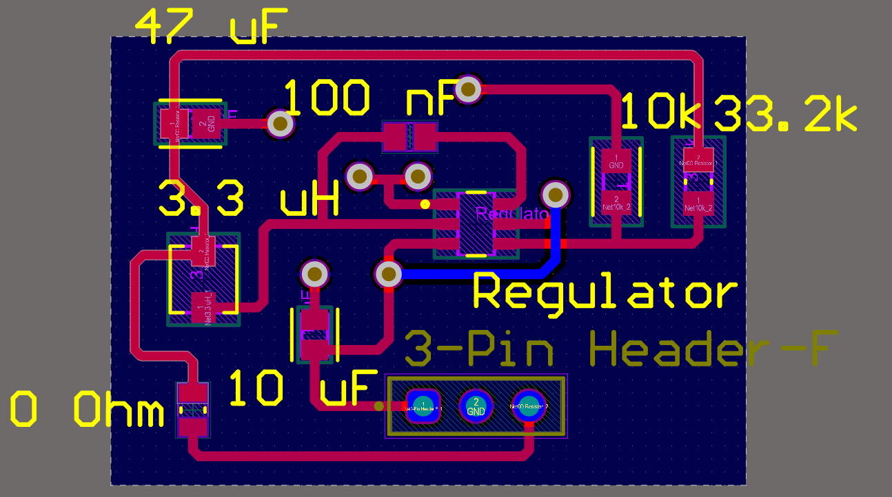
Regulator Breakout PCB

Slide 22
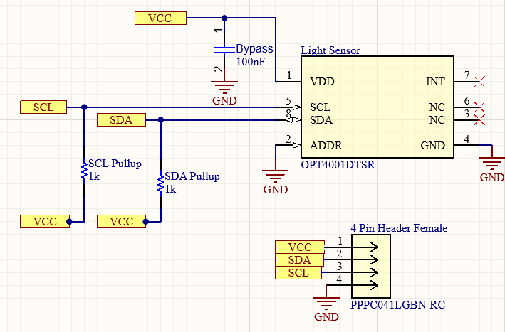
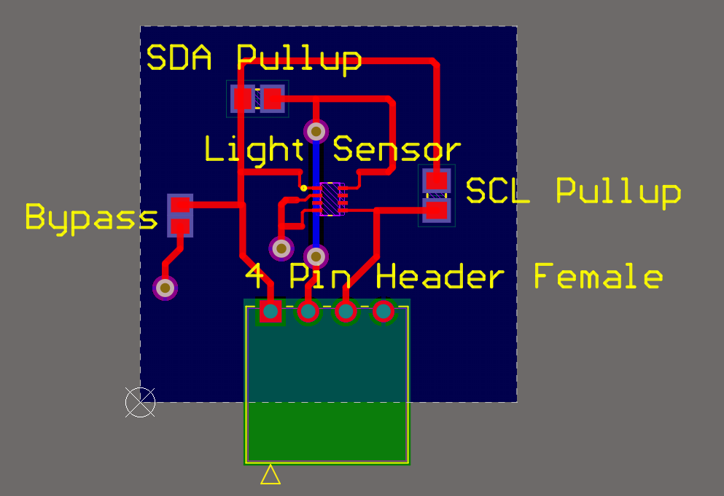
Light Sensor PCB

Slide 23
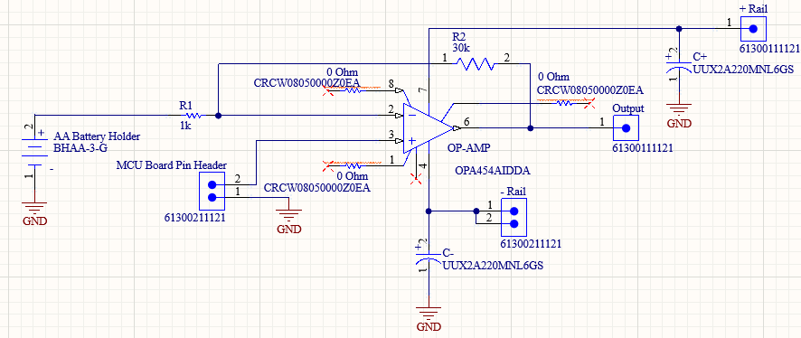
Dimmable
Controller

Slide 24
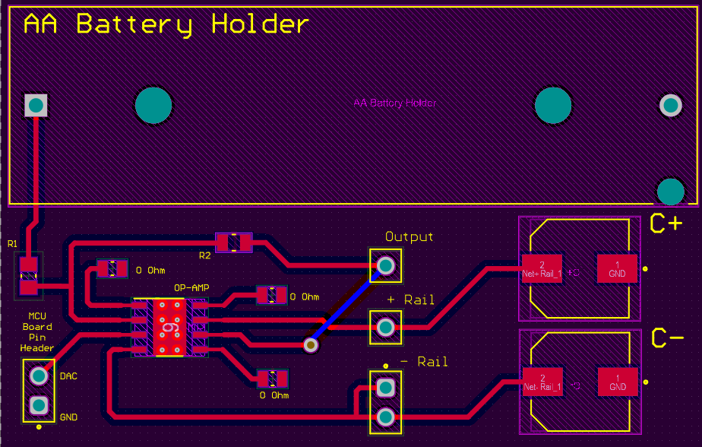
Dimmable
Controller cont'd

Slide 25
Software Design
Case Diagram
Activity Diagram
Sensor and Tint Control
Automatic Tint Algorithm
User Interface
Backend(API)
Database
Development tools

Slide 26
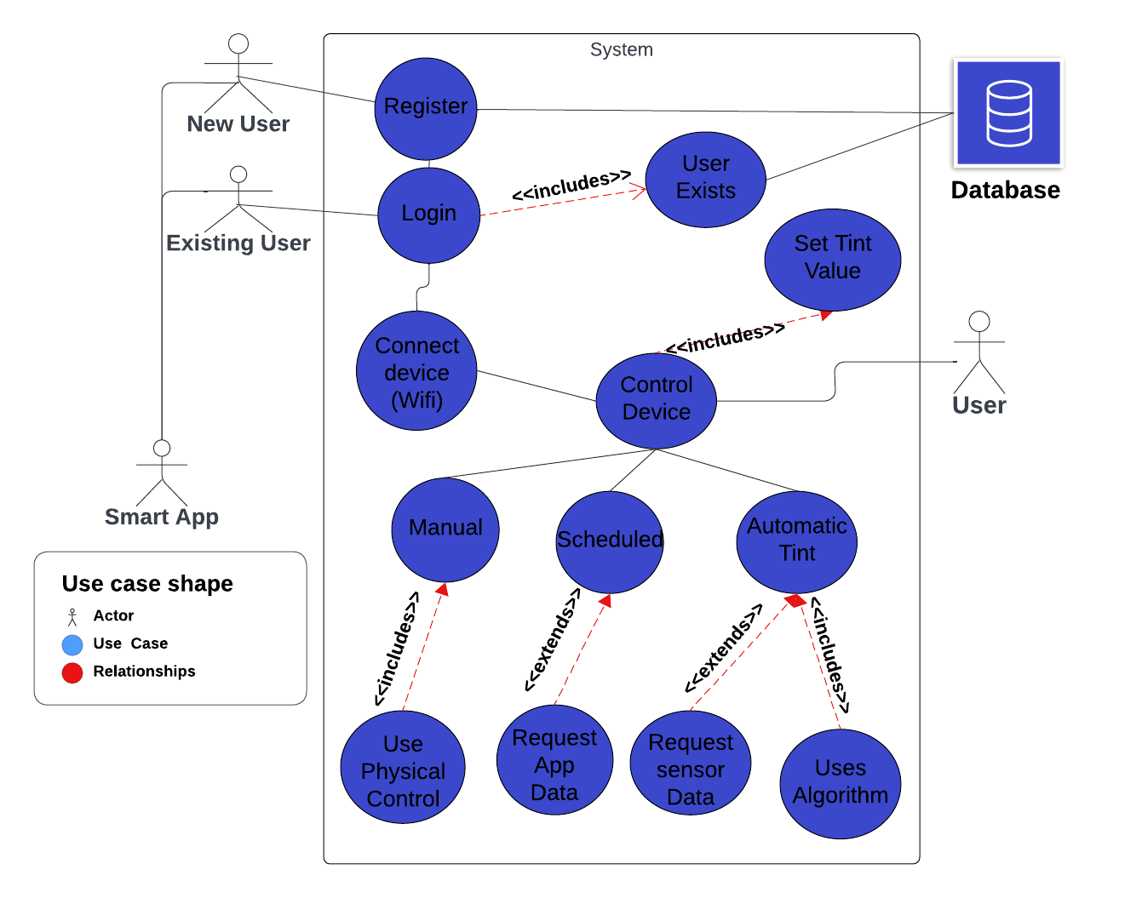
Case Diagram

Slide 27
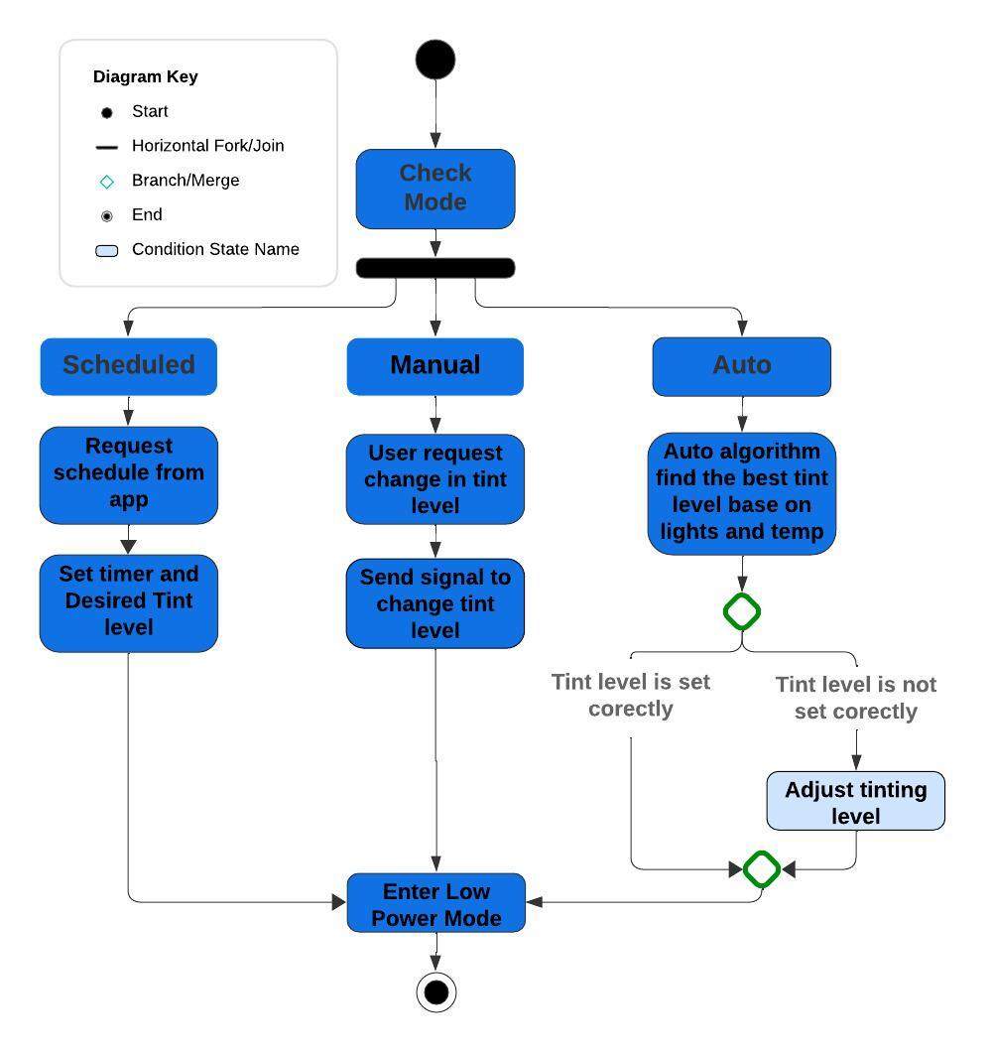
Activity Diagram

Slide 28
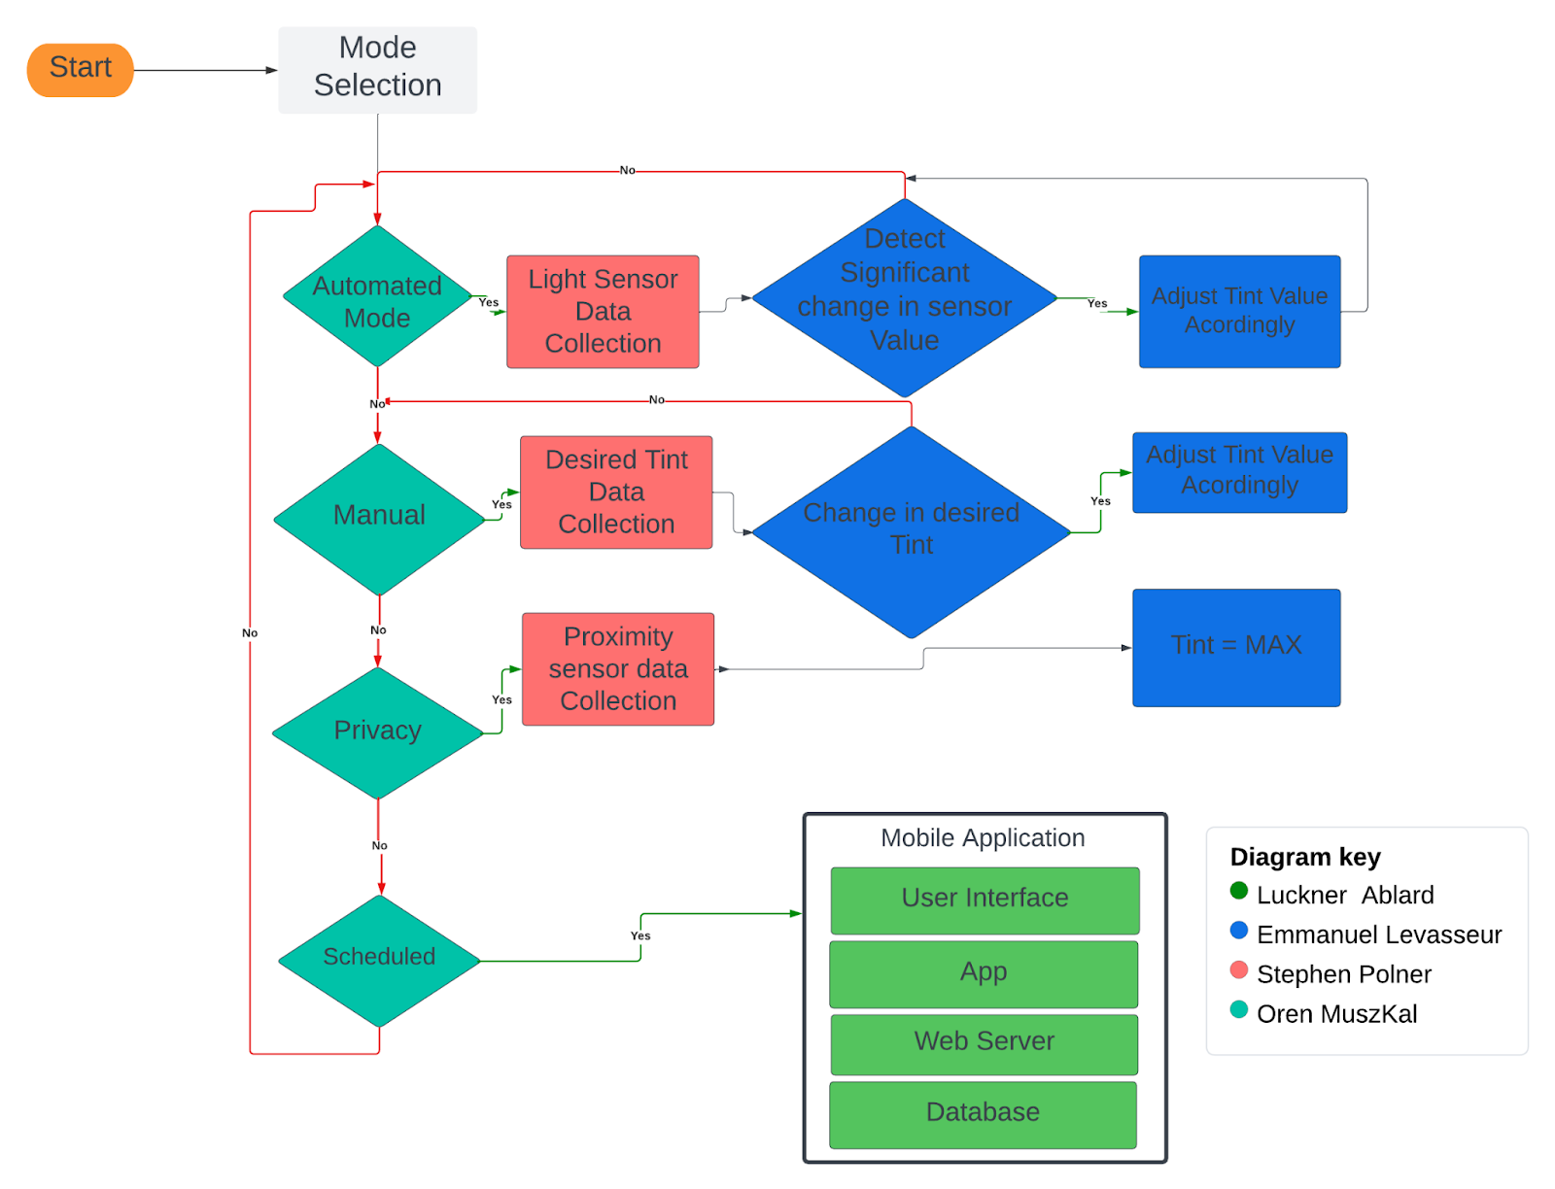
Software
Flow Chart

Slide 29
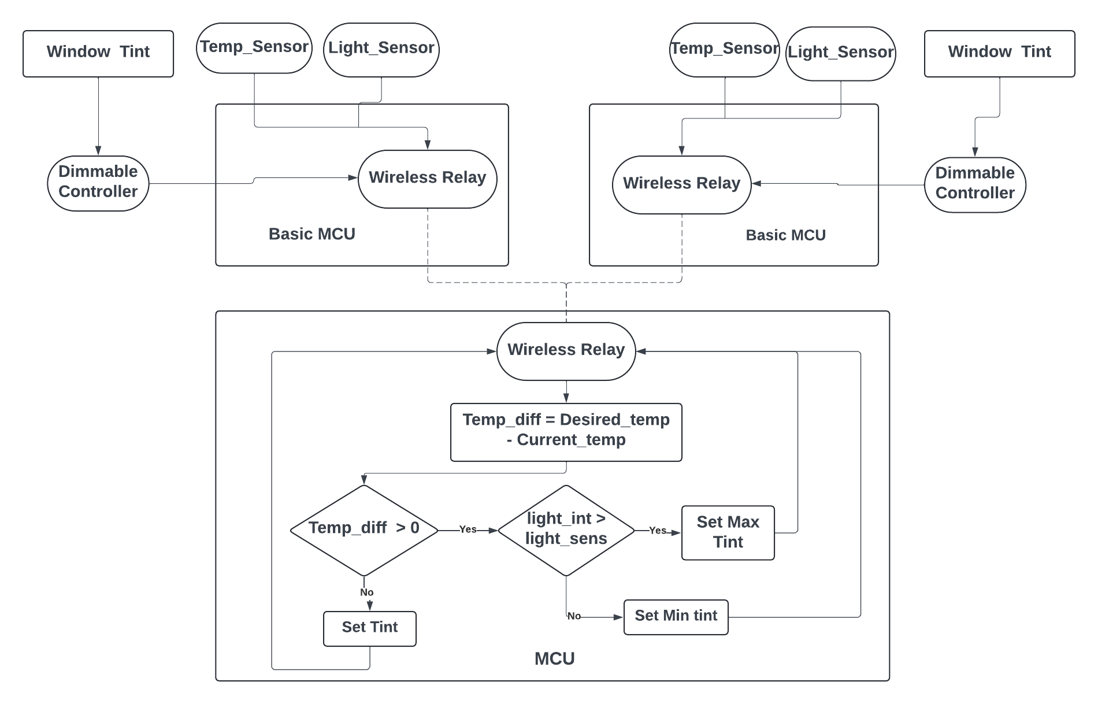
Sensor and Tint Control

Slide 30
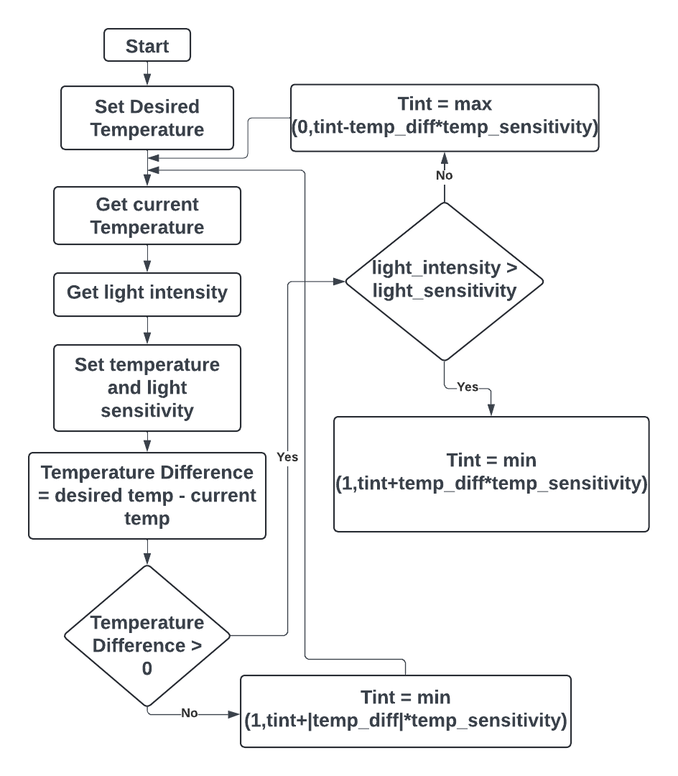
Automatic
Tint Algorithm

Slide 31
Mobile App Stack
Mobile App Stacks | Framework | Components | Programming Languages | Database
LAMP | Linux | Linux Apache MySQL PHP | HTML CSS PHP | MySQL
MERN | React | MongoDB Express.JS React Node.JS | HTML CSS JavaScript | MongoDB
MEAN | Angular JS | MongoDB Express.JS Angular.JS Node.JS | HTML CSS JavaScript | MongoDB
MERN stack is a great choice for mobile app development because it utilizes JavaScript across the entire stack, simplifying development and maintenance. Additionally, React's component-based architecture allows for efficient UI rendering and code reusability, resulting in faster development cycles and a smoother user experience.

Slide 32
Hosting Platform
Hosting Platforms | Advantages | Disadvantages
AWS Amplify | Affordable, scalable solutions with pay-as-you-go pricing, featuring data protection through encryption and IAM, without requiring upfront hardware investments. | Prone to occasional outages impacting accessibility and has vendor lock-in, making migration to other platforms difficult.
Heroku | Supports various programming languages, handles growing user bases effectively, and benefits from extensive community and documentation. | Limited control over server configurations, costly for large-scale or high-traffic apps, and may have lagging performance compared to other platforms.
Microsoft Azure | Offers a wide range of services including AI and analytics, scalability for growing user bases, support for multiple app development platforms, and a secure environment with authentication and encryption. | Requires expertise for complex setup and configuration, with vendor lock-in and potentially increasing costs.
Heroku is an excellent hosting platform due to its streamlined deployment process and scalable infrastructure, allowing developers to easily deploy and manage applications without worrying about server management. Additionally, its extensive marketplace of add-ons and integrations provides a wealth of tools and services to enhance application functionality and performance.

Slide 33
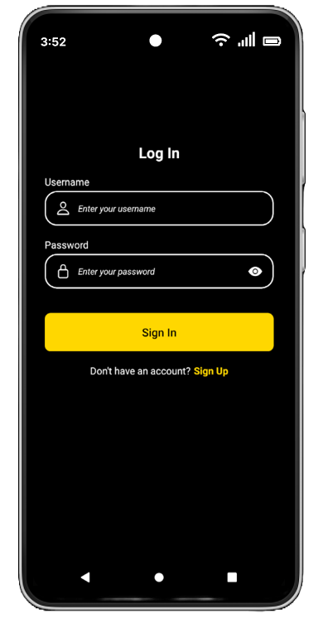
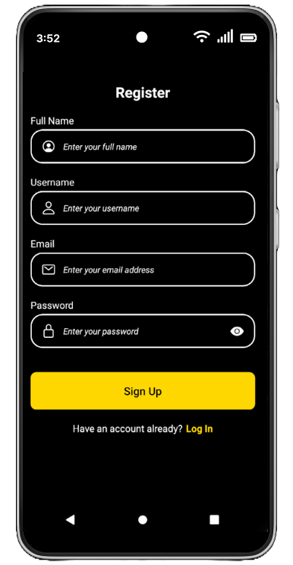
User Interface

Slide 34
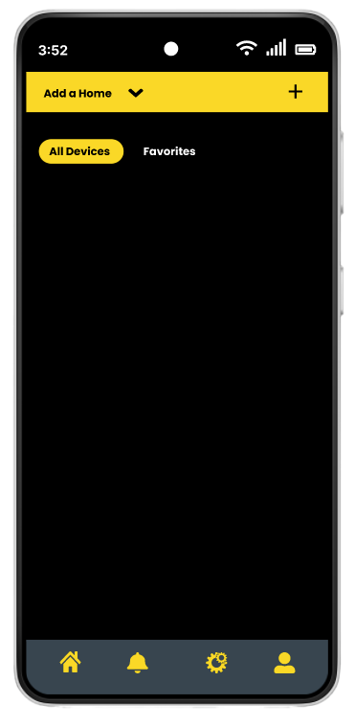
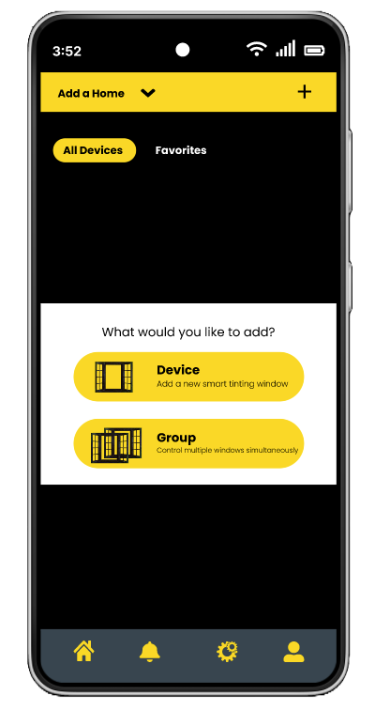
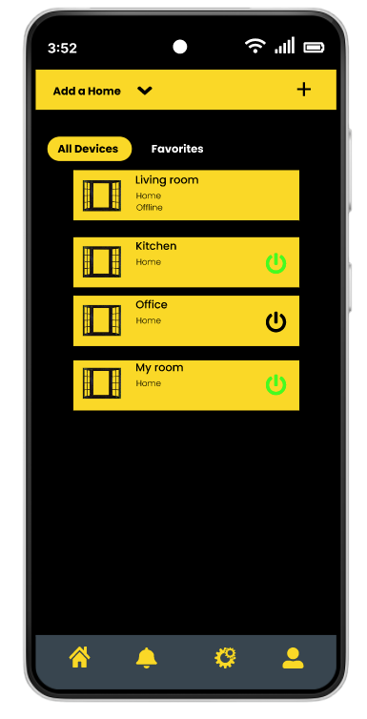
User Interface cont'd

Slide 35
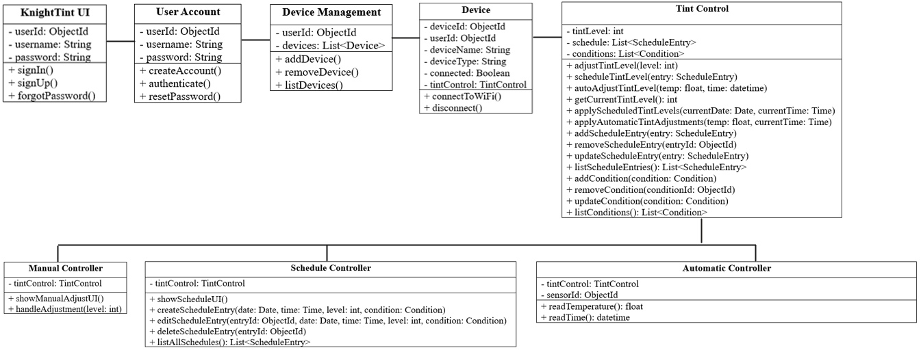
Backend (APIs)

Slide 36
Database
Real-time Data Collection
Centralized Data Storage in MongoDB
Handling Large Volumes of Data Efficiently
Real-time Sensor Data Recording
Automated Window Tint Adjustment
High Performance and Low Latency

Slide 37









Development tools
Github
Visual Studio Code Editor
Arduino IDE
Android Studio
Google Docs
MongoDB
Heroku
Discord
Altium Designer

Slide 38
Administrative Contents
Budget
Task Distribution
Miles Stones
Issues
Progress

Slide 39
Budget
Item | Total Price (USD) | Quantity
PCB | $140.00 | 4
Smart Glass | $80.00 | 2
Microcontroller | $30.00 | 3
Connectivity Devices (Wi-Fi/Bluetooth) | $20.00 | 3
Demo House | $50.00 | 1
Light Sensor | $5.00 | 10
Temperature Sensor | $1.00 | 10
Total | $326.00

Slide 40
Distribution of Tasks
Luckner Ablard- Mobile App Development, Task management
Oren Muszkal- Leader, PCB design, PCB development
Emmanuel Levasseur- Software development, 3D modeling, secretary
Stephen Polner- PCB design, PCB development

Slide 41
Milestones
Week # | Dates | Milestone Description
1 | 5/13/2024 - 5/20/2024 | Append to the 120-page document thing we've learned from the prototype.
2 | 5/20/2024 - 5/27/2024 | Individual System design (APP, MCU, PCB)
3 | 5/27/2024 - 6/3/2024 | Continue working on PCD MCU and APP (update 120-page paper)
4-9 | 6/3/2024 - 7/8/2024 | System integration (Make sure everything is working together and connected )
9-10 | 7/8/2024 - 7/22/2024 | Practice project demo (Go through a knock demonstration in front of our committee members)
11 | 7/22/2024 - 7/29/2024 | Finalize project demo and documentation
12 | TBD | Final Presentation

Slide 42
Issues
Power Supply - Amazon 12V kept destroying our op-amps
Flickering - Without stable voltage, the window flickers
Multithreading - Using tasks to send, receive, and transmit data
Boost Converter Instability - Massive voltage irregularity on 1 boost converter
Notes:
add some actual issue Like with the window and 12V power supply

Slide 43
Progress
Two windows are completely wired and functional
Both MCU and app programs are complete and have full functionality
Notes:
Update

Slide 44

Questions?

