Slide 1
UPRIGHT
Senior Design Project - Group 11

Slide 2
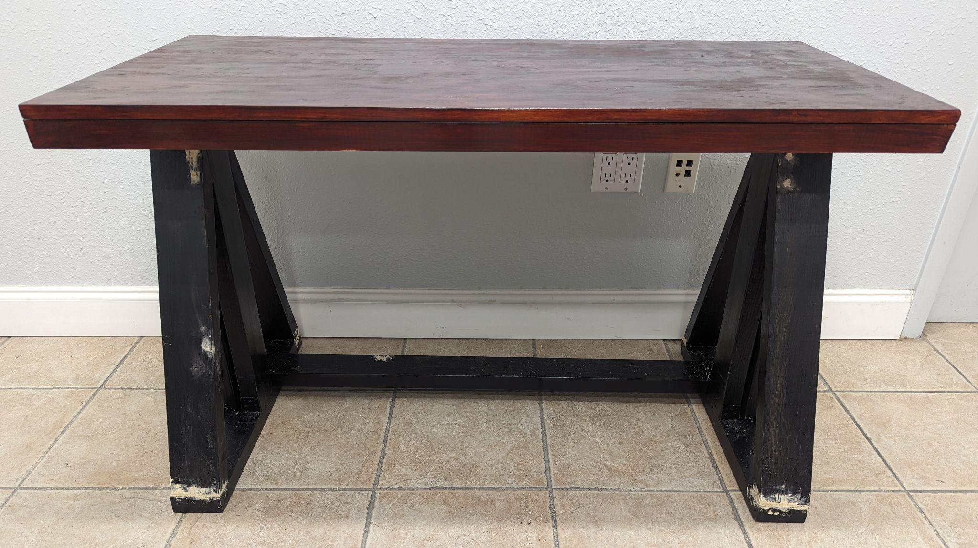




Design Goal
Our Team
Lazaro Sosa
Electrical Engineer
Michael Dumas
Electrical Engineer
Ryan Pettit
Computer Engineer
Ashley Yang
Computer Engineer
Our project aims to develop a fully automated standing desk that seamlessly and dynamically adjusts its height based on individual user needs, enhancing comfort and productivity by promoting better posture.

Slide 3
Motivation and Background
Ashley Yang
Computer Engineer
Lower back pain for desk workers:
Caused by too much sitting
Sudden long periods of standing can have adverse effects as well
Current market:
No built in desk solution to track desk metrics which can be used to reduce back pain by decreasing sitting time
No automatic transitions which could be used to slowly increase standing time for new users.

Slide 4

Key Features
Ryan Pettit
Computer Engineer
Automated Height Adjustment
Webcam and weight-sensitive mat detect user presence and position
User Friendly Features
Digital display for desk height, user profile, and Bluetooth status
Offer manual desk controls
Personalized User Profiles
Mobile app for user calibration and
saving preferences
Bluetooth connectivity
Custom sit-stand reminders
Tracks and logs sitting/standing durations
Notes:
https://pastos.co/blogs/post/are-standing-desks-worth-it-the-benefits-according-to-experts

Slide 5

Engineering Requirements
Lazaro Sosa
Electrical Engineer
System(s) | Parameter | Specification | Value
Vertical Adjustability System | Controllable Up/Down Action for Legs on the Desk | Travel Speed of at Least: | 25 mm/sec
Weight Sensing Functionality | Used to Detect Whether User is Standing Up or Sitting Down | Able to Detect Weight with: | 90% Accuracy
Face Tracking | Used for Tracking of the User’s Face to Determine if They are Sitting or Standing | Accuracy of Tracking: | 80 – 90% Accuracy
System Controller | Will Control the Different Points of Operation Excluding the Camera | Hardware Specifications: | 32 KB Flash Memory 4x Analog/GPIO Pins 10x Digital/GPIO Pins 6 PWM Pins

Slide 6
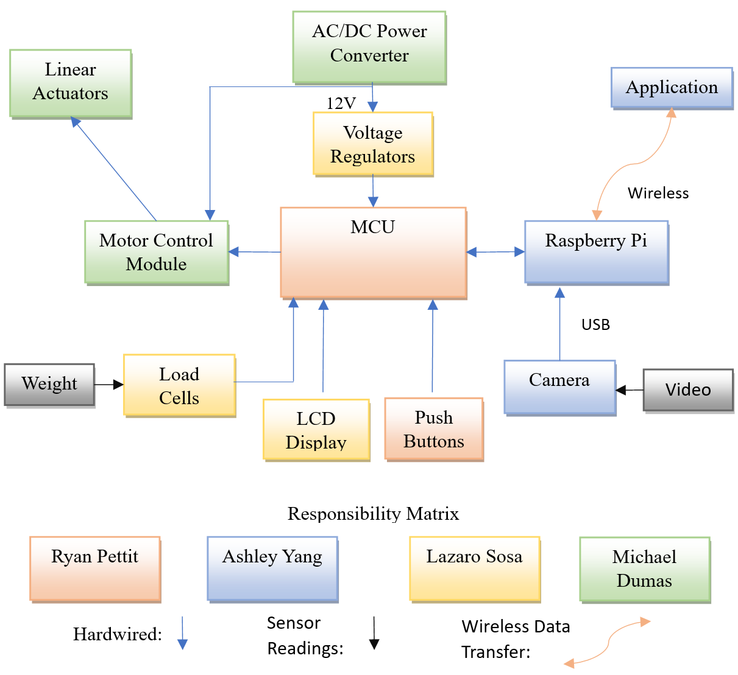
Hardware Block Diagram
Michael Dumas
Electrical Engineer

Slide 7
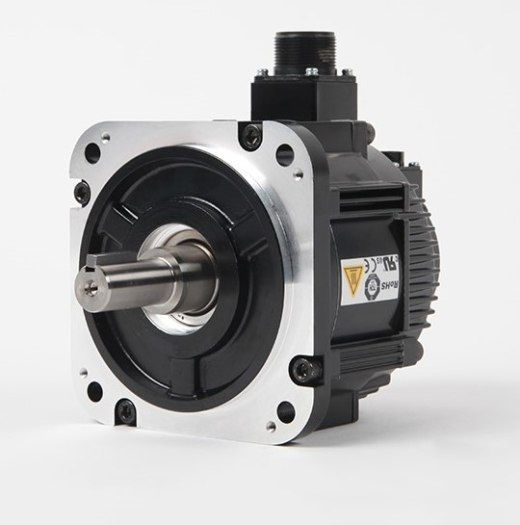
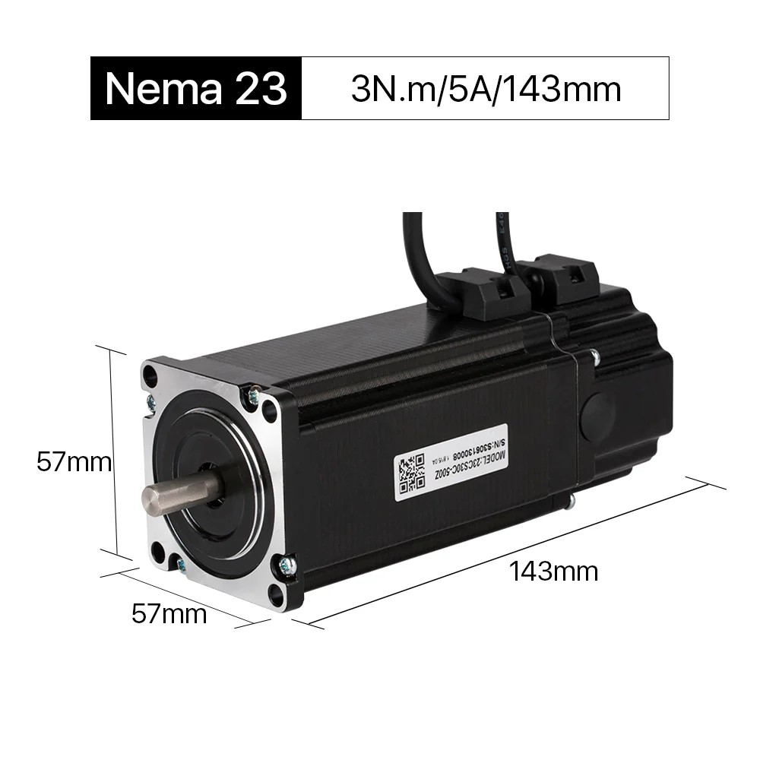
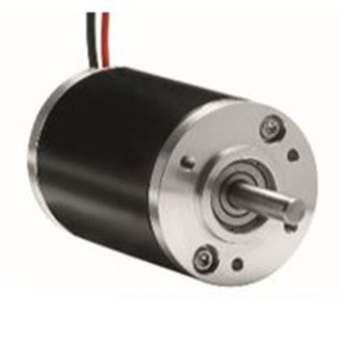
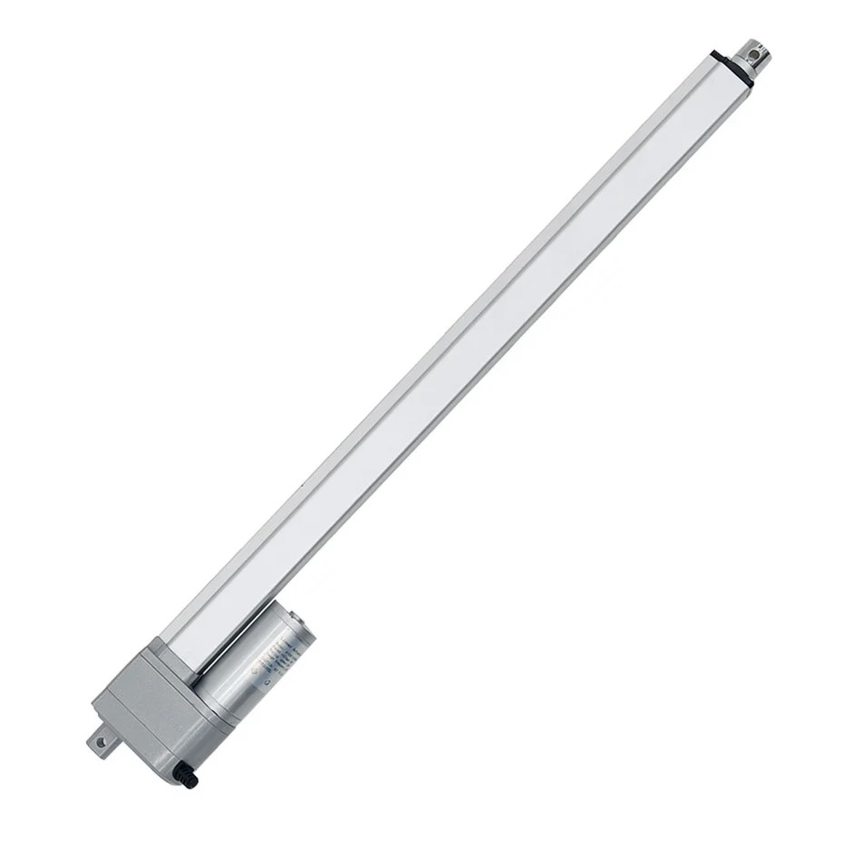
Motor Technology
Michael Dumas
Electrical Engineer
Specific motor technology was a critical factor for the Upright’s overall functionality. The chosen type of motor would need to handle large loads in excess of 50 lbs. and be easily integrated to the MCU for position and speed control. The motor types listed below were the main considerations for this project:
Servo Motors
Stepper Motors
Brushed DC Motors
 | Servo Motors | Stepper Motors | Brushed DC Motors
Voltage/ Current | 4.8 – 12V 0.5 – 15A | 5 – 48V 0.5 – 20A | 6 - 48V 0.5 – 20A
Efficiency | 70 – 90% | 60 – 70% | 70 – 80%
Torque | 0.1 – 5mN | 0.01 – 2mN | 0.01 – 1mN
Cost (From lowest to Highest Current Rating) | $5 - $200 | $5 - $100 | $5 - $50
Brushed DC Motors were chosen because of their use in linear actuators.
Linear Actuators were preferred for a simplistic design that did not require any additional mechanical components.
7A AC Servo
5A Stepper Motor
DC Brushed Motor
Linear Actuator

Slide 8
Linear Actuator Selection
Michael Dumas
Electrical Engineer
Our Criteria:
Withstand the typical load of a desk and an additional load of at least 50 lbs.
Need to continuously maintain at least a 25mm/s speed under full load.
Feedback system crucial in order to accurately track position.
The overall price and availability were the last main considerations
Linear Actuator | Progressive Automations Model: PA-14P-18-xx | Firgelli Automations Model: FA-OS-xx-12-18 | Electric Linear Actuators Model: 0041670
Voltage Rating | 12V DC | 12V DC | 12V DC or 24V DC
Max Current/ Continuous Current | Max Current: 5A No load current: 1A | Max current: 5A | Max load current: 3-6A No load current: 1.5-3A
Load Capacity | Dynamic load is equal to static load. Load options (lbs): 35/50/75/110/150 | Load capacity options: (lbs); 200/500/800 | Dynamic Load capacity options: (lbs) 60/110/160
Pushing Force | Pushing force:: (lbs) 35/50/75/110/150 | Pushing force: (lbs) 35/200/400 | Pushing force: (lbs) 60/110/160
Price | $150.00 | $159.99 | $145.00
Speed | Non-Load speeds (in/sec):2.0/1.14/0.95/0.79/0.37 | Non-load speeds: (in/sec) 2.0/0.3/0.3 | Non-load speeds: (mm/sec) 50/30/20
Feedback System | Yes, Potentiometer system | Yes, Optical sensor system | Yes, Potentiometer system. Also include internal limit switches
Electric Linear Actuator Model 0041670
This model has the best trade off efficiency between load capacity and speed.
It was also the most cost effective.
Feedback system was included

Slide 9
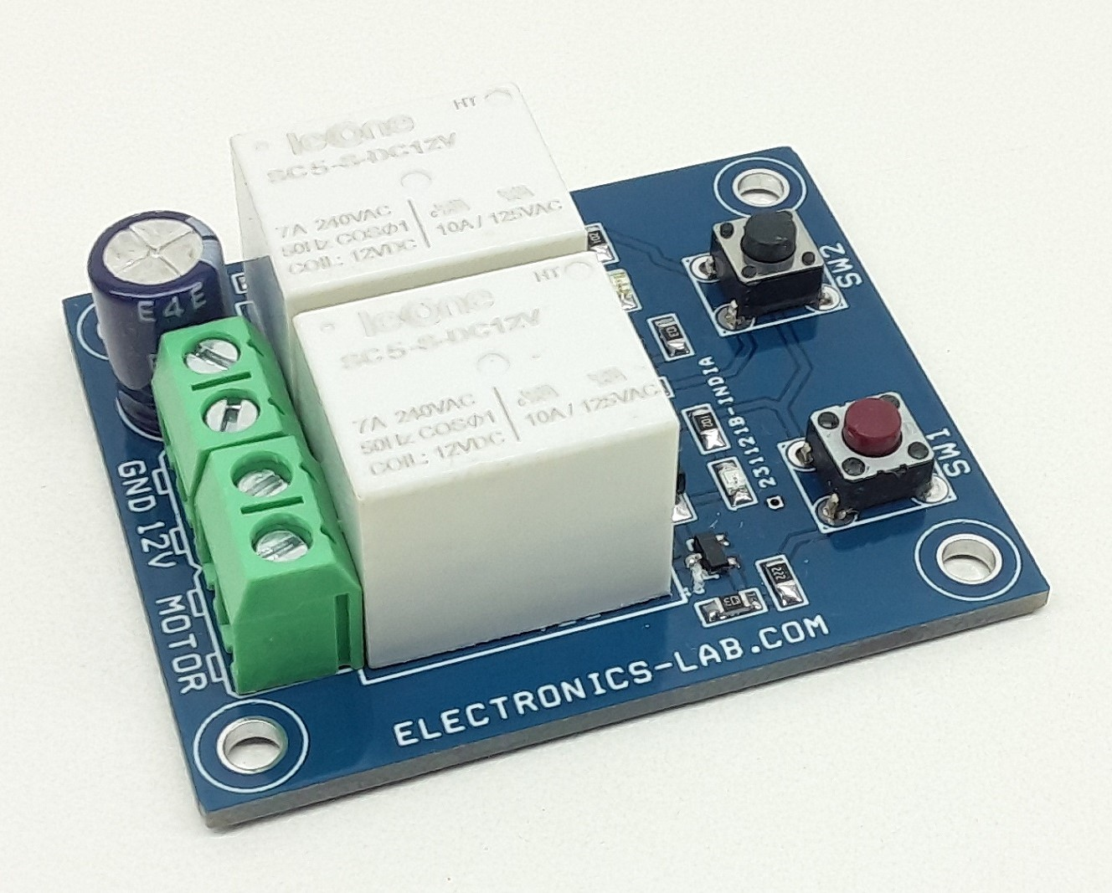
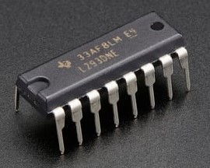
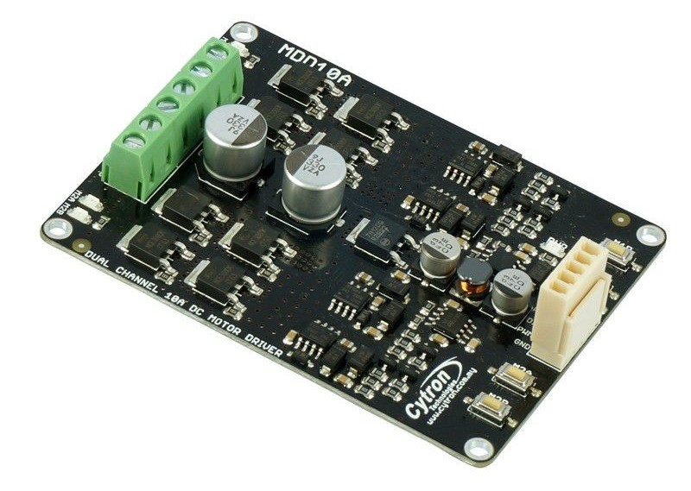
Motor Control Technology
Michael Dumas
Electrical Engineer
Motor control topology will be critical for the integration of automated functionality. The linear actuators need bidirectional control with the ability to adjust speed within a second. Thermal management was also a serious consideration factor, as both motors could pull up to 6A. Listed below are the three main technologies that were considered:
Relays (Utilizing double pull double throw switching)
IC Motor Drivers
Full Motor Controller
 | Relays | IC Drivers | Full Motor Controller
Complexity | Low | Medium | High
Protection | Low | Medium (over-current, thermal shutdown) | Comprehensive (over-current, over-voltage, thermal protection)
Speed Control | None | Yes, PWM Compatibility | Yes, PWM
Thermal Protection | None | None (Will overheat under continuous load) | High (Has onboard heat sinks)
Cost | $5 - $20 | $0.50 - $10 | $15 - $45
Full Motor Controller was chosen for thermal management, in order to keep the motors’ current draw off the PCB.
Directional Control Board using 2 Relays
Dual Channel 0.6A H-Bridge IC Motor Driver
Cytron Model MDD10A

Slide 10
Motor Controller Selection
Michael Dumas
Electrical Engineer
Our Criteria:
Considering the peak current, or stall current, the driver must have 30% greater rating than the motors (6A per motor).
Dual function motor controller
Support PWM, for speed synchronization of the actuators.
Same logic input as the MCU (3.3V)
Price and availability were the last considerations.
Cytron Model MDD10A
Between this model and the DFRobot, but we went with the Cytron because of availability.
Sufficient amperage ratings
MDD10A includes (4) test buttons, enabling easy prototyping before integration of the actuators.
Motor Controller | Elecrow Model #ACS70028DH | DFRobot Model #DRI0041 | Cytron Model # MDD10A
Motor Supply Voltage | 6-22V | Input: 6.5-27V Output: 7-24V | 5-30V
Continuous Current Rating | 8A per motor | 7A per motor | 10A per motor
Peak Current Rating | 15A Total | 50A Total | 30A per motor
Logic Input Voltage | 4.5-5.5V | 3-6.5V | 3.3-5V
Pin Requirements | (1) PWM and (2) I/O pins per motor channel | (1) PWM and (2) I/O pins per motor channel | (1) PWM and (1) I/O direction pin per motor channel
Cost and Availability | $16.00 In stock at elecrow.com | $21.59 @ RobotShop (1 stock) | $23.50 @ Cytron Marketplace (682 in stock)
PWM Frequency | Not listed | Minimum pulse width length of 5 microseconds | 20kHz

Slide 11
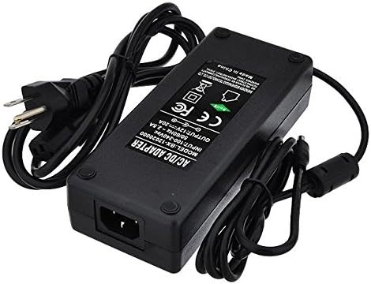
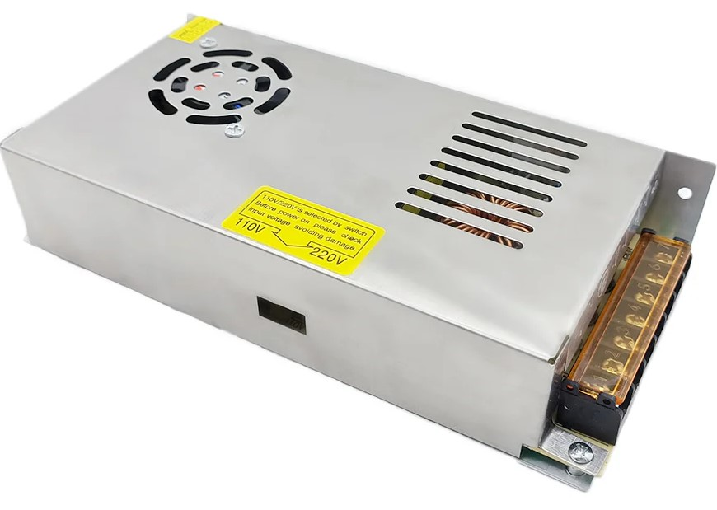
AC/DC Converter Selection
Michael Dumas
Electrical Engineer
Our Criteria:
Total power consumption equal 80% or less of the AC/DC converter’s rated current. (144W/0.8 = 180W)
12V DC output that could directly power the actuators.
Internal overload and short circuit protection
Pricing and availability
AC/DC Converter | LEDWholesalers Product 3262-12V | Linear Electric Actuators: Model 0010128 | Mean Well USA Inc. GSM220A12-R7B
Watt/Current Rating | 240 Watts 20 Amps | 240 Watts 20 Amps | 180 Watts 15 Amps
Efficiency | Not listed | Not listed | 90%
Converter type | Linear Converter | Switching Converter | Linear Converter
Connection types | Barrel type 5.5x2.1mm DC Connector. With a 2.5mm adapter. | Screw type, Input and Output leads are sold separately | Power DIN 4Pin connector, Input lead sold separately
Pricing and Availability | $45.00-$47.00 458 available from LEDWholesalers | $40.00 Available at Linear Electric Actuators | $85.37 145 available at Digikey
Misc. Features | Short circuit protection Automatic thermal and overload cut-off | Short circuit protection Overload and over voltage protection. Built in cooling fan | Overload, over temperature, and over voltage protection.
Linear Converters
Better Voltage Regulation
More Cost effective
Lower EMI
Switching Converters
Better Efficiency
Less heat dissipation
Lighter design
We chose the 3262-12V adapter from LEDWholesalers:
Sufficient Power
Cost effective
Easy connection

Slide 12
Pressure Sensing Technology Comparison
Lazaro Sosa
Electrical Engineer
The main considerations made when determining what the most appropriate pressure sensing technology to be used in our project were:
Feasibility of placing underneath the mat
Cost per unit of the technology
Available stock
Taking these points into account, it was decided that load cells were the best choice due to being the cheapest option, being reasonable to mount under our mat, and having a wide range of products available at the time of planning out the project.
The next section covers the selection between different hardware components.
 | Resistive Pressure Sensors | Capacitive Pressure Sensors | Load Cells
Temp. Range | -40 - +125 °C | -40 - +125 °C | -10 - +40 °C
Cost (PU) | $3 - $11 | $10 - $50 | $1 - $10
Sensitivity Range | 1 - 3 mV/V | .01 - 1 mV/V | 1 - 3 mV/V
Size and Form Factor | Diameter: 10 to 50 mm Thickness: 1 to 10 mm | Diameter: 10 to 50 mm Thickness: 1 to 10 mm | Diameter: 50 to 200 mm Thickness: 10 to 50 mm

Slide 13
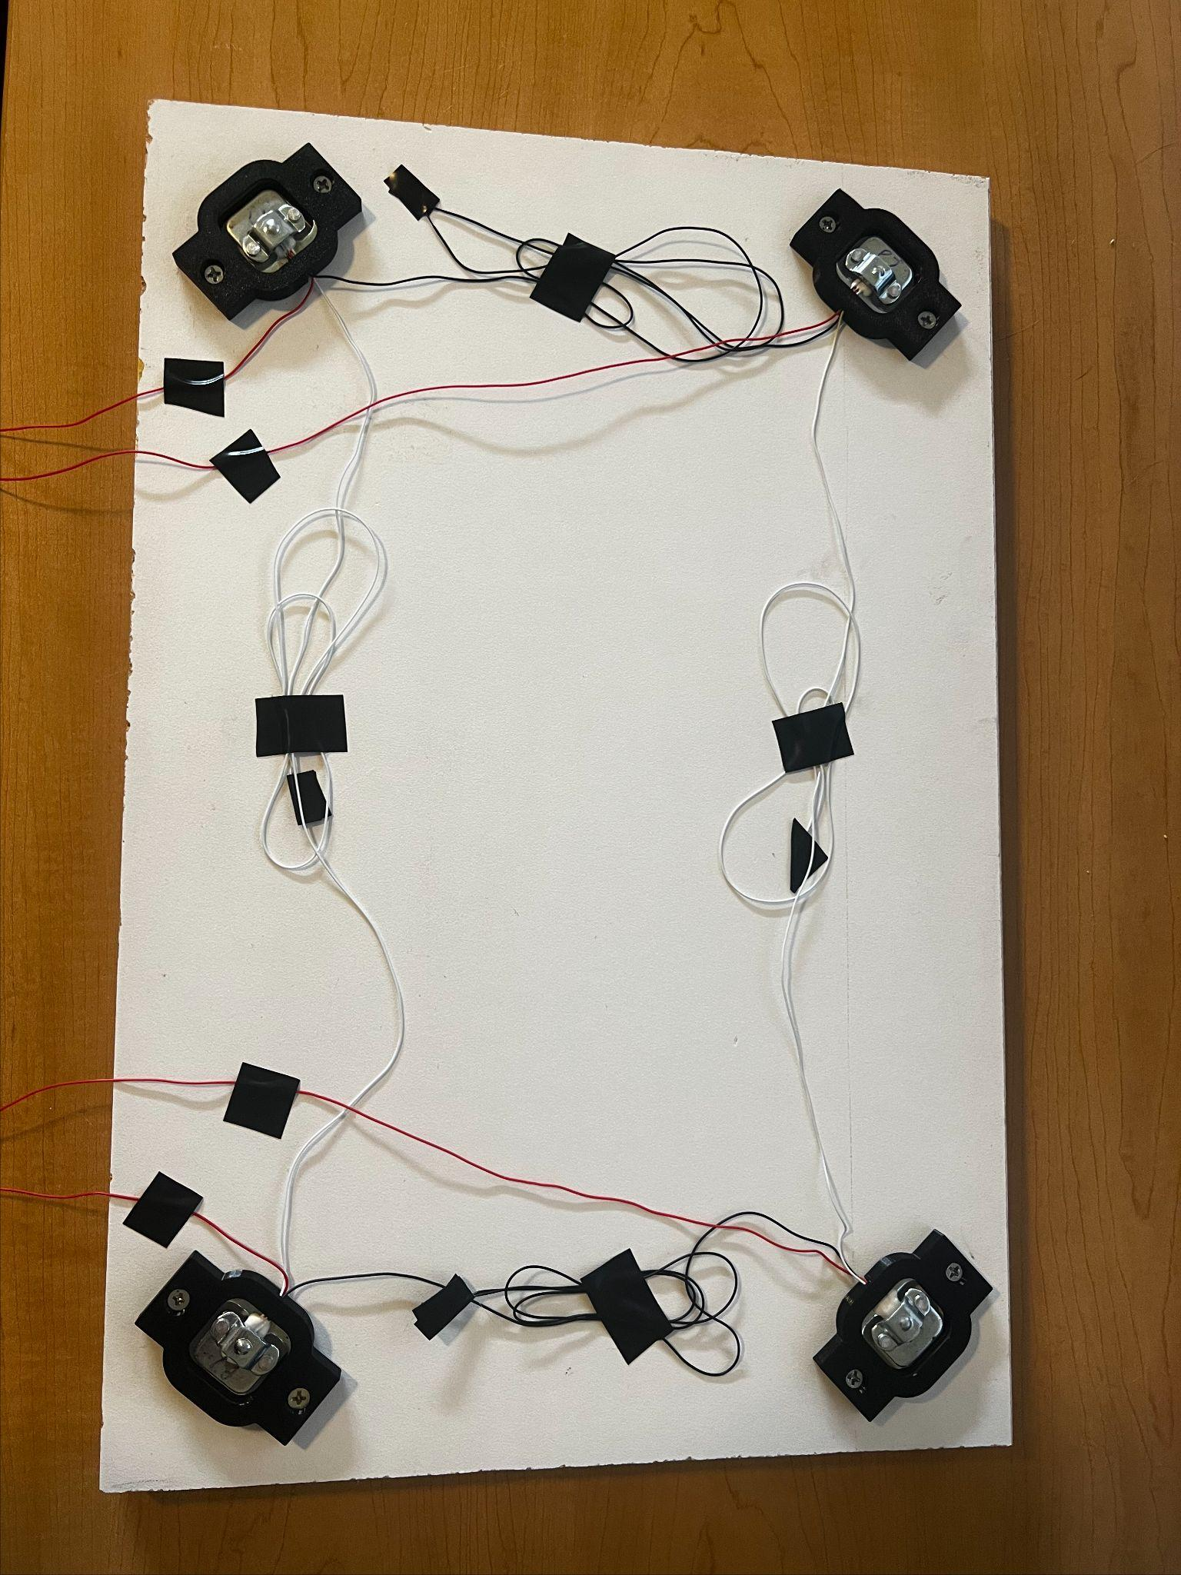
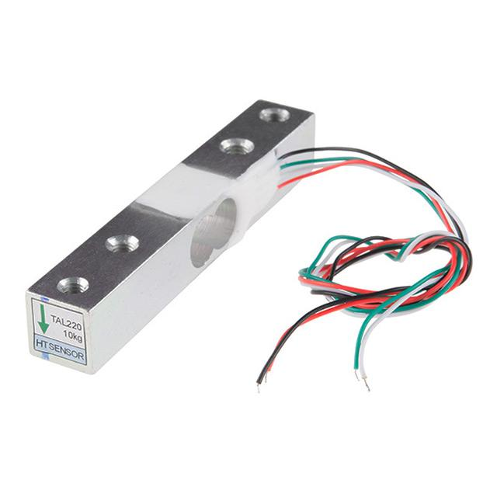
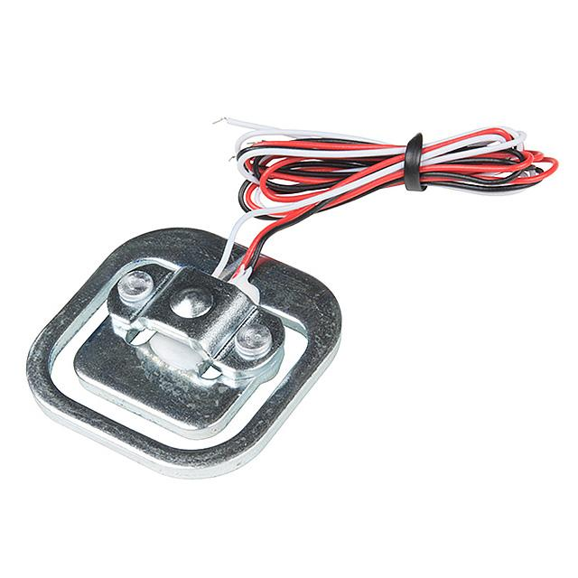
Load Cell Hardware Comparison
Lazaro Sosa
Electrical Engineer
What we need:
Load cells capable of withstanding a range of possible mass of a person (typically between 5 - 200 kg)
Compatible with our chosen amplifier (SEN-13879)
Main Options that Were Considered
 | Load Cell 1 SEN-13329 | Load Cell 2 FX292X | Load Cell 3 SEN-10245
Capacity | 150 - 200 kg (aluminum) | 90 kg - 101 kg | 40 - 50 kg
Rated Output | 1 ± .15 mv/V | 20 ± .1 mV/V | 1 ± .1 mV/V
Safe Overload | 120% FS | 2.5x Rated | 150% FS
Excitation Voltage | 5 - 10 V | 1 - 6 V (Analog) 2.7 - 5.5 V (Digital) | ≤ 10 V
Operating Temp. | -10 ≤ +55 °C | -40 ≤ +85 °C | 0 ≤ +50 °C
SEN-13329
Initial consideration
Option for wider range of force
Issues with available stock
More expensive ($9.50)
Difficult to mount under mat
SEN-10245
Current consideration
Lesser range of force
Widely in stock (generic options also available)
Less expensive ($4.50)
Easy to mount under mat with 3D printed cutouts

Slide 14
Display Panel Technology Comparison
Lazaro Sosa
Electrical Engineer
When choosing a display panel technology to use for our project, we prioritized the following factors:
Relatively low cost
Preferable to have a color display
High brightness to easily read the information displayed
Ability to mount underneath the desk, angled up towards the user
When taking these points into consideration, it was decided that we would use a TFT LCD display. This was due to the technology being relatively inexpensive, bright, having the ability to display a multitude of colors, and being feasible to mount underneath the counter of our desk.
The next section covers the comparison and selection for specific TFT LCD components.
 | Pros | Cons
LCD | Energy efficiency: up to 20 mA with backlight Cost effective: $3 - $5 Longevity: 50,000 to 100,000 hours | Limited viewing angles: around 60° horizontally and vertically Slower refresh rates: 10 - 30 Hz
OLED | High contrast and color depth: 1,000,000:1 Viewing angles: close to 180° Response time: .1 ms | Higher cost: typically around 4x more expensive Shorter lifespan: 14,000 to 20,000 hours
TFT LCD | Brightness: 250 to 500 nits Cost: as low as $10 | Contrast ratio: 600:1 to 1,000:1 Response time: 5 - 16 ms

Slide 15
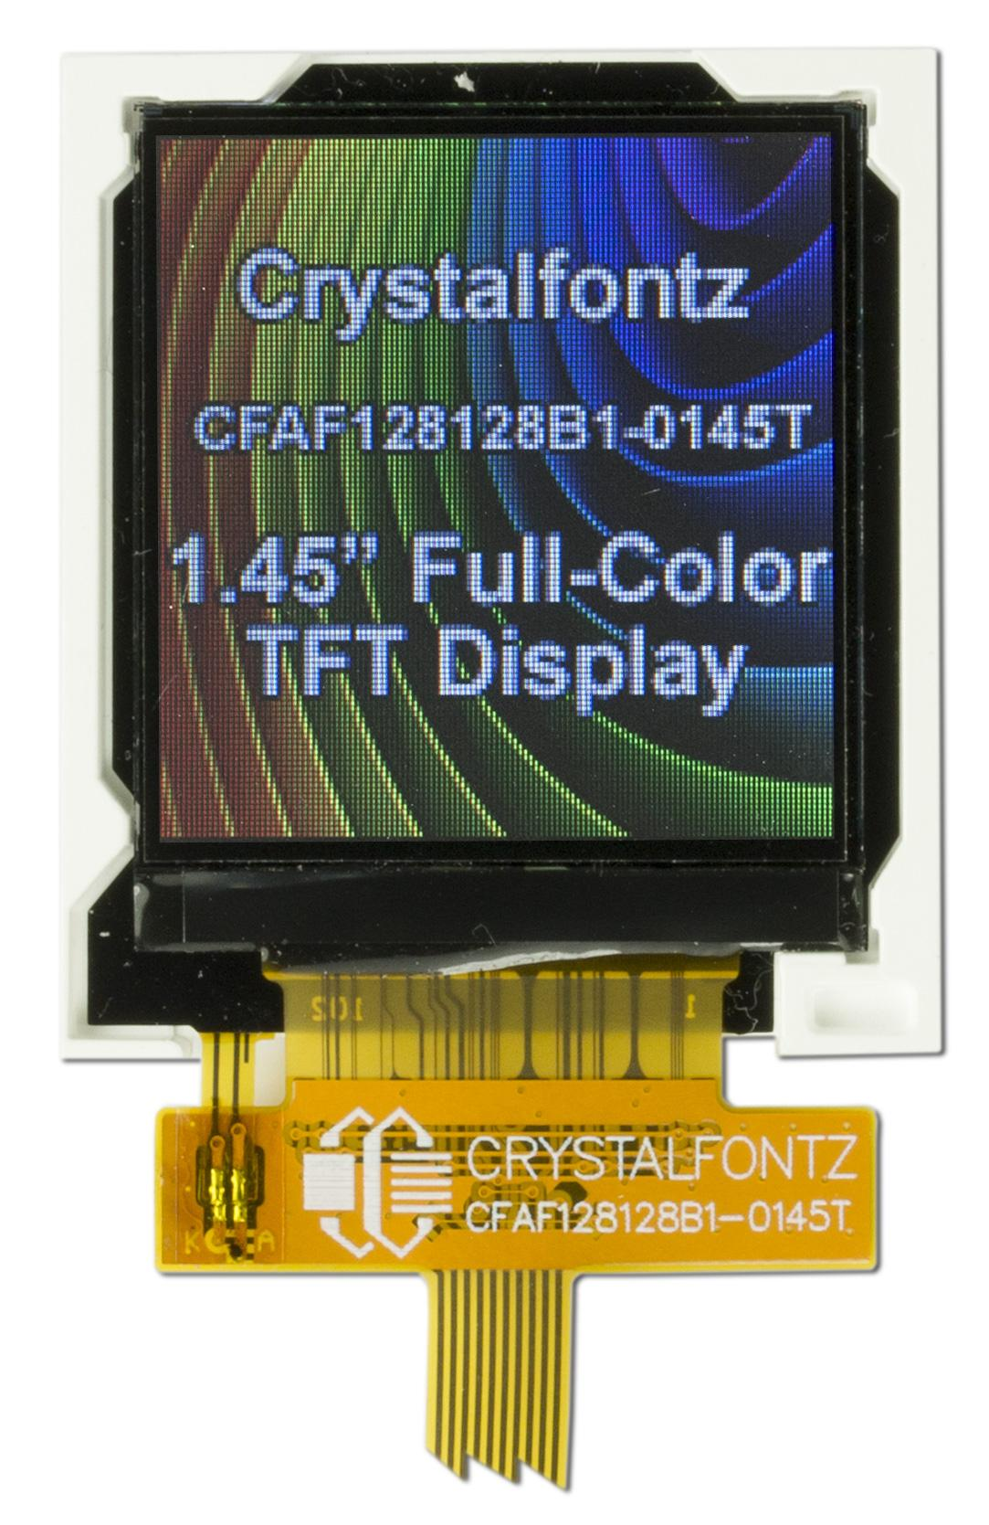
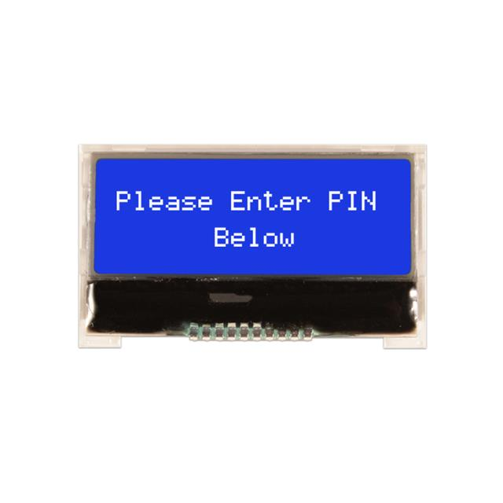
TFT LCD Hardware Comparison
Lazaro Sosa
Electrical Engineer
Display Panel Needs
Cost-effective panel offering visually appealing display
Readily available libraries for output to panel
Main Part Considerations
 | CFAF128128B1-0145T | CFAF80160A0-0096TN | NHD-C0216CZ-NSW
Technology | Full color TFT, 128x128 Dot Matrix | Full color TFT, 80x160 Dot Matrix | Chip on Glass, 16x2 Character LCD
Interface | SPI | SPI | SPI or I2C
Size (WxHxD) (mm) | Module: 33.3 x 38.2 x 2.3 | Module: 13.5 x 27.95 x 1.54 | Module: 41.4 x 24.3 x 4
Controller (Integrated) | Sitronix ST7735S | Sitronix ST7735S | Sitronix ST7032
Availability Price | >1,000 in stock $9.21 PU | >1,000 in stock $12.58 PU | >1,000 in stock $12.75 PU
CFAF128128B1-0145T
Good footprint for mounting for optimal viewing for user
Lowest price per unit
High resolution
Full color display
NHD-C0216-CZ-NSW-3V3
Good height for mounting, but width is not optimal
Highest price per unit
Low resolution
Limited color range

Slide 16

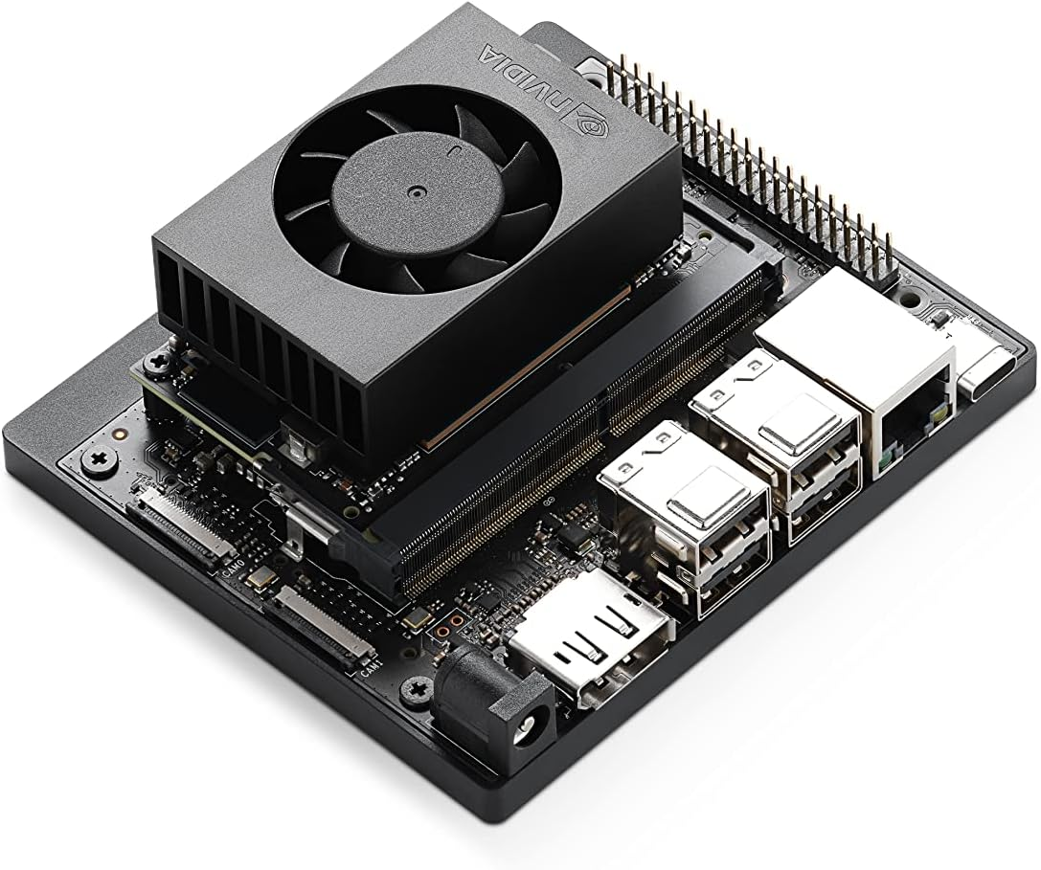
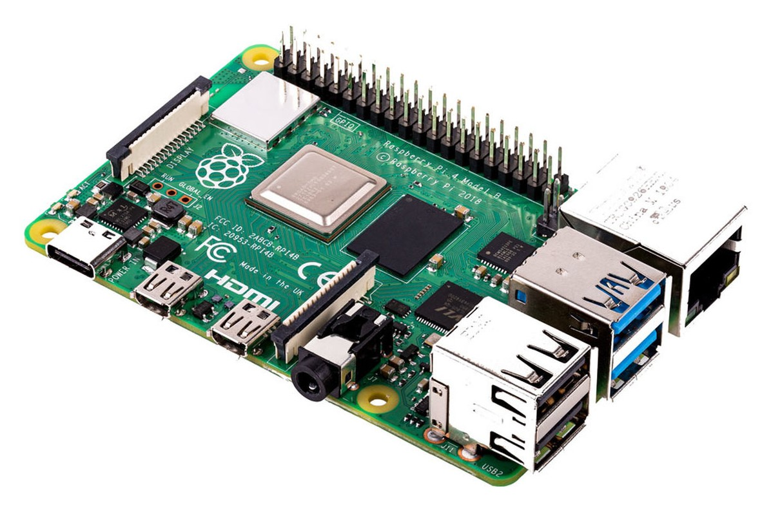
Facial Tracking Device Comparison
Ashley Yang
Computer Engineer
Facial Tracking Needs
Ability to detect whenever a user’s face is within the view of our chosen camera
GPIO pins for communication with our PCB
 | Jetson Nano | Raspberry Pi
CPU | 6-core Arm Cortex-A78AE | Broadcom BCM2711, Quad core Cortex-A72
CPU Clock Frequency | 1.5 GHz | 1.8 GHz
GPU | 512-core NVIDIA Ampere architecture GPU with 16 Tensor Cores | VideoCore VI
Cache | 1.5MB L2 + 4MB L3 | 32 KB data L1 + 48 KB + 1 MB L2
Communication | On-Board Bluetooth not included | Bluetooth included
USB Ports | 3x USB 3.2 Gen2 3x USB 2.0 | 2x USB 3.0 ports 2x USB 2.0 ports
Price | $259.99 | $55.99
Main Options Considered
Jetson Nano
Superior performance
High-quality camera support
Robust Developer Ecosystem
Raspberry Pi
Cost-effectiveness
Software ecosystem
Ease of use
Power consumption
Community and support
Versatility and general-purpose use

Slide 17
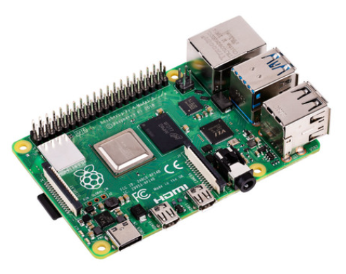
Raspberry Pi Comparisons
Ashley Yang
Computer Engineer
Our specification requirements:
Processing power capable of running computer vision software (at least 2 cores)
At least 4 GB RAM for computer vision software
Bluetooth 5.0
Low cost
Raspberry Pi 4 4GB model
Model | CPU | RAM | Bluetooth | Cost
Raspberry Pi 3 B | Quad Core 1.2GHz Broadcom BCM2837 64bit CPU | 1GB | 4.1 Bluetooth Low Energy (BLE) | $41.09
Raspberry Pi 4 B | Broadcom BCM2711, Quad core Cortex-A72 (ARM v8) 64-bit SoC @ 1.8GHz | 1GB, 2GB, 4GB, 8GB | Bluetooth Low Energy (BLE) / Bluetooth 5.0 | $55.00 (4GB model price)
Raspberry Pi 5 | Broadcom BCM2712 quad-core Arm Cortex A76 processor @ 2.4GHz | 4GB, 8GB | Bluetooth Low Energy (BLE) / Bluetooth 5.0 | $60.00 (4GB model price)
Notes:
Image source: https://www.pishop.us/product/raspberry-pi-4-model-b-4gb/?src=raspberrypi

Slide 18
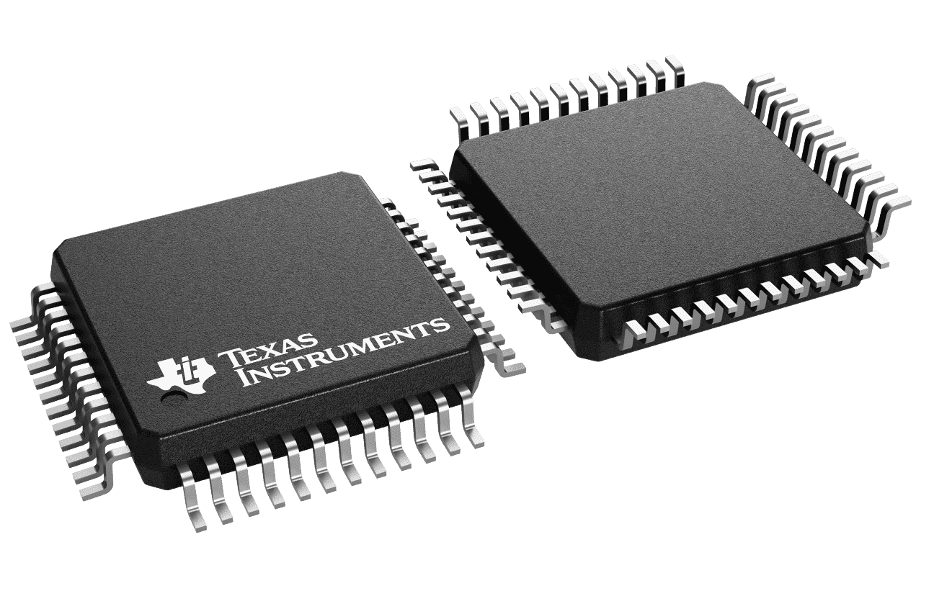
Microcontroller
Ryan Pettit
Computer Engineer
Specifications: Communication protocols, number of pins, and memory.
Our MCU must support 9 peripherals
1 Hx711
1 Motor controller
1 TFT LCD
3 Pushbutton Switches
2 Potentiometers
1 Raspberry Pi
TFT LCDs are RAM intensive
Displaying a colored UCF logo took 1 KB of RAM alone
Form factor and pin count was considered to allow manual soldering if PCB malfunctioned
Microcontroller | ATmega328P | MSP430FR6989 | MSP430FR2476 | ESP32-WROOM-32E-N8
Clock Speed | 16 MHz | 16 MHz | 16 MHz | 240 MHz
Communication Protocols | 6 PWM 1 UART 1 SPI | 14 PWM 2 UART 4 SPI | 14 PWM 2 UART 4 SPI | 16 PWM 3 UART 4 SPI
GPIO | 23 GPIOs | 83 GPIO | 43 GPIO | 26 GPIO
Memory | 32 KB Flash 2 KB SRAM | 127 KB FRAM 2 KB RAM | 64 KB FRAM 8 KB RAM | 8MB Flash 520 KB SRAM
Pin Count/PItch | 32 / 0.50mm | 100 / 0.50mm | 48 / 0.50mm | 38 / 0.50mm
Availability | 49,053 in stock on Mouser $2.65 each | 990 In stock on Mouser $8.70 each | 1,096 in stock on Mouser $2.97 each | 1,270 in stock on Mouser $2.80 each

Slide 19
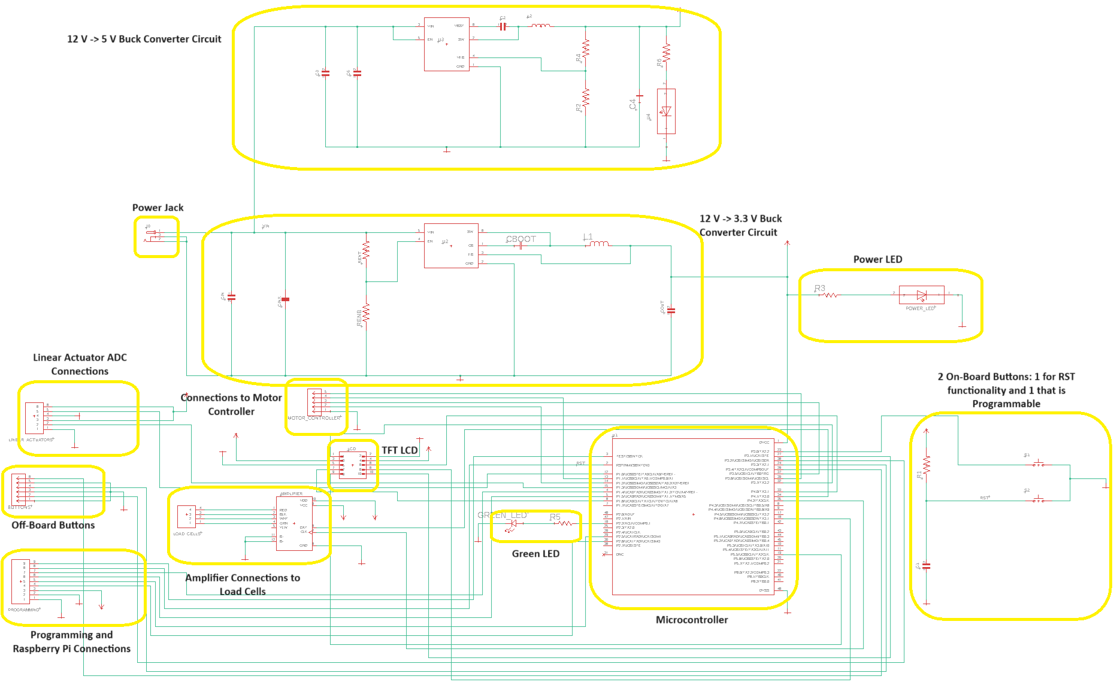
Overall System Schematic
Lazaro Sosa
Electrical Engineer

Slide 20
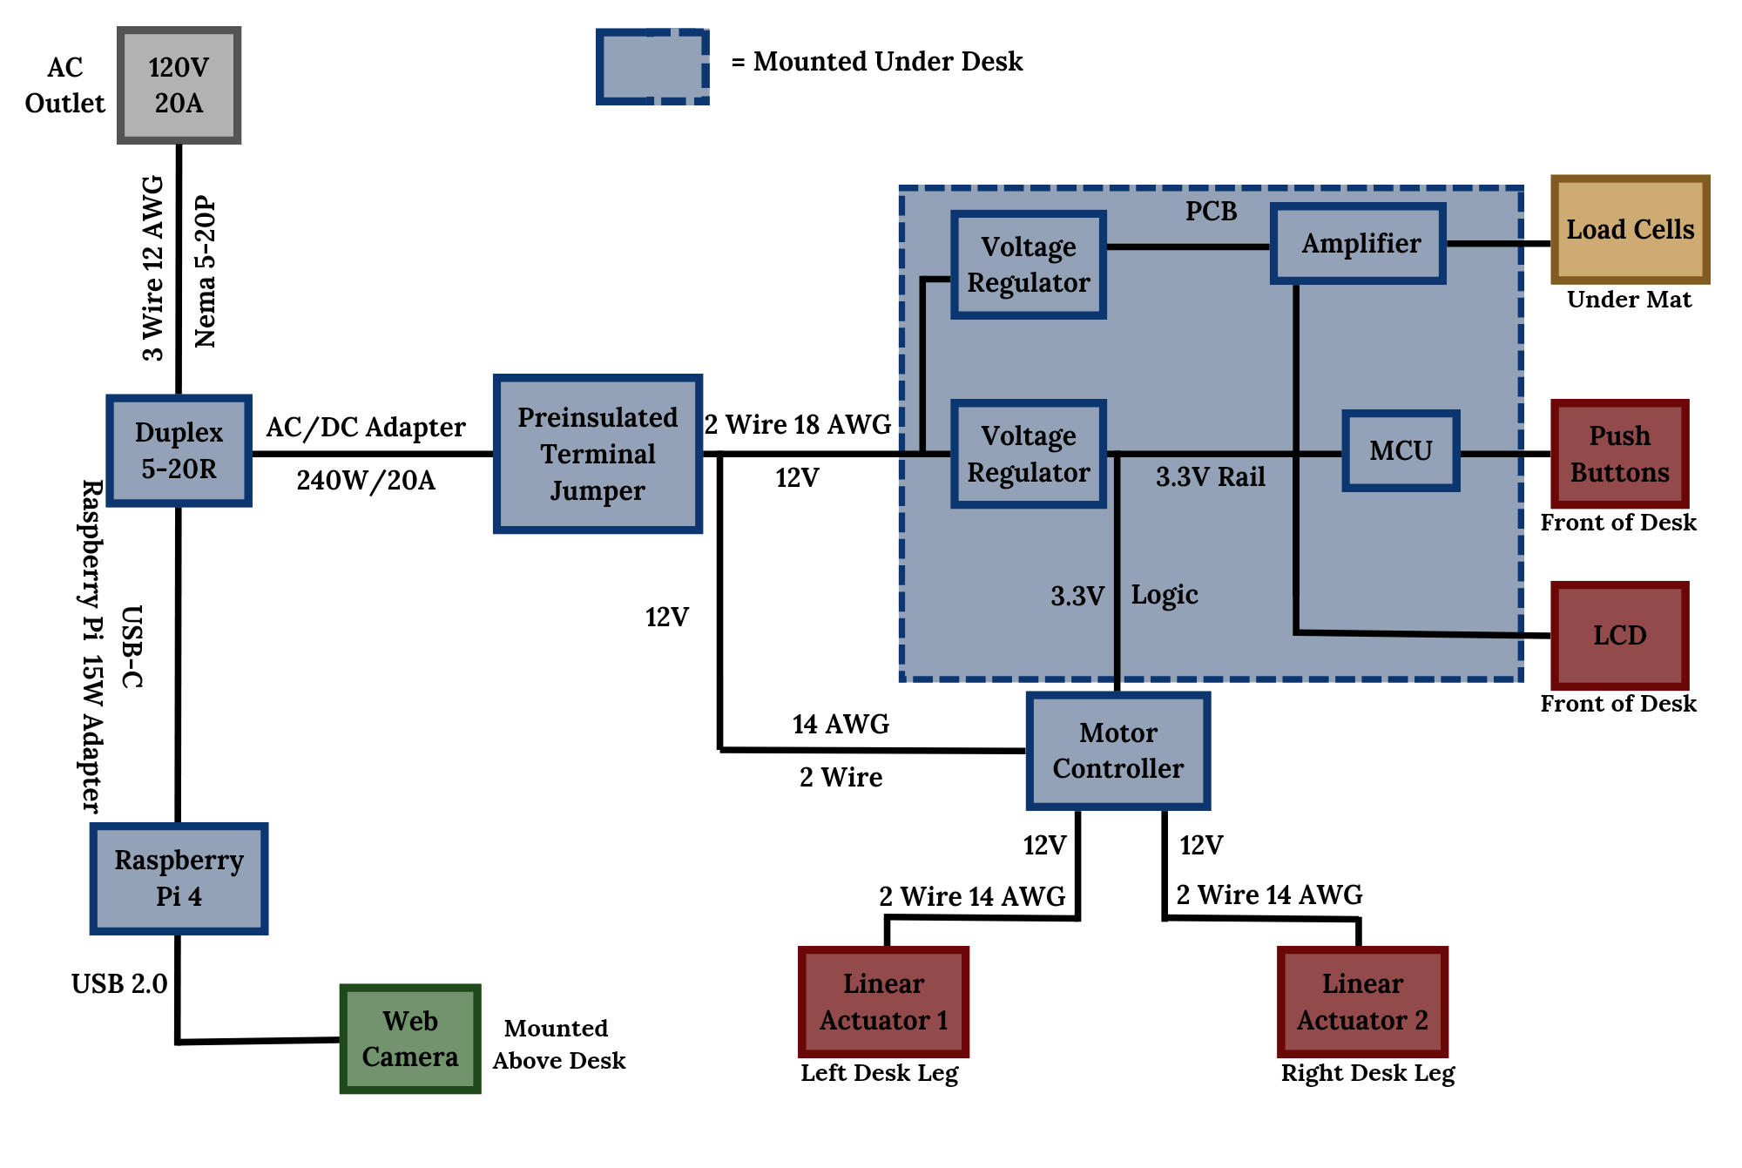
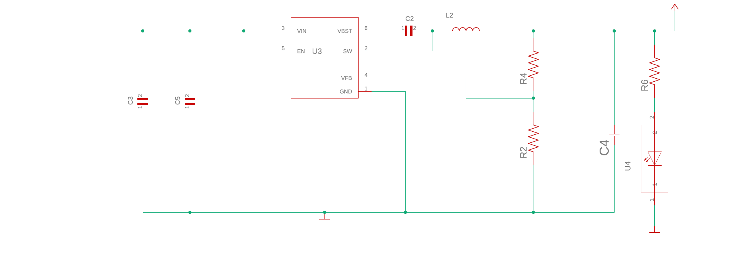
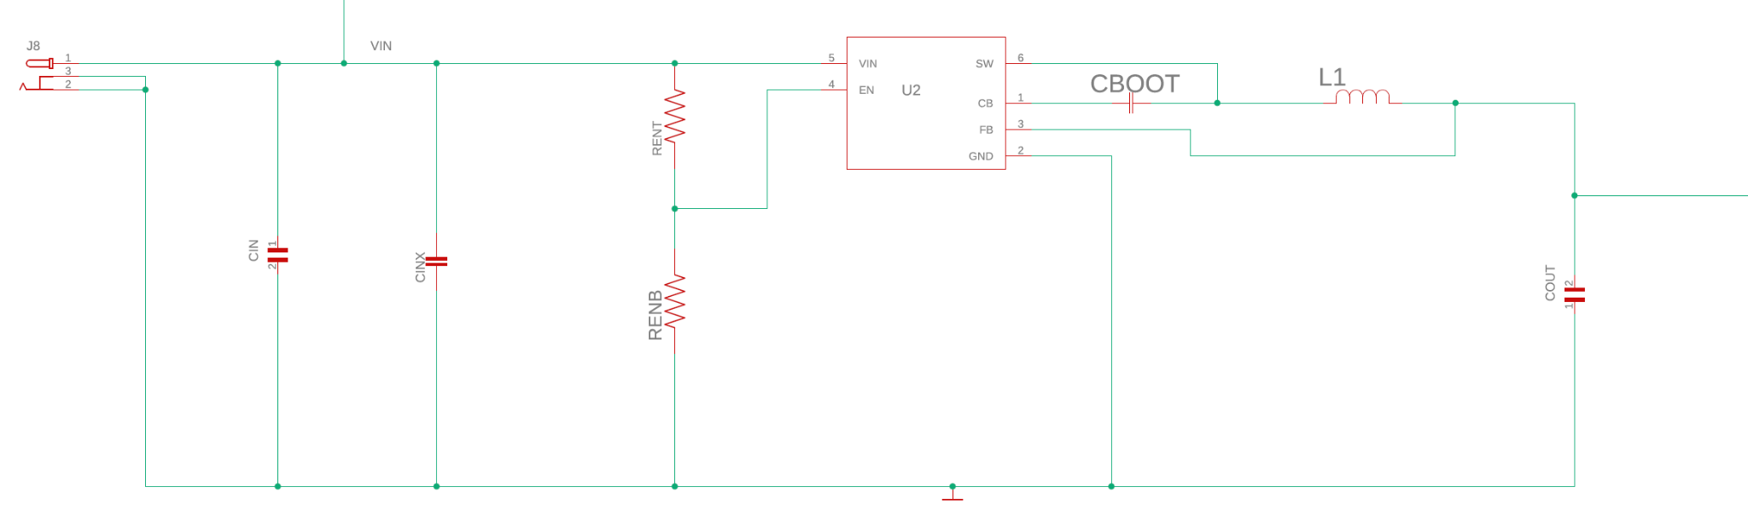
Power Distribution
Michael Dumas
Electrical Engineer
5V Regulator: TPS561208DDCR
3.3V Regulator: TPS560430X3FDBVR
Typical Household 120V AC power source
120V to 12V AC/DC Adapter
Texas Instruments WeBench was used for the designing and selecting the regulators and their schematic.
Voltage regulators utilizing Switching Buck style technology.
3.3V Output
5V Output

Slide 21
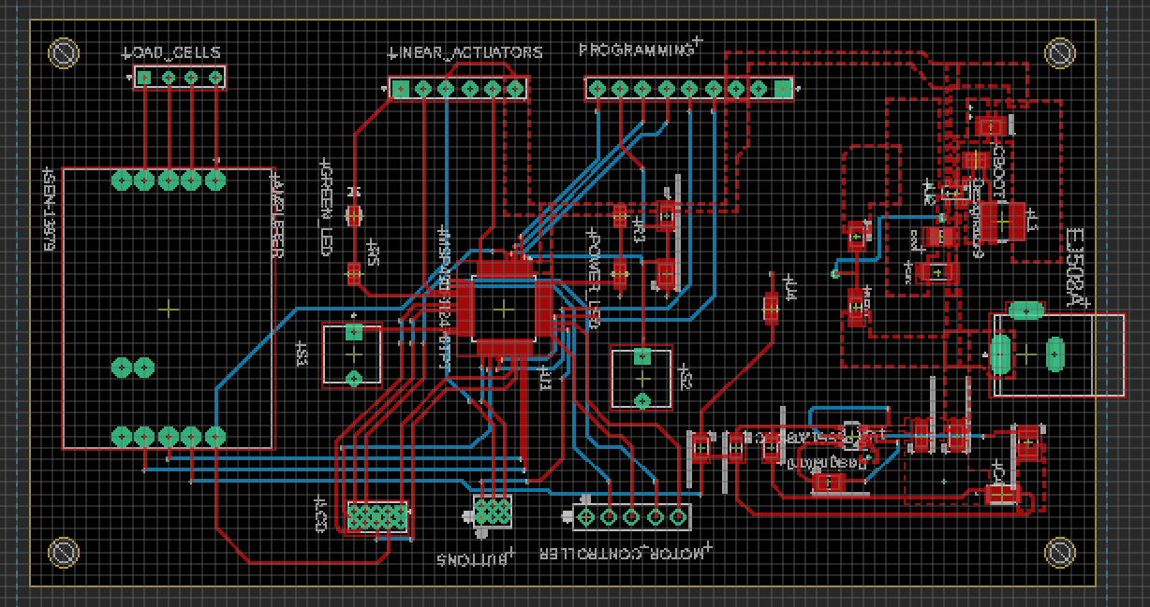
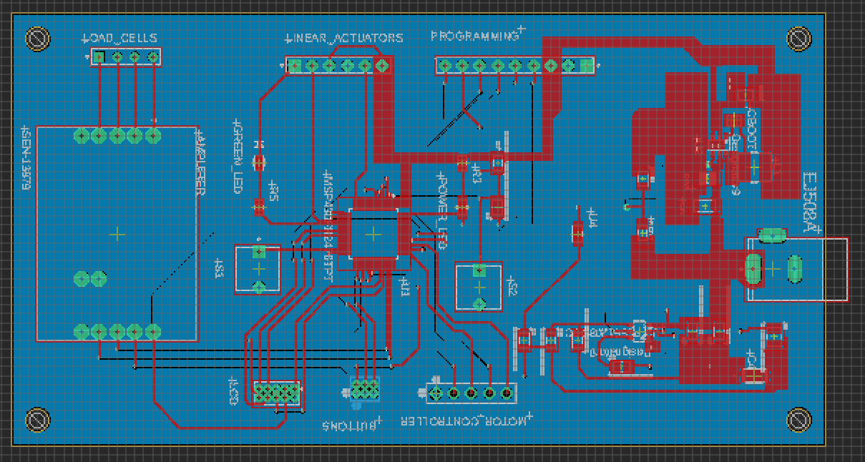
PCB Design
Michael Dumas
Electrical Engineer
Trace routing featured above
Integration of MSP430FR2476 chip
3.3V and 5V Regulators integrated into the board (possible breakout boards for regulators not shown)
2-Layer PCB with bottom layer Ground Pour
Power supply connected through barrel connector
All pin headers for external connections mounted around edge of the board.

Slide 22
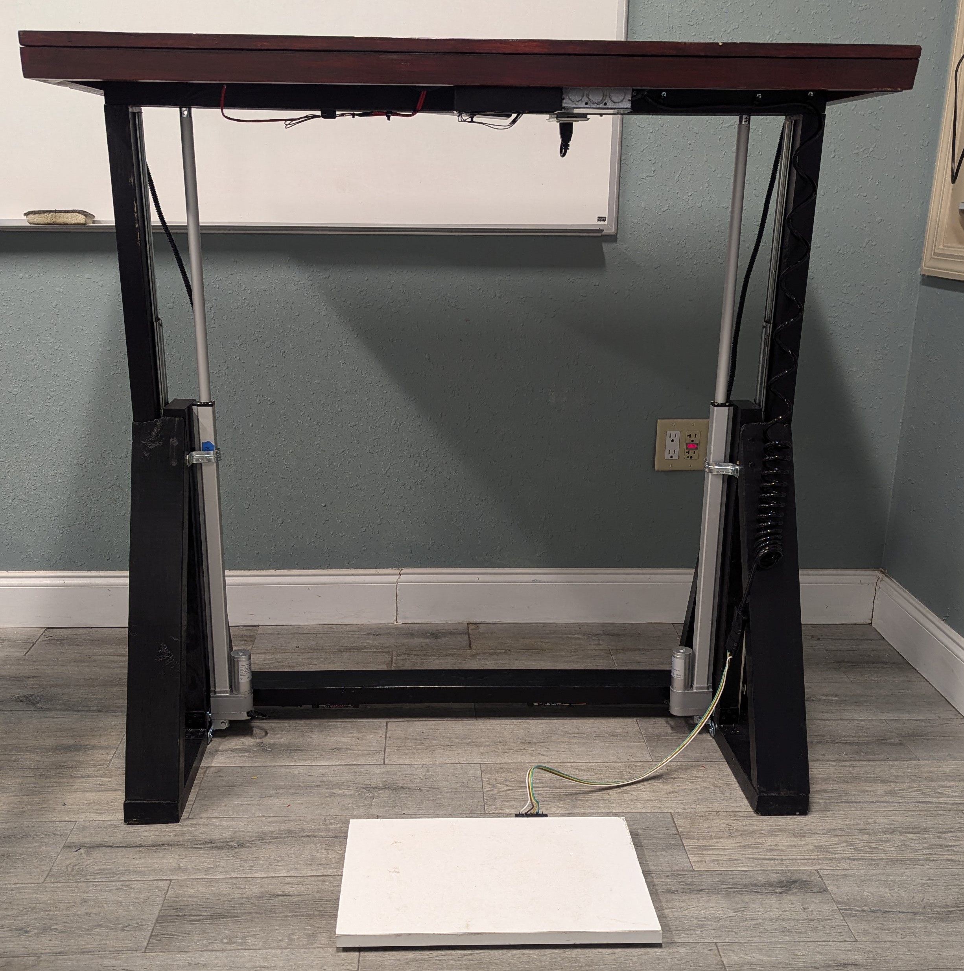
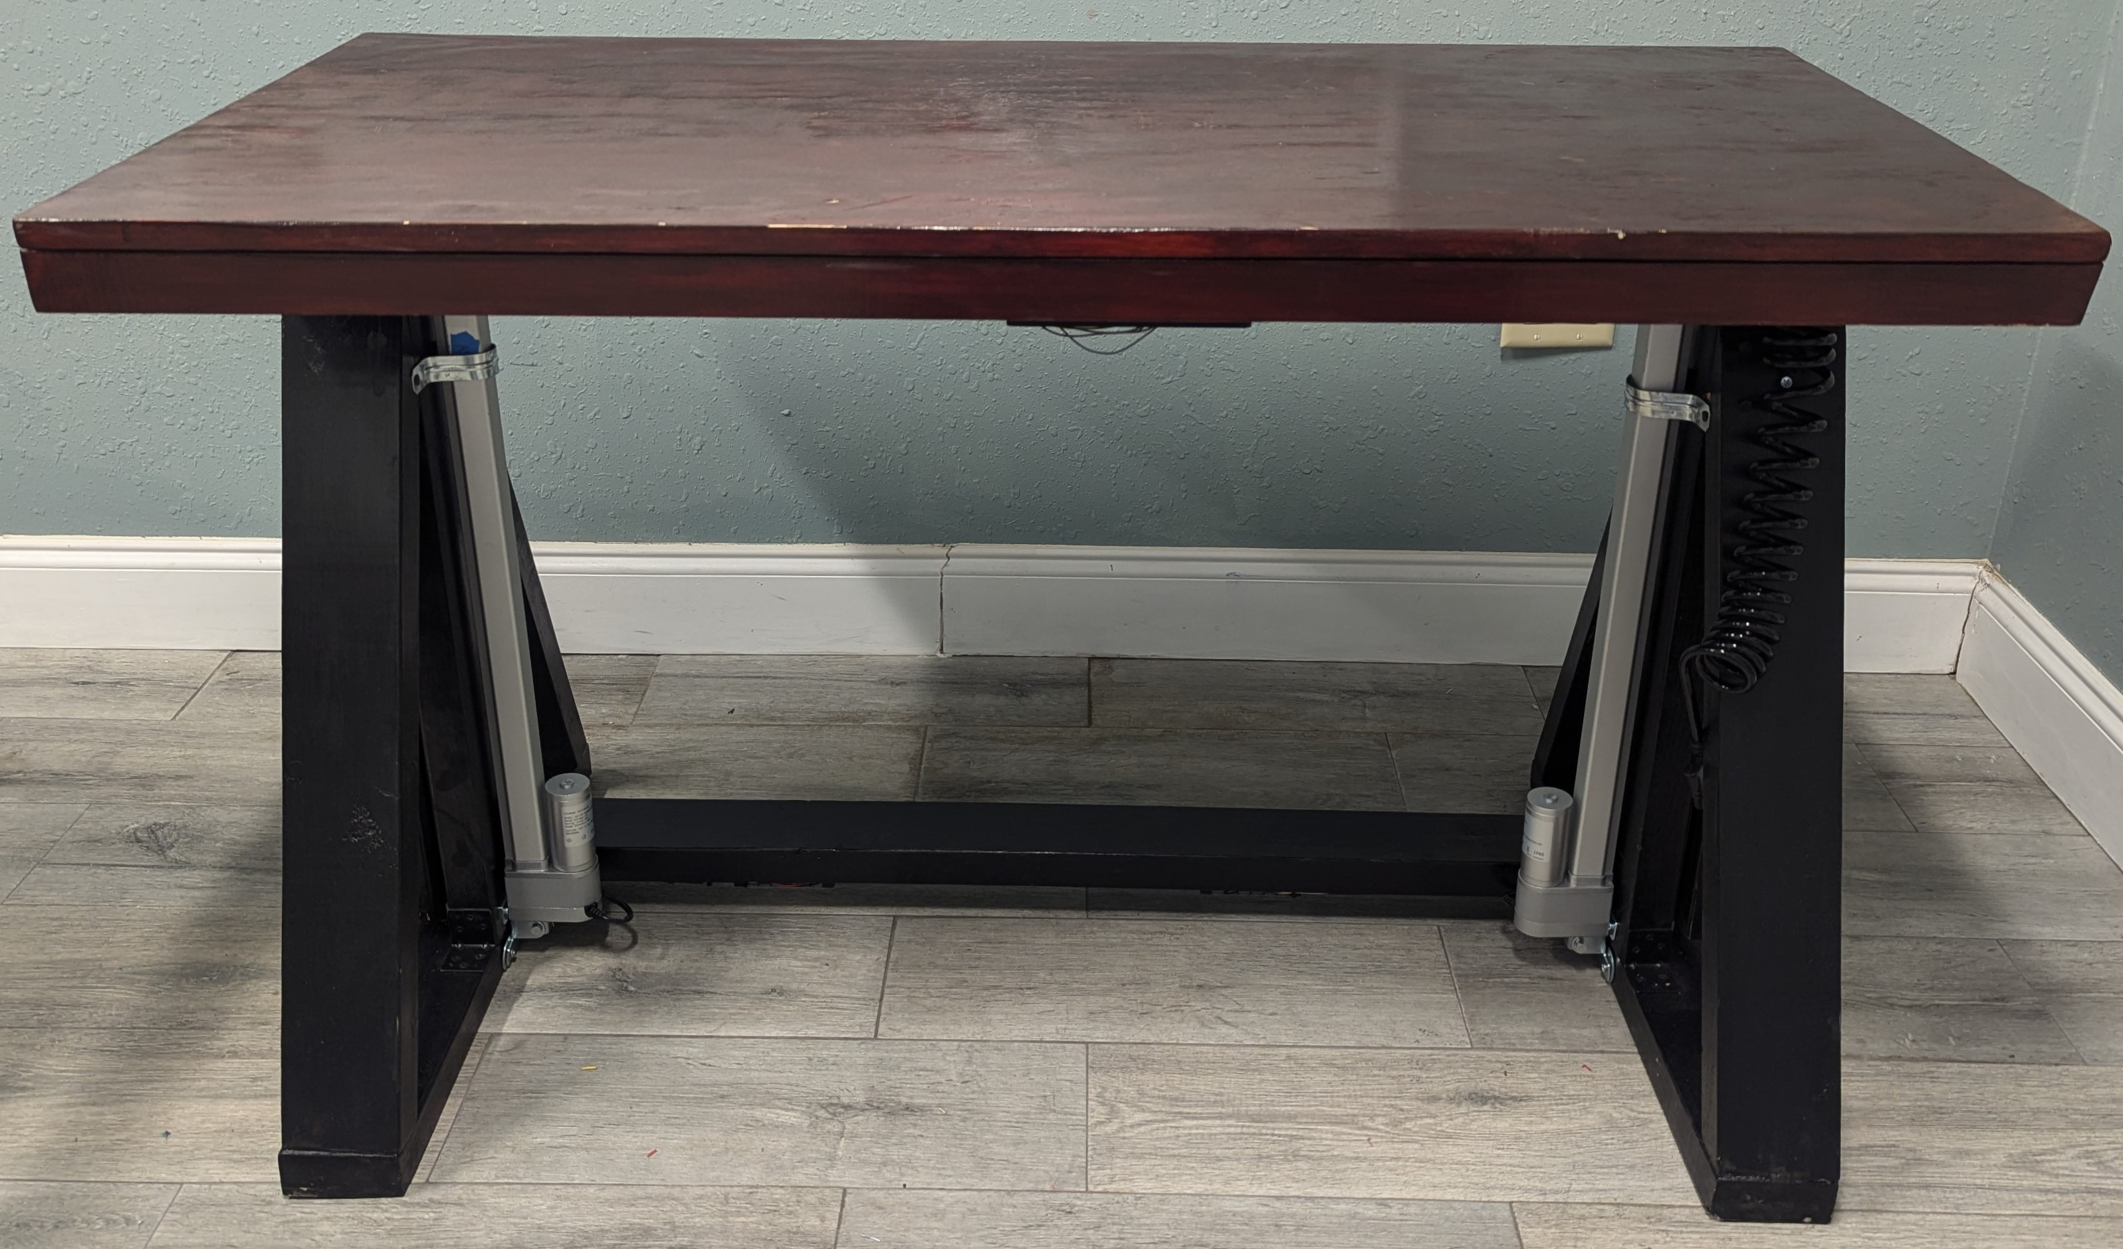
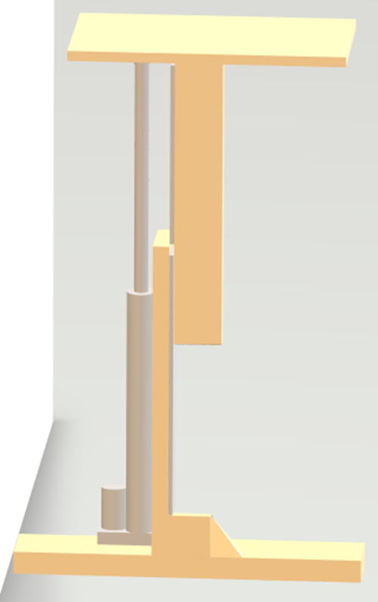
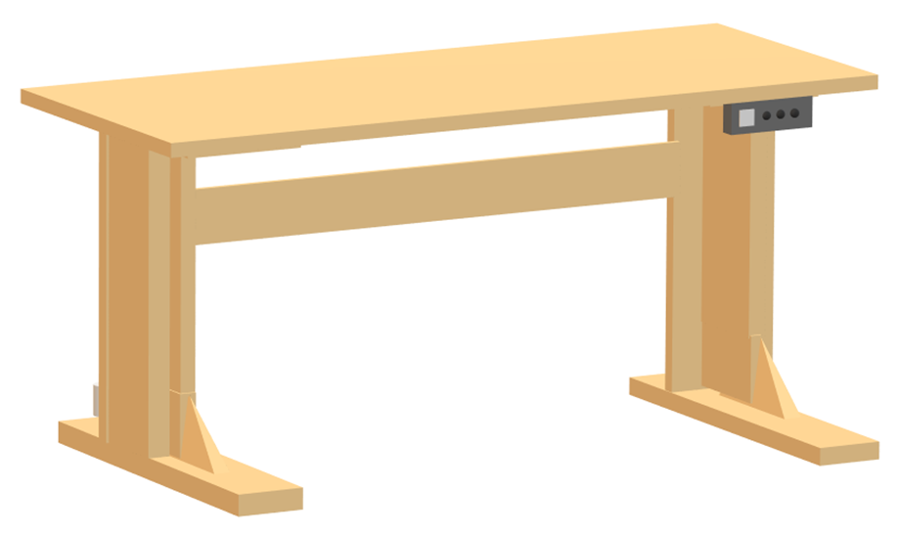
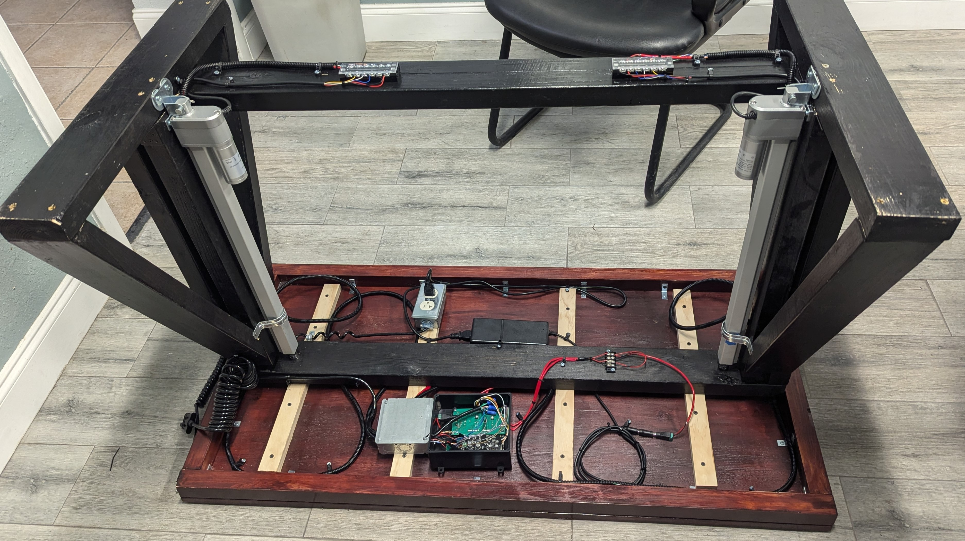
Design of the Desk
Michael Dumas
Electrical Engineer
Current Design:
Initial Design Prototype:

Slide 23
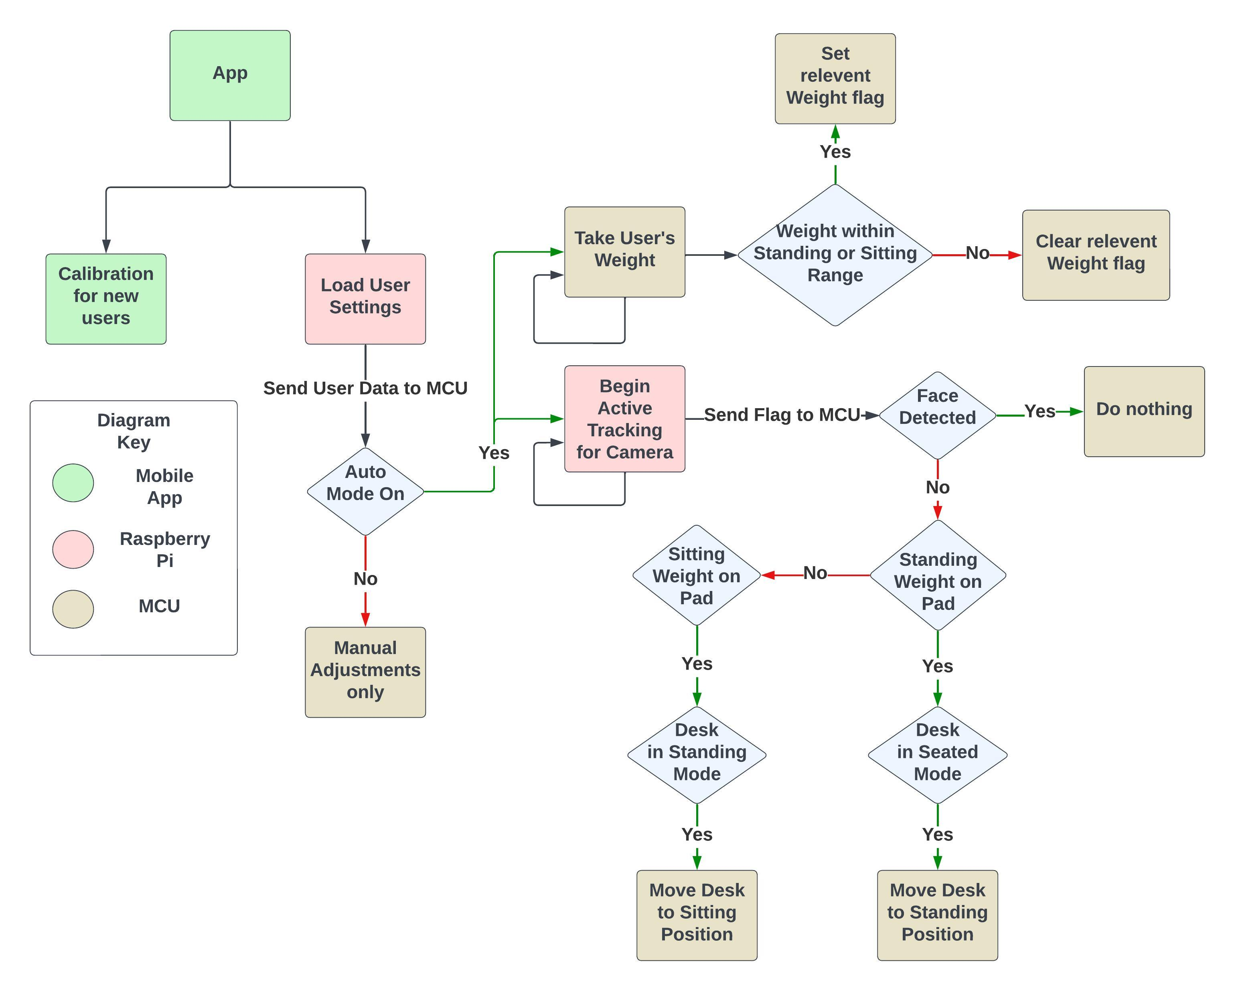
Software Block Diagram
Ryan Pettit
Computer Engineer

Slide 24
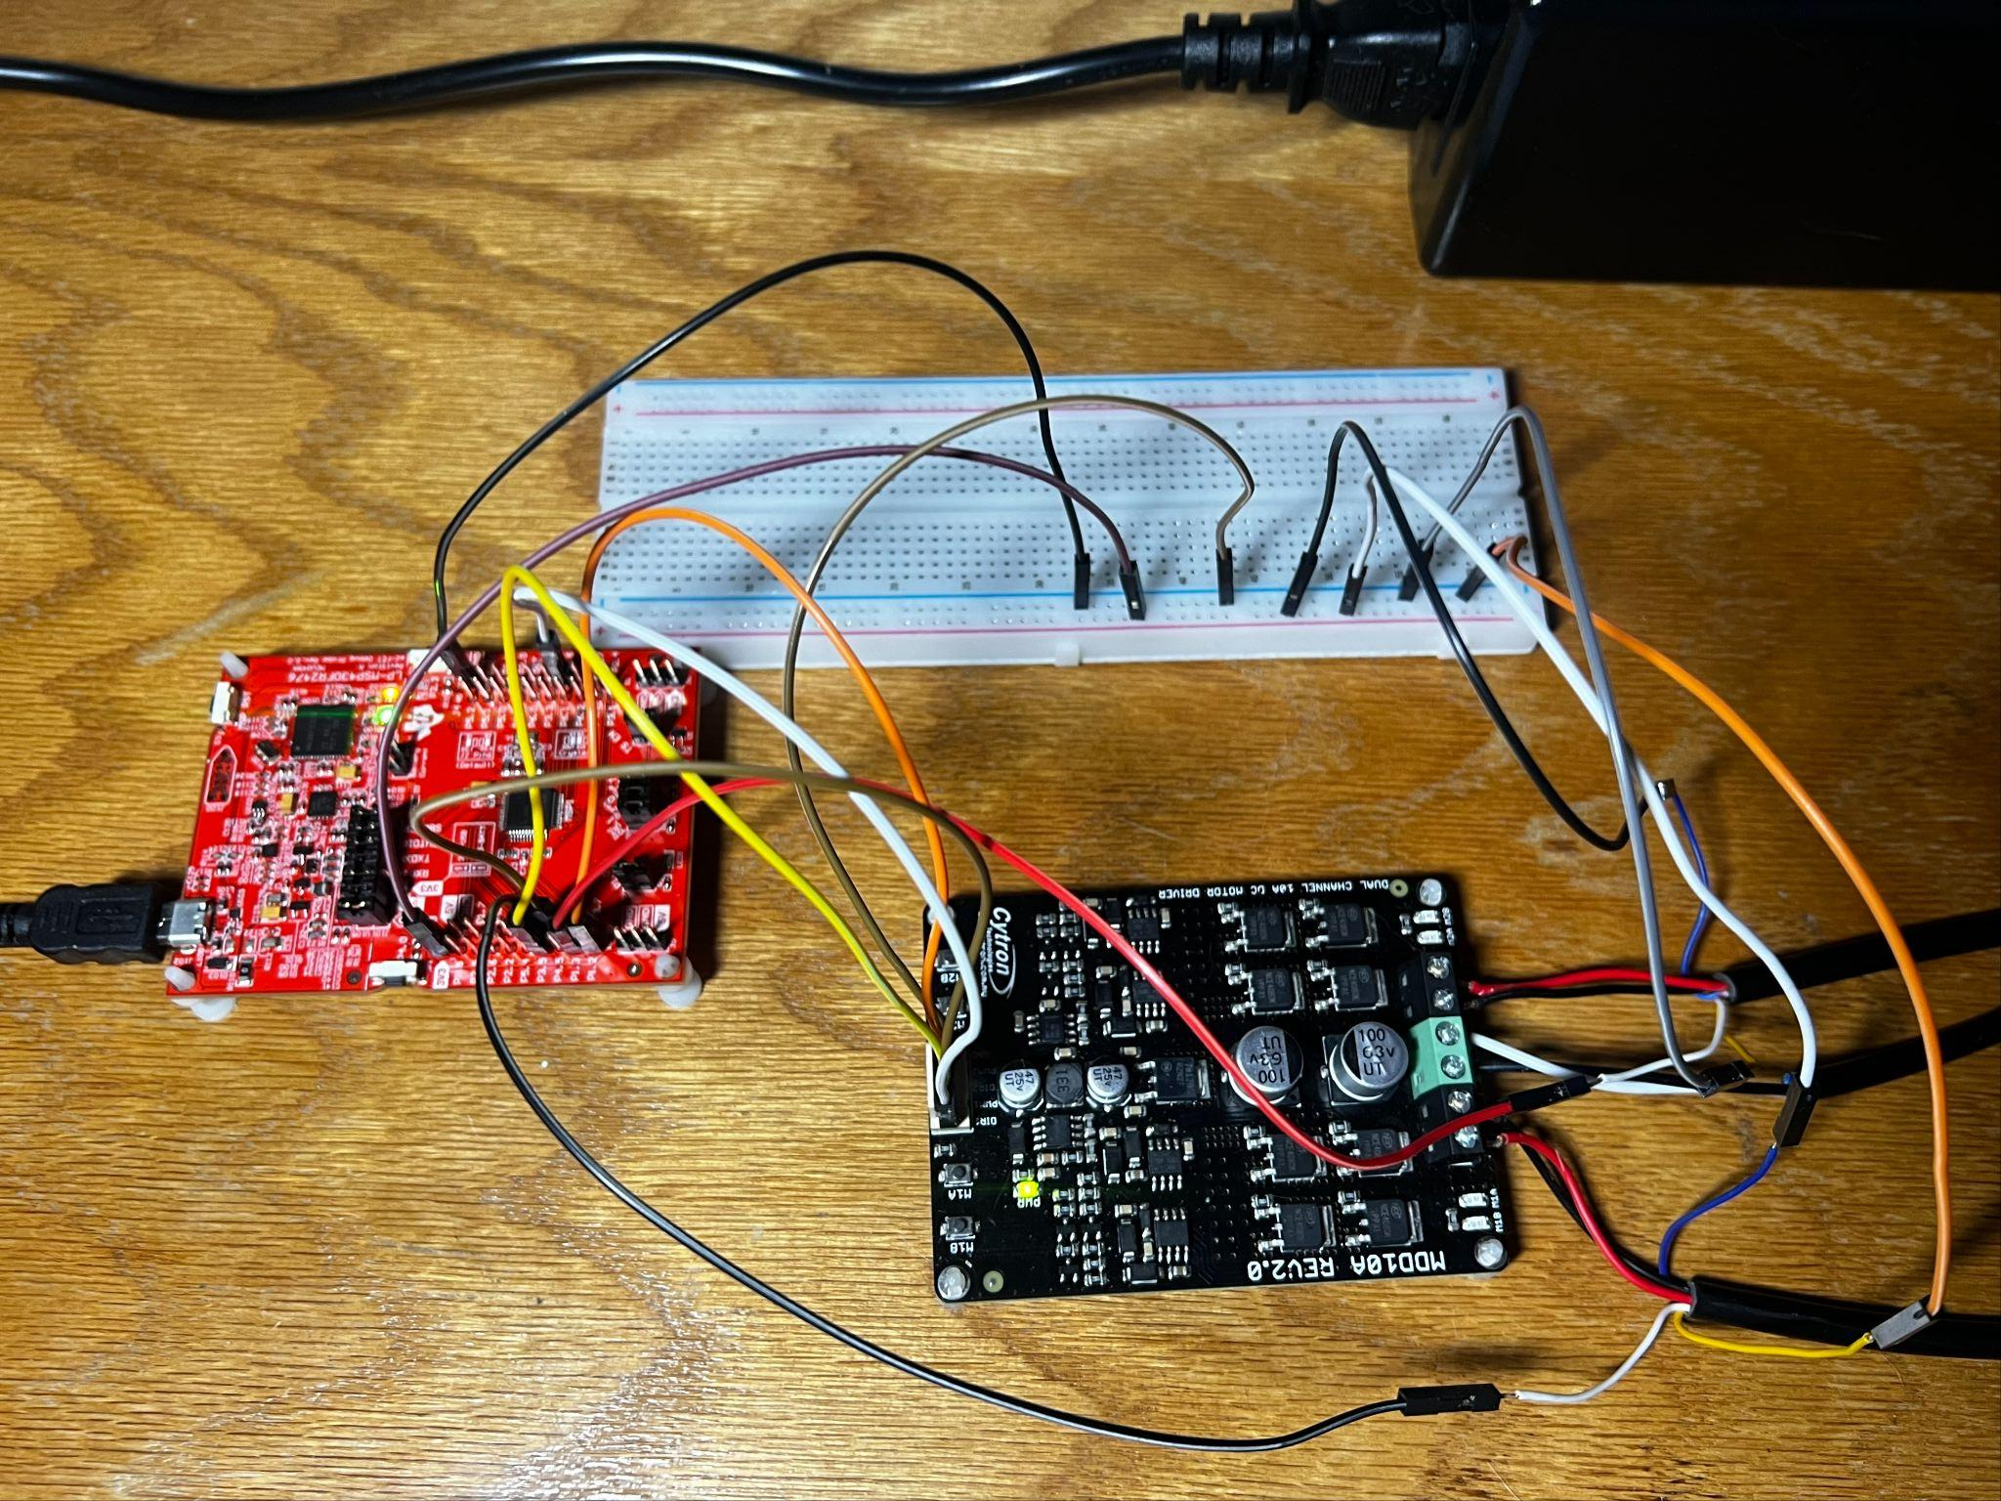
MSP430FR2476 Software
Ryan Pettit
Computer Engineer
TFT LCD
Connect via SPI
Utilize TI’s Graphics Library alongside a customized driver for the LCD’s built in controller
Motor Controller
Output PWM signal to each actuator for precise speed control
Set DIR by writing high or low to each pin
Potentiometers
Read each analog input via ADC configured in 12-bit sequence of channels mode
HX711
Data Retrieval
Two connections: DOUT, SCK
Once DOUT pin goes low, data is ready for retrieval
Use “bit banging” technique to shift each of the 24 bits out of the DOUT pin
The 25th pulse selects the gain (125) and pulls DOUT back to high
Convert Raw Data to pounds
Subtract tare offset and divide by calibration factor
Raspberry Pi Communication
Send and receive data via UART
Uploading Software
Using our development board’s eZ-FET Spy-Bi Wire connection

Slide 25
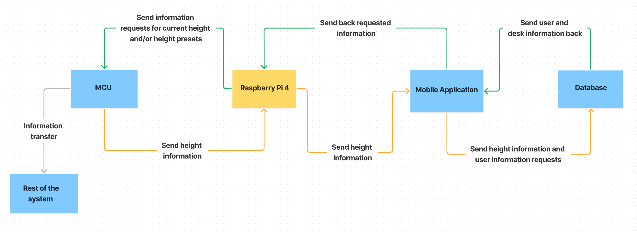
Data Communication Flowchart
Ashley Yang
Computer Engineer
Three main communication methods in design:
UART : MCU ⟷ Raspberry Pi 4
Bluetooth : Raspberry Pi 4 ⟷ Application
REST API : Application ⟷ Database

Slide 26
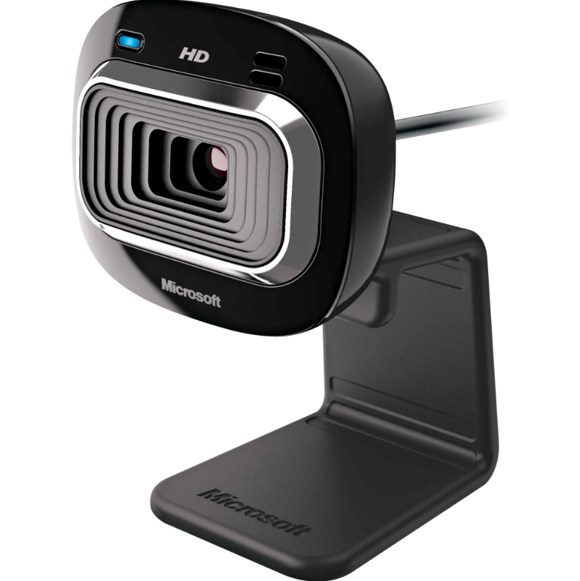
Software Comparison for Facial Tracking
Ashley Yang
Computer Engineer
Computer vision project requirements:
User presence detected through facial tracking
High accuracy tracking (At least 80% accuracy)
No need for other major computer vision capabilities
Microsoft lifecam hd-3000
Software | Interfaces | Accuracy | Use case
OpenCV | Python | Depends on the data on which the model was trained | Camera, video manipulation, object tracking, computer vision libraries
Dlib | C++, Python | Accuracy of 99.38% | Camera, video manipulation, object tracking, computer vision libraries
Face_recognition | Python | Accuracy of 99.38% | Facial tracking
OpenFace | Python | Accuracy of 97.38% | Facial tracking and Pose tracking
Notes:
Image source:https://www.amazon.com/Microsoft-HD-3000-LifeCam-Camera-T3H-00016/dp/B009VL9YJ2?source=ps-sl-shoppingads-lpcontext&ref_=fplfs&psc=1&smid=A4UCFL9LU89NR

Slide 27



Full Stack Development Technologies
Ashley Yang
Computer Engineer
Flutter
Software development kit created and maintained by Google.
Cross platform development
Dart programming language
Widget based
React
JavaScript library developed and maintained by Facebook.
Web application development
Javascript
Component based
React Native
A framework created for mobile application development.
Mobile application development
Javascript
Component based

Slide 28




Full Stack Development Technologies
Ashley Yang
Computer Engineer
Other full stack tools used for creation of application. Selected due to familiarity with tools and low cost.
Used for cloud application hosting for developers:
Cloud Platform
Support several languages
Auto deploys from Git
A scalable and flexible document database:
noSQL database
Can store structured or unstructured data
JSON-like format
Cross-platform JavaScript runtime environment
A lightweight routing framework:
Node web application framework
Handles forming the response
Free and open-source
Notes:
A content delivery network(CDN) is a distributed group of servers that caches content near end users
transport layer security(TLS). It is a protocol or communication rule that allows computer systems to talk to each other Structured data is data that fits neatly into data tables and includes discrete data types such as numbers, short text, and dates. Unstructured data doesn't fit neatly into a data table because its size or nature: for example, audio and video files and large text documents.

Slide 29
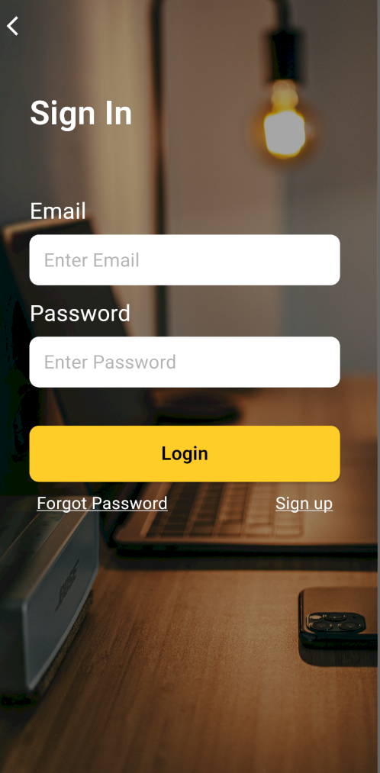
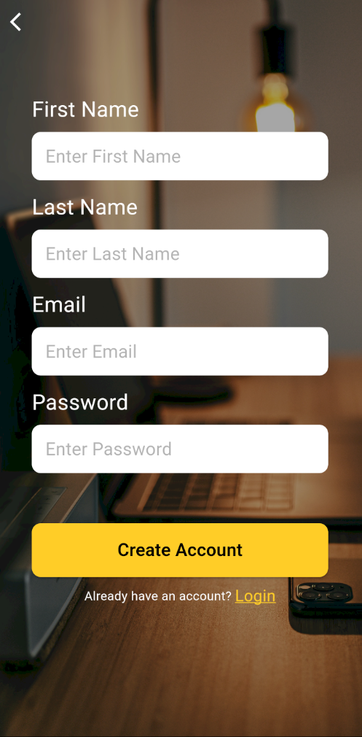
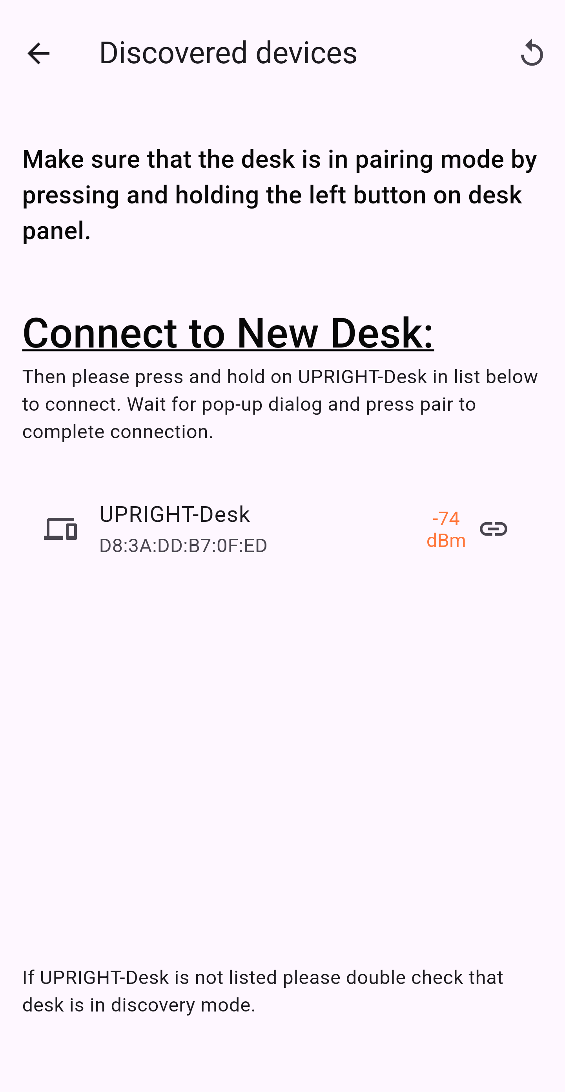
Mobile Application Structure
Ashley Yang
Computer Engineer
Login and Signup
Create and load user profiles
A way to save information for multiple users
Stored Online
Connect to Desk
Initial step to set up the desk calibration
Bluetooth connectivity
Application Goals:
Reliable storage of user information.
Visual representation of the data for the user. This will allow for users to see the time spent in each position. Based on the data collected the user can then adjust time spent in each area the next time they use the desk.

Slide 30
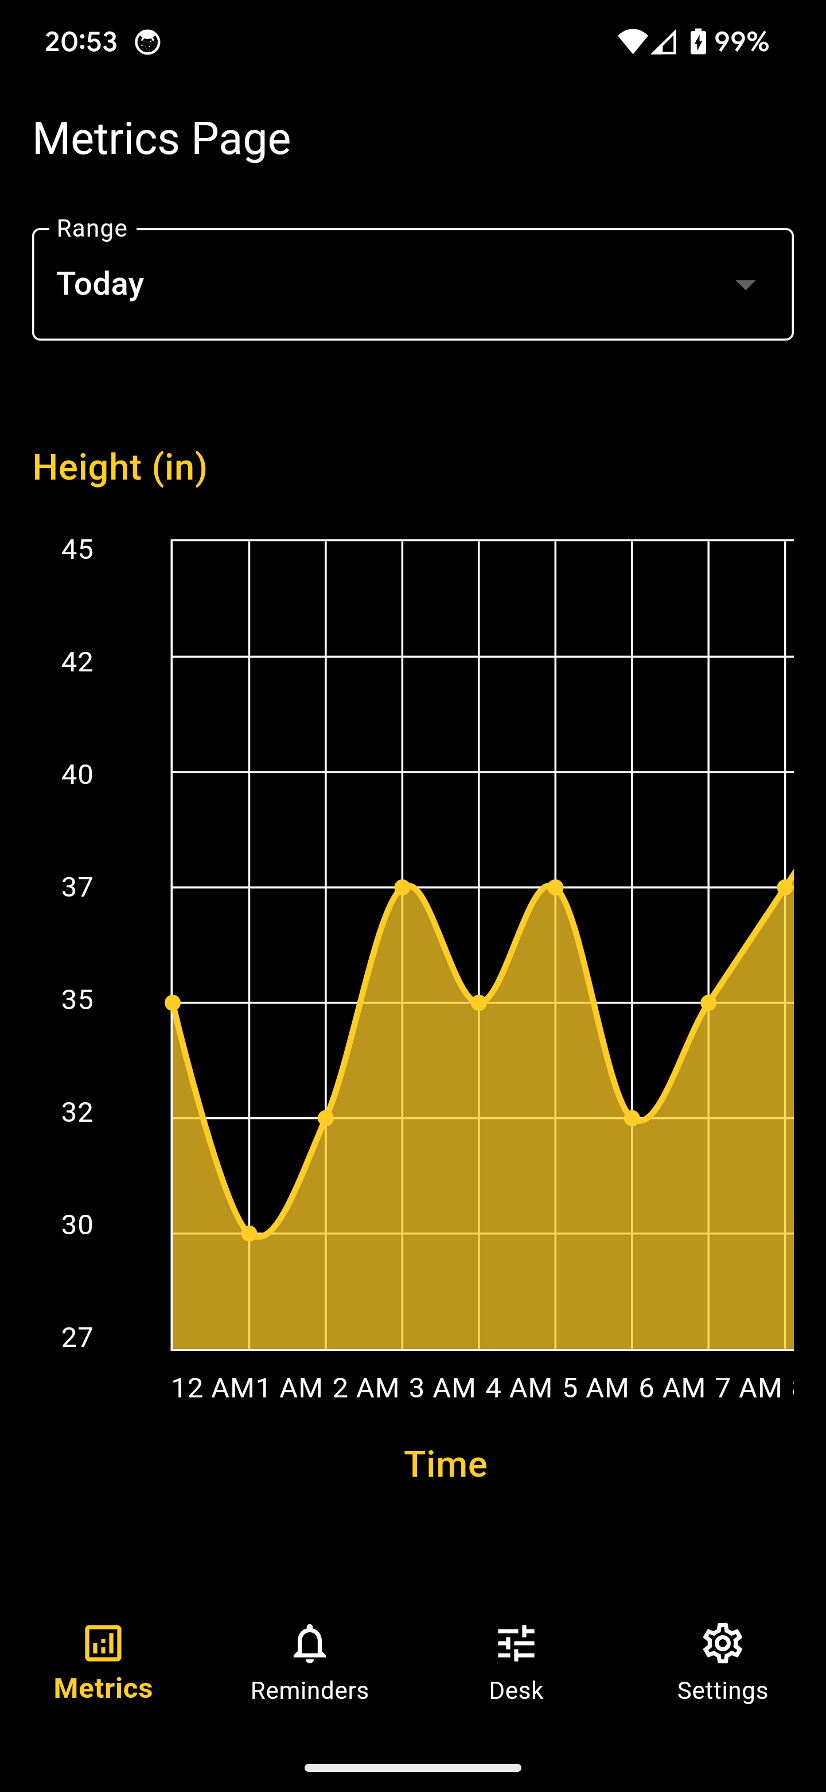
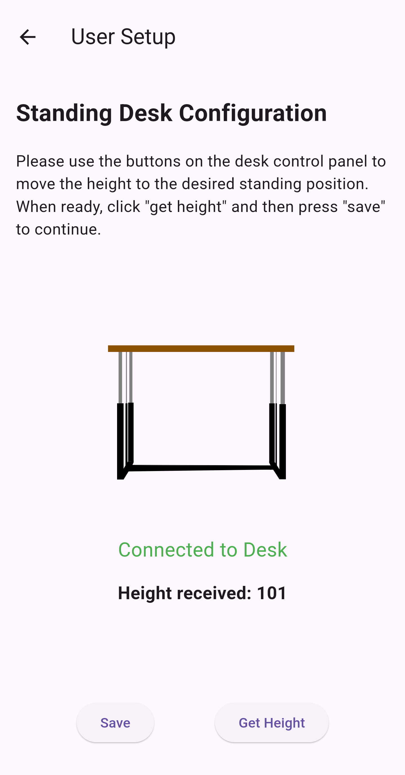
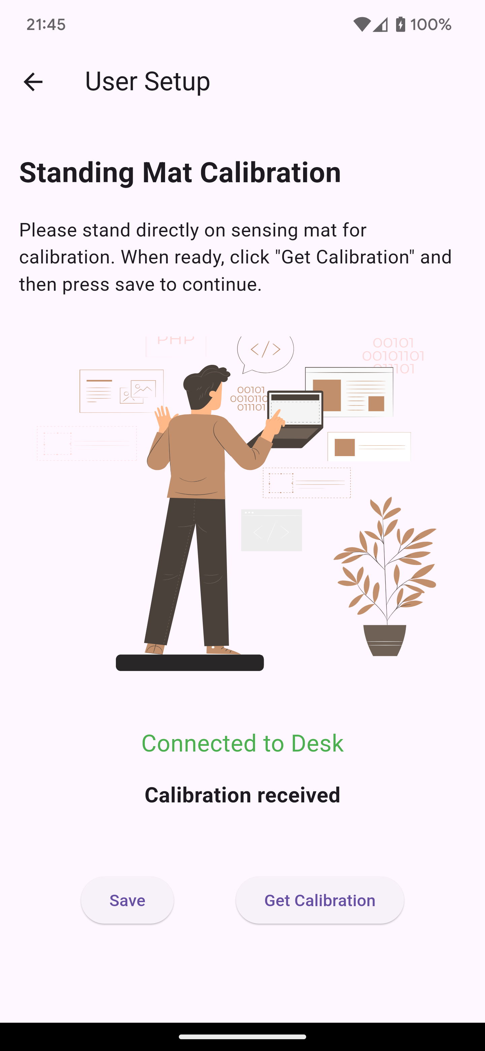
Mobile Application Structure
Ashley Yang
Computer Engineer
User Setup Steps
Save user sitting and standing preference
Calibrates the sensing pad for a new user
Stores in database
Metrics Page
Initial landing page
Desk height over period of time
Standing to sitting visual representation
Main application goals
User interface to communication with the main systems.
Flexibility in switching between different desks through bluetooth setup

Slide 31
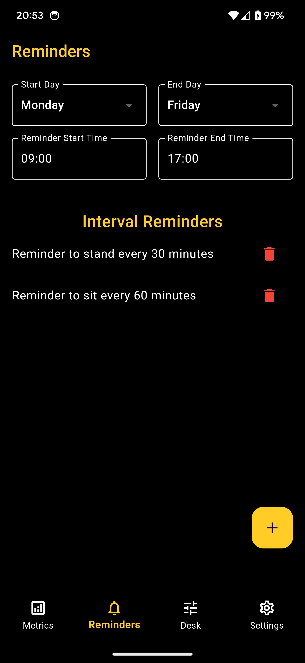
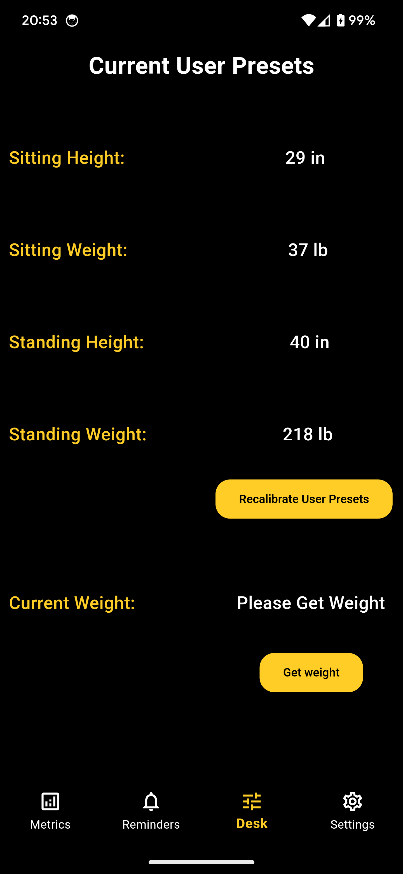
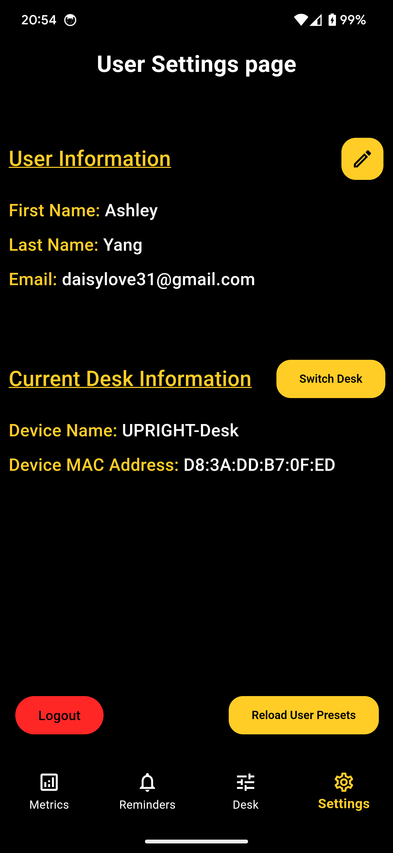
Mobile Application Structure
Ashley Yang
Computer Engineer
Reminders Page
Set phone push notifications
Reminder to sit and stand
Set time interval for reminder
Current User Presets
Shows current height and weight presets
Live access to weight from sensing pad
User Settings Page
Update user information
Allows connection to a new desk
Logout and manual load of user presets

Slide 32
Budget and Bill of Materials
Ryan Pettit
Computer Engineer
Item | Estimated Cost | Actual Cost
Desk | $200 | $238.62
Mat | $50 | $10.69
Load Cells | $20 | $4.50 Per Unit (4 Total)
Power Supply | $20 | $47.99
PCB | $50 Per PCB (5 total) | $59.56 Per PCB (5 total)
Raspberry Pi | $70 | $69.99
Motor Control | $20 | $23.50
Actuators | $300 | $296.00
Item | Estimated Cost | Actual Cost
LCD Display | $30 | $31.79
External Push Buttons | $15 | $41.01
Housing Design | $25 | N/A
Web Camera | $25 | Already Owned ($0)
Dev. Board | $25 | $34.17
Misc | $50 | $14.99
Total: | $1,100 | $1,054.56
Notes:
Spent extra on Power Supply went with a higher rated amperage rating due to the demand of actuators
Actuators - feedback system added cost
Desk - Lumber stain, paint brushes, sand paper, screws

Slide 33

Work Distribution
Ryan Pettit
Computer Engineer
Hardware
Part Selection(s)
Michael Dumas: AC/DC Power Converter, Linear Actuators, Motor Control Module
Ryan Pettit: Microcontroller, LCD Display, Load cells/amplifier, buttons
Lazaro Sosa: Voltage Regulators
Ashley Yang: Camera, Raspberry Pi 4
Responsibilities
Michael Dumas: PCB Layout, Overall System Wiring, Desk Construction
Lazaro Sosa: Active and Passive Component Selection, PCB Schematic, Desk Construction
Software
Ryan Pettit
MSP430 Software Development
Peripherals Integration
Ashley Yang
Mobile Application
Raspberry Pi 4 Software Development
Facial Tracking

Slide 34
Ryan Pettit
Computer Engineer
Thank you!
Are there any questions?

