Slide 1




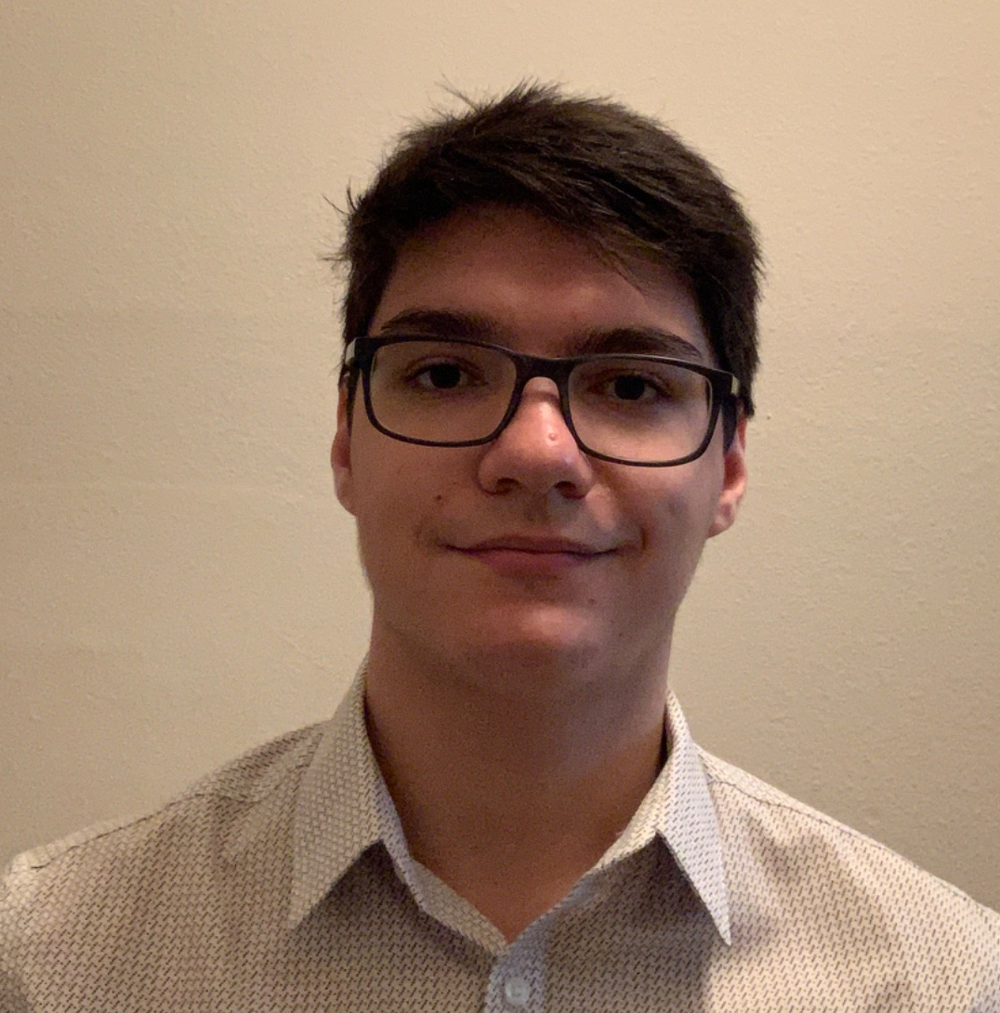
PlantPulse
Group 20
Kevin Shook Computer Engineer | Joshua Barshay Electrical Engineer | Fabrizio Martins Computer Engineer
Notes:
Hello, we are group 20.
I am Kevin Shook and I am joined by Joshua Barshay and Fabrizio Martins.
We are presenting our design review for our project we call PlantPulse.

Slide 2
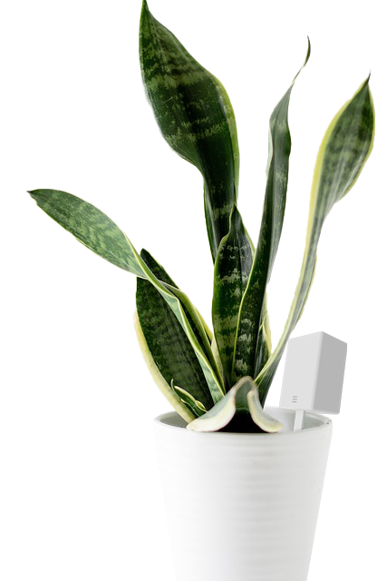
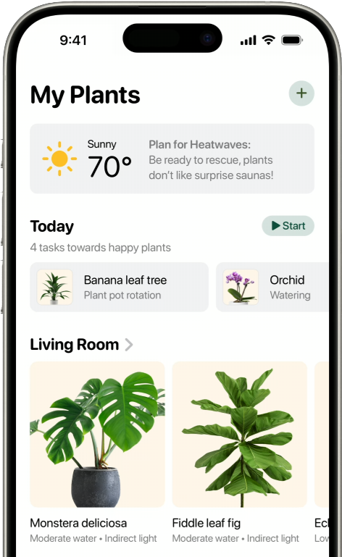

Motivations and Background
Needs:
Simple and intuitive plant care assistant.
Modular and scalable.
Affordable.
Notes:
PlantPulse came from my desire to have plants around my house and to have a garden where I grow much of the vegetables and herbs I use to cook.
I’ve tried for many years but I have never had enough time, energy, or knowhow to keep much alive for very long.
I had the idea that much of the care for the plants could be automated but I couldn’t find a system, available to hobbyists, that could do much but keep plants watered.
The systems were either big and expensive or really small and only supported a fixed number of plants.
Frustrated, I began to envision a system that could scale from supporting a single potted plant to a whole garden.
I discussed my idea with the group and found that they had similar trouble with plants and so plantpulse was born.

Slide 3
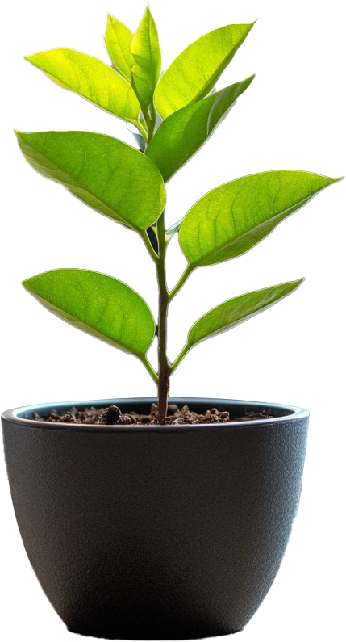
Goals and Objectives
Goals:
Display overall plant health and specific metrics as measured by the various device sensors.
Update metrics periodically to the user.
Stretch goal: Expand the above goals to multiple sensor and camera device combinations.
Stretch goal: Accurate plant detection utilizing AI for more than 5 plant types.
Objectives:
Autonomous sensing of humidity, soil moisture, temperature, and uv irradiance.
Measure active photosynthesis using camera technology.
System is run on solar and battery power as needed without user interaction.

Slide 4
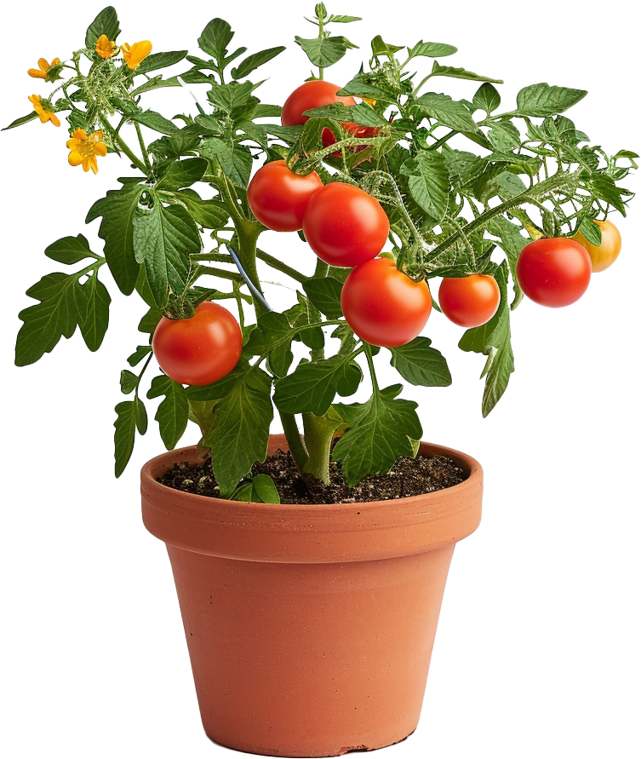
Engineering specifications
Parameter | Specification
Housing Tilt Function | 60 Degrees
Device Max Response Delay | 1 minute
Light Sensor Accuracy | 90%
Humidity Sensor Accuracy | 90%
Operating Temperature | -20-65 °C
Camera Required NIR Sensitivity | 830-870 nm
Humidity Sensor Input Range | 0-100% RH

Slide 5
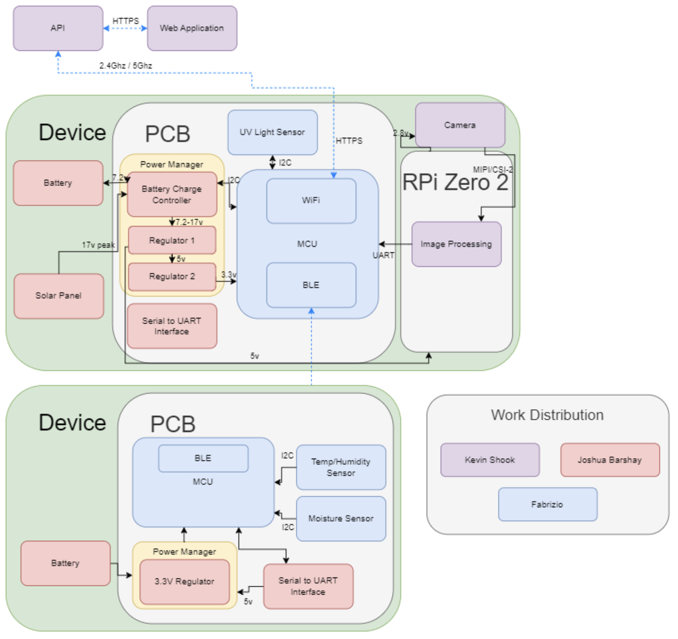
Hardware Flow
Lower Device:
Sensor package which reads the temperature, humidity, and soil moisture sensors and transmits data via bluetooth low energy to Camera Package.
Upper Device:
Camera Package, which reads data from Ultraviolet light sensor, and receives processed photo from Raspberry Pi and sensor data to transmit via WiFi to our application
Raspberry Pi Zero 2:
Communicates with camera to process the images and transmit to the camera package.

Slide 6
Hardware Selection
Microcontroller Unit
 | ESP32-S3 | ESP32-C3 | SAMA7G54 | Raspberry Pi Zero
SRAM: | 512KB | 400KB | 128KB | 512KB
GPIO: | 38 | 22 | 136 | 40
Sleep Amps: | 8µA – 240µA | 5µA – 130µA | N/A | 80mA – 100mA
Communication: | UART, GPIO, ADC, PWM, I2C, I2S, SPI, LCD, DVP, RMT, SDIO, USB, MCPWM, DMA, TWAI | UART, GPIO, ADC, PWM, SPI, I2C | USB, I2C, SPI, EBI | N/A
Price: | $1.85 per chip | $1.00 per chip | $13.00 per chip | $15.00 per chip

Slide 7
Hardware Selection
Temp and Humidity Sensor
 | SHT45 | SHT41 | SHT40
Accuracy: | ΔRH = ±1.0 %RH, ΔT = ±0.1 °C | ΔRH = ±1.8 %RH, ΔT = ±0.2 °C | ΔRH = ±1.8 %RH, ΔT = ±0.2 °C
Current Draw: | 0.4µA | 0.4µA | 0.4µA
Communication: | I2C | I2C | I2C
Price: | $3.47 - $7.81 per chip | $1.72 - $3.12 per chip | $1.68 – $3.28 per chip

Slide 8
Hardware Selection
Soil Moisture Sensor
Available sensors for consumer applications limited to resistive and capacitive sensors.
All sensors in decision were capacitive as they have increased resistance to corrosion.
Sensor: | PIM520 | Adafruit | Grove
Vin: | 3.3V | 3V – 5V | 3.3V – 5V
Communication: | Pulse Width Frequency | I2C | I2C
Price: | $4 | $7.50 | $6.50

Slide 9
Hardware Selection
Ultraviolet Light Sensor
 | AS7331 | LTR-390UV-01 | VEML6075
Bandwidth Range | 260 nm – 360 nm | 270 nm – 470 nm | 300 nm - 365 nm UVA 300 nm - 330 nm UVB
Average Current | 970µA – 2mA Typical: 1.5mA | 100µA – 110µA | 480µA
Interfaces | I2C | I2C | I2C
Price | $10.86 | $3.11 | $5.95
Photodiode based sensor which provided the most accurate sensing and the broadest range of input wavelengths.
AS7331 only available sensor at a reasonable price.

Slide 10
Hardware selection
Solar system
Solar Panel
Charge Controller
 | NPA5S-12I | P105 | 5368
Peak Power | 5W | 5W | 1.2W
Peak Voltage | 17V | 6V | 6V
Price | 21.49 | 35.00 | 14.95
 | BQ25756E | BQ24210 | BQ25798
Integrated MPPT | No | No | Yes
Number of Battery Cells | 1-7 | 1 | 1-4
Charger Topology | Buck-Boost | Linear | Buck-Boost
Power Topology | Non-Power Path | Non-Power Path | Power Path

Slide 11
Hardware selection
Regulators
 | TPS62932 | LM64460-Q1 | TPS566231 | MCP16502 | LMQ644A2-Q1
Output V Range | .08-22 | 3-36 | 0.6-7 | 1.2-3.7 & .6-1.85 | 3-36
Max Output Current | 2 | 6 | 6 | 1-.3 | 6
Estimated Efficiency (Full Load) | 95% | 93% | 95% | 85-96% | 93%

Slide 12
Hardware Design
Two main PCBs (camera package and sensor package)
Three breakouts (two regulators and one sensor)
Communication handled over WiFi and BLE by the ESPs
Power broken supply for the main PCB is a PV panel and rechargeable battery handled by a charge controller

Slide 13
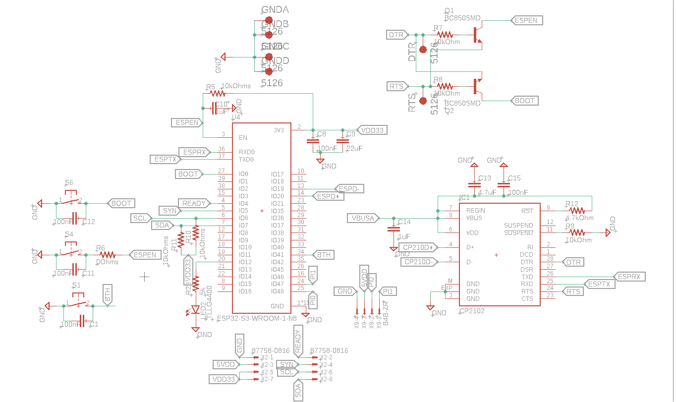
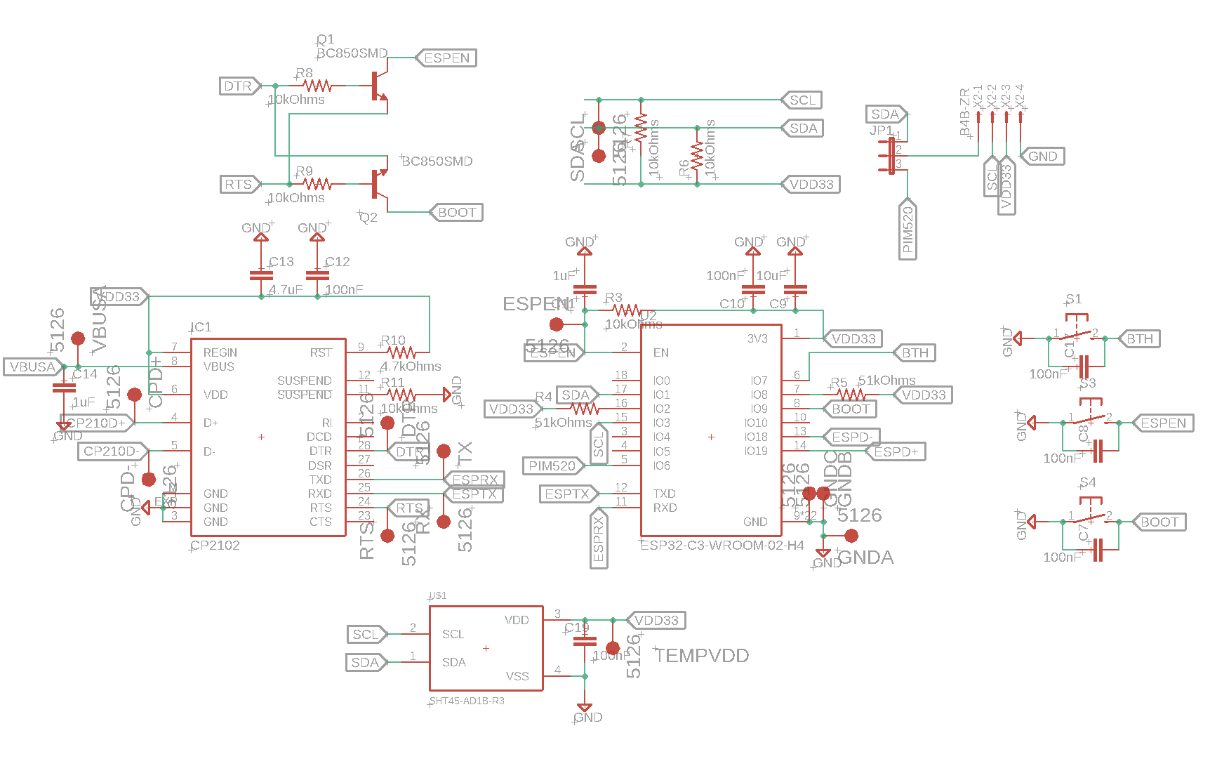
Hardware Schematics
MCU & Sensors
Camera Package
Sensor Package

Slide 14
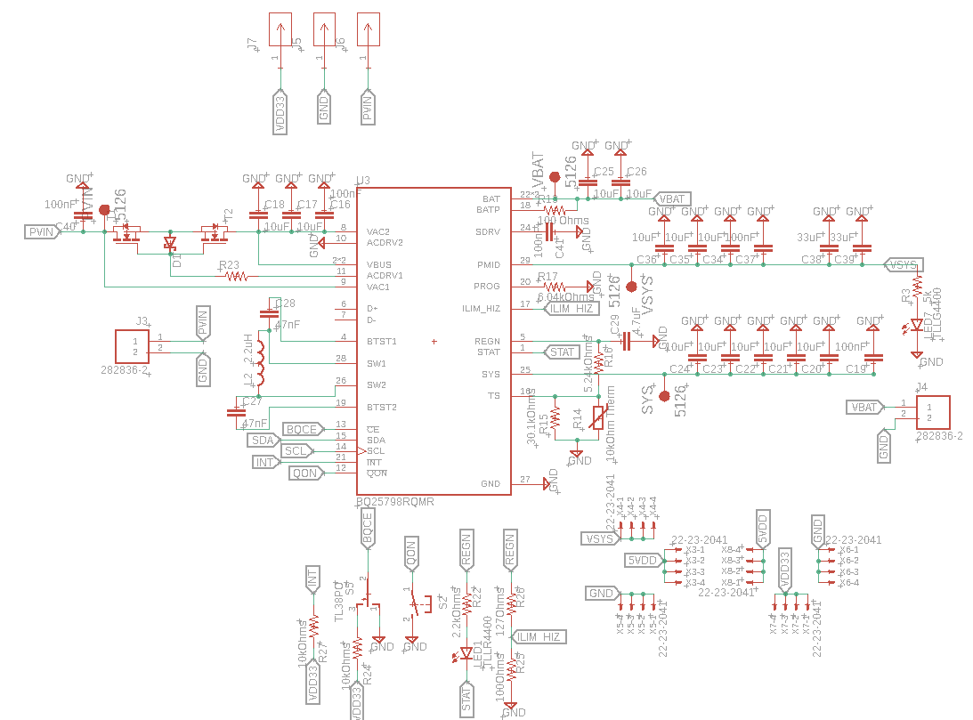
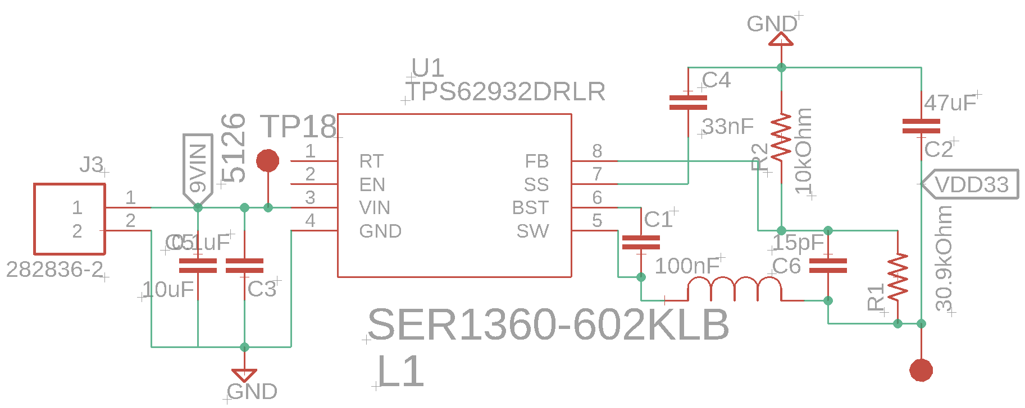
Hardware Schematics
Power
Sensor Package
Camera Package

Slide 15
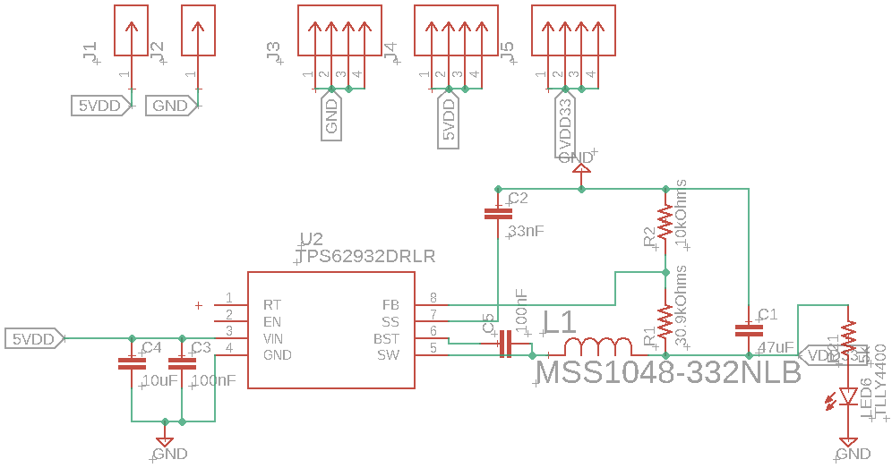
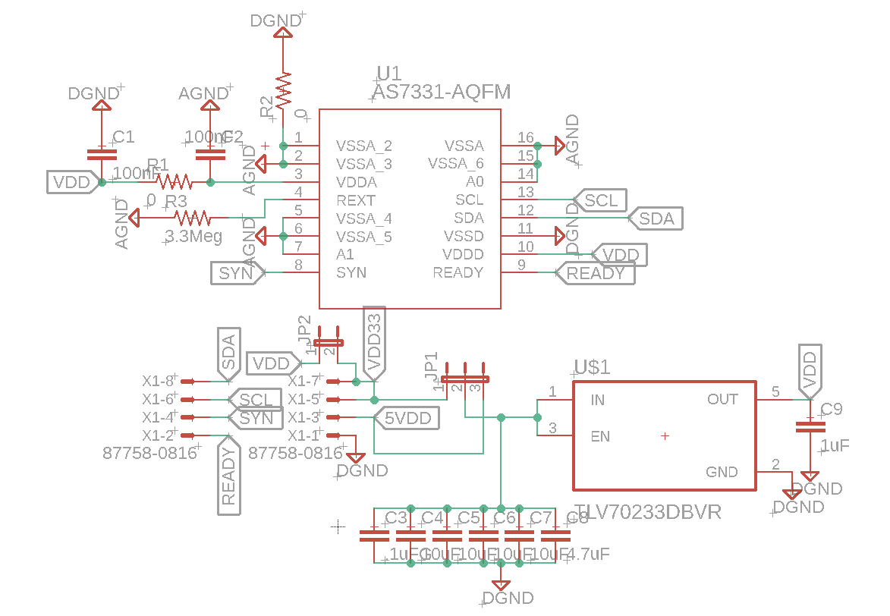
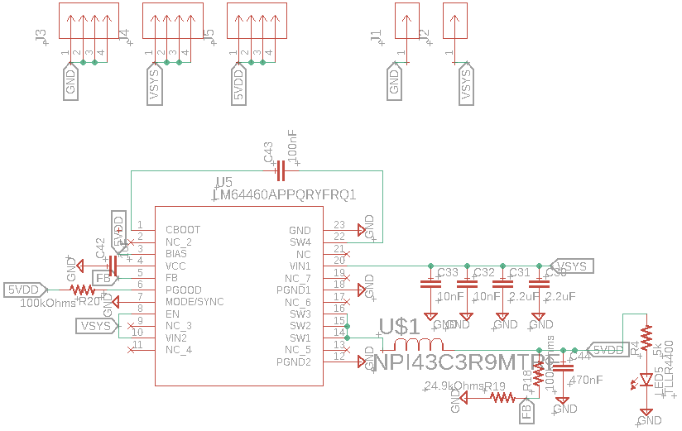
Hardware Schematics
Breakouts
UV Light Sensor Breakout
3.3V Buck Breakout
5V Buck Breakout

Slide 16
PCB Design
The layout for the sensor package is primarily concerned with a low footprint
The layouts were created in autodesk EAGLE
The camera package PCB is 4 layers while the rest are 2 layers
The layouts in this stage have options to enable some level of flexibility in design changes

Slide 17
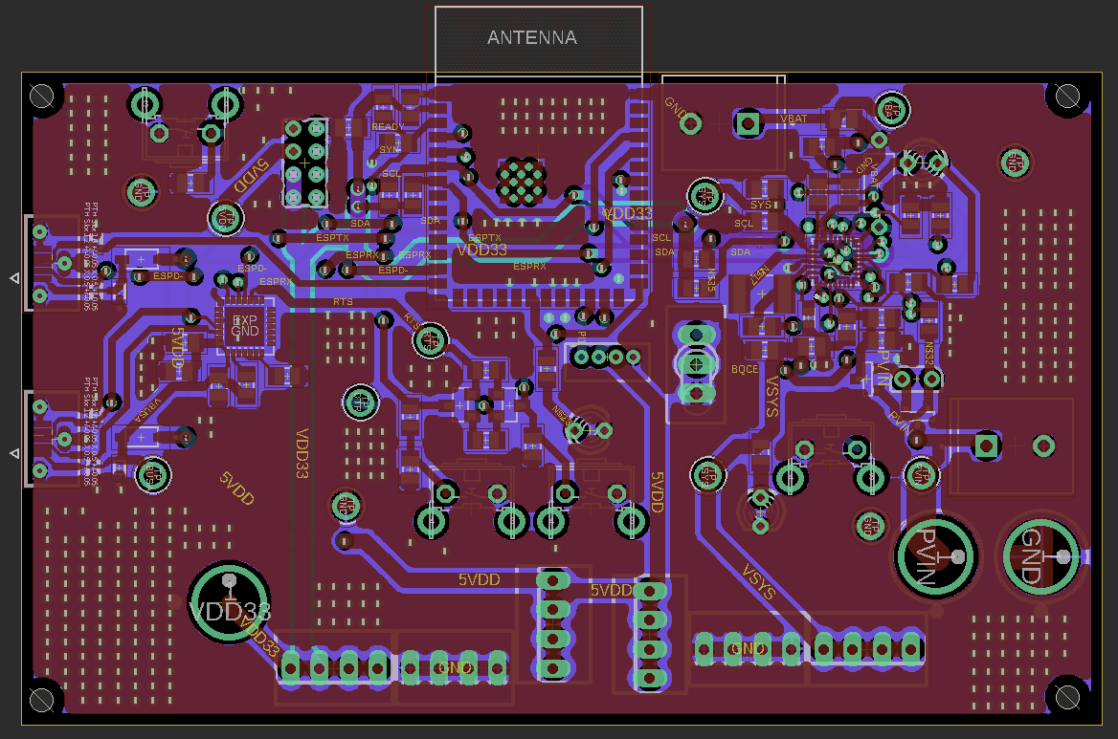
Camera Package PCB Layout
4 layers (top and bottom layers are the primary signal layers with layers 2 & 3 primarily being used for grounding)
The regulator breakout boards connect via the two sets of three four pin headers shown in the bottom center
The UV breakout connects via the 4-pin JST header shown in the center below the ESP
Banana jack connections were provided to allow for testing even if integration of the power subsystem has issues
3850 mils
2150 mils

Slide 18
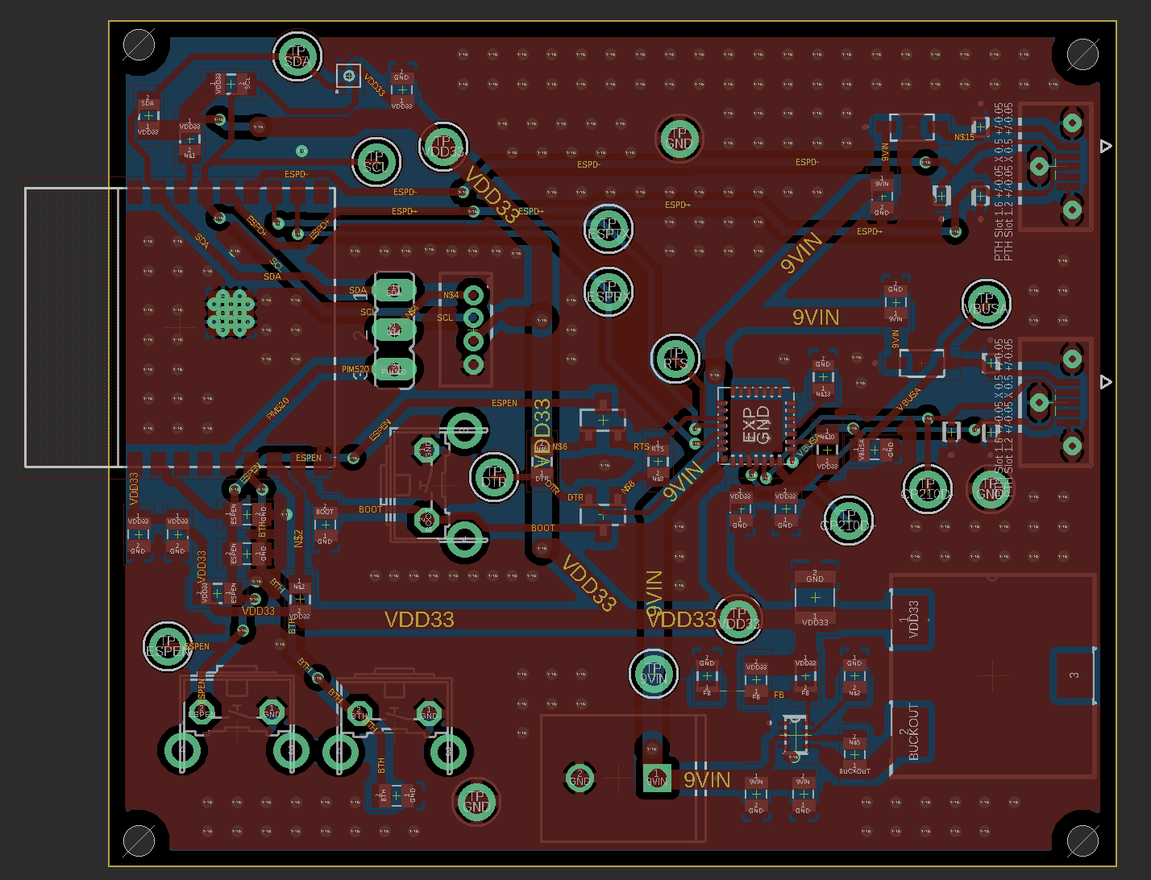
Sensor Package PCB Layout
Unlike the camera package the buck regulator is on board to allow for a smaller profile
The 9V battery power supply connects to this PCB via the screw connector seen in the bottom center of the PCB
2560 mils
2150 mils

Slide 19
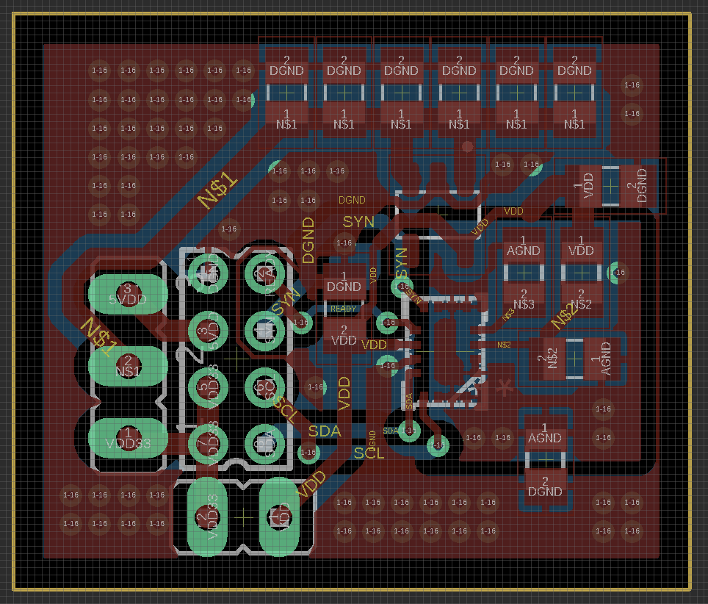
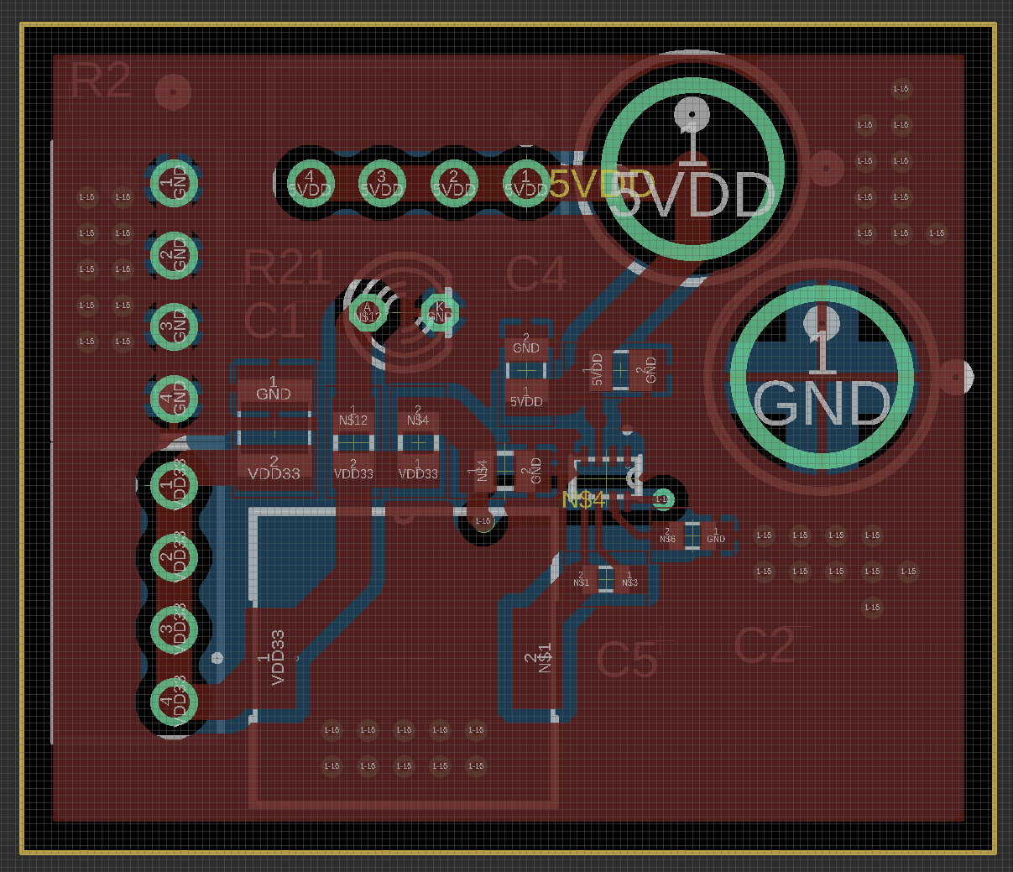
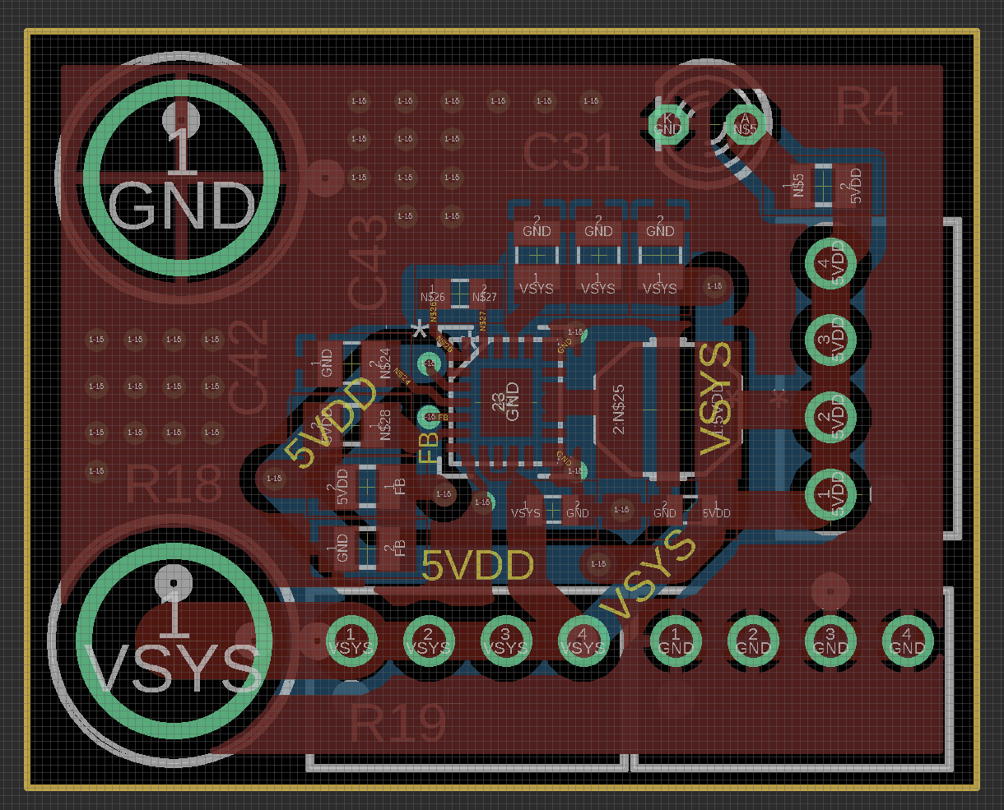
Breakout Board PCB Layouts
UV Light Sensor Breakout
3V Regulator Breakout
5V Regulator Breakout

Slide 20
Software selection
Embedded
Fabrizio:
Wifi:
Satisfies requirement of long range for interfacing between microcontroller units and smartphone.
Bluetooth Low Energy:
Satisfies requirement of short range interfacing between two microcontroller units.
Satisfies requirement of ultra low power consumption to maximize battery life.
ESP-IDF:
Provides native support for FreeRTOS allowing for more robust implementation of a task driven application
Allows for more control and flexibility over memory management, hardware peripherals, and power management.

Slide 21
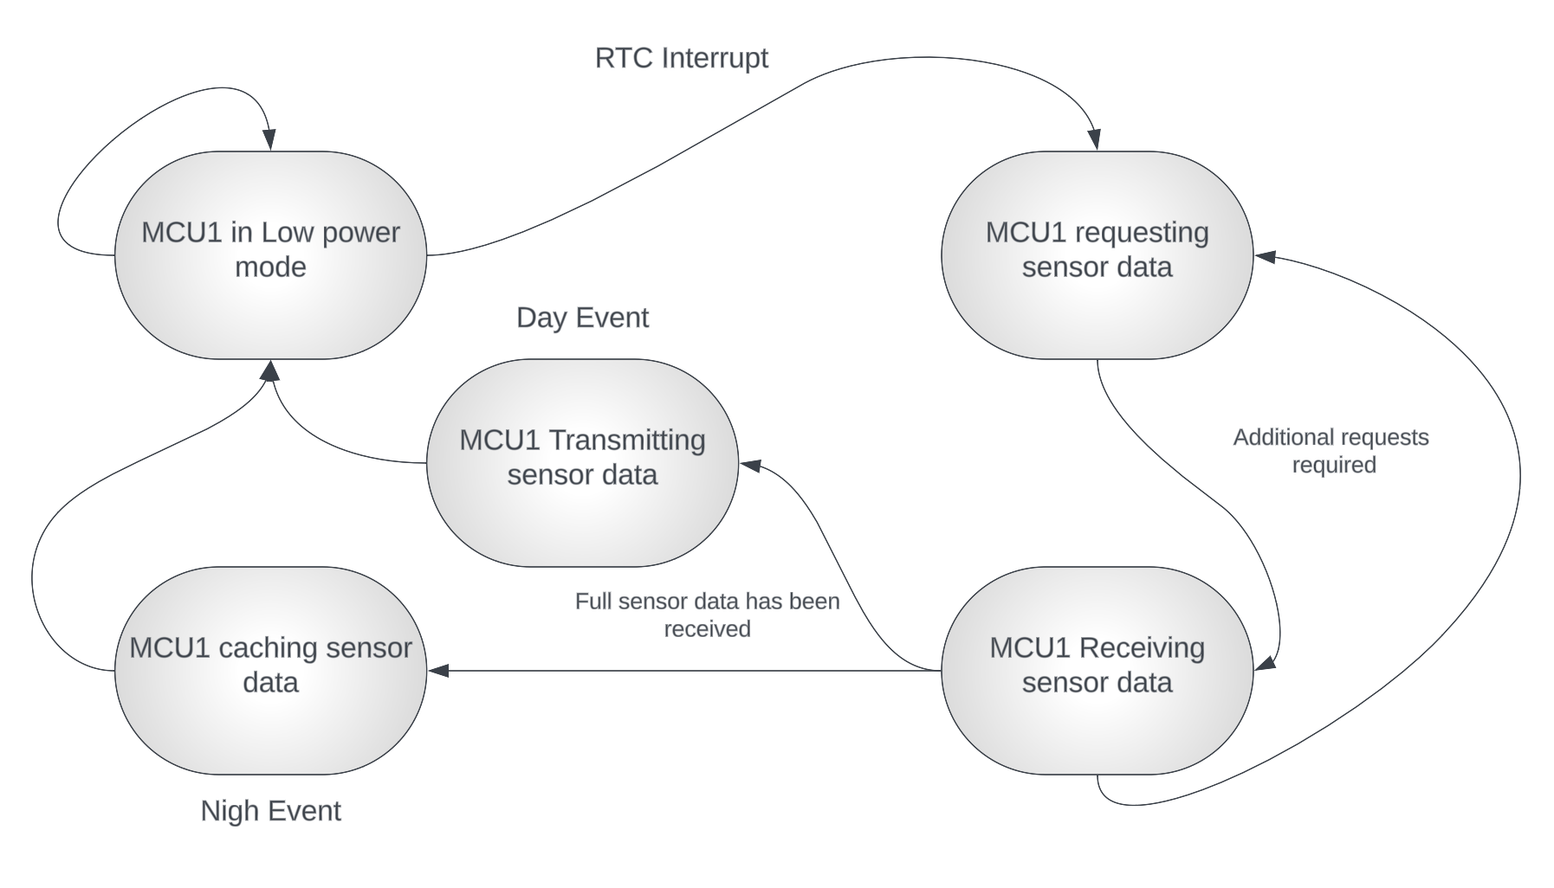
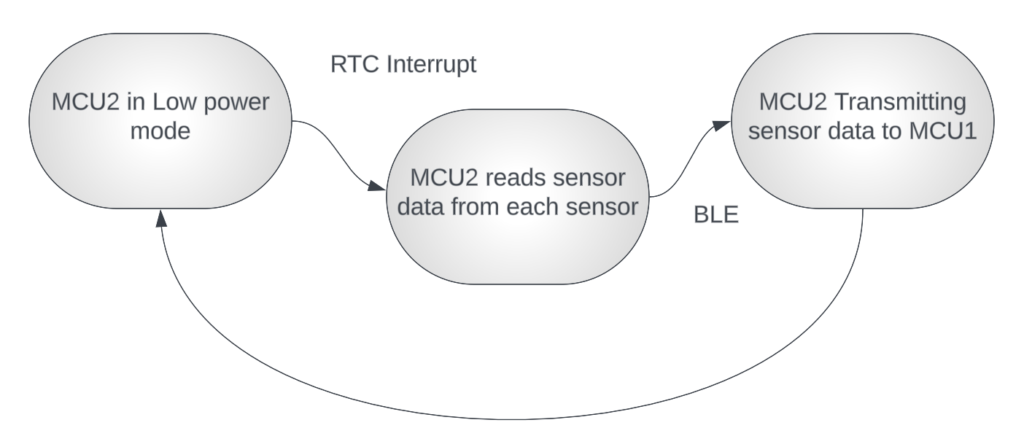
Software design
Embedded
Camera Package
Simplified software flow diagram for the main MCU on the camera package device and secondary sensor package MCU.
Sensor Package

Slide 22
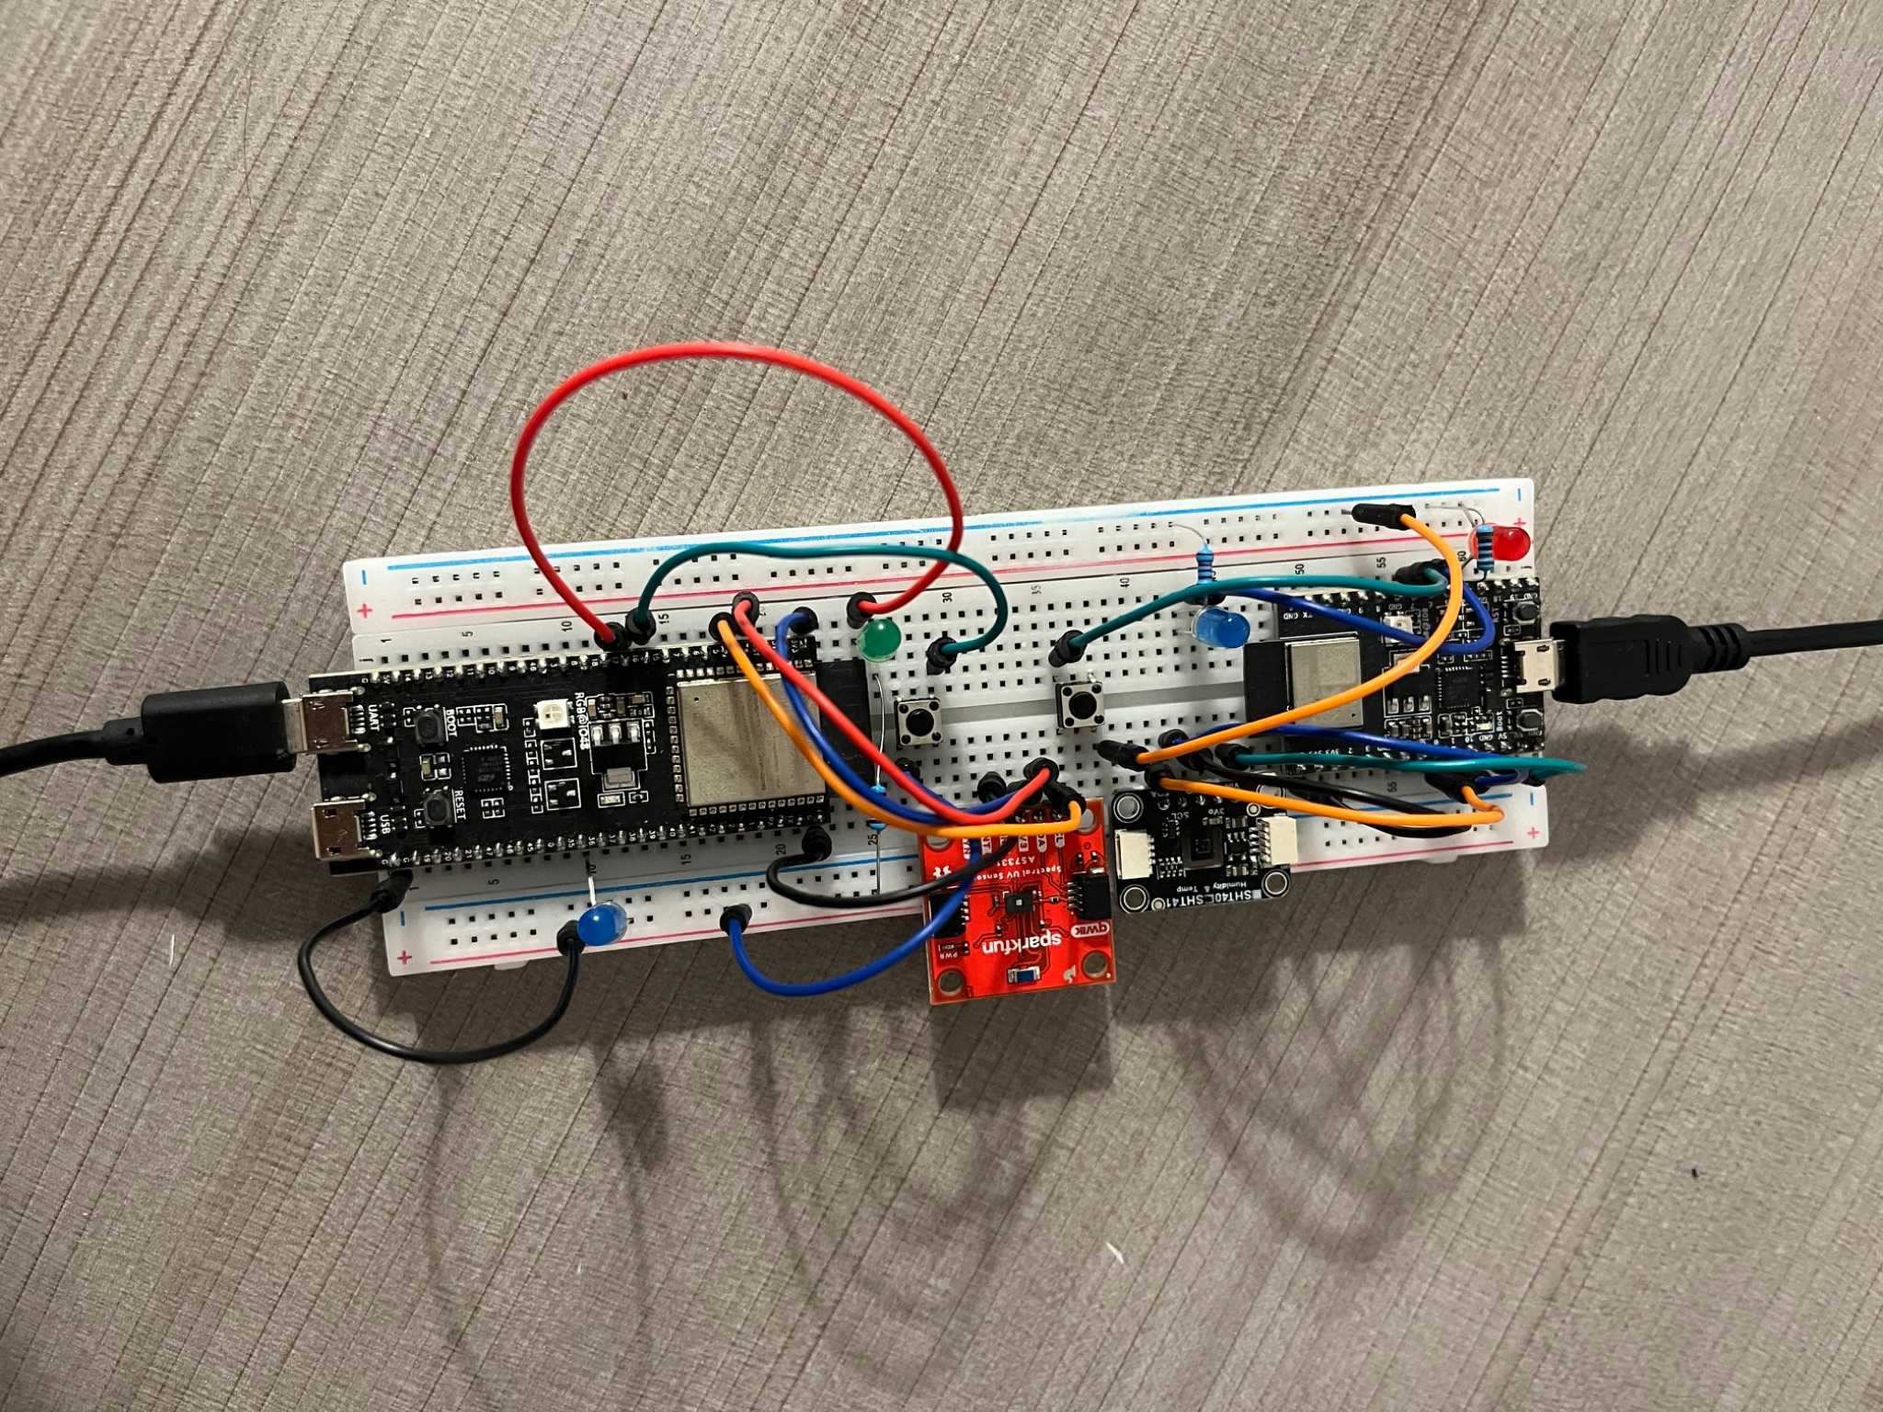
Prototyping and testing
Embedded
Prototype camera package connected to ultraviolet light sensor
Prototype sensor package connected to temperature and humidity sensor
Currently implementing WiFi communication testing and overall software flow.

Slide 23


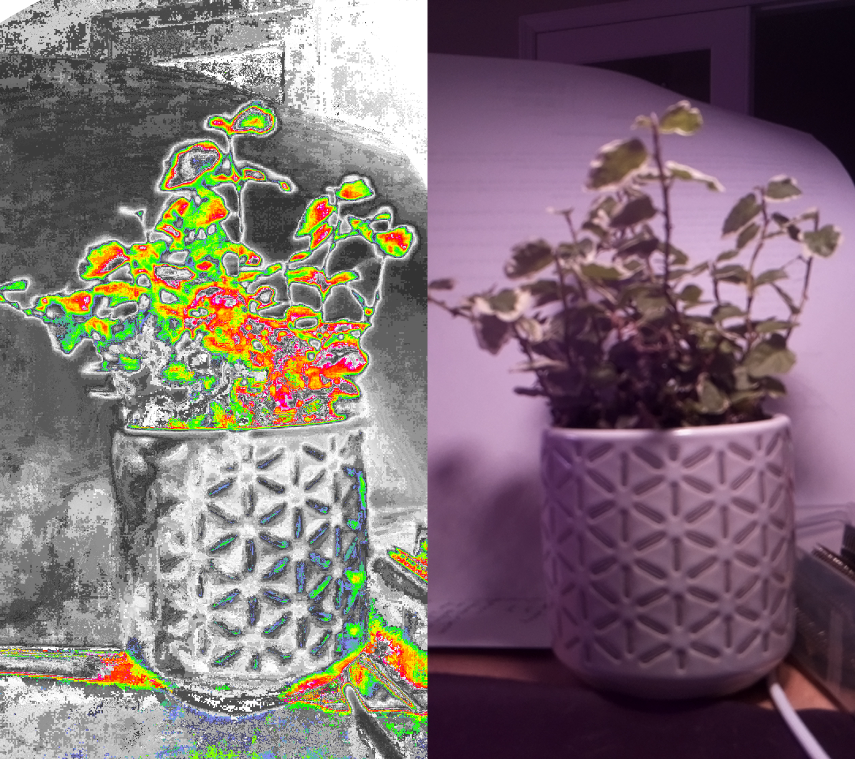
Software Selection
Web Services
Web services
API Gateway - Express.js
Web Client - React
Mobile Client - iOS
Machine Learning
Thresholding - OpenCV
Image Classification (CNN) - Tensorflow
Recommendation Engine (Expert System)
API
Ai
Notes:
The web service can be summed up in three major components, the API gateway which handles all requests and authentication, the web client that interfaces with the user, and the machine learning services that handle much of the intelligent services for our system.
For the API with choose Express as it was easy to integrate with a proven history.
The web client we chose React for its modularity and excellent community support.
For the mobile app we decided to go with native iOS with swift as it was very simple and fast to iterate.
For the machine learning services we have two main libraries OpenCV and Tensorflow.
These were chosen because of existing familiarity and high level of support for many different applications.

Slide 24
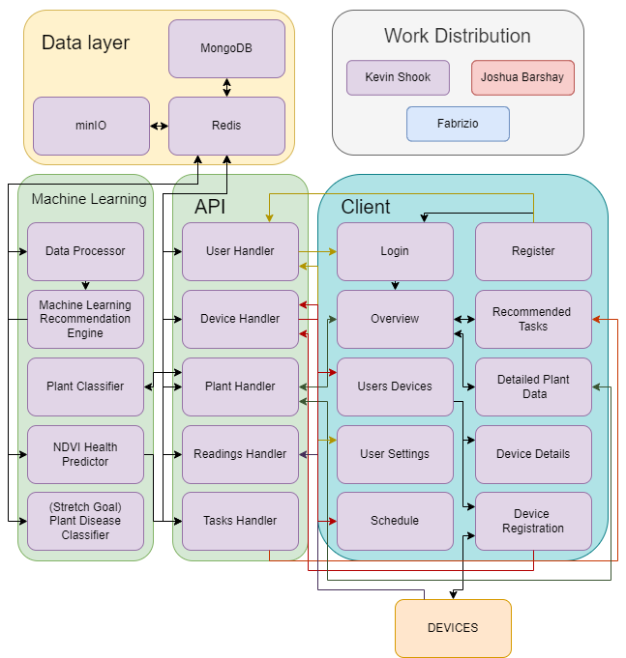
Software Design
Web Services
Separation of concerns
Logic Layer
Data Layer
Client
Scalable Service Model
Allows Replication
Allows Load Balancing
Modular for upgradability
Easy to add services
Easy to swap out for different 3rd party services
Notes:
For the design of the web services we took a modular approach separating our major concerns into purpose focused modules.
Each piece running in an individually scalable, replicable, fault tolerant, container node.
The API is a gateway that handles all incoming requests, authentication, and delivery of data.
It communicates to the other services in the background completely obscured to the end user.
This design allows us to deploy to all the major cloud providers easily and scale the service depending on load.

Slide 25
Prototyping and Testing
Web Services
API gateway
Built initial API framework, supporting user authentication, user registration, device registration, and getting device readings. Tested with Postman.
Machine Learning
Created a CNN model and trained on 3 plants. Tested with postman sending an image and receiving a prediction with confidence level.
Plant Data
Found and implemented an open source plant data API. Trefle API was the only curated dataset that included actual values for the metrics we need.
Week 2
Week 4
Week 1
Week 3
Week 5
Web Client
Basic web client created and attached to the API. Tested user registration, user login, getting user devices, and displaying time sequenced plant data in graphs.
iOS app
Achieved feature parity with web client and added device registration and provisioning process. Tested with an iPhone 12.
Notes:
We started strong, completing the initial framing for the API gateway in the first week using Postman for testing.
Including handling registration and authentication across the system.
Keeping the trend, the web client wireframe prototype went up in similar time during week 2.
Week 3 saw the image classifier take shape initially supporting 3 plants and integrated with the API.
The iOS app has taken a bit longer do to complications figuring out the ESP32 provisioning library, but was able to successfully create the device registration process and test using my iPhone and an ESP32-S3.
Finally we integrated an open source plant knowledge project called Treffle API.
This was the quickest way to support a wide variety of plants and the Trefle API was the only one we found that had numerical values associated to the metrics we were planning to monitor.

Slide 26
Administrative content
Part No. | Quantity | Price per Unit | Total
BQ25798RQMR | 5 | $7.33 | $36.65
LM64460APPQRYFRQ1 | 5 | $6.74 | $33.70
ESP32-S3-WROOM-2-N32R8V | 5 | $6.68 | $33.4
ESP32-C3-WROOM-02-N4 | 5 | $1.9 | $9.5
AS7331 | 5 | $10.86 | $54.30
SHT45-AD1B-R3 | 5 | $5.75 | $28.74
TPS62932DRLR | 10 | $1.11 | $11.07
PCBs and Stencils | 5 | N/A | $53.30
Total | 1 | ~$52.14 | ~$260.68

Slide 27
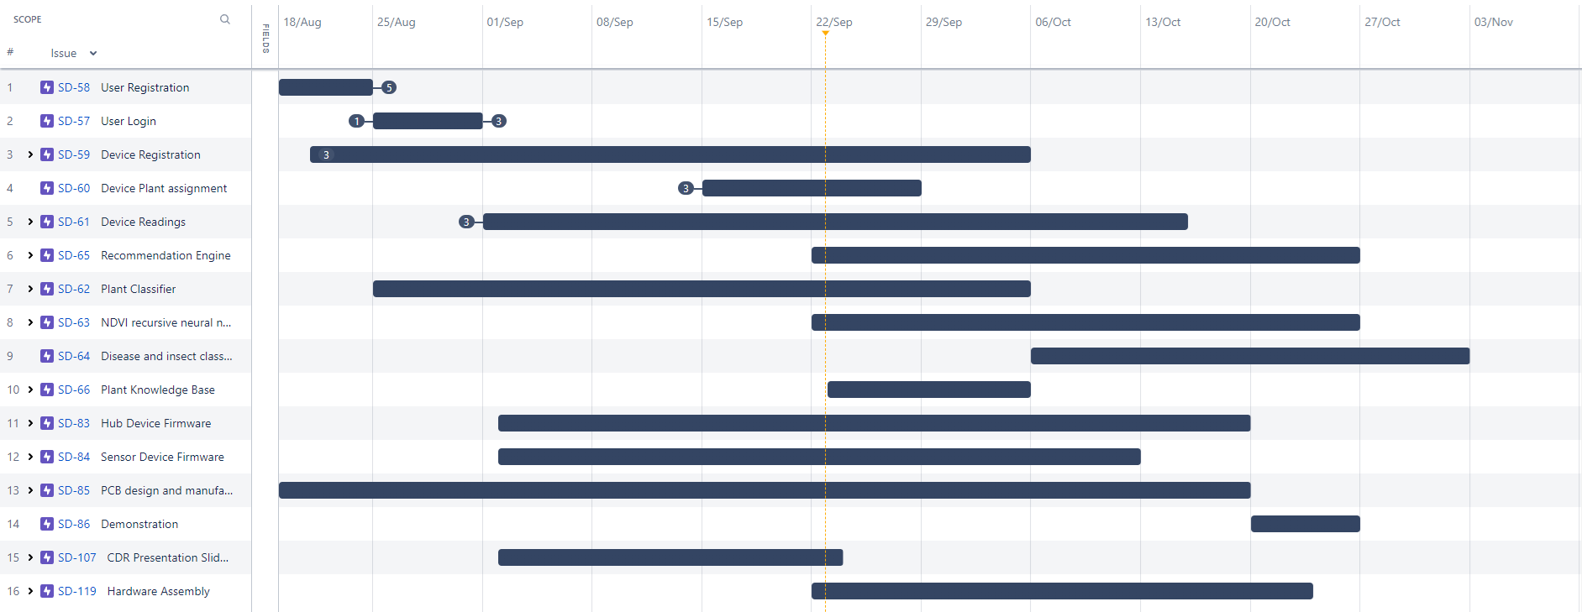
Roadmap to Completion
Notes:
We are a little over a month into development and have made excellent progress having a majority of features working and pending integration testing.
We have the remaining planned tasks scheduled as you see here. We are looking to have a fully functional prototype by mid October barring any major issues.
The remaining time will be spent making the system as robust as we can for final demo.
Again, we are group 20, this was PlantPulse, thank you for your time.

