Slide 1




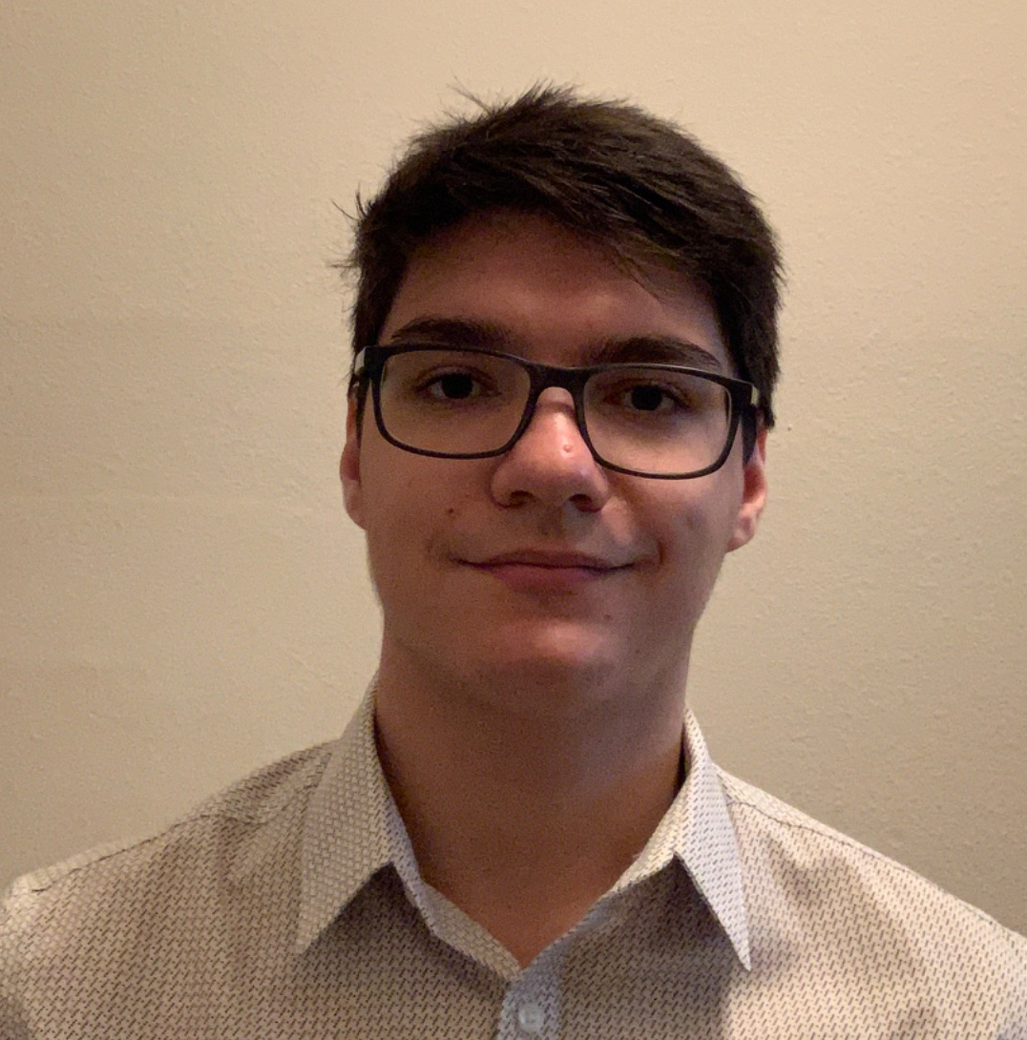
PlantPulse
Group 20
Kevin Shook Computer Engineer | Joshua Barshay Electrical Engineer | Fabrizio Martins Computer Engineer
Notes:
Hello, we are group 20.
I am Kevin Shook and I am joined by Joshua Barshay and Fabrizio Martins.
We are presenting our design review for our project we call PlantPulse.

Slide 2
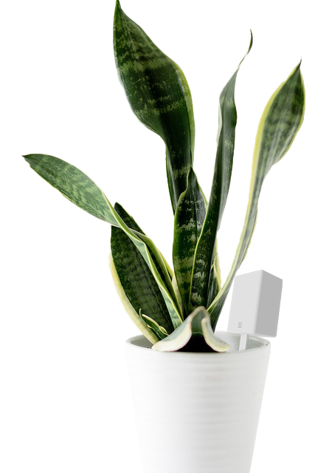
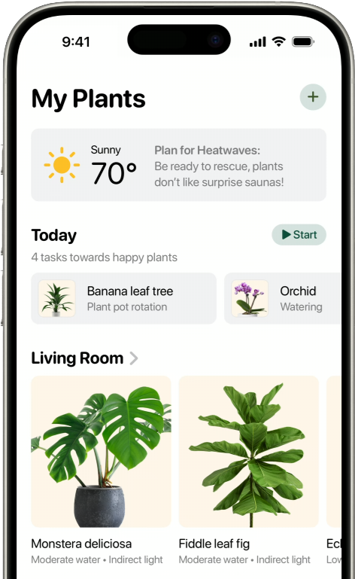

Motivations and Background
Needs:
Simple and intuitive plant care assistant.
Modular and scalable.
Affordable.
Notes:
PlantPulse came from my desire to have plants around my house and to have a garden where I grow much of the vegetables and herbs I use to cook.
I’ve tried for many years but I have never had enough time, energy, or knowhow to keep much alive for very long.
I had the idea that much of the care for the plants could be automated but I couldn’t find a system, available to hobbyists, that could do much but keep plants watered.
The systems were either big and expensive or really small and only supported a fixed number of plants.
Frustrated, I began to envision a system that could scale from supporting a single potted plant to a whole garden.
I discussed my idea with the group and found that they had similar trouble with plants and so plantpulse was born.

Slide 3

Goals and Objectives
Goals:
Display overall plant health and specific metrics as measured by the various device sensors.
Update metrics periodically to the user.
Stretch goal: Expand the above goals to multiple sensor and camera device combinations.
Stretch goal: Accurate plant detection utilizing AI for more than 5 plant types.
Objectives:
Autonomous sensing of humidity, soil moisture, temperature, and uv irradiance.
Measure active photosynthesis using camera technology.
System is run on solar and battery power as needed without user interaction.

Slide 4
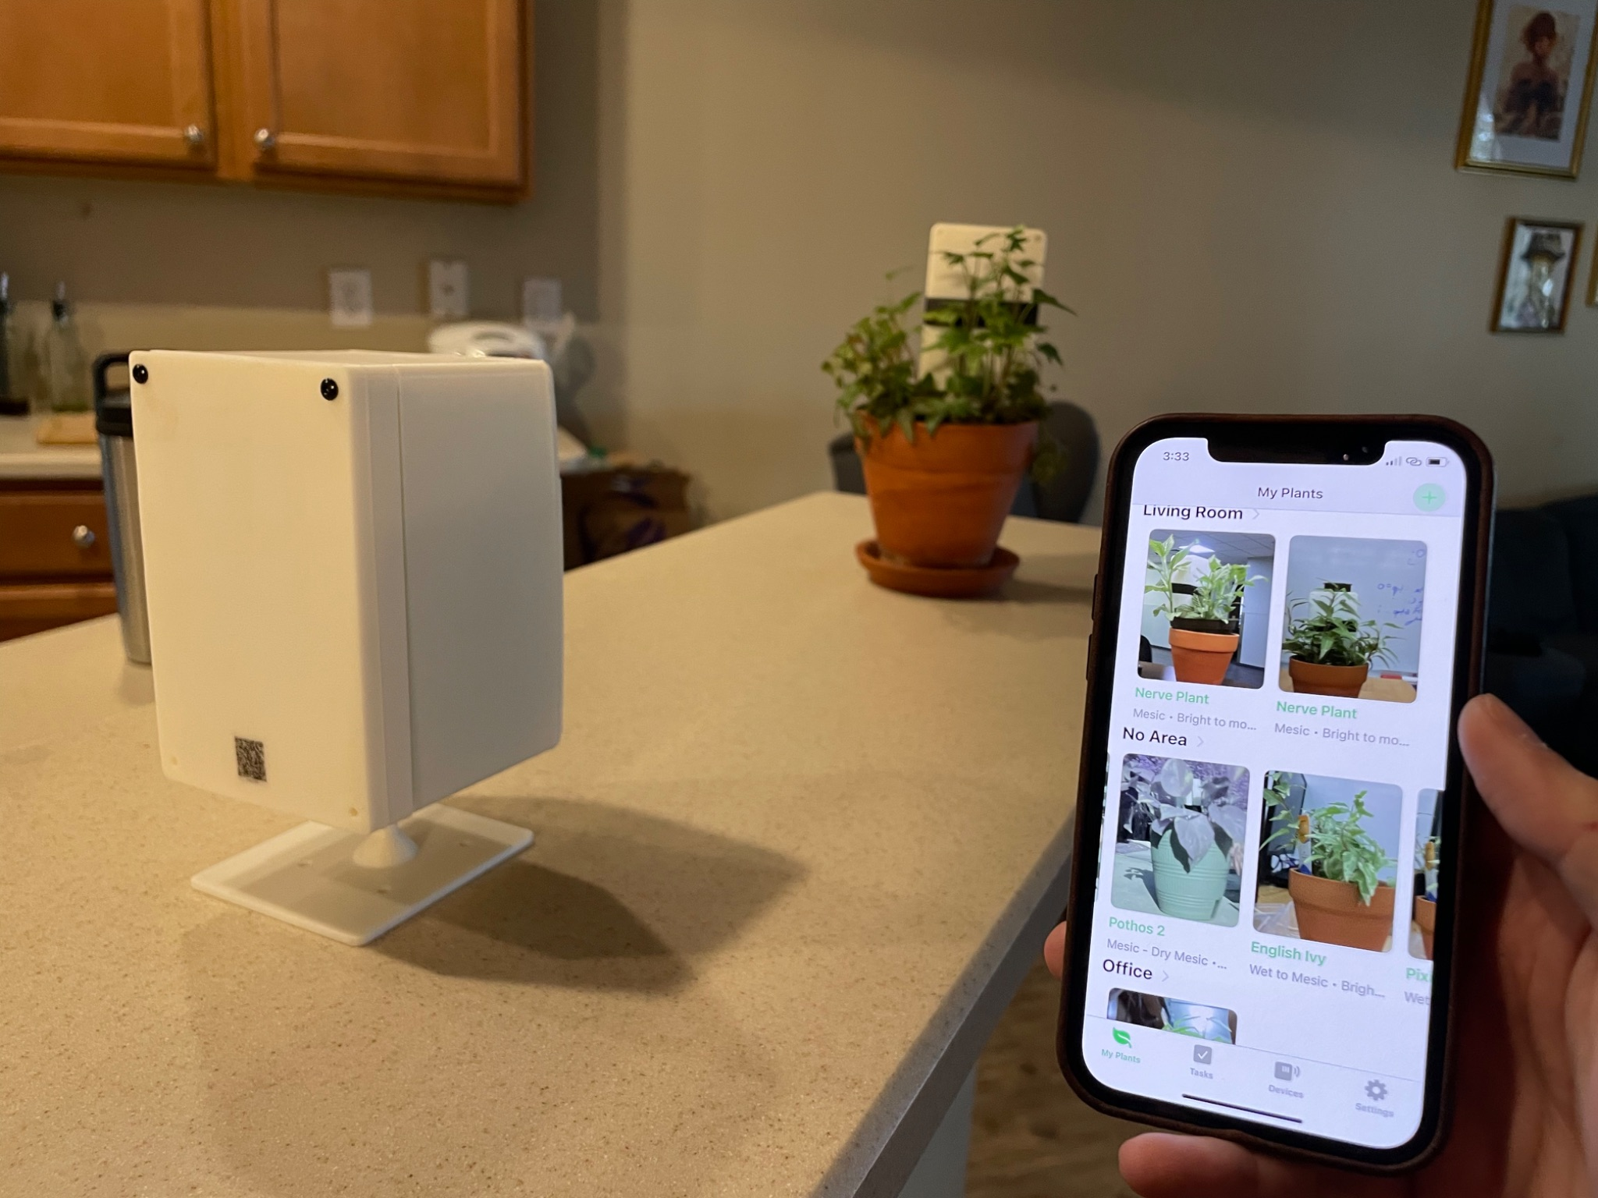
Operation Overview
Shown are the camera and sensor devices along with the main application display.
Sensor and camera devices communicate remotely to combine user metrics.
Data is sent to the application for user interface.

Slide 5
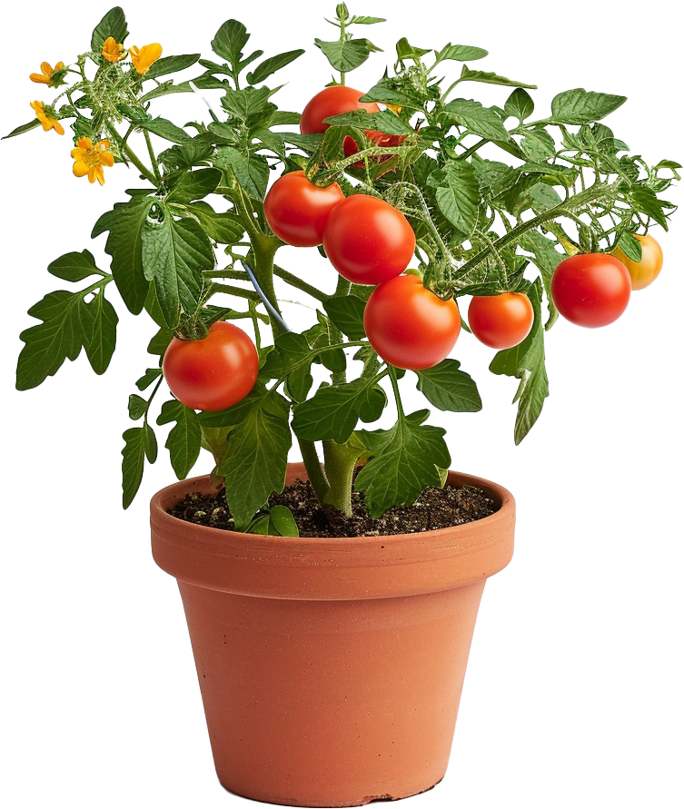
Engineering specifications
Parameter | Specification
Prediction Accuracy | 90%
Device Max Response Delay | 1 minute
Temperature Sensor Accuracy | 90%
Operating Temperature | -20-65 °C
Camera Required NIR Sensitivity | 830-870 nm
Humidity Sensor Input Range | 0-100% RH

Slide 6
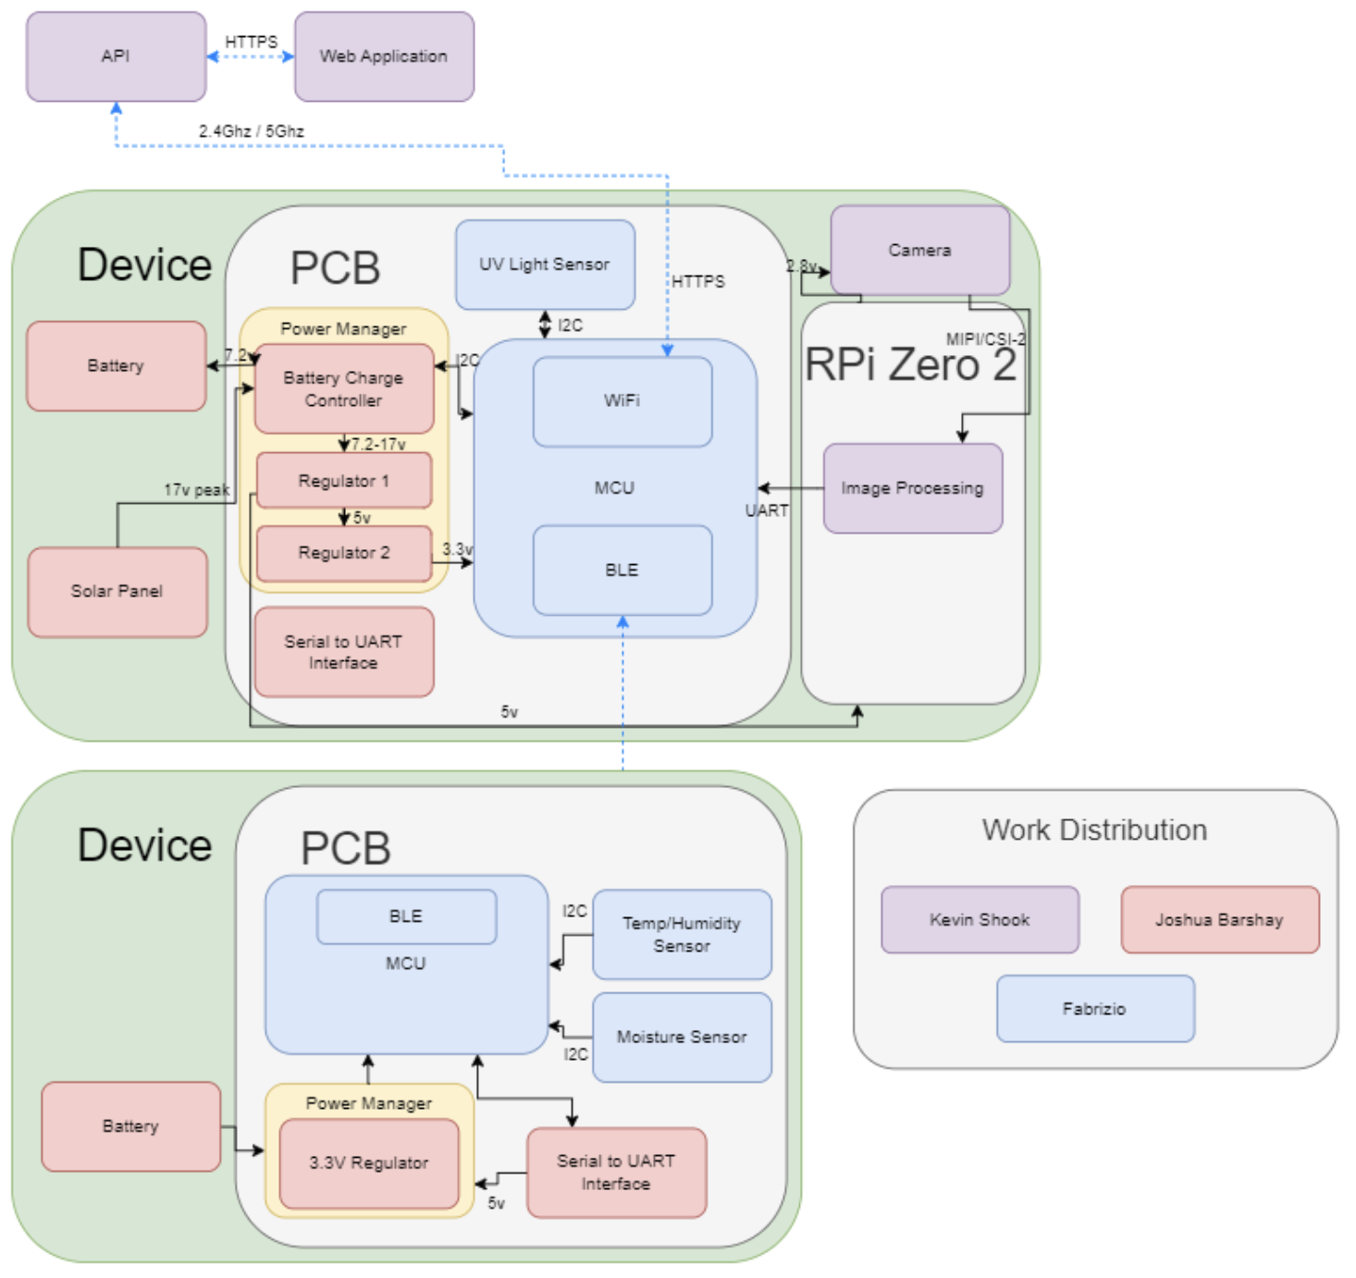
Hardware Flow
Lower Device:
Sensor package which reads the temperature, humidity, and soil moisture sensors and transmits data via bluetooth low energy to Camera Package.
Upper Device:
Camera Package, which reads data from Ultraviolet light sensor, and receives processed photo from Raspberry Pi and sensor data to transmit via WiFi to our application
Raspberry Pi Zero 2:
Communicates with camera to process the images and transmit to the camera package.

Slide 7
Hardware Selection
Microcontroller Unit
 | ESP32-S3 | ESP32-C3 | SAMA7G54 | Raspberry Pi Zero
SRAM: | 512KB | 400KB | 128KB | 512KB
GPIO: | 38 | 22 | 136 | 40
Sleep Amps: | 8µA – 240µA | 5µA – 130µA | N/A | 80mA – 100mA
Communication: | UART, GPIO, ADC, PWM, I2C, I2S, SPI, LCD, DVP, RMT, SDIO, USB, MCPWM, DMA, TWAI | UART, GPIO, ADC, PWM, SPI, I2C | USB, I2C, SPI, EBI | N/A
Price: | $1.85 per chip | $1.00 per chip | $13.00 per chip | $15.00 per chip
ESP32 family selected due to low cost and necessary peripherals.

Slide 8
Hardware Selection
Temp and Humidity Sensor
 | SHT45 | SHT41 | SHT40
Accuracy: | ΔRH = ±1.0 %RH, ΔT = ±0.1 °C | ΔRH = ±1.8 %RH, ΔT = ±0.2 °C | ΔRH = ±1.8 %RH, ΔT = ±0.2 °C
Current Draw: | 0.4µA | 0.4µA | 0.4µA
Communication: | I2C | I2C | I2C
Price: | $3.47 - $7.81 per chip | $1.72 - $3.12 per chip | $1.68 – $3.28 per chip
When comparing all temperature and humidity sensors, selected SHT45 due to highest accuracy metric.

Slide 9
Hardware Selection
Soil Moisture Sensor
Available sensors for consumer applications limited to resistive and capacitive sensors.
All sensors in decision were capacitive as they have increased resistance to corrosion.
Sensor: | PIM520 | Adafruit | Grove
Vin: | 3.3V | 3V – 5V | 3.3V – 5V
Communication: | Pulse Width Frequency | I2C | I2C
Price: | $4 | $7.50 | $6.50

Slide 10
Hardware Selection
Ultraviolet Light Sensor
 | AS7331 | LTR-390UV-01 | VEML6075
Bandwidth Range | 260 nm – 360 nm | 270 nm – 470 nm | 300 nm - 365 nm UVA 300 nm - 330 nm UVB
Average Current | 970µA – 2mA Typical: 1.5mA | 100µA – 110µA | 480µA
Interfaces | I2C | I2C | I2C
Price | $10.86 | $3.11 | $5.95
Photodiode based sensor which provided the most accurate sensing and the broadest range of input wavelengths.
AS7331 only available sensor at a reasonable price.

Slide 11
Hardware selection
Load Power Draw
Load power draw breakdown by highest power consumption components
Component | Voltage (V) | Current (mA)
ESP32 S3 | 3.3 | 355 (Peak)
ESP32 S3 (light sleep) | 3.3 | 0.24
ESP32 C3 | 3.3 | 345 (peak)
ESP32 C3 (light sleep) | 3.3 | 0.24
SHT45 | 3.3 | 0.05
AS7331 | 3.3 | 2
Raspberry Pi 02W | 5 | 220-260
Worst Case 5V | 5 | 500
Worst Case 3.3V | 3.3 | 355

Slide 12
Hardware selection
Solar Panel
The main spec for the solar panel is the peak output power.
The peak voltage was used to size the components for the PCB and the price was used to delineate between similar panels
 | NPA15S-12I | P105 | 5368
Peak Power | 15W | 5W | 1.2W
Peak Voltage | 17V | 6V | 6V
Price | 34.49 | 35.00 | 14.95

Slide 13
Hardware selection
Charge Controller
The charge controller was selected because of its unique combination of technologies
Power path allows for a more efficient system and MPPT allows for easier solar integration
Additionally we need the controller to accommodate a 2 cell battery pack
 | BQ25756E | BQ24210 | BQ25798
Integrated MPPT | No | No | Yes
Number of Battery Cells | 1-7 | 1 | 1-4
Charger Topology | Buck-Boost | Linear | Buck-Boost
Power Topology | Non-Power Path | Non-Power Path | Power Path

Slide 14
Hardware selection
Regulators
The main spec for the regulators were the power efficiency
 | TPS62932 | LM64460-Q1 | TPS566231 | MCP16502 | LMQ644A2-Q1
Output V Range | .08-22 | 3-36 | 0.6-7 | 1.2-3.7 & .6-1.85 | 3-36
Max Output Current | 2 | 6 | 6 | 1-.3 | 6
Estimated Efficiency (Full Load) | 95% | 93% | 95% | 85-96% | 93%

Slide 15
Hardware selection
Battery Technology
For the batteries the technology is far more important that the particular battery part
A high lifespan and energy density is the most important thing for our design
 | Lithium | Lithium-ion | Alkaline | NiMH
Lifespan | N/A | Low-High (Highest max) | N/A | Low-Moderate
Energy Density | High | High | Moderate | low
Price | High | Moderate-High | Low | Moderate

Slide 16
Hardware Design
Two main PCBs (camera package and sensor package)
Three breakouts (two regulators and one sensor)
Communication handled over WiFi and BLE by the ESPs
Power broken supply for the main PCB is a PV panel and rechargeable battery handled by a charge controller

Slide 17
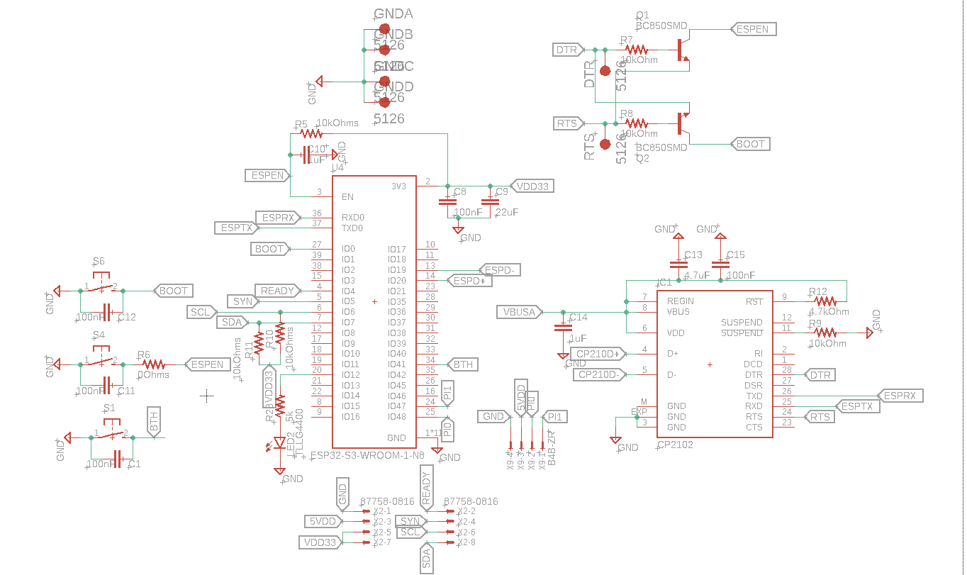
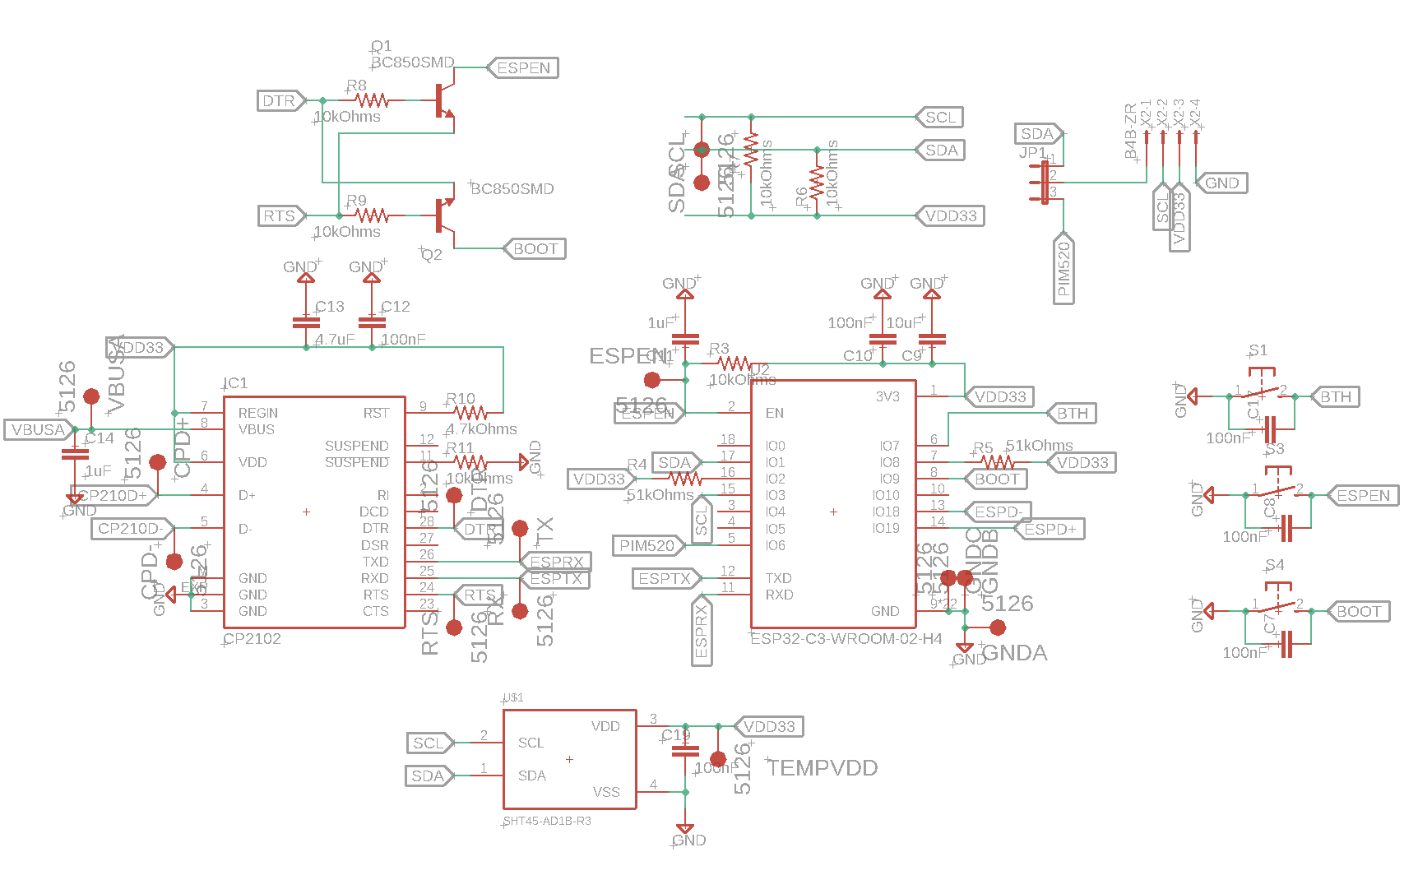
Hardware Schematics
MCU & Sensors
Camera Package
Sensor Package

Slide 18
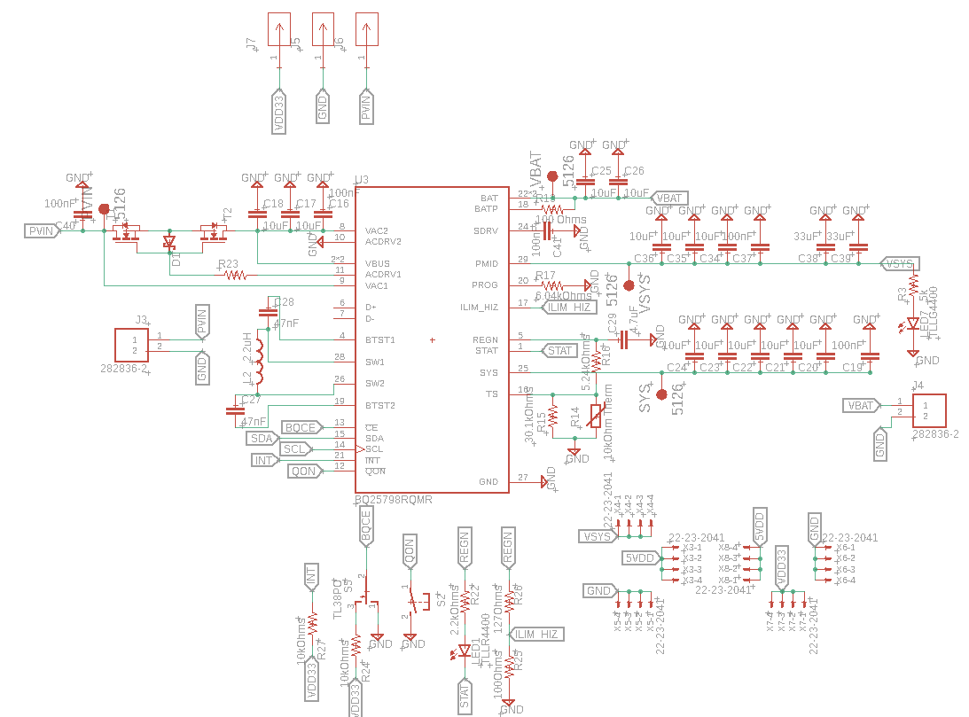
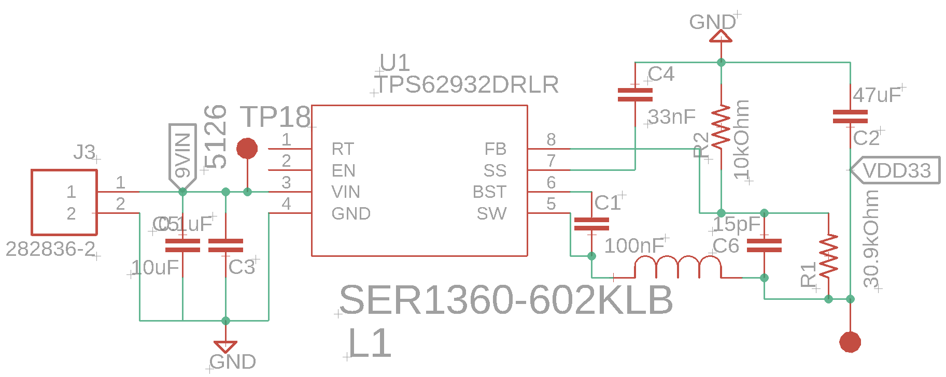
Hardware Schematics
Power
Sensor Package
Camera Package

Slide 19
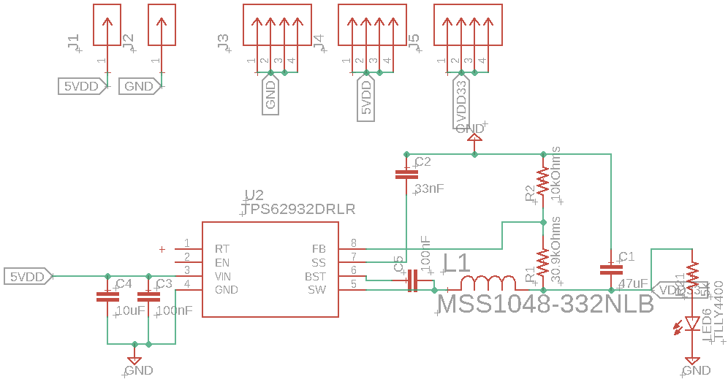
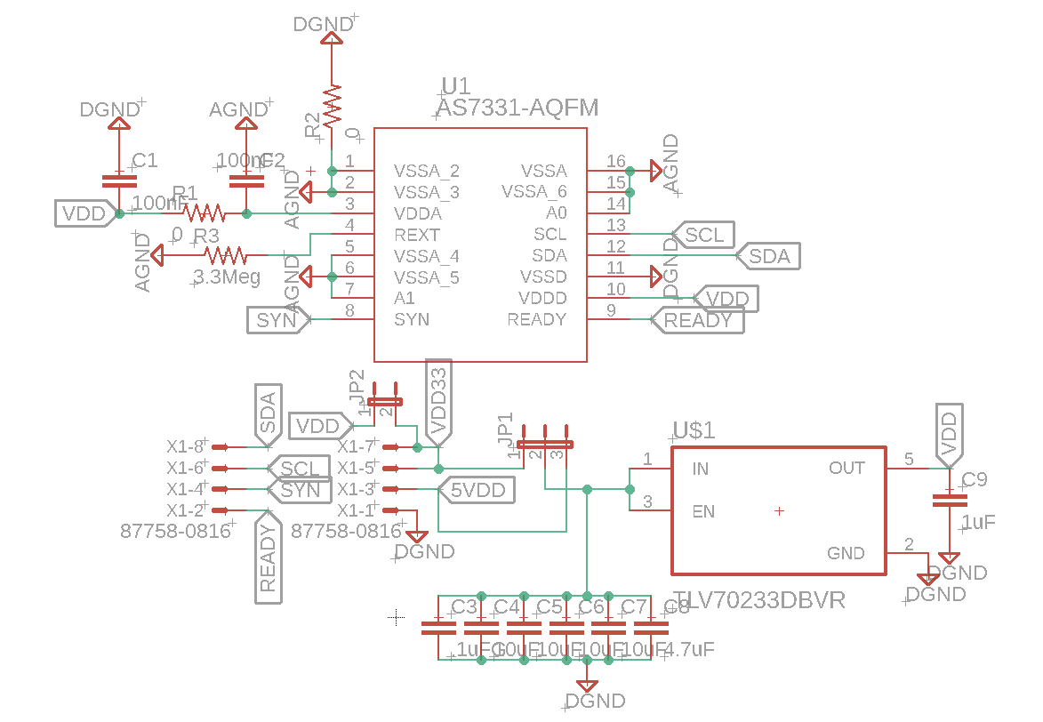
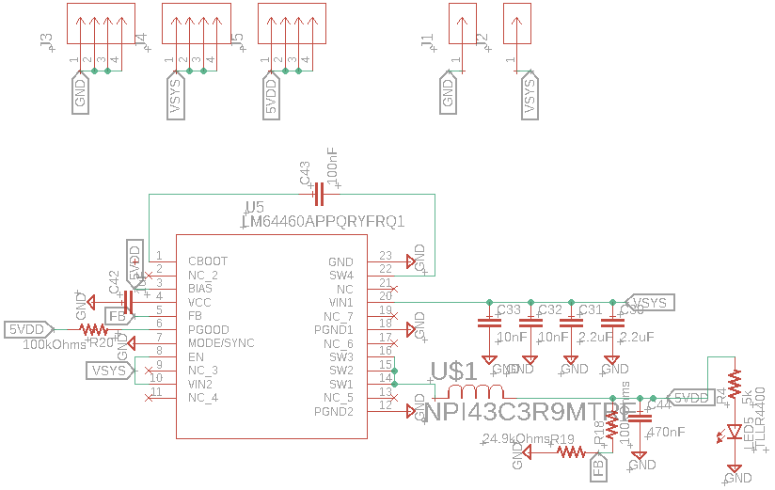
Hardware Schematics
Breakouts
UV Light Sensor Breakout
3.3V Buck Breakout
5V Buck Breakout

Slide 20
PCB Design
The layout for the sensor package is primarily concerned with a low footprint
The layouts were created in autodesk EAGLE
The camera package PCB is 4 layers while the rest are 2 layers
The layouts in this stage have options to enable some level of flexibility in design changes

Slide 21
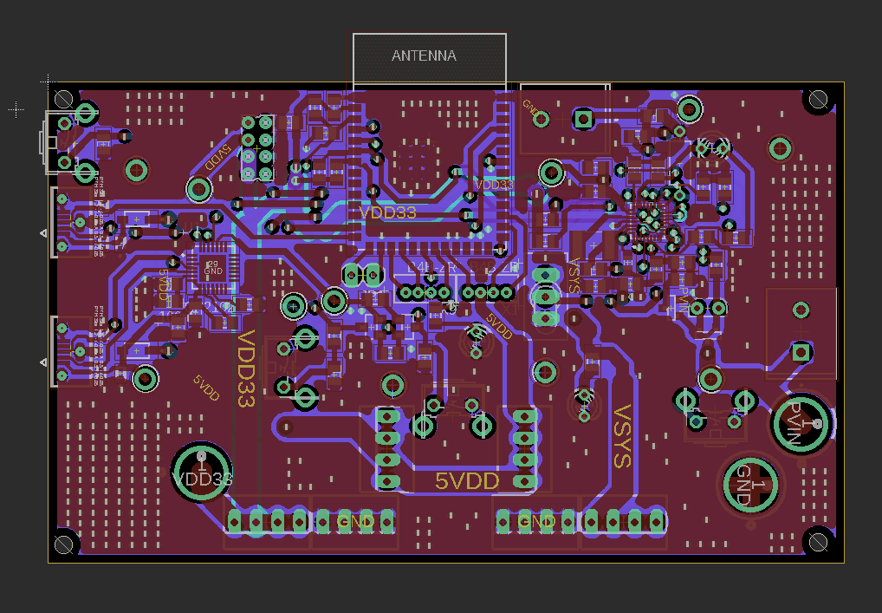
Camera Package PCB Layout
4 layers (top and bottom layers are the primary signal layers with layers 2 & 3 primarily being used for grounding)
The regulator breakout boards connect via the two sets of three four pin headers shown in the bottom center
The UV breakout connects via the 4-pin JST header shown in the center below the ESP
Banana jack connections were provided to allow for testing even if integration of the power subsystem has issues
3850 mils
2150 mils

Slide 22
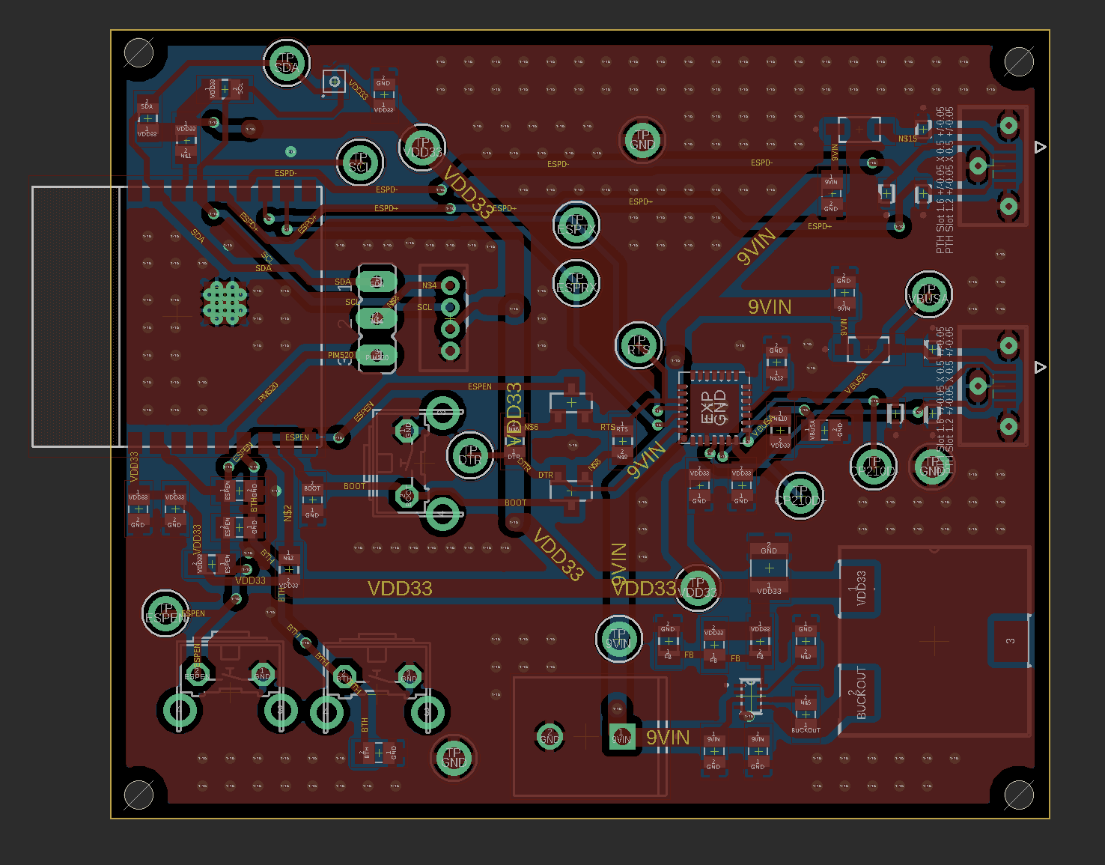
Sensor Package PCB Layout
Unlike the camera package the buck regulator is on board to allow for a smaller profile
The 9V battery power supply connects to this PCB via the screw connector seen in the bottom center of the PCB
2560 mils
2150 mils

Slide 23
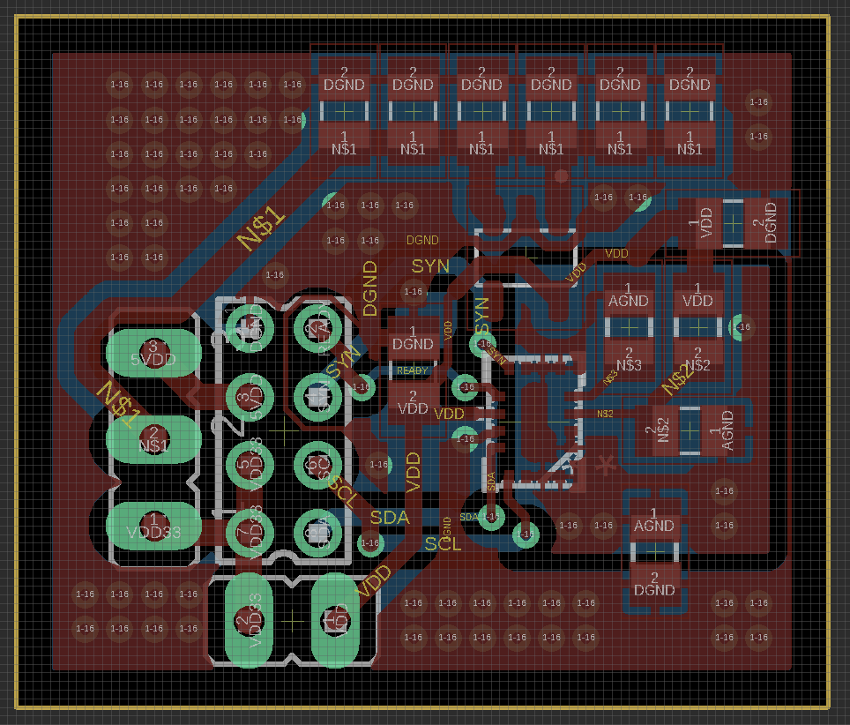
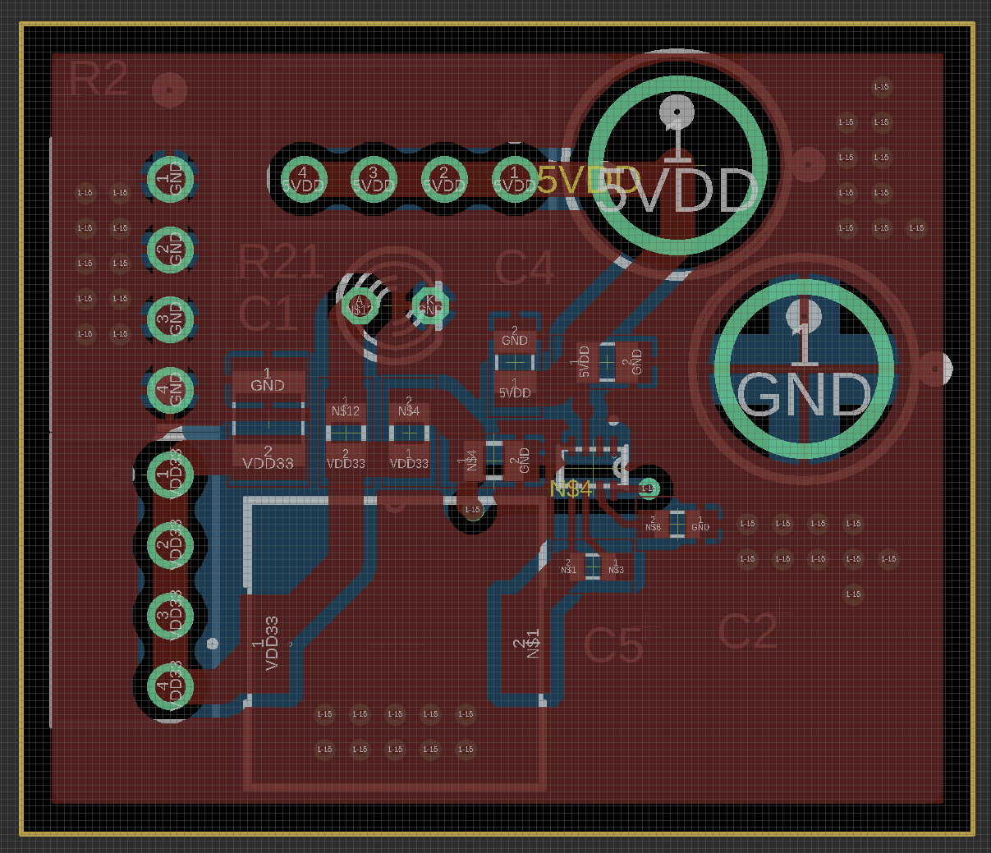
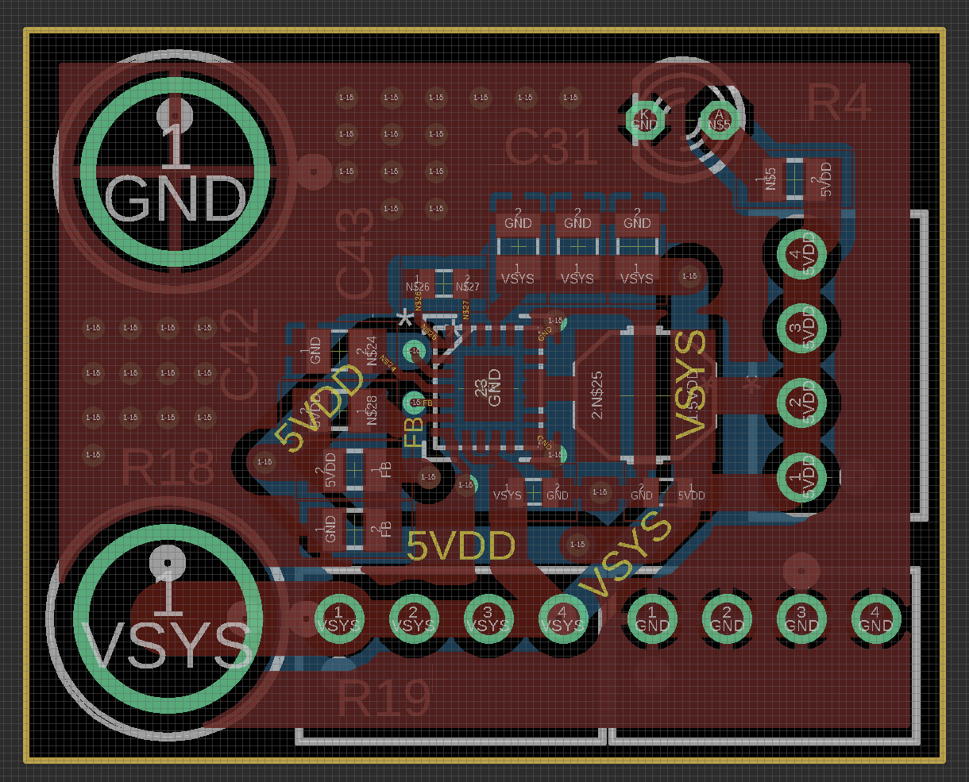
Breakout Board PCB Layouts
UV Light Sensor Breakout
3V Regulator Breakout
5V Regulator Breakout

Slide 24
Software selection
Embedded
Wifi:
Satisfies requirement of long range for interfacing between microcontroller units and smartphone.
Bluetooth Low Energy:
Satisfies requirement of short range interfacing between two microcontroller units.
Satisfies requirement of ultra low power consumption to maximize battery life.
ESP-IDF:
Provides native support for FreeRTOS allowing for more robust implementation of a task driven application
Allows for more control and flexibility over memory management, hardware peripherals, and power management.
Wired Communication:
I2C selected as a hard constraint, all sensors used by the system communicate via I2C.
SPI selected over UART due to transmission time constraint of image.

Slide 25
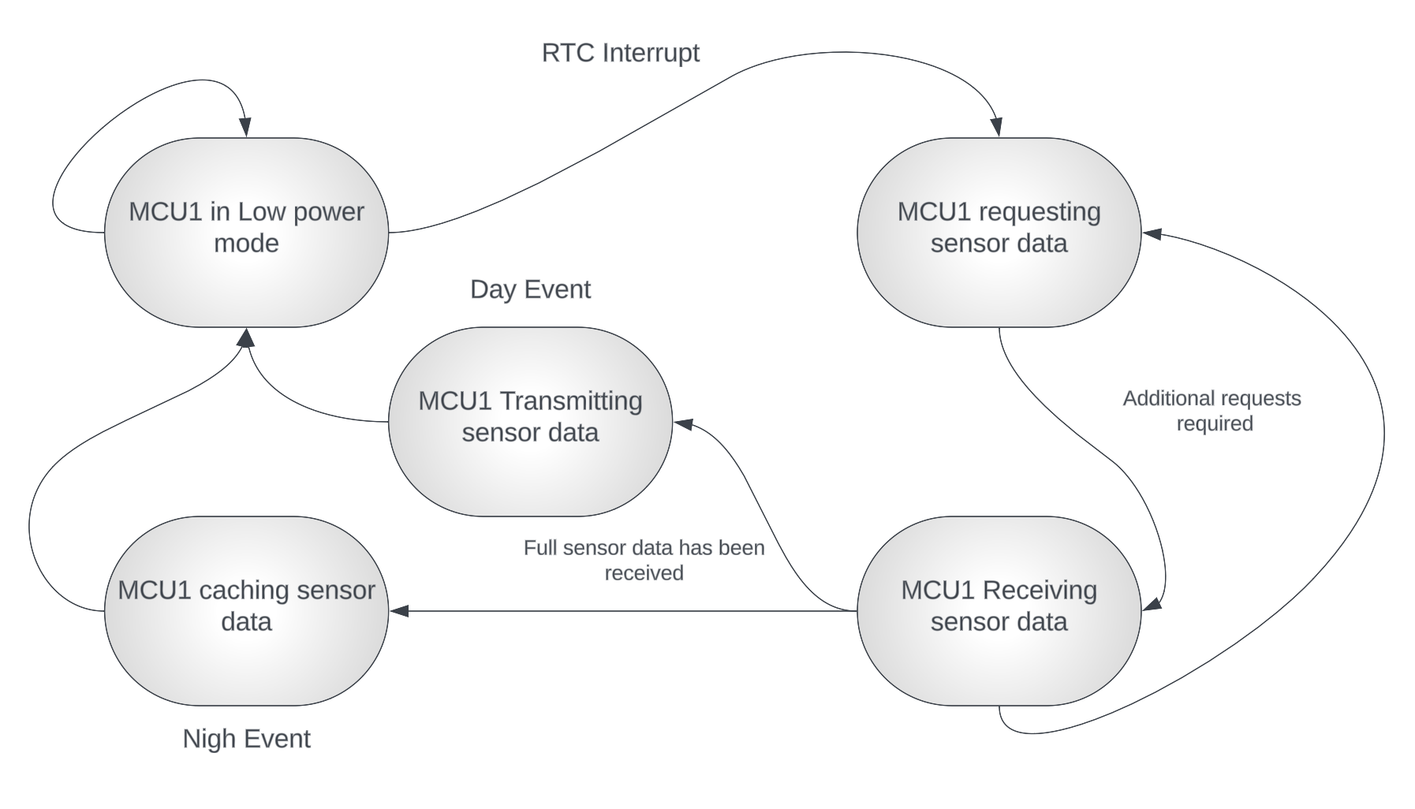
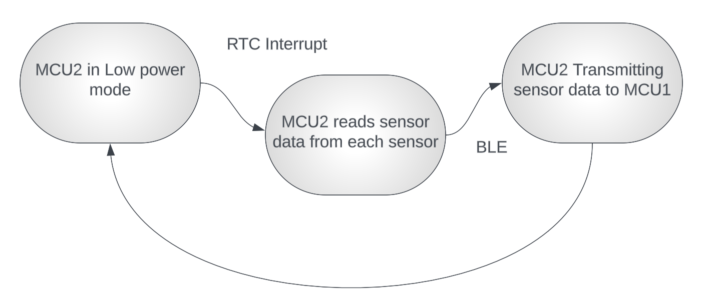
Software design
Embedded
Camera Package
Simplified software flow diagram for the main MCU on the camera package device and secondary sensor package MCU.
Sensor Package

Slide 26
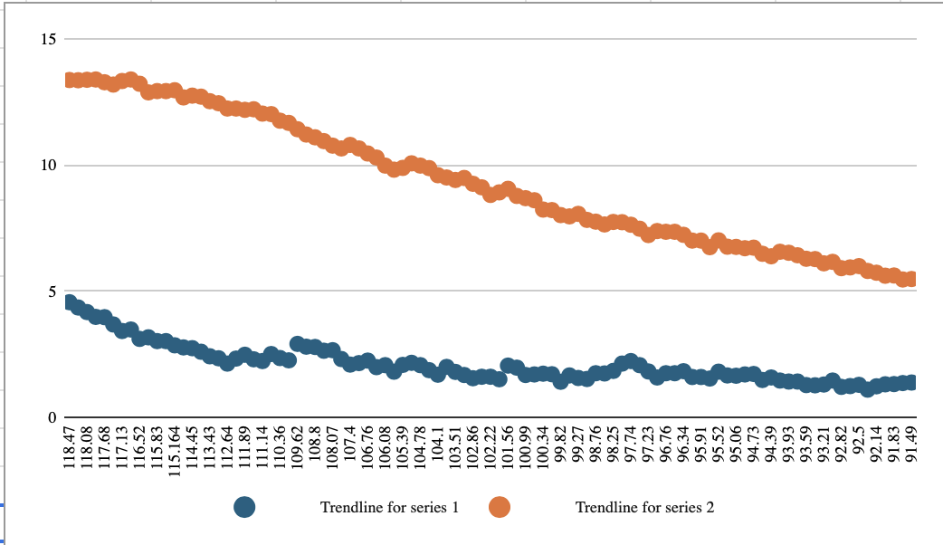
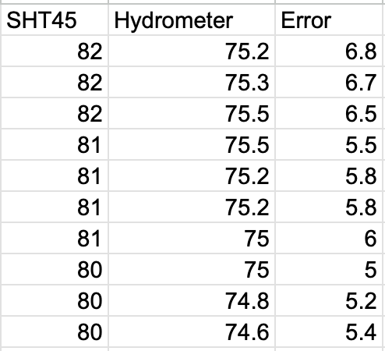
Temperature Testing
Embedded
Design decisions resulted in temperature readings being skewed by nearby component temperature.
Actual sensor accuracy remained high, but ambient readings skewed.
Tested to find a desirable offset to accommodate for this, and remain within our accuracy specification of 90%.

Slide 27
Software Selection
Web Services
Technology | Performance | Mobile Integration | API Support | Scalability | Community & Ecosystem | Security Features | Deployment Flexibility | Skill Level
React.js (Javascript) | High, with Fast Rendering | Via React Native for iOS/Android | Excellent with Axios or Fetch | Horizontally scalable, widely adopted | Large, strong community support | Moderate, security relies on implementation | Highly flexible (cloud, on-premise) | Intermediate
Express.js (Javascript) | Moderate to High (depends on setup) | Via RESTful APIs | Excellent with Axios, Fetch, or custom middleware | High scalability, especially for microservices | Vast, well-established ecosystem | Good, with middleware like Helmet.js | Flexible, can be deployed anywhere | Intermediate
FastAPI (Python) | Very High (async support, fast I/O) | Via RESTful APIs | Excellent, built-in API support | High scalability with async features | Growing community, but smaller than Express | Strong, includes OAuth2, CORS, JWT support | Flexible (containers, cloud, on-premise) | Beginner
iOS (Swift) | High, optimized for iOS hardware | Native integration with iOS apps | Excellent with URLSession, Alamofire | Highly scalable (limited to iOS ecosystem) | Strong Apple developer ecosystem | Very strong, Apple’s built-in security | Limited to iOS deployment | Intermediate
Notes:
The web service can be summed up in three major components, the API gateway which handles all requests and authentication, the web client that interfaces with the user, and the machine learning services that handle much of the intelligent services for our system.
For the API with choose Express as it was easy to integrate with a proven history.
The web client we chose React for its modularity and excellent community support.
For the mobile app we decided to go with native iOS with swift as it was very simple and fast to iterate.
For the machine learning services we have two main libraries OpenCV and Tensorflow.
These were chosen because of existing familiarity and high level of support for many different applications.

Slide 28
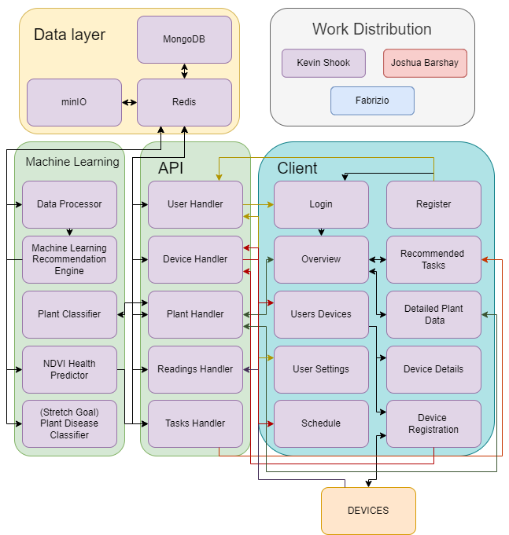
Software Design
Web Services
Separation of concerns
Logic Layer
Data Layer
Client
Scalable Service Model
Allows Replication
Allows Load Balancing
Modular for upgradability
Easy to add services
Easy to swap out for different 3rd party services
Notes:
For the design of the web services we took a modular approach separating our major concerns into purpose focused modules.
Each piece running in an individually scalable, replicable, fault tolerant, container node.
The API is a gateway that handles all incoming requests, authentication, and delivery of data.
It communicates to the other services in the background completely obscured to the end user.
This design allows us to deploy to all the major cloud providers easily and scale the service depending on load.

Slide 29
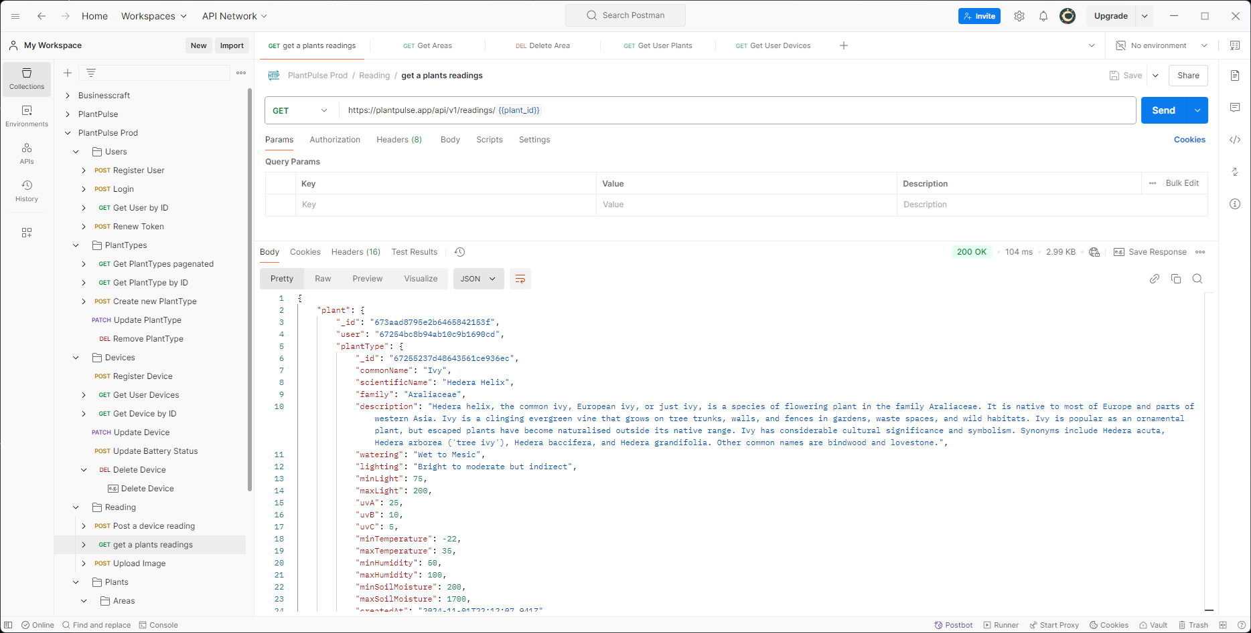
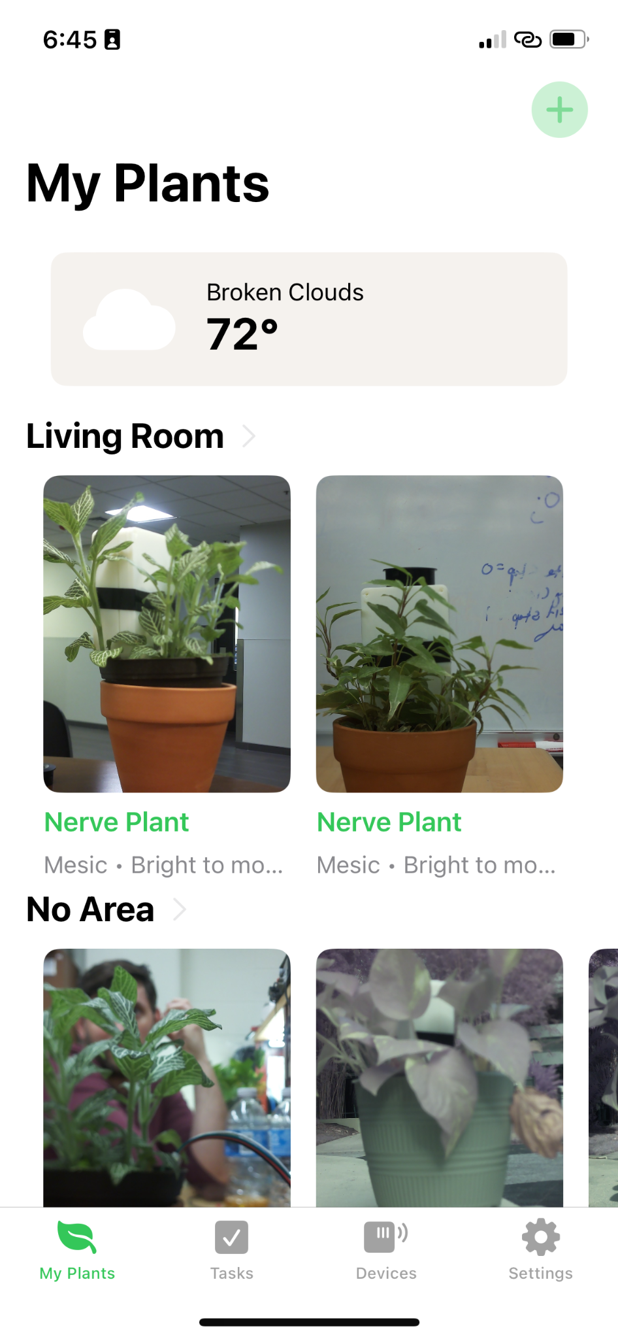
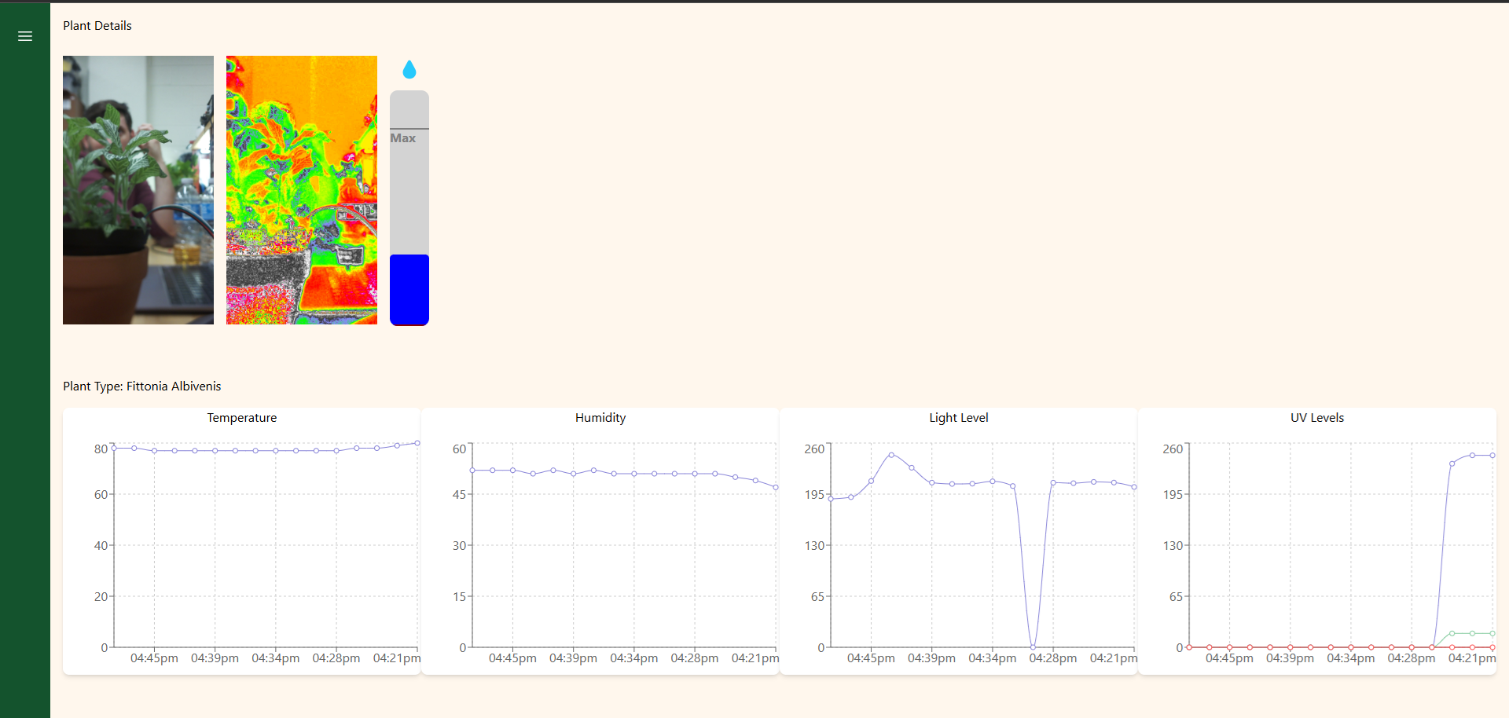
Prototyping and Testing
Web Services
API gateway
Built initial API framework, supporting user authentication, user registration, device registration, and getting device readings. Tested with Postman.
Machine Learning
Created a CNN model and trained on 3 plants. Tested with postman sending an image and receiving a prediction with confidence level.
Plant Data
Researched and pulled plant health metrics from various sources to create our supported plant health dataset.
Week 2
Week 4
Week 1
Week 3
Week 5
Web Client
Basic web client created and attached to the API. Tested user registration, user login, getting user devices, and displaying time sequenced plant data in graphs.
iOS app
Achieved feature parity with web client and added device registration and provisioning process. Tested with an iPhone 12.
Notes:
We started strong, completing the initial framing for the API gateway in the first week using Postman for testing.
Including handling registration and authentication across the system.
Keeping the trend, the web client wireframe prototype went up in similar time during week 2.
Week 3 saw the image classifier take shape initially supporting 3 plants and integrated with the API.
The iOS app has taken a bit longer do to complications figuring out the ESP32 provisioning library, but was able to successfully create the device registration process and test using my iPhone and an ESP32-S3.
Finally we integrated an open source plant knowledge project called Treffle API.
This was the quickest way to support a wide variety of plants and the Trefle API was the only one we found that had numerical values associated to the metrics we were planning to monitor.

Slide 30
Administrative content
Part No. | Quantity | Price per Unit | Total
BQ25798RQMR | 5 | $7.33 | $36.65
LM64460APPQRYFRQ1 | 5 | $6.74 | $33.70
ESP32-S3-WROOM-2-N32R8V | 5 | $6.68 | $33.4
ESP32-C3-WROOM-02-N4 | 5 | $1.9 | $9.5
AS7331 | 5 | $10.86 | $54.30
SHT45-AD1B-R3 | 5 | $5.75 | $28.74
TPS62932DRLR | 10 | $1.11 | $11.07
PCBs and Stencils | 5 | N/A | $53.30
Total | 1 | ~$52.14 | ~$260.68

Slide 31
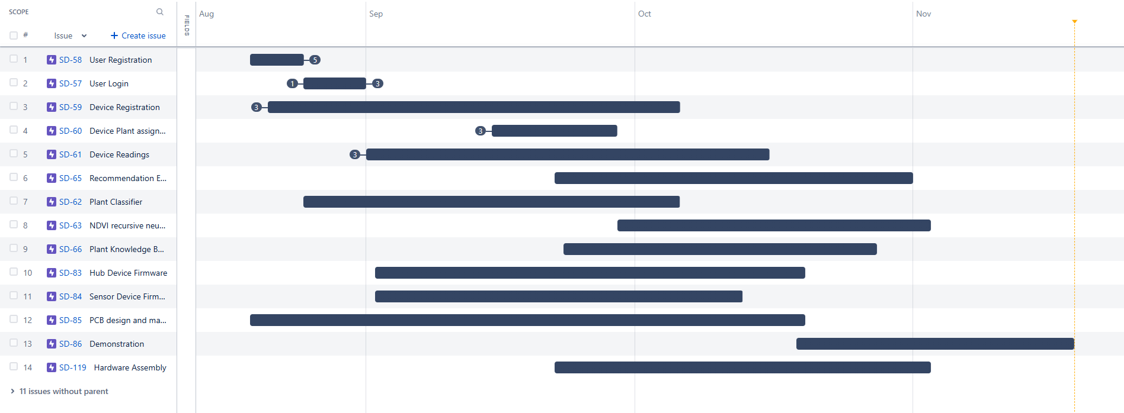
Roadmap to Completion
Notes:
We are a little over a month into development and have made excellent progress having a majority of features working and pending integration testing.
We have the remaining planned tasks scheduled as you see here. We are looking to have a fully functional prototype by mid October barring any major issues.
The remaining time will be spent making the system as robust as we can for final demo.
Again, we are group 20, this was PlantPulse, thank you for your time.

