Slide 1
Optics System
Optics Goals:
Basic:
  Attach an enhancing optical system to a camera to increase overall performance at distance.
  Use a gimbal-mounted camera system to take long-distance photos of potential threats.
Advanced:
  Improve the lens attachment for better overall performance of the optical system.
Stretch:
  Obtain processable images in addition to the visible light camera for operation in moonlight conditions.
  Research and integrate adaptive optics into the system.

Slide 2
Optics System
Optics Objectives:
Basic:
  Select a CMOS sensor optimal for the operating distance and ambient conditions.
  Design and implement a lens system for fixed magnification.
  Integrate a gimbal into the optical system to provide maneuverability.
Advanced:
  Test different lens systems for better overall performance of the optical system.
Stretch:
  Integrate an additional infrared camera capable of operating with low light for target identification.
  Integrate adaptive optics technologies to be able to see targets clearly at the horizon.

Slide 3

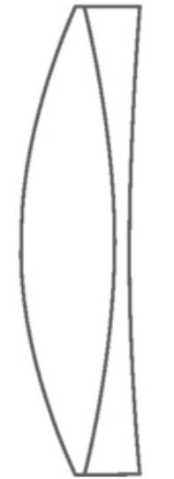
Optical System Schematic
CMOS Sensor
Lens Tubes
Achromatic Doublet
300 mm
Gimbal
303 mm

Slide 4
Optics System Component Specifications
Component | Parameter | Specification | Unit
Allied Vision Alvium 1800 U-050c, 1/3.6" 0.5MP C-Mount, CMOS Sensor | Sensor Size Pixel Size Sensor Type Shutter Type Resolution | 33 x 29 x 29 4.8 CMOS Global 0.50 | mm um — — Megapixels
Thorlabs AC254-300-A Achromatic Doublet | EFL Diameter Coating Material | 300 25.4 None or AR N-BK7 | mm mm — —
SCORP-C Camera Stabilizer 3-Axis Mirrorless Gimbal | Pan Range Tilt Range Roll Range | 360 +120 ~ -201 +20~-20 | Degrees Degrees Degrees

Slide 5
Optical System Specifications
Engineering Requirement | Requirement Specification | Unit
System Magnification | 5 x < | Magnification
Gimbal Rotation Range | < 180 | degrees
Gimbal Tilt Range | <150 | degrees
Imaging Distance | 5 - 7.5 | Meters
Resolution | 0.5 | MP
Field of View (H/V) | 0.74/0.50 | degrees

Slide 6
Optics System Cost Breakdown
Quantity | Component | Cost
1 x | Allied Vision Alvium 1800 U-050c, 1/3.6" 0.5MP C-Mount, CMOS Sensor | $312.58
1 x | AVT Type-A to Micro-B, USB 3.0 Locking Cable, 3m | $46.44
1 x | Thorlabs AC254-300-A Achromatic Doublet | $89.10
1 x | AV Alvium M6 and ¼-20 Mounting Plate | $20.52
1 x | FeiyuTech SCORP-C Gimbal | $211.94
 | Total Cost: | $680.58

Slide 7
Optics System Technology Comparison - Camera Sensor
Feature | CCD | CMOS
Image Quality | Good image quality | Superior image quality in multiple scenarios
Power Consumption | Higher power consumption | Lower power
Cost | Overall less expensive | Market sensors are cheaper
Lighting | Back-thinned for low-lighting | Daylight operation is optimal
Motion | A frame-transfer model can help balance out ship's constant movement | Global shutter is best for constant ship motion
Readout Speed | Slower compared to most CMOS models | Faster readout due to parallel functionality

Slide 8
Optics System Technology Comparison - Lens
Feature | Galilean Telescope | Keplerian Telescope | Achromatic Doublet
Field of View | Narrow | Wider | Narrow
Relative Length | Compact | Longer | Longer
Magnification | Lower Magnification | Higher Magnification | Lower Magnification
Image Orientation | Upright Image | Inverted Image | Upright Image
Aberrations | Chromatic (more at higher power); spherical | Chromatic; spherical | spherical
Lens Count | 2 | 3 | 1

Slide 9
Optics System Technology Comparison - Gimbal
Feature | Altitude Over Azimuth (Alt-Az) | Altitude Over Altitude (Alt-Alt) | Equatorial
Axis of Rotation | Vertical and horizontal | Vertical | Vertical (with alignment at true North)
Zenith Coverage | Poor | Pretty good | Moderate
Applications | Telescopes, radar, etc. | Long-range targeting | Astrophotography, satellites, etc.
Tracking Efficiency | Both axes must move for tracking | Complex, but zenith access is better | Simplest tracking

Slide 10
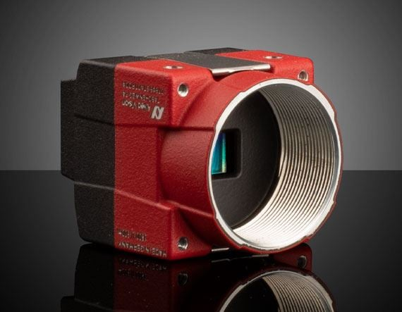
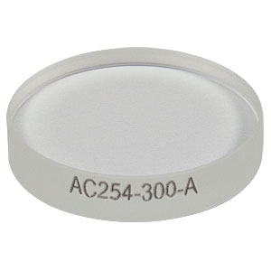
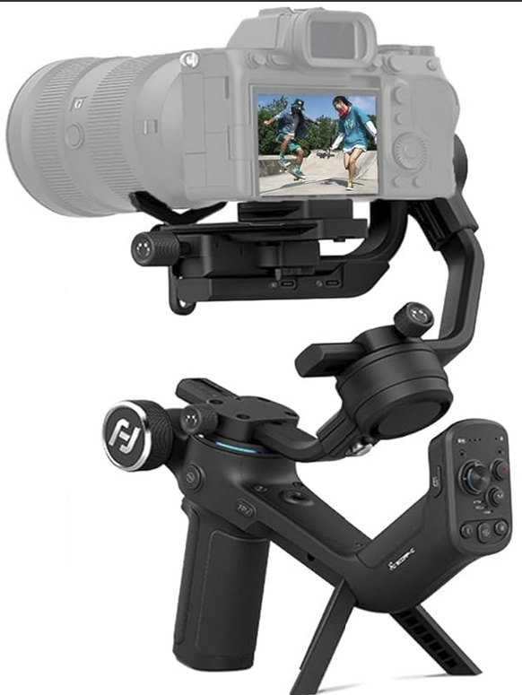
Design Decision Justification
Camera Sensor - CMOS sensor:
Better image quality
More compact while keeping higher resolution
Global shutter superior for constant ship movement
Lens System - Achromatic Doublet:
Narrowed spot size
Reduced chromatic aberration
Higher magnification potential without distortion
Real exit pupil location
Gimbal - Three-Axis:
Vertical tilt and horizontal rotation needed

Slide 11





Design Decision Justification - Calculations
Equations:

Slide 12






Design Decision Justification - Calculations
Calculations:

Slide 13
Optics System Parts Selection - CMOS Sensor
Feature | IDS U3-3864LE-C-HQ-AF, USB 3.0, 1/2.8" Color Camera | Allied Vision Alvium 1800 U-050c, 1/3.6" 0.5MP C-Mount, CMOS Sensor | Basler ace2 a2A2590-60ucPRO Color USB3 Pro Camera
Sensor Format | 1 / 2.8” | 1 / 3.6” | 1 / 2.8”
Resolution | 2.10 MP | 0.50 MP | 5.00 MP
Power Usage | 1 - 1.5 W | 1.5 W | 3.4 W
Frame Rate | 135 fps | 116 fps | 60.00 fps
Shutter | Rolling | Global | Rolling
Price | $462.24 | $312.12 | $477.36

Slide 14
Optics System Parts Selection - Gimbal
Feature | Adafruit Mini Pan-Tilt Kit | SCORP-C Camera Stabilizer 3-Axis Mirrorless Gimbal | DJI RS 3 Mini, 3-Axis Gimbal Stabilizer
Connectivity | Raspberry Pi | Switch Button | Bluetooth
Mount Dimensions | 37mm x 33mm x 3mm | Quick Release Slider Plate | Quick Release Action Plate
Rotation Range | 180° | 360° | 360°
Tilt Range | 150° | +120° ~ -201° | 80°
Cost | $18.95 | $211.94 | $237

Slide 15
Optics System Parts Selection - Lens
Feature | Thorlabs AC254-300-A - Achromatic Doublet | Thorlabs AC254-400-A & Newport -75 mm Biconcave | Newport -75 mm Biconcave & 250 mm Biconvex
Diameter | 25.4 mm | Both 25.4 mm | Both 25.4 mm
Simulated Spot Size | 0.183 um | 0.055 um | 11.267 um
Simulated Image | Clear | Blurry | Very blurry
System Length | 303 mm | 405 mm | 253.5 mm
Cost | $95.34 | $157.34 | $130.50

Slide 16
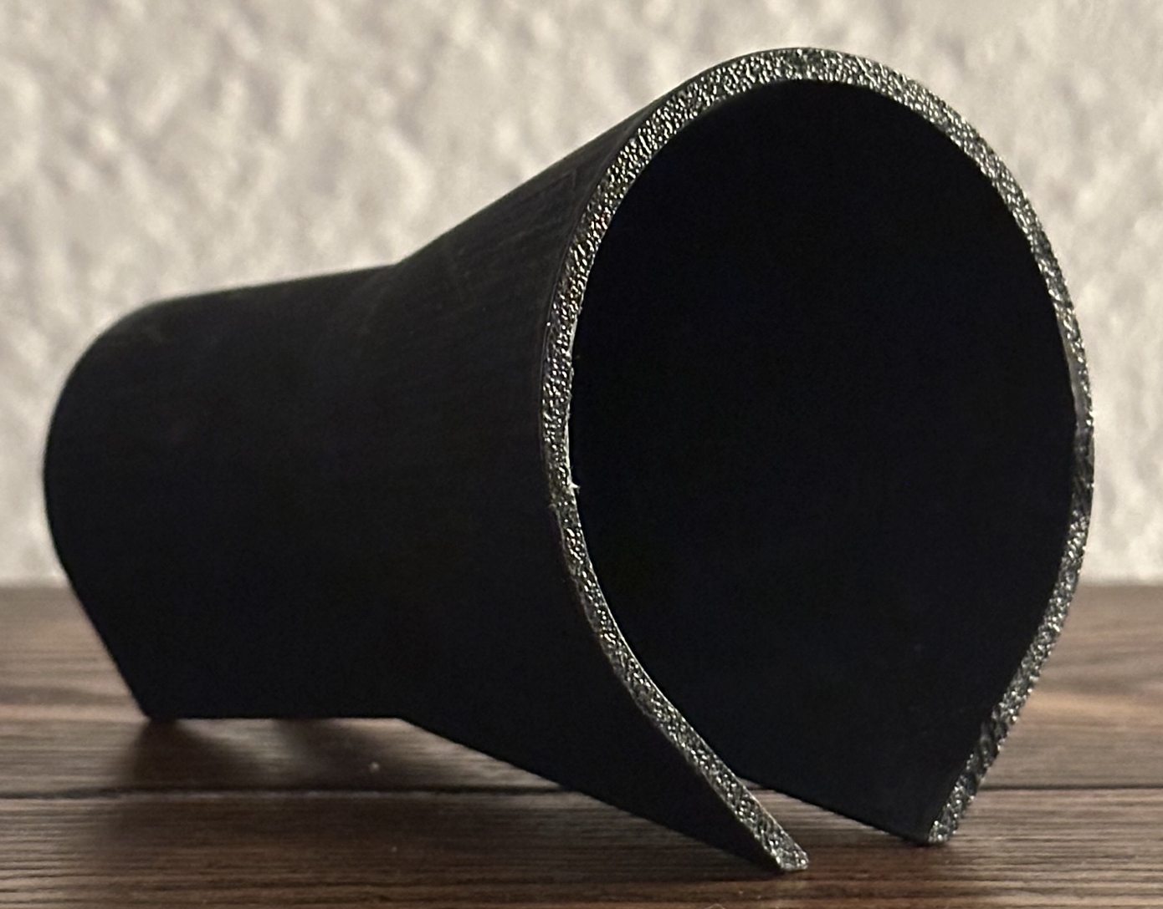
Optics Challenges and Successes
Challenges:
Original Galilean design proved to be ineffective
  Blurry image
Lens tubes weren’t opaque enough
Trying to get precise measurements by hand
Back-ordered parts have led to minimal testing
Successes:
3D printed lens tube were structurally compatible
Relatively compact system design
Simulation issues were resolved to produce positive results

