Slide 1

Maritime Domain Awareness System: Optical Component
Gianna Montevago, PSE
Group 4

Slide 2
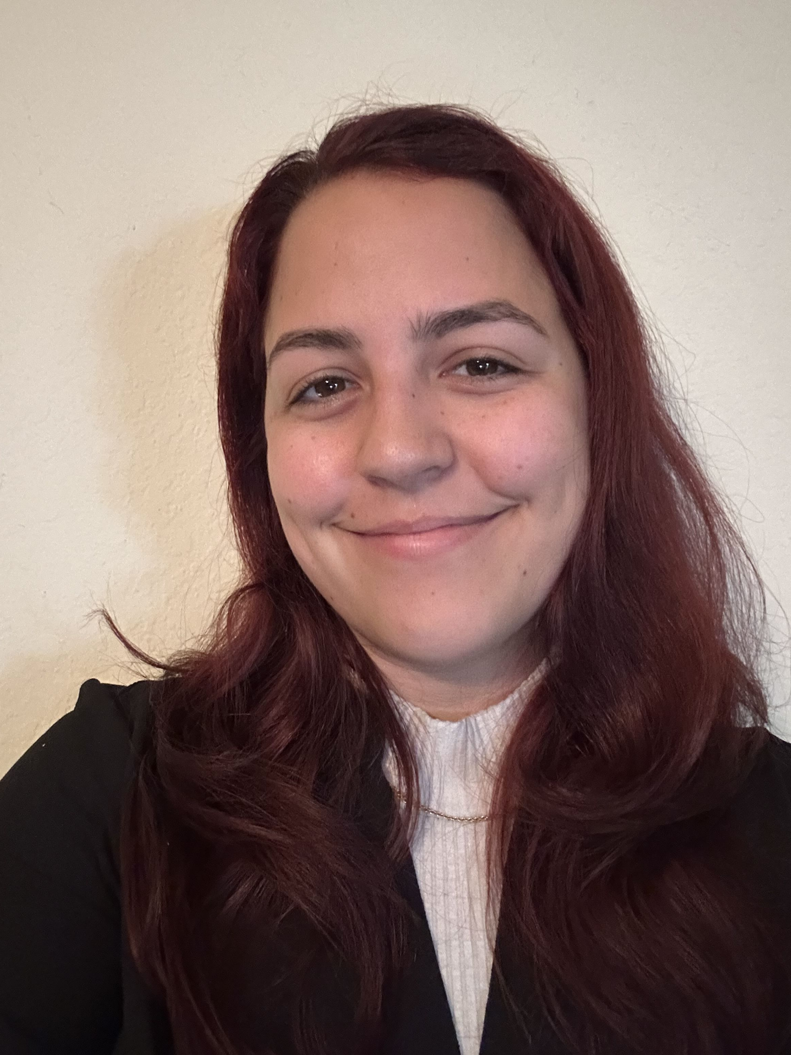
MEET THE ENGINEER
Gianna Montevago
Optical Engineering

Slide 3
OVERVIEW
Camera sensor with a lens system attached
The lens system provides fixed magnification for better performance at a distance
Using an achromatic doublet lens to decrease spot size
Gimbal for maneuverability

Slide 4
OVERVIEW
Optics Goals:
  Basic:
    Attach an enhancing optical system to a camera to increase overall performance at distance.
    Use a gimbal-mounted camera system to take long-distance photos of potential threats.
  Advanced:
    Improve the lens attachment for better overall performance of the optical system.
  Stretch:
    Obtain processable images in addition to the visible light camera for operation in moonlight conditions.
    Research and integrate adaptive optics into the system.

Slide 5
OVERVIEW
Optics Objectives:
  Basic:
    Select a CMOS sensor optimal for the operating distance and ambient conditions.
    Design and implement a lens system for fixed magnification.
    Integrate a gimbal into the optical system to provide maneuverability.
  Advanced:
    Test different lens systems for better overall performance of the optical system.
  Stretch:
    Integrate an additional infrared camera capable of operating with low light for target identification.
    Integrate adaptive optics technologies to be able to see targets clearly at the horizon.

Slide 6
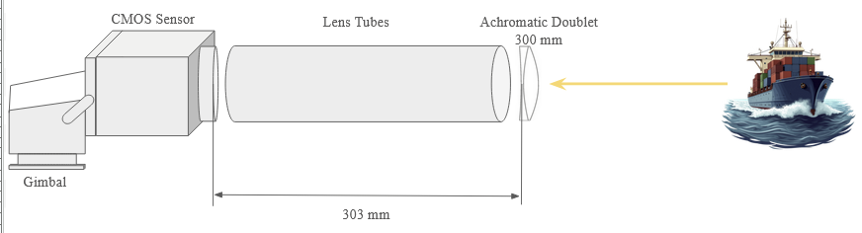
OPTICAL SYSTEM SCHEMATIC

Slide 7
COMPONENT OVERVIEW
Component | Parameter | Specification | Unit
Allied Vision Alvium 1800 U-050c, 1/3.6" 0.5MP C-Mount, CMOS Sensor | Sensor Size Pixel Size Sensor Type Shutter Type Resolution | 33 x 29 x 29 4.8 CMOS Global 0.50 | mm um — — Megapixels
Thorlabs AC254-300-A Achromatic Doublet | EFL Diameter Coating Material | 300 25.4 None or AR N-BK7 | mm mm — —
SCORP-C Camera Stabilizer 3-Axis Mirrorless Gimbal | Pan Range Tilt Range Roll Range | 360 +120 ~ -201 +20~-20 | Degrees Degrees Degrees

Slide 8
SPECIFICATION OVERVIEW
Engineering Requirement | Requirement Specification | Unit
System Magnification | 3 < x < 5 | Magnification
Imaging Distance | 5 - 7.5 | Meters
Field of View (H/V) | 0.74/0.50 | degrees
Gimbal Rotation Range | < 180 | degrees
Gimbal Tilt Range | < 150 | degrees
Resolution | 0.5 | MP

Slide 9
OPTICS SYSTEM COST BREAKDOWN
Quantity | Component | Cost
1 x | Allied Vision Alvium 1800 U-050c, 1/3.6" 0.5MP C-Mount, CMOS Sensor | $312.58
1 x | AVT Type-A to Micro-B, USB 3.0 Locking Cable, 3m | $46.44
1 x | Thorlabs AC254-300-A Achromatic Doublet | $89.10
1 x | FeiyuTech SCORP-C Gimbal | $211.94
1 x | AV Alvium M6 and ¼-20 Mounting Plate | $20.52
 | Total Cost: | $680.58

Slide 10
Optics System Technology Comparison - Camera Sensor
Feature | CCD | CMOS
Image Quality | Good image quality | Superior image quality in multiple scenarios
Power Consumption | Higher power consumption | Lower power
Cost | Overall less expensive | Market sensors are cheaper
Lighting | Back-thinned for low-lighting | Daylight operation is optimal
Motion | A frame-transfer model can help balance out ship's constant movement | Global shutter is best for constant ship motion
Readout Speed | Slower compared to most CMOS models | Faster readout due to parallel functionality

Slide 11
Optics System Technology Comparison - Gimbal
Feature | Altitude Over Azimuth (Alt-Az) | Altitude Over Altitude (Alt-Alt) | Equatorial
Axis of Rotation | Vertical and horizontal | Vertical | Vertical (with alignment at true North)
Zenith Coverage | Poor | Pretty good | Moderate
Applications | Telescopes, radar, etc. | Long-range targeting | Astrophotography, satellites, etc.
Tracking Efficiency | Both axes must move for tracking | Complex, but zenith access is better | Simplest tracking

Slide 12
Optics System Technology Comparison - Lens
Feature | Galilean Telescope | Keplerian Telescope | Achromatic Doublet
Field of View | Narrow | Wider | Narrow
Relative Length | Compact | Longer | Longer
Magnification | Lower Magnification | Higher Magnification | Lower Magnification
Image Orientation | Upright Image | Inverted Image | Upright Image
Aberrations | Chromatic (more at higher power); spherical | Chromatic; spherical | spherical
Lens Count | 2 | 3 | 1

Slide 13
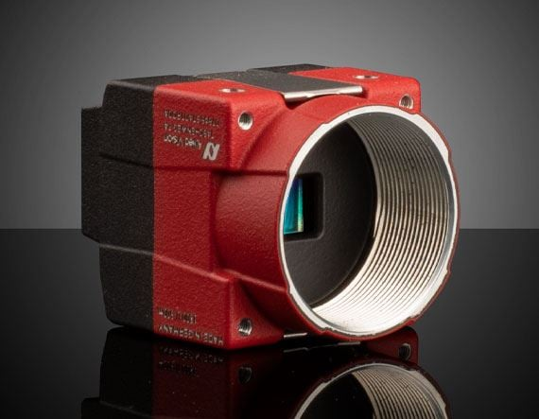
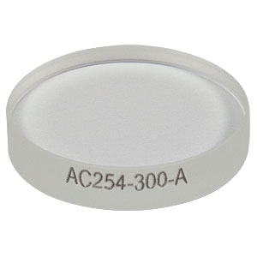
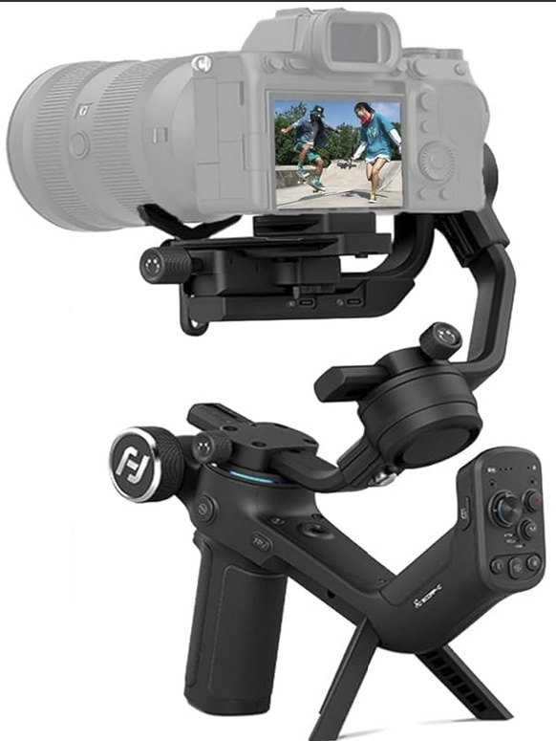
Design Decision Justification
Camera Sensor - CMOS sensor:
Better image quality
More compact while keeping higher resolution
Global shutter superior for constant ship movement
Lens System - Achromatic Doublet:
Narrowed spot size
Reduced chromatic aberration
Higher magnification potential without distortion
Real exit pupil location
Gimbal - Three-Axis:
Movement along all three axis is needed for precise control

Slide 14
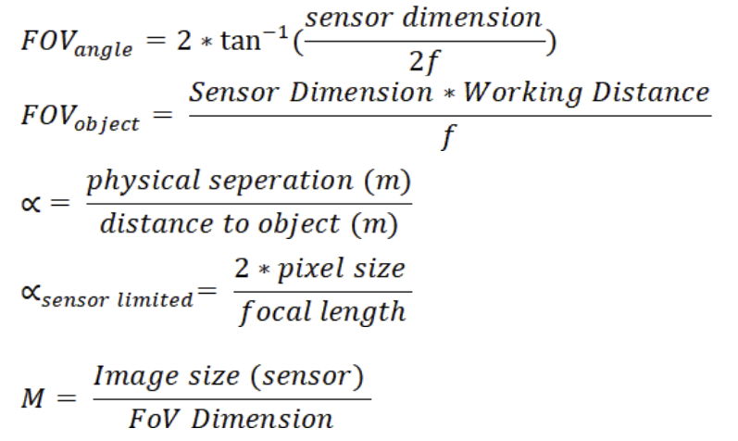
Design Decision Justification - Calculations
Equations:

Slide 15
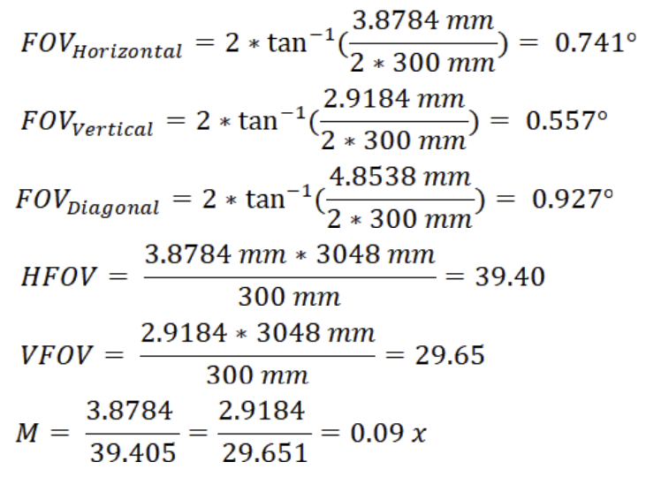
Design Decision Justification - Calculations
Calculations:

Slide 16
Optics System Parts Selection - CMOS Sensor
Feature | IDS U3-3864LE-C-HQ-AF, USB 3.0, 1/2.8" Color Camera | Allied Vision Alvium 1800 U-050c, 1/3.6" 0.5MP C-Mount, CMOS Sensor | Basler ace2 a2A2590-60ucPRO Color USB3 Pro Camera
Sensor Format | 1 / 2.8” | 1 / 3.6” | 1 / 2.8”
Resolution | 2.10 MP | 0.50 MP | 5.00 MP
Power Usage | 1 - 1.5 W | 1.5 W | 3.4 W
Frame Rate | 135 fps | 116 fps | 60.00 fps
Shutter | Rolling | Global | Rolling
Price | $462.24 | $312.12 | $477.36

Slide 17
Optics System Parts Selection - Gimbal
Feature | Adafruit Mini Pan-Tilt Kit | SCORP-C Camera Stabilizer 3-Axis Mirrorless Gimbal | DJI RS 3 Mini, 3-Axis Gimbal Stabilizer
Connectivity | Raspberry Pi | Switch Button | Bluetooth
Mount Dimensions | 37mm x 33mm x 3mm | Quick Release Slider Plate | Quick Release Action Plate
Rotation Range | 180° | 360° | 360°
Tilt Range | 150° | +120° ~ -201° | 80°
Cost | $18.95 | $249.00 | $237

Slide 18
Optics System Parts Selection - Lens
Feature | Thorlabs AC254-300-A - Achromatic Doublet | Thorlabs AC254-400-A & Newport -75 mm Biconcave | Newport -75 mm Biconcave & 250 mm Biconvex
Diameter | 25.4 mm | Both 25.4 mm | Both 25.4 mm
Simulated Spot Size | 0.183 um | 0.055 um | 11.267 um
Simulated Image | Clear | Blurry | Very blurry
System Length | 303 mm | 405 mm | 253.5 mm
Cost | $95.34 | $157.34 | $130.50

Slide 19
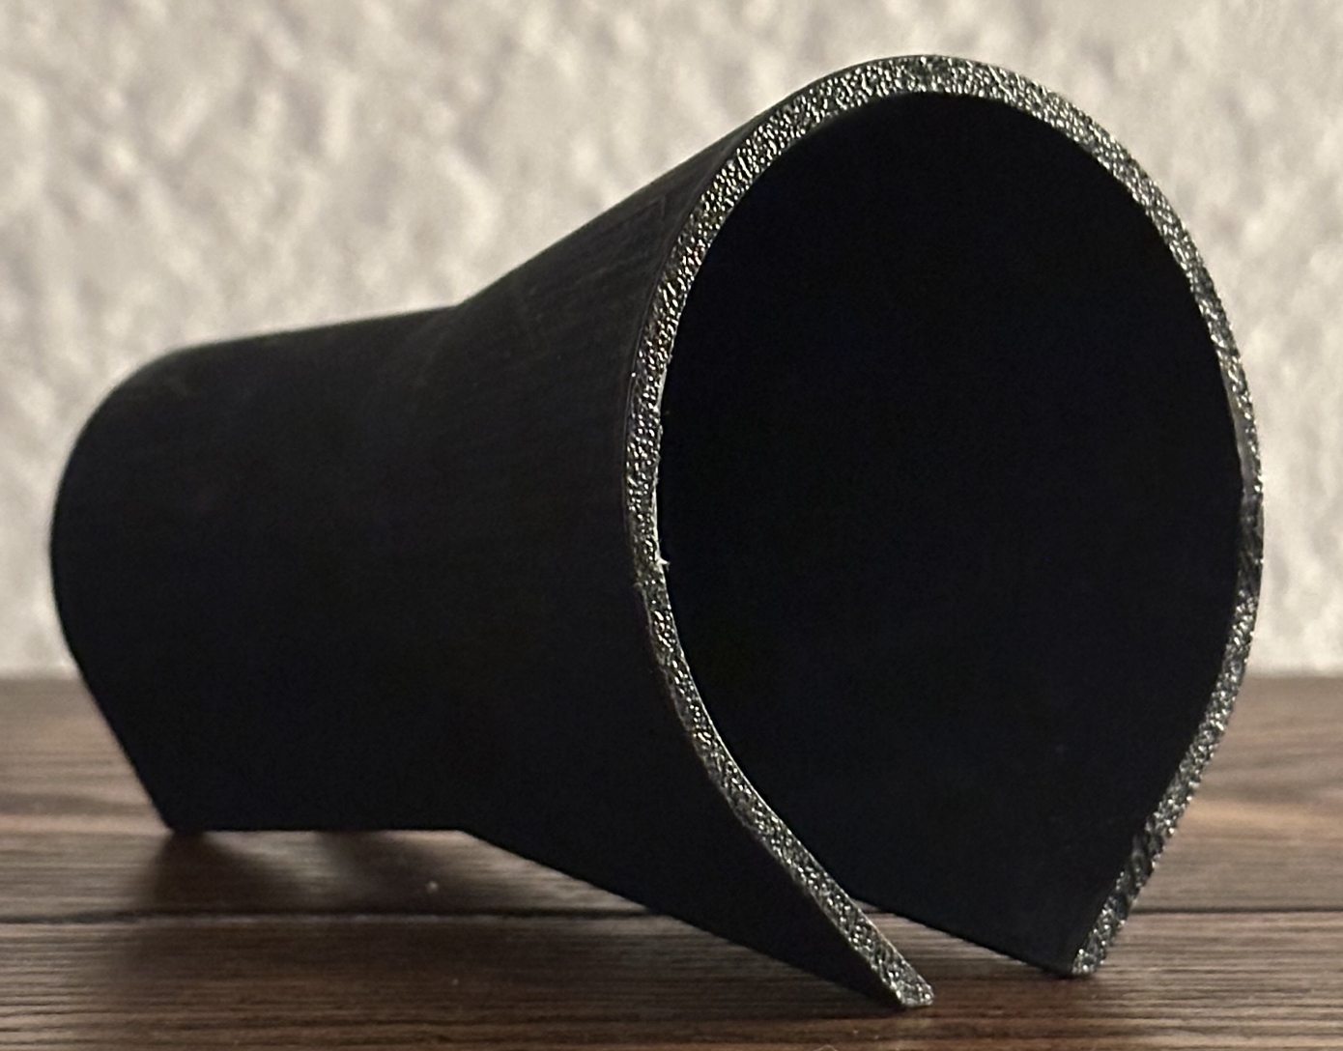
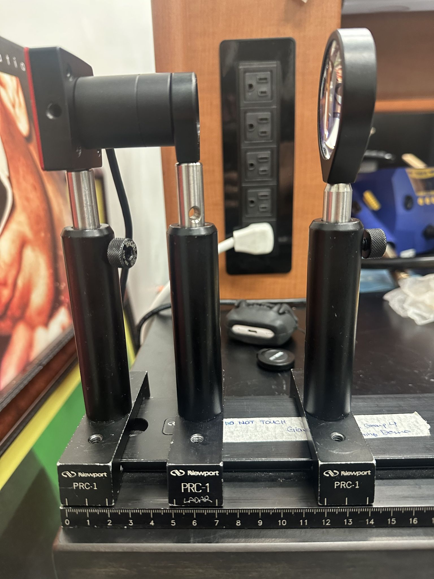
TESTING & OUTCOMES
Senior Design 1 Testing:
  3D printed lens tubes painted with Ultrablack paint
  Two lens setups:
    Galilean Telescope (125 mm biconvex, 75 mm biconcave)
    One lens system 125 mm Biconvex
Outcome:
  Not very successful
  Blurry image
  Lens tubes were deemed not opaque enough, too much light leakage
  Hand measurements weren’t precises enough
  Needed to redo simulation for better results
  Relatively compact design achieved

Slide 20
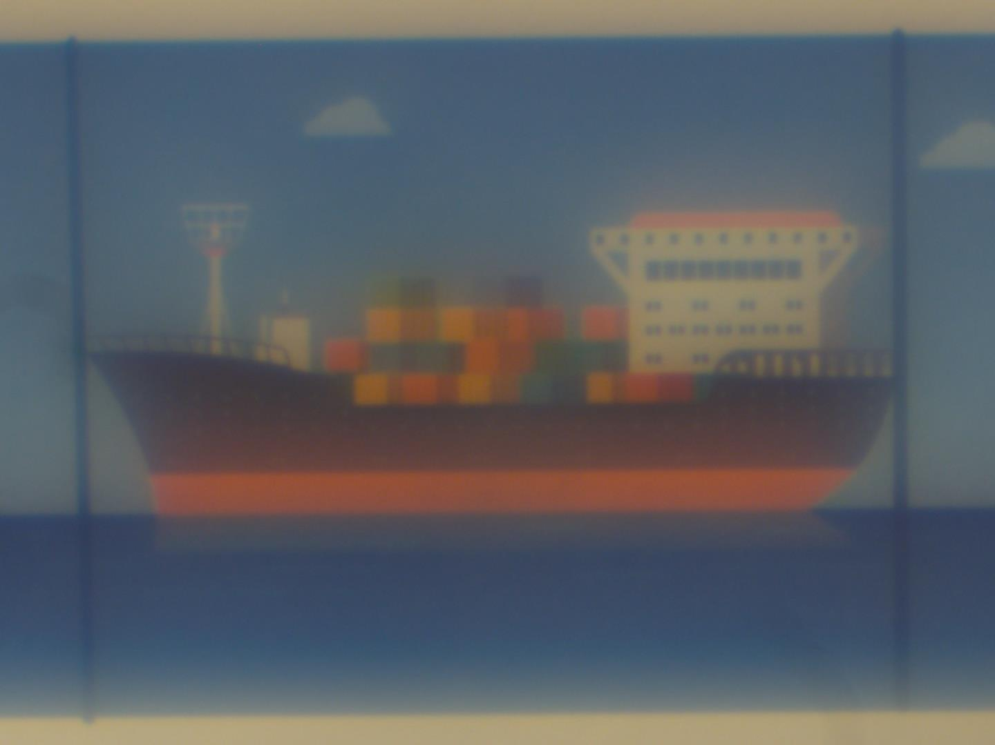
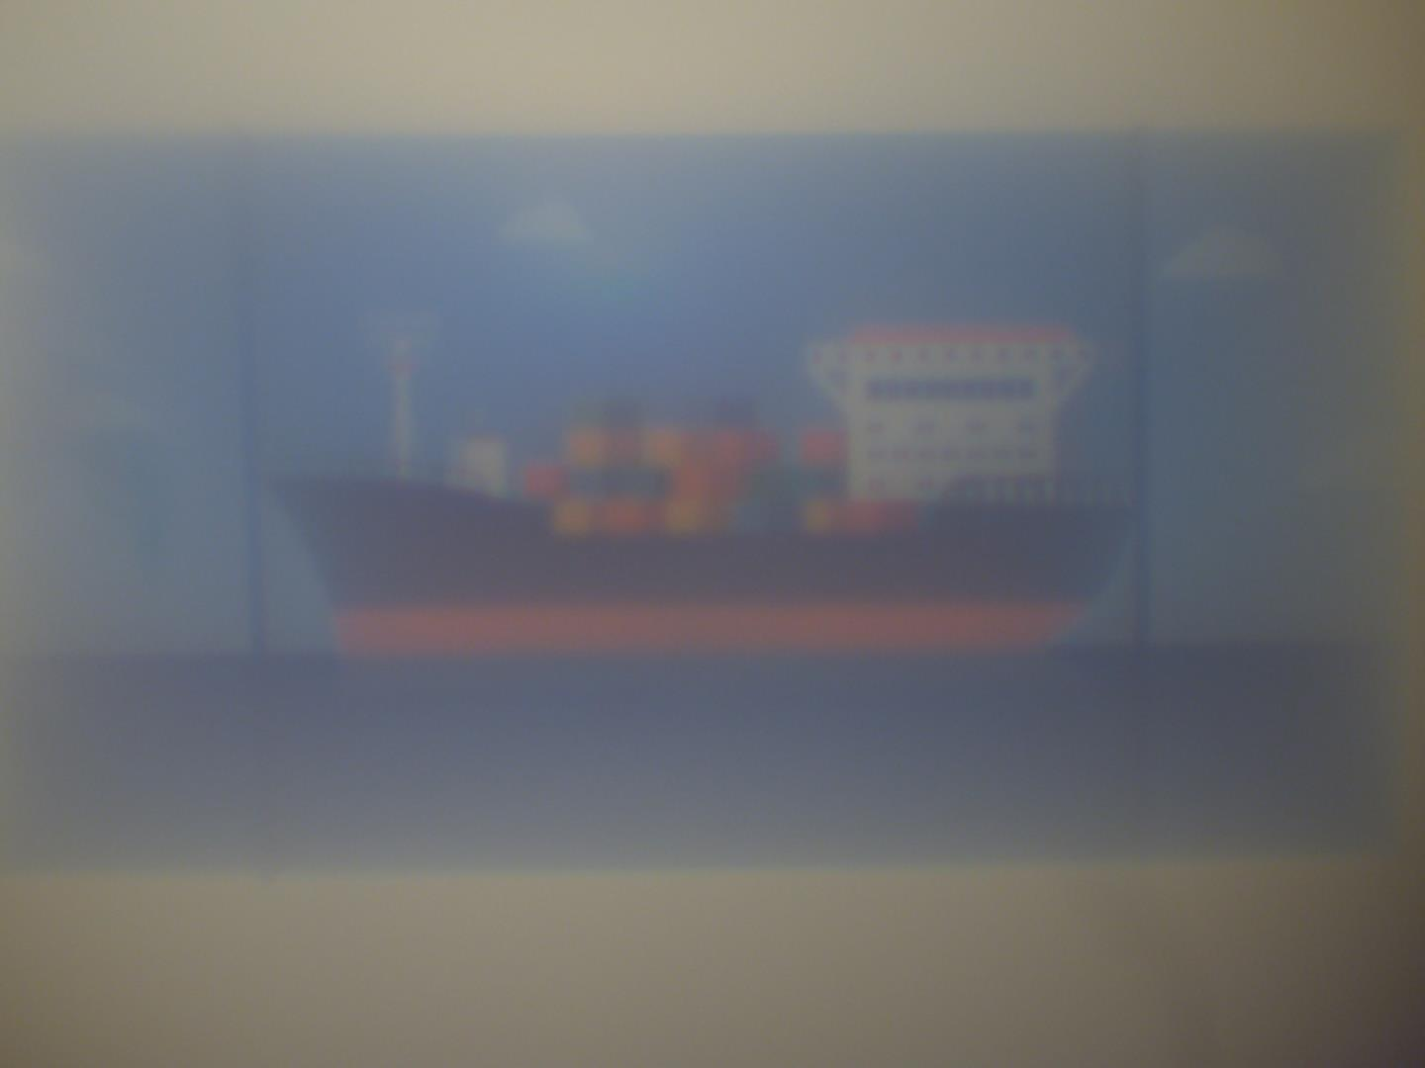
TEST PHOTOS - SD1 FINAL DEMO
One 125 mm Biconvex Lens
Galilean Telescope Setup:
125 mm Biconvex
50 mm Biconcave
Notes:
Allied vision CMOS with 0.5MP resolution

Slide 21
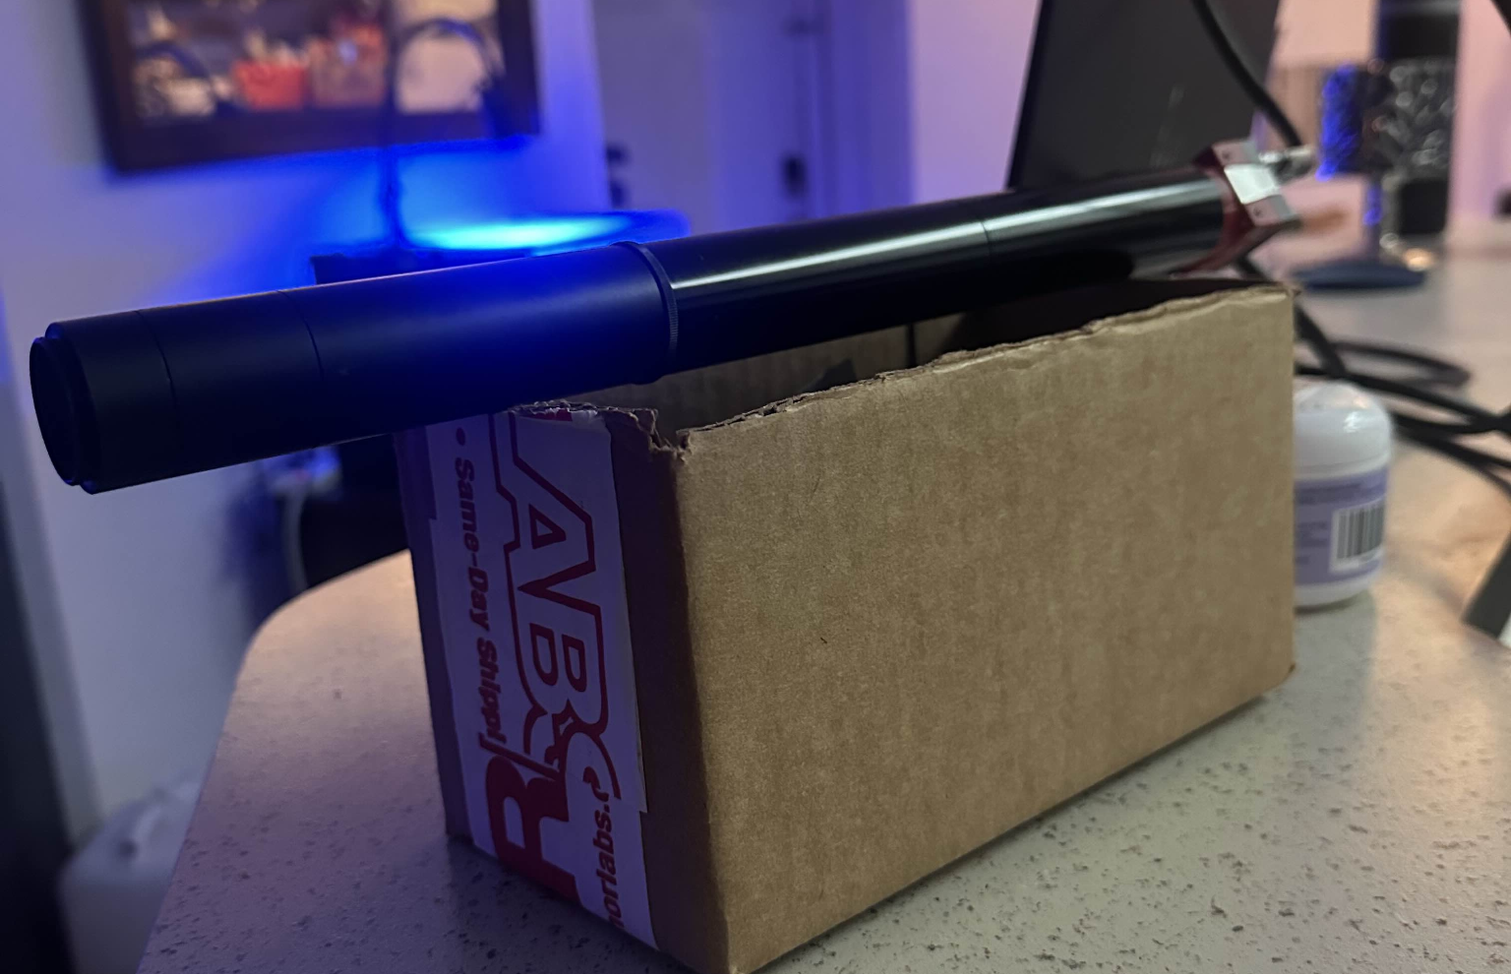
TESTING & OUTCOMES
Senior Design 2 Midterm Testing:
  CMOS sensor and lens tube setup, with 300 mm achromatic doublet lens
  Thorlabs lens tubes got rid of all excess light
Senior Design 2 Additional Testing:
  Gimbal integration
    Adafruit gimbal could not support system, therefore the SCORP-C gimbal was implemented instead
Outcomes:
  Pictures were much more clear
  Pixel deformities cause slight errors in the images
  Better gimbal led to more precise movements
  Distance requirement adjusted

Slide 22
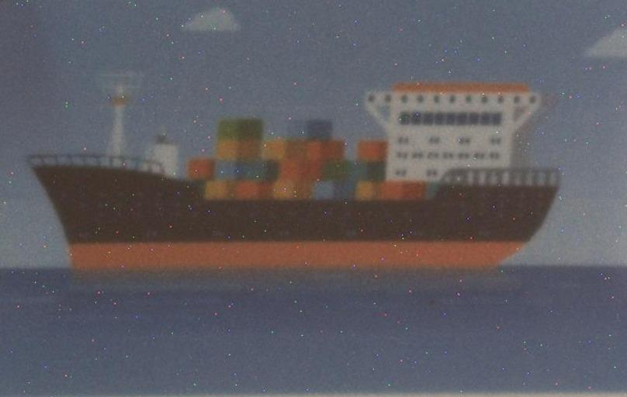
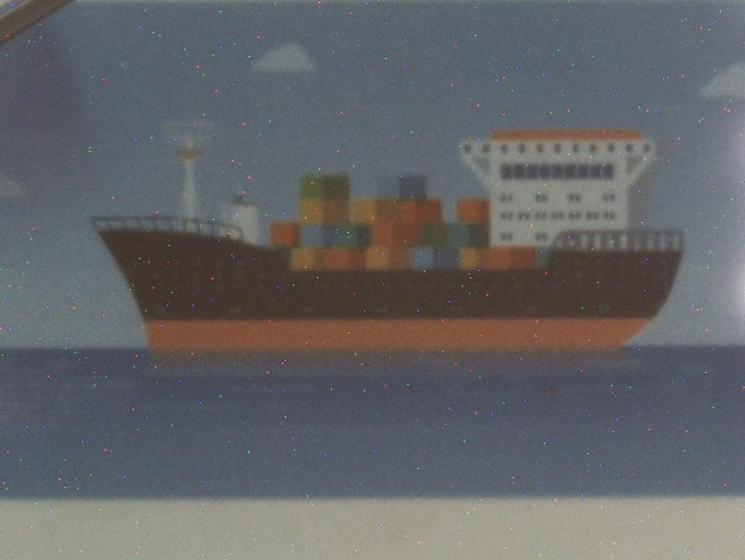
TEST PHOTOS - SD2 MIDTERM DEMO
9 feet
10 feet
Notes:
Allied vision CMOS with 0.5MP resolution

Slide 23
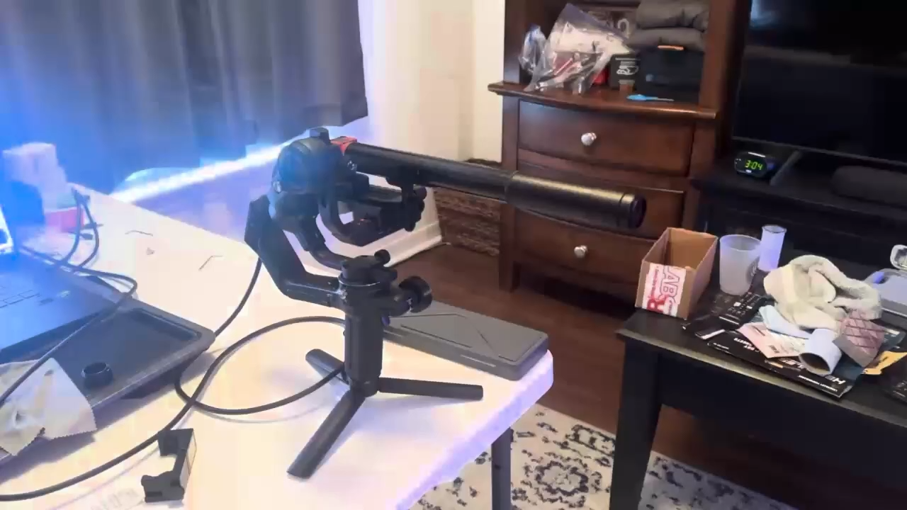
FINAL SETUP
Notes:
Allied vision CMOS with 0.5MP resolution

Slide 24
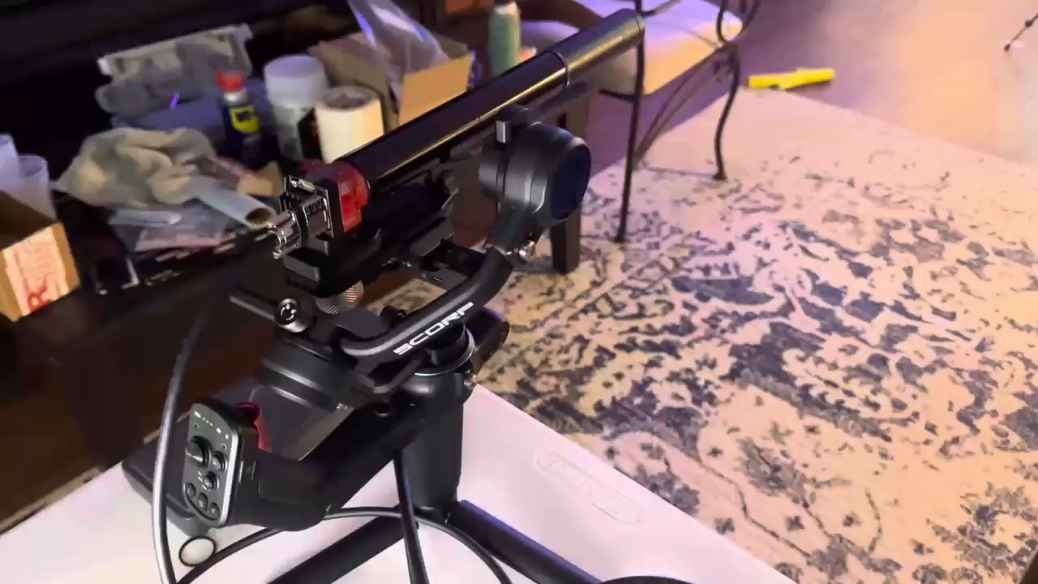
FINAL SETUP - GIMBAL ROTATION
Notes:
Allied vision CMOS with 0.5MP resolution

Slide 25
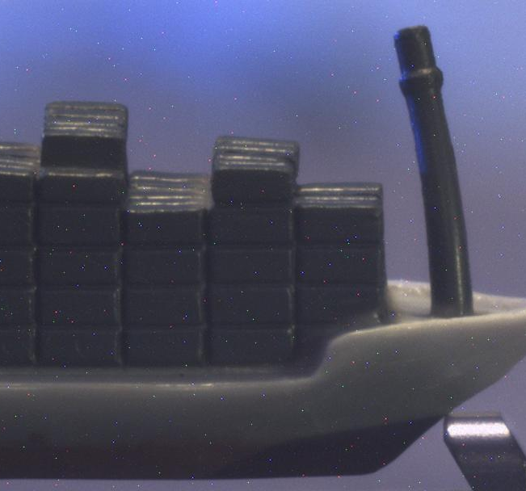
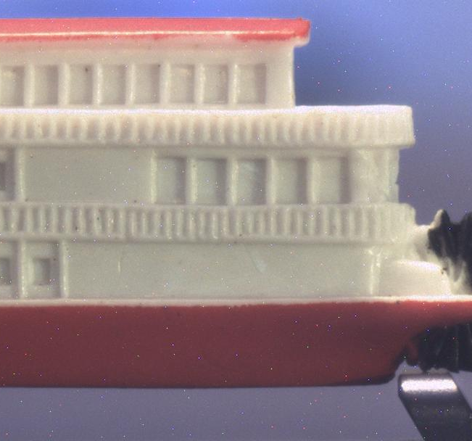
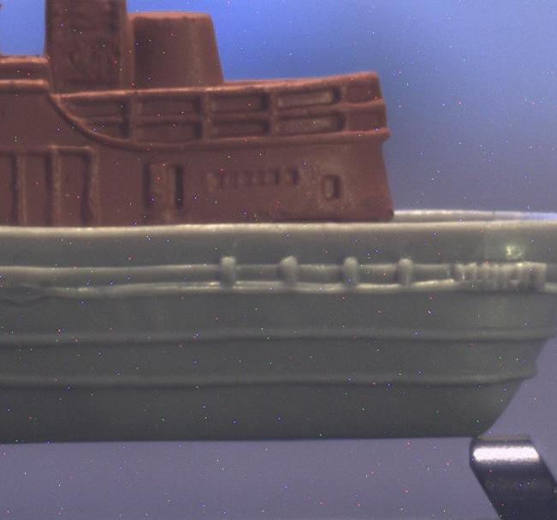
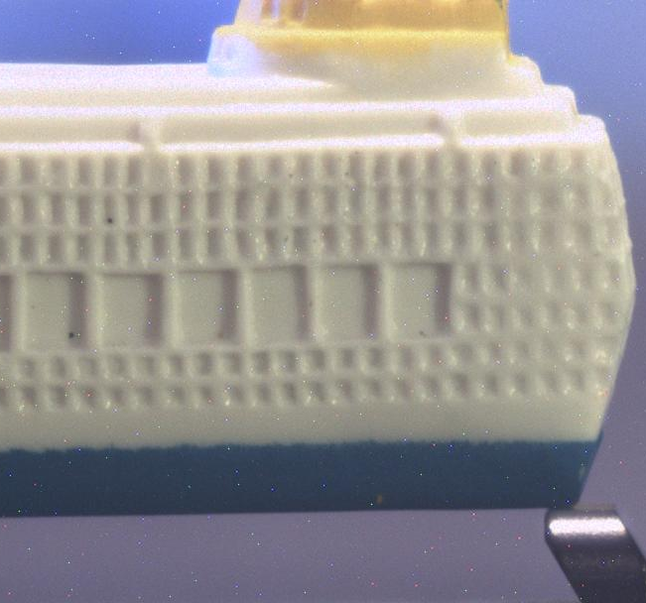
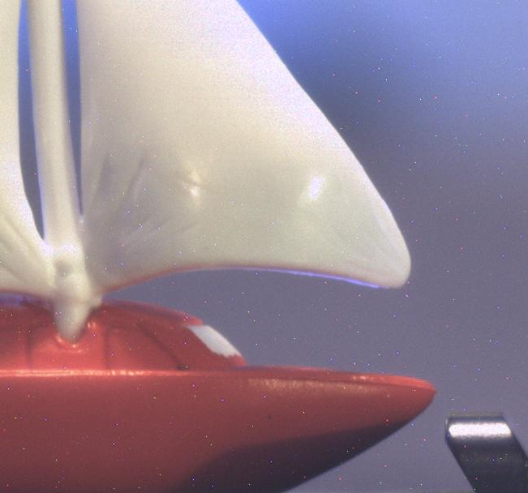
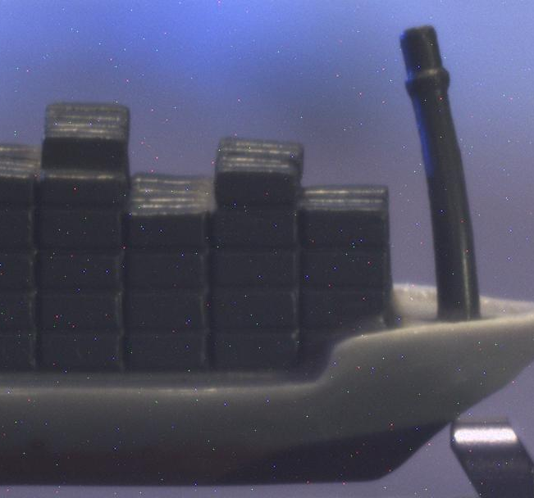

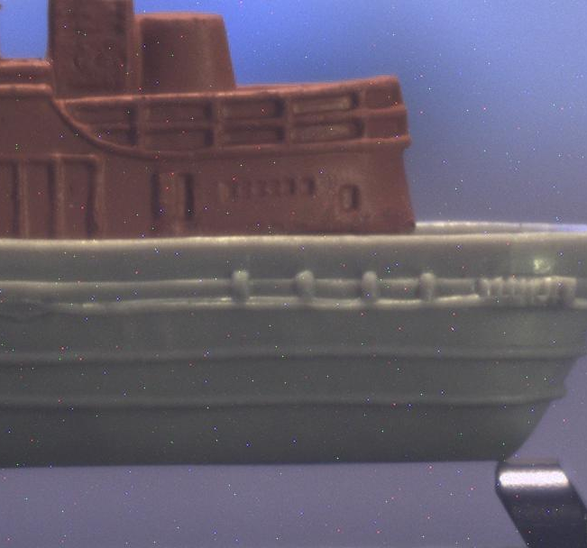


FINAL PHOTOS
Notes:
Allied vision CMOS with 0.5MP resolution

Slide 26
CHALLENGES & SOLUTIONS
The CMOS sensor was backordered for quite some time
  Initial testing was done using a different sensor, with different specs but discrepancies between the two systems led to further issues.
There were defective pixels on the CMOS sensor causing specs in the images
  Needed to be altered using software
There are severe hardware and software limitations
  The sensors are very high definition, and the processing capability of the laptop limits the real-time video feed from the sensor. This leads to blurry pictures and much longer time to get calibrated. An ideal fix would be to purchase additional memory for the sensor, as well as operate the system on a computer with a better processing system. In terms of cost and time, this was not feasible.
Inconsistent testing methods
  Originally testing with a printed image instead of a figurine led to poor image quality

Slide 27
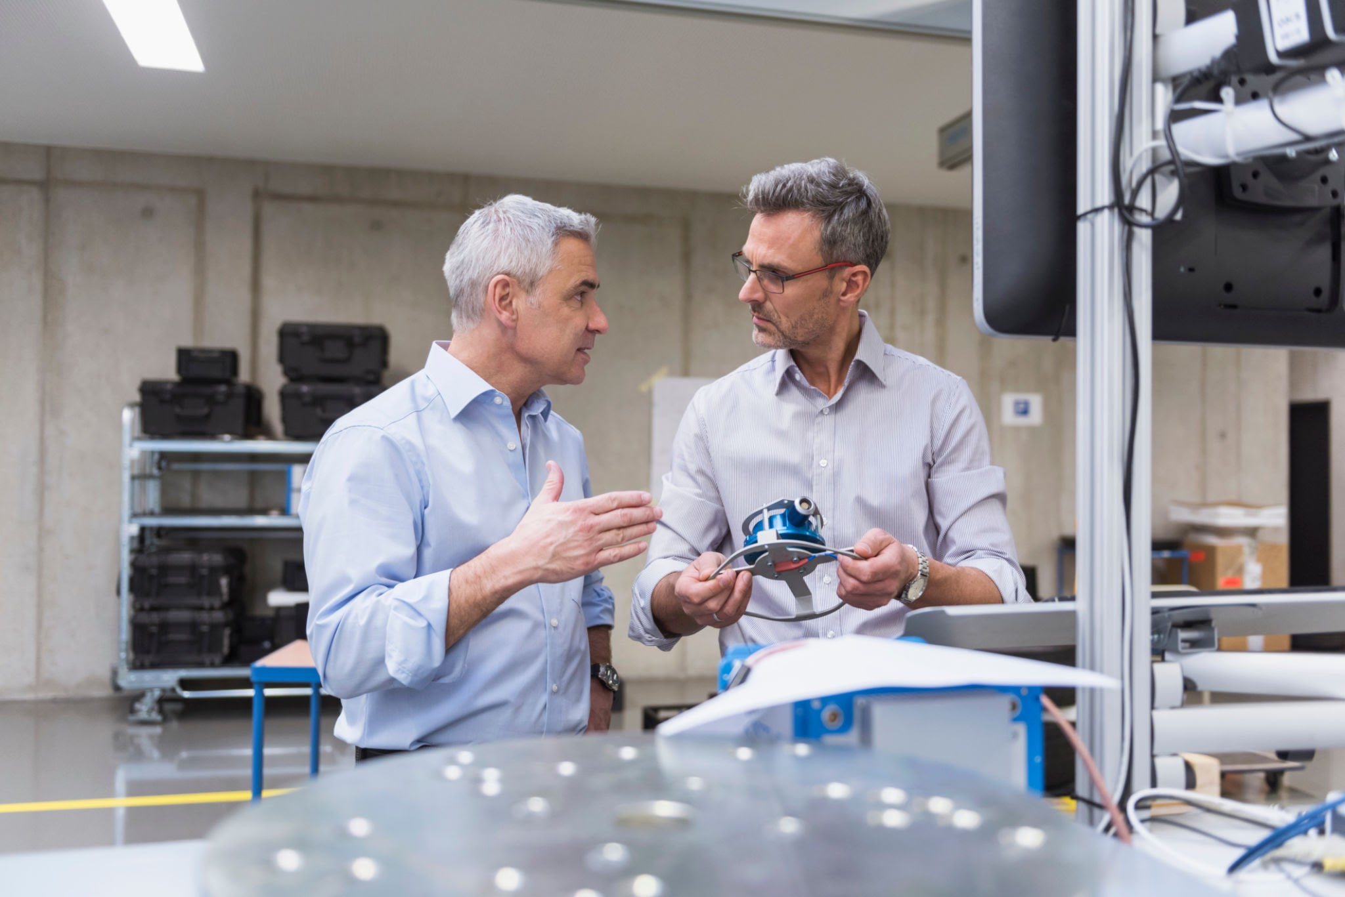
THANK YOU

