Slide 1
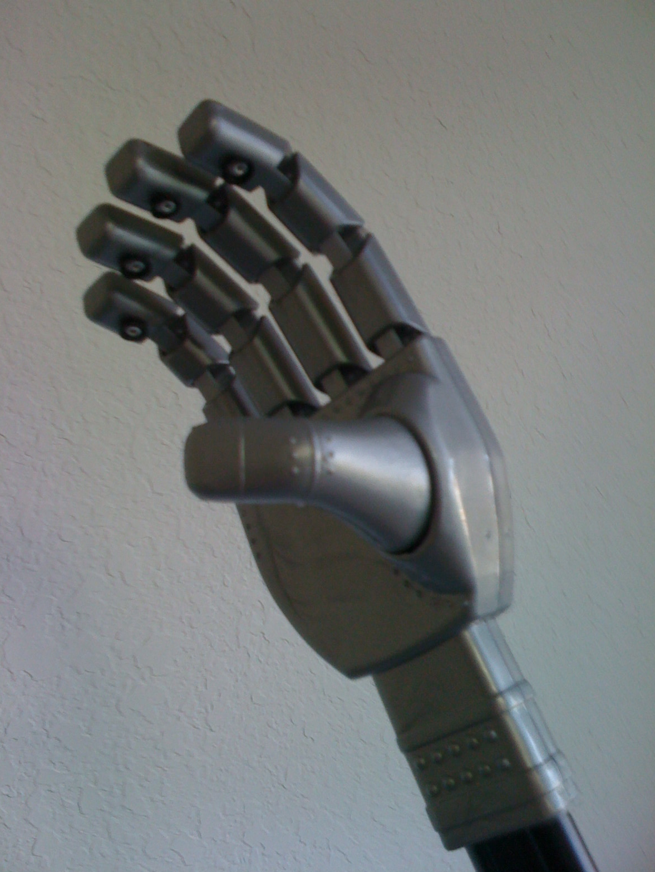
Luke’s Hand
Alex bermudez
Esteban Guerra
Cesar oleas
Jose suarez
Group # 6

Slide 2
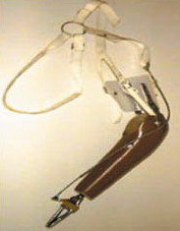
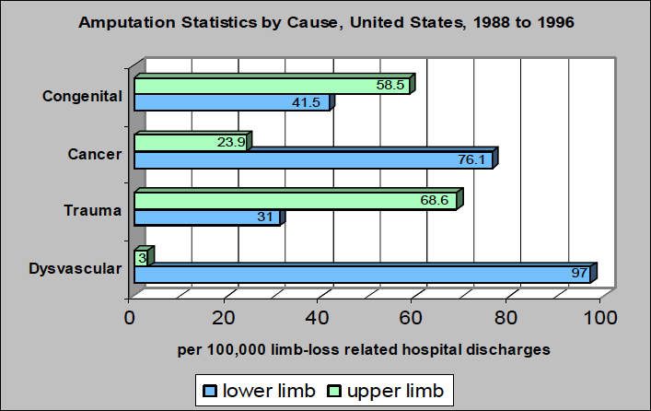
Inspiration

Slide 3
Objectives
Grab Objects
Independent motion of fingers
Control hand with an external Glove Interface
Autonomous detection/grabbing of objects
Inexpensive implementation of the hand

Slide 4
Requirements and Specifications
Detect object within 2cm range
Grab objects up to 2 lb of weight and a maximum and minimum diameters of 5 and 2.5 cm
Response times no longer than 100ms
5% tolerance between finger’s position and the glove’s motion
A switch should control all aspects of the hand

Slide 5
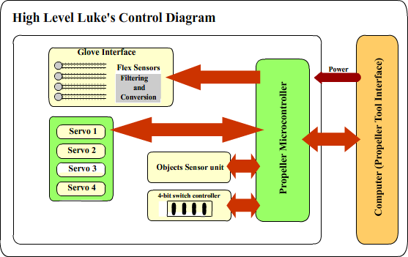
Robotic Hand Diagram

Slide 6
Sensors

Slide 7
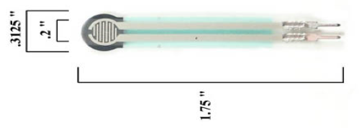
FSR Touch Sensors
Resistance inversely proportional to force
No suitable for precision measurements
Force sensitivity range from 100 g to 10 Kg
Stand-off resistance about 1 Megaohms
Active area 5 mm

Slide 8
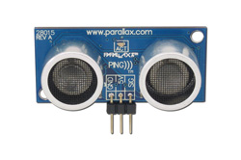
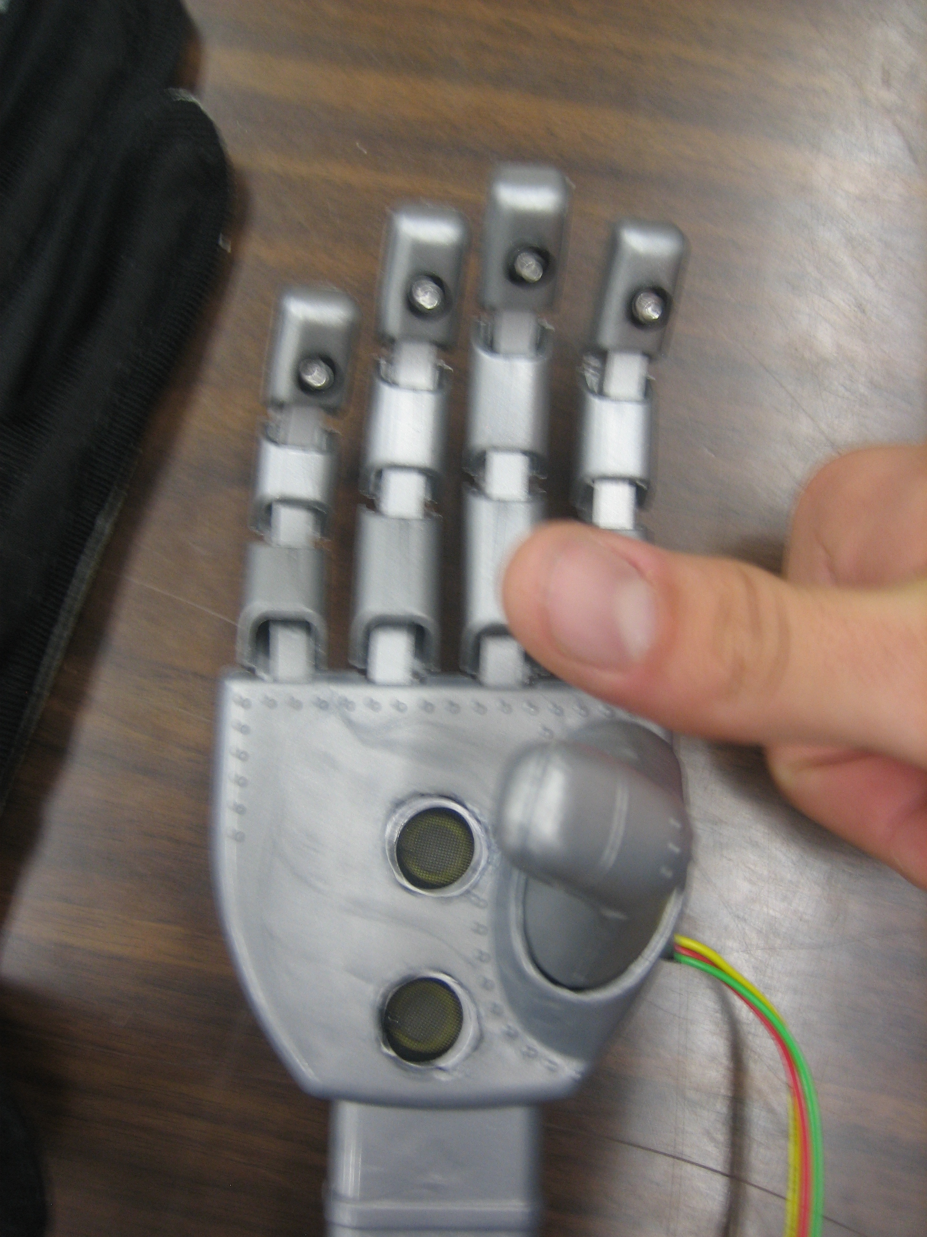
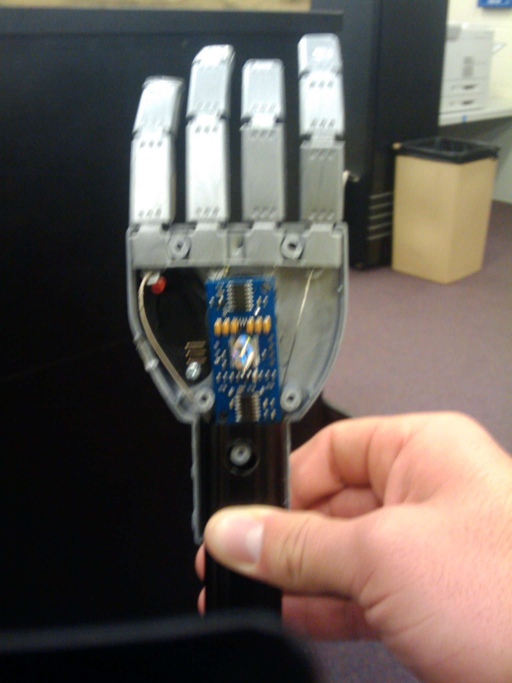
Ping!!! Sonar Sensor
Precise non-contact
distance measurements
within 2-3 cm range
20 mA power consumption
0.81 x 1.8 x 0.6 in
Reprinted with permission of the copyright owner, Parallax, Inc © 2008. All rights reserved.

Slide 9
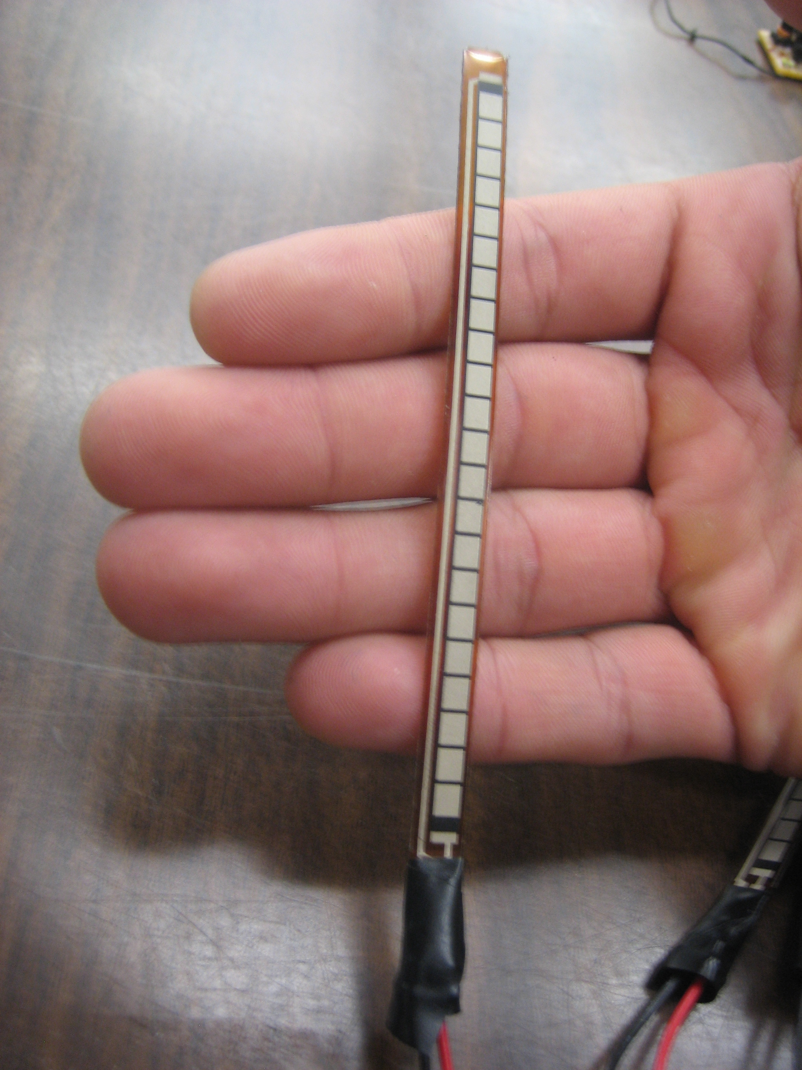
Flex Sensor
Variable resistance Sensor
Activated with 3.3v
Connected to voltage divider
Use for Glove Interface
Notes:
Using not activated

Slide 10
Glove Interface
FlexSensors
Connected to an AD Converter
Find relation between voltage from sensors and pulse needed to control the servos
Use and unique cog to process the output motion for each servo.

Slide 11
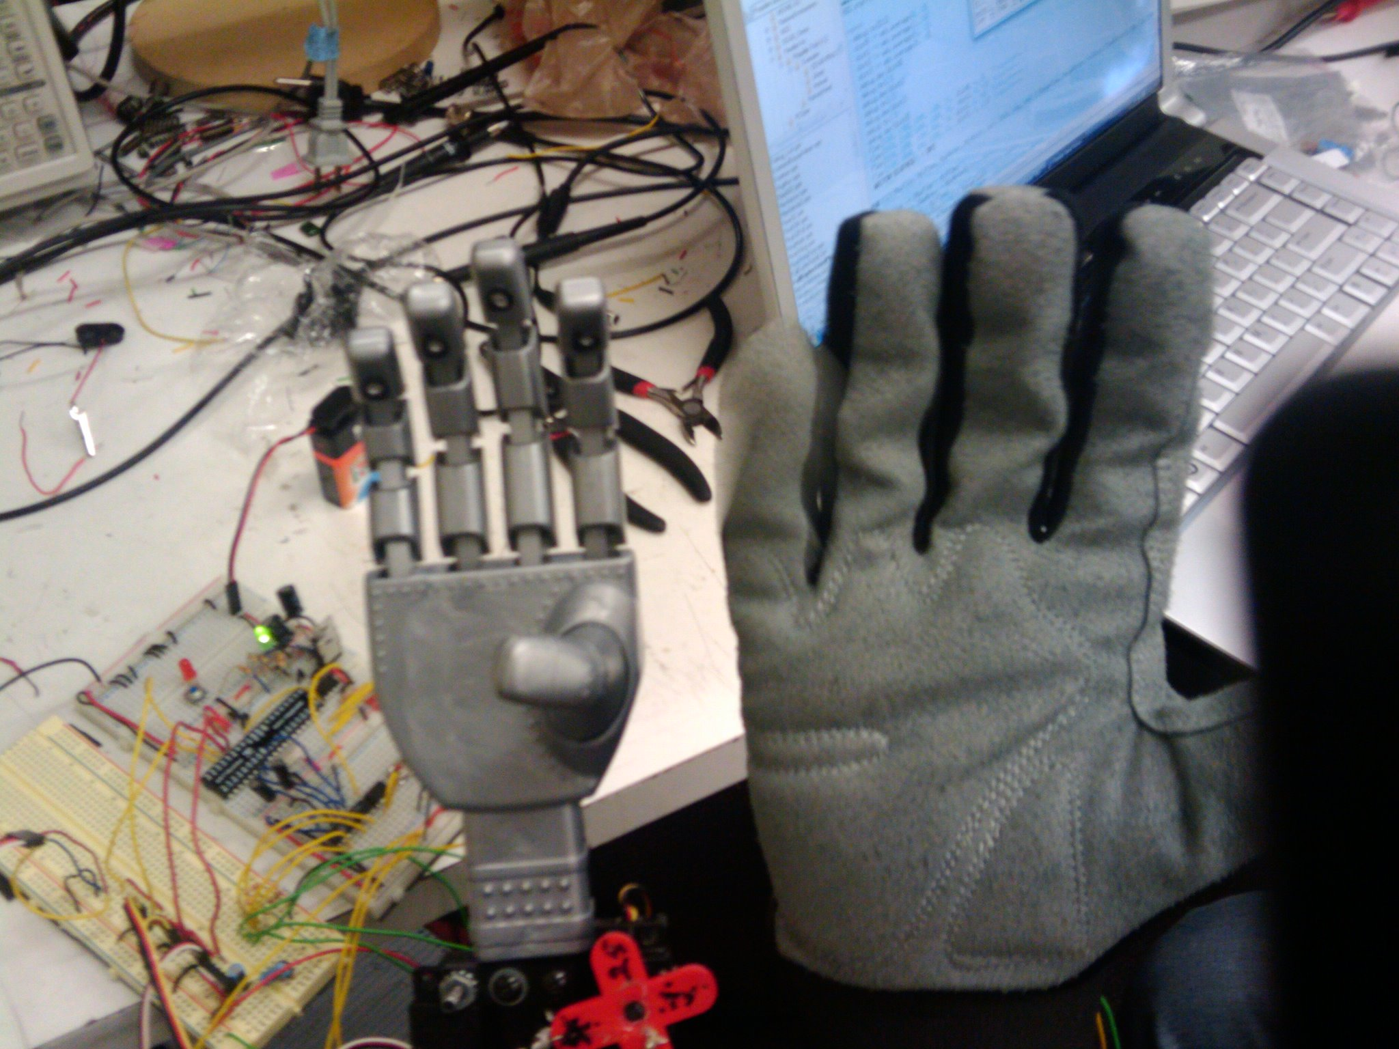
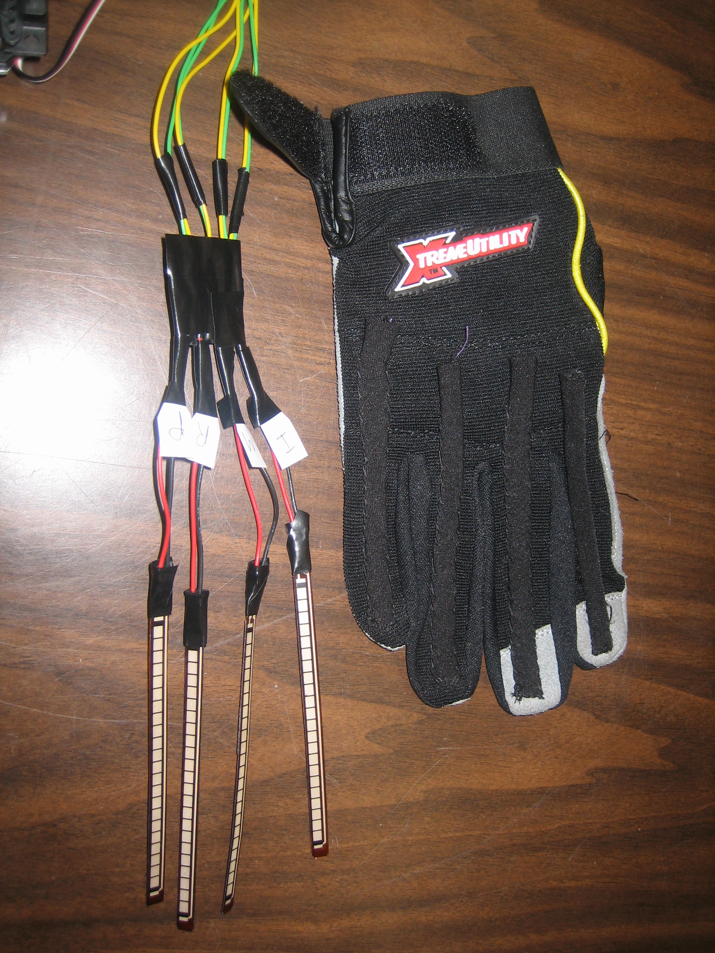
Glove Interface
Includes 4 Flex Sensors
4 finger control motion
5% tolerance
Human – Robot interface
Program based on rate of
percent change

Slide 12
Motors

Slide 13
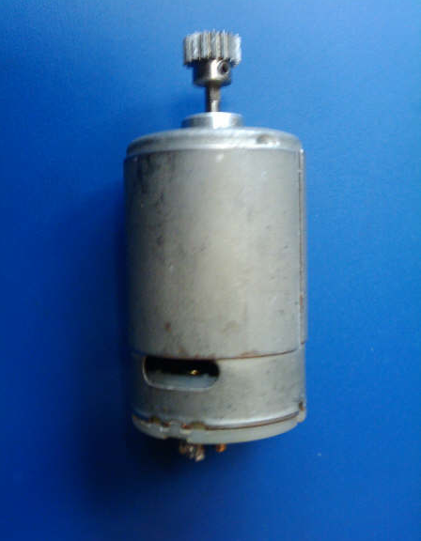
Motors: DC Continous
Was considered but rejected
because of mechanical design.
Use of gears to transfer motion
Torque was dependent from
Gear ratio

Slide 14
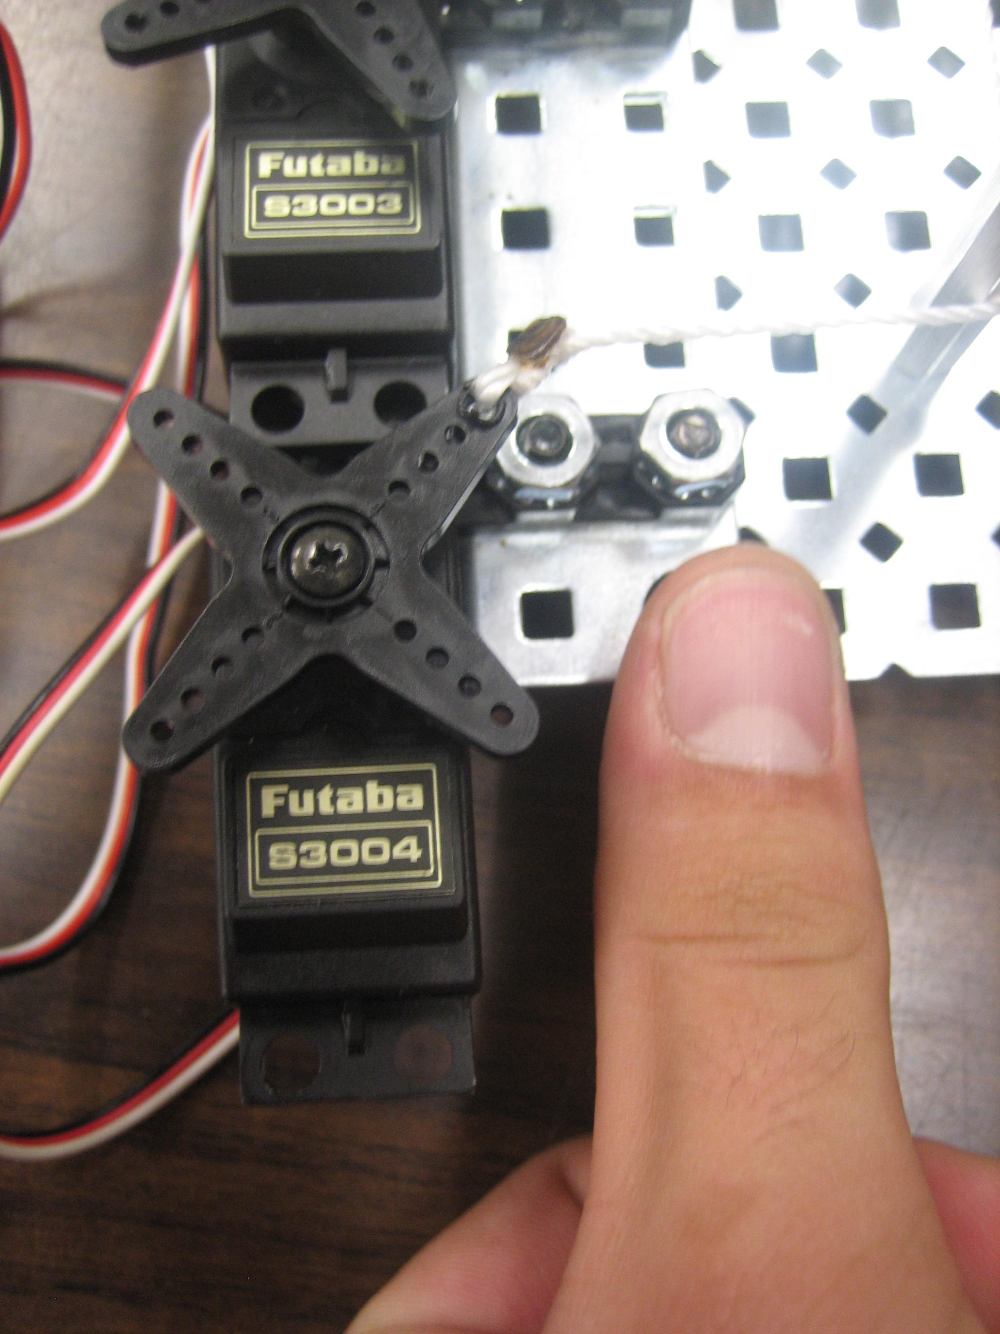
Motors: Servo
4 Futuba S3004 servo
Responsible for finger
motion
4.8 to 6.0 volts required
2.6→3.0 Kg/cm of torque.
900us PWM – Finger contraction
1900us PWM –Finger extension

Slide 15
Microcontroller
Although, there is a vast variety of microcontrollers and manufactures in the market, they are classify by their computer architecture, which is whether Von Neumann or Harvard Architecture.
Critical parameters for selecting the microcontroller:
Documentation available for the chip
Compatible with the design specifications of the robotic hand
Technical support offered by the vendor
Cost of the microcontroller
Integrated development environment (IDE)
Overall efficiency

Slide 16
Major Manufacturers in the Robotic Industry
The search was narrowed to
Microchip Technology Inc
Atmel Corporation
Parallax Inc
Zilog, Inc
Texas Instruments

Slide 17
Microcontrollers
Manufacturer | Product | Architecture | Advantage | Disadvantage
Microchip | PIC series | Harvard Architecture, mono-processor | Widely used for more than 20 years | Learning curve of IDE interface, which slows the developing process. Some issues reported with compilers and compatibility
Parallax | Propeller | RISC multi-processor | Easy interface for fast results, object oriented programming language | Programming language developed exclusively for this chip; called Spin. Price
Parallax | Stamp series | Harvard Architecture | Commonly used by hobbyist, easy IDE based on Basic programming language. Huge amount of discussion groups sharing their thoughts. | IDE developed for people without experience in microcontroller leaving the code expose to the world without security, small glitches with the debugger has been reported
Zilog | Z series | CISC Architecture | Price. | Convoluted instruction set. Not so popular in the robotics industry thus, lack of documentation on solving issues.
Atmel | AVR series | Harvard Architecture, mono-processor | Free compiler constantly updated with cross platforms and high portability of code. Highly used and documented | Ethernet, CAN, USB, and RF are not supported for the smaller chips.
TI | MSP430 C2000 | Harvard Architecture | Modern, powerful. Huge documentation on TI site. | Not so much documentation on the robotics community

Slide 18
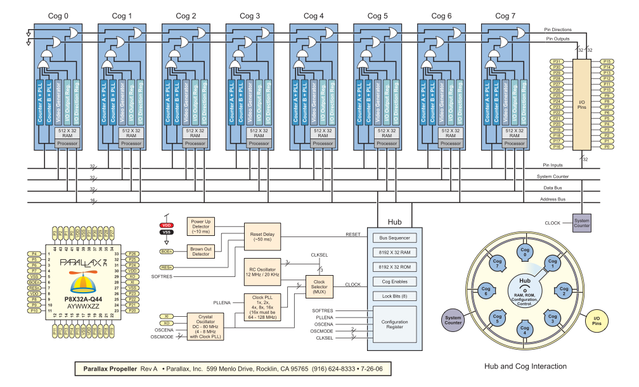
Propeller’s Block Diagram

Slide 19
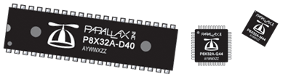
Physical Characteristics of the MCU
Operating temp range: -67 to +257 °F (-55 to +125 °C) Dimensions: 44-pin LQFP → 0.39 x 0.39 x 0.05 in (10 x 10 x 1.4 mm) 44-pin QFN → 0.35 x 0.35 x 0.05 in (9 x 9 x 1.4 mm)
40-pin DIP → 0.48 x 2.0 x 0.13 in (12.3 x 51 x 3.41 mm)

Slide 20
Integrated Development Environment (IDE)
At the time of programming this chip, developers have each one of the cogs available to decide how and when they should be employed
All the cogs share the same clock signal to give them a desired synchronization

Slide 21
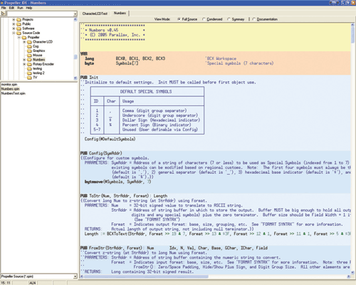
Parallax Tools (IDE)

Slide 22

Power Supply
One 3.3V Propeller Microcontroller
One 24 LC256 EEPROM
Four Futaba S3003 Standard Servo
Ping Sonar Sensor
Four Flex Variable Resistors
A/D Converter MCP 3208
Propeller Plug
4-Bit Switch Controller

Slide 23
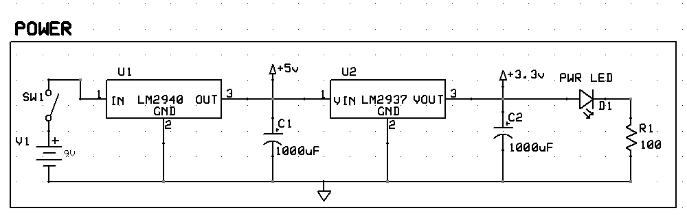
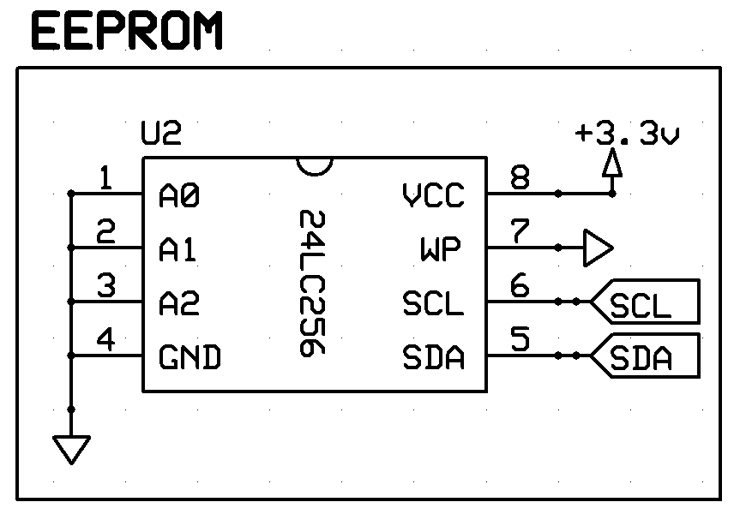
Propeller and EEPROM
Two Voltage Regulators (LM2940-5V-1A, LM2937-3.3V-500mA)
Two 1000uF Capacitors
LED Power Indicator
One 100Ohm Resistor
P28 (SDA) and P29 (SCL) interface to an external 32KB EEPROM
One 9 Volt Alkaline Battery

Slide 24
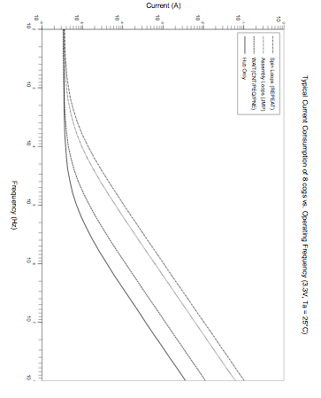
Current Consumption
At 80 MHz with all the 8
cogs running, the current
consumption is going to
be around 8mA

Slide 25
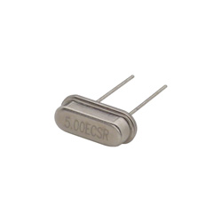
5Mhz Crystal HC-49
For application that are timing sensitive like serial communication, tone generation, servo control and time keeping. It is recommended to use a 5MHz crystal.
For Servo Control, it is better to use a system clock of 80MHz
CON
_xinfreq = 5_000_000
_clkmode = xtal1 + pll16x
System Clock = (5MHz * 16) = 80MHz
Pll1x, pll2x, pll4x, pll8x, plla16x
This crystal is efficient and cheap $1.10

Slide 26
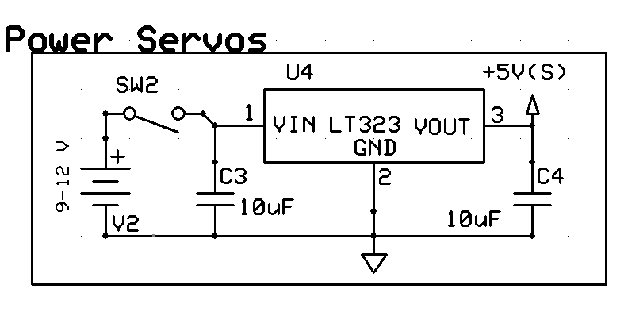
Servos
Require 5V to operate
Current Draw:
No motor movement is 9.6mA
Motor movement 115mA but no load
Motor movement and load it can reach up to 250mA
Four servos with load can reach up to 1.00 A in the worst case
Linear Voltage Regulator: LM323(5 V – 3A)
Important to have separate Battery (9V)

Slide 27
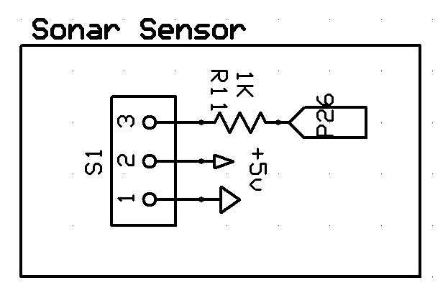
Ping Sonar Sensor
5 V required to work properly
Distance Range control by R11, larger its value shorter the distance range
Voltage Supply coming from the LM2940 (5V-1A) regulator output
Signal pin is connected to pin26 of Propeller
LED will turn on every time an object is detected.

Slide 28
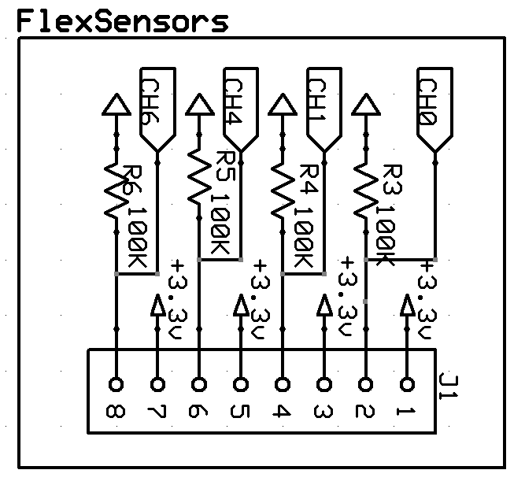
Flex Variable Resistors
Supply 3.3V to each Sensor
Same circuitry for all of them
Voltage Divider is used to read changes in the variable resistance sensors
Connected to channels of MCP3208
MCP3208 will perform A/D Conversion

Slide 29
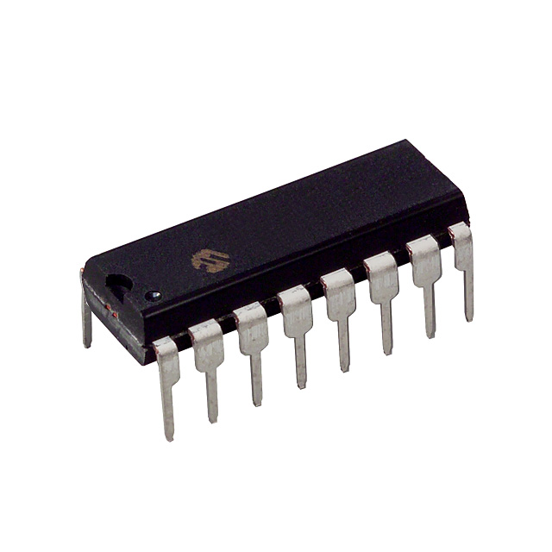
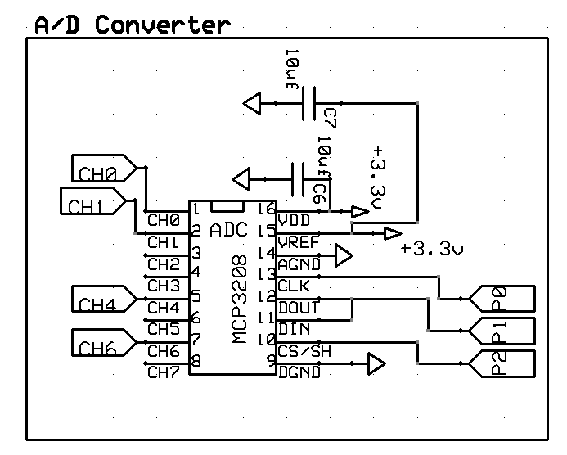
MCP3208
8 Channel 12 bit A/D Converter
Voltage supply is 3.3V
Typical Standby and active currents of only 500nA and 320uA
Capable of conversion rates of up to 100,000sps
Bypass Capacitors used for cleaner signal and reduce noise (10uF)
It is connected to 3 pins of the propeller (P0-P2)
16-Pin Dip package

Slide 30
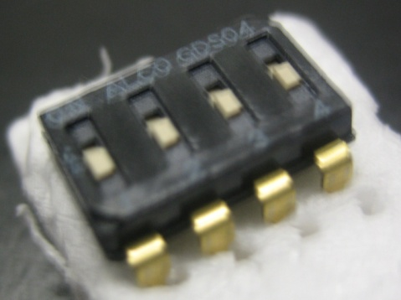
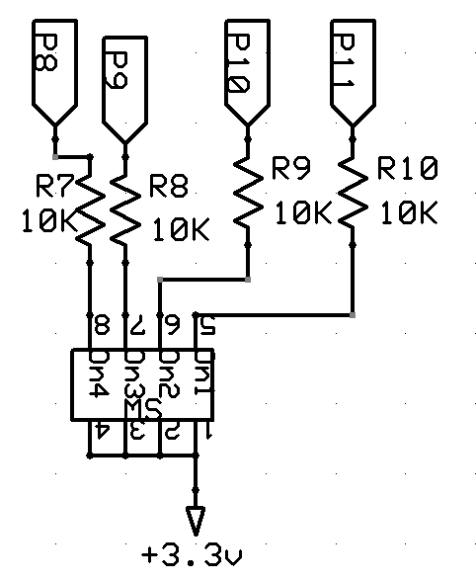
4-Bit Switch Control
On/Off switch (SPST)
Connected to 3.3V and to four pins of the microcontroller (P8-P11)
10K ohms resistors between the microcontroller pins and the switch for protection purposes
Microcontroller will read high or low (0000-1111)
16 different combinations
For each combination the Robotic hand will perform a different function

Slide 31
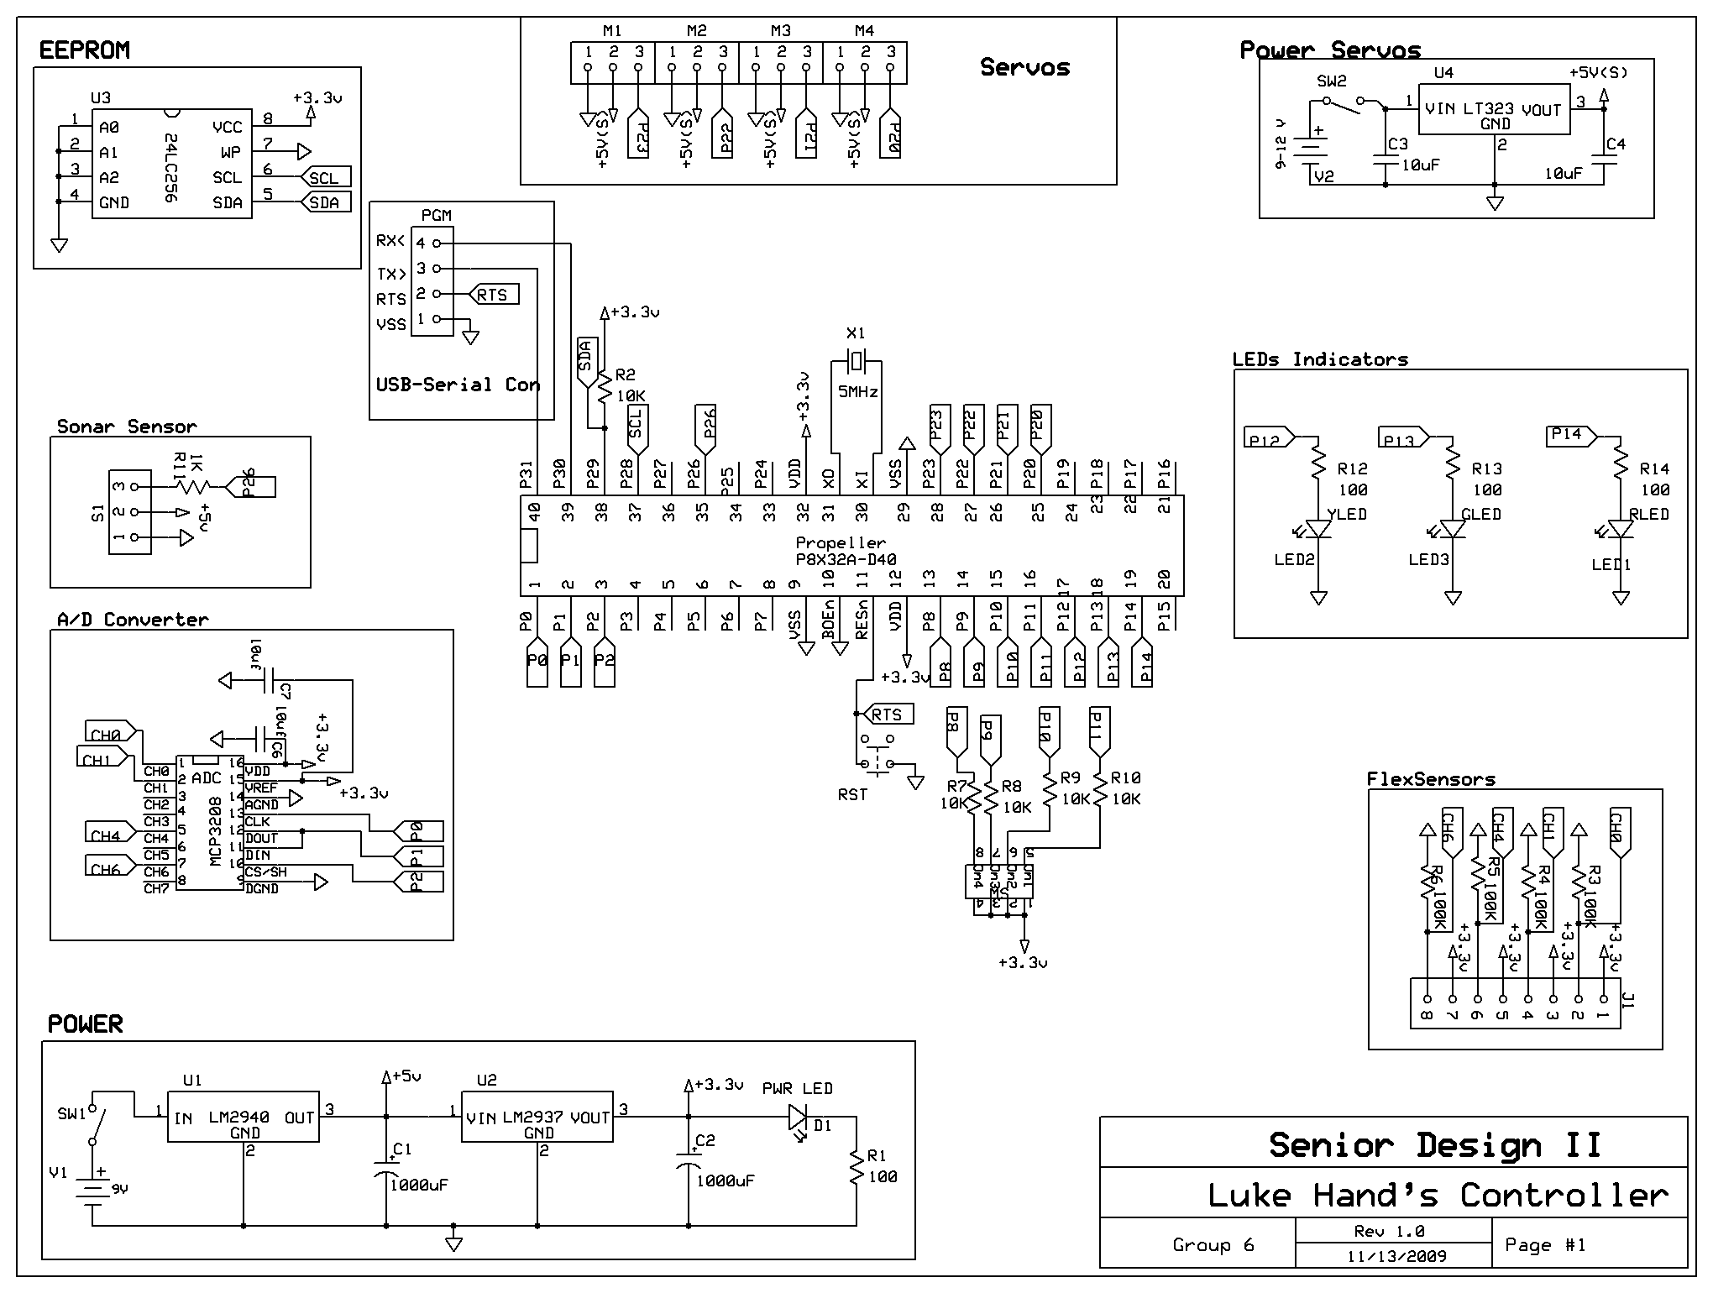
Schematic and PCB Design
Easy to use and it is free to download.
Offers error checking connection
Cheap price for PCBs: $51 for three 2-layer boards

Slide 32
Software Approach
MCU Selection
Real Time System: Multiple Cores
Easy Programming: C/Java Like Language
Enough RAM and ROM: 64K Ram/ 32K ROM
Clock Speed: 80Mhz
Object Oriented: Modularity

Slide 33
Software Approach
Propeller MCU is programmable in:
Spin (Object Oriented, Java-Like Language)
Assembly
C (Commercial Solution, costs around $100) ImageCraft

Slide 34
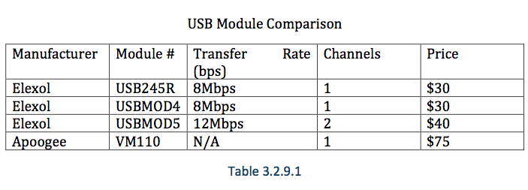
Interfaces (Data Protocols)
USB, FireWire (IEEE 1394), Serial, etc
Data rate? Cost? Compatibility? MCU Support?
Parallax ProPlug: USB-Serial Interface $20

Slide 35
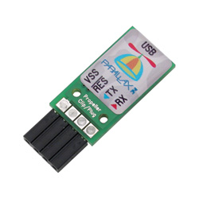
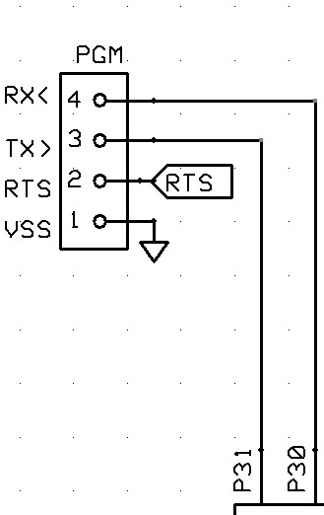
ProPlug
Used to provide an USB-to-Serial port connection that is convenient for Microcontroller programming and communication.
Capable of asynchronous communication up to 3M baud with 3.3V and 5V devices such as the Propeller.
Plug is Power up by the computer’s USB port, which supplies the 5V needed for the Plug to work.

Slide 36
Main Program
Reads current state from the 4-DIP Switch
Calls the corresponding program
Executes the program only once, even if the current state hasn’t changed.
Initializes and closes a cog for each program when required for parallel programming.
Resets the hand to its open position

Slide 37
Object Sensing Program
Continuously check for objects within range using the Ping!!! Sensor (Sonar).
If an object is within range, the hand will start closing until it makes contact with the object.
Once it makes contact with the object, it will close at a slower speed until the change in force is to large. At this point it will hold the object for 5 seconds and release it.

Slide 38
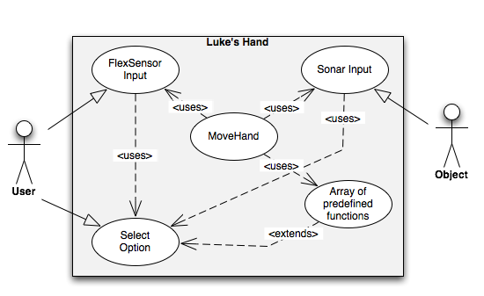
Hand’s Use Case Diagram

Slide 39
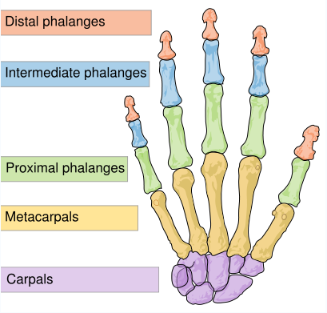
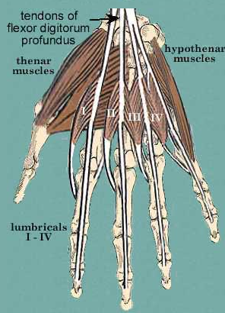
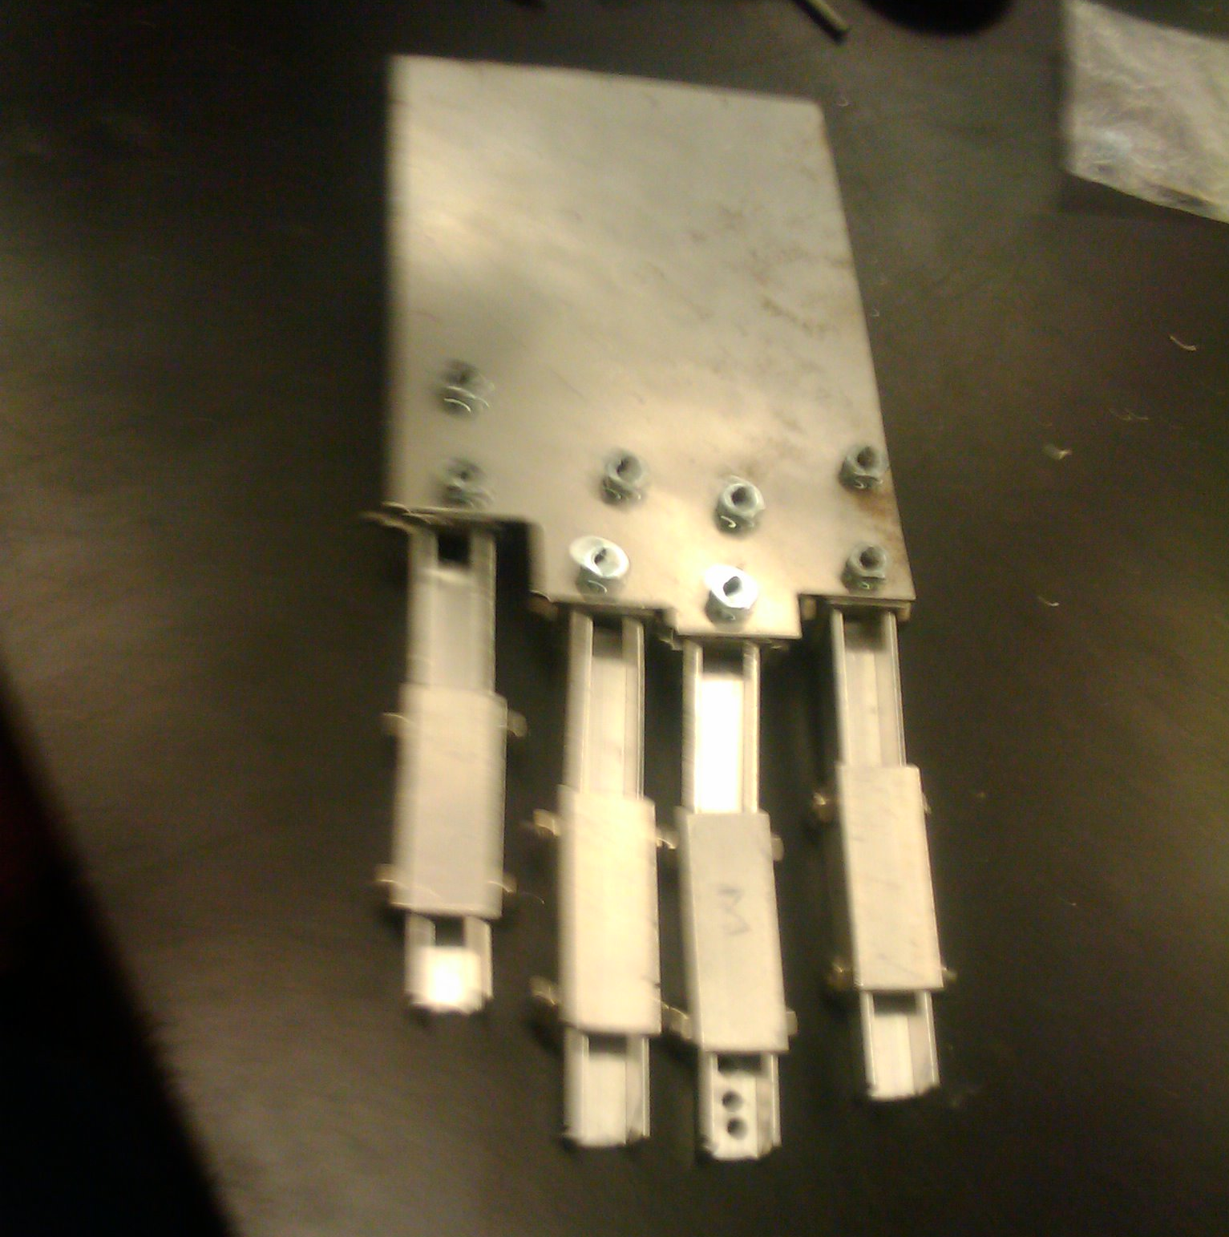
Design Background

Slide 40
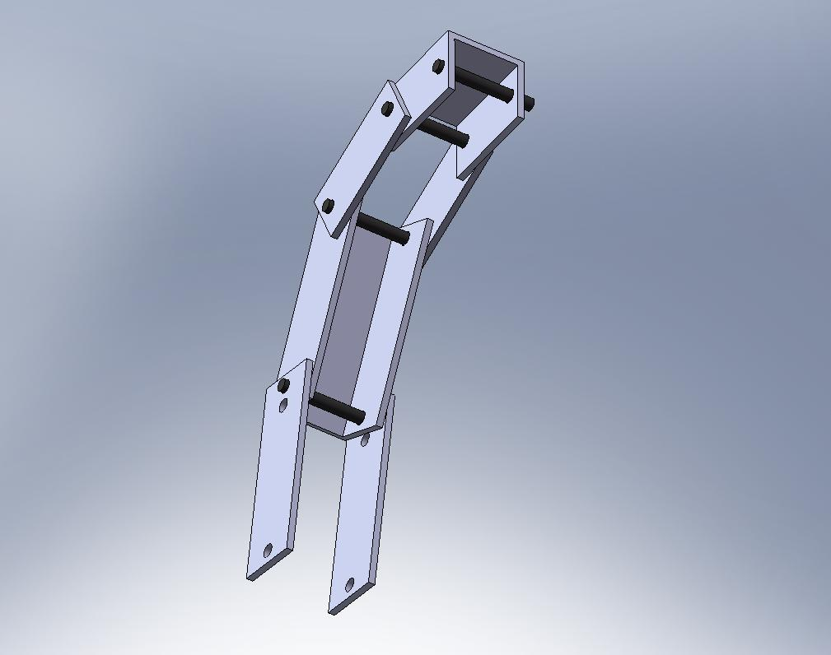
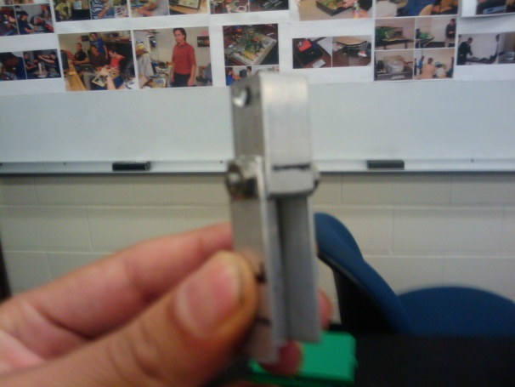
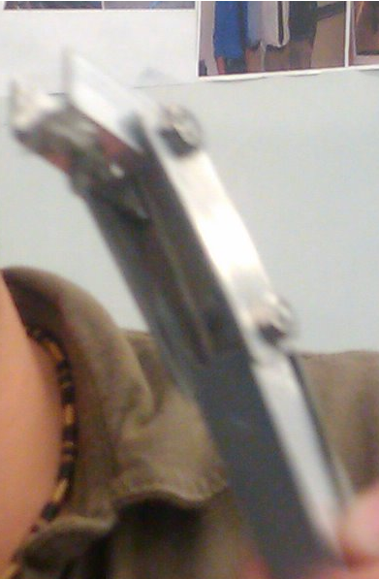
Evolution of Mechanical Design
First approach
Second approach
Third approach

Slide 41
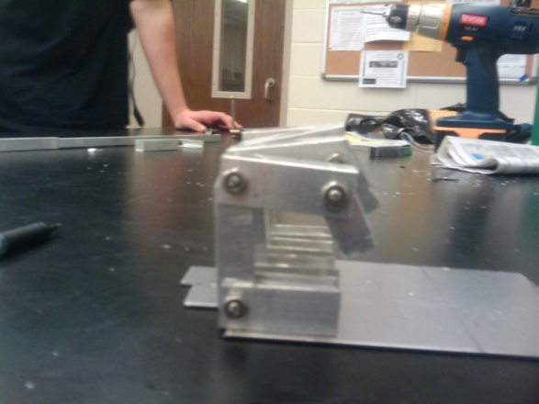
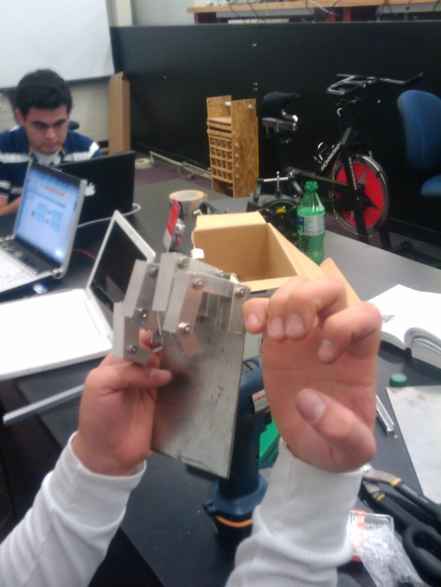
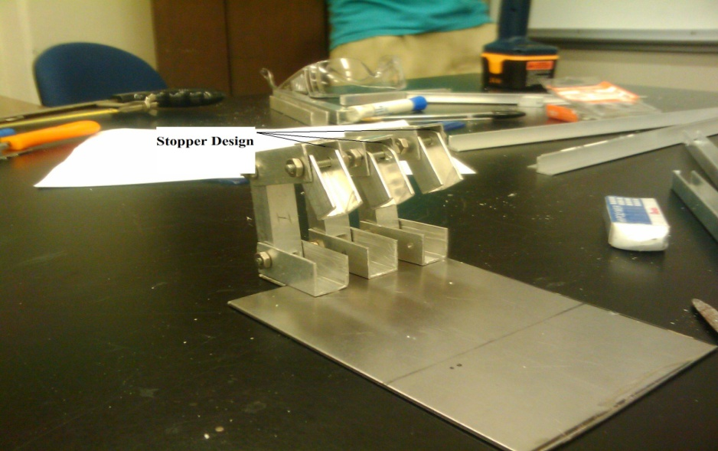
Different Stages of Design and Prototyping

Slide 42
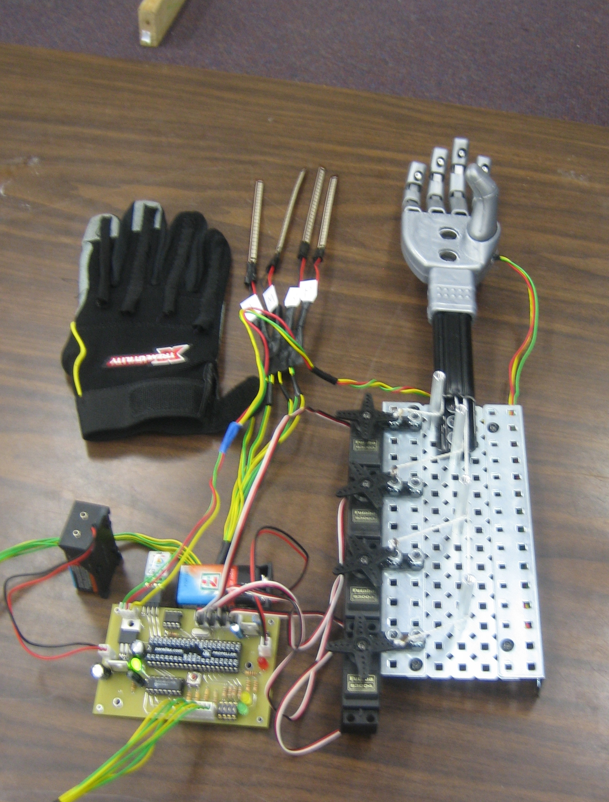
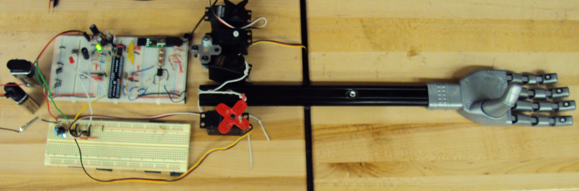
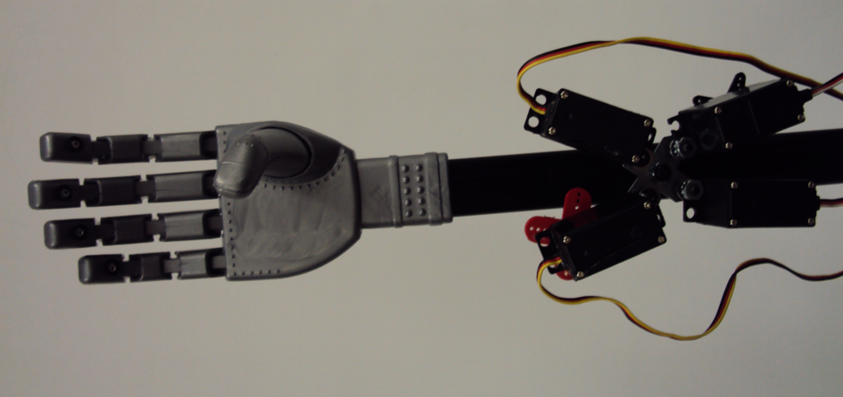
Luke’s Hand Construction Phases

Slide 43
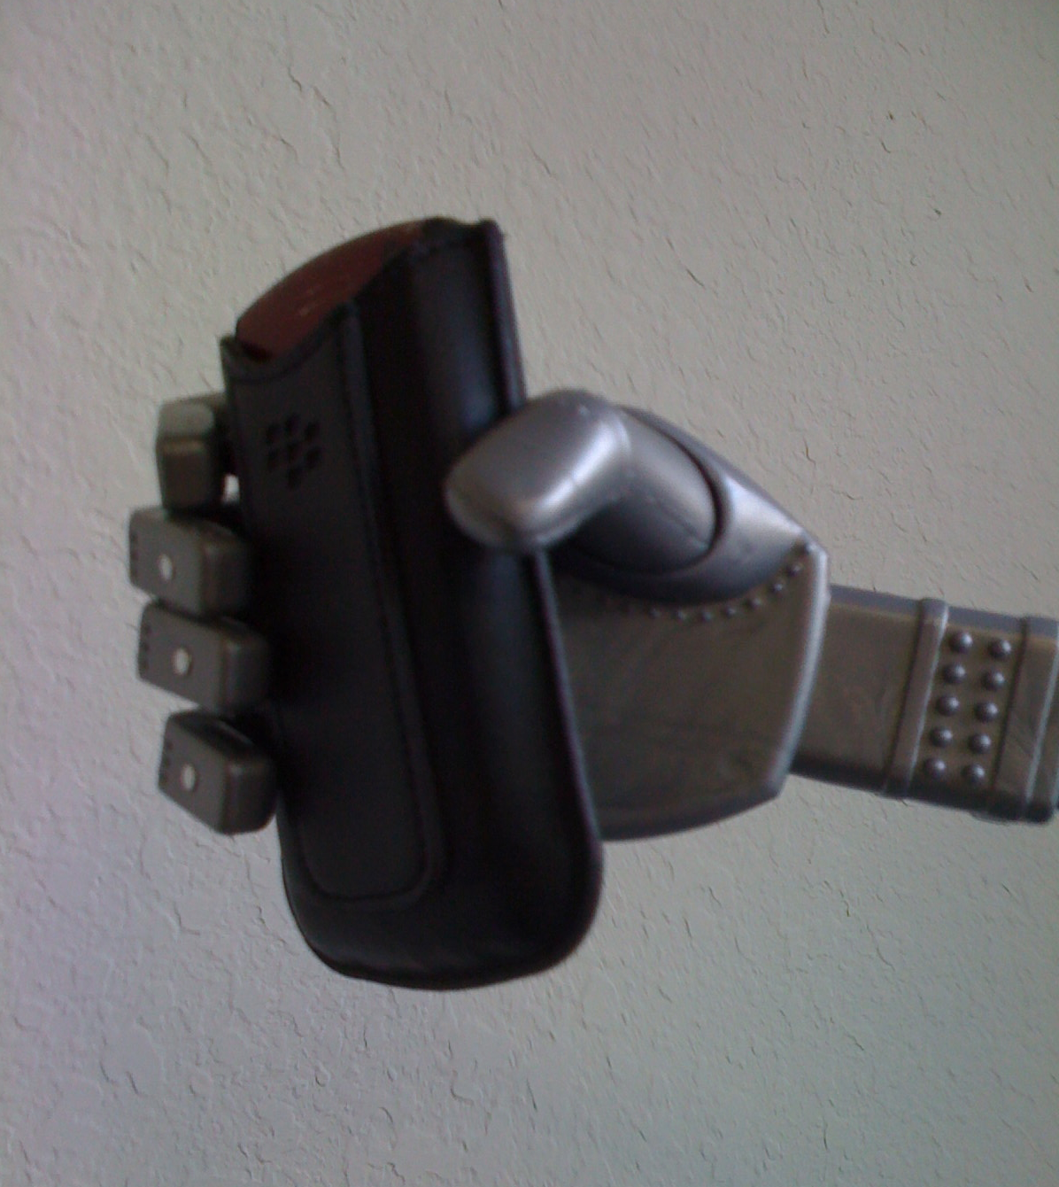
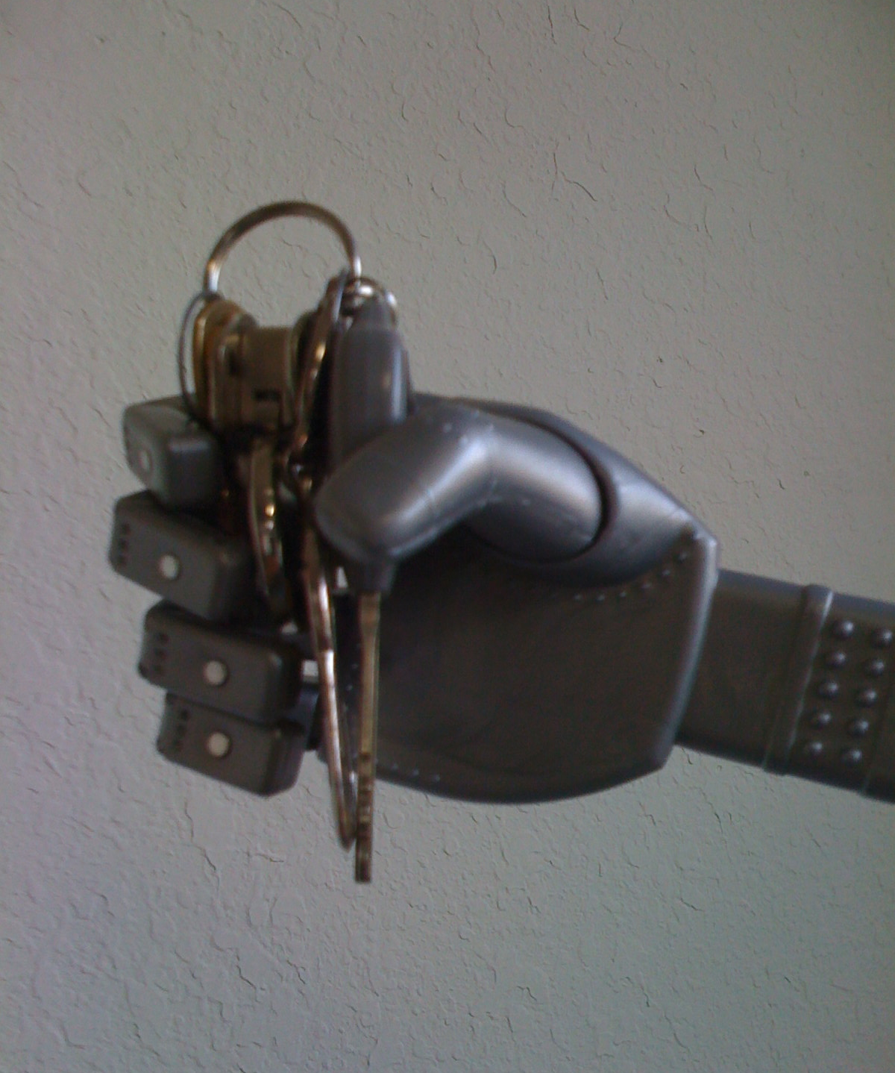
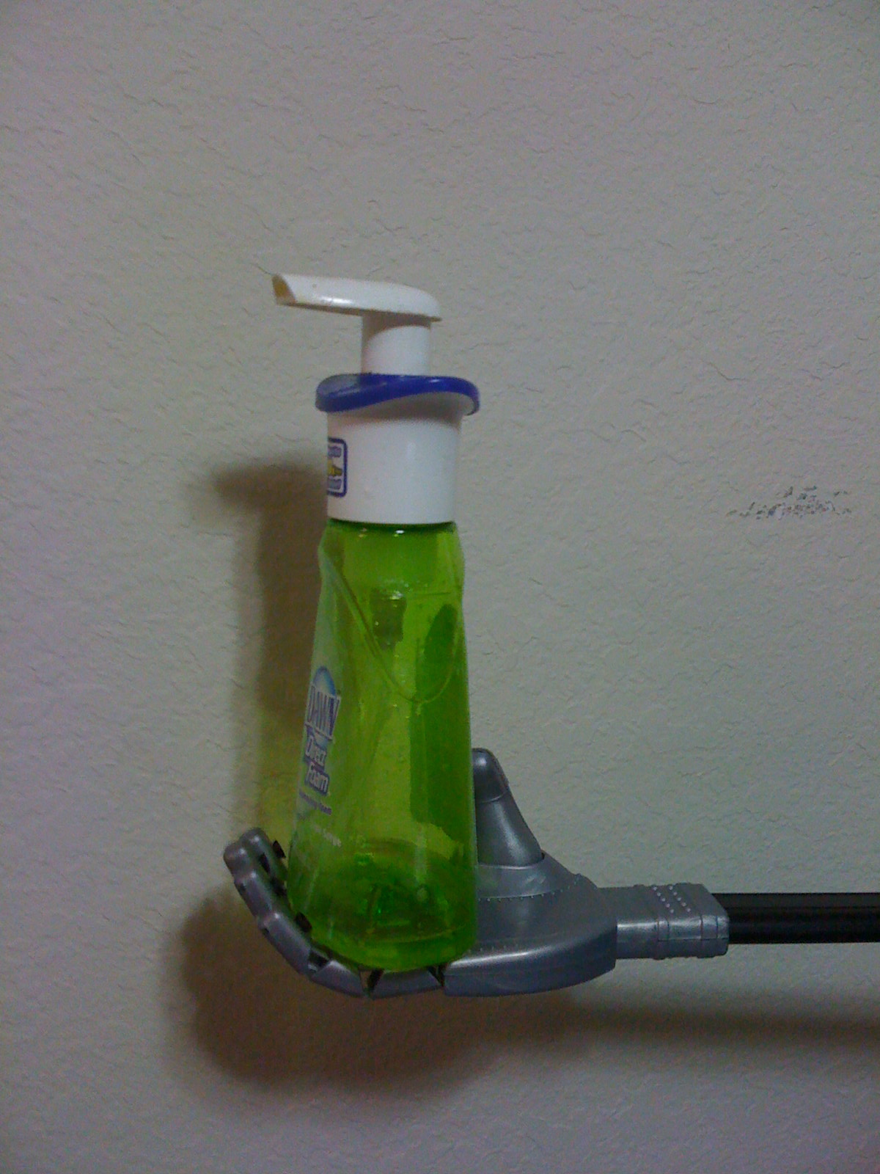
Testing and Prototyping

Slide 44
Limitations
The trade-off of using the plastic hand are reflected in:
Mechanical issues
Change of requirements such as:
Objects size
Objects weight
Force Sensor implementation
Limited space for physical integration
Compromise the tendon system

Slide 45
Limitations
Force Implementation
Data was collected using the Force Sensing Resistor and a high tech instrument from Physics Lab (Force Sensor CI-6537) and the Data Studio software. The results are as follows.

Slide 46
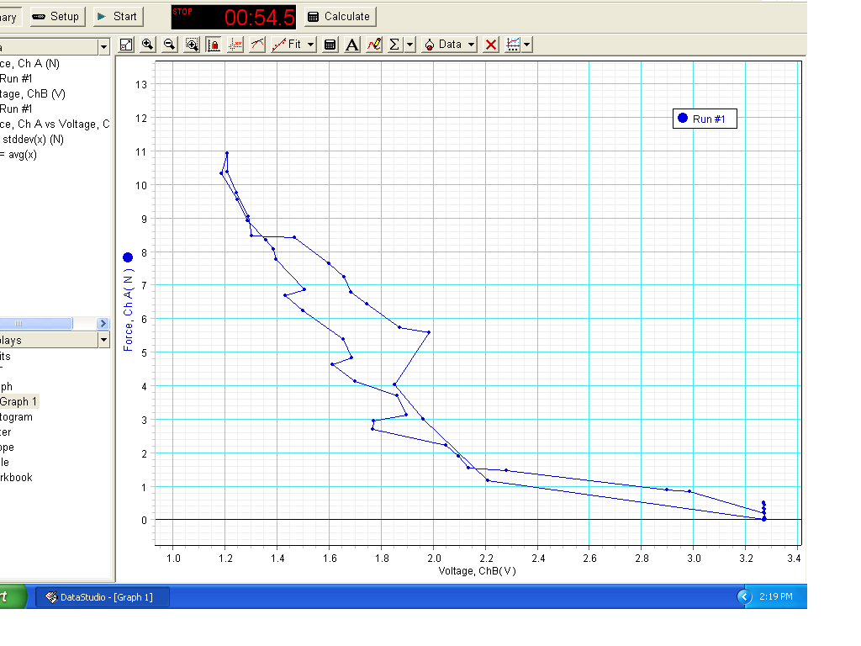
Limitations

Slide 47
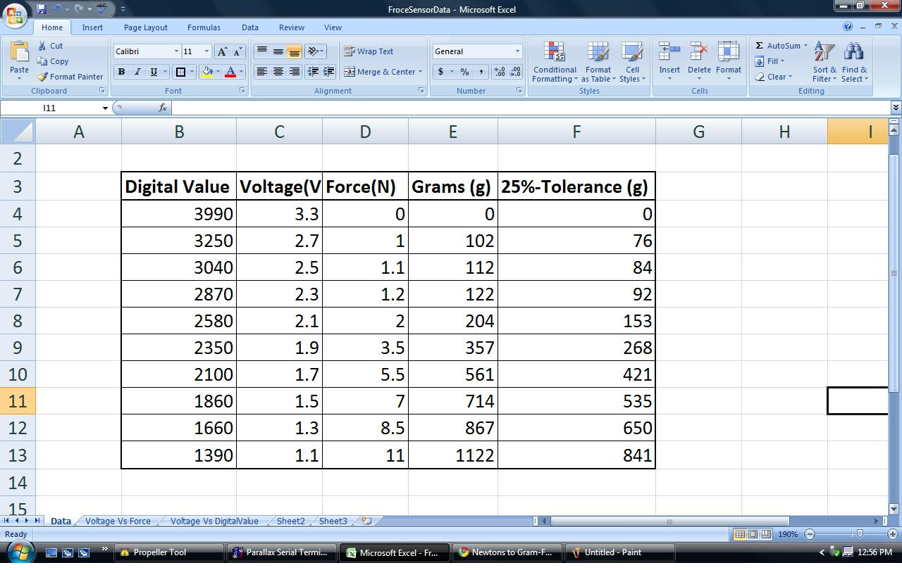
Limitations
With the experimental data collected, the following table was built

Slide 48
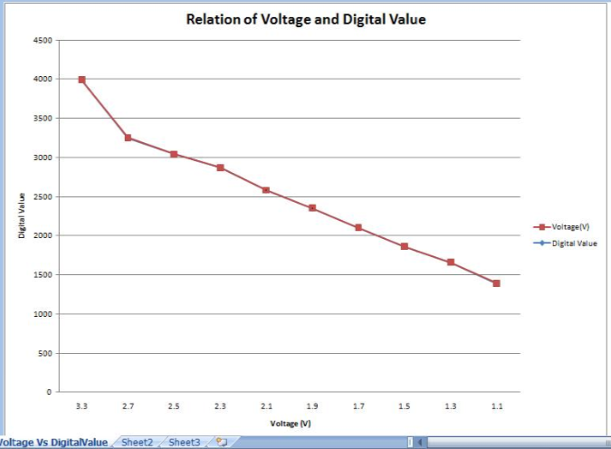

Limitations
- Experimental plots - Ideal plot (from spec sheets)

Slide 49

Limitations
This is the plot of Voltage vs Force

Slide 50
Testing
0000: Open Hand
0001: One
0010: Two
0011: Three
0100: Four
0101: Motion Sequence
0110: Love
0111: Rapid wave
1000: Soft Grab
1001: Mild Grab
1010: 2 Step Grab
1011: Sonar Detection
1100: Glove Interface

Slide 51
Budget
So far in Senior Design project. $366.34
First Hand Prototype $79.85
Propeller Educational Kit $99.99
Servos $77.94
Sensors $94.75
Darth Vader Robotic Hand $32.09
Extra Parts $61.57
We are expecting to spend $500 more.
Express PCB Board $65
Batteries $50
New Hand Prototype $200
Glove $30

Slide 52
Budget
Description | Cost | R&D | Per Unit
Tools/Supplies | $250 | 50> | --
Servos | 25*8 = $200 | 8 | 4
FlexSensors | 13*10 = $130 | 10 | 4
FSR Sensor | 7*7 =$49 | 7 | 0
Sonar Sensor | $32 | 2 | 1
Dev. Boards | $120 | 2 | N/A
MCU/ADC/ROM | $80 | 8 | 3
PCB/Components | $80 | 3, 100> | 1, >20
Other | $70 | --
Total | $1011 | $711 | $300

Slide 53

Questions ???

