Slide 1
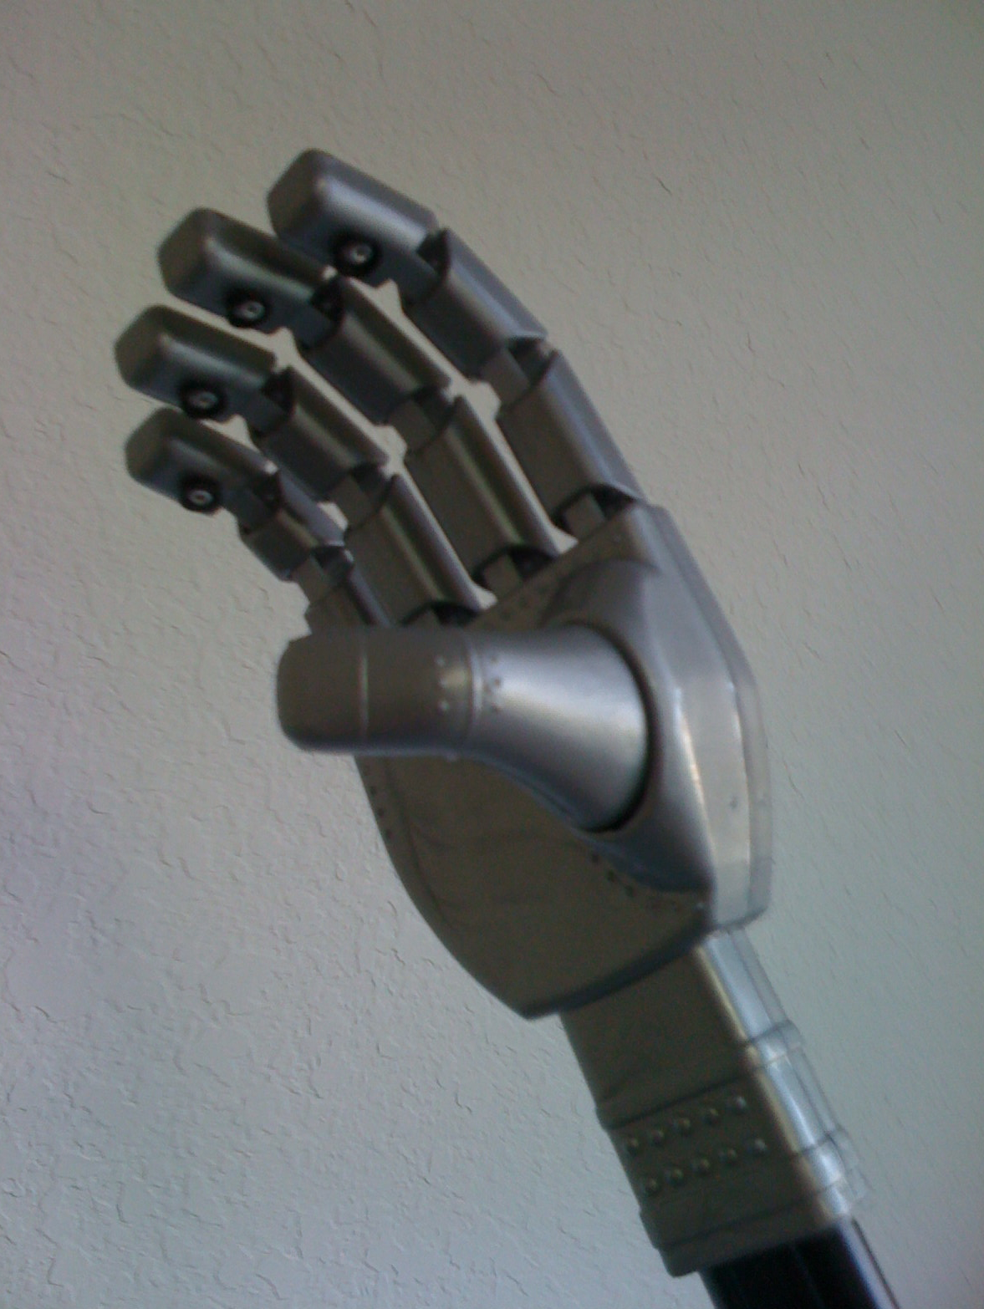
LUKE’S HAND
Group No. 6
Alex Bermudez
Esteban Guerra
Cesar Oleas
Jose Suarez

Slide 2
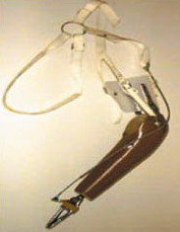
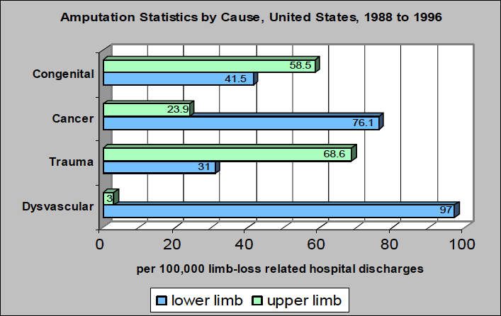
inspiration

Slide 3
Objectives
Grab Objects
Independent motion of finger
Control hand with an external
interface
Inexpensive implementation of
the hand

Slide 4
Requirements &
specifications
Detect object within 0.7”
Grab a 1 lb object with max
2.5” diameter.
FSR sensors to avoid crushing
Response time of 100ms
5. 5% error between finger position and
  the glove’s motion

Slide 5
Robotic Hand Diagram

Slide 6
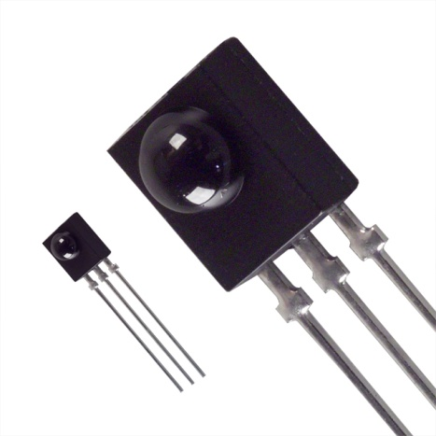

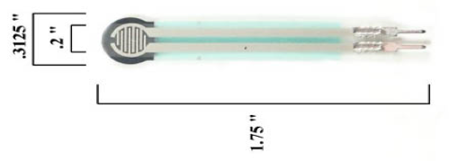
SENSORS
FSR
SENSOR
IR
sensor
Flex
sensor
3.3V to each Sensor
5 V required to work properly
2.4mA Max Current Consumption
Maximum Range Detection 10m
Variable resistance
sensor

Slide 7
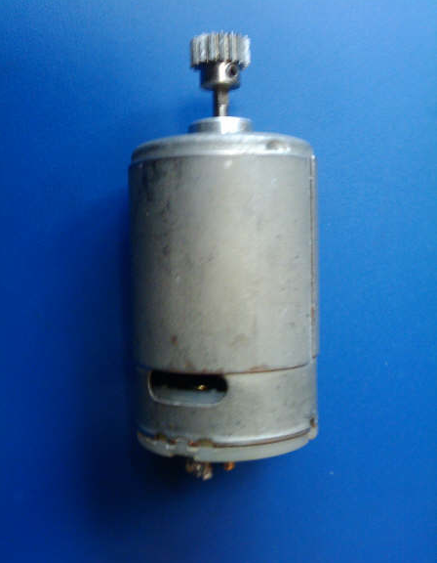
MOTORS
DC
Continuous

Slide 8
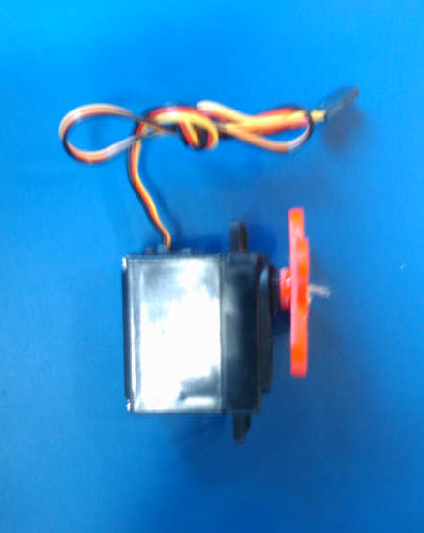
SERVOS

Slide 9
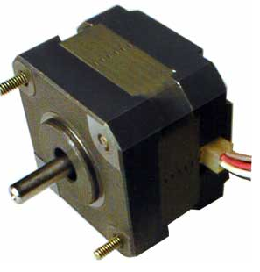
STEPPER

Slide 10
microcontroller
Although, there is a vast variety of microcontrollers and manufactures in the market, the architecture of them is whether RISC or CISC.
Critical parameters for selecting the microcontroller:
  Documentation available for the chip
  Compatible with the design specifications of the robotic hand
  Technical support offered by the vendor
  Cost of the microcontroller
  Integrated development environment (IDE)
  Overall efficiency

Slide 11
Major manufactures most used in the robotics industry
The search was narrowed to
Microchip Technology Inc
    Atmel Corporation
Parallax Inc
Zilog, Inc
    Texas Instruments

Slide 12
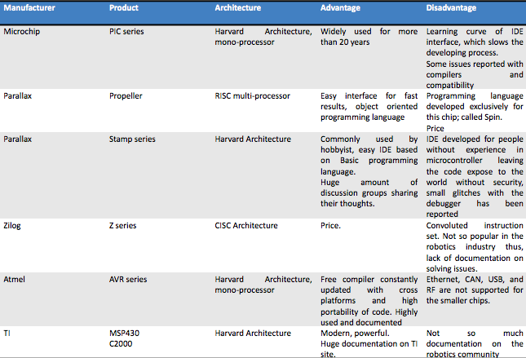
Summary table of microcontrollers considered for the project

Slide 13
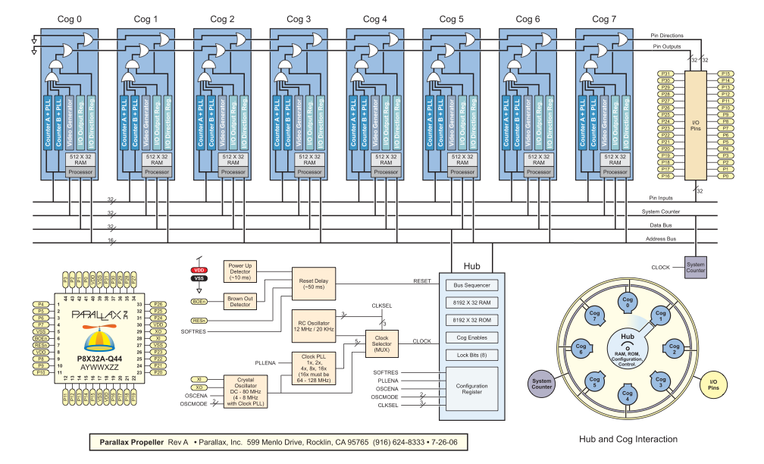
Propeller’s block diagram

Slide 14
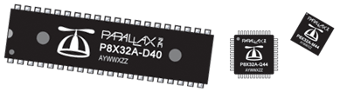
Physical characteristics of the chip
Operating temp range: -67 to +257 °F (-55 to +125 °C)
Dimensions:
40-pin DIP → 0.48 x 2.0 x 0.13 in (12.3 x 51 x 3.41 mm)
44-pin LQFP → 0.39 x 0.39 x 0.05 in (10 x 10 x 1.4 mm)
44-pin QFN → 0.35 x 0.35 x 0.05 in (9 x 9 x 1.4 mm)0

Slide 15
Integrated Development Environment (IDE)
Outstanding characteristics
At the time of programming this chip, developers have each one of the cogs available to decide how and when they should be employed
All the cogs share the same clock signal to give them a desired synchronization

Slide 16
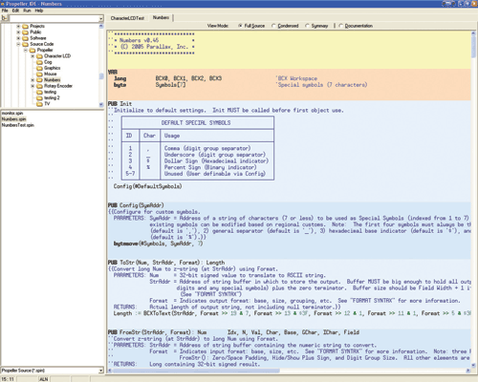
Screenshot of a Spin program

Slide 17

POWER SUPPLY
One 3.3V Propeller Microcontroller
One 24 LC256 EEPROM
Five Rotation Servos
PNA4602 (Infrared Receiver)
Five Flex Sensing Resistors
Three 0.2’’Force Sensing Resistors
Propeller Plug

Slide 18
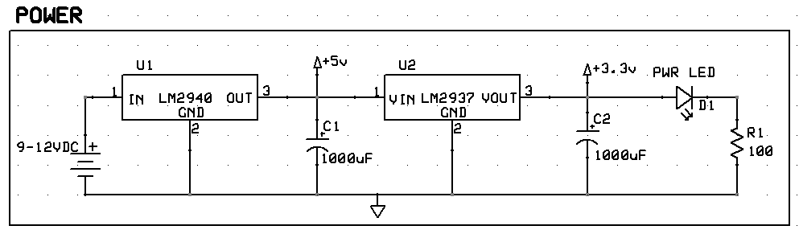
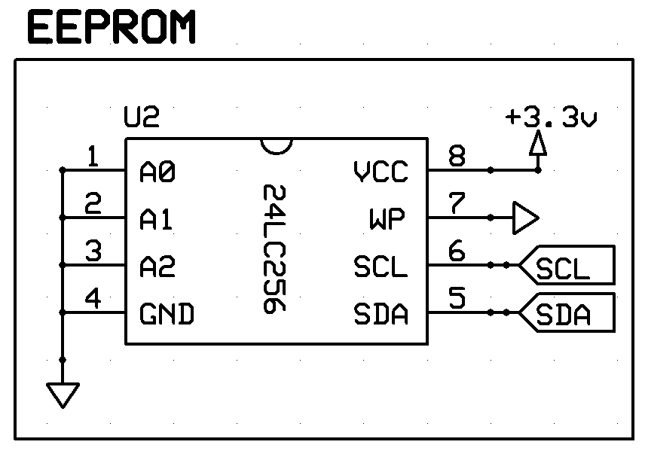
Propeller and EEPROM
Two Voltage Regulators (LM2940-5V-1A, LM2937-3.3V-500mA)
Two 1000uF Capacitors
LED Power Indicator
One 100Ohm Resistor
P28 (SDA) and P29 (SCL) interface to an external 32KB EEPROM
One 9 Volt Alkaline Battery

Slide 19
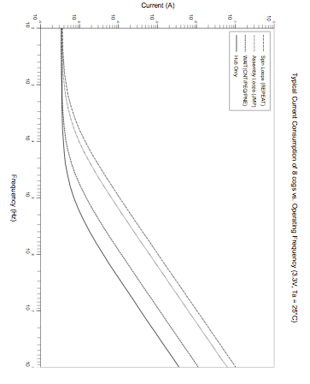
current consumption
At 80 MHz with all the 8 cogs running, the current consumption is going to be around 8 mA

Slide 20
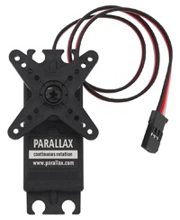
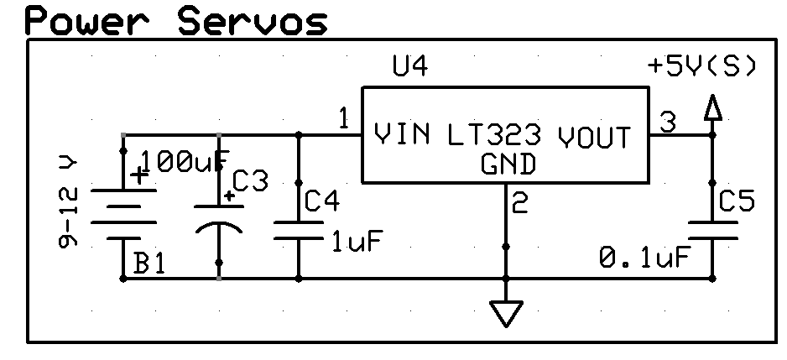
Servos
Require 5V to operate
Current Draw:
  No motor movement is 9.6mA
  Motor movement 115mA but no load
  Motor movement and load it can reach up to 250mA
Five servos with load can reach up to 1.25 A in the worst case
Linear Voltage Regulator: LM123(5 V – 3A)
Important to have separate Battery (9-12Volts)

Slide 21
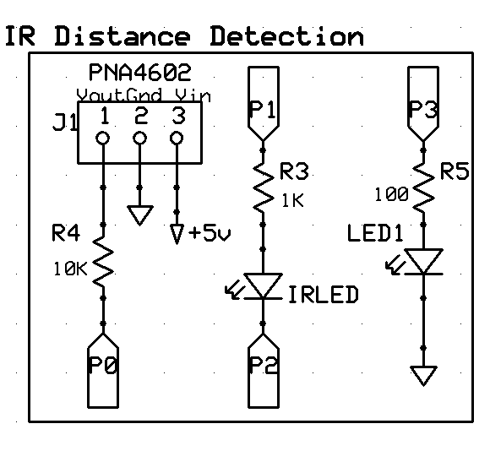
Infrared Receiver
Distance Range control by R3, larger its value shorter the distance range
A Propeller cog’s counter can be used to generate the 38KHz for the IRLED to broadcast for IR Detection Control
LED1 will turn on every time an object is detected.
P0, P1, P2, P3 are the pin numbers in the Microcontroller

Slide 22
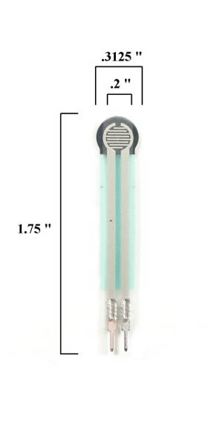
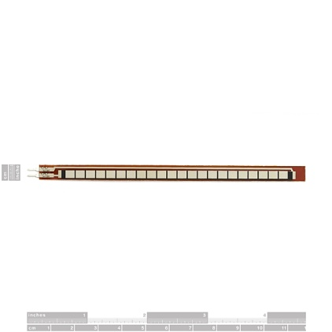
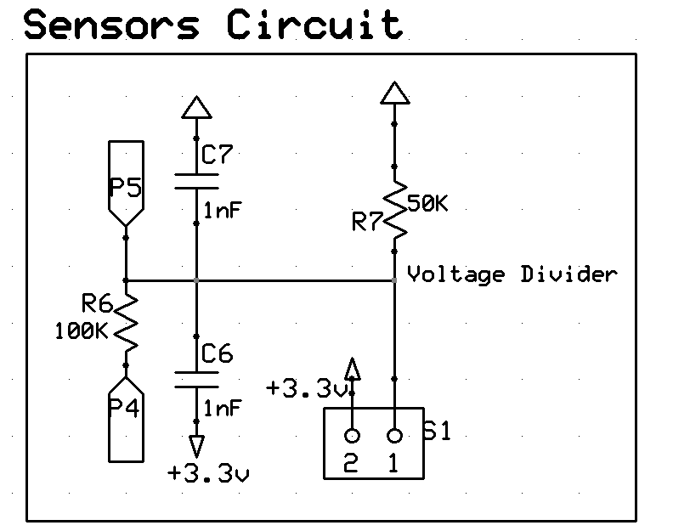
Sensors
Same circuitry for all of them
Voltage Divider is used to read changes in the variable resistance sensors
Microcontroller will perform Analog to Digital Conversion
Sigma-Delta ADC is used for the conversion.

Slide 23
Software Approach
MCU Selection
  Real Time System
  Multiple I/O Pins
  Easy programming
  Enough RAM and ROM
  Clock Speed
  Object Oriented Language
  Multiple Cores
  20+ I/O Ports
  C/Java like language
  64KRAM/32KEPROM
  80Mhz
  Modularity

Slide 24
Software Approach
Propeller (Parallax) MCU is Programmable in:
  Spin (Object Oriented and Java-like language)
  Assembly
  C ( Commercial solution, cost around $100)
  ImageCraft

Slide 25
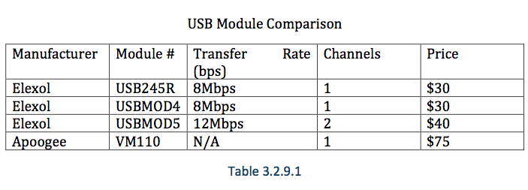
Interfaces (Data Protocols)
USB, FireWire (IEEE 1394), Serial, etc.
Cost? Data rate? Compatibility? MCU Support?
Parallax ProPlug: USB Interface: $20

Slide 26
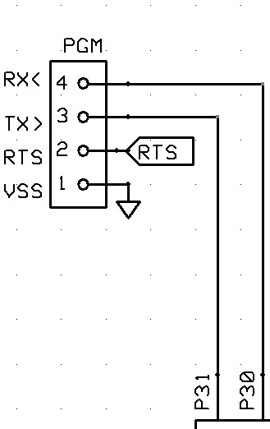
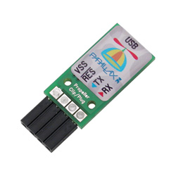
Propeller Plug
Used to provide an USB-to-Serial port connection that is convenient for Microcontroller programming and communication.
Capable of asynchronous communication up to 3M baud with 3.3V and 5V devices such as the Propeller.

Slide 27
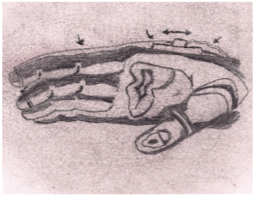
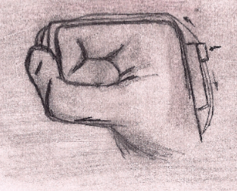
Glove Interface
Individual finger motion
Human - Robot Interface
Flex sensor integration

Slide 28
Glove Interface
Flex Sensors
  A/D Converter
  Function to calibrate the sensors
  Find relation between voltage from sensors and pulse to control servos
Use an unique Cog to process the input from each sensor (Parallel Programming)

Slide 29

Glove Interface
Main Cog will create five instances of the object Finger, and assigned them to 5 different cogs.
Each object will read the input from the Flex Sensors, convert the voltage to a pulse, and send the pulse to the correct servo-motor.

Slide 30
Switch based Control panel
Ideal for testing
Each switch will control a given function of the hand
No need to have the glove interface to test the
mechanics
Use the Object detection and slip prevention
functionality

Slide 31
Schematic and PCB Design
ExpressPCB is the software chose for this project. Easy to use and it is free to download.
Express Schematic offers error checking connection, which alert the designer of any miss connection or error in the schematic.
ExpressSch includes a large library with hundred of components symbols.
When the schematic is complete, it can be linked to the circuit board layout file. This option makes really easy to design the PCB layout.
After PCB Design is done. ExpressPCB offers a cheap price for PCBs: $51 for three 2-layer boards, $98 for three 4-layer boards

Slide 32
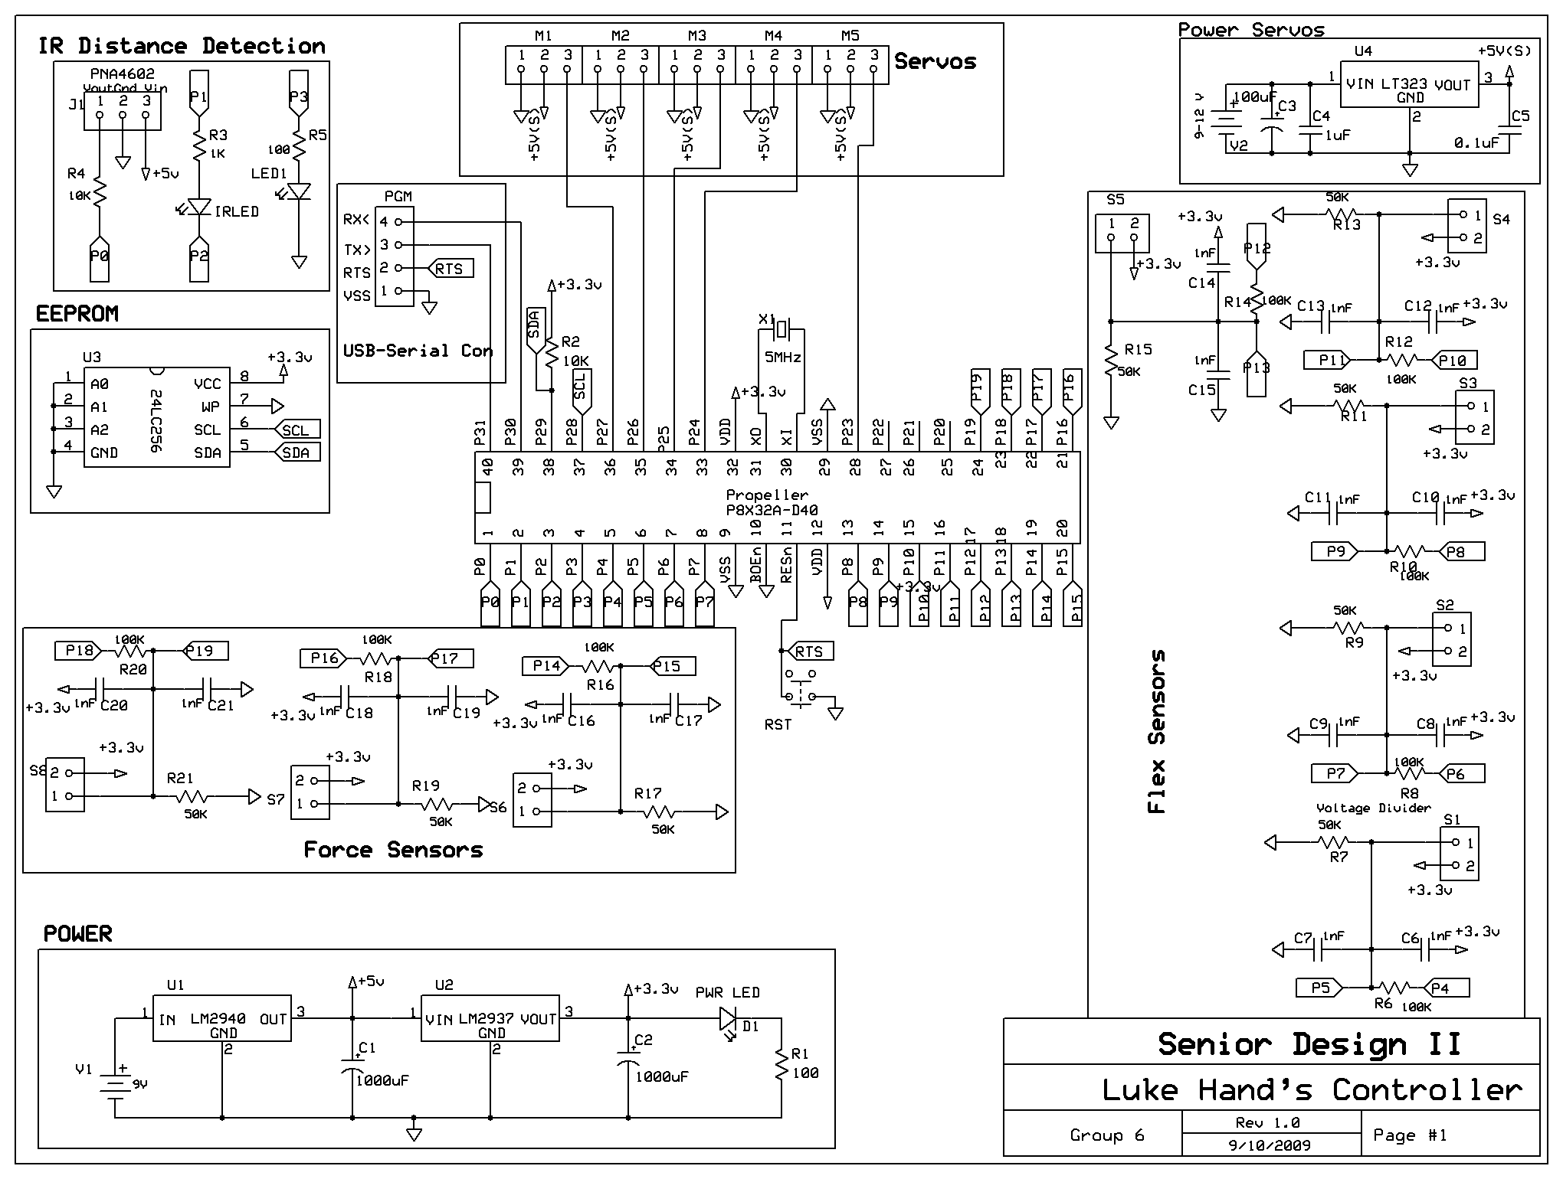
Schematic

Slide 33
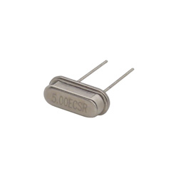
5MHz Crystal HC-49
For application that are timing sensitive like serial communication, tone generation, servo control and time keeping. It is recommended to use a 5MHz crystal.
For Servo Control, it is better to use a system clock of 80MHz
CON
_xinfreq = 5_000_000
_clkmode = xtal1 + pll16x
System Clock = (5MHz * 16) = 80MHz
Pll1x, pll2x, pll4x, pll8x, plla16x
This crystal is efficient and cheap $1.10

Slide 34
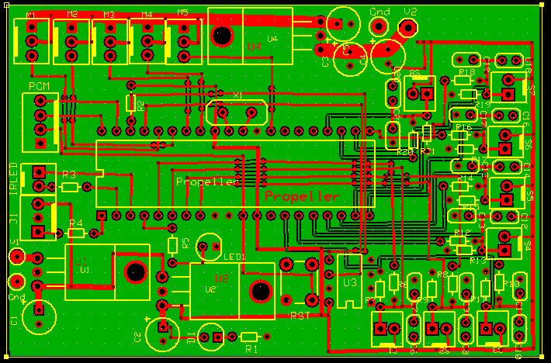
PCB Design Tips
When building a PCB, it is important to have a common ground for all the components in order to reduce noise.
The traces for power supply has to be bigger that the traces for signal because power supply carries large amount o current and space it’s needed to carry all of it.

Slide 35
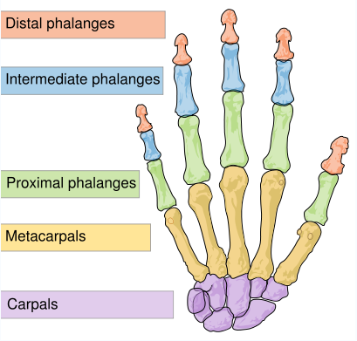
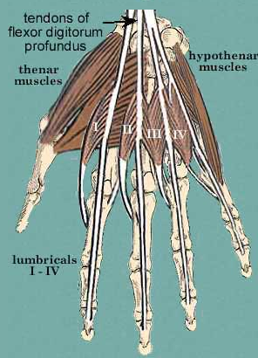
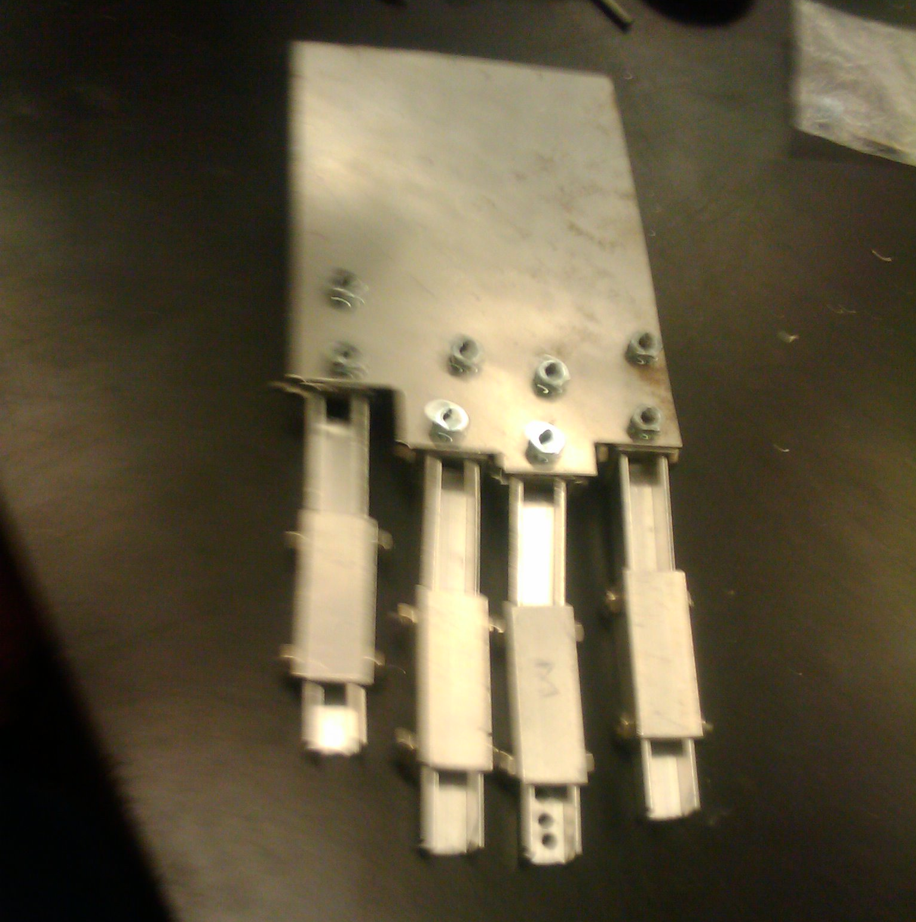
Design background

Slide 36
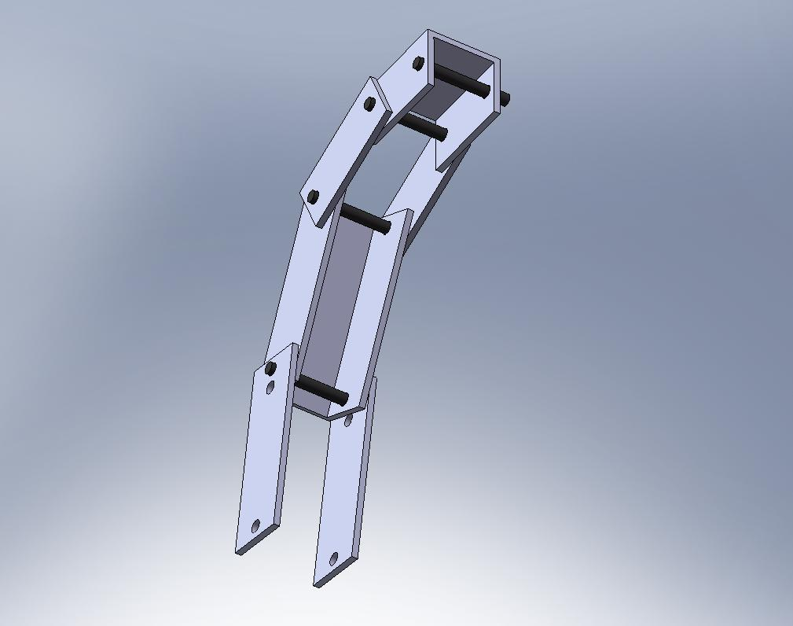
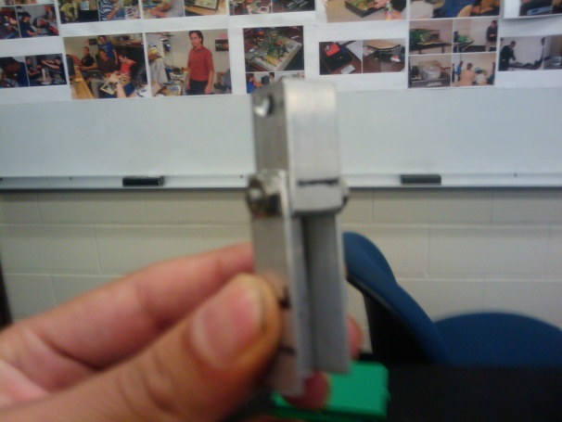
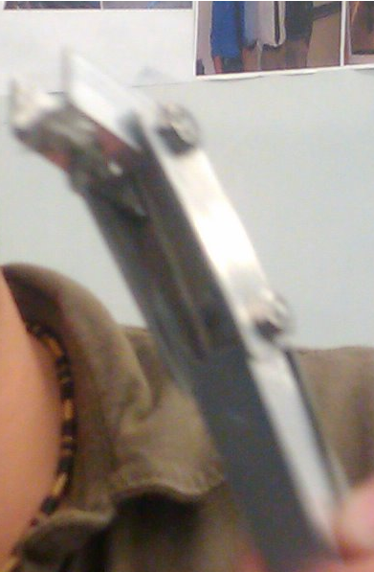
Evolution of
mechanical design
First approach
Second approach
Third approach

Slide 37
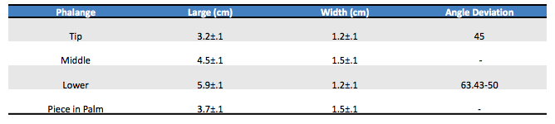
MEASUREMENTS
Phalanges’ measurements and angles of deviation required for each finger

Slide 38
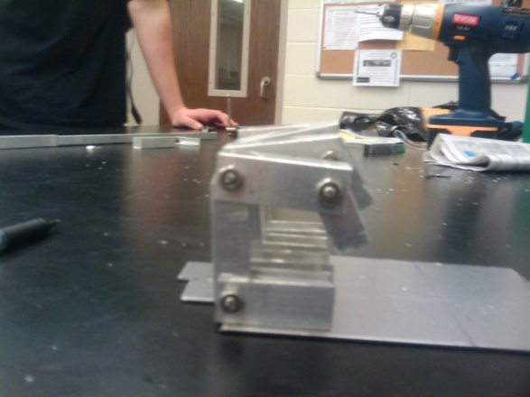
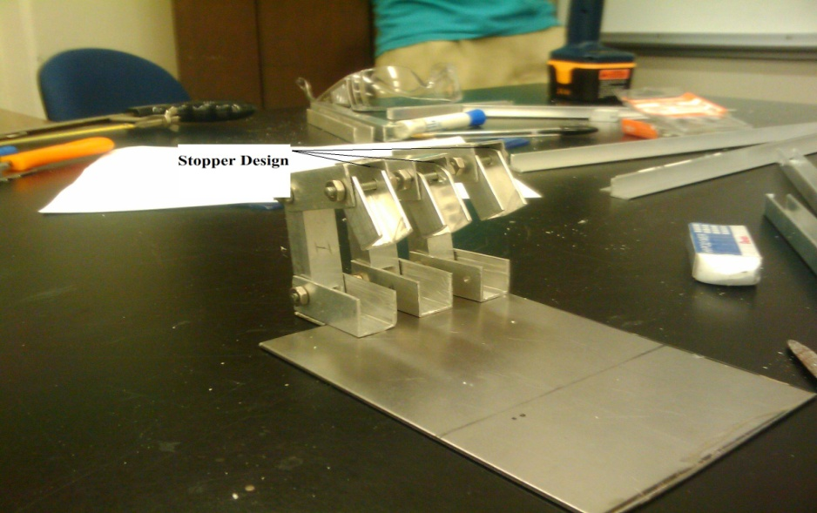
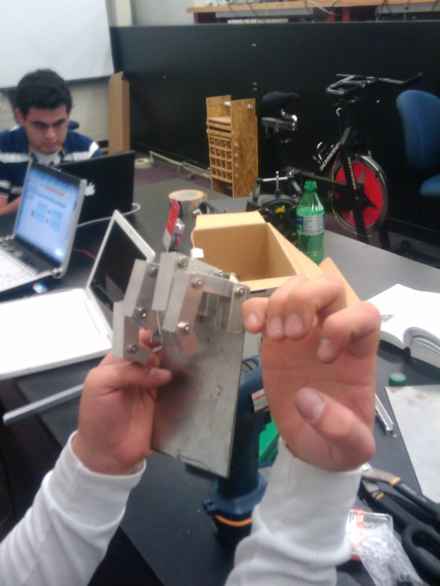
Different stages of design and prototyping

Slide 39
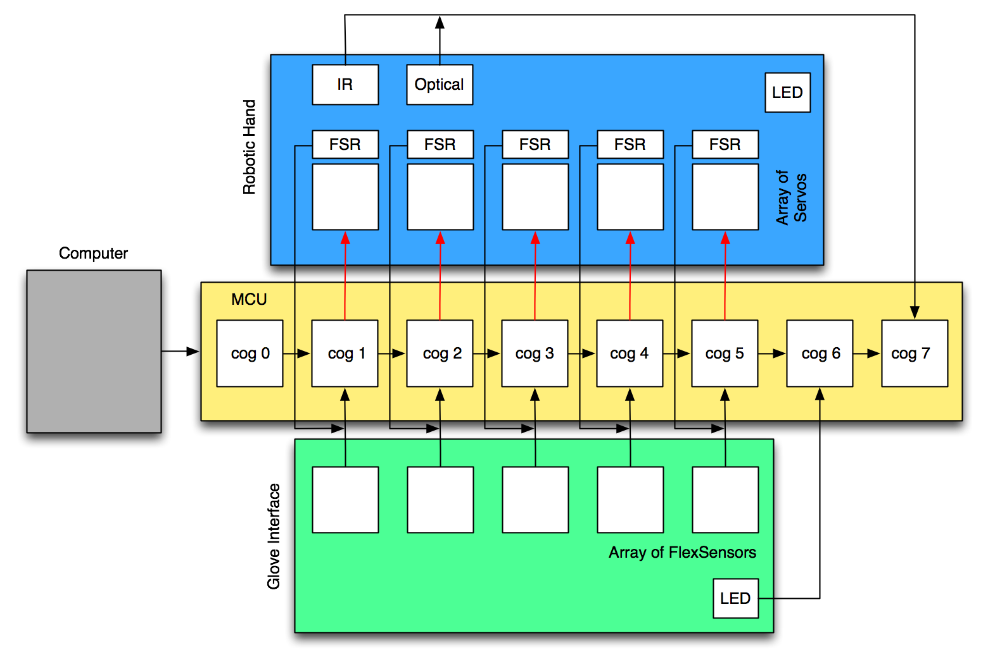
Control diagram

Slide 40
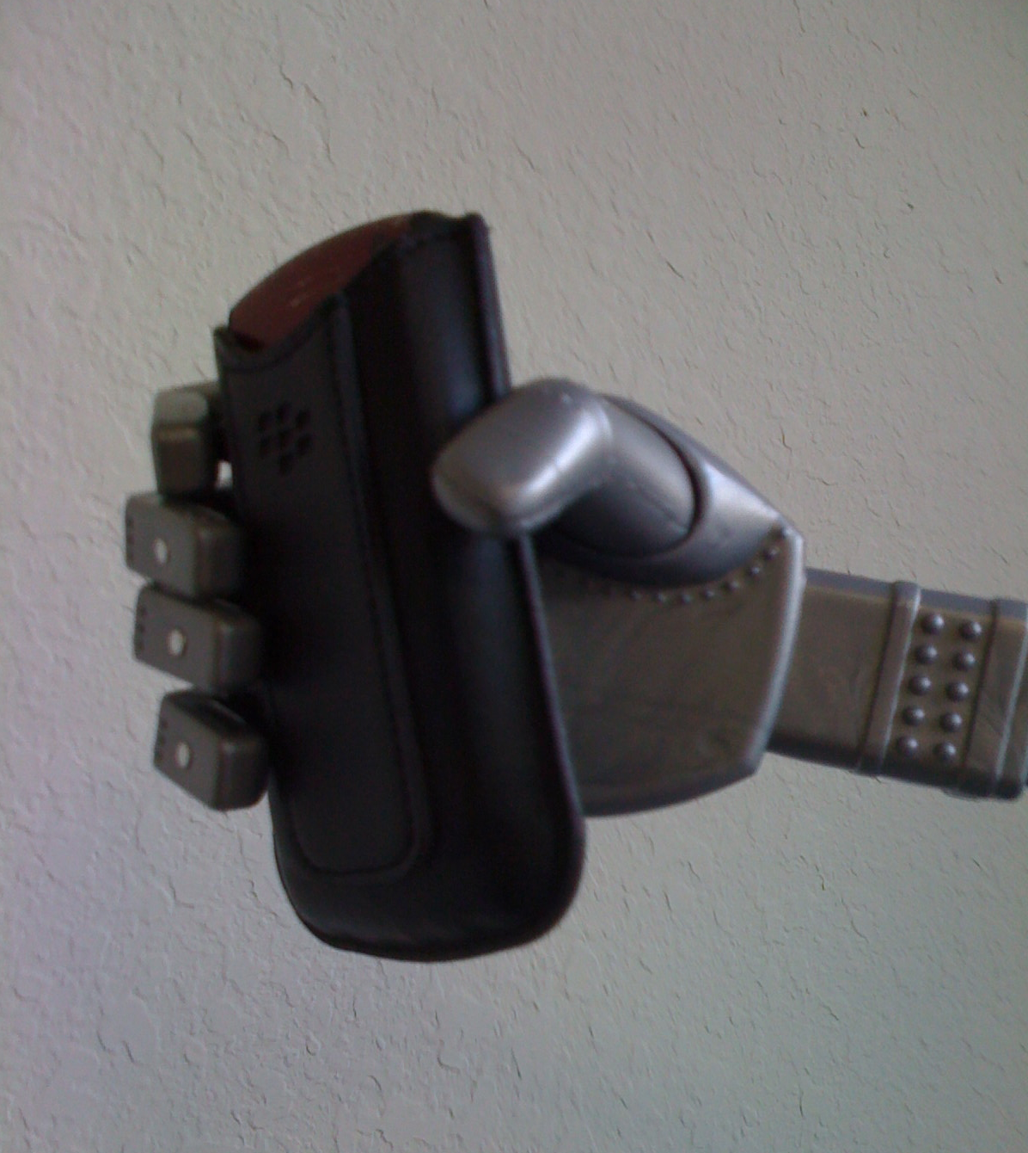
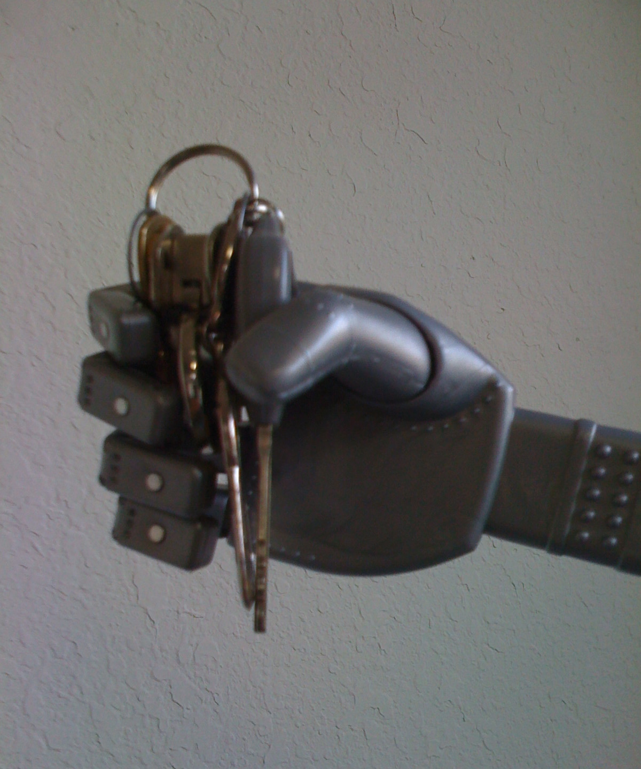
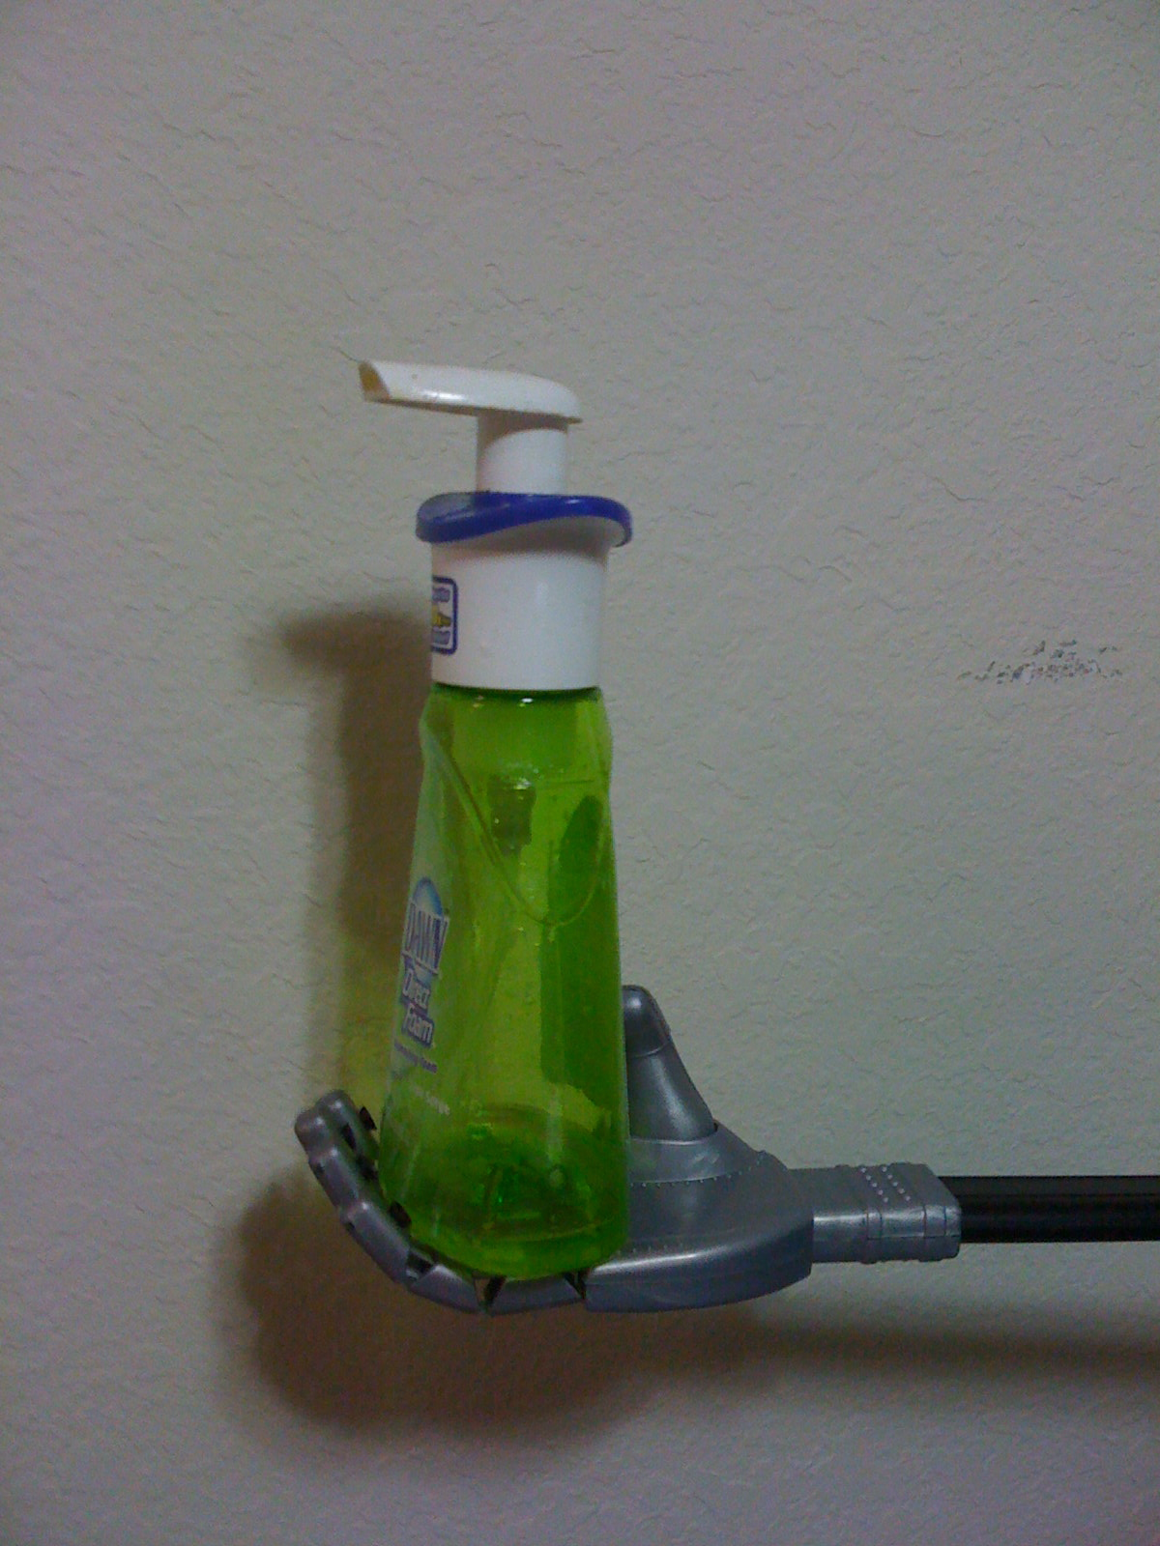
Testing & prototyping

Slide 41
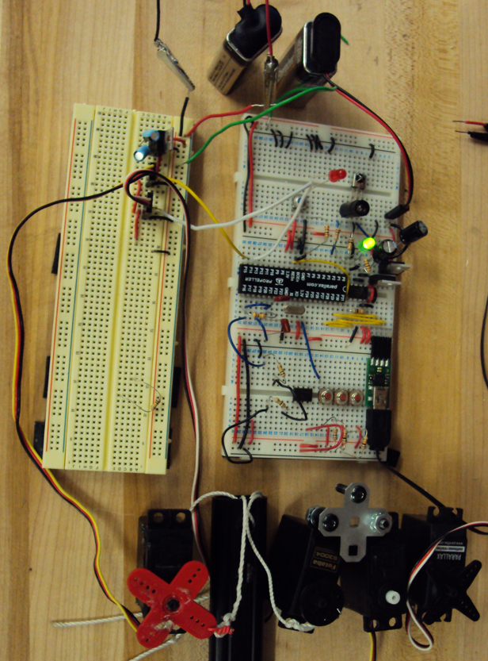
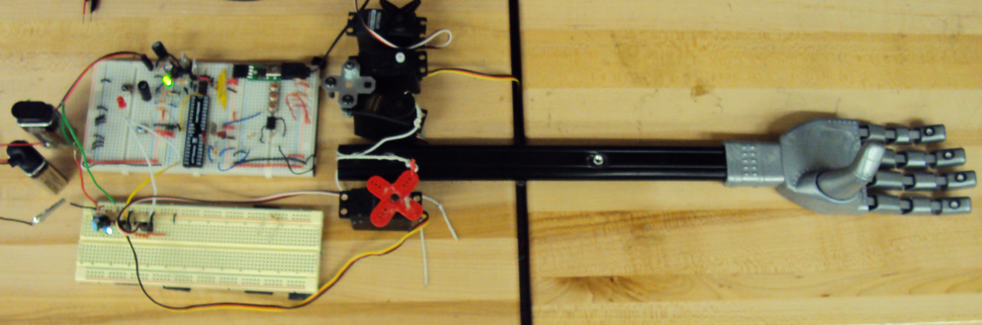
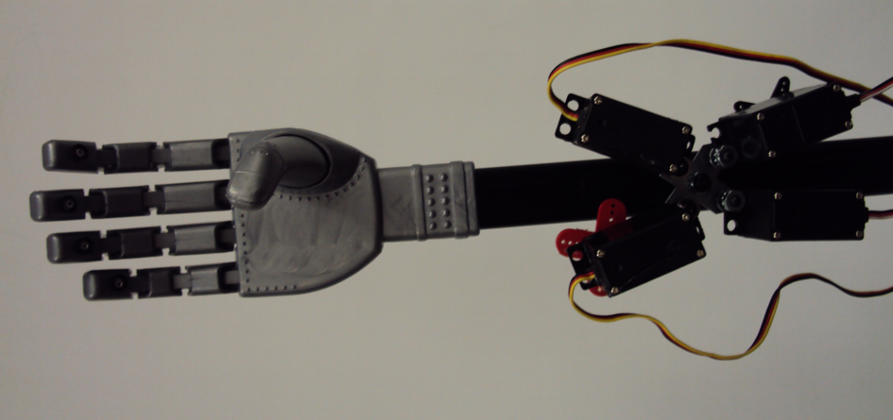
Testing & prototyping

Slide 42
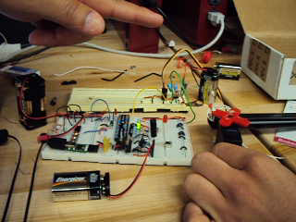

Slide 43
Expenses
So far in Senior Design project. $563.34
First Hand Prototype $79.85
  Propeller Educational Kit $99.99
  Servos $77.94
  Sensors $94.75
  Darth Vader Robotic Hand $32.09
  Tool and Materials $178.57
We are expecting to spend about $500
  Express PCB Board $51
  Batteries $20
  New Hand Prototype $180
  Glove $30

Slide 44
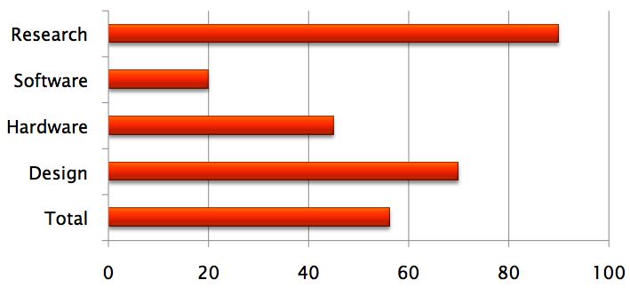
Progress Report

Slide 45
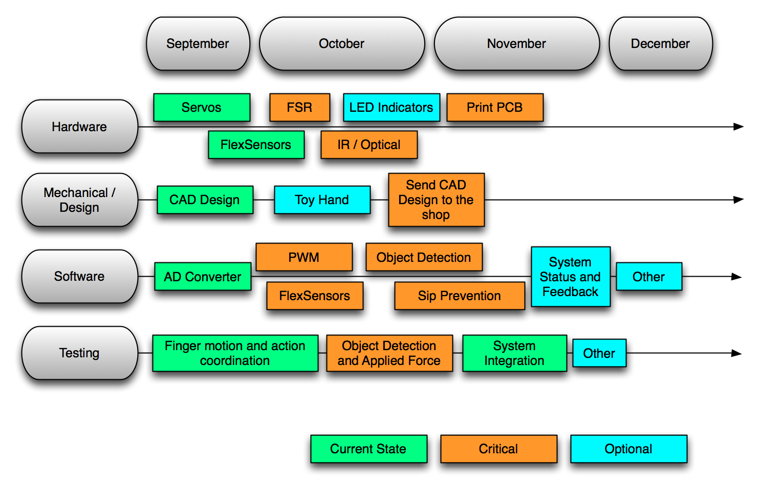
Intended agenda

