Slide 1
A2D
Group #4
Chris de Guzman
Jon Gonzalez
Frank Reed Jr.
Paolo Ronquillo
Analog to Digital HUD/PMD Instrument Cluster with Touch Screen Command Center

Slide 2
Agenda
Project introduction and overview
Design Approach
Overall Specifications
Simulation Design
Sub-System presentation
Administrative
Design Changes
Current status vs. Milestone chart
Questions?

Slide 3
What is it?
Digital Instrument Cluster
Replacement to a traditional analog cluster
Draws information from various sensors
Pseudo Heads Up Display
Supplements the main cluster
Touch Screen Interface
Menu Driven UI

Slide 4
Goals and Objectives
The Displays should show typical vehicle data
Analog Gauges will be replaced with digital representations
Typical control knobs will be represented in the vehicle simulator

Slide 5
Design Approach
Simulation
Modular – customizable
Mobile – easy to transport
Less Risk – no damage to a real vehicle

Slide 6
Design Approach
2 Sub-Systems
A simulation sub system, controlling the HUD/PMD, with a gas pedal, seat and LCD.
A sub system for the touch screen which provides an interface for ambient temperature and compass.
This allows independent development
Each sub-system is developed individually
Minimizes dependencies between systems
Project can continue to progress despite delays in other systems

Slide 7
Simulation Design
The simulation of the dash board will be in a 4’ wide x 4’ tall x 2’ deep wooden box.
16”
48”
48”

Slide 8
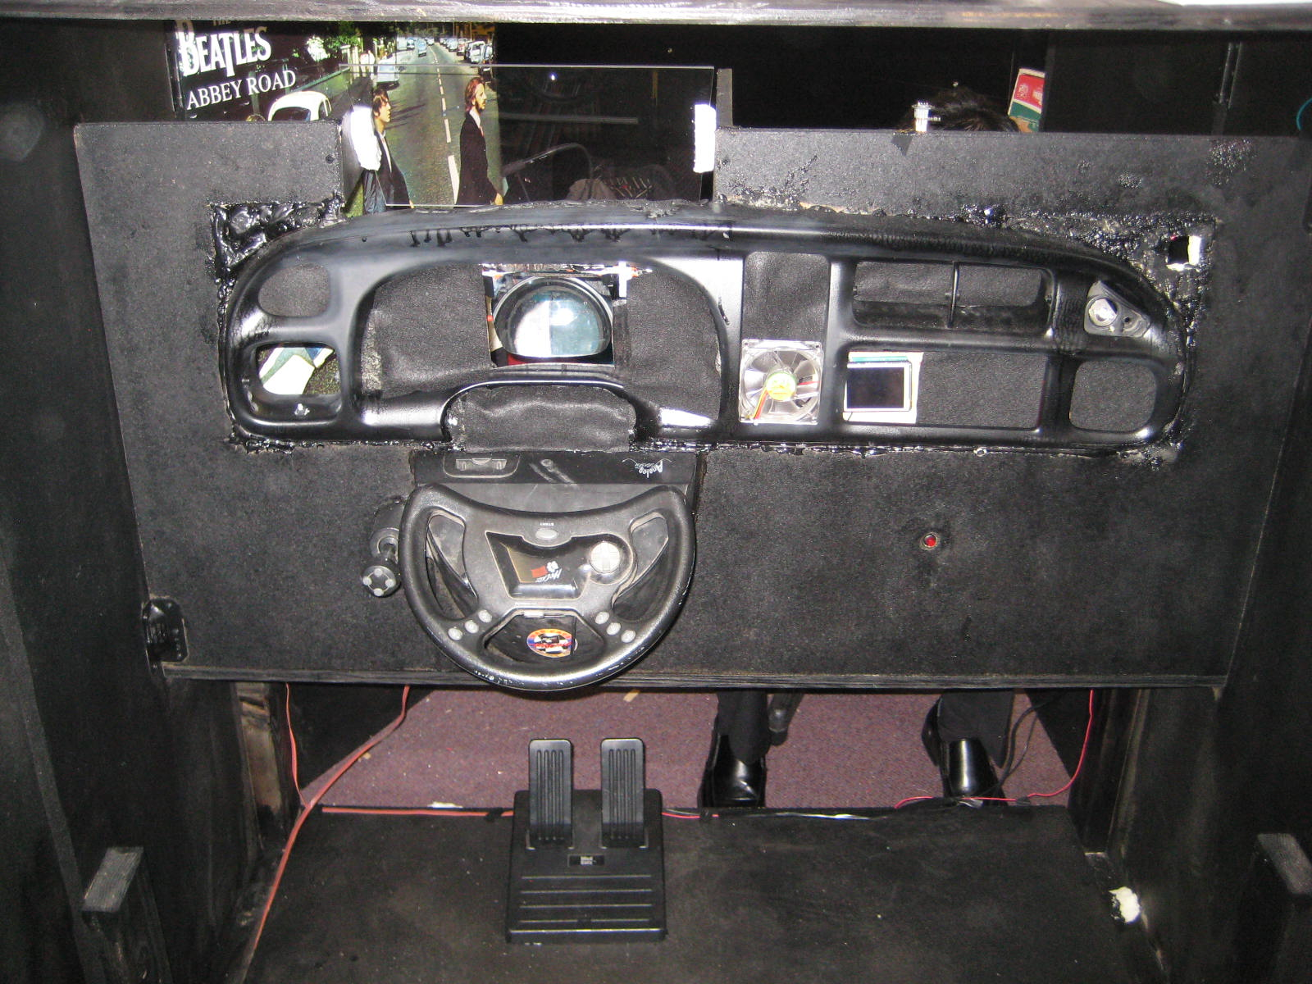
Inside the Simulation (Front)
Inside the front, the user will see the custom dashboard.
There will be a main button to power on the instrument cluster, which can be changed from dashboard to windshield and to turn on the touch screen.
Insert front image

Slide 9
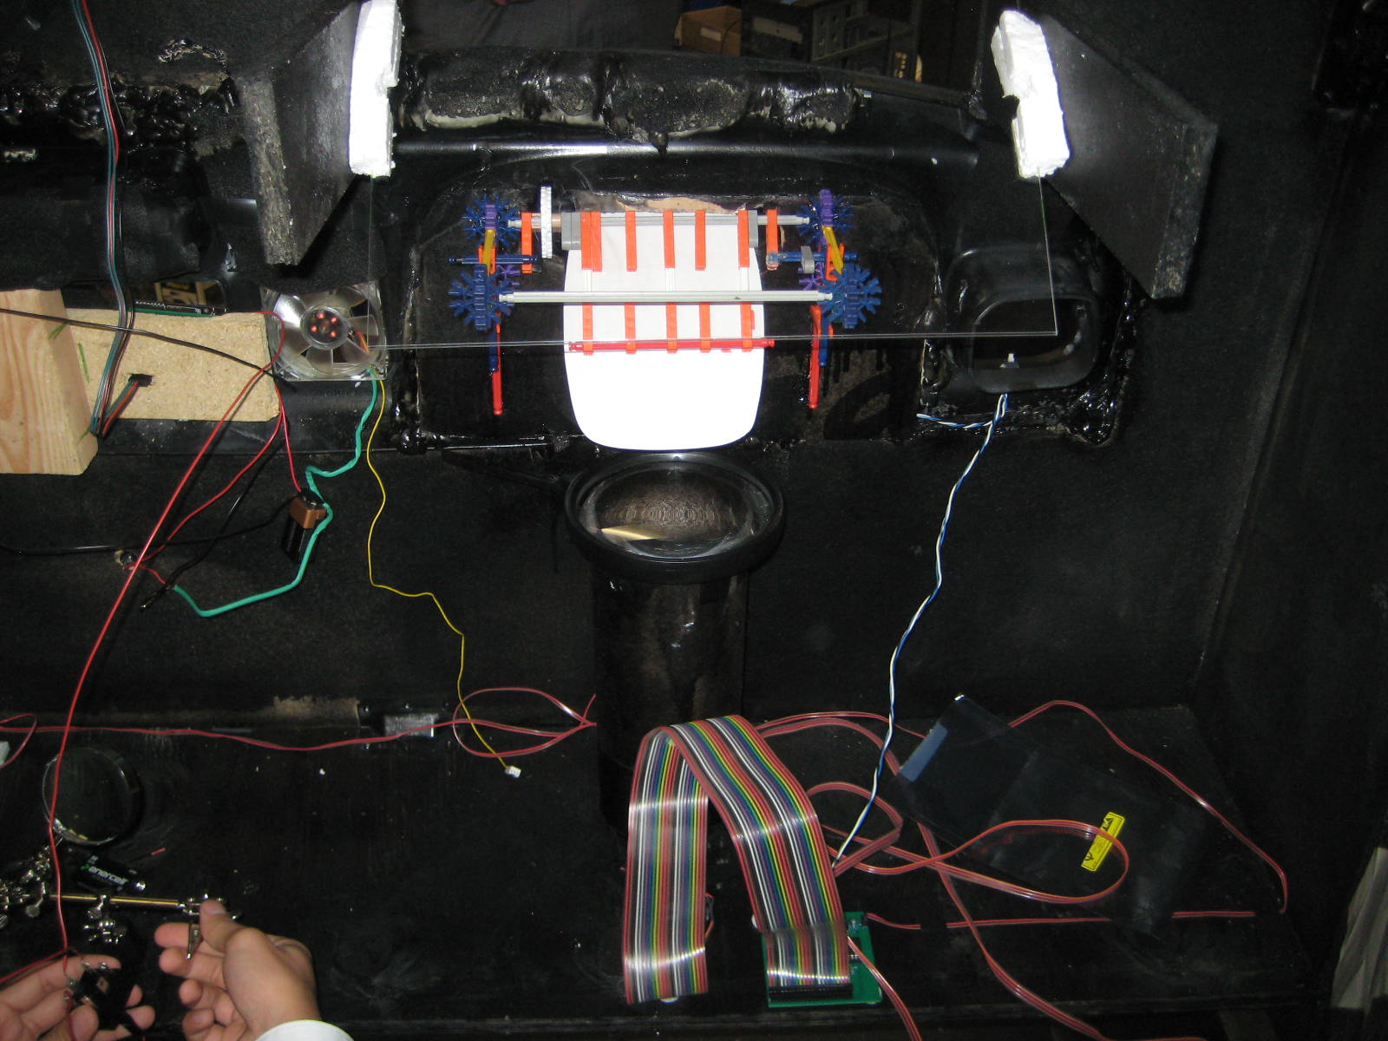
Inside the Simulator (Rear)
Inside the rear, there will be all of the electrical components and optical equipment.

Slide 10
Specifications
The system shall be powered by 9 volts.
The instrument cluster, HUD and touch screen shall have a 60 ° viewing angle.
The instrument cluster and touch screen shall be able to be viewed at 30 inches
The Ambient Temp sensor shall operate at a ±2.0°C accuracy.
The Compass field range shall be of at least ±2.0 gauss.
Occupant detection sensor Shall operate when no less than 10lbs. of force is detected.

Slide 11
Overall BD
L
C
D
Car data controller
Buckle
Gas pedal
Flex Sensor
Touch screen MCU
Compass Sensor
Temperature Sensor
TS controller
regulator
TS Display
9 volt PS

Slide 12
Sensors

Slide 13
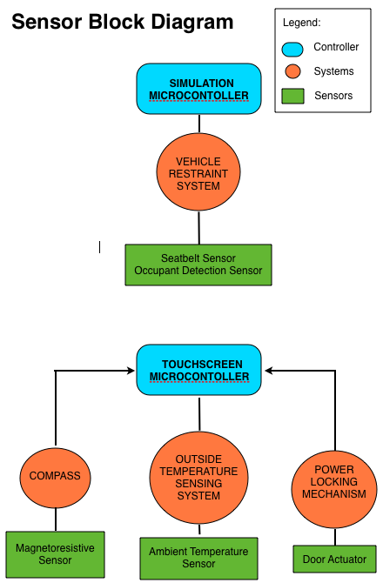

Slide 14
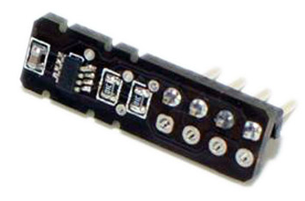
DESIGN & COMPONENT DECISION
Outside Temperature Sensing System
TMP421
12 bit I2C chip
1 Bi-directional data pin1 Clock pin
-40 to 125 degrees with +/- 1 degree C
Resolve .04 degrees C per bit
Arduino Compatible
Mapping:
Analog 2 = Ground Analog 3 = Vin Analog 4 = Data Analog 5 = Clock

Slide 15
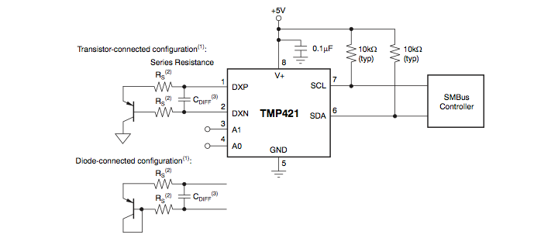
Outside Temperature Sensing System Schematic
***DXP/DXN pins were not used because
These are for remote temperature sensing

Slide 16
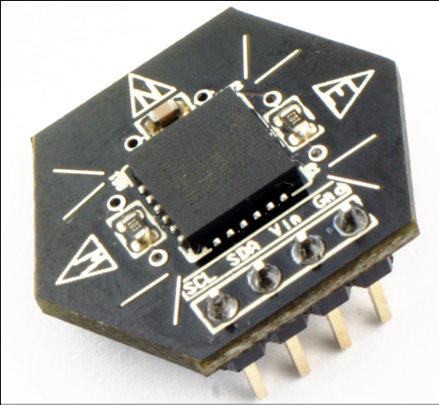
DESIGN & COMPONENT DECISION
B) Compass
Honeywell HMC6352
2-axis magneto-resistive sensors output (0-360 degrees)
I2C 2-Wire Serial Interface
3 output modes: Standby, Query, and Continuous
Heading accuracy: 2.5 degrees
Heading resolution: 0.5 degrees
Arduino pin compatible+5V Tolerant I/O
Analog 2 = Ground Analog 3 = Vin Analog 4 = Data Analog 5 = Clock

Slide 17
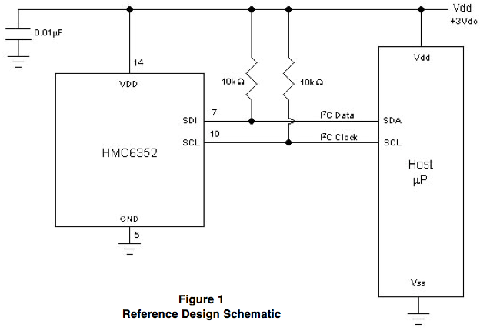
Honeywell HMC6352 2-Axis Magnetic Sensor Schematic

Slide 18
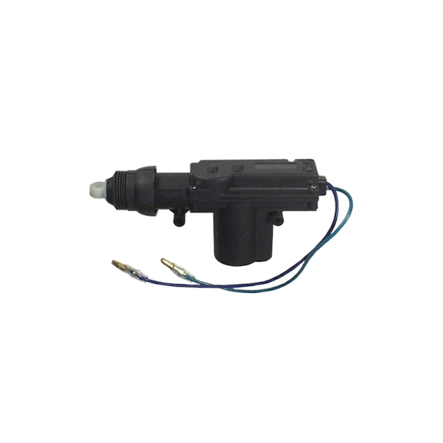
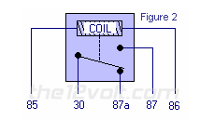
C) Power Locking Mechanism
2-Wire Door Lock Actuator
Commercial Car door Actuator
+/- 12V Operating Voltage
1 Amp Operating Current
Relay
12 Volt Operating Voltage
SPST (Single-Pole Single-Throw)
Automotive Rated Relay

Slide 19
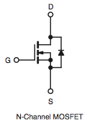
Power Locking Mechanism Schematic
12V
5V
RELAY 1
12V
RELAY 3
5V
RELAY 2
12V
12V
12V Door Actuator

Slide 20
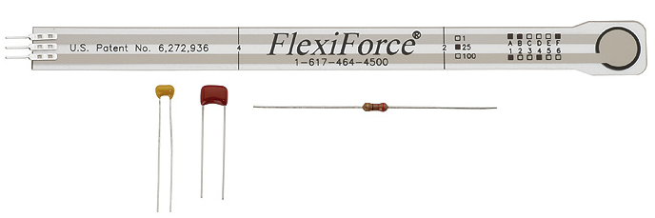
D) Vehicle Restraint System
1) Seatbelt sensor
Digital ON/OFF controlled by Simulation Controller
Actual Automotive Seatbelt
Completes Circuit when buckle is inserted
2)Occupant Detection sensor
FlexiForce sensor
flexible printed circuit that senses contact force
Superior linearity & accuracy (±3%)
output is not a function of loading area
High temperature force measurements (up to 400ºF)

Slide 21
Vehicle Restraint System Schematic
RE1
3.3V
OPEN
RA5
Vin(R2/R1 + 1) = Vout
OPEN
675K

Slide 22
Project difficulties
MOSFET problem with High Current 12V relay and Actuator circuit
- Programming PWMs to turn on 5V on a short period of time.
Lack of technical information about actual Automotive sensor systems
Sensor systems from manufacturers are EOL/Out of stock/ not available for consumer use.

Slide 23
Project Successes
Sensor Systems
Sensors are 100% working
Microprocessor software code are written and working
Able to solve MOSFET problem with High Current 12V relay and Actuator circuit

Slide 24
Optical Design

Slide 25
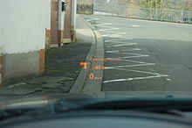
Dual Operation Display system
HUD/“PMD” design
Swiveling mirror
Easy to read
Doesn’t distract driver

Slide 26
Final Components
LCD screen
Tube
Lens (Magnifying glass)
Windscreen (Plexiglas)
Instrument Cluster (Mirror)

Slide 27
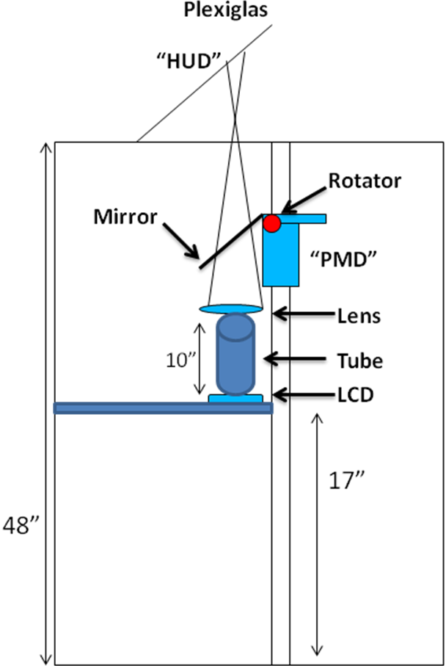

Optical Design
M=2
d₀ = 10 in
→ f ≈ 20 in

Slide 28
Comparison
 | PMD | HUD
Image medium: | Mirror, directly in front of driver | Windscreen, above dashboard
Clear image?
Best viewed in: | Any lighting conditions | Low light conditions
Default mode is PMD mode.
Rotate small wheel to switch modes.

Slide 29
Lens
Original Design: Two Bi-convex spherical lenses
Precisely calculated focal length
Uncoated
Cost: ~30/lens
Final Design: One lens system
Thin lens equation for rough dimensions
Retail purchased, 2X magnification

Slide 30
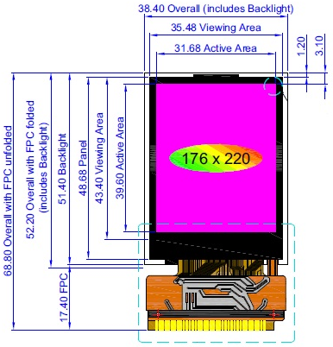
LCD
Crystalfontz graphic LCD TFT with Orise Tech OTM2201A driver integrated circuit
Very small LCD
Cheap

Slide 31
Optical Successes and Difficulties
Successes
Clear, easy to read image in both modes.
Difficulties
Prototyping without having to buy parts (lenses)
Focal Length
LCD Ribbon cable

Slide 32
Photograph

Slide 33
Touch Screen

Slide 34
Touch Screen Components
4-Wire was chosen for cost and availability
OLED was chosen
Built in touch screen + TS controller
MCU for graphics processing
MCU chosen
Experience + Arduino IDE

Slide 35
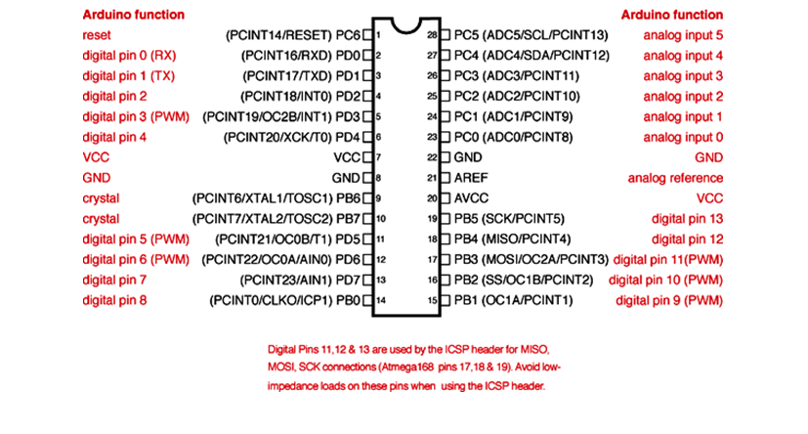
Pin Mapping ATMEGA328
distributed under a Creative Commons Attribution Share-Alike 2.5 license and are available on the Arduino Web site

Slide 36
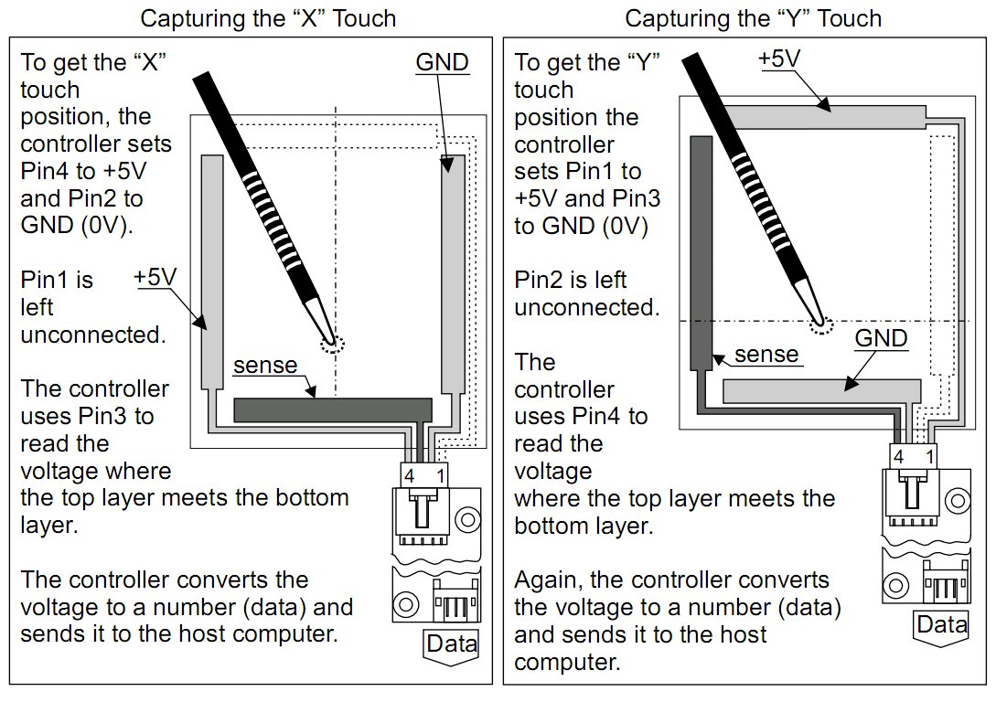
Capturing Touch
distributed under a Creative Commons Attribution Share-Alike 2.5 license and are available on the Arduino Web site

Slide 37
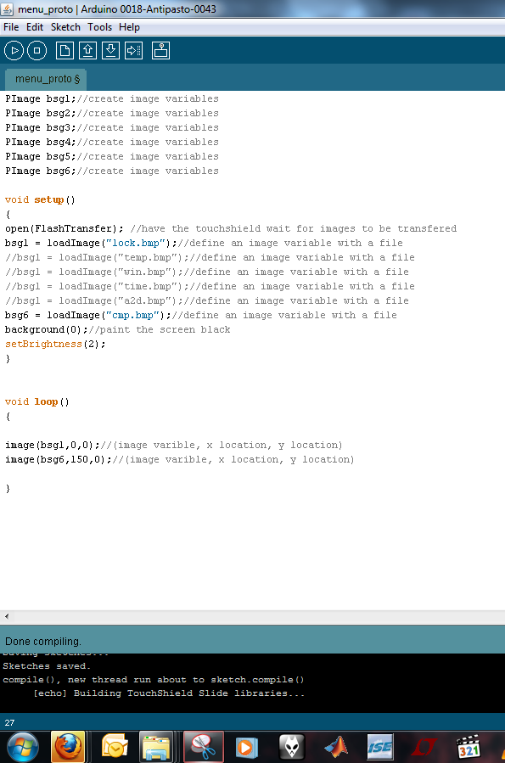
Images to The Screen

Slide 38
Touch Screen GUI
Insert real TS menu

Slide 39
Touch Screen Block Diagram
OLED
4-Wire TS
ATMega2560
5V
Step Down
Voltage
ATMega328
User Input
Sensor
Inputs

Slide 40
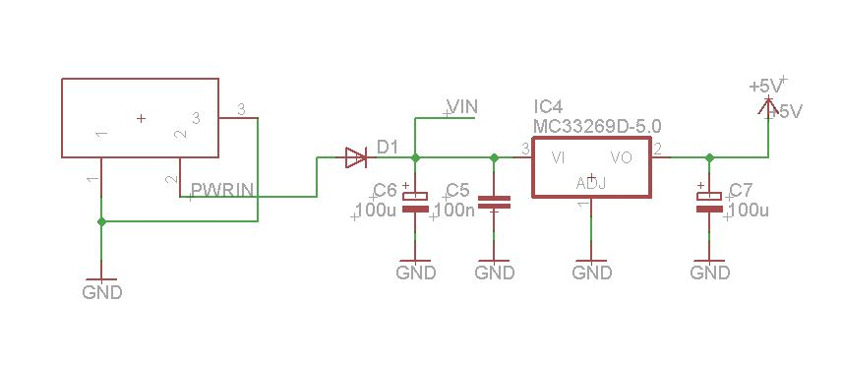
Touch display Schematics power

Slide 41
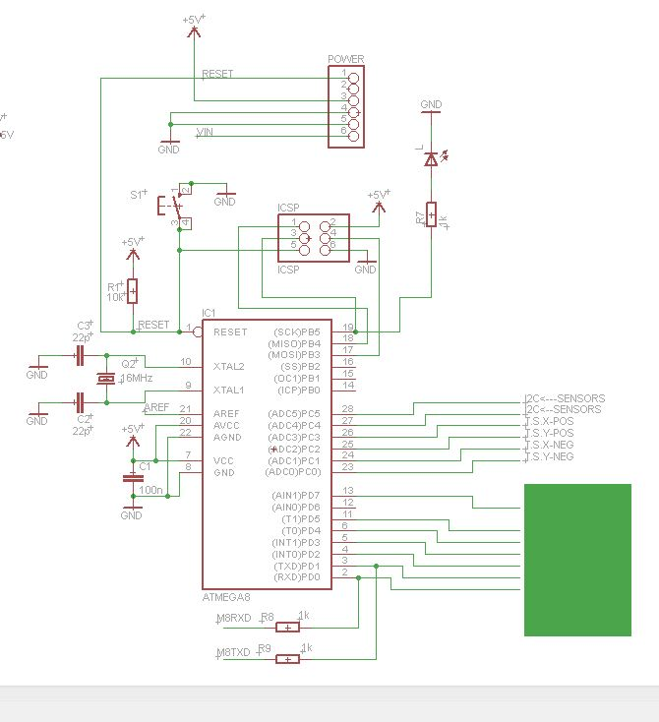
Touch display Schematics

Slide 42
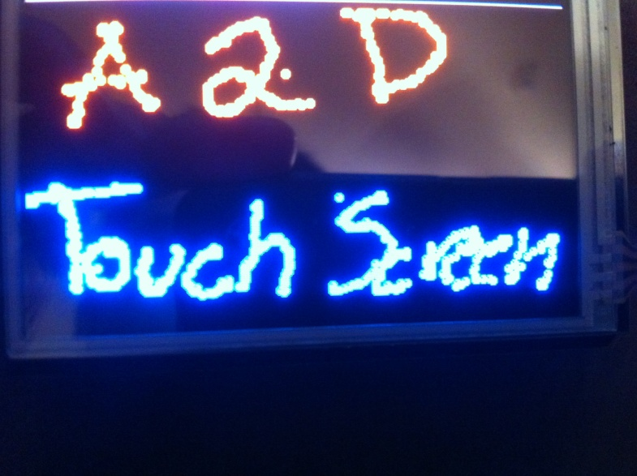
System Success to date
Fully integrated with sensor system
Reliable Touch input from user has been achieved

Slide 43
Instrument Cluster Design

Slide 44
Design Flow of the Instrument Cluster
Graphic TFT LCD
PIC18F4500
Flex Sensor
Gas Pedal
Buckle Sensor

Slide 45
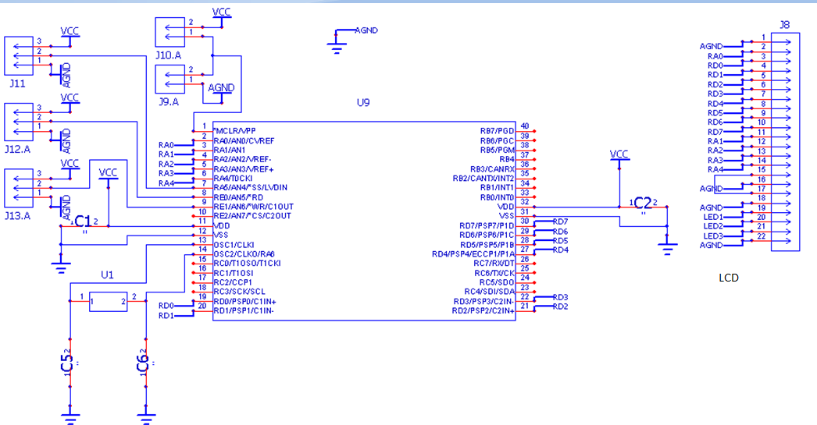
Schematic of the Instrument Cluster
PIC18F4550

Slide 46
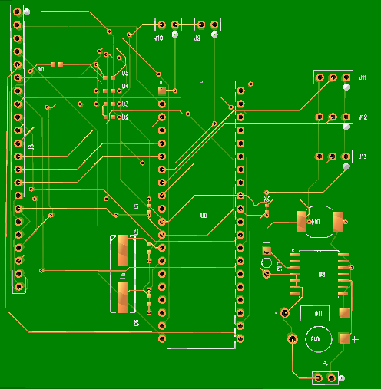
PCB of the Instrument Cluster
MCLR
Flex Sensor
LCD
Gas Pedal
Buckle
Regulator
Crystal
Power In

Slide 47
Program Flow Diagram for the PIC18F4550
Init PIC
Init LCD
Display background image on LCD
Buckle and Flex Sensor
Gas pedal
Update image on LCD

Slide 48
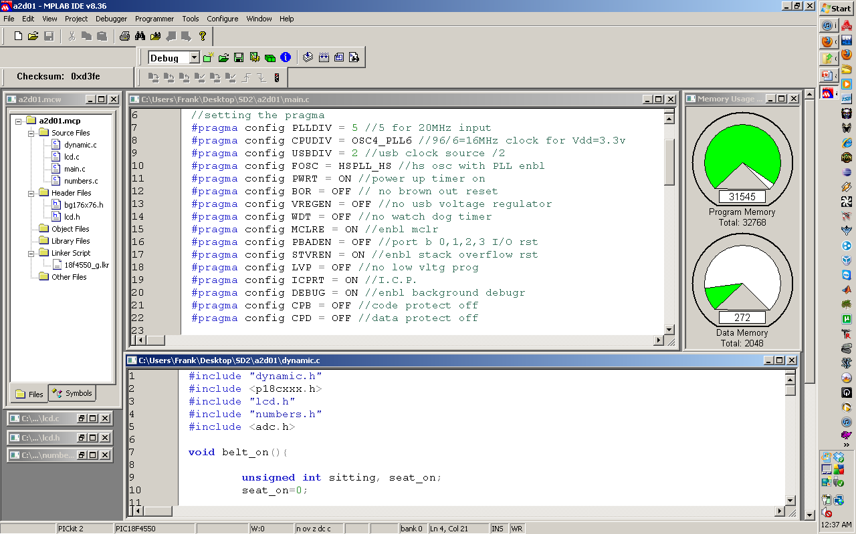
How do u program the PIC and LCD?
Using the MPLAB IDE with the C18 compiler.

Slide 49
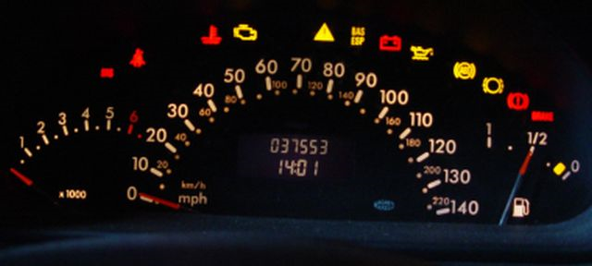
Graphic Instrument Cluster Design
Background of the Instrument Cluster is a Static image
The Dynamic part will be:
RPM bars
Speed
Seatbelt icon
EGN
Temp
Gas
RPM
x1000
H
F
45
1 2 3 4 5 6 7
C
E
MPH
0 8 6 7 4 5 . 8

Slide 50
Successes and Problems
Gas pedal implemented
Flex sensor implemented
Buckle implemented
LCD implemented
Only difficulty was not being able to fill up the whole screen.

Slide 51
Total Expenditure: $954

Slide 52
Budget
The production cost shall not exceed $1000.00
Overall, the group is satisfied with the spending on the project, though we acknowledge that we could have saved more had it not been for a few mishaps.

Slide 53
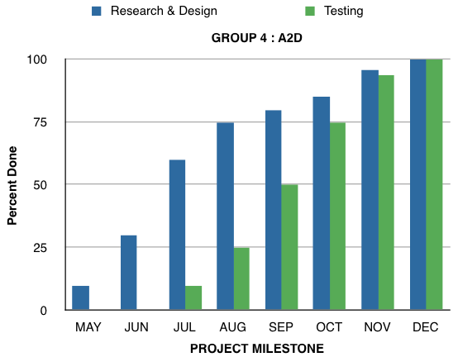
PROJECT MILESTONE
Proposed Project Milestone
May 2010
As of December 2010

Slide 54
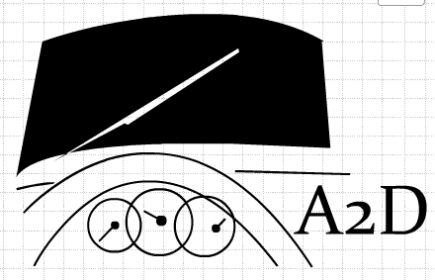
Questions?

