Slide 1
Self-Stabilizing Quad-Rotor Helicopter
Group 7
Daniel Goodhew
Angel Rodriguez
Jared Rought
John Sullivan

Slide 2
Agenda
Project Motivation and Goals
Project Specifications
System Block Diagram
Inertial Measurement Unit and Sensors
User Interface
Vehicle Body
Power
Problems and Successes
Administrative Details
Questions

Slide 3
Motivation and Goals

Slide 4
General Requirements and Specifications
Weigh around 1kg
Have 12 minutes of flight time
Be able to change motor speed at a rate of 50 Hz
Self Stabilize
Have a camera for video
User controlled from an iPhone
Send status and video data for display on iPhone
Communicate with iPhone 4 times per second

Slide 5
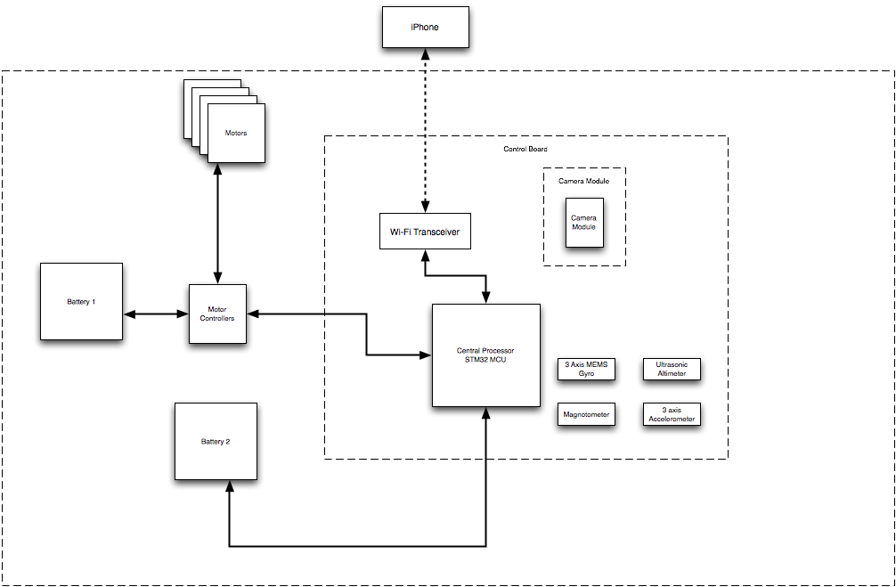
Block Diagram
Notes:
Presented above is the overall block diagram for the quad-copter that we are developing. Depicted in the center is the control board, this board houses the majority of the electronics necessary for the copter and is also responsible for IMU calculations and interfacing with the user. Also apparent from the block diagram is the fact that we have decided to utilize dedicated batteries for both the motors and electronics, Daniel will have more on the rational behind this later.

Slide 6
Inertial Measurement Unit Goals and Objectives
Provide data regarding the orientation of the aircraft
Be able to track tri-axial rotations in a timely manner
Easily interface with microcontroller
Notes:
The core functionality, and where we are devoting much of our time, is implementing an inertial measurement unit, or IMU. The goal of the IMU is to provide data regarding the orientation of the aircraft. The IMU must also be able to track tri-axial rotations in a timely manner to be able to implement stable flight. In addition it would be helpful for the IMU to be easily interfaced with the selected microcontroller.

Slide 7
IMU Specifications and Requirements
Track pitch, roll and yaw
At minimum, have a refresh rate of 50 Hz
Operate off a 610 mAh battery
Notes:
In order to meet these goals, such a device must track pitch, roll and yaw movements. To ensure fast and efficient stabilization, the IMU must have a refresh rate of at minimum 50 Hz, or 20 milliseconds. Because the device is mobile there must also be power requirements to adhere to. The IMU must minimize current draw from the 610 mAh battery that was selected for the control board.

Slide 8
Selection of Orientation Algorithm
Many approaches available
  Simple control loop
  Modeling Flight Dynamics
Draw backs
  Not accurate enough to provide highly stable flight
  Requires extensive modeling of aircraft and environment
Notes:
While we were doing the research on how we were going to track the orientation of the aircraft, there were several methods that were explored. First was utilizing a simple control loop that sensed whether the aircraft was level and adjusted motor speed if necessary. the second method explored involved modeling the flight dynamics experienced by the aircraft. There are downsides to both of these methods. With regards to the first method, it is simply not accurate enough to provide the level of flight stability that we are trying to achieve. The second method, while highly accurate, involved a knowledge of aeronautics at a level none of the group members currently do not possess.

Slide 9
Alternative Algorithm Selected: Directional Cosine Matrix (DCM)
Provides accurate orientation tracking
Loosely based of a flight control method developed for planes
Draw backs
  Method is limited by the accuracy of the sensors
  Gyro drift
Notes:
The alternative that was chosen was using a directional cosine matrix to track orientation. This method provides very accurate orientation tracking and is fairly simple to implement. We based our approach off a method that was developed for autonomous airplanes
The draw backs of this method is that it is limited by the accuracy of the sensors that were chosen and because the measurements rely heavily on those produced by a MEMs based electronic gyroscope, gyro drift must be accounted for.

Slide 10
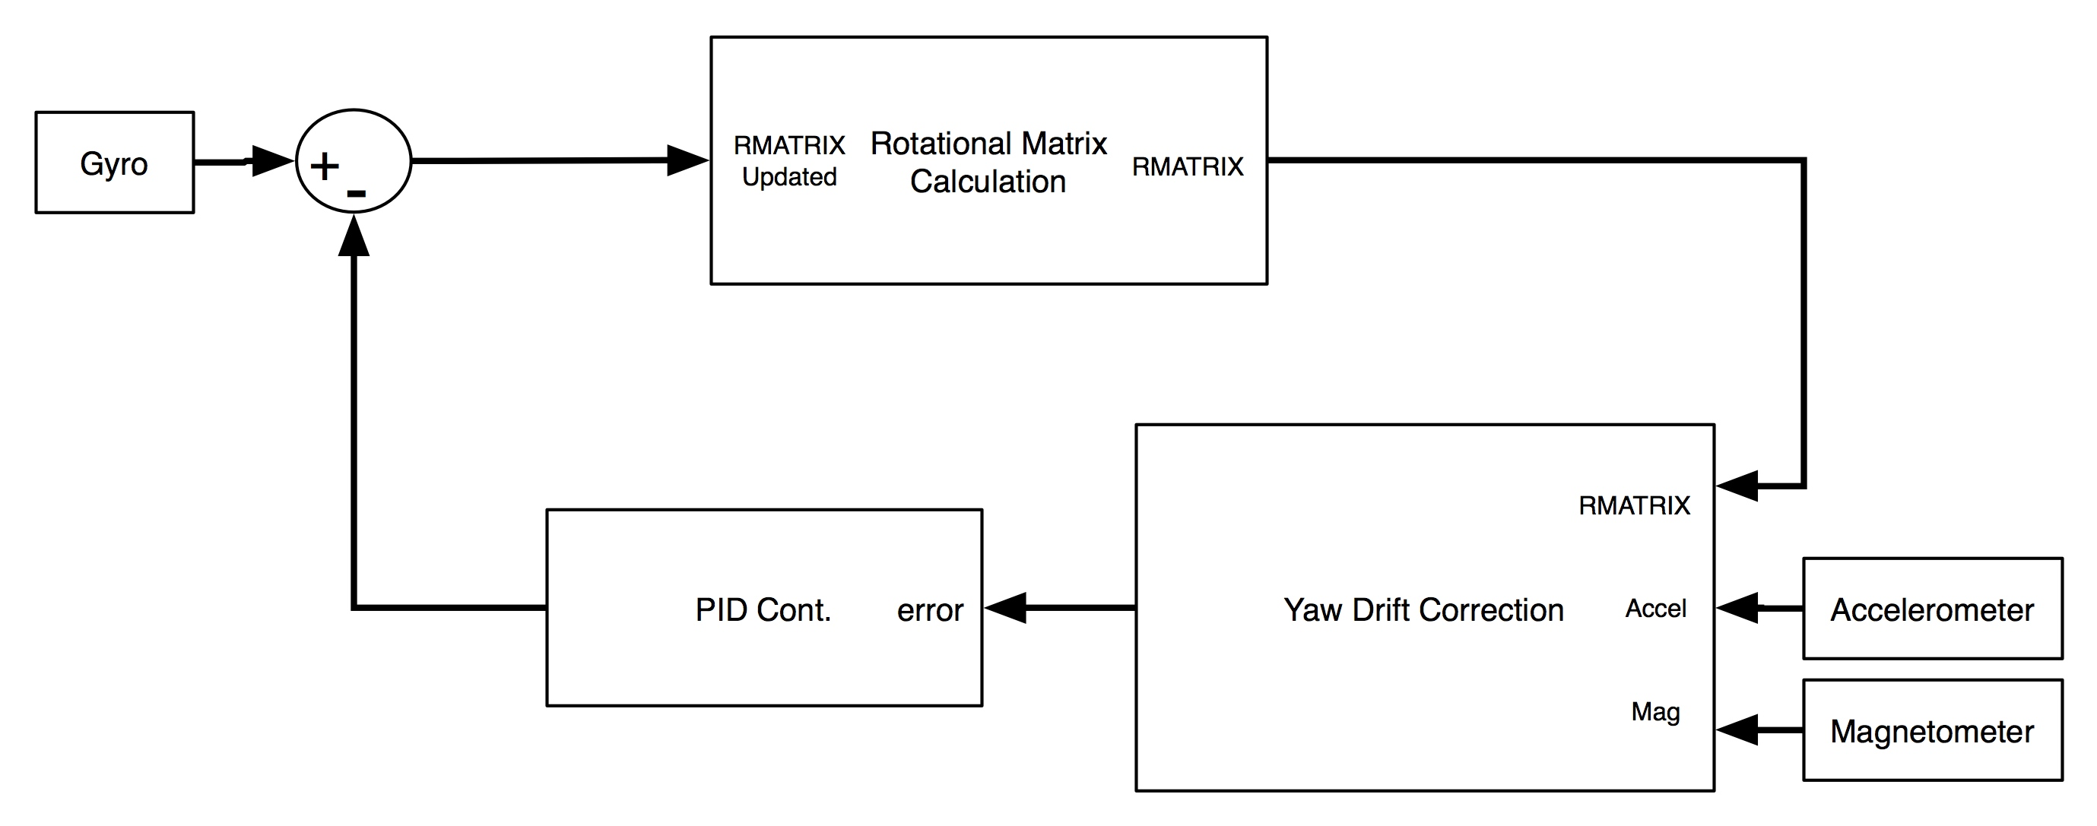
Control Algorithm Overview
Notes:
This diagram presents the overall configuration of the control loop necessary to implement our orientation tracking algorithm. Looking at the algorithm from a top-down view, essentially what is going on is gyro measurements are taken at an interval equal to the specified time period, which at the moment is done every 20 ms. These measurements are then sent to the rmatrix update function, which updates the rotational matrix based values returned from the drift compensation. I will go into further detail about these functions and the theory behind them in a moment.

Slide 11
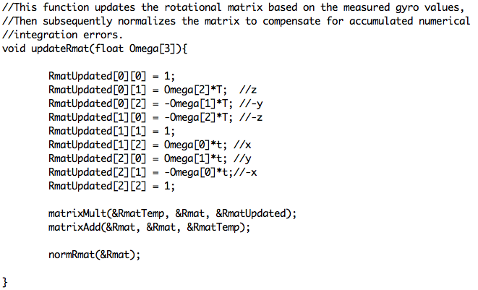
DCM Code: Update

Slide 12
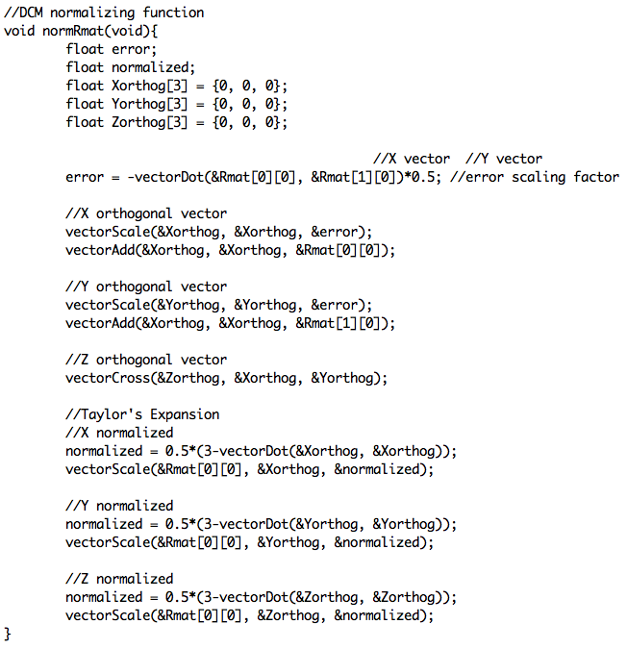
DCM Code: Renormalization

Slide 13
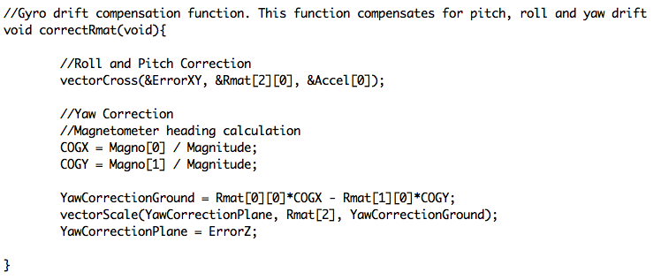
DCM Code: Drift Compensation

Slide 14
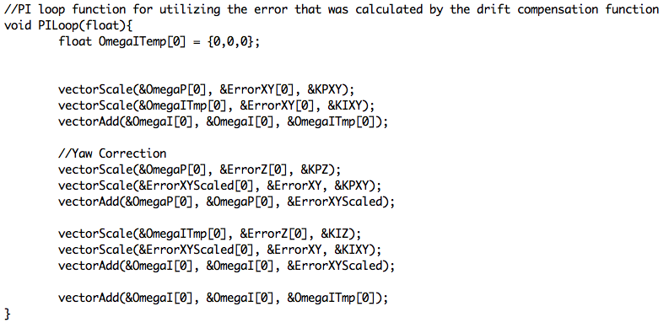
DCM Code: PI Control Loop

Slide 15
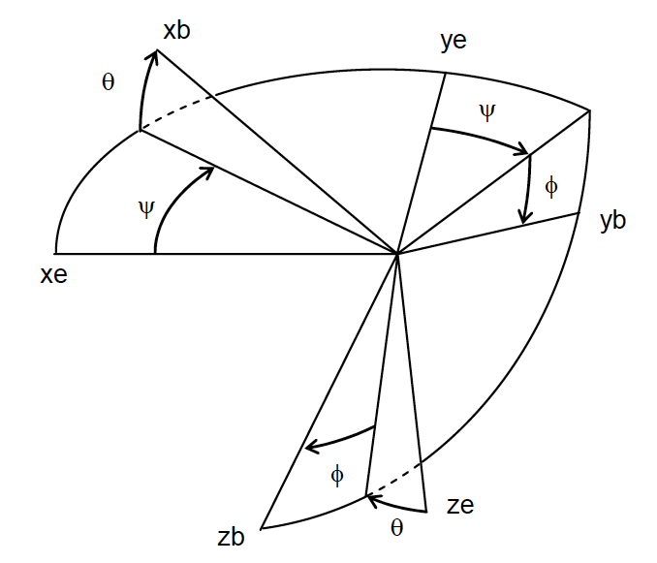
DCM Explained
Rotational matrices describe orientation of one reference frame with respect to another
  Earth
  Aircraft
Notes:
A directional cosine matrix allows you to track the orientation of one reference frame with respect to another. In our case movements made in the aircraft’s frame of reference as seen by the earths. This figure depicts the three different spatial axis that we are concerned with and the rotations pertaining to them.

Slide 16
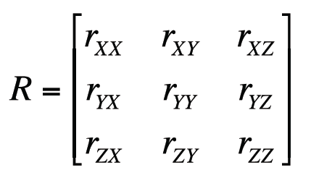
DCM Explained
The earth’s reference frame is fixed
Each row represents a vector R
Notes:
The rotational matrix is comprised of positional vectors, which are then in tern comprised of their corresponding vector components, based on the figure in the previous slide.

Slide 17
DCM Design
Gyro measures rate of change in rad/s
Using the kinematics of a rotating vector…
Notes:
We can derive these positional vectors from the measurements provided by the gyro. furthermore, we use the property derived from kinematics that states that the rate of change of a rotating vector is proportional to the cross product of the angular velocity and the positional vector. Gyro’s measure the aircrafts rate of change in rad/s, this value equates to the angular velocity of the rotating vector

Slide 18
DCM Design
This equation can then be integrated to derive the tracking vector
Integration is done through numerical integration
Notes:
We can subsequently integrate the rotating vector’s rate of change to realize the positional vector. To achieve the necessary integration in code, we use numerical integration.

Slide 19
DCM Design
Utilizing numerical integration, our equation becomes…
r(0) = Starting vector value
= Change in vector
Notes:
Upon integrating the rate of change we realize the presented equation where dtau is the time period of measurements that is selected.

Slide 20
DCM Design
Gyro measurements are taken in the aircrafts frame of reference
  Rotations in the earth’s reference frame is equal and opposite rotations in the aircraft’s frame of reference
  Thus, we invert the sign of all the measurements
Notes:
Note all measurements generated by the gyro are in the aircraft’s frame of reference and must be converted to the earth’s to be of use. To do this we invert the sign of the measurements.

Slide 21
DCM Design
To preserve computational efficiency we bring the first term into the matrix, thus removing one addition per vector
Utilizing these equations, we then present the matrix formulation…
Notes:
The initial term can be brought into the matrix to preserve computational efficiency, this is where we realize the diagonal terms present in the matrix.

Slide 22
DCM Design: Issues
Gyroscopic drift errors attributed to MEMS based electronic gyroscopes
Accumulation of numerical errors
Notes:
As stated before drift is present in the measurements that are generated by the gyroscope. Also, given the fact that we are using numerical integration errors can accumulate in the rotational matrix

Slide 23
DCM Design: Solutions
Utilize sensor blending to mitigate gyro drift
  Accelerometer is used to correct pitch and roll drift
  Magnetometer is used to correct yaw drift
Renormalization of the DCM is used to correct numerical integration error accumulation
Notes:
To handle the drift that is present in the gyro measurements we utilize sensor blending. Sensor blending involves using independent sensors to make similar measurements then using these measurements to compensate for the drift experienced by the gyros
To mitigate the error accumulation experienced by the numerical integration we must renormalize the rotational matrix. It is also worth mentioning that normalization is necessary because the vectors are directional unit vectors with a magnitude of one.

Slide 24
DCM Renormalization
Compute dot product of X and Y rows of DCM
  This should normally be zero because the X and Y axes are orthogonal
  Recall that…
A value other than zero signifies error in measurement
Notes:
Implementing the renormalization algorithm involves exploiting the properties of vectors and matrices. We begin by equating the error experienced to the dot product of the X and Y components of the rotational matrix, which we know to be realized through transposing the X components and matrix multiplying it by the Y components. We also realized that and value other than zero means that there is an error present.

Slide 25
DCM Renormalization
To find Z, we utilize the property of the cross product…
Notes:
We then rotate each of the vectors approximately half of the error value, for each vector. For example half of the error value is multiplied by the Y components, this tells us how much we must rotate the X components to become orthogonal again. The same process is followed for the Y components.
Now that we have X and Y orthogonal once again we simply find the cross product of the two vectors to make the Z components orthogonal to X and Y

Slide 26
DCM: Renormalization
The orthogonal vectors must be scaled to ensure a magnitude of one
Use a Taylor expansion
Notes:
Now that the values are orthogonal once again we must return the magnitudes to one. To achieve this we divide the vectors by their magnitude. We implement this in code by using a Taylor expansion to scale the vectors. The dot product equates to the sum of the squares which is then subtracted from three and divided by 2. This will give you the value that the orthogonal vector needs to be multiplied by to scale the magnitude to 1

Slide 27
DCM Drift Correction
Accelerometer corrects pitch and roll drift
Centrifugal Acceleration
  Not accounted for
  Further testing and investigation needed
Notes:
The next issue that needs to be addressed is the drift that is present in the gyro measurements. Pitch and roll drift is handled by using an accelerometer as a reference to the gyro measurements. The accelerometer measurements provide a measurement of the gravitational vector which is then compared with the estimate produced by the Z components of the rotational matrix. To compensate for the pitch and roll drift we matrix multiply the Z components of the rotational matrix by the measurements produced by the accelerometers.

Slide 28
DCM: Yaw Drift Correction
Magnetometer is used to correct yaw drift
Produces heading
Reference vector is taken during initialization
Used to produce yaw error
Notes:
To compensate for the yaw drift a magnetometer is used as a reference. Magnetometer measurements must first be scaled to be used as a unit directional vector. This scaled value is then matrix multiplied by the Z components of the rotational matrix to produce the yaw correction values

Slide 29
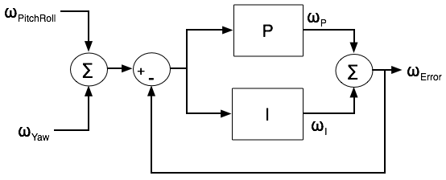
PI Controller
Error values processed through a PI controller
Notes:
The total correction that is needed to adjust the rotational matrix to compensate for drift is equal to the pitch and roll value added to the yaw value. The total correction is then fed into a Proportional Integral controller. This step allows us to implement a weighted average of the corrections that are necessary

Slide 30
DCM Algorithm Status
Completed
  Main DCM update and roll pitch correction coded
To be completed
  DCM initialization code
  Yaw correction
  DCM code testing
Notes:
We have completed the function that updates the rotational matrix as well as the pitch and roll correction. The Yaw correction still needs some work, we simply have not had the time to finish coding it as of yet. We also need to test the actual DCM code, we really havent had a chance to do this yet because of some issue we have been having with sensor communication. Also left to be done is the DCM initialization code, this is another function that we just haven’t had the time to code yet.

Slide 31
Control Board
STM32
All the IMU components
Two 3.3V voltage regulators, one for analog components, the other for digital
Will have headers to connect to outside components
Have a small area to reduce fabrication cost
Dimensions: 2.2 X 3.0 inches
Originally planned to have two boards fabricated by PCB123 for around $20 after $100 credit
Fabricated for free from Daniel’s employer Intersil.

Slide 32
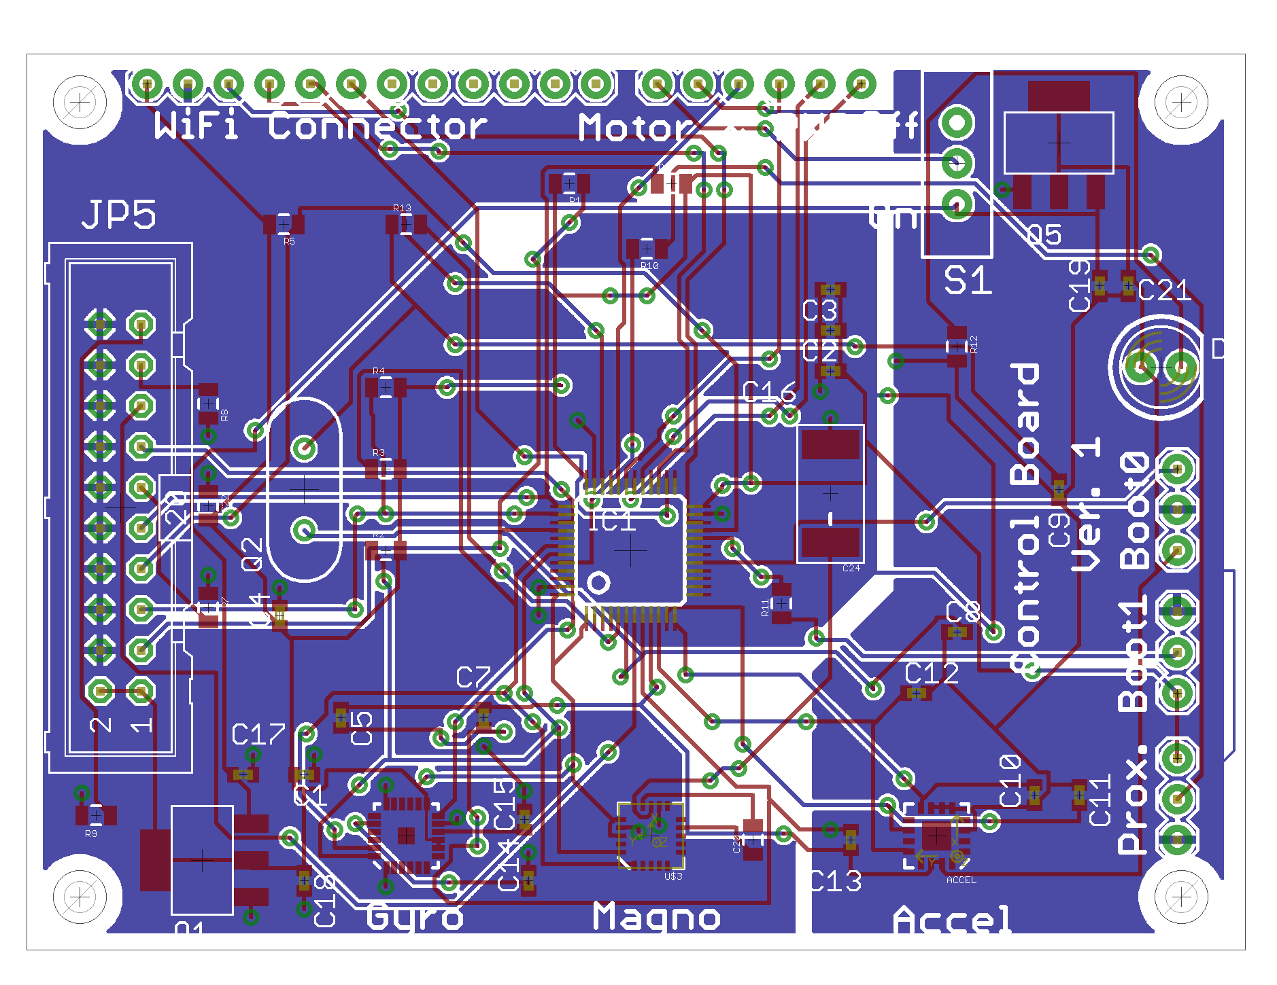
PCB Layout

Slide 33
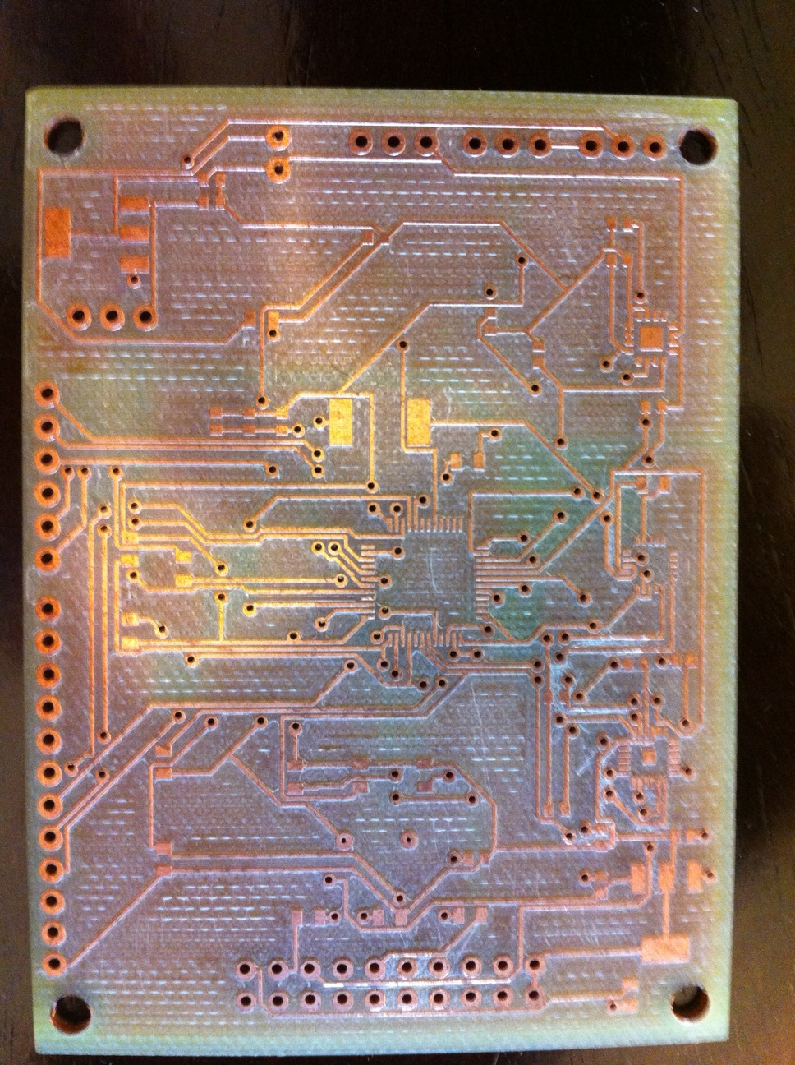
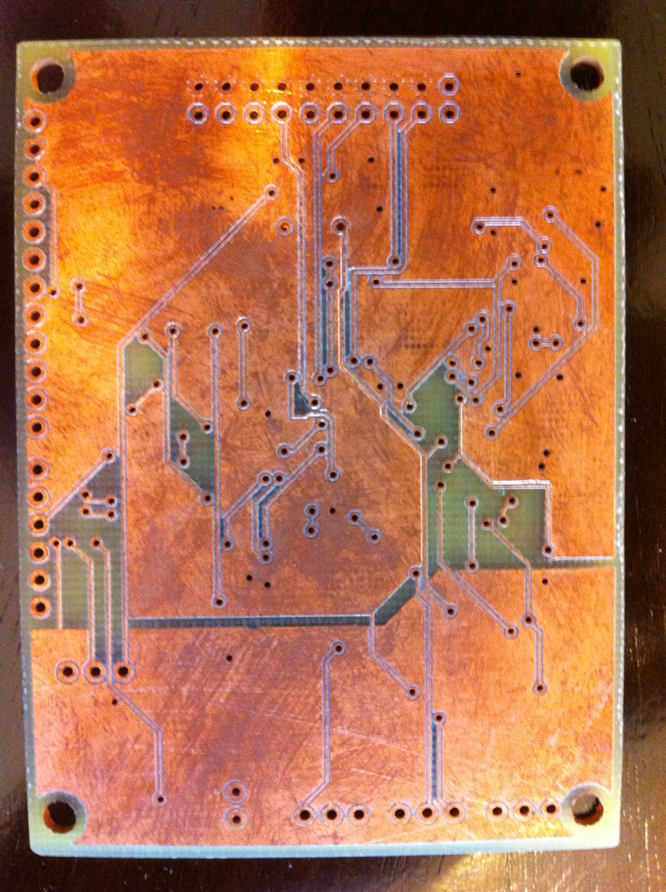
PCB
PCB completed

Slide 34
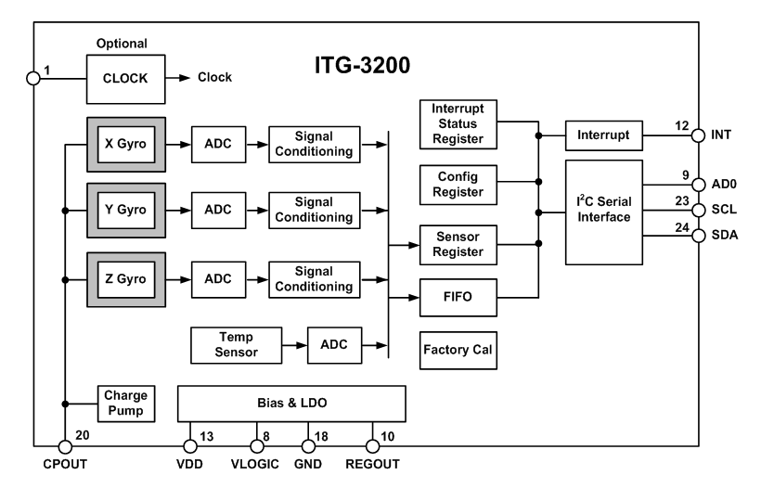
Sensor selection: Gyroscope
Originally used a 2-axis and 1-axis analog sensors
New design utilizes a 3-axis digital gyro
ITG-3200 from Inversense

Slide 35
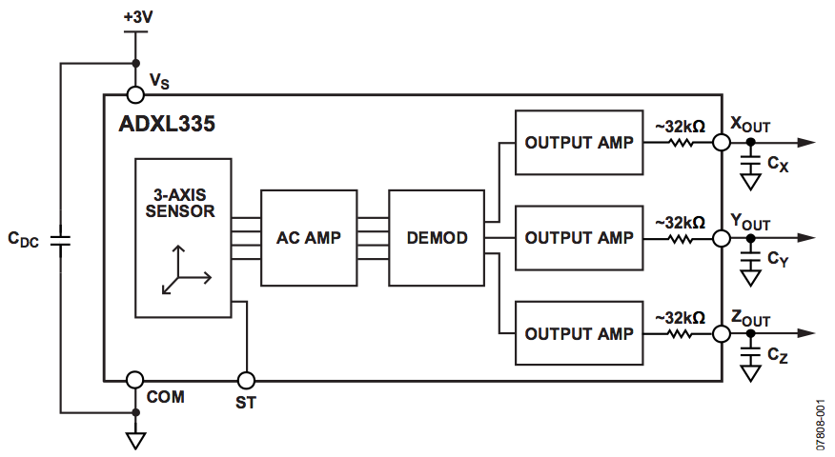
Sensor selection: Accel
Selected ADXL335
3-axis analog accelerometer
Readily available from Sparkfun

Slide 36
Sensor selection: Magnetometer
Selected HMC5843
3-axis digital Magnetometer
Readily available from Sparkfun
Not tilt compensated

Slide 37
Ultrasonic Sensor
Used for automated landing and takeoff
Displays altitude
Must be able to sense the ground up to 15ft away

Slide 38
Ultrasonic Sensor
Chose to go with the Max Botix XL-MaxSonar EZ0 sensor
Determine the distance by dividing the voltage out by 1024 and multiplying by 3.2mV to find out the range in centimeters
max range of 600cm

Slide 39
Microcontroller Requirements
I2C and 4 ADC channels to receive and convert IMU and range finder data
Timer with four PWM outputs to control motors
UART to communicate with Wi-Fi module
Fast enough to run the DCM and control loop once every PWM period of 20 ms.
Enough memory to store all the code

Slide 40
Microcontroller Specifications
 | ATMega328 | dsPIC30F4011 | STM32F103CBT6
Data Bus Width | 8-bit | 16-bit | 32-bit
Clock Speed | 20 MHz | 40 MHz | 72 MHz
Operating Voltage | 5 V | 5 V | 2.4-3.6 V
Current Consumption | Not Given | 132 mA | 36 mA
ADCs | 10-bit, 8 ch. | 10-bit, 9 ch. | 2x 12-bit, 10 ch.
Communication | USART, SPI, I2C | 2x(UART), SPI, I2C | 2x(USART, SPI, I2C)
Timers | 2x(8-bit), 16-bit | 5x(16-bit) | 4x(16-bit)
Flash | 32 KB | 48 KB | 128 KB
SRAM | 1 KB | 2 KB | 20 KB
Price | $4-5 | $7-8 | $8-10

Slide 41
Microcontroller Selection
Selected STM32F103CBT6
Reasons for Selection:
  Has the most processing power
  Has a lot of storage
  Used in a project implementing DCM
Other Information
  ARM Cortex-M3
  Produced by STMicoelectronics
  Received free samples from STMicroelectronics

Slide 42
STM32 Development
Hardware
A JTAG interface will be used to program and debug the STM32
  Olimex USBTINY
    Uses USB Port to interface to PC
Development Board
  Olimex STM32-H103
    Inexpensive ~$40
    Uses JTAG
    Powered from USB
    Small size

Slide 43
Software Development
C used as programming language
STMicroelectrnics STM32 Library
Eclipse used as IDE
OpenOCD used to debug code running on STM32
Source code compiled with Codesourcery’s G++ Lite GNU tool chain
All software tools are open source and are free to use

Slide 44
STM32 Software
Functions
  Completed Functions
    void SystemInit(void); //Initializes STM32 clocks
    void PeriphInit(void); //Configures STM32 Pins and Peripherals
    void IMURead(uint_8 device); //reads and converts the specified IMU component and stores the values in an array
  Functions to be Completed
    void MotorCmd(uint_8 state); //Function that can start or stop the motors
    void UpdateMotor(int motor, uint_16 duty); //Updates the speed of the specified motor
    void WifiCmd(int direction); //Receive instructions or send information via UART to or from wifi
    void Takeoff(void); //Sets quadcopter to lift-off the ground and hover
    void Land(void); //Makes quadcopter slowly lose altitude until it lands

Slide 45
Video Camera

Slide 46
Communication: Options
Wi-Fi vs. Bluetooth Class 1
The Bluetooth had better range for both indoor and outdoor applications. The Wi-Fi device had better Data rates that was more essential to use for the use of sending video to the Iphone. We chose to go with the RN-131 Wifi device by Roving Networks.
 | Wi-Fi RN-131 | Bluetooth Class 1
Indoor Range | Up to 100 ft | Up to 330 ft
Outdoor/LOS | Up to 300 ft | Up to 330 ft
Data Rate | Up to 54 Mb/s | Up to 3 Mb/s
Unit Price | $45.00 | $69.00

Slide 47
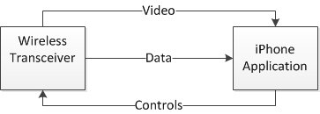
Communication Overview
The Copter will communicate through the Wi-Fi transceiver to the iPhone
The iPhone will receive the battery data and also the video data coming from the copter
The iPhone will send the copter the controls that the user is inputting

Slide 48
iPhone Interface
An iPhone will be used to control the Quad-copter through an iPhone application
Will be using the Touch based functions of the iPhone to control the copter
Will show a live video stream coming from the copter

Slide 49
Software
iPhone application is written in Objective C
    Objective C is an object oriented version of C by Apple
  The application is developed using Xcode IDE and through the Interface Builder
    The Interface Builder provides easy design capabilities such as drag and drop functionality

Slide 50
GUI Design

Slide 51
Package Structure
  From iPhone to Copter
    LXX RXX BXX
    Left Slider Value, Right Slider Value, Bottom Slider Value
  From Copter to iPhone
    Altitude of copter
    Video data

Slide 52
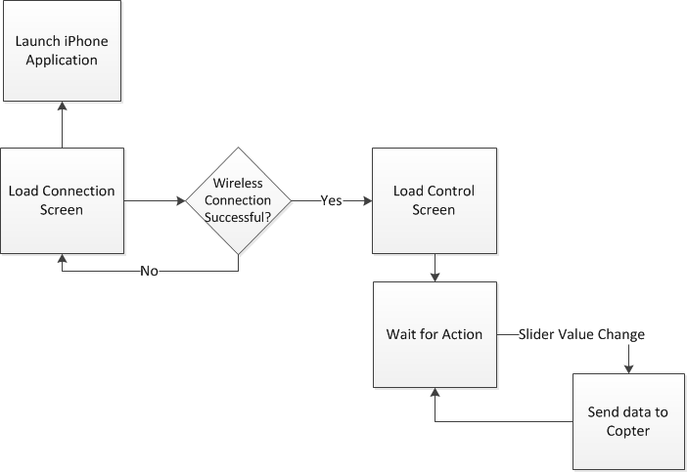
iPhone Software

Slide 53
Difficulties
The only major difficulty encountered to date was getting the I2C communication to work which has been resolved.

Slide 54
Body
Specifications
  Under 1 kg
  25” x 25” x 10”
Aluminum Frame
  Lightweight
  Reasonably priced
  Impact resistant
Item | Weight (g)
Electronic Speed Controller (x4) | 6 (x4)
Propeller (x4) | 22.7 (x4)
Four-Way Connector | 62
Landing Base | 90
Bracket (x4) | 5 (x4)
Frame | 319.5
Total | 606.3

Slide 55
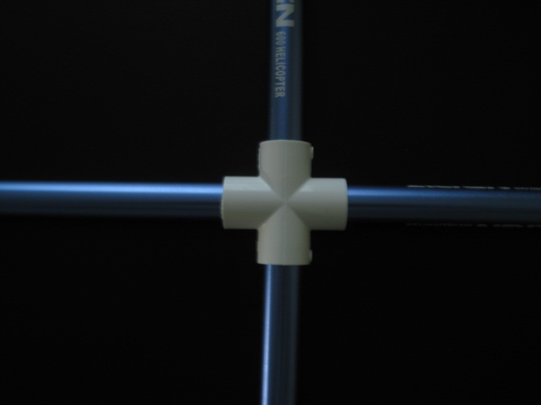
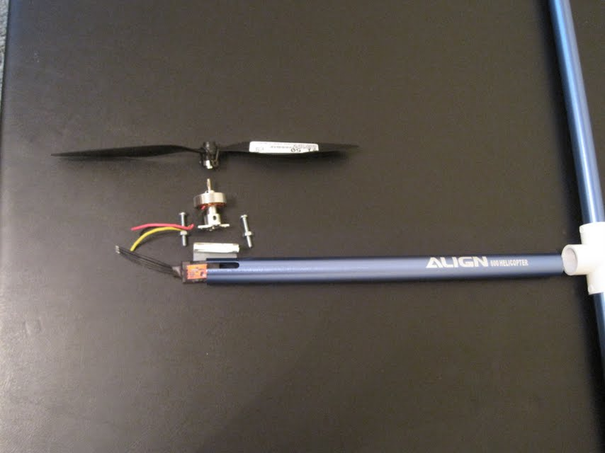
Body
The frame is constructed with four aluminum tubular arms connected in the center by a four-way PVC connector.
Motors are bolted to the tubes with a three-sided bracket in between to provide stability.
All wiring and ESCs are placed inside the tubing.

Slide 56
Top level diagram

Slide 57
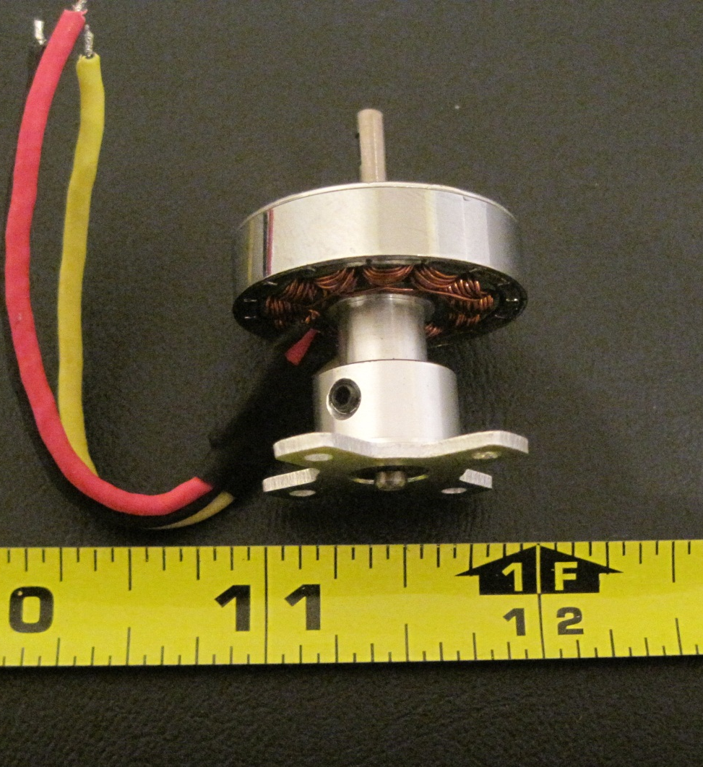
Motor
Brushless
  More efficient
  Less susceptible to damage
  More complex to control
Brushed
  Cheaper
  Simple to control

Slide 58
Motor
The motor selection was based on the estimated weight of the quad copter.
The current draw affects the weight of the battery, so equilibrium must be found to achieve the desired flight time.

Slide 59
Power
Specifications
  Provide 11.1V at up to 8 A for 12 minute flight time.
  Provide 3.3 V for board components.
  Weigh under 300 grams.

Slide 60
Power
Two batteries will be used to maintain a clean power source for the PCB.
We are using two TLV1117-33 linear voltage regulators to provide separate digital and analog power sources. The ground plane is also divided accordingly.

Slide 61
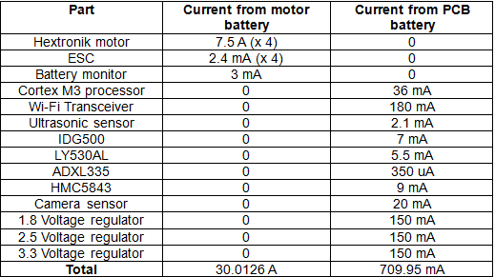
Power
Estimated maximum current for each component is used to determine battery size necessary.

Slide 62
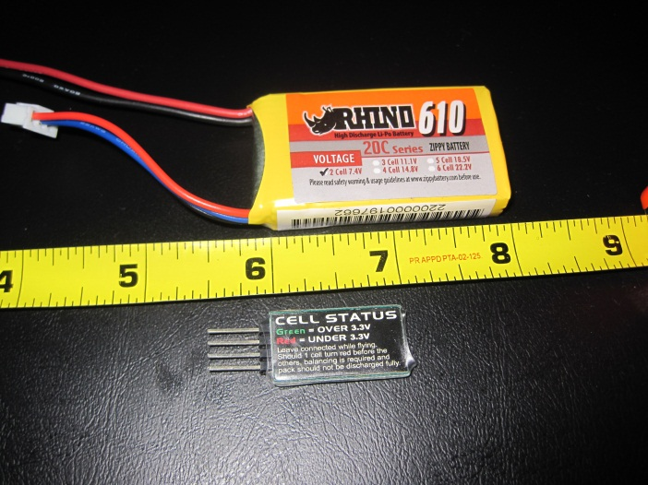
Power
4400mAh LiPo for the motors.
  Will run for 8.8 minutes at max current draw.
610mAh Lipo for the PCB.
  Will run for much longer than the motors.
Battery Comparison | NiCa | NiHM | LiPo
Energy density (Wh/kg) | 45 to 80 | 60 to 120 | 90 to 140
Cycle Life | 1500 | 300 to 500 | 500
Charge Time (hours) | 1 | 2 to 4 | < 1

Slide 63
Electronic Speed Controllers (ESC)
Controlled by a 50 Hz signal with 1 to 2 ms pulse width modulation (PWM).
  1 ms PWM = 0 throttle
  2 ms PWM = full throttle
10A capacity.

Slide 64
Potential Problems
ESCs may overheat if placed in the tubular arms.
Long lines on the PCB may decrease performance.
Board must be soldered carefully as there is no silk screen.
Motors and ESCs are known to fail.

Slide 65
Difficulties
Resolved
  Floating point arithmetic
  I2C implementation
Possible
  ESCs may overheat if placed in the tubular arms
  Long lines on the PCB may decrease performance
  Board must be soldered carefully as there is no silk screen
  Motors and ESCs are known to fail
Current
  Difficulty getting Xcode to operate

Slide 66
Team Management
Group Member Name | Responsibility
Jared Rought | Project Manager, IMU Design, Camera Implementation
Daniel Goodhew | Power Design, Frame Design
John Sullivan | iPhone interfacing and GUI Design and Wireless Communication
Angel Rodriguez | Microcontroller interfacing and controller software design, Control Board Design

Slide 67
Budget
Component | Quantity | Price Per Unit | Total Cost
Camera | 1 | 39.43 | 39.43
IMU | 1 | 74.95 | 74.95
4400 mAh battery | 1 | 26.79 | 26.79
610 mAh battery | 1 | 3.92 | 3.92
Battery Charger | 1 | 23.99 | 23.99
Battery Sensor | 1 | 2.10 | 2.10
Microcontroller | 1 | Free | Free
Header Board | 1 | 40.95 | 40.95
Motors | 4 | 7.99 | 31.95
Power Sensor | 1 | 6 | 6
Body | 1 | 12.99 | 12.99

Slide 68
Budget
Component | Quantity | Price Per Unit | Total Cost
Electronic speed Controllers | 4 | 6.50 | 26
Wireless Transceiver Kit | 1 | 149.00 | 149.00
iPhone SDK | 1 | 99.00 | 99.00
Gyro | 1 | 59.38 | 59.38
Accelerometer | 1 | 17.30 | 17.30
Breakout for Accelerometer | 1 | 24.95 | 24.95
Total cost so far has come to $637.65 and we estimated for $550

Slide 69
Progress Status

Slide 70
Immediate Plans for Success
Add something
Add something
Add something
Add something

Slide 71
Milestones

Slide 72
Questions?

