Slide 1
Self-Stabilizing Quad-Rotor Helicopter
SSQUARe
Group 7
Daniel Goodhew
Angel Rodriguez
Jared Rought
John Sullivan

Slide 2
Agenda
Project Motivation and Goals
Project Specifications
System Block Diagram
Inertial Measurement Unit and Sensors
Microcontroller
User Interface
Vehicle Body
Power
Problems
Administrative Details
Questions

Slide 3
Motivation and Goals
To create a fun and useful aerial vehicle
Cost will be moderate to low, but must not sacrifice quality of design
Must be lightweight
Unit will self-stabilize
Have live video streaming
Be controlled through an IPhone application

Slide 4
General Specifications
Weigh less than 1kg
Have 4 motors
Have 12 minutes of flight time
Be able to change motor speed at a rate of 50 Hz
Communicate with iPhone 4 times per second

Slide 5
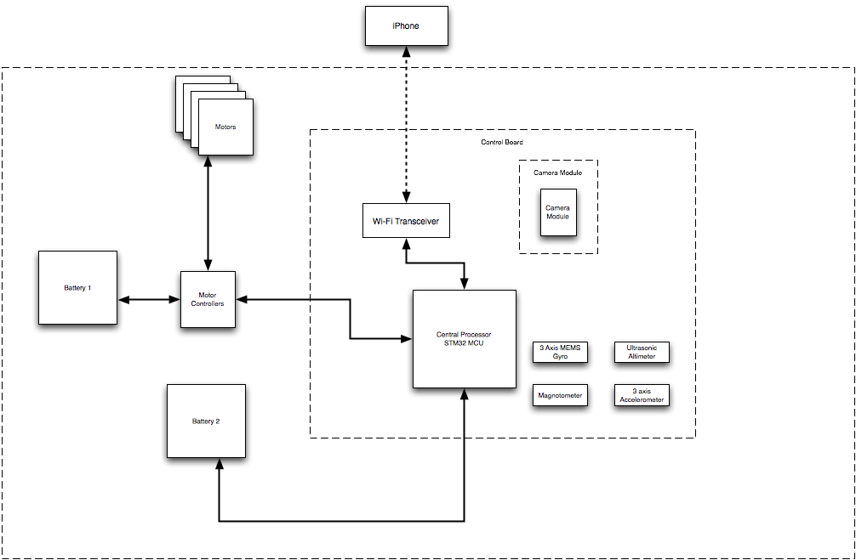
Block Diagram
Notes:
Presented above is the overall block diagram for the quad-copter that we are developing. Depicted in the center is the control board, this board houses the majority of the electronics necessary for the copter and is also responsible for IMU calculations and interfacing with the user. Also apparent from the block diagram is the fact that we have decided to utilize dedicated batteries for both the motors and electronics, Daniel will have more on the rational behind this later.
-overall block diagram
-Center control board
-houses all necessary electronics
-IMU sensors
-wifi interfacing
-two dedicated batteries
-motor
-electronics

Slide 6
Inertial Measurement Unit Goals and Objectives
Provide data regarding the orientation of the aircraft
Be able to track tri-axial rotations in a timely manner
Easily interface with microcontroller
Notes:
The core functionality, and where we are devoting much of our time, is implementing an inertial measurement unit, or IMU. The goal of the IMU is to provide data regarding the orientation of the aircraft. The IMU must also be able to track tri-axial rotations in a timely manner to be able to implement stable flight. In addition it would be helpful for the IMU to be easily interfaced with the selected microcontroller.
-core functionallity, much of time devoted
-IMU, tracking
-Goals and objectives
-provide orientation data
-track tri-axial rotations
-helpful, easily interface w/ micro

Slide 7
IMU Specifications and Requirements
Track pitch, roll and yaw
At minimum, have a refresh rate of 50 Hz
Operate off a 610 mAh battery
Notes:
In order to meet these goals, such a device must track pitch, roll and yaw movements. To ensure fast and efficient stabilization, the IMU must have a refresh rate of at minimum 50 Hz, or 20 milliseconds. Because the device is mobile there must also be power requirements to adhere to. The IMU must minimize current draw from the 610 mAh battery that was selected for the control board.
-Spec and requirements
-Track pitch, roll and yaw
-have refresh rate of 50 Hz
-must operate off the selected 610 miliAmpHour battery

Slide 8
Selection of Orientation Algorithm
Many approaches available
  Simple control loop
  Modeling Flight Dynamics
Draw backs
  Not accurate enough to provide highly stable flight
  Requires extensive modeling of aircraft and environment
Notes:
While we were doing the research on how we were going to track the orientation of the aircraft, there were several methods that were explored. First was utilizing a simple control loop that sensed whether the aircraft was level and adjusted motor speed if necessary. the second method explored involved modeling the flight dynamics experienced by the aircraft. There are downsides to both of these methods. With regards to the first method, it is simply not accurate enough to provide the level of flight stability that we are trying to achieve. The second method, while highly accurate, involved a knowledge of aeronautics at a level none of the group members currently do not possess.
-selection of orientation algorithm
-many approaches
-simple control loop
-sense whether aircraft was level and adjust motor speed if necessary
-Model flight dynamics
-Drawbacks to both
-first is not accurate enough
-second, accurate but requires knowledge of aeronautics at a level none of the group members currently possess.

Slide 9
Alternative Algorithm Selected: Directional Cosine Matrix (DCM)
Provides accurate orientation tracking
Loosely based of a flight control method developed for planes
Draw backs
  Method is limited by the accuracy of the sensors
  Gyro drift
Notes:
The alternative that was chosen was using a directional cosine matrix to track orientation. This method provides very accurate orientation tracking and is fairly simple to implement. We based our approach off a method that was developed for autonomous airplanes
The draw backs of this method is that it is limited by the accuracy of the sensors that were chosen and because the measurements rely heavily on those produced by a MEMs based electronic gyroscope, gyro drift must be accounted for.
-alternative chosen directional cosine matrix to track orientation.
-provides very accurate orientation tracking
- fairly simple to implement.
-based our approach off a method that was developed for autonomous airplanes
-draw backs
-limited by the accuracy of the sensors
-measurements rely heavily on those produced by a MEMs based electronic gyroscope, gyro drift must be accounted for.

Slide 10
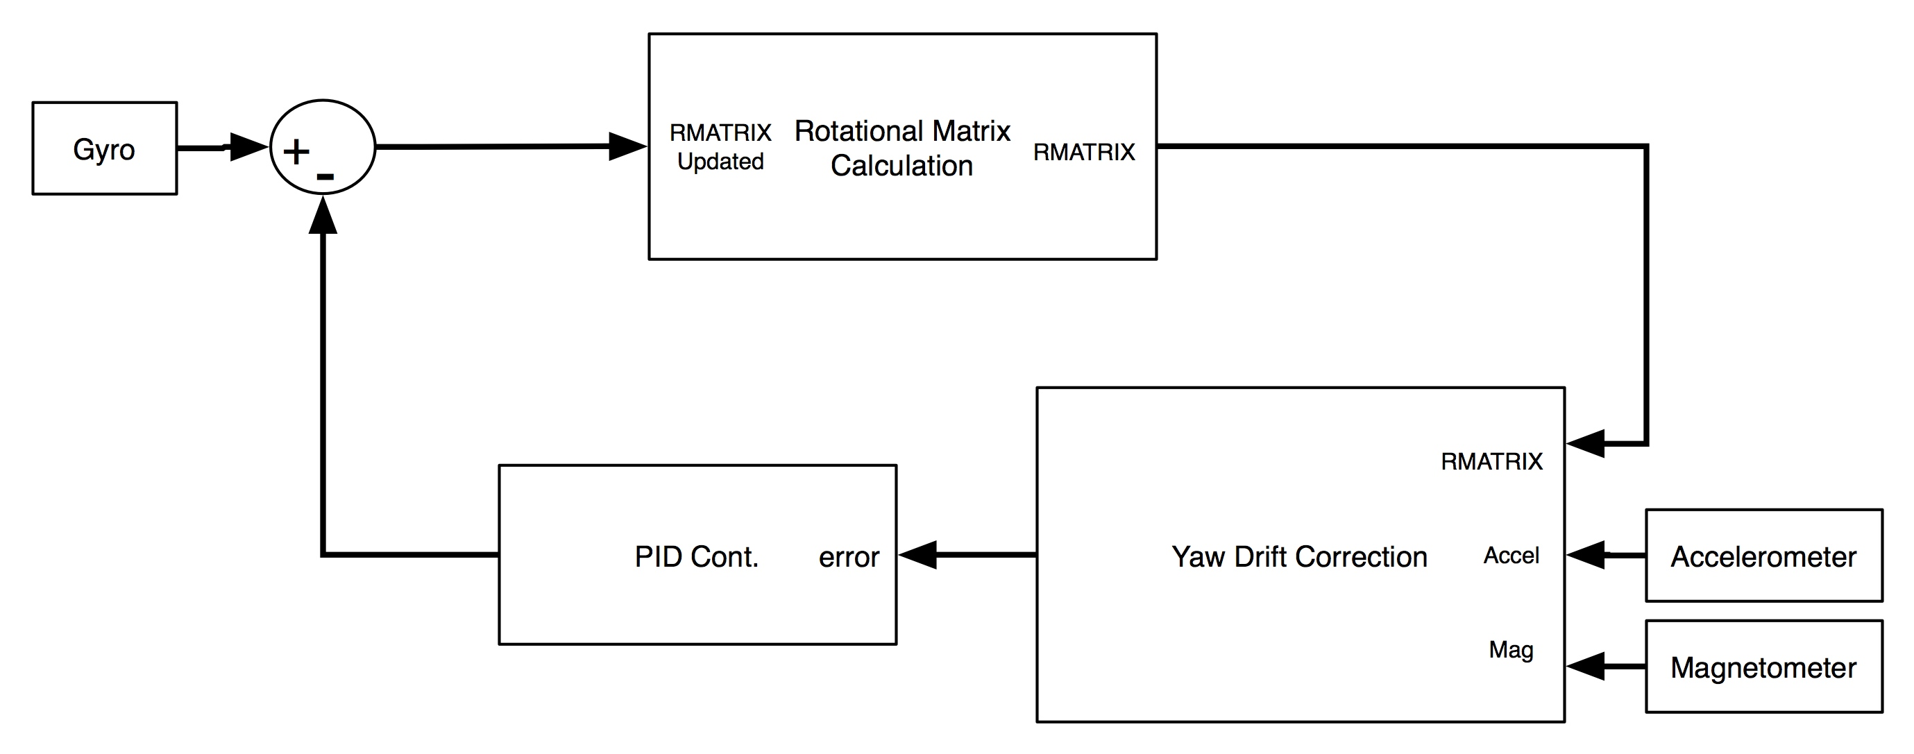
Control Algorithm Overview
Notes:
This diagram presents the overall configuration of the control loop necessary to implement our orientation tracking algorithm. Looking at the algorithm from a top-down view, essentially what is going on is gyro measurements are taken at an interval equal to the specified time period, which at the moment is done every 20 ms. These measurements are then sent to the rmatrix update function, which updates the rotational matrix based values returned from the drift compensation. I will go into further detail about these functions and the theory behind them in a moment.
-Top down view of control loop for orientation tracking
-go into detail in a moment

Slide 11
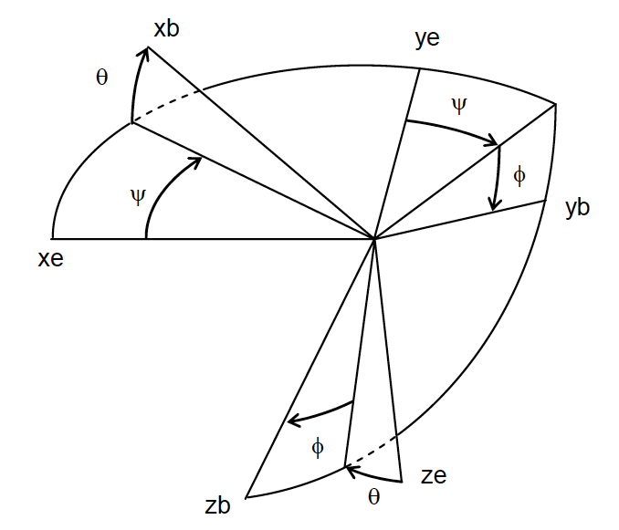
DCM Explained
Rotational matrices describe orientation of one reference frame with respect to another
  Earth
  Aircraft
Notes:
A directional cosine matrix allows you to track the orientation of one reference frame with respect to another. In our case movements made in the aircraft’s frame of reference as seen by the earths. This figure depicts the three different spatial axis that we are concerned with and the rotations pertaining to them.
-rotational matrix
-track one ref frame with respect to another
-our case
-movements in aircraft as seen by earth

Slide 12
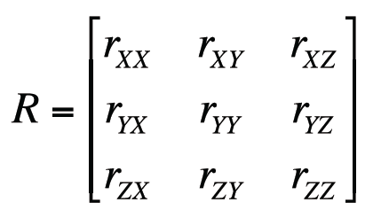
DCM Explained
The earth’s reference frame is fixed
Each row represents a vector R
Notes:
(from previous slide) A directional cosine matrix allows you to track the orientation of one reference frame with respect to another. In our case movements made in the aircraft’s frame of reference as seen by the earths. This figure depicts the three different spatial axis that we are concerned with and the rotations pertaining to them.
-rotational matrix
-track one ref frame with respect to another
-our case
-movements in aircraft as seen by earth
The rotational matrix is comprised of positional vectors, which are then in tern comprised of their corresponding vector components, based on the figure in the previous slide.
-this is the rotational matrix
-continuously updated
-each row position vector

Slide 13
DCM Design
Using the kinematics of a rotating vector…
This equation can then be integrated to derive the tracking vector
Integration is done through numerical integration
Notes:
We can derive these positional vectors from the measurements provided by the gyro. furthermore, we use the property derived from kinematics that states that the rate of change of a rotating vector is proportional to the cross product of the angular velocity and the positional vector. Gyro’s measure the aircrafts rate of change in rad/s, this value equates to the angular velocity of the rotating vector
-Using kinematics we derive the rotational vector
-equal to cross product of
-angular velocity (gyro measurements)
-rotational vector
(from previous slide) We can subsequently integrate the rotating vector’s rate of change to realize the positional vector. To achieve the necessary integration in code, we use numerical integration.
-tracking vector realized through integration
-realized in code, numerical integration

Slide 14
DCM Design
This equation can then be integrated to derive the tracking vector
Integration is done through numerical integration
Notes:
We can subsequently integrate the rotating vector’s rate of change to realize the positional vector. To achieve the necessary integration in code, we use numerical integration.
-tracking vector realized through integration
-realized in code, numerical integration

Slide 15
DCM Design
Equation becomes…
r(0) = Starting vector value
= Change in vector
Notes:
Upon integrating the rate of change we realize the presented equation where dtau is the time period of measurements that is selected.
-using integration, equation becomes
-where dtau is time period of measurement
-r(0) = starting vector value

Slide 16
DCM Design
Gyro measurements are taken in the aircraft’s frame of reference
  A Rotation in the earth’s reference frame is equal and opposite a rotation in the aircraft’s frame of reference
  Thus, we invert the sign of all the measurements
Notes:
Note all measurements generated by the gyro are in the aircraft’s frame of reference and must be converted to the earth’s to be of use. To do this we invert the sign of the measurements.
-measurements taken in aircraft ref frame
-Recognizing symmetry, invert signs of measurements

Slide 17
DCM Design
Initial term brought into matrix
Utilizing these equations, we then present the matrix formulation…
Notes:
The initial term can be brought into the matrix to preserve computational efficiency, this is where we realize the diagonal terms present in the matrix.
-initial term brought into matrix
-computational efficiency
-yields diagonal terms
-

Slide 18
DCM Design: Issues
Gyroscopic drift errors attributed to MEMS based electronic gyroscopes
Accumulation of numerical errors
Notes:
As stated before drift is present in the measurements that are generated by the gyroscope. Also, given the fact that we are using numerical integration errors can accumulate in the rotational matrix
-several issue to address
-gyro drift in measurements
-accumulation of numerical error ( due to numerical integration)

Slide 19
DCM Design: Solutions
Utilize sensor blending to mitigate gyro drift
  Accelerometer is used to correct pitch and roll drift
  Magnetometer is used to correct yaw drift
Renormalization of the DCM is used to correct numerical integration error accumulation
Notes:
To handle the drift that is present in the gyro measurements we utilize sensor blending. Sensor blending involves using independent sensors to make similar measurements then using these measurements to compensate for the drift experienced by the gyros
To mitigate the error accumulation experienced by the numerical integration we must renormalize the rotational matrix. It is also worth mentioning that normalization is necessary because the vectors are directional unit vectors with a magnitude of one.
-To account for these errors
-sensor blending to alliviate drift errors
-renormalize the DCM corrects error accumulation due to Num Int

Slide 20
DCM Renormalization
Compute dot product of X and Y rows of DCM
  This should normally be zero because the X and Y axes are orthogonal
  Recall that…
A value other than zero signifies error in measurement
Notes:
Implementing the renormalization algorithm involves exploiting the properties of vectors and matrices. We begin by equating the error experienced to the dot product of the X and Y components of the rotational matrix, which we know to be realized through transposing the X components and matrix multiplying it by the Y components. We also realized that and value other than zero means that there is an error present.
-To renormalize
-exploit prop of vectors and matrices
-equate errror to dot product
-X comp
-Y comp
-realize dot equals
-transpose of X comp mult Y comp
-Any value other than Zero means error

Slide 21
DCM Renormalization
To find Z, we utilize the property of the cross product…
Notes:
We then rotate each of the vectors approximately half of the error value, for each vector. For example half of the error value is multiplied by the Y components, this tells us how much we must rotate the X components to become orthogonal again. The same process is followed for the Y components.
Now that we have X and Y orthogonal once again we simply find the cross product of the two vectors to make the Z components orthogonal to X and Y
-Vectors rotated propor to half the error
-done to both X and Y comp
-more accurate than only rotating one vector
-since X and Y are ortho again
-Z is found by crossing X and Y comp

Slide 22
DCM: Renormalization
The orthogonal vectors must be scaled to ensure a magnitude of one
Use a Taylor expansion
Notes:
Now that the values are orthogonal once again we must return the magnitudes to one. To achieve this we divide the vectors by their magnitude. We implement this in code by using a Taylor expansion to scale the vectors. The dot product equates to the sum of the squares which is then subtracted from three and divided by 2. This will give you the value that the orthogonal vector needs to be multiplied by to scale the magnitude to 1
-Vectors must be scaled
-ensure magnitude of one
-implemented in code with taylor expansion
-yields value vector must mult by to scale magnitude

Slide 23
DCM: Drift Correction
Accelerometer corrects pitch and roll drift
Notes:
The next issue that needs to be addressed is the drift that is present in the gyro measurements. Pitch and roll drift is handled by using an accelerometer as a reference to the gyro measurements. The accelerometer measurements provide a measurement of the gravitational vector which is then compared with the estimate produced by the Z components of the rotational matrix. To compensate for the pitch and roll drift we matrix multiply the Z components of the rotational matrix by the measurements produced by the accelerometers.
-Drift correction
-pitch and roll
-matrix mult rmat Z comp by accel ref
-yields amount of correction needed
-centripetal accel not accounted for
-further testing need to justify

Slide 24
DCM: Yaw Drift Correction
Magnetometer is used to correct yaw drift
Produces heading
Reference vector is taken during initialization
Used to produce yaw error
Notes:
To compensate for the yaw drift a magnetometer is used as a reference. Magnetometer measurements must first be scaled to be used as a unit directional vector. This scaled value is then matrix multiplied by the Z components of the rotational matrix to produce the yaw correction values
-Yaw correction
-handled by using magnetometer as ref
-measured values must be scaled
--to be used as unit vectors
-value mult by z comp of rotational matrix

Slide 25
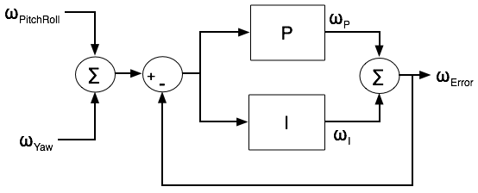
PI Controller
Error values processed through a PI controller
Notes:
The total correction that is needed to adjust the rotational matrix to compensate for drift is equal to the pitch and roll value added to the yaw value. The total correction is then fed into a Proportional Integral controller. This step allows us to implement a weighted average of the corrections that are necessary
-total correction to adjust rmat
-yaw + pitch and roll
-value fed into a proportional integral controller
-allows implementation of weighted average of corrections necessary
-error then added to rmat during update

Slide 26
Using DCM
When r_{ZX} and r_{ZY} = 0, the helicopter is level
Notes:
To control the pitch and yaw
-need pitch angle
-need roll angle
-Pitch angle is arcsin of X comp of Z vector
-Roll angle Y comp of Z vetor

Slide 27
Using DCM
Pitch and roll control
  No Commands, aircraft auto levels
  Commands alter this state
  Default Pitch and Roll angle
Yaw control
  No command, no yaw adjustment
  Default yaw adjust rate
Notes:
Pitch and roll control
-These values are then compared with the desired angle
-If no desired angle (no command from iphone) auto level, hover
-there will be a default pitch and roll angle
-slider example
Yaw control
-default yaw adjust rate
-slider example

Slide 28
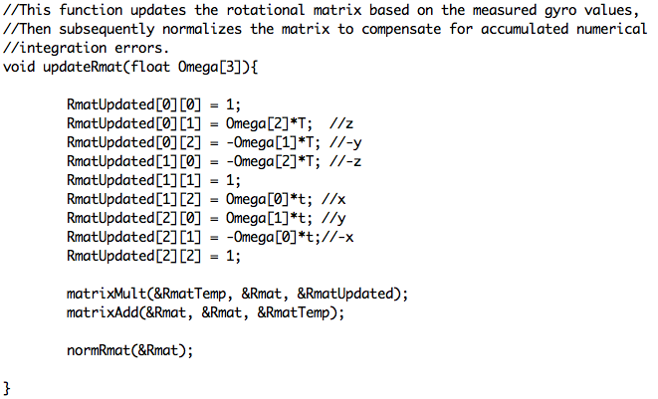
DCM Code: Update
Notes:
-DCM update code
Delete

Slide 29
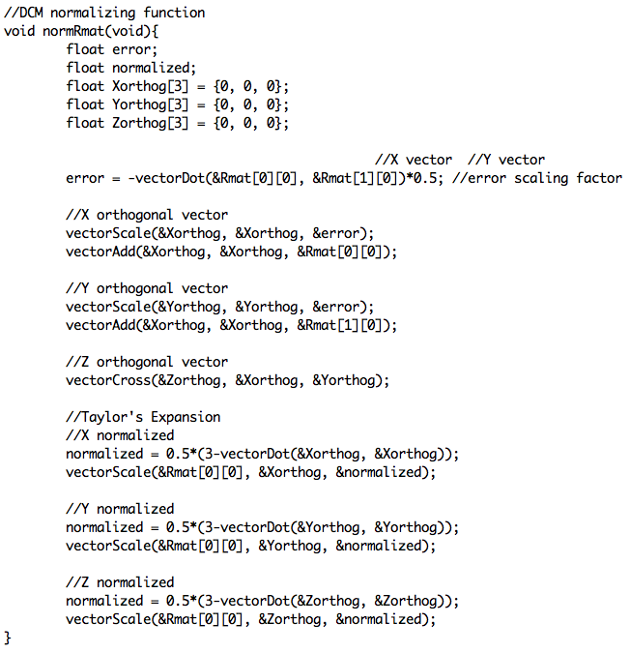
DCM Code: Renormalization
Notes:
-DCM renormalization code

Slide 30
DCM Algorithm Status
Completed
  Main DCM update
  roll pitch correction
  PI controller
To be completed
  DCM initialization code
  Yaw correction
  DCM code testing
  Motor control loop
Notes:
We have completed the function that updates the rotational matrix as well as the pitch and roll correction. The Yaw correction still needs some work, we simply have not had the time to finish coding it as of yet. We also need to test the actual DCM code, we really havent had a chance to do this yet because of some issue we have been having with sensor communication. Also left to be done is the DCM initialization code, this is another function that we just haven’t had the time to code yet.
-Completed
-main DCM update
-pitch roll correction
-To be comp
-DCM intialization code
-Yaw correction
-DCM code test
-need to code motor control loop

Slide 31
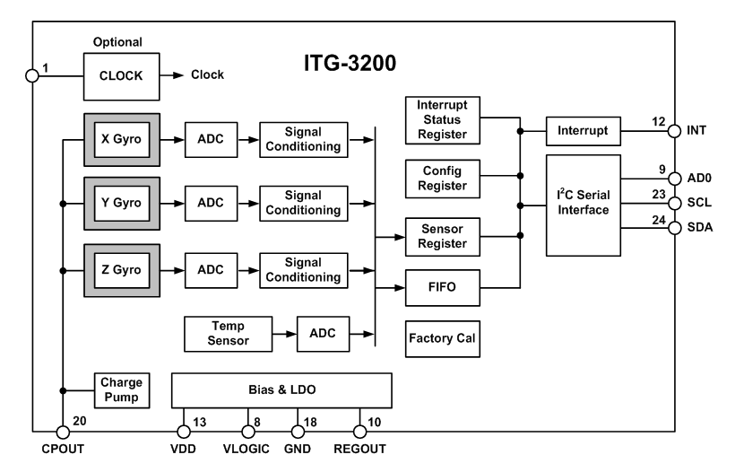
Sensor selection: Gyroscope
Originally used a 2-axis and 1-axis analog sensors
New design utilizes a 3-axis digital gyro
ITG-3200 from Inversense

Slide 32
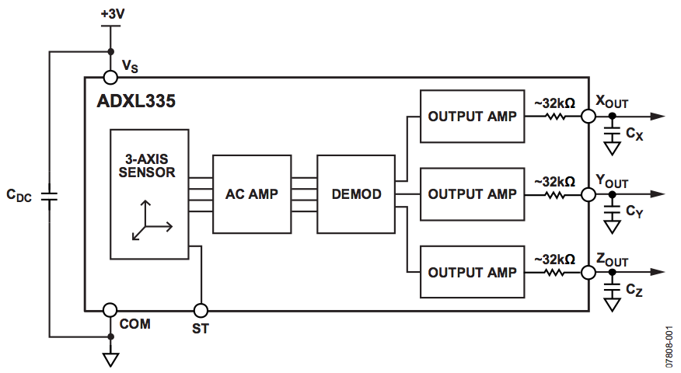
Sensor selection: Accel
Selected ADXL335
3-axis analog accelerometer
Readily available from Sparkfun

Slide 33
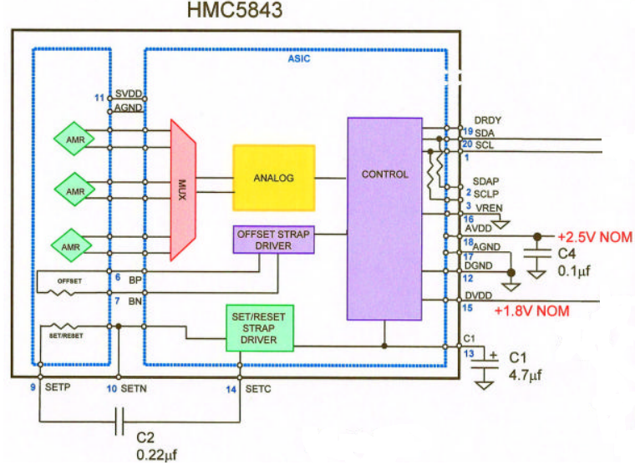
Sensor selection: Magnetometer
Selected HMC5843
3-axis digital Magnetometer
Readily available from Sparkfun
Not tilt compensated

Slide 34
Ultrasonic Sensor
Must be able to sense the ground up to 15ft away
Determine the distance by dividing the voltage out by 1024 and multiplying by 3.2mV to find out the range in centimeters
max range of 600cm

Slide 35
Microcontroller Requirements
I2C and 3 ADC channels to receive and convert IMU
Timer with four PWM outputs to control motors
UART to communicate with Wi-Fi module
Fast enough to run the DCM and control loop once every PWM period of 20 ms.
64 KB minimum to store all the code

Slide 36
Microcontroller Selection
Selected STM32F103CBT6
Reasons for Selection:
  Has a lot processing power at 72 Mhz
  Has 128 KB of onboard flash storage
  Used in a project implementing DCM
Other Information
  ARM Cortex-M3
  Produced by STMicoelectronics
  Received free samples from STMicroelectronics

Slide 37
STM32 Development
Hardware
A JTAG interface was used to program and debug the STM32
  Olimex USBTINY
    Uses USB Port to interface to PC
Development Board
  Olimex STM32-H103
    Inexpensive ~$40
    Uses JTAG
    Powered from USB
    Small size

Slide 38
Software Development
C used as programming language
STMicroelectronics STM32 Library
Eclipse used as IDE
OpenOCD used to debug code running on STM32
Source code compiled with Codesourcery’s G++ Lite GNU tool chain
All software tools are open source and are free to use

Slide 39
STM32 Software
Functions
    void SystemInit(void); //Initializes STM32 clocks
    void PeriphInit(void); //Configures STM32 Pins and Peripherals
    void IMURead(void); //reads, converts, and stores data from IMU components
    void MotorCmd(uint_8 state); //Function that can start or stop the motors
    void WifiCmd(void); //Receive instructions or send information via UART to or from wifi

Slide 40
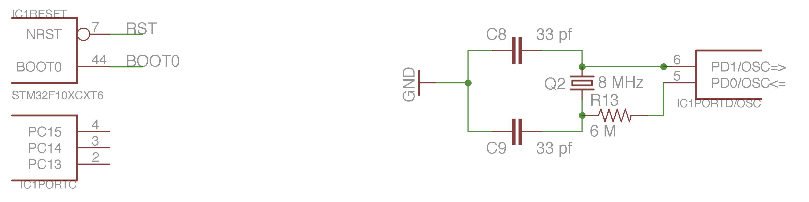
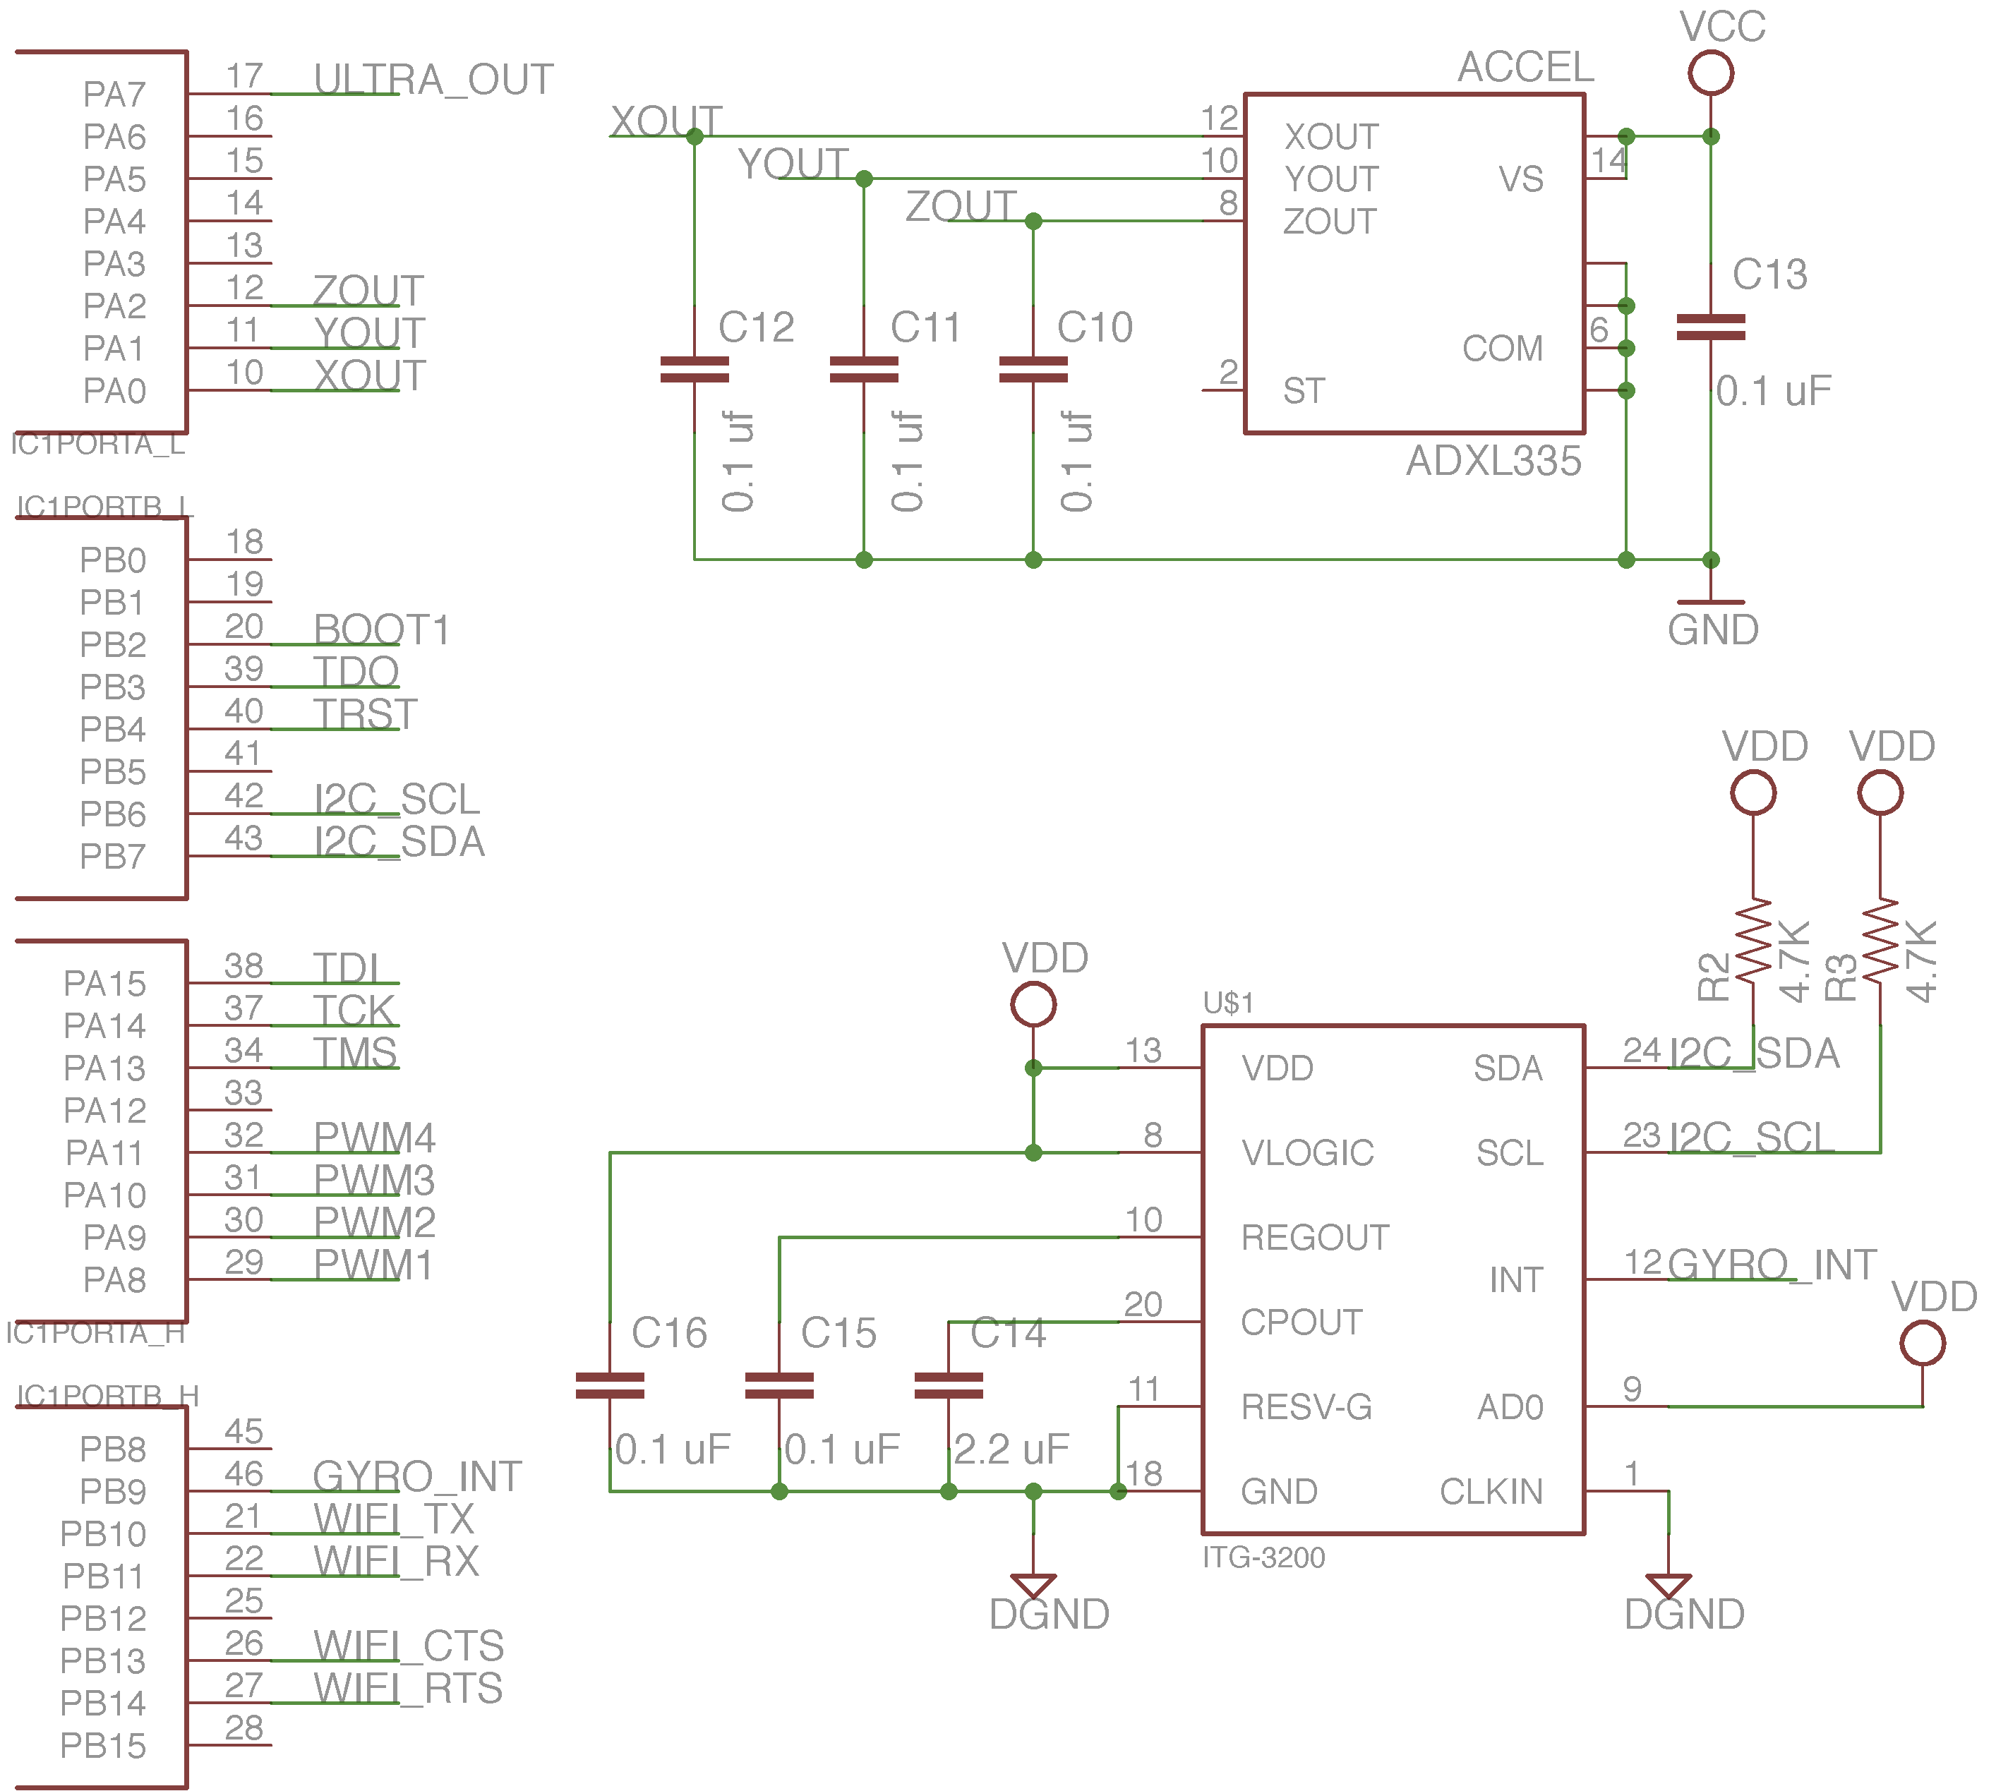
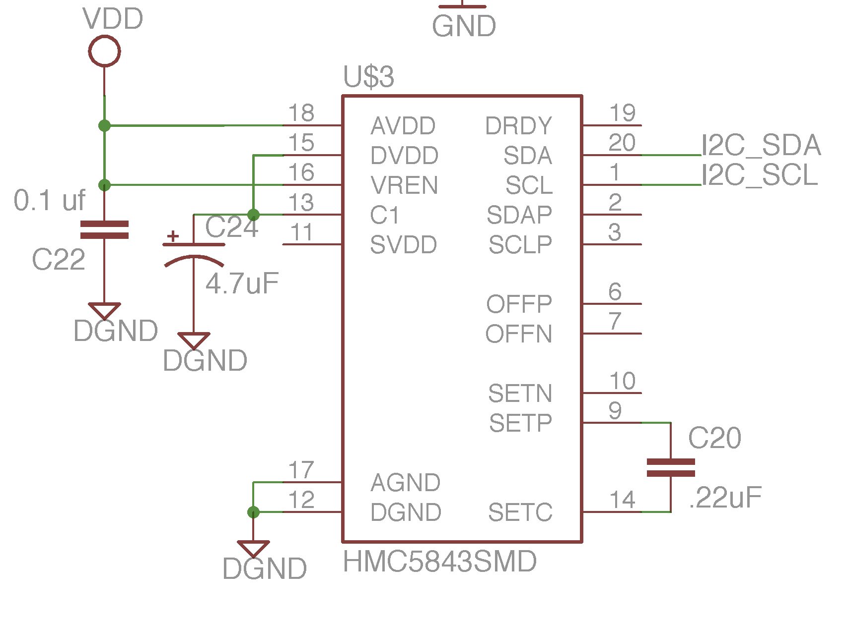
Control Board Schematic: Microcontroller interface and sensors

Slide 41
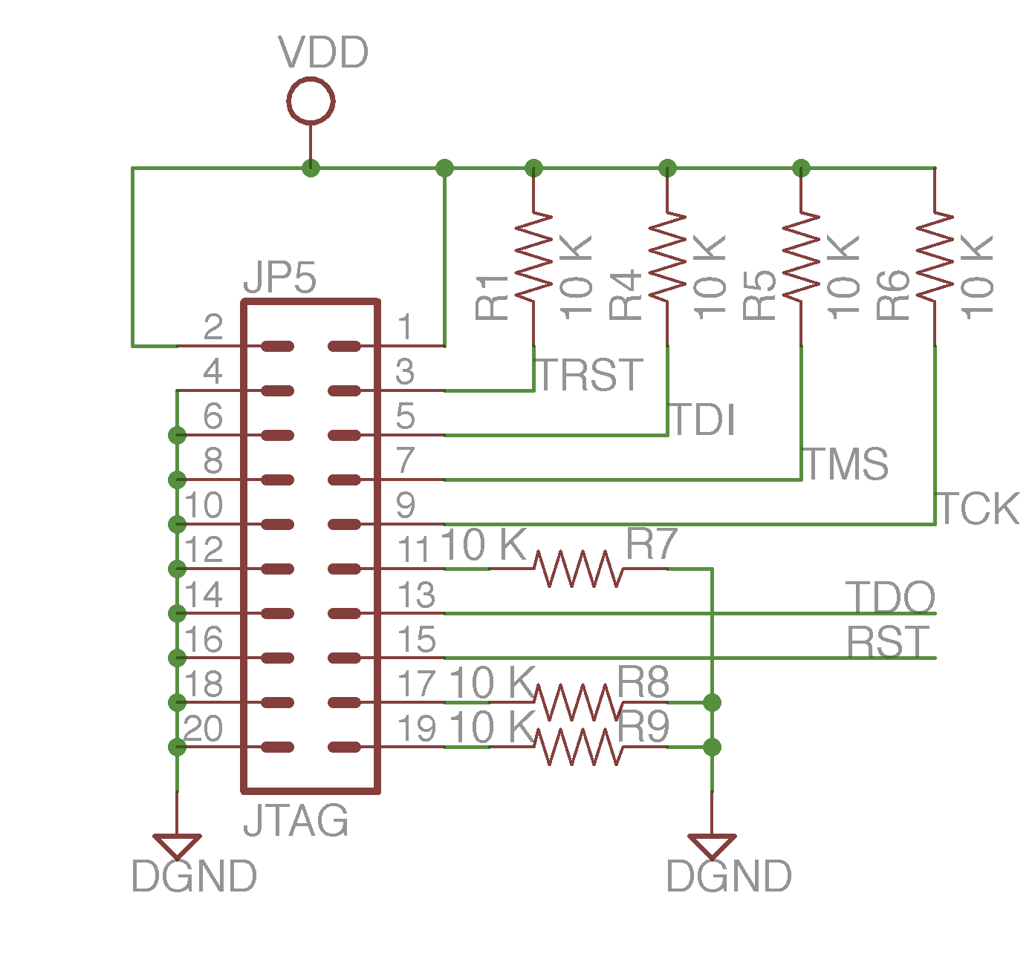
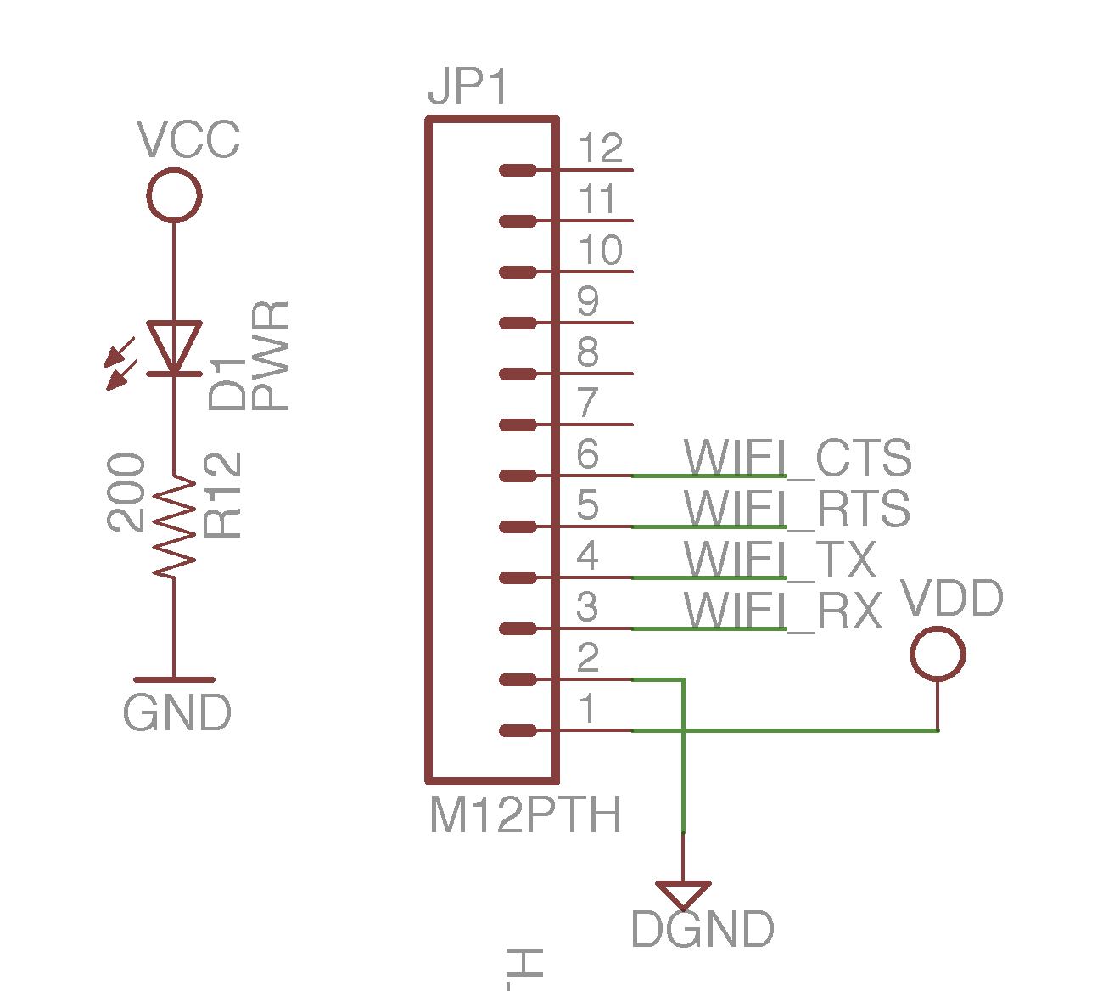
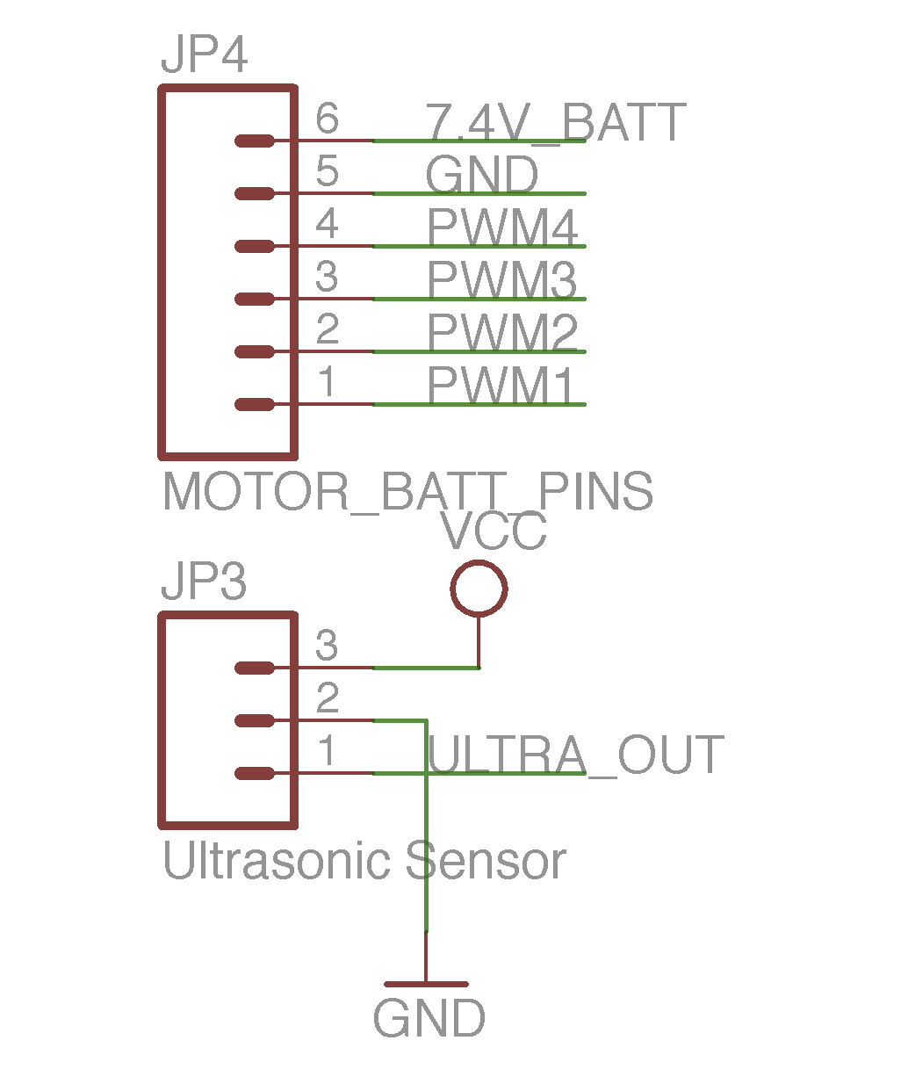
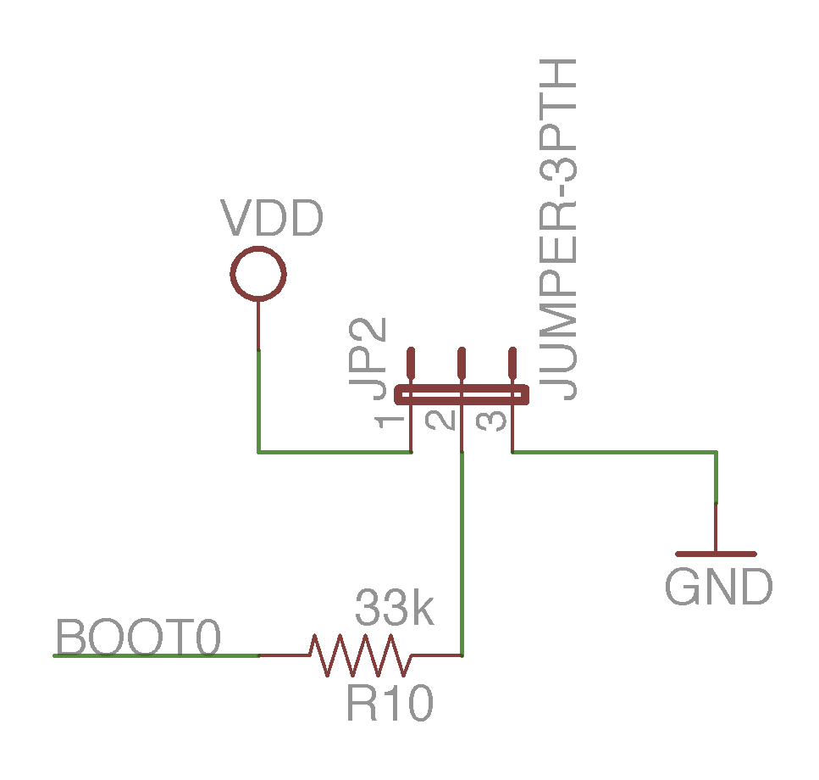
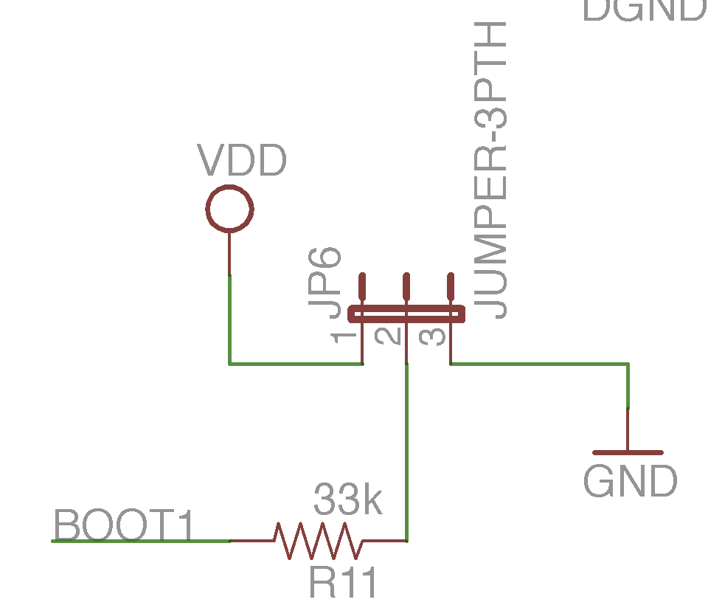
Control Board Schematic: Connectors

Slide 42
Communication: Options
Wi-Fi vs. Bluetooth Class 1
 | Wi-Fi RN-131 | Bluetooth Class 1
Indoor Range | Up to 100 ft | Up to 330 ft
Outdoor/LOS | Up to 300 ft | Up to 330 ft
Data Rate | Up to 54 Mb/s | Up to 3 Mb/s
Unit Price | $45.00 | $69.00

Slide 43
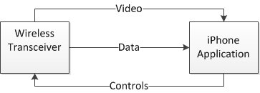
Communication Overview
Use Wi-Fi to send and receive data between the copter and iPhone
The iPhone receives the height data coming from the copter
The iPhone sends the copter the controls that the user is inputting

Slide 44
iPhone Interface
An iPhone is used to control the Quad-copter through an iPhone application
The Touch based functions of the iPhone are used to control the copter
Will show DCM angle values, height, orientation correction values, and motor throttle control

Slide 45
Software
iPhone application was written in Objective C
    Objective C is an object oriented version of C by Apple
  The application was developed using Xcode IDE and through the Interface Builder
    The Interface Builder provides easy design capabilities such as drag and drop functionality

Slide 46
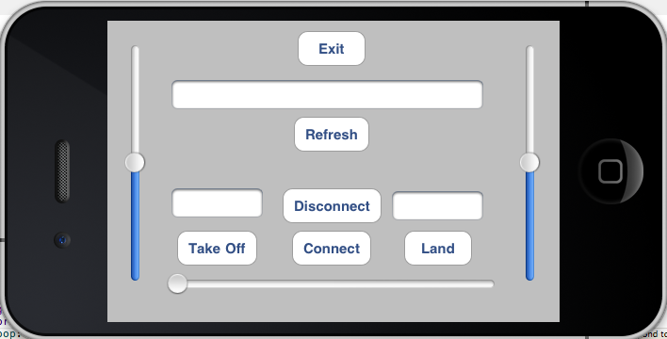
GUI Design

Slide 47
Package Structure
  From iPhone to Copter
    LXXRXXBXXF
    Left Slider Value, Right Slider Value, Bottom Slider Value, Control Flag
  From Copter to iPhone
    Altitude of copter
    DCM angles

Slide 48
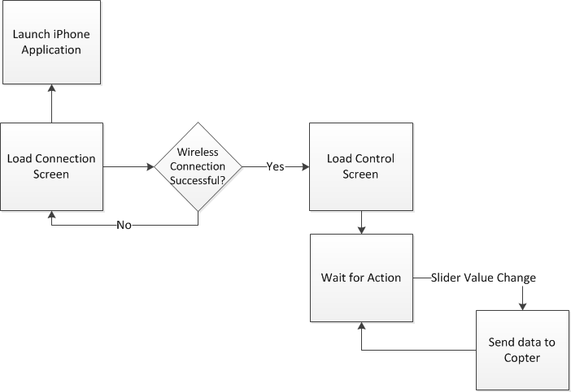
iPhone Software

Slide 49
Vehicle Body
Item | Weight (g)
Tubular Arm | 35 (x4)
PVC Connector | 22
Motor | 24 (x4)
Propeller | 8.5 (x4)
Bracket | 5 (x4)
ESC | 6 (x4)
Landing Base | 25
Wire | 28
Bullet Connector | 0.8 (x22)
#4 Bolt and Nut | 5 (x13)
#0 Bolt and Nut | 1 (x8)
PCB | 40
WiFi | 37
Ultrasonic Sensor | 15
Total | 571.6
Goals
  Lightweight
  Reasonably priced
  Impact resistant
Specifications
  Under 1 kg
  25” x 25” x 10”

Slide 50
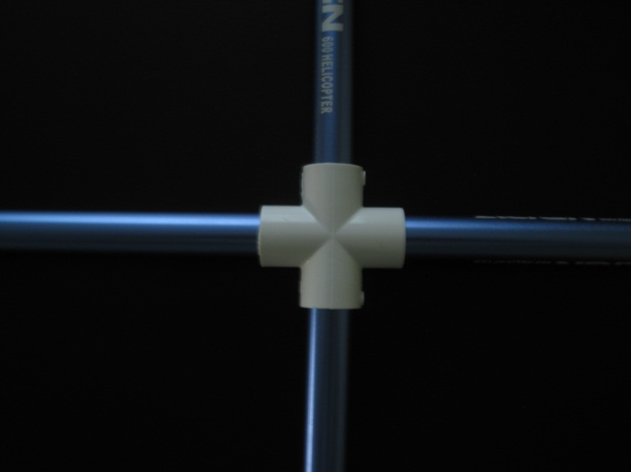
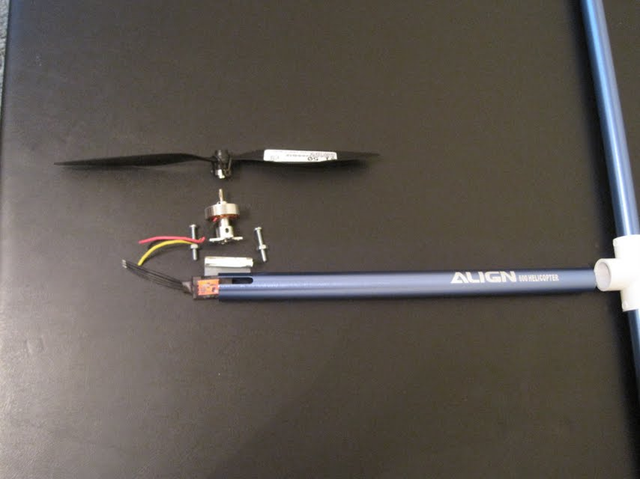
Vehicle Construction
The frame is constructed with four aluminum tubular arms connected in the center by a four-way PVC connector.
Motors are bolted to the tubes with a three-sided bracket in between to provide stability.
All wiring and ESCs are placed inside the tubing.
The PCB and landing base are glued in place.
PCB

Slide 51
Motors
Goals
  Thrust of 1.5 times quad copter weight
  Equilibrium between current draw and thrust
Specifications
  7.5 A maximum current draw
  Up to 400 g thrust
Controlled with electronic speed controllers (ESC)
  A 50 Hz signal with pulse width modulation (PWM) controls the current draw of the motors
    1 ms PWM = 0 throttle
    2 ms PWM = full throttle
  10 A capacity

Slide 52
Power Specifications
Provide 11.1V at up to 7.5 A for 12 minute flight time.
Provide 3.3 V for board components.
Weigh under 400 grams.

Slide 53
Power Design
Two batteries are used to maintain a clean power source for the PCB.
  4400mAh LiPo for the motors.
    Will run for 8.8 minutes at max current draw.
    Sensor will indicate when battery is low.
  610mAh Lipo for the PCB.
    Will run for much longer than the motors.
We are using two TLV1117-33 linear voltage regulators to provide separate digital and analog power sources. The ground plane is also divided accordingly.

Slide 54
Current Draw
Estimated maximum current for each component is used to determine battery size necessary.
Part | Current Draw from Motors | Current from Circuit Components
Hextronik motor | 7.5 A (x 4) | 0
ESC | 2.4 mA (x 4) | 0
Battery monitor | 3 mA | 0
Cortex M3 processor | 0 | 36 mA
Wi-Fi Transceiver | 0 | 250 mA
Ultrasonic sensor | 0 | 2.1 mA
IDG500 | 0 | 7 mA
ADXL335 | 0 | 235 uA
HMC5843 | 0 | 9 mA
3.3 Voltage regulator | 0 | 150 mA
Total | 30.0126 A | 454.335 mA

Slide 55
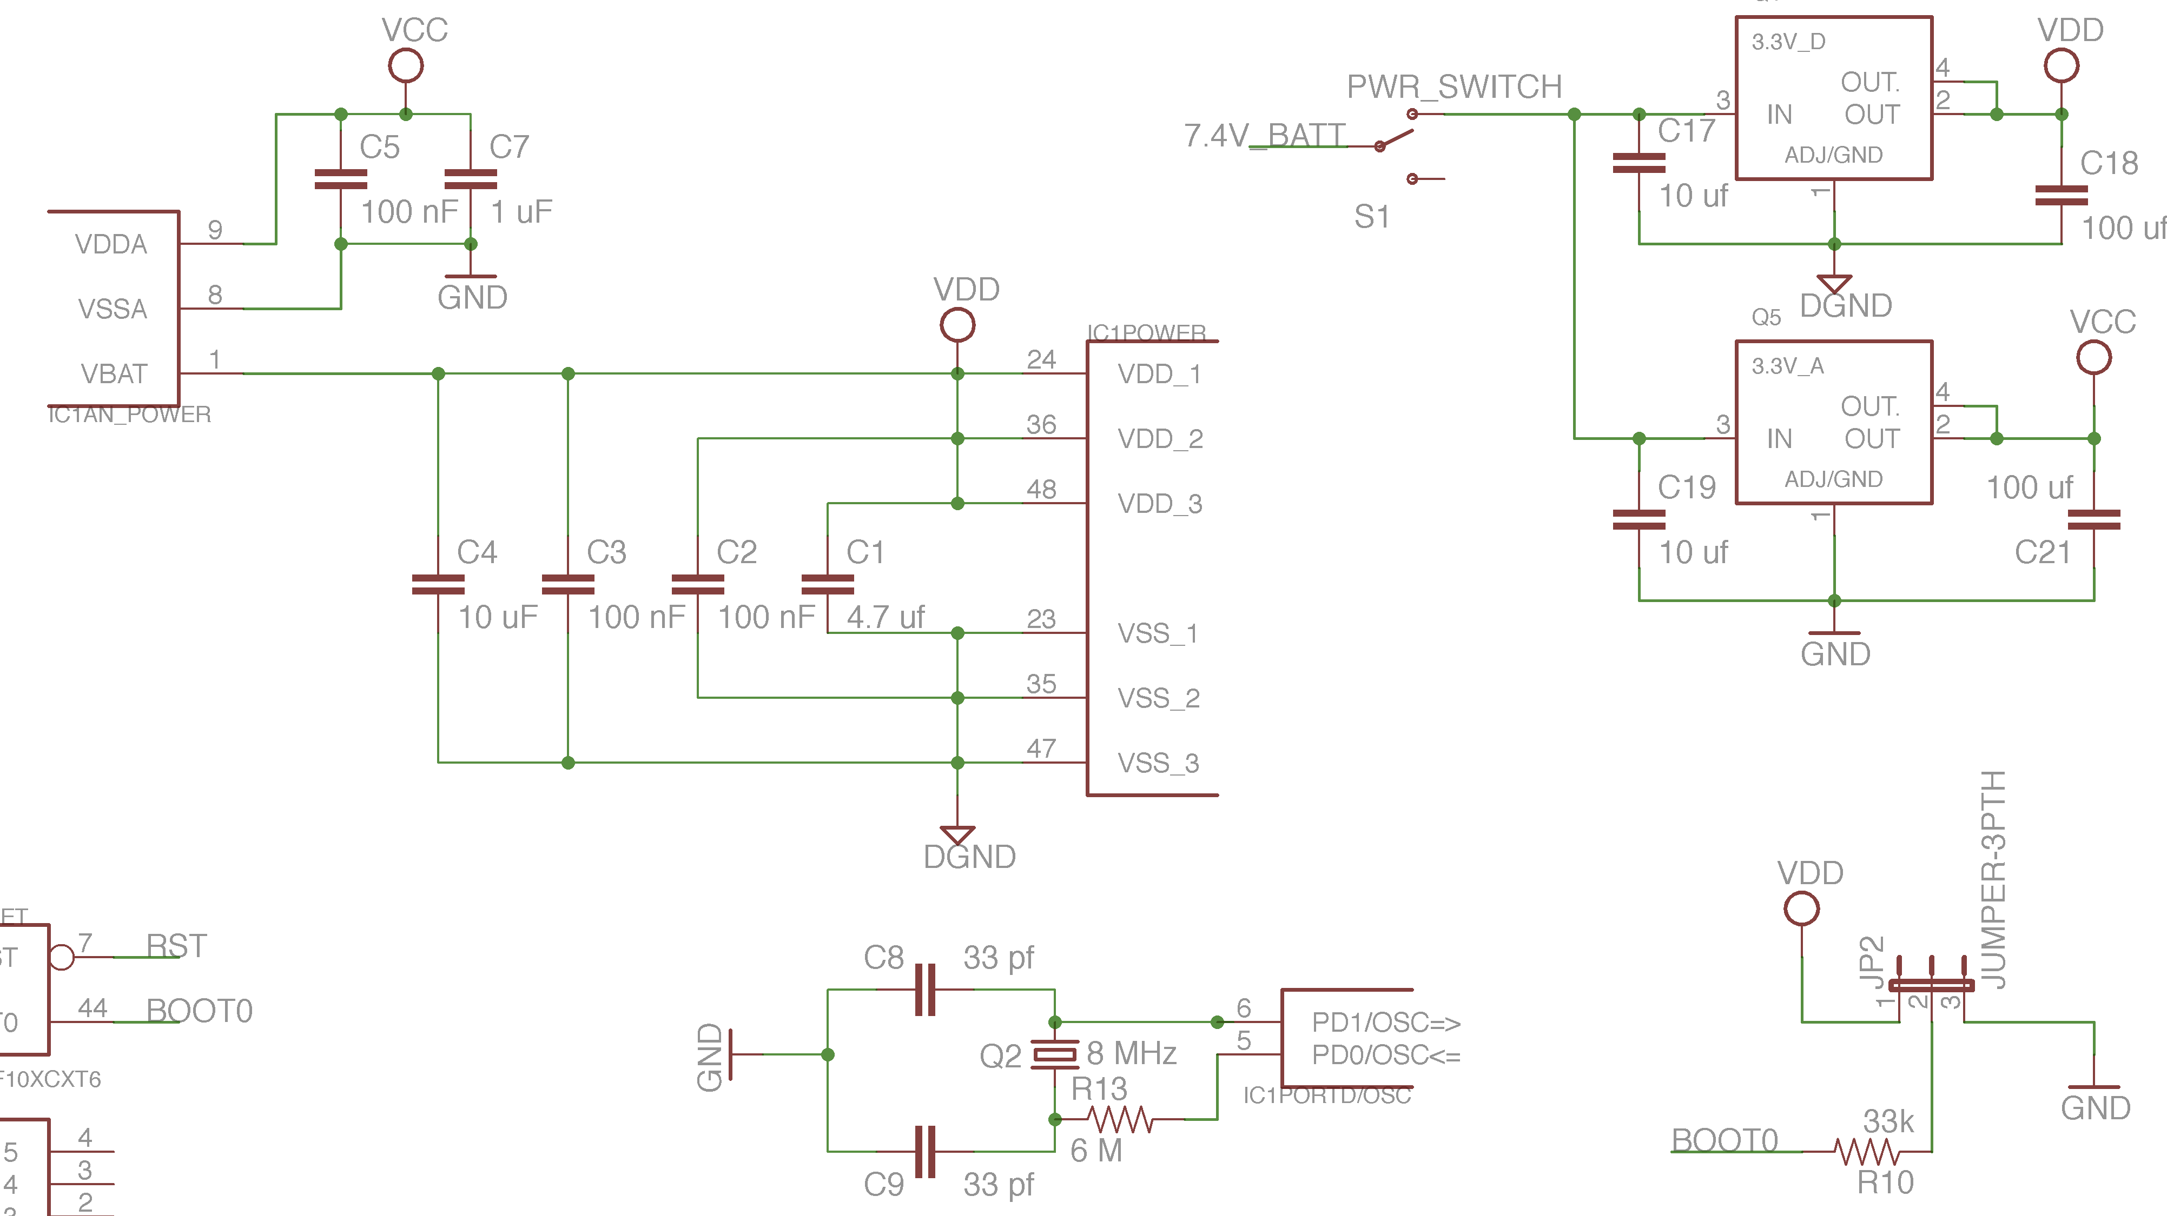
Control Board Schematic: Power

Slide 56
Control Board
Two 3.3V voltage regulators are next to power switch
Headers connect to outside components
Dimensions: 3 X 4 inches
Components mounted by hand
Mounted to frame on top of plastic stand-offs
Fabricated for free from Daniel’s employer Intersil.

Slide 57
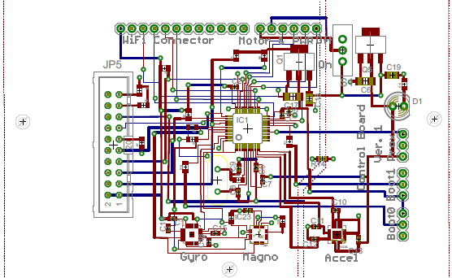
PCB Layout

Slide 58
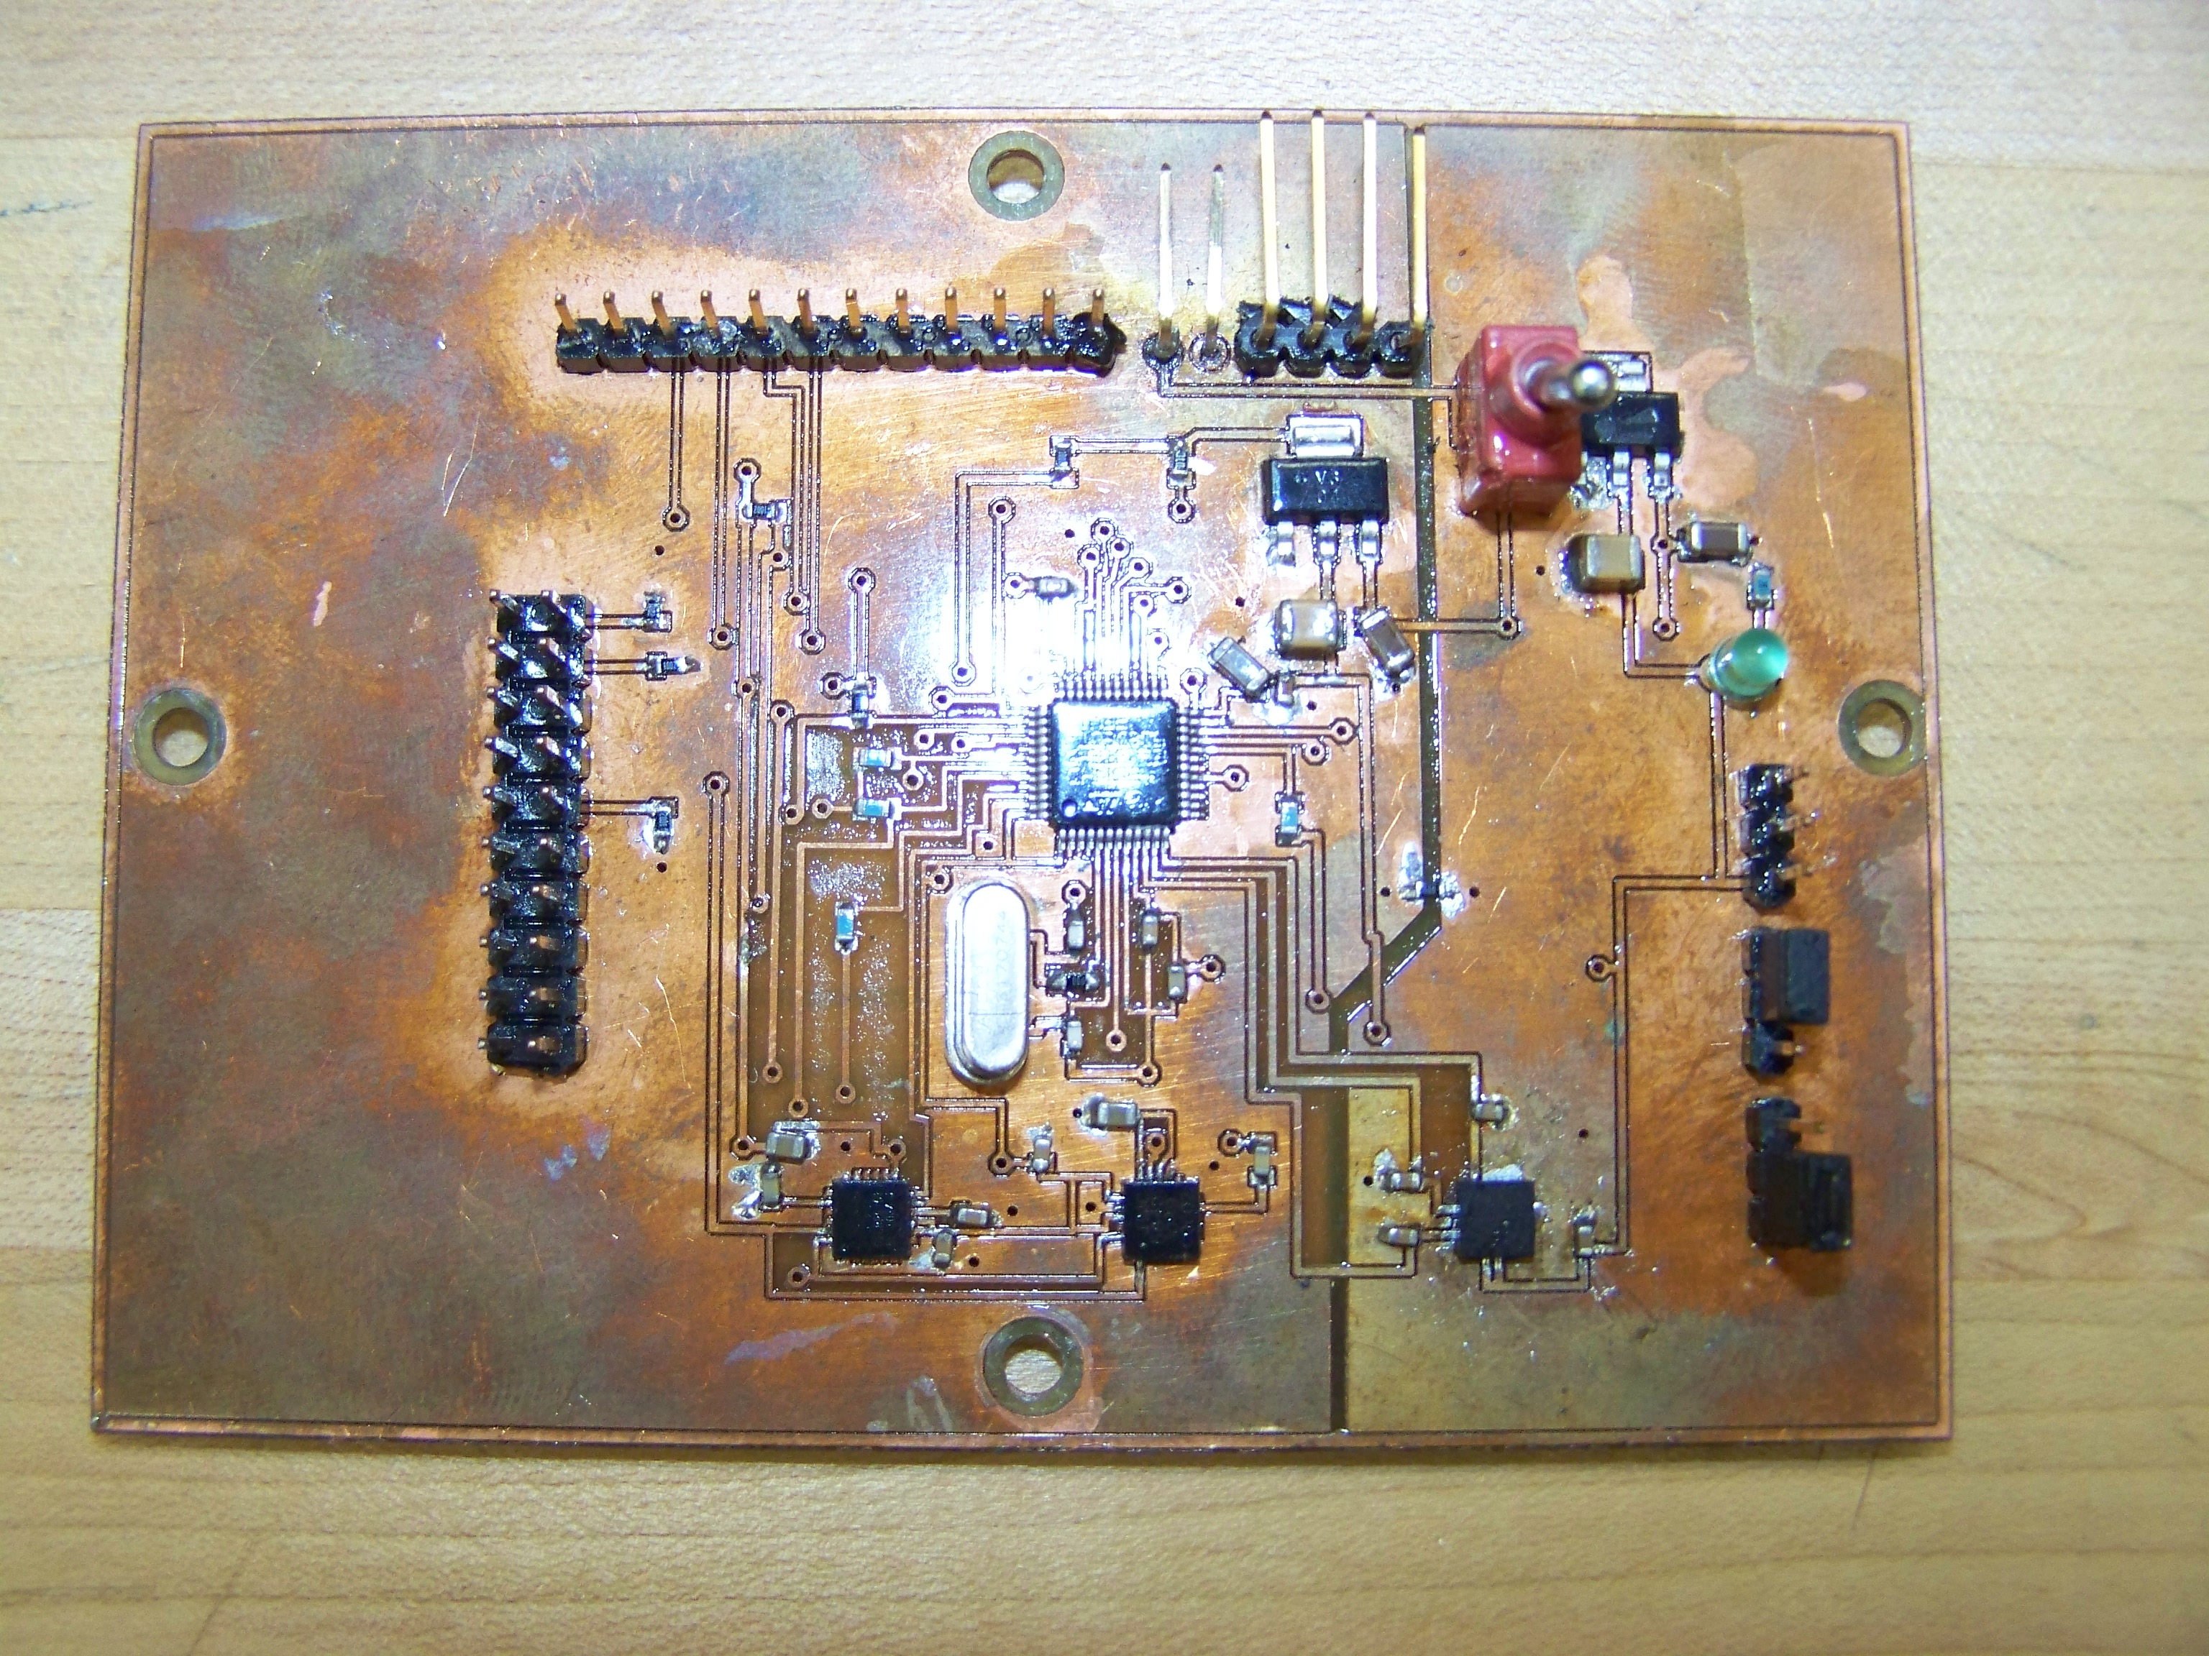
Constructed PCB

Slide 59
Difficulties
  PCB Issues
    Exposed traces shorted and damaged PCB components
    Original PCB redesigned
      Move and make traces smaller to eliminate problems
      Added a ground plane to top layer
      PCB shorted 2 hours before presentation moved to development board
  Motors and ESCs Failures
    ESC problems
      Shorted one damaged and repaired another
    Motor problems
      Winding leads breaking
      Burning out motors from to much current
  Frame Issues
    Time consuming to change components once mounted
    Control board stand offs breaking of frame.
Notes:
Components such as Microcontroller, Accelerometer, Resistor connecting gound planes

Slide 60
Difficulties
  Flight Testing
    Drooping arm
      Possible causes that were explored
        PID gains
        DCM angle tracking
        DCM code update time
        Bad connections
        Damaged motor
        Damaged ESC

Slide 61
Team Management
Group Member Name | Responsibility
Jared Rought | IMU Design, Camera Implementation
Daniel Goodhew | Power Design, Frame Design
John Sullivan | iPhone interfacing and GUI Design and Wireless Communication
Angel Rodriguez | Microcontroller interfacing and controller software design, Control Board Design

Slide 62
Budget
Component | Quantity | Price Per Unit | Total Cost
IMU | 2 | 74.95 | 150.90
4400 mAh battery | 2 | 26.79 | 53.58
610 mAh battery | 1 | 3.92 | 3.92
Battery Charger | 1 | 23.99 | 23.99
Battery Sensor | 2 | 2.10 | 4.20
Microcontroller | 3 | Free | Free
Header Board | 2 | 40.95 | 81.90
Motors | 8 | 7.99 | 63.82
Power Sensor | 1 | 6 | 6
Body | 1 | 12.99 | 12.99

Slide 63
Budget
Component | Quantity | Price Per Unit | Total Cost
Electronic speed Controllers | 8 | 9 | 72
Wireless Transceiver Kit | 2 | 115 | 230
iPhone SDK | 1 | 99.00 | 99.00
Gyro | 1 | 59.38 | 59.38
Accelerometer | 4 | 9 | 36
Breakout for IMU | 1 | 75 | 75
Total cost so far has come to around $1000 and we estimated for $550

Slide 64
Questions?

