Slide 1
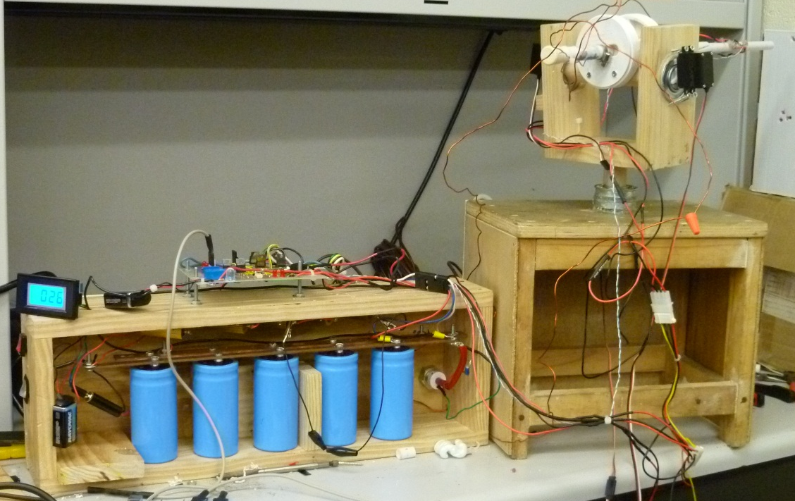
High powered AUTOMATED COIL GUN
Group 8
Brian Hoehn
Kwok Ng
Ricardo Reid
Josef Von Niederhausern
Notes:
Budget
Milestones
Percent Complete
Schematics
Tech design
Goals
Specs

Slide 2
Motivation
Power Design Project
Fascination with Firearms
Interest in Electromagnetic Fields
Building a Low Noise Alternative Gun

Slide 3
Requirements
Self Monitoring
Projectile Velocity Sensing
Optical Speed Trap
Capacitor Charge Voltage
Digital Voltmeter
Manual Control System
Manual Input
Capacitor Charging
Firing Mechanism

Slide 4
Specifications
100 fps muzzle velocity (30.48 m/s)
Accept 120 V AC input
120 ° Range of Motion Azimuth
60 ° Range of Motion Elevation

Slide 5
Project Breakdown
Four Functional Subsystems each managed by one group member
Power Subsystem
Field Generation Subsystem
Motion Control Subsystem
Controls and Software Subsystem

Slide 6
Power Subsystem
Power Source
Transformer & AC to DC converter
Diodes & Resistors
Capacitor Charging
Voltage Sensing
Switching

Slide 7
Power Source
Power System will:
Accept Standard 120V AC outlet
Provide:
400 V DC for Capacitor Bank
1.5V & 5V Speed Trap
FPGA is powered separately by USB connected to a laptop.
Provides 5V to DC Servomotors (2)

Slide 8
Transformer & AC to DC Power
Transformer
Step up transformer
500VA Power Transformer HT97818
Receives 120V AC
Outputs 480V AC
AC to DC converter
4 diodes
Full-wave bridge rectifier

Slide 9
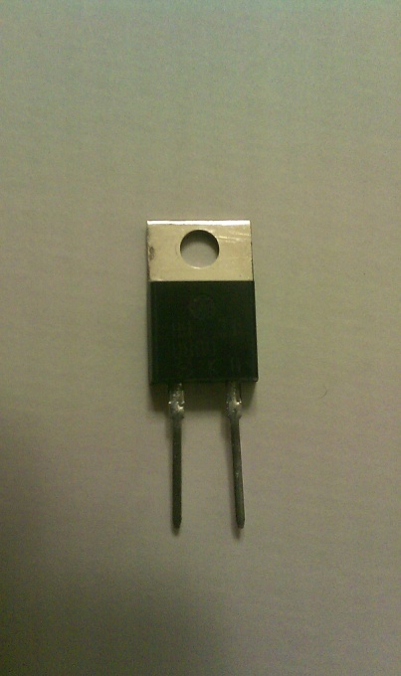
Diodes
MUR860
Ultrafast
8A maximum average forward rectified current.
600 V maximum DC-blocking voltage
Schottky Diode rated at 60A Perfect for use as flywheel diodes
Prevent damage to SCR & Capacitor Bank from back EMF
Block reverse peak voltage

Slide 10
Switching Devices
4 Options:
n-channel Power MOSFET, NPN BJT, IGBT, and thyristor
Disadvantages
NPN BJT
For the bipolar transistor to operate in saturation mode there must be a large current supplied to the base.
N-channel power MOSFET
The transistor is easily damaged from back electromagnetic fields.
IGBT(Insulated Gate Bipolar Transistor)
The major drawback is cost and susceptibility to voltage spikes.

Slide 11
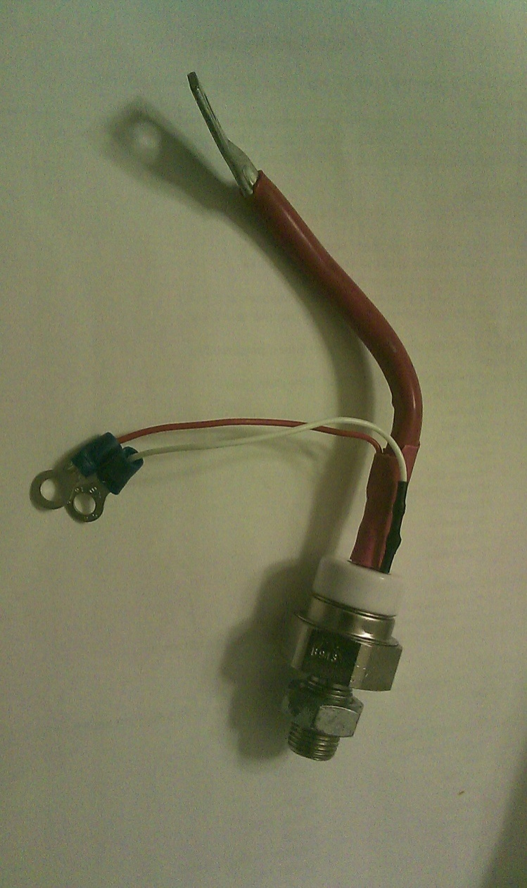
Releasing Current
SCR
(Silicon Controlled Rectifier)
GE C155D
3V gate trigger voltage
The gate is connected to the circuit of the FPGA.
The ground is connected to the negative terminal of the FPGA.
110A rated current
SCRs can handle surge currents up to 10 times their rated current

Slide 12
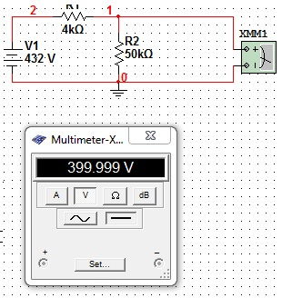
Resistors
Voltage Divider – 400V output
The schematic to the right shows the configuration of the voltage divider.
High resistance in the circuit is to prevent over-heating of the resistors.
Resistors are rated at 50W. A 4k and 50 k resistor in series. Output on the 50k resistor.
The circuit outputs exactly 400V preventing capacitors from exceeding maximum rated voltage.

Slide 13
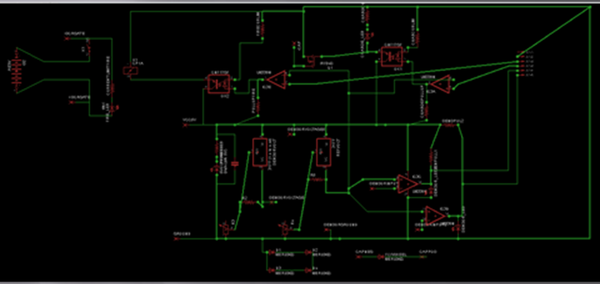
Circuit Schematics

Slide 14
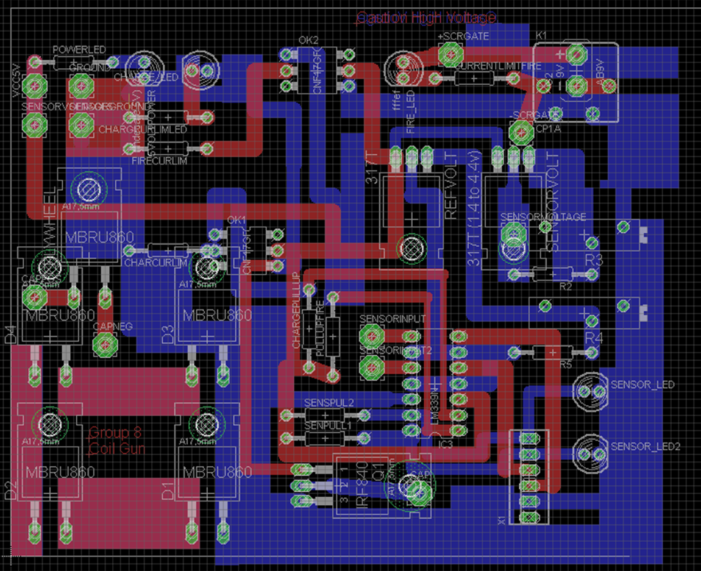
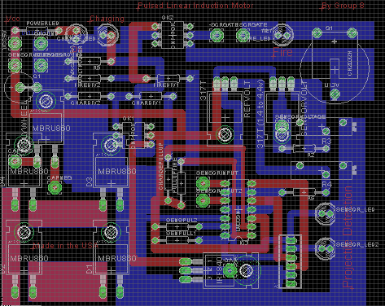
Printed Circuit Board in EagleCAD

Slide 15
Field Generation Subsystem
Barrel
Coil (solenoid)
Projectile
Capacitor Bank
External Iron Casing

Slide 16
Field Generation Subsystem
– Barrel –
Minimal Impact to Projectile Velocity
Low Coefficient of Friction (COF)
Non-Ferrous
Brass
Pros - Low COF; Rigid
Cons – Conductor
Eddy Currents; could be reduced with channeling
Potential Shock Hazard
PVC
Pros - Low COF; Low Cost
Cons – Flimsy
3/8 inch water lines used for refrigerators

Slide 17
Field Generation Subsystem
– Coil –
Single Stage or Multi Stage?
Doubling the number of Coils
increases the velocity by a factor of square root of two
With constant coil sizes
As velocity increases the projectile spends less time in each coil

Slide 18
Field Generation Subsystem
– Coil –

Slide 19
Field Generation Subsystem
– Coil –

Slide 20
Field Generation Subsystem
– Coil –

Slide 21
Field Generation Subsystem
– Coil –

Slide 22
Field Generation Subsystem
– Coil –

Slide 23
Field Generation Subsystem
– Coil –

Slide 24
Field Generation Subsystem
– Coil –
Wire Size calculated by equation for fuses
AWG | Time to Melt (ms) | 20% De-rated
14 | 19 | 15.2
15 | 15 | 12
16 | 11.9 | 9.5
17 | 9.5 | 7.6
18 | 7.5 | 6

Slide 25
Field Generation Subsystem
– Coil –

Slide 26
Field Generation Subsystem
– Coil –

Slide 27
Field Generation Subsystem
– Coil –
Final Coil Design: 171 Turns
Trade off between field strength and increased inductance, resistance, current
Coil Length 26 mm
Inner Diameter 13 mm
Outer Diameter 29 mm
16 AWG
High tech Enamel
Coil Inductance 0.352 mH
Coil Resistance 0.184 Ohms

Slide 28
Field Generation Subsystem
– Coil –

Slide 29
Field Generation Subsystem
– Capacitor Bank –
Typical coil gun efficiency 2-5 %
Worked backwards from energy need for acceleration by assuming Energy Transfer assuming 2% Efficiency

Slide 30
Field Generation Subsystem
– Capacitor Bank –
Aluminum Electrolytic Capacitor
GS High-Cap Screw Terminal
400 Volt 1000 μ Farad capacitor
ESR 140 milliohms
$28.80 each
Five of these capacitors in parallel joined by a rigid bus

Slide 31
Field Generation Subsystem
– External Iron –
Pros
Focus Flux Lines
Increase Energy Transfer
Cons:
Heavy weight
Reduce air flow
Conductor

Slide 32
Field Generation Subsystem
– Projectile –
Phillips Head Bit
5 grams
Pre-fabricated
Consistent Mass
Cylindrical Steel Dowel
Nominal Length ¾ of the Coil Length
Minimal Air Gap in Barrel

Slide 33
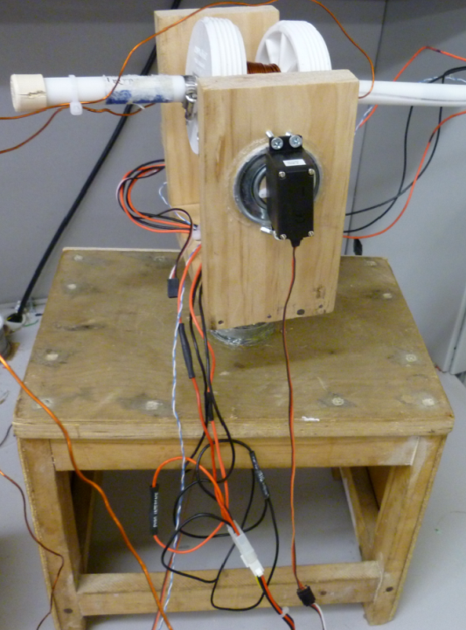
Motion Control Subsystem -Turret-
Self make turret with rotating shaft mounted allows gun to pan and tilt
Used rotational physics to calculate the torque required for the right-left motor is 59 oz-in, and the torque require for the up –down motor is 110 oz-in

Slide 34
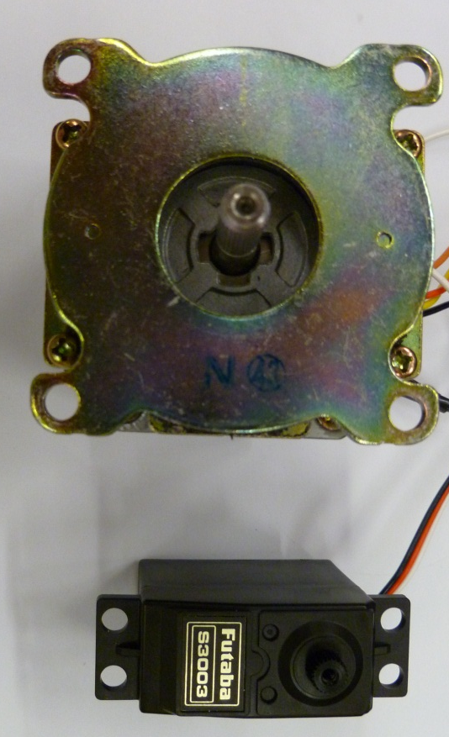
Motion Control Subsystem
- DC step motor Vs Servo Motor
 | Step Motor | Servo Motor
Cost | $19.99 | $23.99
Torque | 120 oz-in | 146 oz-in
Weight | 34.3 oz | 1.8 oz
Power | 24V | 2V to 6V

Slide 35
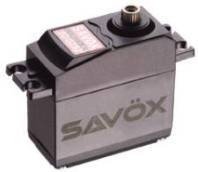
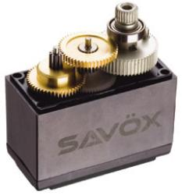
Servo Motor
SAVOX SC 0252
- power supply 4 to 6 V
-metal gear servo
-light weight 1.8 oZ
-higher torque 146 oz-in

Slide 36
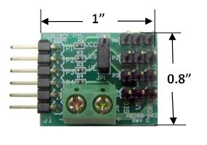
Servo Motor Controller
PmodCON3 Servo Connector Module Board
PmodCon3 connection: compatible for most of the Diligent system board as well as the FPGA board that was used in our project.
Terminal power supply: power up 6V power, enough power for 50 to 300 oz-inch of torque
4 set 3 pins connection: Enough for up to 4 servo motors connection
Low Price : $10 dollars
Drawback and solution: not exactly a servo motor controller, but we can use the FPGA board to generate the PWM to control the motors

Slide 37
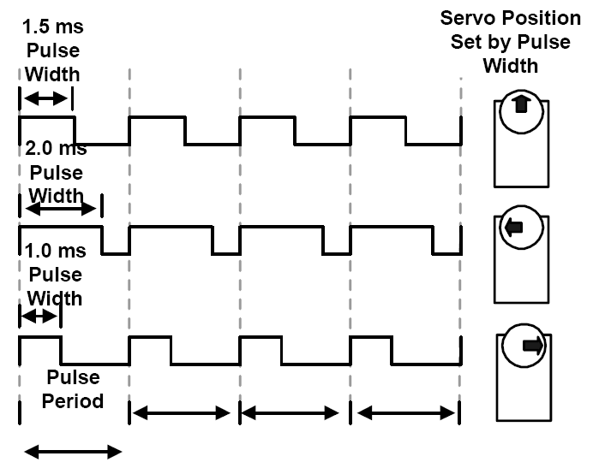
Pulse Width Modulation
PWM change the pulse widths then can change the direction
usually signal should be sent of 30-60 pulses every second
Period: 1 / 50 pulses = 20 ms
FPGA Board Period: 1/50 Mz =0.02 us
98 steps motor control
1/98 ms = 0.0102 ms
Notes:
Jeff

Slide 38
Controls & Software Subsystem
FPGA
Functions of FPGA
Selection
Block Diagram of Integration with other Components
Software Architecture
Basic Function Description
Function Block Diagram

Slide 39
FPGA
The User will communicate with the Program through the FPGA’s onboard switches and buttons
The FPGA will allow for the User to
Control the Servo Motors manually
Charge the Capacitors
Fire the Projectile
Measure the Mussel Velocity (Using Seven Segment Display)

Slide 40
Manual Control
The Azimuth and Elevation will Increment/Decrement based on the User’s input
FPGA onboard toggle switches are used for controlling horizontal and vertical motion of the barrel.

Slide 41
Charging and Firing SW
The Charging Circuit is connected to an output pin of the FPGA, by way of a High Power MOSFET.
The Firing Circuit is connected to an output pin of the FPGA, by way of a SCR.
Both Circuits use an opto-isollator to protect the FPGA.
When the User wants to Fire or Charge the Capacitor Bank a Switch will used to open the gate of the transistor allowing the circuit to do so.

Slide 42
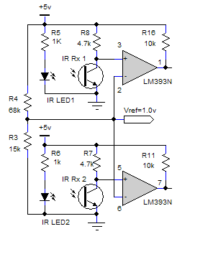

Sensors and Motion Control Subsystem
– Speed Trap –
Optical triggered Speed Trap mounted on barrel
Each of the Outputs from the Optical Sensors are connected as Inputs to the FPGA

Slide 43
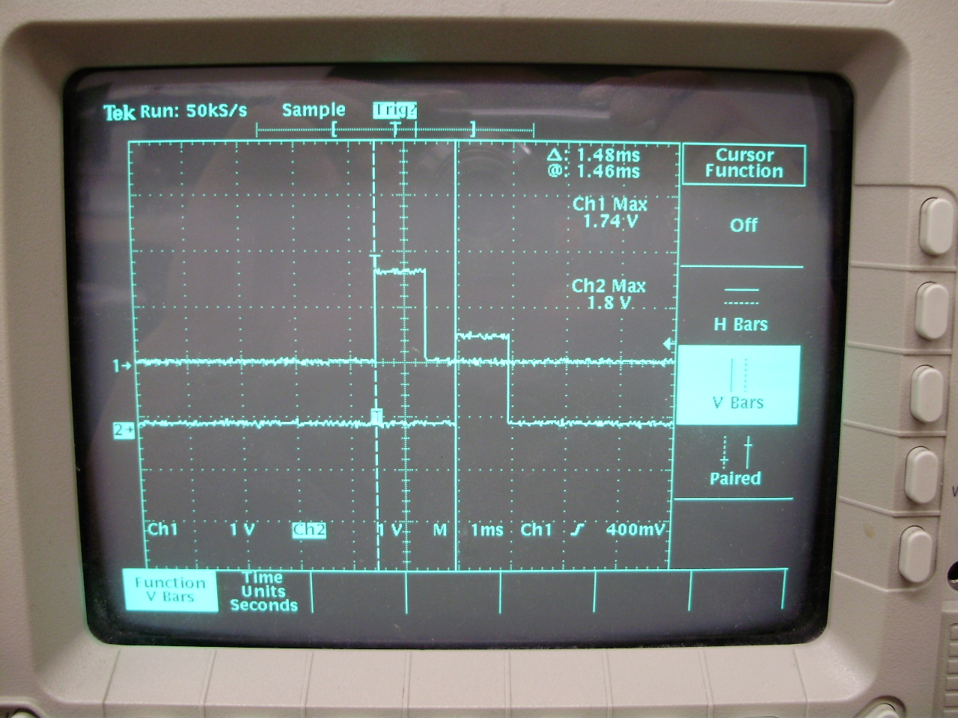
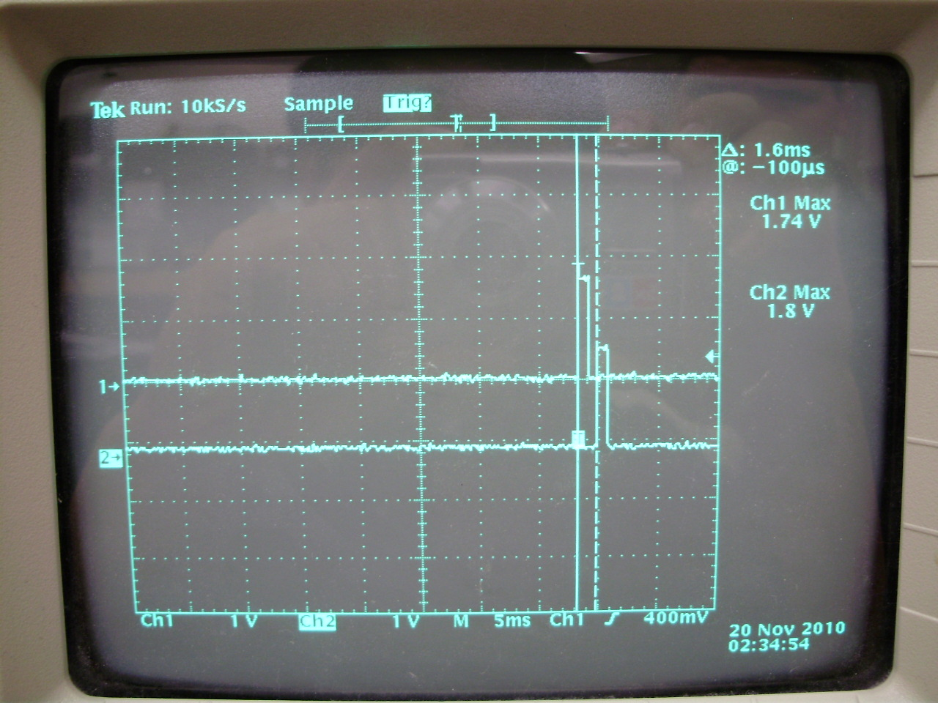
Sensors and Motion Control Subsystem
– Speed Trap –

Slide 44
Speed Trap SW
Two Optical Sensors on Barrel
When the first sensor goes low a counter is started.
When the second sensor then goes low the counter is stopped.
The counter is then outputted to the Seven Segment Display
Velocity Calculation
Once the counter has ended the Muzzle Velocity is calculated by :
velocity = (x/(count*clk))*3.3
Where x is the distance between sensors, clk is for the 50MHz clk, and 3.3 is the conversion from mps to fps.

Slide 45
Function Descriptions
DCMotorAz | Turns on the Azimuth motor for the desired time period
DCMotorEl | Turns on the Elevation motor for the desired time period
Charge | Starts the charging of the Capacitors and turns on Voltmeter
FireStandby | Waits until User is finished charging
Fire | Stops Charging the Capacitors, and dumps the load
SpeedSensor1 | Waits until Sensor one sends a pulse and then begins counter
SpeedSensor2 | Waits until Sensor two sends a pulse and then end counter
SpeedOutput | Once counter ends, Calculate velocity. Output Velocity to Seven Segment Display

Slide 46
FPGA Selection
Xilinx Spartan 3E
Low cost at $150
High-performance logic solution for high-volume, consumer-oriented applications
Larger amount of RAM.
Xilinx Basys
Low cost at $89
High-performance logic solution for high-volume, consumer-oriented applications
Lower RAM vs Spartan 3e

Slide 47
Basys
The Xilinx Basys FPGA has been chosen for this project
The Basys FPGA has a sufficient amount of I/O pins and RAM, and will allow for the possibility for other capabilities that may be given to the Turret.

Slide 48
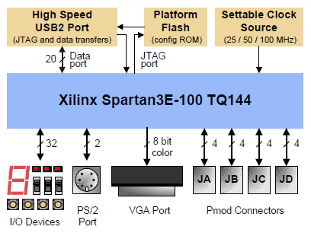
Basys Block Diagram

Slide 49
Control System Block Diagram
FPGA
Elevation Servo Motor
Azimuth Servo Motor
Speed Trap Optical Sensors
Charge
Fire

Slide 50
Budget
 | Quantity | Price | Total
Basys FPGA | 1 | $89.00 | $89.00
Resistor Package | 1 | $20.00 | $20.00
PModCon3 | 1 | $9.99 | $9.99
Servo Motor | 3 | $23.99 | $71.97
PCB Materials | 1 | $210.00 | $210.00
Capacitor | 5 | $28.80 | $144.00
Silicon-Controlled Rectifier | 3 | $20.00 | $60.00
MUR860 Rectifier Diodes (10) | 2 | $19.99 | $40.00
Digital Voltmeter | 1 | $89.99 | $89.99
LM339 | 4 | $2.00 | $8.00
Switches | 1 | $9.99 | $9.99
IR LED/Sensor | 6 | $11.90 | $72.00
Miscellaneous | 1 | $100.00 | $100.00
Magnetic Wire (100ft) | 1 | $68.70 | $68.70
Transformer | 1 | $8 | $8
 |  |  | $1001.99

Slide 51
Project Difficulties
Measuring Current through the Coil
Monitoring Voltage with FPGA
Integrating the Charging and Firing Circuits together
Stepper Motors (Weight, Current)
Low Output Current from FPGA

Slide 52
Questions
?

