Slide 1


UCF Rain Simulator “ ” Project
R
Group 10:
Luke Falls
Adam Cutting
David Levy
Brenda Garcia

Slide 2

Introduction
Largest rain simulator of its kind in North America
Trouble with existing control system
Need a fix for the existing problems

Slide 3
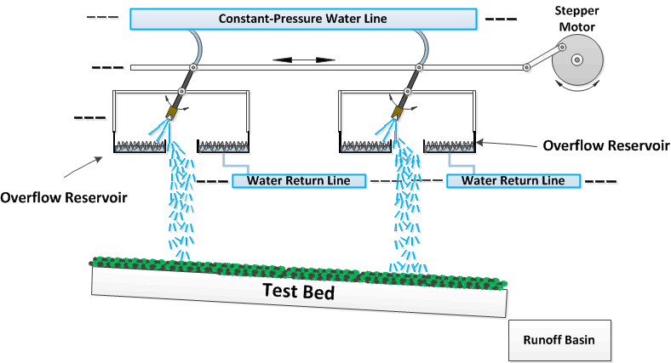
Introduction

Slide 4
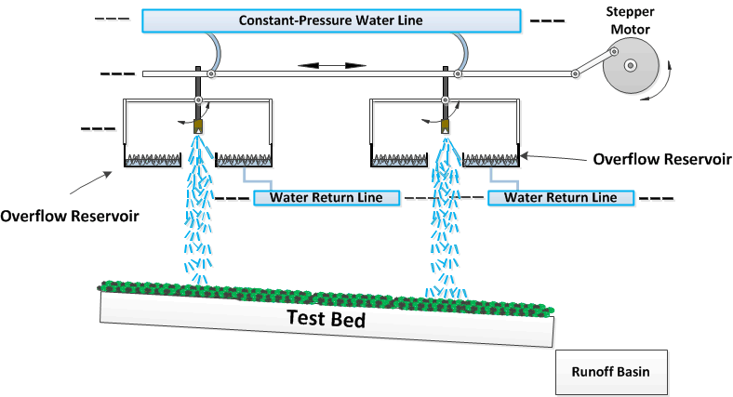
Introduction

Slide 5
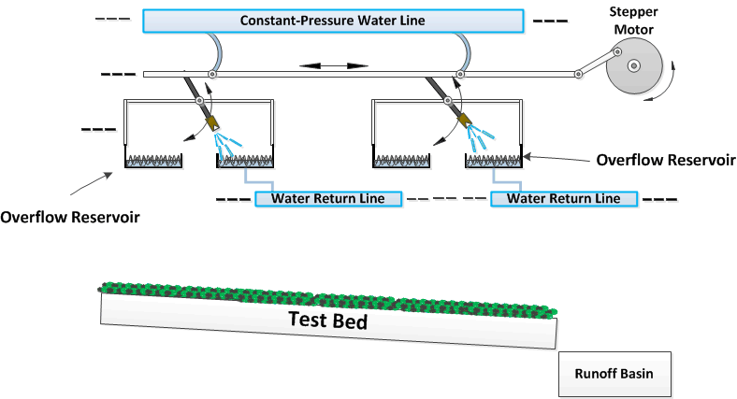
Introduction

Slide 6
Introduction

Slide 7
Introduction

Slide 8
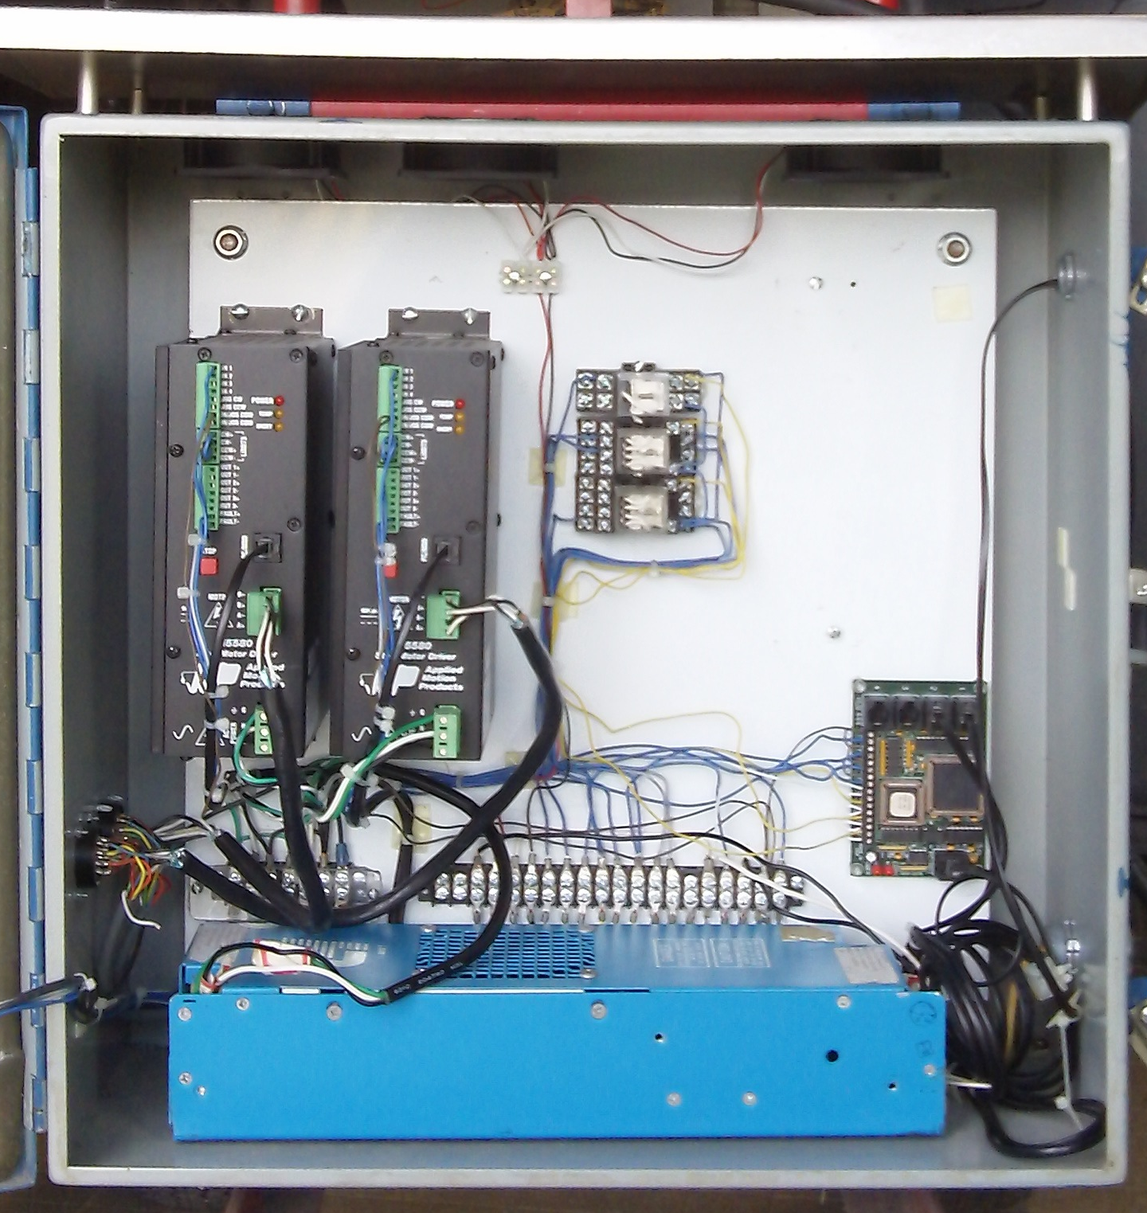
Existing Control System Overview
Communication to laptop is unreliable
Power supply is intermittent
Problems hinder their ability to meet simulation deadlines
Very Expensive: Approximately $ 5,000.00 for control system.
Far more capable than what is necessary for the application
Inefficient Design

Slide 9
Motivation
Fixing the existing problems is not sufficient
Power supply
Hub-444 communication module
Avoid ruining the existing system
Project benefits another UCF department
To gain experience with motor control systems

Slide 10
Goals & Objectives
Provide a reliable control system that can accurately deliver the desired amount of rain
Make new control system interchangeable with the existing system
Water resistant enclosure
Keep the design simple
User friendly interface
Eliminate the need for a computer

Slide 11
Specifications & Requirements
Two user inputs: Intensity and Duration
0.5 in/hr of rainfall accuracy (max 12 in/hr)
1 minute duration accuracy
The microcontroller needs to have 2 serial communication modules and 60 GPIO pins
Rain sensors need to be accurate within 0.25 inches
Each motor driver needs to be able to handle at least 5.66 amps per phase
Stepper motor power supply rating of 65 Watts.

Slide 12
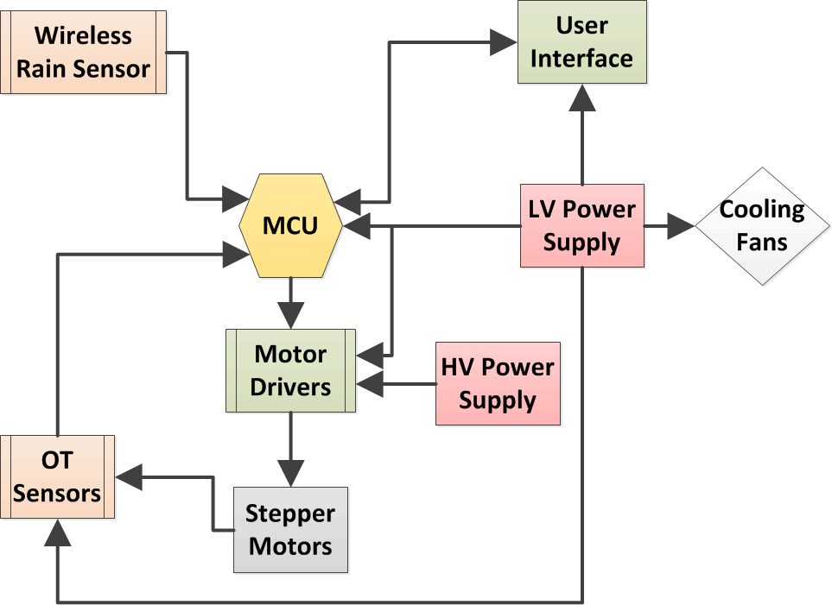
Overall Control System Design

Slide 13
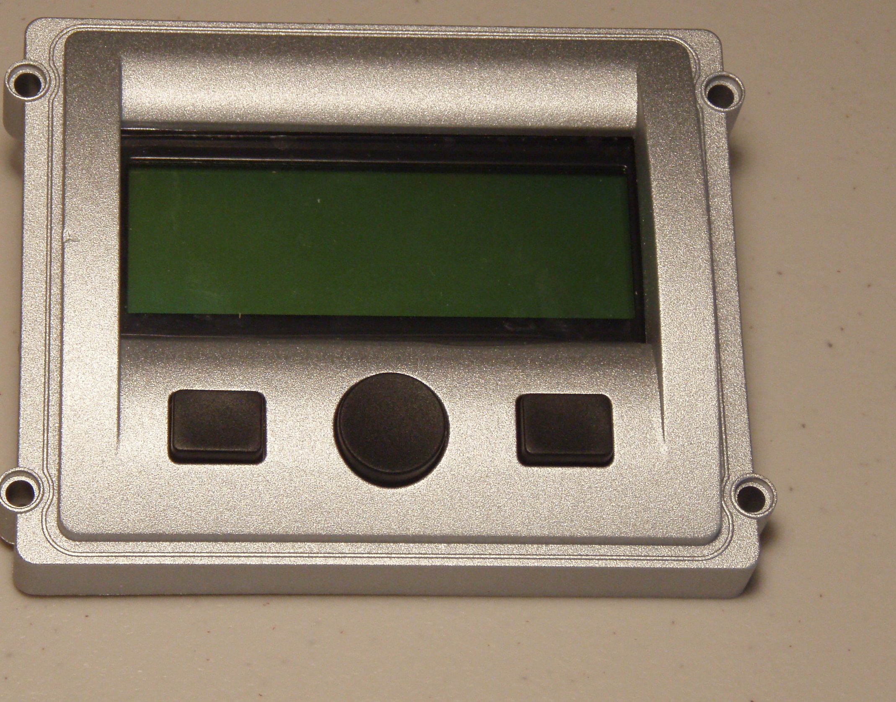
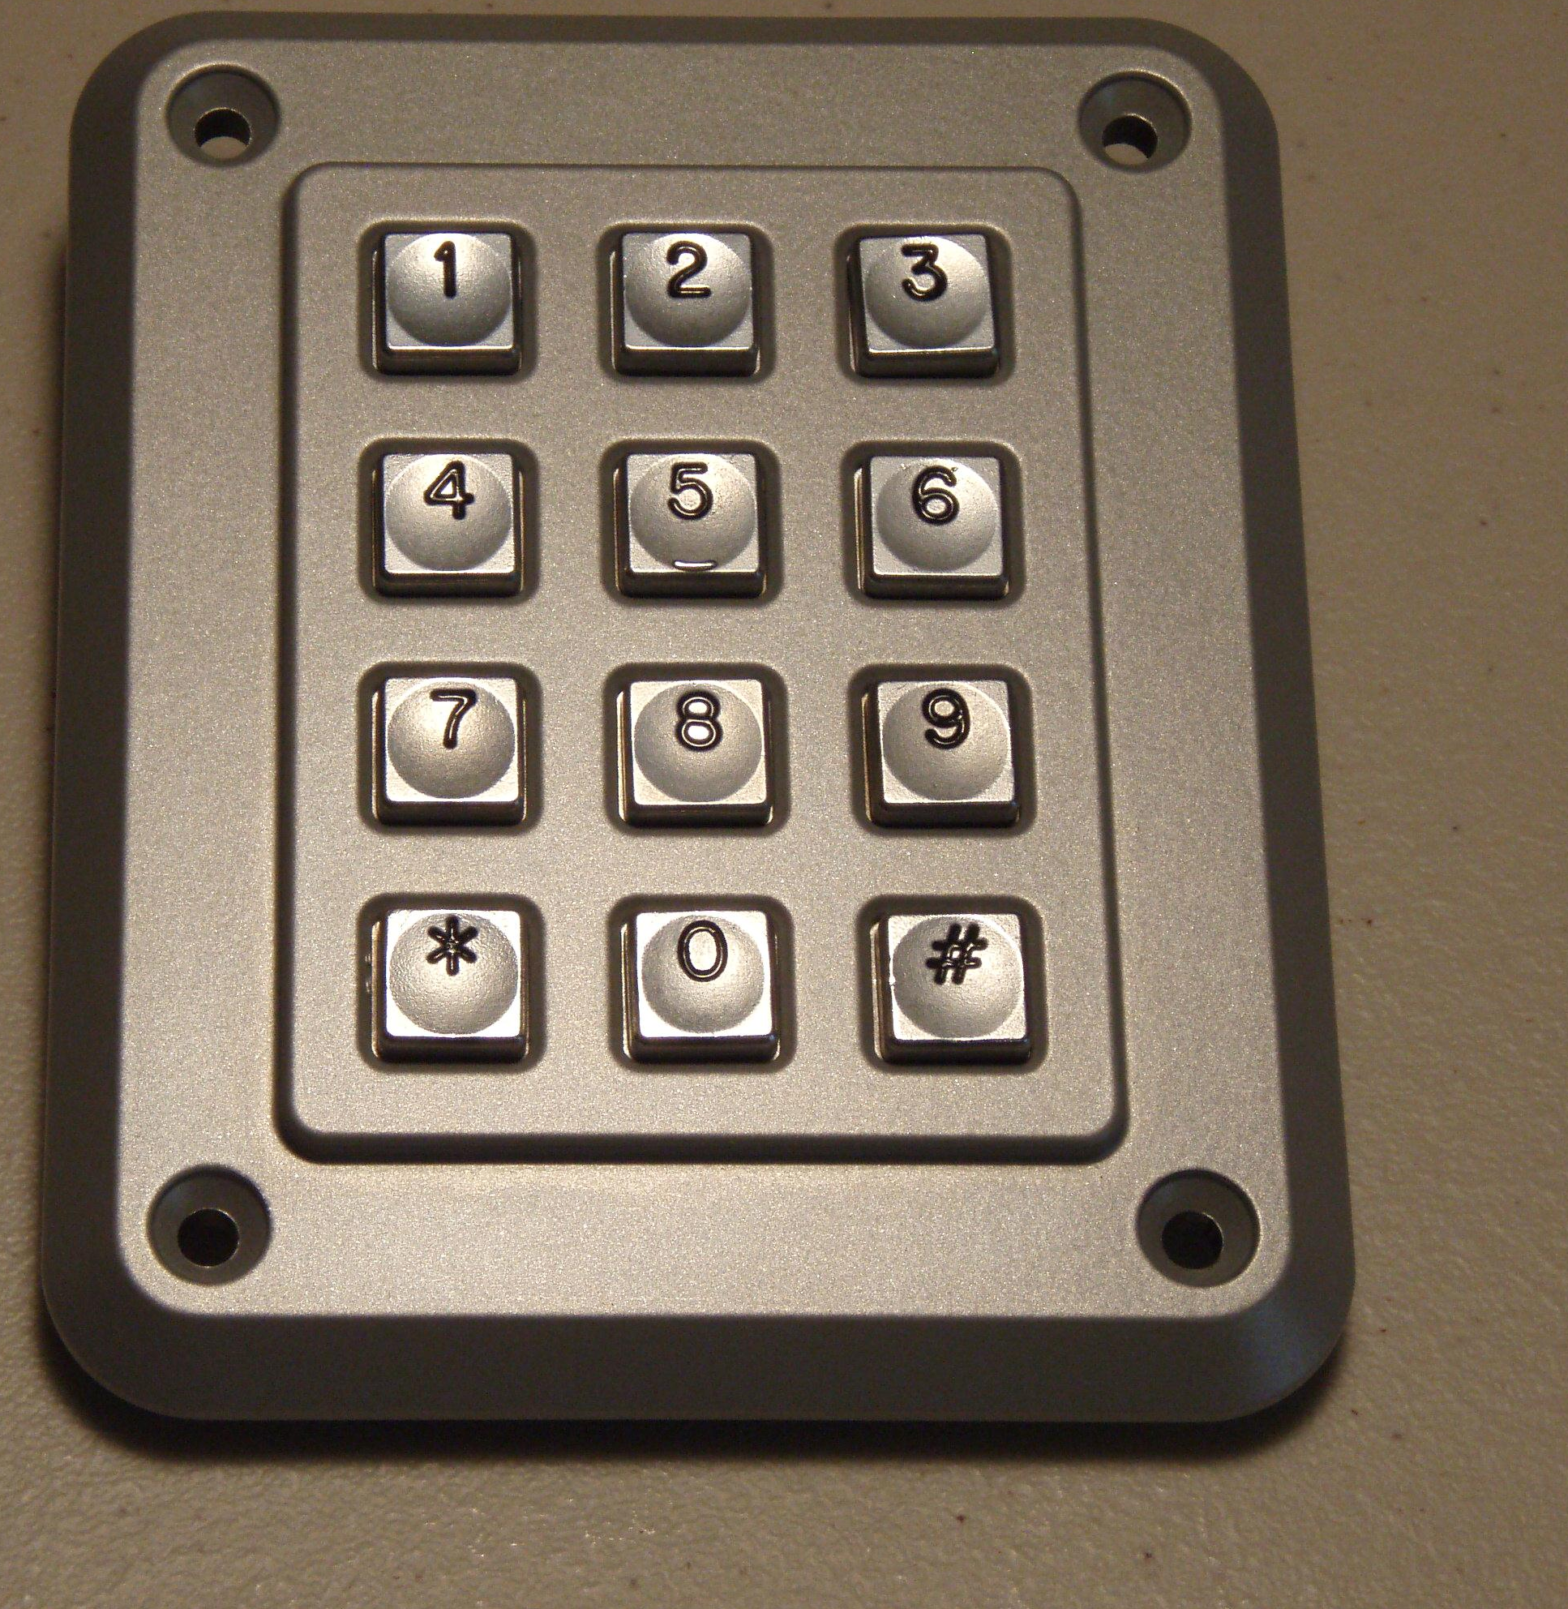
User Interface Components
Storm-Interface Display Bezel
Impact Resistant
4x20 Character LCD
3 Navigation Buttons
Weather Sealed for outdoor use
Storm-Interface Keypad
Vandal and impact resistant
Weather, water, and dust resistant (IP65)
-40ºC to 100ºC Operating Temperature
Operating Life of at least 4 million
cycles per key
3.40”
4.20”
4.70”
3.90”

Slide 14
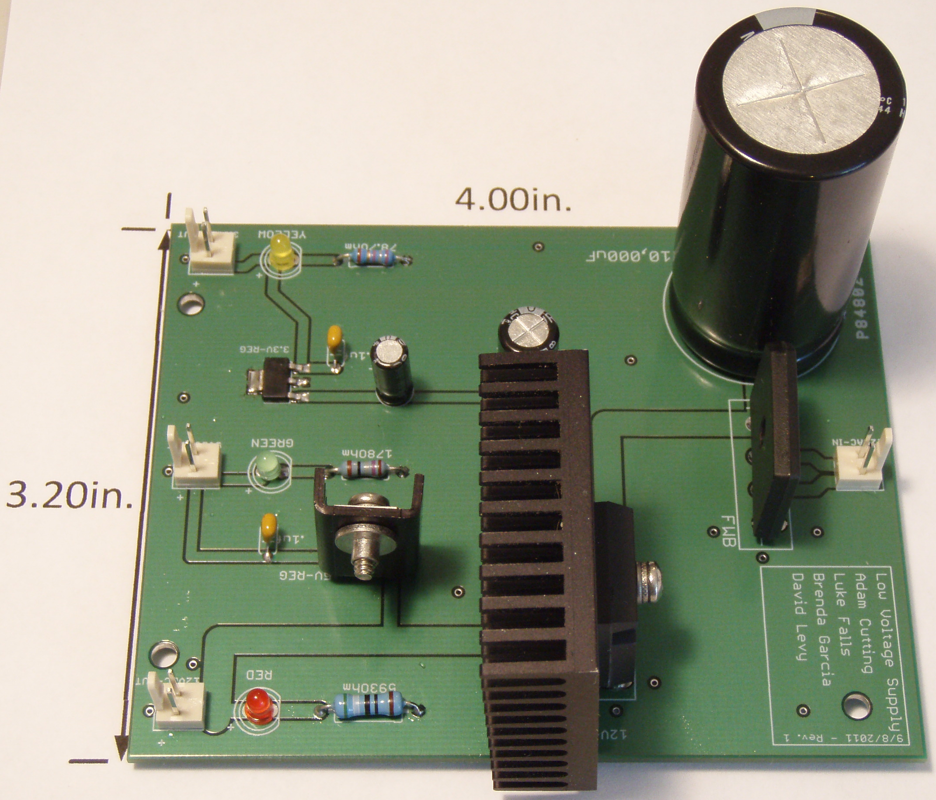
Low Voltage Power Supply Design

Slide 15














Low Voltage Thermal Design
12 Volt Regulator
$$V_{Drop}=6.4 Volts$$
$$T_{Ambient}=38\text{º}C$$
$$I_{Out}=2.7 Amps$$
$θ_{Total}=θ_{Junc−Case}+θ_{Case−HS}+θ_{HS−Amb}$ = 5.8$\text{º}$C/W
$$P_{Reg}=17.3 Watts$$
$T_{Junc}=T_{Amb}+ θ_{Total}×P_{Reg}$= 138.3$\text{º}$C < 150$\text{º}\text{C}$
5 Volt Regulator
$$V_{Drop}=7 Volts$$
$$T_{Ambient}=38\text{º}C$$
$$I_{Out}=0.5 Amps$$
$θ_{Total}=θ_{Junc−Amb}$ = 53$\text{º}$C/W
$$P_{Reg}=3.5 Watts$$
$T_{Junc}=T_{Amb}+ θ_{Total}×P_{Reg}$= 126.2$\text{º}$C < 150$\text{º}\text{C}$
3.3 Volt Regulator
$$V_{Drop}=8.7 Volts$$
$$T_{Ambient}=38\text{º}C$$
$$I_{Out}=0.1 Amps$$
$θ_{Total}$ = 5.8$\text{º}$C/W
$$P_{Reg}=0.87 Watts$$
$T_{Junc}=T_{Amb}+ θ_{Total}×P_{Reg}$= 84.1$\text{º}$C < 150$\text{º}\text{C}$

Slide 16
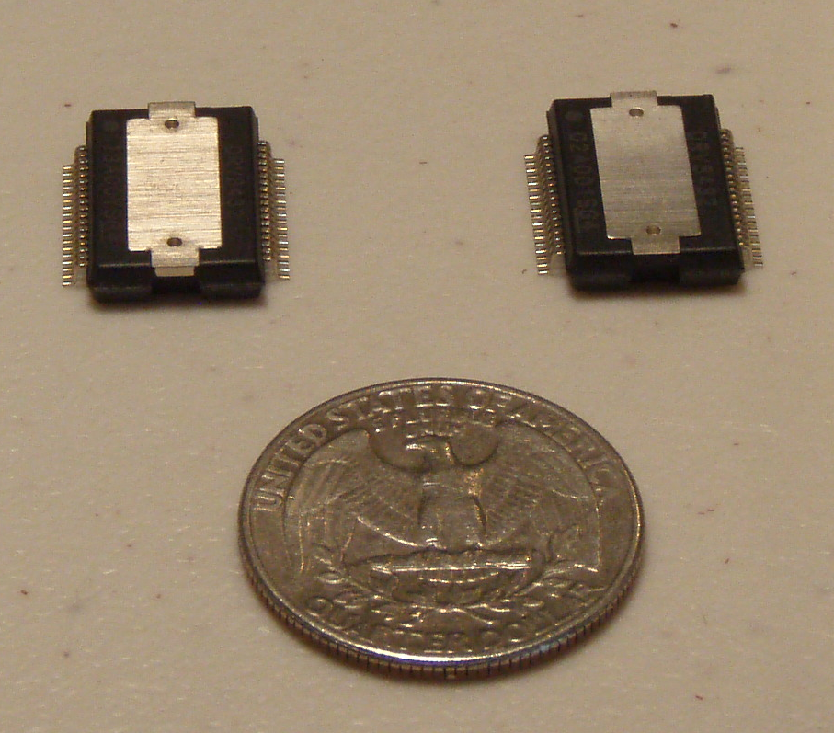
TI DRV8432 Motor Driver
Operating Supply Voltage – up to 52VDC
Continuous Output Current – 2 @ 7A
Transient Peak Output Current – 2 @ 16A
Integrated self protection from undervoltage, overtemperature, overcurrent, and short circuit
Up to 97% efficient
Each IC contains two full H-Bridges with 12 VDC gate supply voltage

Slide 17
TI DRV8432 Motor Driver

Slide 18
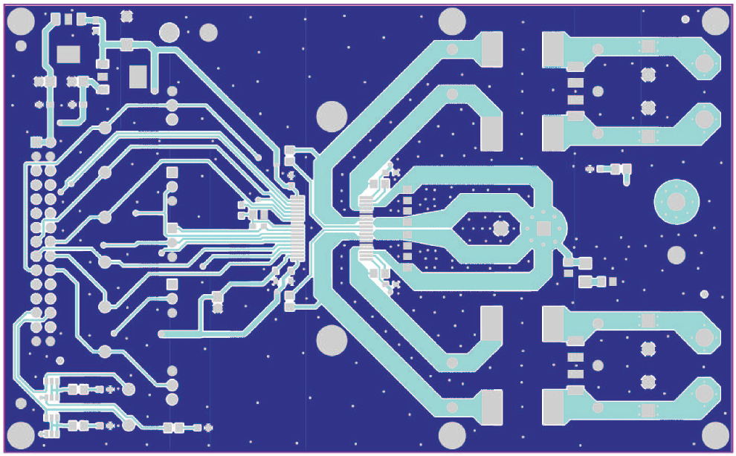
Motor Driver PCB Considerations
2 oz copper on both top and bottom layers for improved thermal performance and lower noise
Short and wide ground traces with multiple vias to ground plane to reduce noise
Clear space around IC to improve heat sinking
Separate PCB for each motor driver

Slide 19
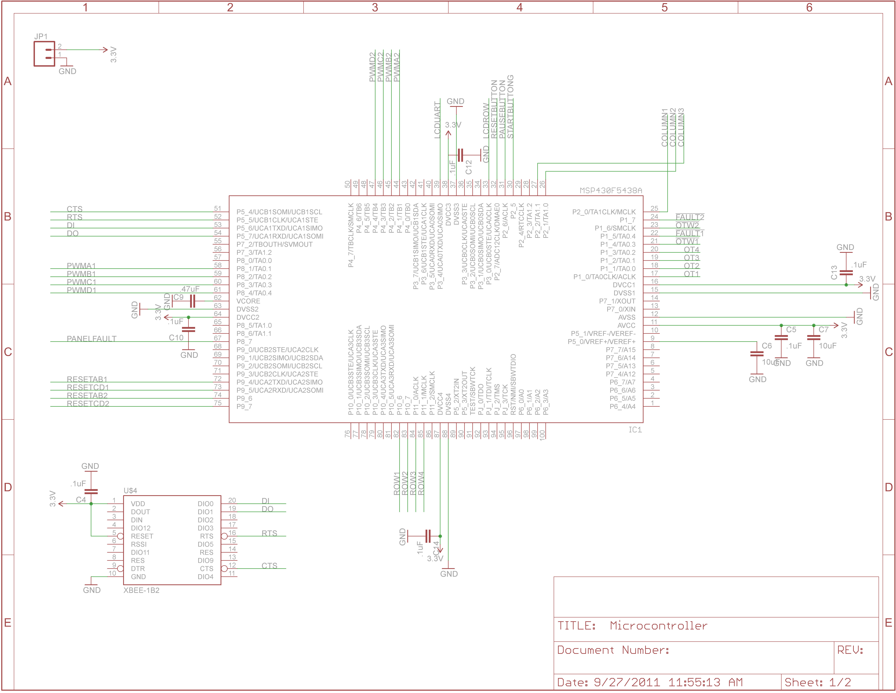
Microcontroller Schematic

Slide 20
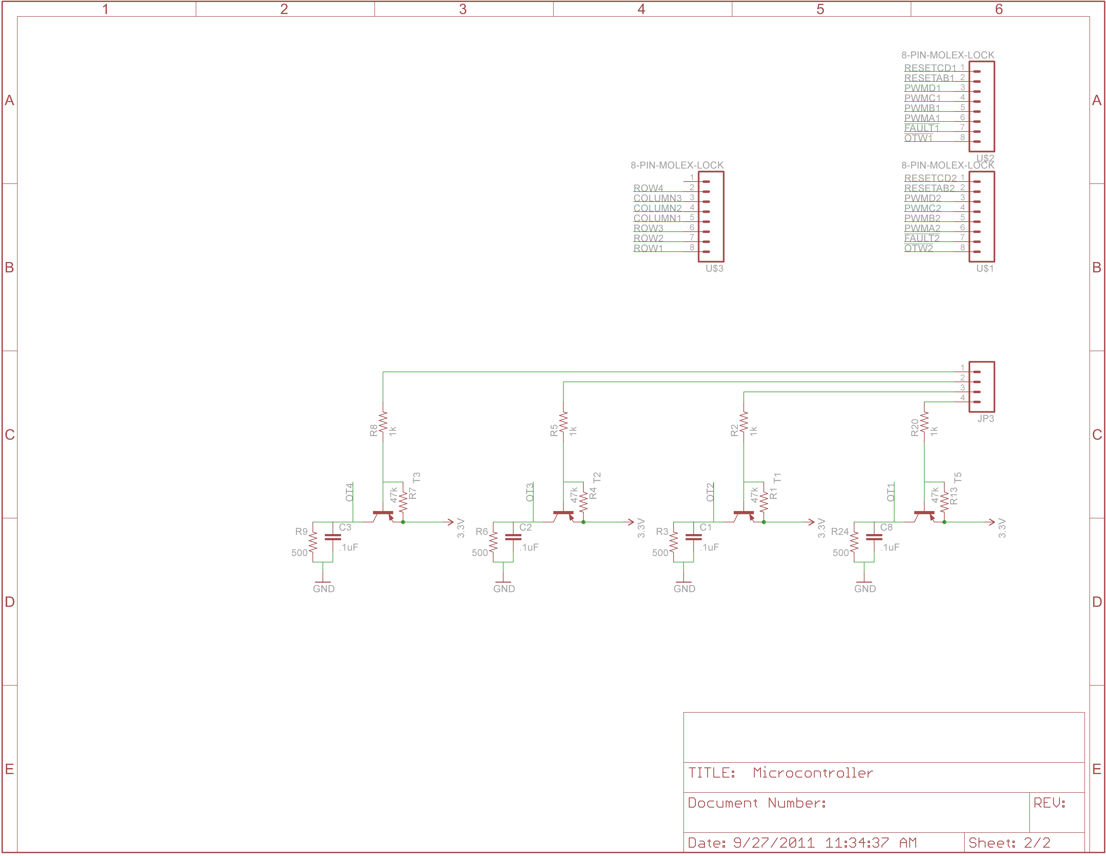
Microcontroller Schematic

Slide 21
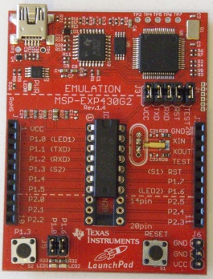
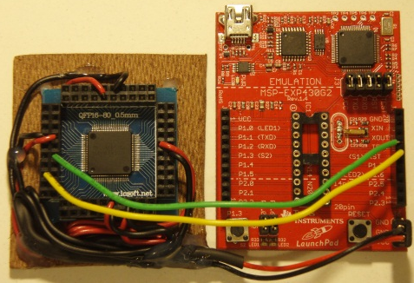
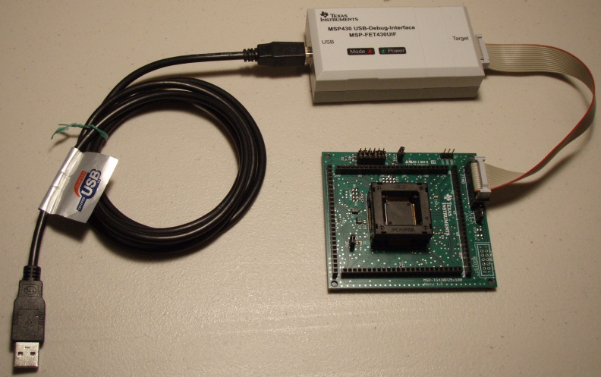
Microcontroller Selection
Launchpad
MSP430F5435
MSP430F5438a
 | GPIO | Communication Modules | RTC | External Interrupts | PWM Outputs | Free Target Board
G2452 | 14 | SPI, I2C | No | 16 | 3 | No
F5435 | 67 | SPI, I2C, UART | Yes | 16 | 15 | No
F5438a | 87 | SPI, I2C, UART | Yes | 16 | 15 | Yes

Slide 22
Software Design Approach
Make the system interrupt driven
Simplify code using interrupt vectors
Utilize the MCU’s built-in peripheral modules
Modularize the software
Verify desired functionality of all software on the target board
Write all code in C using TI’s Code Composer Studio IDE
Implement a software state machine

Slide 23
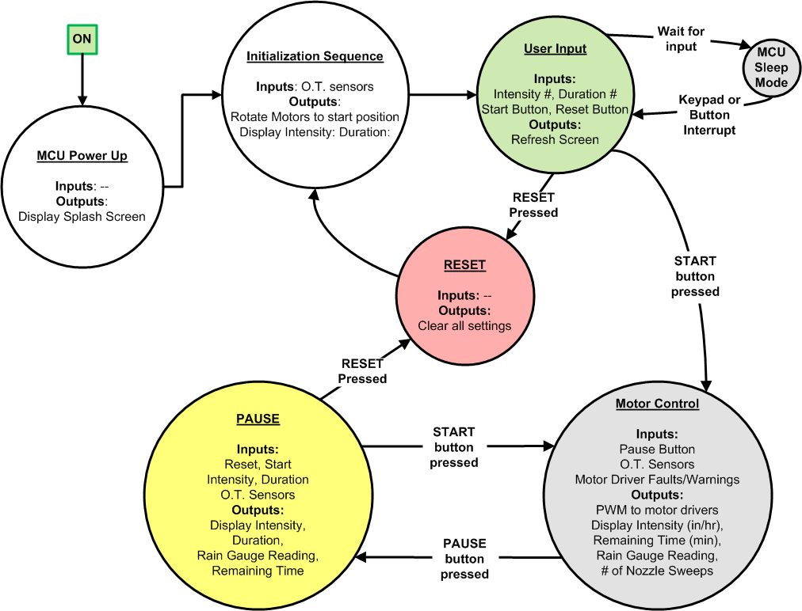
Software Design

Slide 24
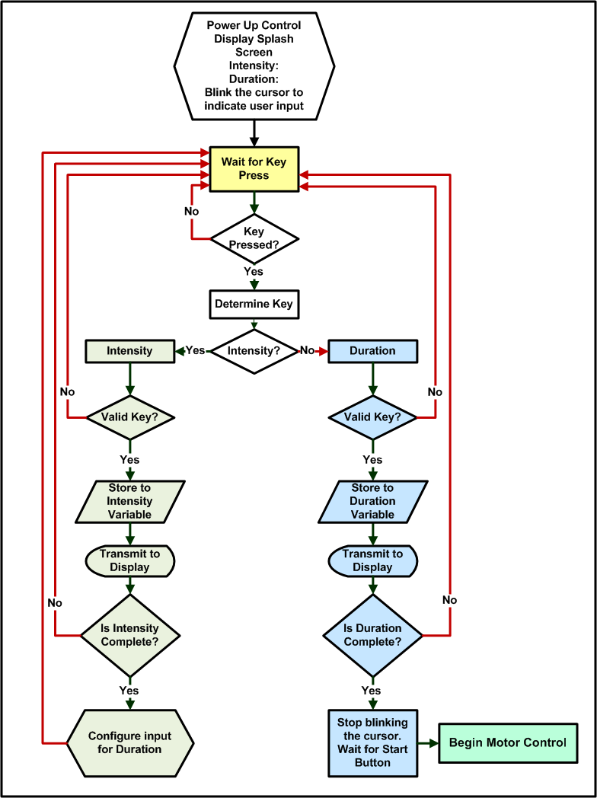
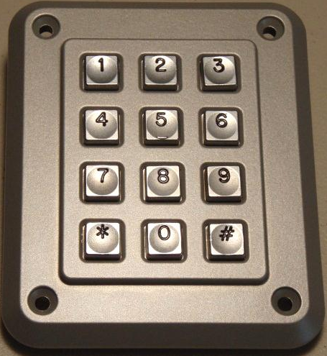
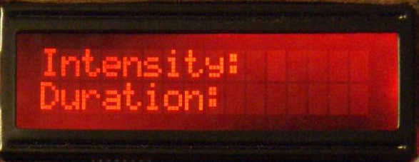
User Input Software Routine

Slide 25
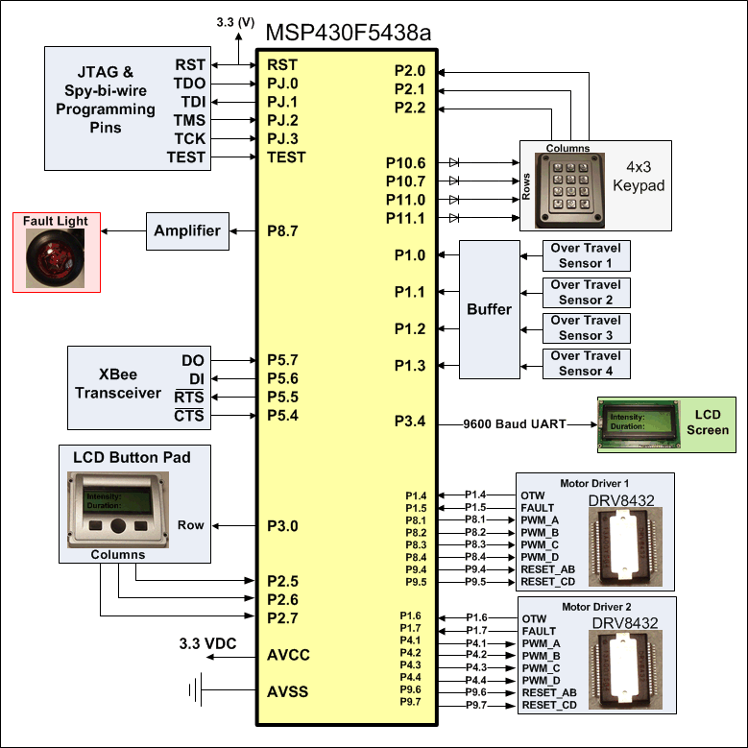
Microcontroller I/O

Slide 26
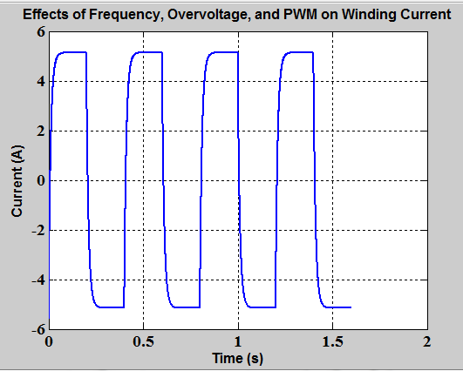
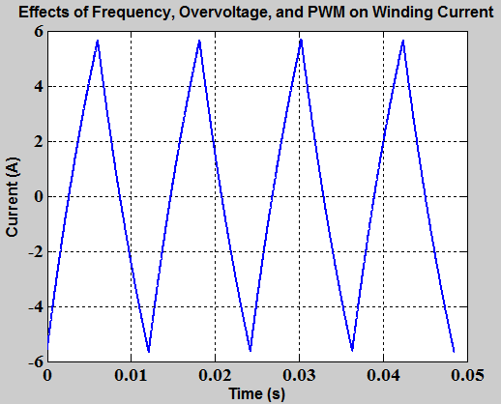
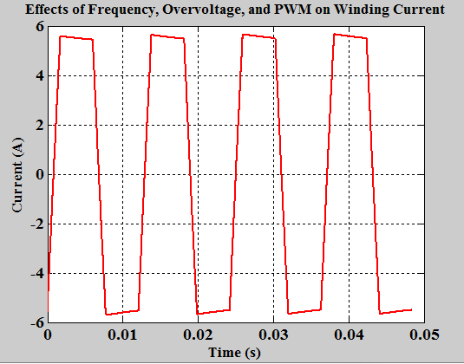
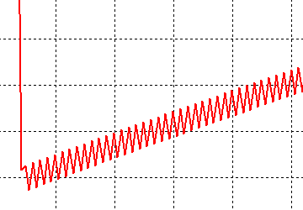
“ ” Issues
R
PWM Frequency = 40 kHz
PWM Duty Cycle = 7%
Motor Speed = 50 steps/sec
PWM Frequency = 40 kHz
PWM Duty Cycle = 25%
Motor Speed = 330 steps/sec
PWM Frequency = 40 kHz
PWM Duty Cycle =
85%, then 7%
Motor Speed = 330 steps/sec

Slide 27
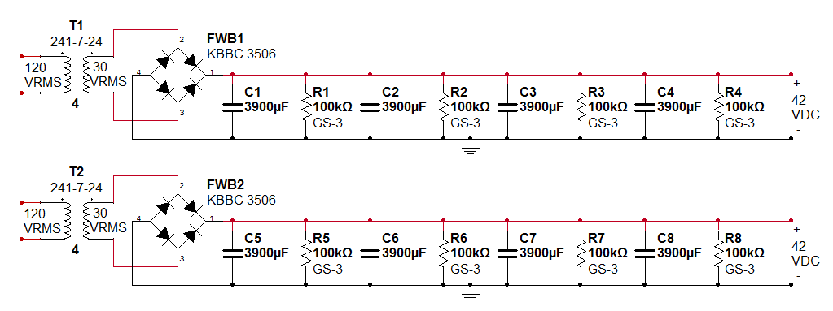
High Voltage Power Supply
Provides power to the stepper motors via the drivers
Simple unregulated power supply
Handles back EMF better than a SMPS
Difficulty in determining the voltage and current ratings

Slide 28
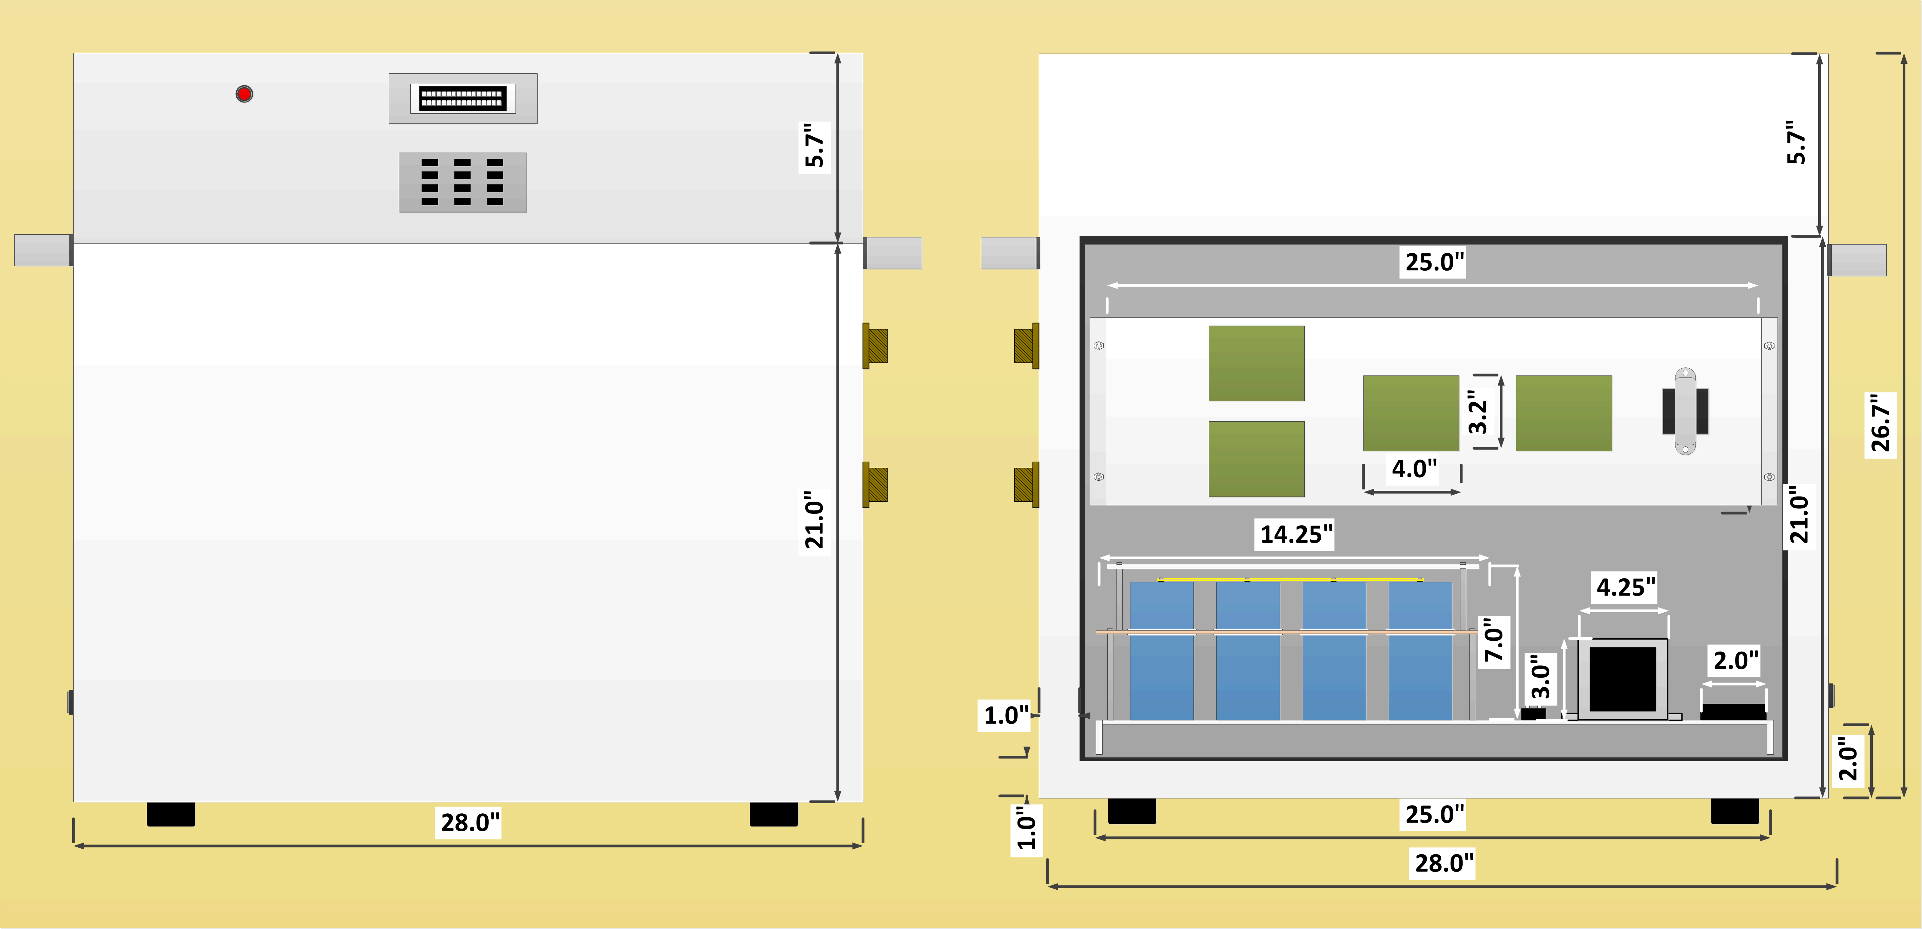
Enclosure

Slide 29
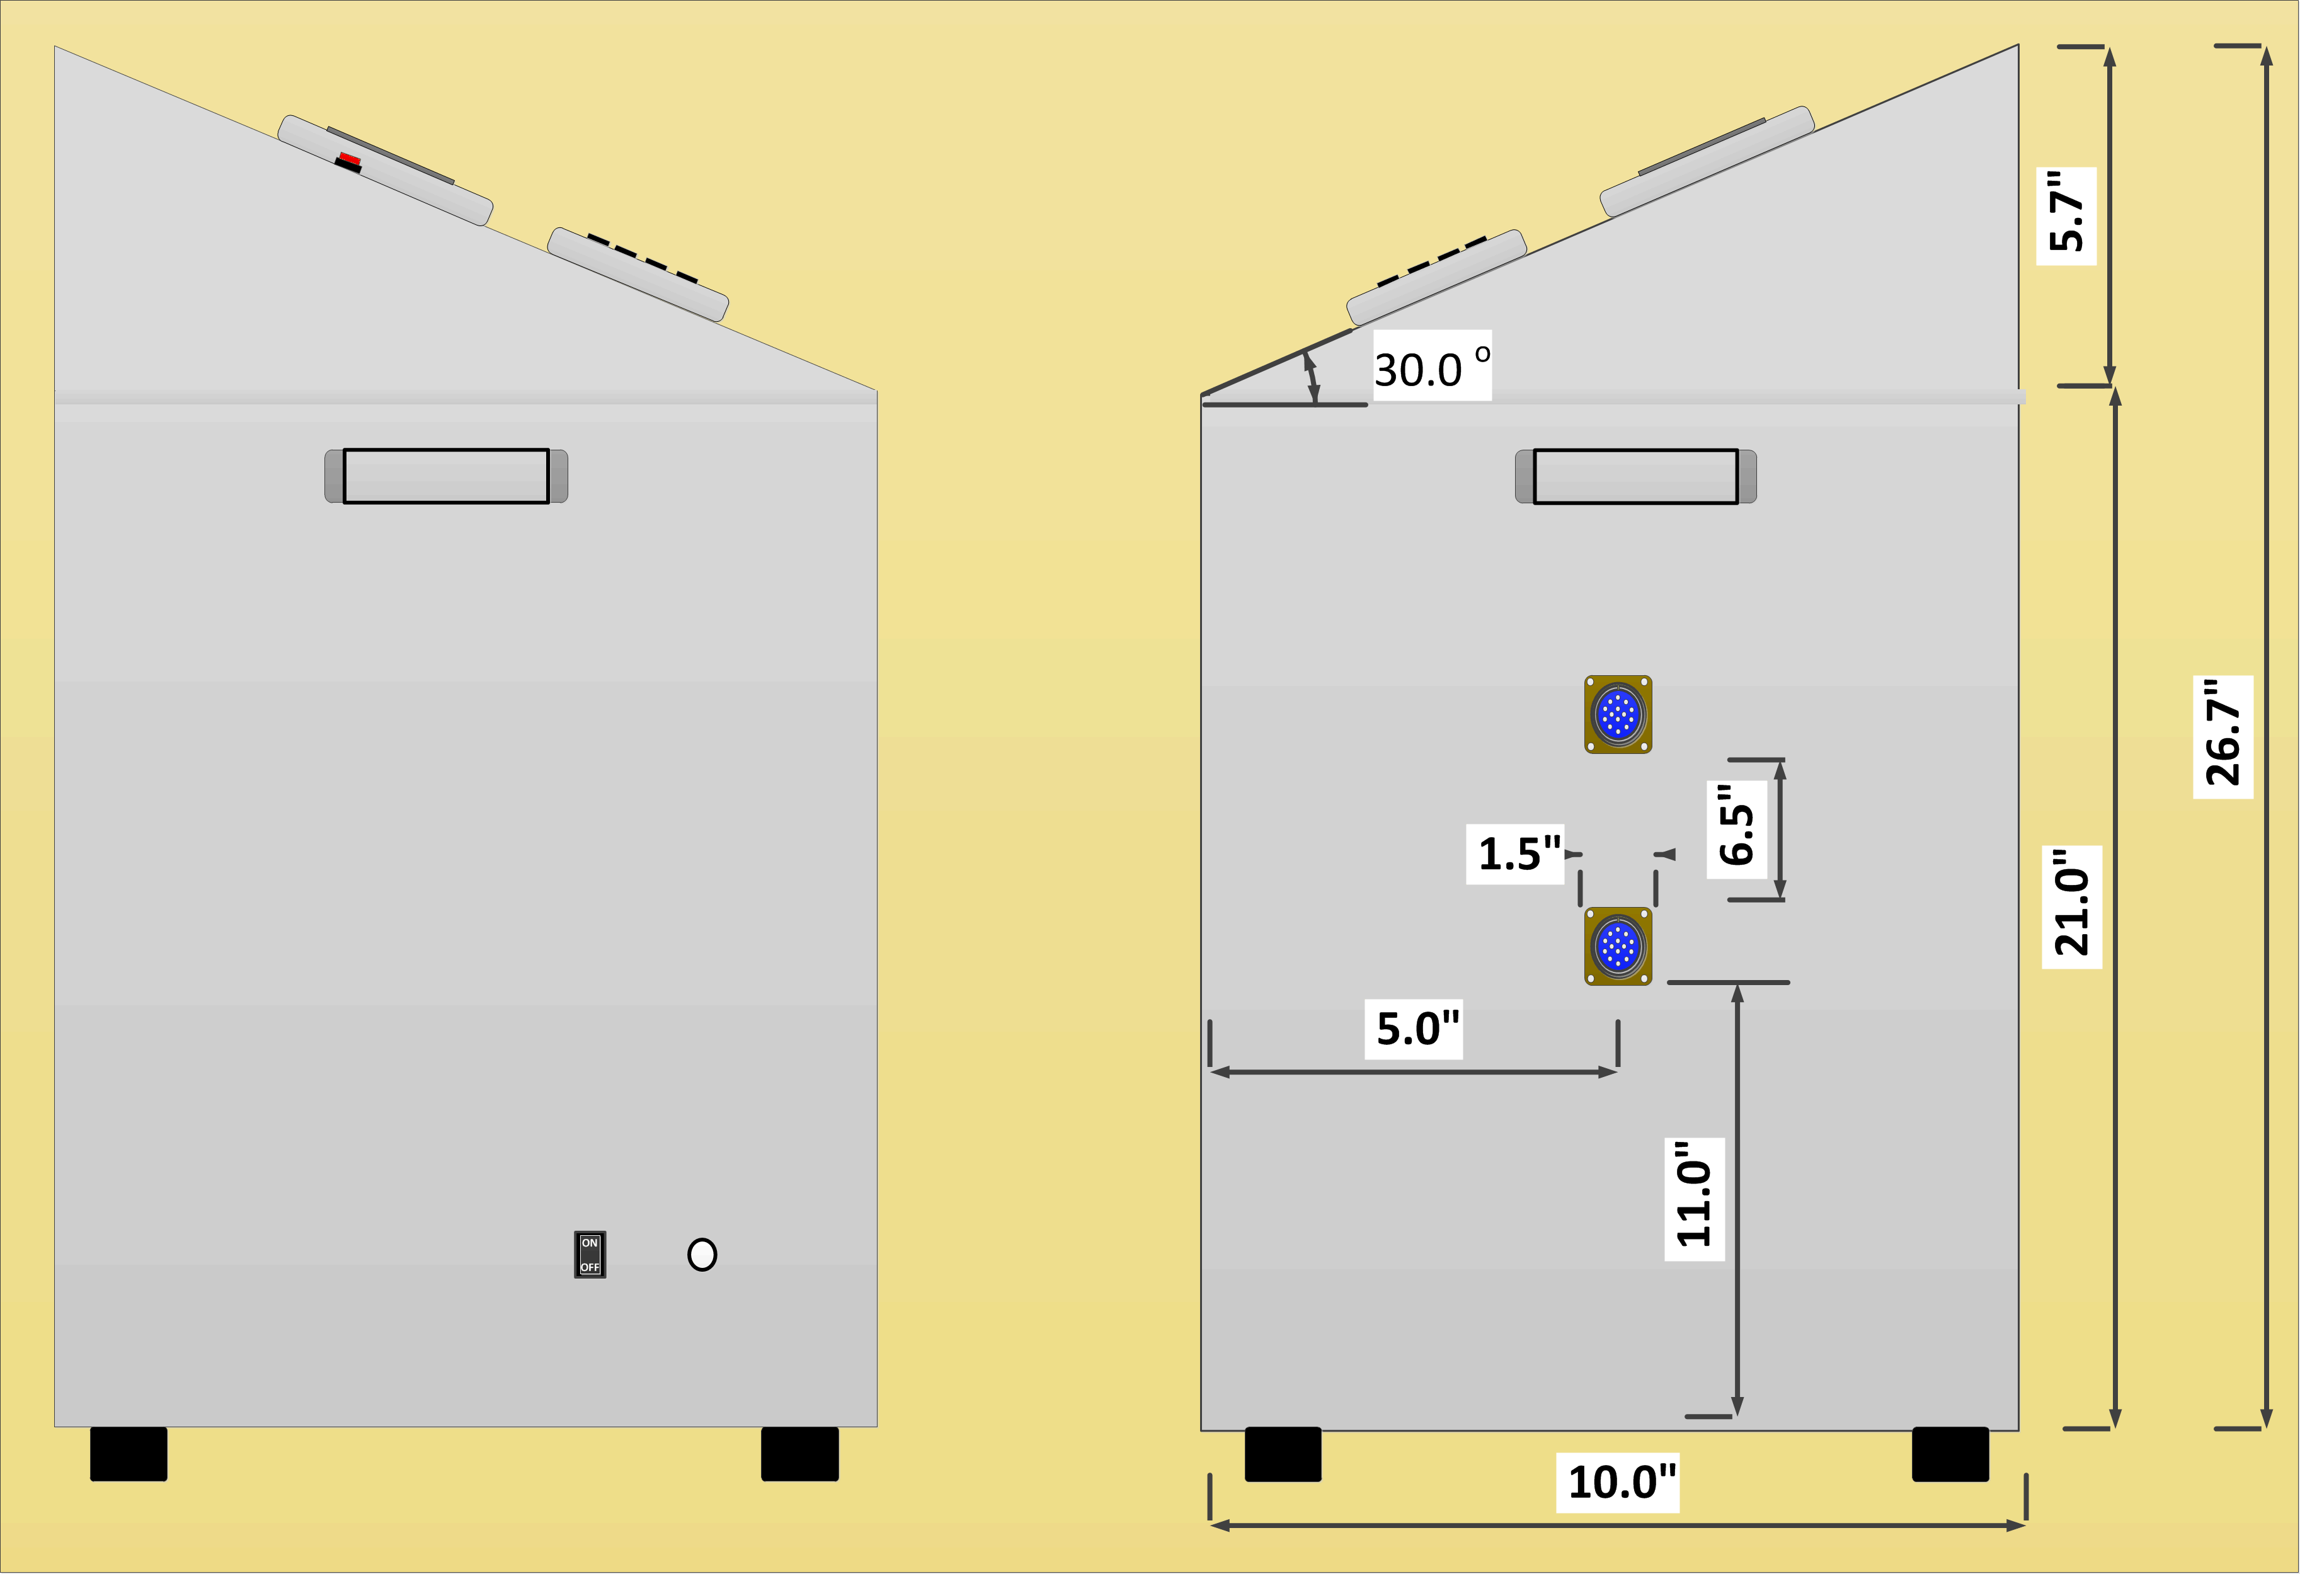
Enclosure

Slide 30
Wireless Rain Sensor
Uses:
Measure rainfall for duration of the simulation
To check calibration of nozzle sweep-stop frequency
To indirectly check the water pressure of the rain nozzles

Slide 31
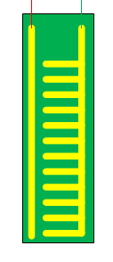
Wireless Rain Sensor- PCB Design
Open Circuit without any water in the gauge

Slide 32
Wireless Rain Sensor- PCB Design
1st Level-
Water conducts current and acts as a single resistor

Slide 33
Wireless Rain Sensor- PCB Design
2nd Level-
Water conducts current and acts as two resistors in parallel

Slide 34
Wireless Rain Sensor- PCB Design
At the n^{th} level of water, there are ‘n’ equivalent resistors in parallel

Slide 35
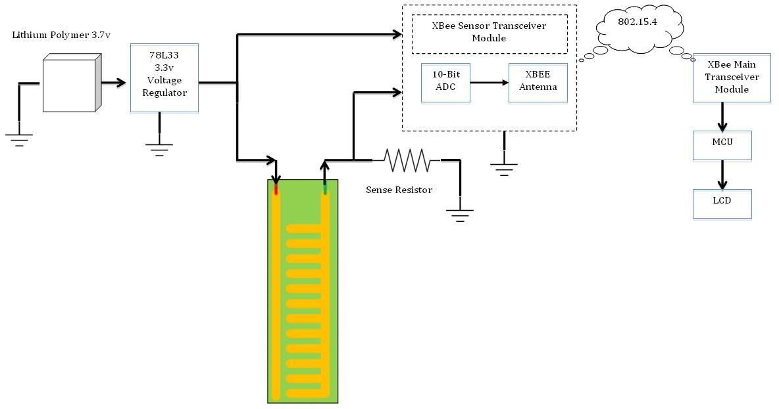
Wireless Rain Sensor- Block Diagram
LDO
3.3 volt
regulator

Slide 36
Wireless Rain Sensor- PCB Simulation
R_{sense} = 1.0 kΩ
The Sense Resistor Value greatly impacts the linearity of the input voltage to ADC

Slide 37
Wireless Rain Sensor- PCB Simulation
R_{sense} = 100Ω

Slide 38
Wireless Rain Sensor- PCB Simulation
R_{sense} = 10Ω

Slide 39
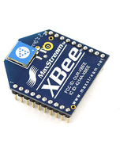
Wireless Rain Sensor- XBee 2.4GHz
6 Built-In 10-bit ADC
Requires 3.3v Input
On-Chip antenna
Easy to Integrate to PCB
Serial Communication to MCU

Slide 40
“ ” Issues
R
Wireless Rain Sensor
Resistance of copper changes with oxidation due to electrolysis
Potential Solution
Use different material → Stainless Steel
Use lower voltage → 3.3-4.5 volts
Pulsed readings

Slide 41
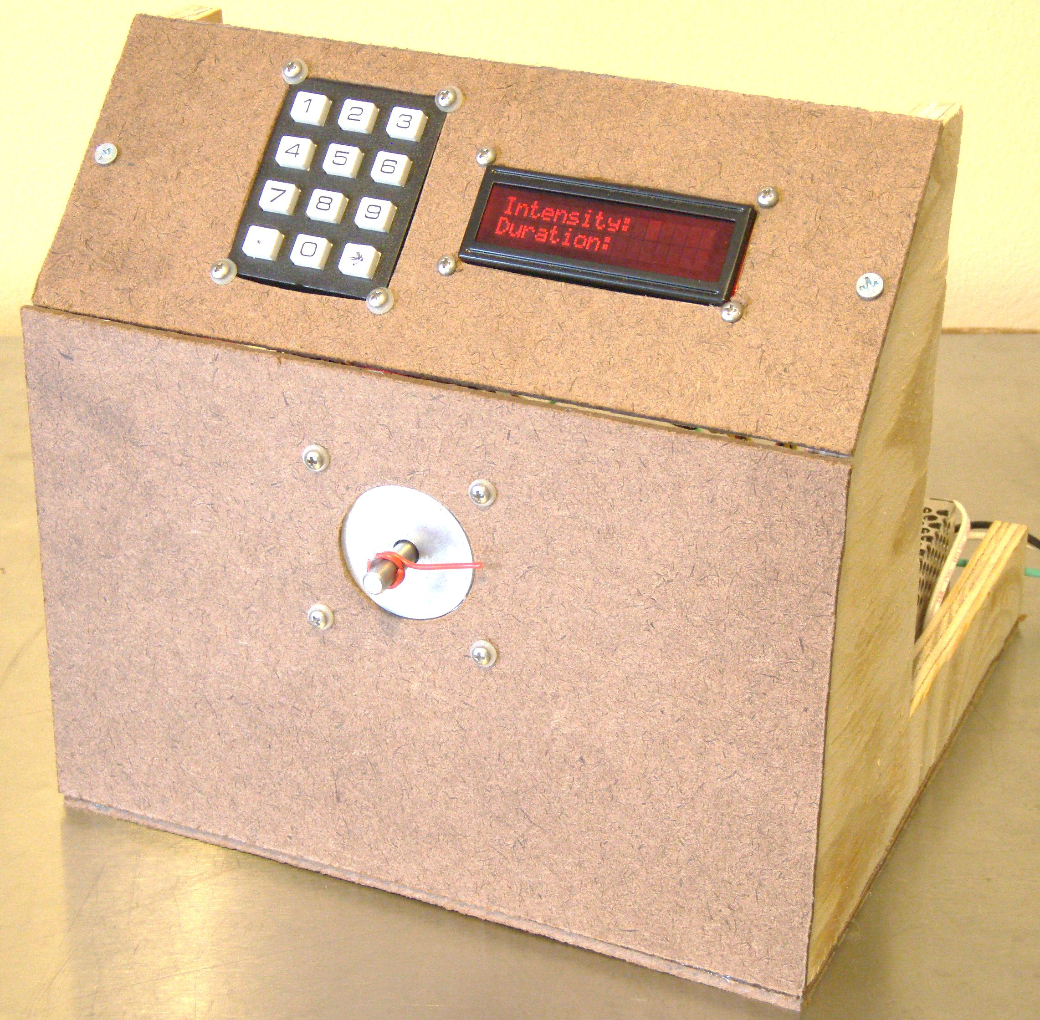
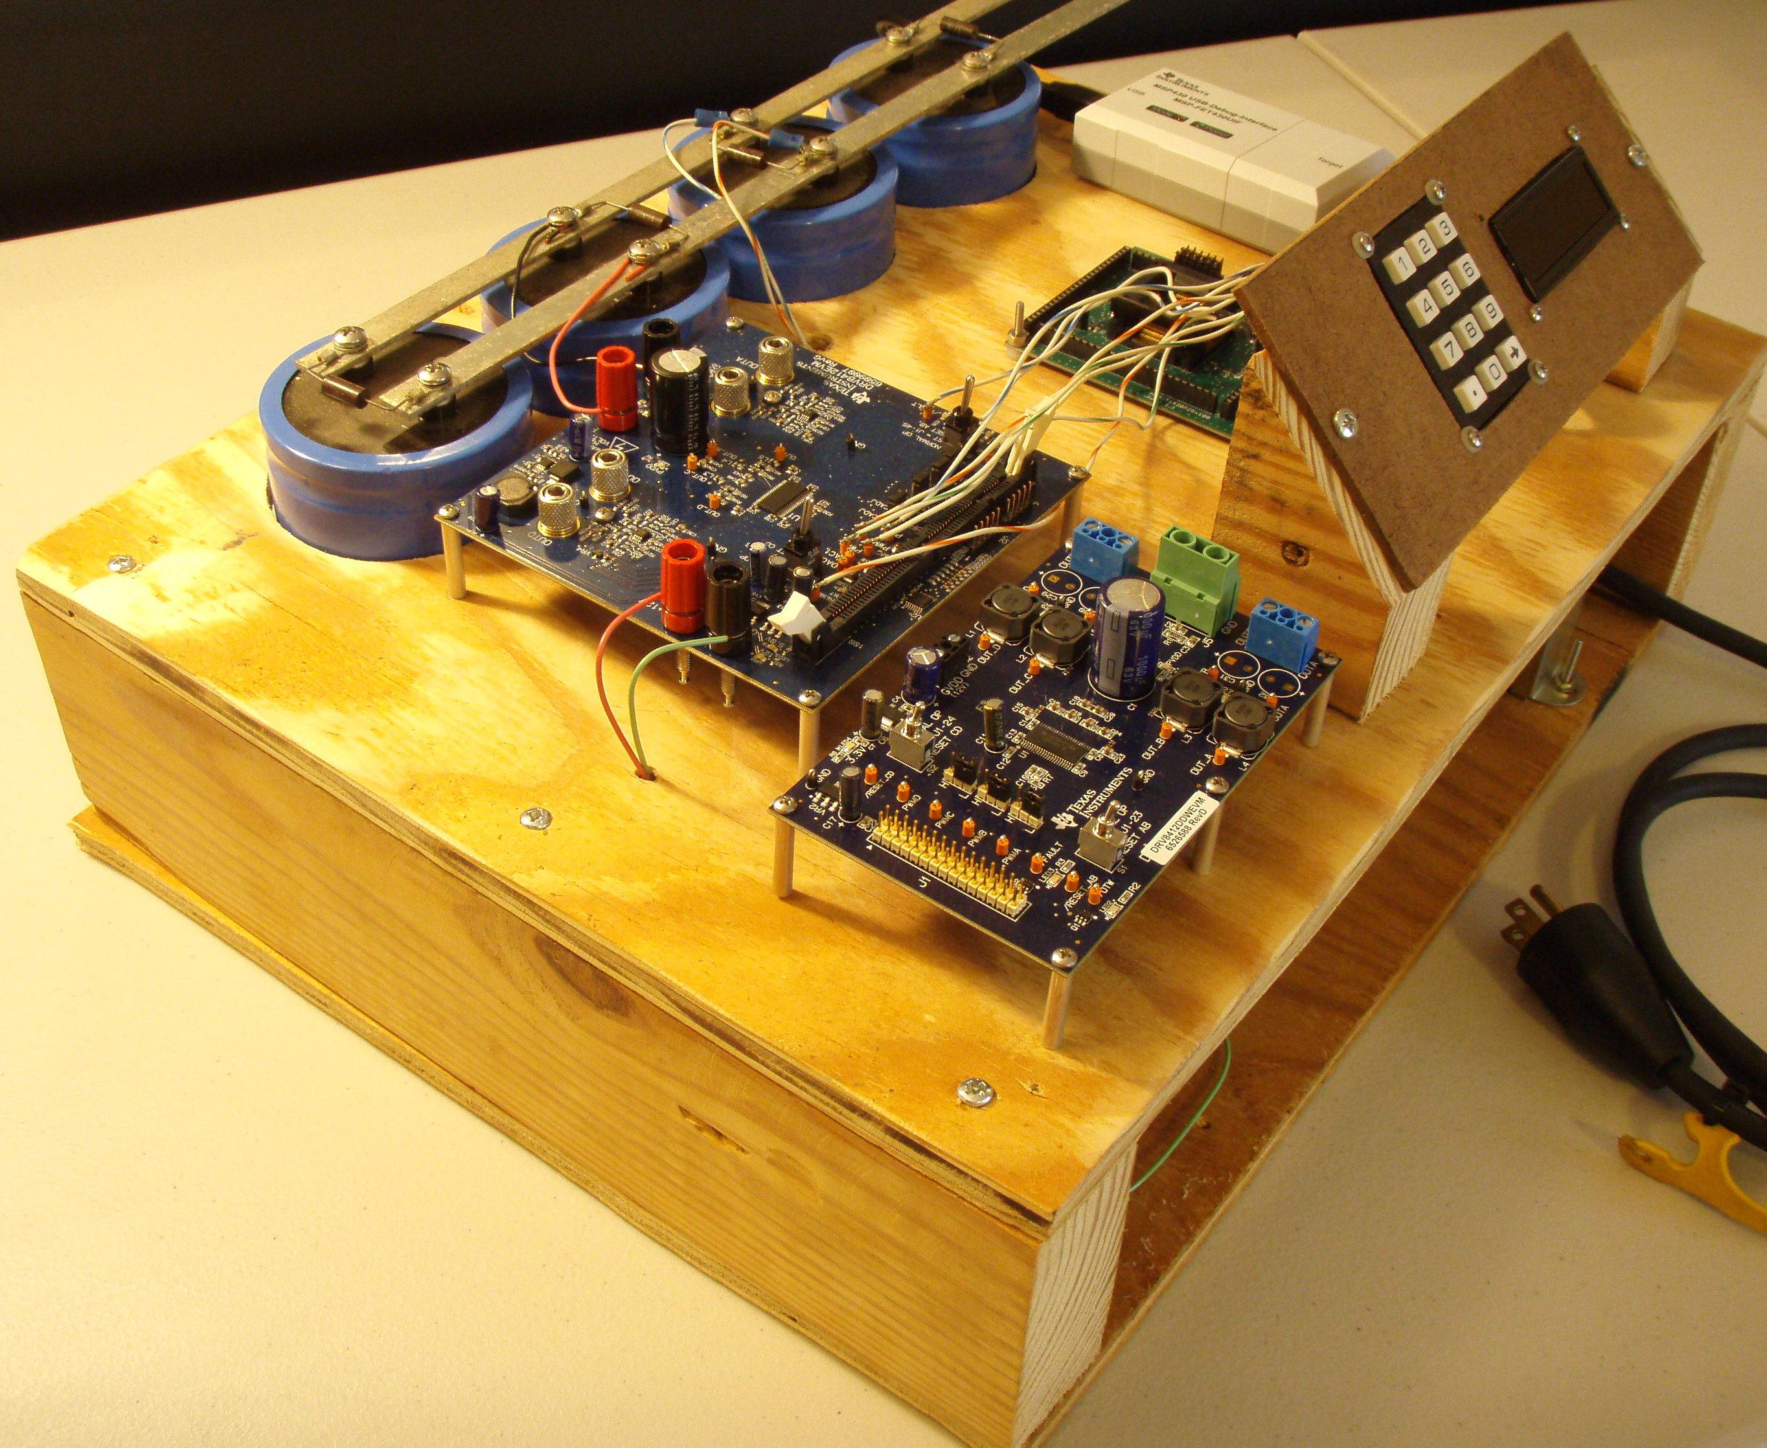
Budget & Financing - Development
Development Costs
 | Item | Quantity | Price/Unit | Projected Cost | Actual Cost
1 | Small Scale Model | 1 | $150.00 | $150.00 | $82.84
2 | MSP430 Development Board | 2 | $4.30 | $8.60 | $8.60
3 | Motor Driver Dev Kit | 2 | $175.00 | $350.00 | FREE
4 | MSP430F5438A Target Board | 1 | $149.00 | $149.00 | FREE
 |  |  |  | $657.60 | $91.44
Team Budget |  | $200.00
Rev1
Rev2

Slide 42
Budget & Financing - Deliverable
Costs for Rain Simulator
 | Item | Quantity | Price/Unit | Projected Cost | Actual Cost
1 | Motor Drivers | 2 | $14.26 | $28.52 | FREE
2 | Custom Stainless Steel Enclosure | 1 | $500.00 | $500.00 | FREE
3 | Amphenol Receptacles | 2 | $33.75 | $67.50 | $67.50
4 | Rain Gauges | 1 | $65.00 | $65.00 | $65.00
5 | Microcontroller | 1 | $11.67 | $11.67 | FREE
6 | PCBs | 2 | $50.99 | $101.98 | $102.00
7 | Storm-Interface LCD | 1 | $92.53 | $92.53 | FREE
8 | Storm-Interface Keypad | 1 | $64.72 | $64.72 | FREE
9 | Circuit Components | 1 | $40.00 | $40.00 | $40.00
10 | High Voltage Power Supply | 1 | $500.00 | $500.00 | $24.00
11 | Low Voltage Power Supply | 1 | $35.00 | $35.00 | $13.41
 |  |  |  | $1,466.92 | $206.91
Team Budget |  | $600.00
Sponsorship |  | $200.00

Slide 43
Current Progress

Slide 44
Final Steps
 | 7-Oct | 15-Oct | 21-Oct | 30-Oct | 7-Nov | 14-Nov | 21-Nov | 30-Nov
Replace 5v regulator on LV power supply
Order motor driver and MCU PCBs
Order PCB components
Assemble/Test PCBs
Build the enclosure
Determine step speed/pause times
Build/Test the rain gauge
Final assembly
Verify simulations

Slide 45
Questions about “ ” Project?
R

