Slide 1

Group 11
Cristovian Basden
Andrew Pagliari
Rebecca Rashkin
Javier Vazquez

Slide 2
Motivation
Extremely dangerous to ride at night
Surrounding motorists have trouble seeing bikers
Motorists are already distracted with smart phones, etc
In 2009, 630 bicyclists were killed and 51,000 injured in traffic*
Lighting system allows for greater visibility
Shows the riders intentions - turning and braking
*Statistics are taken from U.S. Department of Transportation 2009 Traffic Safety Facts released in 2010

Slide 3
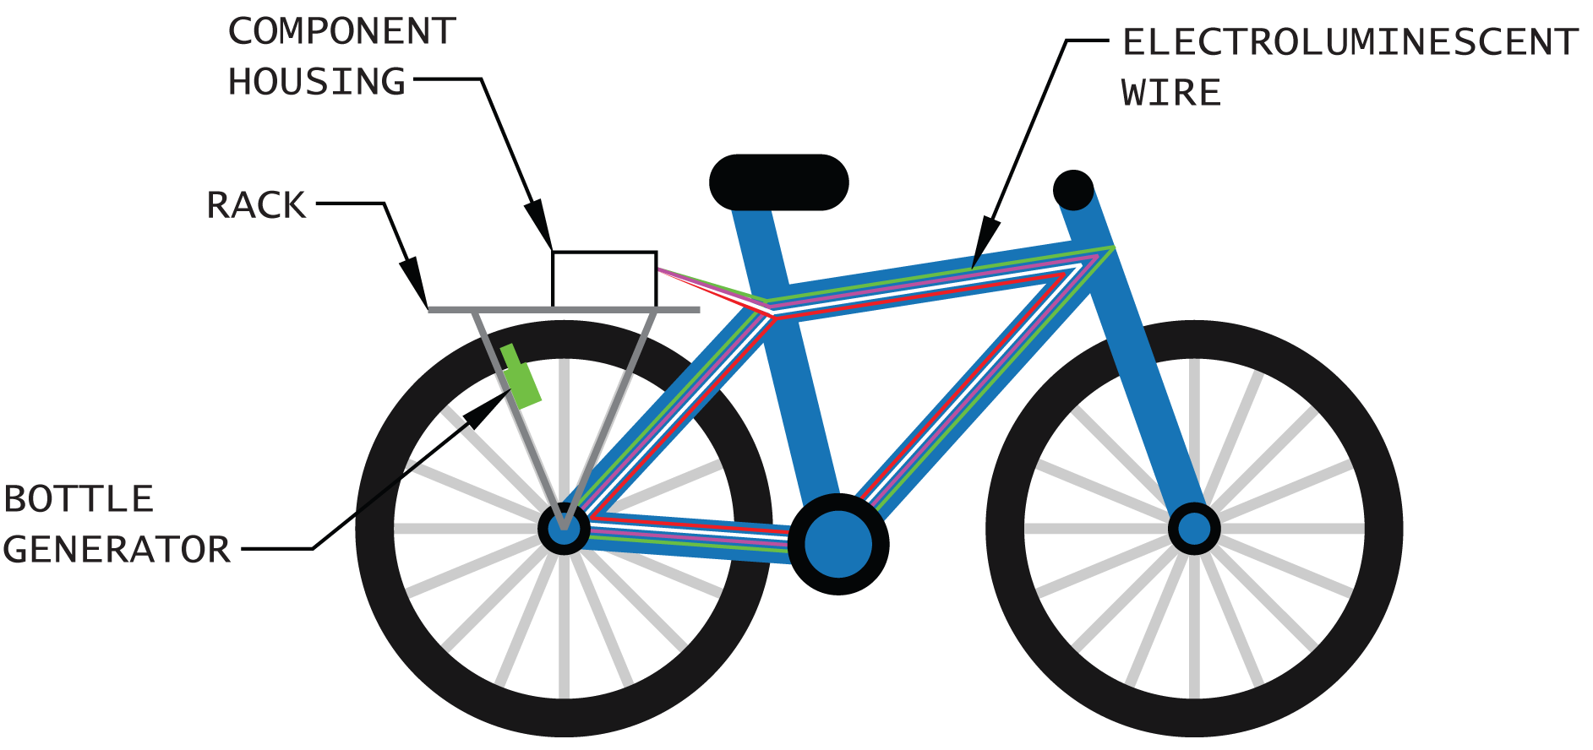
Goals and Objectives
Four part lighting system to increase visibility to other motorists
  Headlight, taillight, front and rear turn signals, frame lights
Three tiered security system to protect bike from being stolen
  RFID user authentication, tripwire alarm, GPS
All systems energized by human power – generator on wheel
Mobile application interfaces with all other systems

Slide 4
Specifications
Component | Parameter | Design Specification
Battery | Charge time | 6 hours
Battery | Discharge time | 2 hours
Mobile wireless link | Minimum range | 3 meters
GPS receiver | Accuracy | 10 meters
Compass | Accuracy | One cardinal direction
Speed | Accuracy | 2 miles per hour
GPS (Android) | Accuracy | 30 feet
GPS (Android) | Update time | 5 seconds

Slide 5
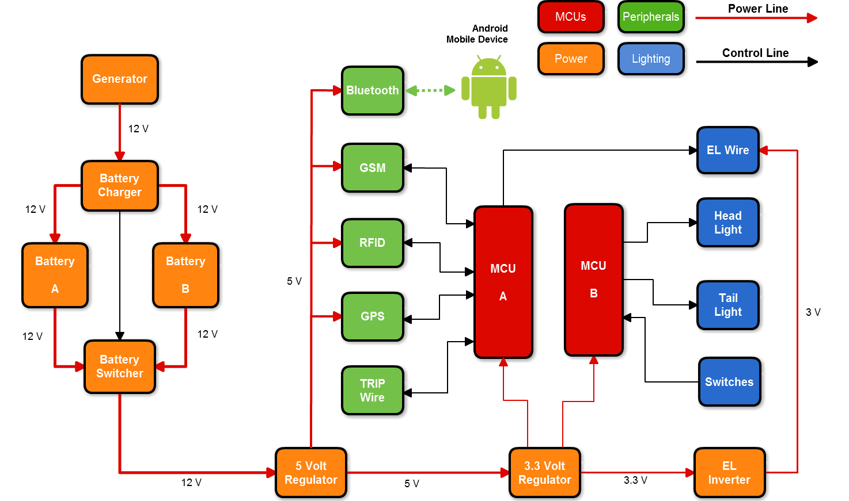
Overall Block Diagram

Slide 6
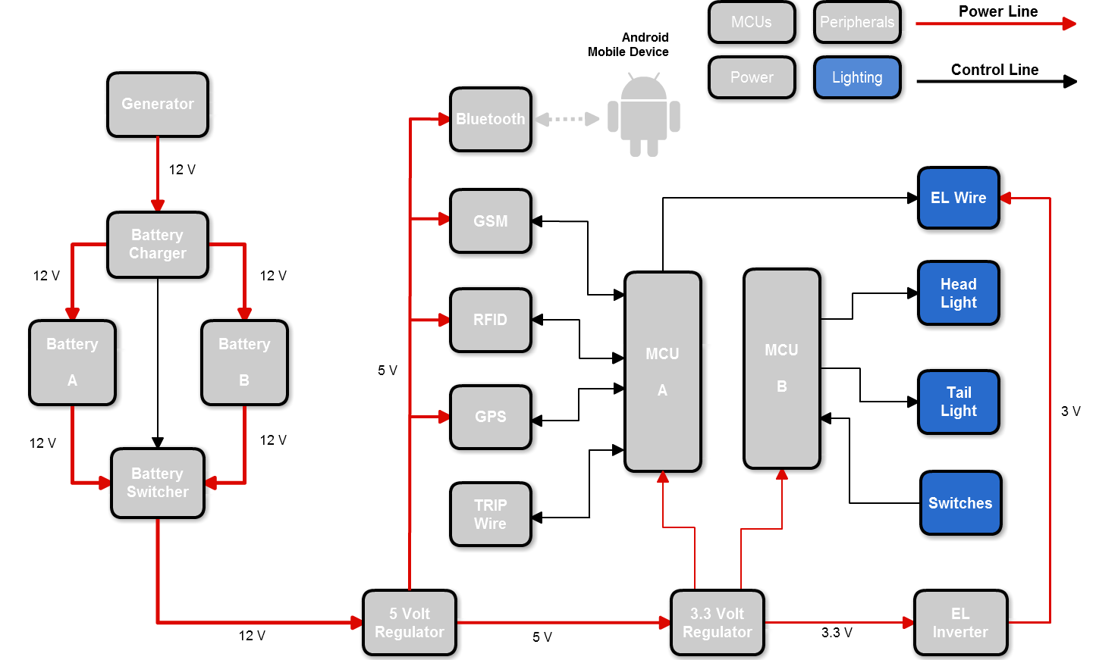
Lighting

Slide 7



Taillight
3 LED matrices of 64 LEDS
Each can be red or green
Can show both brake light and turn signals
Lit when headlight is on
Each LED requires 20 mA current
1.8 – 2.4 V for red, 2.2 – 2.8 V for green
2.4 in (60 mm)
Turn signal
Turn signal with brake

Slide 8
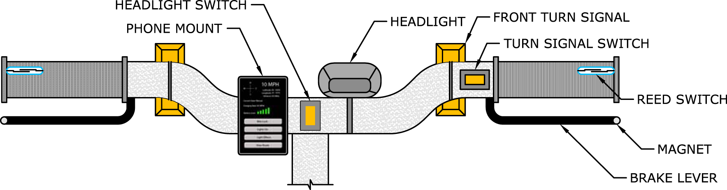
Handlebar View
Magnetic reed switch on handlebars, magnet on brake lever
Magnetic field closes switches
Rocker switches for turn signals and headlight
Pre-made headlight wired to LiteBike’s power system
Separate front turn signals

Slide 9
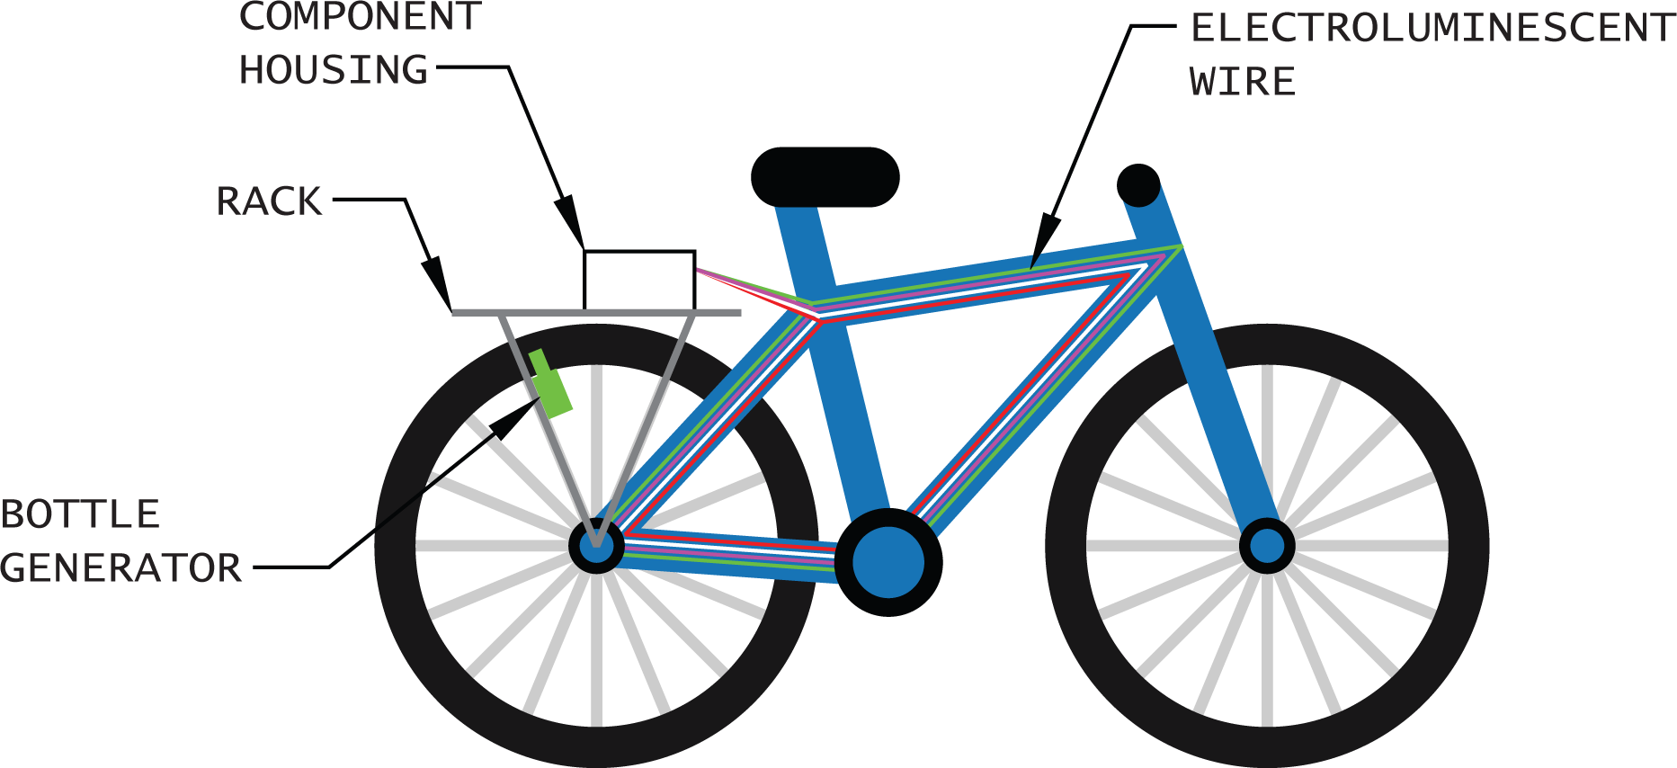
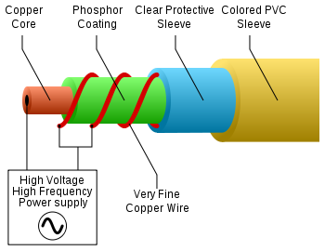
Frame Lighting – RGB LEDs vs EL Wire
RGB LEDs can light up in any color
EL wire is cheaper, easier to assemble, and is more stylish
Requires AC current, so inverter must be used
Frequencies usually between 2000 Hz and 6000 Hz
Higher frequencies = brighter, shorter life for EL wire

Slide 10
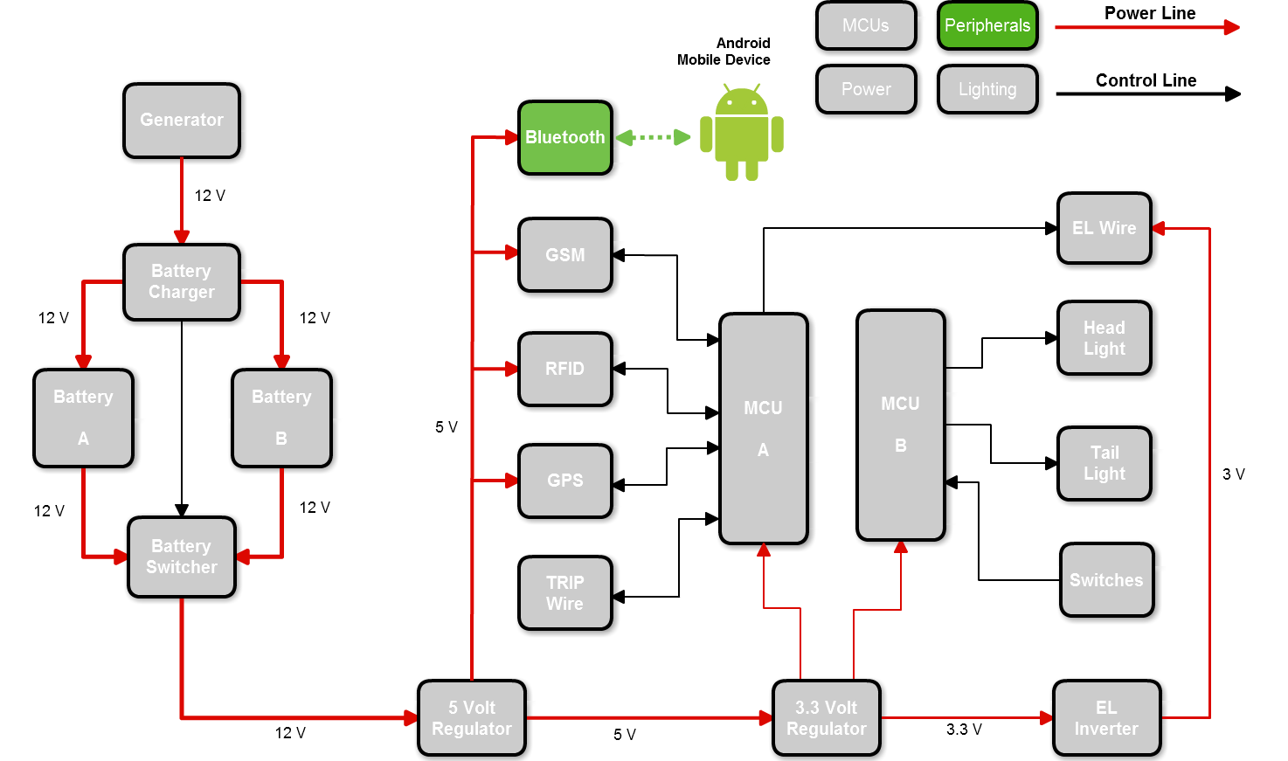
Mobile Wireless Link

Slide 11
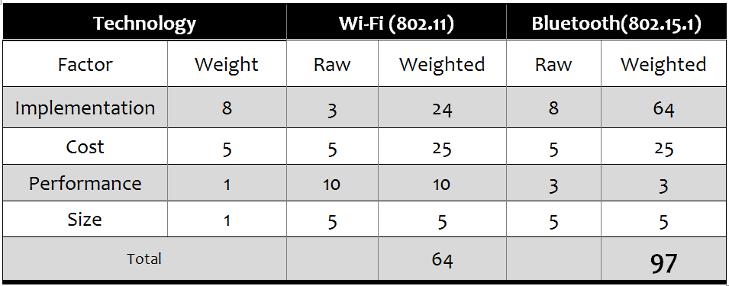
Wireless Technology Selection
Wireless Link between Android and LiteBike systems
Modern smart phones natively include Wi-Fi and Bluetooth
Wi-Fi is harder to implement
Bluetooth consumes less power, and is easier to implement

Slide 12
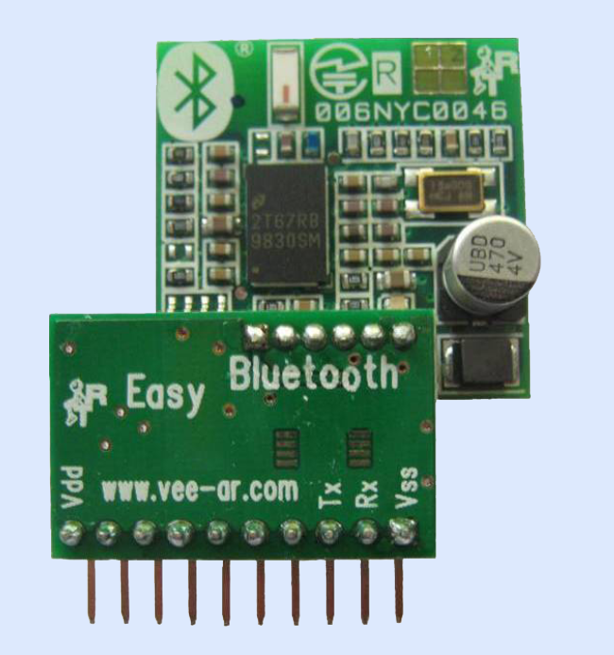
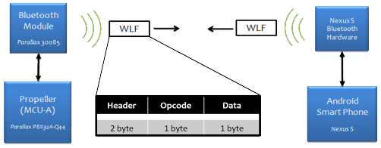
Parallax Easy Bluetooth Module
Purpose:
Interface Bluetooth enabled smart phone with microcontroller.
1.79 in(45.65 mm)
1.4 in (34.41mm)
(Custom Protocol)
Bluetooth Serial Port Profile (SPP)
Opcode | Function | Data
0x01 | Turn Lights On | Light Pattern
0x02 | Turn Lights Off | None
0x03 | Lock Bike | None
0x04 | Unlock Bike | None
0x05 | Request GPS Data | Data Type
0x06 | Request Battery Charge | None
0x07 | Request Battery Voltage | None
0x08 | Arm Alarm System | None
0x09 | Disarm Alarm System | None
Manufacturer | Parallax
Part No. | 30085
Price | $69.99
I/O Lines | 4 (TX, RX, VCC, GND)
Power Supply | 5 V

Slide 13
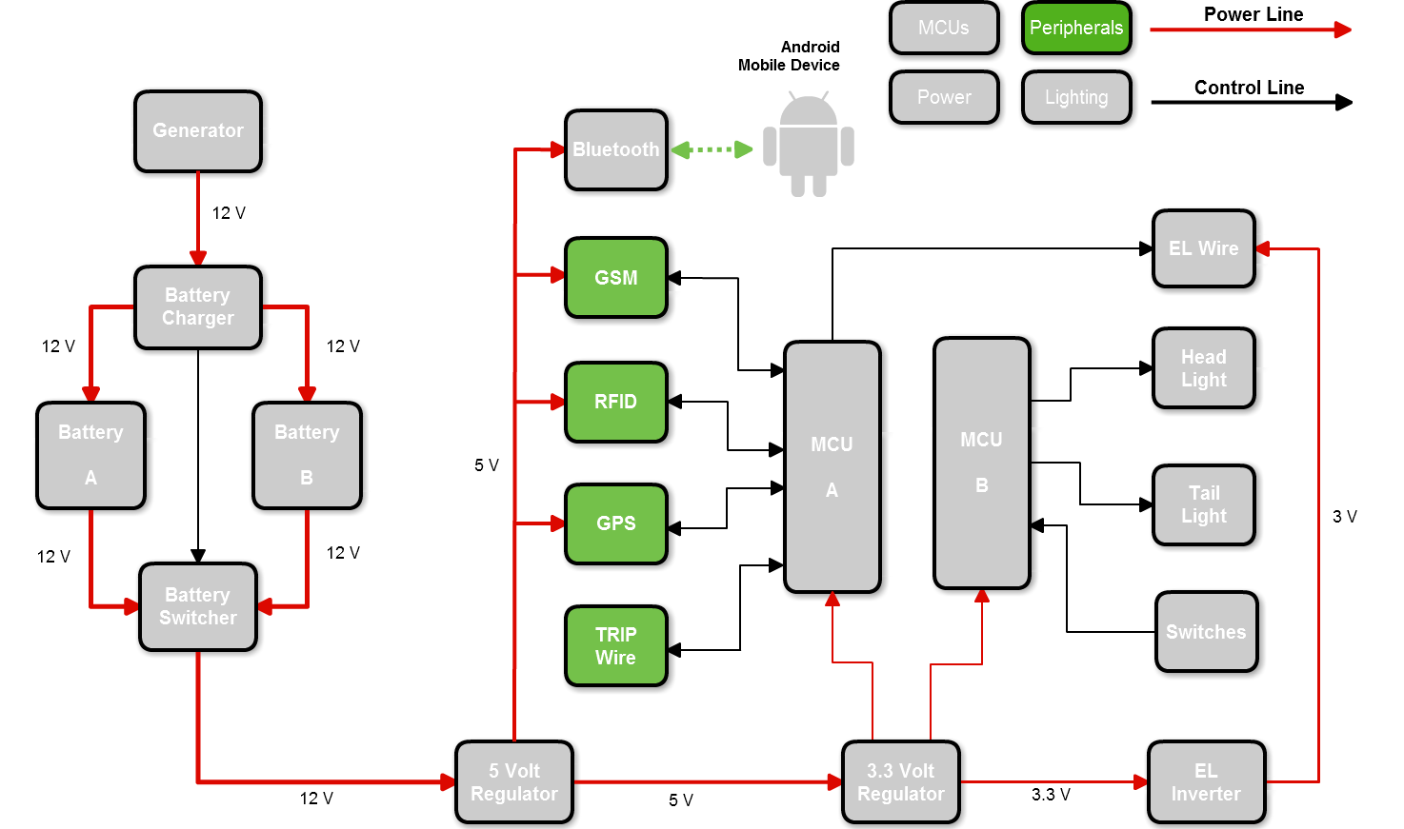
Security

Slide 14
Security System
Tier | Feature | Description | Sub-Systems
1 | Lock-Tampering Detection | Detects if chain lock is compromised or removed and triggers alarm. | Tripwire
2 | Theft Detection | Detects if bike moves more than 20 feet by unauthorized user and triggers alarm. | GPS
3 | Recovery Assistance | Relays position coordinates to user to assist in recovery bike. | GPS, GSM

Slide 15
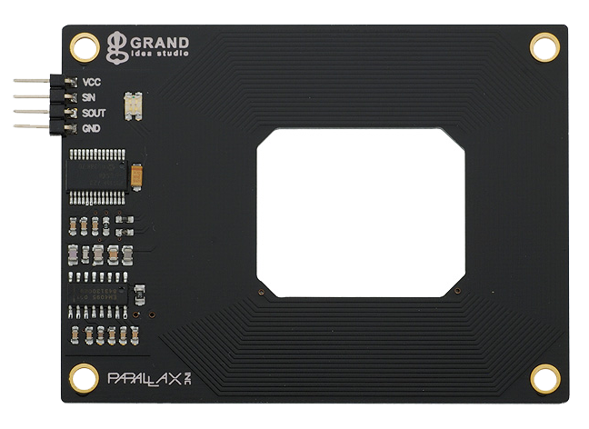
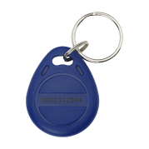
RFID
Purpose:
User Authentication; allows user to enable and disable the LiteBike’s alarm system.
RFID Tag
3 in
Manufacturer | Parallax
Part No. | 28440
Price | $49.99
I/O Lines | 4 (TX, RX, VCC, GND)
Power Supply | 5 V
ALARM:
ARMED
DISARMED
DISARMED – Bike can be moved without triggering alarm
ARMED – Bike will trigger alarm if
Bike moved more than 20 feet
Tripwire is severed
Serial communication allowed for easy interfacing with MCU
Built-in Antenna

Slide 16
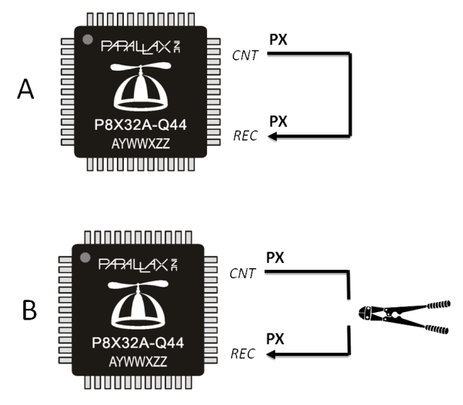
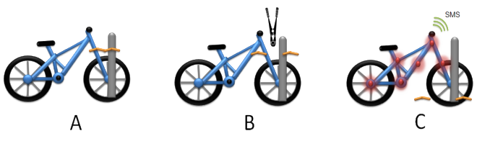
Tripwire (Lock Tampering Detection)
Purpose:
Detects attempts to sever bike chain lock. If the alarm is ARMED, severing the tripwire triggers the alarm.
A signal is continuously sent out on MCU pin into tripwire
As long as tripwire is uninterrupted, loop continues
If tripwire is severed, signal is interrupted, triggering alarm

Slide 17
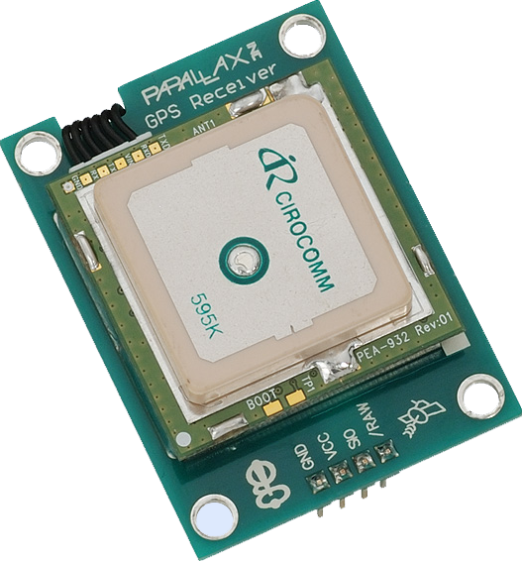
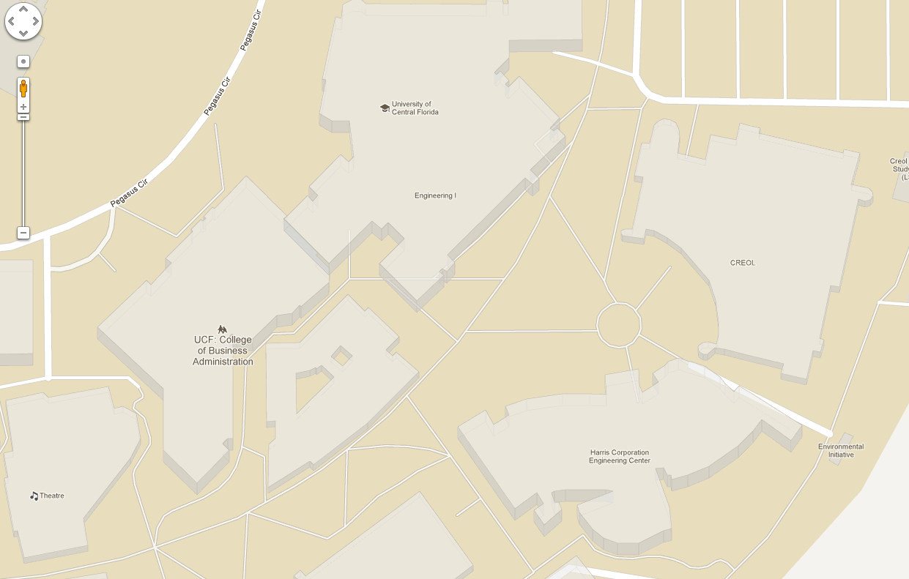

GPS
Purpose:
Determine if LiteBike has left security radius
Provide user with LiteBike’s location
1.17 in
Manufacturer | Parallax
Part No. | 28146
Price | Already Owned
I/O Lines | 4 (TX, RX, VCC, GND)
Power Supply | 5 V
20’ security radius

Slide 18
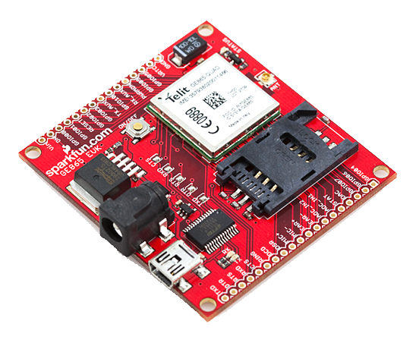
GSM - GE865 Development Board
Purpose:
Send user SMS alerts with GPS coordinates in the
event the LiteBike is stolen.
2.4 in
GSM uses national cell phone networks
Sending SMS every few minutes to save money
Development board cheaper than custom PCB
Manufacturer | SparkFun
Part No. | 28146
Price | $149.99
I/O Lines | 4 (TX, RX, VCC, GND)
Power Supply | 5 V

Slide 19
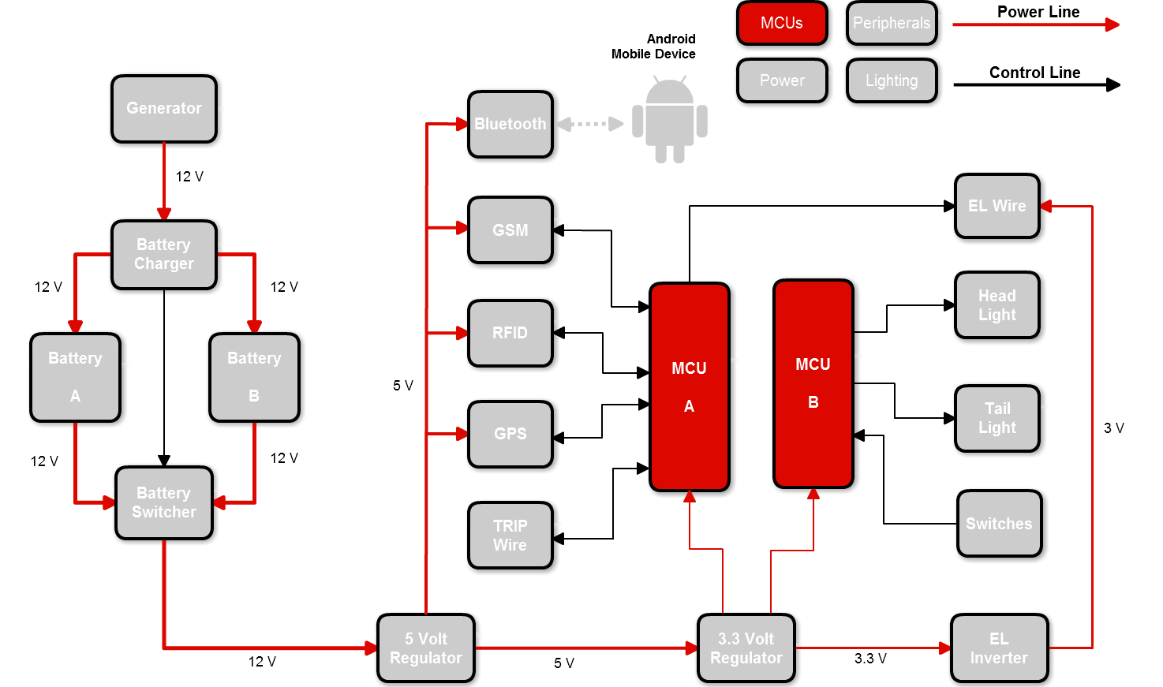
Microcontrollers

Slide 20
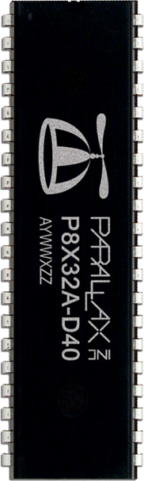
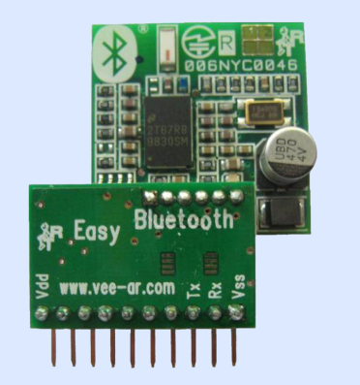
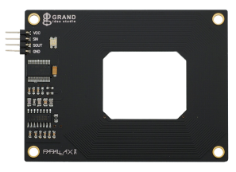
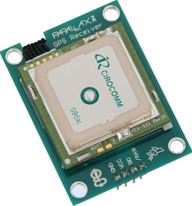
Parallax Propeller
Selection Criteria:
Ease of interfacing with peripheral devices
Large number of I/O lines
Multi-Core
Easy to mount on PCB (ideally DIP package)
DIP-40
Manufacturer | Parallax
Part No. | P8X32A
Price | $7.99
I/O Lines | 32 CMOS Lines
Cores | 8
Clock Speed | Up to 80 MHz
Main Memory | 64 KB
Memory per Core | 2 KB
Parallax
Parallax
Parallax

Slide 21
MCU A - Software
Android
Bluetooth
GSM
Main Memory
Bluetooth
(Core 6)
GSM
(Core 5)
GPS
(Core 2)
Position
Coordinates
GPS
Main
(Core 1)
RFID
(Core 3)
Alarm
Status
RFID
TRIPWIRE
(Core 4)
Wire
Status
WIRE
Mobile
Device
Software
Component
Hardware
Peripherals

Slide 22
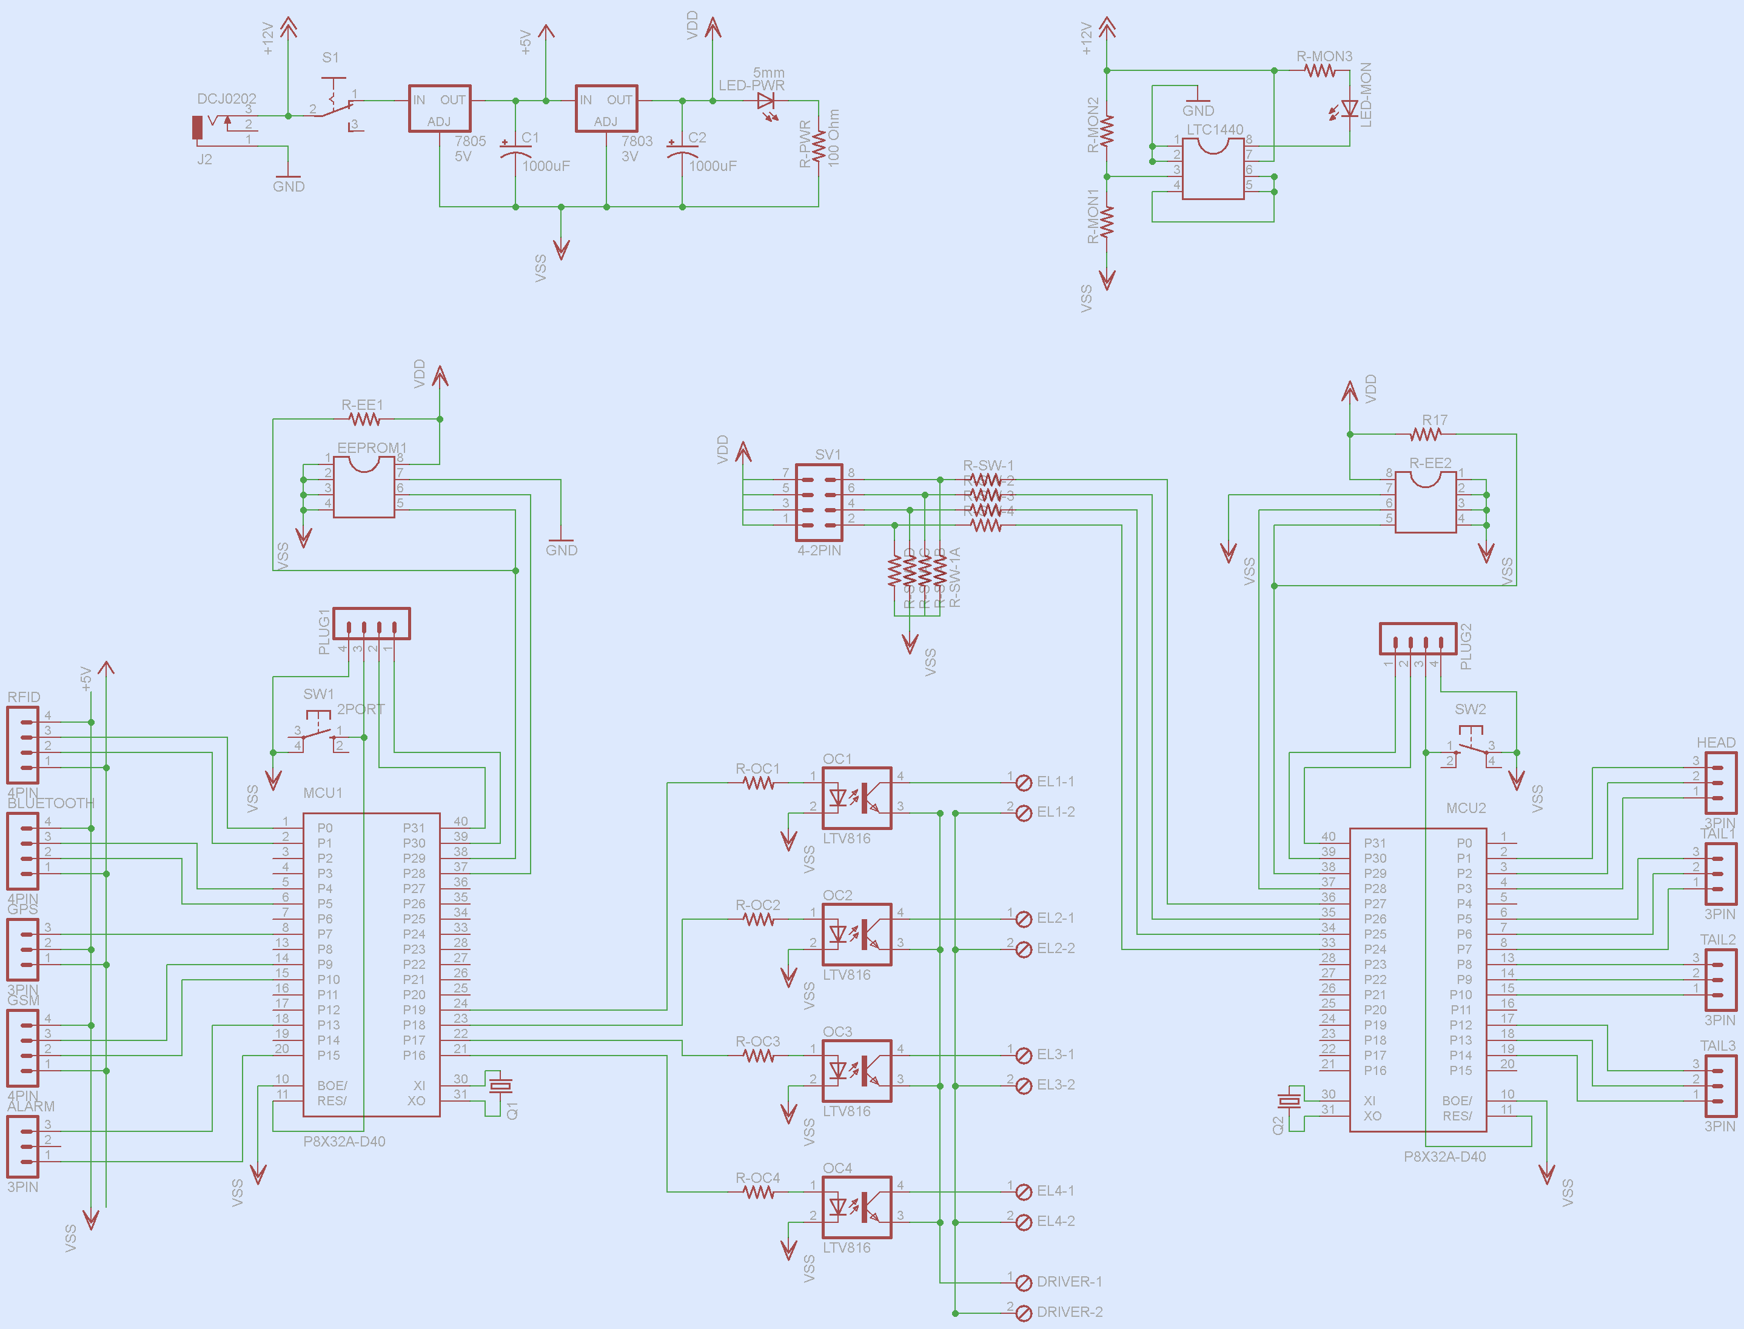
PCB Schematic

Slide 23
PCB Schematic
MCU A
MCU B

Slide 24
PCB Schematic
Power Regulation

Slide 25
PCB Schematic
Battery
Monitor

Slide 26
PCB Schematic
EL Wire

Slide 27
PCB Schematic
Security System
I/O
RFID
BT
GPS
GSM
Alarm

Slide 28
PCB Schematic
Lighting
System
I/O
Head
Light
Tail
Light

Slide 29
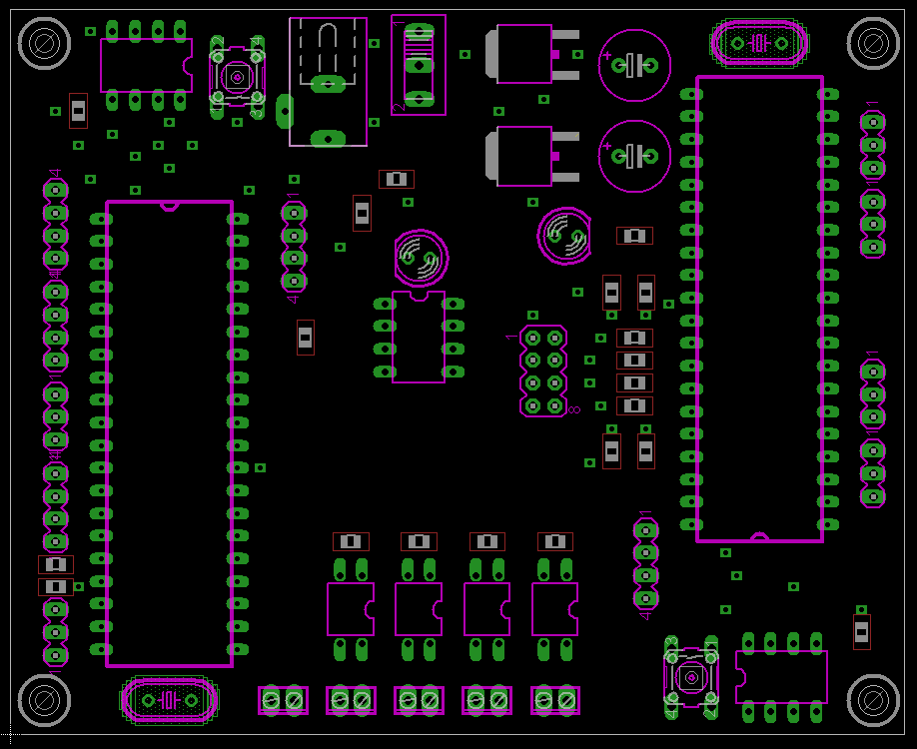
PCB Layout

Slide 30
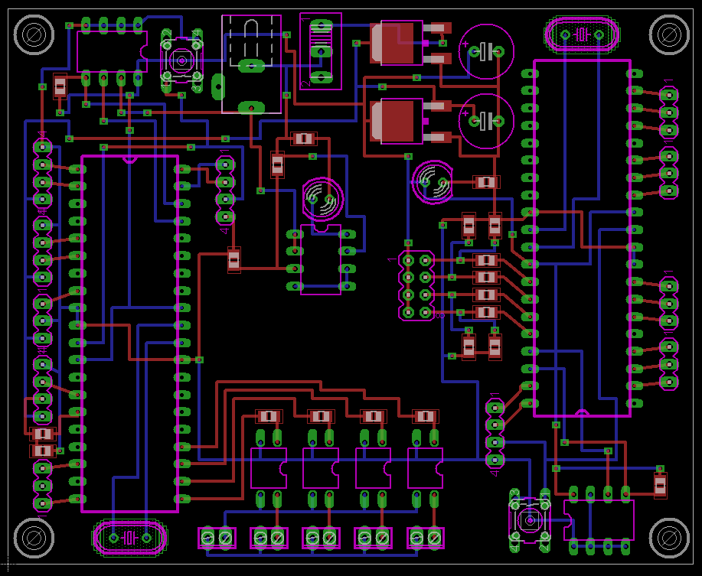
PCB Layout

Slide 31
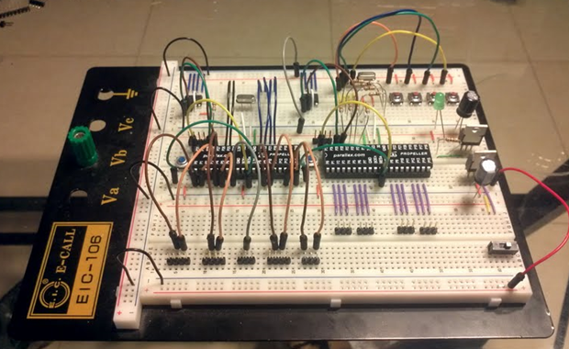
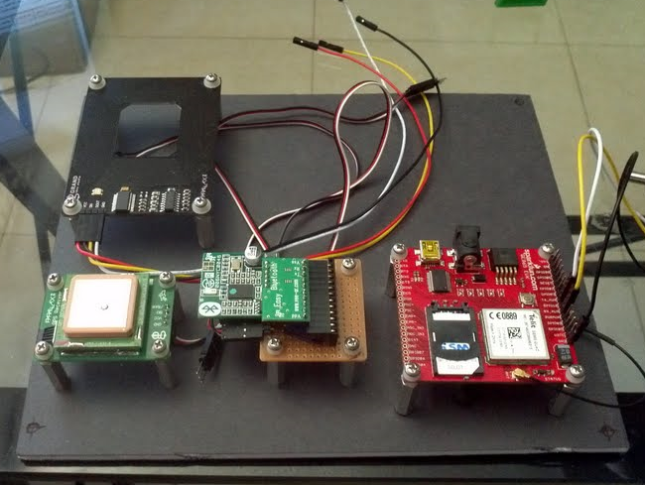
Prototyping
PCB Goes Here
PCB Components (MCU A & MCU B)
Electronics Bay (peripherals)

Slide 32
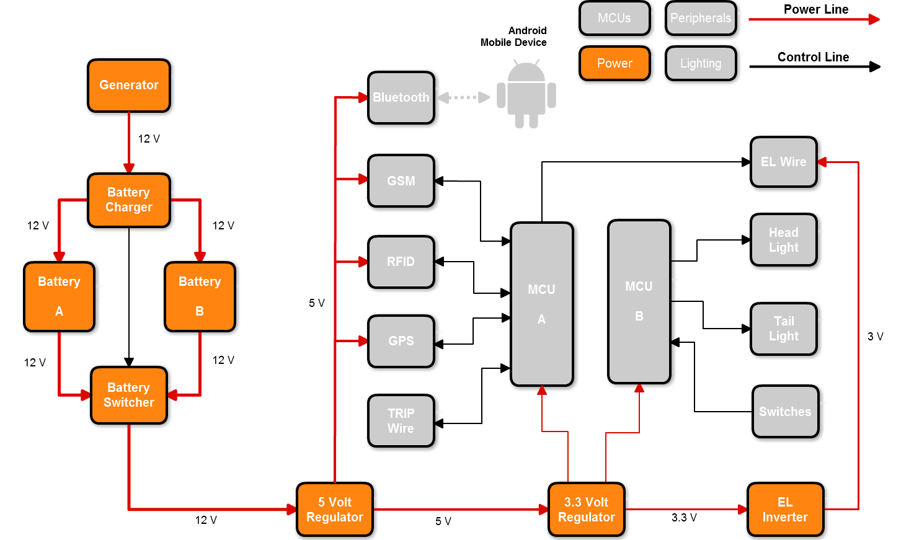
Power

Slide 33
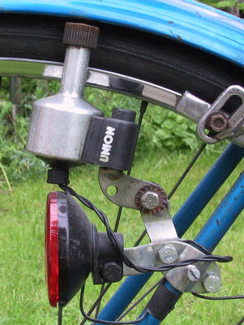
Generator
3-wire bicycle generator
Outputs AC
12 VAC terminal
3.6 VAC terminal
6 Watts
Low friction against motion

Slide 34
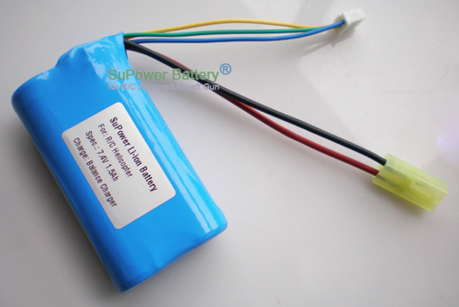
Lithium-Ion Battery
High energy density (Wh/kg)
High energy/dollar (Wh/$)
High charge efficiency (80-90%)
Low self-discharge
Durable
12.6 V
6800 mAh
85 Wh

Slide 35
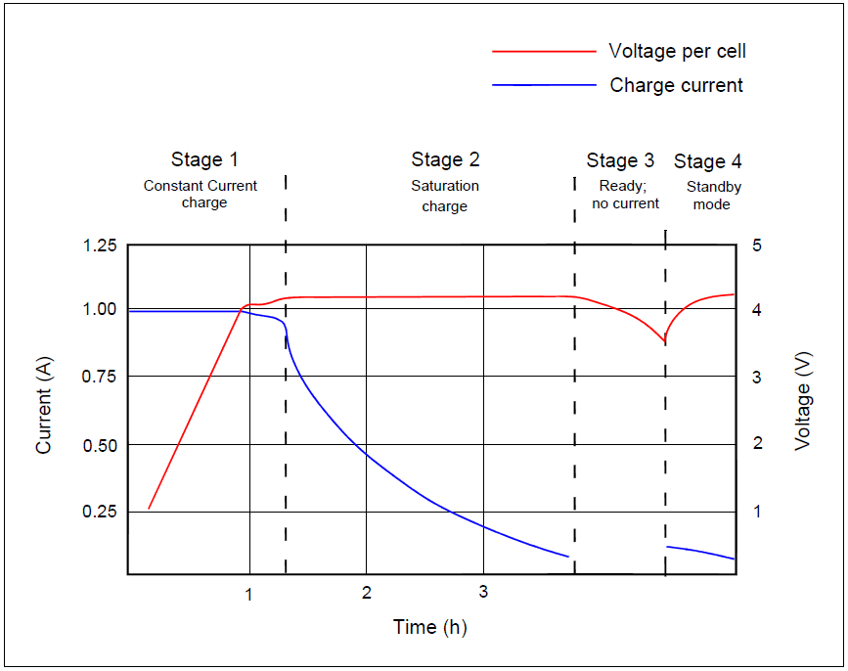
Battery Charging
Stage 1: Voltage rises at
  constant current
Stage 2: Voltage peaks,
current decreases
Stage 3: Charge terminates
Stage 4: Occasional topping
charge

Slide 36
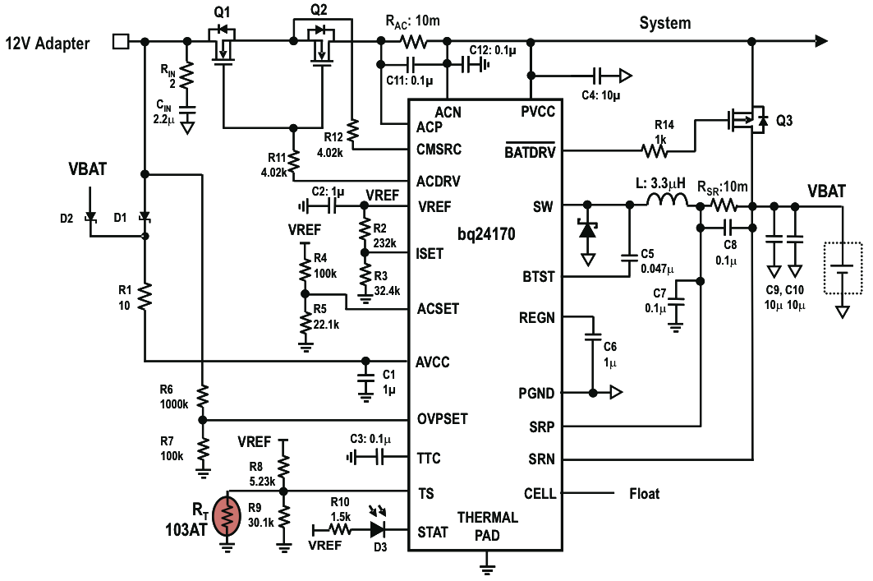
Battery Charging – BQ24172

Slide 37
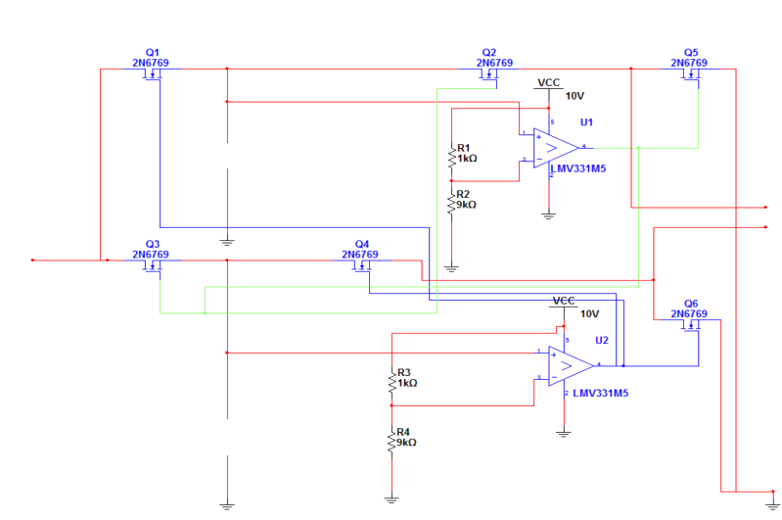
Battery Switching
A
Battery Charger
System
B

Slide 38
Power

Slide 39
Mobile Application

Slide 40


Android vs iPhone
Programmable on any OS
Java with Eclipse plug-in
Concise and fluent layout
Offline guide and API reference
Open source: in depth explanations
Javadoc and commenting
Easy debugging
>

Slide 41
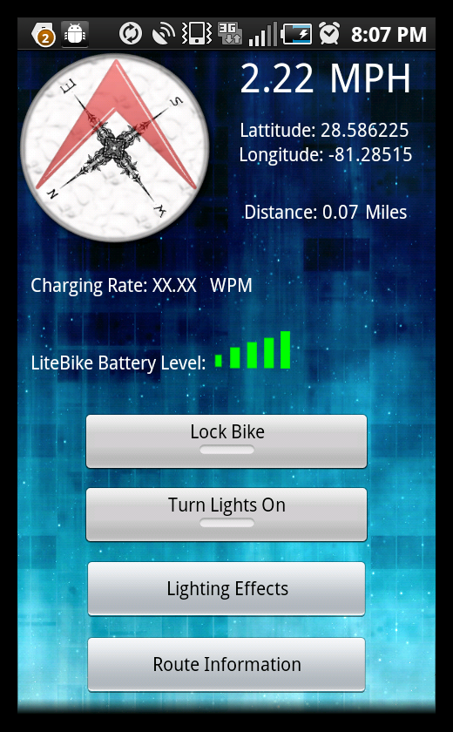
Mobile Application Features
Displays
  Compass
  GPS coordinates
  Speed
  Battery charging rate
  Battery levels
Controls
  Lighting effects
  Security system
Routes
  Allows user to create, edit and
  view bike routes

Slide 42
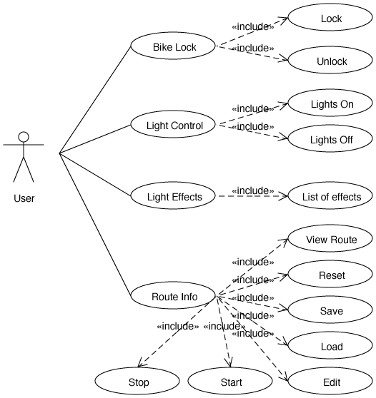
Use Case Diagram

Slide 43
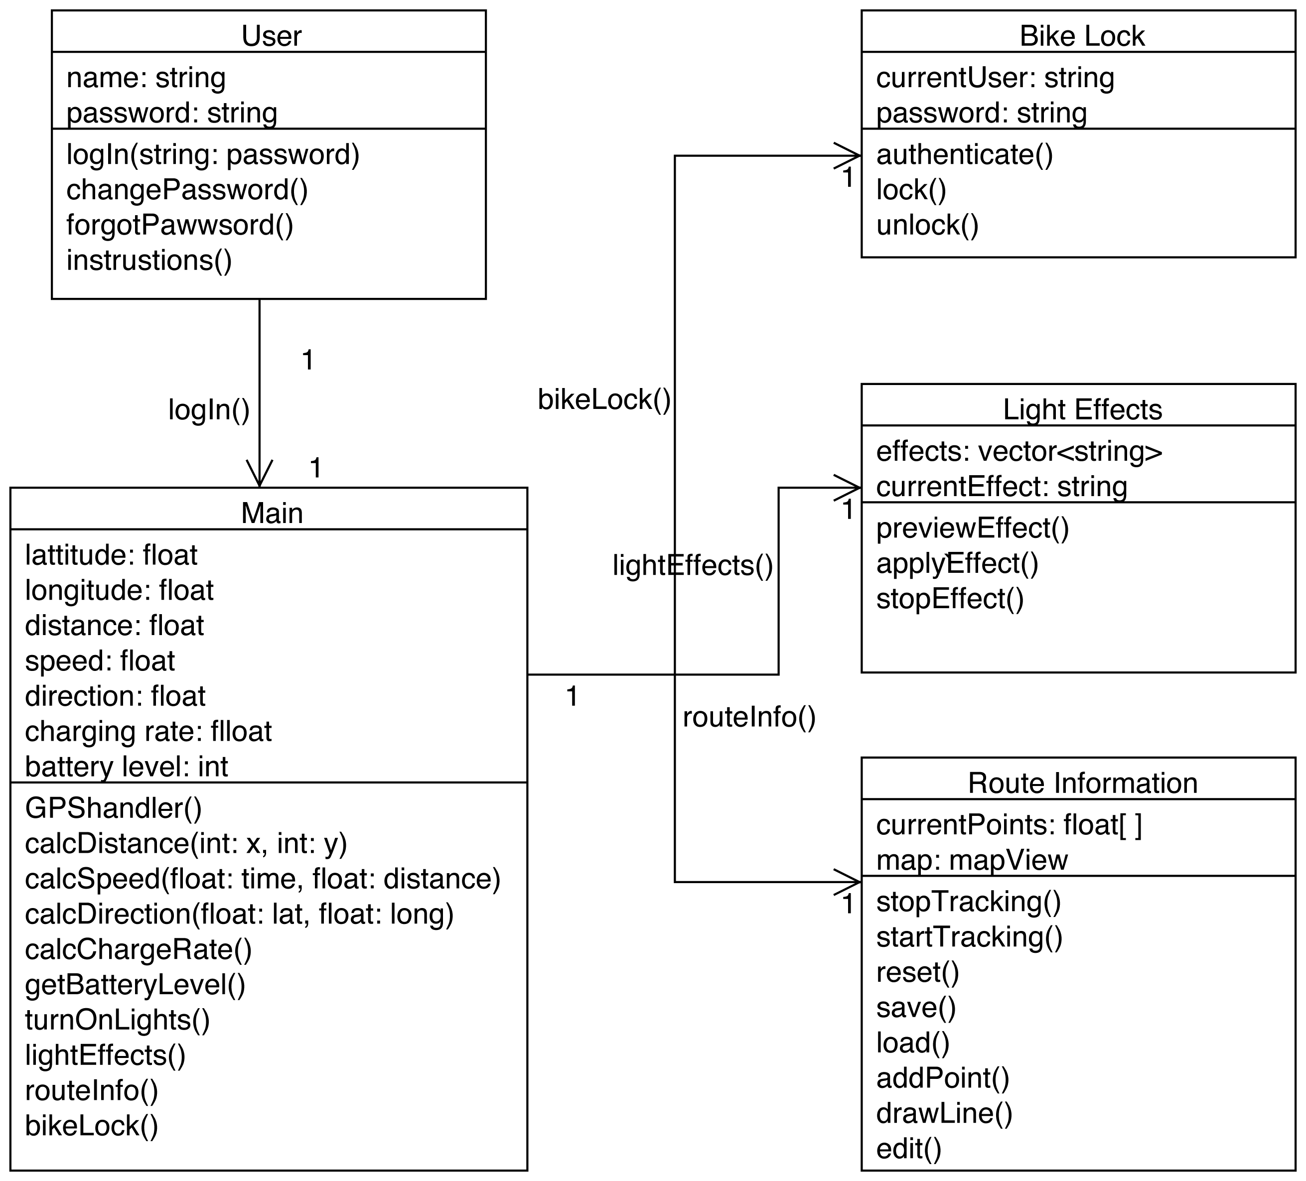
Class Diagram

Slide 44
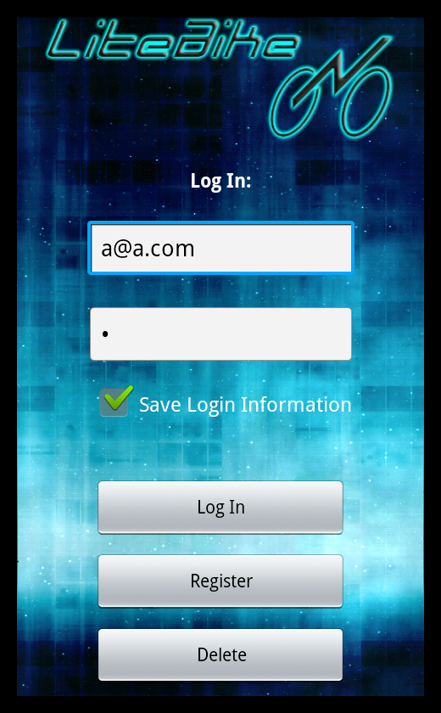
Login GUI

Slide 45
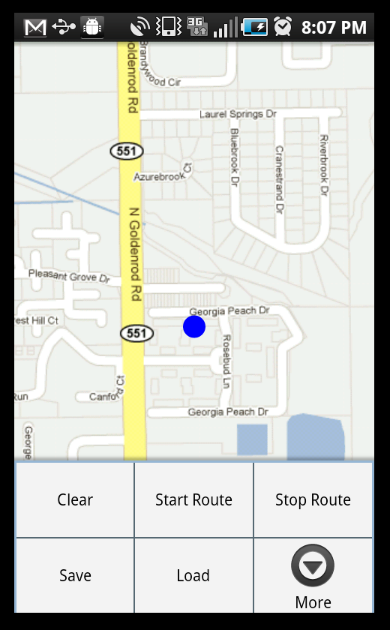
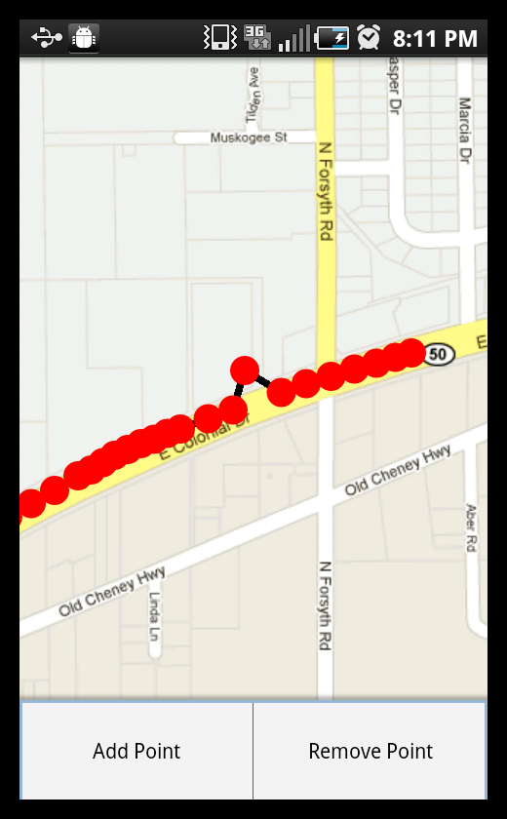
Route GUIs

Slide 46
Administrative Content

Slide 47
Work Distribution
Name | Power | Security | Mobile Application | Lighting
Cristovian | X
Andrew |  |  | X
Rebecca |  |  |  | X
Javier |  | X

Slide 48
Budget
Item | Supplier | Price/Unit | # Units | Total Cost | Item | Supplier | Price/Unit | # Units | Total Cost
Power Generation |  |  |  |  | Security System
Bottle Generator | Amazon | $16.95 | 1 | $16.95 | RFID Serial Module | Parallax | $39.99 | 1 | $39.99
Schottky Diodes | DigiKey | $0.51 | 6 | $3.06 | RFID Tag | Parallax | $0.99 | 1 | $0.99
LTC1921-Power Sensor | DigiKey | $5.00 | 1 | $5.00 | GPS Receiver | Parallax | $59.99 | 1 | $59.99
LM 317-Regulator | DigiKey | $1.06 | 6 | $6.36 | Bluetooth Module | Parallax | $69.99 | 1 | $69.99
LTC4007-Battery Charger | DigiKey | $7.63 | 1 | $7.63 | GSM Module | SparkFun | $99.99 | 1 | $99.99
MAX921-Comparator | DigiKey | $5.00 | 1 | $5.00 | Propeller Microcontroller | Parallax | $7.99 | 2 | $15.98
ADS7953-A/D Converter | DigiKey | $11.93 | 1 | $11.93 | Propeller DIP Kit | Parallax | $24.99 | 1 | $24.99
12 V Li-Ion Battery | BatteryWorld | $50.00 | 2 | $100.00 | Other
Lighting System |  |  |  |  | Bicycle | Wal-Mart | $150.00 | 1 | $150.00
8 x 8 LED Matrix | Futurelec | $3.90 | 6 | $23.40 | Rack | Wal-Mart | $30.00 | 1 | $30.00
EL Wire | Coolight | $1.40 | 72 | $100.80 | Wire | Skycraft | $0.09 | 20 | $1.80
Zip ties | SkyCraft | $12.50 | 1 | $12.50 | PCB Manufacturing | 4PCB | $50.00 | 3 | $150.00
Inverter | Coolight | $18.52 | 1 | $18.52 | Resistor Pack |  | $5.00 | 1 | $5.00
Tri-State Buffers | DigiKey | $0.52 | 10 | $5.20 | Capacitor Pack |  | $10.00 | 1 | $10.00
Headlight | Target | $15.99 | 1 | $15.99 | Acrylic Enclosure |  | $30.00 | 1 | $30.00
LEDs | SparkFun | $19.95 | 1 | $19.95 | Shipping |  | $100.00 | 1 | $100.00
Rocker Switches | SkyCraft | $3.50 | 5 | $17.50
Reed Switches | DigiKey | $0.44 | 5 | $2.20
Magnets | SkyCraft | $0.50 | 5 | $2.50 | Total |  | $1,163.21
Total: 1,163.21

Slide 49
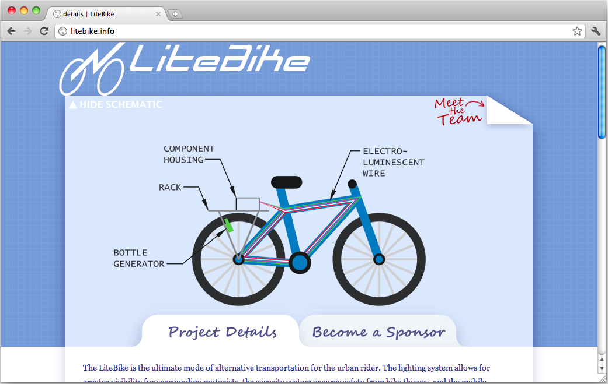
Financing
Seeking sponsorship for specific components
  EL wire supplier – 30% discount
  UCF police department for bike – unable to donate
  Bike shops for work, other bicycle components
Website for potential sponsors to visit: http://litebike.info

Slide 50
Progress

Slide 51
Issues
Communication between battery and MCU about battery stats
  Analog to digital converter?
Power consumption – lighting system is most power intensive
  Testing will provide insight

Slide 52
Questions?

