Slide 1

Group 11
Cristovian Basden
Andrew Pagliari
Rebecca Rashkin
Javier Vazquez

Slide 2
Motivation
Extremely dangerous to ride at night
Surrounding motorists have trouble seeing bikers
Motorists are already distracted with smart phones, etc
In 2009, 630 bicyclists were killed and 51,000 injured in traffic*
Lighting system allows for greater visibility
Shows the riders intentions - turning and braking
*Statistics are taken from U.S. Department of Transportation 2009 Traffic Safety Facts released in 2010

Slide 3
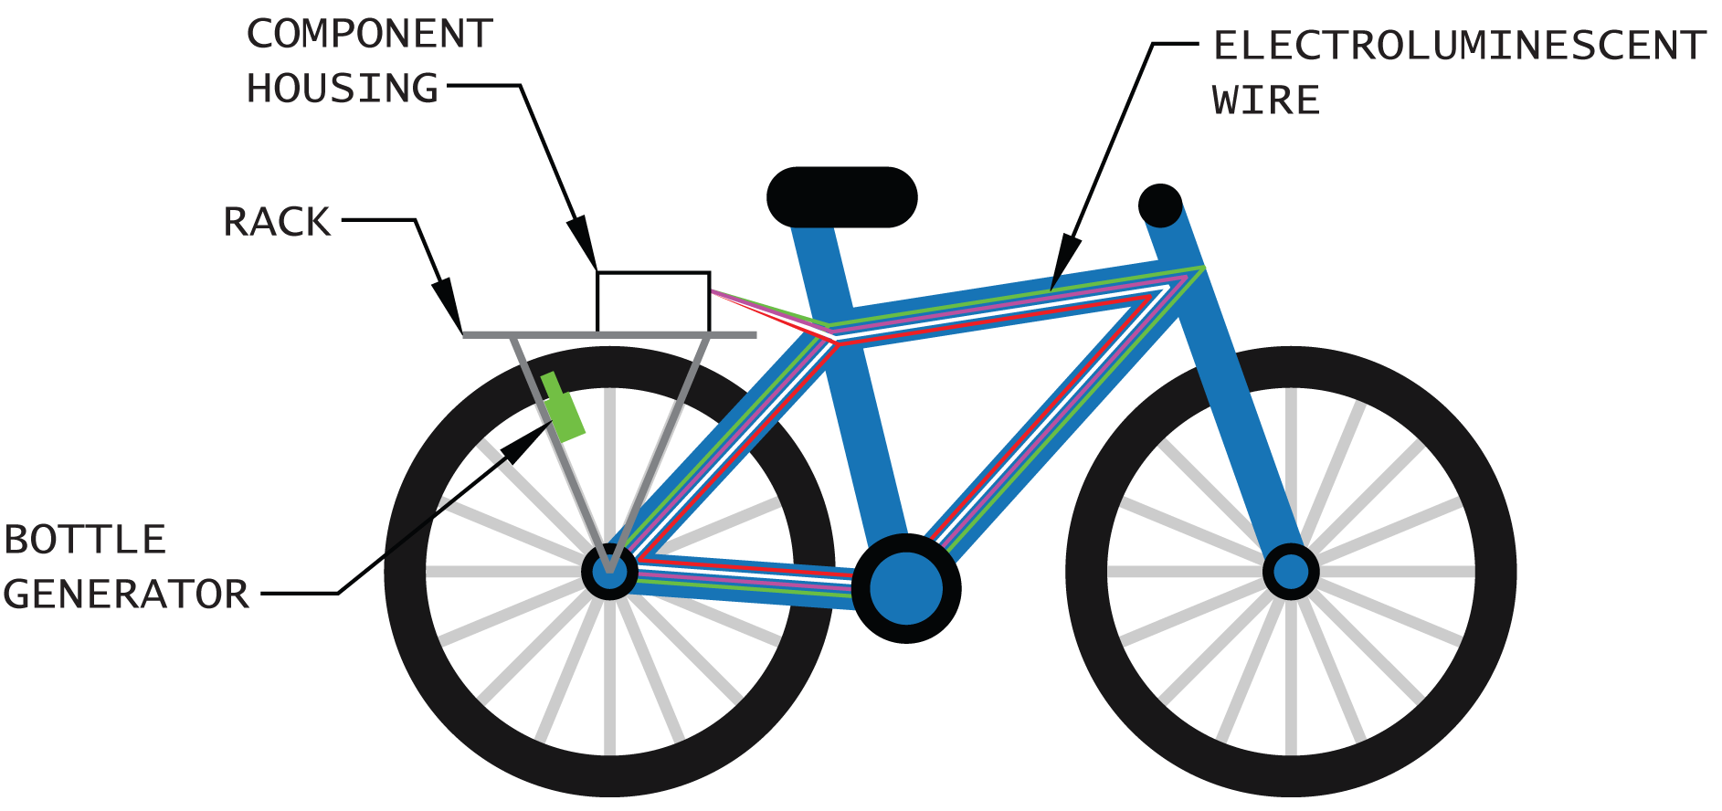
Goals and Objectives
Four part lighting system to increase visibility to other motorists
Headlight, taillight, front and rear turn signals, frame lights
Three tiered security system to protect bike from being stolen
Lock-Tampering Detection, Theft Detection, Recovery Assistance
All systems energized by human power – generator on wheel
Mobile application interfaces lighting and security systems

Slide 4
Specifications
Component | Parameter | Design Specification
Battery | Charge time | 6 hours
Battery | Discharge time | 2 hours
Mobile wireless link | Minimum range | 3 meters
GPS receiver | Accuracy | 10 meters
Compass | Accuracy | One cardinal direction
Speed | Accuracy | 2 miles per hour
GPS (Android) | Accuracy | 30 feet
GPS (Android) | Update time | 5 seconds

Slide 5
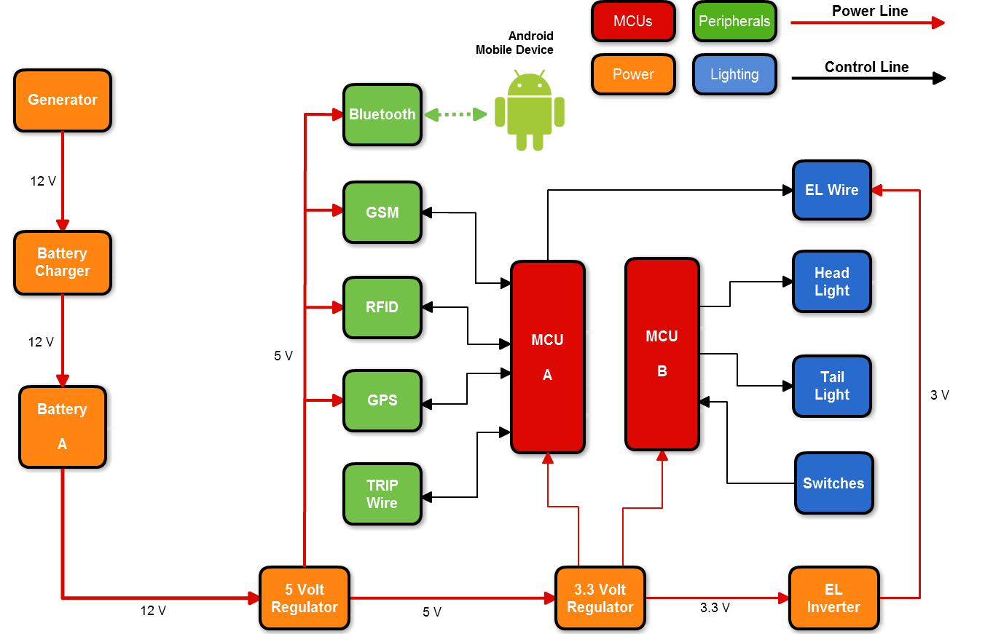
Overall Block Diagram

Slide 6
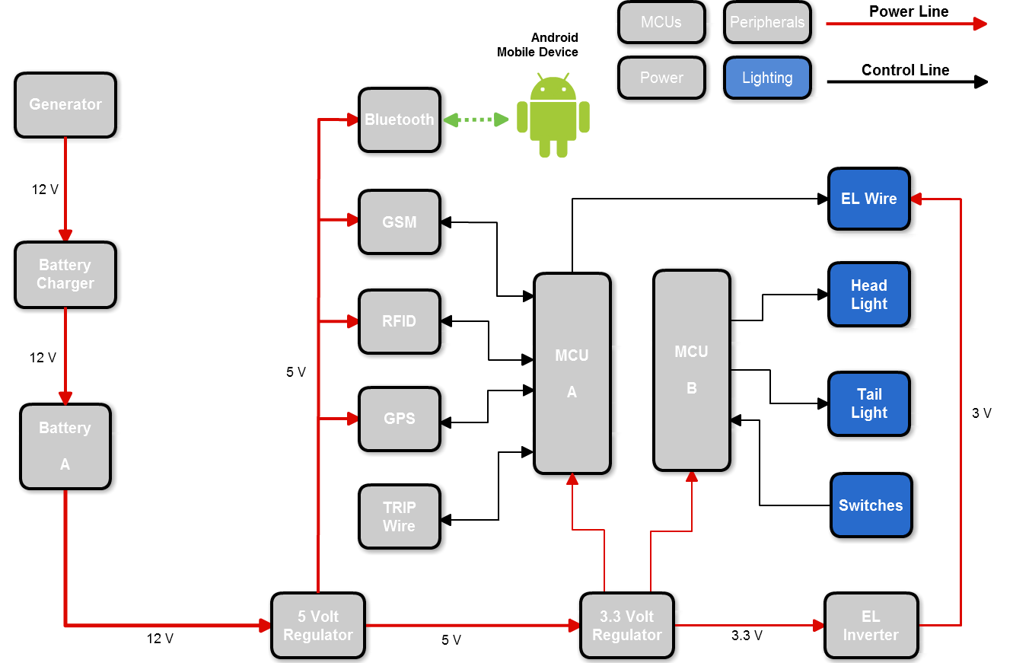
Lighting

Slide 7
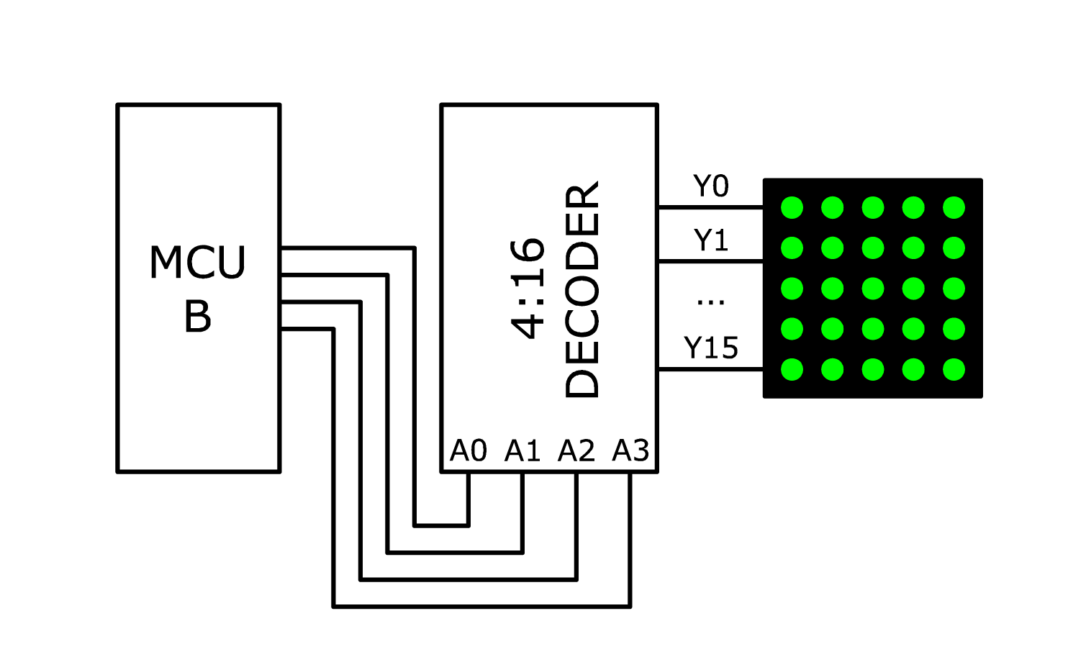


Taillight
3 LED matrices of 64 red/green LEDS
Can show both brake light and turn signals
Lit when headlight is on
Each LED requires 20 mA current
1.8 – 2.4 V for red, 2.2 – 2.8 V for green
Decoder used to control lights
One column on at a time to conserve power
Turn signal
Turn signal with brake

Slide 8
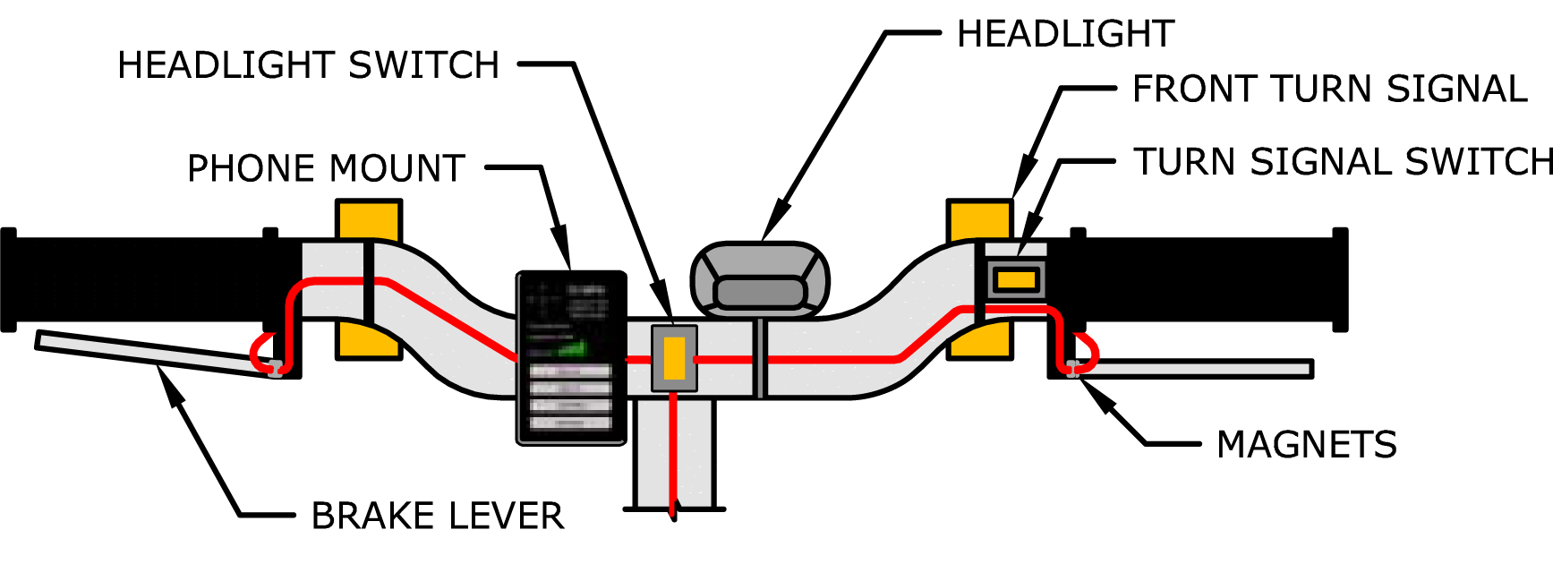
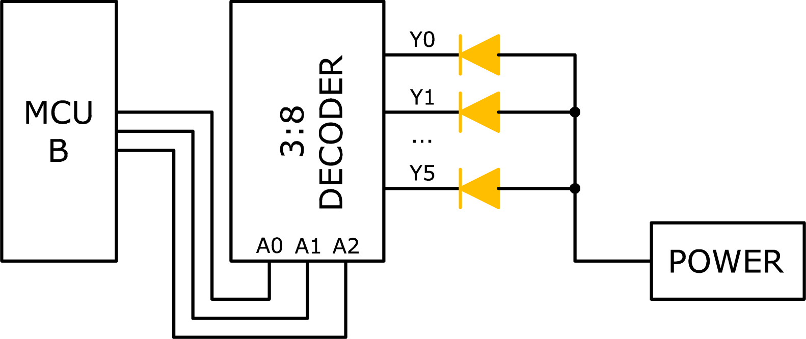
Handlebar View
Conductive magnets on brake lever
Normally closed - when lever is pulled, circuit is broken
Rocker switches for turn signals and headlight
Pre-made headlight wired to LiteBike’s power system
Separate front turn signals
Rider’s View
Front Turn Signal Control

Slide 9
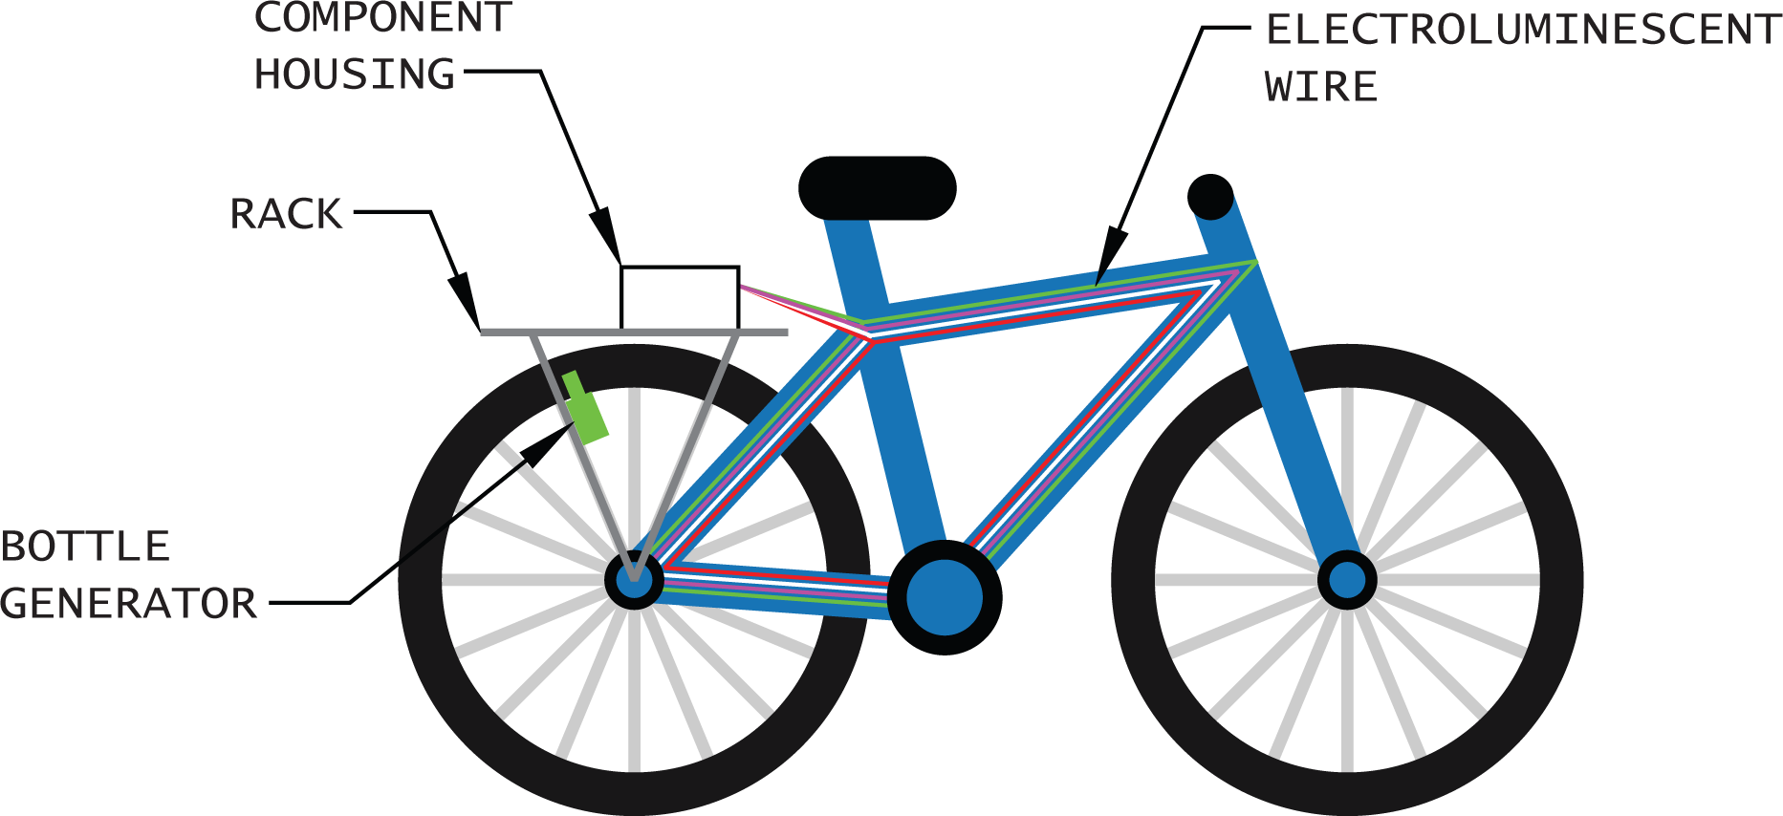
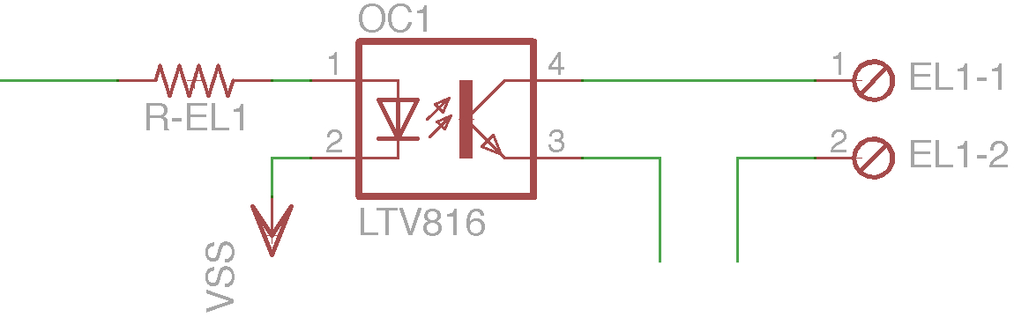
Frame Lighting – EL Wire
Cheap, easy to assemble, stylish
Requires AC current, so inverter must be used
Frequencies usually between 2000 Hz and 6000 Hz
Higher frequencies = brighter, shorter life for EL wire
Optocoupler to switch on and off
Optocoupler

Slide 10
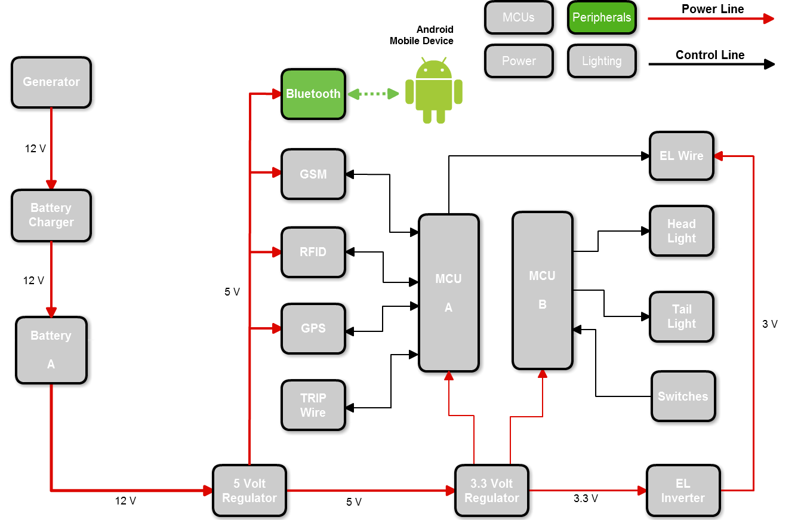
Mobile Wireless Link

Slide 11
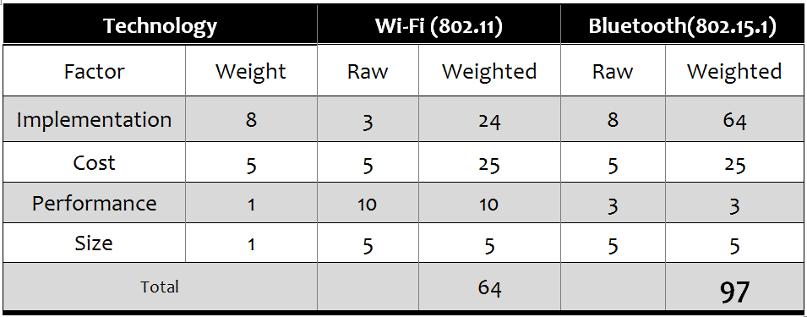
Wireless Technology Selection
Wireless Link between Android and LiteBike systems
Modern smart phones natively include Wi-Fi and Bluetooth
Wi-Fi is harder to implement
Bluetooth consumes less power, and is easier to implement

Slide 12
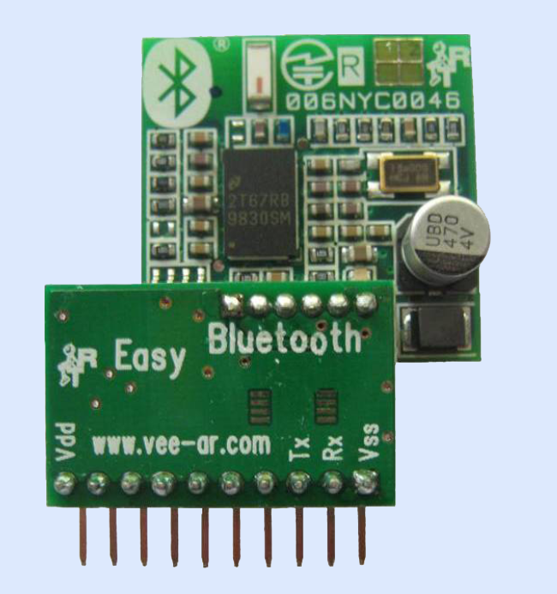
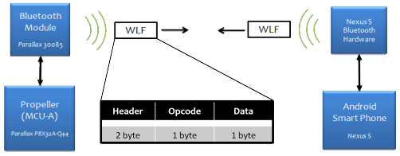
Parallax Easy Bluetooth Module
Purpose:
Interface Bluetooth enabled smart phone with microcontroller.
1.79 in(45.65 mm)
1.4 in (34.41mm)
(Custom Protocol)
Bluetooth Serial Port Profile (SPP)
Opcode | Function | Data
0x01 | Turn Lights On | Light Pattern
0x02 | Turn Lights Off | None
0x03 | Lock Bike | None
0x04 | Unlock Bike | None
0x05 | Request GPS Data | Data Type
0x06 | Request Battery Charge | None
0x07 | Request Battery Voltage | None
0x08 | Arm Alarm System | None
0x09 | Disarm Alarm System | None
Manufacturer | Parallax
Part No. | 30085
Price | $69.99
I/O Lines | 4 (TX, RX, VCC, GND)
Power Supply | 5 V

Slide 13
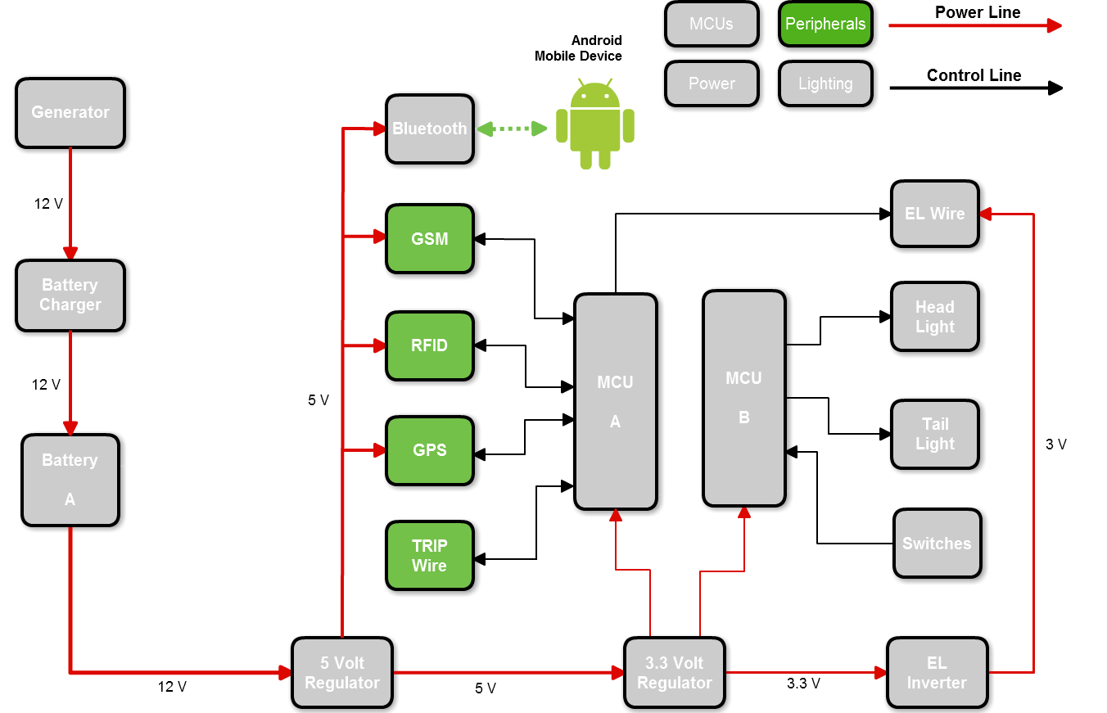
Security

Slide 14
Security System
Tier | Feature | Description | Sub-Systems
1 | Lock-Tampering Detection | Detects if chain lock is compromised or removed and triggers alarm. | Tripwire
2 | Theft Detection | Detects if bike moves more than 30 feet by unauthorized user and triggers alarm. | GPS
3 | Recovery Assistance | Relays position coordinates to user to assist in recovery bike. | GPS, GSM

Slide 15
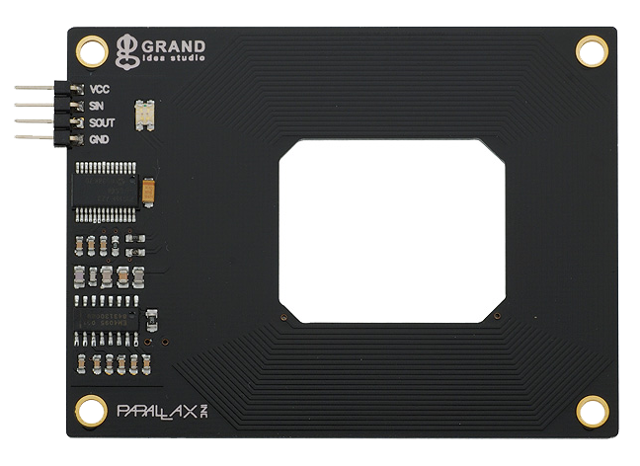
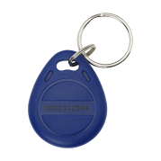
RFID
Purpose:
User Authentication; allows user to enable and disable the LiteBike’s alarm system.
RFID Tag
3 in
Manufacturer | Parallax
Part No. | 28440
Price | $49.99
I/O Lines | 4 (TX, RX, VCC, GND)
Power Supply | 5 V
ALARM:
ARMED
DISARMED
DISARMED – Bike can be moved without triggering alarm
ARMED – Bike will trigger alarm if
Bike moved more than 30 feet
Tripwire is severed
Serial communication allowed for easy interfacing with MCU
Built-in Antenna

Slide 16
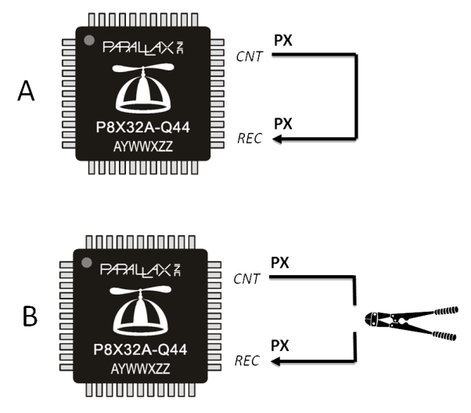
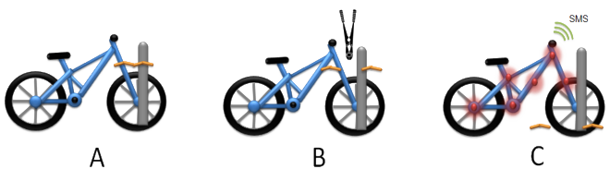
Tripwire (Lock Tampering Detection)
Purpose:
Detects attempts to sever bike chain lock. If the alarm is ARMED, severing the tripwire triggers the alarm.
A signal is continuously sent out on MCU pin into tripwire
As long as tripwire is uninterrupted, loop continues
If tripwire is severed, signal is interrupted, triggering alarm

Slide 17
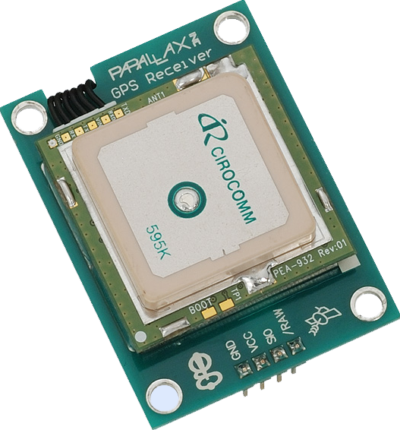
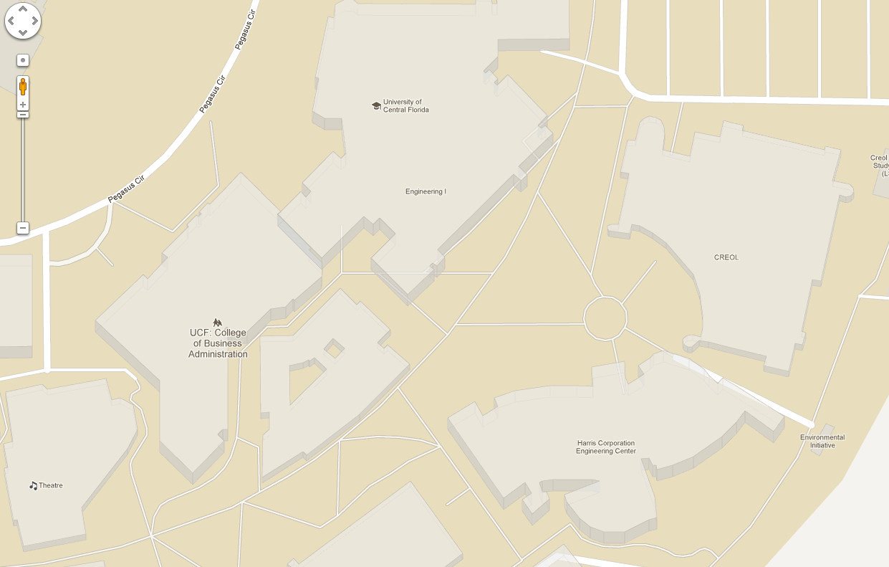

GPS
Purpose:
Determine if LiteBike has left security radius
Provide user with LiteBike’s location
1.17 in
Manufacturer | Parallax
Part No. | 28146
Price | Already Owned
I/O Lines | 4 (TX, RX, VCC, GND)
Power Supply | 5 V
20’ security radius

Slide 18
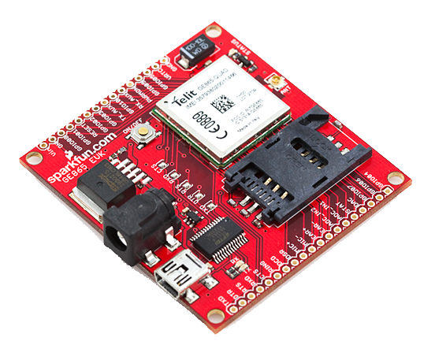
GSM - GE865 Development Board
Purpose:
Send user SMS alerts with GPS coordinates in the
event the LiteBike is stolen.
2.4 in
GSM uses national cell phone networks
Sending SMS every few minutes to save money
Development board cheaper than custom PCB
Manufacturer | SparkFun
Part No. | 28146
Price | $149.99
I/O Lines | 4 (TX, RX, VCC, GND)
Power Supply | 5 V

Slide 19
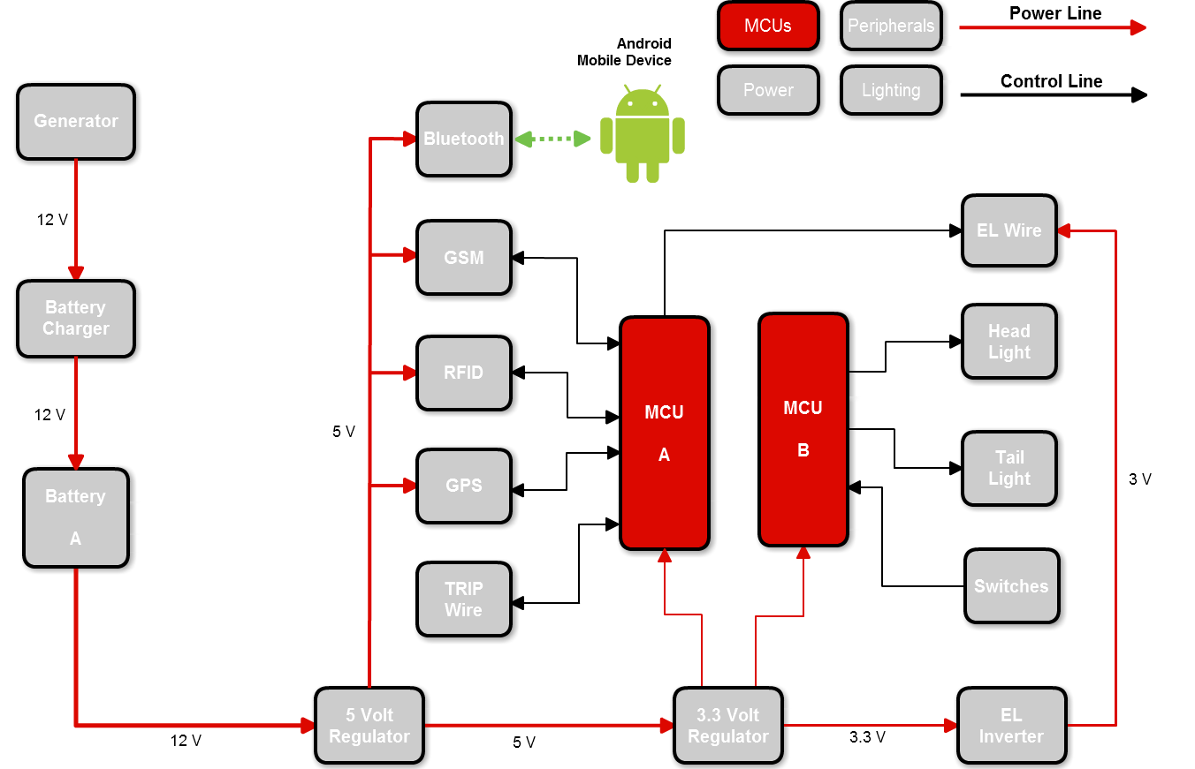
Microcontrollers

Slide 20
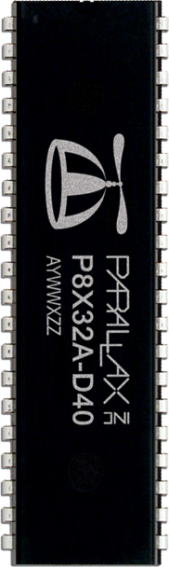
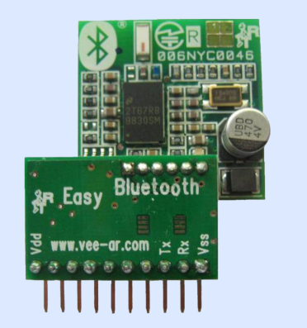
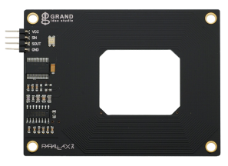
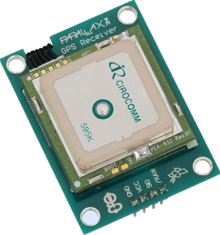
Parallax Propeller
Selection Criteria:
Ease of interfacing with peripheral devices
Large number of I/O lines
Multi-Core
Easy to mount on PCB (ideally DIP package)
DIP-40
Manufacturer | Parallax
Part No. | P8X32A
Price | $7.99
I/O Lines | 32 CMOS Lines
Cores | 8
Clock Speed | Up to 80 MHz
Main Memory | 64 KB
Memory per Core | 2 KB
Parallax
Parallax
Parallax

Slide 21
MCU A - Software
Android
Bluetooth
GSM
Main Memory
Bluetooth
(Core 6)
GSM
(Core 5)
GPS
(Core 2)
Position
Coordinates
GPS
Main
(Core 1)
RFID
(Core 3)
Alarm
Status
RFID
TRIPWIRE
(Core 4)
Wire
Status
WIRE
Mobile
Device
Software
Component
Hardware
Peripherals

Slide 22
MCU B - Software
Taillight Segment 1
(Core 2)
4:16 Decoder
Taillight Segment 2
(Core 3)
3:8
Decoder
Taillight Segment 3
(Core 4)
4:16 Decoder
Switches
(Core 1)
Front Right Turn Signal
(Core 5)
3:8
Decoder
Front Left Turn Signal
(Core 6)
3:8
Decoder
Headlight
(Core 7)
Tri-state
Buffer
Software
Component
Hardware
Peripherals

Slide 23
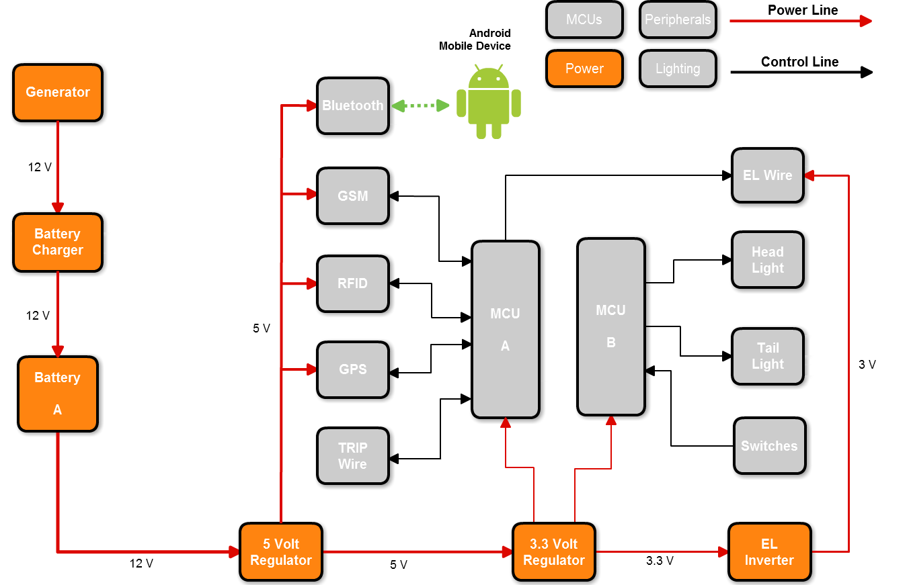
Power

Slide 24
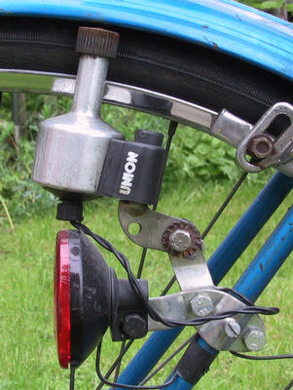
Generator
3-wire bicycle generator
Outputs AC
12 VAC terminal
3.6 VAC terminal
6 Watts
Low friction against motion

Slide 25
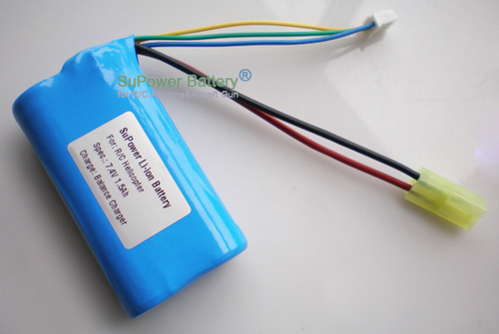
Lithium-Ion Battery
High energy density (Wh/kg)
High energy/dollar (Wh/$)
High charge efficiency (80-90%)
Low self-discharge
Durable
12.6 V
6800 mAh
85 Wh

Slide 26
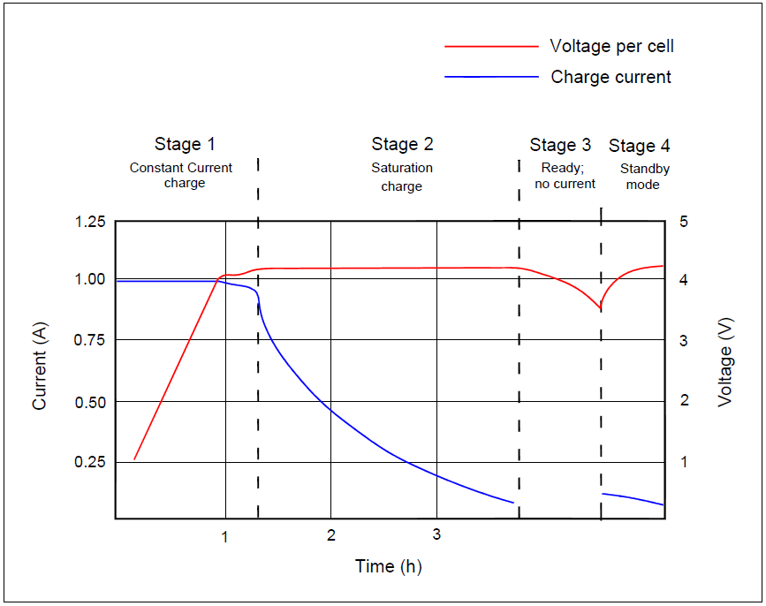
Battery Charging
Stage 1: Voltage rises at
constant current
Stage 2: Voltage peaks,
current decreases
Stage 3: Charge terminates
Stage 4: Occasional topping
charge

Slide 27
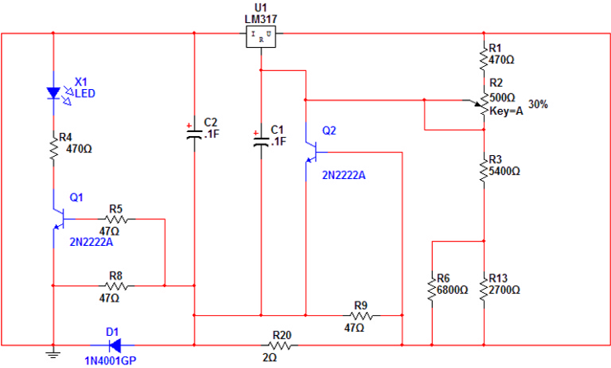
Battery Charging
System
Battery

Slide 28
Power

Slide 29
Mobile Application

Slide 30


Android vs iPhone
Programmable on any OS
Java with Eclipse plug-in
Concise and fluent layout
Offline guide and API reference
Open source: in depth explanations
Javadoc and commenting
Easy debugging
>

Slide 31
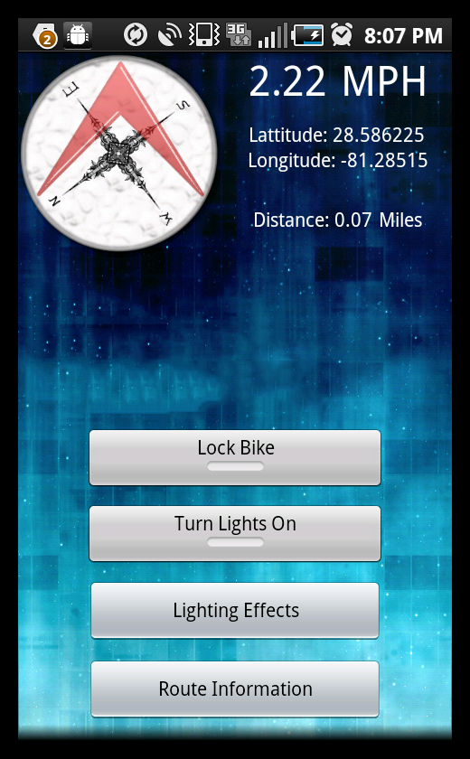
Mobile Application Features
Displays
Compass
GPS coordinates
Speed
Controls
Lighting effects
Security system
Routes
Allows user to create, edit and
view bike routes

Slide 32
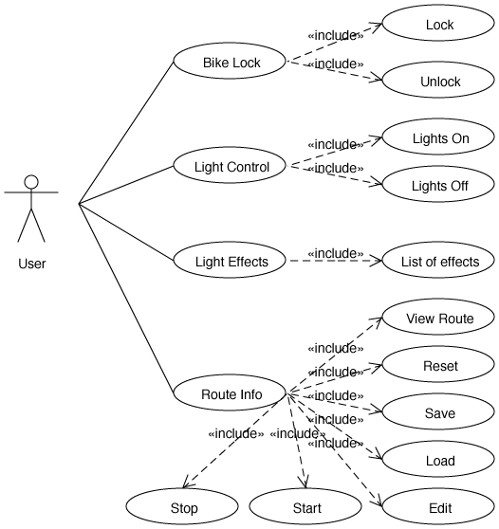
Use Case Diagram

Slide 33
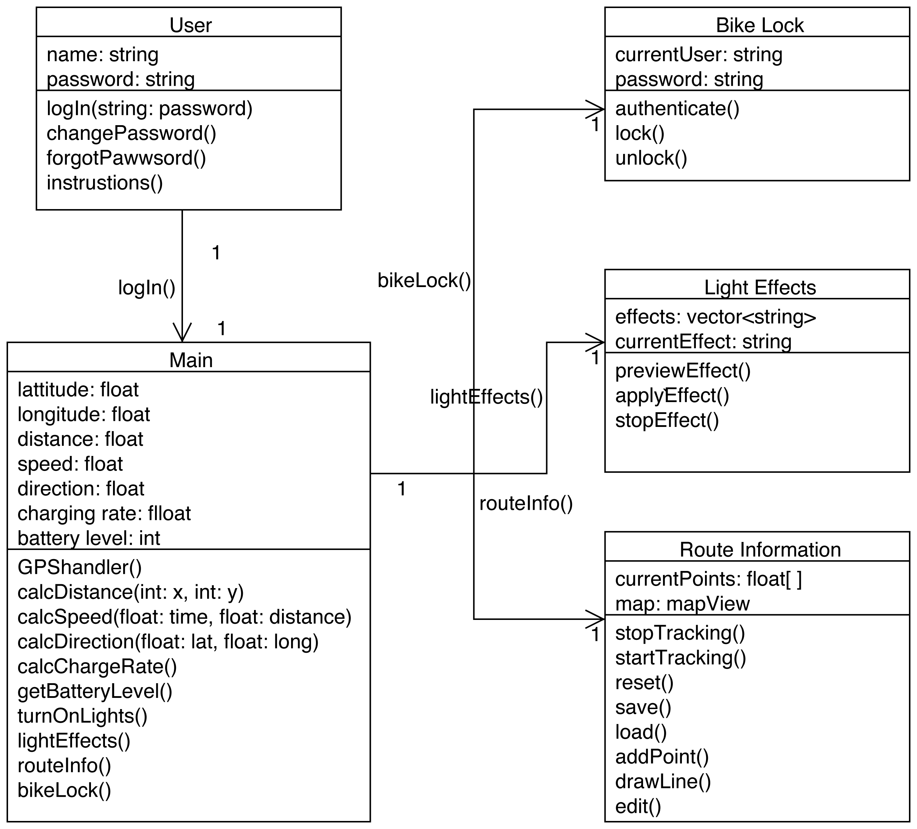
Class Diagram

Slide 34
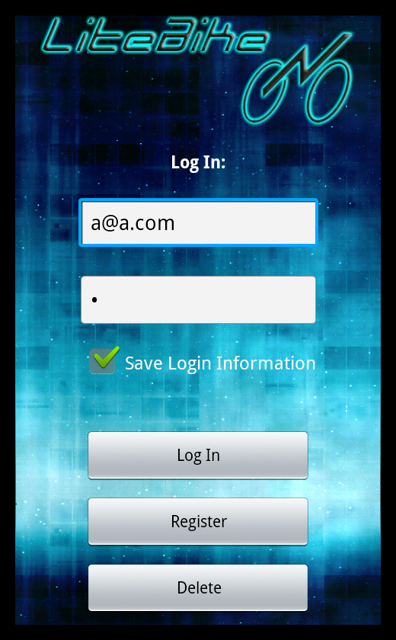
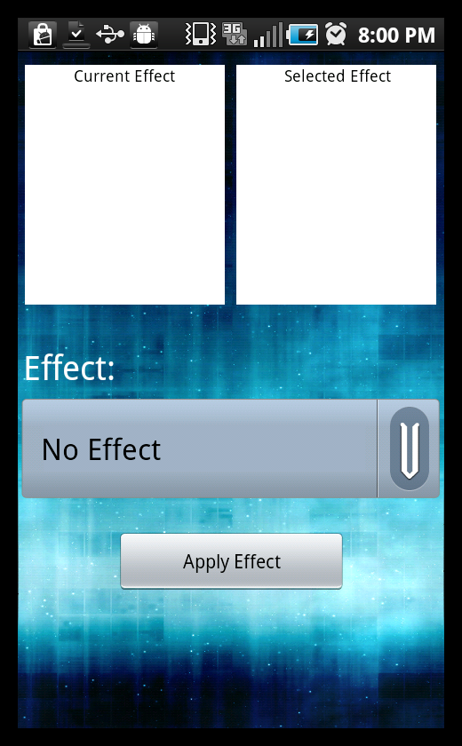
Login, Lighting Effects GUIs

Slide 35
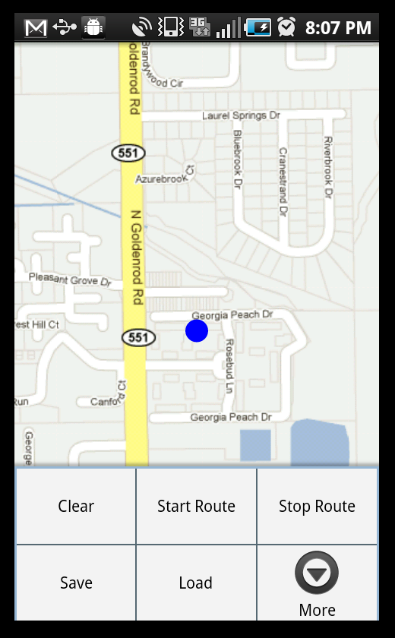
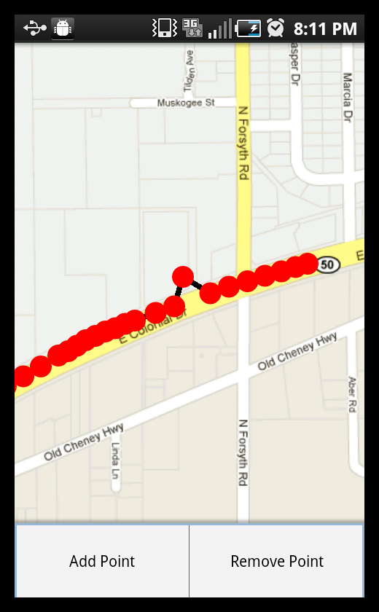
Route GUIs

Slide 36
Printed Circuit Board Design

Slide 37
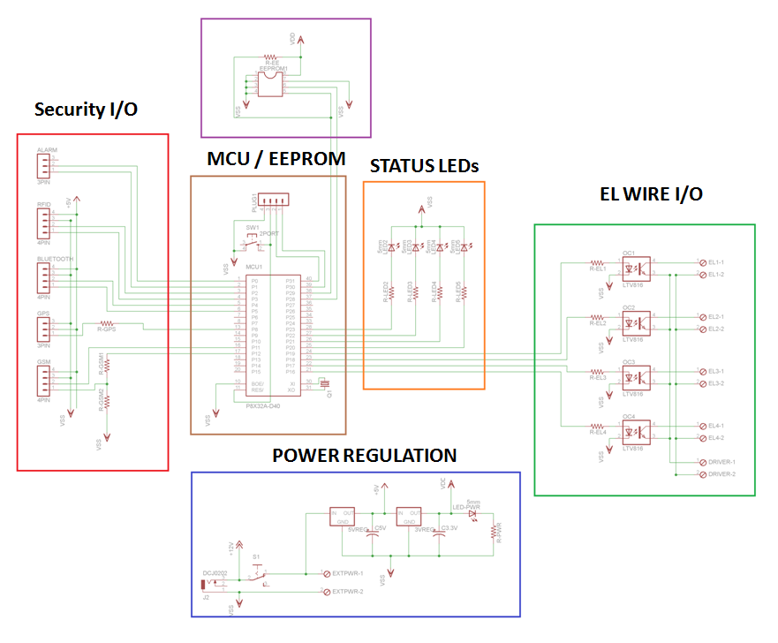
PCB A - Schematic

Slide 38
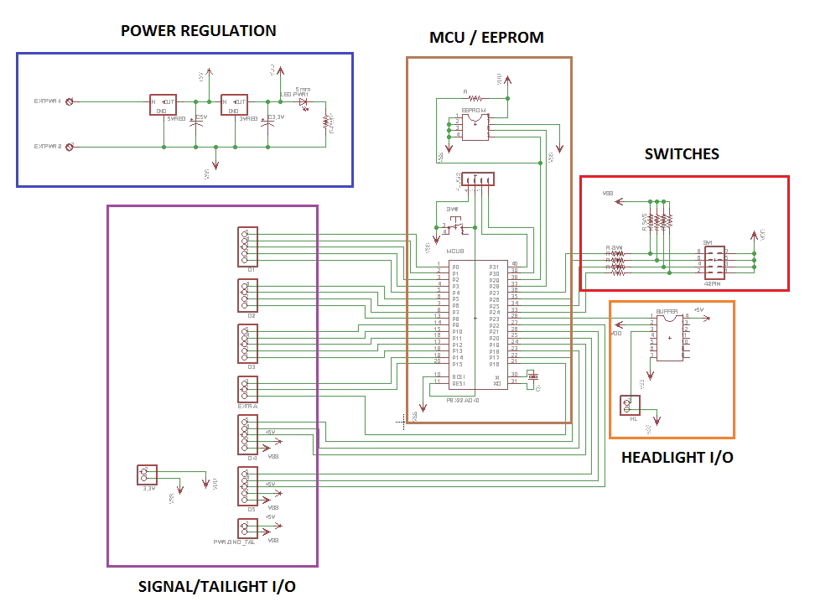
PCB B - Schematic

Slide 39

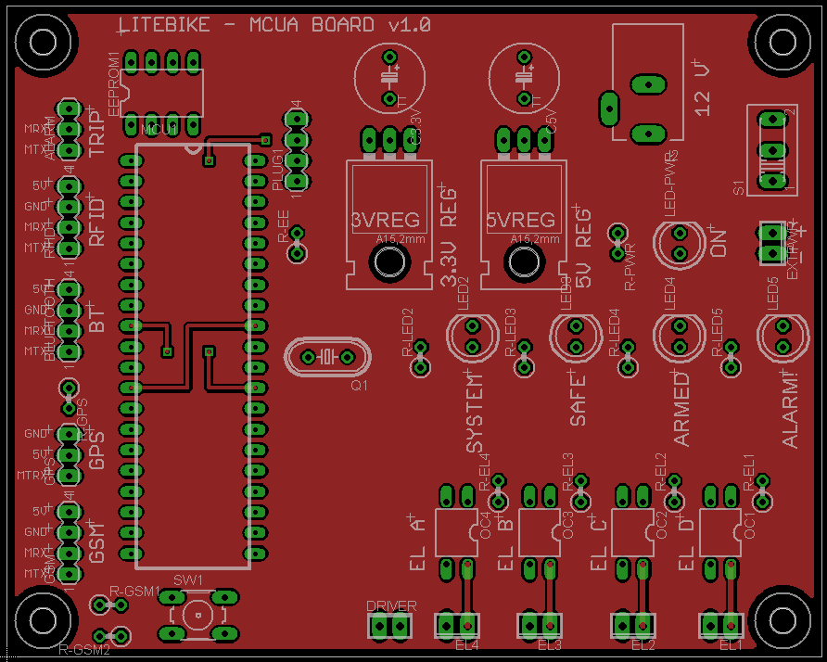
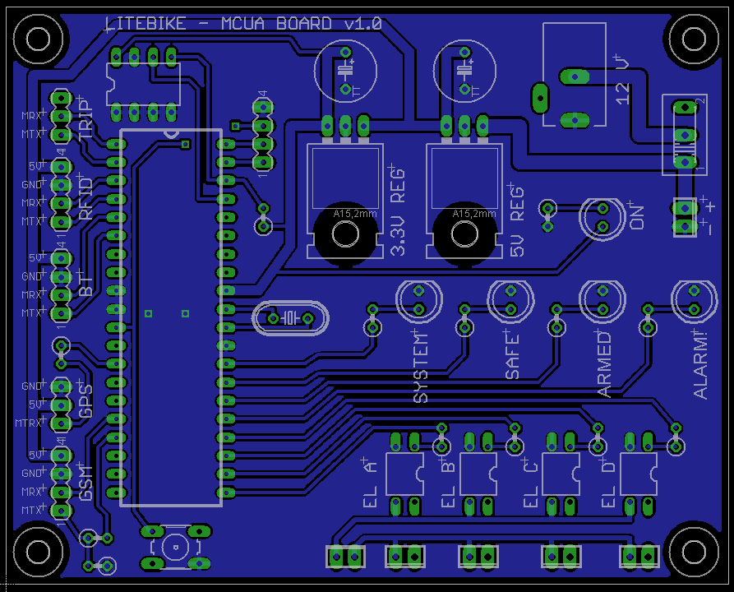
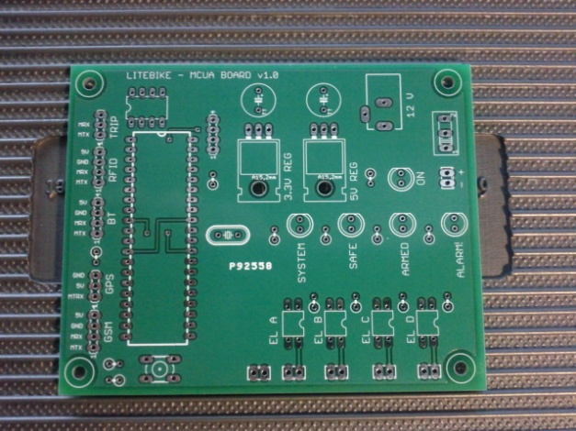
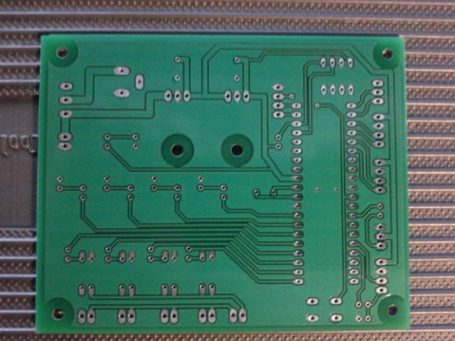
PCB Layout – PCB A
Board were manufactured by Advanced Electronics (www.4pcb.com)

Slide 40
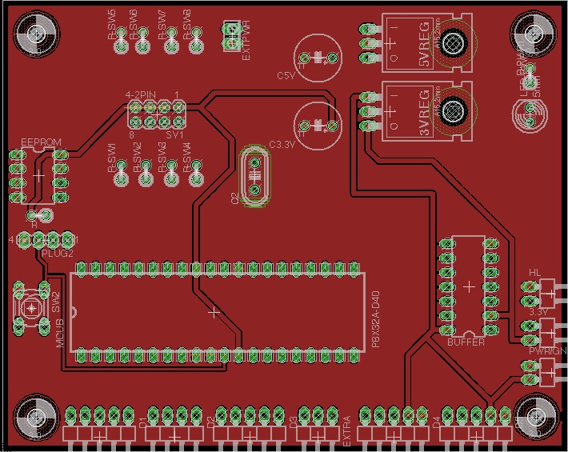
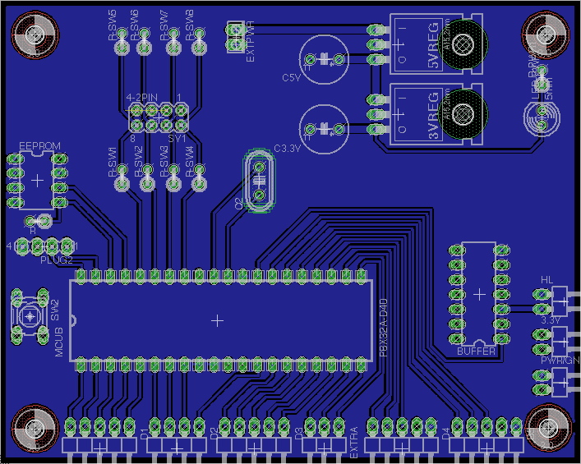
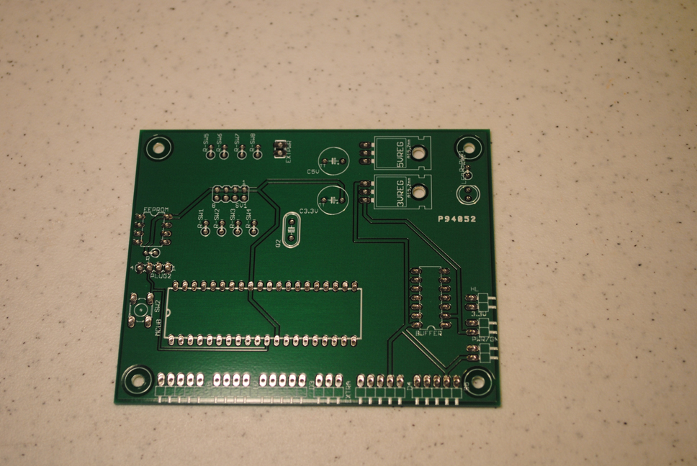
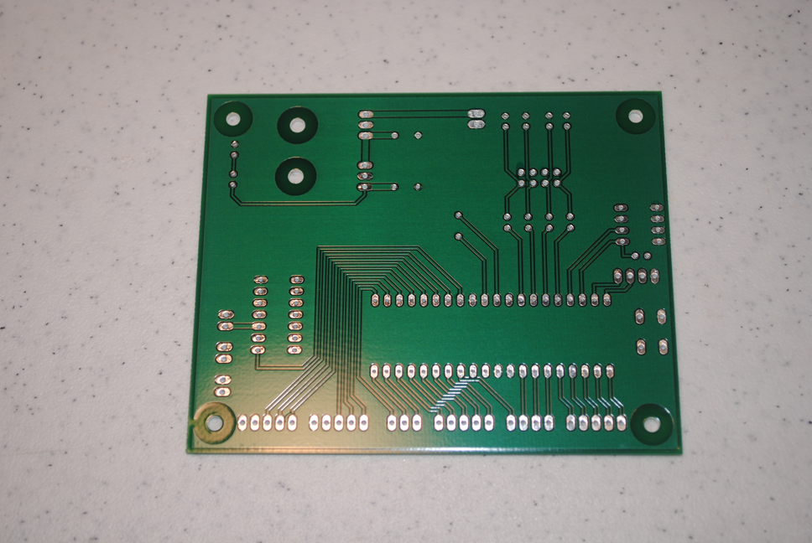
PCB Layout – PCB B
Board were manufactured by Advanced Electronics (www.4pcb.com)

Slide 41
Prototyping

Slide 42
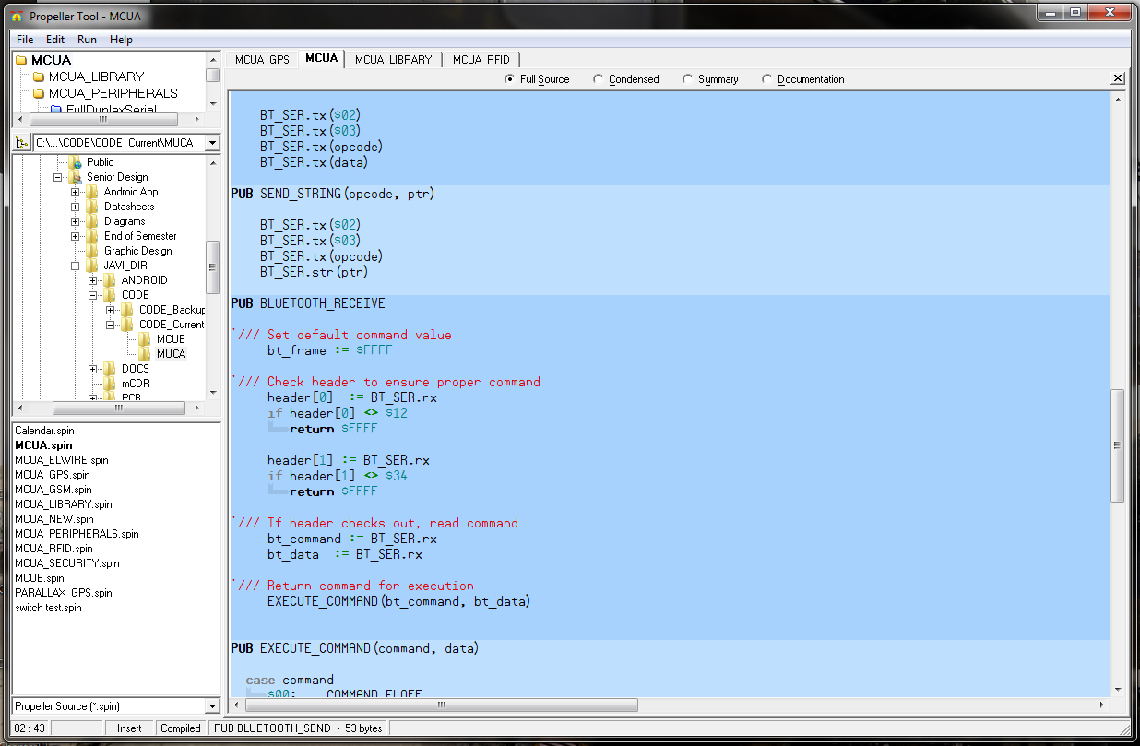

Development Environment – Propeller (MCU)
Propeller Tool v1.2
SPIN– simple object-oriented programming language. Both simple and powerful.

Slide 43
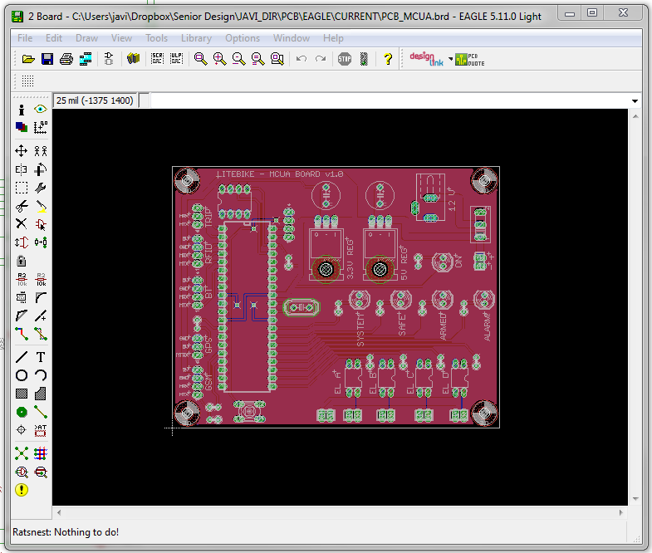

Development Environment – PCB
EAGLE 5.11.0
• Flexible
• Large number of existing parts libraries

Slide 44
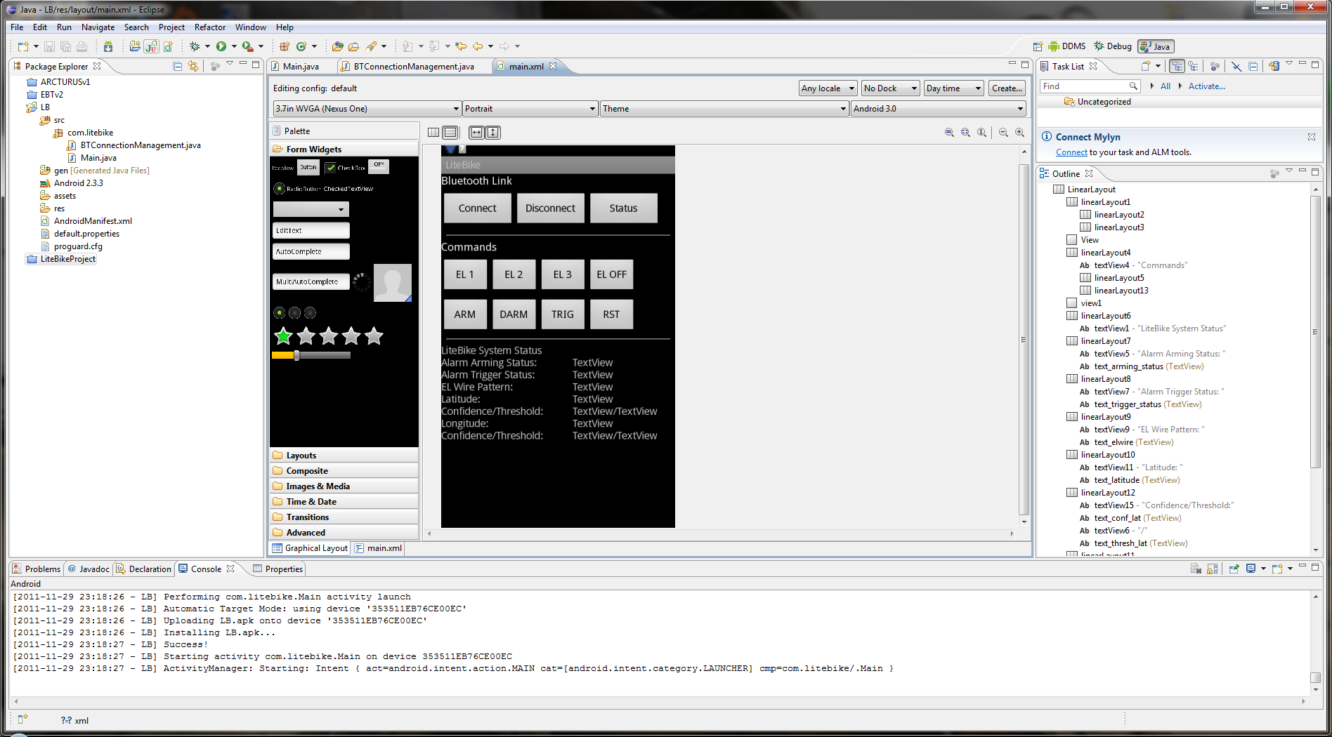
Development Environment – Mobile App
Eclipse & Google Android Development Kit

Slide 45




Prototyping – Electronics Bay
Solderless Breadboard
Breadboard
PCB Design
Printed Circuit Board

Slide 46




Taillight
LED Matrix
Breadboard
Finished Taillight
Taillight Segment

Slide 47




Turn Signal / Headlight
Front Turn Signal
Headlight
Turn Signal Switch
Headlight Switch

Slide 48




Prototyping – Battery Charger
Attempt 1
Attempt 2
Attempt 3
Success!

Slide 49



Mobile Application
Early Development
Main module
Map Module
Lighting Effects Module
Final Product
Main module
Map Module
Lighting Effects Module

Slide 50
Testing

Slide 51




Turn Signal / Headlight
Brake Light
Rear Turn Signal
Front Turn Signal
Headlight

Slide 52
Testing – Mobile Wireless Link
Bluetooth Link Range
Specification: wireless link should have a range of at least 30 feet
Testing Procedure:
Initiate Mobile Application connection to LiteBike
Verify that commands are received (ARMING/DISARMING)
Move away 10 feet and repeat Step 2
Repeat Step 3 for increasing increments until commands no longer work

Slide 53
Testing – Security System
User Authentication System
Component Purpose: toggle security system
state between armed and disarmed.
Testing Procedure:
Power on PCB
Verify “SAFE” LED is on (indicating LiteBike is disarmed)
Present RFID Tag to reader
Verify that “SAFE” LED turns off, and “ARMED” LED turns on
Again, present RFID Tag to reader
Verify that “ARMED” LED turns off, and “SAFE” LED turns on

Slide 54

Testing – Security System
Tampering Detection System
Component Purpose: detect if the tripwire has been severed or removed when the LiteBike is in the “ARMED” state.
Testing Procedure:
Verify the LiteBike is in the “SAFE” state (visual inspection of LED)
‘Trigger’ the tripwire by disconnecting it
Verify that the alarm is not triggered (visual inspection of LED)
ARM the LiteBike (using the RFID User Authentication System)
Verify the LiteBike is in the “ARMED” state (visual inspection of LED)
‘Trigger’ the tripwire by disconnecting it
Verify that the alarm is triggered (visual inspection of LED)

Slide 55
Testing – Security System
Theft Detection System
Component Purpose: detect if the LiteBike has been moved from its “LOCKED POSITON” while in the “ARMED” state.
Testing Procedure:
ARM the LiteBike (using the RFID User Authentication System)
Verify that the Theft Detection System has obtained calibration (visual inspection of the blinking ARMED LED)
Move the LiteBike 30 feet
Verify that the alarm is triggered (visual inspection of LED)

Slide 56
Testing – Security System
Recovery Assistance System
Component Purpose: send user SMS messages with GPS coordinates of the LiteBike
Testing Procedure:
ARM the LiteBike (using the RFID User Authentication System)
‘Trigger’ the alarm using both methods (Tripwire & Theft)
Verify that SMS message is received with GPS coordinates

Slide 57
Mobile Application Testing
Testing Outline
GPS
(speed, latitude,
longitude, compass)
Bluetooth
(lighting effects,
security system)
Route
(tracking, plotting,
saving, editing)
Overall System

Slide 58
Testing – Power System
Verified voltages and current produced by current were accurate
Battery charging
Tested circuit in lab with DC power supply
Tested circuit with generator power supply
Extrapolated data to verify target charging time was attained

Slide 59
Administrative Content

Slide 60
Work Distribution
Name | Power | Security | Mobile Application | Lighting
Cristovian | X
Andrew |  |  | X
Rebecca |  |  |  | X
Javier |  | X

Slide 61
Budget
Item | Supplier | Price/Unit | # Units | Total Cost | Item | Supplier | Price/Unit | # Units | Total Cost
Power Generation |  |  |  |  | Security System
Bottle Generator | Amazon | $16.95 | 1 | $16.95 | RFID Serial Module | Parallax | $39.99 | 1 | $39.99
Schottky Diodes | DigiKey | $0.51 | 6 | $3.06 | RFID Tag | Parallax | $0.99 | 1 | $0.99
LTC1921-Power Sensor | DigiKey | $5.00 | 1 | $5.00 | GPS Receiver | Parallax | $59.99 | 1 | $59.99
LM 317-Regulator | DigiKey | $1.06 | 6 | $6.36 | Bluetooth Module | Parallax | $69.99 | 1 | $69.99
LTC4007-Battery Charger | DigiKey | $7.63 | 1 | $7.63 | GSM Module | SparkFun | $99.99 | 1 | $99.99
MAX921-Comparator | DigiKey | $5.00 | 1 | $5.00 | Propeller Microcontroller | Parallax | $7.99 | 2 | $15.98
ADS7953-A/D Converter | DigiKey | $11.93 | 1 | $11.93 | Propeller DIP Kit | Parallax | $24.99 | 1 | $24.99
12 V Li-Ion Battery | BatteryWorld | $50.00 | 2 | $100.00 | Other
Lighting System |  |  |  |  | Bicycle | Wal-Mart | $150.00 | 1 | $150.00
8 x 8 LED Matrix | Futurelec | $3.90 | 6 | $23.40 | Rack | Wal-Mart | $30.00 | 1 | $30.00
EL Wire | Coolight | $1.40 | 72 | $100.80 | Wire | Skycraft | $0.09 | 20 | $1.80
Zip ties | SkyCraft | $12.50 | 1 | $12.50 | PCB Manufacturing | 4PCB | $50.00 | 3 | $150.00
Inverter | Coolight | $18.52 | 1 | $18.52 | Resistor Pack |  | $5.00 | 1 | $5.00
Tri-State Buffers | DigiKey | $0.52 | 10 | $5.20 | Capacitor Pack |  | $10.00 | 1 | $10.00
Headlight | Target | $15.99 | 1 | $15.99 | Acrylic Enclosure |  | $30.00 | 1 | $30.00
LEDs | SparkFun | $19.95 | 1 | $19.95 | Shipping |  | $100.00 | 1 | $100.00
Rocker Switches | SkyCraft | $3.50 | 5 | $17.50
Reed Switches | DigiKey | $0.44 | 5 | $2.20
Magnets | SkyCraft | $0.50 | 5 | $2.50 | Total |  | $1,163.21
Total: 1,163.21

Slide 62
Questions?

