Slide 1
Small Projector Array System
Group #7
Nicholas Futch
Ryan Gallo
Chris Rowe
Gilbert Duverglas Sponsor: Q4 Services LLC

Slide 2
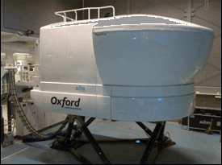
Project Motivation
Problems:
High cost of current projector systems
Degradation of image quality due to image warping
Time loss due to image correcting
Maintenance cost and time associated with lamp based projectors

Slide 3
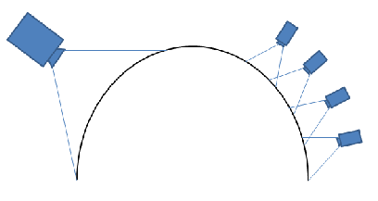
Our Solution
Implement an array of low cost pico projectors
Lowers degradation of image due to the curvature of the screen
Internal image warping to save time on installs
LED projectors with extremely high life cycles

Slide 4
Specifications
Low cost solution
Easy implementation with existing simulators
Longer MTBF (Mean Time Between Failure)
Lower amount of pixel loss due to image warping

Slide 5
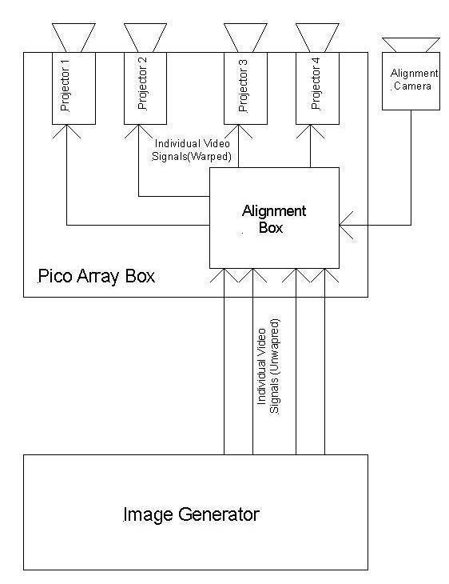
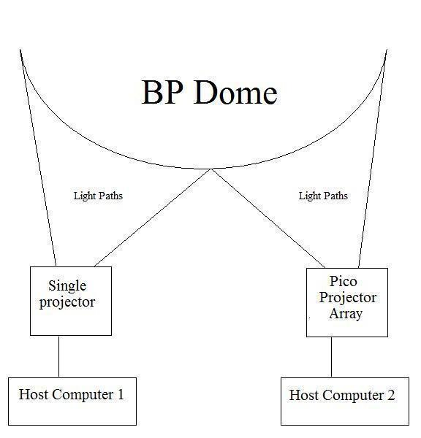
System Block Diagrams

Slide 6

Graphics Cards
AMD (formerly known as ATI)
NVidia
Proprietary Crossfire Technology
Significantly better multi-monitor Support
Currently supports projector overlap
Warping and edge blending support soon
Proprietary SLI Technology
Slightly better overall Graphics

Slide 7
Projector Box Control System
Microcontroller system
Low power
Must accept RS-232 data from host computer
Must accept TTL data from the light sensor array
Digital outputs for control of various other parts

Slide 8
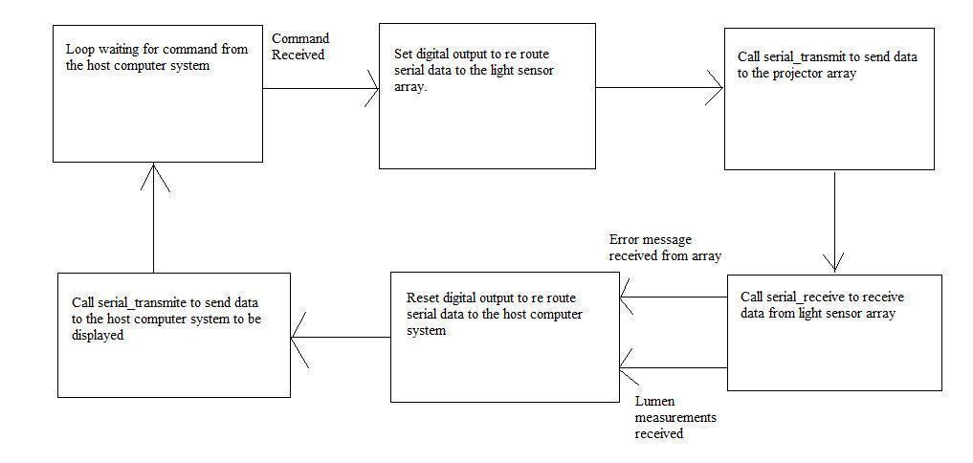
Program Flow Chart

Slide 9
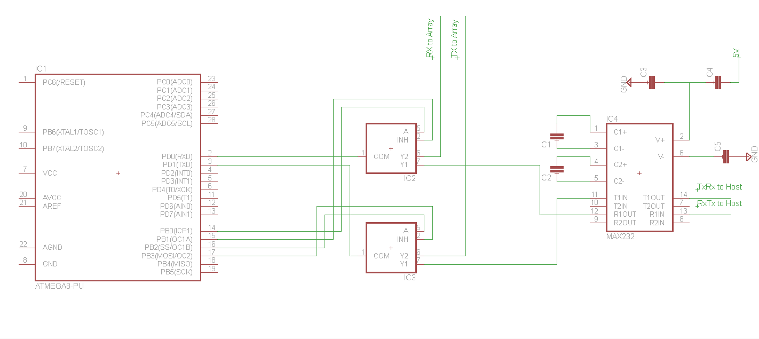
Schematic
Atmega 328 microcontroller
MAX232 chip for TTL to RS-232 signal conversion
Two 2 to 1 Multiplexors to route Serial data to either the light sensor or the host computer system

Slide 10
Light Sensor Array Control System
Must accept TTL data from projector box
Must accept Analog signals from light sensor array

Slide 11
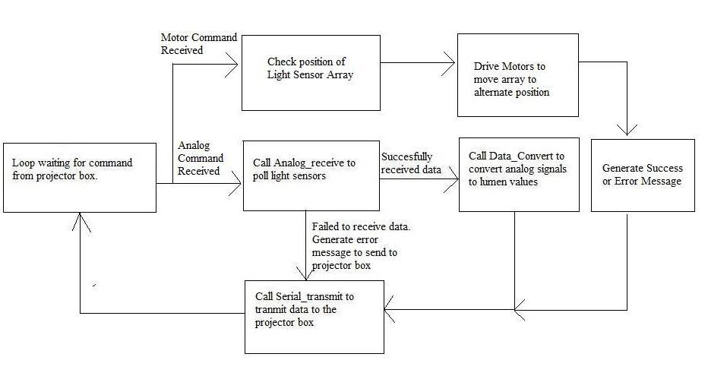
Program Flow Chart

Slide 12
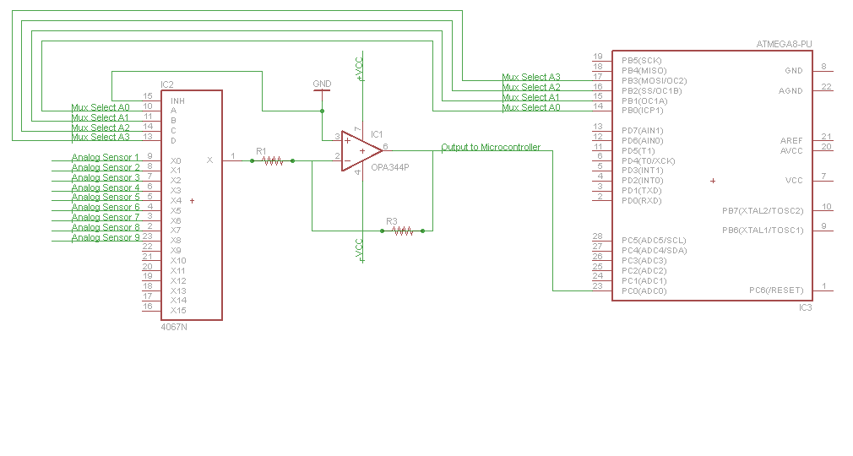
Schematic
Atmega 328 Microcontroller
16 to 1 Multiplexor to switch between analog outputs
Low pass filter for filtration of light sensor signals

Slide 13
Human Interface Specifications
Easy to use user interface
Ability to send data up to 50 feet
Independent interface for the light sensor array
Low power consumption
Cross-platform

Slide 14
Projectors Specifications
Requirements
Solutions
Low Cost
High Pixel Count
LED
Low Power
High MTBF
High Brightness and Contrast
Low Noise
Variable Focus Control
Pico Projectors
1280 x 800 Resolution
DLP LED
< 120 watts
20,000+ lamp liftime

Slide 15
Pico Projector Comparison
Projector | Contrast | Focus Control | Brightness | Noise | Overall Image
Acer K11 | 6.5 | 8 | 7 | 4 | 6
Acer K130 | 9 | 6 | 6 | 7 | 7
Acer K330 | 8 | 8 | 10 | 7 | 8
ViewSonic PLED | 4 | 8 | 5 | 3 | 4
Vivitek Qumi Q2 | 8 | 3 | 7 | 7 | 7.5

Slide 16
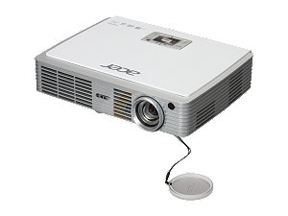
Acer K330
Device Type | DLP
Native Resolution | WGXA(1280x800)
Maximum Resolution | 1600x1200
Projector Distance | 35.43 in – 9.83 ft
Throw Ratio | .85
Display Size | 30 in – 8.33 ft
ANSI Lumens | 500
Contrast | 4000:1
Lamp | LED
Aspect Ratio | Native: 16:10 Supported: 16:9, 4:3
Power supply | 100-240V AC 50/60 Hz
Power Consumption | 120w
Video Inputs | D-Sub, HDMI, Composite
Dimensions | 8.6 x 6.6 x 1.8 in
Weight | 2.73 lbs

Slide 17
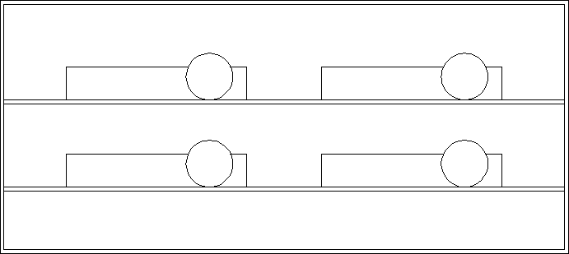
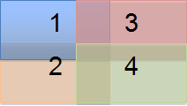
Projector Orientation and Overlap
The 4 projector layout with an aspect ratio of 1:1
Resolution of 2600 x 1600 for a total of over 4.5M pixels
Almost identical to the latest WQXGA format at a fraction of the cost.
Will make the most use out of the usable area of the screen.

Slide 18
Analog Light Sensor
Used to get measurements from the single projector and the projector array for comparison.
Readings will be read by microcontroller and displayed on a GUI on the host computer

Slide 19
Light Sensor Specifications
PCB form factor no greater than 1in^2
Low power consumption (less than .5 mW)
Max input voltage @ 5V (provided by microcontroller)
Analog output less than 5V
Range of illuminance between 0 and 100k lx
Maximum photosensitivity @ 550nm to mimic human eye

Slide 20
SFH 5711 by Osram
Opto hybrid (photodiode with an integrated circuit)
Mimics the human eye almost exactly
Very low power consumption
Logarithmic current output (High accuracy over wide illumination range)
Surface mount

Slide 21
SFH 5711 Specifications
Parameter | Symbol | Value |  |  | Unit
 |  | Minimum | Typical | Maximum
Supply Voltage | V_{CC} | 2.5 |  | 5.5 | V
Illuminance T_{A}= -30ºC to 70ºC T_{A}= -40ºC to 100ºC | E_{V} |  | 3 to 80k |  | lx
 |  |  | 10 to 80k
Spectral Range Sensitivity | λ_{10%} | 475 |  | 650 | nm
Wavelength of Max Photosensitivity | λ_{s max} | 540 | 555 | 570 | nm
Output Current @ E_{V}= 1000 lx | I_{out} | 27 |  | 32 | μA
Current Consumption V_{CC}= 2.5 V V_{CC}= 5.0 V @ E_{V}= 0 lx | I_{CC} |  | 410 | 500 | μA
 |  |  | 420
Current Consumption V_{CC}= 2.5 V V_{CC}= 5.0 V @ E_{V}= 1000 lx | I_{CC} |  | 460 | 550 | μA
 |  |  | 470

Slide 22
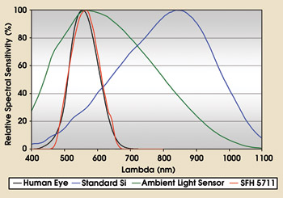
SFH 5711 vs. Human eye

Slide 23
SFH 5711 vs. Human eye cont.

Slide 24
Light Sensor Circuit Diagrams
Illuminance: 0 - 10k lx
Output voltage: 0 - 3V

Slide 25
Maximum detectable light level

Slide 26
Light Sensor Array
Find a way to arrange light sensor in an array setup in front of projector screen
Must be easily stable, lightweight, and easily portable
Wires must not be obstructed so communication with projector box can happen
Solution: use a PVC pipe structures as array to house light sensors

Slide 27
ANSI Lumens Test
Describes the standard method for testing the brightness of projectors.
Method involves measuring brightness of a projector screen at 9 specific points using light sensors and finding average value between these points.

Slide 28
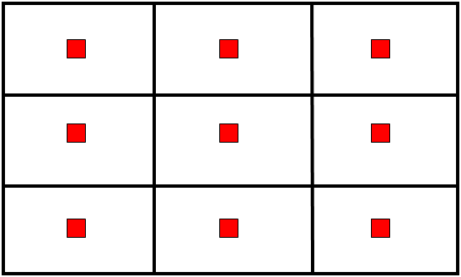
ANSI Lumens Test

Slide 29
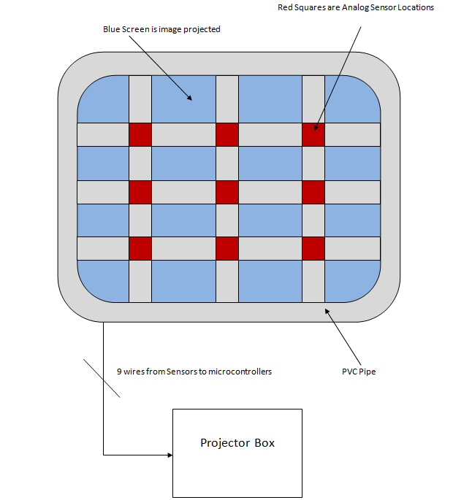
Light Sensor Array

Slide 30
Light Sensor Array Testing
Warped image will be projected onto BP dome screen.
PVC light sensor array will be placed in front of screen facing projector box.
The wires coming from the array will be connected to the microcontroller in the projector box.
Lumens rating will be displayed on computer host system from each sensor and total lumens will also be displayed.

Slide 31
Light Sensor Array Considerations
Make array 3 x 6 instead of 3 x 3 so that array can cover and measure whole BP screen at once without physically moving array.
Automated light sensor array

Slide 32
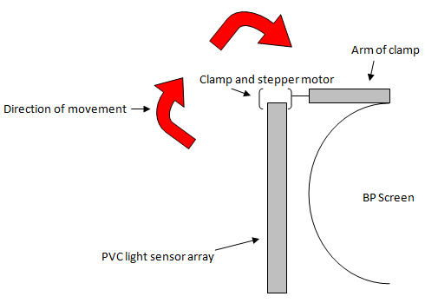
Automated Light Sensor Array
Automatically move the PVC light sensor on top of BP projector screen
Use of stepper motor and gears to apply rotational movement of array
Clamp will be used to hold the array
Array will be moved manually side to side to compare both projector systems

Slide 33
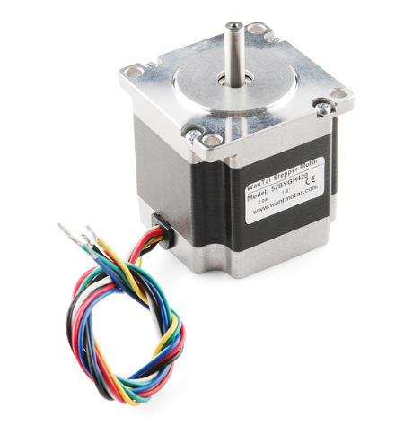
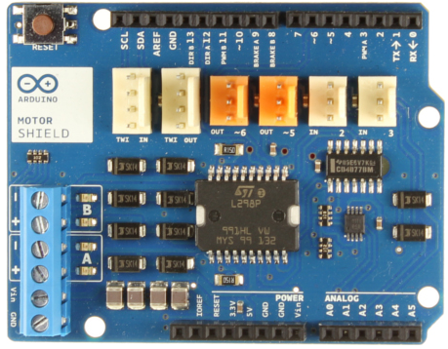
Motor and Motor Drive
Unipolar Stepper Motor
Operates at 4V at 1.2A per channel
Torque 27 lb/ft
Arduino Motor Shield
Capable of driving one stepper
Operates at 5-12V, 2A per channel 4A total
Allows easy control for motor direction and speed

Slide 34
Power System
Requirements:
Capable of powering following devices
4 Pico Projectors (120 VAC)
2 Microcontrollers (3.3 – 5 VDC)
1 Servo Motor (4 VDC @ 2.4 A)
Host Computer System (120 VAC)
Power system should be capable of providing power to all these components from a single point or “power box” and only receiving the standard main power signal from a traditional wall outlet

Slide 35
Power System
Specifications
Input: Should be able to take incoming power signal from any outlet (100-240 VAC 50/60 Hz)
Output: Independent from incoming signal, will output regulated 3.3 – 5 VDC signal to microcontrollers and 4 VDC signal to servo motor, as well as remaining circuit components
Size: will be housed within the “power box” enclosure

Slide 36
Power System
Design Options:
4 options considered that all met our power system design requirements.
Design | Efficiency | Design Difficulty | Cost | Electronic Noise
Linear Power Supply | ~ 58 – 70% | Moderate | ~ $20-30 | Low
Switched Mode Power Supply | ~ 79 – 90% | High | ~ $60-75 | High
Step Down DC to DC Converter | ~ 70 – 78% | Moderate | ~ $35 | Low
AC to DC Converter | ~ 74 – 85% | Low | ~ $15-30 | Low

Slide 37
Power System
Power Flow Diagram

Slide 38
Power System
Power Flow Diagram for components that require DC Power

Slide 39
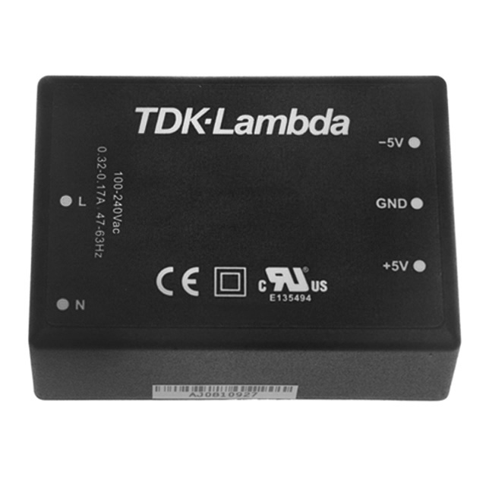
Power System
KMS40-12 AC to DC Converter:
Input: 90-264 VAC
Output: 12 VDC
Current: 3.33 A
Power: 40 W
Type: Switching (Closed Frame)
Efficiency: 83%
Through Hole Board Mount
Load Regulation: ± 1%

Slide 40
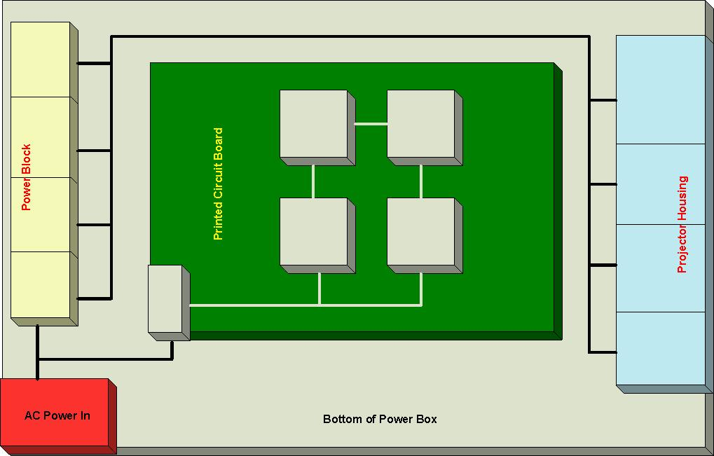
Power System

Slide 41
Distribution of Work
 | Programming | Control System Schematics | Sensor Array Mechanics | Sensor Array Schematics | Power | Projector Array
Nick | 85% | 40% | 10% | 10% | 5% | 25%
Chris | 5% | 10% | 10% | 70% | 5% | 25%
Ryan | 5% | 40% | 10% | 10% | 85% | 25%
Gilbert | 5% | 10% | 70% | 10% | 5% | 25%

Slide 42
Budget
Part | Price per Unit | Quantity | Total
Projectors | $549 | 4 | $2169
Host Computer | $1399 | 1 | $1399
Graphics Card | $550 | 1 | $550
Warping Software | $191.95 (per channel) | 4 | $767.80
PCB parts | $450 | 1 | $450
Box PCB | $100 | 1 | $100
Sensor Array PCB | $75 | 1 | $75
Sensor PCB | $30 | 9 | $270
TOTAL |  |  | $5780.80

Slide 43
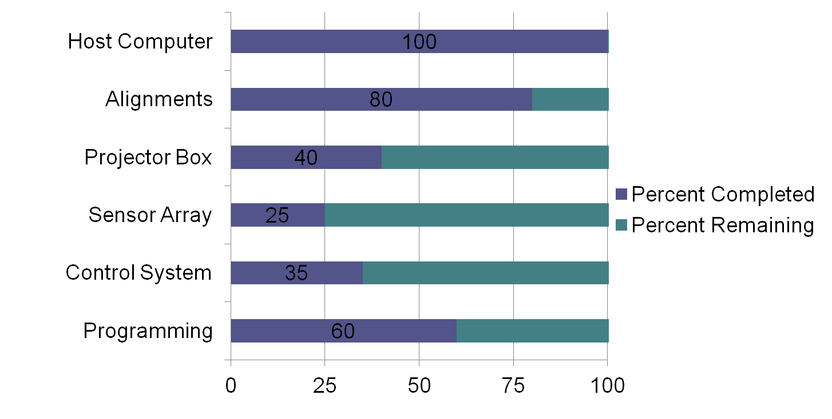
Project Accomplishments to Date

Slide 44
Potential Issues
Alignment of Projectors
Single Stepper Motor torque
Sensitivity of Light Sensors
Overall Projected Image

