Slide 1
Surveillance Bot
Group 9
Charlie Grubbs
Daniel Lanzone
Mike Roosa
Ryan Tochtermann

Slide 2
Overview
Goals
Motivation
To create a scalable all-terrain remote surveillance system with stabilization platform
Audio detection capable of monitoring stereo sound levels
Real-time video link
Intuitive user-interface
Robotics
Systems Integration
Scalability

Slide 3
Objectives
Vehicle can operate at a minimum of 4 MPH for at least 30 minutes
Camera stabilization platform capable of correction at a rate of 50 Hz
  Pitch and roll correction of 45 deg. and a minimum of 60 deg/s correction rate
Stereo audio detection up to 10kHz
Wireless communication of at least 100 yards outdoors
Control via PC based GUI

Slide 4
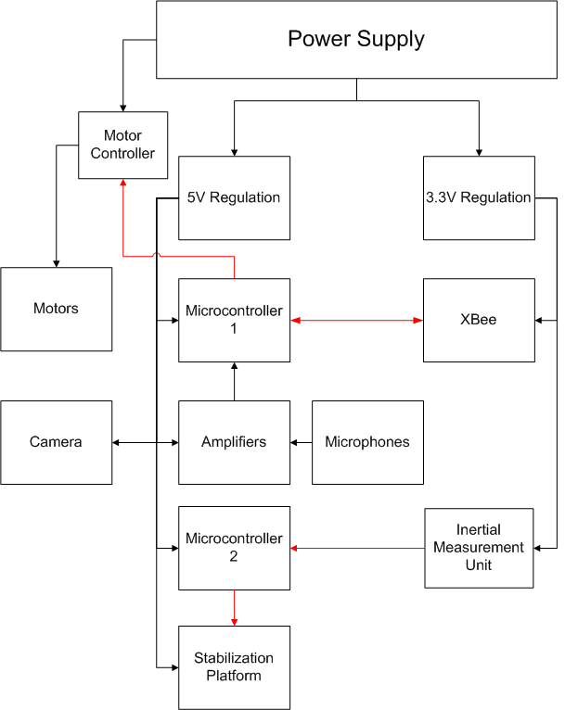

Slide 5
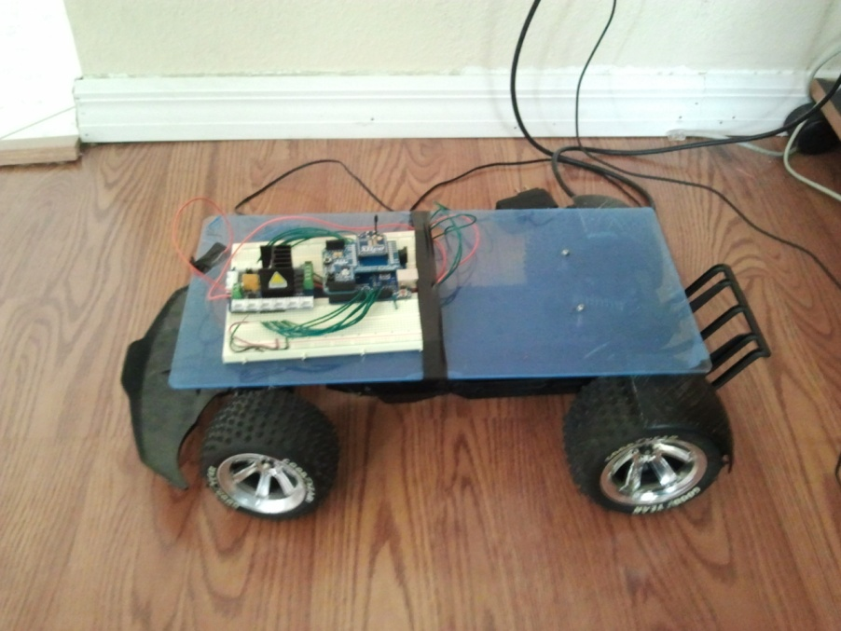
Vehicle Chassis Overview
Capable of moving over semi-rugged terrain (unlevel, rocky, grassy)
Capable of overcoming ramped obstacles (< 35˚)
Moderate suspension for Z-axis stabilization
4 mph
Low profile for stability

Slide 6
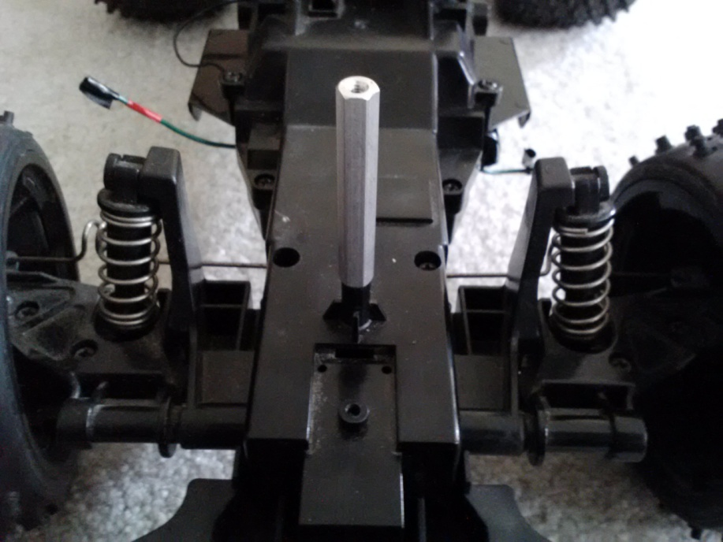
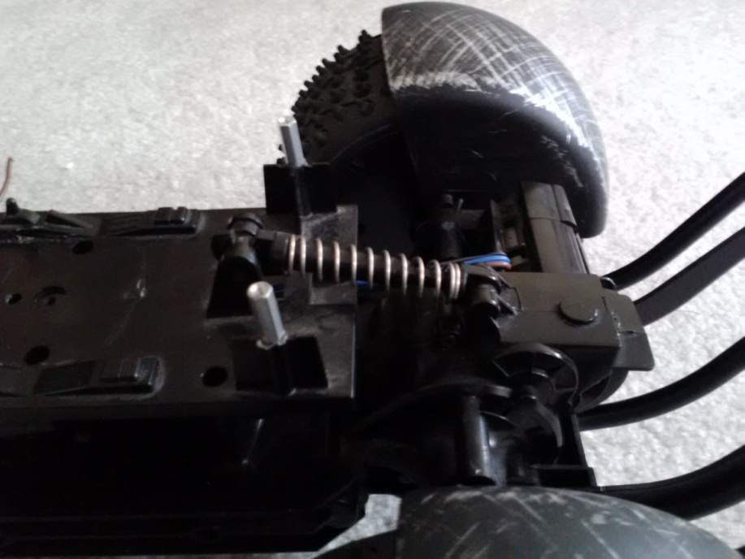
Vehicle Chassis : Suspension
Two passive shock absorbers on each front wheel
One passive shock absorber for rear axis

Slide 7
Vehicle Chassis: Motors
Steering Motor
50 RPM
12 VDC rating
High torque gear box
Built-in potentiometer for position sensing
Drive Motor
2500 RPM
12 VDC rating
Direct drive

Slide 8
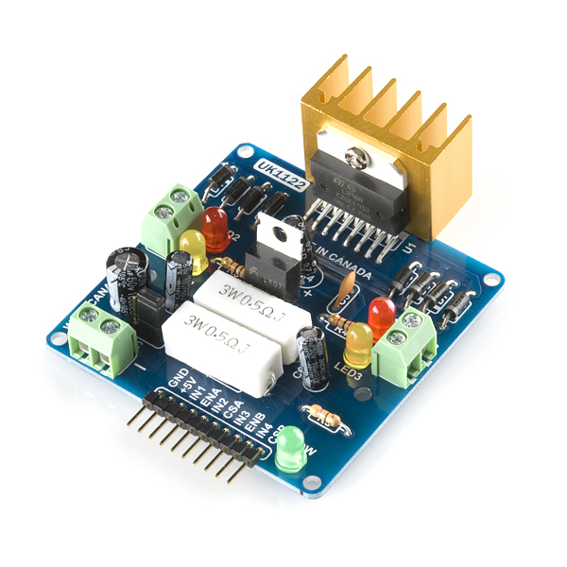
Vehicle Chassis: Motor Controller
Two bidirectional motor ports
Driver: L298 Dual H-Bridge IC
Control: 3 digital pins per motor: 1 for enable, and 2 for motor direction
6- 35 VDC Regulation
Up to 2A Output

Slide 9
Stabilization Platform

Slide 10
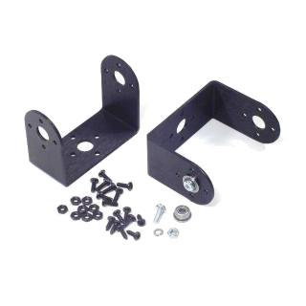
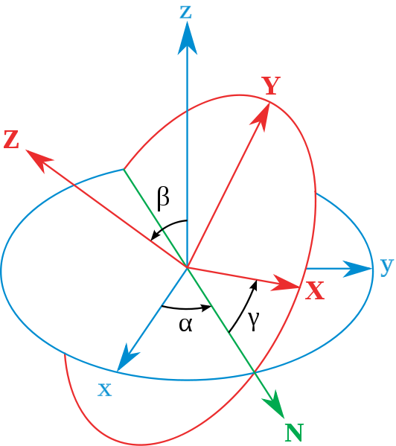
Stabilization Requirements
Will provide pitch and roll stabilization for the mounted equipment (i.e. camera)
Correction rate of 50 Hz
10 W peak power consumption (pitch and roll servos)
Platform does not change the CG significantly

Slide 11
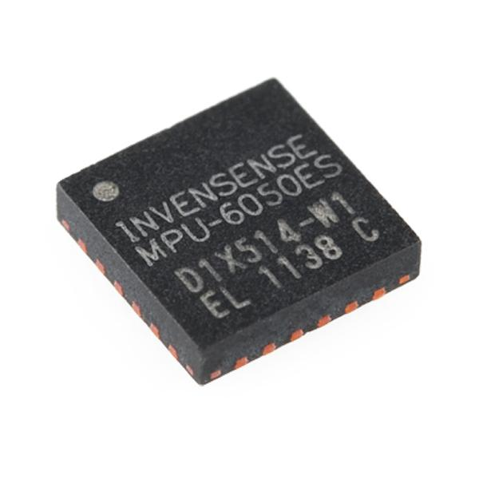
Inertial Measurement Unit (IMU)
Sensitivity ±250, ±500, ±1000, and ±2000dps
Small form-factor (4x4x0.9mm QFN)
Low power consumption
Low drift

Slide 12
Sensor Decision Matrix
Part Number | Axes | Type | Size | Price
ITG-3200 | 3 | Gyroscope | Small | $24.95
ITG-3200 BO | 3 | Gyroscope | Large | $49.95
MPU-6050 | 3 | Accelerometer/Gyroscope | Large | $39.95
9DOF Razor | 3 | Accelerometer/Gyroscope/ Magnetometer | Large | $124.95
IDG1215 | 2 | Gyroscope | Small | $24.50

Slide 13
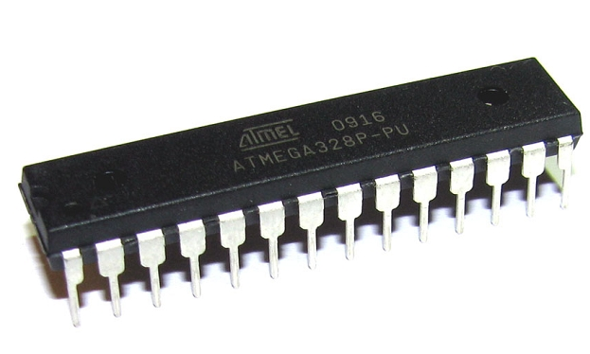
Microcontroller Decision
Model | Input Voltage | I/O Pins | Frequency | CPU | Flash
ATmega2560 | 1.8-5.5V | 86 | 16MHz (Max) | 8-bits | 256KB
ATmega16U2 | 2.7-5.5V | 22 | 16MHZ (Max) | 8-bits | 16KB
ATmega328 | 1.8-5.5V | 23 | 20MHZ (Max) | 8-bits | 32KB

Slide 14
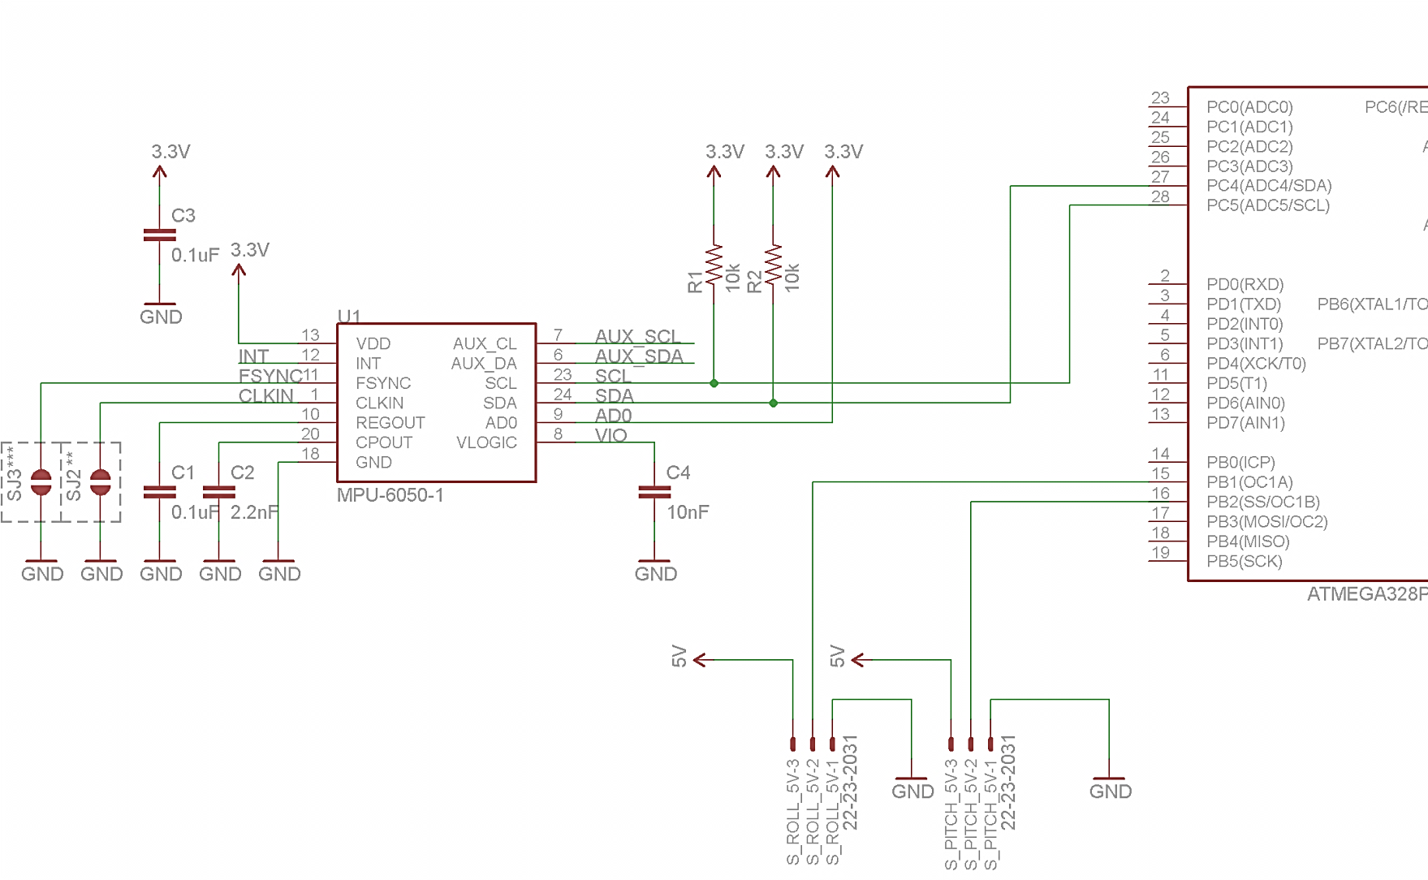

Slide 15
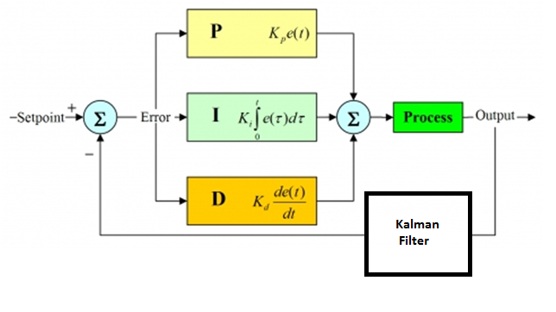
Stabilization Software
Controlled by ATMega328
Microcontroller will be used to implement the PID and Kalman filter algorithms
Kalman filter will be used as sensor fusion between accelerometer and gyroscope

Slide 16
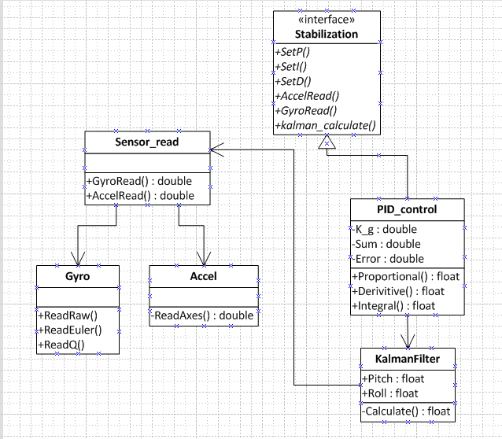
Stabilization software

Slide 17
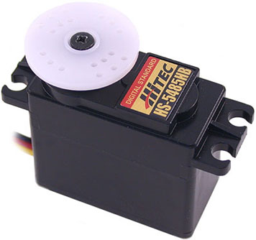
Hitec HS-5485 Servo motors
Controls:
  Pitch
  Roll
3.3 V to 6 V
60 deg in .18 seconds (no load)
Mass: 59.82g
Dimensions: 40.39mm x 19.56mm x 37.59mm
180 degree resolution

Slide 18
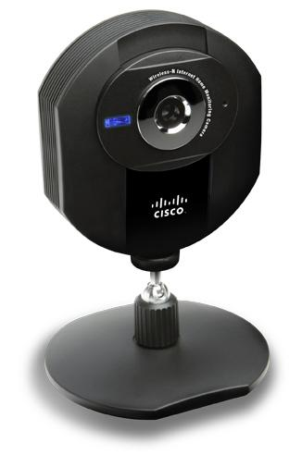
Wireless camera
Camera requirements
Cisco-Linksys Wireless-N
320x240 resolution
IP camera
15 FPS
640x480 max resolution
MJPEG stream
Microphone
30 FPS
5V Barrel-jack input

Slide 19
Camera Testing
Camera tested at a peak bandwidth 1.2 Mbps with highest image quality setting and 30 FPS
Configured as an Ad-hoc network, the latency was reduced significantly

Slide 20
Audio Detection System

Slide 21
Overview
Stereo detection
  Two microphones shock mounted to chassis, facing east and west
Two stage signal amplification chain
DSP on ATmega328
Wireless communication via Xbee
User alerted via the GUI

Slide 22
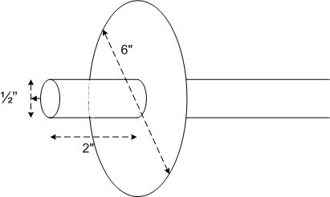
Microphone Specs
Logitech desktop microphone
Generates peak of ~1.5mV
Modifications
Shielding

Slide 23
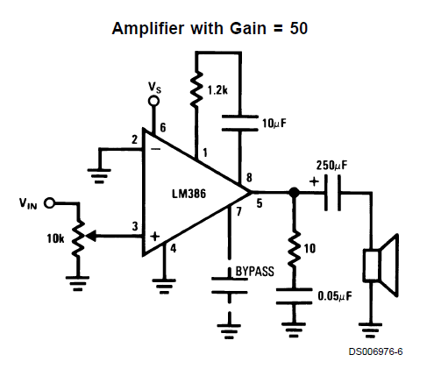
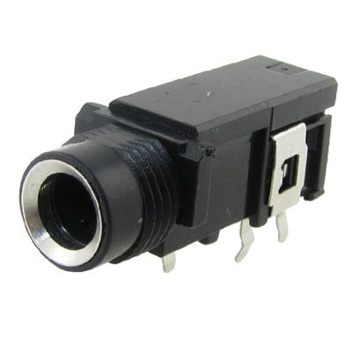
Analog Onboard Audio Signal Processing
Microphone connection to PCB
Amplifier LM386
Two gain stages
  Gain of 2500
  Small signal

Slide 24
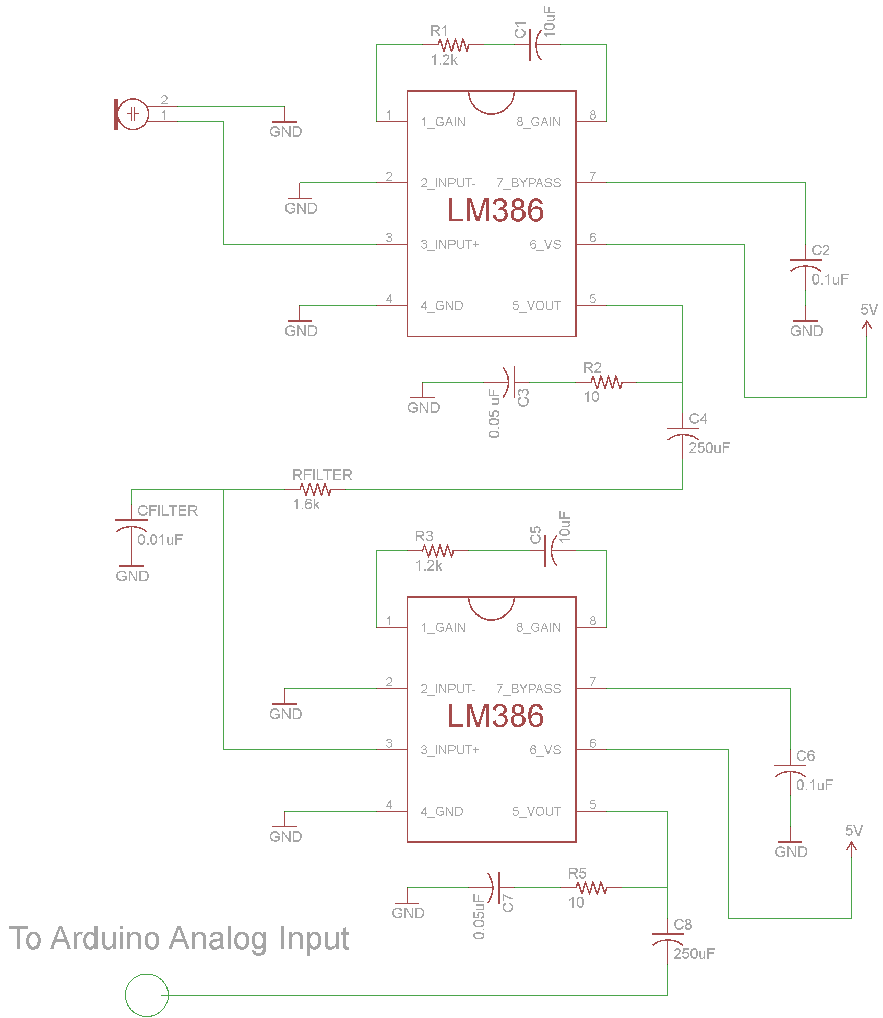

Slide 27
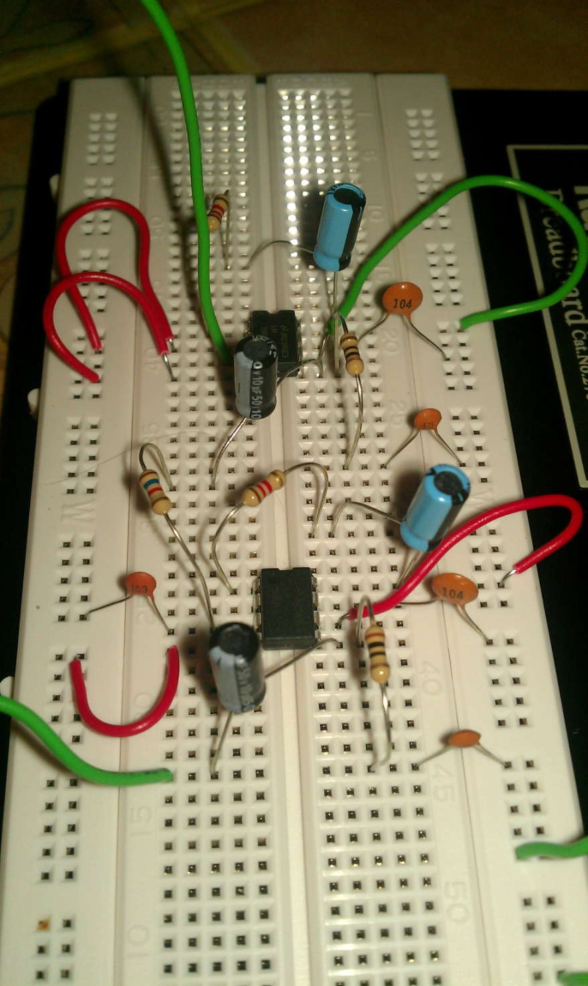

Slide 28
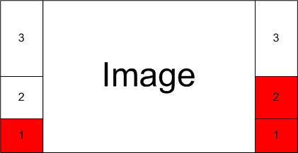
GUI
Visual Design

Slide 29
Sound Level / Notification Correspondence
Decibel Level Examples Table
SPL | Example | Notification Level
0 dB | Threshold of Human Hearing | 0
10 dB | Rustling of Leaves | 0
20 dB | Human whisper | 0
40 dB | Ambient Noise in a Library | 0
50 dB | Quiet Human Conversation | 1
60 dB | Normal Human Conversation | 2
70 dB | Busy Street Traffic | 3
80 dB | Vacuum Cleaner | 3
100 dB | Large Orchestra | 3

Slide 30
SPL Input / Output Voltage Correspondence
SPL Input (dB ) | Voltage Output (mV) | Voltage Output (dBV) | Gain Adjusted Voltage Output (V)
0 | ~ 0 | 100 (Noise Floor) | 0
10 | ~ 0 | -100 | 0
20 | ~ 0 | -100 | 0
30 | ~ 0 | -100 | 0
40 | 0.04 | -90 | 0.106
50 | 0.14 | -80 | 0.353
60 | 0.42 | -70 | 1.061
70 | 1.41 (Max Sensitivity) | -60 | 3.535
80 | 1.41 | -60 | 3.535

Slide 31
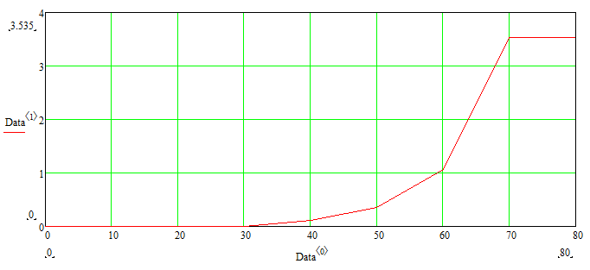
SPL Input / Output Voltage Correspondence
Gain
Adj.
Voltage
(V)
SPL Input (dB)

Slide 32
Sound Level / Notification Correspondence
0V to 0.353V
Gain
Adj.
Voltage
(V)
Level 0
SPL Input (dB)

Slide 33
Sound Level / Notification Correspondence
0.353V to 1.061V
Gain
Adj.
Voltage
(V)
Level 1
SPL Input (dB)

Slide 34
Sound Level / Notification Correspondence
1.061V to 3.535V
Gain
Adj.
Voltage
(V)
Level 2
SPL Input (dB)

Slide 35
Sound Level / Notification Correspondence
3.353V
Gain
Adj.
Voltage
(V)
Level 3
SPL Input (dB)

Slide 36
Microcontroller Interfacing
analogRead()
  Maps input voltages from 0 V to 5 V
  Will use full resolution of 4.8 mV (10 bit)
Software/Programming
  Loop that constantly checks input voltage from microphone
  Changes output based on notification level

Slide 37
Communication Systems

Slide 38

Communications System Overview
  Capable of reliable and accurate data transmission
  Relatively long range (100+ yards)
  Low power consumption
  Relatively simple setup and configuration
  Low cost

Slide 39
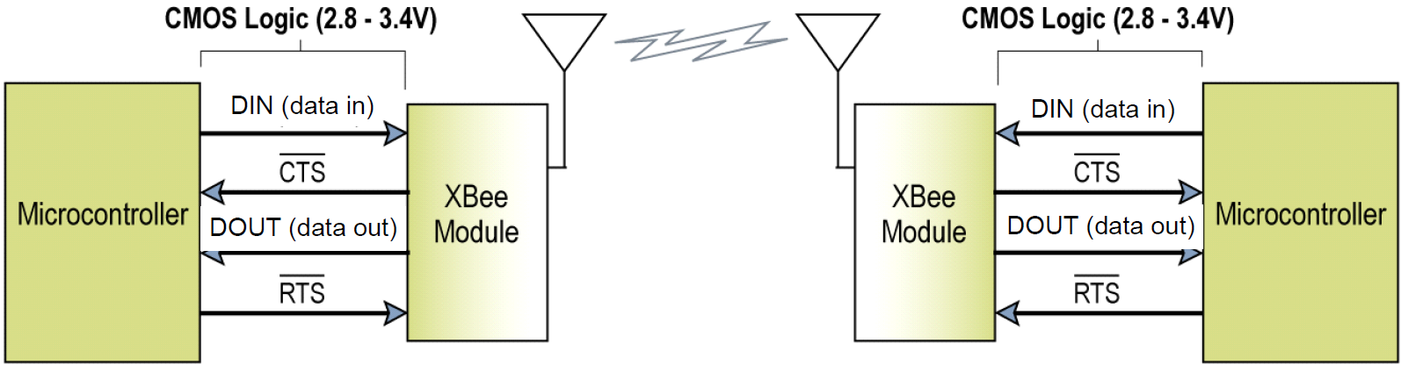
Communications System Overview
The goal is to create a network between the PC and the vehicle in order to send control and sensor data between them.
It will feature a PC-side and embedded-side system, each consisting of a wireless RF module and a regulated serial interface between the module and the PC or onboard microcontroller.

Slide 40
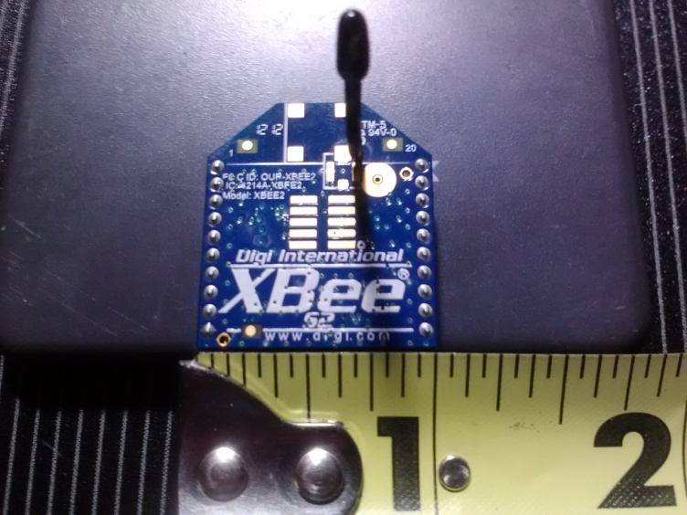
XBee Series 2 RF Modules
Key Features:
  3.3V @ 40mA operation
  Data rates up to 250 kb/s
  400 ft (133.33 yd) range
Pros:
  Long range
  Low power consumption
  Low cost
Cons:
  For Series 2 modules; difficult to configure for point-to-point communication
Xbee Series 2 Module – 2mW Antenna Model

Slide 41
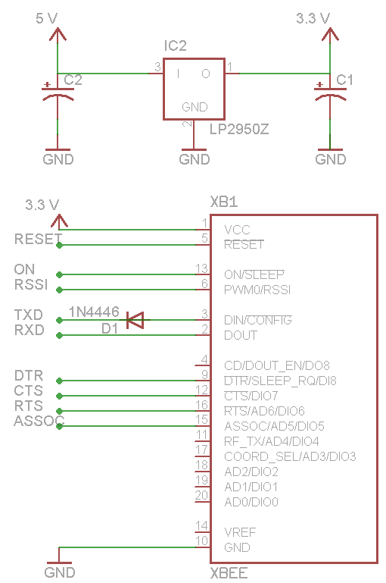
Embedded-Side Interfacing
Because the XBee operates at 3.3 V and the AtMega328 operates at 5 V, a voltage regulator is required for VCC input.
A level-shifting diode is also required on the Xbee’s Data In line to account for this voltage difference.
Other pins are connected to the microcontroller accordingly.

Slide 42
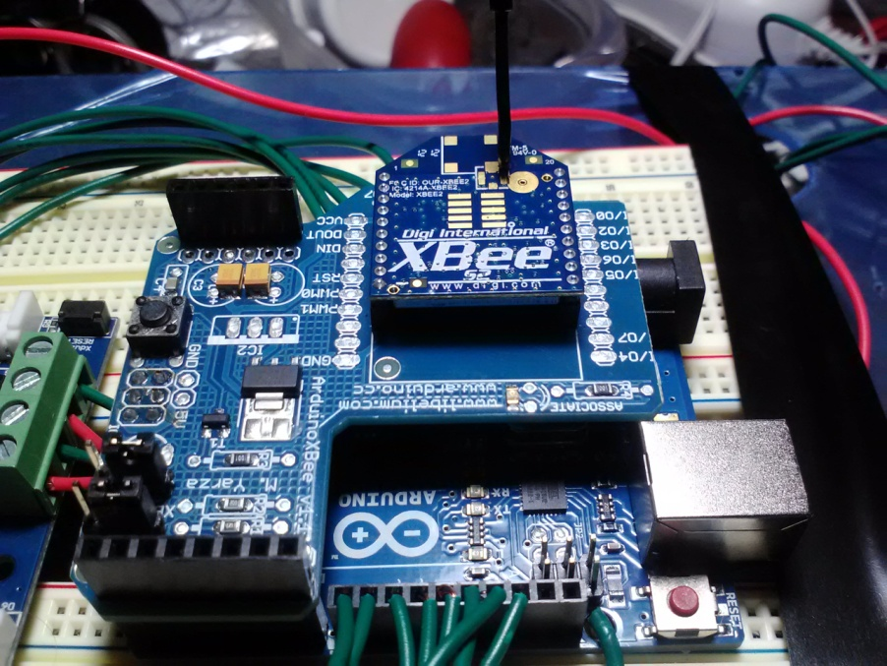
Embedded-Side Development
The Arduino XBee Shield is a simple interface between wireless module and microcontroller
Takes care of all voltage regulation, I/O connections, and status LEDs
Still allows access to all other Arduino pins
Development/Testing using Arduino’s XBee Shield

Slide 43
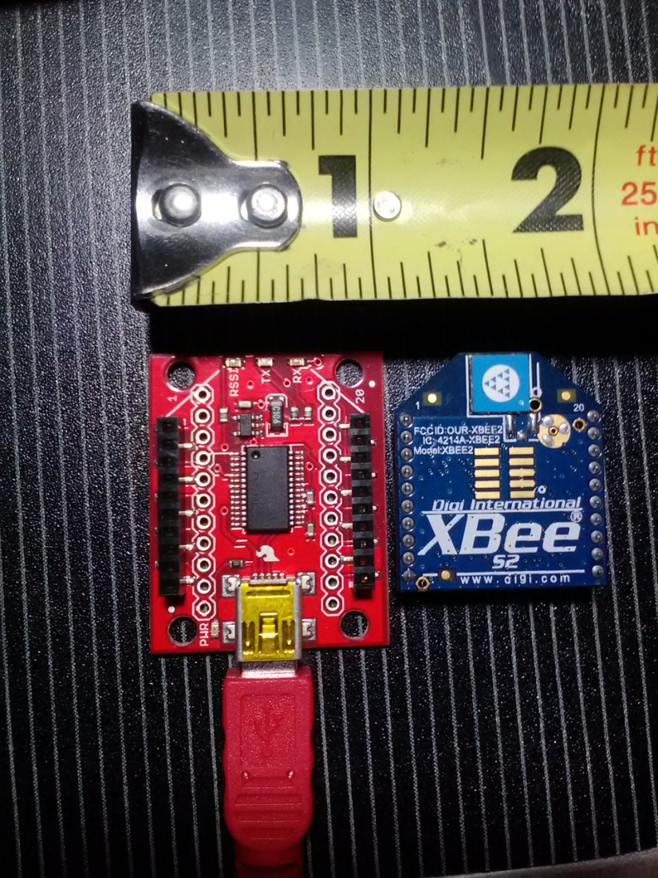
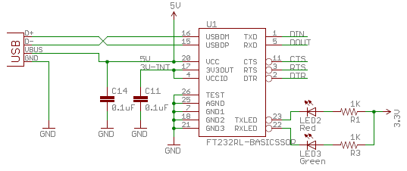
PC-Side Interfacing
An XBee Explorer USB will be used to connect the other XBee module to the PC.
The device uses an FT232RL USB to RS-232 serial UART to interface between the XBee and the PC.
Takes care of voltage regulation and I/O connections for easy development and testing.
RS-232 to USB connection via XBee Explorer

Slide 44
Successes and Difficulties
Successes:
Established a reliable wireless network.
Sent and received messages between microcontroller and PC
Wireless drive control of surveillance vehicle for over 100 yards.
Sensor data acquired for over 100 yards.
Difficulties:
Getting the Series 2 XBee modules to talk quickly and reliably.
  Solution: Module is configured to broadcast mode for mesh networks by default. Must be changed to have only one destination node every time it is powered up.

Slide 45
Control Software Overview
PC-Side Software
  Simple GUI for complete control and current status of surveillance vehicle
  Must receive sensor data and display it in a simple format
  Must transmit user control data quickly
Embedded-Side Software
  Must receive user control data and respond accordingly
  Must relay sensor data to PC-side software

Slide 46
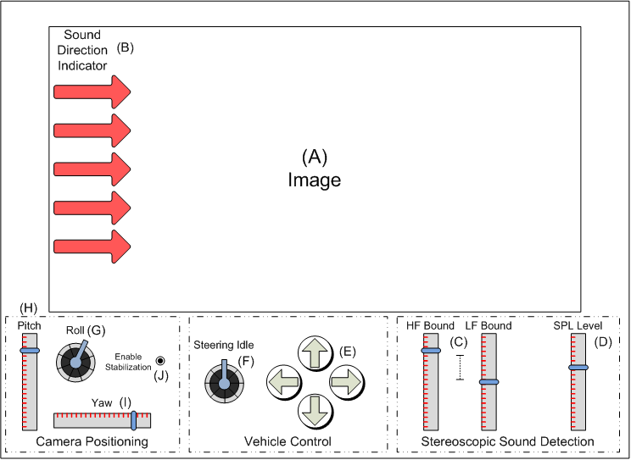
PC-Side Software: GUI
Features:
  Centered image of IP webcam feed
  Sound detection indicators on left and right side of image
  Vehicle drive controls
  Camera positioning controls
  Enable/disable stabilization option
Sketch of a desired GUI Layout

Slide 47
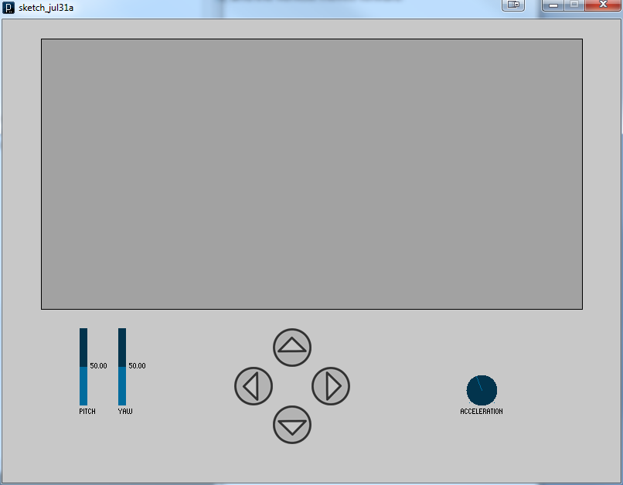
PC-Side Software: Processing IDE
High-compatibility with Arduino platform
Simple graphical user interface design
Useful libraries:
  Controlp5 library for GUI components
  Video library for webcam stream
  Serial library for communications
Sample GUI written in Processing

Slide 48
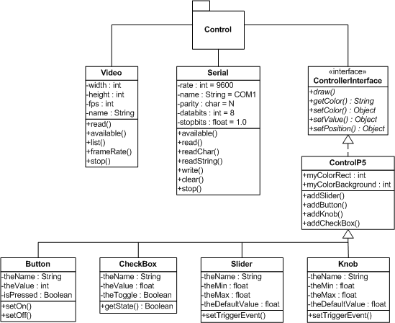
PC-Side Software: UML Diagram

Slide 49
Embedded-Side Software
Will be programmed in the Arduino IDE
Will utilize the Serial library for read/write communications
Will have the following functionality:
  Read input values and send control data to the motor controller
  Write sensor data to the PC-side software to be displayed on the GUI

Slide 50
Power System

Slide 51
Power Overview
Device | Voltage | Current Draw | Power | Quantity
ATmega328 | 5V | 9mA | 900mW | 2
MPU-6050 | 3.3V | 3.9mA | 12.87mW | 1
Servo Motors | 5V | 1A | 15W | 3
XBee | 3.3V | 40mA | 132mW
Amplifiers | 5V |  |  | 4
Camera | 5V | 1A | 5W | 1
Motor Controller | 11.1V | 2A /Channel | 22.2W /Channel | 1

Slide 52
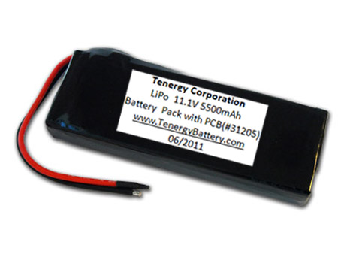
Power Supply
Tenergy 11.1V LIPO Battery Pack
5500mAh
148 x 52 x 23 mm
333 grams

Slide 53
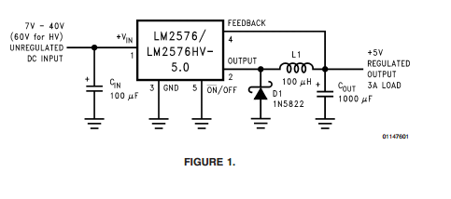
5V Voltage Regulation
LM2576
≥75% Efficiency
3A output
4V to 40V input range
5-pin through-hole

Slide 54
3.3V Voltage Regulation
LM109 Linear Regulator
TL2575 Buck Converter
Pros:
  Easy to use
  Small PCB footprint
  Additional components unnecessary
Cons:
  Heatsinking required
  Low efficiency
Pros:
  88% Efficiency
  Heatsinking not required
  Higher output current
Cons:
  Requires additional components
  Cost

Slide 55
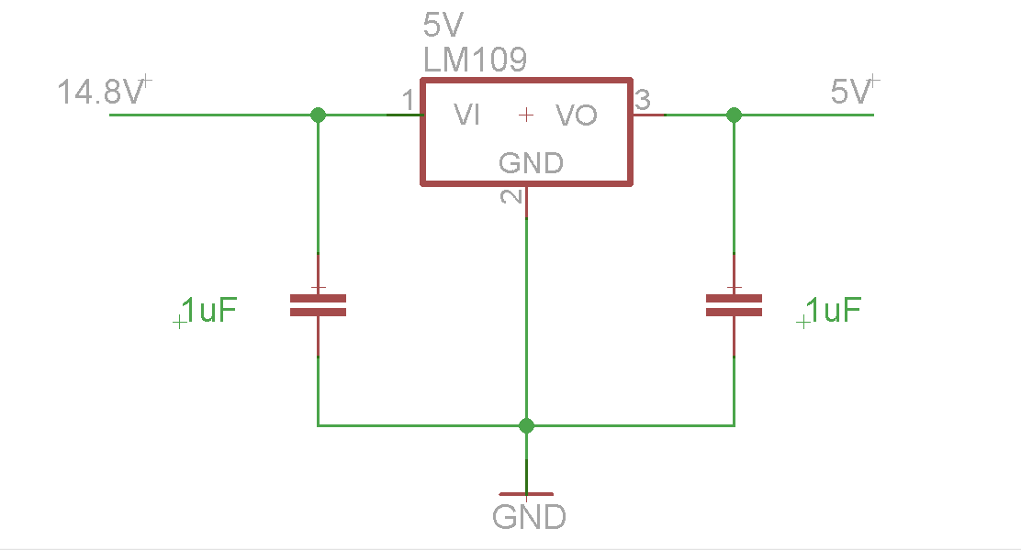
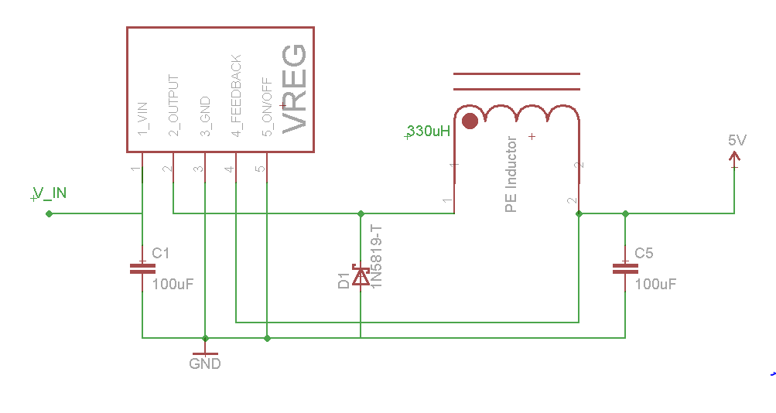
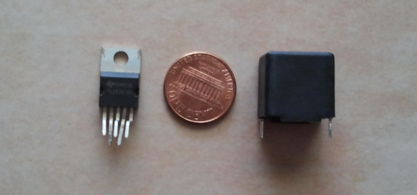
Voltage Regulation
Linear
Switching

Slide 56
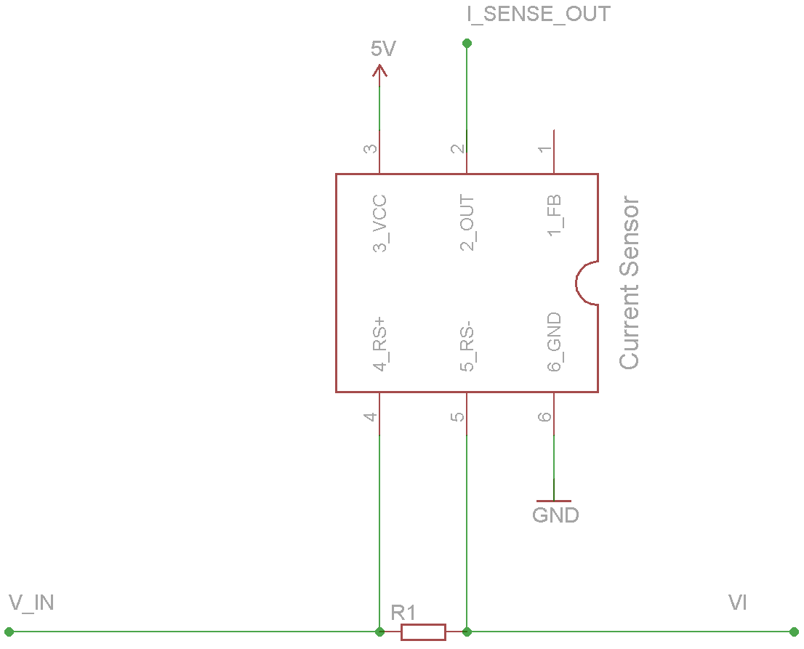
Current Sensing
ISL28006 used in conjunction with .0002Ω, 5W shunt resistor

Slide 57
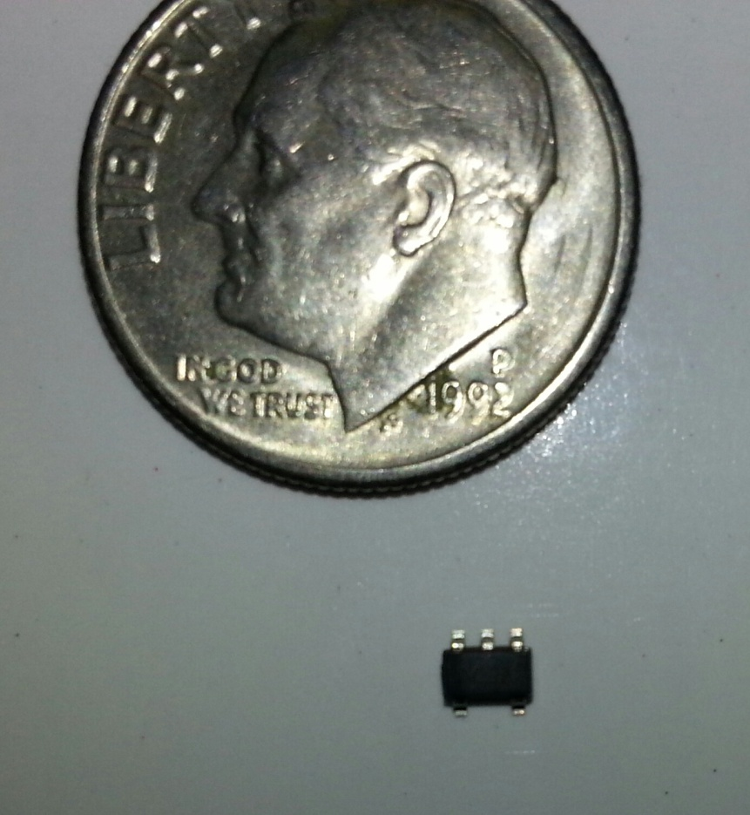
Current Sensing
ISL28006 Specs
60 uA power consumption
Power supply range from 2.7V to 28V
100V/V Gain
Uni-directional

Slide 58
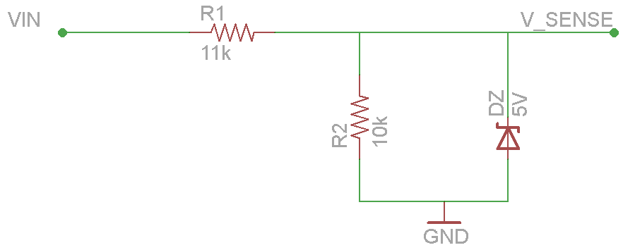
Voltage Sensing
ATmega328 10-bit ADC pin
Scale input voltage to 5V

Slide 59
Budget
Part | Qty | Projected Cost | Actual Cost
Chassis | 1 | $85.00 | $0.00
Arduino Uno Dev Board | 2 | $59.90 | $29.95
MPU-6050 | 1 | $39.95 | $39.95
XBee Explorer USB | 1 | $24.95 | $24.95
XBee Shield | 1 | $29.95 | $29.95
XBee Series 2 | 2 | $50.90 | $25.95
Motor Controller | 1 | $34.95 | $34.95
Battery /Charger | 1 | $79.94 | $79.94
PCB | 2 | $160.00 | $160.00
Bracket set | 1 | $19.00 | $19.00
HiTech 5845 servos | 3 | $137.85 | $0.00
Voltage regulators | 2 | $10.00 | $10.00
Current sensors | 2 | $6.00 | $0.00
Audio components | 1 | $50.0 | $50.00
Microphone | 2 | $16.00 | $16.00
Cisco IP Camera | 1 | $100.00 | $100.00
TOTAL |  | $904.39 | 675.54

Slide 61
Questions?

