Slide 1
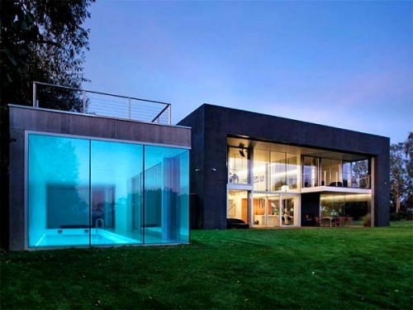
SMART HOME SYSTEMS
Group 10
Daniel Moody CpE
Thien Luu EE
Joel LeGros EE
Vu Ha EE

Slide 2


Motivations
Energy efficiency
light automation, appliance control
Convenience
control through your portable smartphone
Security
Motion detection, windows and doors sensing

Slide 3
Objectives
1. Control systems and status
Relay switch control from internet
Motion/security sensing
2. Wireless communications
Wireless networks
Portable control device
3. Database management

Slide 4
Specs and Requirements
Low power usage
System modules needs to use less then 3 Watts
Low Cost
Less than $300 for basic system setup
Less than $600 for development cost
Requires smart phone or similar device
Needs internet connection to fully utilize system

Slide 5
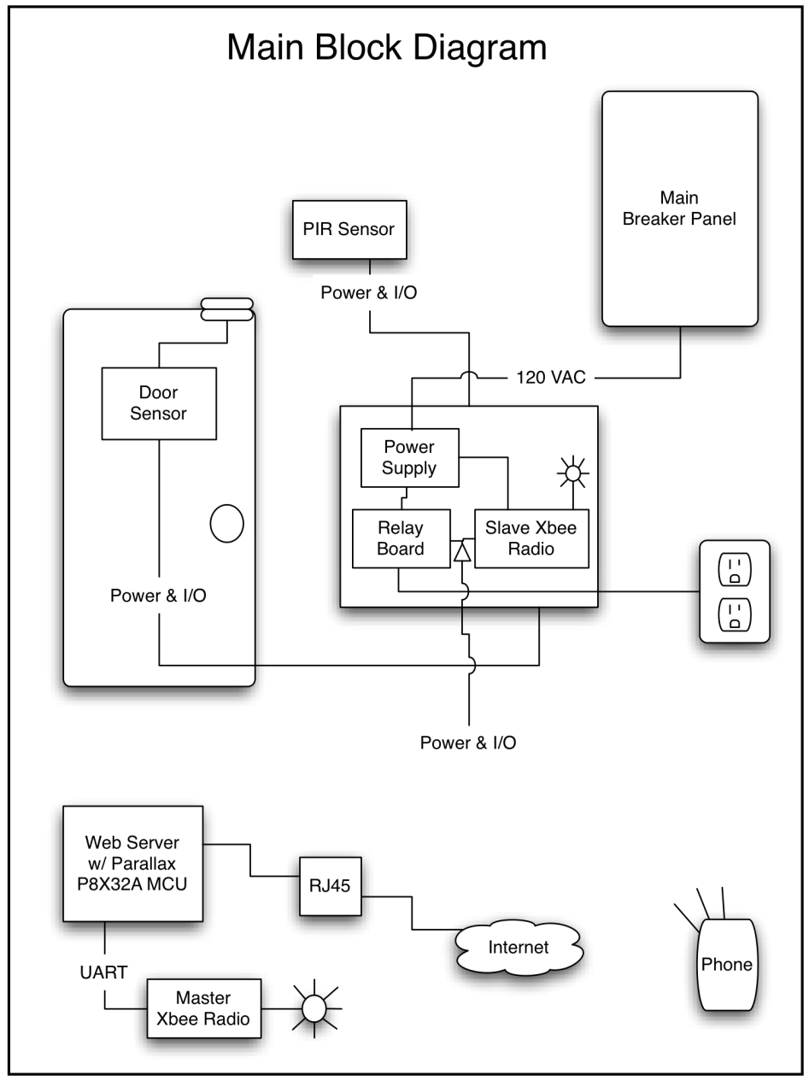
Overall Block Diagram
Processor chip
Parallax Propeller P8X32A
WIZnet W5100 Ethernet Controller
Wireless Modules
Master and Slave Configuration
PCB Module
Power supply
Supports XBee
PIR sensor
Seco Magnetic sensor
Smartphone application
Notes:
C

Slide 6
Wireless Modules
Xbee 802.15.4 Series 1
1 mW RF antenna
2.4 GHz frequency band (accepted world-wide)
Industrial temperature rating (-40C to 85C)
Supply voltage 2.8-3.4 VDC;
transmit current 45 mA, receive current 50 mA
3.3V CMOS UART interface level

Slide 7
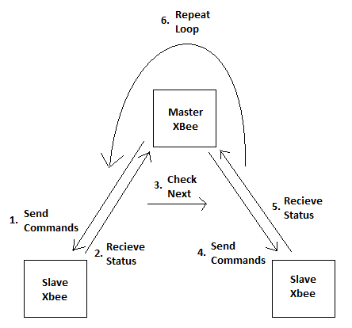
Wireless Network
The wireless network is setup in a master-slave configuration
The slave units do not initiate communication, they only respond to the master unit ‘s request to avoid data collisions
The master unit will loop through all the slave units sending commands and letting the slave unit know it is OK to broadcast

Slide 8
Wireless Module Master Protocol
The master unit reads commands from the web server through a transfer and receive UART communication lines.
The web server tells the master which address of the slave unit to broadcast to
The web server I/O pins are connected to the master Xbee’s I/O pin, and takes a reading from the I/O pins for the corresponding module

Slide 9
Android Application
Home Status is for basic control functions
Change I/O
Get status updates
User can log in to verify who is interfacing with the system

Slide 10

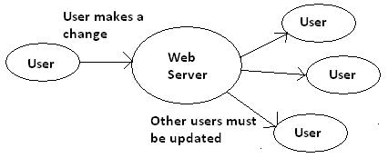


Android Programming
Application is being programmed in Eclipse IDE with Android plug-ins.
The application uses Apache libraries to setup network communication.
The application will store the user accounts, system status changes and commands in an SQLite database.
The database will need to be updated from the web server so all instances of the application will be congruent.

Slide 11
Smartphone Database
The android application will use SQLite to store user information and module information in separate tables for quick lookup.
A string will be generated from a text file on the web server, and will be parsed and the correct information will be stored in corresponding fields on the phone database.
After an update the database will then be immediately opened and the needed data will be read from the database.

Slide 12
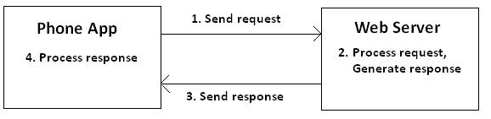
Application communication
So far the commutation between the spinneret web server and home is a simple design.
The communication transactions are always: send a request and web server sends a response.
Depending on the request the web server will execute commands, and then send back a response, indicating what it did and the current state of something.

Slide 13
Web Server Security
Because the web server is receiving request, there needs to be a way to identify which user is accessing the system.
User names and passwords will be used to verify identity.

Slide 14
Web server database
The web server will use text files to store the user and module information on the SDcard.
The text files will use space, comma, period and newline characters to organize data within the text file.
When a phone needs to be update it request the entire database text file and process it on the phone.

Slide 15


Propeller Programming
An open-source multi-socket web server program was modified for the purposes needed in this project.
The program is written in an OO language, SPIN
(similar to python), specifically
made for propeller chips.
Several spin libraries were used for drivers of the SDcard, Xbee communication, and a custom database object was created.

Slide 16
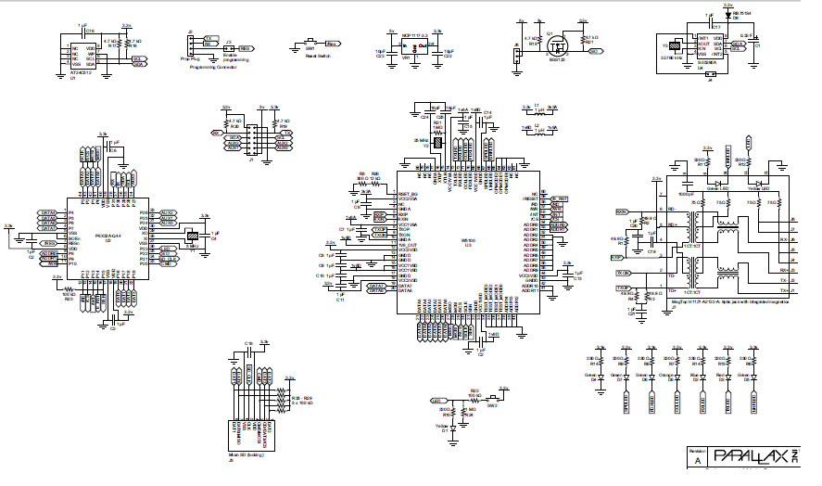
Web server Schematic
Daniel

Slide 17


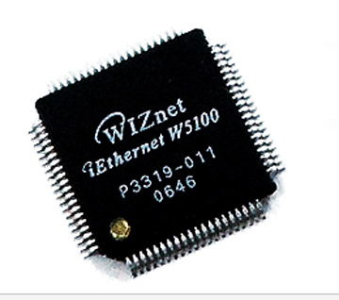
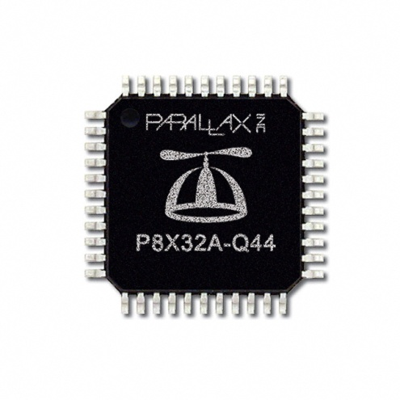
Web server
Cheap and efficient chips to run a web server.
Propeller P8X32A – 160 MIPS(~80 MHz), 32K RAM, 32 I/O
Wiznet W5100 - Ethernet Controller, 16K Tx/Rx Buffer
Pros
MicroSD slot for data storage
Doesn’t require OS
Cons
Rated at 80 Mhz processor

Slide 18
Use of Web server
The web server is the master control unit of the system
Database information is stored on the web server
Phone application updates it self through request to the web server
The web server issues commands to the Xbee network to be transferred to the power outlet modules

Slide 19
Lighting/Outlet Control
JQX-15F(787) Relay
rated up to 220 VAC at 20 Amps
Single pole double throw
controlled by Xbee series 1 module
3.2 V signal can turn the relay off and on

Slide 20
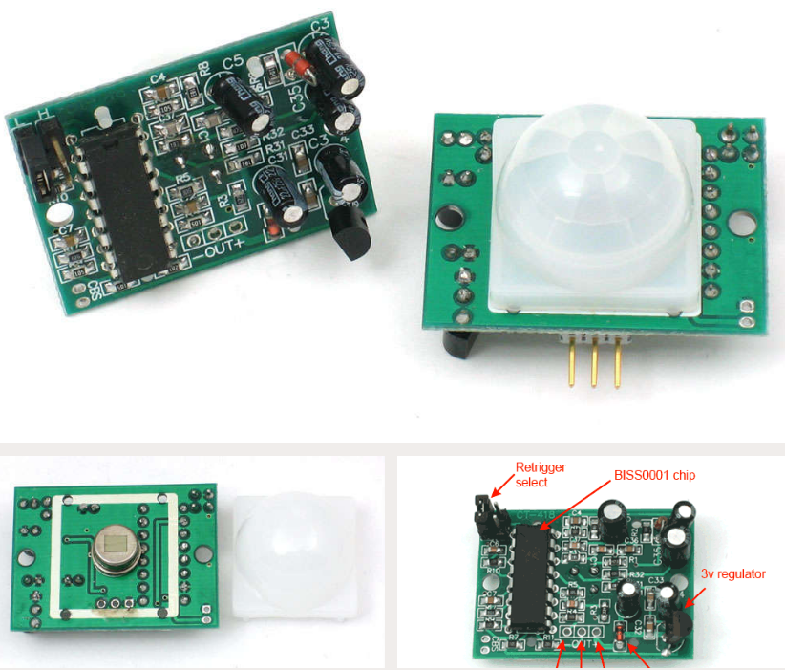
Parallax PIR Motion Sensor
Detect a IR source up to 30 ft. away
110 degrees x 70 degrees detection range
Power: 3.3 to 5 VDC input; 130 µA idle, 23 mA active
Single bit high/low output
Dimensions: 1.27 x 0.96 x 1.0 in
Applications:
Motion-activated lights
Alarm systems
Holiday animated props

Slide 21
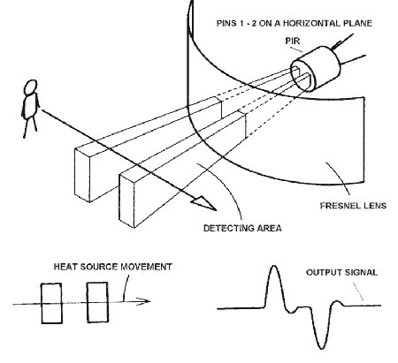
PIR Motion Sensor

Slide 22
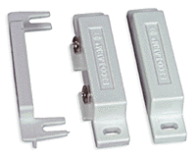
Security Sensors
Door/Window Sensor
SECO-LARM SM-200Q/WH Surface Mount Magnetic Contact Switch
Weight: 0.05 lbs
Dimensions: 2.48" x 0.5"
Compatibility: Closed circuit systems
handle up to 100mA at 100 volts DC
up to 50 million openings and closings
operate in temperatures between -15°F and 160°F

Slide 23
Security Sensor Applications
Motion sensing light activations
Status updates to know if someone has tripped a sensor
Door or window sensing to detect if the home has been breached

Slide 24
PCB Requirements
PCB needs to
Support a power system for the slave Xbee, sensors and relay switch
Allow for I/O connections from the sensors to the Xbee to read sensor input
Provide an I/O to send control signals to the relay switch
Allow the outlet to work without the system in case system is down

Slide 25
PCB Design
Allow AC to DC voltage conversion using a transformer and a diode rectifying bridge to bring 120V AC to 9V DC
Two regulators to take the 9V DC to 3.2V and 5V DC required by Xbee, sensors, and relay
Use capacitors to stabilize the DC voltage from ripple voltage from the rectifying bridge
Use screw terminals to allow sensors to be connected to the Xbee module

Slide 26
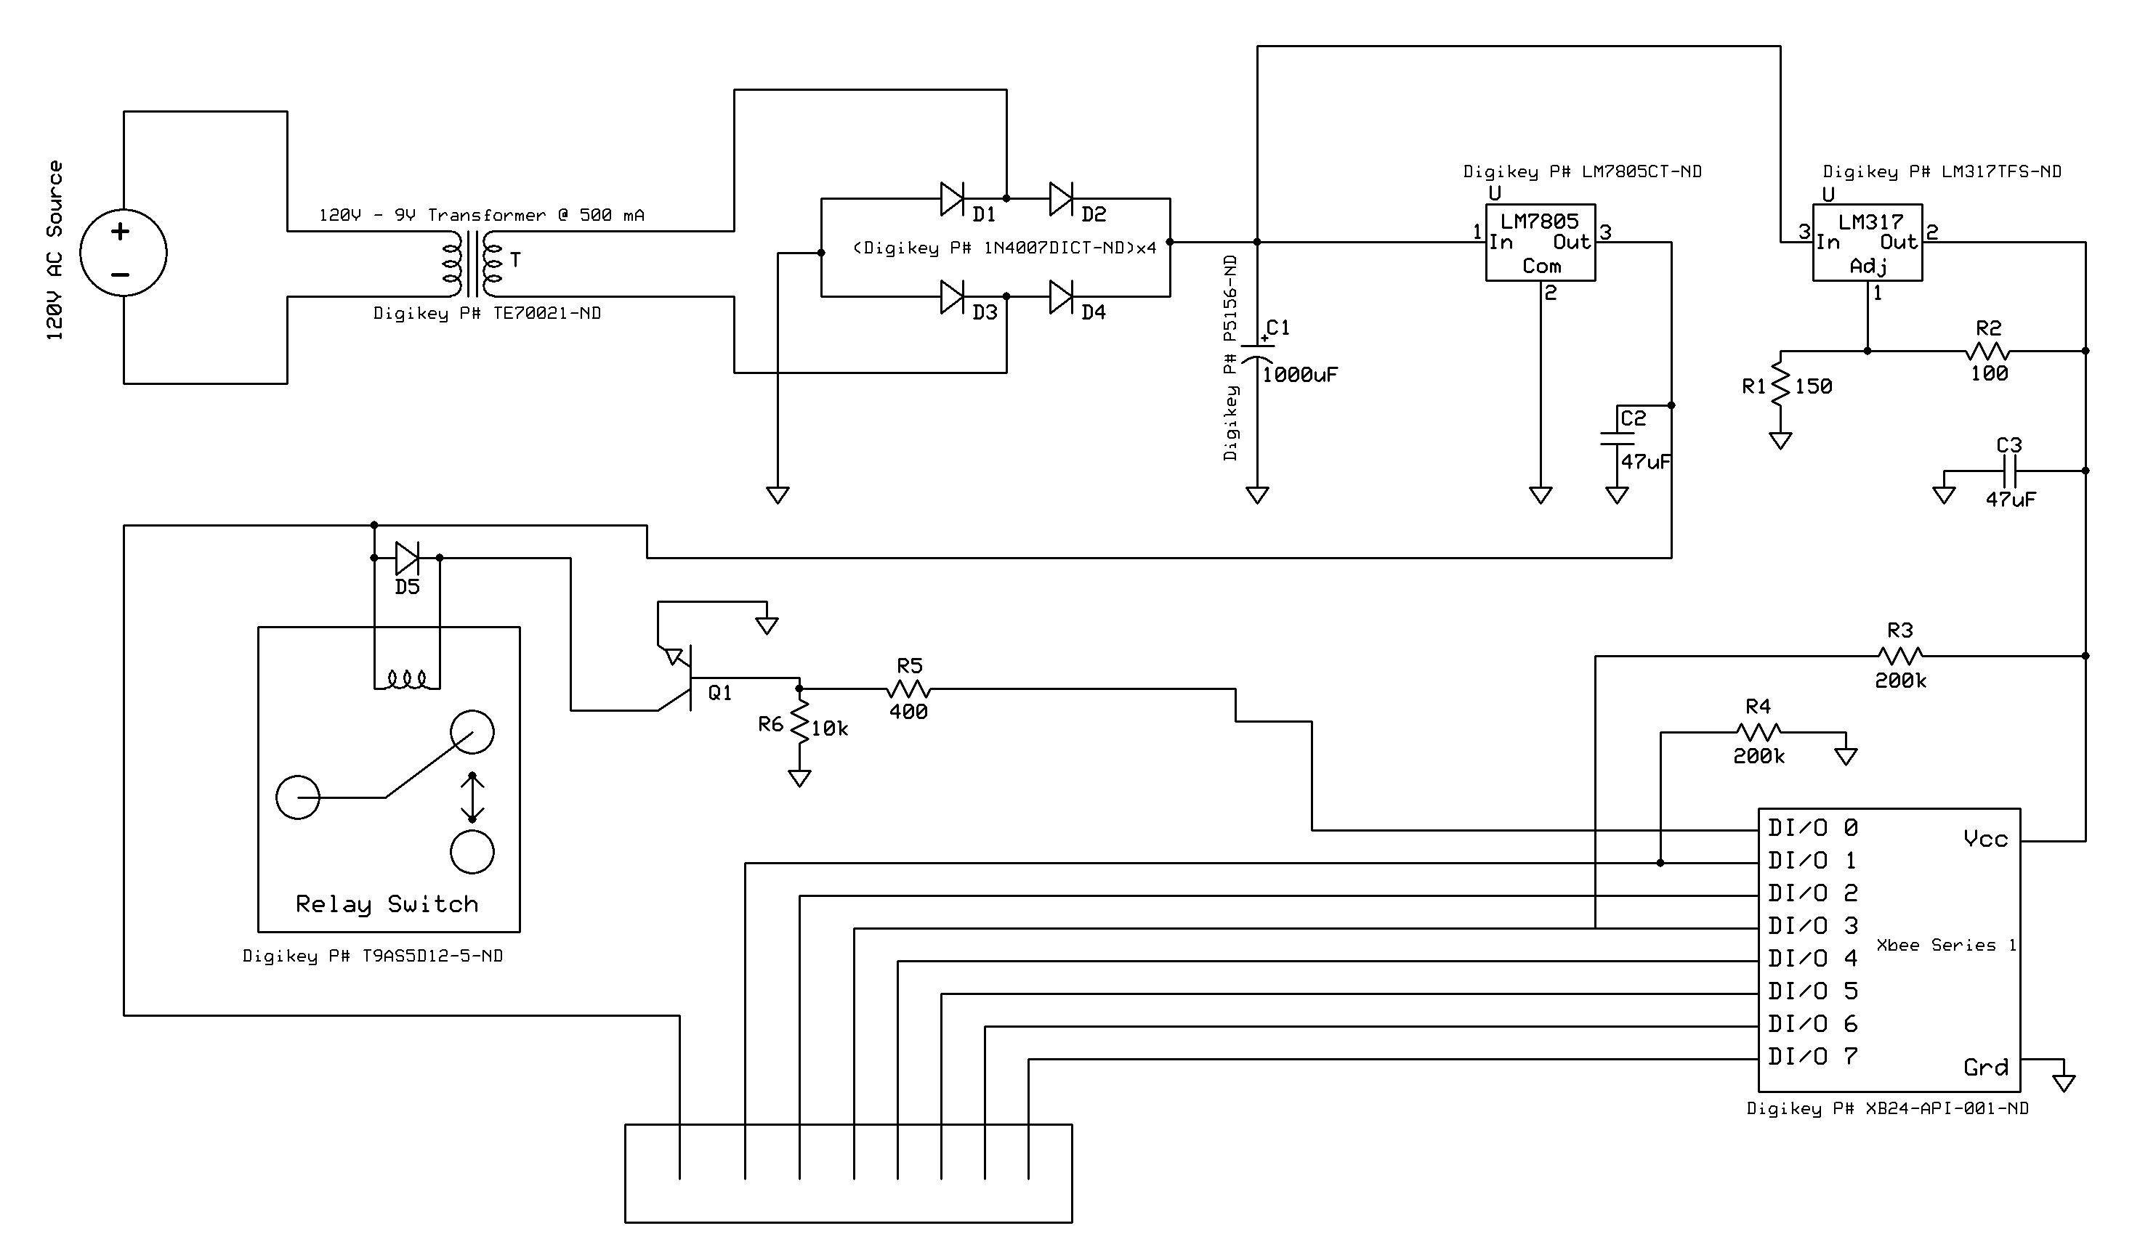
PCB Power Schematic

Slide 27
Power Supply
System runs on 110V AC
Power outlet modules have AC-DC power system
Web Server needs external AC-DC adapter at 7V, 400 mA
Power outlet modules draw 300 mA at 9 V (less than 3 watts)

Slide 28
Progress

Slide 29
Work Distribution

Slide 30
Budget
Item | Manufacturer | Quantity | Cost per unit | Total
Web server | Parallax | 1 | $59.99 | $59.99
Xbee Modules | Digi International | 9 | $21.99 | $197.91
Relay Switch | Generic | 2 | $5.00 | $10.00
GFCI outlet | Leviton | 2 | $10.00 | $20.00
Motion Sensors | Parallax | 1 | $10.00 | $10.00
PCB | ExpressPCB | 3 | $28.36 | $85.10
Door Sensor | Seco | 3 | $6.33 | $20.00
Circuit components | N/A | 3 | $30.00 | $90.00
 |  |  | Grand Total | $493.00

Slide 31
Our Goal Budget
Budget = $600
Current spending = $493.00
Spending room = $107
Percent of budget used = 82.2%

Slide 32
Problems
Motion sensors sensitivity
System Speed
Alerting the user of changes
Deleting modules

Slide 33
Questions

