Slide 1
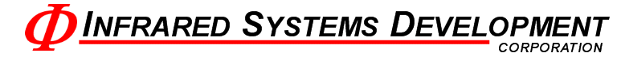
High Precision Temperature Controller
Group 13
Ashley Desiongco
Stacy Glass
Martin Trang
Cara Waterbury

Slide 2
Objectives
Replace COTS controller
  More Efficient
  More Economical
Use modern technology
  Part selection must consider production life

Slide 3
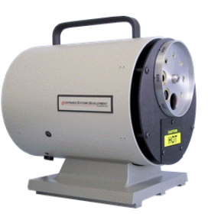
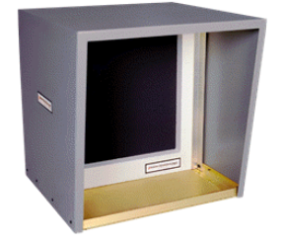
Application
Extended Area
Cavity
Uses 2 Type T T/C or 4 RTDs
From -30°C to 700°C
Uses 2 Type S T/C
From 50°C to 1200°C

Slide 4
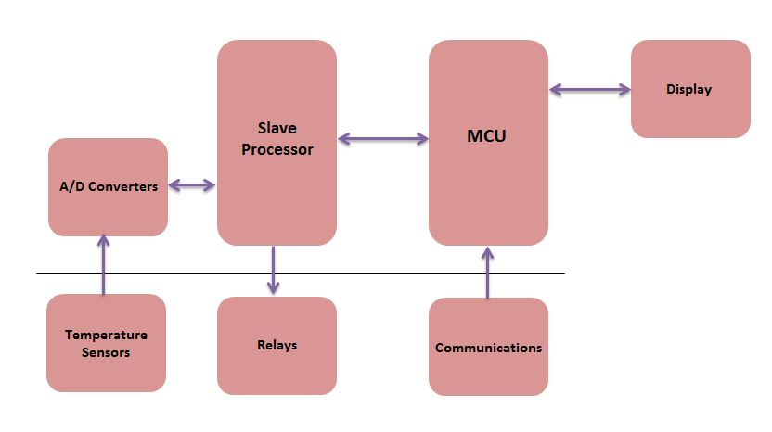
Top Level Block Diagram

Slide 5
Analog Subsystem

Slide 6
Sensor & Reading Specifications
Must be accurate within +/- 0.1 C
Read a minimum of:
  2 differential thermocouple signals
  5 RTD signals
Convert to digital signal and send to PIC
All noise/drift must be accounted for

Slide 7
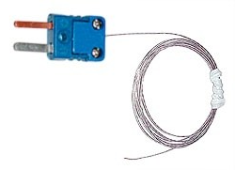
Sensor Types
Thermocouples
RTDs
Type S
  20 ⁰C min
  1300 ⁰C max
  0.1107 mV to 13.17 mV
  Cavity source
Type T
  -30 ⁰C min
  400 ⁰C max
  -1.21 mV to 20.87 mV
  Extended area source
PT100
  -30 ⁰C min
  400 ⁰C max
  Extended area source:
    88.22 Ω to 247.09 Ω
  Cold junction comp:
    100 Ω to 123.24 Ω

Slide 8
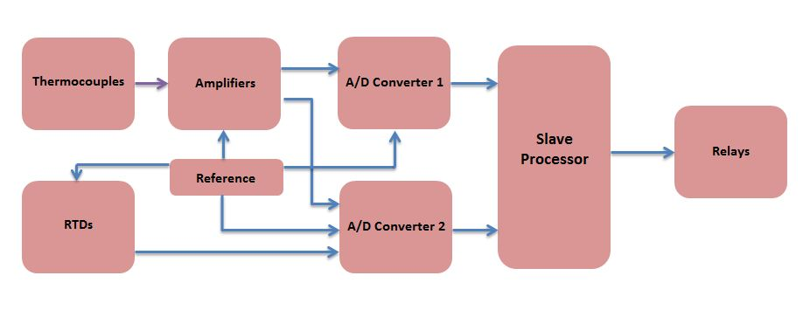
Block Diagram

Slide 9
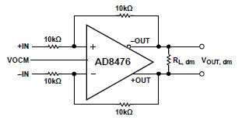
Thermocouple Readings
Output range of -1.21 mV to 20.87 mV
Differential reading
Amplify signal to match min input requirements of AD converter

Slide 10
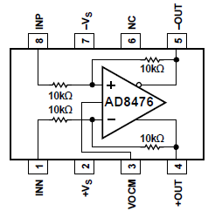
Differential Op Amp
Unity gain
V_{OCM} = 2.5 V reference voltage
Internal precision 10kΩ resistors

Slide 11
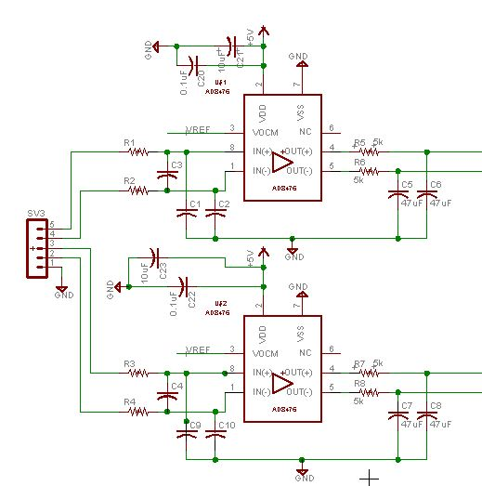

Slide 12
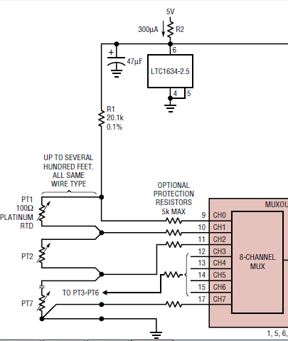
RTD Readings
RTD ladder
Requires only 1 precision resistor
Must match min input requirements of AD converter

Slide 13
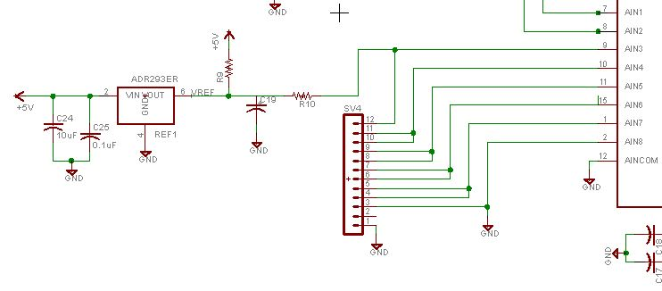
Schematic

Slide 14
A-D Converters
AD7797
AD7718
24 bit resolution
1 differential input
SPI interface
Internal gain amplifier fixed at 128
Used for heater (TC) reading
24 bit resolution
8 channel input MUX
SPI interface
Internal PGA of 1 or 128
Used for all RTD readings and secondary TC reading

Slide 15

Reference Voltage Considerations
Component | Current Draw
AD7797 | 1 μA
AD7718 | 1.25 μA
AD8476 – Op Amp (2) | 5 μA
RTD Ladder | 713 μA
TOTAL | 720.25 μA
V_{out} = 2.5 V
I_{out} = 40 mA
Temp drift = 3ppm/ ⁰C

Slide 16
Microcontroller
Notes:
Once the information is on the ADC, it’s the MCU job to process that information

Slide 17
Microcontroller Specifications
Capable of Communicating with 8 Peripheral Devices.
Capable of Handling RS-232, RS-485, USB, and Ethernet Protocols.
Capable of performing signed, floating point math.
Notes:
These are the main three specs we have for it. First

Slide 18
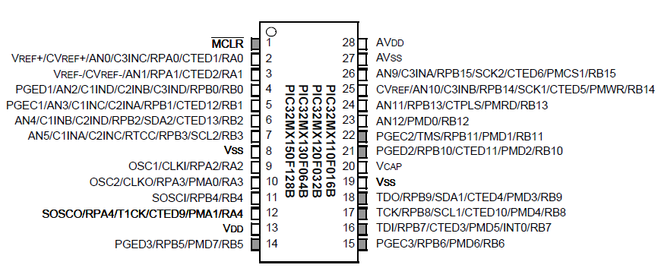
PIC32MX150F128B
2 SPI Lines
2 UART Lines
Full-featured ANSI-Compliant C
Notes:
And the MCU that fit the bill was the pIC32mx150F128B

Slide 19
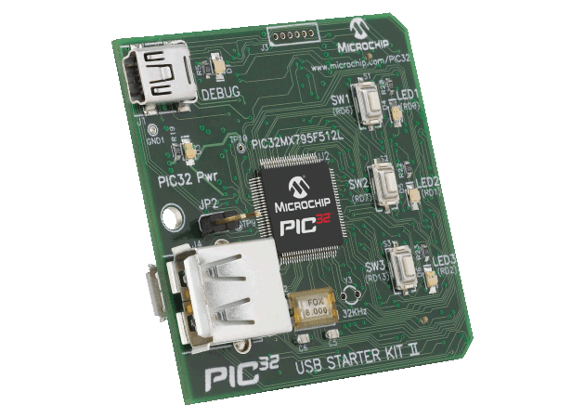
General Design
Two PIC32MX150F128B connected in Master-Slave configuration.
Slaves will be customized to serve a single purpose.
Master will handle outside communication and slave coordination.
Notes:
Our general configuration for the microcontroller is to have two pIC32MX150128B connected in Master-Slave Configuration

Slide 20
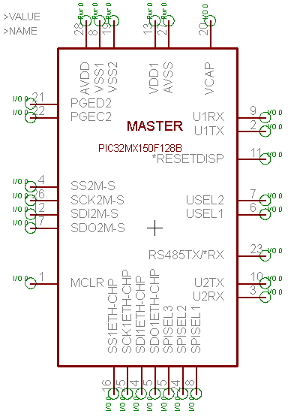
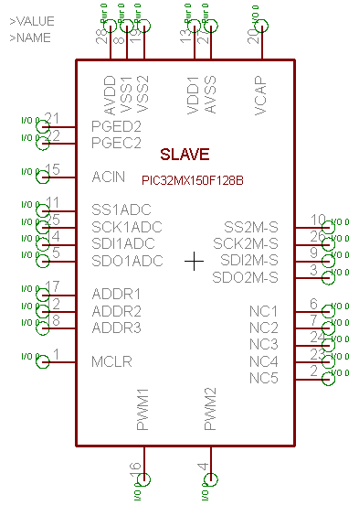
Pinout Table

Slide 21
Peripherals (from the Master)
MAX232 – RS232 - UART
MAX481 – RS485 - UART
MCP2200 – USB - UART
ENC28J60 – Ethernet – SPI
µLCD-32032 – Display – UART
PIC32MX150F128B – Slave – SPI

Slide 22
Peripheral Interfacing (Software)
No Interrupt Driven Pins
  Polling Transmit/Receive Buffers
Custom LABVIEW software to handle all interfacing
MAX232/MAX481 – No TX/RX Buffer
MCP2200 – 128 Bytes TX/RX Buffer
ENC28J60 – 8 KBytes TX/RX Buffer

Slide 23

Development Environment
MPLABX using MPLAB C32
Simulation Capability
Debugging
  Using PICKIT3

Slide 24
Display

Slide 25
Requirements
Touch Screen
Low-Cost
Fit in existing chassis
Interface easily to microcontroller

Slide 26
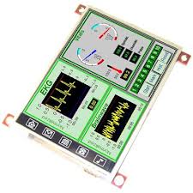
4D-Systems uLCD32 (GFX)
Deliver a diverse range of features in a single, compact, cost effective unit
Built in Graphics Controller
Easy 5-pin interface
On-board Audio
Micro-SD card connector
Expansion Ports
Built in Graphics Libraries

Slide 27
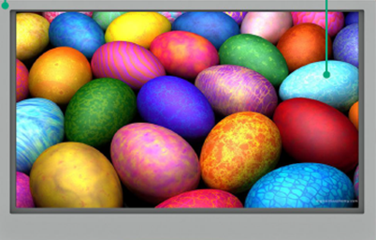
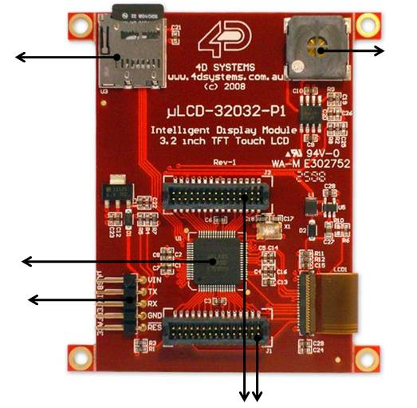
Features
1
480x272 Resolution with 65k True to Life Colors
Expansion Ports (2)
5 Pin Serial Programming Interface
PICASO-GFX2 Processor
Micro-SD Card Slot
1.2W Audio Amplifier with Speaker
3.2”
5
6
4
3
2

Slide 28
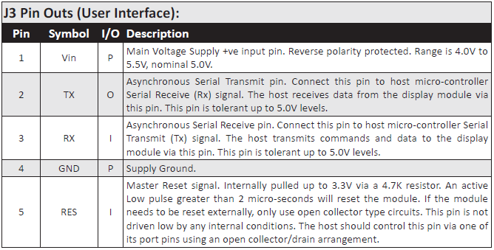
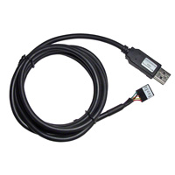
Hardware Interface
Easy 5 pin interface
  Vin, TX, RX, GND, RESET
Also used to program display with 4D Programming Cable

Slide 29
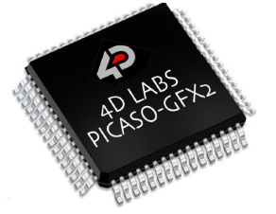
PICASO-GFX2 Processor
Custom Graphics Controller
All functionality, including the high level commands are built into the chip
Configuration available as a PmmC (Personality-module-micro-Code)
PmmC file contains all low level micro-code information
Provides an extremely flexible method of customization

Slide 30
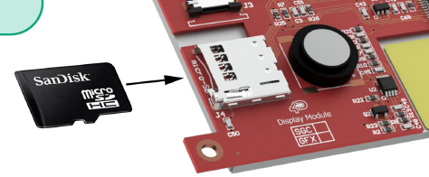
Audio/Micro-SD Card
Audio support is supplied by the PICASO-GFX2 processor, an onboard audio amplifier and 8-ohm speaker
Executed by a simple instruction
Micro-SD card is used for all mulitmedia file retrieval such as images, animations and movie clips
Can also be used as general purpose storage for data logging applications

Slide 31
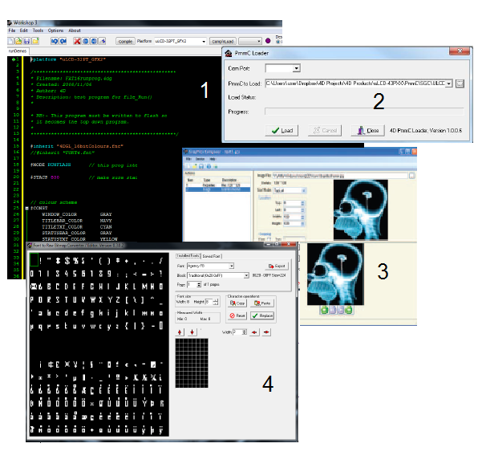
Software Tools
1. 4D Workshop IDE
2. PmmC Loader
3. Graphics Composer
4. FONT Tool

Slide 32
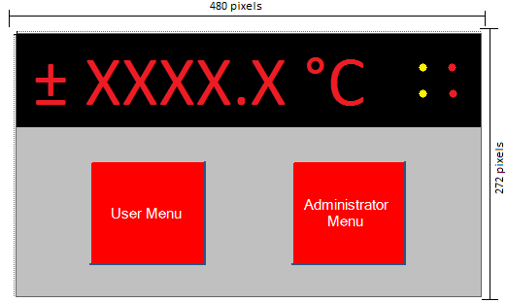
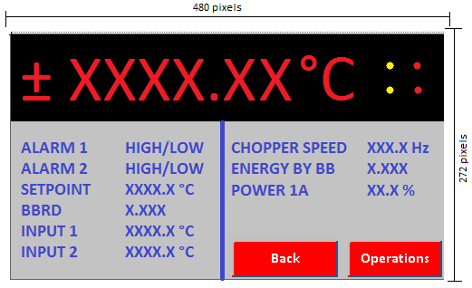
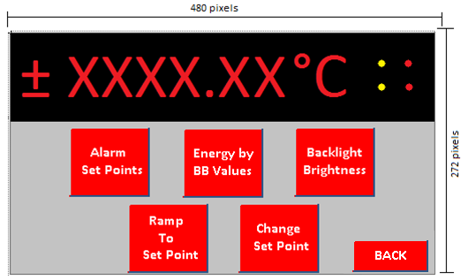
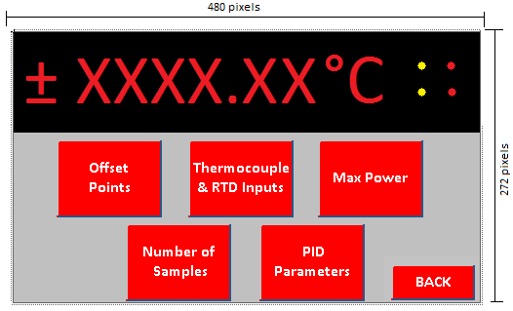
Temperature displayed at all times
User/Administrator Menu

Slide 33
Power

Slide 34
Power
Part | Current (mA) | Voltage (V) | Quantity | Power (mW)
ADC | 0.65 | 5 | 1 | 3.25
ADC | 0.325 | 5 | 1 | 1.625
OpAmp | 0.33 | 5 | 2 | 3.3
Ref | 0.8 | 5 | 1 | 4
Quad Buffer | 30 | 5 | 1 | 150
RS485 | 0.9 | 5 | 1 | 4.5
RS232 | 15 | 5 | 1 | 75
USB | 95 | 5 | 1 | 475
Ethernet Controller | 180 | 3.3 | 1 | 594
Display | 150 | 5 | 1 | 750
Microcontroller | 50 | 3.3 | 2 | 330
4:1 MUX | 75 | 3.3 | 1 | 247.5
TOTALS | 648.335 |  |  | 2638.175

Slide 35
Power Block Diagram
ADC RS485
OpAmp RS232
Ref. Display
Buffer USB
LS25-5
90 – 240 Vac
5V
LT1129-3.3
Ethernet
Microcontroller
4:1 MUX
3.3V

Slide 36
PID

Slide 37
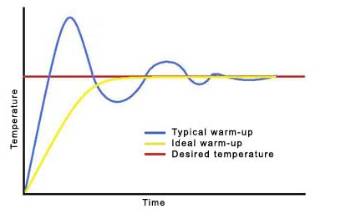
PID Requirements
Eliminate noise
Minimize overshoot
More efficient than standard PID

Slide 38
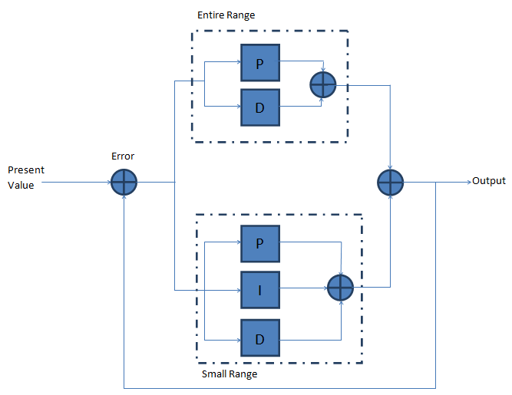
Nested PID
Initial loop encompasses entire temperature range using only P and D parameters
Next loop focuses on a smaller range and uses P, I and D
Through testing we will determine the optimum repetition of these loops

Slide 39
Computer user interface

Slide 40
Requirements
Read data from the device
Ability to view PID values
Legible and convenient display

Slide 41
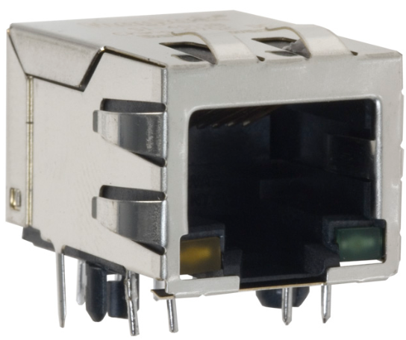
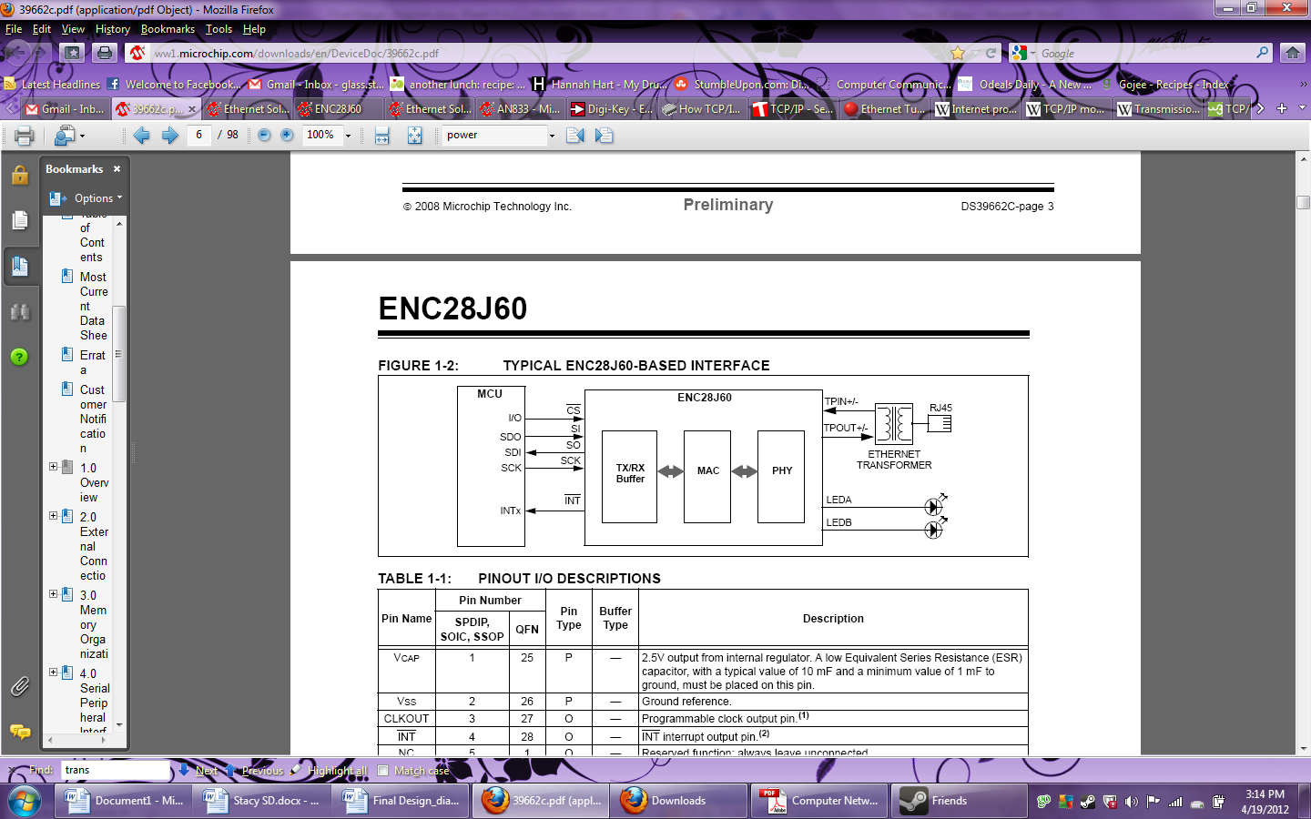
MagJack
Works with ENC28J60
RJ45 with built in masgnetics
Dual LEDs to inform of network activity

Slide 42
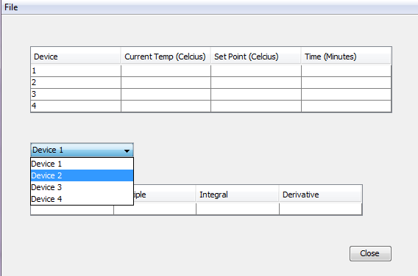
User Interface
Using NetBeans
Java based IDE (Intergrated Development Environment)
Good WYSIWYG Editor

Slide 43
Work Breakdown
 | Ashley | Martin | Cara | Stacy
Analog Hardware | 95% | 5% | - | -
Digital Hardware | - | 80% | - | 20%
Display | - | 5% | 95% | -
Software | 5% | 10% | 5% | 80%
Power | - | - | 100% | -

Slide 44
Progress

Slide 45
Potential Problems
Prototyping 24-SOIC parts
PID overshoot
Non-ideal operation of parts
Screen size

Slide 46
Budget
Parts
Digital Devices | $ 192
Display | $ 101
Analog Devices | $ 30
Prototyping Tools | $ 25
Power | $ 18
TOTAL | $ 366
Goal: $500

Slide 47
QUESTIONS?

