Slide 1
eHVAC: Wireless Modular Multi-Zone HVAC Controller
Group 14
Michael Trampler EE
Javier Arias EE
Ryan Kastovich EE
Genaro Moore EE

Slide 2
Overview
Heating
Ventilation
Air Conditioning
Some provide advanced features such as humidity control and CO2 monitoring/control
Scheduling and adaptive set-points will allow the user to reduce the systems run time.
Run time data logging will give the user a better understanding of the systems activities

Slide 3
Motivation
Increased cost of electricity
Great cost of commercially available HVAC controllers
Limited feature set of commercially available HVAC controllers, especially web enabled controllers

Slide 4
Objectives
Accurately read temperature and relative humidity both inside and outside building.
System management through web application
Scheduling capabilities
CO2 monitoring for a gauge of air quality
Zone control
Expandable to multiple zones
Wireless connectivity to RSM
Reduction of energy consumption due to scheduling and set-point control
Simple and easy installation with minimal wiring.

Slide 5
Project Specifications
Main Controller
Control up to 8 zones
Wireless connectivity to RSM at a minimum of 30ft
Web Interface
Host at least 5 users simultaneously
Manage week long schedules for each zone
Display status of up to 8 zones simultaneously
RSM
Temperature ±0.125°C
Humidity ±5% relative
CO2 At least ±500 ppm
744 hours of battery life

Slide 6
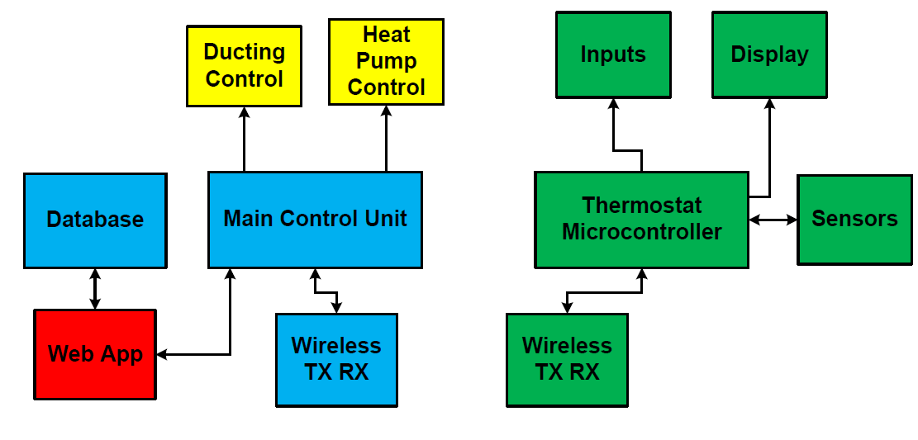
System Block Diagram

Slide 7
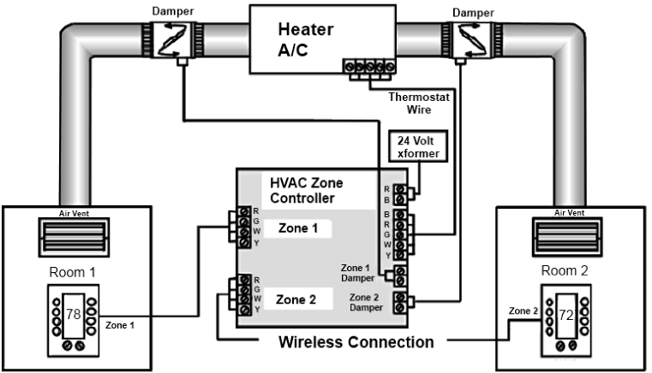
Plant Block Diagram
00

Slide 8
Plant Specifications
Need to supply 24VAC to drive the different components
Be able to support up to 8 zones
Continuous uptime for 2 months

Slide 9
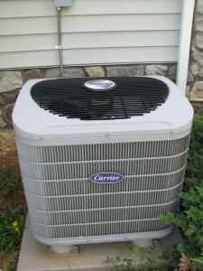
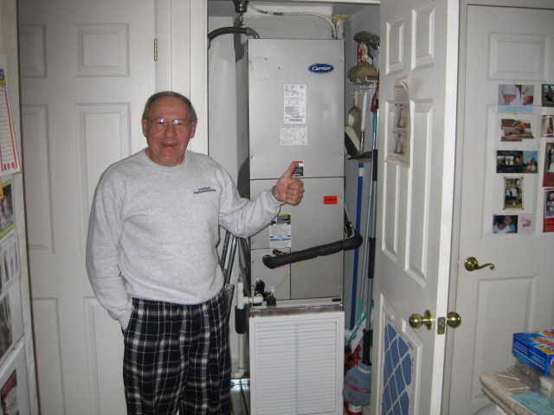
Heat Pump
Various types: single stage, multi-stage, variable compressor, variable fan, oil, gas, etc…
Single stage heat pump very common in FL
Design to implement a multi-stage system
Air handler indoors, 2 compressors outdoors

Slide 10
Heat Pump Components
Reversing Valve (changeover)
Controls heating/cooling mode
2 Compressors
Each compressor with has a fan
Fan (Air Handler)
Automatic – turns on when ever the whole unit is on
ON (continuous) – on regardless of the state of the unit

Slide 11
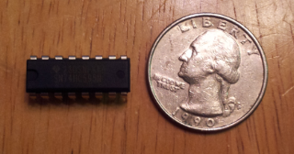
Control (Hardware)
74HC595 (from TI)
8-bit serial input shift register
Serial or parallel output
Vcc: -0.5V - +7V
Needs only 3 inputs: data, latch, and clock
Outputs 0 – Vcc (V)

Slide 12
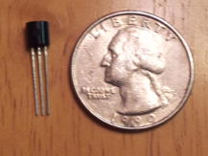
Control (Hardware) Continued
MAC97 Triac
Connected to 24VAC supply to drive the heat pump components
Can handle up to 600V
2V max gate trigger voltage
0.66V typical trigger voltage

Slide 13
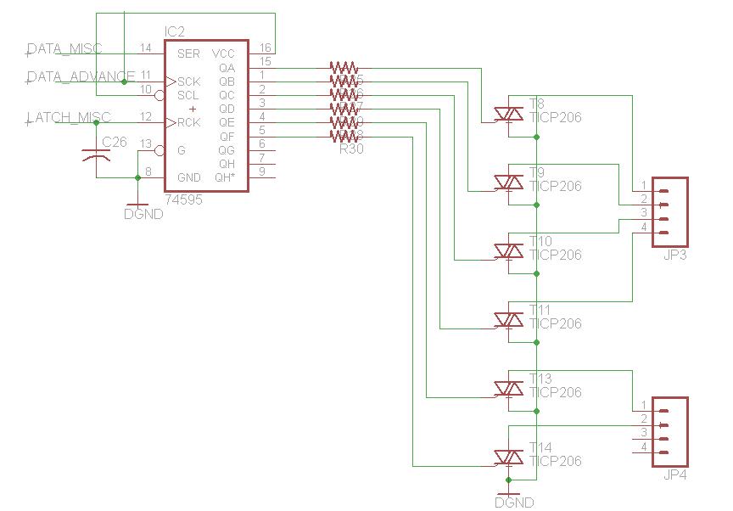
Heat Pump Control Schematic

Slide 14
Plant Block Diagram

Slide 15
Damper Control
Dampers act as a door for air to flow through ducts
Dampers come either N-O/N-C
Require 24VAC
Utilize normally open 2 position dampers
Makes system modular
Able to implement up to 8 zones
74HC595 Shift Register
8 outputs for 8 zones
MAC97 Triacs
8 triacs for the 8 zones

Slide 16
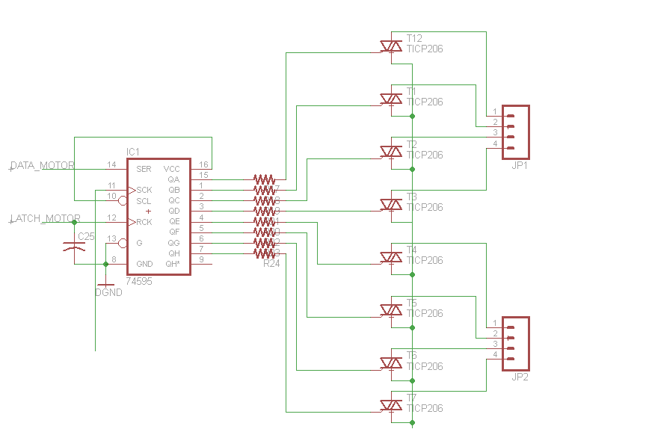
Damper Control Schematic

Slide 17
Breakout Board
To demonstrate the ability to control the different components, a demo board will be attached to the MCU
Consists of rectifiers for the AC voltage
Drives LEDs to simulate the different components

Slide 18
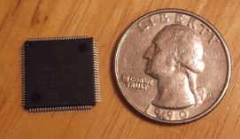
Main Control Unit (Hardware)
Software control of the plant will be housed in the MCU
Sends 2 2-digit hex values to shift registers
Each bit responsible for a single component
Responsible for gathering and parsing through data from the Remote Sensor Modules
Communicates with RSMs through a wireless module
Talks to wireless module via UART
Communicates with Web App through
CGI commands
Stellaris LM3S8962 Microcontroller

Slide 19
System Block Diagram

Slide 20
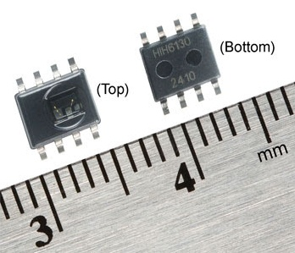
Temperature/ Humidity Hardware
Using a digital Temperature/Humidity Sensor from Honeywell
HIH-6130
Accurate to 4% RH
Operates from 0-100% RH
Accurate to .025 C
SPI
3.3V supply
0.6-0.75mA current consumption

Slide 21
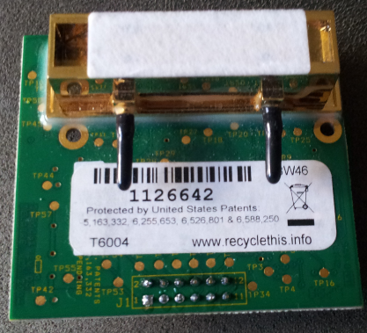
CO2 Measurement
Telaire T6004
Ultra High Accuracy in DIR (Infrared)
Digital Sensor
Efficient Power Consumption
Sensitive from 0ppm to 20,000ppm
Requires 100mA at 5V
Has SPI Interface

Slide 22
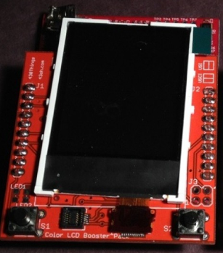
User Interface
One 1.8 inch TFT color display
16 bit color resolution
160 x 128 pixels
SPI interface
2 push buttons
Used for simple input

Slide 23
Wireless Communication Specifications
MSP430G2553
UART Connectivity to modules
CC110L Transceiver
Anaren booster pack
Frequency Band: 779 – 928 MHz
200nA sleep mode consumption
SPI connection between transceiver and MSP
Creates single code base for wireless communications

Slide 24
System Block Diagram

Slide 25
Stellaris Interface
Modified lwIPhttpd (web server) implementation provided with Stellarisware.
Common Gateway Interface (CGI) adapter provided by Stellarisware sample code.
CGI Calls for polling and updating RSMs, and plant components.

Slide 26
Web App Hosting
 | Stellaris LM3S8962 | Beaglebone | Google App Engine
Clock Frequency | 50 Mhz | 720 Mhz | N/A
RAM | 64 KB SRAM | 256 MB DDR2 | N/A
Storage | 256 KB Flash + microSD | microSD | N/A
Ethernet | Yes | Yes | N/A
Operating System | None | Linux | N/A
HTTP Server | C (Custom coded using lwIP) | Apache/Lighttpd | N/A
Application Programming | C | C/Python/PHP/Perl/Java | Python/Java/Go
Data storage | CSV | CSV/SQL | Datastore
Cost | ~$90 (dev board) | ~$90 (dev board) | N/A

Slide 27
End-to-End Connectivity

Slide 28
Google App Engine
Cloud computing: Platform as a service
Hosting on Google's infrastructure
Google Cloud = Distributed resources
No need to manage server
Application development:
Python
Java
Data storage: Google Datastore

Slide 29
Python/ Java
 | Python | Java
Is it Free? | Free and Open Source | Free and Open Source
Learning Curve | Simple Syntax | Lacks Simple Syntax
Does it need to compile? | No | Yes
Other tools? | Wide range of tools and libraries | Large range of libraries
Built In Docs? | Yes | No
Script? | Yes | No
Difficulty of Implementation in the Google App Engine | Very straight forward implementation | Not very straight forward

Slide 30
Webapp2
Lightweight framework
Built into Google App Engine
WSGI Adapter
Interface between web server and web application
Also responsible for handling uncaught exceptions
Jinja2 Templating Engine
Using a templating system we can dynamically generate portions of the HTML and embed special placeholders in the HTML files to indicate where the generated content should appear.
Routes
Handle requests in the web application by dispatching handlers for different events (i.e. Display Zones, Display Readings, Schedule, etc.)

Slide 31
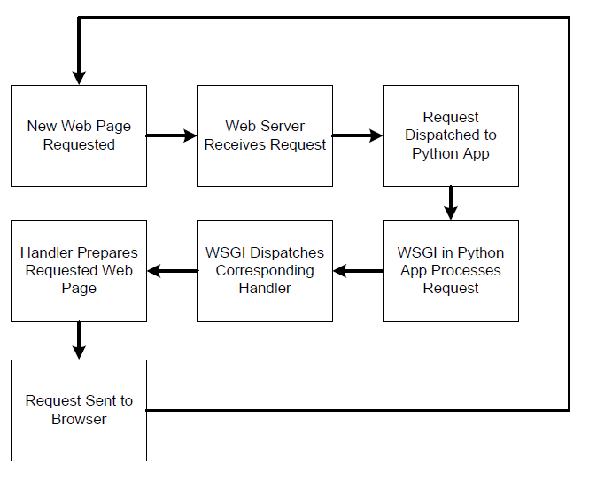
Webapp2 Handlers Flowchart

Slide 32
Automatic Polling
Web Application polls MCU every 2 minutes.
Requests status of Plant and RSMs via CGI call.
Processes received information (JSON format):
Update system readings
Checks if schedule needs to run
Sends updates to plant and RSMs via CGI calls available in Main Control Unit.

Slide 33
Google Datastore
Horizontally distributed database based on Google's Bigtable
Manages very large sets of structured data
Allows for scaling of applications as they receive more traffic
Object datastore
Objects are called entities
Entity kinds (classes) Modeled in Python or Java
Supports atomic transactions
Python and Java APIs
Google Query Language: flexible but not as much as SQL

Slide 34
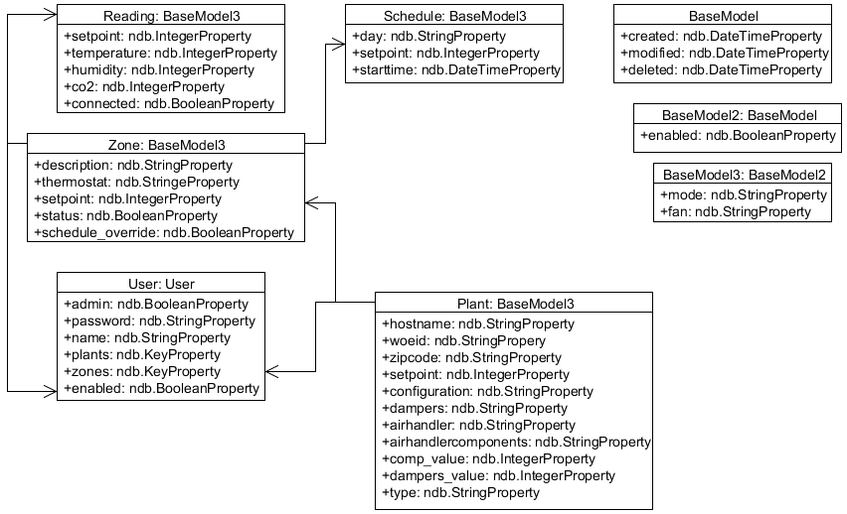
Data Models
Every entity has its own unique key property
Implicitly created by the App Engine during entity creation.
Includes the entity kind and a unique numeric ID that is automatically assigned.

Slide 35
System Block Diagram

Slide 36
Operating Environment
Development Platform:
Google App Engine
Backend Programming Language:
Python
Primary Client-Side Scripting Framework:
jQuery Mobile (JavaScript)

Slide 37
Why jQuery Mobile?
HTML5 and CSS3 Compatibility
Works on both Android and iOS
Professional Layout for PC, Tablet and Mobile Devices
Compatibility with Firefox, Chrome, Safari and others
Allows for rich touch screen interfaces for mobile devices

Slide 38
jQuery Mobile Interface
jQuery Mobile API which resizes depending on the pixel size of the device which is perfect for mobile and Tablet devices.
A PC/ Tablet layout has the ability to display on both sides of the screen with a primary and secondary table structure
A Mobile layout will fit the menu options to the screen and upon user interaction will display the data

Slide 39
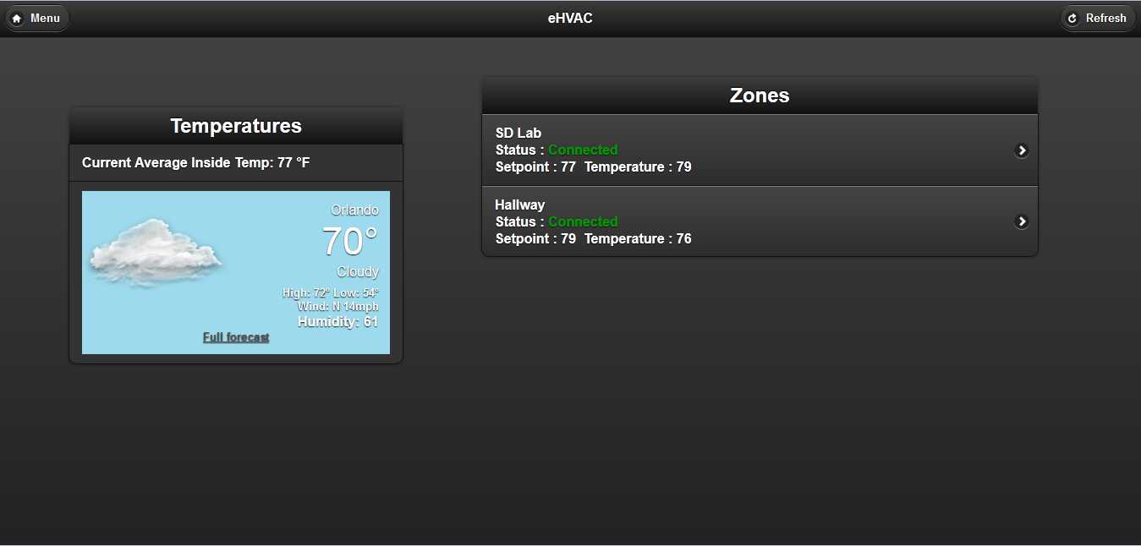
PC/ Tablet Landscape View

Slide 40
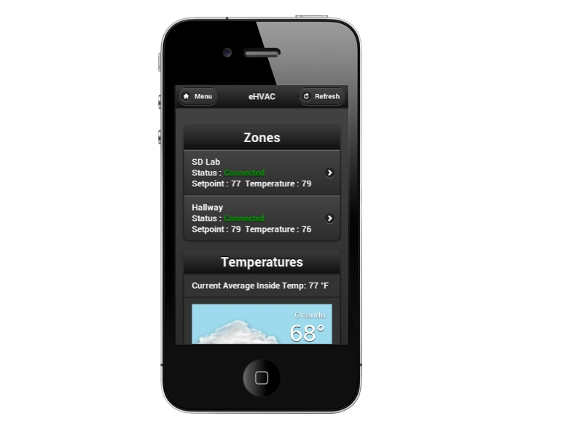
Mobile View

Slide 41
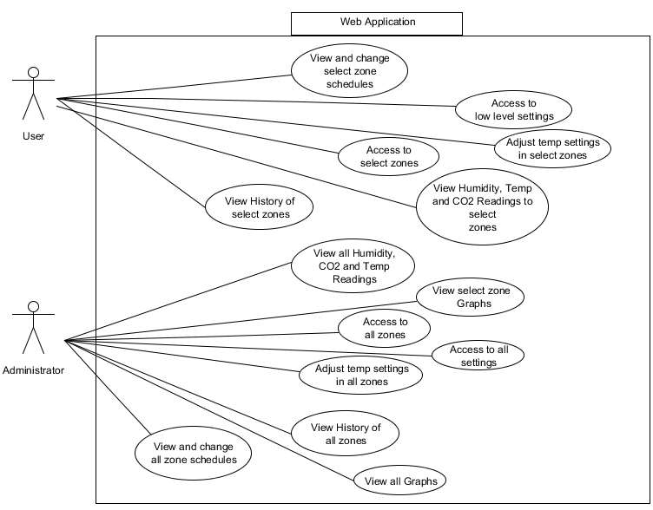
Web App Use Case Diagram

Slide 42
Scheduler
Standard HVAC systems typically do not include embedded schedulers for their users
User will be able to adjust Set times, Fan Modes, System Modes and Set Points for specific zones in the system
Users will be able to adjust their scheduler for a week at a time
Coded in pure HTML/CSS/JS with Python backend

Slide 43
Output Power Supply
Use readily available 24VAC supply
Most commercial HVAC controllers use a 24VAC supply as standard
Output 24VAC for HVAC system control
This 24VAC will drive the Breakout Board
Control will come directly from main board therefore no need for logic power

Slide 44
Main Controller Power Supply
Use readily available 17V Laptop power supply
5V switching regulator for logic level power
3.3V LDO Linear Regulator
 | OKI-78SR-3.3 | DE-SW033 | LM2574M
Input Voltage Range | 7-36V | 5-30V | 0-60V
Efficiency | 75-90% | 83% | 80-95%
Current | 1.5A | 1.0A | 1.5A
Cost | $4.35 | $15.00 | $.20

Slide 45
RSM Power Supply
RSM will use 4 AA batteries to supply unregulated power
A 5V regulator will supply power to the CO2 sensor
3.3V regulator will be used for the sensors, the wireless communication and the main microcontroller

Slide 46
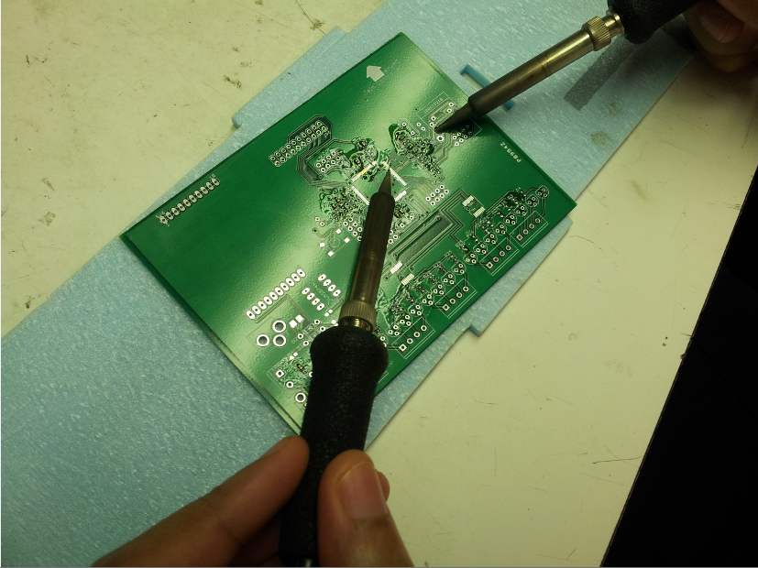
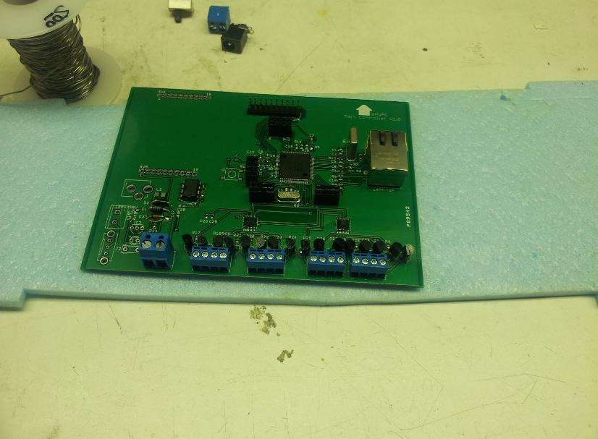
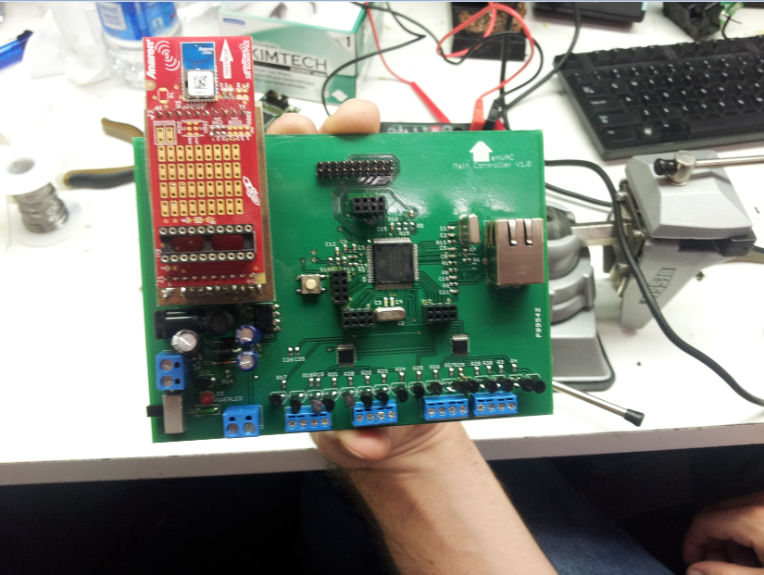
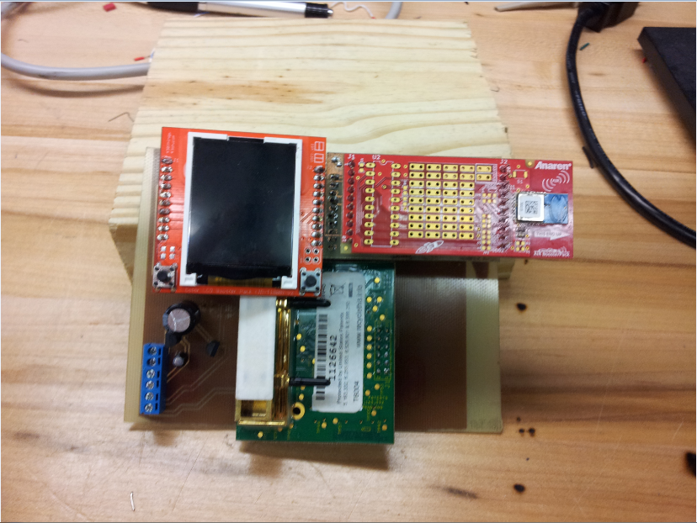
Testing

Slide 47
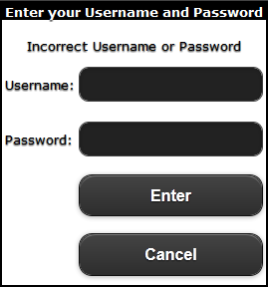
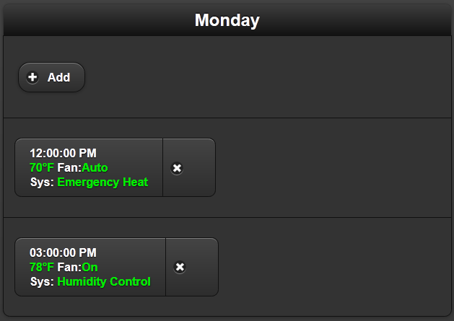
Web Application Testing

Slide 48
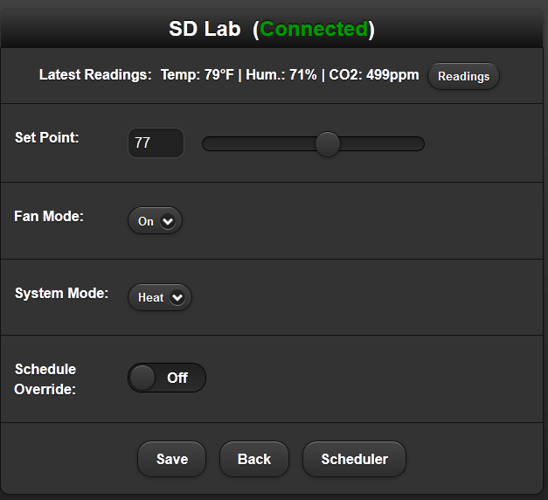
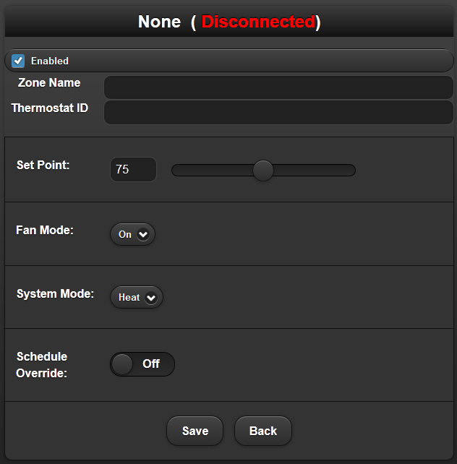
Web Application Testing

Slide 49
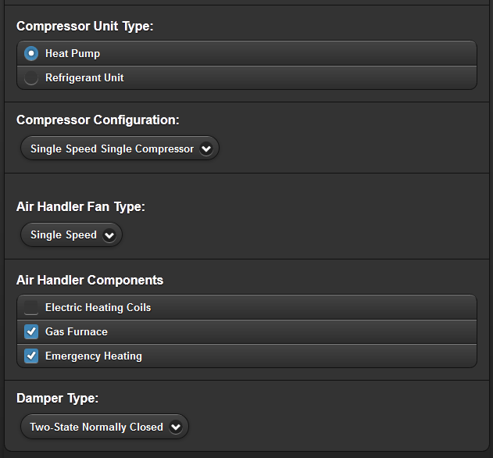
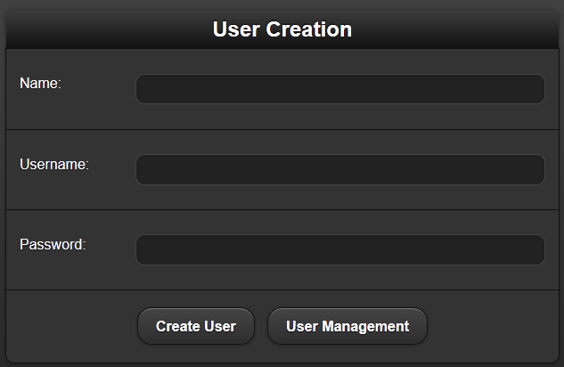
Web Application Testing

Slide 50
Project Distribution
 | Michael | Javier | Ryan | Genaro
Plant Control | 5% | 15% | 5% | 75%
RSM | 85% | 5% | 5% | 5%
Database | 5% | 55% | 35% | 5%
Web App | 5% | 35% | 55% | 5%
PCB | 75% | 5% | 5% | 15%

Slide 51
Budget
Item | Quantity | Price (of each) | Expected Budget | Final Budget
Sensor Microcontroller | 8 | $3.00 | $24.00 | $48.00
Humid/ Temp Sensors | 2 | $15.00 | $30.00 | $60.00
CO2 Sensors | 3 | $10.00 | $30.00 | $60.00
Graphical Display Unit(s) | 6 | $12.50 | $75.00 | $75.00
Input Peripheral Suite | 4 | $5.00 | $20.00 | $20.00
RSM Power Supplies | 4 | $10.00 | $40.00 | $80.00
Main Controller Power Supplies | 1 | $15.00 | $15.00 | $30.00
RF Module | 6 | $15.00 | $90.00 | $180.00
PCB | 1 | $70.00 | $70.00 | $140.00
Main Controller | 1 | $60.00 | $60.00 | $120.00
Grand Total |  |  | $454.00 | $813.00

Slide 52
Issues
Rapid degradation of Thermostat LCD’s
Web App Handlers Redirect issues
CO2 Sensor Power Consumption very high
Anaren Booster Packs requiring .2V higher than specified
Lack of Reliability from Wireless and Sensors

Slide 53
Questions?

