Slide 1
SPF 2000
SmartPetFeeder
Tim Forkenbrock
Austin Scruggs

Slide 2
Motivation
Eliminate chance of animal not being fed while owner is away
Eliminate opportunity for one animal to eat another’s food while owner is away

Slide 3
Project Description
The Smart Pet Feeder (SPF) is a semi-automated device that can feed your household pets at their convenience
The SPF works by attaching an RFID tag to a pets collar which is scanned in by the RF antenna mounted on the SPF when the animal is within the antenna read distance range
Upon receiving the RFID tag information, the PCB will then drive a DC motor which will rotate a paddle wheel and dispense food down into the food bowl.
Each pet will have their own RFID tag which will correspond to a specific food bowl
A DC motor will rotate the food bowls to allow food to be dispensed then be accessed by the pet

Slide 4
Goals & Objectives
Allow pet to have unassisted access to food
Ensure cost Efficiency
Up to 2 different pets can be fed
Food trays designed for controlled pet access
Food portion consistency

Slide 5
Overall Specifications
System will be composed of a base with food bowls, PCB , Motorshield to control 2 DC motors, RFID system, and food dispenser
System will consume 9 volts of power and motors will consume 12 volts of power
All components of the system shall come together in such a way as to minimize space and appeal to the pet

Slide 6
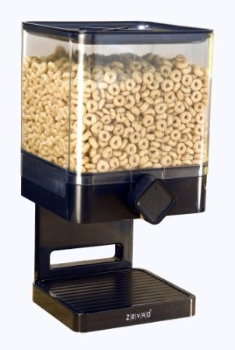
Design Approach
Turn a dry food dispenser into an automatic pet feeder.
System mounted on base platform
Food tray mounted on motor
RFID antenna positioned in front of
exposed food bowl
DC motor mounted to dispensing knob
Proximity sensor positioned to minimize
errors
LCD Screen mounted on top of dispenser

Slide 7
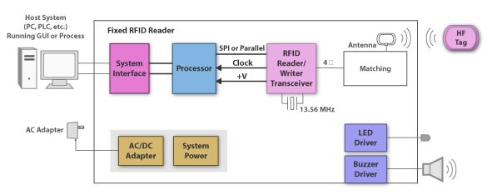
RFID Tag Specifications
Operating Frequency: 125 kHz
Baud rate: 9600 symbols/sec
O/P Format : Uart or Weigand
Uart output: TTL(Transistor-Transistor Logic) output, 9600baudrate, 8 data bits, 1 stop bit, and no verify bit.
Power supply: 5v
Current <50 mA
Max Sensing Distance: 7 cm*

Slide 8
Food Dispenser Specifications
System shall not allow food to become jammed in dispenser
System shall disperse an exactly 1 oz of dry pet food when given a tag is read
Motor to power dispenser will run off 12v power supply
System shall be no more than 3 ft tall
System shall hold 12 meals worth of dry pet food

Slide 9
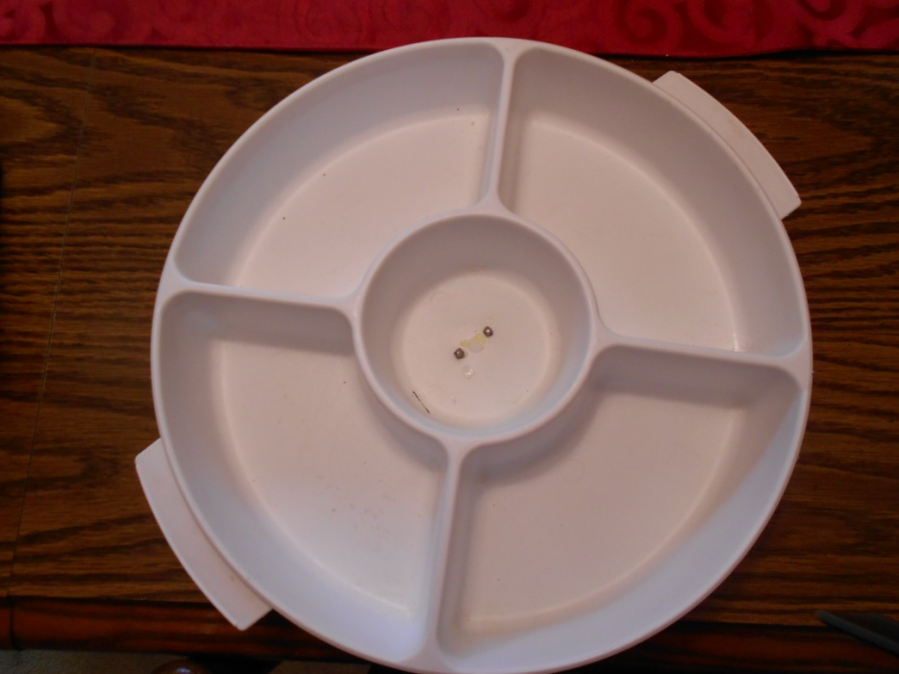
Food Tray Specifications
Plastic food dishes shall be easily removed and dishwasher safe for ease of use
Total diameter of food tray will not exceed 12 inches
Motor will be cut-off by switch once the tray reaches its specified location
No food will be spilled

Slide 10
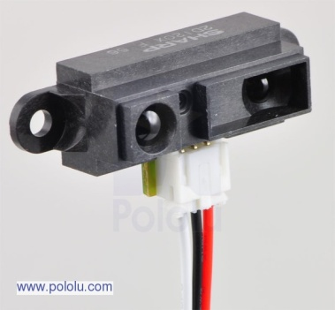
Proximity Sensor Specs
Operating voltage: 4.5 – 5.5 V
Average current consumption: 33 mA
Distance measuring range 8” – 60”
O/P type: Analog
O/P voltage differential over distance range: 2V
Response time: 38+/- 10 ms

Slide 11
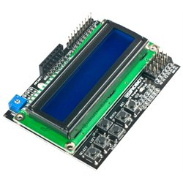
LCD Key Pad Shield
Allows user to identify animal with its corresponding RFID tag and specify food portion.
Shield can be programmed using only 2 I2C pins

Slide 12
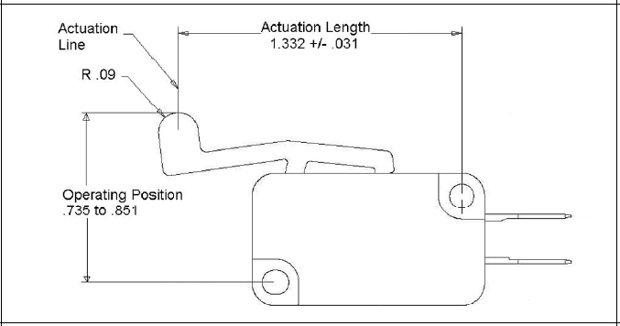
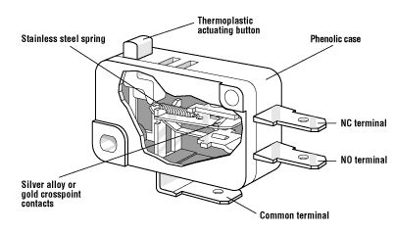
Actuator Switch
Cherry Electric E33
8 current ratings AC
3 current ratings DC
Long-life coil spring mechanism
10A, 0.5 HP, 125/250 VAC

Slide 13
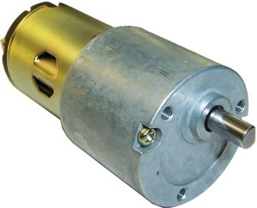
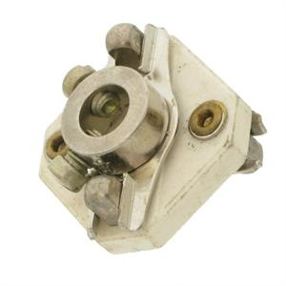
DC Gearhead Motor Specifications
3 RPM @ 6VDC
4.9 RPM @ 9VDC
6.8 RPM @ 12VDC
14.6 RPM @ 24 VDC
Current draw : 90-150 mA
Ceramic Insulated Shaft Coupling
¼” by ¼”

Slide 14
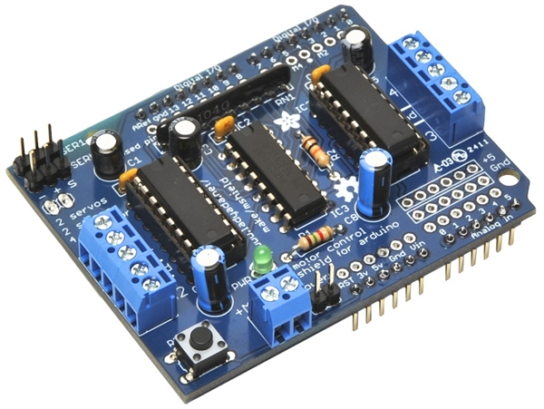

Motor Shield
Mounts on top of Duemilanove
4 H-bridges
Run motors on 4.5 VDC to 25 VDC
Requires 12v power source
Run up to 4 bi-directional DC motors
Run up to 2 stepper motors
2 connections for 5V hobby servos
Pull down resistors keep motors disabled during power up

Slide 15
Requirements
RFID tag successfully and consistently read by antenna within read range.
DC motor rotating paddle wheel and dispensing 1 oz of dry food each time
DC motor rotating food bowls to allow bowl to be filled as well as give access to that bowl while blocking off other bowl
Food bowl coming in contact with cut-off switch and cut power to the motor with food bowl being under slot where food is dispensed down
Final Code running everything in sync

Slide 16
Block Diagram
DC Motor
125 KHz
RFID tag
Motorshield
RF Reader
DC Motor
External
Antenna
SPF
Food Dispenser
Food Tray
Food Container
Paddle Wheel dispense
Base w/ DC motor
Food bowls

Slide 17
Block Diagram

Slide 18
Completed Work

Slide 19
Block Diagram
Yes, check if tag already read
RF Antenna
Scan
Pet w/ tag
Yes, activate food tray motor and move to out position
No, wait for tag
No, activate food dispenser
Activate food tray to rotate food to out position
Proximity sensor check if pet still eating
Yes, hold tray position
No, rotate food tray to initial position

Slide 20
System Design-Food housing
Steel Frame mounted to stand
  Supports food container & Stepper motor
  Stand supports weight of food bowls with plastic wheels
  Stand has external antenna positioned around edges

Slide 21
Development Board
 | Arduino Duemilanove | Arduio Mega 2560
Processor | ATmega328 | ATmega2560
Voltage | 5V | 5V
Flash | 32 kB | 256 kB
Digital I/O Pins | 14 | 54
Analog Input Pins | 6 | 16
Cost | $20 | $50

Slide 22
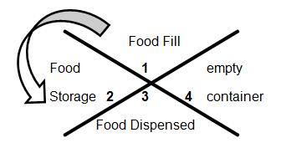
System Design- Food Dispenser

Slide 23
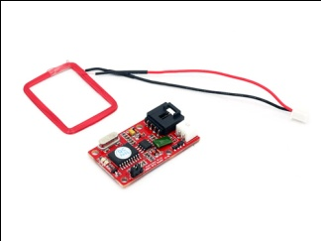
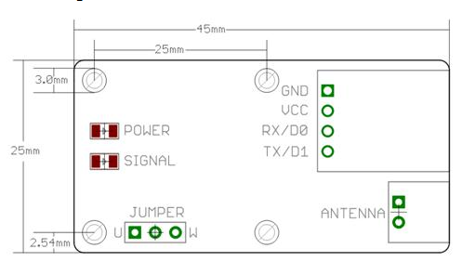
System Design-RFID
The RDM630 125 KHZ RFID reader by SeedStudio operates on 5v and the antenna provided has a maximum sensing distance of 7cm.
External antenna had to be created to increase sensing distance to make sure the pet can get fed.

Slide 24
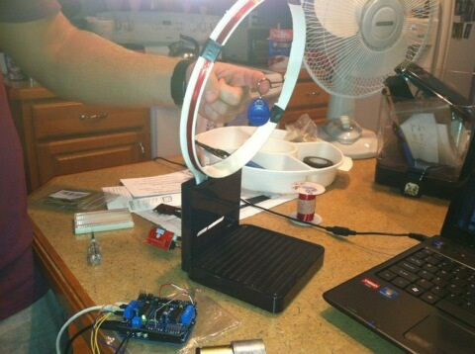
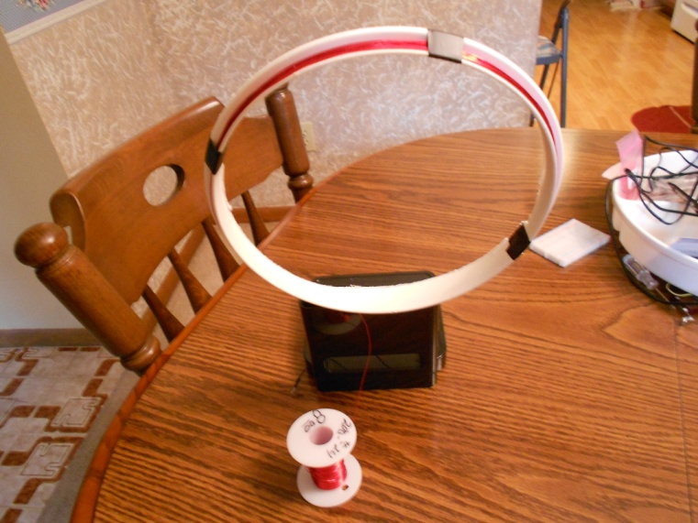
System Design-Antenna
24 AWG magnet wire wrapped around the lid of a plastic bowl
1.6" diameter, 90-110 turns, no range measurement
3.1" diameter, 75 turns, no range measurement
4.1" diameter, 48 turns, no range measurement
6" diameter, 43 turns, range 3-3.5"
9" diameter, 35 turns, range 4"
10" square shape, 24 turns, range 4“

Slide 25
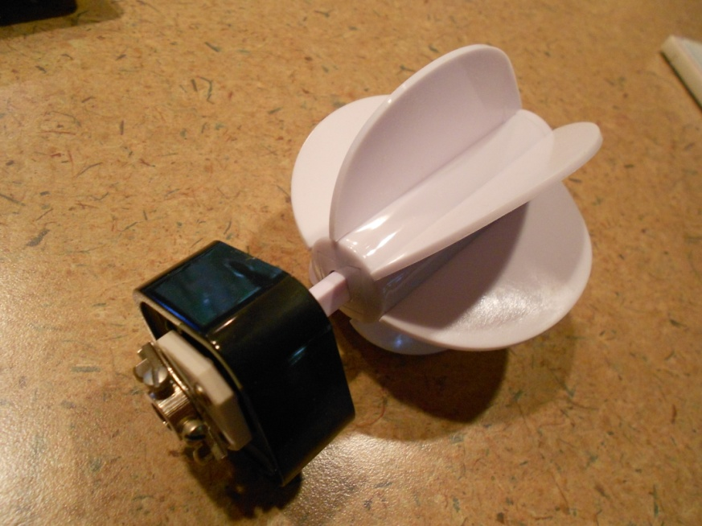
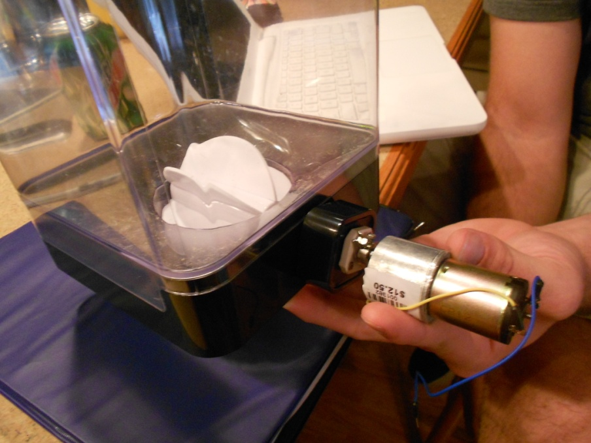
System Design-DC motors
The paddle wheel food dispenser will be mounted using a ¼” by ¼” ceramic insulated shaft coupling attached to the motor gearhead

Slide 26
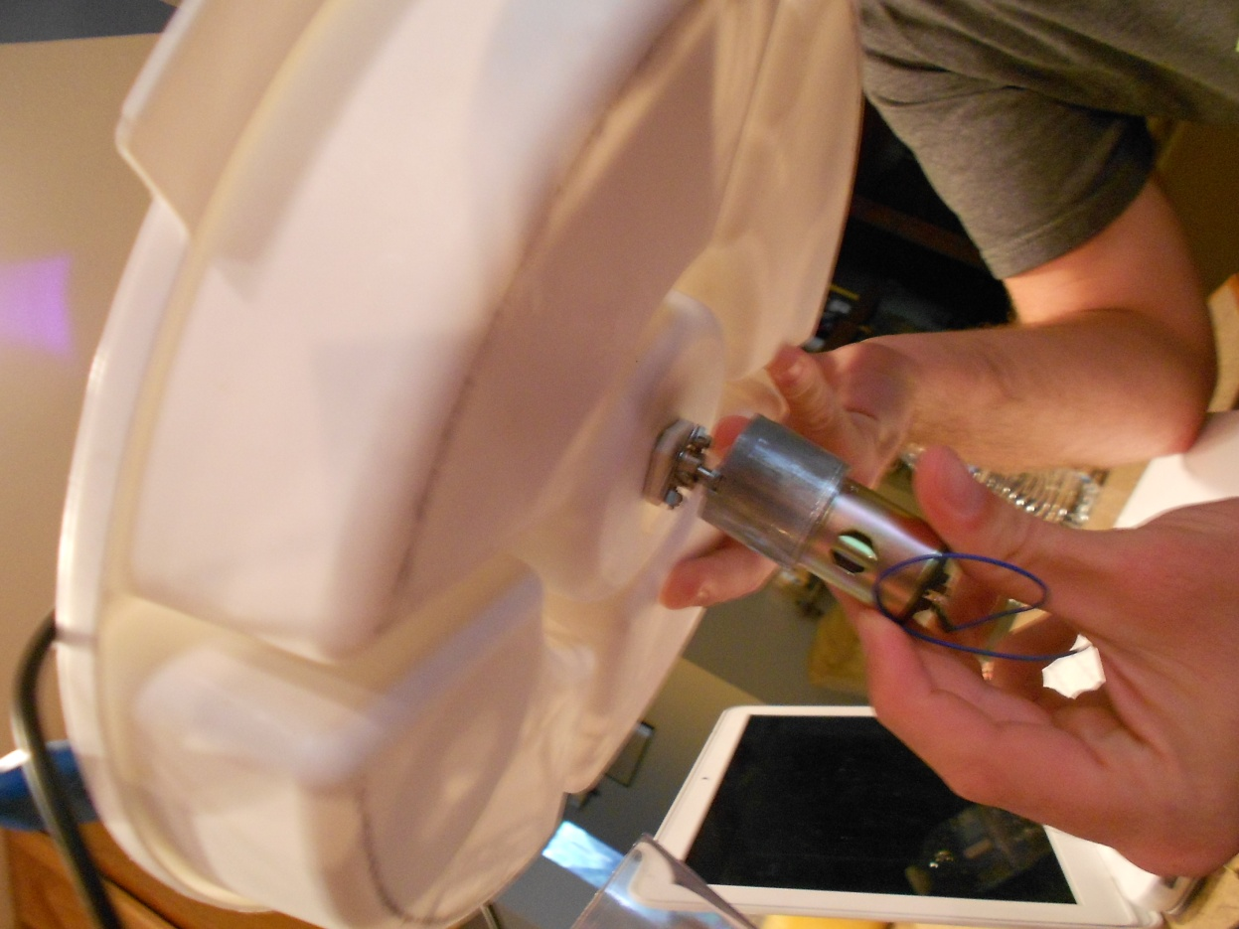
System Design-DC motor
The food tray will be mounted to the motor in the same way as the dispenser

Slide 27
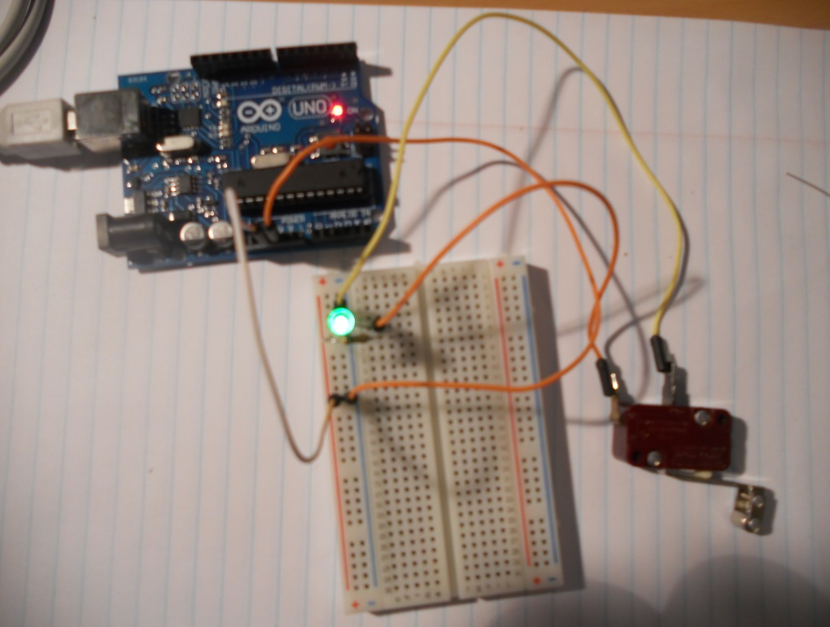
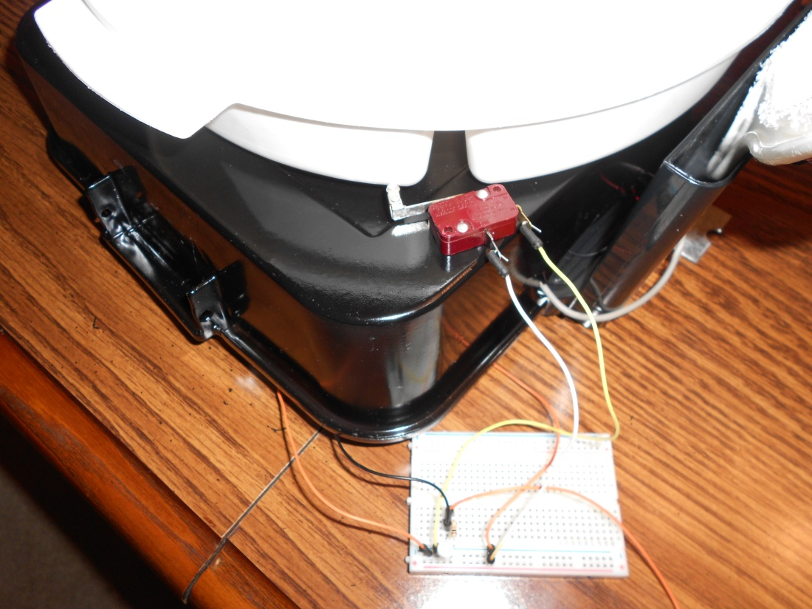
System Design- Switch

Slide 28
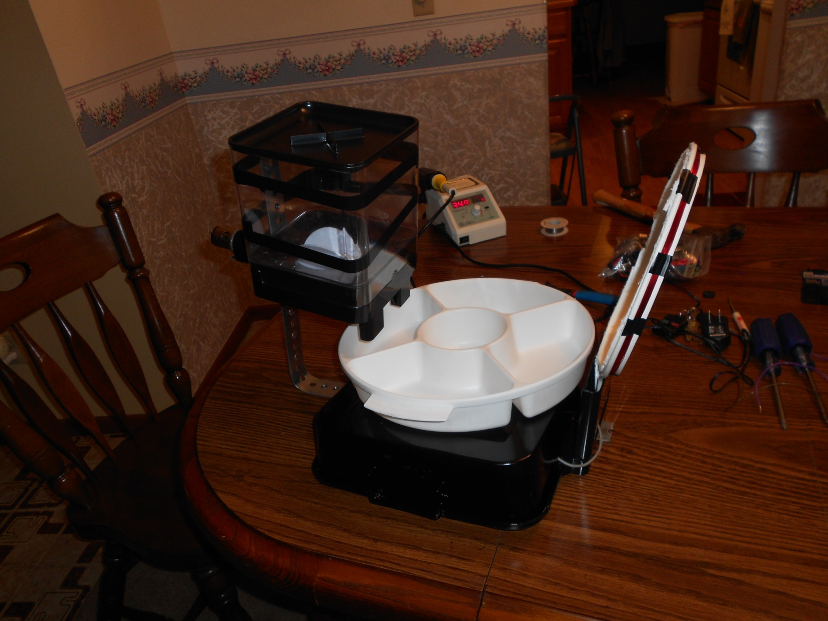

Slide 29
Design Approach
Test RFID tag with RF reader
Antenna read distance is approximately 3 mm. This distance will not be accurate enough so an external antenna must be constructed. By using 24 AWG magnet wire with a 9 inch diameter and 35 turns, the read distance is increased to 4 inches
2 tags will be used, one each assigned to a food bowl

Slide 30
Design Approach
DC motors with Motorshield
    Ceramic Insulated Shaft Coupling ¼” by ¼”
    6-24VDC Gearhead Motor
    Mounted to rotator
    Dispense 1 oz food portions
  Food Dish Motor
    Rotate food dish
    Cut-off switch activate bowl to stop rotating

Slide 31
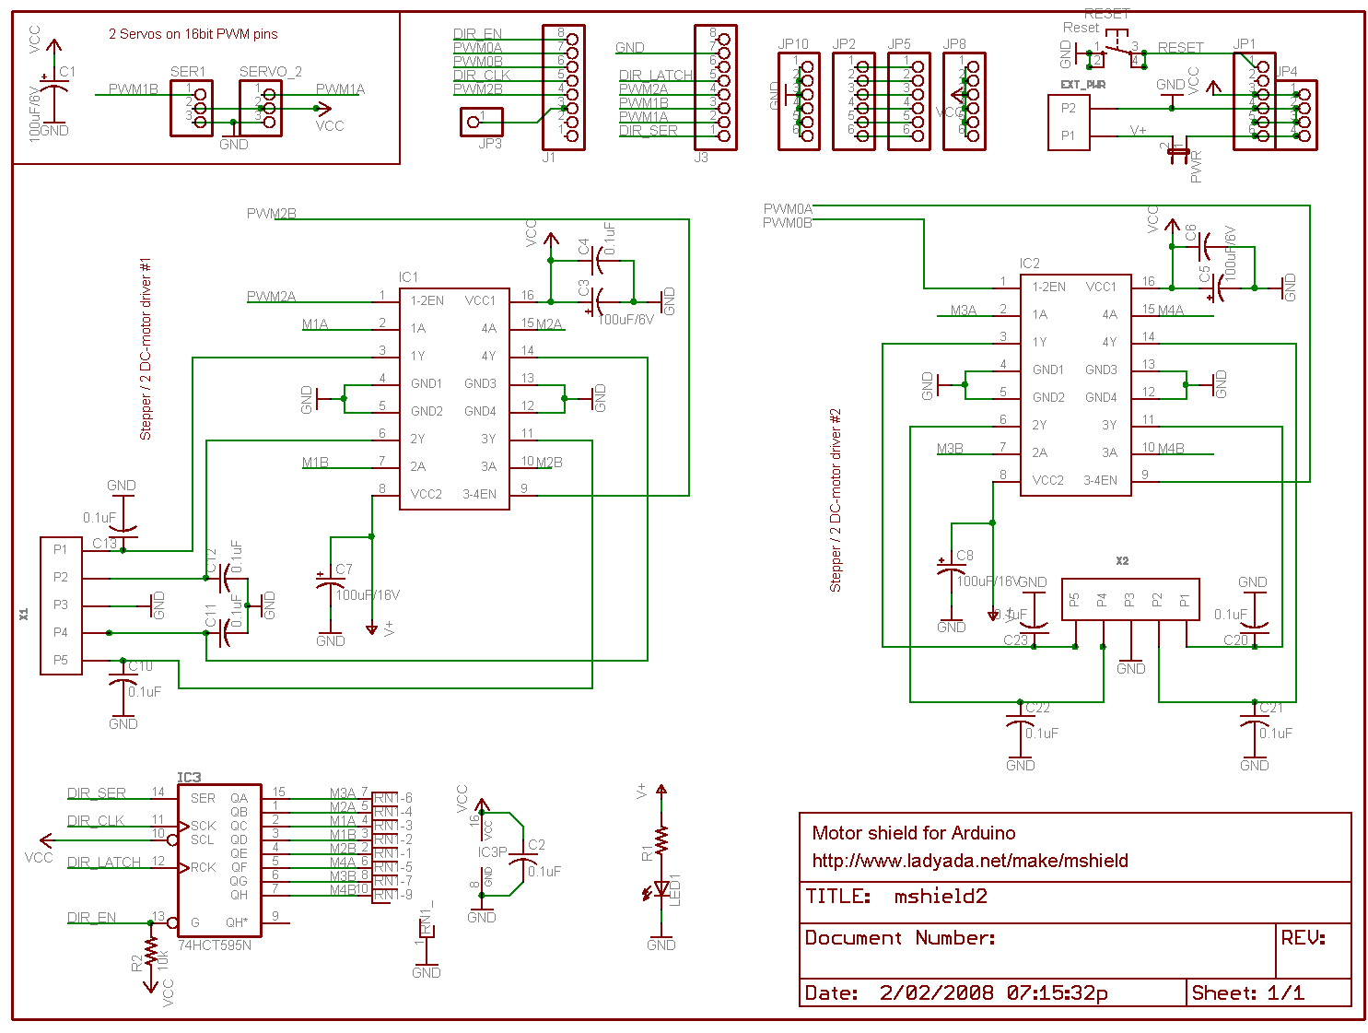

Slide 32
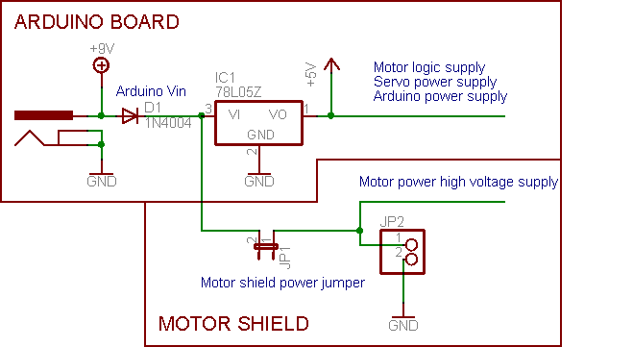

Slide 33
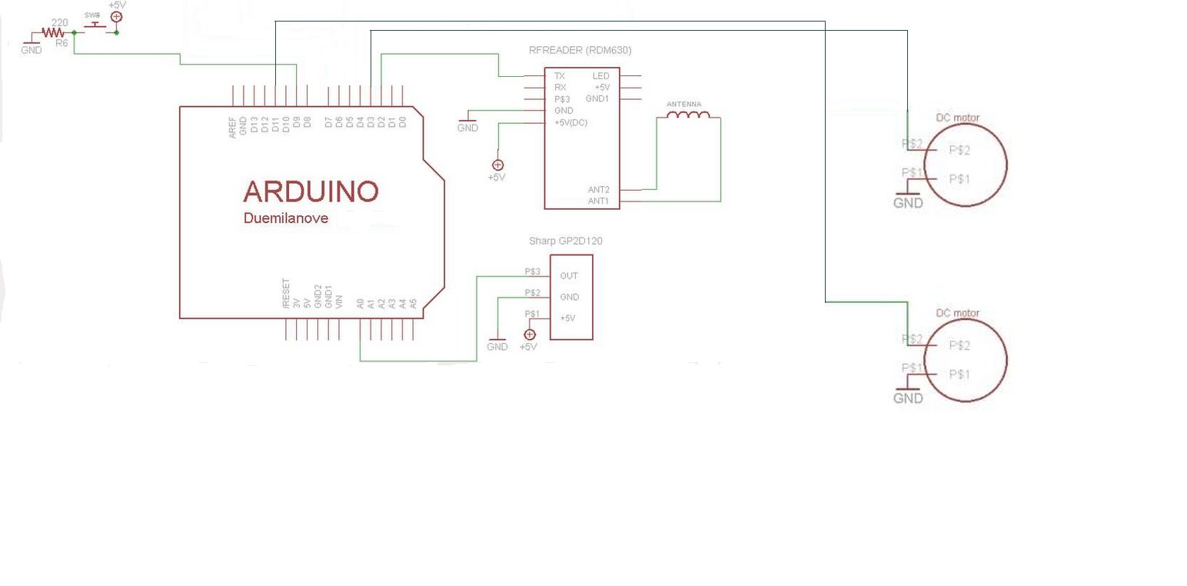

Slide 34
Implementation
RFID
  Test that each tag gets scanned in while inside the read range
  Test that external antenna constructed provides maximum read range
  Test that when RFID tag scans, stepper motor is activated to dispense food, then DC motor is activated to rotate food to make available to the pet

Slide 35
Implementation
Stepper Motor
  Test that power supply provides enough power and torque to rotate paddle wheel
  Steps so no food will get jammed while rotating
  Correct amount of steps to provide one proper serving of food into the bowl

Slide 36
Implementation
DC motor
  Power supply provides enough power to rotate food dish
  Power is cut to the motor when food dish engages cut-off switch

Slide 37
Power
Part | Voltage | Current | Power
Motorshield | 12v | 1.2A | 14.4 W
RFID reader | 5v | <50mA | <250 mW
Switch | 5V
LCD Screen | 5v | 20-30 mA | 100-150 mW
Proximity Sensor | 5v | 33 mA | 165 mW
Arduino | 9v | 150 mA | 1.35 W
Food dispenser Motor | 6v | 90-150 mA | 540-900 mW
Food tray Motor | 6v | 90-150 mA | 540-900 mW

Slide 38
Design Decisions
Several decisions were made on the frame for the SPF
Several decisions were made on the food bowl and dispensing machine

Slide 39
Component Decisions
The 125 KHz RFID tags and 125 KHz RF reader was chosen because the reader allows for an external antenna which is essential to ensuring accuracy and efficiency of the SPF
A DC motor was chosen for the food dispenser because the paddle wheel is designed with 4 slots that need to be filled and rotated. This action requires a slow continuous rotation for easy food transportation
A DC motor was chosen for the food dish because a 6V input would provide only 3 rpm with high torque which will be needed to turn the food dish filled with food

Slide 40
Success/Difficulties for project subsystems
SUCCESS | DIFFICULTIES
RFID reader with tag | Finding correct size of external antenna to provide maximum read distance
Food Dispenser | PCB
Food bowl | Stepper Motor
Frame | DC Motor
Code | Cut off Switch

Slide 41
Budget
Part | Cost | Paid
Arduino | 20.00 | 20.00
RFID Tags | 2.50 | 2.50
RF reader | 13.50 | 13.50
Stepper motor | 6.00 | 6.00
DC motor | 12.50 | 25.00
H-Bridge | 4.00 | 4.00
Food Container | 5.00 | ----
Motor Shield | 20.00 | 20.00
Actuator Switch | 1.00 | 1.00
200’ 24 AWG Magnent wire | 8.00 | 8.00
12V Power Adapter | 12.00 | ----
9V Power Adapter | 10.00 | 10.00
Food Bowl | 10.00 | ----
Support Frame | 5.00 | 5.00
Proximity Sensor | 15.00 | 15.00
LCD Screen | 24.00 | 24.00
TOTAL | 168.50 | 141.50

Slide 42
Concerns
Power
RFID tag scanning every time
Pet Behavior
Proximity sensor if two pets are within range

Slide 43
Immediate plans for successful completion
Get system running as a whole with all components
Cut-off switch stopping food dish in precise location for food to be dispensed
Solid Frame with all components

Slide 44
Questions ?

