Slide 1
SPF 2000
SmartPetFeeder
Tim Forkenbrock
Austin Scruggs
Group 17

Slide 2
Project Description
The Smart Pet Feeder (SPF) is a semi-automated device that can feed your household pets at their convenience
The SPF works by attaching an RFID tag to a pets collar which is scanned in by the RF antenna mounted on the SPF when the animal is within the antenna read distance range
Upon receiving the RFID tag information, a DC motor will rotate a paddle wheel and dispense food down into a food bowl. A second DC motor will then rotate the food bowl to allow food to be accessed by the pet
Each pet will have their own RFID tag which will correspond to a specific food bowl

Slide 3
Motivation
Minimize chance of animal not being fed while owner is away
Minimize opportunity for one animal to eat another’s food while owner is away

Slide 4
Goals & Objectives
Unassisted access to food
Cost Effective
Two different pets can be fed
Controlled pet access
Food portion consistency

Slide 5
System Block Diagram
DC Motor
125 KHz
RFID tag
Motor shield
RF Reader
DC Motor
External
Antenna
SPF
Microcontroller
Food Dispenser
Food Tray
Food Container
Paddle Wheel dispense
Base w/ DC motor
Food bowls

Slide 6
Requirements
RFID tag read consistently
Motor 1 dispenses correct amount of food
Motor 2 rotates food tray to correct position
Proximity Sensor determines if pet is still in area
System designed to minimize space and appeal to the pet

Slide 7
Overall Specifications
System will be composed of:
  Food tray
  Food dispenser
  LCD screen
  RFID system
    RFID tags
    RF reader
    Antenna
  Motorshield
  Proximity Sensor
  Two DC motors
  Housing

Slide 8
Control Unit Block Diagram
PCB
Pet with RFID tag
RF Antenna
Food dispense motor
Food tray motor
LCD Keypad Shield
Proximity Sensor

Slide 9
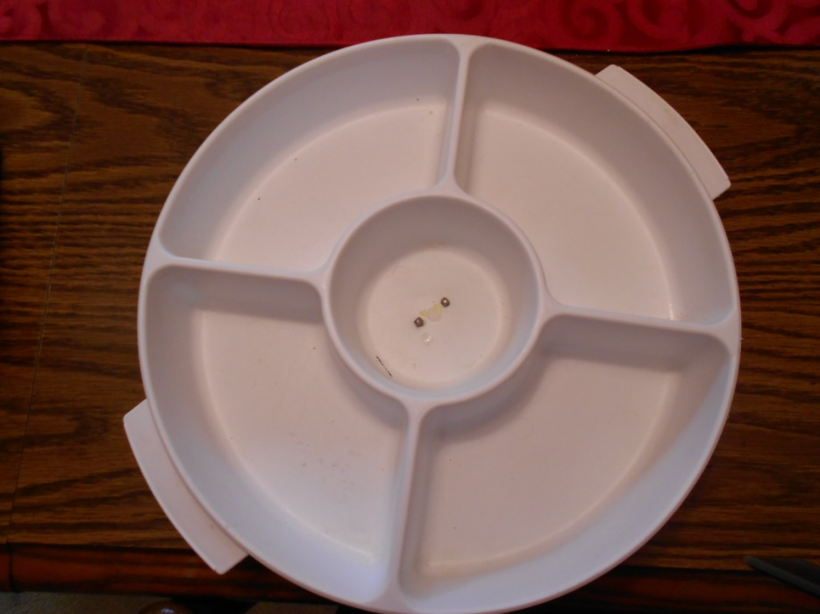
Food Tray Specifications
Easily removed and dishwasher safe
12 inch diameter
4 trays
Pet 1
Pet 2
Empty
Empty

Slide 10
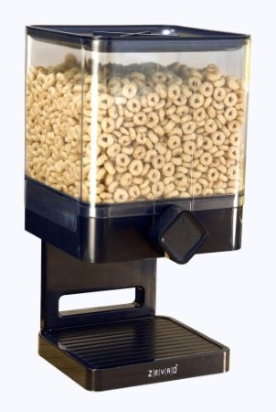
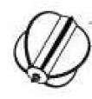
Food Dispenser Specifications
Canister holds 17.5 ounces of dry food
Dimensions: 6.31 in D x 7.19 in W x 12.13 in H
1 oz portion

Slide 11
Development Board
 | Arduino UNO | Arduino Mega 2560
Processor | ATmega328 | ATmega2560
Voltage | 5V | 5V
Flash | 32 kB | 256 kB
Digital I/O Pins | 14 | 54
Analog Input Pins | 6 | 16
Cost | $20 | $50

Slide 12
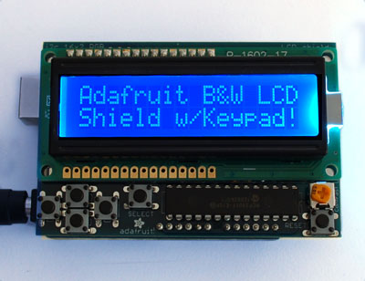
LCD Key Pad Shield
Allows user to identify animal
with its corresponding RFID tag
and specify food portion.
Operating Voltage: 5V
6 push buttons
Shield can be programmed
using only 2 I2C pins

Slide 13
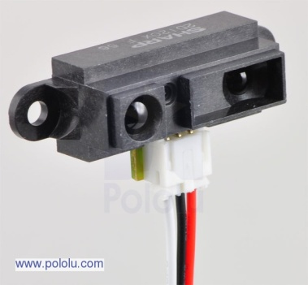
Proximity Sensor
Operating voltage: 4.5 – 5.5 V
Average current consumption: 33 mA
Distance measuring range 8” – 60”
O/P type: Analog
O/P voltage differential over distance range: 2V
Response time: 38+/- 10 ms

Slide 14
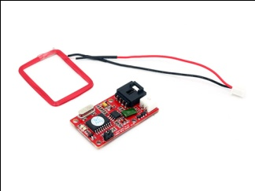
RF Reader
Operating Frequency: 125 kHz
Baud rate: 9600 symbols/sec
O/P Format : Uart
Uart output: TTL(Transistor-Transistor Logic) output, 9600baudrate, 8 data bits, 1 stop bit, and no verify bit
Power supply: 5v
Current <50 mA
Max Sensing Distance: 7 cm*

Slide 15
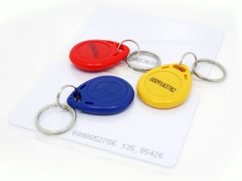
RFID Tags
Operating Frequency: 125 KHz
Contactless Read & Write
Compatible with RF reader
Hang from pets collar

Slide 16
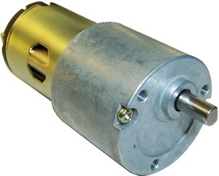
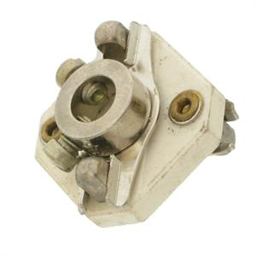
DC Gearhead Motor
3 RPM @ 6VDC
4.9 RPM @ 9VDC
6.8 RPM @ 12VDC
14.6 RPM @ 24 VDC
Current draw : 90-150 mA
Ceramic Insulated Shaft Coupling
¼” by ¼”

Slide 17
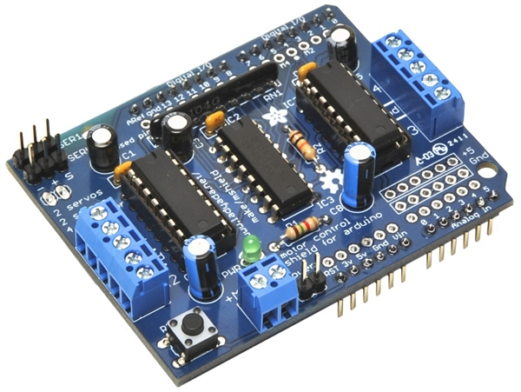

Motor Shield
Mounts on top of PCB
Run motors on 4.5 VDC to 25 VDC
Requires 12v power source
Run up to 4 bi-directional DC motors
Run up to 2 stepper motors
2 connections for 5V hobby servos
Pull down resistors keep motors disabled during power up

Slide 18
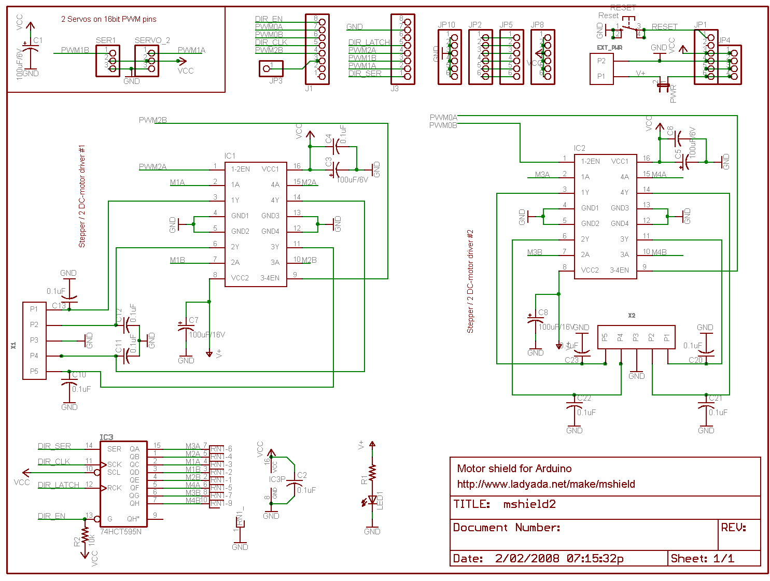

Slide 19
Flow chart
Yes, check if tag already read
RF Antenna
Scan
Yes, activate food tray motor and move to out position
No, wait for tag
No, activate food dispenser
Activate food tray to rotate food to out position
Proximity sensor check if pet still eating
Yes, hold tray position
No, rotate food tray to initial position

Slide 20
Design Approach
Turn a dry food dispenser into an automatic pet feeder.
Base platform covers electronics
Food tray mounted on motor
RFID antenna positioned in front of exposed food bowl
DC motor mounted to dispensing knob
Proximity sensor positioned to read if pet
is in front of bowl
LCD Screen mounted on top of housing

Slide 21
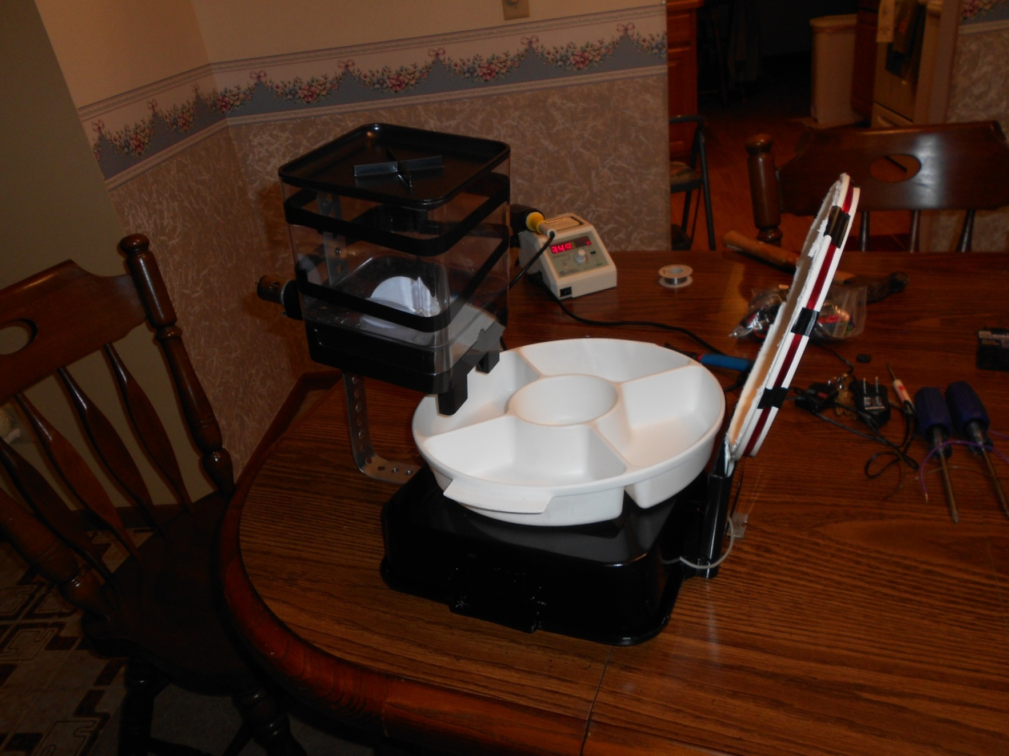

Slide 22
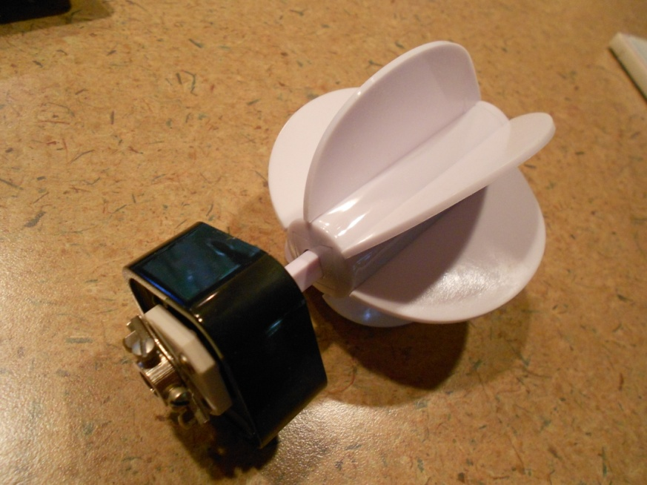
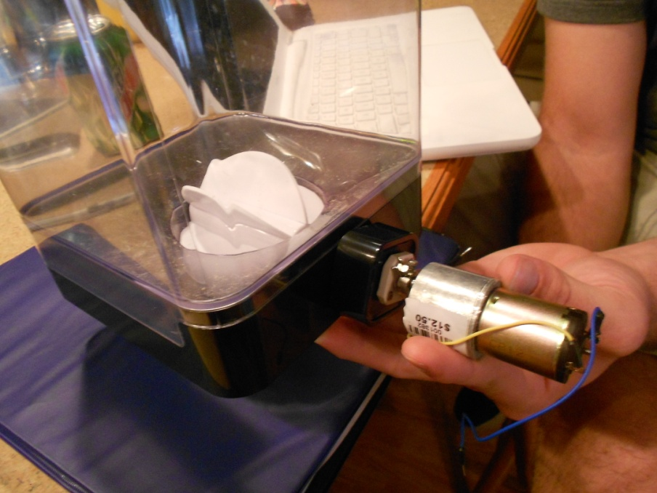
System Design-Dispenser motor
The ceramic insulated shaft coupling is attached to the paddle dispenser

Slide 23
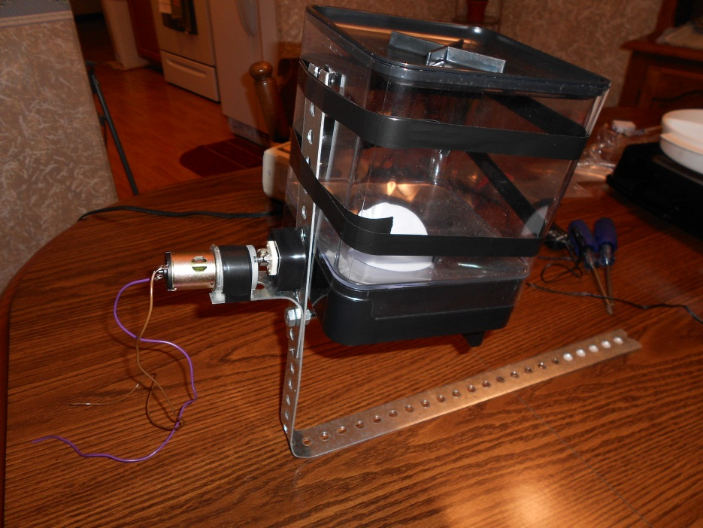
System Design-Food container
Steel strip mounted to food container
  Supports weight of food
  Mounting for motor

Slide 24
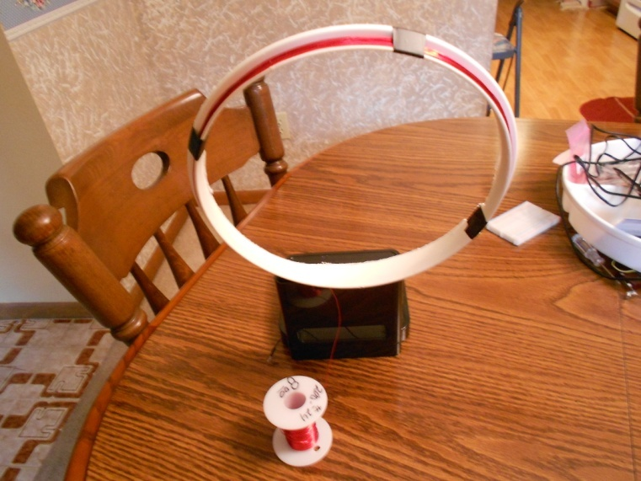
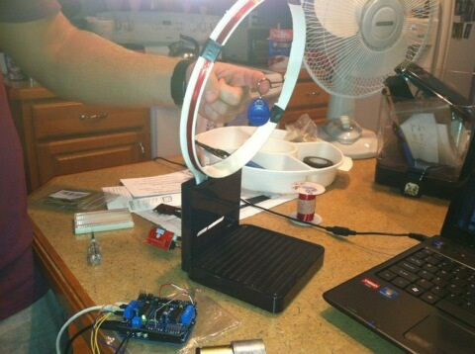
System Design-Antenna
24 AWG magnet wire wrapped around the lid of a plastic bowl
6" diameter, 43 turns, range 3-3.5"
9" diameter, 35 turns, range 4"
10" square shape, 24 turns, range 4“

Slide 25
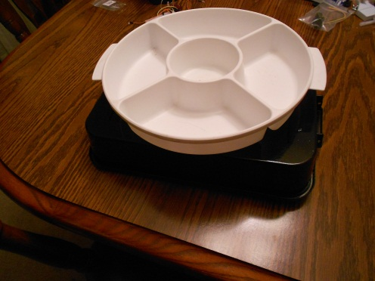
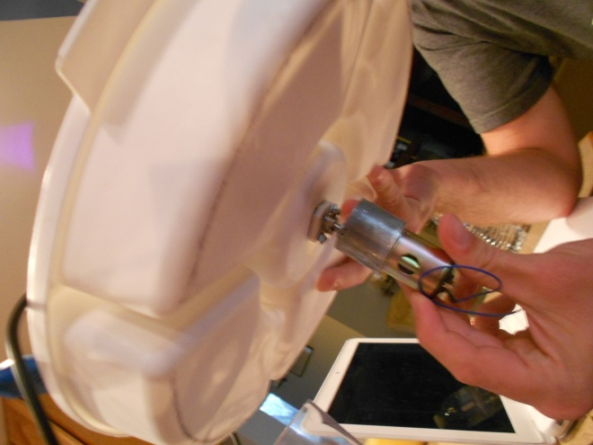
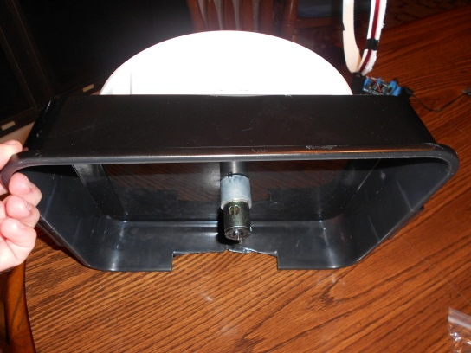
System Design-Food tray motor
The food tray will be mounted to the motor in the same way as the dispenser

Slide 26
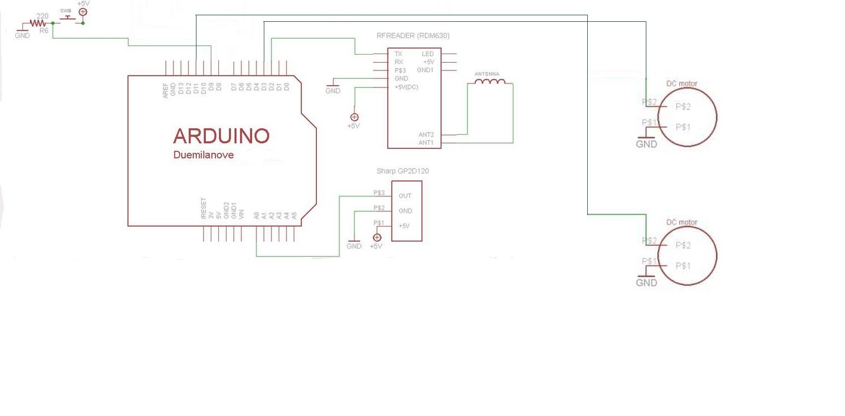

Slide 27
Implementation- RFID
RFID
  Each tag gets scanned in while inside the read range
  External antenna constructed provides maximum read range
  When RFID tag scans, DC motor1 is activated to dispense food, then DC motor2 is activated to rotate food to make available to the pet

Slide 28
Implementation- Housing
An enclosure had to be constructed so the animals could not access the food from the side
16” X 17” Wooden base with legs
13” X 12” Side walls
16” X 12” Hinged Door for easy access of electronics
16” X 12” Top

Slide 29
Implementation- Motor
Dispensing Motor
  Power supplied provides enough power and torque to rotate paddle wheel
  Correct rotation speed so no food will get jammed
  Correct amount of rotations to provide one proper serving of food into the bowl

Slide 30
Implementation-Motor
Food tray motor
  Correct rotation speed so no food is spilled
  Correct time of rotation for accurate bowl placement

Slide 31
Power
Part | Voltage | Current | Power
Motorshield | 12v | 1.2A | 14.4 W
RFID reader | 5v | <50mA | <250 mW
LCD Screen | 5v | 20-30 mA | 100-150 mW
Proximity Sensor | 5v | 33 mA | 165 mW
Arduino | 9v | 150 mA | 1.35 W
Food dispenser Motor | 6v | 90-150 mA | 540-900 mW
Food tray Motor | 6v | 90-150 mA | 540-900 mW

Slide 32
Component Decisions
The 125 KHz RFID tags and 125 KHz RF reader was chosen over a 13.56 MHz reader/tag because the reader allows for an external antenna which is essential to ensuring accuracy and efficiency of the SPF
A DC motor was chosen for the food dispenser because the paddle wheel is designed with 5 slots that need to be filled and rotated. This action requires a slow continuous rotation for easy food transportation
A DC motor was chosen for the food dish because a 6V input would provide only 3 rpm with high torque which will be needed to turn the food dish filled with food

Slide 33
Completed Work

Slide 34
Work Distribution

Slide 35
Budget
Part | Cost | Paid
Arduino | 20.00 | 20.00
RFID Tags | 2.50 | 2.50
RF reader | 13.50 | 13.50
Stepper motor | 6.00 | 6.00
DC motor | 12.50 | 25.00
Wood Housing | 15.00 | ----
Food Container | 5.00 | ----
Motor Shield | 20.00 | 20.00
PCB | 450.00 | 175.00
200’ 24 AWG Magnent wire | 8.00 | 8.00
12V Power Adapter | 12.00 | ----
9V Power Adapter | 10.00 | 10.00
Food Bowl | 10.00 | ----
Support Frame | 5.00 | 5.00
Proximity Sensor | 15.00 | 15.00
LCD Screen | 24.00 | 24.00
TOTAL | 627.50 | 324.00

Slide 36
Difficulties & Concerns
Power
RFID tag scanning every time
Pet Behavior
Proximity sensor if two pets are within range
Code/ system awareness
LCD Screen

Slide 37
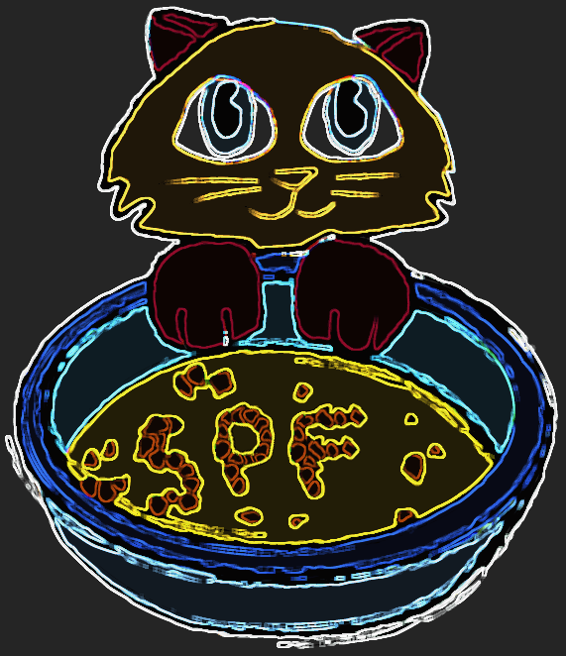
Any Questions right meow?

