Slide 1
Group 18: Disaster Zone Emergency Response Vehicle
Marcial (T.J.) Rosario, EE
Michael Lopez, CpE
Robert Smith, EE

Slide 2
Motivation
Keeping search and rescue crew members safe.
Exploring the field of robotics.
Gaining insight into real-world engineering design, prototyping, and testing processes.

Slide 3
Goals
To create a low-power, low-cost, easy-to-use mobile module to allow search and rescue crews to safely carry out their duties without unnecessarily putting themselves in danger.
Creating a simple graphical user interface which will allow them to do so.

Slide 4
Specifications
Max wireless range of 275 ft.
Power Consumption of < 10 W
Final weight of < 10 lbs.
Operational battery life of at least 30 min.
All sensors accurate to within 10%

Slide 5
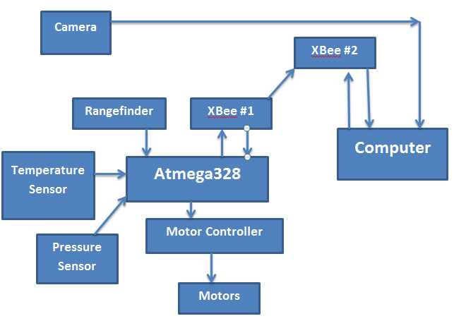
Hardware Block Diagram

Slide 6
Chassis

Slide 7
Chassis Modifications
Wheels, motors and base of car will remain stock
Yellow covering will be removed and replaced with a raised platform to allow for more area for components
Batteries will be stored below this platform on plastic base in order to save space and account for heat from batteries

Slide 8
Wireless Communication

Slide 9
XBee Wireless Starter Kit
Includes 2 Xbee 1 mW communication modules
XBee Explorer USB
XBee Explorer Regulated
Mini USB cable
$79.99

Slide 10
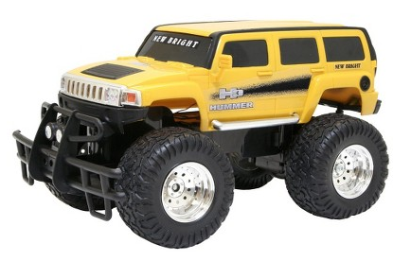
Wireless Flowchart

Slide 11
Motor Controller

Slide 12
Pololu Qik Dual Serial Motor Controller (qik 2s9v1)
Controls 2 DC brush motors
4.5-13.5 V motor supply range
2.7-5.5 V logic supply
Automatic baud rate detection (up to 38400 bps)
Supports daisy-chaining the qik to other qiks and Pololu serial motor and servo controllers with 1 serial line

Slide 13
Motor Controller Pin Layout
Regulated 5 V will be connected to Vcc
Rx and Tx pins will be routed to our XBee module
Motors will be connected to M0 and M1
12 V supply will be connected to the VMOT pin

Slide 14
Sensors

Slide 15
Rangefinder
Efficiently navigate through search and rescue path
Detect and avoid obstacles which could impede the vehicle’s movement or damage it.
Detect possible injured life forms unable to communicate

Slide 16
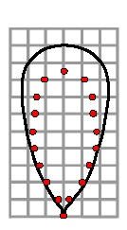
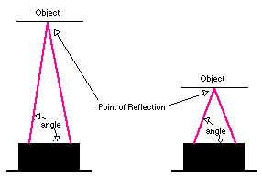
Ultrasonic or Infrared?
Ultrasonic Range Finder
Infrared Range Finder
Accurate distance
Can be used indoors or out
Sound absorbing materials affect accuracy
Can be costly >$25
Inexpensive <$20
Not as accurate
Cannot be used in the sun
Narrow beam width

Slide 17
Obstacle Detection
Maxbotix LV-MaxSonar-EZ1 mounted on front of vehicle
2.5V – 5.5V supply with typical 2mA draw
Pulse Width output detection range of 6” – 254”
Beam width of about 45°

Slide 18
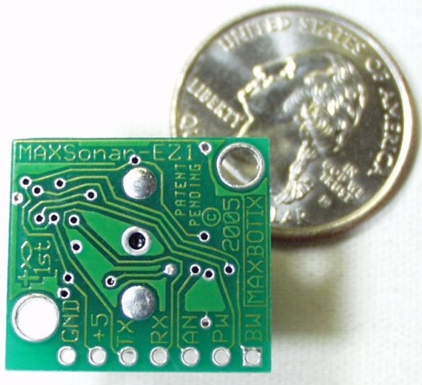
Maxbotix LV-MaxSonar-EZ1
We will utilize three pins
+5 (V_{cc})
GND
PW (Output)
Pulse Width Output
Will output a PW representation of the range
Detection Formula: calcInches = PW/Vi
calcInches: measure distance in inches
PW: pulse width output
Vi : Volts/inch; scaling factor of 147 μS/inch

Slide 19
Atmospheric Pressure Detection

Slide 20
Atmospheric Pressure Detection
Detect sudden changes in altitude
Detect dangerous explosive atmospheres
Detect changes in weather

Slide 21
Pressure Sensor Selection
Part Number | MPL115A1 | BMP085
Brand | Freescale | Bosch
Operating Voltage | 2.375V – 5.5V | 1.8V – 3.6V
Power | 10 μA @ 1 sample/sec. | 5 μA @ 1 sample/sec.
Interface | SPI | I²C
Accuracy | ±1 kPa | ±0.1 kPa
Range | 50 – 115 kPa | 30 – 110 kPa
Price | $24.95 | $19.95

Slide 22
Atmospheric Pressure Detection
Freescale MPL115A1 Miniature SPI Digital Barometer
50 kPa – 115 kPa absolute pressure
Integrated ADC
SPI interface

Slide 23
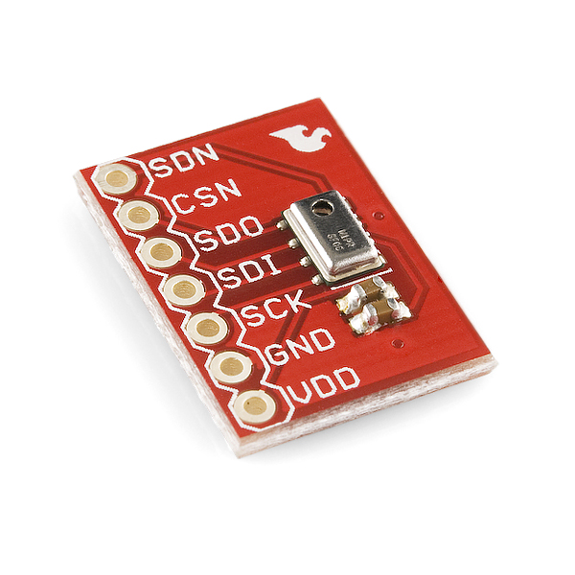
MPL115A1 Pressure Sensor
We will utilize all the pins on the chip
V_{DD}, GND, SHDN, SCLK, DIN, DOUT, CS
Formula: Pcomp = a0 + (b1+c12*Tadc) * Padc + b2 * Tadc
Padc: 10b pressure ADC output
Tadc: 10b temp. ADC output
a0: pressure offset coefficient
b1: pressure sensitivity coefficient
b2: temp. coefficient of offset
c12: temp. coefficient of sensitivity
Pressure(kPa) = Pcomp * [115 - 50/1023] + 50

Slide 24
Temperature and Humidity Sensor

Slide 25
Temperature and Humidity Sensor
Gain a better sense of surrounding environment
Be able to detect extreme heat or cold
Can injure both survivors and vehicle
Detect levels of humidity
Gather level of comfort of area

Slide 26
Sensor Selection
Part Number | SHT15 | HTM1735LF | SHT10
Brand | Sensiron | Measurement Specialties | Sensiron
Operating Voltage | 2.4V-5.5V | 2.5V – 7V | 2.4V – 5.5V
Power | 150 μW | 20 mW | 90 μw
Interface | I²C | Analog Output | I²C
Accuracy | ±2% RH ±0.3 C | ±3% RH ±3% C | ±3% RH ±0.4 C
Range | 0 – 100% RH -40 – 123.8 C | 0 – 100% RH -30 – 80 C | 0 – 100% RH -40 – 125 C
Price | $28.95 | $14.95 | $15.00

Slide 27
Temperature and Humidity Sensor
Measurement Specialties HTM1735LF Temperature and Relative Humidity Module
Direct interface with μC with humidity linear V and direct NTC output
Typical 1 – 3.6V output for 0 – 100% RH
Temp. measurement through NTC 10kΩ ±3% direct output

Slide 28
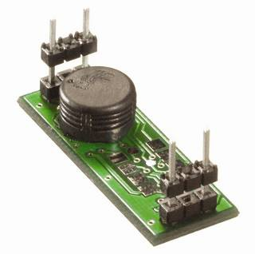
HTM1735LF Sensor
We will utilize all 4 pins on board
NTC (Temp.), GND, V_{CC}, Vout (Hum.)
Humidity Formula:
Vout = 25.68RH + 1079
RH = 0.03892Vout – 41.98
Temperature Formula:
R_{T} = R_{N} * e^{β[1/T – 1/Tn ]}
R_{T:} NTC resistance (Ω) at temp. T (K)
R_{N:} NTC resistance (Ω) at temp. T (K)
T, T_{N}: Temperature (K)
β: Material specific constant of NTC

Slide 29
Vehicle Vision

Slide 30
Vehicle Vision
Necessary to navigate over various types of terrain
Help operator detect obstacles the obstacle detection system might miss
Help operator locate victims or survivors in need of aid

Slide 31
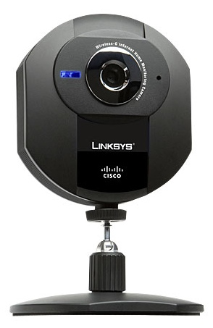
Linksys WVC54GC Wireless-G
Integrated web server; view from browsers via PC/phone
Simple to set up
320x240 pixel resolution
5V power barrel jack does not require outlet

Slide 32
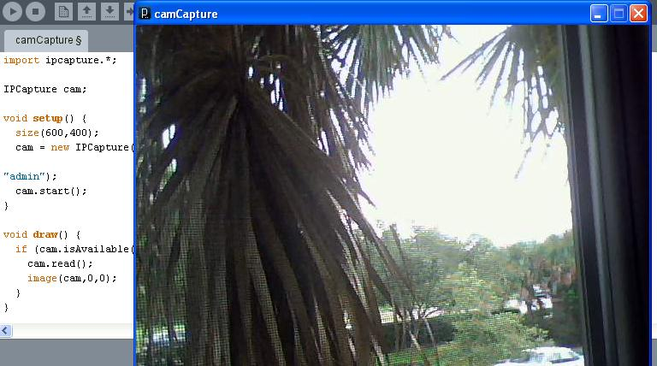
Live Video Stream
In order to lead effective mission, video stream must be live
Processing Sketchbook will be software of choice
IPCapture libraries to capture feed
Will be integrated with operator GUI

Slide 33
Vehicle Illumination

Slide 34
Vehicle Illumination
Robot must be able to navigate under lowlight conditions
Be able to view camera feed at all times
Search for survivors in all conditions

Slide 35
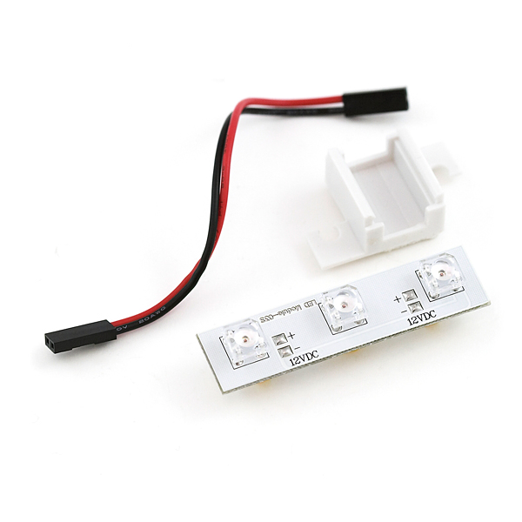
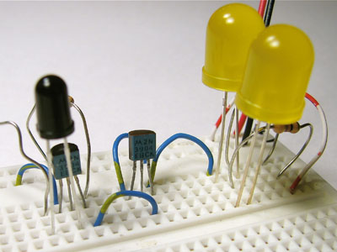
Vehicle Illumination
LED Bar
Dark-Detecting Circuit
Pre-Packaged, ready to go
Inexpensive
Simple to interface
Will drain power from our battery (30mA @ 12V)
Needs some kind of control to know when to run
Inexpensive, Simple
Will not drain power from main battery
Automatically turns on in dark lighting situations
Needs a separate power source

Slide 36
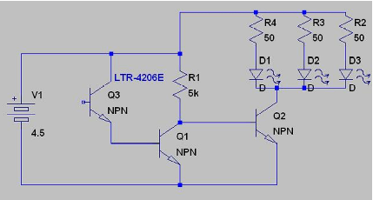
Dark-Detecting Circuit
Simple and automatic circuit utilizing a phototransistor
NPNs to drive the LEDs
Will utilize separate AA batteries
Only draws about 35mA

Slide 37
Microcontroller

Slide 38
Microcontroller
Part | ATmega1280 | ATmega328 | PIC16F886
Flash Memory | 128 KB | 32 KB | 14 KB
Pin Count | 100 | 32 | 28
CPU | 8-bit AVR | 8-bit AVR | 5 MIPS
Frequency | 16 MHz | 20 MHz | 8 MHz
EEPROM | 4096 B | 1024 B | 256 B
ADC | 16 ch, 10-bit | 8 ch, 10-bit | 11 ch, 10-bit
Price | Chip: Sampled Dev Board: $28.00 | Chip: Sampled Dev Board: $29.95 | Chip: Sampled Dev Board: $28.95

Slide 39
ATmega328
Atmel ATmega328 offers enough computational power for out application
Tied to sensors and TX/RX module for data communication
32 total pins, with 23 I/O pins
Programmed with Arduino IDE/Bootloader

Slide 40
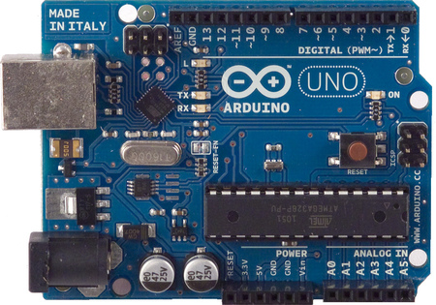
Arduino Uno
For testing purposes, we will use Uno Dev. Board
14 digital I/O pins (6 PWM), 6 analog input pins
SPI communication
Serial RX and TX pins for TTL serial data
Abundance of code examples, libraries

Slide 41
ATmega328 Schematic

Slide 42
Software

Slide 43
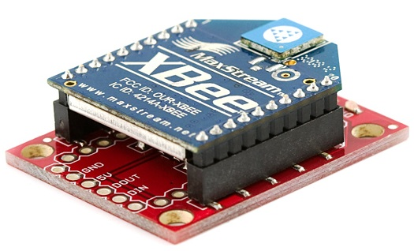
Software Overview
Operator Software
Operator Control
Operator Interface
Sensor Data Receive
Live Camera Feed
Vehicle Software
System Initialization
Sensor Polling/Reading
Sensor Data Transmit
Navigation/Motor Control

Slide 44
Operator Software

Slide 45
Operator Software
Written using Processing and Arduino
Displays camera feed and sensor data
Allows for on-screen control of vehicle

Slide 46
Vehicle Software
Must handle all sensor polling and incoming sensor readings
Must handle live camera feed
Must be capable of controlling rear drive and front steering motors
Must communicate with XBee modules to send/receive data

Slide 47
System Class Diagram

Slide 48
Power Supplies

Slide 49
Power Supply
Will be used to power electronics
Needs to be powerful enough to run electronics for at least 30 minutes
Must be relatively compact in order to save space on chassis
Minimal memory effect
Low cost is crucial

Slide 50
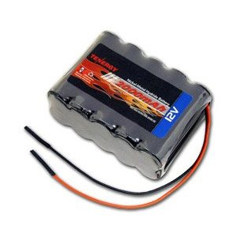
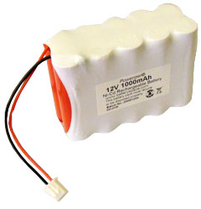
What kind of battery suits us best?
 | NiMH | NiCd
Brand | Tenergy | Battery Space Custom
Voltage Provided | 12 V | 12 V
Current Rating | 2000 mAh | 1000 mAh
Dimensions | 50 mm (W) x 29 mm (H) x 72 mm (L) | 51 mm (W) x 32 mm (H) x 76.2 mm (L)
Memory Effect | Very Little (Provides 3000 cycles before deterioration) | Very Little (Amount of cycles not specified)
Cost | $21.99 | $21.99

Slide 51
Battery Charger

Slide 52
Charger Details
Charges both NiCd and NiMH batteries
7.2 – 12 V Selector Switch
Light indicator when charging
Charges our battery in less than 2 hours
Costs $10.05

Slide 53
Voltage Regulation
Due to using a supply with more voltage than our parts are rated for, it is necessary to regulate our supply’s voltage.
Two options: linear regulators and switching regulators

Slide 54
Voltage Regulation
Due to using a supply with more voltage than our parts are rated for, it is necessary to regulate our supply’s voltage.
Two options: linear regulators and switching regulators

Slide 55
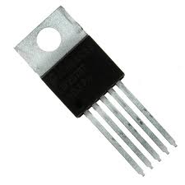
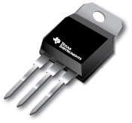
Linear vs. Switching Regulators
Linear Regulators
Switching Regulators
Easy to use
Available in popular three-terminal T0-220 package as seen in the 78xx and 79xx family of regulators, or as a surface mount part.
Very inefficient, 15%-40% in some cases.
Easy to implement, circuit becomes slightly more complex
Available in 5-terminal TO-220 package, as well as a surface mount part.
Highly efficient, some as high as 90%

Slide 56
Need to regulate down to 5 V from 12V power supply.
Due to the need for such heavy regulation, a switching regulator would better suit our needs in terms of efficiency and power losses due to heat.

Slide 57
LM2576
Previous experience
Simple setup.
77% efficiency for 5V model, 75% for 3.3V model.
Free samples readily available from Texas Instruments
Sampled both through-hole and surface-mount parts.

Slide 59
Power Consumption
Component |  | Max Current | Input Voltage | Power
Camera (WVC54GC) |  | 1 A | 5 V | 5 W
Range Finder (LV-EZ1) |  | 2 mA | 5 V | 10 mW
Pressure Sensor (MPL115A1) |  | 10 μA | 5 V | 50 μW
Temp/Humidity Sensor (HTM1735LF) |  | 4 mA | 5 V | 20 mW
Dark Detecting Circuit |  | 35 mA | 5 V | 0.175 W
Microcontroller |  | 0.5 mA | 5 V | 2.5 mW
XBee |  | 50 mA | 3.3 V | 0.165 W
Total |  |  |  | 5.395 W

Slide 60
Project Milestones

Slide 61
Division of Labor

Slide 62
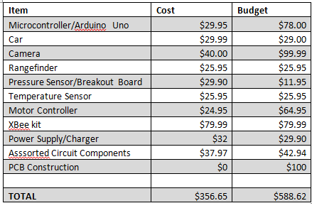
Finances

Slide 63
Possible Problems / Concerns
Issuing commands to the vehicle while transmitting/receiving data from the sensors.
Incorporating all data into our GUI
Temperature Sensor Issues
Motor control issues

Slide 64
QUESTIONS?

