Slide 1
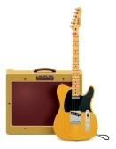
Guitar Amplifier with
Analog/Digital Effects
(Senior Design Project Fall/2013)
Group 5 Members:
Alex Chen
Audrey Hernandez
Brittany Delose
Robert John

Slide 2
Motivation
Explore music and technology
Have analog and digital effects
User control
Produce a quality output for the musician and listeners

Slide 3
Objectives
Amplifier housing is easily moveable
Controlled output power
Quality output that is low noise over a wide volume range
User controlled effect systems
Wireless user interface

Slide 4
Specifications
Output Power Rating | 50 Watts
Frequency Response | 5 Hz - 100 kHz
Total Harmonic Distortion (THD) | 0.1% (1 kHz at 30 Watts)
Input Impedance | 500 kOhms
Output Impedance | 4 - 8 Ohms
Signal to Noise Ratio (S/N) | 80 dB
Bluetooth Range | ~10 Meters
Number of Analog Effects | 6
Number of Digital Effects | 7
Cabinet Size (H x W x D) | 18” x 12” x 6”

Slide 5
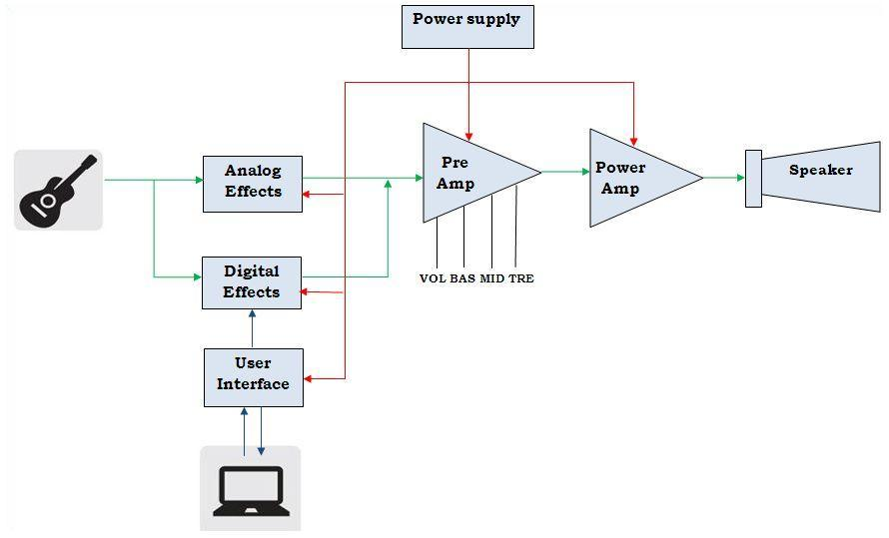
Block Diagram

Slide 6
Analog Effects

Slide 7
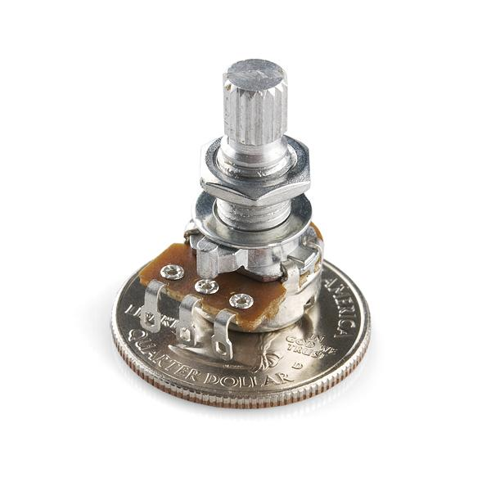
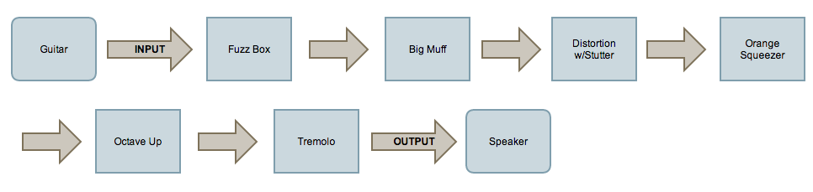
Analog Effects
Specifications
+9V supply
.25 W 1206 Resistors
>= 16V electrolytic and
aluminum capacitors
Linear and Audio rotary Potentiometers

Slide 8
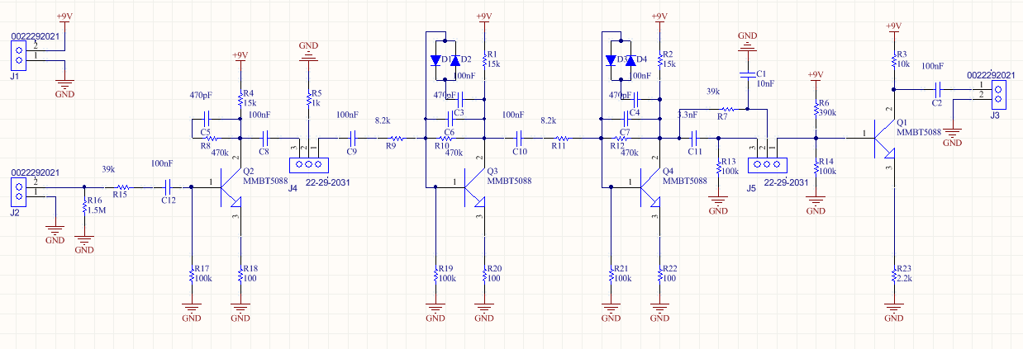
Big Muff

Slide 9
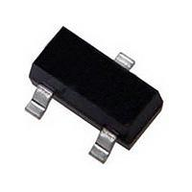
Big Muff
MMBT5088
NPN general purpose amplifier
High gain
Low noise
SOT-23 package
Potentiometers
2 100k Linear (Tone and Sustain)
1 100k Audio (Volume)

Slide 10
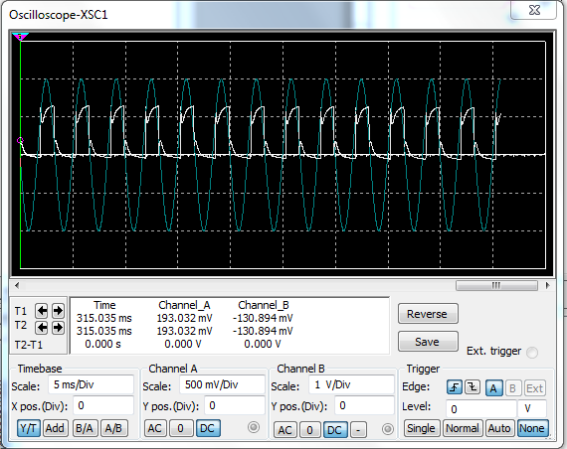
Big Muff

Slide 11
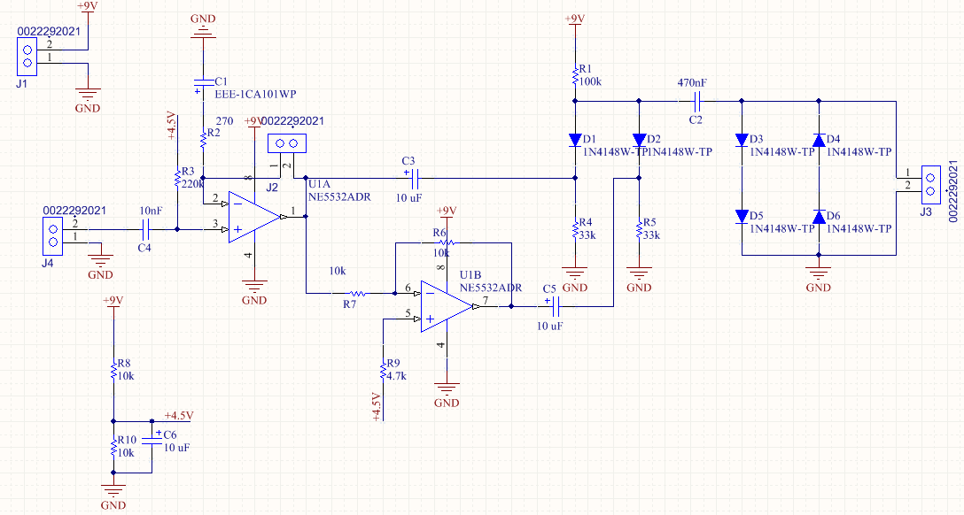
Octave Up

Slide 12
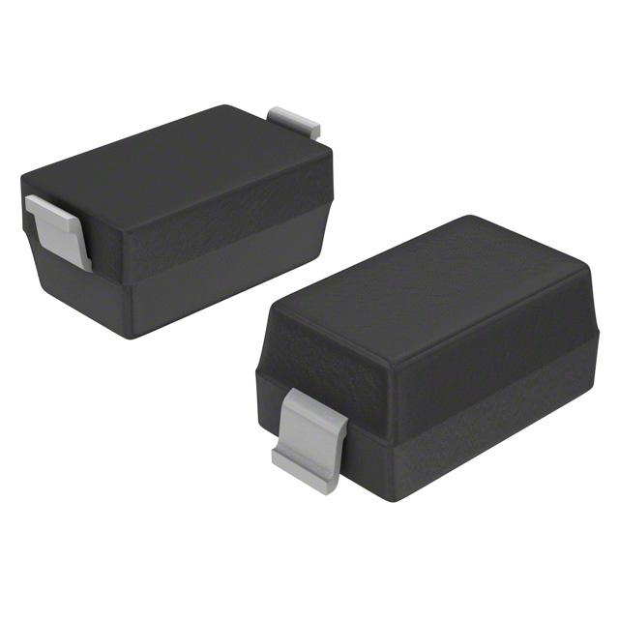
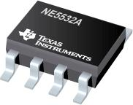
Octave Up
N4148W
Fast switching speed
Fast reverse recovery
SOD-123 package
NE5532ADR
General purpose (pre) amplifier
Low level
Low noise
8-SOIC

Slide 13
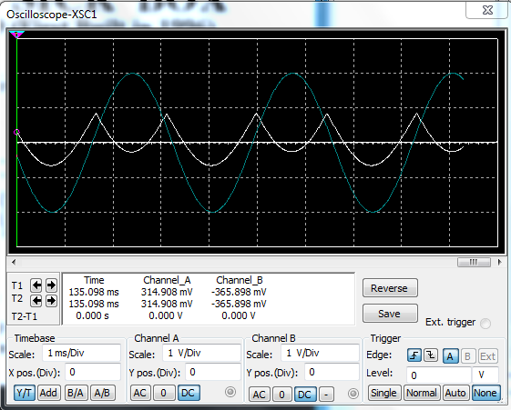
Octave Up

Slide 14
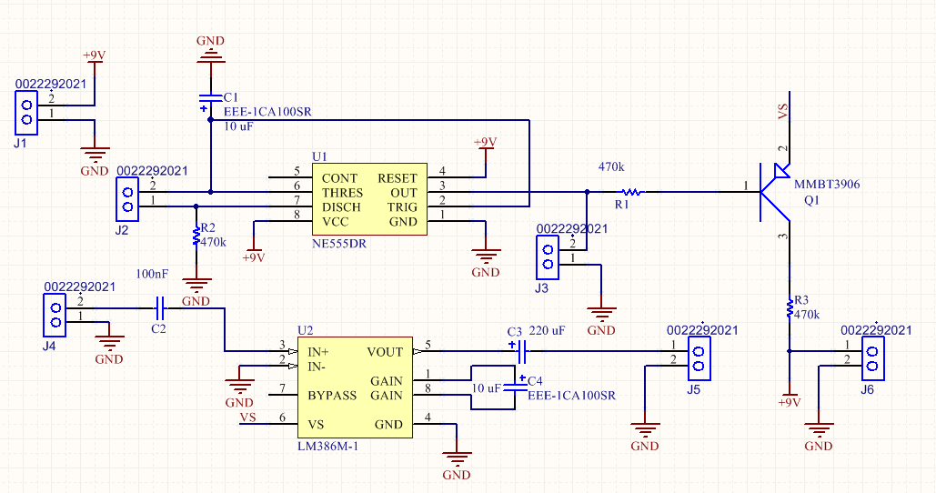
Tremolo

Slide 15
Tremolo
MMBT3906
NPN Transistor
Ideal for medium power amplification
SOT-23
Potentiometers
1 100 K Linear (Duty Cycle)
1 100 K Audio (Volume)

Slide 16
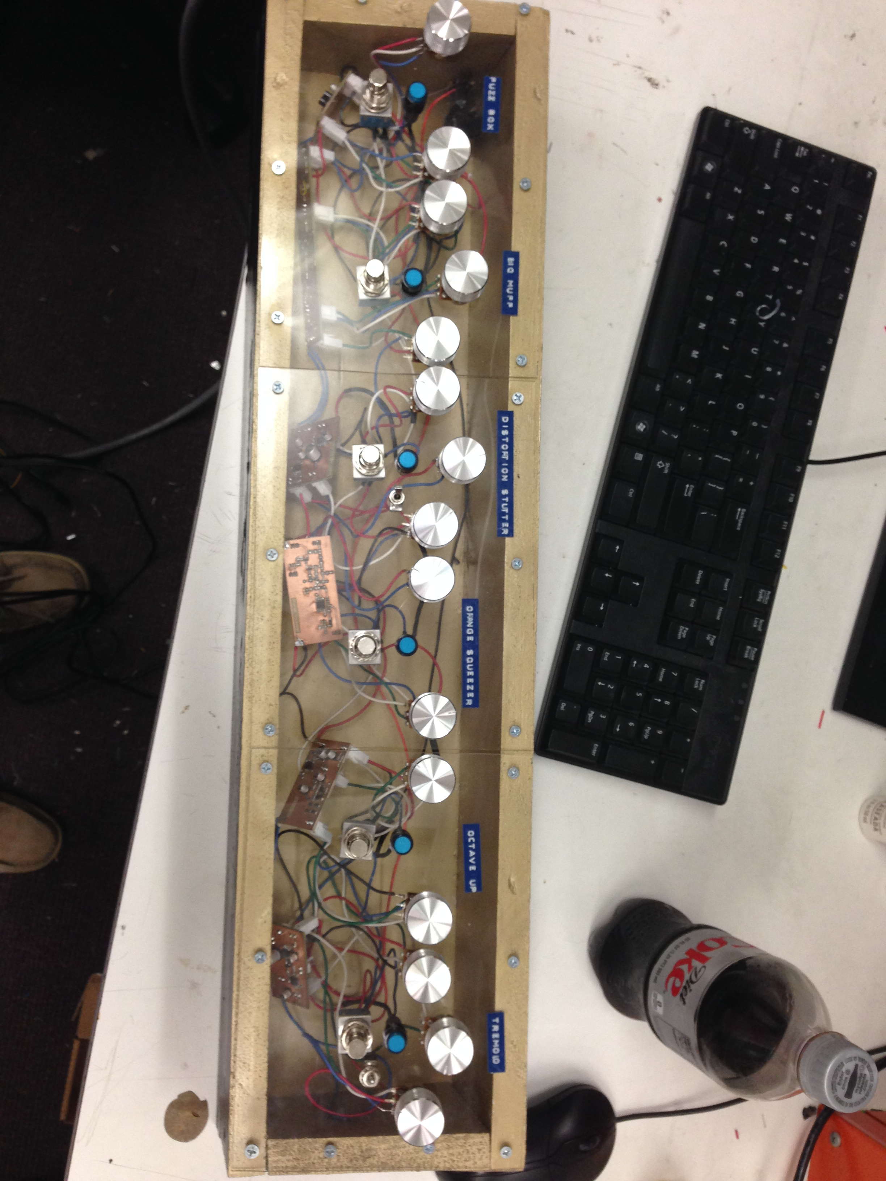
The Stomp Box

Slide 17
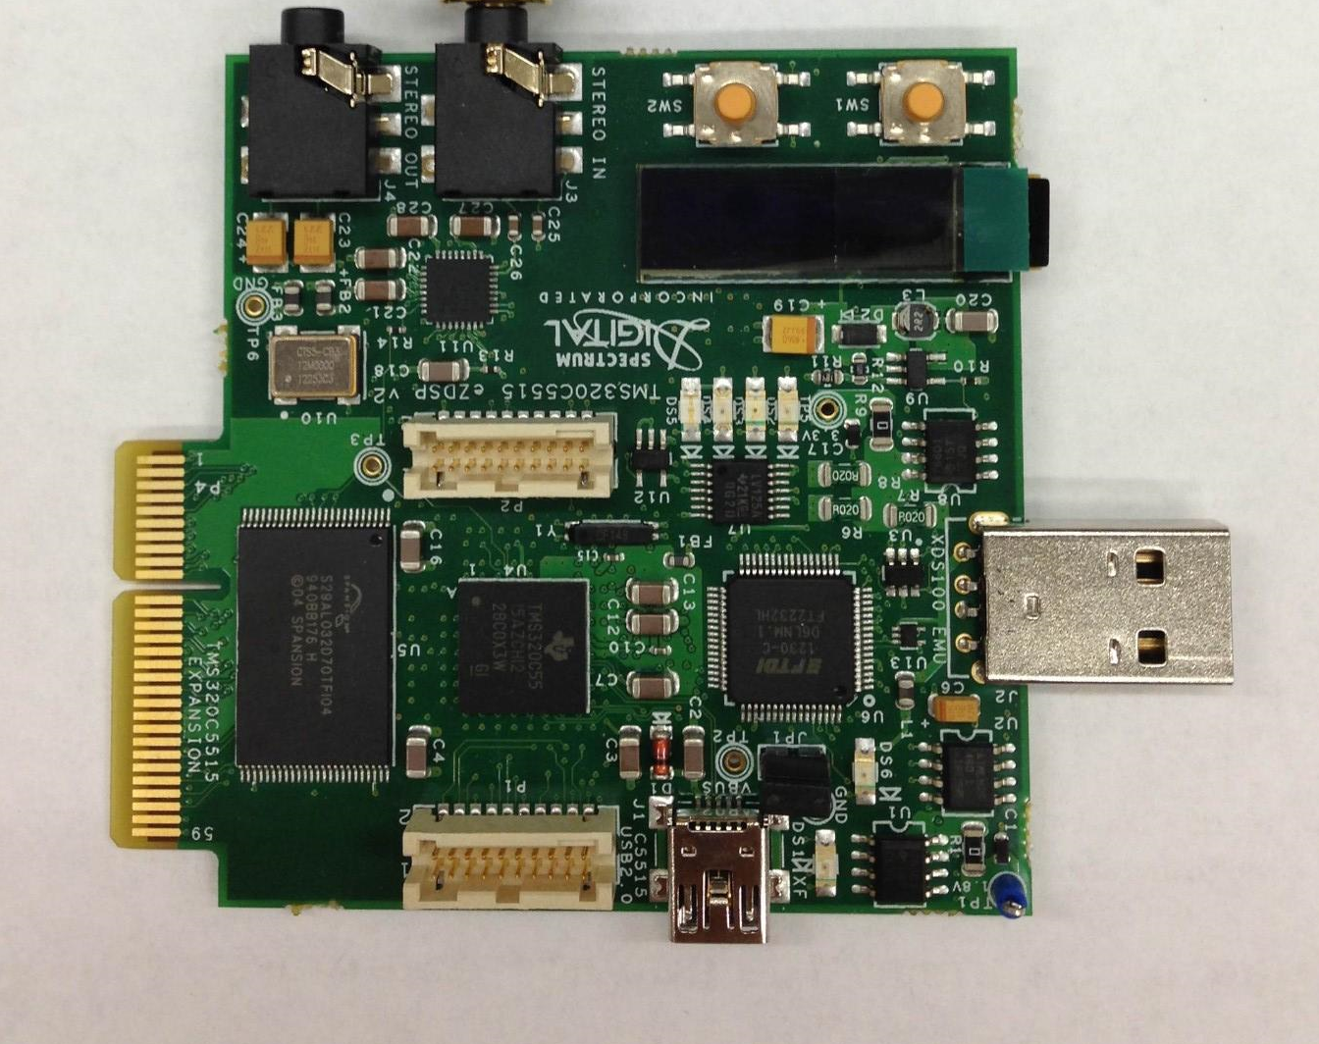
Digital Effects
TI’s TMS320C5515 eZdsp was the prototype board selected
Digital effects algorithms designed on the prototype board

Slide 18
TMS320C5515 eZdsp
TMS320C5515 16 bit fixed point DSP
TLV320AIC3204 for ADC and DAC conversions 48ksps
Eighth inch Stereo input and output jacks
USB 2.0
Interfaces with TI’s Code Composer Studio
Within budget

Slide 19
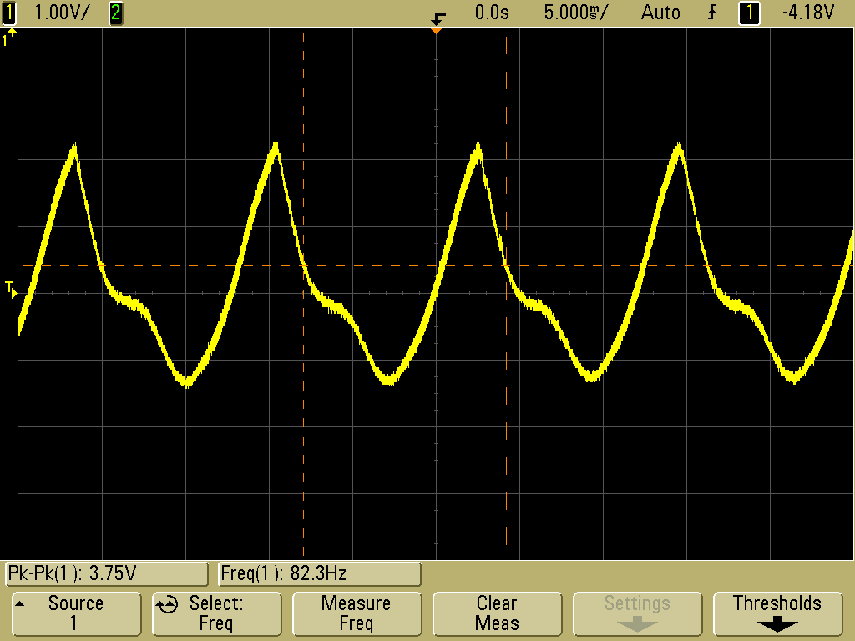
No effect

Slide 20
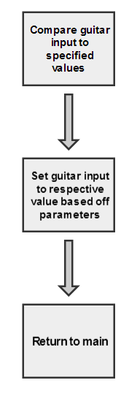
Fuzz
The fuzz effect compares the guitar input to three conditions
If the input between a parameter +X and -X passed through
If the input is less than -X it is set to a fixed value - Y
If the input is greater than X is it set to +Y

Slide 21
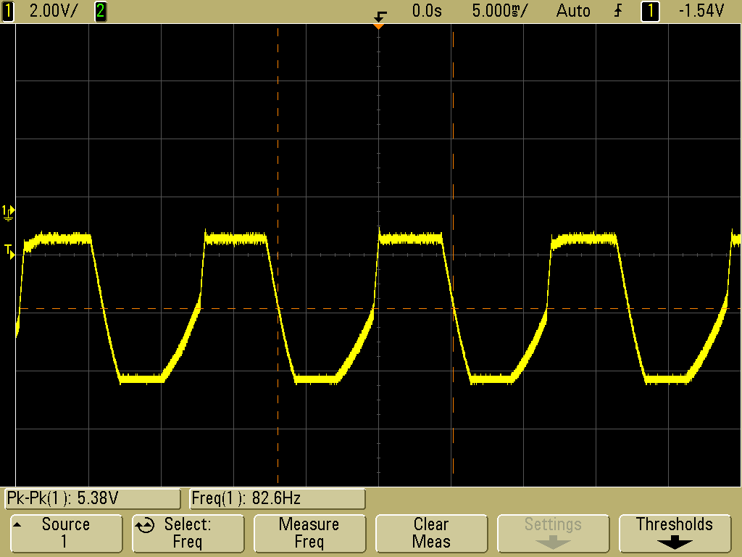
Fuzz

Slide 22
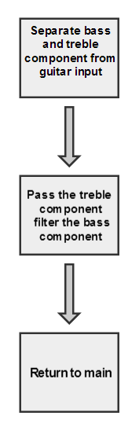
Tin Can
This is a highly treble sounding effect
The treble and the bass components of signal are separated
Higher frequencies passed
Low frequencies are filtered by downsampling

Slide 23
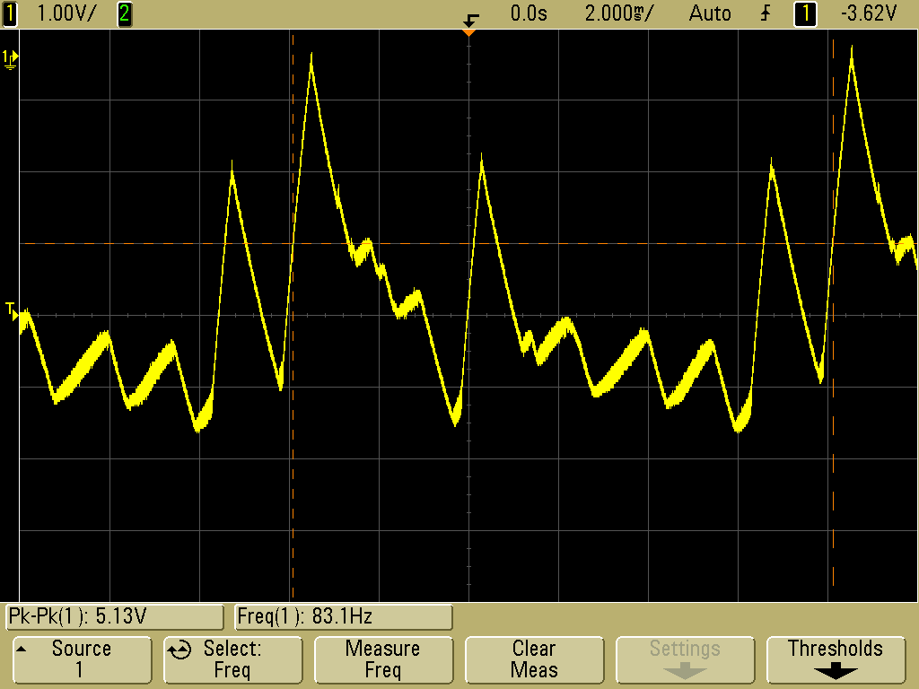
Tin Can

Slide 24
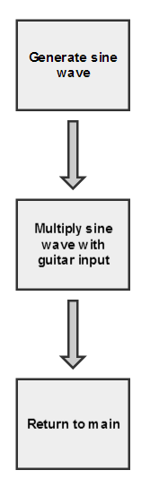
Robot
A sine wave is generated then it is multiplied with the guitar input
The frequency of the sine wave can be increased or decreased to modify the effect

Slide 25
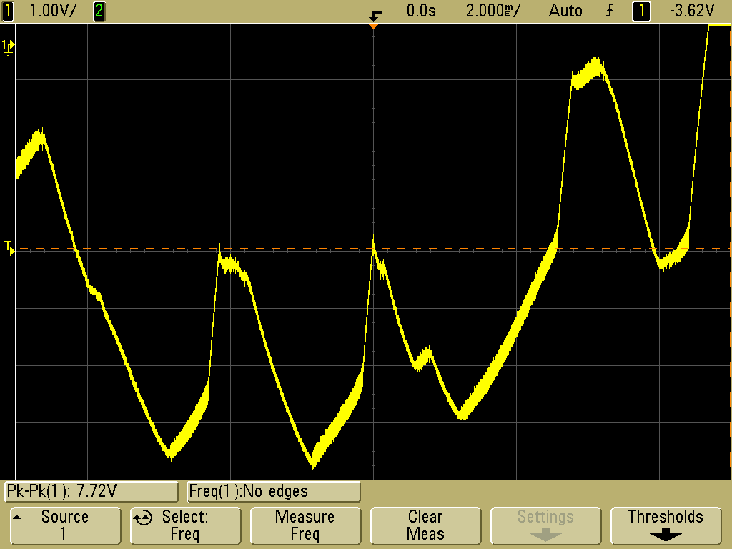
Robot

Slide 26
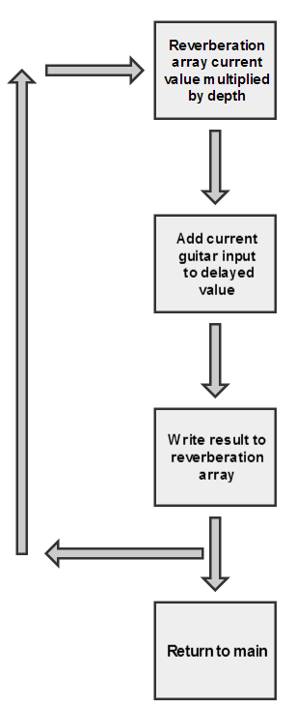
Reverberation
Reverberation works by adding the current input to a delayed output
There are two main parameters to the effect, the depth and size of the reverberation array
Depth determines amount delay of the signal that is added to the input
The size of reverberation array determines the amount of the previous signal is saved

Slide 27
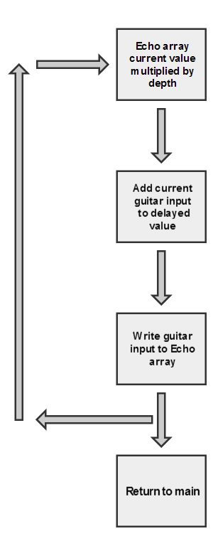
Echo
The echo effect works by adding the current input to a delayed input
There are two main parameters to the effect, the depth and size of the echo array
Depth determines amount delay of the signal that is added to the input
The size of the echo array determines the amount of the previous signal is saved

Slide 28
User Interface
• Netbeans IDE
-Free, open-source, growing community of users/developers
• Select between various effects, modify certain parameters
-Effects are processed one at a time
-Default setting: ‘NONE’ (all modifications disabled except ‘MUTE’ )
-Update current parameters button
Notes:
The user interface will be a stand alone application
designed to run on a Windows laptop.
It was developed using the Java IDE Netbeans for many reasons including:
its cost, public accessibility, and extensive support.
The design method for the 7 effects was decided such that only one effect
could be modified at one time and
therefore would not account for mixing multiple effects.

Slide 29
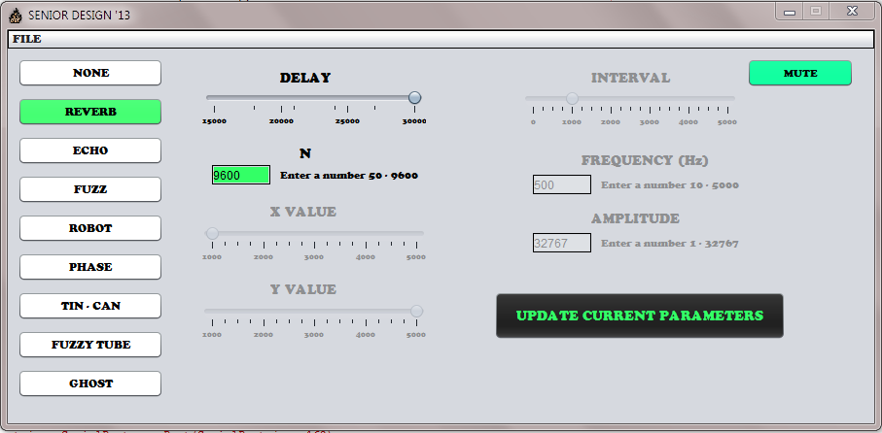
User Interface
Reverb Effect
-Depth and N enabled
-Must update current parameters
Notes:
For example, by clicking on the Reverb effect, a new window appears, allowing the user
to modify any or all of the three parameters,
including the sampling frequency, depth, and N.
The update button will notify the DSP which effect and which parameters were adjusted,
and the output will be heard accordingly.
A different effect will be chosen by Xing out of the current effect’s window FIRST.
Quitting the application will disconnect and turn off the BT module’s auto-discovery/pairing
to save minimal power.

Slide 30
Bluetooth Evaluation Boards
PAN1323ETU
- Plugs directly into the MSP430F5430 Experimenter Board
- BT stack provided free
- Matching P1/P2 pinouts
- Contacted SSO; BT stack not
developed for the TMS320C5515ezDSP
Notes:
The first evaluation board researched was the PAN1323ETU.
Panasonic offers this easy to use module based on TI’s CC256x single-chip solution for about $50.
It plugs directly into the MSP430 Experimenter Board,
and its Bluetooth software is provided free through MindTree’s Ethermind Bluetooth stack.
The pinouts P1/P2 are identical to those on the C5515 ezDSP board.
The downfall to this board is that there is no available evaluation copy of the BT stack.
This realization led to researching evaluation boards with an embedded BT stack.

Slide 31
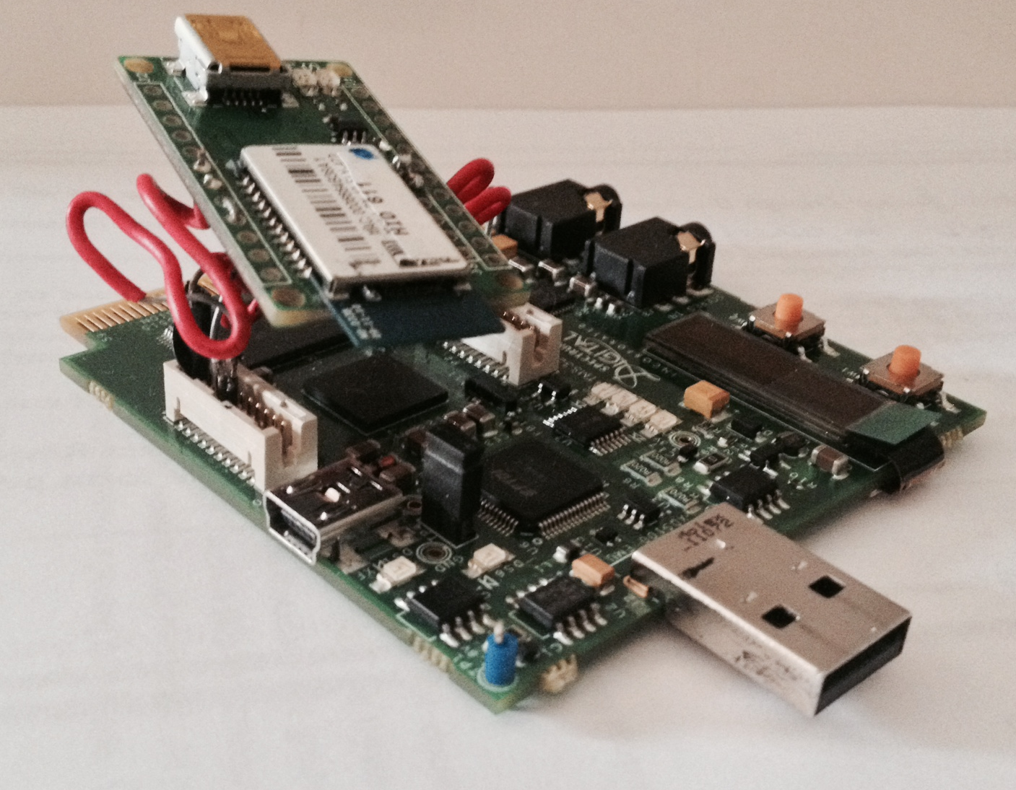
Bluetooth Evaluation Boards
● RN-42-EK
- Embedded BT stack
(CSR BlueCore-04)
- PCB trace antenna
- 3Mbps Data Rate
- Various baud rates
- Error correction,
auto-discovery/pairing,
auto-connect master
● BT/Chipcon Expansion Connectors P1/P2
-RX, TX, CTS/RTS, GND,
VDD
Notes:
Roving Networks offers an evaluation board for the RN-42 module priced at $40.
Its embedded BT stack profiles from CSR Synergy include SPP, DUN, HCI, as well as a few others.
Some other features include a USB to serial UART interface,
four dip switches, and a PCB trace antenna.
The RN-42 module has a maximum data rate of 3Mbps and has a range of about 10 m.
It supports baud rate speeds from 1,200 – 921Kbps.
It also provides error correction and auto-discovery/pairing.

Slide 32
Communicating between
DSP/Bluetooth Module
jSSC
-Simple serial connector library for accessing serial ports in Java
-Serial port specifics
(115200 baud rate, 8 data bits, 1 stop bit, no parity)
-Serial port event listener
TI’s C55X Chip Support Library (v3.01)
-CSL_UART_INTexample (update port parameters)
-Successfully tested via Blueterm, TeraTerm, Netbeans

Slide 33
Pre Amplifier
Functions
Prepares signal for further amplification
Provides necessary voltage gain
Controls the volume and equalization
Cleans up a signal by eliminating high frequency noise
Advantages of Op Amps over Discrete
Components matching
High CMRR
High gain
Lower power consumption
Simplicity
Low cost
TI’s high precision low noise OPA134 was selected.

Slide 34
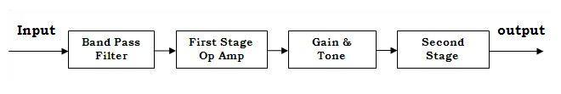
Pre Amplifier
Block Diagram
BP filter obtains range from 5 Hz to 1 MHz
Active BP filters for each Op Amps further restrict the BW to 30Hz – 20kHz
First and second stage Op Amps each provides voltage gain of 10
“Tone stack” equalization circuit for low, mid, and high tone control.
Volume control is done by adjusting the input of second stage Op Amp

Slide 35
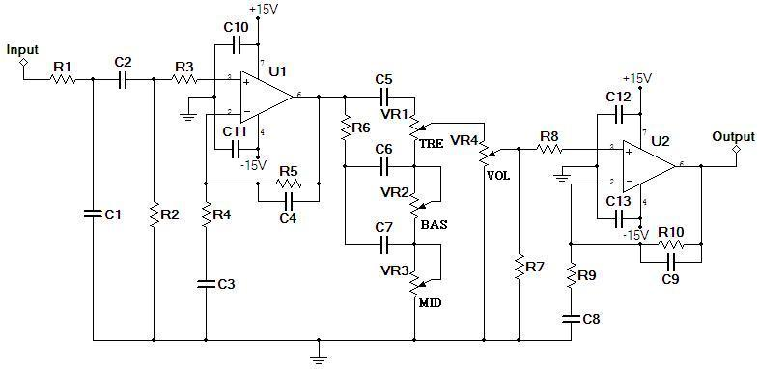
Pre Amplifier

Slide 36
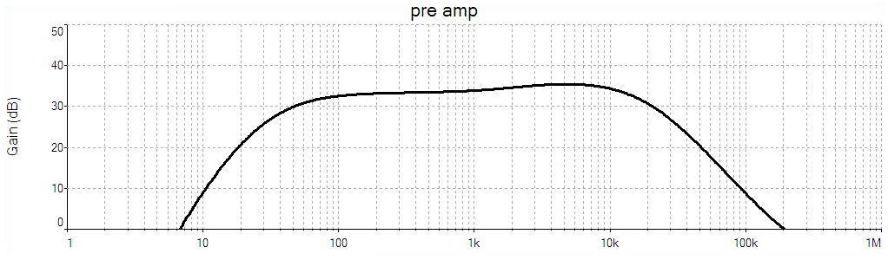
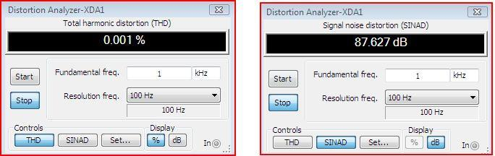
Pre Amplifier
Frequency Response and Distortion

Slide 37
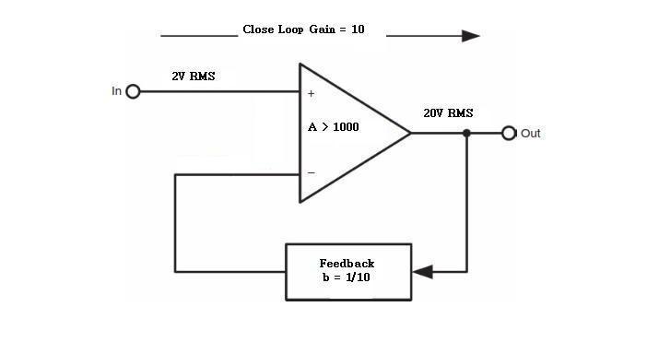
Power Amplifier
Functions
Provides high current gain
Provides enough output power to drive a speaker
Design Concept
A 50W output power amplifier for an 8 Ohms speaker requires:
Vrms = 20V, Vpeak = 28V, Irms = 2.5A, Ipeak = 3.5A

Slide 38
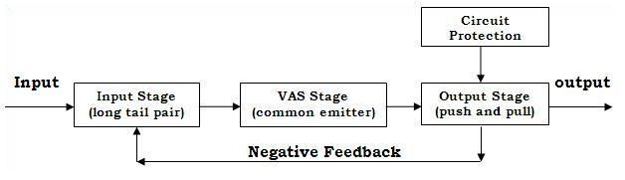
Power Amplifier
Block Diagram
Differential circuit w/ constant current source for input stage
Common emitter amplifier for middle stage
Class AB in Darlington pair for output stage
Circuit protection for short load
No IC’s used for more control and high current requirements

Slide 39
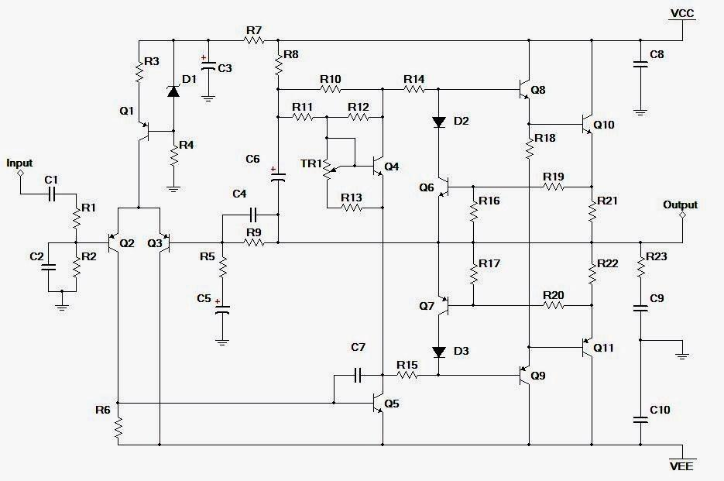
Power Amplifier
Schematic

Slide 40
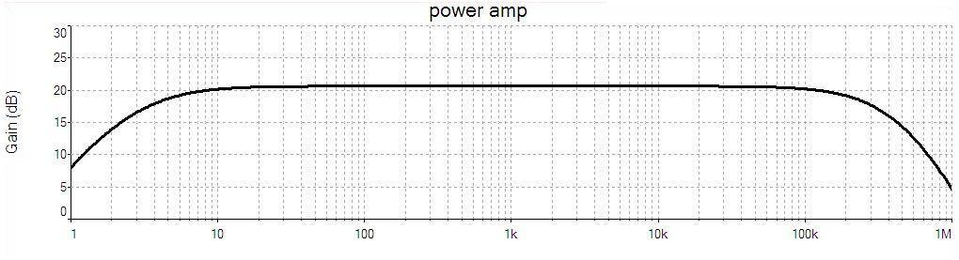
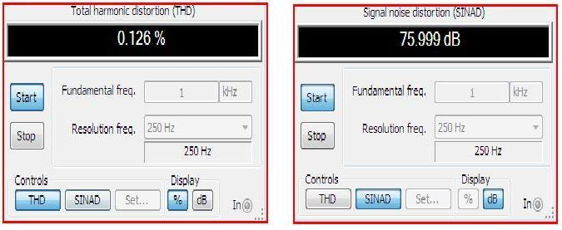
Power Amplifier
Frequency Response and Distortion

Slide 41
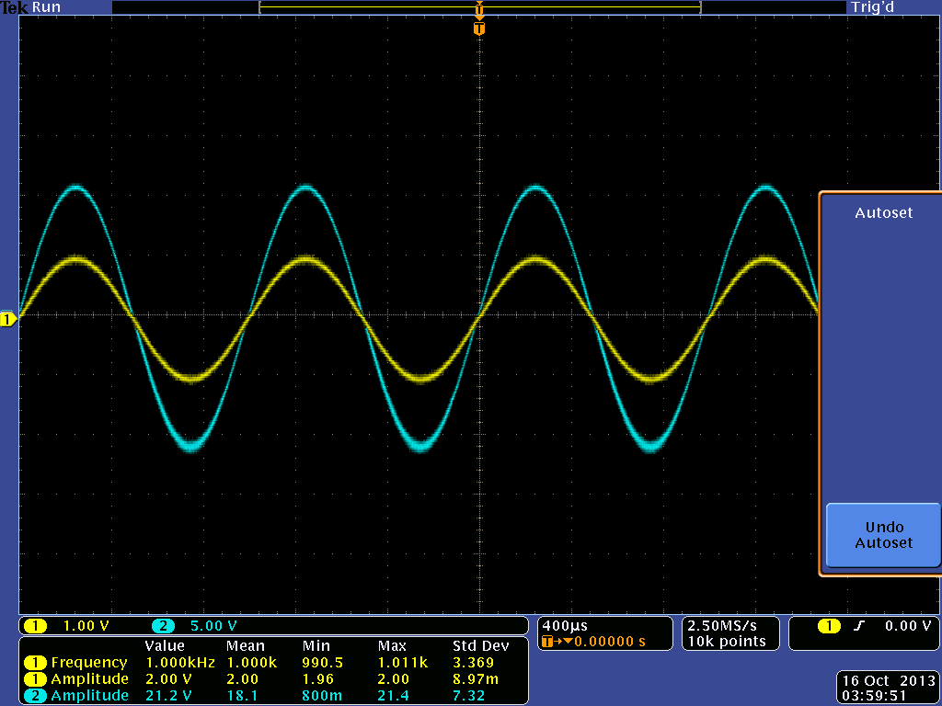
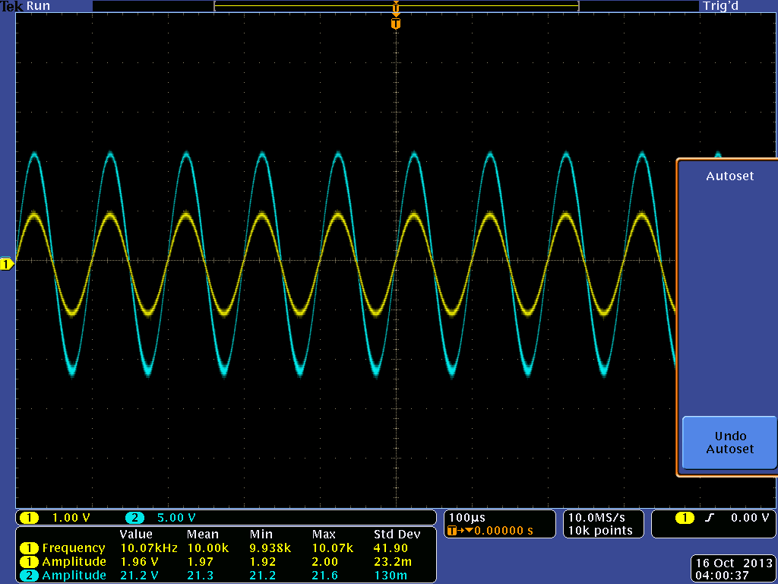
Response with 1k & 10k Sinusoidal

Slide 42
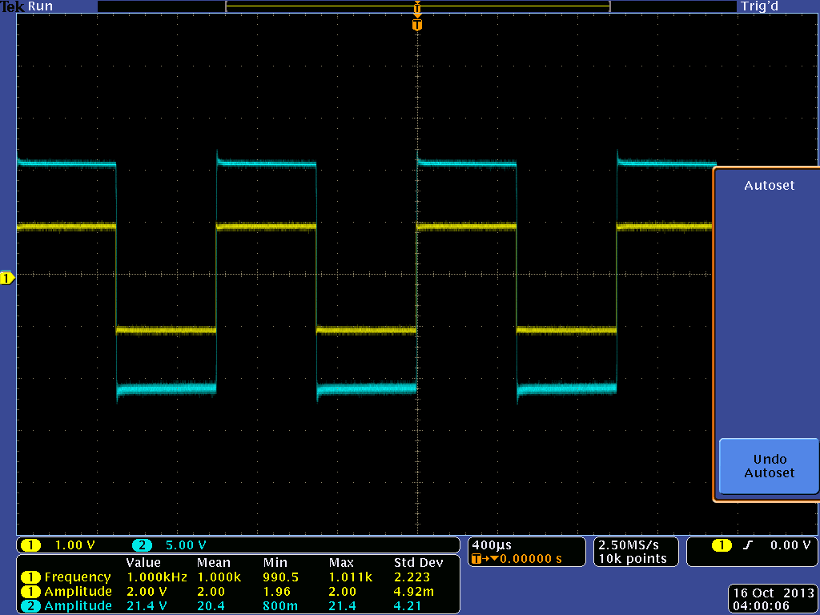
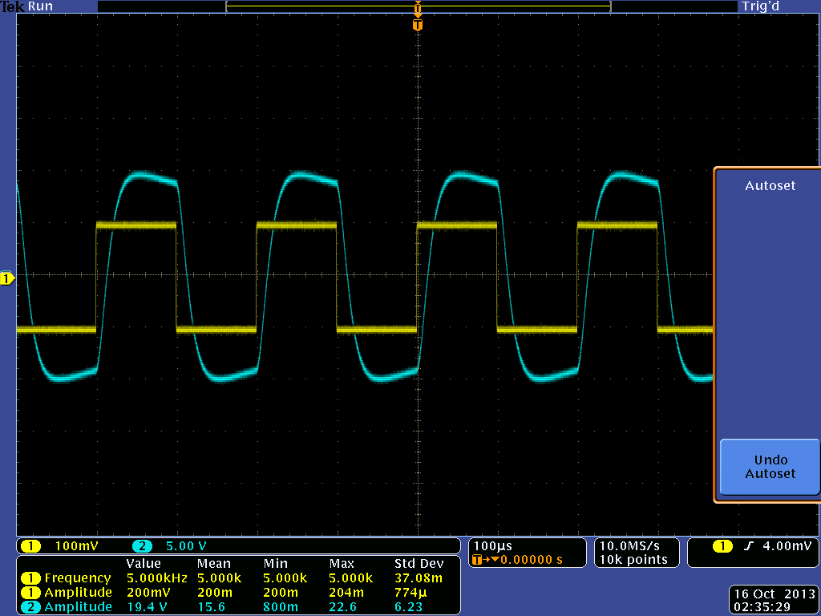
Response with 1k & 10k Square

Slide 43
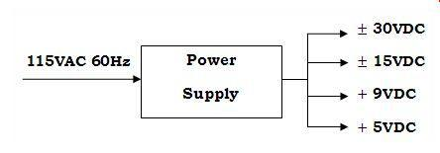
Power Supply
Function
Converts 115VAC to DC’s needed for the project
Filters out as much AC ripples as possible
Outputs
30 VDC for power amplifier module
15 VDC for pre amplifier module
9 VDC for analog effects module
5 VDC for digital effects module

Slide 44
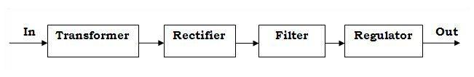
Power Supply
Block Diagram
Center tapped with secondary output 24VAC and power rating of 100VA transformer
100V/4A full wave bridge rectifier
Simple RC filter
LM78XX and LM79XX voltage regulator IC’s

Slide 45
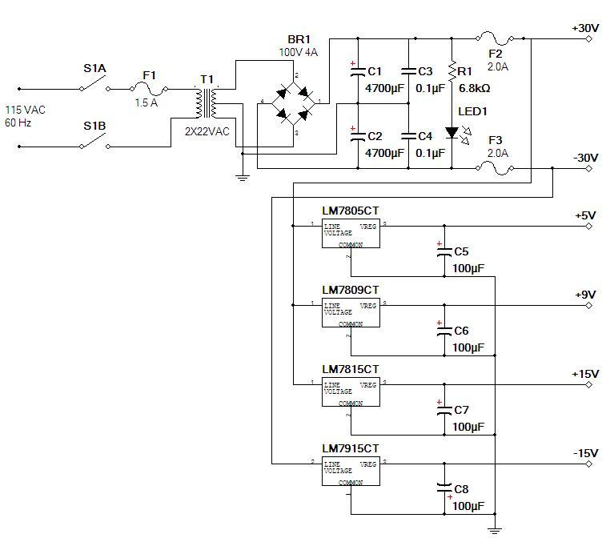
Power Supply

Slide 46
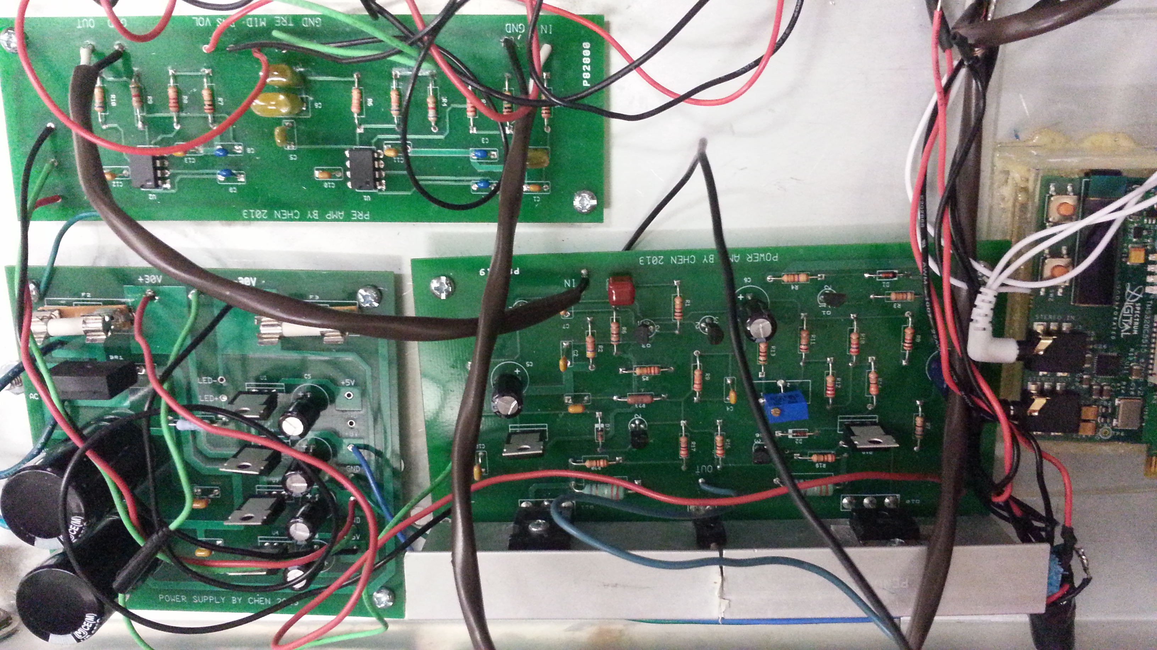
PCB’s

Slide 47
Distribution of Workload
 | Analog Effects | Digital Effects | User Interface | Bluetooth | Pre Amp & Power Amp | Power Supply | Cabinet Assembling
Alex
Audrey
Brittany
Robert

Slide 48
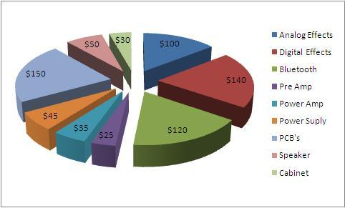
Budget and Financing
Estimate Total: $850

Slide 49
Questions?

