Slide 1
M.A.S.S.
(Mobile Aerial Security System)
Group 6
Derrick Shrock
Henry Chan
Eric Hernandez
Sanjay Yerra

Slide 2
Motivation
Experience with Aviation work
Extra protection at public events
Doubles as an advertising system

Slide 3
Goals and Objectives
Personal Surveillance System
Autonomous Blimp System
  Basic aviation functions
Camera System
  Stabilization System
  Video Recognition
GPS
  Enter waypoints into system
  Record Flight Path
Long Range Control

Slide 4
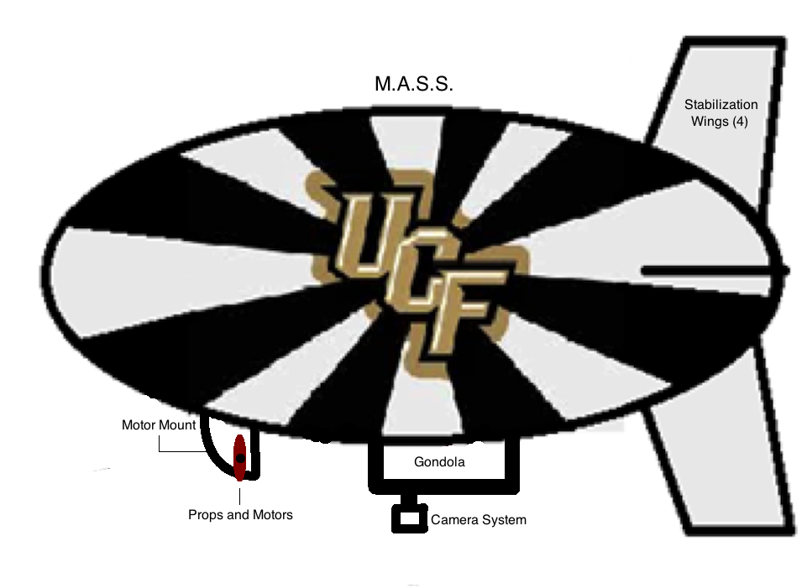
Components of Blimp Design
7 Feet
3.5 Feet

Slide 5
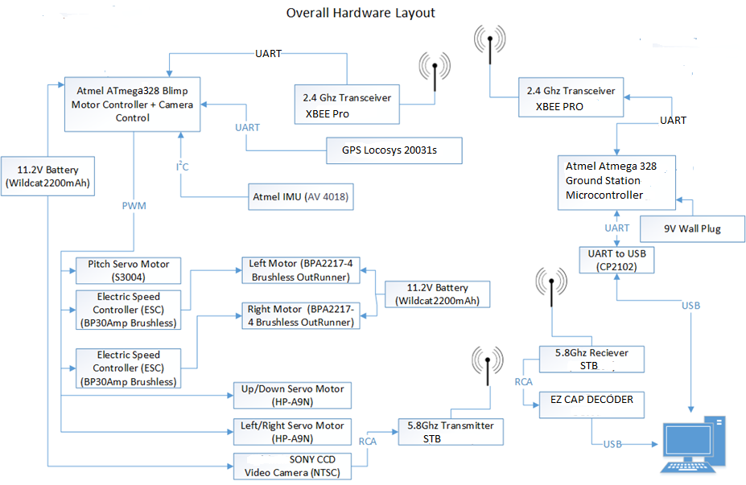

Slide 6
Blimp Design Structure

Slide 7
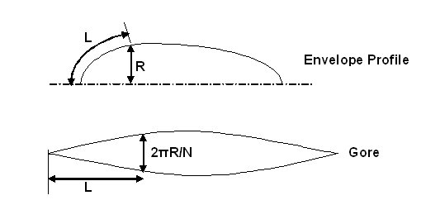
Section Design
Typical non-rigid ellipses design
The envelope is made up of six different sections
Each section follows the overall profile measurements
Using the arc length and the radius of the envelope profile each section was measured out accordingly

Slide 8
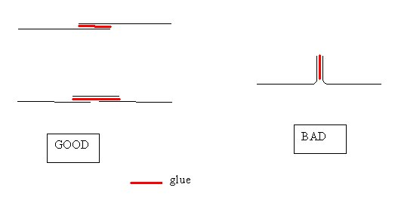
Joining the Sections
There are good and bad ways to join the sections
Sections will were joined with a tool using the same profile as the envelope
Overlapping Technique
Webbing Technique

Slide 9

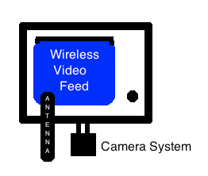
Gondola
The Gondola houses the controls system (includes: microcontroller, GPS, IMU, etc.)
Material: Balsa Wood; lightweight and inexpensive
Side View
The rear view of the gondola shows the camera wireless system attached as well as the camera system fused to the bottom side.

Slide 10
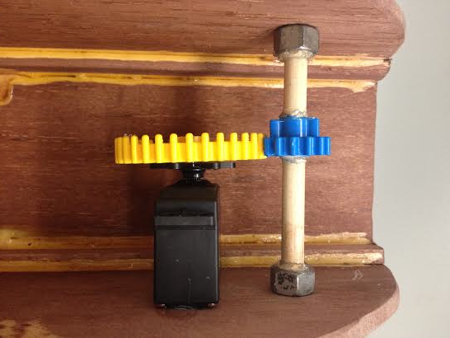
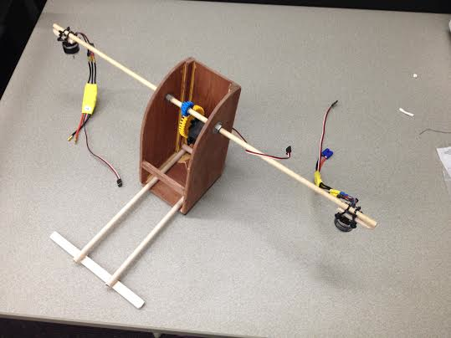
Motor Mount
The motor mount houses the servo gear used for pitch control, the gears to drive the pitch axel with the motors attached at either end, and is made of light-weight Balsa wood.

Slide 11
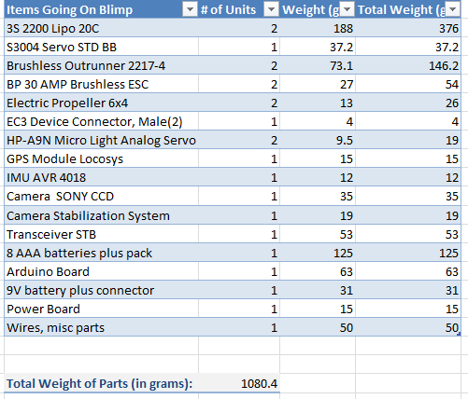
Weight Considerations
One cubic foot of helium will lift about 28.2 grams
Our Blimp size: ~70 - 90 cubic feet
Projected Lift: ~ 1,900- 2,500 grams

Slide 12
Blimp Motors and Servos

Slide 13
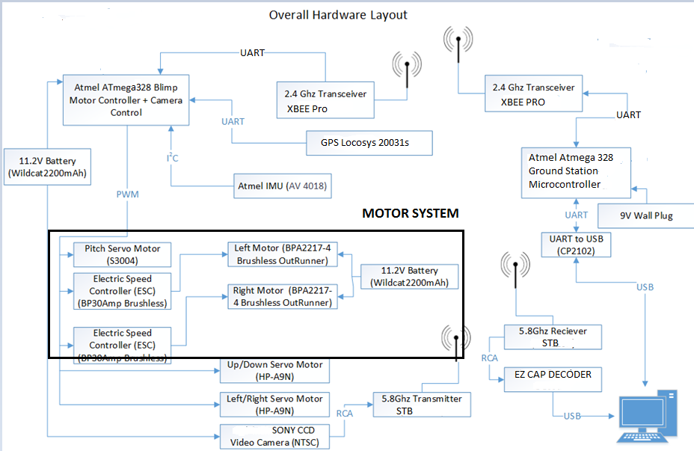

Slide 14
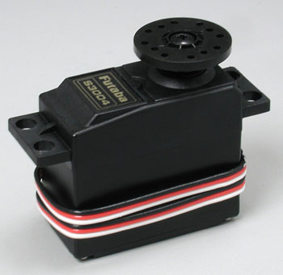
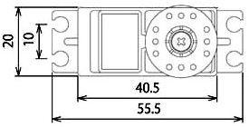
Pitch Axel Servo Motor (S3004)
Control System: +Pulse Width Control
360 Modifiable: Yes
Required Pulse: 3-5 Volt Peak to Peak Square Wave
Operating Voltage: 4.8-6.0 Volts
Operating Speed (4.8V): 0.23sec/60 degrees at no load
Stall Torque (4.8V): 44 oz/in. (3.2kg.cm)
Current Drain (4.8V): 7.2mA/idle
Weight: 1.3oz. (37.2g)
mm
mm
mm
mm

Slide 15
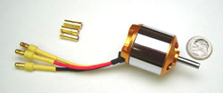
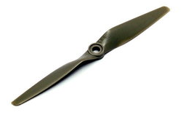
Brushless Outrunner 2217-4 Motor
Battery Requirement:
  2 – 3 Cell Li-Poly
  6 – 10 Cell NiCd/NiMH
Kv: 950 RPM/V
Max Efficiency: 80%
Max Efficiency Current: 5 - 15A (>75%)
No Load Current: 0.9A @10V
Max Current: 18A for 60S
Max Watts: 200W
Weight: 73.4 g / 2.59 oz
Size: 27.8 mm x 34 mm
Shaft Diameter: 4mm
Running at lower speed: 2-3 MPH
Propeller
Model: LP 06040E
Dimensions: 6 x 4 inches / 15cm x 10cm
Material: Plastic

Slide 16

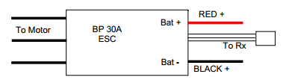
BP 30 AMP Brushless Electronic Speed Controller (ESC)
Max Continuous Current: 30A on 3 Cells
Input Voltage: 2-3 Lithium Polymer
4-10 NiCD/NiMH
Resistance: 0.0050 ohm
Lithium Cut-Off Voltage: 3.0V / cell
Size: 45 x 24 x 9mm
Temperature Protection: 110C
PWM: 8kHz
  Needs “Arming Sequence” before controlling to set propeller position and then the motors start spinning.
Max Rotation Speed: 40,000 RPM for 14 pole motor

Slide 17
Blimp Control System

Slide 18
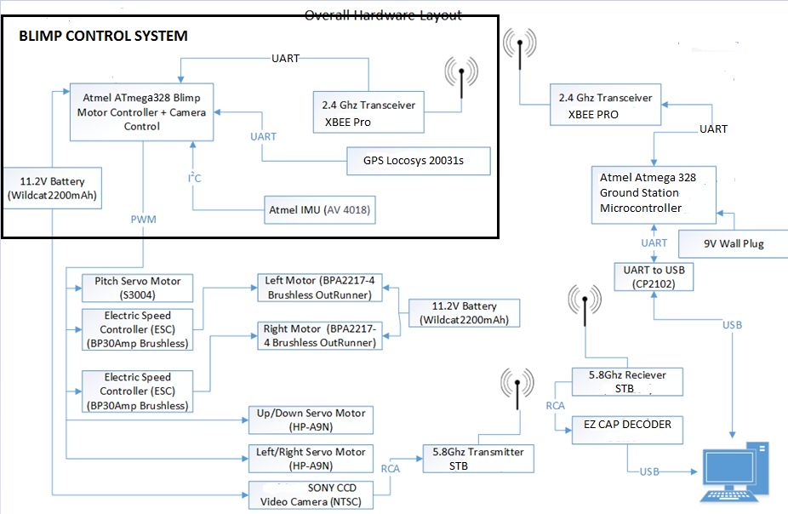

Slide 19
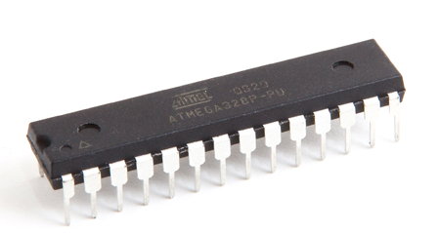
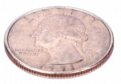
Microprocessor on the Blimp
AVR Atmega328 microprocessor (ATMEGA328-PwB)
  Up to 20 MIPS Throughput at 20MHz
  Low power settings
  SPI, I²C, and UART serial communication ports
  Six PWM Channels
  23 Programmable I/O Pins
  5 Volts operating voltage
  DIP packaging
Cost: $5.21

Slide 20
Sensors (IMU) Comparison
Design | Own IMU | AVR IMU
Cost | 14.60 | 24.99
Accelerometer G Values | 2,4,6,8 | 2,4,6,8
DOF | 9 | 9
Advantages | Parts are already in. Familiar with parts. | All parts are on same board. Noise Regulators included.
Disadvantages | Would have to buy separate breakout boards for programming. Several comments complained about sensor flaws due to noise. | Spend more money. Have to wait for parts.

Slide 21
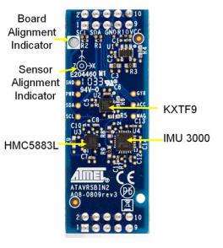
Inertial Measurement Unit-ATAVRSBIN2
IMU 3000 Gyroscope
  X,Y,Z axis
  I2C Serial Output
  ±250, ±500, ±1000, and ±2000 degrees/sec
  1MHz clock output to synchronize with digital 3-axis accelerometer
KXTF9 Accelerometer
  ±2g, ±4g or ±8g
  I2C interface
HMC5883L Magnetometer
  s 1° to 2° compass heading accuracy
  I2C interface
  Wide Magnetic Field Range (+/-8 Oe)
58 mm
14 mm

Slide 22
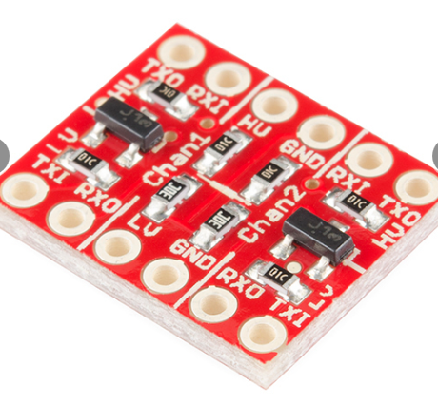
Logic Level Converter
Due to using an ATMEL sensor board with an Arduino development board modifications had to be made
The Arduino Uno board runs at 5.0 volts while the IMU runs at 3.3 volts.
This logic level converter correctly adjusts the voltages
.6”
.5”

Slide 23
Transmission Comparison
 | Frequency | Antenna | Weight | Power Consumption | Max Range | Data Rate | Price
nRF24L01+ | 2.4Ghz | External SMA | 4.3 grams (no Antenna) | 11.3mA TX Mode 13.3mA RX Mode | 1000 meters | 250kbps, 1Mbps or 2Mbps | $19.84
XBee 60 mW PRO | 2.4Ghz | On-Chip | 5.7 grams | 3.3V @ 250mA | 1500 Meters | 250kbps Max data rate with 128-bit encryption | $ 37.95

Slide 24
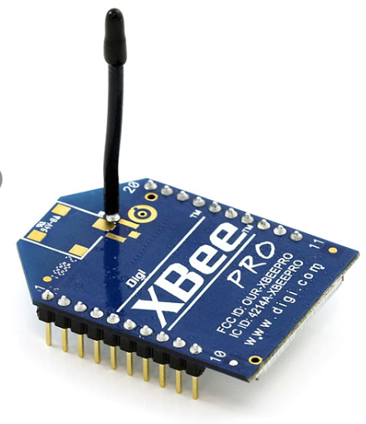
Transmitter/Receiver Module (XBEE PRO)
2.4 GHz ISM Band
250 kbps Max Data Rate
6o mW output Power
UART serial communication
Weight: 39g
Cost: $37.95

Slide 25
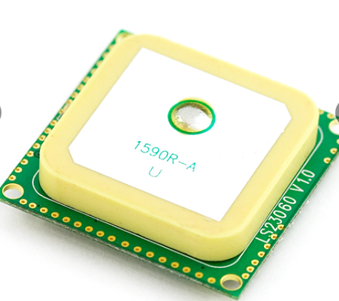
GPS MODULE- LOCOSYS LS20031
66 Channel
10 Hz update rate
Built in micro battery to
preserve system data
Precision: ~2-3 m
Cost: $59.95
3.3V @ 41 mA
15X15(mm)

Slide 26
NMEA Codes
Name | Example Data | Description
Sentence Identifier | $GPGGA | Global Positioning System Fix Data
Time | 170834 | 17:08:34 Z
Latitude | 4124.8963, N | 41d 24.8963' N or 41d 24' 54" N
Longitude | 08151.6838, W | 81d 51.6838' W or 81d 51' 41" W
Fix Quality: - 0 = Invalid - 1 = GPS fix - 2 = DGPS fix | 1 | Data is from a GPS fix
Number of Satellites | 05 | 5 Satellites are in view
Horizontal Dilution of Precision (HDOP) | 1.5 | Relative accuracy of horizontal position
Altitude | 280.2, M | 280.2 meters above mean sea level
Height of geoid above WGS84 ellipsoid | -34.0, M | -34.0 meters
Time since last DGPS update | blank | No last update
DGPS reference station id | blank | No station id
Checksum | *75 | Used by program to check for transmission errors
NMEA Codes will use
  GGA
    Longitude
    Latitude
    Altitude
  GSA (confirmation of satellite connections)
    A,2 – Only Longitude and Latitude Confirmation
    A,3 – Longitude, Latitude, Altitude Confirmation
Example:
  $GPGSA,A,3,,,,,,16,18,,22,24,,,3.6,2.1,2.2*3C
,A,3

Slide 27
Camera System

Slide 28
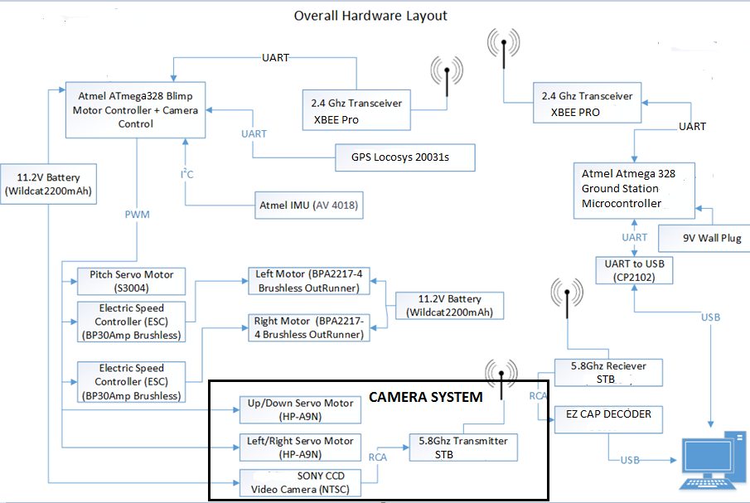

Slide 29
Camera Qualifications
Lightweight
Crisp Picture and High Resolution
Inexpensive
Limited Video Feed Delay

Slide 30
Camera Comparison
Camera | GoPro Hero 3 Black Edition | SC2000 Sony CCD Video Camera
Weight | 204g | 35g
Price | $240 | $32.76
Resolution | 1080p | 540TV
Wifi Compatible | Yes | No
Power Supply | Battery included | 12V with 150 mA current draw
Flight Time | 90 minutes | Completely dependent on size of external battery
Delay for Stream of Video | 3 seconds | Delay of Transceiver <1s
Selected |  | This one!!! (It is all about the money)

Slide 31
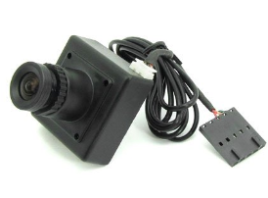
SC2000 Sony CCD Video Camera
Pixels 752 X 582
Internal Synchronization
Horizontal Resolution is 540 TV Lines
Lens is 3.6 mm
Power Supply: 12V/150 mA
Net weight 14 grams

Slide 32
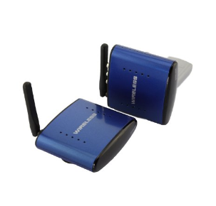
Camera Feed Transmitter/Receiver
Video Camera will have a 5.8 GHz AV Transceiver
Choose 5.8 GHz in order to not cross signals with 2.4 GHz Transceiver
200m range
Power Regulation:
  5 Volt, 1A
Uses RCA adapter from Camera
3” x 4” x 1”

Slide 33
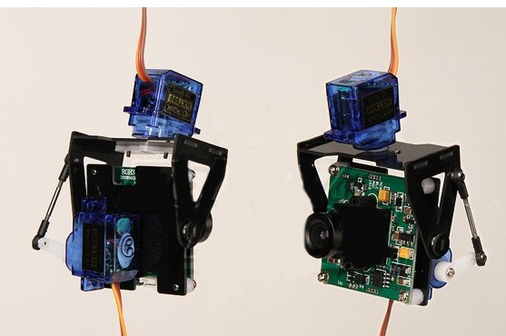
Camera Mount
Lightweight 19g
This particular mount was made for our specific camera
Gives complete 180 degree pan & full tilt
Uses two 9.5g (Torque rating) servos

Slide 34
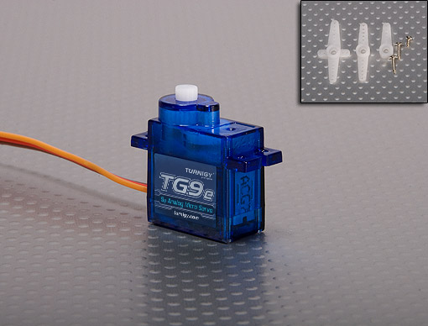
Servo Motor Turnigy TG9e
Dimension: 23x12.2x29mm
Torque: 1.5kg/cm (4.8V)
Operating speed:
0.10sec/60 degree
Operating voltage: 4.8V

Slide 35
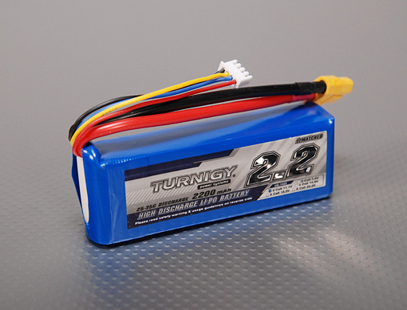
LiPo 2200mAh 3s Battery
Minimum Capacity: 2200mAh
11.1v
3cell
Constant Discharge: 25C
Peak Discharge (10sec): 35C
Pack Weight: 188g
Pack Size: 105 x 33 x 24mm

Slide 36
Blimp Functionality & Microcontroller Program

Slide 37
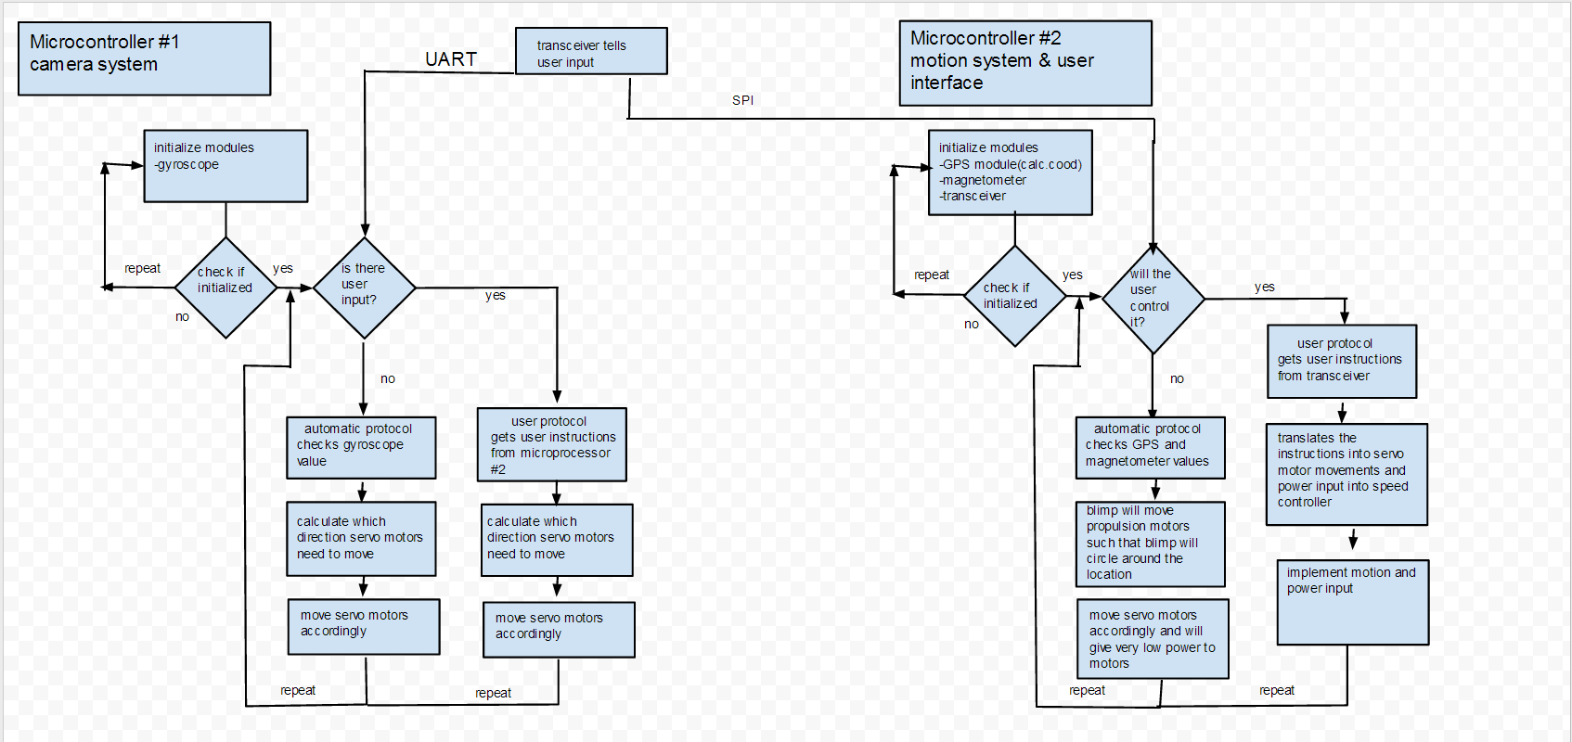
Blimp Control Flowchart

Slide 38
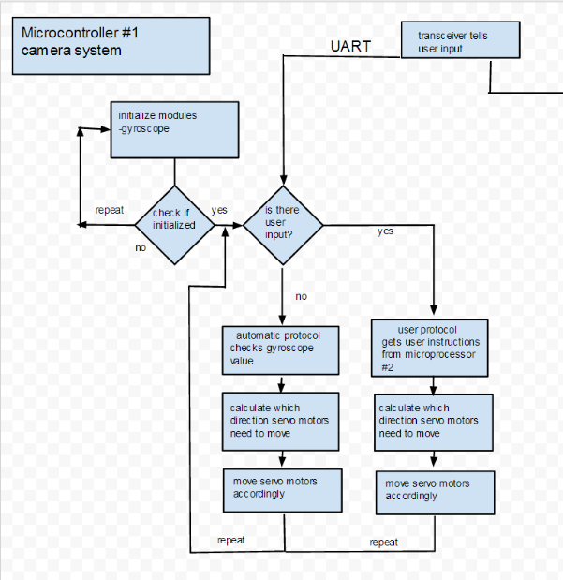
Camera System Program

Slide 39
Camera System Explained
Camera system has two modes
  User control
    The user can control at which view to see from the camera
    Controlled by the Graphic User Interface
  Auto control
    The blimp will stabilize the camera through 2 servo motors which get data from the IMU
    Auto-corrects for turbulence be it wind or debris

Slide 40
Camera Servo Controls
The commands sent from the computer GUI through the XBee to the Blimp
Camera11-camera up tilt
Camera22-camera down tilt
Camera33-camera left pan
Camera44-camera right pan

Slide 41
Servo Control Commands
Servo motors will be used to turn the blimp system and the camera system
Each button press will turn the servo approximately 30 degrees.

Slide 42
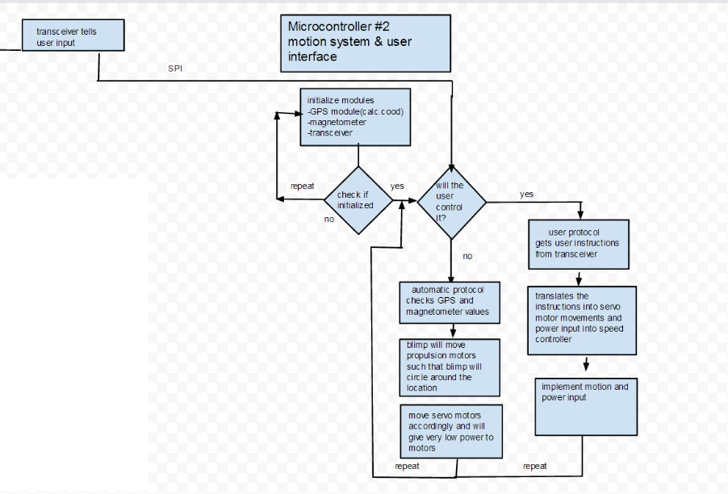
Motor controls and User interface

Slide 43
Motor control System Explained
Motor control system has 2 modes
  User control
    The user can control how the blimp will move
    Controlled by the Graphic User Interface
  Auto control
    The blimp will read in the GPS coordinates of the starting location and fly around
    The blimp automatic flight path will determined by the Graphic User Interface

Slide 44
Motor Control Commands
Some basic controls for the blimp
There will be 5 speeds on 2 rear motors
Speed111, speed222, speed333 and so on
The speed555 will set the limit of max speed possible
For directional control of the blimp, the speed’s of the individual motors are manipulated

Slide 45
Blimp Ground Station

Slide 46
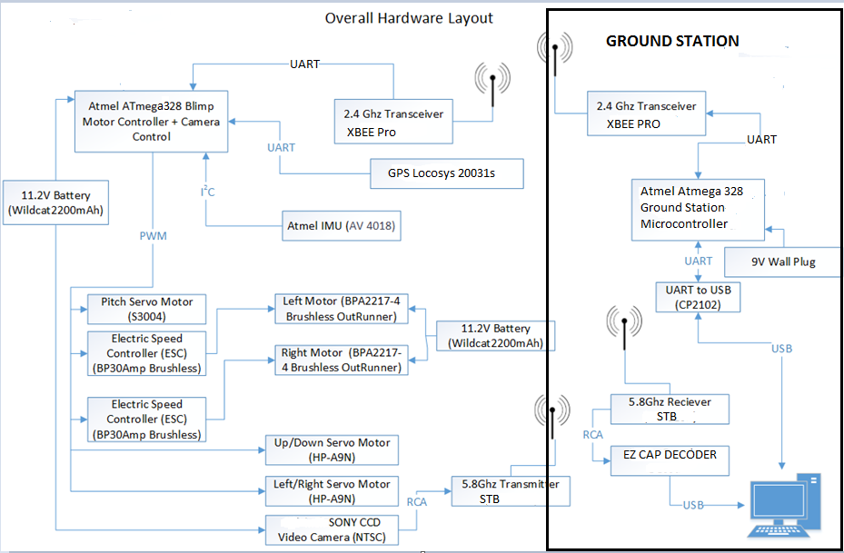

Slide 47
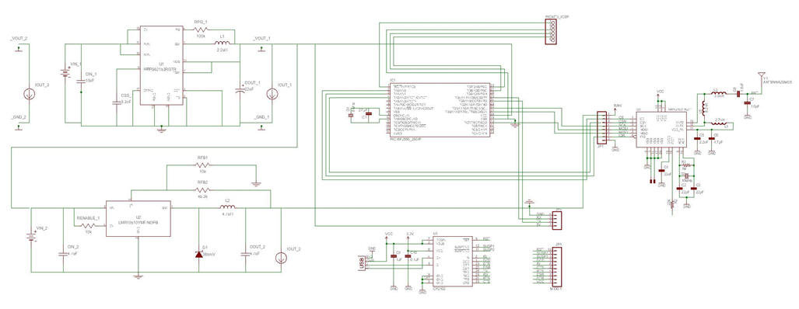
Ground Station Schematic

Slide 48
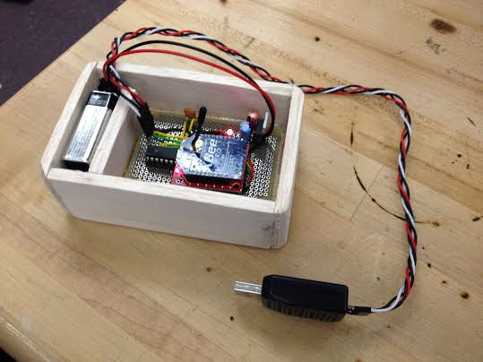

Slide 49
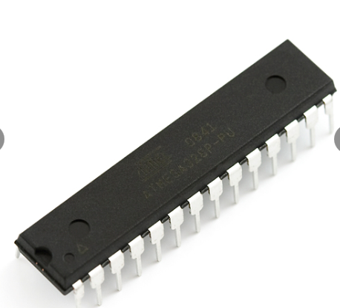
Ground Station Microcontroller (atmega328)
 | Atmega 328
Speed | 16 MHz
Package | 28-pin DIP
Program Flash Memory | 32KB
Data EEPROM | 32 kBytes
Voltage Operation Range | 1.8 to 5.5 V
Digital Communication | UART SPI I2C
Cost | $ 5.25
Software UART
Hardware UART Pins

Slide 50
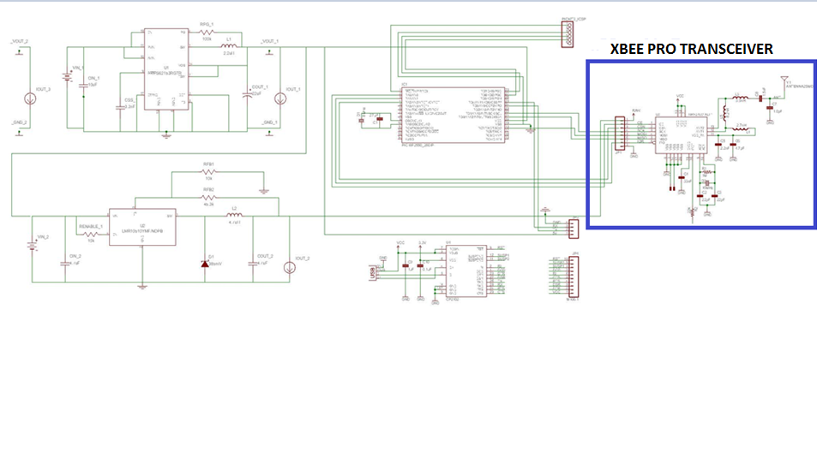
Ground Station Schematic

Slide 51
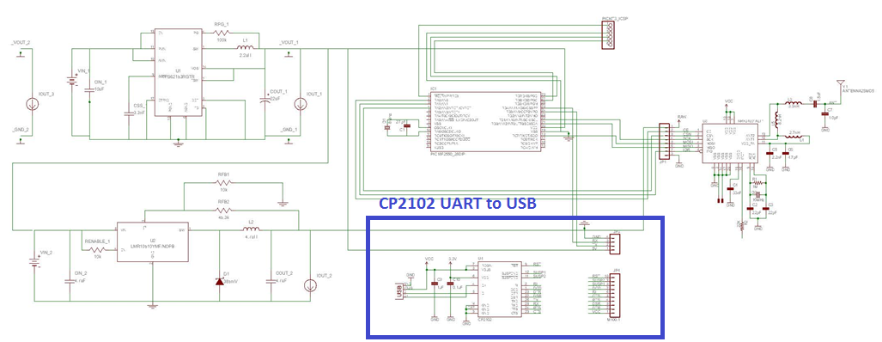
Ground Station Schematic

Slide 52
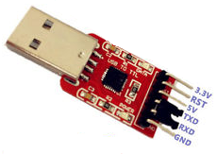
Ground Station USB Connector (CP2102)
UART Connection.
5 Volts
No need for external crystal for full USB speed (48Mhz).
Cheap Solution for USB Connection
  $7.50

Slide 53
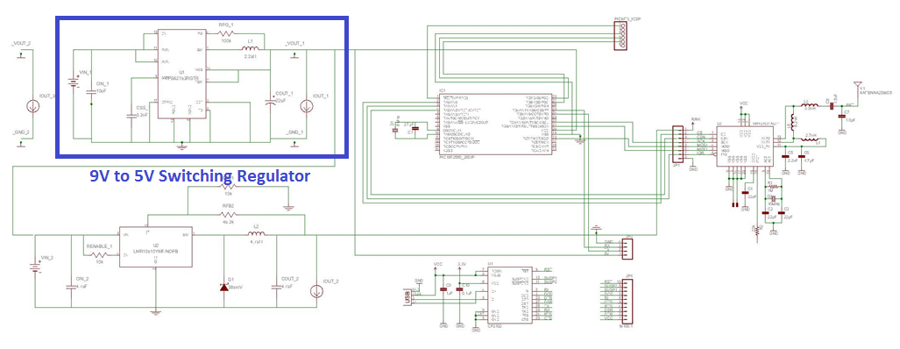
Ground Station Schematic

Slide 54
Graphical User Interface

Slide 55
C++ GUI On Computer
Connected to Ground Station. (2.4GHz Transmitter)
Connected to Video Decoder. (5.8GHz Transmitter)
Provides
  OpenCV Video Feed
    Person Detection (HOG Descriptor)
    Tracking and Follow (Template Matching)
  Drawing Automatic Patrol Path (OpenStreetMap)
  Display of IMU and GPS Data.

Slide 56
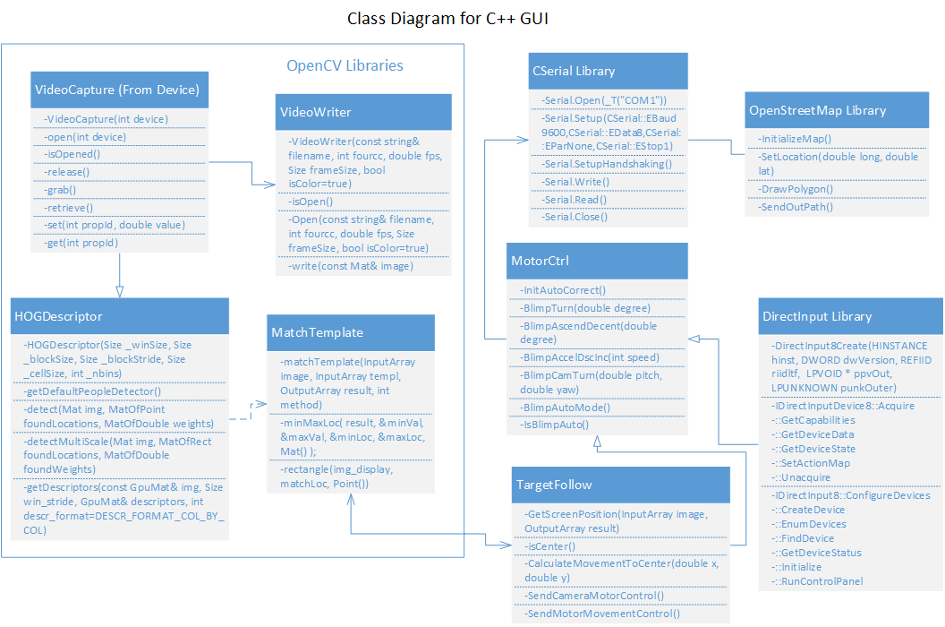

Slide 57
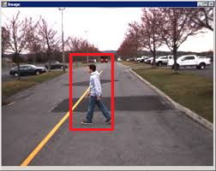
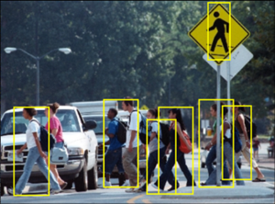
OpenCV (Computer Visions) – HOG Descriptor
Full body person detection.
Large Amount of Processing Power
  Takes time for detection to converge.
Works on each frame of video.
  Limit: 15-20 frames per second

Slide 58
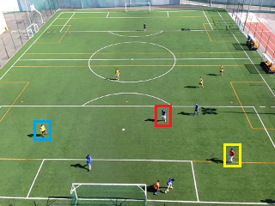
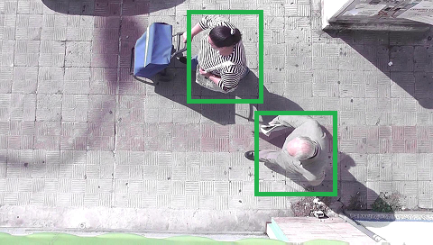
OpenCV HOG Algorithm (Added Implementation)
Fix Size Limitation (Default 128x64)
Change based on Blimp Current Altitude
Add Overhead View to HOG
Create custom blob for detection
Or find shirt Colors and Shape

Slide 59
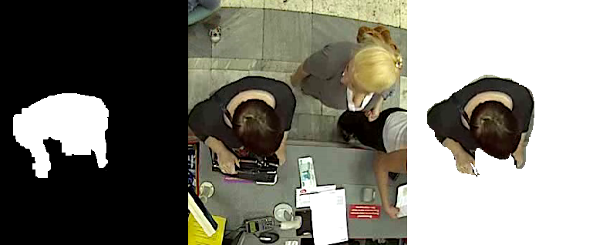
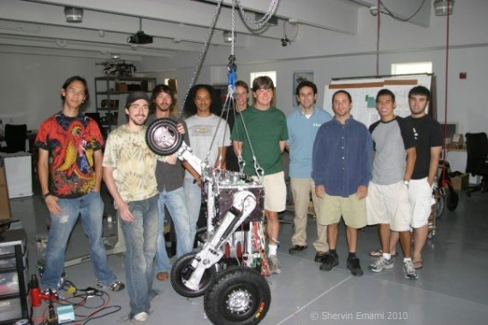
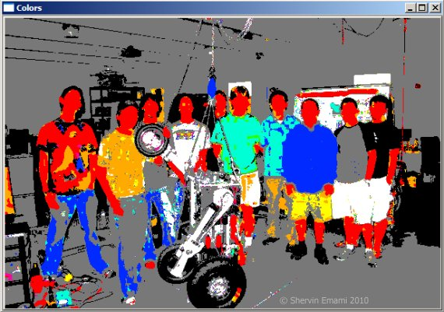
OpenCV – Custom Blob Detection and Color Detection
Create Custom Blob and Look for it in Picture.
  High False Positive Rate
Need to Combine with Color Detection for shirt and hair.

Slide 60
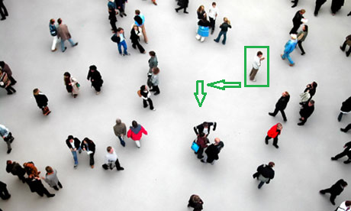
OpenCV (Computer Visions) – Template Matching
Used for Tracking and Following System.
Select Target (Person) found using HOG.
Move Camera and/or
motors so person is in
Center of View.
Blimp will be in
autonomous mode.
Template

Slide 61
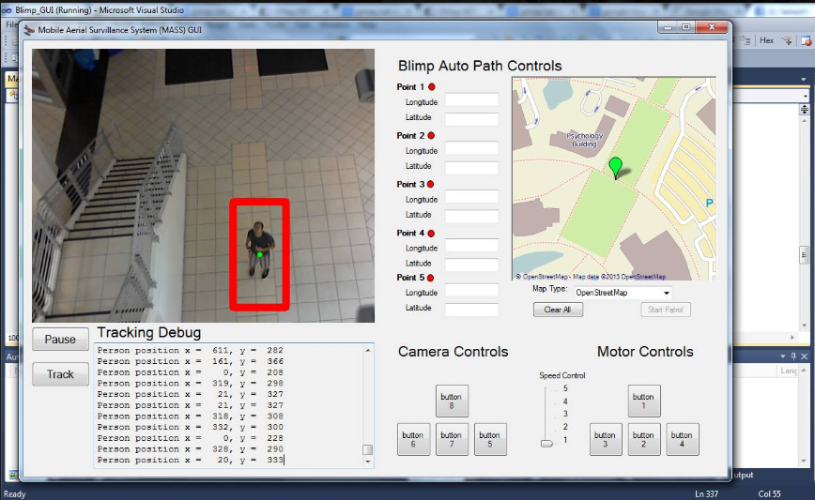
Here is Sanjay being detected from the Third floor of HEC

Slide 62
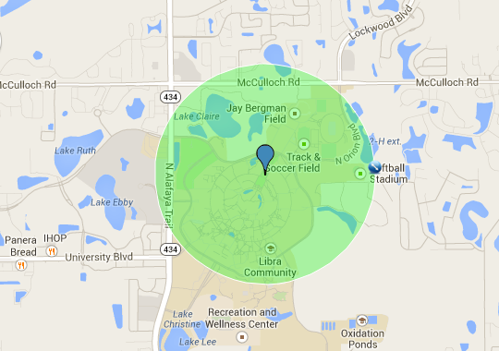
Map Patrol Path (OpenStreetMap)
Enables the user to setup a automatic path for the Blimp to Patrol.
Set Altitude on GUI before able to Start a Patrol. (Minimum of 100 meters).
Maximum Distance Determined by Transmission Range.
Reason why we didn’t use Google Maps:
  Against Terms of Service to use in
  applications. (Can only use API in Public
  Websites)
Formula for Heading (Between 2 GPS Coordinates):
θ = atan2( sin(Δλ).cos(φ₂), cos(φ₁).sin(φ₂) − sin(φ₁).cos(φ₂).cos(Δλ) )
1000 Meters Around Memory Mall

Slide 63
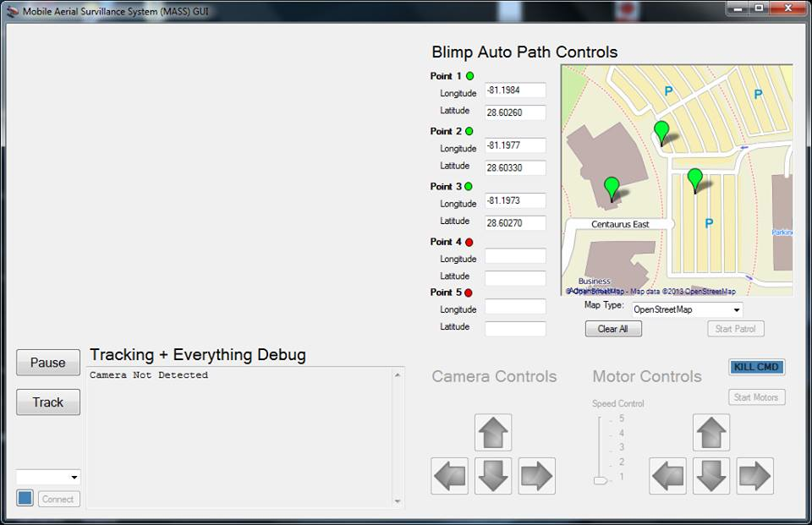

Slide 64
Administrative Content

Slide 65
Division of Task
Tasks | Power | Blimp Controller | Camera System | Blimp Structure | Ground Station | C++ GUI
Henry | X |  |  |  | X | X
Eric | X | X | X
Derrick | X |  |  | X
Sanjay |  | X | X

Slide 66

Cost of Design
Predicted Project Cost: $1063.00
Actual Project Cost: $952.64

Slide 67
Issues and Troubleshooting
Communication between Pic and Atmel
Burnt out transmitters
Logic Level Problems
Structure Design
Delay in communications
Financial Difficulties

Slide 68

Questions???

