Slide 1
M.A.S.S.
(Mobile Aerial Security System)
Group 6
Derrick Shrock
Henry Chan
Eric Hernandez
Sanjay Yerra

Slide 2
Motivation
Experience with Aviation work.
Extra protection at public events.
Doubles as an advertising system.
In past years, there have been attacks and shootings that could have been prevented with this type of system.

Slide 3
Goals and Objectives
Personal Surveillance System
Autonomous Blimp System
  Basic aviation functions
Camera System
  Stabilization System
  Video Recognition
GPS
  Enter waypoints into system
  Record Flight Path.
Long Range Control

Slide 4
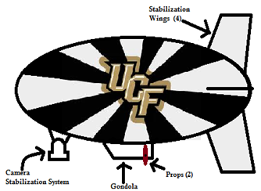
Components of Blimp Design
8 Feet
3.5 Feet

Slide 5
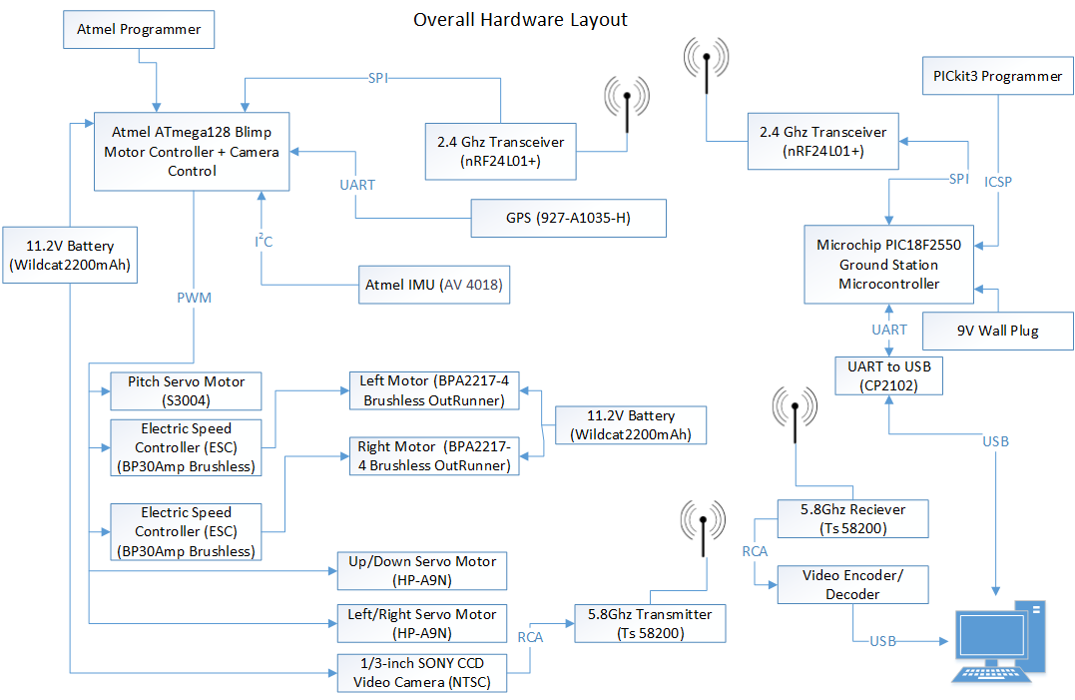

Slide 6
Blimp Design Structure

Slide 7
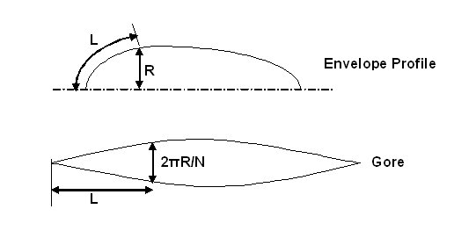
Section Design
Typical non-rigid ellipses design
The envelope will be made up of eight different sections
Each section will follow the overall profile measurements
Using the arc length and the radius of the envelope profile each section will be measured out accordingly

Slide 8
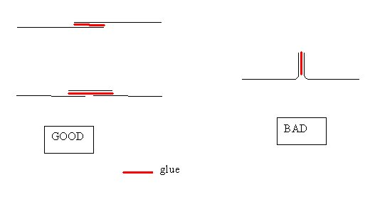
Joining the Sections
There are good and bad ways to join the sections
Sections will be joined with a tool using the same profile as the envelope
Overlapping Technique
Webbing Technique

Slide 9

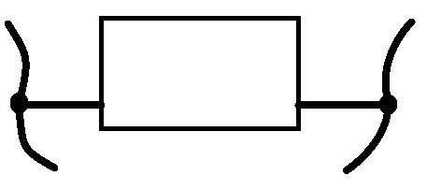
Gondola
The Gondola houses the controls system (includes: microcontroller, GPS, IMU, etc.)
Material: Fiber-glass or Light Weight Foam
Side View
This rear view representation of the gondola shows the two propellers being attached by a singular axel.
Rear View
Dimensions to be determined.
- Based on PCB size.

Slide 10
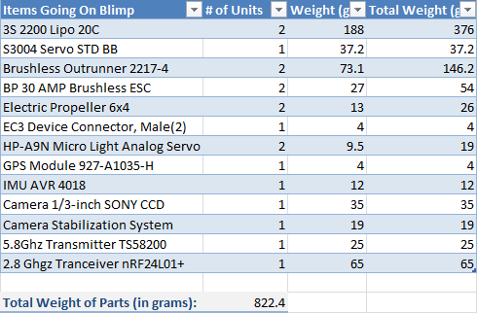
Weight Considerations
One cubic foot of helium will lift about 28.2 grams
Our Blimp size: ~110 cubic feet Lifts: ~3100 grams

Slide 11
Blimp Motors and Servos

Slide 12
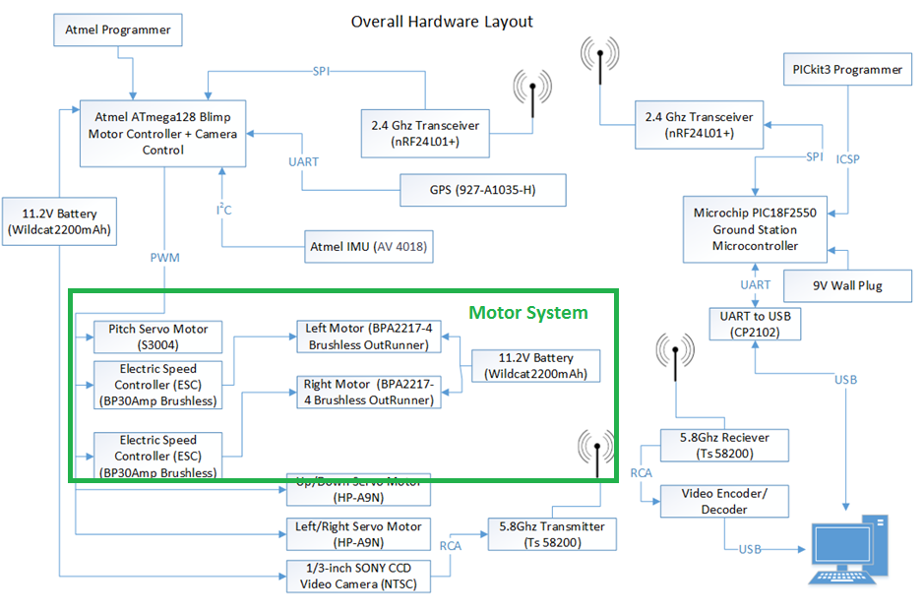

Slide 13
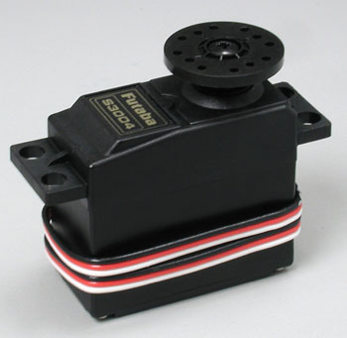
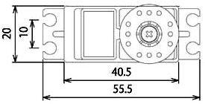
Pitch Axel Servo Motor (S3004)
Control System: +Pulse Width Control
360 Modifiable: Yes
Required Pulse: 3-5 Volt Peak to Peak Square Wave
Operating Voltage: 4.8-6.0 Volts
Operating Speed (4.8V): 0.23sec/60 degrees at no load
Stall Torque (4.8V): 44 oz/in. (3.2kg.cm)
Current Drain (4.8V): 7.2mA/idle
Weight: 1.3oz. (37.2g)
mm
mm
mm
mm

Slide 14
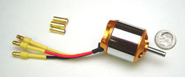
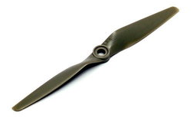
Brushless Outrunner 2217-4 Motor
Battery Requirement:
  2 – 3 Cell Li-Poly
  6 – 10 Cell NiCd/NiMH
Kv: 950 RPM/V
Max Efficiency: 80%
Max Efficiency Current: 5 - 15A (>75%)
No Load Current: 0.9A @10V
Max Current: 18A for 60S
Max Watts: 200W
Weight: 73.4 g / 2.59 oz
Size: 27.8 mm x 34 mm
Shaft Diameter: 4mm
Running at lower speed: 2-3 MPH
Propeller
Model: LP 06040E
Dimensions: 6 x 4 inches / 15cm x 10cm
Material: Plastic

Slide 15

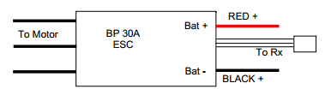
BP 30 AMP Brushless Electronic Speed Controller (ESC)
Max Continuous Current: 30A on 3 Cells
Input Voltage: 2-3 Lithium Polymer
4-10 NiCD/NiMH
Resistance: 0.0050 ohm
Lithium Cut-Off Voltage: 3.0V / cell
Size: 45 x 24 x 9mm
Temperature Protection: 110C
PWM: 8kHz
  Needs “Arming Sequence” before controlling to set propeller position and then the motors start spinning.
Max Rotation Speed: 40,000 RPM for 14 pole motor

Slide 16
Blimp Control System

Slide 17
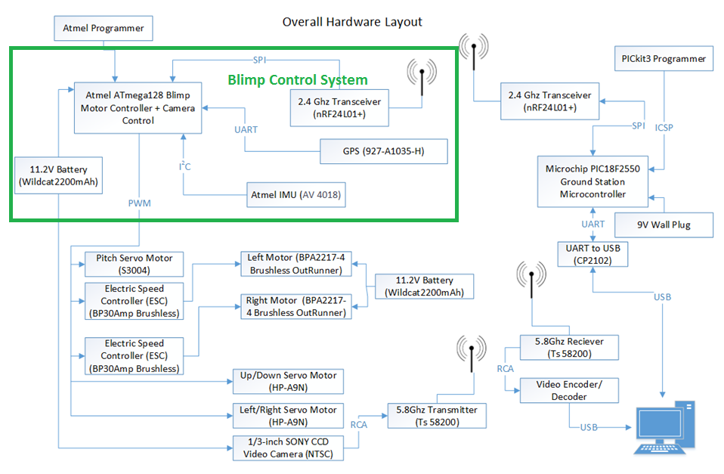

Slide 18
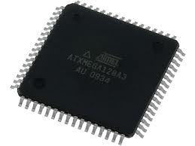
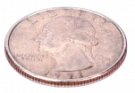
Microprocessor on the Blimp
AVR Atmega128 microprocessor (ATMEGA128-16AU)
  Up to 16 MIPS Throughput at 16MHz
  Low power settings
  128 kbytes of In-system programmable memory
  SPI, I²C, and UART serial communication ports
  Six PWM Channels
Cost: $11.63

Slide 19
Sensors (IMU) Comparison
Design | Own IMU | AVR IMU
Cost | 14.60 | 24.99
Accelerometer G Values | 2,4,6,8 | 2,4,6,8
DOF | 9 | 9
Advantages | Parts are already in. Familiar with parts. | All parts are on same board. Noise Regulators included.
Disadvantages | Would have to buy separate breakout boards for programming. Several comments complained about sensor flaws due to noise. | Spend more money. Have to wait for parts.

Slide 20
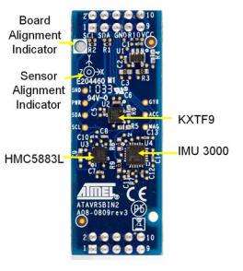
Inertial Measurement Unit (AV 4018)
IMU 3000 Gyroscope
  X,Y,Z axis
  I2C Serial Output
  ±250, ±500, ±1000, and ±2000 degrees/sec
  1MHz clock output to synchronize with digital 3-axis accelerometer
KXTF9 Accelerometer
  ±2g, ±4g or ±8g
  I2C interface
HMC5883L Magnetometer
  s 1° to 2° compass heading accuracy
  I2C interface
  Wide Magnetic Field Range (+/-8 Oe)
58 mm
14 mm

Slide 21
Transmission Comparison
 | Frequency | Antenna | Weight | Power Consumption | Max Range | Data Rate | Price
nRF24L01+ | 2.4Ghz | External SMA | 4.3 grams (no Antenna) | 11.3mA TX Mode 13.3mA RX Mode | 1000 meters | 250kbps, 1Mbps or 2Mbps | $19.84
XBee 1mW Series 1 | 2.4Ghz | On-Chip | 5.7 grams | 3.3V @ 50mA | 100 Meters | 250kbps Max data rate with 128-bit encryption | $ 29.95

Slide 22
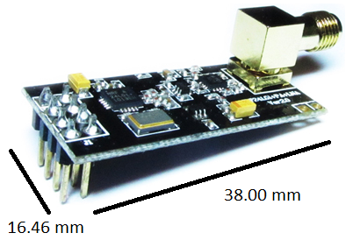
Transmitter/Receiver Module (nRF24L01+)
2.4 Ghz ISM Band
126 RF channels w/ Frequency Hopping Protocol
Programmed through SPI
SMA Antenna with 2dB Gain
Weight: 65 grams w/ SMA Antenna
Cost: $19.99
Range (Open Area) | Data Rate
520 Meters | 2 Mbits/s
720 Meters | 1 Mbits/s
>1000 Meter | 250 Kbps

Slide 23
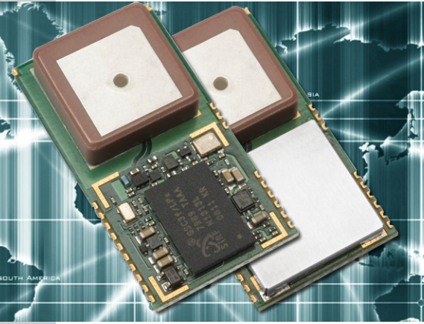
GPS MODULE
-159 dBm tracking
20 Channels Parallel Tracking
Time To First Fix
  Cold Start < 35 s
Precision: ~2 m
Cost: $20.63
15X15(mm)

Slide 24
NMEA Codes
Name | Example Data | Description
Sentence Identifier | $GPGGA | Global Positioning System Fix Data
Time | 170834 | 17:08:34 Z
Latitude | 4124.8963, N | 41d 24.8963' N or 41d 24' 54" N
Longitude | 08151.6838, W | 81d 51.6838' W or 81d 51' 41" W
Fix Quality: - 0 = Invalid - 1 = GPS fix - 2 = DGPS fix | 1 | Data is from a GPS fix
Number of Satellites | 05 | 5 Satellites are in view
Horizontal Dilution of Precision (HDOP) | 1.5 | Relative accuracy of horizontal position
Altitude | 280.2, M | 280.2 meters above mean sea level
Height of geoid above WGS84 ellipsoid | -34.0, M | -34.0 meters
Time since last DGPS update | blank | No last update
DGPS reference station id | blank | No station id
Checksum | *75 | Used by program to check for transmission errors
NMEA Codes will use
  GGA
    Longitude
    Latitude
    Altitude
  GSA (confirmation of satellite connections)
    A,2 – Only Longitude and Latitude Confirmation
    A,3 – Longitude, Latitude, Altitude Confirmation
Example:
  $GPGSA,A,3,,,,,,16,18,,22,24,,,3.6,2.1,2.2*3C
,A,3

Slide 25
Camera System

Slide 26
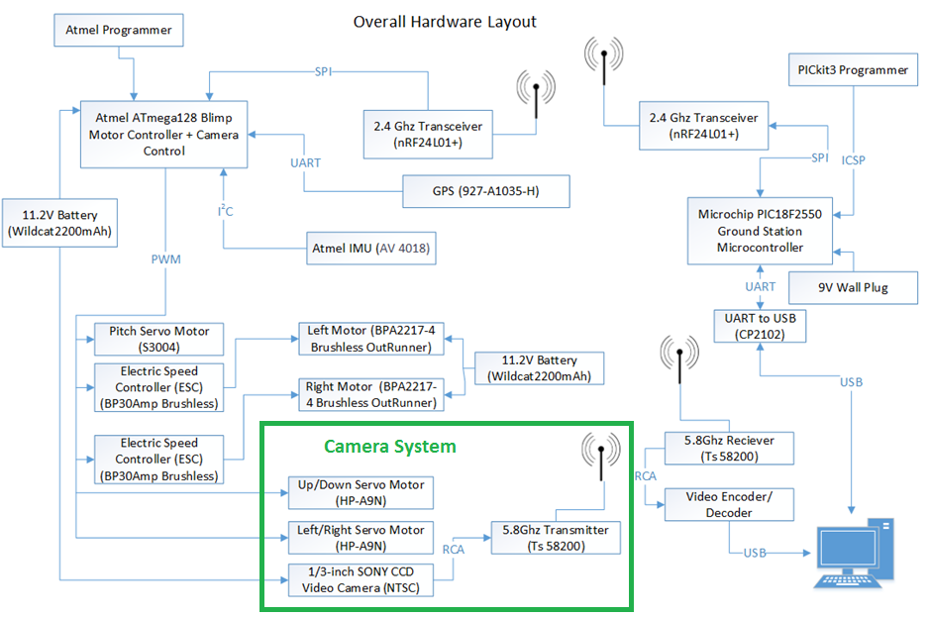

Slide 27
Camera Qualifications
Lightweight
Crisp Picture and High Resolution
Inexpensive
Limited Video Feed Delay

Slide 28
Camera Comparison
Camera | GoPro Hero 3 Black Edition | 1/3 inch Sony CCD Video Camera
Weight | 204g | 35g
Price | $240 | $32.76
Resolution | 1080p | 520TV
Wifi Compatible | Yes | No
Power Supply | Battery included | 12V with 150 mA current draw
Flight Time | 90 minutes | Completely dependent on size of external battery
Delay for Stream of Video | 3 seconds | Delay of Transceiver <1s
Selected |  | This one!!! (It is all about the money)

Slide 29
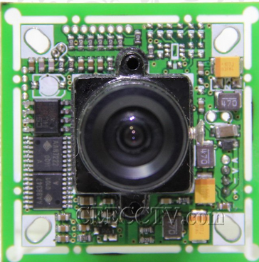
1/3 Inch Sony CCD Video Camera
Pixels 752 X 582
Internal Synchronization
Horizontal Resolution is 520 TV Lines
Lens is 3.6 mm
Power Supply: 12V/150 mA

Slide 30
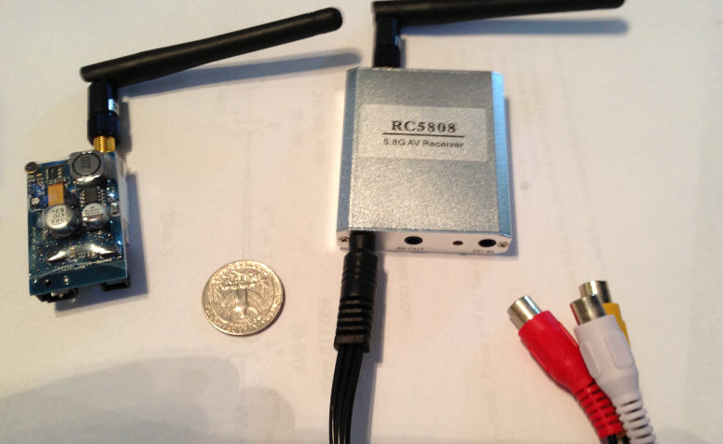
Camera Feed Transmitter/Receiver
Video Camera will have a 5.8 GHz AV Transceiver
Choose 5.8 GHz in order to not cross signals with 2.4 GHz Transceiver
2 km range
Power Regulation:
  12 Volt 150 mA
RCA to USB adapter

Slide 31
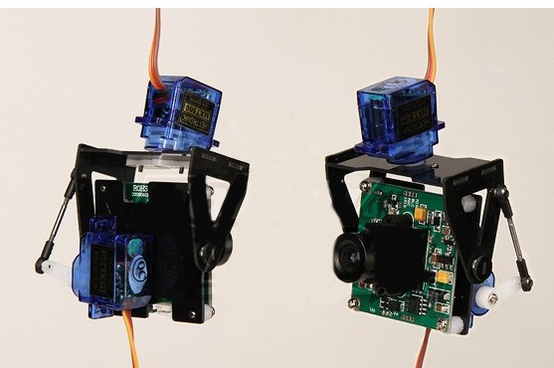
Camera Mount
Lightweight 19g
This particular mount was made for our specific camera
Gives complete 180 degree pan & full tilt
Uses two 9.5g (Torque rating) servos

Slide 32
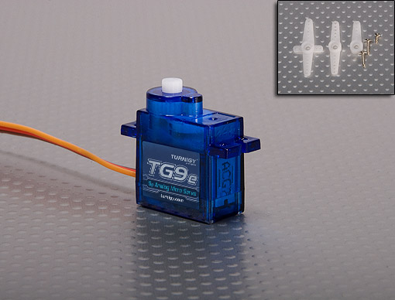
Servo Motor Turnigy TG9e
Dimension: 23x12.2x29mm
Torque: 1.5kg/cm (4.8V)
Operating speed:
0.10sec/60 degree
Operating voltage: 4.8V

Slide 33
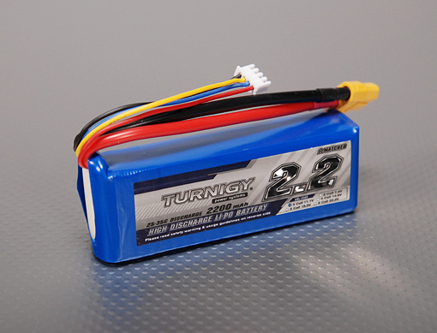
LiPo 2200mAh 3s Battery
Minimum Capacity: 2200mAh
11.1v
3cell
Constant Discharge: 25C
Peak Discharge (10sec): 35C
Pack Weight: 188g
Pack Size: 105 x 33 x 24mm

Slide 34
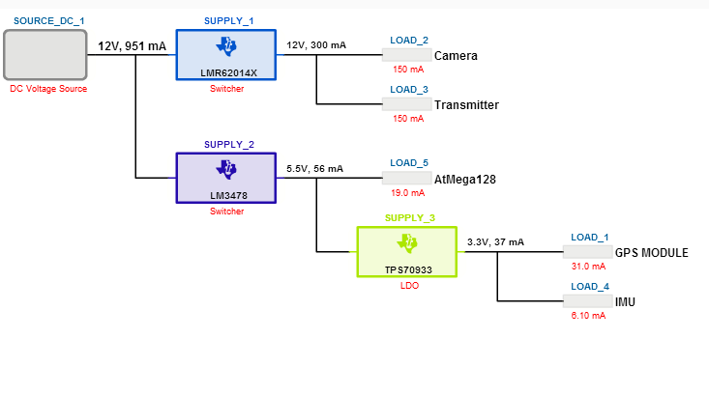
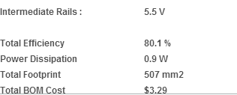
Blimp Power System

Slide 35
Blimp Functionality & Microcontroller Program

Slide 36
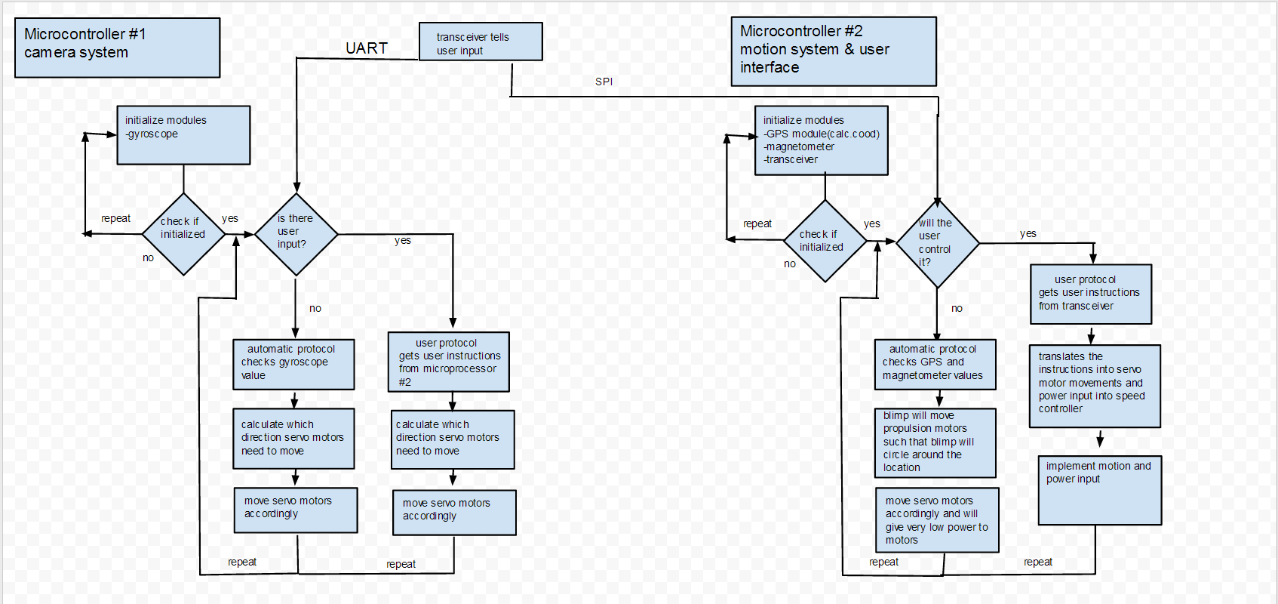
Blimp Control Flowchart

Slide 37
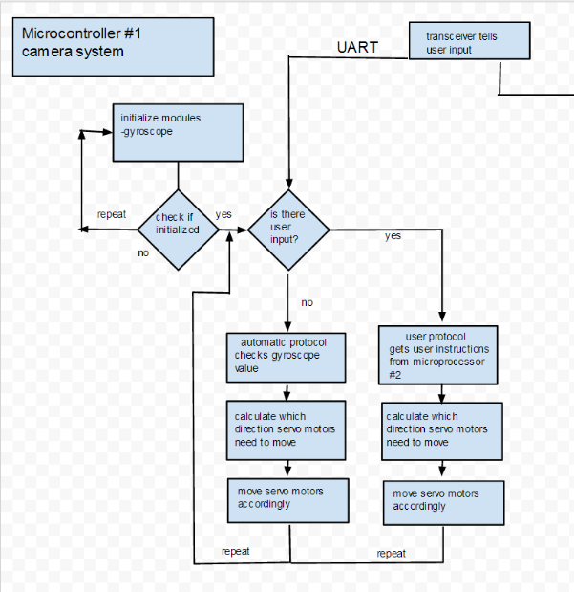
Camera System Program

Slide 38
Camera System Explained
Camera system has 2 modes
  User control
    The user can control at which view to see from the camera
    Controlled by the GUI or the Logitech Gamepad
  Auto control
    The blimp will stabilize the camera through 2 servo motor which get data from the IMU
    Auto-corrects for turbulence be it wind or debris

Slide 39
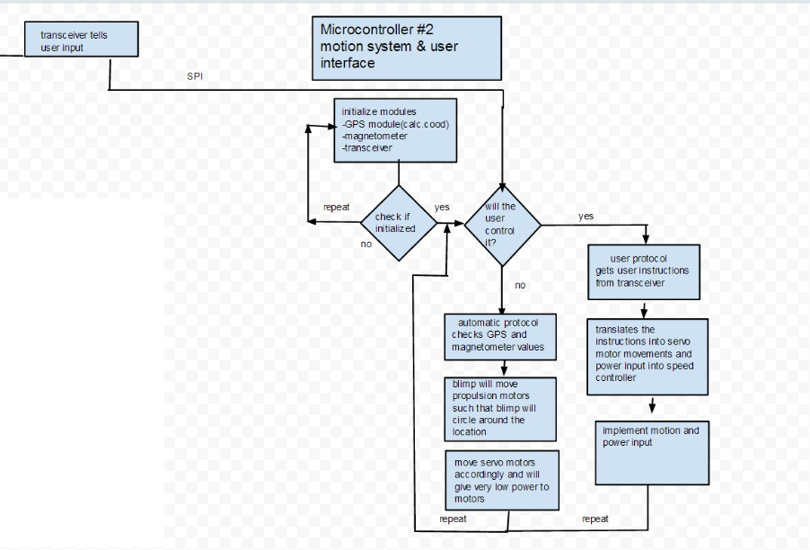
Motor controls and User interface

Slide 40
Motor control System Explained
motor control system has 2 modes
  User control
    The user can control how the blimp will move
    Controlled by the GUI or the Logitech Gamepad
  Auto control
    The blimp will read in the GPS coordinates of the starting location and fly around
    The blimp automatic flight path will determined by the GUI

Slide 41
Blimp Ground Station

Slide 42
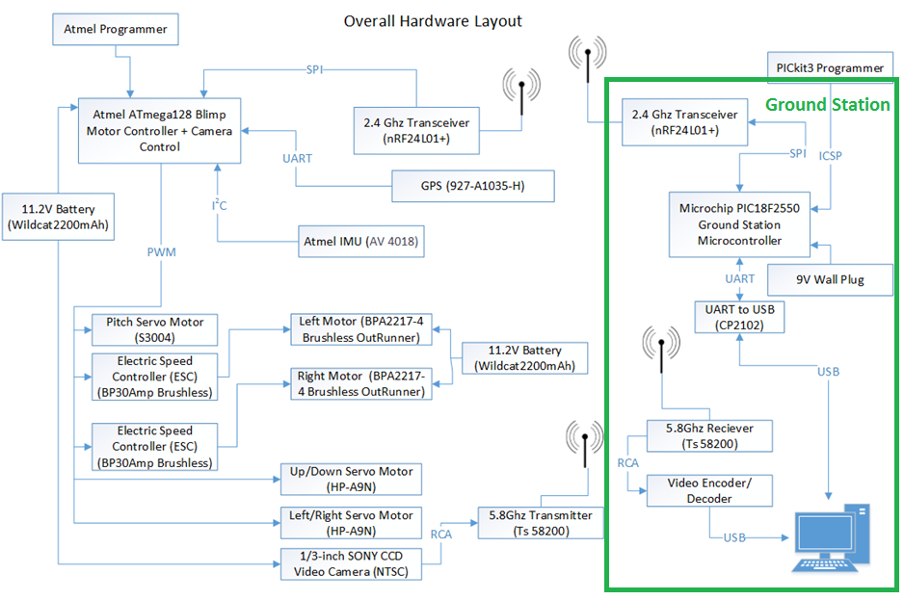

Slide 43
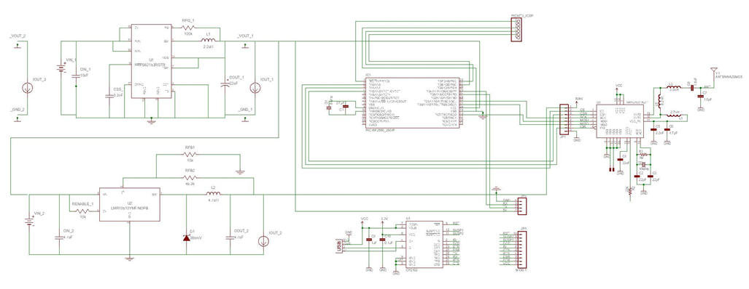
Ground Station Schematic

Slide 44
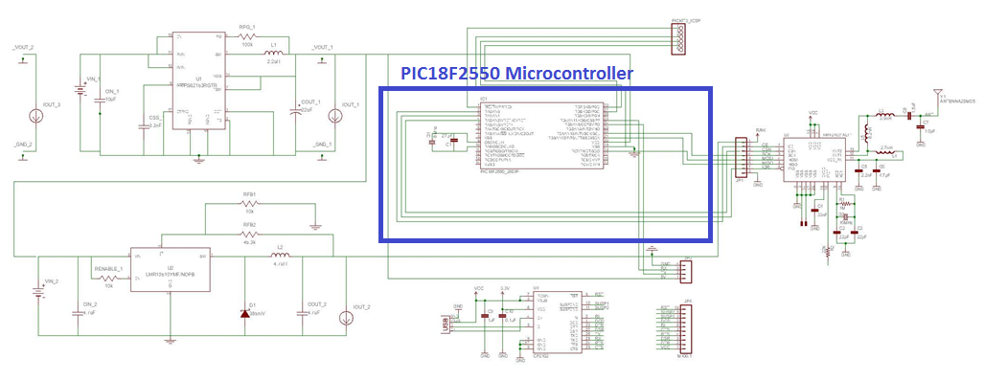
Ground Station Schematic

Slide 45
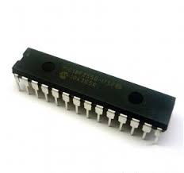
Ground Station Microcontroller (PIC18F2550)
 | PIC18F2550
Speed | 48 Mhz
Package | 28-pin DIP
Program Flash Memory | 32KB
Data EEPROM | 256 Bytes
Voltage Operation Range | 2 to 5.5 V
Digital Communication | 1-UART 1-A/E/USART 1-SPI 1-I2C 1-MSSP(SPI/I2C)
Cost | $ 4.13
8Mhz External Oscillator
Software UART
Hardware SPI Pins
5V V_{cc}
Programing: C18 Compiler

Slide 46
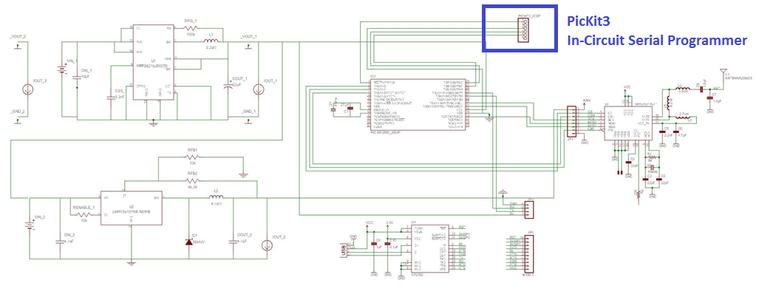
Ground Station Schematic

Slide 47
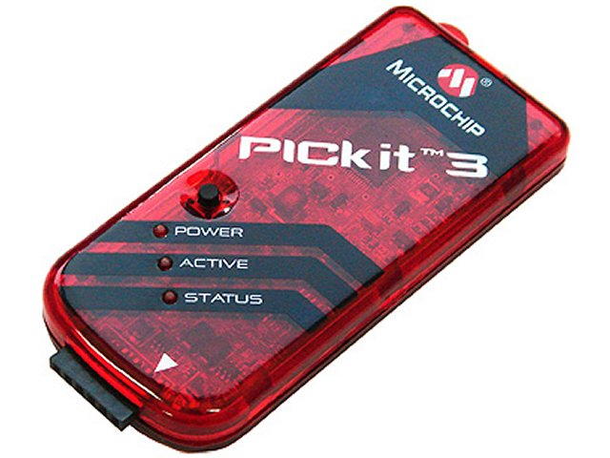
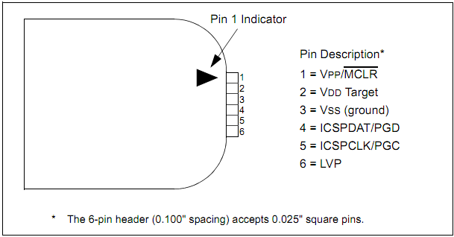
Ground Station Programmer (PicKit3)
In Circuit Serial Programmer (ICSP)
Proprietary to Microchip PICs
Custom Connector built onto PCB for programming:
  4-Pins Used
Pin | Function
1 | Vpp/MCLR
3 | Vss(Ground)
4 | ICSPDAT/PGD
5 | ICSPCLK/PGC

Slide 48
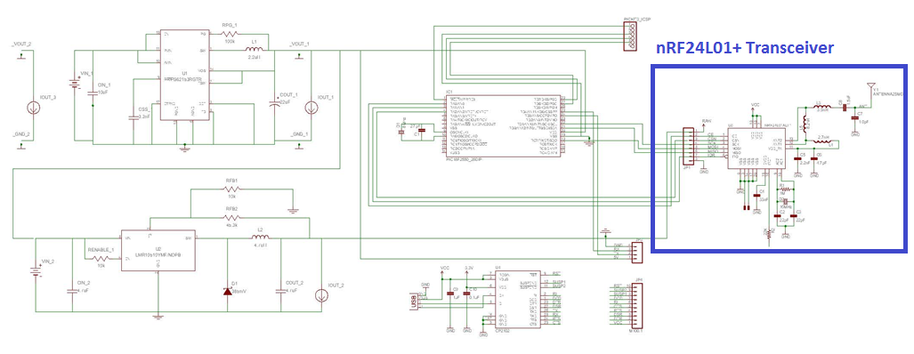
Ground Station Schematic

Slide 49
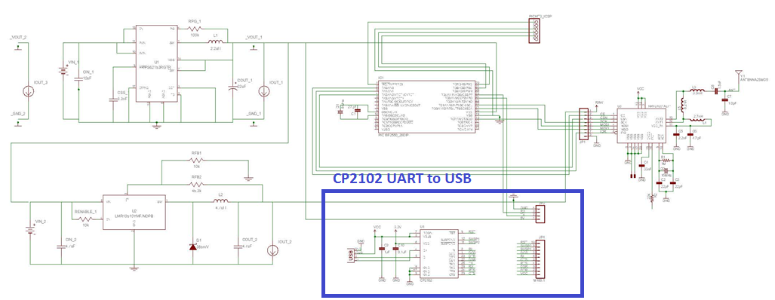
Ground Station Schematic

Slide 50
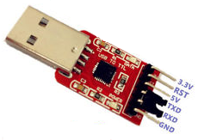
Ground Station USB Connector (CP2102)
UART Connection.
5 Volts
No need for external crystal for full USB speed (48Mhz).
Cheap Solution for USB Connection
  $7.50

Slide 51
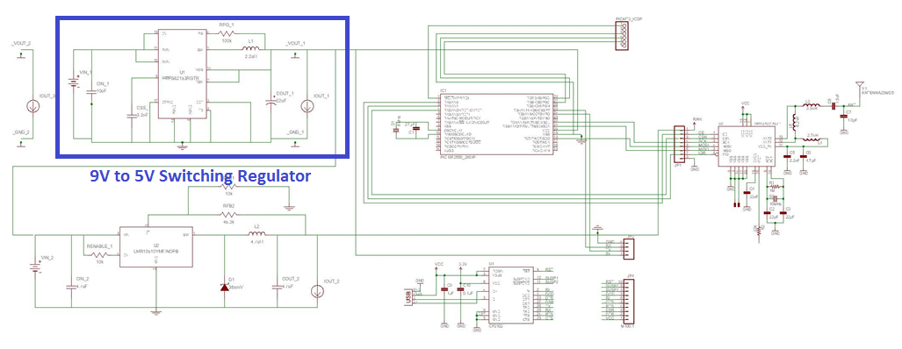
Ground Station Schematic

Slide 52
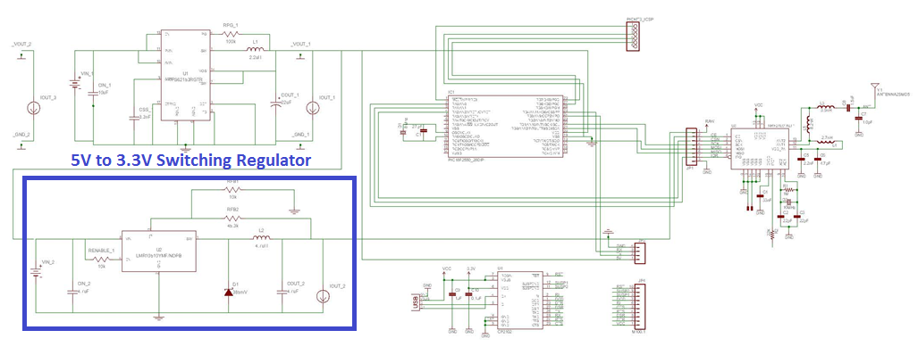
Ground Station Schematic

Slide 53
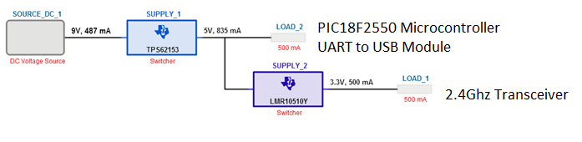
Ground Station Power System
Switching Voltage Regulators
  9V Power Supply (Wall Plug)
  5V output
  3.3V output
Voltage Regulator | Efficiency | 5V Rail | 3.3V Rail | Power Dissipation | Total Cost
Switching | 91% | TPS62153 | LMR10510Y | 0.4 W | $1.84
LDO | 67% | LM2940 | LM3940 | ?? | $1.36

Slide 54
Graphical User Interface

Slide 55
C++ GUI On Computer
Connected to Ground Station. (2.4Ghz Transmitter)
Connected to Video Decoder. (5.8Ghz Transmitter)
Provides
  OpenCV Video Feed
    Person Detection (HOG Descriptor)
    Tracking and Follow (Template Matching)
  Drawing Automatic Patrol Path (OpenStreetMap)
  Controller Support (DirectInput)
    Includes buttons on screen (when no controller is plugged in)
  Display of IMU and GPS Data.

Slide 56
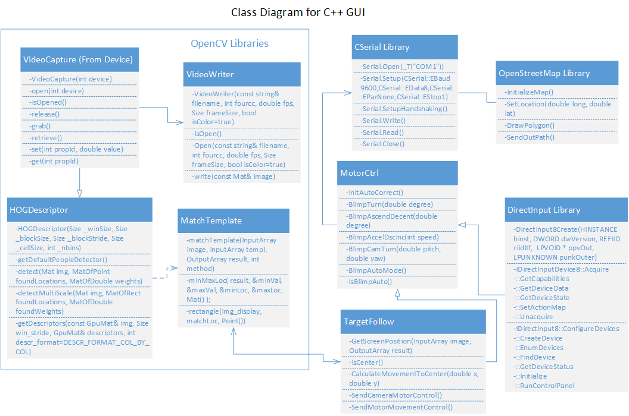

Slide 57
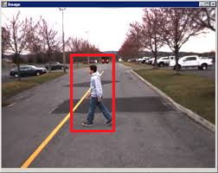
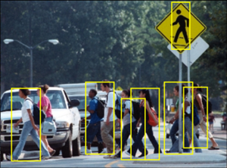
OpenCV (Computer Visions) – HOGDiscriptor
Full body person detection.
Large Amount of Processing Power
  Takes time for detection to converge.
Works on each frame of video.
  Limit: 15-20 frames per second

Slide 58
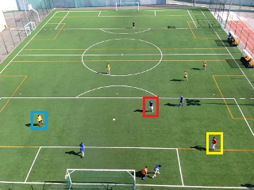
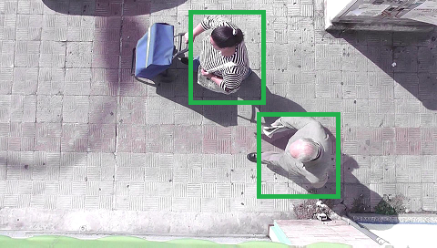
OpenCV HOG Algorithm (Added Implementation)
Fix Size Limitation (Default 128x64)
Change based on Blimp Current Altitude
Add Overhead View to HOG
Create custom blob for detection
Or find shirt Colors and Shape

Slide 59
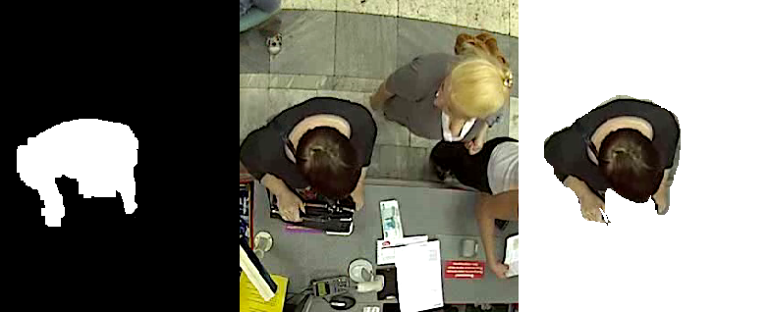
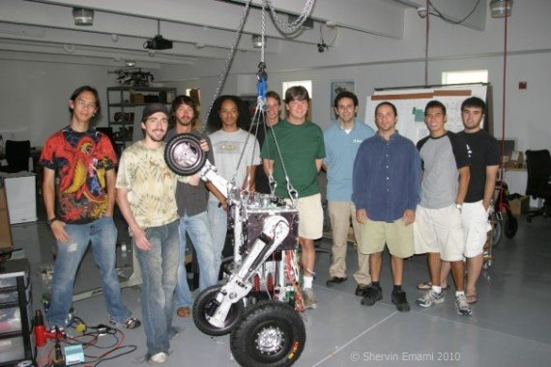
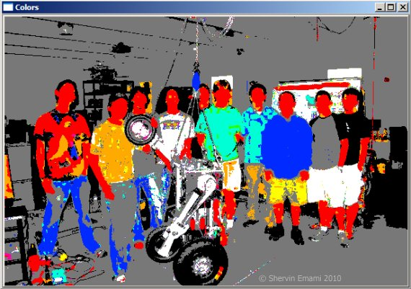
OpenCV – Custom Blob Detection and Color Detection
Create Custom Blob and Look for it in Picture.
  High False Positive Rate
Need to Combine with Color Detection for shirt and hair.

Slide 60

OpenCV (Computer Visions) – Template Matching
Used for Tracking and Following System.
Select Target (Person) found using HOG.
Move Camera and/or
motors so person is in
Center of View.
Blimp will be in
autonomous mode.
Template

Slide 61

Map Patrol Path (OpenStreetMap)
Enables the user to setup a automatic path for the Blimp to Patrol.
Set Altitude on GUI before able to Start a Patrol. (Minimum of 100 meters).
Maximum Distance Determined by Transmission Range.
Reason why we didn’t use Google Maps:
  Against Terms of Service to use in
  applications. (Can only use API in Public
  Websites)
Formula for Heading (Between 2 GPS Coordinates):
θ = atan2( sin(Δλ).cos(φ₂), cos(φ₁).sin(φ₂) − sin(φ₁).cos(φ₂).cos(Δλ) )
1000 Meters Around Memory Mall

Slide 62

Gamepad Controller (Logitech F310)

Slide 63
Administrative Content

Slide 64
Division of Task
Tasks | Power | Blimp Controller | Camera System | Blimp Structure | Ground Station | C++ GUI
Henry | X |  |  |  | X | X
Eric | X | X | X
Derrick | X |  |  | X
Sanjay |  | X | X

Slide 65

Cost of Design
Estimated Costs:
Hand Made Structure: 200$
Cost of Helium w/ Tank Rental: 200$
Total Project Cost: $1063.00

Slide 66

Project Progress as a Percentage

Slide 67
Questions?

