Slide 1


Eco-Sense
Group 7:
Neil Northcutt
Jamie Olheiser Daniel Haggerty

Slide 2
Eco-Sense
System to automate the lawn watering process through the use of
Climate sensors
Ground sensors
Weather prediction
Three subsystems
Sensor subsystem
Central HUB subsystem
Solenoid subsystem

Slide 3
Goals/Motivation
Conserve water by reducing wasteful watering of traditional watering methods.
Hand watering
General sprinkler system
Timer, automated system
Promote a healthier, greener lawn.

Slide 4
Hardware Specifications
Component | Parameter | Specification
Wireless Module | Range | 20ft to 1 mile
Sensors | Voltage | 3.3 or 5
Microcontroller | Power consumption Storage RAM/Flash Clock Speed I/O Pins | <10mW sleeping, <50mW on 128B+, 8kB+ 8 MHz 4+ Analog, 5+ Digital
Sensor Node | Power consumption | <50mW sleeping, <300mW on
Temperature Sensor | Sensing Range | 0°F to 120°F.

Slide 5
Water Efficiency

Slide 6
Water Efficiency
Primary goal of Eco-Sense
Reduce the waste of water by not watering under certain climate conditions.
Soil Moisture
Temperature
Humidity
Allow watering only when rain is not predicted.

Slide 7
When to Water Algorithm
Within USWT limits?
Soil Field Capacity below 75%?
Temperature below 5˚C?
Sensor Data
Yes
Yes
No
No
Yes
No
Water
Do Not Water
Temperature above 32˚C
Yes
No
No
Yes
No
Temperature below dew point?
Humidity below 50%?
Temperature above 25˚C?
USWT: User Specified watering times.
Yes
Yes
No

Slide 8
Weather Prediction
Not an exact science
Use of the barometric pressure, temperature, and humidity sensors.
Most weather prediction algorithms are proprietary, have to create our own.
Not yet completed

Slide 9
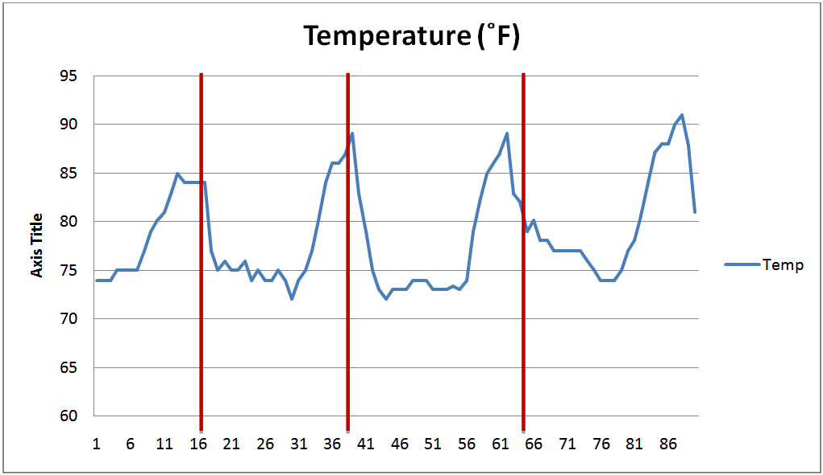
Weather Prediction - Temperature
Generally, temperature increases before the onset of rain (red lines).

Slide 10
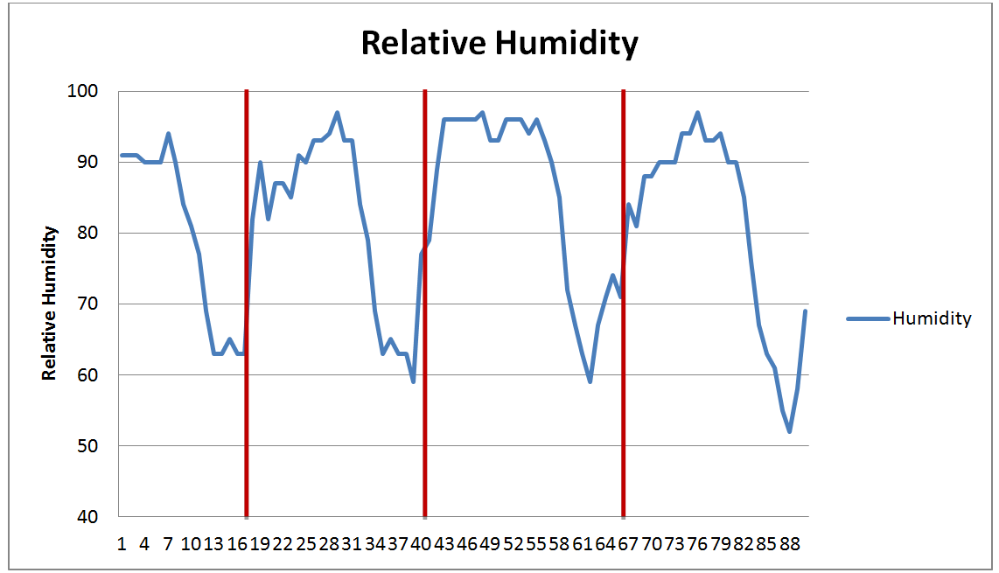
Weather Prediction - Humidity
Generally, relative humidity rises before the onset of rain.

Slide 11
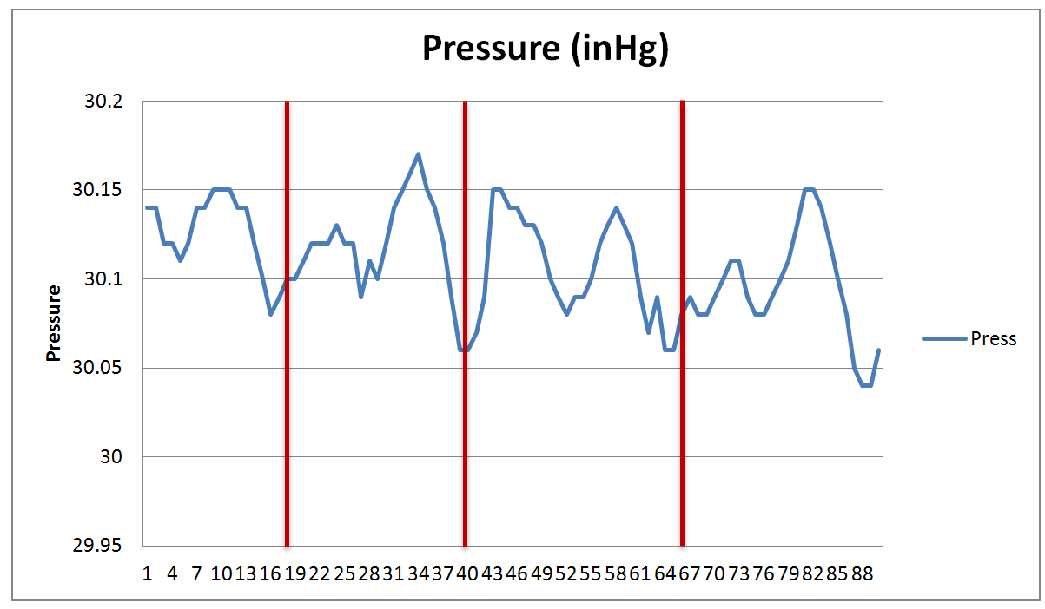
Weather Prediction - Pressure
Generally, barometric pressure drops before the onset of rain.

Slide 12
Hardware

Slide 13
Solenoid S.S.
Sensors S.S.
Transmitter Receiver
Micro-Controller
Solenoid
Rain Detection Sensor
Barometric Pressure Sensor
Ambient Temp. Sensor
Power Source
Humidity Sensor
Micro-Controller
Ground Temp. Sensor
User Interface
Transmitter Receiver
Ground Moisture Sensor
Transmitter Receiver
Micro-Controller
LCD Display
Power Source
Power Source
Central HUB S.S.

Slide 14
Humidity Sensor
Measures the absolute humidity of the surroundings.
Used for weather prediction and when to water algorithms.
Needs to be exposed to the elements for accurate readings.

Slide 15
Humidity Sensor
Part | Supply Voltage | Current | Humidity Range | Accuracy | Shutdown Current | Cost
DHT11 | 3 to 5.5 V | 0.5 to 2.5mA | 20 - 90% | ± 5% | 100μA | $5
DHT22 | 3 to 5 V | 0.5 to 2.5mA | 0 to 100% | ± 2% | 40-50μA | $15
SHT10 | 2.4 to 5.5 V | 28μA | 0 to 100% | ± 4.5% | 1 to 2μA | $20
SHT11 | 2.4 to 5.5 V | 28μA | 0 to 100% | ± 3% | 1 to 2μA | $30
SHT15 | 2.4 to 5.5 V | 28μA | 0 to 100% | ± 2% | 1 to 2μA | $35
HH10D | 2.7 to 3.3 V | 120 to 180μA | 0 to 99% | ± 3% | - | $10
HIH-4000 | 4 to 5.8 V | 200 to 500μA | 0 to 100% | ± 3.5% | - | $20
HIH-4030 | 4 to 5.8 V | 200 to 500μA | 0 to 100% | ± 3.5% | - | $18

Slide 16
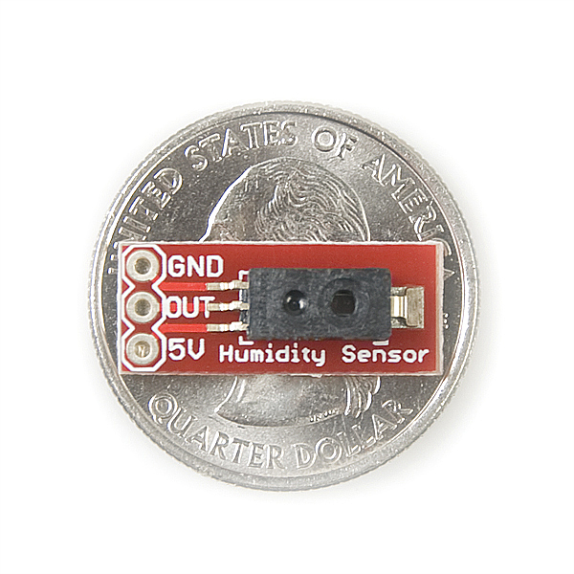
Humidity Sensor
Inexpensive breakout board.
Good power usage.
Reasonable sensor accuracy.
.75 inch
.3 inch
HIH-4030

Slide 17
Solenoid S.S.
Sensors S.S.
Transmitter Receiver
Micro-Controller
Solenoid
Rain Detection Sensor
Barometric Pressure Sensor
Ambient Temp. Sensor
Power Source
Humidity Sensor
Micro-Controller
Ground Temp. Sensor
User Interface
Transmitter Receiver
Ground Moisture Sensor
Transmitter Receiver
Micro-Controller
LCD Display
Power Source
Power Source
Central HUB S.S.

Slide 18

Rain Detection Sensor
Detects the presence of rain.
Used for when to water algorithm and shutting off watering if rain starts.
Uses a PCB board and resistivity properties.
2 Inch
3 Inch

Slide 19
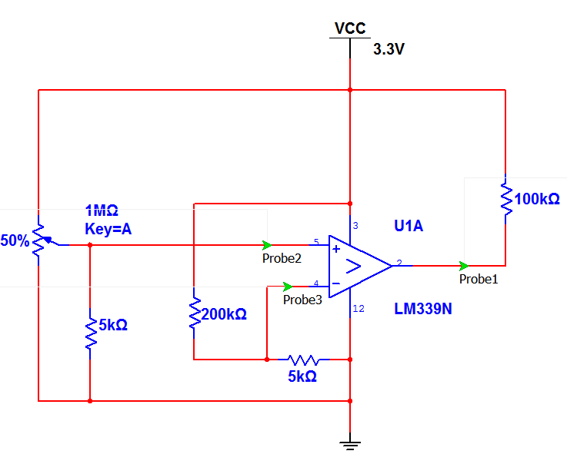
Rain Detection Sensor

Slide 20
Solenoid S.S.
Sensors S.S.
Transmitter Receiver
Micro-Controller
Solenoid
Rain Detection Sensor
Barometric Pressure Sensor
Ambient Temp. Sensor
Power Source
Humidity Sensor
Micro-Controller
Ground Temp. Sensor
User Interface
Transmitter Receiver
Ground Moisture Sensor
Transmitter Receiver
Micro-Controller
LCD Display
Power Source
Power Source
Central HUB S.S.

Slide 21
Barometric Pressure Sensor
Measures ambient pressure caused by weather patterns.
Used with the weather prediction algorithm
Needs to be exposed to the elements.
Part | Supply Voltage | Average Current | Pressure Range | Accuracy | Shutdown Current | Cost
BMP085 | 1.8 to 3.6 V | 3 to 12μA | 300 to 1100hPa | ±1hPa | 0.1μA | $20
MPL115A1 | 2.4 to 5.5 V | 5μA | 500 to 1150hPa | ±10hPa | 1μA | $25
HP03M | 2.2 to 3.6 V | - | 300 to 1100hPa | ±3hPa | 1μA | $30

Slide 22
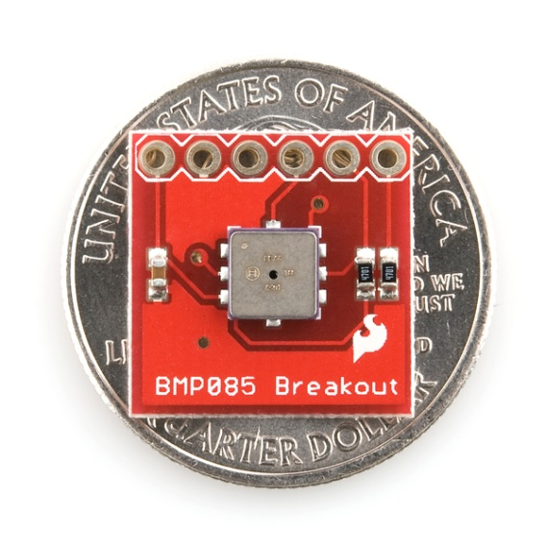
Barometric Pressure Sensor
Low current
Breakout board
Contains a thermometer used as the ambient temperature sensor needed
for the sensor system.
I2C connection
.65 inch
.65 inch
BMP085

Slide 23
Solenoid S.S.
Sensors S.S.
Transmitter Receiver
Micro-Controller
Solenoid
Rain Detection Sensor
Barometric Pressure Sensor
Ambient Temp. Sensor
Power Source
Humidity Sensor
Micro-Controller
Ground Temp. Sensor
User Interface
Transmitter Receiver
Ground Moisture Sensor
Transmitter Receiver
Micro-Controller
LCD Display
Power Source
Power Source
Central HUB S.S.

Slide 24
Ground Moisture Sensor
Used to measure the water content in soil.
Necessary for the when to water algorithm.
General resistive method.

Slide 25
Solenoid S.S.
Sensors S.S.
Transmitter Receiver
Micro-Controller
Solenoid
Rain Detection Sensor
Barometric Pressure Sensor
Ambient Temp. Sensor
Power Source
Humidity Sensor
Micro-Controller
Ground Temp. Sensor
User Interface
Transmitter Receiver
Ground Moisture Sensor
Transmitter Receiver
Micro-Controller
LCD Display
Power Source
Power Source
Central HUB S.S.

Slide 26
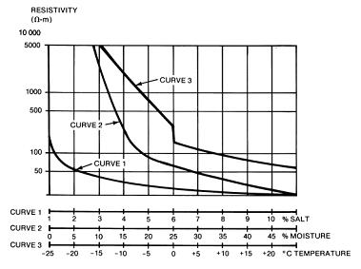
Ground Temperature Sensor
Necessary for accuracy of ground moisture sensor.
Needs to be exposed to the elements.
Used under the Creative Commons Attribution-Share Alike 3.0 Unported. Created by Danieleccc

Slide 27
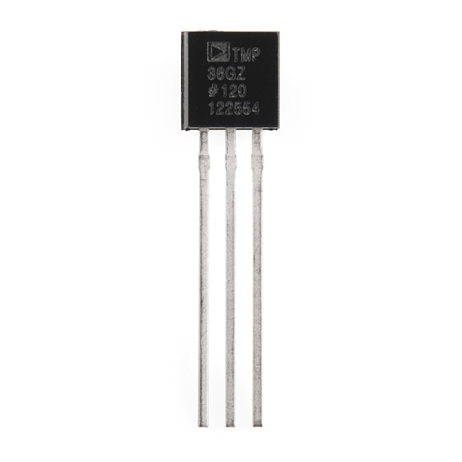
Ground Temperature Sensor
Part | Supply Voltage | Average Current | Temperature Range | Accuracy | Cost
AD22103 | 2.7 to 3.6V | 350 to 600μA | 0 to 100⁰C | ±0.5⁰C | $3.50
TMP36 | 2.7 to 5.5V | 50μA | -40 to 125⁰C | ±1.0⁰C | $0.80 to $1.50
LM45 | 4.0 to 10.0V | 10μA | -20 to 100⁰C | ±3.0⁰C | $2.50
AD22100K | 4.0 to 6.5 V | 500μA to 650μA | -50 to 150⁰C | ±2.0⁰C | $1.90
Small, basic transistor package.
Created into a probe style sensor.
.21 inch
.2 inch
.5 inch
TMP36

Slide 28
Solenoid S.S.
Sensors S.S.
Transmitter Receiver
Micro-Controller
Solenoid
Rain Detection Sensor
Barometric Pressure Sensor
Ambient Temp. Sensor
Power Source
Humidity Sensor
Micro-Controller
Ground Temp. Sensor
User Interface
Transmitter Receiver
Ground Moisture Sensor
Transmitter Receiver
Micro-Controller
LCD Display
Power Source
Power Source
Central HUB S.S.

Slide 29
Wireless Communication
Transmission Range: > 20 feet.
Low power consumption: < 100mW (on)
Concurrent transmissions without interference.

Slide 30
Wireless Communication
 | Xbee | Xbee pro | Zigbee 802.15.4 | Bluetooth 802.15.1 | WIFI b/g 802.11b/g
Battery Days |  |  | 100-1000 | 1-7 | .1-5
Power transmitting | 1mW | 63mW | 100 mW | 160 mW | 1600 mW
Current sleeping | <1uA | <1uA | .3 mA | .2 mA | 20 mA
Nodes/Network |  |  | 255/65K+ | 7 | 30
Bandwidth | 250 kbps | 250 kbps | 20-250 kbps | 720 kbps | 11-54 mbps
Range (m) | 30(indoor) 90(outdoor) | 90(indoor) 1600(outdoor) | 75+ | 10+ | 100
Key attribute | Low cost, Low power | Low power | Low power, reliable | convenience | speed

Slide 31
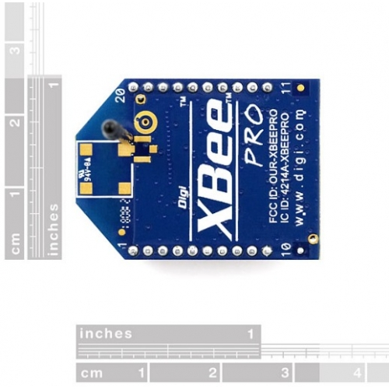
Xbee
Inexpensive $17
Transmission Range: 400 ft
Data Rate: 250 kbps
Transmit Power: 1.25 to 2 mW
Voltage: 2.1 - 3.6 VDC
1 inch
1.25 inch

Slide 32
Solenoid S.S.
Sensors S.S.
Transmitter Receiver
Micro-Controller
Solenoid
Rain Detection Sensor
Barometric Pressure Sensor
Ambient Temp. Sensor
Power Source
Humidity Sensor
Micro-Controller
Ground Temp. Sensor
User Interface
Transmitter Receiver
Ground Moisture Sensor
Transmitter Receiver
Micro-Controller
LCD Display
Power Source
Power Source
Central HUB S.S.

Slide 33
Microcontroller
Low power consumption.
Communicates with the computer via serial connection.
Inexpensive.
Easily programmable.
I/O for all sensors.

Slide 34
Microcontrollers
Item | AT90L S8535 | Atmega 103L | PIC16F8X | MSP430 F149 | StrongARM SA-1100 | At91M 42800A | MC68HC05PV8A | 80C51RD | EM6603 | MC9328MX1 | ATMega328
Bits | 8 | 8 | 8 | 16 | 32 | 16 | 8 | 8 | 4 | 16 | 8
Flash kB | 8 | 128 | 68 | 60 |  |  |  | 64 |  |  | 32
RAM B | 512 | 4k | 1 | 2k |  | 8k | 192 | 1k | 96x4 | 128k | 2k
ADC bits | 10 | 10 |  | 12 |  | 08 |  |  |  | 13 | 2x8
Timers | 3 | 3 | 1 | 3 |  | 6 | 1 | 1 | 1 | 2 | 2+1
Operating Voltage | 4-6v | 2.7-3.6v | 2-6v | 1.8-3.6v | 3-3.6v | 2.7-3.6v | 3.3-5v | 2.7-5.5v | 1.2-3.6v | 1.62-3.3v | 1.8-5.5v
Current Active | 6.4 mA | 5.5 mA | 2 mA | .4 mA | 230 mA |  | 4.4 mA | 16 mA | 1.8 μA | 90 mA | .2 mA
Current Idle Mode | 1.9 mA | 1.6 mA |  | 1.3 μA | 50 mA |  | 1.95 mA | 4 mA | .35 μA | .16 mA | .75 μA
Powered Down Current | 1 μA | 1 μA | 1 μA | .1 μA | 25 μA |  | 485 μA | 50 μA | .1 μA |  | .1 μA

Slide 35
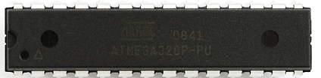
ATmega 328P
Inexpensive $4
14 digital I/O pins
6 Analog I/O pins
Programmable over serial using USB to serial converter
Has I²C capability
Low power
Different power modes
1.32 inch
.28 inch

Slide 36
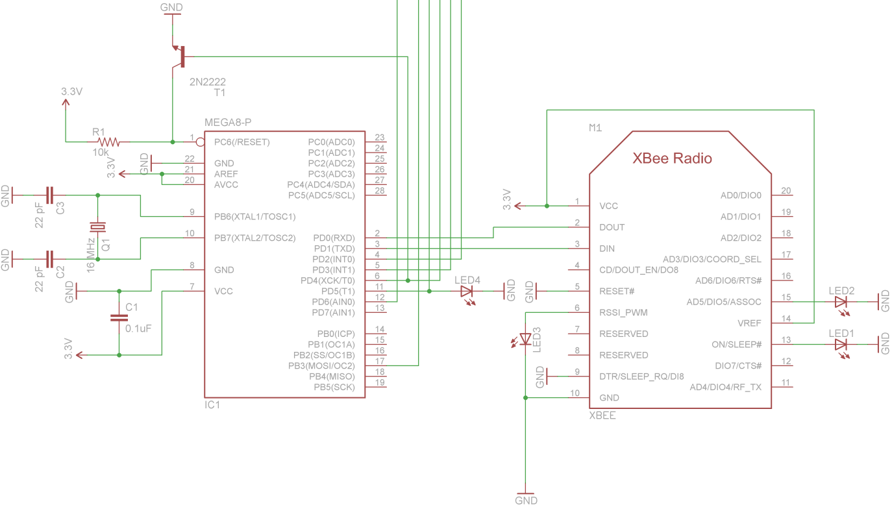
ATmega 328P to Xbee Module

Slide 37
Solenoid S.S.
Sensors S.S.
Transmitter Receiver
Micro-Controller
Solenoid
Rain Detection Sensor
Barometric Pressure Sensor
Ambient Temp. Sensor
Power Source
Humidity Sensor
Micro-Controller
Ground Temp. Sensor
User Interface
Transmitter Receiver
Ground Moisture Sensor
Transmitter Receiver
Micro-Controller
LCD Display
Power Source
Power Source
Central HUB S.S.

Slide 38
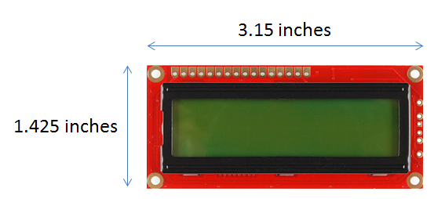
LCD Module
The LCD module that will fit Eco-Sense:
Low power mode
LED backlighting GDM1602K
16x2 character display
Image provided under Creative Commons (CC) by Sparkfun

Slide 39
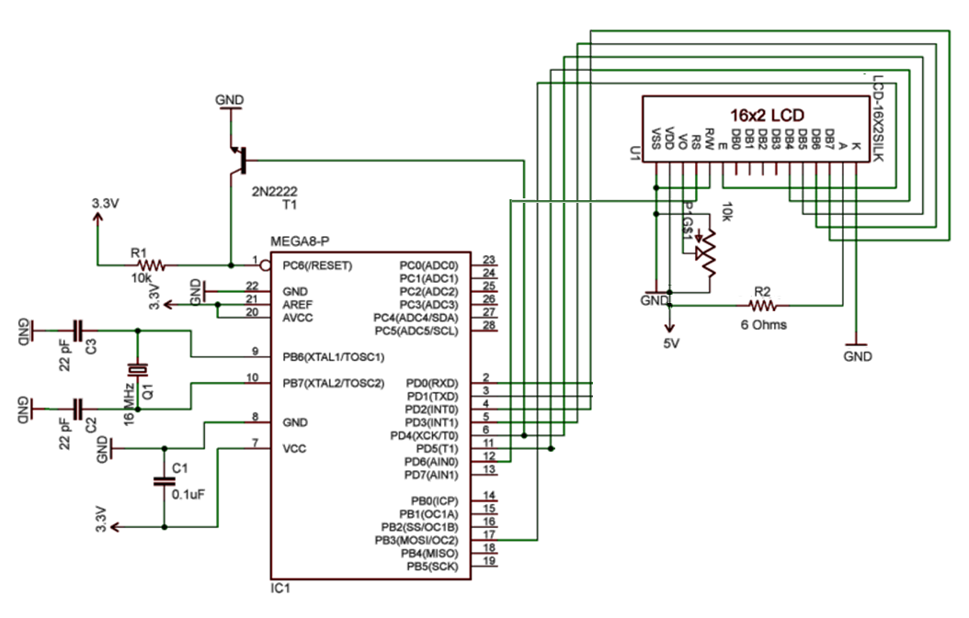
LCD Display

Slide 40
Solenoid S.S.
Sensors S.S.
Transmitter Receiver
Micro-Controller
Solenoid
Rain Detection Sensor
Barometric Pressure Sensor
Ambient Temp. Sensor
Power Source
Humidity Sensor
Micro-Controller
Ground Temp. Sensor
User Interface
Transmitter Receiver
Ground Moisture Sensor
Transmitter Receiver
Micro-Controller
LCD Display
Power Source
Power Source
Central HUB S.S.

Slide 41
Power
High efficiency: > 70%
DC-DC from 7.4 volts to 3.3 volts and 5 volts.
Low Cost
Rechargeable, high energy density battery.

Slide 42
Power- Battery
Specification | Ni-Cad | Ni-MH | Li-ion / Li-poly | Rechargeable Alkaline | Lead Acid
Charge/Discharge life cycles | 500-700 | 300-400 | 300-1000 | 100+ | 500-800
Memory Effect | High effect | Little effect | No effect
Operating Temperature | -22 to +140°F | -4 to +122°F | +14 to +140°F | -20º F to 130º F | -85º F to 149º F
Self-Discharge | 20% loss of charge/ month at 77°F | 30% loss of Charge/ month at 77°F | Self-discharge 3% loss of charge/ month at 77°F | (5/12)% loss per month
Energy density (Wh/kg) | 40-60 | 30-80 | 150-250 (Li-poly 130-200) |  | 30-40
Power W/kg | 150 | 250-1000 | 1800 (Li-poly 3000+) |  | 180

Slide 43
Regulators
Linear Regulators
Easy to use
Heat sink usually required
50% efficiency
Clean voltage
Switching Regulators
Requires more components
Smaller heat sink required
80% efficiency
Some ripple voltage on the output

Slide 44
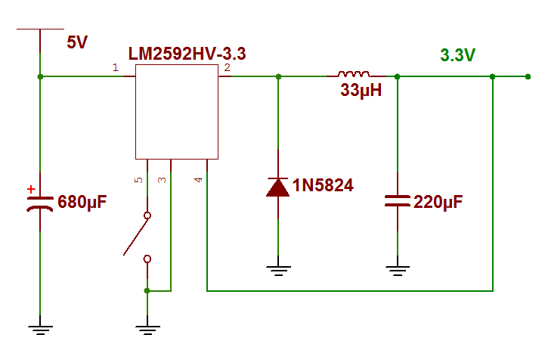
Switching Regulator Circuit

Slide 45
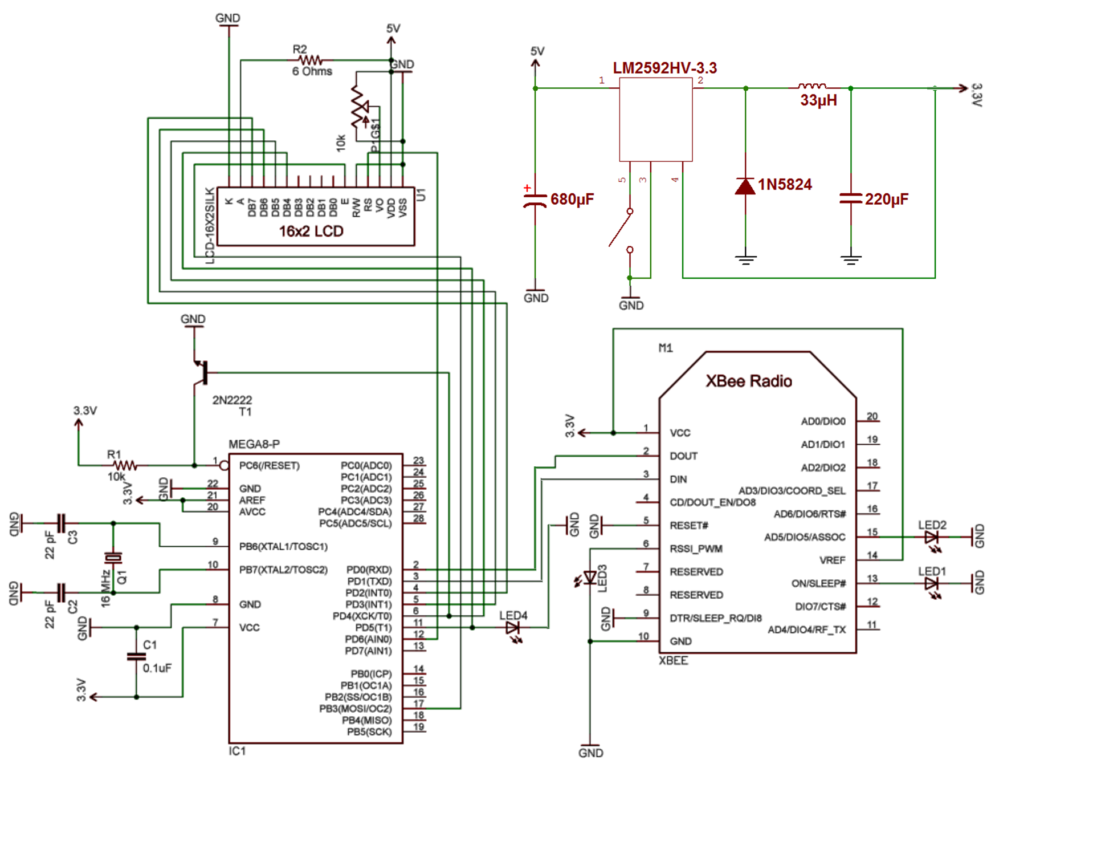
Power
Display
Communication
Microcontroller

Slide 46
Solenoid S.S.
Sensors S.S.
Transmitter Receiver
Micro-Controller
Solenoid
Rain Detection Sensor
Barometric Pressure Sensor
Ambient Temp. Sensor
Power Source
Humidity Sensor
Micro-Controller
Ground Temp. Sensor
User Interface
Transmitter Receiver
Ground Moisture Sensor
Transmitter Receiver
Micro-Controller
LCD Display
Power Source
Power Source
Central HUB S.S.

Slide 47
Water Solenoid
Used to control distribution of water
Must be GHT (Garden Hose Threaded) for US standards
Must operate with minimum power

Slide 48
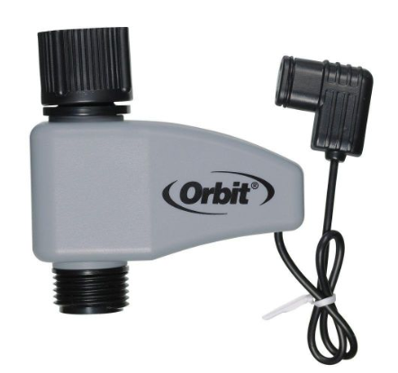
Water Solenoid
Orbit Yard Watering Valve
Operates +/- 24V
Water flows +24V, stops -24V
Uses latch solenoid, power is only supplied during solenoid state transitions

Slide 49
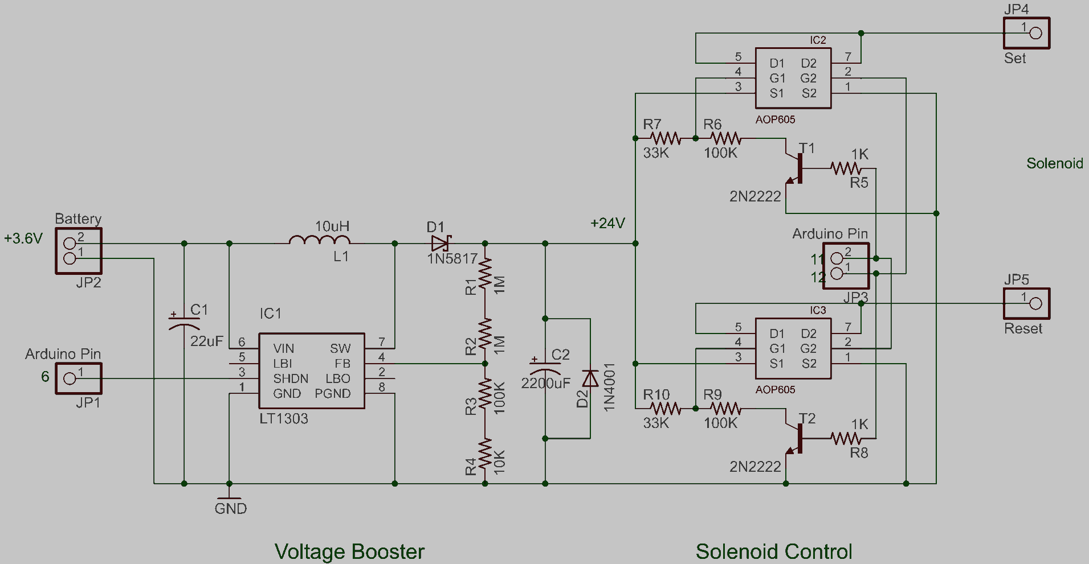
Water Solenoid
Arduino to Orbit Watering Valve
Schematic created by Rui Wang
as an open source project

Slide 50
Subsystem Software

Slide 51
Subsystem Software Design
3 different approaches, one for each subsystem
Must be able to communicate to each other
Minimal memory usage for code
Sleep mode would be ideal

Slide 52
Subsystem Software Design
Central Subsystem
Sensor Subsystem
Solenoid Subsystem

Slide 53
Sensor Software
Sensor Data
Collection
Memory Store
Data Storage
Read Moisture
Convert / Compress
Reset Timer
Read Temperature
Receive Data
Read Humidity
Fetch Memory
Data Transfer
Read Pressure
Transmit Data
Read Rain Status
System Timer
Clear Memory

Slide 54
Subsystem Software Design
Central Subsystem
Sensor Subsystem
Solenoid Subsystem

Slide 55
Central Software
Receive Data
Extract Data
Moisture Flag
Sum Flags
Temp Flag
Water Signal
Store in Memory
Humidity Flag
Display Statistics
Pressure Flag
Override
Rain Flag
Button Input
Manual Input
Transmit Data
Water Algorithm
System Timer
Data Transfer

Slide 56
Subsystem Software Design
Central Subsystem
Sensor Subsystem
Solenoid Subsystem

Slide 57
Solenoid Software
Receive Signal
Open Valve
Countdown Timer
Data Transfer
Close Valve
Solenoid Controller

Slide 58
Software Design Overview
Sensor subsystem collects data at set intervals
Central subsystem requests data, computes water signal, transmits water signal to solenoid
Solenoid subsystem controls the operation of the valve and water distribution

Slide 59
Solenoid S.S.
Sensors S.S.
Transmitter Receiver
Micro-Controller
Solenoid
Rain Detection Sensor
Barometric Pressure Sensor
Ambient Temp. Sensor
Power Source
Humidity Sensor
Micro-Controller
Ground Temp. Sensor
User Interface
Transmitter Receiver
Ground Moisture Sensor
Transmitter Receiver
Micro-Controller
LCD Display
Power Source
Power Source
Central HUB S.S.

Slide 60
User Interface
The user interface (UI) is for allowing the user to access to the system in an efficient manner
Provide overriding actions for user
Provide data feedback to the user
Display system status

Slide 61
User Interface
The UI will include the following:
LCD module
Pushbuttons
Protective box

Slide 62
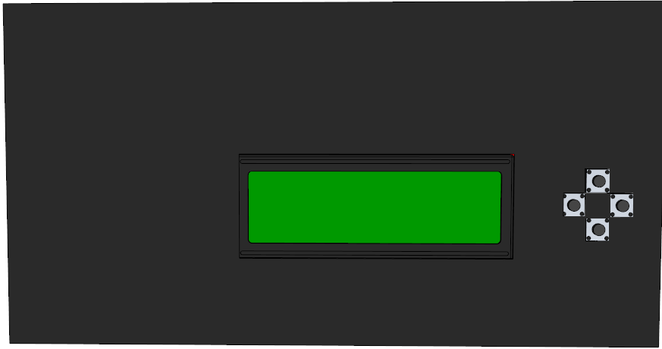
UI Model
3.5 inches
6.5 inches

Slide 63
Progress

Slide 64
Work Distribution
 | Neil (EE) | Jamie (CpE) | Daniel (CpE)
Sensor Configuration | X
Sensor Subsystem Circuitry | X | X | X
Weather Algorithms | X
Wireless Communications |  |  | X
Power Management | X |  | X
Solenoid Subsystem Circuitry | X | X | X
Watering Algorithms |  | X
User Interface |  | X
Central Subsystem Circuitry | X | X | X
Solenoid Controller |  | X | X

Slide 65
Bill of Materials
Part | Buy from where? | How many | Price | Extended Price
Mini Push Button Switch | Sparkfun | 4 | $0.35 | $1.40
LCD Module | Sparkfun | 1 | $13.95 | $13.95
Orbit Watering Valve | Home Depot | 1 | $15.97 | $15.97
Orbit Spike Sprinkler | Lowe's | 1 | $8.98 | $8.98
Custom Housing Estimate | SkyCraft | 3 | $10.00 | $30.00
Miscellaneous Electrical Components | N/A | 1 | $5.00 | $5.00
Atmega 328 DIP Socket Low Power Version | Sparkfun | 3 | $4.30 | $12.90
PCB | 4PCB | 3 | $33.00 | $99.00
Xbee Series 2 | Digikey | 3 | $17.00 | $51.00
HIH-4030 Hygrometer | Sparkfun | 1 | $16.95 | $16.95
BMP085 Barometer/Thermometer | Sparkfun | 1 | $19.95 | $19.95
12 Gauge Galvanied Steel Wire (2 feet) | N/A | 1 | $5.00 | $5.00
Black Electrical Tape | N/A | 1 | $5.00 | $5.00
4" x 4" x 4" Packing Foam Block | N/A | 1 | $5.00 | $5.00
Rain Detection PCB board | Baaqii | 1 | $3.01 | $3.01
LM339N Comparator | Jameco | 1 | $0.25 | $0.25
TIP120 transistor for solenoid | Jameco | 1 | $0.39 | $0.39
LM2592HV 3.3v (input 4.5-60v) | Jameco | 3 | $1.95 | $5.85
1000mAh 2S 20C Lipo Pack | HobbyKing | 3 | $4.62 | $13.86
Battery Charger (Owned) | HobbyKing | 1 | $0.00 | $0.00
 |  |  | Total | $313.46

Slide 66
Issues
Housing material
Time for testing

Slide 67
Project Completion
To complete this project, the following work needs to be finished:
PCB layout and purchase
Decide on housing material and design
Prototype each subsystem
Testing, testing, testing

Slide 68
Questions?

Slide 69
Complaints?

