Slide 1

LED Globe
Group #8
Viet Nguyen | Omar Vazquez | Rhonal Soto

Slide 2
Motivations
To create an Innovative and attractive means of displaying information via a lighting system which allows the information to be displayed in the dark.
To display images on a 360 degree angular sphere with different sequences.
To be able to control displays through wireless communication.

Slide 3
Goals and Objectives
Display images using different algorithms
Energy efficient
Wireless interface
Entertainment Light source

Slide 4
Specifications
Component | Design Specification
Motor | 12 V DC brushless
Microcontroller | ATMEGA328
LED | 3.5 V; 20 mA
Shift register 74HC595 | 5 V; 35 mA Max
JY-MCU Bluetooth Module | 5 V
Power supply | 120/36V DC, 36 V Max; 10 A Max; 360W Max
Voltage regulators | 36V/12V; 36V/5V DC; 36V/adjustable voltage up to 24V

Slide 5
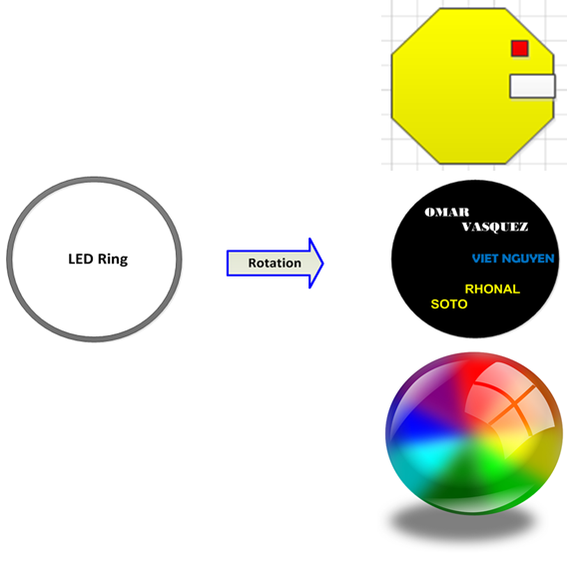
3 Output Modes
Pac-Man
Names
Random

Slide 6
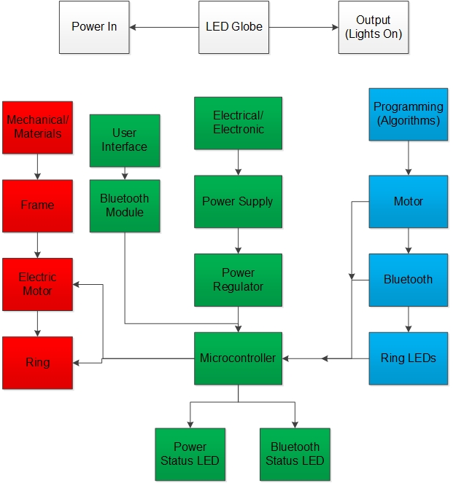
Overall Block Diagram

Slide 7
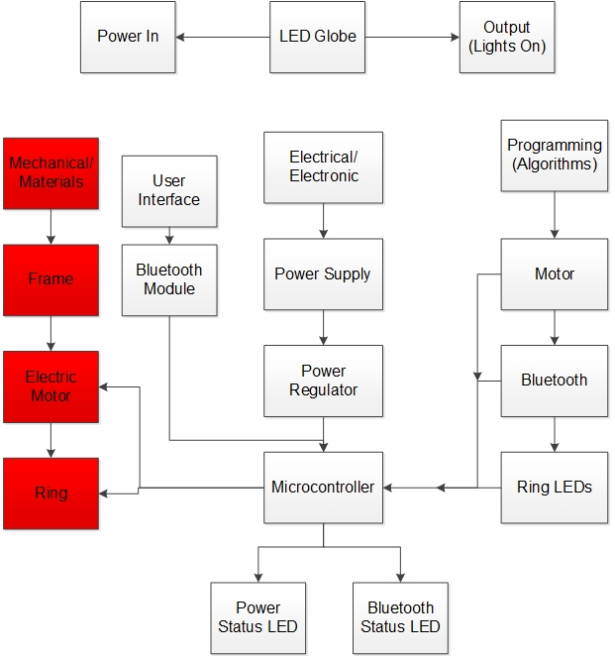
Mechanical Materials

Slide 8
LED Globe Motor
Fasco 7103.0113 Brushless DC motor
0-24volts
5.2A
124.8w Max
8,000RPM max
3.32in wide, 3.15Long, 1.8pounds
5/16 in shaft

Slide 9
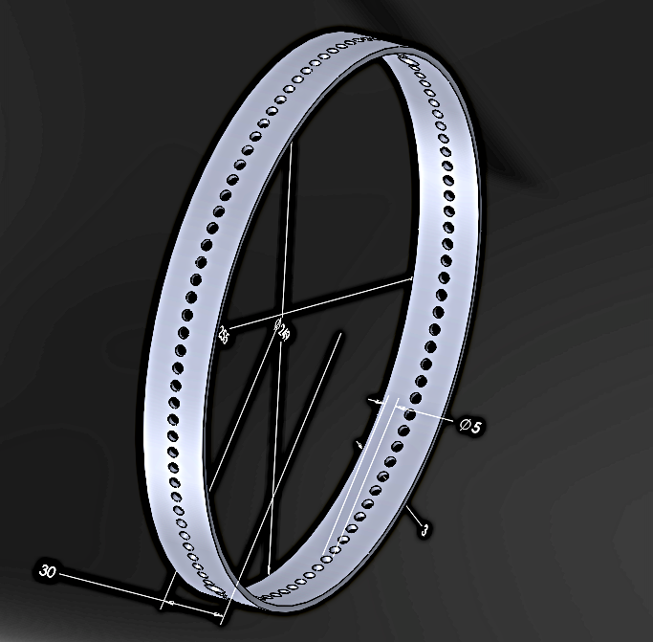
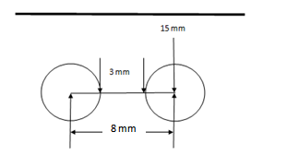
LED Ring Structure
Inner Diameter: 252mm
Outer Diameter: 255mm
Width (Outer and Inner Surface): 30 mm
Thickness: 3mm
97 holes
Diameter: 5 mm each
Holes location: at 15 mm from the edge
Separation hole to hole: 8.0 mm center to center

Slide 10
Ring Support Shaft
15in long, .5in outer diameter, .4in inner diameter hollow aluminum tube
Two .5 in long, .75 outer diameter, .5in inner diameter hollow copper slip rings to provide power to the microcontroller
Two ball bearings for rotational support. .63in by 1.13in diameter ball bearing at the bottom and .6in by .62in diameter ball bearing at the top.
Three wire holes.

Slide 11
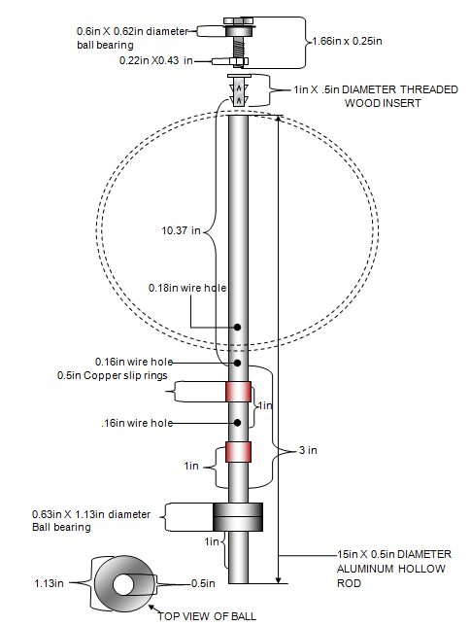

Slide 12
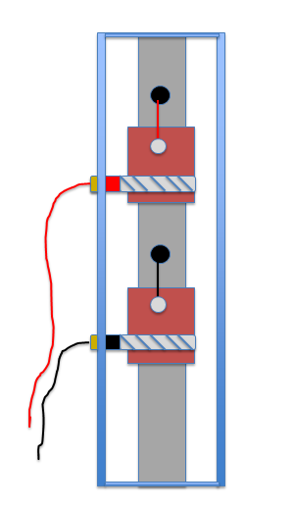
Slip Ring Voltage Terminals
Two Copper braided mesh clamped around
.56 Copper hollow tubes insulated over the ring support shaft.
The top braid is set to a positive potential of five volts
and the bottom is set to ground.
Two holes are drilled into the support shaft, one over the positive terminal and the other over the negative terminal. The holes are for the positive and negative wires to be inserted into the support shaft and fed to the micro controller.

Slide 13
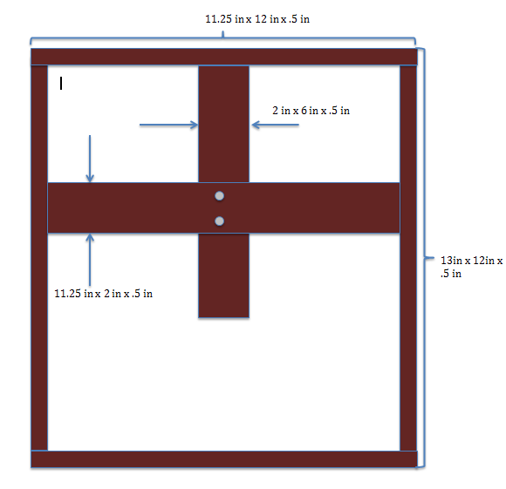
Wood Housing
Housing for the motor and the power supply.
Stability for the support bar and motor due to vibrations.

Slide 14

PCB Mount
Used for mounting the microcontroller and the shift registers.
Two 5in by 2in by .027in aluminum sheets
Secured by four .5in by .15in diameter threaded hollow rods on each corner
Ring support shaft

Slide 15
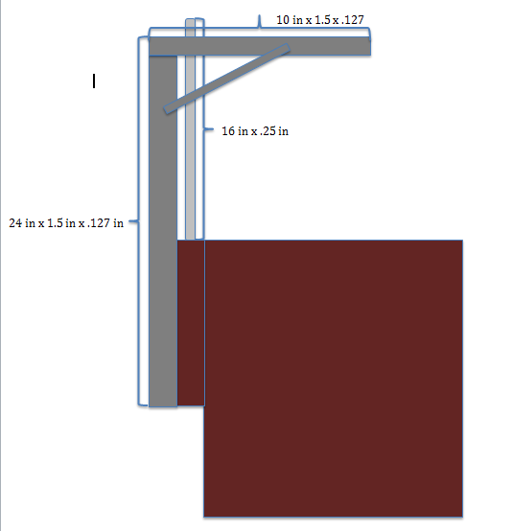
Support Bar
To support the ring support shaft and stabilize due to vibration.
The vertical piece is 24 in x 1.5 in x .127 in L shape bar.
Top piece is a 10 in x 1.5 in x .127 in L bar with a .63in circle cut out for fitting top RSS ball bearing.

Slide 16
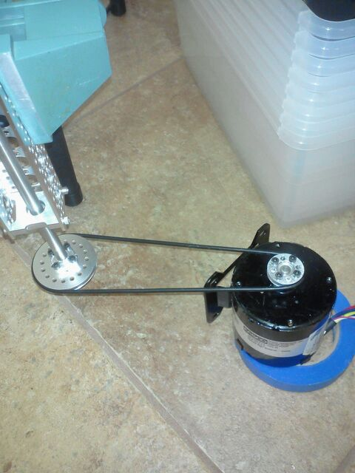
Electric Motor
Testing configuration to reduce shaft oscillation

Slide 17
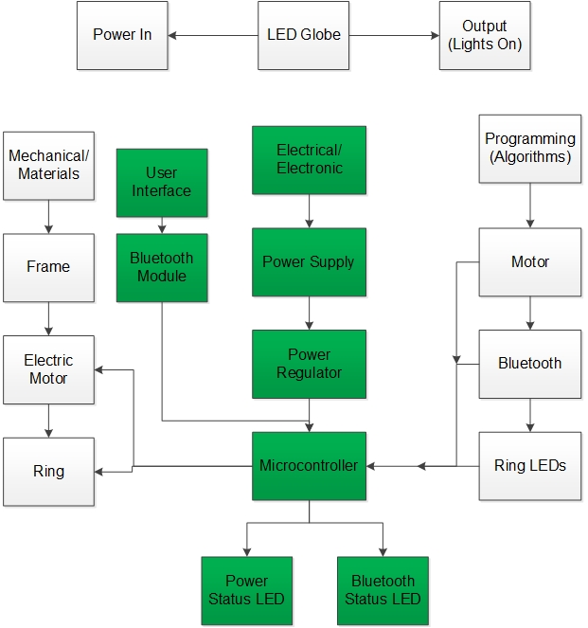
Electronics

Slide 18
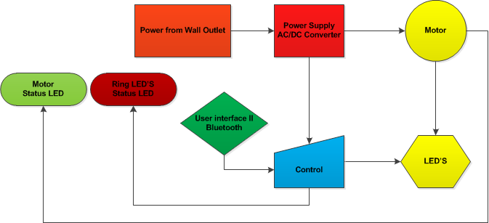
Electronic Block Diagram

Slide 19
LED Globe Power Supply
Motor cooling fan
12V Regulator
Motor
120Vac
Rectifier
Smoothing Capacitor
36V
10A max
Adjustable Voltage Regulator
5V Regulator
Micro controller and LED’s

Slide 20
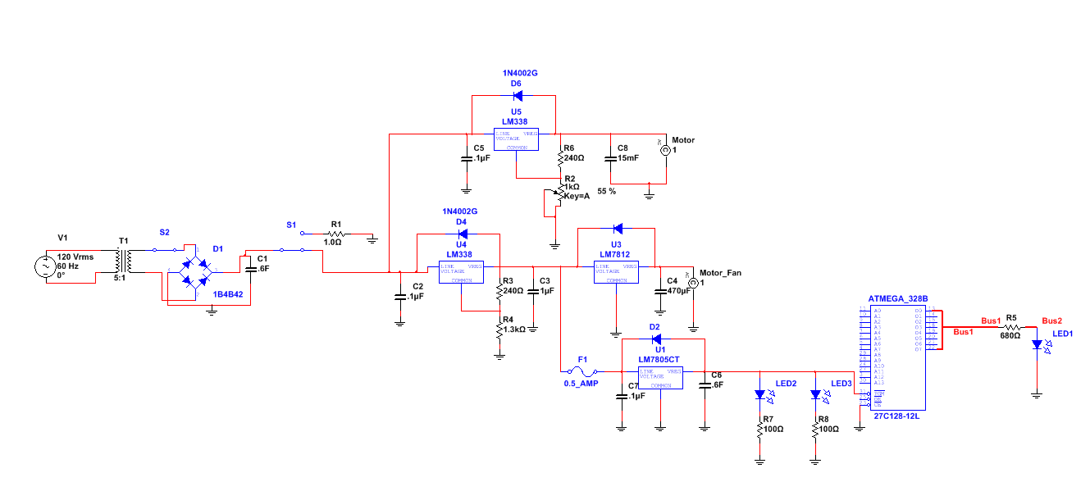

Slide 21
Motor Power Supply
187.2Watts
62.4Watts
36V
5.2A
Adjustable Voltage Regulator
Motor

Slide 22
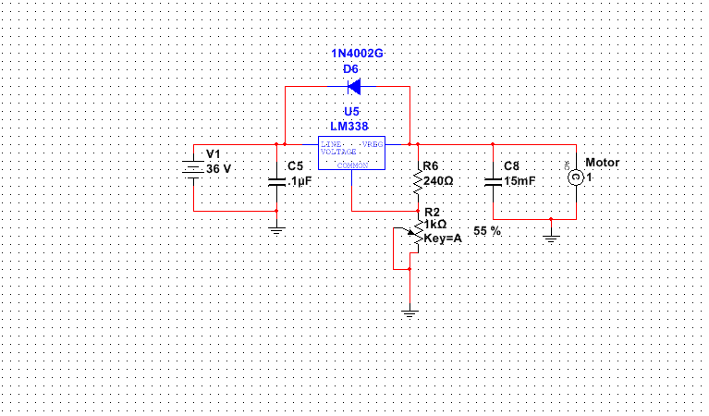
Motor Voltage Regulator

Slide 23
Microcontroller Power Supply
172.8Watts
18Watts
36V
4.8A
5V Regulator
Microcontroller

Slide 24
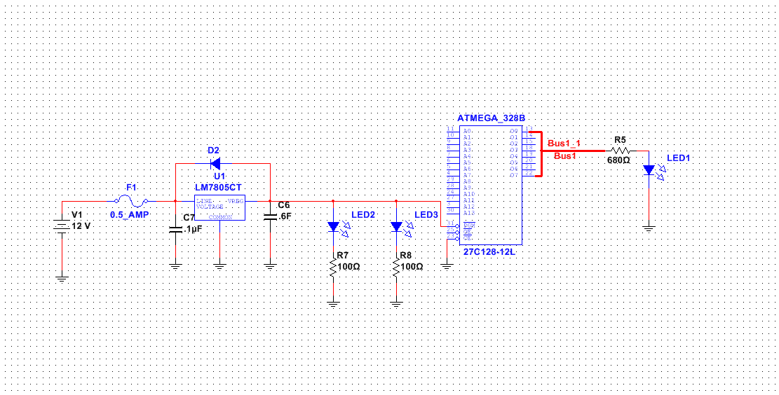
Microcontroller Voltage Regulator

Slide 25
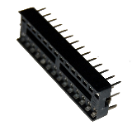
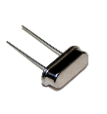
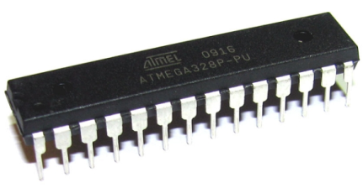
Microcontrollers
 | ATMEGA328 | MSP430G2553 | ATMEGA2560
Development Board | $27.19 | $10.99 | $46.29
Microcontroller | $2.88 | $2.35 | $18.00
Flash Memory | 32 Kb | 16 Kb | 256 Kb
I/O Pins | 20 | 14 | 70
Surface Mounted | No | No | Yes
$7.26 =
+
+

Slide 26
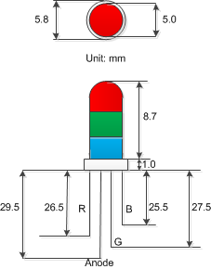

90-92 RGB Ultra-Bright Diffused LED
Specifications
Red (Luminous Intensity) | 1200 mcd max
Green (Luminous Intensity) | 5000 mcd max
Blue (Luminous Intensity) | 3000 mcd max
Voltage | 5 V max
Current | 25 mA

Slide 27

Configuration I2C vs. Shift Registers Charlieplex vs. Shift Registers
Charlieplex
Number of Pins | Outputs
3 | 6
4 | 12
5 | 20
6 | 30
10 | 90
17 | 270

Slide 28
I2C

Slide 29
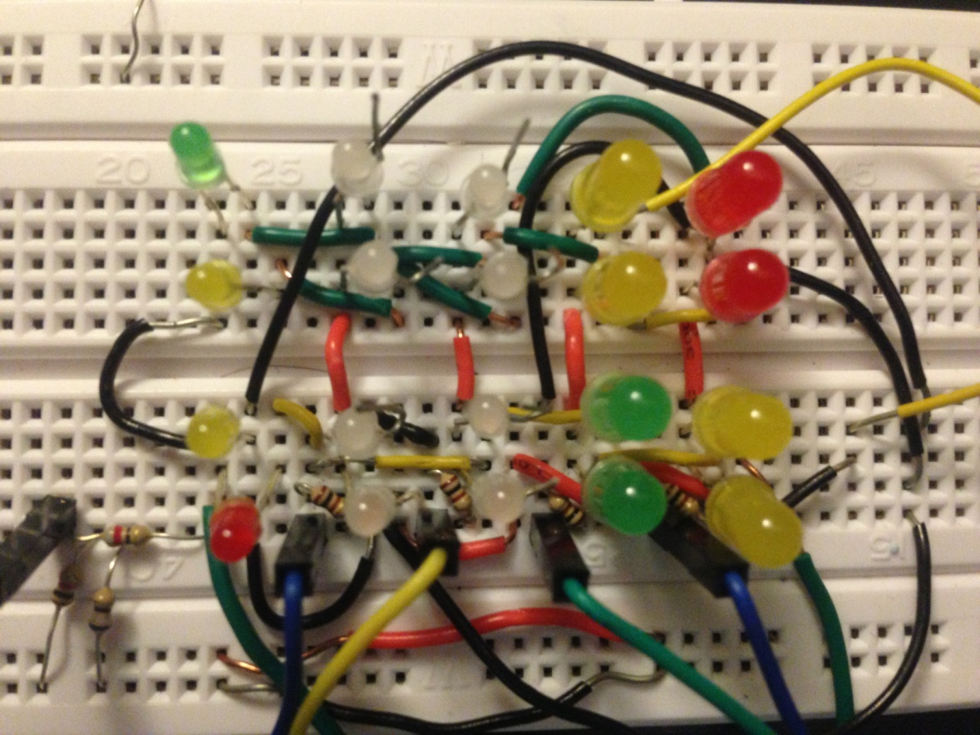
Configuration
I2C
Complex circuitry
Complex Algorithm

Slide 30
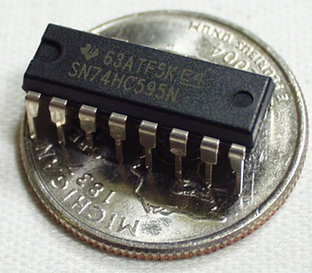
Configuration 34 Shift Registers 74HC595
90 RGB LEDs = 270 Outputs
270/8 = 33.75
≈ 34 SR

Slide 31
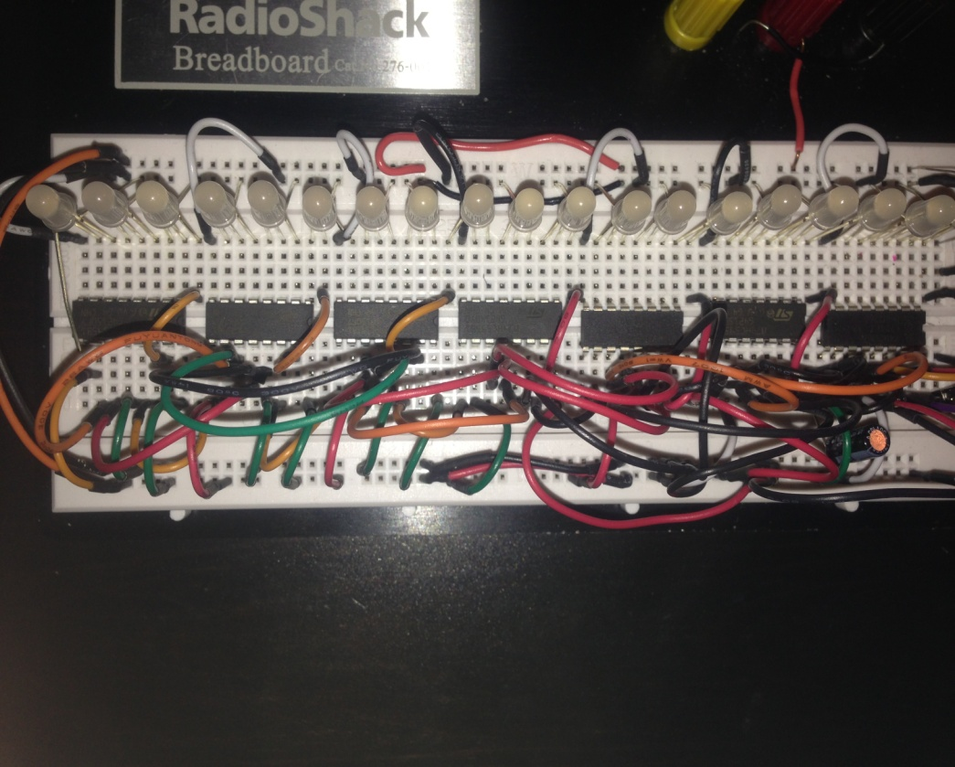
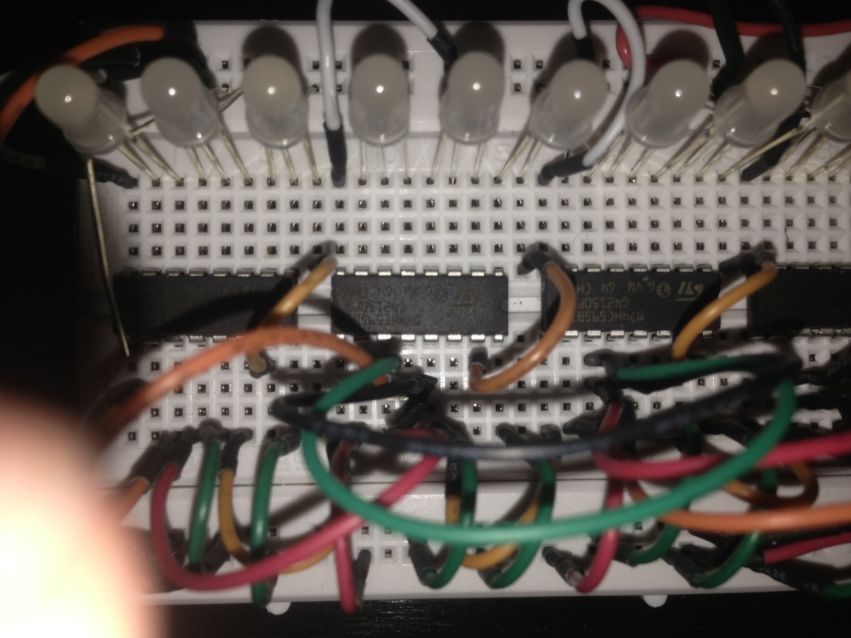
Configuration Shift Register
Less complex circuitry
Less complex algorithm

Slide 32
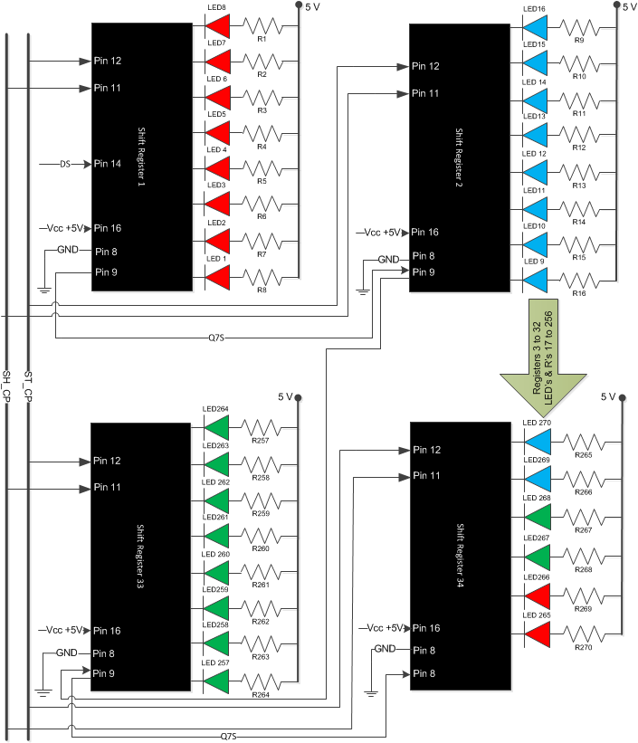
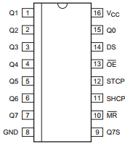
LEDs Configuration
Q0-Q7 – Outputs
Pin 11 – Clock
Pin 12 – Latch
Pin 13 – Low
Pin 10 – High

Slide 33
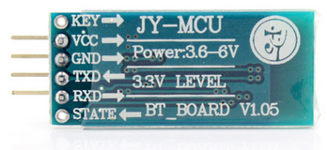
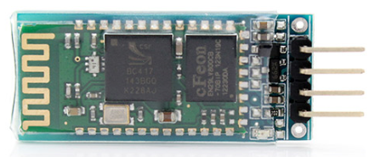
MCU-JY Bluetooth Module
26.9 mm
13 mm
Lack of documentation
After testing the device:
Slave
Serial communication UART
Baud rate 9600
Connect after uploading the sketch
It does not work with apple devices

Slide 34
MCU-JY Bluetooth Module
One command for each sequence
P: Pac-Man
N: Names
L: Random

Slide 35
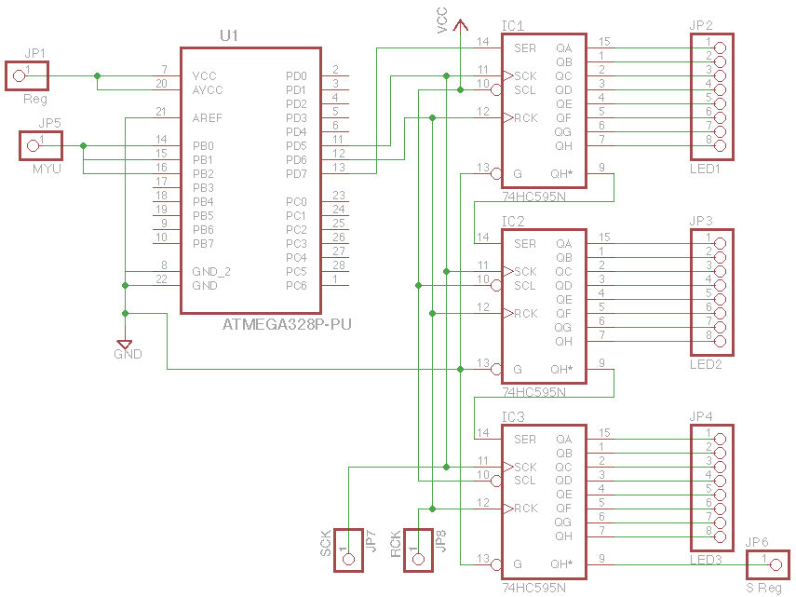

Slide 36
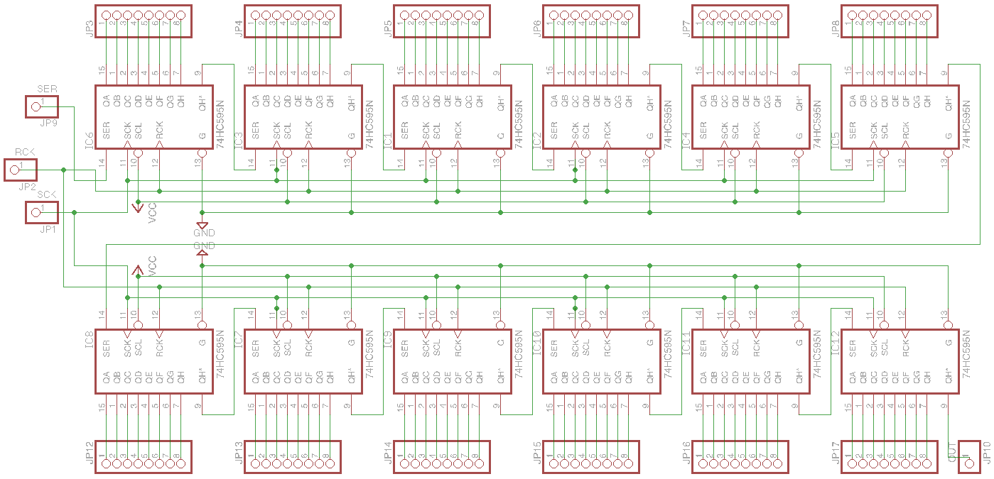

Slide 37
Algorithm
3 Pins from the microcontroller
Data (8- bits hexadecimal values )
Clock pin toggles after each bit is taken
Latch pin goes high when the sequence is completed

Slide 38
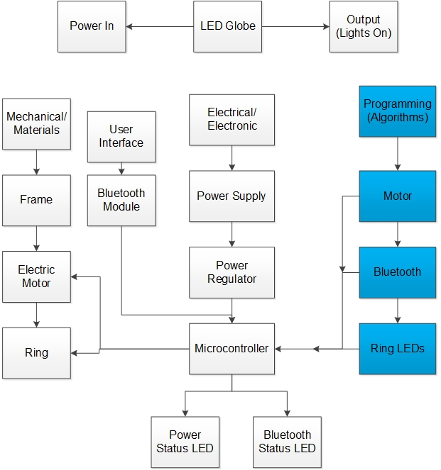
Algorithm

Slide 39
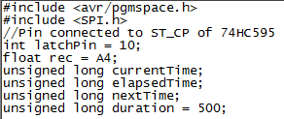
Software
Include the SPI library for use
SPI = Serial Peripheral Interface
Set the latch pin as an output
Declare time variables

Slide 40
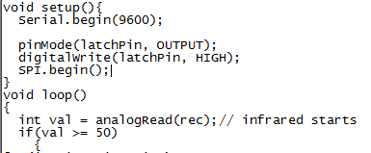
Software
Bitmap array is declared above
Set up the serial communication Baud rate
Declare output latch pin
Initialize SPI

Slide 41
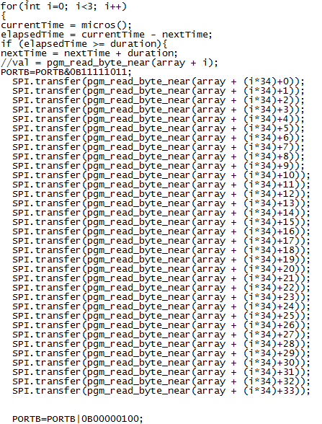
Software
For Loop:
Self-correcting delay using micros()
Latch pin goes high to display the sequence
Pgm_read_byte_near to read bitmap array

Slide 42
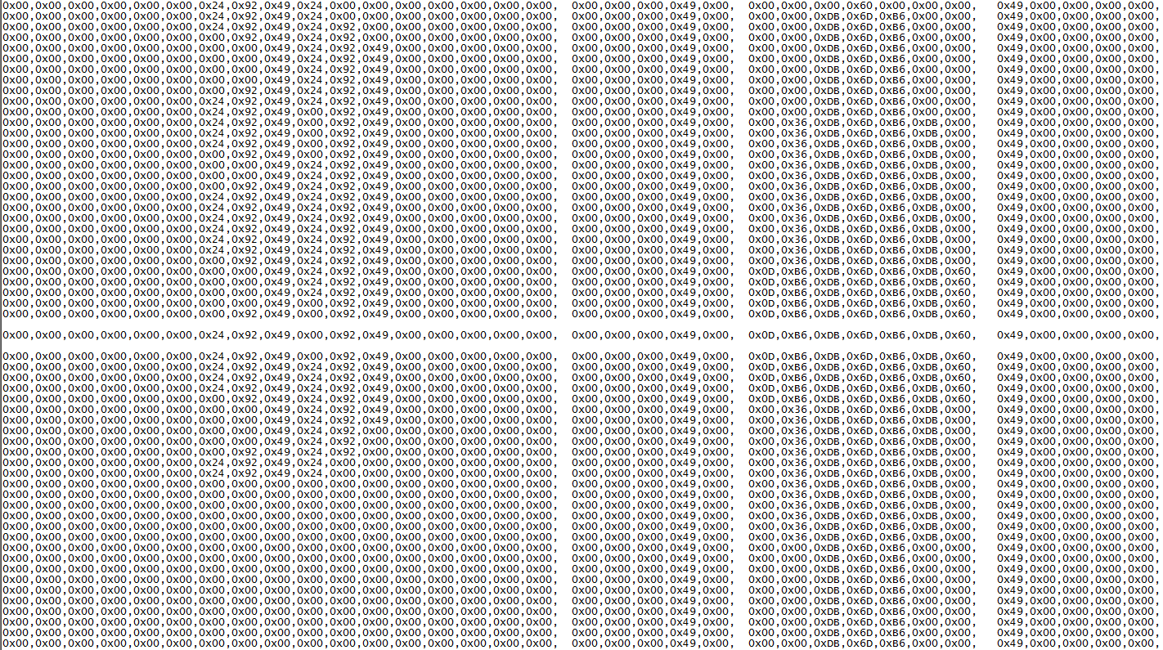
Bitmap Array

Slide 43
Budget
Part | Cost
Mechanical Parts | $42.30
Power Supply Parts | $321.21
Electronic Parts | $77.10
Other/Miscellaneous | $100.00
Total | $540.61

Slide 44
Work Distribution
Name | Electronics | Mechanical and Power Supply | Coding/PCB Design
Rhonal Soto | X
Omar Vazquez |  | X
Viet Nguyen |  |  | X

Slide 45
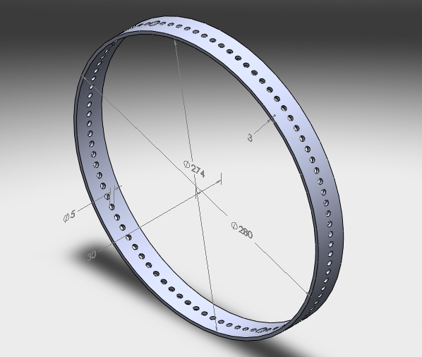
Prior Issues:
Machine Shop Price for Ring
Motor Voltage Regulator getting too hot
Motor to Shaft Coupling
Software

Slide 46
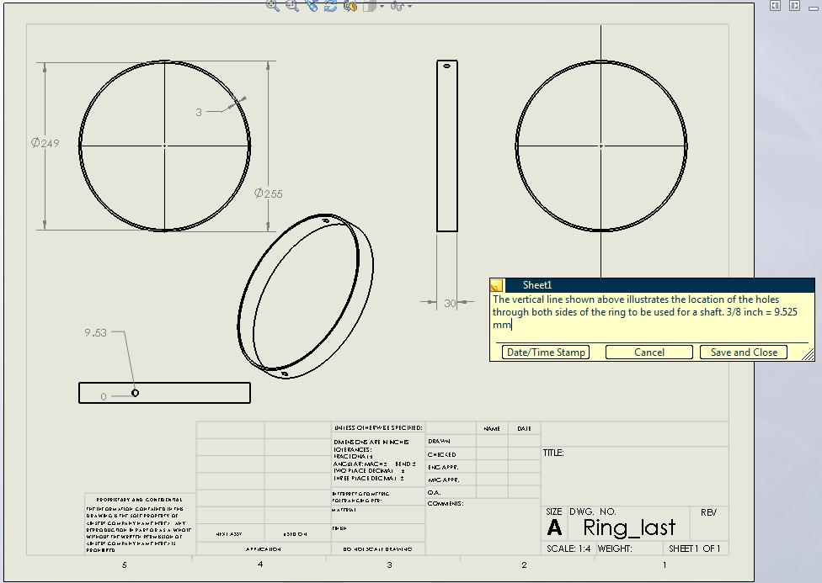
Solutions

Slide 47
Questions?

