Slide 1
TrackAlert
A Short-Range Emergency Tracking System
Group 14
Melissa Grenier
Carlos Gonzalez
Gina McGhee
Sainjulien Senatus

Slide 2
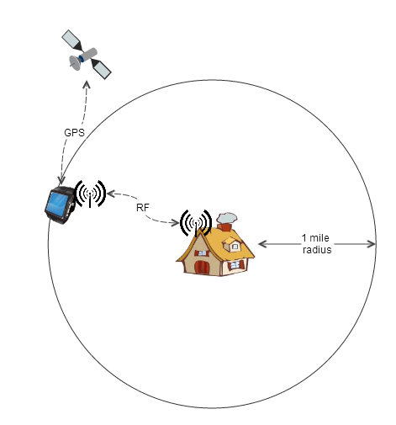
Project Description
A tracking system that can track a person within at least a 1 mile radius
The person will be wearing a traceable GPS device that communicates with a stationary base station
The device’s location will be available through a web application accessible through a computer and/or handheld internet-enabled device
RFID will be used as an alarm system to alert the base station when the person has left the perimeter (home)
Notes:
Melissa

Slide 3
Motivation and Purpose
Implementation of GPS, RFID, and different aspects of electrical and computer engineering
Meaningful project that can be useful and beneficial in a real life setting
Idea: To keep people that require around the clock supervision from wandering off from their homes:
  Small children and mentally handicapped people
  One example, autistic children
    2012 survey: Out of 1,218 children, half of them had wandered off or attempted to wander off at least once after the age of 4
There are existing products that require a monthly fee (due to the use of cell towers)
Notes:
Melissa
In November 2012, a survey of parents of 1,218 children who have autism spectrum disorders, revealed that half of the parents reported their child had wandered off or attempted to wander off at least once after the age of 4.
Many of those reported incidents involved some sort of injury that could have resulted in death. Of the missing reports that involved a close call situation, the most common incidents were drowning (24%) and traffic injury (65%).
The places children wandered off from the most are their homes (74%), stores (40%), and schools (29%). Unfortunately, there have been cases were the children were found too late. 22 wandering-related death cases were identified when the study was published…a large number of those children had wandered off from their home. Wandering poses a significant risk for many children and adults with autism, Alzheimer’s, and other disorders.

Slide 4
Goals and Objectives
Families with small children or mentally handicapped relatives
Daycares
Mental Institutions
GPS Device
  Lightweight
  Low On Power Consumption
  Easily carried (even by a child)
  Long battery life
RFID System
  Act as an alarm monitoring system
  Alert base station when and which GPS device leaves the house
Web Application
  Easy to use user interface
  Available from any device that has internet connectivity
  Host multiple users simultaneously
  Be able to display GPS location on a map
Base Station
  Communicate with more than one GPS device
  Communicate with device up to a 1 mile distance
  Receive messages from RFID system
  Communicate with web app
Notes:
Gina
So the main purpose of this system is to ASSIST in KEEPING TRACK of those who CANT CARE for THEMSELVES
-The goals for the GPS Device include IT BEING:
-Lightweight
-Low On Power Consumption
-Easily carried (even by a child)
-And having a LONG battery life
-The RFID DEVICE should: Act as an ALARM SYSTEM
-AND also Alert the base station when a GPS device has left the area
-The Web Application should be: Easy to use
-Available from any device with internet
-Support multiple users simultaneously
-And Be able to display GPS locations on a map
-The Base Station should be: Able to communicative with more than 1 GPS device
-Interact with devices within a MILE RADIUS
-Receive messages from the RFID System
-And interface with the WEB APP

Slide 5
Specifications
Component | Specification
Base Station/GPS Device Communication | Wireless - Up to 1 mile radius
Base Station/Web App Communication | Internet
Base Station/RFID Communication | Wireless
GPS Device Battery Life | 5 hours active mode 30 hours standby mode
GPS Battery | Rechargeable from external source
GPS Boot-up Time | 12.5 minutes (first time) Up to 2 minutes (from sleep mode)
GPS Location | Within 10 feet of person being located
GPS Size | Not to exceed size of an iPhone
Time to send GPS data to Web App | <to be tested>
Notes:
Gina
To be more specific with the specifications for our project
- The GPS Device should have a :
-5 hr battery life when in ACTIVE MODE
-30 hr BATTERY life when in STANDBY
-Take 12 ½ min to BOOT UP when FIRST ACTIVATED
- 2 minutes to boot from SLEEP MODE
- BE accurate to within 10 feet
- And be no bigger than an Iphone

Slide 6
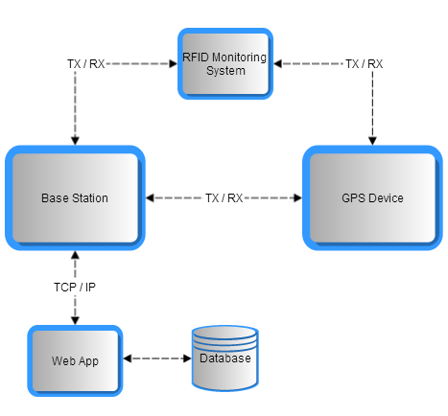
Overall System
Notes:
Carlos:
What you guys are seeing right now is the overall system of our project, so we have identify 4 different components.
GPS Device, RFID System, A Base Station and A Web Application.
The GPS Device is an outdoor system that would operate in open areas where GPS devices are accurate.
The RFID System would be installed inside places like hospitals, schools, malls and so on.
Then, we have a base station that would communicate with the other components.
So, the tracking information that is coming from GPS device will be sent to the Base station and also the tracking information that is coming from the indoors tracking system is also sent to the Base station.
Once our base station has that information, it will communicate with the Web Application.

Slide 7

Overall System
Notes:
Now, let jump into some specifications of the outdoor tracking system Device.

Slide 8
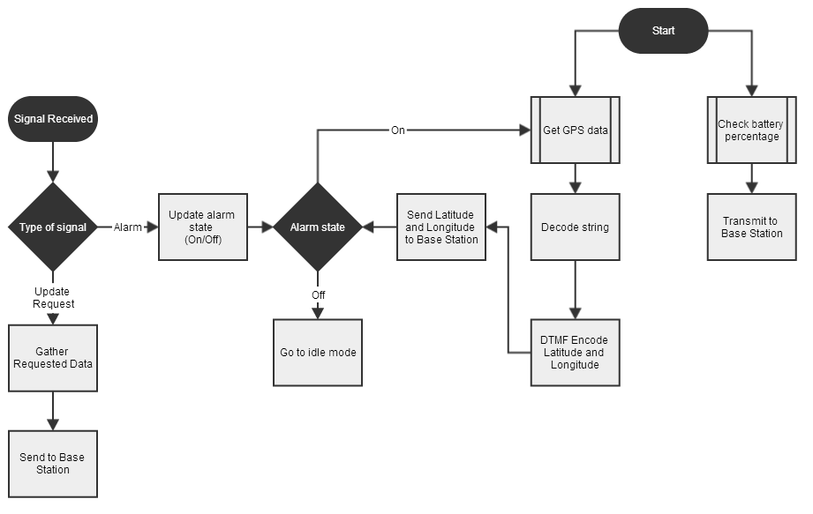
GPS Device

Slide 9
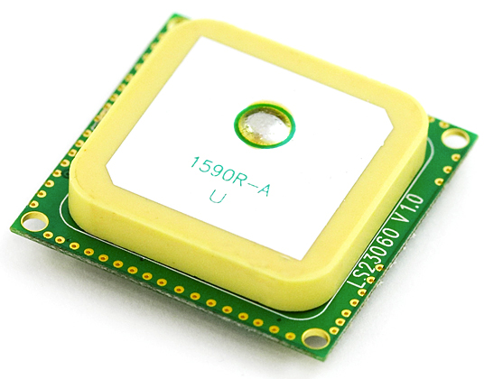
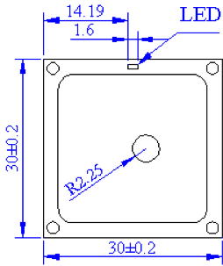
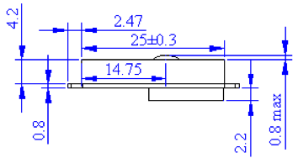
GPS Device
LS20031 Module
  Embedded Antenna
  Up to 66 satellites at time
  Build-in battery
  3.3V
  42mA
  Operating Temperature
  14g
  Dimensions (mm)
Notes:
In the market, there are so many GPS modules where to pick from;
however we decided to go with the LS20031 Module because it has already an incorporated antenna that will save us money and space on the PCB board.
We can get up to 66 satellites at a time, but only 22 will do the tracking.
I addition, this GPS Module has a Built-in micro battery to preserve system data for rapid satellite acquisition.
This module operates at 3.3 Volts at 41 milli-Amps.
Also can holds temperature from -30 to 85 degree Celsius
and it is a lightweight device component. Only 14 Grams.
Voltage: 3.3V
Current: 41mA
P = 0.1353 Watts
Temperature: -30 to 85 C (-22F to 185F)
Weight: 14 grams
Size: 30mm by 30 mm 5.8mm

Slide 10
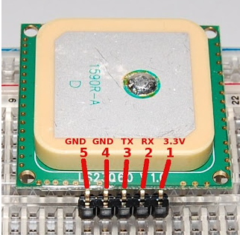
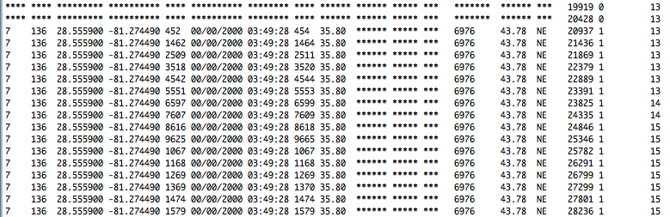
GPS Device
GPS Module Connection
  1. Power Input
  2. Data Input
  3. Data Output
  4. Ground
  5. Ground
Output
Notes:
Here, we can see the 5 different pins of this part.
At the bottom is a sample of the output message that is being display in the serial monitor.
The first Column shows the number of satellites that are providing information.
Third and fourth columns are the latitude and longitude and more and more information for that specific location.
The GPS is program to update information every second.
How much voltage do I need for project X?
How much current do I need for project X?
Which battery should I choose?
How much battery capacity do I need for my project?
Atmega 20mA
Total calculations: MCU + Xbee + LCD Character + GPS
Battery Life Hours = Battery Capacity(Ampere Hours) / Current Draw (Amperes)
PMU : Power Management Unit
Specifications for power: MCU- 5V at 40mA
GPS- 3.3V at 41mA
Xbee- 3.3 at 210 mA
LCD – 3.3 at 1.5mA

Slide 11
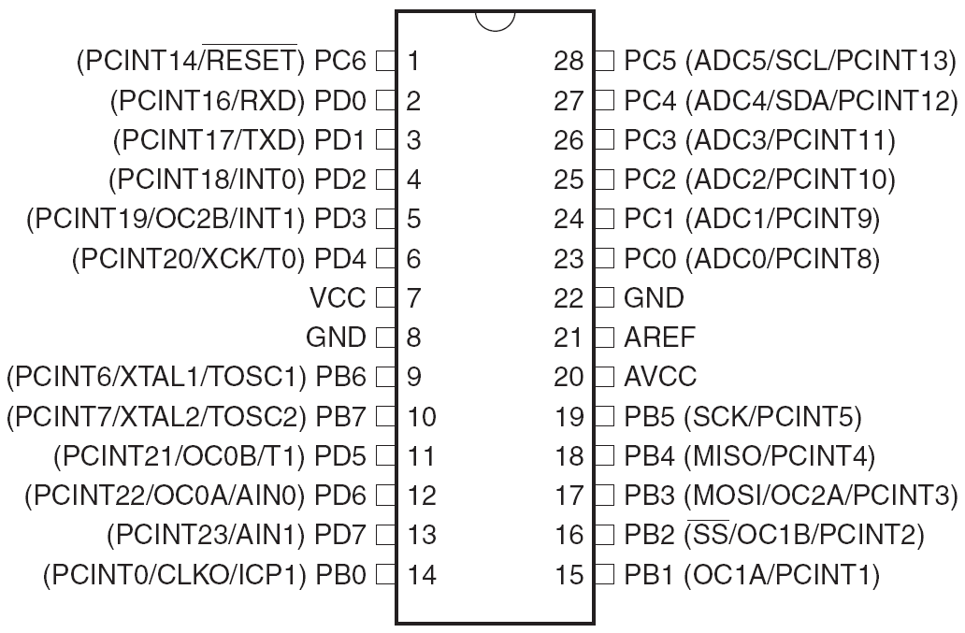
GPS Device
Atmega328
  Six Sleep Modes
  23 Programmable I/O lines
  Operating Voltage1.8 -5.5V
  5V, 8 MHz, Active: 5.2mA typical, 9mA max
  Temperature Range -40C to 85C
Notes:
We are going to use the ATmega328P microcontroller in the GPS device. It is 23 programmable I/O lines, its operating voltage is between 1.8 and 5.5 volts at a typical current of 5.2mA. One of the main reasons we choose this microcontroller is because there are lots of information online, and since we are using an stellaris in the base station, we don’t want to spend too much programming the GPS.
Voltage: 5V
Current: 20mA actual value
Temperature: -40 to 85C
Weight:
Size:

Slide 12
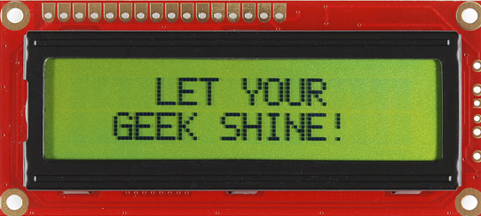
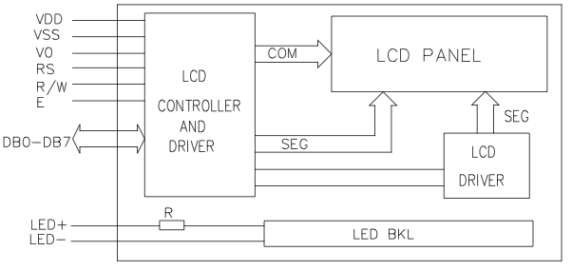
GPS Device
LCD Character Display
  Personal Information
  Odometer
  High Quality 16x2
  3.3V Power Supply
  1.5mA
  Operating Temperature 0C to 50C
  Size: 8.6 x 36 x 80mm
Notes:
The GPS device will also have a LCD Character display that will allow us to display information like Name, Age, and contact number.
An odometer to track running and walking millage will be implemented as well.
It is a high quality 16x2 Character LCD that operates at 3.3 volts at 1.5mA. The operating temperature is between 0 and 50 Celsius.
Its size is 36 by 80 mm

Slide 13
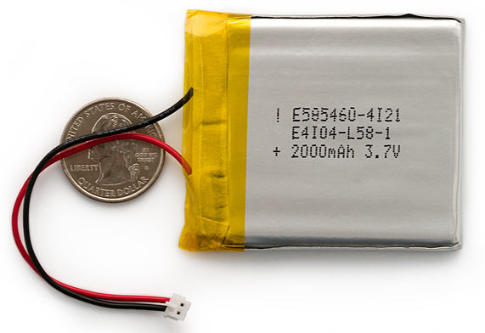
GPS Device
Rechargeable Battery
  Polymer Lithium Ion Battery
  3.7V at 2000mAh
  Temperature
  Weight: 36g
  Size:5.8x54x60mm
Notes:
The battery that we are going to use is a Polymer Lithium Ion Battery that outputs 3.7 Volts at 2000mAh. This battery is very slim and extremely light weigh, and has a built in protection for over voltage, over current and minimum voltage. It holds temperature from -25 to 60 Celsius. It weights around 36 grams and it’s 54 by 60 mm.
Battery Life Hours = Battery Capacity(Ampere Hours) / Current Draw (Amperes)

Slide 14
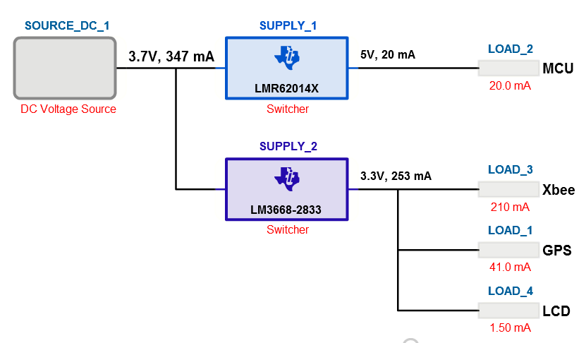
GPS Device
Power Supply
  LMR62014X
  LM3668-2833
  Loads
  5 hours minimum in active mode
Notes:
Finally we have the power system for the device.
We are using two components from TI, the LMR62014X and the LM3668-2833.
As we can see we have all the different loads,
the Microcontroller operating at 5V, the Xbee, GPS, and LCD operating at 3.3 Volts.
According with our calculations the Device for will last for for 7 Hours.
The GPS device meet our requirements of 5 hours min in active mode.
Battery Life Hours = Battery Capacity(Ampere Hours) / Current Draw (Amperes)
= (2000mAh)/(41+20+210+1.5)= 7.33 hours

Slide 15
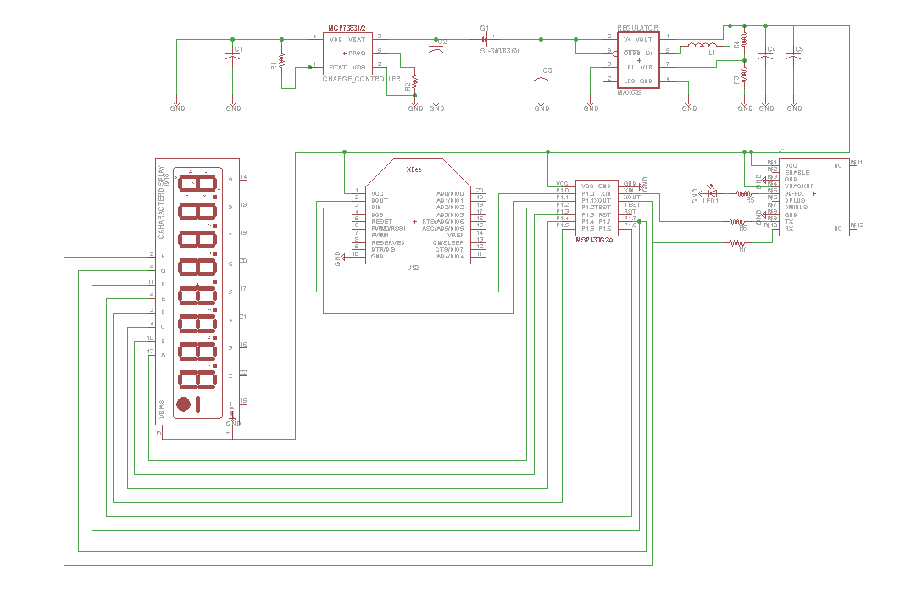
GPS Device
Schematic
Notes:
This is the schematic for the GPS device.

Slide 16
Overall System

Slide 17
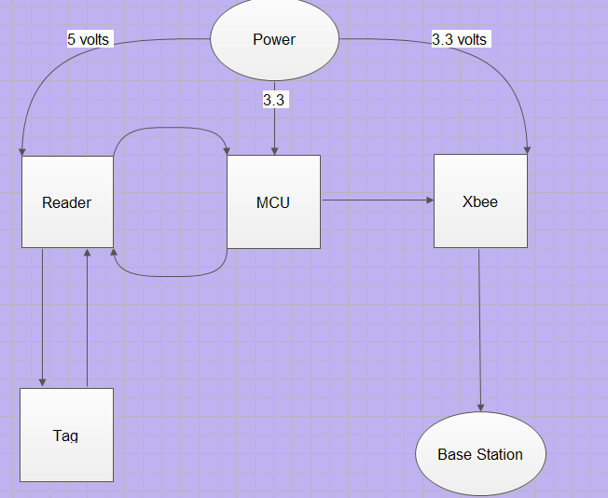
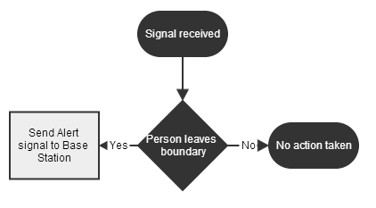
RFID control system

Slide 18
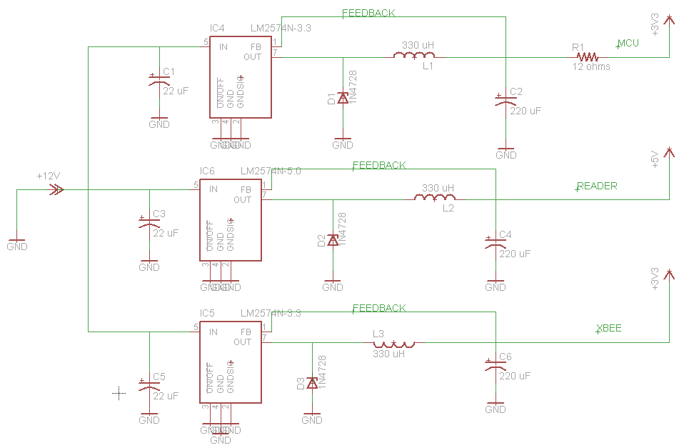
Electrical schematic
12 volts (source)
3 voltage regulators (LM2574). These voltage regulators will be placed in parallel in order to have the same 12 volts as input.
3.3 VDC (MCU)
5 VDC (Reader)
3.3 VDC (Xbee)

Slide 19
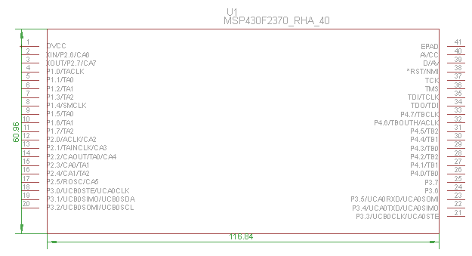
Microcontroller: MSP430F2370
# of pins 40
Voltage range 1.8-3.6 V
Interfacing parallel/SPI
Frequency 13.56 MHz
USCI mode UART, IrDA
AMC 270 uA
AMC: Active Mode Current

Slide 20
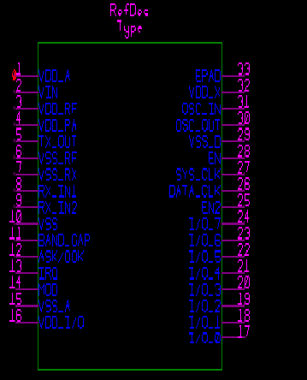
Reader
# of pins 32
Voltage range 2.7 V-5.5 V
Protocol ISO 15693
Interfacing parallel/SPI
Frequency 13.56 MHz
Dimension 5mmx5mm

Slide 21
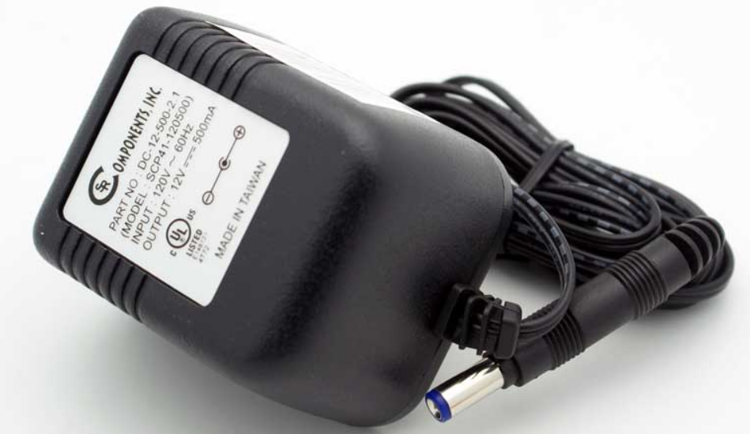
AC/DC Adapter
Input:
Voltage 120 VAC
Frequency 60 Hz
Output:
Voltage 12 VDC
Current 500mA

Slide 22
Overall System

Slide 23
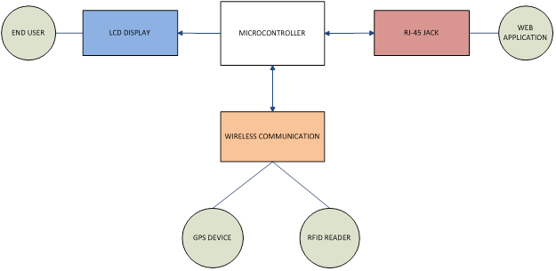
Base Station Overview
Notes:
Here is an OVERVIEW of the HARDWARE COMBINED to CREATE the BASE STATION
-The base station itself only consists of a LCD Character Display, RF Transmitter, and an RJ-45 Jack
-The RF Transmitter is used to communicate with the GPS Device and RFID Reader
-AND the RJ-45 jack provides Ethernet connective for Web Application Access
FIX: MAKE THE FONT LARGER, BETTER CONTRAST WITH BACKGROUND COLOR

Slide 24
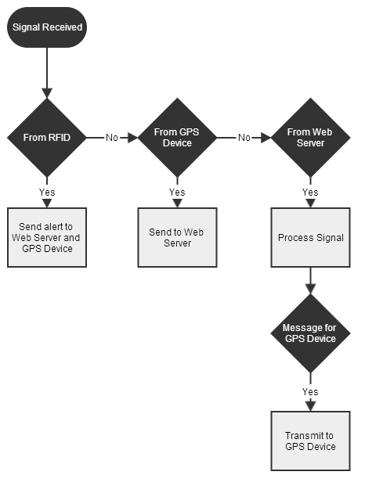
Flowchart
Notes:
This FLOW CHART provides more of a LOGIC BASED illustration on the base station
Once a signal is RECIEVED by the Microcontroller :
-If it is from the RFID: an alert is sent to the Web Server and GPS Device
-If it is from the GPS: GPS data is sent to the Web Server
-If it is from the WEB SERVER to the GPS: INSTRUCTIONS DIRECTING the GPS on its next action are sent

Slide 25
MCU Necessities
UART Connectivity
Baud Rate Variability
TCP/IP Stack Integration
10/100 Ethernet MAC/PHY
Notes:
The criteria used to select the microcontroller for the base station included:
-UART Connectivity
-Baud Rate Variability
-TCP/IP Stack Integration
-Ethernet MAC and Physical Layer Support

Slide 26
MCU Comparison
Features | Arduino Mega 2560 | TI Stellaris | Microchip PIC32
Processor | ATmega2560 | ARM Cortex 32 bit | MIPS2 M4K 32 bit
Max Frequency | 16 Mhz | 50 Mhz | 80 Mhz
Flash Memory | 256K | 256K | 512K
SRAM | 8K | 64K | 64K
GPIO | 54 | 42 | 85
UART Pins | 19 | 2 | 6
10/100 Ethernet | no | yes | yes
Operating Voltage | 7V to 12V | 2.25V to 2.75V | 2.3V to 3.6V
Max Baud Rate | 96000 | 3.125 Mbps | 12.5 Mbps
Notes:
Three main microcontrollers that were considered for the base station:
-Include the Arduino Mega 2560, the Stelllaris from TI, and Microchip’s PIC32.
-The main factors considered when selecting the microcontroller for the base station were the
Important features : the BAUD RATE, UART PINS, 10/100 Ethernet CONNECTIVITY, and OPERATING VOLTAGE

Slide 27
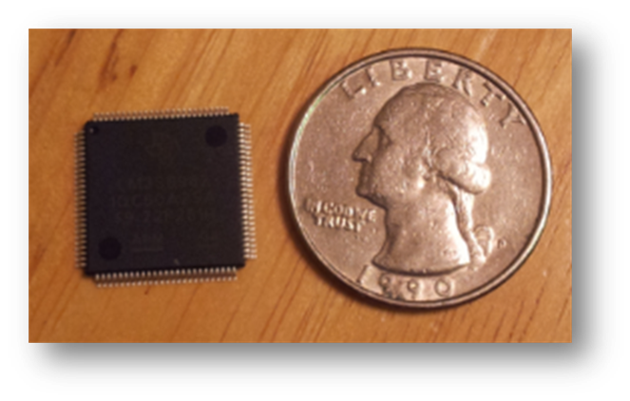
Stellaris LM3S8962
Stellaris LM3S8962
Features | Data
Processor | ARM Cortex 32 bit
Max Frequency | 50 Mhz
Flash Memory | 256K
SRAM | 64K
GPIO | 42
UART Pins | 2
10/100 Ethernet | yes
Operating Voltage | 2.25V to 2.75V
Max Baud Rate | 3.125 Mbps
Development Board
Code Composer
Used In Similar Project
100-pin LQFP
Integrated Ethernet controller
Notes:
Over all the Stellaris LM3S8962 was chosen because it provides:
-A large Baud Rate Range of up to about 3 Mbps, to support various UART transmission rates
-Has A DEVELOPMENT BOARD for MCU TESTING AND DEBUGGING ,
-SUPPORTS 10/100 Ethernet CONNECTIVITY,
-And has BEEN USED in SIMILAR PROJECTS

Slide 28
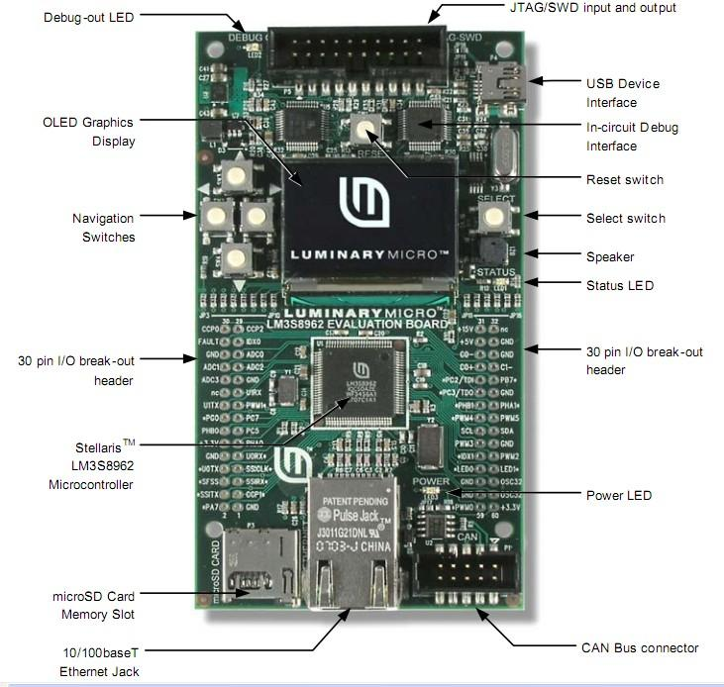
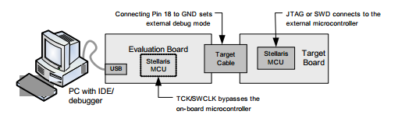
Programming
Uses Code Composer
Preinstalled Examples
C/C++
In-Circuit Debugger Interface
JTAG Port
Notes:
The Stellaris Development Board uses Code Composer to facilitate programming in either C or C++,
-Provides example programs,
-Acts as an IN-CIRCUIT DEBUGGER INTERFACE for the on board microcontroller,
-It also provides a JTAG PORT to DEBUG EXTERNAL TARGET BOARDS ,
-Which will be used to program the MCU mounted to our PCB

Slide 29
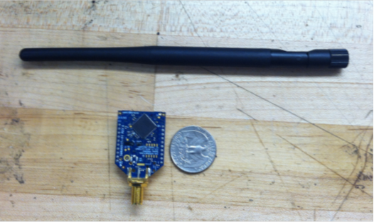
Wireless Communication
Bluetooth
Wifi
Radio frequency
A09-HASM-675-ND
Specs | Xbee Pro 900 RPSMA | Xbee Pro XSC RPSMA
Range | 6 miles | 15 miles
Voltage | 3.3 V | 3.3 V
Current | 210mA | 256mA
Frequency | 900Mhz | 900Mhz
Antenna | RPSMA High Gain | RPSMA High Gain
Data Rate | 156kbps | 9.6kbps
Notes:
Although there are many types of wireless communication,
- Radio Frequency was selected because it is best suited for LONG RANGE TRANSMISSION and PERFORMS BETTER in URBAN AREA.
-Of the two Xbee’s seen in the chart the Xbee Pro 900 was chosen because:
Its 210mA current consumption can be supported by the GPS Device
And its 6 mile range, with a HIGH GAIN ANTENNA, should COMPENSATE for the LOSS in TRANSMISSION RANGE noted in REVIEWS.

Slide 30
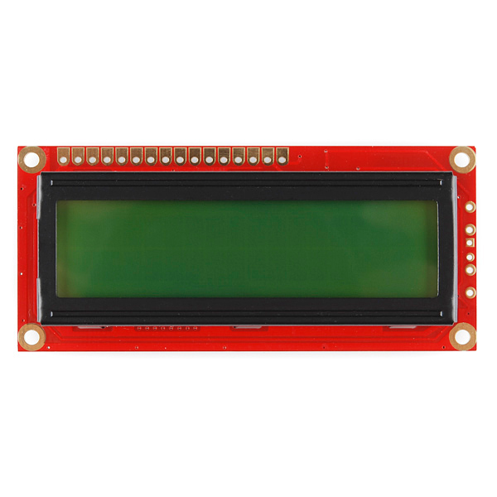
Display System
16x2 character LCD
3.3V power supply
Yellow LED Backlight
5x8 dot characters
11 general I/O pin interface
1/16 duty cycle
Dimensions: 0.34 x 1.4 x 3.2" (8.6 x 36 x 80mm)
Notes:
The Base Station will implement the same LCD display as the GPS device
-And boasts all the same features Carlos spoke about earlier.

Slide 31
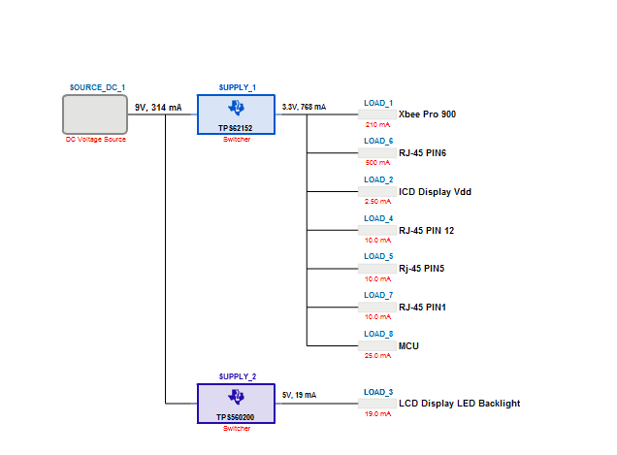
Power Supply
9V AC/DC Adapter
1A Output Current
TPS6215X /TPS560200
DC-DC Step Down Converter
Notes:
Ti’s Webench was used to generate the most efficient power supply for the base station
-A 9V AC to DC Power Adapter with an Output Current on 1A will be used in conjunction with the STEP DOWN CONVERTS SUGGESTED BY TI
TPS6215X and TPS560200 step down DC-DC converters suggest by TI
9 VDC 1000mA regulated switching power adapter
Xbee
MCU
LCD
Ethernet
AC vs DC
Battery Pack

Slide 32
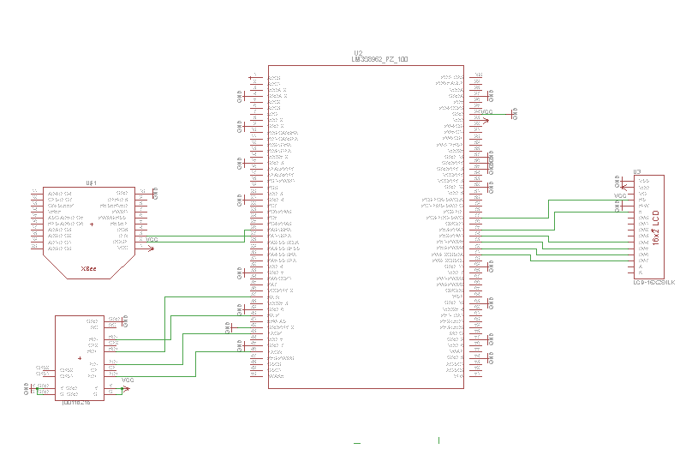
Base Station Schematic
Notes:
This schematic provides a basic illustration of the how the pins for each device will interface with the MCU

Slide 33
Overall System

Slide 34
Database
Looking for:
Scalability
Security
Low Maintenance
Reliability
Low Complexity Level
 | Stellaris | Google App Engine
Storage | 256 KB Flash + microSD | No Upper Limit
Programming Language | C | Java/Python/Go/PHP(preview)
Data Storage | CSV | Datastore
Associated Costs | Yes (Cost of Device) | Free (up to 5GB)
Ethernet | Yes | N/A
Notes:
Scalability: Automatic scaling is built in with App Engine
Security and Reliability: Built on Google’s infrastructure
Low Maintenance

Slide 35
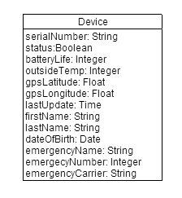
Database
Google App Engine
  Cloud
  No need to manage server
  Python/Java
Web2Py Framework
  Python
  Data Abstraction Layer
  MVC Framework
  Built to work with Google App Engine
Notes:
Scalability: Automatic scaling is built in with App Engine
Security and Reliability: Built on Google’s infrastructure
Low Maintenance

Slide 36



User Interface
Desired Features:
Cross-Platform
Free of Charge
Software Availability
 | Android | iOS | HTML5
Cross-Platform? | No | No | Yes
Associated Fees | Free | Annual Fee | Free
IDE | Several | X-Code Only | Several
HTML5 Web App WINS!
Notes:
Another reason: I own an iPhone and don’t want to depend on someone else’s Android phone for testing

Slide 37



User Interface
Backend Platform
  Google App Engine
Frontend Framework
  JQuery Mobile and Angular.js
APIs
  Google Authentication
  Google Geo
  Twilio Global Text Messaging

Slide 38
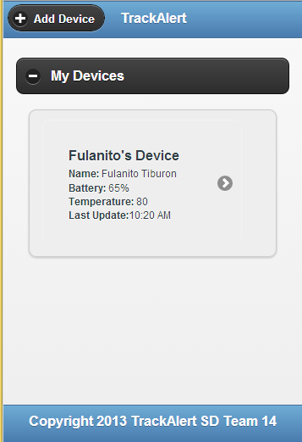
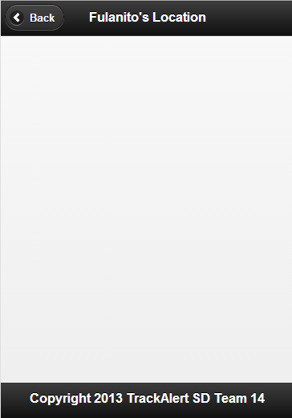
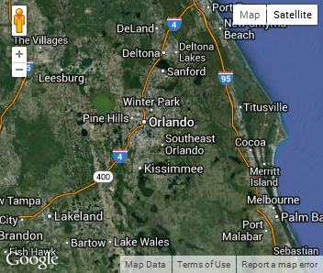
User Interface
  Allows user to:
    Add a new device
    Check current status:
      Battery life
      Last known location
      Last update time
    Delete device
    Request update

Slide 39
Expenses
GPS Device Component
Base Station Component
Part | Qty | Acquired (Y/N) | Price per Unit | Total
GPS Module | 1 | Y | $59.95 | $59.95
Microcontroller | 1 | Y | $21.00 | $21.00
Microcontroller | 1 | Y | $4.78 | $4.78
Recharge Circuit | 1 | Y | $15.00 | $15.00
Buck Regulator | 1 | Y | $2.06 | $2.06
Rechargeable Battery | 1 | Y | $10.85 | $10.85
LCD | 1 | Y | $24.95 | $24.95
PCB | 1 | N | $16.00 | $16.00
Part | Qty | Acquired (Y/N) | Price Per Unit | Total
Microcontroller | 1 | Y | $14.12 | $14.12
RF Module | 3 | Y | $42.95 | $128.85
RJ-45 | 1 | Y | $7.69 | $7.69
PCB | 1 | N | $33 | $4
AC Adapter | 1 | N | $6.00 | $6.00
DC Barrel Power Jack | 2 | Y | $0.20 | $0.20
Antenna | 3 | Y | $29.91 | $89.73
LCD Screen | 1 | Y | $13.95 | $13.95
Break Away Headers | 3 | Y | $1.50 | $4.50
Breakout Board | 3 | Y | $2.95 | $8.85
2mm 10pin Xbee Socket | 6 | Y | $1.00 | $6.00
Stellaris Dev Board | 1 | Y | $89.90 | $89.90
RFID Alarm Component
Part | Qty | Acquired (Y/N) | Price per Unit | Total
Reader | 1 | Y | $6.52 | $6.52
Microcontroller | 1 | Y | $4.50 | $4.50
Tags | 5 | Y | $0.78 | $3.90
Antenna 1 | 1 | Y | $20.00 | $20.00
Antenna 2 | 1 | Y | $42.55 | $42.55
PCB | 1 | N | $33.00 | $33.00
AC/DC Adapter | 1 | N | $6.00 | $6.00
Grand Total | $644.85
Notes:
Gina
So the cost to fund this project is about $645
-The high cost of this project can be attributed to components such as the xbees,
-Their high gain xbee antennas,
-And the $90 dollar development board for the base station MCU.

Slide 40
Project Distribution
 | GPS Component | Base Station | Web Application | RFID Component
Carlos
Gina
Melissa
Sainjulien
Notes:
Carlos
Like we have said before, Gina is in charge of the Base Station.
Melissa is dealing with the web application.
Sainjulien is in charge of the rfid monitoring system
And I have been working on the GPS Component

Slide 41
Progress Chart
Notes:
There is the progress of our project:
Most of the research was done in senior design 1.
We have spent 60% designing this project
So far, we have bought 80% of the components we need.
Also we have spent 55% in the prototyping and Testing process.
That will give us around 68% of what we have done so far.

Slide 42
Issues and Concerns
Soldering
Programming
Range (possibly, based on research)
GPS boot up time takes a while
PCB Layout

Slide 43
Questions?

