Slide 1
TrackAlert A Short-Range Emergency Tracking System
Group 14
Melissa Grenier
Carlos Gonzalez
Gina McGhee
Sainjulien Senatus

Slide 2
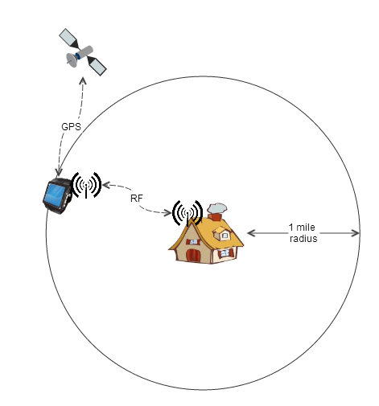
Project Description
A tracking system that can track a person within at least a 1 mile radius
The person will be wearing a traceable GPS device that communicates with a stationary base station
The device’s location will be available through a web application accessible through a computer and/or handheld internet-enabled device
RFID will be used as an alarm system to alert the base station when the person has left the perimeter (home)
Notes:
Melissa

Slide 3
Motivation and Purpose
Implementation of GPS, RFID, and different aspects of electrical and computer engineering
Meaningful project that can be useful and beneficial in a real life setting
Idea: To keep people that require around the clock supervision from wandering off from their homes:
Small children and mentally handicapped people
One example, autistic children
2012 survey: Out of 1,218 children, half of them had wandered off or attempted to wander off at least once after the age of 4
There are existing products that require a monthly fee (due to the use of cell towers)
Notes:
Melissa
In November 2012, a survey of parents of 1,218 children who have autism spectrum disorders, revealed that half of the parents reported their child had wandered off or attempted to wander off at least once after the age of 4.
Many of those reported incidents involved some sort of injury that could have resulted in death. Of the missing reports that involved a close call situation, the most common incidents were drowning (24%) and traffic injury (65%).
The places children wandered off from the most are their homes (74%), stores (40%), and schools (29%). Unfortunately, there have been cases were the children were found too late. 22 wandering-related death cases were identified when the study was published…a large number of those children had wandered off from their home. Wandering poses a significant risk for many children and adults with autism, Alzheimer’s, and other disorders.

Slide 4
Goals and Objectives
Families with small children or mentally handicapped relatives
Daycares
Mental Institutions
GPS Device
Lightweight
Low On Power Consumption
Easily carried (even by a child)
Long battery life
RFID System
Act as an alarm monitoring system
Alert base station when and which GPS device leaves the house
Web Application
Easy to use user interface
Available from any device that has internet connectivity
Host multiple users simultaneously
Be able to display GPS location on a map
Base Station
Communicate with more than one GPS device
Communicate with device up to a 1 mile distance
Receive messages from RFID system
Communicate with web app
Notes:
Gina
So the main purpose of this system is to ASSIST in KEEPING TRACK of those who CANT CARE for THEMSELVES
-The goals for the GPS Device include IT BEING:
-Lightweight
-Low On Power Consumption
-Easily carried (even by a child)
-And having a LONG battery life
-The RFID DEVICE should: Act as an ALARM SYSTEM
-AND also Alert the base station when a GPS device has left the area
-The Web Application should be: Easy to use
-Available from any device with internet
-Support multiple users simultaneously
-And Be able to display GPS locations on a map
-The Base Station should be: Able to communicative with more than 1 GPS device
-Interact with devices within a MILE RADIUS
-Receive messages from the RFID System
-And interface with the WEB APP

Slide 5
Specifications
Component | Specification
Base Station/GPS Device Communication | Wireless - Up to 1 mile radius
Base Station/Web App Communication | Internet
Base Station/RFID Communication | Wireless
GPS Device Battery Life | 5 hours active mode 30 hours standby mode
GPS Battery | Rechargeable from external source
GPS Boot-up Time | 12.5 minutes (first time) Up to 2 minutes (from sleep mode)
GPS Location | Within 10 feet of person being located
GPS Size | Not to exceed size of an iPhone (115.2x58.6)
Time to send GPS data to Web App | <to be tested>
Notes:
Gina
To be more specific with the specifications for our project
- The GPS Device should have a :
-5 hr battery life when in ACTIVE MODE
-30 hr BATTERY life when in STANDBY
-Take 12 ½ min to BOOT UP when FIRST ACTIVATED
- 2 minutes to boot from SLEEP MODE
- BE accurate to within 10 feet
- And be no bigger than an Iphone

Slide 6
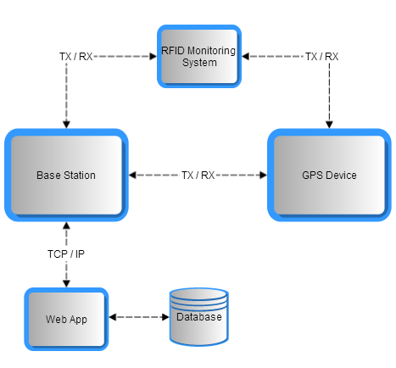
Overall System
Notes:
Carlos:
What you guys are seeing right now is the overall system of our project, so we have identify 4 different components.
GPS Device, RFID System, A Base Station and A Web Application.
The GPS Device is an outdoor system that would operate in open areas where GPS devices are accurate.
The RFID System would be installed inside places like hospitals, schools, malls and so on.
Then, we have a base station that would communicate with the other components.
So, the tracking information that is coming from GPS device will be sent to the Base station and also the tracking information that is coming from the indoors tracking system is also sent to the Base station.
Once our base station has that information, it will communicate with the Web Application.

Slide 7

Overall System
Notes:
Now, let jump into some specifications of the outdoor tracking system Device.

Slide 8
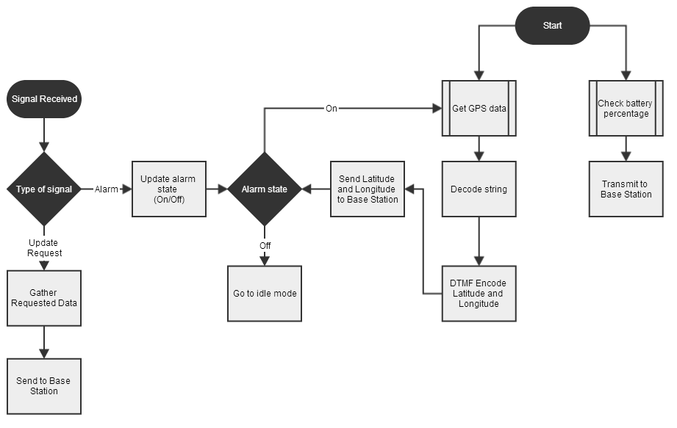
GPS Device
Notes:
So, what you are seeing right now is the flow chart for the GPS Device, and I want to try to explain how it works. The device will start working when getting a signal requesting data from the base station and there are two types of data will be sent. One of them is the battery percentage and that is what you see in the last two blocks- Check the battery percentage and transmit that data to the base station.
The other data that is also requested from the base station is GPS data. And that is what we see right here. We request data from the GPS module, decode that string and we only requesting latitude and longitude, so altitude, velocity, time are disregard.
One last thing, I would like to mention is the alarm state because every time GPS data is requested the RFID system went on. So child carrying the device is outside the safe area or outside the building and fro that reason it is an alarm state.

Slide 9
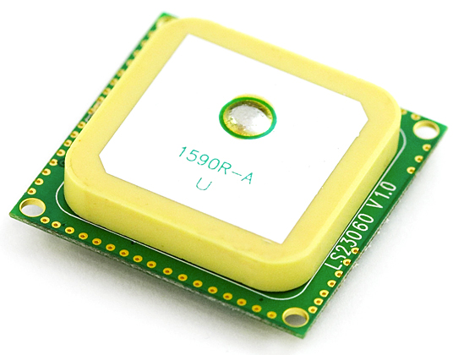
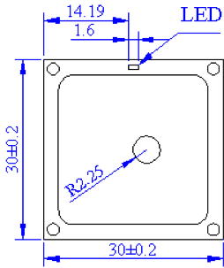
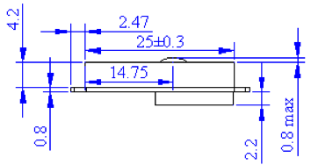
GPS Device
LS20031 Module
Embedded Antenna
Up to 66 satellites at time
Build-in battery
5V
42mA
Operating Temperature
14g
Dimensions (mm)
Notes:
In the market, there are so many GPS modules where to pick from;
however we decided to go with the LS20031 Module because it has already an incorporated antenna that will save us money and space on the PCB board.
We can get up to 66 satellites at a time, but only 22 will do the tracking.
I addition, this GPS Module has a Built-in micro battery to preserve system data for rapid satellite acquisition.
This module operates at 3.3 Volts at 42 milli-Amps.
Also can holds temperature from -30 to 85 degree Celsius
and it is a lightweight device component. Only 14 Grams.
Voltage: 3.3V
Current: 41mA
P = 0.1353 Watts
Temperature: -30 to 85 C (-22F to 185F)
Weight: 14 grams
Size: 30mm by 30 mm 5.8mm

Slide 10
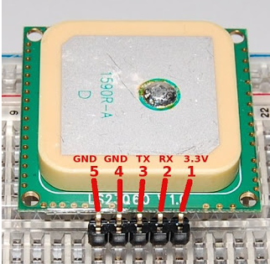
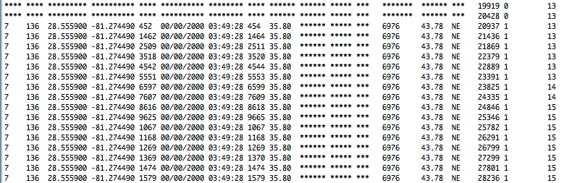
GPS Device
GPS Module Connection
1. Power Input
2. Data Input
3. Data Output
4. Ground
5. Ground
Output
Notes:
Here, we can see the 5 different pins of this part.
At the bottom is a sample of the output message that is being display in the serial monitor.
The first Column shows the number of satellites that are providing information.
Third and fourth columns are the latitude and longitude and more and more information for that specific location.
The GPS is program to update information every second.
Atmega 20mA
Total calculations: MCU + Xbee + LCD Character + GPS
Battery Life Hours = Battery Capacity(Ampere Hours) / Current Draw (Amperes)
PMU : Power Management Unit
Specifications for power: MCU- 5V at 40mA
GPS- 3.3V at 41mA
Xbee- 3.3 at 210 mA
LCD – 3.3 at 1.5mA

Slide 11
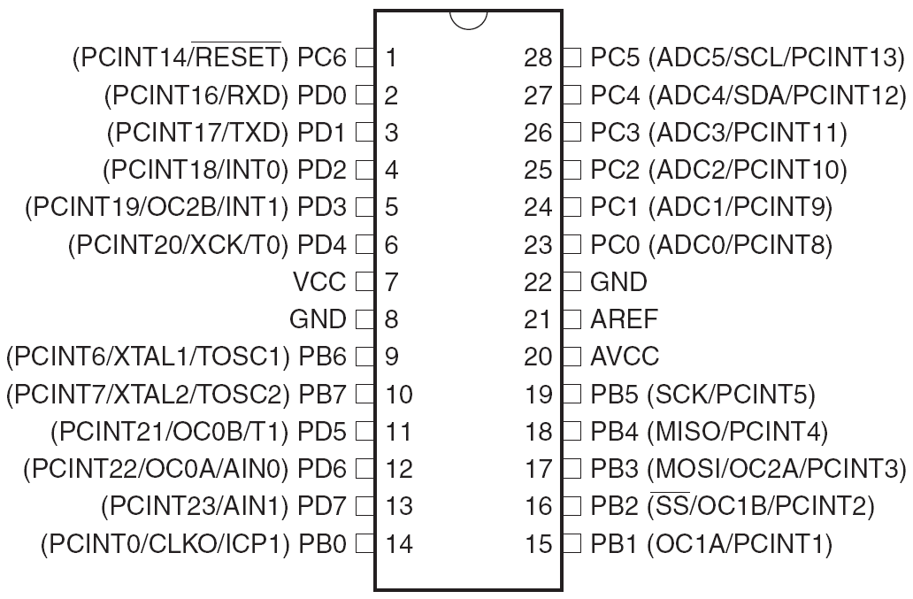
GPS Device
Atmega328
Six Sleep Modes
23 Programmable I/O lines
Operating Voltage1.8 -5.5V
5V, 8 MHz, Active: 5.2mA typical, 9mA max
Temperature Range -40C to 85C
Notes:
We are going to use the ATmega328P microcontroller in the GPS device. It is 23 programmable I/O lines, its operating voltage is between 1.8 and 5.5 volts at a typical current of 5.2mA. The other microcontroller that was on consideration was the MSP430 which is an excellent MCU with14-/20-pin DIP (N) socket,Built-in flash emulation for debugging and programming, 2 programmable LEDs, 1 power LED, 1 programmable button,1 reset button, low in power consumption and some many others characteristics. But I own a MAC and code composer only run in windows. And since I am testing a GPS device I need to carry my laptop around. Also, the Arduino has Simple, clear programming environment
Voltage: 5V
Current: 20mA actual value
Temperature: -40 to 85C

Slide 12
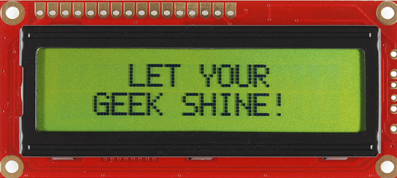
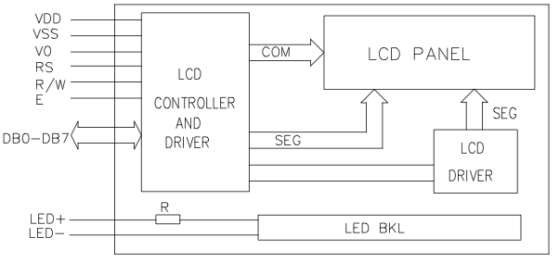
GPS Device
LCD Character Display
Personal Information
High Quality 16x2
5V Power Supply
1.5mA
Operating Temperature 0C to 50C
Size: 8.6 x 36 x 80mm
Notes:
The GPS device will also have a LCD Character display that will allow us to display information like Name, Age, and contact number.
It is a high quality 16x2 Character LCD that operates at 5 volts at 1.5mA. The operating temperature is between 0 and 50 Celsius.
Its size is 36 by 80 mm

Slide 13
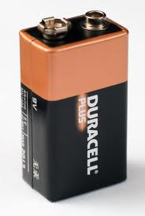
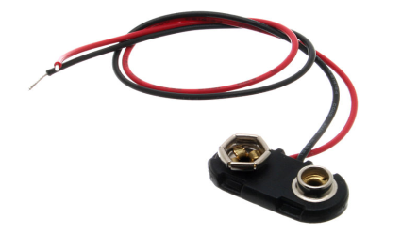
GPS Device
Battery
Alkaline or carbon-zinc 9-volt battery
9V at 565mAh
Temperature
Weight: 45.6g
height 48.5 mm, length 26.5 mm, width 17.5 mm
Voltage Regulator
LM7805
Notes:
The battery that we are going to use is a Alkaline Battery that outputs 9 Volts at 565mAh. This battery is , and has a built in protection for over voltage, over current and minimum voltage. It holds temperature from -18 to 55Celsius. It weights around 46 grams and it’s 48.5 by 26.5 mm.
We use an LM7805 to take the voltage down to 5 volts and porwer all the componets
Battery Life Hours = Battery Capacity(Ampere Hours) / Current Draw (Amperes)
0 to 130F

Slide 14
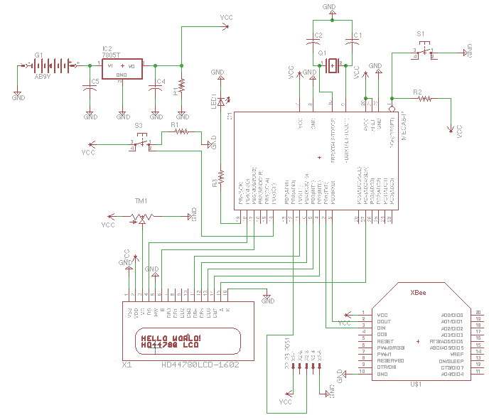
GPS Device
Schematic
Notes:
Finally, This is the final schematic for the GPS device using Eagle software with all the connections required to make this awesome device to work

Slide 15
Overall System

Slide 16
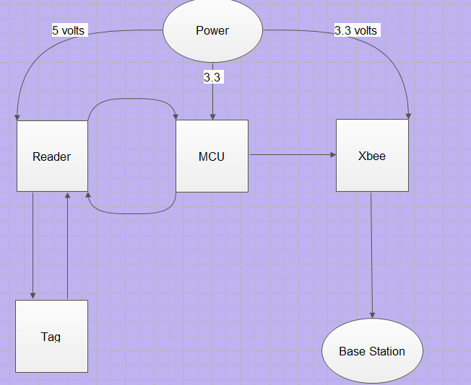
RFID control system

Slide 17
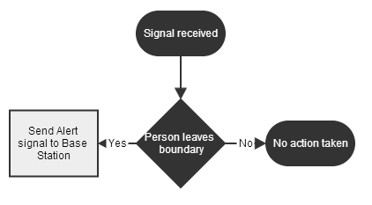
Flow Chart
A signal is received?
Yes: Send alert signal to the base station
No: No action taken

Slide 18
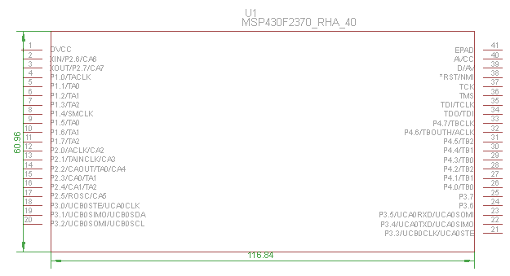
Microcontroller: MSP430F2370
# of pins 40
Voltage range 1.8-3.6 V
Interfacing parallel/SPI
Frequency 13.56 MHz
USCI mode UART, IrDA
AMC 270 uA
AMC: Active Mode Current

Slide 19
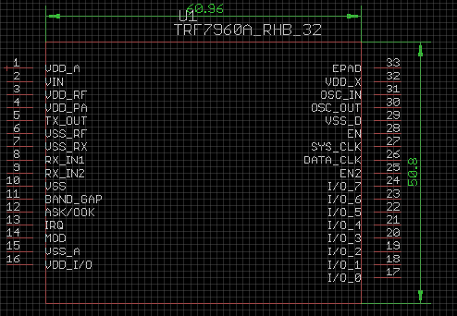
Reader
# of pins 32
Voltage range 2.7 V-5.5 V
Protocol ISO 15693, 14443A, 14443B, and tag it
Interfacing parallel/SPI
Frequency 13.56 MHz
Dimension 5mmx5mm

Slide 20
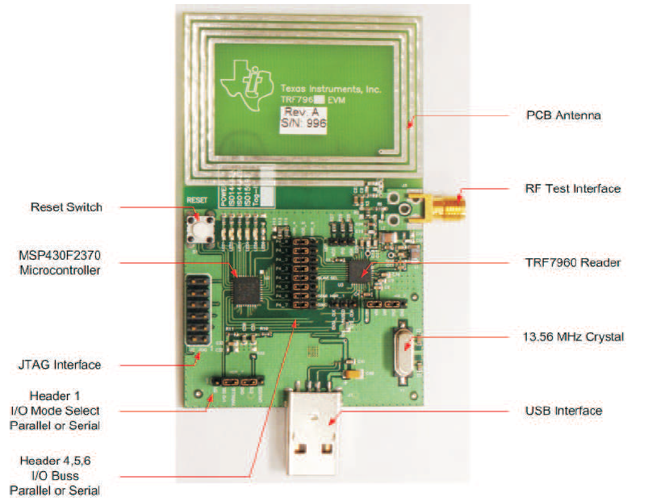
Development Board

Slide 21
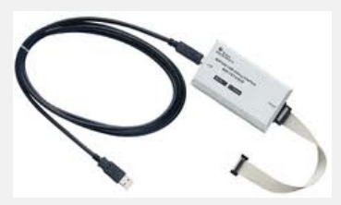
Debugger

Slide 22
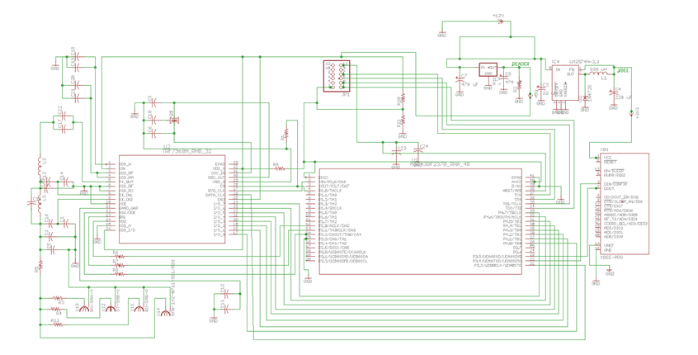
Schematic of the RFID System

Slide 23
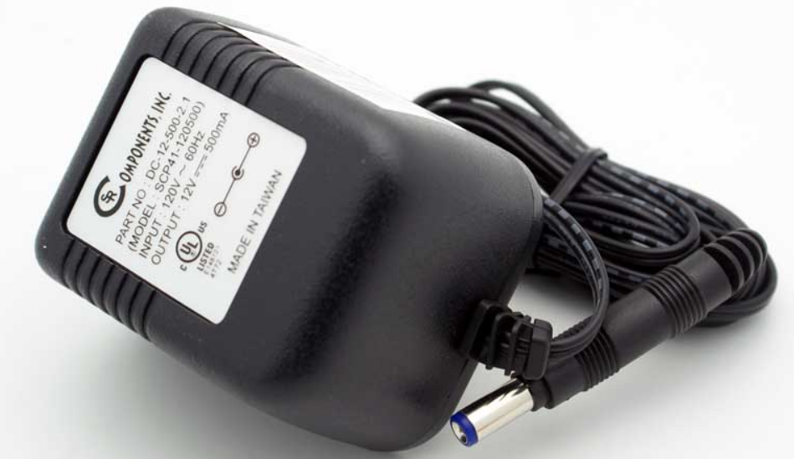
POWER: AC/DC Adapter
Input:
Voltage 120 VAC
Frequency 60 Hz
Output:
Voltage 12 VDC
Current 500mA

Slide 24
Overall System

Slide 25
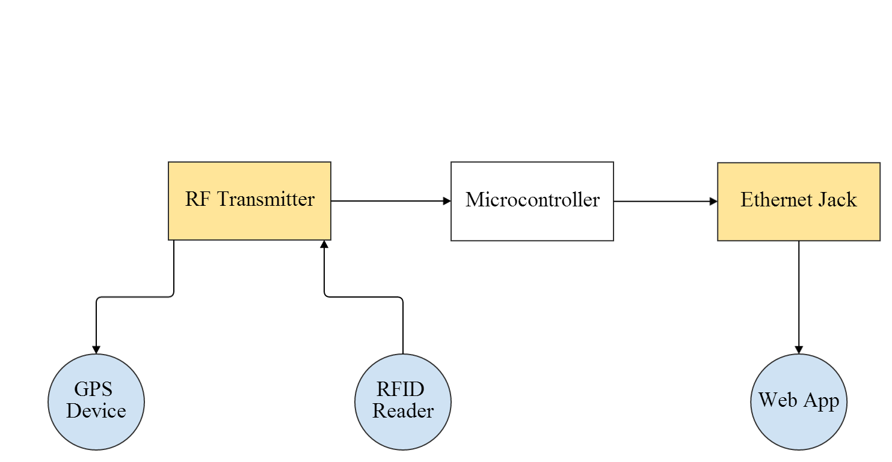
Base Station Overview
Notes:
Here is an OVERVIEW of the HARDWARE COMBINED to CREATE the BASE STATION
-The base station itself only consists of an RF Transmitter and an RJ-45 Jack
-The RF Transmitter is used to communicate with the GPS Device and RFID Reader
-AND the RJ-45 jack provides Ethernet connective for Web Application Access
FIX: MAKE THE FONT LARGER, BETTER CONTRAST WITH BACKGROUND COLOR

Slide 26
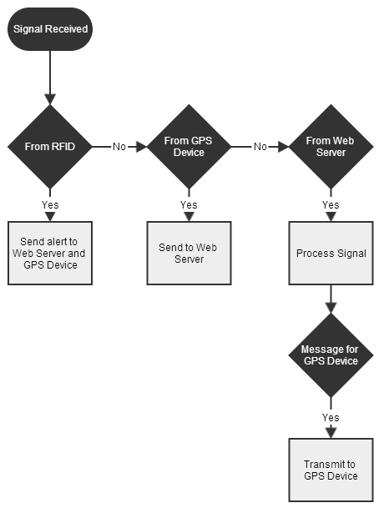
Flowchart
Notes:
This FLOW CHART provides more of a LOGIC BASED illustration on the base station
Once a signal is RECIEVED by the Microcontroller :
-If it is from the RFID: an alert is sent to the Web Server and GPS Device
-If it is from the GPS: GPS data is sent to the Web Server
-If it is from the WEB SERVER to the GPS: INSTRUCTIONS DIRECTING the GPS on its next action are sent

Slide 27
MCU Necessities
UART Connectivity
Baud Rate Variability
TCP/IP Stack Integration
10/100 Ethernet MAC/PHY
Notes:
The criteria used to select the microcontroller for the base station included:
-UART Connectivity
-Baud Rate Variability
-TCP/IP Stack Integration
-Ethernet MAC and Physical Layer Support

Slide 28
MCU Comparison
Features | Arduino Mega 2560 | TI Stellaris | Microchip PIC32
Processor | ATmega2560 | ARM Cortex 32 bit | MIPS2 M4K 32 bit
Max Frequency | 16 Mhz | 50 Mhz | 80 Mhz
Flash Memory | 256K | 256K | 512K
SRAM | 8K | 64K | 64K
GPIO | 54 | 42 | 85
UART Pins | 19 | 2 | 6
10/100 Ethernet | no | yes | yes
Operating Voltage | 7V to 12V | 2.25V to 2.75V | 2.3V to 3.6V
Max Baud Rate | 96000 | 3.125 Mbps | 12.5 Mbps
Notes:
Three main microcontrollers that were considered for the base station:
-Include the Arduino Mega 2560, the Stelllaris from TI, and Microchip’s PIC32.
-The main factors considered when selecting the microcontroller for the base station were the
Important features : the BAUD RATE, UART PINS, 10/100 Ethernet CONNECTIVITY, and OPERATING VOLTAGE

Slide 29
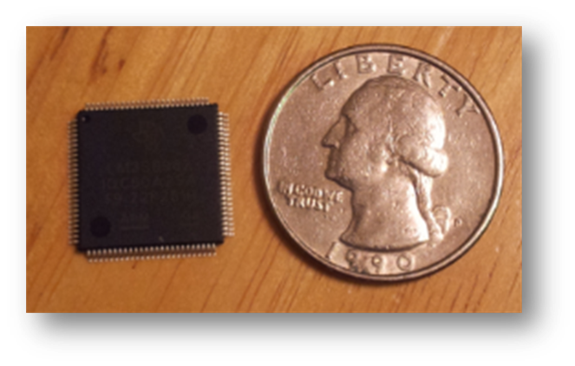
Stellaris LM3S8962
Stellaris LM3S8962
Features | Data
Processor | ARM Cortex 32 bit
Max Frequency | 50 Mhz
Flash Memory | 256K
SRAM | 64K
GPIO | 42
UART Pins | 2
10/100 Ethernet | yes
Operating Voltage | 2.25V to 2.75V
Max Baud Rate | 3.125 Mbps
Development Board
Code Composer
Used In Similar Project
100-pin LQFP
Integrated Ethernet controller
Notes:
Over all the Stellaris LM3S8962 was chosen because it provides:
-A large Baud Rate Range of up to about 3 Mbps, to support various UART transmission rates
-Has A DEVELOPMENT BOARD for MCU TESTING AND DEBUGGING ,
-SUPPORTS 10/100 Ethernet CONNECTIVITY,
-And has BEEN USED in SIMILAR PROJECTS

Slide 30
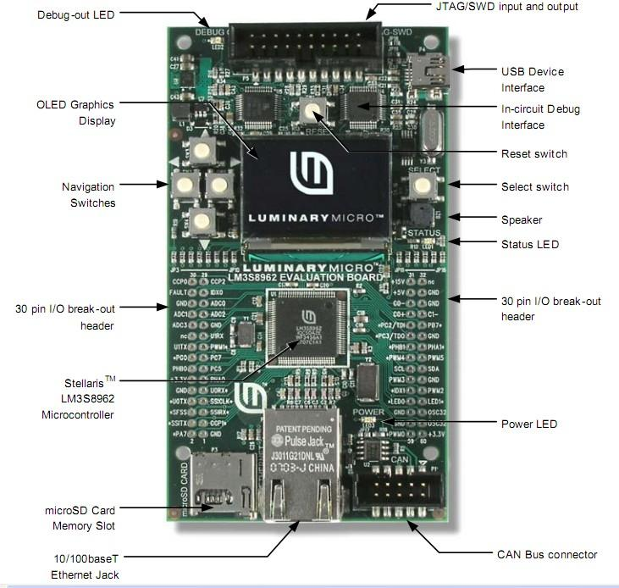
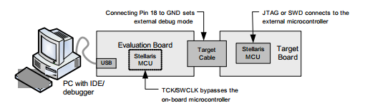
Programming
Uses Code Composer
Preinstalled Examples
C/C++
In-Circuit Debugger Interface
JTAG Port
Notes:
The Stellaris Development Board uses Code Composer to facilitate programming in either C or C++,
-Provides example programs,
-Acts as an IN-CIRCUIT DEBUGGER INTERFACE for the on board microcontroller,
-It also provides a JTAG PORT to DEBUG EXTERNAL TARGET BOARDS ,
-Which will be used to program the MCU mounted to our PCB

Slide 31
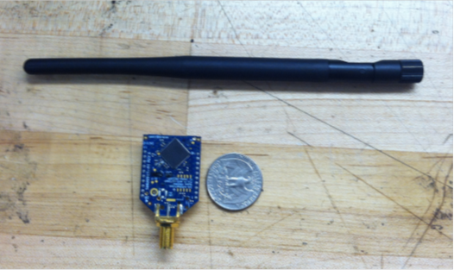
Wireless Communication
Bluetooth
Wifi
Radio frequency
A09-HASM-675-ND
Specs | Xbee Pro 900 RPSMA | Xbee Pro XSC RPSMA
Range | 6 miles | 15 miles
Voltage | 3.3 V | 3.3 V
Current | 210mA | 256mA
Frequency | 900Mhz | 900Mhz
Antenna | RPSMA High Gain | RPSMA High Gain
Data Rate | 156kbps | 9.6kbps
Notes:
Although there are many types of wireless communication,
- Radio Frequency was selected because it is best suited for LONG RANGE TRANSMISSION and PERFORMS BETTER in URBAN AREA.
-Of the two Xbee’s seen in the chart the Xbee Pro 900 was chosen because:
Its 210mA current consumption can be supported by the GPS Device
And its 6 mile range, with a HIGH GAIN ANTENNA, should COMPENSATE for the LOSS in TRANSMISSION RANGE noted in REVIEWS.

Slide 32
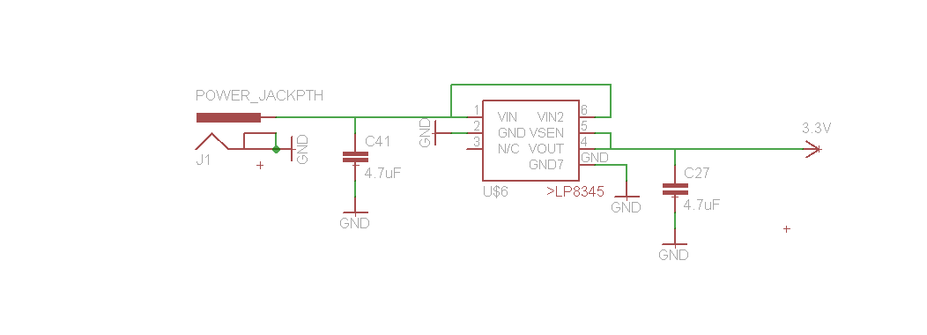
Power Supply
5V AC/DC Adapter
1A Output Current
LP8345ILD
4.7 uF Capacitors
Notes:
-The board is powered by a: 5V AC to DC adapter; Which delivers 1 amp of current
-Based on the Stellaris development board
-The same LP8345 Voltage Regulator is used provide the
- 3.3 Volts and 500 mA needed by the system
Ti’s Webench was used to generate the most efficient power supply for the base station
-A 9V AC to DC Power Adapter with an Output Current on 1A will be used in conjunction with the STEP DOWN CONVERTS SUGGESTED BY TI
TPS6215X and TPS560200 step down DC-DC converters suggest by TI
9 VDC 1000mA regulated switching power adapter
Xbee
MCU
LCD
Ethernet
AC vs DC
Battery Pack

Slide 33
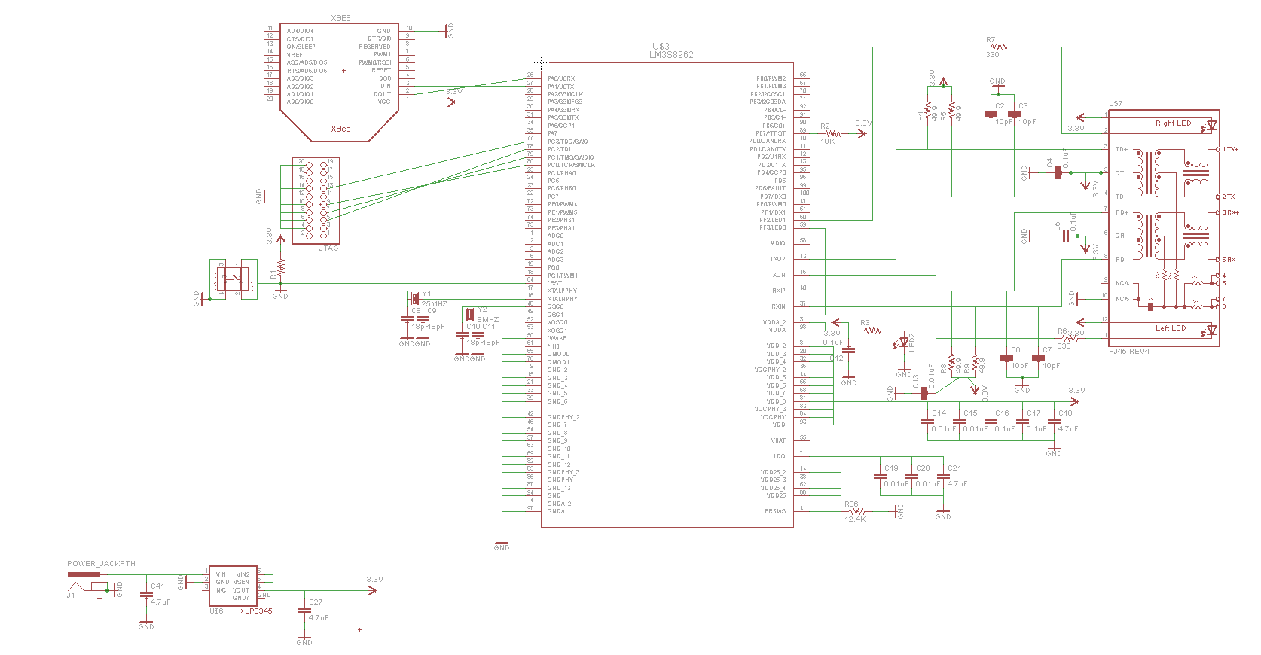
Base Station Schematic
Notes:
-This schematic provides a thorough illustration of the pin out for the base station
-Created in Eagle, libraries for the Xbee, Jtag Port, and Mcu where found online
-Custom libraries were create for the voltage regulator, switch, and RJ-45 Jack

Slide 34
Overall System

Slide 35
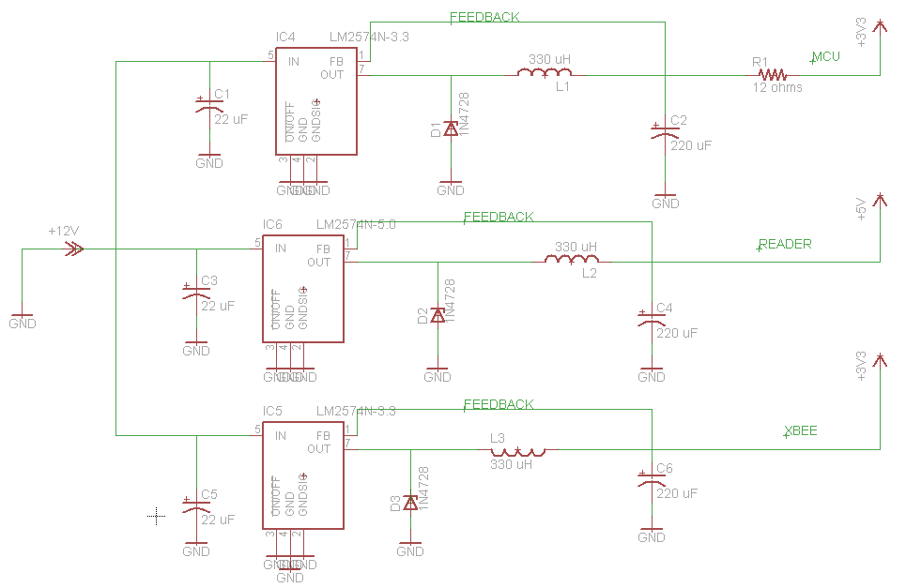
Electrical schematic
12 volts (source)
3 voltage regulators (LM2574). These voltage regulators will be placed in parallel in order to have the same 12 volts as input
3.3 VDC (MCU)
5 VDC (Reader)
3.3 VDC (Xbee)

Slide 36
Issues
Software
BOM
PCB
Antenna

Slide 37
Database
Looking for:
Scalability
Security
Low Maintenance
Reliability
Low Complexity Level
 | Stellaris | Google App Engine
Storage | 256 KB Flash + microSD | No Upper Limit
Programming Language | C | Java/Python/Go/PHP(preview)
Data Storage | CSV | Datastore
Associated Costs | Yes (Cost of Device) | Free (up to 5GB)
Ethernet | Yes | N/A
Notes:
Scalability: Automatic scaling is built in with App Engine
Security and Reliability: Built on Google’s infrastructure
Low Maintenance

Slide 38
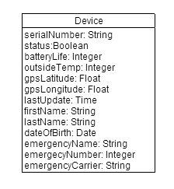
Database
Google App Engine
Cloud
No need to manage server
Python/Java
Web2Py Framework
Python
Data Abstraction Layer
MVC Framework
Built to work with Google App Engine
Notes:
Scalability: Automatic scaling is built in with App Engine
Security and Reliability: Built on Google’s infrastructure
Low Maintenance

Slide 39



User Interface
Desired Features:
Cross-Platform
Free of Charge
Software Availability
 | Android | iOS | HTML5
Cross-Platform? | No | No | Yes
Associated Fees | Free | Annual Fee | Free
IDE | Several | X-Code Only | Several
HTML5 Web App WINS!
Notes:
Another reason: I own an iPhone and don’t want to depend on someone else’s Android phone for testing

Slide 40


User Interface
Backend Platform
Google App Engine
Frontend Framework
JQuery Mobile
APIs
Google Authentication
Gmaps.js

Slide 41
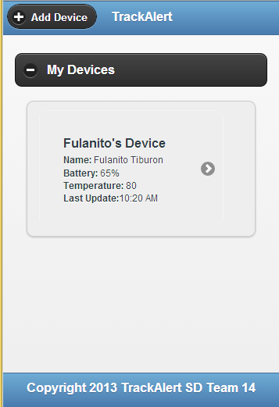
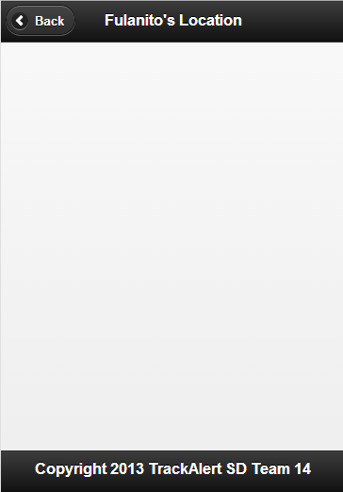
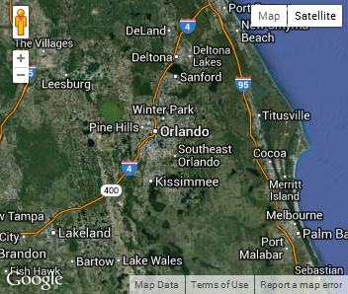
User Interface
Allows user to:
Add a new device
Check current status:
Battery life
Last known location
Last update time
Delete device
Request update

Slide 42
MCU Communication
Background script with HTTP request to MCU
Common Gateway Interface (CGI) functionality on the Stellaris
Server Side Include (SSI) to include the updated values to the response page.
WSGI on the web application

Slide 43
Expenses
GPS Device Component
Base Station Component
Part | Qty | Acquired (Y/N) | Price per Unit | Total
GPS Module | 1 | Y | $59.95 | $59.95
Microcontroller | 1 | Y | $21.00 | $21.00
Microcontroller | 1 | Y | $4.78 | $4.78
Recharge Circuit | 1 | Y | $15.00 | $15.00
Buck Regulator | 1 | Y | $2.06 | $2.06
Rechargeable Battery | 1 | Y | $10.85 | $10.85
LCD | 1 | Y | $24.95 | $24.95
PCB | 1 | N | $16.00 | $16.00
Part | Qty | Acquired (Y/N) | Price Per Unit | Total
Microcontroller | 1 | Y | $14.12 | $14.12
RF Module | 3 | Y | $42.95 | $128.85
RJ-45 | 1 | Y | $7.69 | $7.69
PCB | 1 | N | $33 | $4
AC Adapter | 1 | N | $6.00 | $6.00
DC Barrel Power Jack | 2 | Y | $0.20 | $0.20
Antenna | 3 | Y | $29.91 | $89.73
LCD Screen | 1 | Y | $13.95 | $13.95
Break Away Headers | 3 | Y | $1.50 | $4.50
Breakout Board | 3 | Y | $2.95 | $8.85
2mm 10pin Xbee Socket | 6 | Y | $1.00 | $6.00
Stellaris Dev Board | 1 | Y | $89.90 | $89.90
RFID Alarm Component
Part | Qty | Acquired (Y/N) | Price per Unit | Total
Reader | 1 | Y | $6.52 | $6.52
Microcontroller | 1 | Y | $4.50 | $4.50
Tags | 5 | Y | $0.78 | $3.90
Antenna 1 | 1 | Y | $20.00 | $20.00
Antenna 2 | 1 | Y | $42.55 | $42.55
PCB | 1 | N | $33.00 | $33.00
AC/DC Adapter | 1 | N | $6.00 | $6.00
Grand Total | $644.85
Notes:
Gina
So the cost to fund this project is about $645
-The high cost of this project can be attributed to components such as the xbees,
-Their high gain xbee antennas,
-And the $90 dollar development board for the base station MCU.

Slide 44
Project Distribution
 | GPS Component | Base Station | Web Application | RFID Component
Carlos
Gina
Melissa
Sainjulien
Notes:
Carlos
Like we have said before, Gina is in charge of the Base Station.
Melissa is dealing with the web application.
Sainjulien is in charge of the rfid monitoring system
And I have been working on the GPS Component

Slide 45
Issues and Concerns
Soldering
Programming
Range (possibly, based on research)
GPS boot up time takes a while
PCB Layout

Slide 46
Improvements
GPS size
Wireless
Battery Power Supply

Slide 47
Questions?

