Slide 1
ICG Sensor
Group 17
Daniel Arfstrom, Tuyen Do, Chris McCord, Stephen Wilkes
Sponsor: Dr. Thomas Looke (Anesthesiologist/EE)

Slide 2
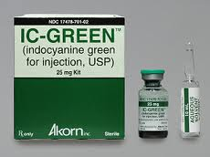
Indocyanine Green
Medical Dye used for its fluorescent properties.
Comes in powdered form, mixed with water to create an injectable dye.

Slide 3
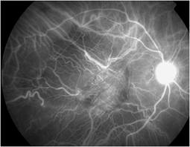
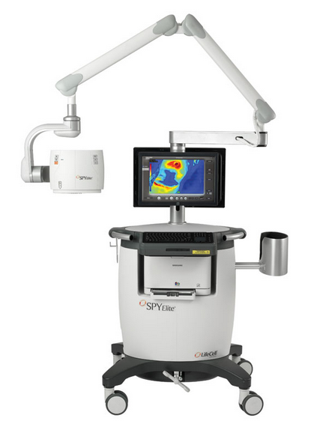
SPY Elite System ( SPYE)
Used during surgeries, typically to pinpoint areas with little to no blood flow
Room must be darkened to filter out external light
Extremely costly
Specific to only certain surgeries
Only usable in operating room

Slide 4
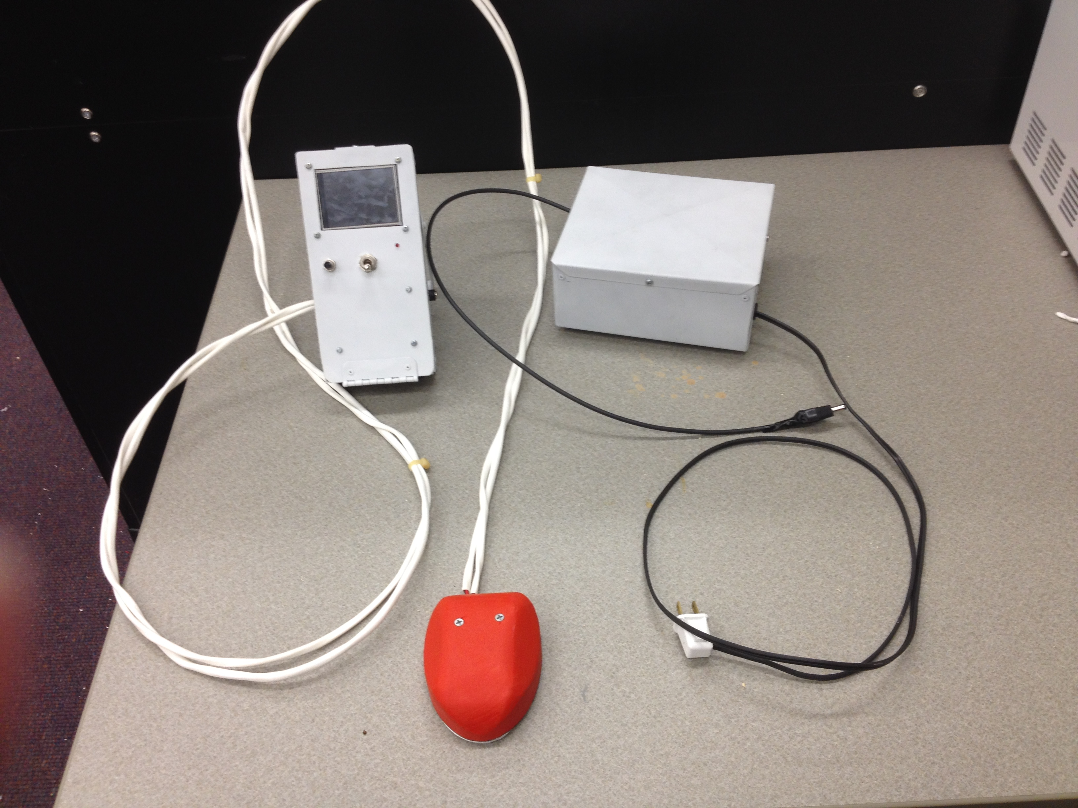
Goals and Objectives
Safe
Compact
Easy to use
Easily read output

Slide 5
What is the Purpose of the Final Product?
“There are two uses that I have in mind for this device. 1. The steady state value of fluorescence (shortly after injection prior to the dye being metabolized) should give an indicator of dye concentration which can be used to calculate blood volume. 2. The dynamic response, plot of fluorescence vs. time, is related to cardiac output. So we should have an indicator of both blood volume and cardiac output with this dye fluorescence time plot.” -Dr. Looke

Slide 6
System I/O
Emitter
Medium w/ ICG
Photodiode
Micro-Controller
Display
Data Processing

Slide 7
ICG Sensor Block Diagram
5V
Near Infrared Light
Emitter
Touchscreen LCD
Battery
Indocyanine Green
Button Presses
Data points
PSU
Collector
MCU
Fluorescence
Analog signal

Slide 8
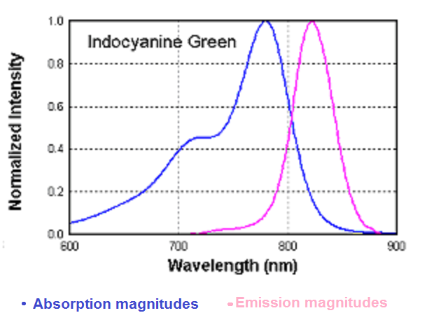
Properties of ICG
Indocyanine Green possesses useful optical properties.
Absorbs light of a specific range of frequencies, steps it down in energy, and re-releases it (as fluorescence).
ICG's emission frequency is altered slightly in blood plasma, as it binds to proteins.
Ideal measure wavelength ~830 nm.

Slide 9
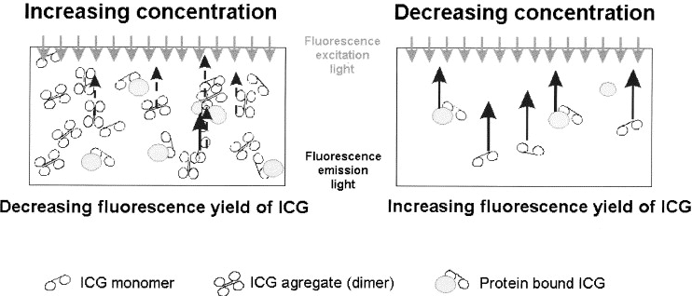
Properties of ICG
Process called "Quenching" makes fluorescence decrease with concentration after a certain concentration is reached.
Our measurable range then is from 8 to 100 micrograms per milliliter (before quenching takes effect).

Slide 10
Photodiode Substrate Choices
Silicon photodiodes have an optimal wavelength range around 830 nm and are more cost effective.
Substrate | Wavelength Range | Typical Pricing
Si | 350-1100 nm | $13-$100
Ge | 800-1800 nm | $130-$430
InGaAs | 800-1800 nm | $130-$260

Slide 11
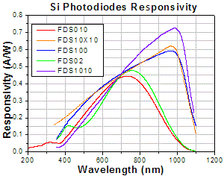
Si Photodiode Choices
Item # | Range (nm) | Active Area | Dark Current | Price
FDS010 | 200-1100 | .82 mm² | .3 nA@10V | $42.10
FDS10X10 | 340-1100 | 100 mm² | 200 pA@5V | $100.00
FDS100 | 350-1100 | 13 mm² | 35 pA@5V | $73.50
FDs02 | 400-1100 | .049 mm² | 35 pA@5V | $73.50
FDS1010 | 400-1100 | 100 mm² | 1.05 nA@5V | $48.80

Slide 12
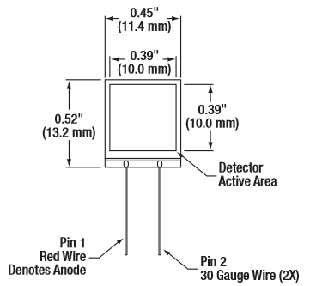
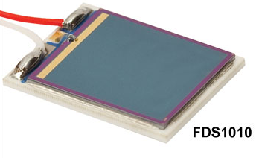
Si Photodiode Selection

Slide 13
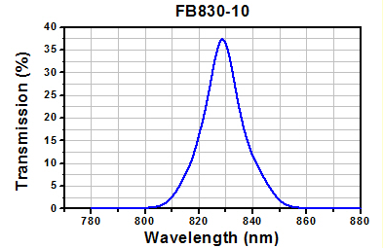
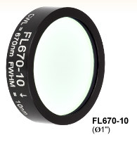
Filter Choices
The same manufacturer had a line of 10 nm FWHM bandpass filters with 1 inch diameter
Shown left is the transmission graph of the selected 830nm-centered bandpass filter.

Slide 14
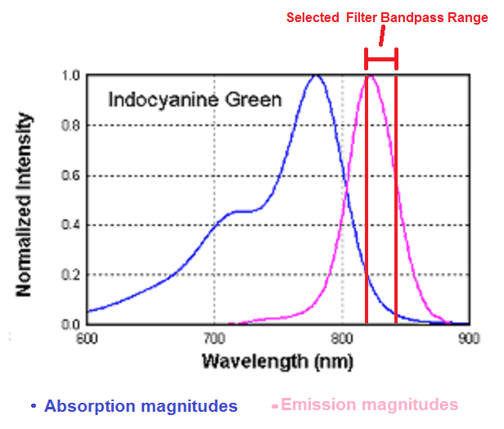
Sensing Range

Slide 15
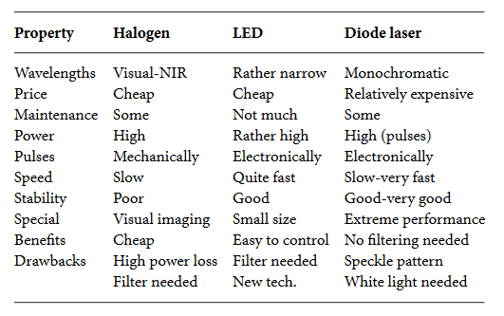
Emitter Selection
Simply needed excitation source within absorption range.
Excitation light should be a broader range than collection, so that it is made sure that ICG fluoresces within the pass band.

Slide 16
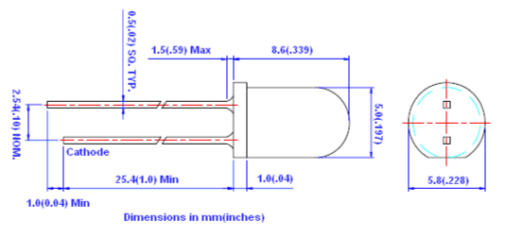
Emitter Selection
Thorlabs' LED780E
780 nm centered with FWHM 30 nm
190 mW max power dissipation
100 mA max DC forward current
1.75 V typical forward voltage

Slide 17
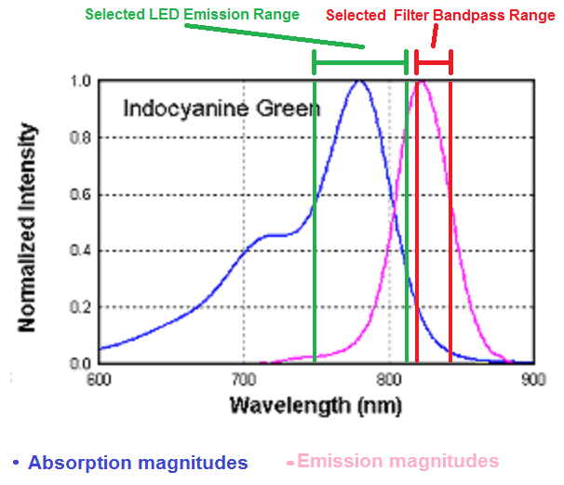
Emission/Collection Ranges

Slide 18
Alternate Filter for Testing
Since real blood is not a testing option, the focus must shift to the properties of ICG for an aqueous solution.
The peak fluorescence for such a situation is 800 to 810 nm, instead of 830 for blood plasma.
This project implements a Thorlabs 810 nm version of the previously mentioned filter.

Slide 19
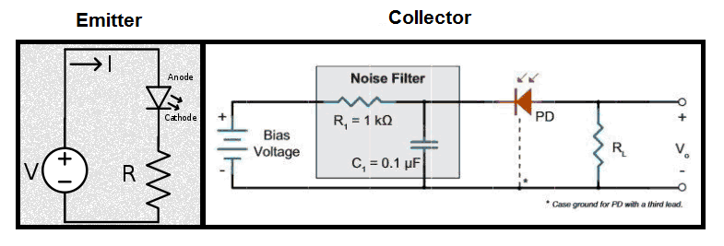
Complete Sensor Circuitry

Slide 20
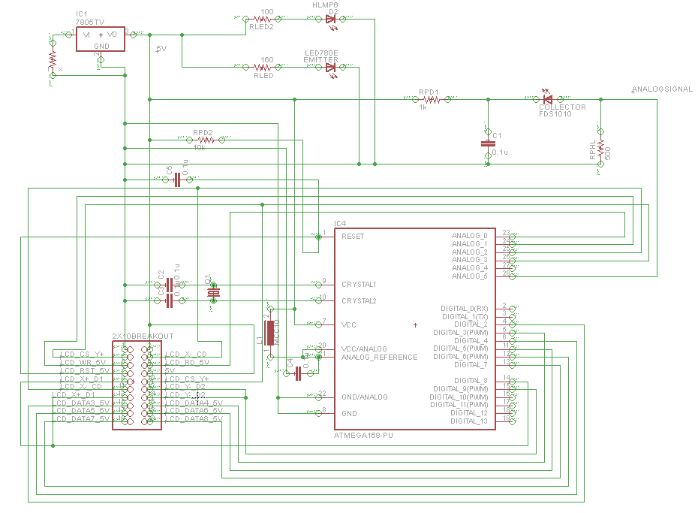
PCB Schematic

Slide 21
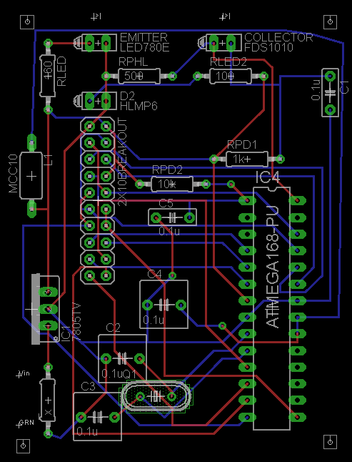
PCB Layout

Slide 22
Output
Snapshot display:
Main body: Various Statistics and most recent 12 data points.
Primary display:
Main body: Graphical display of collected data.
ICG Level indicator:
Indicator for user to note critically low level of ICG
.

Slide 23
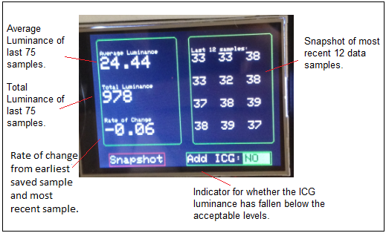

Slide 24
Comparison of Displays
Display | V_{in} | Size | Resolution | PPI | Color | Backlight | I/O | Touchscreen | Price
ILI9325 | 3-5V | 2.8” | 320x240 | 142 | 18 bit | Yes | 12 lines | Resistive | $40.00
GDM12864HLCM | 4.5-5.5V | 2.4” | 128x64 | 59 | 1 bit | Yes | 10 lines | None | $19.95
μLCD-32PTU | 4-5.5V | 3.2” | 320x240 | 125 | 16 bit | Yes | 13 lines | Resistive | $84.95
Preferably be powered by 5V
~3” (diagonal) in size
High PPI for time-magnitude graph
Color
Backlight for low light environments

Slide 25
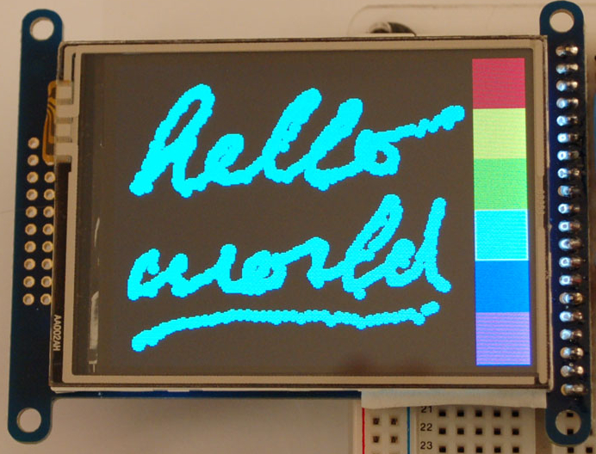
Display Specifications
Adafruit 2.8” TFT LCD (ILI9325)
3-5V
8 Digital, 4 Analog Control Lines
2.8" TFT LCD
320x240 Resolution
18 Bit Color (262,000 Colors)
LED Backlight
Resistive Touchscreen
RGB, SPI Interfaces

Slide 26
Comparison of Microcontrollers
ATmega328P-PU
MSP430
1.8-5.5V
20 MHz
32kB Flash
2kB RAM
23 GPIO pins
8ch 10-bit ADC
I2C, SPI, UART Interfaces
1.8-3.6V
16 MHz
16kB Flash
512B RAM
16 GPIO pins
8ch 10-bit ADC
I2C, SPI, UART Interfaces

Slide 27
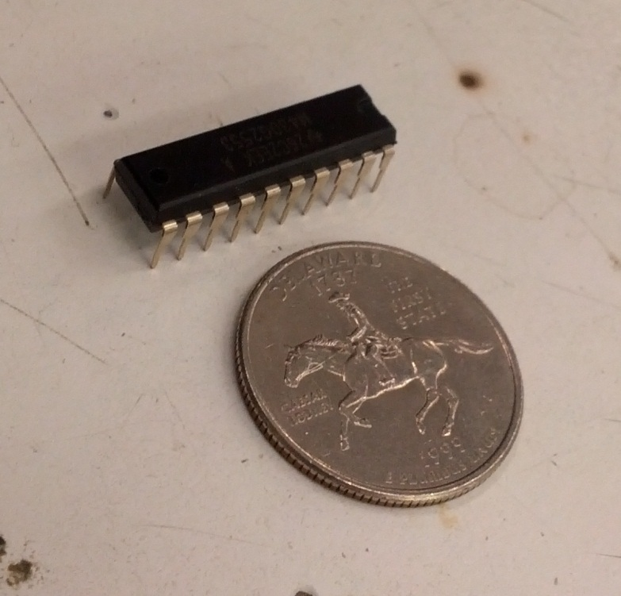
Originally…
We chose the MSP430G2553 due to
Our familiarity with the microcontroller
Sufficient GPIO pins
Launchpads readily available

Slide 28
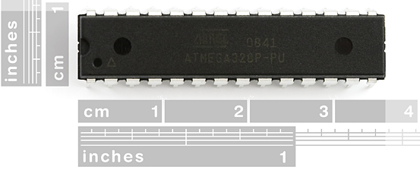
ATmega328P
Advantages over the MSP430
Simplified power requirements; no longer needed a 3V regulator.
2x the flash memory; software currently exceeds 20 kB.
4x the RAM will allow the software to do more things at once.
Extra pins for expandability.
More abundant software libraries.

Slide 29
Software States
Collection
Storing
Drawing
Touch Listener

Slide 30
Data Storage Implementation
Circular Linked List
Limited space means old data will be purged for new incoming data (FIFO).
Two pointers will be needed: head and tail.
Running Times
Insertion O(1) – we will only be inserting at the end of the list.
Search O(n)
Deletion O(n)

Slide 31
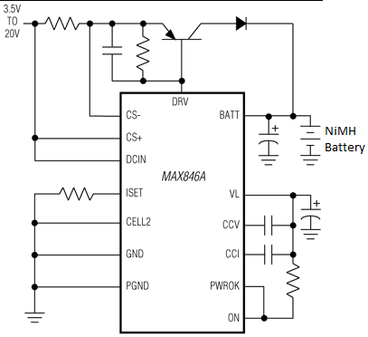
Power System
Max 846A Linear IC
Rechargeable Battery Pack
Type | LIPO
Cells | 2
Voltage | 7.4 V
Capacity | 2200mAh

Slide 32
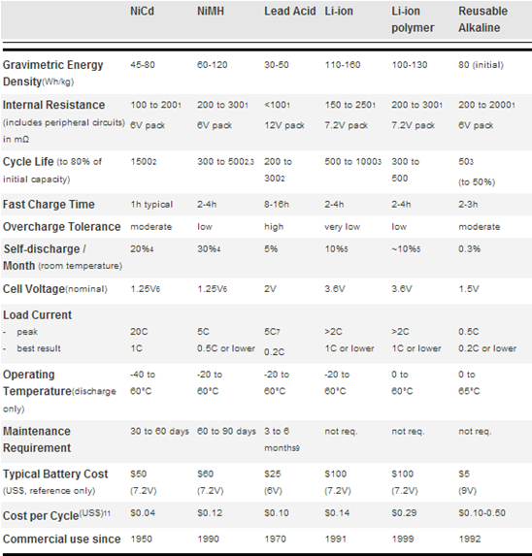
Why LIPO?
1.Li-ion has slower discharge but it is not a problem due to consistent use.
2.High per cell voltage.
3.High capacity.
4.Switching is easy!
(Picture courtesy of Battery University's Isidor Buchmann)

Slide 33
Voltage Regulation
Voltage regulator: LM7805
All components run off 5V except for small red 3V LED; LED 780E, photodiode, LCD, microcontroller, and reference voltage. 100 ohm resistor in series with the LED will take care of voltage difference.
Input (V) | Output (V)
11 | 5.01
10 | 5.01
9 | 5.01
8 | 5.01
7 | 5.01
6 | 4.99
5 | 4.06

Slide 34
Charging Circuit Block Diagram
Transformer
Resettable Fuse
Rectifier
Wall Socket
LIPO IC
Resettable Fuse
Battery

Slide 35
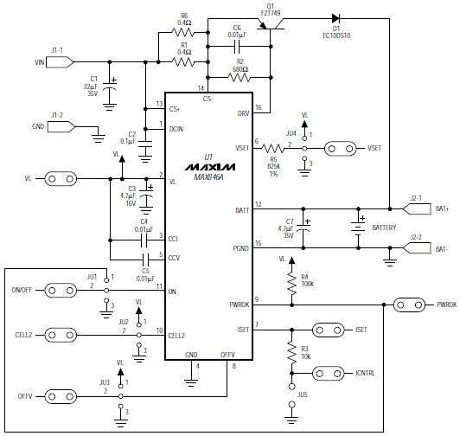
Charging IC
MAX846EVKIT+

Slide 36
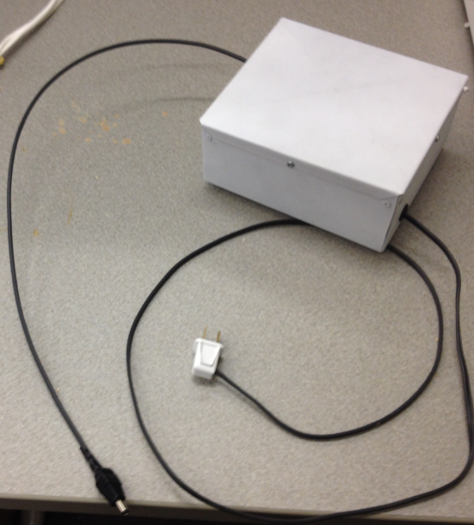
Charger Casing
Connection from the wall socket, to charger circuit, to the main housing unit.
Made of Aluminum.
Simple rectangular/box casing.
5.5in.
7 in.

Slide 37
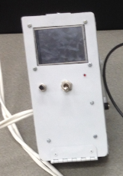
Main Housing Unit
Contains the rechargeable battery, MCU, LCD, and PCB
Flips open where one side houses the battery and the other houses the PCB, MCU, and LCD
Easy access to battery makes replacement simple
3mm hole for red LED "on light"
Mechanical on/off switch
Reset switch
Wires running from the main housing to the sensor are twisted in a helical formation to limit noise and are kept together using heat shrink tubing
3.5 in.
8 in.

Slide 38
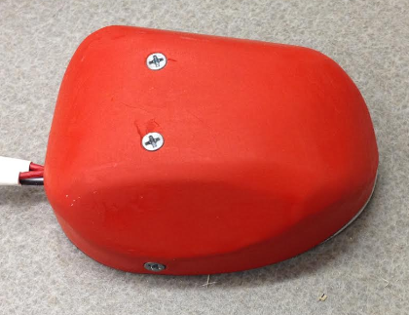
Sensor Casing
4 in.
Contains the collector, emitter, and filter.
Oval in shape
Easy to hold with flat side corners
Must be constantly held over test area by user.
3 in.

Slide 39
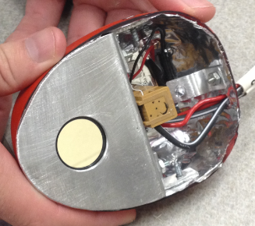
Bottom View of Sensor
Collector has a < 1 in. in diameter hole for filter to reside
Physical separation between collector and emitter by bent aluminum plate
Wire runs through the hole in separation to collector
Metalized Mylar in the walls of the entire closure.
Terminal block for convenience and aesthetics to hold wires

Slide 40
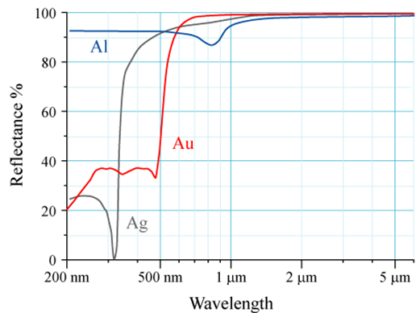
Aluminum Foil Reflectivity
Slight drop at 800 nm

Slide 41
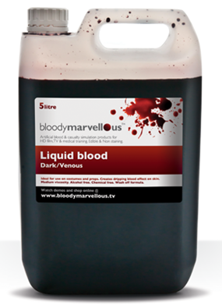
Testing Medium, Synthetic Blood
The ideal testing environment would be using a human patient.
Problems with legality.
Next option, Synthetic blood.
Needed enough for thorough testing.
Issue with customs; importing 5 liters of "blood".

Slide 42
Testing methods
Testing materials will be covered from external light to avoid false ICG fluorescence and false sensor readings.
Clear plastic containers and bags will be used to contain the synthetic blood and ICG.
Were going to use Synthetic skin and muscle, but determined it would not be necessary for a proof of concept.
Magnitude of fluorescence of ICG is understood to be directly related to ICG concentration in the testing medium (Synthetic blood).

Slide 43
Primary Tests
Three Tests:
Responsiveness Test
Infusion Test
Decay Test
Responsiveness Test:
Testing to ensure collector responds to an LED that emits a readable signal.
Turn on sensor and start recording.
Introduce the powered LED to the collector.
Verify the device indicates an increased signal magnitude.

Slide 44
Primary Tests (Cont’d)
Infusion Test:
Start with a clean volume of testing medium.
Turn on sensor and start recording.
Slowly introduce a sample of ICG and verify that the device indicates a trend of increasing magnitude of fluorescence.
Decay Test:
Start with a volume of testing medium with a predetermined quantity of ICG .
Turn on sensor and start recording.
Slowly introduce a quantity of clean testing medium. Verify the device indicates a decreasing magnitude of fluorescence.

Slide 45
Budget
Part | Cost | Quantity | Shipping | Notes | Total
Atmel ATMEGA328P-PU | $0.00 | 3 | $0.00 | Samples | $0.00
Adafruit 2.8” TFT LCD Display | $40.00 | 1 | $3.99 | N/A | $43.99
Synthetic Blood (5 liters) | $287.67 | 1 | $57.53 | N/A | $345.20
LIPO Rechargeable Battery | $33.34 | 1 | $0.00 | N/A | $33.34
PCB | $23.75 | 8 | $0.00 | N/A | $190
Charging Unit | $255.15 | 1 | $0.00 | N/A | $255.15
Wire/Cable | $3.94 | 1 | $0.00 | N/A | $3.94
FDS1010 Photodiode | $48.80 | 1 | $8.58 | N/A | $57.38
830nm Bandpass Filter | $84.67 | 1 | $0.00 | N/A | $84.67
LED780E x5 | $26.00 | 1 | $0.00 | N/A | $26.00
Misc. | $19.50 | 1 | $0 | N/A | $19.50
Total |  |  |  |  | $1059.17

Slide 46
Distribution of Work
 | ICG | Sensor | MCU | LCD | PSU | Coding | Casing | Testing
Daniel |  |  | X | X |  | X |  | X
Tuyen |  |  | X | X |  | X |  | X
Chris | X |  |  |  | X |  | X | X
Stephen | X | X |  |  |  |  | X | X

Slide 47
Issues
Touchscreen not functioning properly.
ICG:
Provided in limited quantities.
Scale is not very precise.
Not performing as expected.
The possibility exists that emitter light is not sufficient.
Testing
Noise
Precision
Compatibility between synthetic blood and real blood with ICG

Slide 48
Questions
Thank you for your attention, feel free to ask any questions.

