Slide 1

Smart Umbrella
Group 9
Derek Workman EE
Eugene McDonald EE
Nicholas Van Nice CpE

Slide 2
Motivation
Work with photovoltaics
Design a unique solar panel tracking application
Implementation of multiple controlled systems into a single design
- Lighting control
- Motor control
- Sensor control

Slide 3
Project Goals
Light weight means of collecting solar energy using solar panels.
Maximize efficiency from the solar panels by designing, building, and coding a Maximum Power Point Tracking synchronous switching regulator with a greater than 90% efficiency.
Design a solar panel tracking system
Learn how to design and create a PCB

Slide 4
Project Objectives
Objectives | Explanation
Increased shading | Motorized sun tracking umbrella top provides no user interaction to maintain shading
Self Sustained Power Supply | Solar panel battery charging
Transportable | Needs to be easily foldable for transporting or storing
Weather Resistant | Able to withstand high heat and high humidity conditions
6 Mode Lighting System | Constant lighting, lighting pattern, and entertainment modes
Solar Panel Status Screen | Back lit LCD screen shows Solar Panel status
Battery Charging Status Indicators | Shows status of battery including battery present, charging and fully charged

Slide 5
Project Specifications
Specification | Explanation
Lightweight Design | Less than 20 pounds total weight
Long Battery Life | 4 hours of battery life in low sunlight under normal operating conditions
USB Phone Charger | 2.0 USB phone charging port able to maintain trickle charge of 0.5 amps.
High Efficiency | Greater than 90% efficiency
Entertainment Modes | Include 5 entertainment modes
Sun Tracking Timing | 30 minutes

Slide 6


Umbrella
Height: 7.0’
Width: 7’ 6”
Reason:
1 ¼” hollow steel pole Price: $26.00
6 steel straight splines wind flap decreases affects of added torque
7 lbs. total weight easy setup

Slide 7
Project Block Diagram
10-13 variable voltage
8.4 volt
5 volt
Power
7.4 volt
3.3 volt
Control
Solar Panel
MCU
LED’s
Solar Panel Current Sensor
LED Driver
MOSFET Driver
LCD Screen
Solar Panel
Voltage Sensor
Top Motor
USB Charger
5 Volt Regulator
MPPT Synchronous Switching Regulator
Battery Charger IC
LI-ION
Battery
Top Motor Controller
Battery Voltage Sensor
Battery charging indicator LED’s
Bottom Motor
Controller
Bottom Motor

Slide 8
10-13 variable voltage
8.4 volt
5 volt
Power Generation
10-13 variable voltage
8.4 volt
5 volt
Power
Power
7.4 volt
3.3 volt
7.4 volt
3.3 volt
Control
Control
MCU
LED’s
Solar Panels
MCU
LED’s
Solar Panel
Solar Panel Current Sensor
Solar Panel Current Sensor
LED Driver
LCD Screen
MOSFET Driver
LCD Screen
MOSFET Driver
Solar Panel
Voltage Sensor
Solar Panel
Voltage Sensor
Top Motor
Top Motor
USB Charger
5 Volt Regulator
USB Charger
5 Volt Regulator
MPPT Synchronous Switching Regulator
MPPT Synchronous Switching Regulator
Top Motor Controller
LI-ION
Battery
Top Motor Controller
Battery Charger IC
LI-ION
Battery
Battery Charger IC
Battery Voltage Sensor
Battery Voltage Sensor
Bottom Motor
Bottom Motor
Controller
Bottom Motor
Battery charging indicator LED’s
Bottom Motor
Controller
Battery charging indicator LED’s

Slide 9
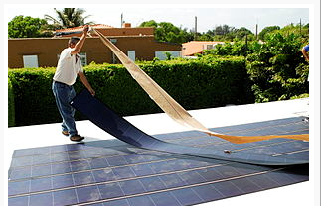
Solar Panel
Issues:
Finding a lightweight solar panel
Size of solar panel
Mounting that required no heavy bracket
Durability of solar panel
Cost of solar panels
Solution?
Build our own panel using individual solar cells
Courtesy of Wikipedia

Slide 10
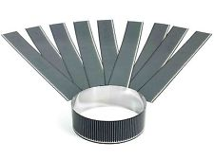
Solar Panel
Solopower’s CIGS thin film technology
Highest efficiency in thin film technology
28 individual 1.25 watt solar cells connected in series
Produces 35 watts
14 volts at 2.5 amps
Lightweight and flexible
Raw solar cell needs weatherproof encapsulation
Courtesy of Solopower
item | value
Manufacturer | Solopower
Total weight | 1lb
Price | $130.60

Slide 11
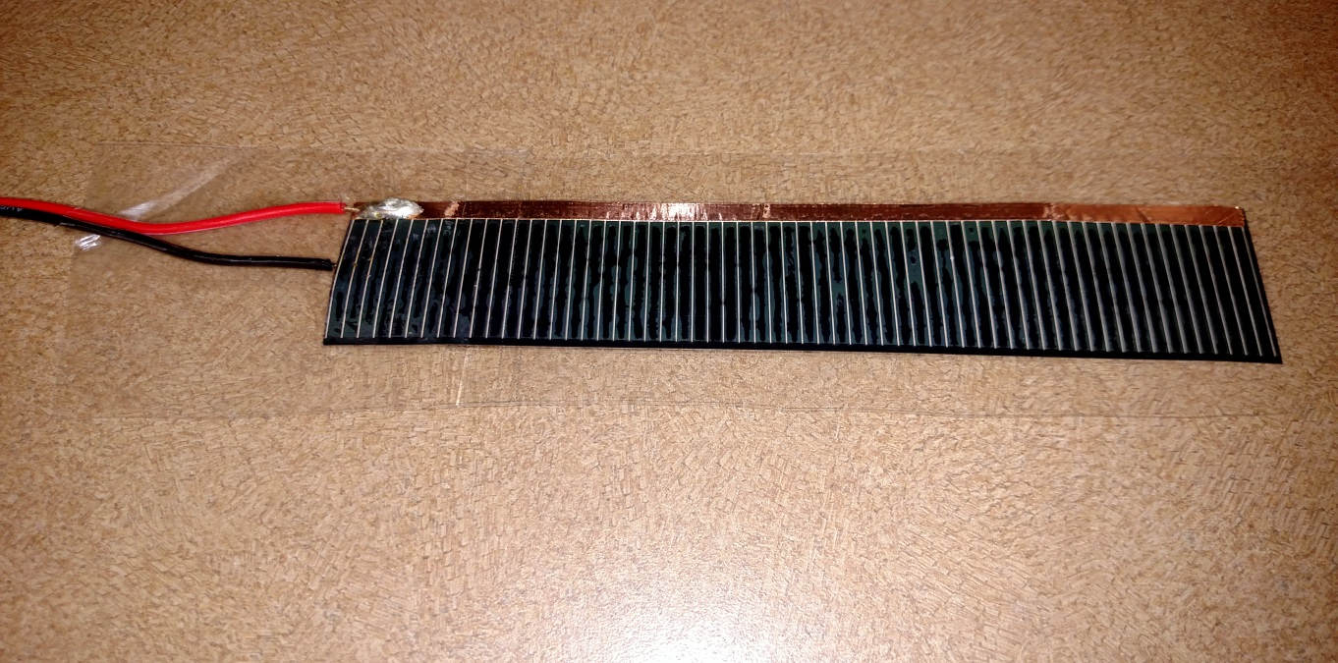
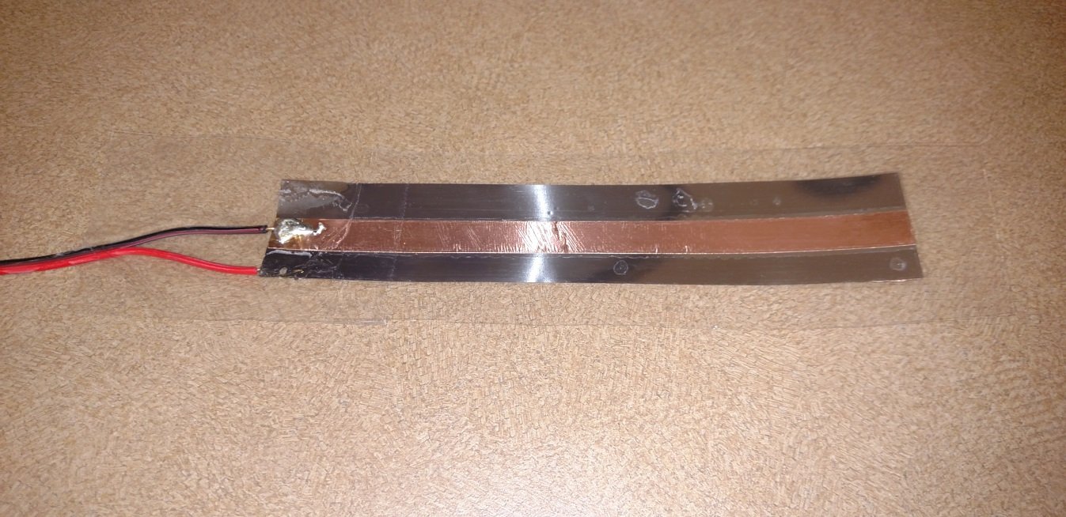
Solar Panel Build
Copper tape tabbing
Benefits:
Electrically conductive glue
Low resistivity
Solderable
positive
Gorilla shipping tape encapsulation
Benefits:
Durable non stretching
Non yellowing
High heat rating
negative
1.75
inch
14 inch

Slide 12
Maximum Power Point Tracking (MPPT)
10-13 variable voltage
8.4 volt
5 volt
Power
7.4 volt
3.3 volt
Control
Solar Panels
MCU
LED’s
3 analog inputs
to MCU
Solar Panel Current Sensor
2 outputs from MCU
10mA
LED Driver
MOSFET Driver
LCD Screen
Solar Panel
Voltage Sensor
130mA
Top Motor
USB Charger
5 Volt Regulator
MPPT Synchronous Switching Regulator
PWM control
Battery Charger IC
LI-ION
Battery
Top Motor Controller
Battery Voltage Sensor
Battery charging indicator LED’s
Bottom Motor
Controller
Bottom Motor

Slide 13

Current and Voltage Sensors
Solar panel and battery voltage sensors are simple voltage divider circuits
Allegro’s hall effect-based ACS712 linear current sensor IC
Allows MCU to calculate maximum power from solar panel and regulate output voltage to battery
Courtesy of Allegro
Item | Value
Manufacturer | Allegro
Model Number | ACS712ELCTR-05B-T
Packaging | SOIC 8
Price | $1.58

Slide 14
Power MOSFETS
Testing 2 different power MOSFETS in Prototype board
Texas Instruments CDS18503KCS Power MOSFET much more efficient
 | CDS18503KCS | IRFZ44N
Manufacturer | Texas Instruments | International Rectifier
Max voltage | 40V | 55V
Max current | 100A | 49A
Threshold voltage | 1.9V | 2-4V
Drain-to-Source On-Resistance | 3.6mohm | 17.5mohm
Price | Free | $1.97/each

Slide 15
MOSFET Driver
 | LM27222 | IR2104
Manufacturer | Texas Instrument | International Rectifier
Input voltage | 4V to 6.85V | 10 V– 20V
Operating current | 0.65mA | 130mA
Packaging | SOIC 8 | DIP 8
Price | $2.65 | $1.46
Chose the LM27222 to begin testing mainly because of input voltage and lower operating current
Had issues with LM27222 not switching MOSFETS
Decided to switch to IR2104 with great success

Slide 16
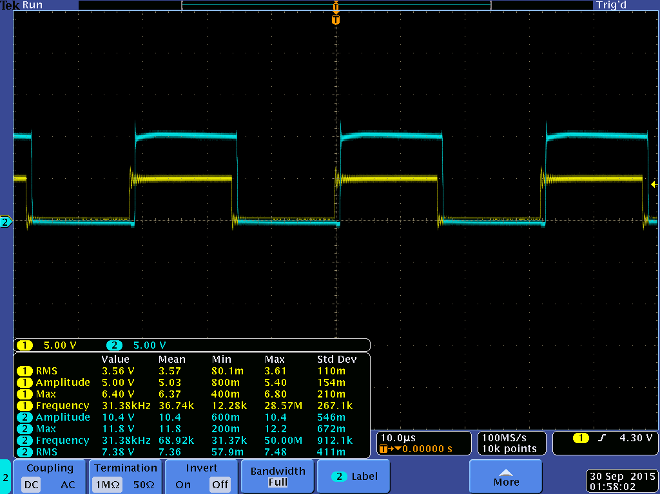
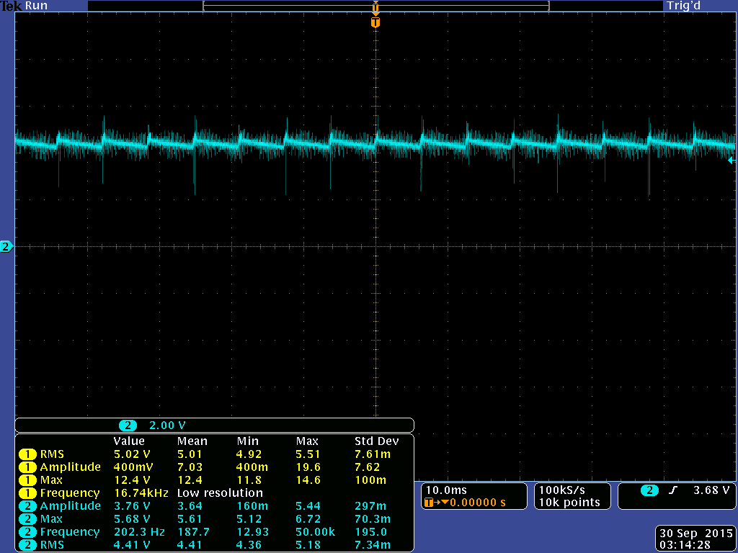
Initial Testing of MPPT
MOSFET output before filtering
12 volt input
62.75kHZ switching frequency
50% duty cycle
Yellow: Output from microcontroller
Light Blue: Output from MOSFET's
Light blue: Output after Inductor
Issue:
Having trouble getting consistent output

Slide 17
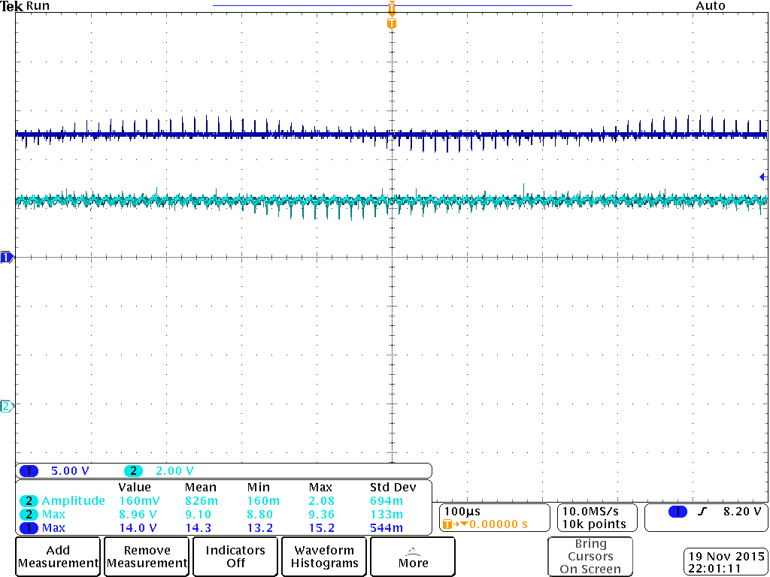
Final Testing of MPPT
Initial ripple voltage was
approximately 1.3V
Final ripple voltage is 0.694 mV
Included an RC snubber circuit
And increased the filter capacitor
From 220uF to 560uF which nearly
cut the ripple voltage in half
Dark Blue: Input voltage
Light Blue: Filtered output voltage

Slide 18
10-13 variable voltage
8.4 volt
5 volt
Power
Battery Charging
7.4 volt
3.3 volt
Control
Solar Panels
MCU
LED’s
Solar Panel Current Sensor
LED Driver
MOSFET Driver
LCD Screen
Solar Panel
Voltage Sensor
Top Motor
USB Charger
0.5 A
5 Volt Regulator
MPPT Synchronous Switching Regulator
Battery Charger IC
LI-ION
Battery
Top Motor Controller
2A
Battery Voltage Sensor
Battery charging indicator LED’s
Bottom Motor
Controller
Bottom Motor

Slide 19
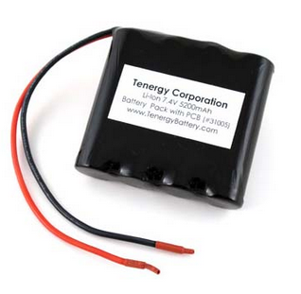
Battery
Tenergy’s 7.4V 5200mAh Li-ion battery pack
Lightweight
Small size
No battery memory effects
Low self discharge rate
Built in over charge and over
discharging IC prolongs battery
life
Courtesy of Battery Junction
Item | Value
Manufacturer | Tenergy
Weight | 0.42 lbs (6.7 oz)
Dimensions(lxwxh) | 2.83”x2.76”x0.79”
Fully charged voltage | 8.4V
Cut-off voltage | 6V
Price | $47.04

Slide 20
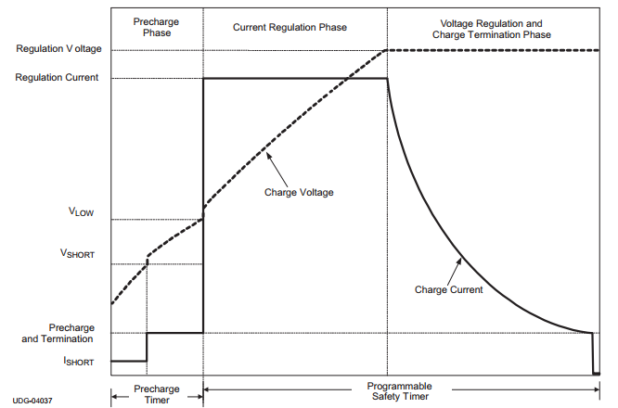
Battery Charging
BQ24123 charge management IC
Charges 2 cell Li-ion battery packs
3 stage charging: conditioning,
constant current, and constant
voltage
Added safety features include
charging timer, thermal protection
Charging indicator LED’s
Courtesy of Texas Instruments
Item | Value
Output voltage | 8.4V
Max charge rate | 2A
Price | Free

Slide 21
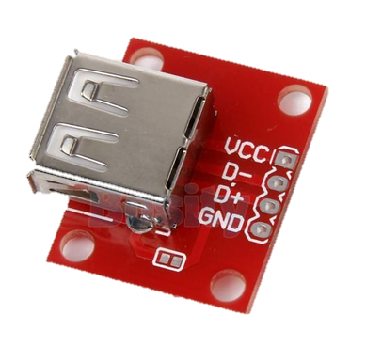
USB charger
USB 2.0 female dedicated charging port
Type A Female breakout board
for easy enclosure mounting
Restricted to a 0.5A trickle charge
Future upgrade possible:
USB charging chip to charge
Apple devices
Courtesy of ebay
Item | Value
Output voltage | 5V
Max output current | 0.5A
Price | $1.50

Slide 22
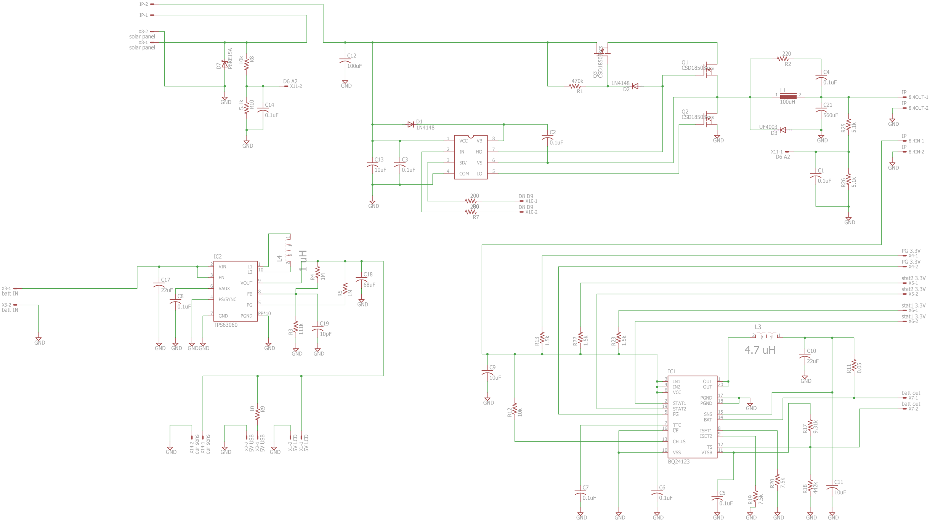
Eagle Schematic: MPPT and Charger

Slide 23

Eagle Schematic: MPPT and Charger
Battery
Voltage
Sensor
Solar panel
voltage sensor
5 volt
voltage
regulator
Battery
Charging IC

Slide 24
Eagle Schematic: MPPT and Charger
Battery feedback
MOSFET
MPPT Switching regulator

Slide 25
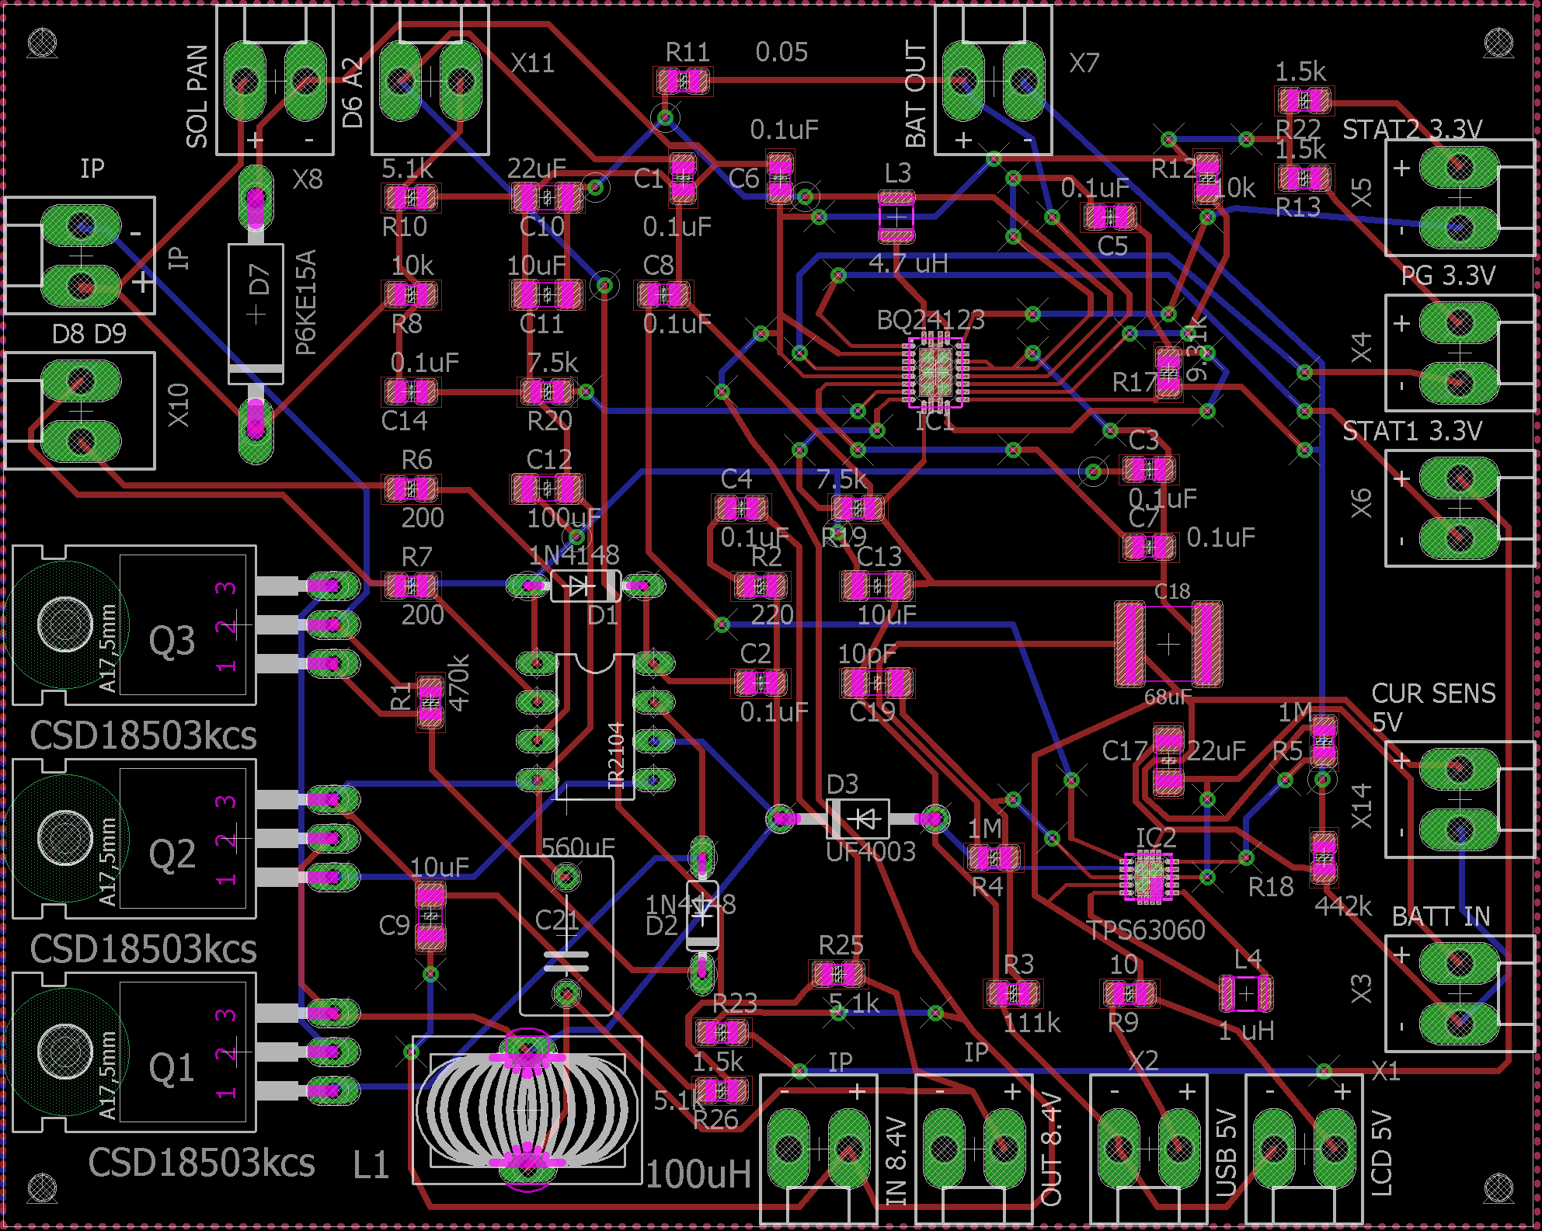
Eagle Board Layout: MPPT and Charger

Slide 26
Motors and Motor Control
10-13 variable voltage
8.4 volt
5 volt
Power
7.4 volt
3.3 volt
Control
Solar Panels
MCU
LED’s
Solar Panel Current Sensor
LED Driver
MOSFET Driver
LCD Screen
8 output pins
4 per motor driver
Solar Panel
Voltage Sensor
Top Motor
USB Charger
5 Volt Regulator
MPPT Synchronous Switching Regulator
600 mA
Battery Charger IC
LI-ION
Battery
Top Motor Controller
Battery Voltage Sensor
1200 mA
Battery charging indicator LED’s
Bottom Motor
Controller
Bottom Motor

Slide 27
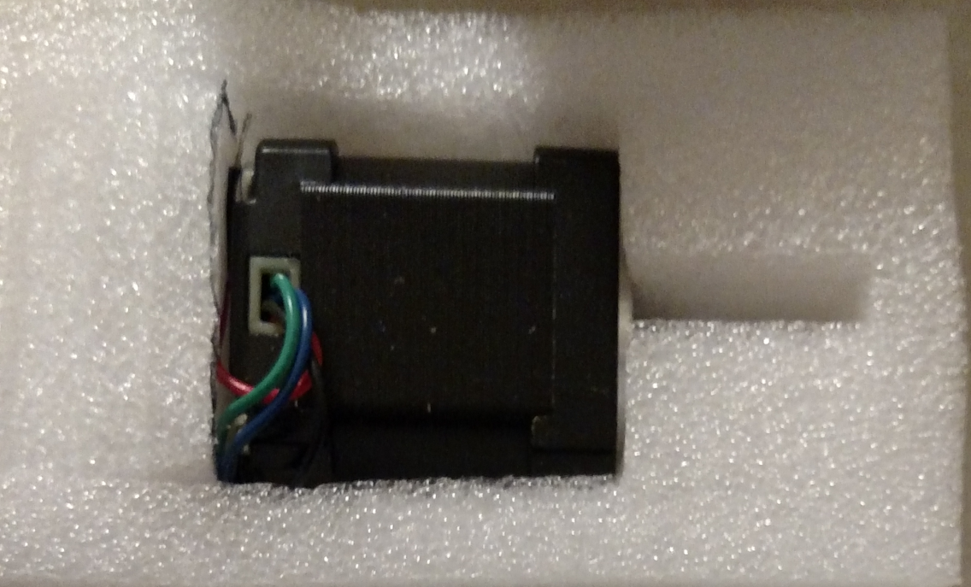
Motors
Bipolar stepper motor
Open loop feedback design with position control
2 motors control rotation and tilt of umbrella
Issues:
  Initial motors didn’t have enough torque
  Complex control scheme
Item | Value
Manufacturer | OSM
Model Number | 14HS17-0504S
Current | 500 mA/phase
Voltage | 12 V
Torque | 23 Ncm
Price | $13.00

Slide 28
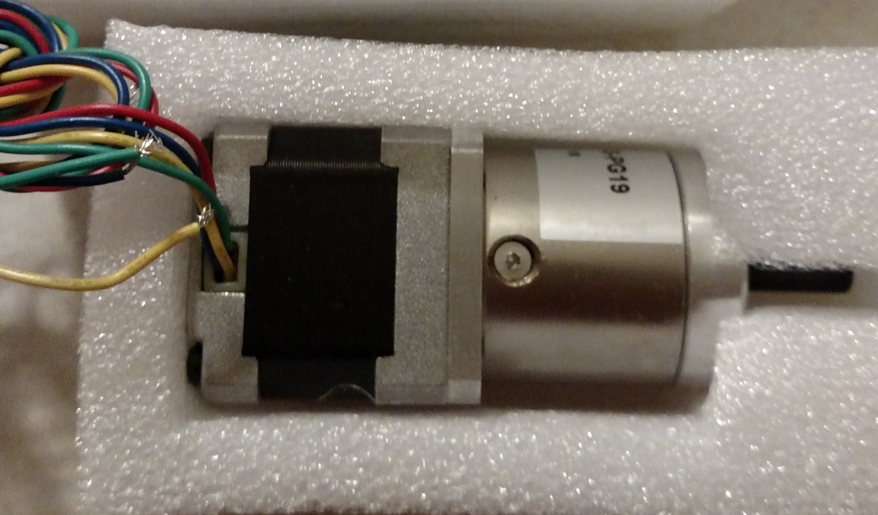
Motors
Lower motor needed more torque
Planetary gear motor design, 19:1 ratio
Because of gears, project has slower rotational speed
Issues:
  Much stronger, but required pole modification to existing design
  Complex control scheme
Item | Value
Manufacturer | OSM
Model Number | 14HS13-0804S-PG19
Current | 800 mA/phase
Voltage | 12 V
Torque | 280 Ncm
Price | $38.00

Slide 29
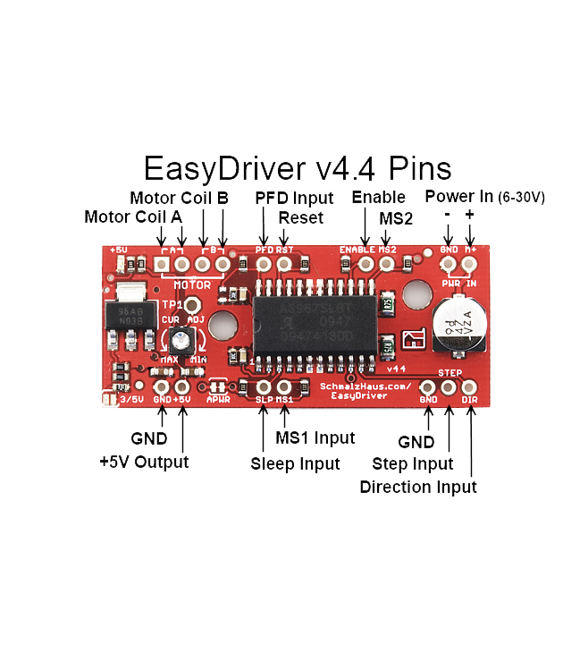
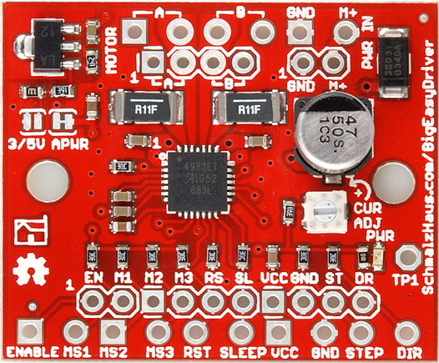
Motor Control
Simplify motor control
Step on rising edge of signal
Adjustable current output range
Sleep mode
Courtesy of Brian Schmalz
Item | Easy Driver | Big Easy Driver
Manufacturer | SparkFun | SparkFun
Model Number | ROB-12779 | ROB-12859
Current Output | 150-750 mA | 1400-1700 mA
Motor Voltage | 6-30 V | 6-30 V
Price | $8.00 | $15.00

Slide 30
10-13 variable voltage
8.4 volt
5 volt
Power
Peripherals
7.4 volt
3.3 volt
Control
17mA per LED
Solar Panels
MCU
3 output pins
LED’s
Solar Panel Current Sensor
2 output pins
LED Driver
MOSFET Driver
LCD Screen
Solar Panel
Voltage Sensor
Top Motor
USB Charger
5 Volt Regulator
MPPT Synchronous Switching Regulator
Battery Charger IC
LI-ION
Battery
Top Motor Controller
Battery Voltage Sensor
Battery charging indicator LED’s
Bottom Motor
Controller
Bottom Motor

Slide 31
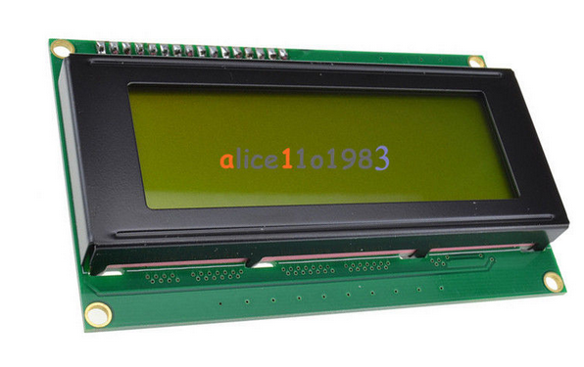
LCD and Charging LED Indicators
LCD screen:
Simple 20 x 4 char LCD display
Backlit lighting will be on push button
to increase efficiency
Displays:
Solar panel voltage, current, power
Battery voltage
MPPT PWM
Charging Status LED’s:
3 LED’s show battery charging status
Courtesy of ebay
Battery Battery Battery
present Full charging

Slide 32
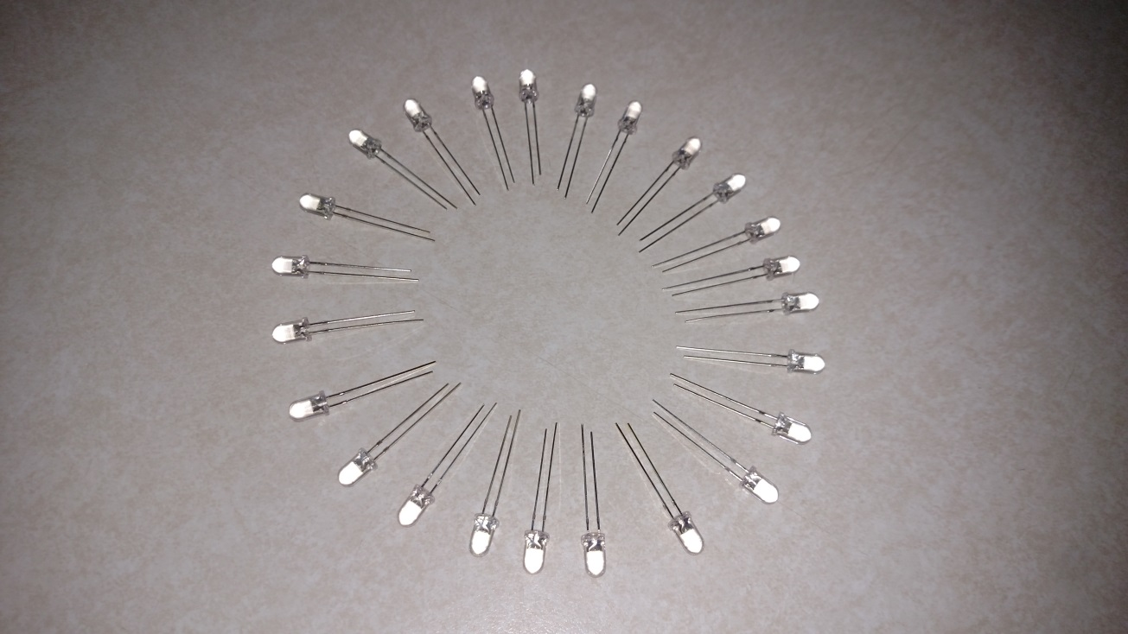
Lighting System
Light weight with high efficiency
24 individual LED’s connected 4 per umbrella spline
Display different blinking patterns for entertainment mode
Issues:
  Initial design used 12 IO pins from MCU
Item | Value
Manufacturer | China Young Sun LED Technology Co.
Model Number | YSL-R547W2C-A13
Max Current | 20 mA
Luminous intensity | 8000-10,000 mcd
Price | $0.95/LED

Slide 33
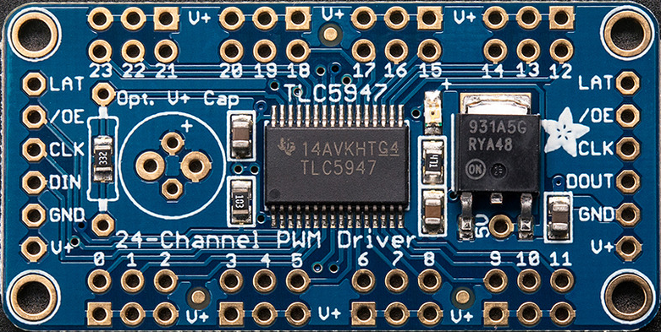
Lighting Control
Control up to 24 LEDs
Only uses 3 digital pins
Communication with microcontroller is done via SPI
Has a Arduino library to help make coding less changeling
Enable pin to put driver to sleep mode.
Future upgrades
  Chainable design
Item | Value
Manufacturer | Adafruit
Model Number | 1429
Control | 24 LEDs
Current output | 20 mA
Price | $14.95

Slide 34
10-13 variable voltage
8.4 volt
5 volt
Power
Control Block Diagram
7.4 volt
3.3 volt
Control
Solar Panels
MCU
LED’s
Solar Panel Current Sensor
LED Driver
MOSFET Driver
LCD Screen
Solar Panel
Voltage Sensor
Top Motor
USB Charger
5 Volt Regulator
MPPT Synchronous Switching Regulator
Battery Charger IC
LI-ION
Battery
Top Motor Controller
Battery Voltage Sensor
Battery charging indicator LED’s
Bottom Motor
Controller
Bottom Motor

Slide 35
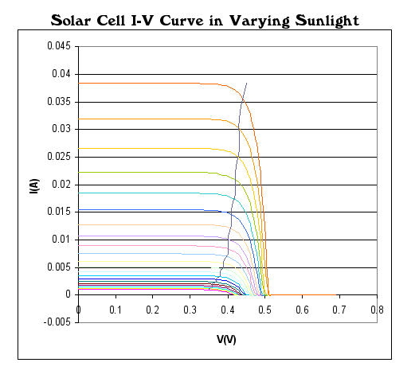
MPPT Algorithms
Two types of algorithms under consideration
Perturb and Observe
Incremental Conductance

Slide 36
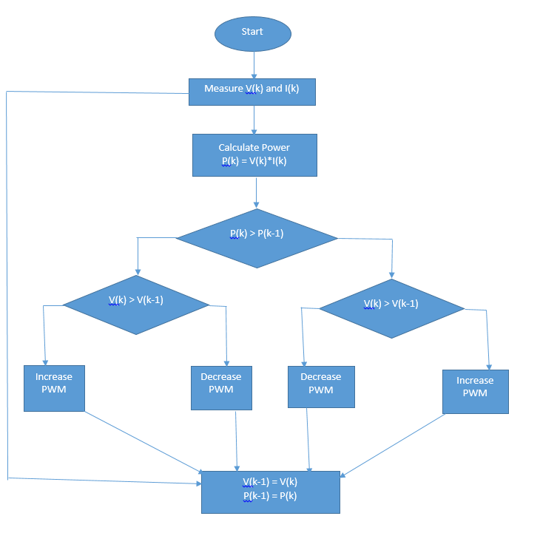
Perturb and Observe
Most common
Adjusts PWM
Less computations
Computes power, compares power to previous, compares voltage
Oscillates around Maximum Power Point

Slide 37

Solar Tracking Sensor Design
After doing much research on sensors that track the sun, I noticed that there wasn't a quick solution. To be able to maximize the power the solar cells can output, all 28 cells will have to have maximum exposure. To be able to accomplish this, the controller will have to take readings from a solar tracking sensor, to be able to adjust the motors so the top of the umbrella can be pointed at the sun. There are two sensors I tested for this design.

Slide 38
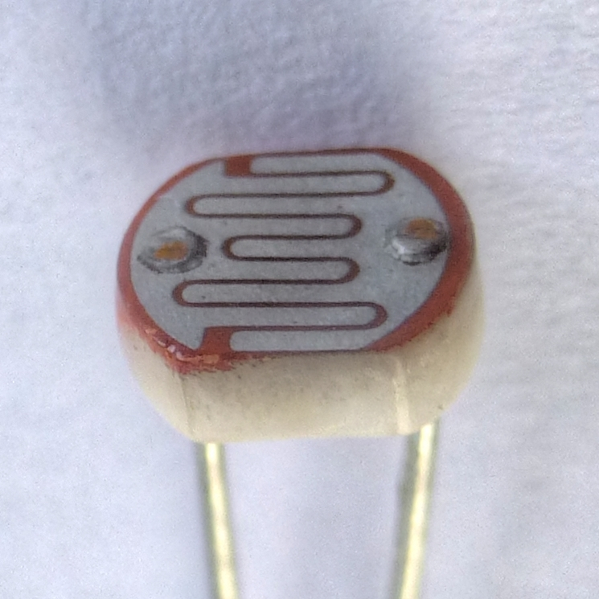
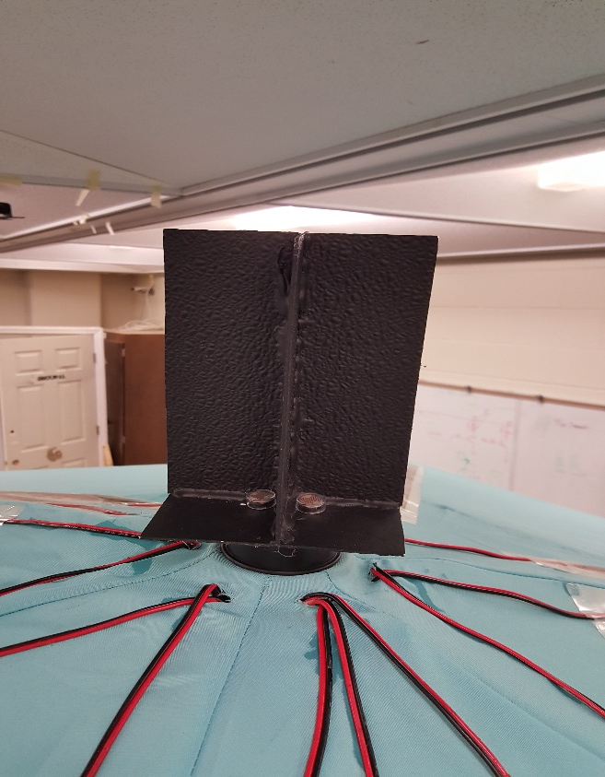
Sensor Using LDRs
4 Light Dependent Resistors
Measure voltage across 220 ohm resistor
Controller pins A4-A7 can measure voltage
analogRead();
Light Shading mechanism to receive better readings
Photoresistor or Light Dependent Resistor

Slide 39
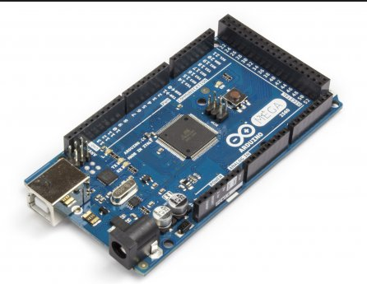
Prototyping with ATmega 2560
Item | Value
Operating Voltage | 5V
Input Voltage | 6-20V
Digital I/O Pins | 54 (15 provide PWM output)
Analog Input Pins | 16
DC Current per I/O Pin | 20 mA
DC Current for 3.3V Pin | 50 mA
Flash Memory | 256 KB
Clock Speed | 16 MHz
Price | $14.00

Slide 40
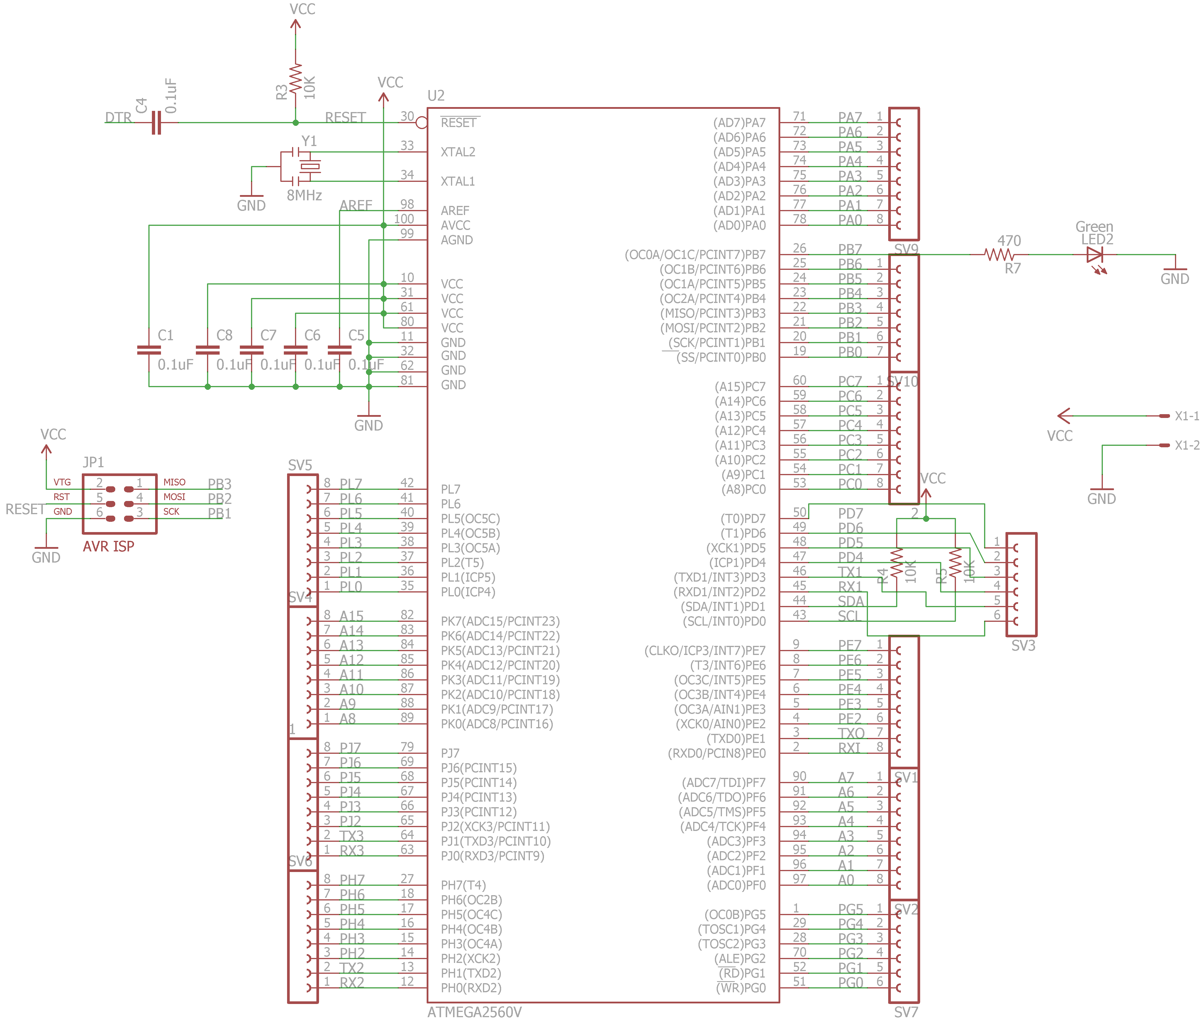
Eagle Schematic: Microcontroller

Slide 41
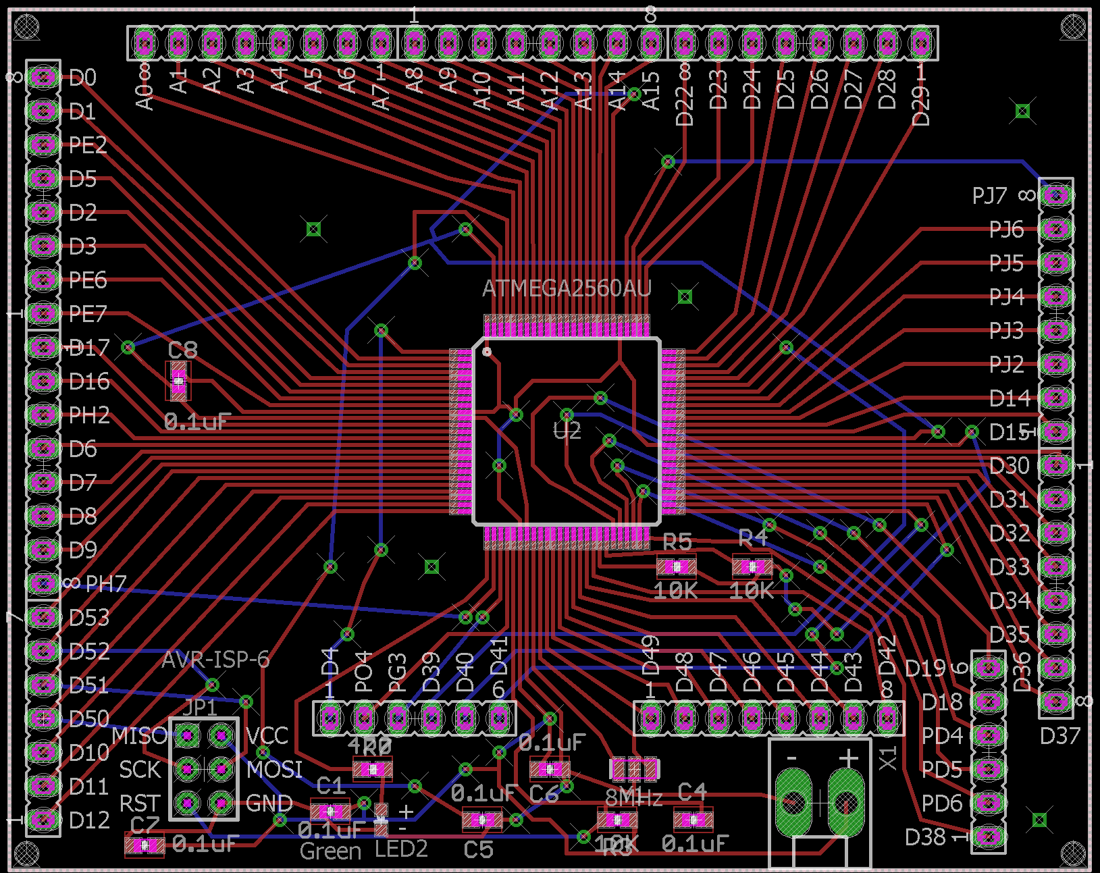
Eagle Board layout: Microcontroller

Slide 42
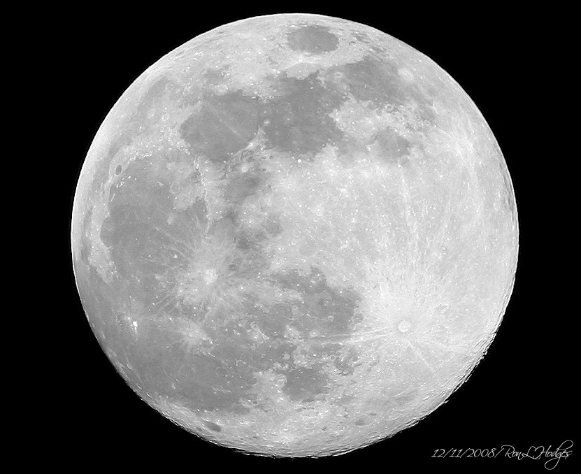

Entertainment Mode
Night Time Use
Rotate umbrella 360 degrees
Constant Lighting Mode
5 Lighting Modes

Slide 43
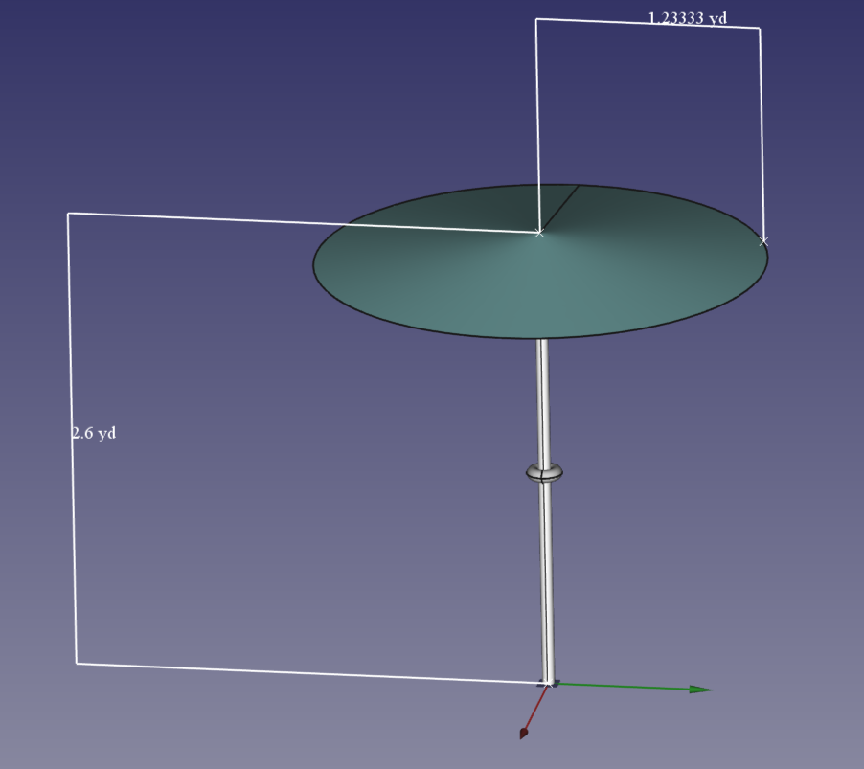
Pole Design
JB welding and bolts to reduce weight
Mounting bracket for top motor
Mounting bracket for bottom motor
Mounting bracket for enclosure

Slide 44
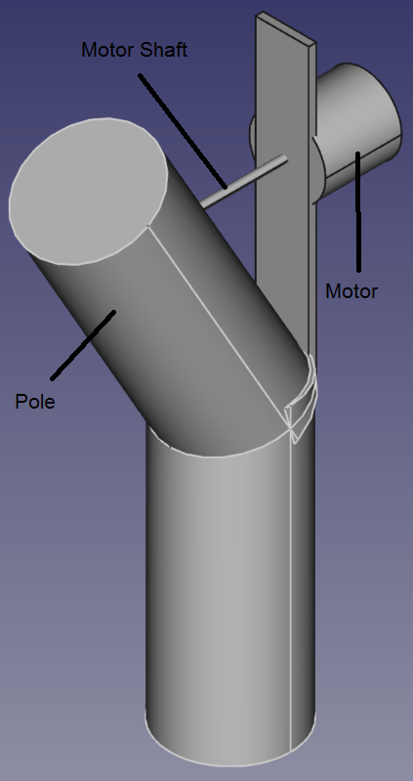
Top Motor Mounting
Motor placement 36 inches from top of umbrella to allow folding for storage or transporting
JB welded hinge to decrease pole displacement
Stepper motor will be used as an actuator to control tilt of umbrella
- increases motor torque capabilities
- allows for sleep mode increasing system efficiency
5mm diameter motor shaft extended with 10-24 all thread rod
Rotatable smooth pin and all thread connector inside pole allows motor shaft to remain straight
30 degrees tilt

Slide 45
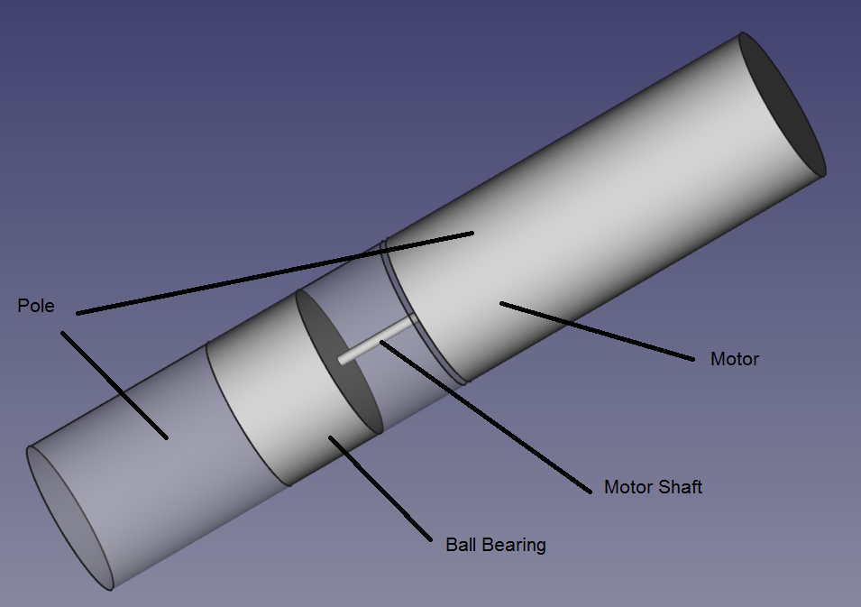
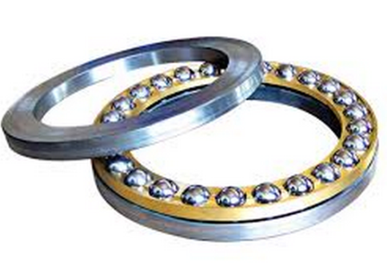
Bottom Motor Mounting
Bottom motor mounted inside pole at 51 inches from top of pole
Top part of pole sleeves into bottom part of pole
Pole will rest on ball thrust bearing to take weight off motor shaft
Shaft extended to be able to pin to bottom part of pole with removable pin allowing pole separation for storing and transporting
Allows 360 degree rotation

Slide 46
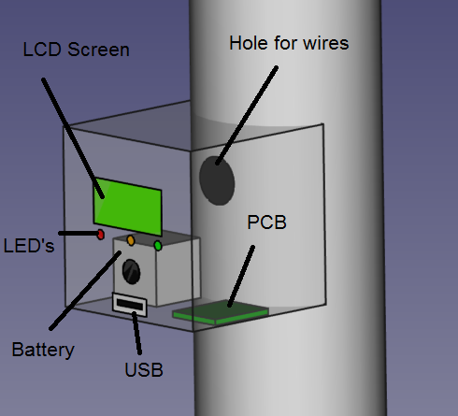
Enclosure
Houses:
Battery
MPPT
Microcontroller
LCD screen
Battery status lights
USB charging port
Motor drivers

Slide 47
Work Distribution
 | Derek | Eugene | Nicholas
Lighting System | Primary
MPPT design |  | Primary
Pole design | Primary | Primary | Primary
Coding |  |  | Primary
Motor system | Primary
USB Charger |  | Primary
Solar Panels |  | Primary
Solar tracking |  |  | Primary
MCU design |  |  | Primary
Battery |  | Primary

Slide 48
Budget
item | supplier | number | Total cost | item | supplier | number | Total cost
7’6” patio umbrella | Target | 2 | $52.00 | EEU-FC1A561 560uF capacitor | Mouser | 2 | $1.08
Solopower solar cells | Solopower | 30 | $81.00 | LCD screen | ebay | 1 | $7.24
Battery pack | Battery Junction | 1 | $47.04 | Push button switches | ebay | 10 | $1.60
Stepper Motor | eBay | 2 | $51.00 | USB type A | ebay | 2 | $3.18
Motor controller | Amazon | 2 | $24.00 | Weatherproof on/off switch | ebay | 1 | $4.99
LED’s | SparkFun | 24 | $21.60 | Gorilla Packaging tape | Lowe’s | 1 | $10.00
LED driver | Mouser | 1 | $14.95 | Copper tabbing tape | amazon | 1 | $22.95
microcontroller | Amazon | 1 | $14.00 | wire | ebay | 200ft | $30.00
BQ24123RHLT charging IC | Texas Instrument | 5 | Free | Thrust bearing | Grainger | 1 | $8.84
PCB boards | PCB’s4u | 2 | $135.00 | Various resistors and capacitors | Mouser | N/A | $50.00
CDS18503KCS MOSFET | Texas Instrument | 5 | Free | Metal for mounting | Lowe’s | N/A | $30.00
IR2104 MOSFET driver | Mouser | 2 | $3.50 | enclosure | Lowe’s | 1 | $10.00
TPS63060DSCR 5 volt regulator | Texas Instrument | 5 | Free | connectors | N/A | N/A | $20.00
ACS712 current sensor | ebay | 5 | $8.50 | miscellaneous | N/A | N/A | $20.00
Light dependent resistors | ebqy | 6 | $19.50 | Shipping and Handling | N/A | N/A | $75.00
UF4003 fast switching diode | Mouser | 2 | $1.72
IN4148 diode | Lab | 2 | Free | TOTAL |  |  | $752.03
P6KE10A TVS diode | Mouser | 2 | $0.88
P6KE15A TVS diode | Mouser | 2 | $1.12
5505-RC 100uH inductor | Mouser | 2 | $2.85

Slide 49
Project Schedule
Projected
Actual
milestone | Oct 2 – Oct 9 | Oct 10 – Oct 16 | Oct 17 – Oct 23 | Oct 24 – Oct 30 | Oct 31 – Nov 6 | Nov 7 – Nov 13 | Nov 14 – Nov 20 | Nov 21 – Nov 27 | Nov 28 – Dec 1
Prototyping
PCB ordering
Pole build
Solar panel mounting
Motor mounting and testing
LED mounting and testing
PCB build and testing
Enclosure build
Sun tracking sensor build and testing
Final testing

Slide 50
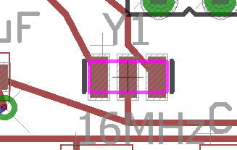
Issues/Problems
Had an issue with programming to MCU chip through SPI communication
Issue: Input of Resonator was grounded because the trace clipped the corner of the grounding pad
Solution: Cut grounding pad in half, separating resonator trace from grounding pad

Slide 51
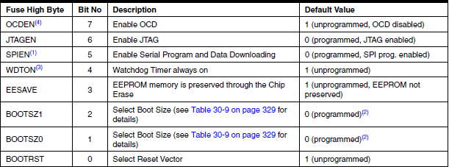
Issues/Problems
Had an issue programming ATMega 2560 using another Arduino as ISP because sketches being uploaded were overwriting bootloader
Solution: Changing the High Fuse Byte in EEPROM/ROM so the BOOTRST bit was set to 1 (unprogrammed) as oppose to 0 (programmed)
BOOTRST – Sets memory address to beginning of bootloader

Slide 52
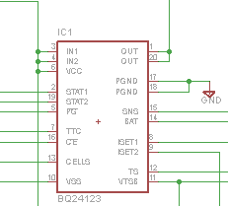
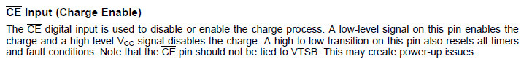
Issues/Problems
Problem: Battery Charging Chip BQ24123 on 2 separate PCBs not working properly. Initially thought 20 pin QFN packaging chip was not properly mounted
Solution: Bottom of page 17 of the BQ24123 datasheet, explained how to reset all timers and fault conditions. Toggled pin 13 (CE) with 5 volts

Slide 53
Questions?
“The important thing is to not stop questioning. Curiosity has its own reason for existing.”
- Albert Einstein – Life Magazine, May 2, 1955

