Slide 1

Smart Umbrella
Group 9
Derek Workman EE
Eugene Mcdonald EE
Nicholas Van Nice CpE

Slide 2
Motivation
Work with photovoltaics
Design a unique solar panel tracking application
Implementation of multiple controlled systems into a single design
- Lighting control
- Motor control
- Sensor control

Slide 3
Goals and Objectives
Light weight means of collecting solar energy using solar panels.
Maximize efficiency from the solar panels by designing, building, and coding a Maximum Power Point Tracking synchronous switching regulator with a greater than 90% efficiency.
Design a solar panel tracking system
Learn how to design and create a PCB

Slide 4
Project Specifications
Specification | Explanation
Lightweight Design | Less than 12 pounds total weight
Increased Shading | Motorized sun tracking umbrella top provides no user interaction to maintain shading
Self Sustained Power Supply | Solar panel battery charging
Long Battery Life | 4 hours of battery life in low sunlight under normal operating conditions
Transportable | Needs to be easily foldable for transporting or storing
Weather Resistant | Able to withstand high heat and high humidity conditions
3 Mode Lighting System | Constant lighting, lighting pattern, and entertainment modes
USB Phone Charger | 2.0 USB phone charging port able to maintain trickle charge of 0.5 amps.
Solar Panel Status Screen | Back lit LCD screen shows Solar Panel status
Battery Charging Status Indicators | Shows status of battery including battery present, charging and fully charged.

Slide 5
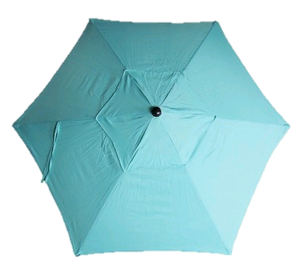

Umbrella
Height: 7.0’
Width: 7’ 6”
Reason:
1 ¼” hollow steel pole Price: $26.00
6 steel straight splines wind flap decreases affects of added torque
7 lbs. total weight easy setup

Slide 6
Project Block Diagram
10-13 variable voltage
8.4 volt
5 volt
Power
7.4 volt
3.3 volt
Control
Solar Panel
MCU
LED’s
Solar Panel Current Sensor
Motor
Control Sensors
MOSFET Driver
LCD Screen
Solar Panel
Voltage Sensor
Top Motor
USB Charger
5 Volt Regulator
MPPT Synchronous Switching Regulator
Battery Charger IC
LI-ION
Battery
Top Motor Controller
Battery Voltage Sensor
Battery charging indicator LED’s
Bottom Motor
Controller
Bottom Motor

Slide 7
10-13 variable voltage
8.4 volt
5 volt
Power Generation
10-13 variable voltage
8.4 volt
5 volt
Power
Power
7.4 volt
3.3 volt
7.4 volt
3.3 volt
Control
Control
MCU
LED’s
Solar Panels
MCU
LED’s
Solar Panel
Motor
Control Sensors
Solar Panel Current Sensor
Motor
Control Sensors
Solar Panel Current Sensor
LCD Screen
MOSFET Driver
LCD Screen
MOSFET Driver
Solar Panel
Voltage Sensor
Solar Panel
Voltage Sensor
Top Motor
Top Motor
USB Charger
5 Volt Regulator
USB Charger
5 Volt Regulator
MPPT Synchronous Switching Regulator
MPPT Synchronous Switching Regulator
Top Motor Controller
LI-ION
Battery
Top Motor Controller
Battery Charger IC
LI-ION
Battery
Battery Charger IC
Battery Voltage Sensor
Battery Voltage Sensor
Bottom Motor
Bottom Motor
Controller
Bottom Motor
Battery charging indicator LED’s
Bottom Motor
Controller
Battery charging indicator LED’s

Slide 8
Solar Panel
Issues:
Finding a lightweight solar panel
Size of solar panel
Mounting that required no heavy bracket
Durability of solar panel
Cost of solar panels
Solution?
Build our own panel using individual solar cells

Slide 9
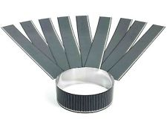
Solar Panel
Solopower’s CIGS thin film technology
Highest efficiency in thin film technology
28 individual 1.25 watt solar cells connected in series
Produces 35 watts
14 volts at 2.5 amps
Lightweight and flexible
Raw solar cell needs weatherproof encapsulation
Courtesy of Solopower
item | value
Manufacturer | Solopower
Total weight | 1lb
Price | $130.60

Slide 10
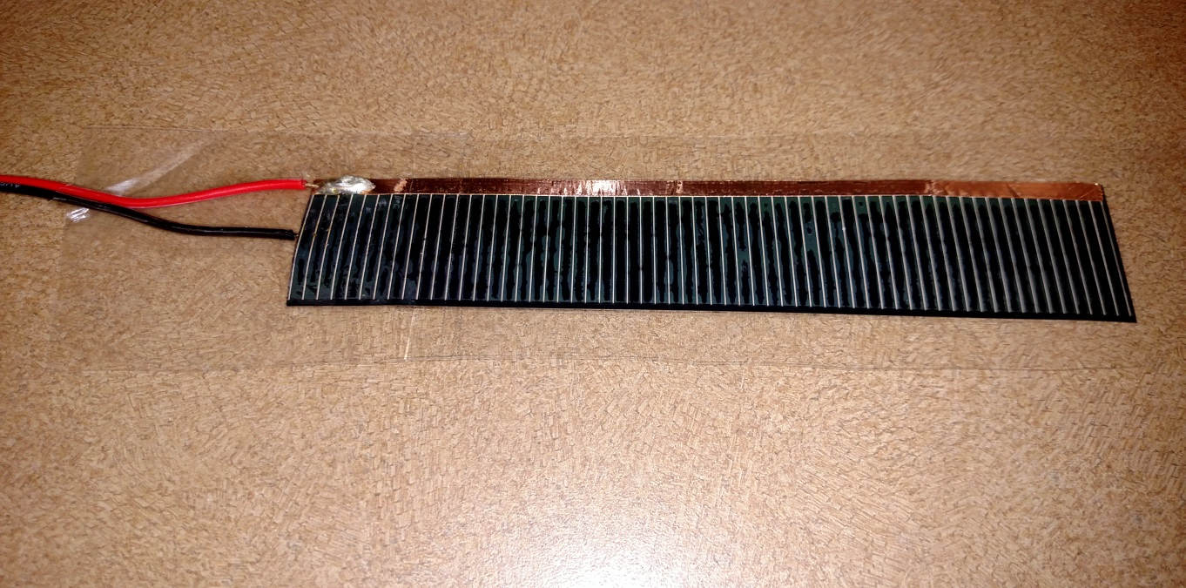
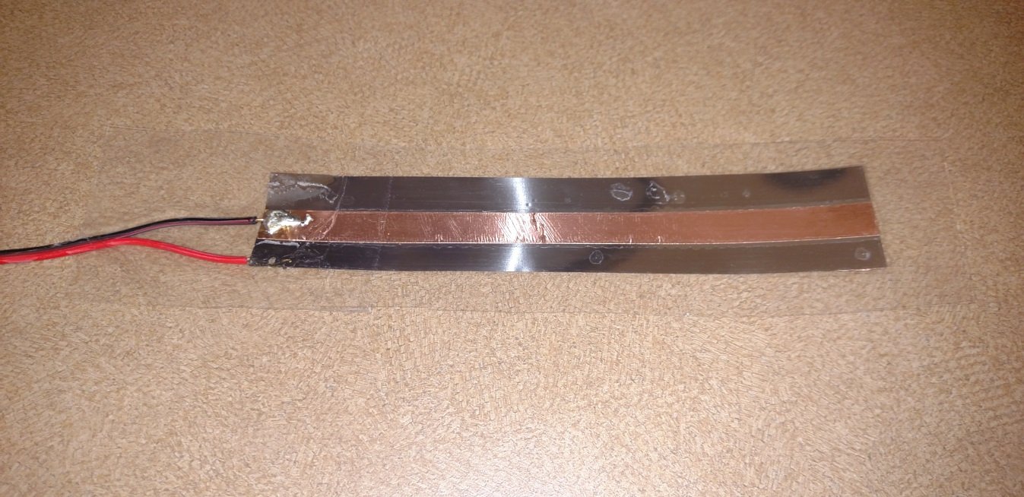
Solar Panel Build
Copper tape tabbing
Benefits:
Electrically conductive glue
Low resistivity
Solderable
positive
Gorilla shipping tape encapsulation
Benefits:
Durable non stretching
Non yellowing
High heat rating
negative
1.75
inch
14 inch

Slide 11
Maximum Power Point Tracking (MPPT)
10-13 variable voltage
8.4 volt
5 volt
Power
7.4 volt
3.3 volt
Control
Solar Panels
MCU
LED’s
3 analog inputs
to MCU
Solar Panel Current Sensor
Motor
Control Sensors
2 outputs from MCU
10mA
MOSFET Driver
LCD Screen
Solar Panel
Voltage Sensor
130mA
Top Motor
USB Charger
5 Volt Regulator
MPPT Synchronous Switching Regulator
PWM control
Battery Charger IC
LI-ION
Battery
Top Motor Controller
Battery Voltage Sensor
Battery charging indicator LED’s
Bottom Motor
Controller
Bottom Motor

Slide 12

Current and Voltage Sensors
Solar panel and battery voltage sensors are simple voltage divider circuits
Allegro’s hall effect-based ACS712 linear current sensor IC
Allows MCU to calculate maximum power from solar panel and regulate output voltage to battery
Courtesy of Allegro
Item | Value
Manufacturer | Allegro
Model Number | ACS712ELCTR-05B-T
Packaging | SOIC 8
Price | $1.58

Slide 13
Power MOSFETS
Testing 2 different power MOSFETS in Prototype board
Texas Instruments CDS18503KCS Power MOSFET much more efficient
 | CDS18503KCS | IRFZ44N
Manufacturer | Texas Instruments | International Rectifier
Max voltage | 40V | 55V
Max current | 100A | 49A
Threshold voltage | 1.9V | 2-4V
Drain-to-Source On-Resistance | 3.6mohm | 17.5mohm

Slide 14
MOSFET Driver
 | LM27222 | IR2104
Manufacturer | Texas Instrument | International Rectifier
Input voltage | 4V to 6.85V | 10 V– 20V
Operating current | 0.65mA | 130mA
Packaging | SOIC 8 | DIP 8
Chose the LM27222 to begin testing mainly because of input voltage and lower operating current
Had issues with LM27222 not switching MOSFETS
Decided to switch to IR2104 with great success

Slide 15
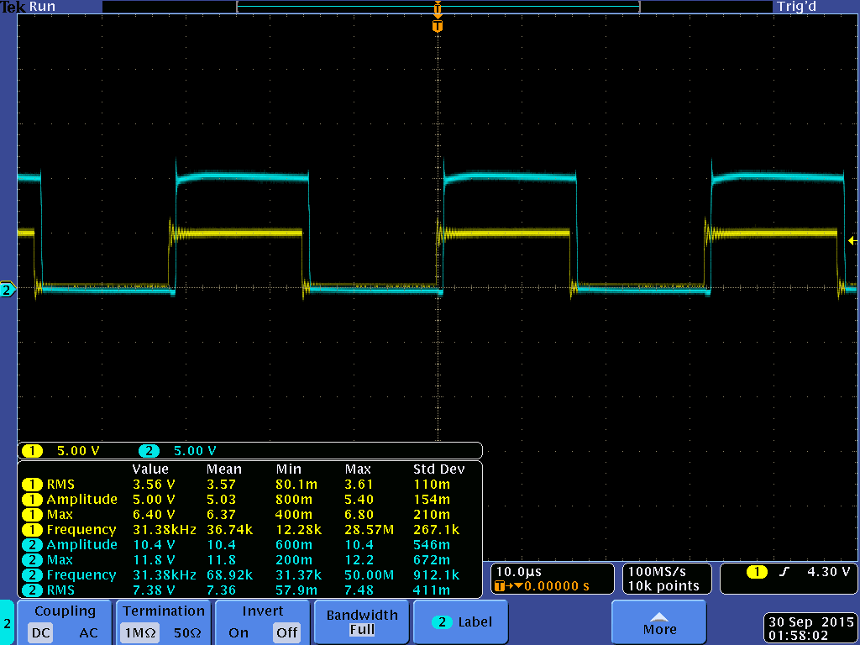
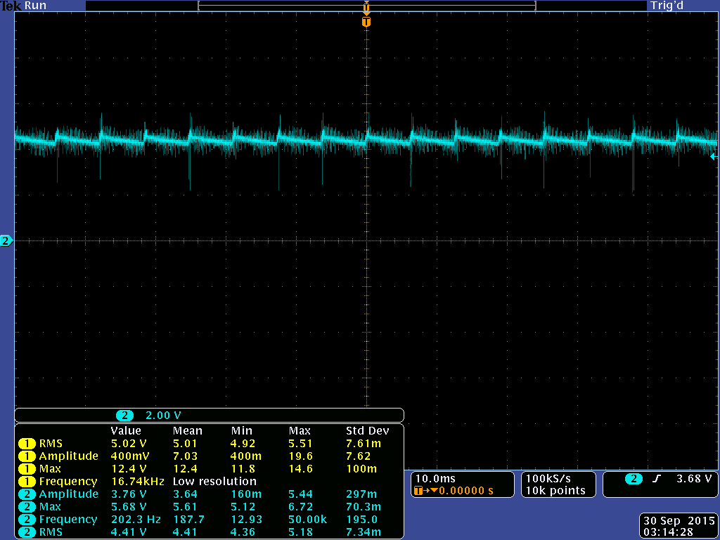
Initial Testing of Switching Regulator
MOSFET output before filtering
12 volt input
62.75kHZ switching frequency
50% duty cycle
Yellow: Output from microcontroller
Light Blue: Output from MOSFET's
Light blue: Output after Inductor
Issue:
Having trouble getting consistent output

Slide 16
10-13 variable voltage
8.4 volt
5 volt
Power
Battery Charging
7.4 volt
3.3 volt
Control
Solar Panels
MCU
LED’s
Solar Panel Current Sensor
Motor
Control Sensors
MOSFET Driver
LCD Screen
Solar Panel
Voltage Sensor
Top Motor
USB Charger
0.5 A
5 Volt Regulator
MPPT Synchronous Switching Regulator
Battery Charger IC
LI-ION
Battery
Top Motor Controller
2A
Battery Voltage Sensor
Battery charging indicator LED’s
Bottom Motor
Controller
Bottom Motor

Slide 17
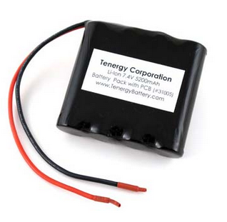
Battery
Tenergy’s 7.4V 5200mAh Li-ion battery pack
Lightweight
Small size
No battery memory effects
Low self discharge rate
Built in over charge and over
discharging IC prolongs battery
life
Courtesy of Battery Junction
item | value
Manufacturer | Tenergy
Weight | 0.42 lbs (6.7 oz)
Dimensions(lxwxh) | 2.83”x2.76”x0.79”
Fully charged voltage | 8.4V
Cut-off voltage | 6V

Slide 18
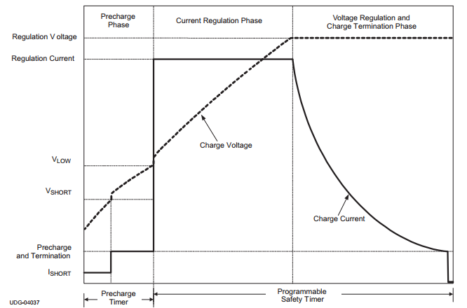
Battery Charging
BQ24123 charge management IC
Charges 2 cell Li-ion battery packs
3 stage charging: conditioning,
constant current, and constant
voltage
Added safety features include
charging timer, thermal protection
Charging indicator LED’s
Courtesy of Texas Instruments
item | value
Input voltage | 8.4V
Max charge rate | 2A
price | Free

Slide 19
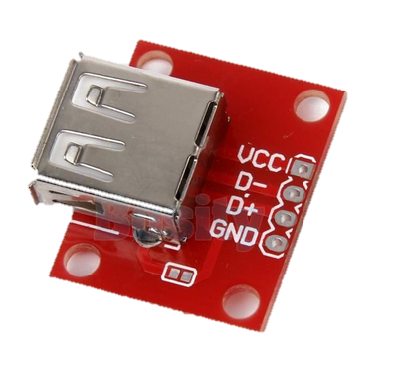
USB charger
USB 2.0 female dedicated charging port
Type A Female breakout board
for easy enclosure mounting
Restricted to a 0.5A trickle charge
Future upgrade possible:
USB charging chip to charge
Apple devices
Courtesy of ebay
item | value
Output voltage | 5V
Max output current | 0.5A
Price | $1.50

Slide 20
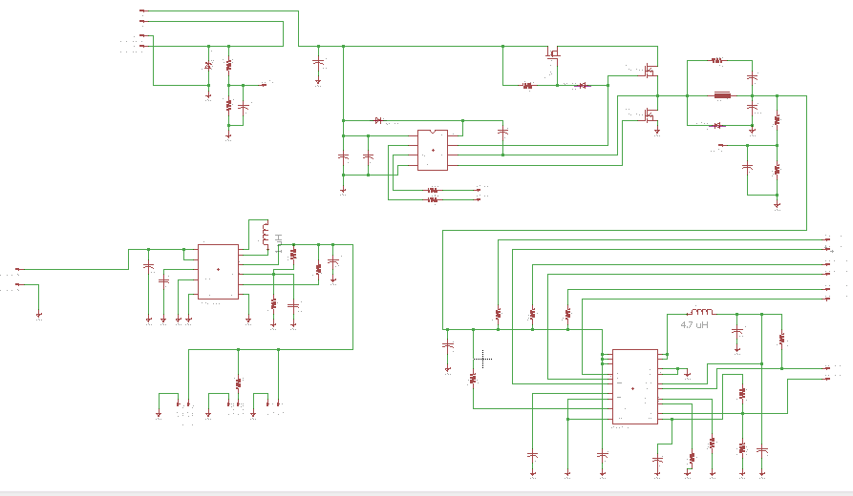
Eagle Schematic: MPPT and Charger

Slide 21
Eagle Schematic: MPPT and Charger
Battery
Voltage
Sensor
Solar panel
voltage sensor
5 volt
voltage
regulator
Battery
Charging IC

Slide 22
Eagle Schematic: MPPT and Charger
Battery feedback
MOSFET
MPPT Switching regulator

Slide 23
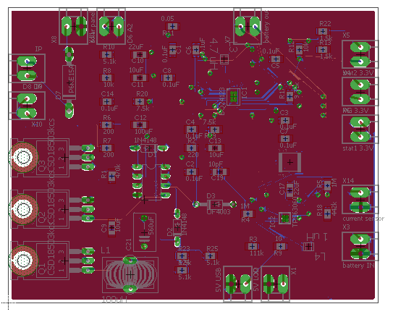
Eagle Board Layout: MPPT and Charger

Slide 24
Motors and Motor Control
10-13 variable voltage
8.4 volt
5 volt
Power
7.4 volt
3.3 volt
Control
Solar Panels
MCU
LED’s
14 output pins
7 per motor driver
Solar Panel Current Sensor
Motor
Control Sensors
MOSFET Driver
LCD Screen
Solar Panel
Voltage Sensor
Top Motor
USB Charger
5 Volt Regulator
MPPT Synchronous Switching Regulator
580 mA
Battery Charger IC
LI-ION
Battery
Top Motor Controller
Battery Voltage Sensor
580 mA
Battery charging indicator LED’s
Bottom Motor
Controller
Bottom Motor

Slide 25
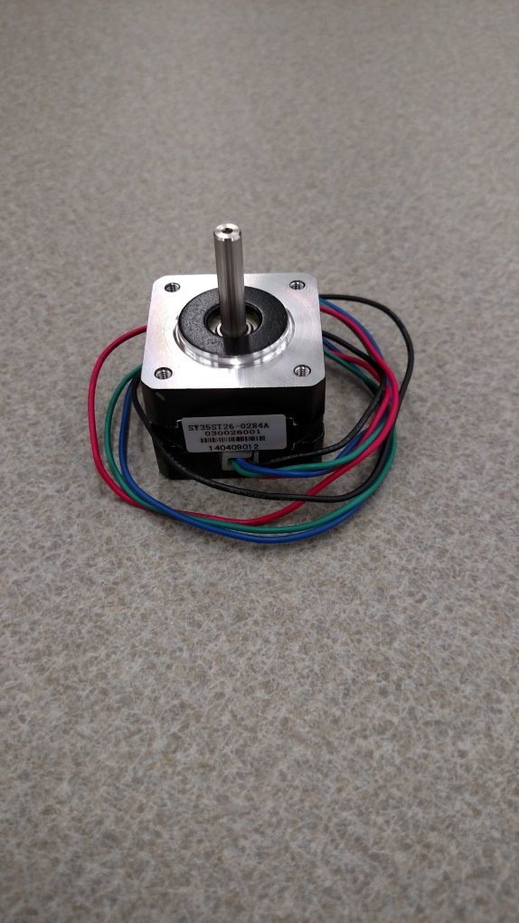
Motors
Bipolar stepper motor
Open loop feedback design with position control
2 motors control rotation and tilt of umbrella
Issues:
  Motors may not deliver enough torque for the tilt portion of umbrella
  Complex control scheme
Item | Value
Manufacturer | SOYO
Model Number | SY35ST26-0284A
Current | 280 mA/phase
Voltage | 7.4 V

Slide 26
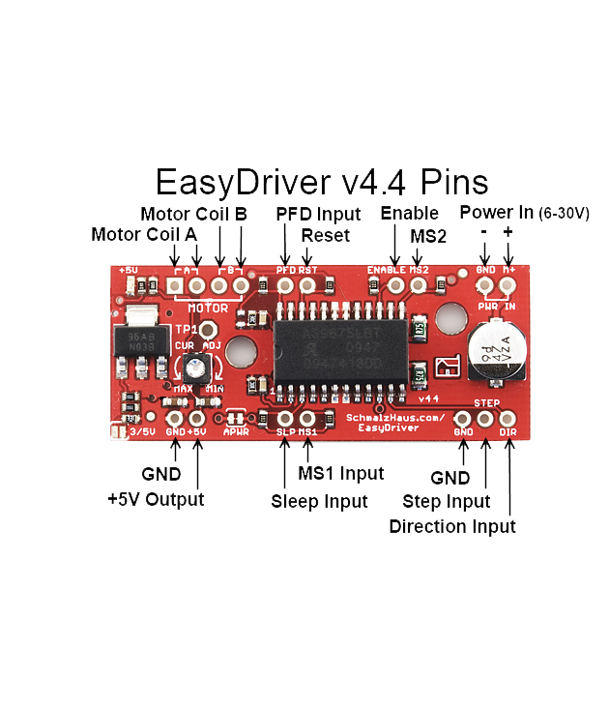
Motor Control
Simplify motor control
Step on rising edge of signal
Adjustable current output range
Sleep mode
Courtesy of Brian Schmalz
 | MS1 | MS2 | RST | ENABLE
Digital | 0 | 0 | 1 | 0
Item | Value
Manufacturer | SparkFun
Model Number | ROB-12779
Current Output | 150-750 mA
Motor Voltage | 6-30 V

Slide 27
10-13 variable voltage
8.4 volt
5 volt
Power
Peripherals
7.4 volt
3.3 volt
Control
Solar Panels
MCU
LED’s
12 output pins
20mA per LED
Solar Panel Current Sensor
Motor
Control Sensors
2 output pins
MOSFET Driver
LCD Screen
Solar Panel
Voltage Sensor
Top Motor
USB Charger
5 Volt Regulator
MPPT Synchronous Switching Regulator
Battery Charger IC
LI-ION
Battery
Top Motor Controller
Battery Voltage Sensor
Battery charging indicator LED’s
Bottom Motor
Controller
Bottom Motor

Slide 28
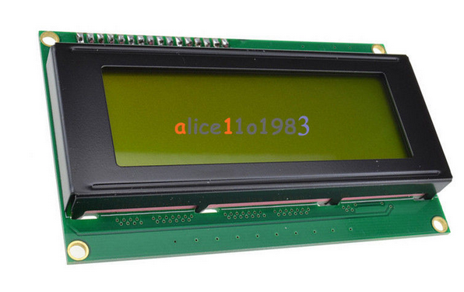
LCD and Charging LED Indicators
LCD screen:
Simple 20 x 4 char LCD display
Backlit lighting will be on push button
to increase efficiency
Displays:
Solar panel voltage, current, power
Battery voltage
Charging Status LED’s:
3 LED’s show battery charging status
Courtesy of ebay
Battery Battery Battery
present charging full

Slide 29
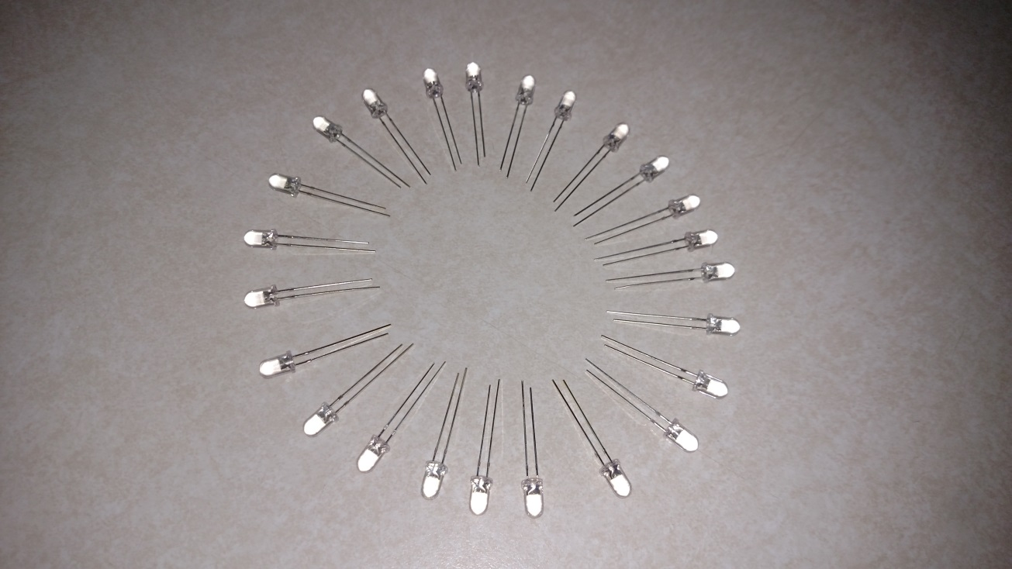
Lighting System
Light weight with high efficiency
24 individual LED’s connected in pairs (4 per umbrella spline)
Display different blinking patterns for entertainment mode
Issues:
  12 IO pins from MCU
Item | Value
Manufacturer | China Young Sun LED Technology Co.
Model Number | YSL-R547W2C-A13
Max Current | 20 mA
Forward Voltage | 3.4 V
Luminous intensity | 8000-10,000 mcd

Slide 30
10-13 variable voltage
8.4 volt
5 volt
Power
Control Block Diagram
7.4 volt
3.3 volt
Control
Solar Panels
MCU
LED’s
Solar Panel Current Sensor
Motor
Control Sensors
MOSFET Driver
LCD Screen
Solar Panel
Voltage Sensor
Top Motor
USB Charger
5 Volt Regulator
MPPT Synchronous Switching Regulator
Battery Charger IC
LI-ION
Battery
Top Motor Controller
Battery Voltage Sensor
Battery charging indicator LED’s
Bottom Motor
Controller
Bottom Motor

Slide 31
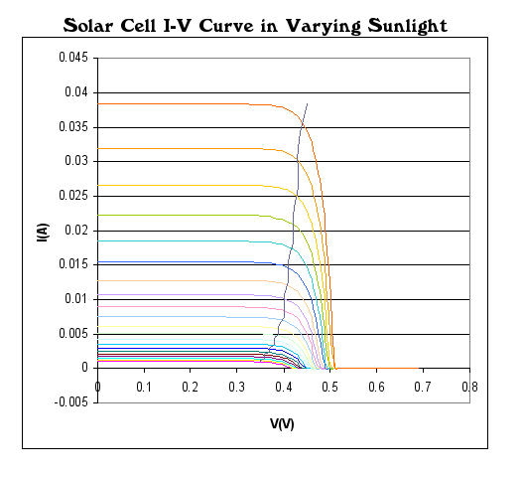
MPPT Algorithms
Two types of algorithms under consideration
Perturb and Observe
Incremental Conductance

Slide 32
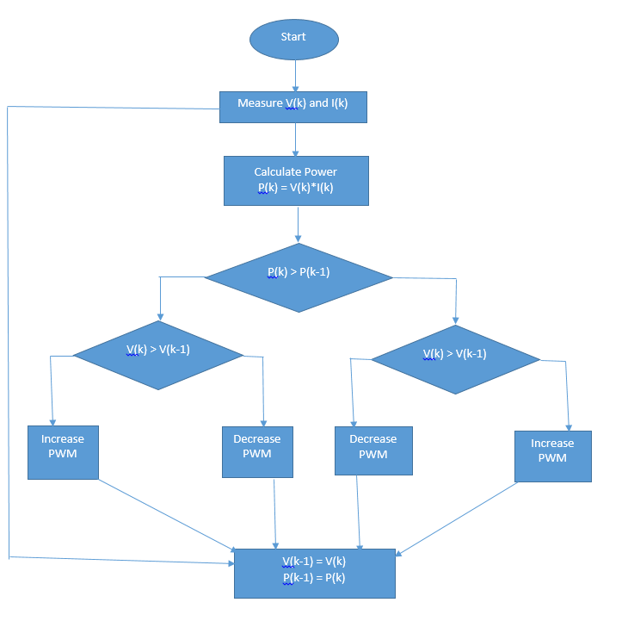
Perturb and Observe
Most common
Adjusts PWM
Less computations
Computes power, compares power to previous, compares voltage
Oscillates around Maximum Power Point

Slide 33
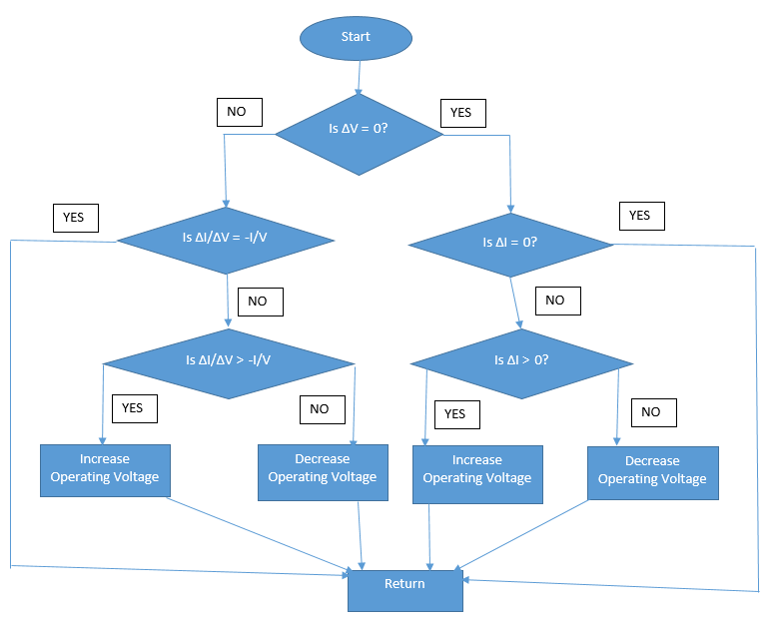
Incremental Conductance
Measures incremental Changes in current and voltage
Predicts the change in voltage change
Requires More Computations
Tracks changing conditions more rapidly
This method computes the maximum power point by comparing the incremental conductance IΔ/ VΔ to the array conductance (I/V).

Slide 34

Solar Tracking Sensor Design
Controller needs inputs from sensor to efficiently track the sun
Two prototypes under consideration
1- Sensor Using LDRs
2- Sensor using Photovoltaic Cells

Slide 35
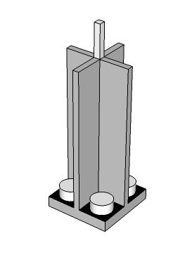
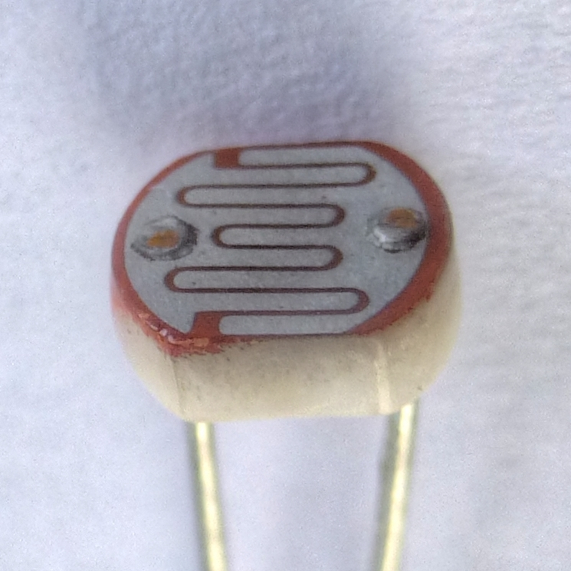
Sensor Using LDRs
3 Light Dependent Resistors
Measure voltage across 10k resistor
Controller pins A0-A5 can measure voltage
Light Shading mechanism to receive better readings
Photoresistor or Light Dependent Resistor

Slide 36
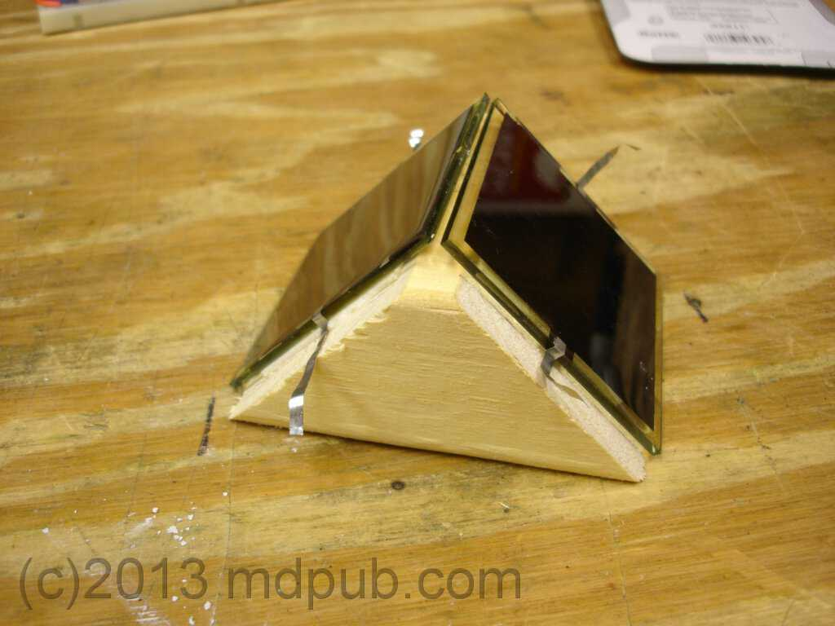
Sensor using Photovoltaic Cells
Keeping it Solar
2 Photovoltaic Cells
1 Wooden Block
2 Current Sensors

Slide 37
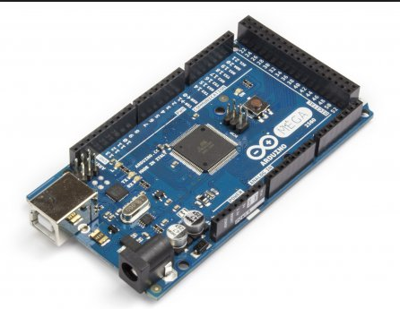
Prototyping with ATmega 2560
Item | Value
Operating Voltage | 5V
Input Voltage | 6-20V
Digital I/O Pins | 54 (15 provide PWM output)
Analog Input Pins | 16
DC Current per I/O Pin | 20 mA
DC Current for 3.3V Pin | 50 mA
Flash Memory | 256 KB
Clock Speed | 16 MHz

Slide 38
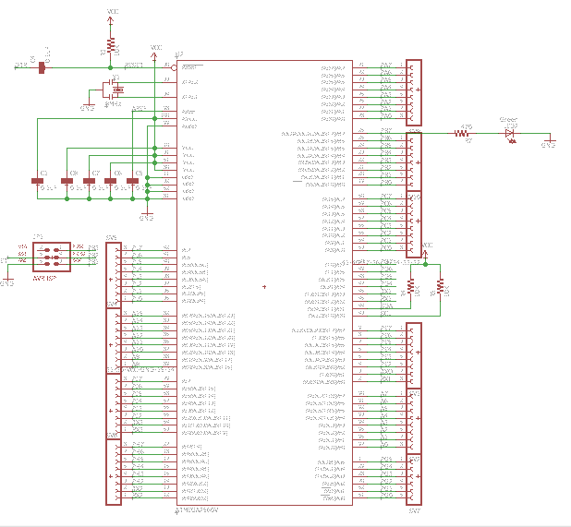
Eagle Schematic: Microcontroller

Slide 39
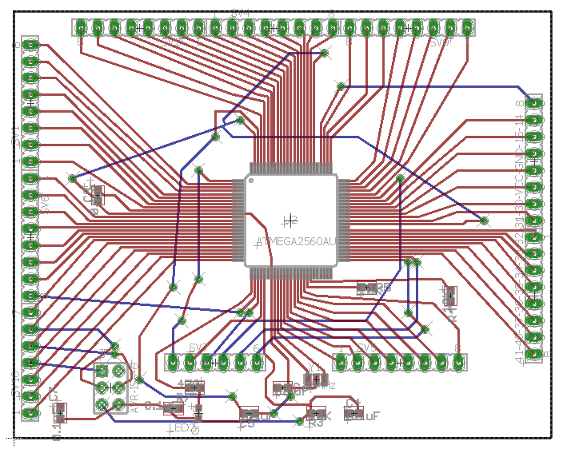
Eagle Board layout: Microcontroller

Slide 40
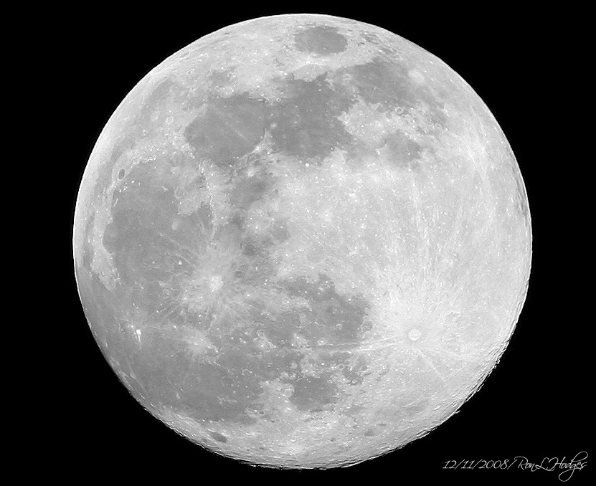

Entertainment Mode
Night Time Use
Rotate umbrella 360 degrees
4 Lighting Modes

Slide 41
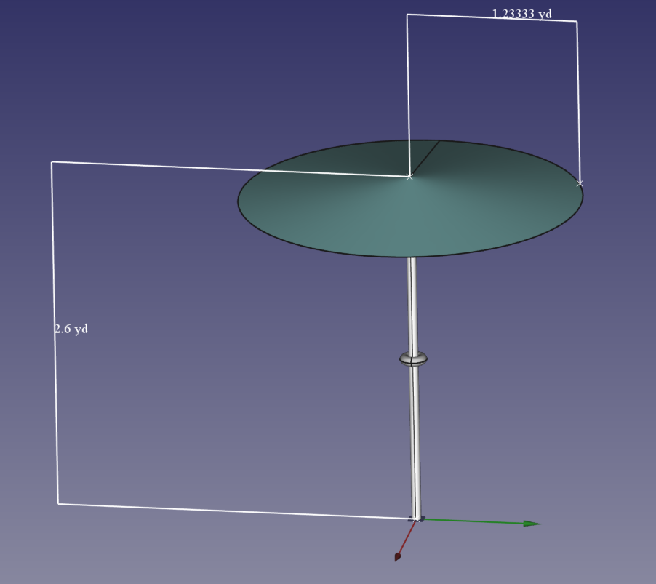
Pole Design
Wire welding instead of bolts to reduce weight
Mounting bracket for top motor
Mounting bracket for bottom motor
Mounting bracket for enclosure

Slide 42
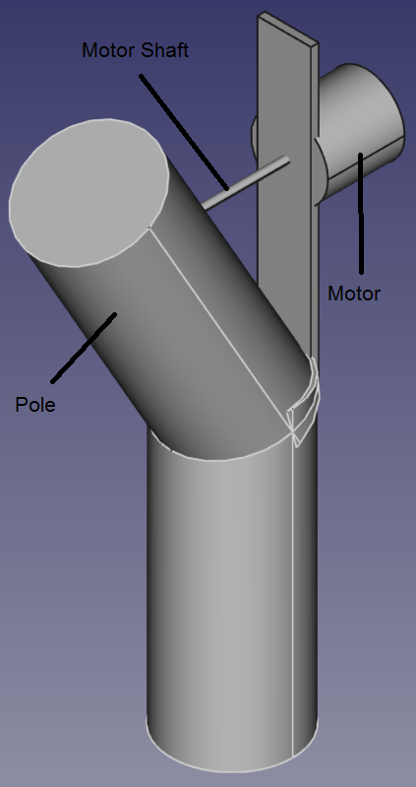
Top Motor Mounting
Motor placement 36 inches from top of umbrella to allow folding for storage or transporting
Welded hinge to decrease pole displacement
Stepper motor will be used as an actuator to control tilt of umbrella
- increases motor torque capabilities
- allows for sleep mode increasing system efficiency
5mm diameter motor shaft extended with 10-24 all thread rod
Rotatable smooth pin and all thread connector inside pole allows motor shaft to remain straight
3 stages at 10, 20, and 30 degrees tilt

Slide 43
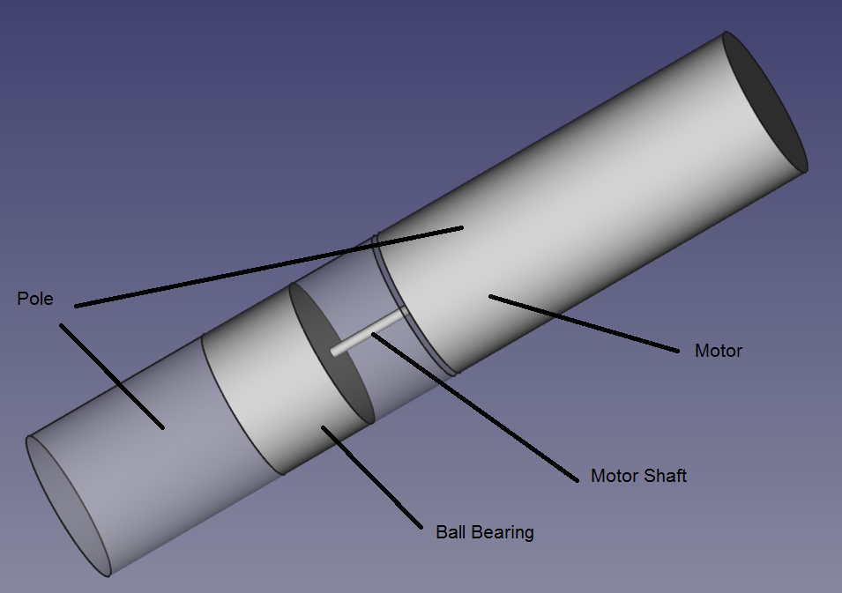
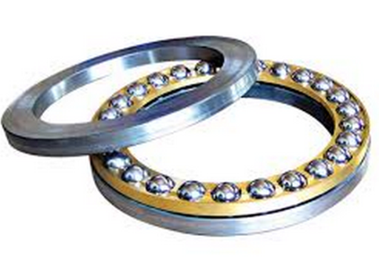
Bottom Motor Mounting
Bottom motor mounted inside pole at 51 inches from top of pole
Top part of pole sleeves into bottom part of pole
Pole will rest on ball thrust bearing to take weight off motor shaft
Shaft extended to be able to pin to bottom part of pole with removable pin allowing pole separation for storing and transporting
Allows 360 degree rotation

Slide 44
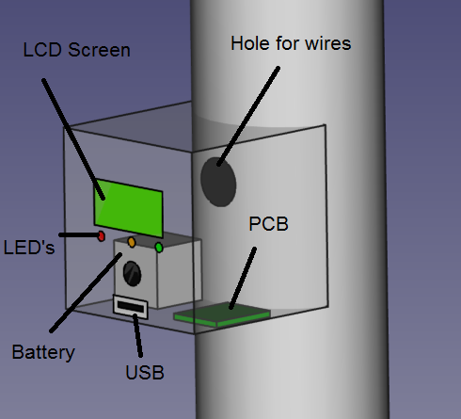
Enclosure
Houses:
Battery
MPPT
Microcontroller
LCD screen
Battery status lights
USB charging port
Motor drivers

Slide 45
Work Distribution
 | Derek | Eugene | Nicholas
Lighting System | Primary
MPPT design |  | Primary
Pole design | Primary | Primary | Primary
Coding |  |  | Primary
Motor system | Primary
USB Charger |  | Primary
Solar Panels |  | Primary
Solar tracking |  |  | Primary
MCU design |  |  | Primary
Battery |  | Primary

Slide 46
Budget
item | supplier | number | Total cost | item | supplier | number | Total cost
7’6” patio umbrella | Target | 2 | $52.00 | LCD screen | ebay | 1 | $7.24
Solopower solar cells | Solopower | 30 | $81.00 | Push button switches | ebay | 10 | $1.60
Battery pack | Battery Junction | 1 | $47.04 | USB type A | ebay | 2 | $3.18
Stepper Motor | Robotshop | 2 | $31.42 | Weatherproof on/off switch | ebay | 1 | $4.99
Motor controller | Amazon | 2 | $16.00 | Gorilla Packaging tape | Lowe’s | 1 | $10.00
LED’s | SparkFun | 24 | $21.60 | Copper tabbing tape | amazon | 1 | $22.95
microcontroller | ebay | 1 | $35.00 | wire | ebay | 200ft | $30.00
BQ24123RHLT charging IC | Texas Instrument | 5 | Free | Thrust bearing | Grainger | 1 | $8.84
PCB boards | PCB’s4u | 2 | $135.00 | Various resistors and capacitors | Mouser | N/A | $50.00
CDS18503KCS MOSFET | Texas Instrument | 5 | Free | Metal for mounting | Lowe’s | N/A | $30.00
IR2104 MOSFET driver | Mouser | 2 | $3.50 | enclosure | Lowe’s | 1 | $10.00
TPS63060DSCR 5 volt regulator | Texas Instrument | 5 | Free | connectors | N/A | N/A | $20.00
ACS712 current sensor | ebay | 5 | $8.50 | miscellaneous | N/A | N/A | $20.00
Light dependent resistors | ebqy | 6 | $19.50 | Shipping and Handling | N/A | N/A | $75.00
UF4003 fast switching diode | Mouser | 2 | $1.72
IN4148 diode | Lab | 2 | Free
P6KE10A TVS diode | Mouser | 2 | $0.88 | TOTAL |  |  | $752.03
P6KE15A TVS diode | Mouser | 2 | $1.12
5505-RC 100uH inductor | Mouser | 2 | $2.85
EEU-FC1A561 560uF capacitor | Mouser | 2 | $1.08

Slide 47
Progress

Slide 48
Projected Schedule
milestone | Oct 2 – Oct 9 | Oct 10 – Oct 16 | Oct 17 – Oct 23 | Oct 24 – Oct 30 | Oct 31 – Nov 6 | Nov 7 – Nov 13 | Nov 14 – Nov 20 | Nov 21 – Nov 27 | Nov 28 – Dec 1
prototyping
PCB ordering
Pole build
Solar panel mounting
Motor mounting and testing
LED mounting and testing
PCB build and testing
Enclosure build
Sun tracking sensor build and testing
Final testing

Slide 49
Questions?
“The important thing is to not stop questioning. Curiosity has its own reason for existing.”
- Albert Einstein – Life Magazine, May 2, 1955

