Slide 1
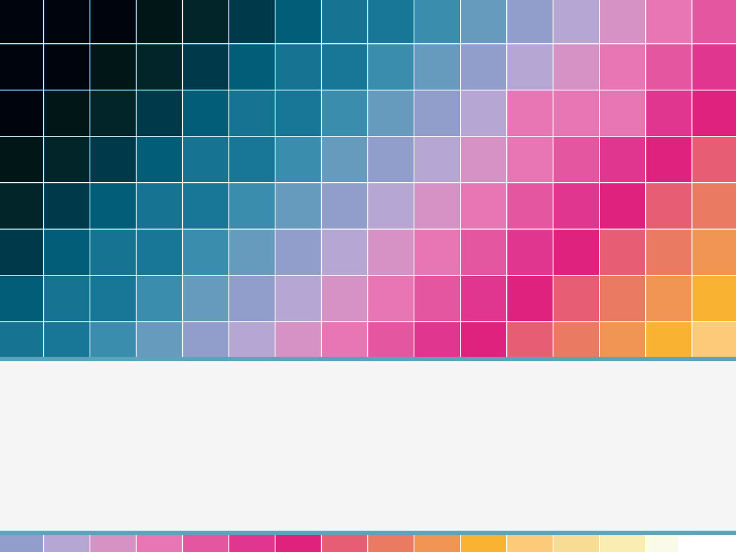
THE BEER GRID
TEAM 13:
Edgar Alastre (EE) | Jonathan Chang (CpE) | Colton Myers (EE) | Ashish Naik (CpE)

Slide 2
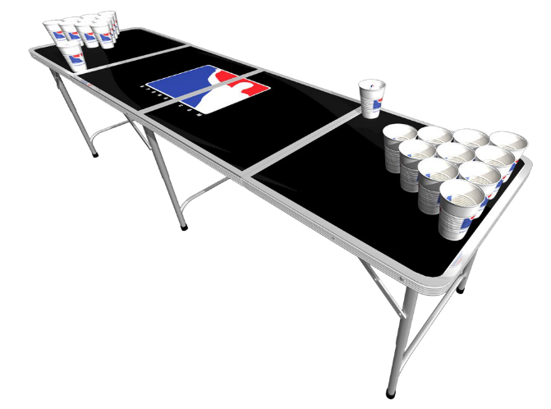
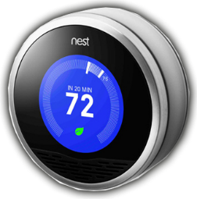
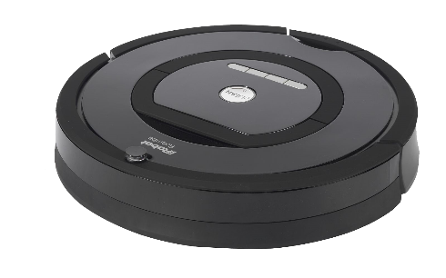

Motivation
Today's devices are getting “ smarter” (Devices Interact).
Beer Pong most popular game in social gatherings.
Modernize Beer Pong.
Improve experience with embedded systems.
Fun but challenging Senior Design project.
+
= Beer GRID

Slide 3
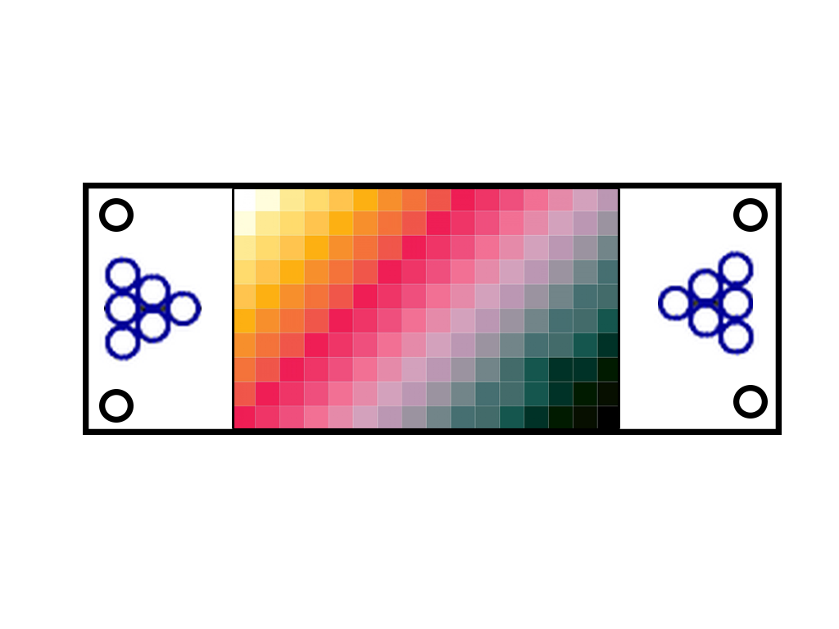
Objectives
RGB LED Array
Drive 80 RGB LED (80 Pixel “Grid” Display) which are individually controlled and responds from inputs of the Sensor array. These inputs are event triggered.
Sensor Array
Detect contact of ball or object into the “main” area of the table.
RGB LED Array
Sensor Array
Ball Cleaner
Cup Display

Slide 4
Objectives
Cup Display System
Detects cup which translates into games score sent to Smartphone App.
Smartphone App
App will include users profiles that track wins and losses as well as in-game score tracking.
Ball Cleaner System
Allows user to clean regulation sized beer pong balls.
RGB LED Array
Sensor Array
Ball Cleaner
Cup Display

Slide 5
Specifications
Component | Parameter | Design Specification
Table | Spilled Liquid | Withstand 6oz w/o Damage
Ball Cleaner | Cleaning Routine | 2 Consecutive Beer Pong Balls
Impact Sensor Array | Responsiveness | Real Time
RGB LED Array | Color density | 64 Different Colors
RGB LED Array | Control Specification | Independently Control Each LED
PSU | Power Specification | 90 Watts with 5V and 10V outputs
Smartphone/PC App | Controllability | Full Control/Customization of Table

Slide 6
Block Diagram

Slide 7
Block Diagram

Slide 8
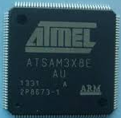
mCU
Selection Criteria:
At least 128 kBytes of flash memory
At least 44.1 MHz frequency
SPI compatible for IC selection
Recommended: 5V I/O Voltage
Selection: ATSAM3X8E Microcontroller
84-MHz 32-bit ARM Cortex M3
512 kBytes of flash memory
6x SPI, 4x I2C, 1x UART
Operating Voltage : 1.62 – 3.6v

Slide 9
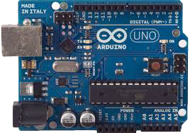
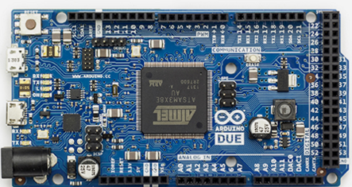
EXPERIMENT BOARD
Arduino UNO
Easy-to-use IDE to learn how to program
ICs used in project
Vast amount of resources available online
Runs at 5V and also includes SPI -> Essential
Team had Exp. Board available (Free)
Arduino DUE
Powered by MCU of choice
Has more pins than UNO
Compatible with Arduino IDE
Runs on 3.3V
Low cost: 15.99 USD

Slide 10
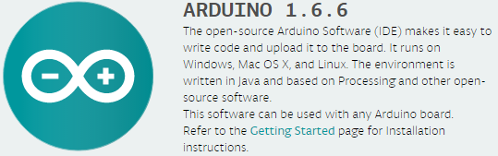
ide
Well received interface design
Specifically designed for Arduino experiment boards

Slide 11
The LED Array

Slide 12
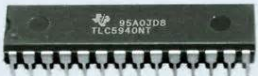
LED Array DESIGN DETAILS
Microcontroller only has limited amount of input/outputs pins.
Impossible to drive 80 RGB LEDs without the need of a multiplex or IC.
Solutions:
Multiplexing or Charlieplexing – Requires extensive and precise wiring
Shift Register – Requires extensive amount of resistors given high amount of LEDs
LED Driver – Integrated Circuit specialized in Driving tons of LEDs

Slide 13
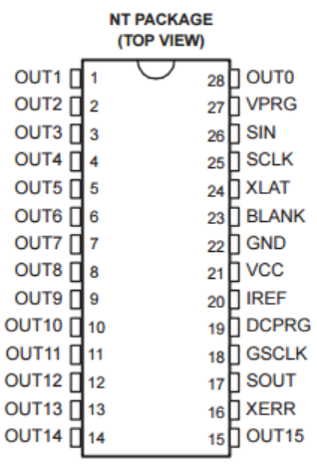
LED Driver
TLC 5940 From Texas Instruments
16 Output channels
  Effectively drive 5 RGB LEDS per TLC5940
12 bit (4096 Steps) Grayscale PWM Control
  Higher color resolution than PWM included in MCU
Drive Capability (Constant-Current Sink)
    Allows us to have fewer electronic components per LED
Serial Data Interface
  Requires SPI to fully control
30 Mhz Data Rate
  Useful when having lots of RGB LEDs -> Our Case.
Can be configured in Cascade mode
  Essential for our project

Slide 14
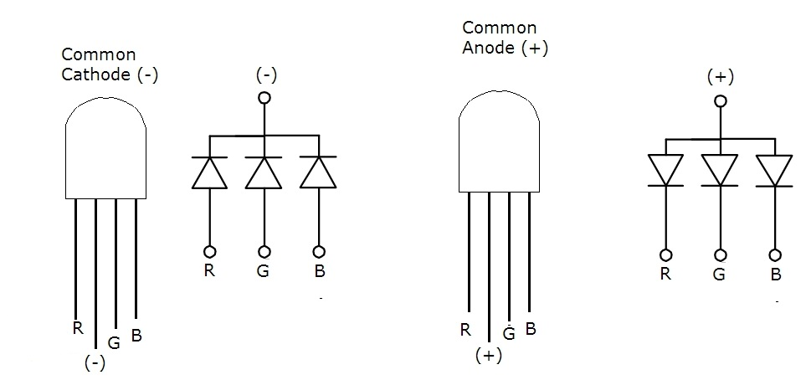
LED Driver
TLC 5940 From Texas Instruments
Design Constraints by Choice:
Can only use Common anode RGB LEDs
5mm Common anode RGB LED 20mA of max current

Slide 15
LED Driver schematic

Slide 16
LED Driver schematic
Cascaded

Slide 17
LED Array Program Structure
Pixel Nodes
  One per pixel (80)
  Arranged as a matrix
  Holds current state information
  Used to coordinate pixel reactions
LedNode
idNumber current blinking off *north *east *south *west

Slide 18
LED Array Program Structure
Pattern Programming
  Cascade effect
  Blinking effect
  Color Fade
  Color Vanish
LedNode
idNumber current blinking off *north *east *south *west
Pattern Class

Slide 19
The Sensor Array

Slide 20
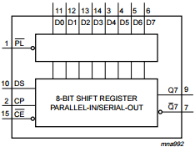
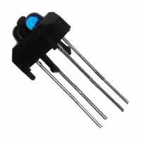
Sensor Array design details
Similar Problem as RGB LED Array (Extend our I/O Pins of MCU)
Require Electronic component that can detect nearby object (Impact of Beer Pong Ball)
Solution:
Shift Register IC to extend amount of I/O Pins of MCU
Infrared Proximity sensor to detect impact of Beer Pong Ball
74HC165 Shift Registers
TCRT5000L infrared sensor

Slide 21
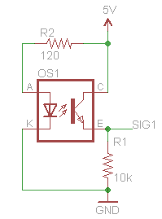
Infrared Sensor
TCRT5000L from Vishay Semiconductors
Includes IR Emitter and Receiver in a single package
  Convenient for project size
Low Cost
Accurate detection parameter for our project.
TCRT5000L Wiring Schematic

Slide 22
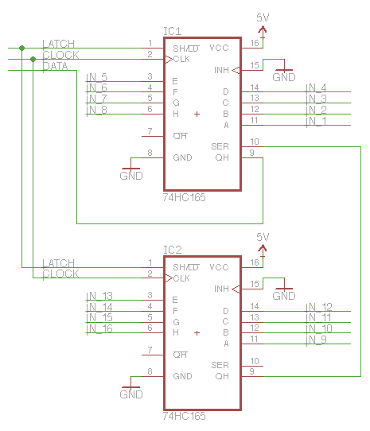
Shift Register
74HC165 Shift Register from NXP
8-bit Serial-in Shift Register
  Creates more output pins for use
  Allow 8 IR Proximity Sensors per IC
Synchronous Serial Input
  Communicates via SPI
Allows to be Cascaded
  Essential to drive tons of sensors
74HC165 Configured in Cascade Schematic

Slide 23
Sensor Array Program Structure
Signals used as input
Switch between 1 and 0
Specific signals per pixel (80)
May require semaphores

Slide 24
The Cup Display System

Slide 25
Cup Display System
Uses components from LED and Sensor Array:
  RGB LEDs
  Infrared Sensors
  LED Drivers
  Shift Registers
Detects the removal of cups
Determines score based on cups presence in table
RGB LED part of “Theme Scheme” set by user
Cup Display

Slide 27
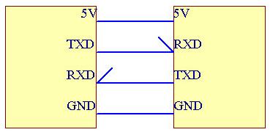
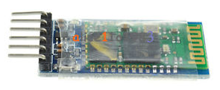
Bluetooth Module
HC-05 RS232 from InnoGear
Allows wireless connection with Smartphone
Input Power 3.3-6 V
  Compatible with our Microcontroller
Easy to program

Slide 28
The App

Slide 29
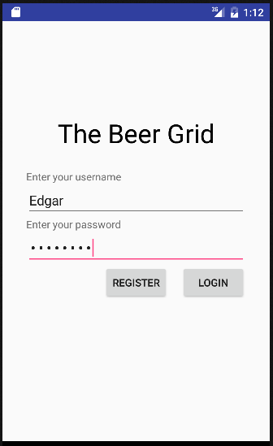
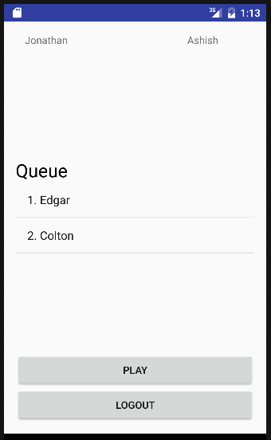
Smartphone App
Smartphone App will keep track of current game being played.(How many cups are left on each player’s side)
Will keep an updated record of each player’s wins losses.
Keep a queue of the players to determine who will play next.
      Shows work in progress

Slide 30

Smartphone App
OS Choices
Android
iOS
Prior experience developing an Android application
Cheaper to develop for
No experience in developing on iOS
Requires more money than android to start developing
Choice: Android
Windows
Nobody uses a Windows phone

Slide 31


Smartphone App IDE
Android Studio
Android Studio is the official Android application development IDE .
Android studio allows better testing with AVM
Choice : Android Studio
Eclipse

Slide 32
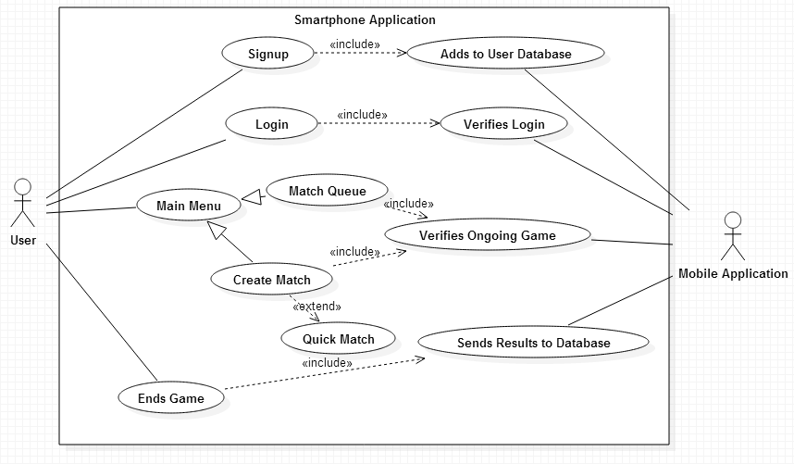
Smartphone App
Use Case diagram

Slide 33
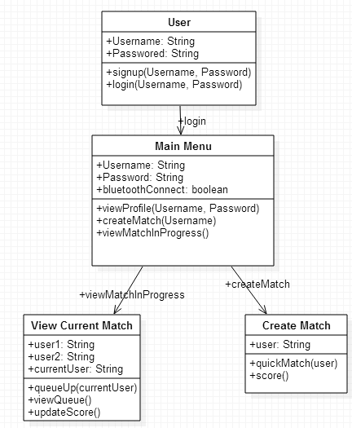
Smartphone App
Class Diagram

Slide 34
The Ball Cleaner

Slide 35
Ball Cleaner BLOCK DIAGRAM

Slide 36
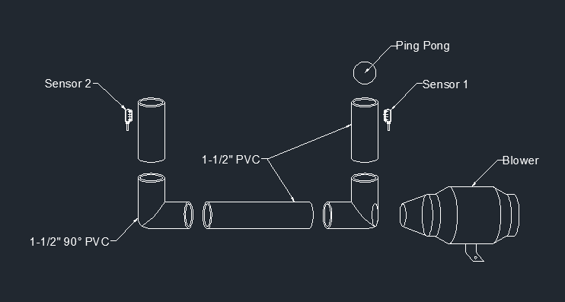
Ball Cleaner

Slide 37
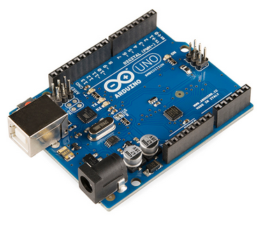
Ball
Cleaner microcontroller
Specifications | ATmega328P | MSP430F5529
Manufacturer | Atmel | Texas Instruments
Max Operating Freq. | 20 MHz | 25 MHz
Flash Memory | 32 KB | 128 KB
RAM | 2 KB | 8 KB
# of Channels | 16 | 16
I/O Pins | 23 | 63
Timers | 3 | 4
Operating Voltage | 1.8 - 5.5 Volts | 1.8 – 3.6 Volts
Applications | Arduino Uno Model | MSP-EXP430F5529LP

Slide 38
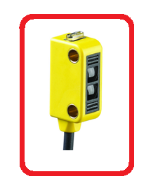
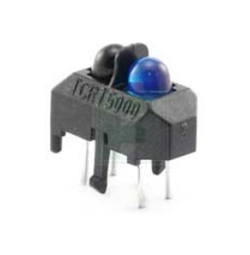
Ball
Cleaner sensors
Specifications | Q12AB6FF50 | TCRT5000
Manufacturer | Banner | Vishay
Sensing Method | Proximity | Reflective
Max Range | 50mm | 15mm
Voltage Rating | 10-30 V | 1.5 V (Forward Voltage) 5.0 V (Reverse Voltage)
Current Rating | 50 mA | 60 mA (Forward Current)
Pros | Simple Wiring | Shorter Range
Cons | Higher Voltage Input | More Complex

Slide 39
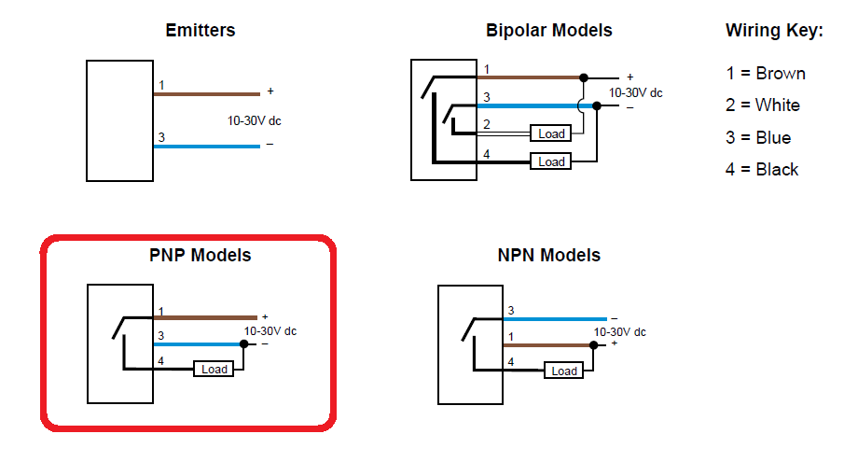
Sensor wiring
Banner.com

Slide 40
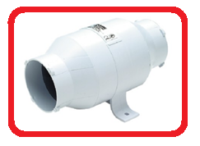
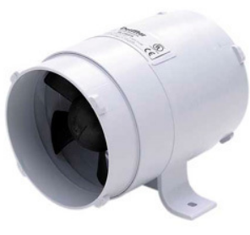
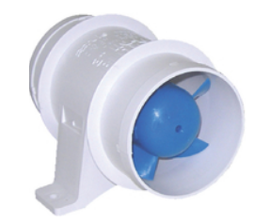
Ball
Cleaner fans
Specifications | 41851 Bilge Blower | 41841 Bilge Blower | 140 Bilge Blower
Manufacturer | Seachoice | Seachoice | Rule
Intake Diameter | 3 inches | 4 inches | 3 inches
Exhaust Diameter | 3 inches | 4 inches | 3 inches
Length | 8 inches | 5-3/4 inches | 3-1/4 inches
Flow Rate | 170 CFM | 240 CFM | 135 CFM
Hose Connections | Yes | Yes | No
Voltage | 12 VDC | 12VDC | 13.6 VDC
Current | 4.5 Amps | 5 Amps | 2.9 Amps
Price | $20.89 | $20.89 | $21.87

Slide 41
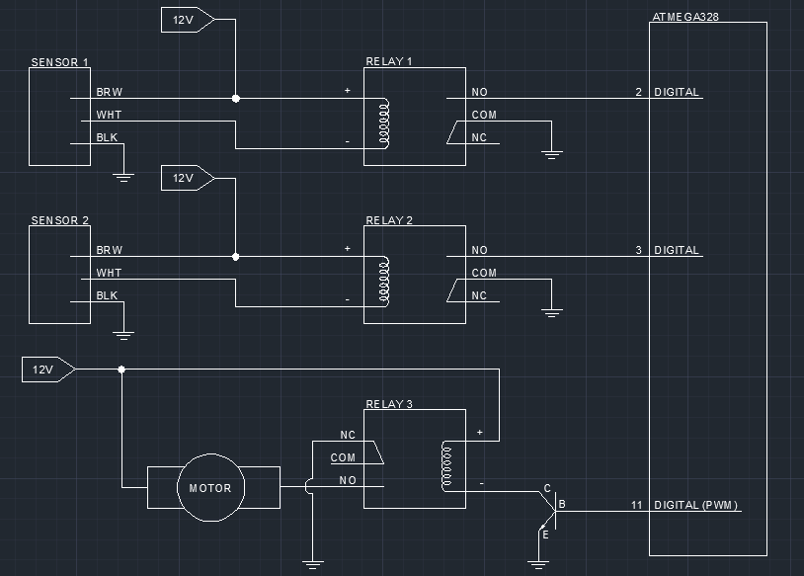
Ball cleaner schematic

Slide 42
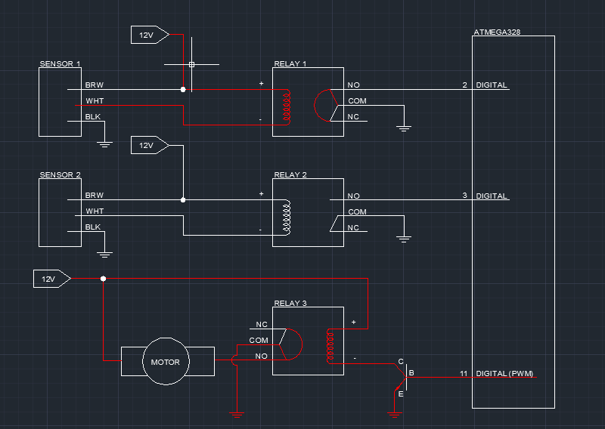
Ball cleaner schematic

Slide 43
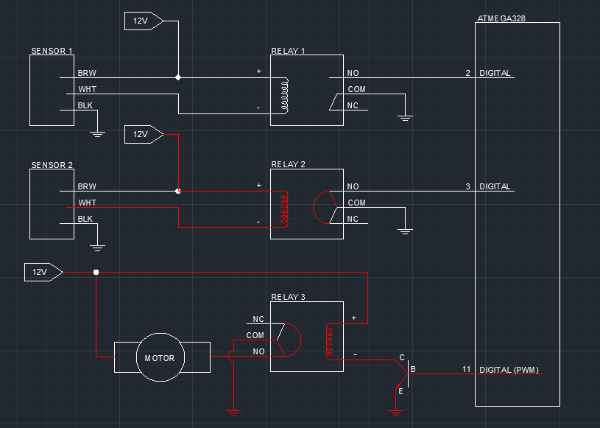
Ball cleaner schematic

Slide 44
The Power Supply Unit

Slide 45
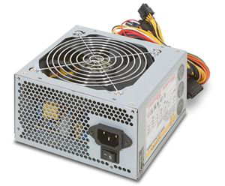
Power Supply Unit
Specifications | ATX
Manufacturer | Rosewill
Voltage Output | 3.3, 5, 12 Volts
Current Output | 24 A, 30 A, 18 A
Maximum Output Power | 300 Watts
Efficiency | 60 %
Price | $29.99

Slide 46
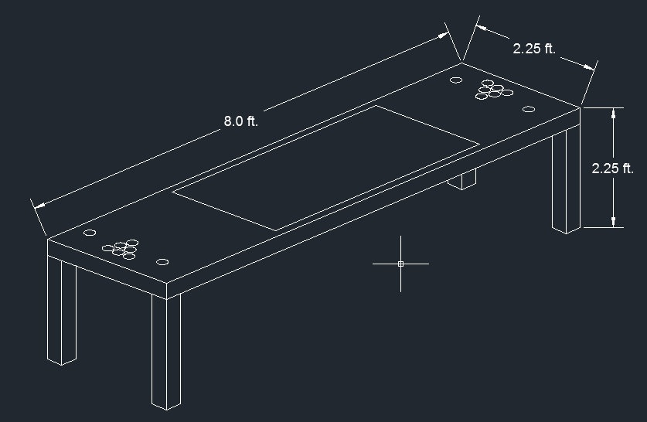
Table STRUCTURE

Slide 47
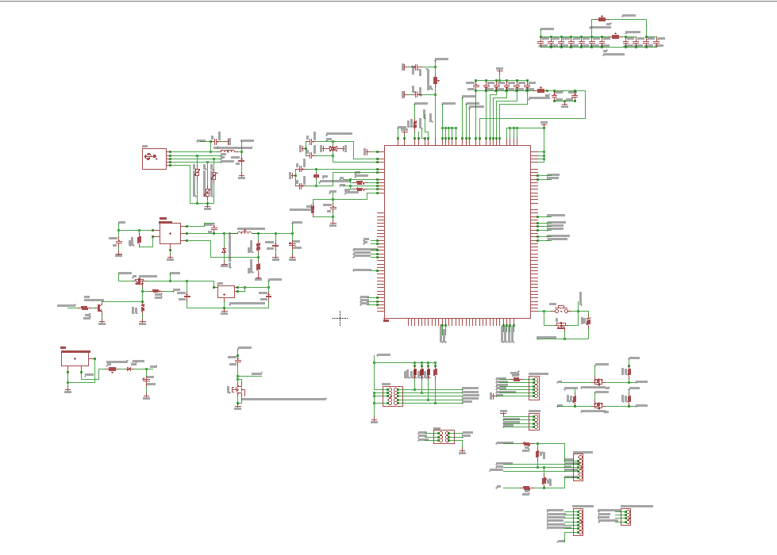
Printed circuit boards

Slide 48
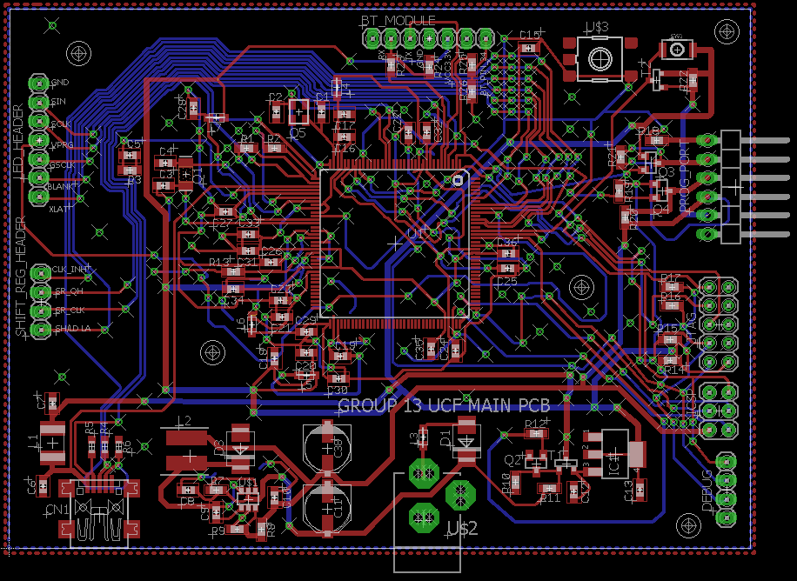
Printed circuit boards
MAIN CIRCUIT BOARD
-92 Components

Slide 49
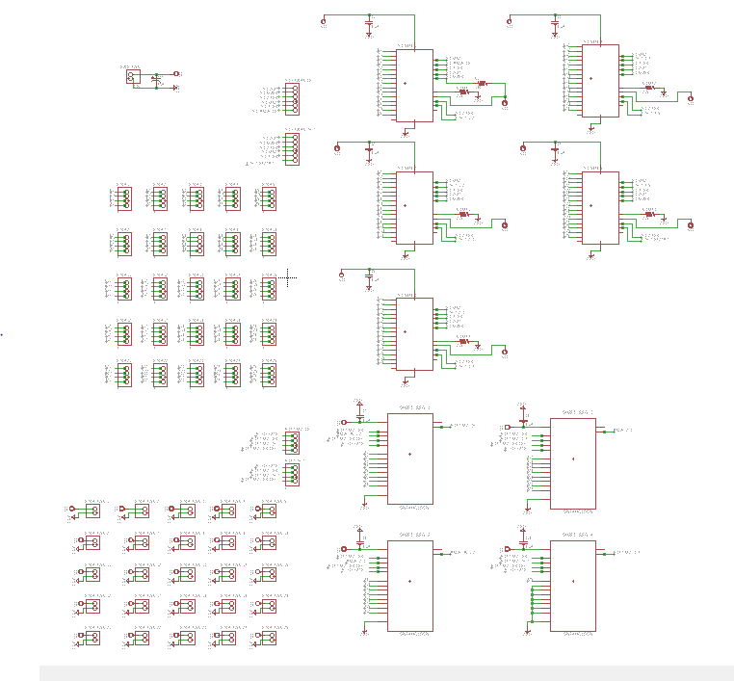
Printed circuit boards
LED DRIVERS AND SHIFT REGISTERS SCHEMATIC

Slide 50
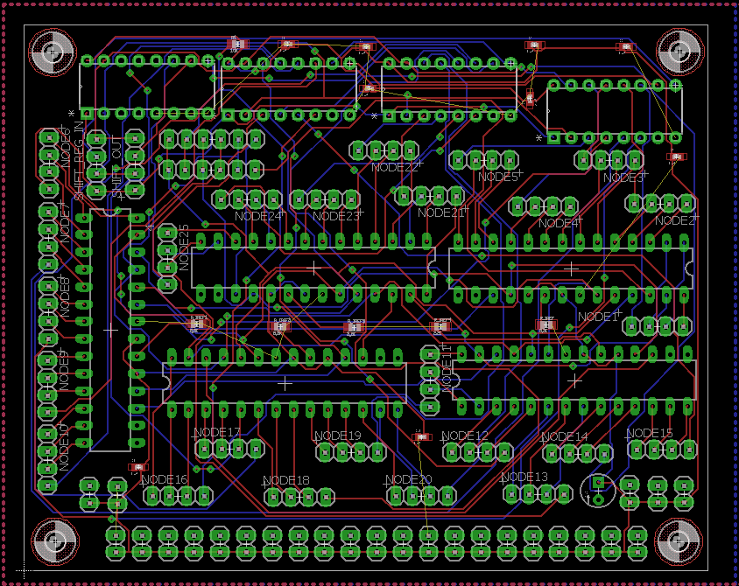
Printed circuit boards
5 LED DRIVERS, 4 SHIFT REGISTERS. 6 MADE

Slide 51
Bill of materials
Parts | Amount | Price | Total
Bluetooth | 1 | $3.90 | $3.90
TLC5940 LED Driver | 17 | $6.98 | $118.66
74HC165 Shift Register | 35 | $1.88 | $65.80
Common Anode LED | 80 | $0.07 | $5.60
Infrared Sensor | 80 | $0.34 | $27.0
4 Color RGB extension Cable | 4 | $11.00 | $40
Protoboard | 10 | $2.00 | $20.00
Resistors |  |  | $30
2-pin connectors | 80 | $0.44 | $35.20
4-pin connectors | 80 | $0.40 | $32
PCB |  |  | $130
Table materials |  |  | $100
Plexiglass |  |  | $40
Bilge Blower | 1 | $20.89 | $20.89
Power Supply |  |  | $35
Proximity Sensor | 2 | $76 | $152
DPDT Relay | 1 | $3.95 | $3.95
SPDT Relay | 2 | $3.50 | $7
Grand Total |  |  | $1033.41
Grand Total:
$1033.41

Slide 52
Labor Division
Edgar Alastre
  Primary Responsibility: Circuit Design
  Secondary Responsibility: Programming Table
Jonathan Chang
  Primary Responsibility: Programming App
  Secondary Responsibility: Programming Table
Ashish Naik
  Primary Responsibility: Programming Table
  Secondary Responsibility: Programming App
Colton Myers
  Primary Responsibility: Power Supply, Table, and Ball Cleaner Design/Construction
  Secondary Responsibility: Circuit Design

Slide 53
hope YOU ENJOYED

Slide 54
QUESTIONS SECTION

