Slide 1
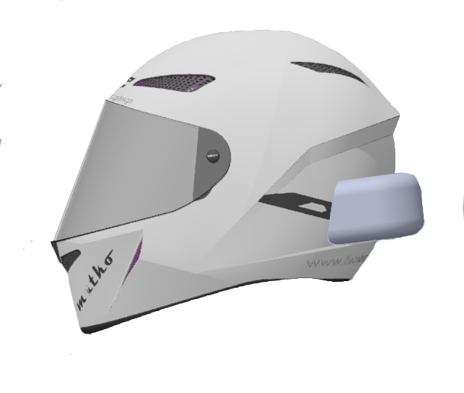

BRAIN Helmet
Group 4
Ryan Mortera EE Nada Algharabawi CpE
Jordan Yamson EE Stephan Morales CpE

Slide 2
Motivation
Motorcyclist deal with the danger of mobile device distractions when navigating to an unknown location and have the need for a GPS.
It is not only dangerous but a rather difficult feat to navigate with a GPS application or take phone calls while riding.
Utilizing features of a smartphone whilst riding a motorcycle isn’t possible without endangering the rider and others on the road

Slide 3
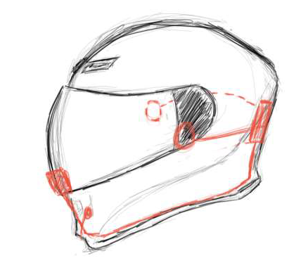
Goals and Objectives
Low-cost approach of implementing a smart Bluetooth motorcycle helmet
Allow the user of the helmet to accept phone calls, stream music, and be able to utilize a GPS through an application.
The GPS instructions will be sent to an On-Board HUD on the visor of the helmet, so that the user will be able to see the instructions without ever taking out their phone

Slide 4
Specifications
Helmet completely wireless between user’s phone and helmet
PCB and Housing Dimensions 4 x 6 x 3 inches
2 speakers integrated into helmet at 0.25 in. thick.
A helmet will include a microphone wired through the helmet
HUD on the visor at a resolution of 128x64 pixels
Rechargeable battery of at least 6 hours (2000 mAh), No larger than 2 x 3 in.
Pairing distance of about 10 meters
Pairing process of less than 1 minute
5 buttons for answering phone calls, track control, and toggling display.
PCB will be attached and covered directly to the helmet.

Slide 5
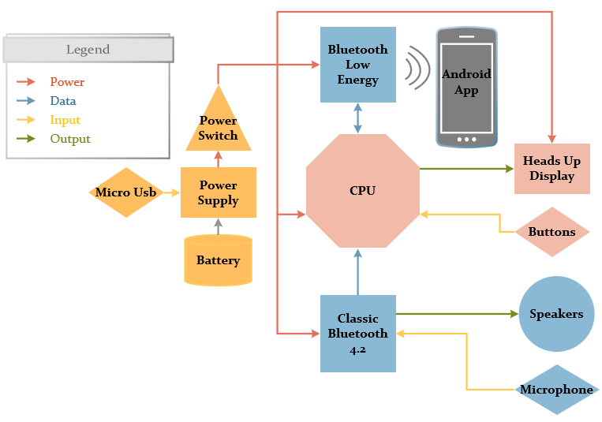
Overall Block Diagram
Notes:
Wrong diagram

Slide 6

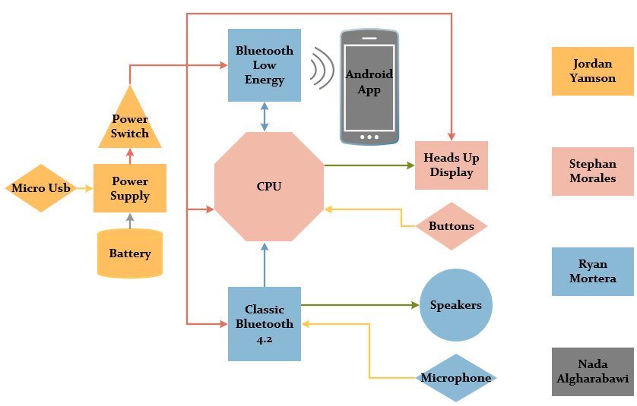
Work Distribution
Primary
Secondary
Ryan Mortera
Nada Algharabawi
Jordan Yamson
Stephan Morales
Notes:
Wrong diagram

Slide 7



Wireless Technology Selection
Wireless connection between B.R.A.I.N Helmet and User’s Cellphone
Modern smart phones already have Bluetooth integrated
Wi-fi is off the scope of our project and Zigbee isn’t enough transfer rate
Bluetooth consumes less power

Slide 8
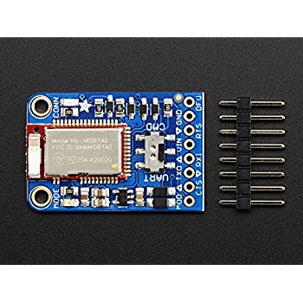
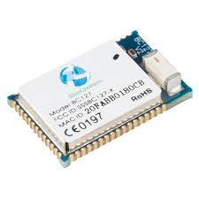
Bluetooth Modules
We chose two types of Bluetooth Modules: One Bluetooth 4.2 and Bluetooth Low Energy
Bluetooth 4.2: Module BlueCreations-127
Bluetooth Low Energy: Adafruit Bluefruit LE

Slide 9
Reasons for separate Bluetooth
The low-energy Bluetooth is used for the connection between the app and our system
The class Bluetooth is used for audio signals between the phone and our system
The complexity for audio signals over BLE aren’t as simple as classic Bluetooth profiles. (For example: SPP, A2DP, AVRCP, GVADP aren’t supported on BLE.

Slide 10
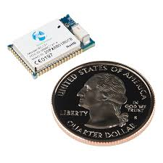
BC127 Bluetooth Module
Component
Maximum Data rate | 3 Mbps
Operating Range | 20m to 30m
Supply Voltage | 3.3V to 4.7V
Dimensions | 11.8mm x 18mm x 3.2mm
Weight | 1.1g

Slide 11
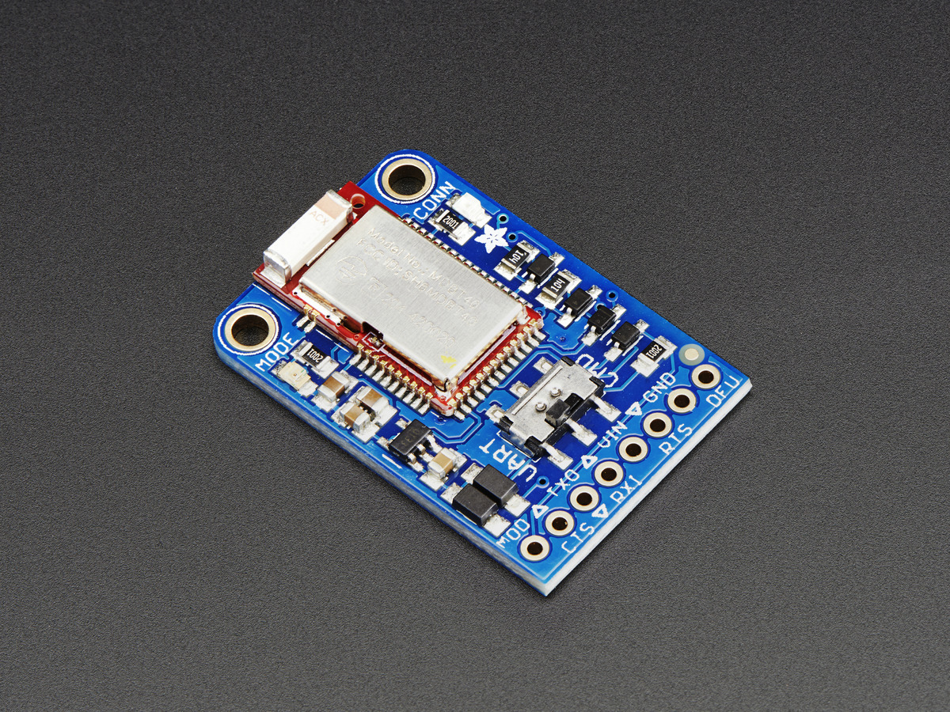
Bluefruit LE UART Friend
Component | Bluefruit LE UART Friend
Flash Memory | 256KB
RAM | 32KB SRAM
Baud Rate | UART at 9600 Baud
Supply Voltage | 5v safe inputs with voltage regulation
Dimensions | 21 x 32 x 5 mm
Weight | 3.4g

Slide 12
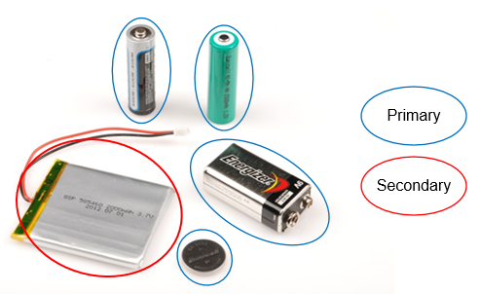
Power Options
There are multiple factors to account for when choosing a power source for the BRAIN Helmet.
Weight?
Economic?
Size?

Slide 13
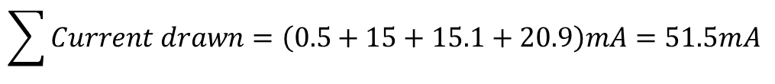
Stock Battery Consumption for Calculations
Device | Operational Voltage | Active current | Sleep current
Microprocessors
ATmega 2560 | 1.8 – 5V *Not using above 3.6V | ~500 μA | 0.1 μA
Bluetooth Modules
BC127 | 3 ~ 3.6V | ~15 mA | <1mA
Bluefruit LE UART Friend | 3.3-16V | Avg: 1.86mA Peak: 15.1mA | <1mA
Heads-Up Displays
LCD-13003 Breakout [48x64 pixels] | 3.3V *generates V _{LCD} = 7.0-7.5V | 10-20.9mA | <300 μA
Battery Life Time Comparisons
Battery Capacity (mAh) | Battery Life Time (Hours)
1000 mAh | 13.59
2000 mAh | 27.18
2500 mAh | 33.98
6000 mAh | 81.55
The BRAIN Helmet will use a 2500 mAh 3.7V Adafruit 328 Lithium Polymer battery
$$\sum{Current drawn=\left(0.5+15+15.1+20.9\right)mA=51.5mA }$$

Slide 14
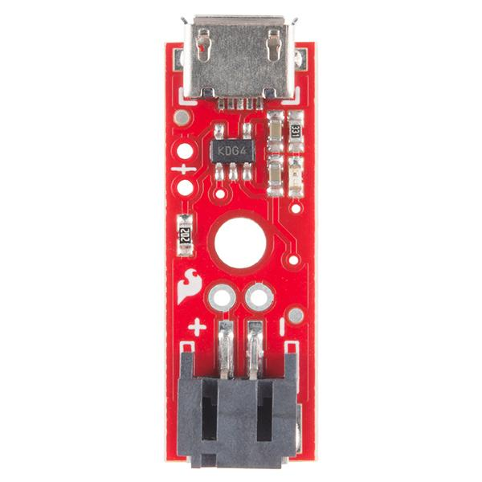
Proper Lithium-Ion charging
The SparkFun LiPo Charger prevents any damage to the battery with an adjustable charge current. (Set to 500 mA for a 3.7V Lithium-Ion Polymer battery)
Common JST Connector
Micro-USB connector to supply charge

Slide 15
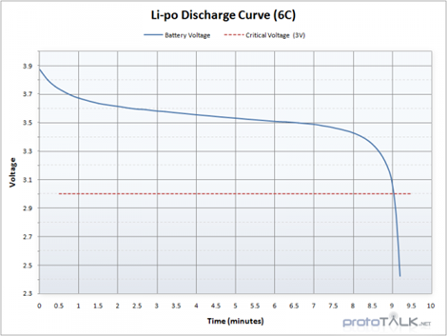
Implementing the battery
The Adafruit 328 peaks at a charge voltage of 4.2V and cuts off at 2.8V.
With a varying discharge voltage, the battery will be regulated via a switching voltage regulator on the BRAIN Helmet capable of outputting 500 mA.

Slide 16
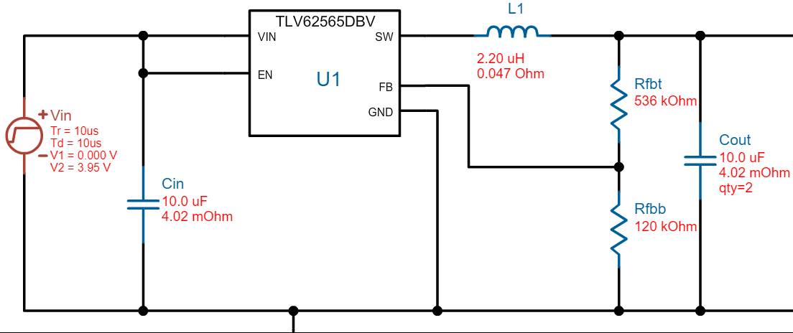
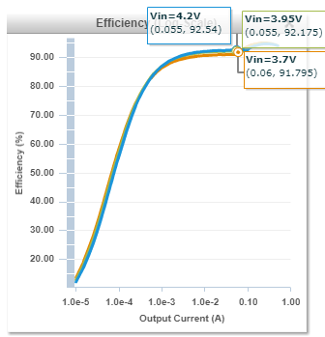
Switching Voltage Regulator
TI Webench helped assure a safe power system.
$Vout=VFB\left(1+\frac{R1}{R2}\right)$ = 600mV(1+536k/120k) = ~3.3V

Slide 17
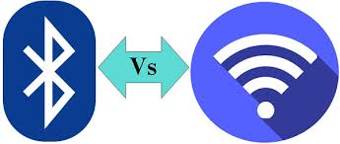
Mobile Wireless Connection
A wireless connection has to be established between main module and Android device
Almost all devices nowadays are able to be connected via Wi-Fi and Bluetooth
Bluetooth implementation is simpler and more secure
Wi-Fi implementation is difficult

Slide 18
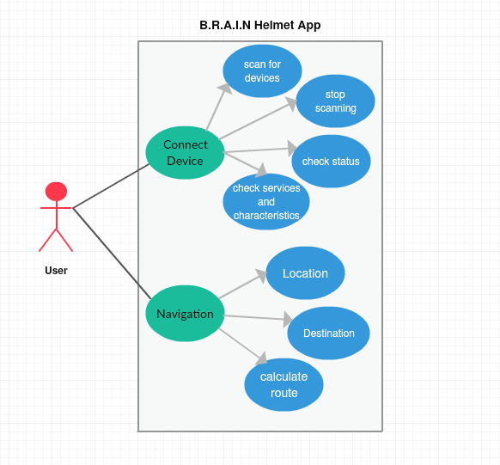
Use Case Diagram for the Brain Hemet Application

Slide 19
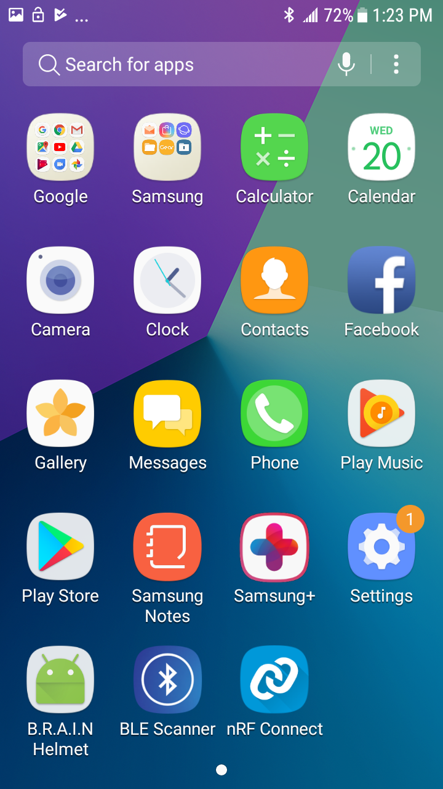
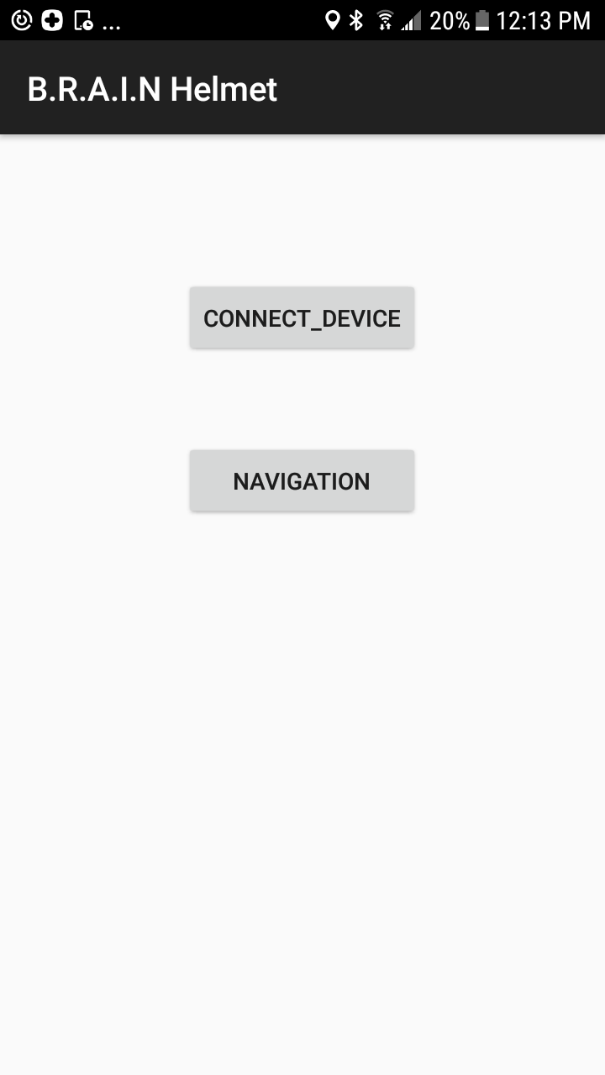
Mobile Application
Phone Home Screen
App Main Screen

Slide 20
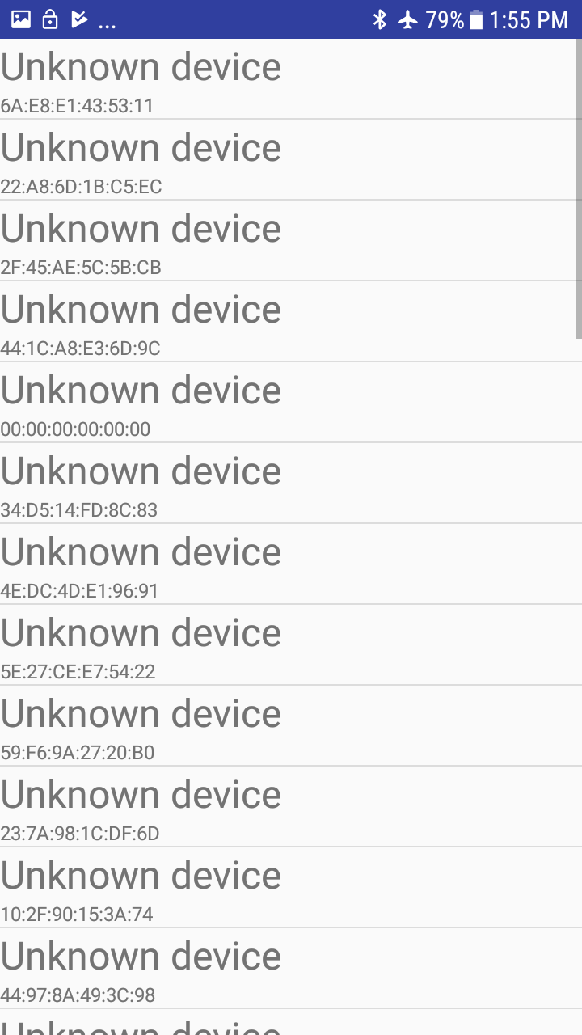
Scan for other Bluetooth devices
Query the local Bluetooth adapter for paired Bluetooth devices
Connect to other devices through service discovery
Transfer data to and from other devices
User should be able to choose the desired device

Slide 21
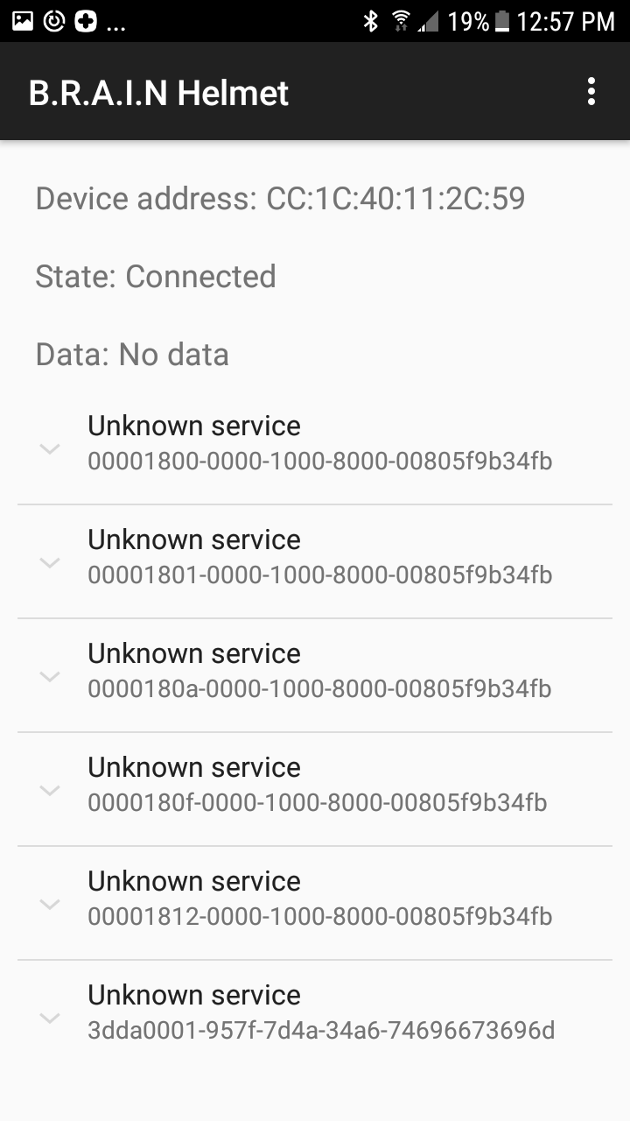
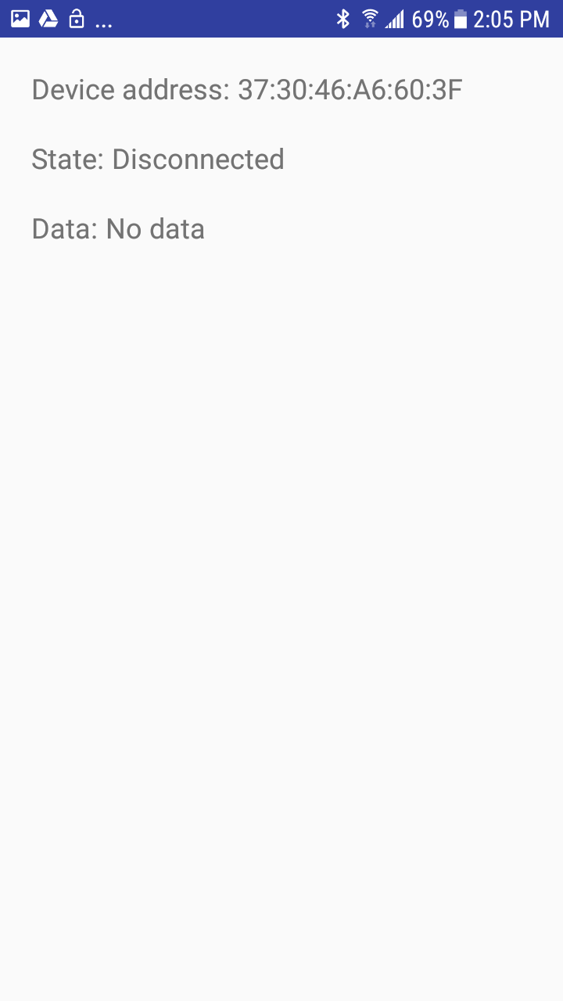
Connected Device
Disconnected Device

Slide 22
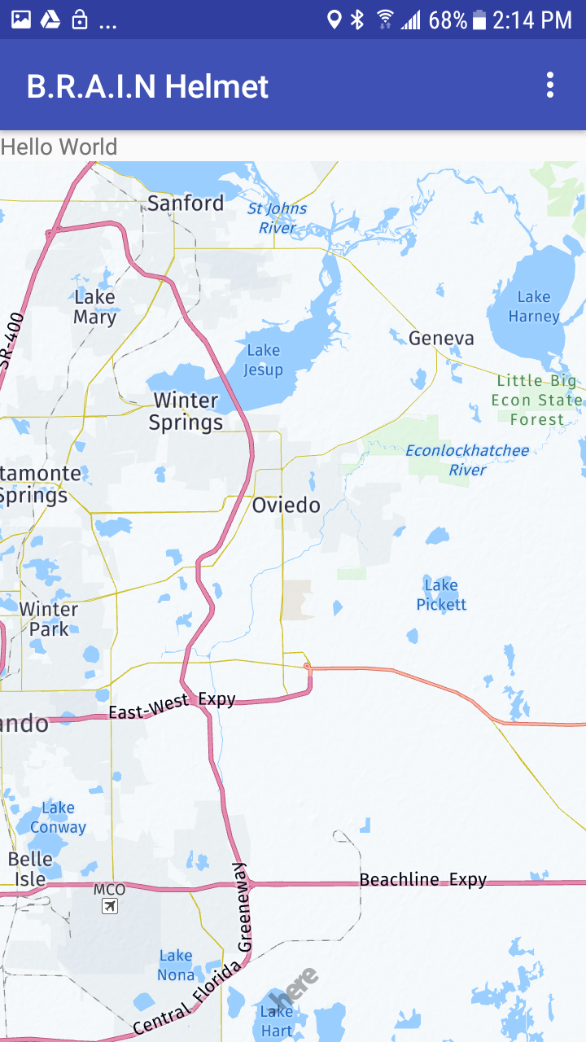
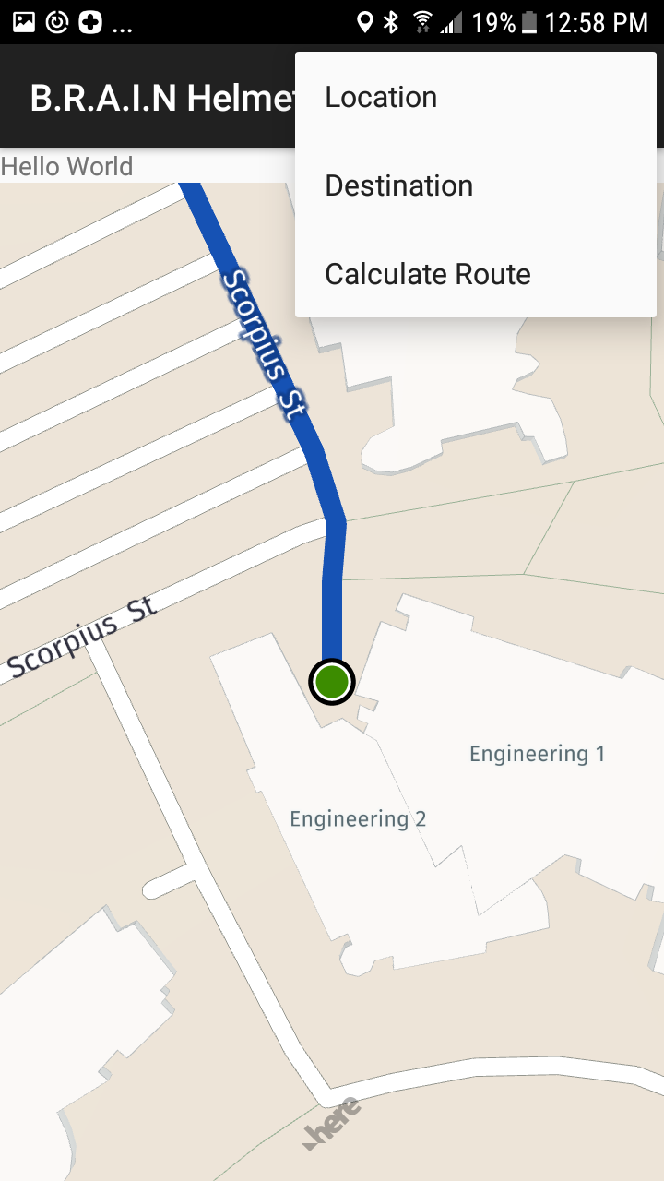
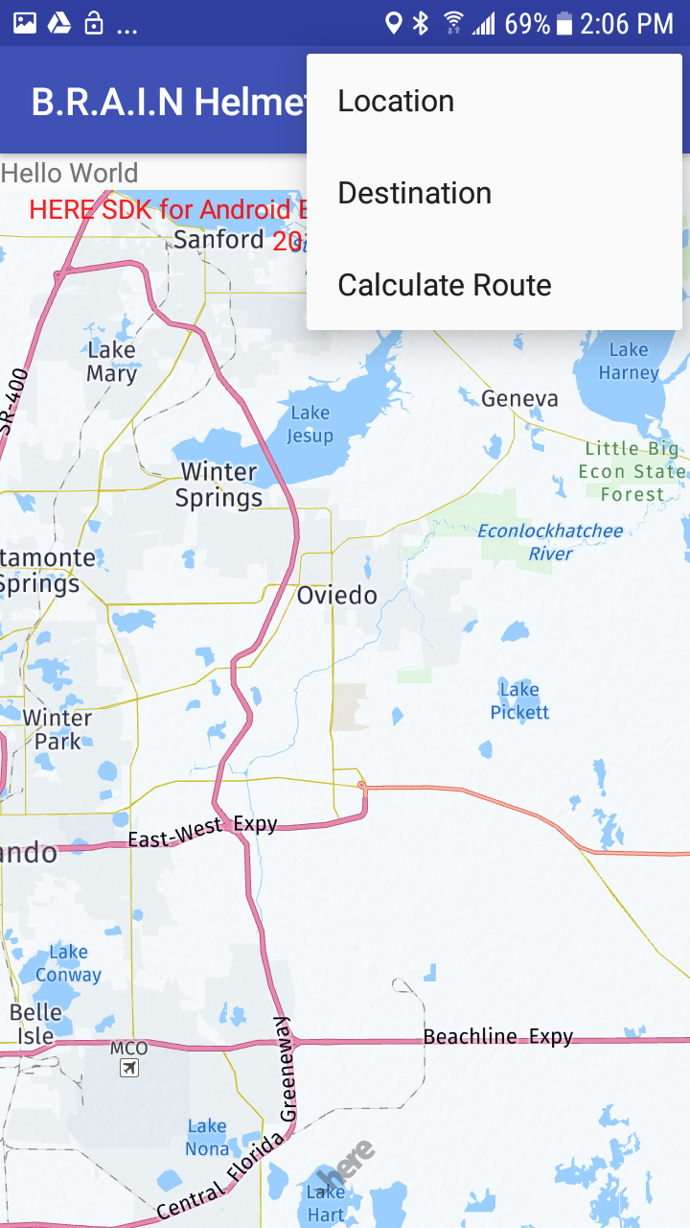
Navigation Setting

Slide 23
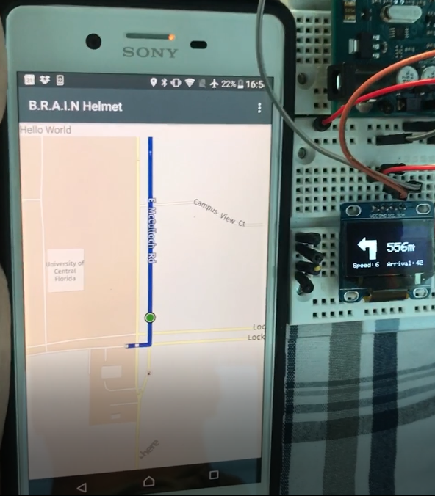
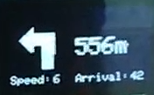

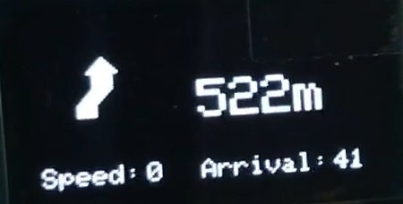

Slide 24
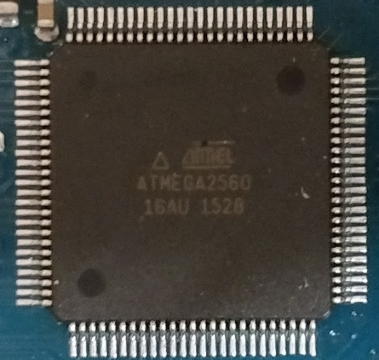
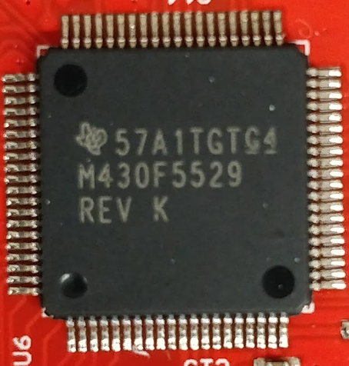
Microcontroller and HUD

Slide 25
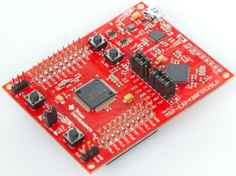
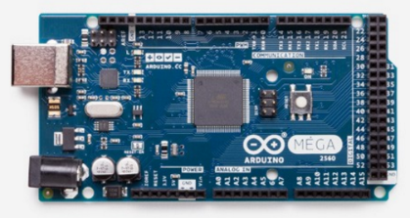
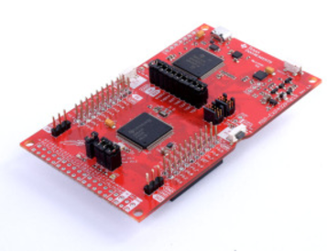
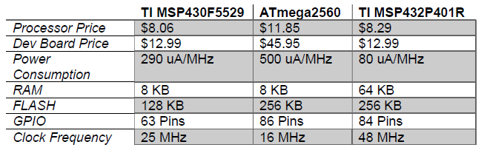
Selection
GPIO
Memory Size
RAM
FLASH

Slide 26
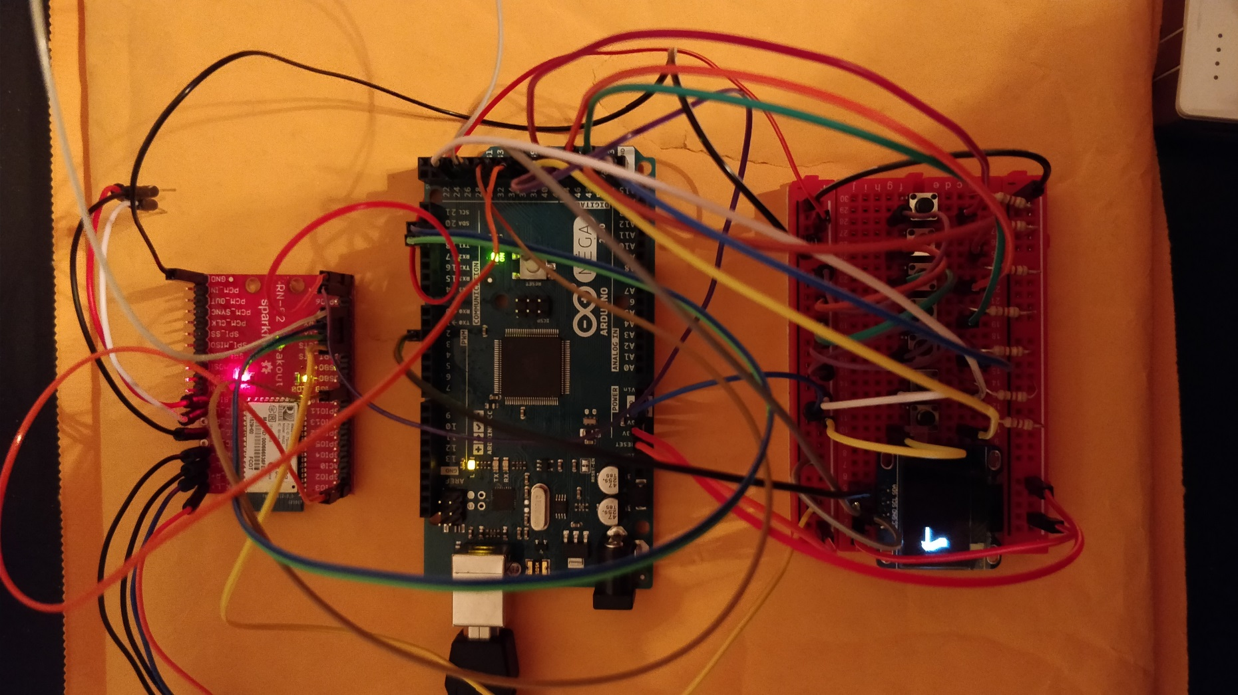
Design

Slide 27
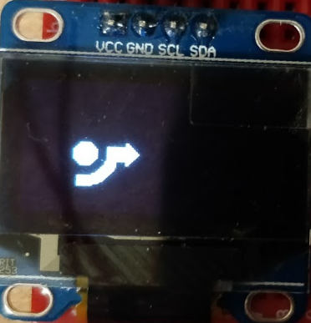
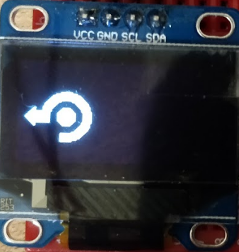
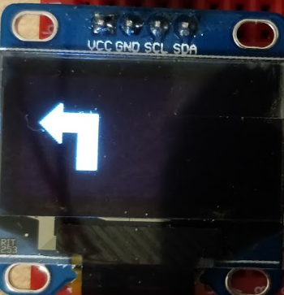
Design

Slide 28
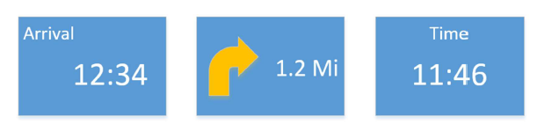
Programming Methodology
Initialization
Establishing connection
Obtain information from device
I/O
Display updates

Slide 29
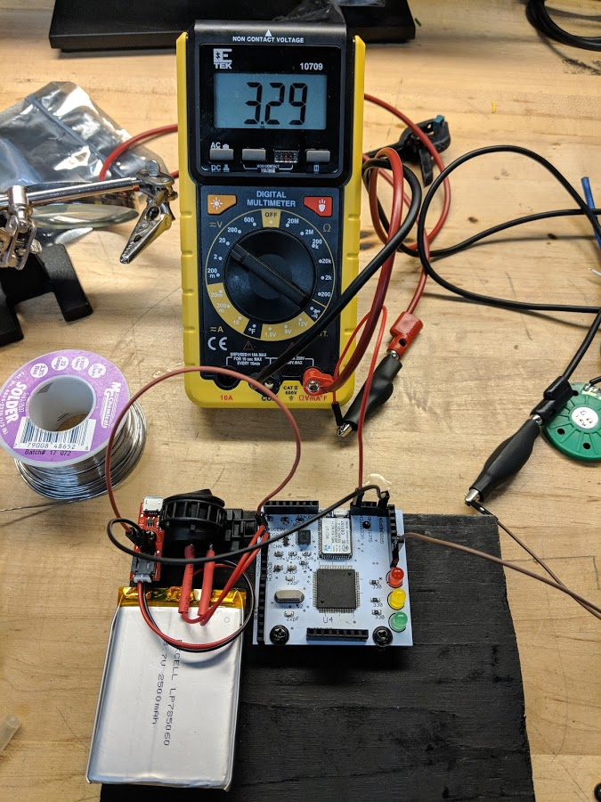
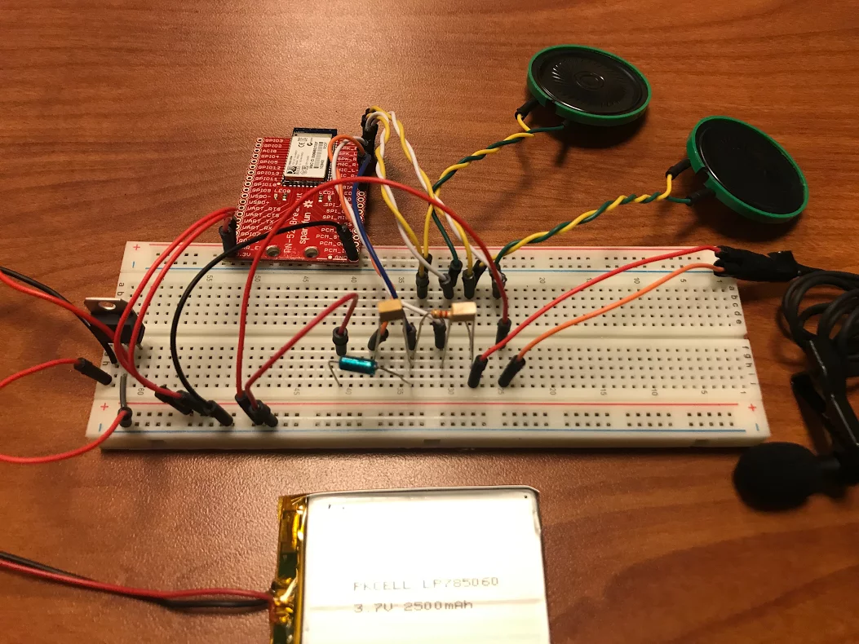
Prototyping

Slide 30
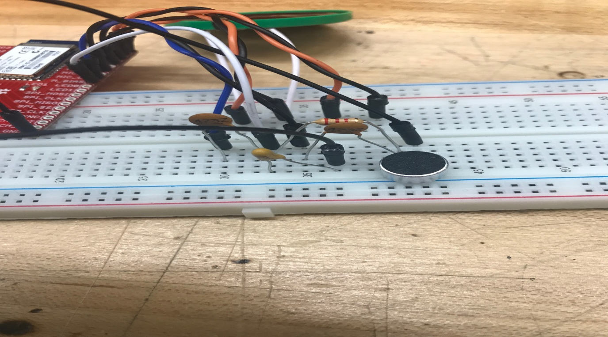
Audio Challenges
When working with the Bluetooth module, the microphone had a lot of noise when first integrated. Implemented a filter to reduce noise through the microphone.

Slide 31
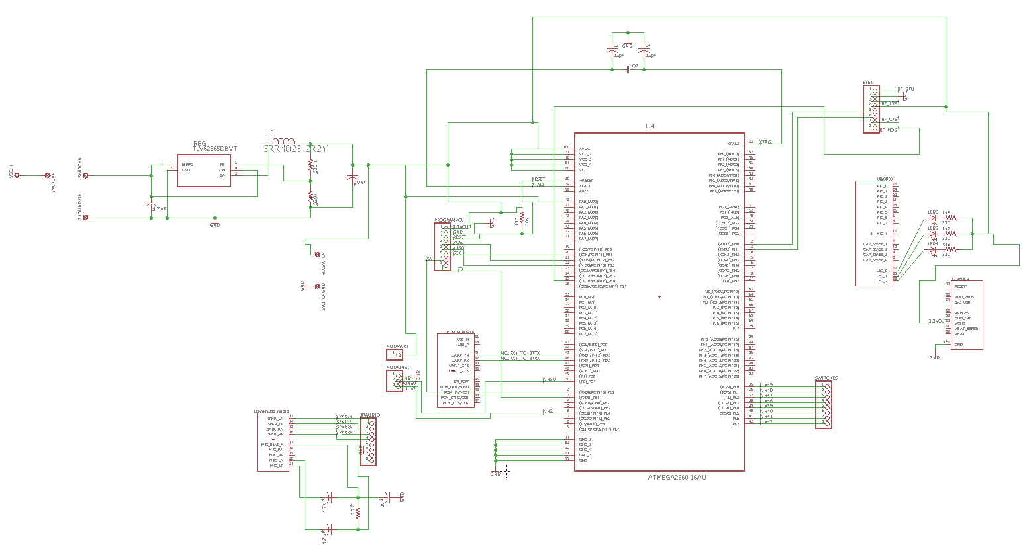
PCB Schematic

Slide 32
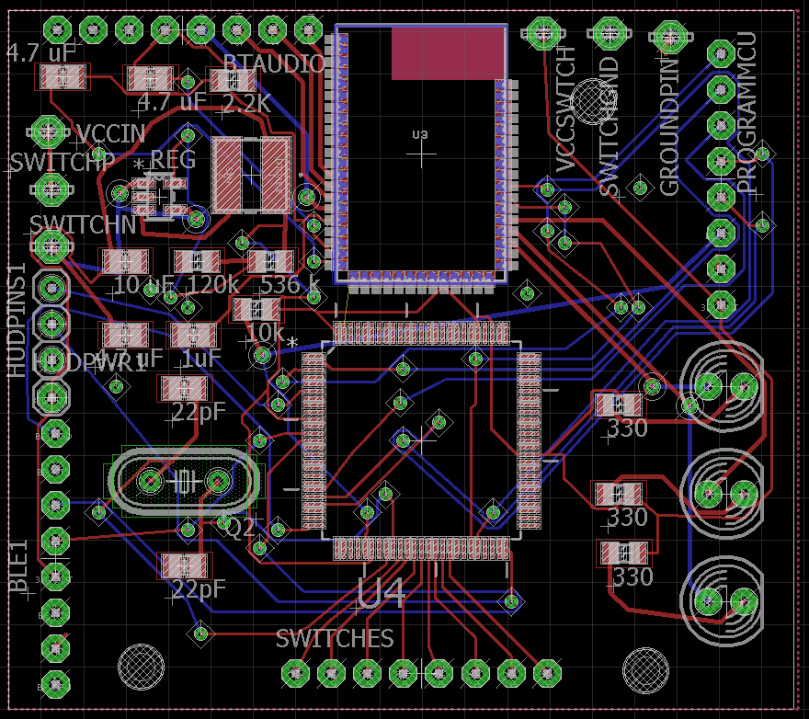
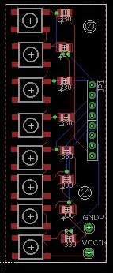
PCB Design
2 Layer
~ 2” x 2”
Pairs with Button PCB

Slide 33
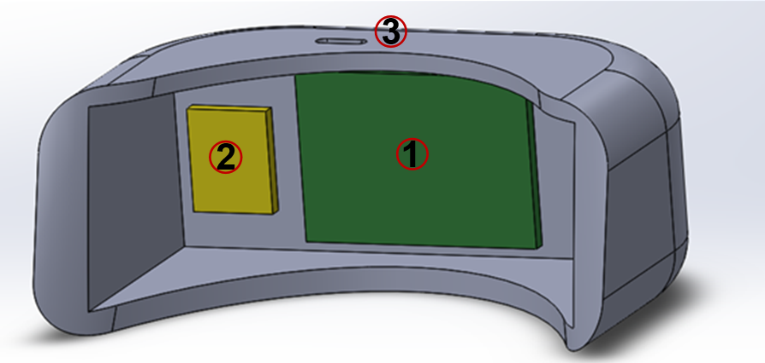
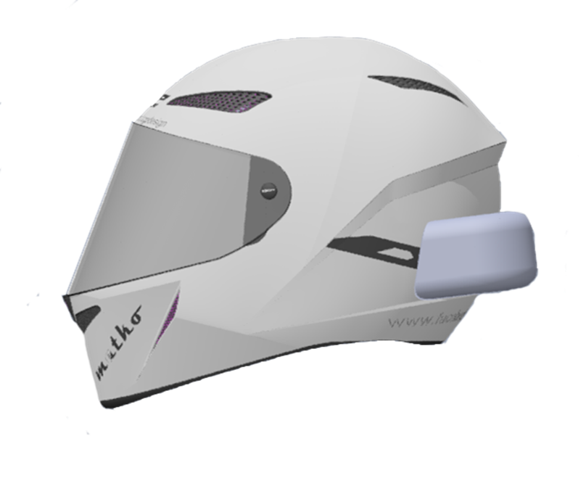
Electronic Housing

Slide 34
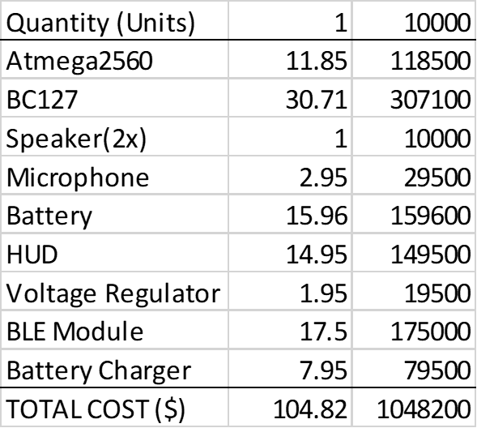
Budget
 | Part Number | Unit Cost ($) | Quantity | Total Cost
Processor | MSP430F5529 | 8.06 | 1 | 8.06
 | ATmega2560 | 11.85 | 1 | 11.85
BT Module | RN52 | 12.50 | 2 | 25.00
 | RN52 Breakout | 22.50 | 2 | 45.00
Speaker (x2) | 00050016FP035A | 3.50 | 2 | 7.00
 | Com-10722 | 0.51 | 6 | 3.06
Microphone | BOB-12758 Breakout | 2.95 | 2 | 5.90
Battery | Adafruit 328 | 15.96 | 1 | 15.96
 | Ofeely 458292 | 13.59 | 1 | 13.59
LiPo Battery Charger | PRT-102177 | 7.95 | 2 | 15.90
Helmet | SH-FF0016 | 42.99 | 1 | 42.99
Buttons | COM-09339 | 1.95 | 0 | 0
 | Tactile Button | 0.50 | 0 | 0
Potentiometer | COM-09288 | 0.95 | 0 | 0
 | COM-09117 | 2.95 | 0 | 0
HUD | LCD-13003 | 14.95 | 1 | 14.95
 | DiyMall I2C OLED | 8.50 | 2 | 17.00
Voltage Regulator | COM-00526 | 1.95 | 3 | 5.85
Tools | Mini-Breadboards | 1.00 | 6 | 6.00
 | Solder-Kit | 25.50 | 1 | 25.5
 | Solder Tip Cleaner | 9.14 | 1 | 9.14
 |  |  | SUM = | 267.10

Slide 35
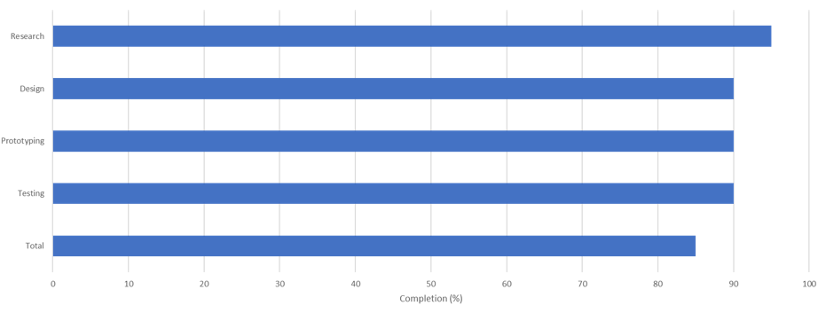
Progress

Slide 36
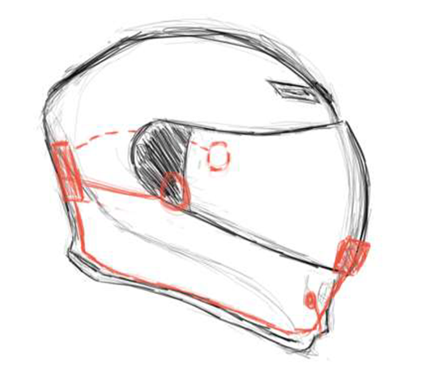
Questions?

