Slide 1
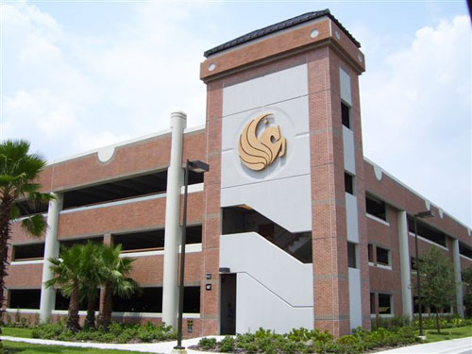
The Garaginator
Car Tracking System For Garages
Group 5
Sebastian Rodriguez E.E.
Jonathan Gillis CPE
Jon Staudt E.E.
Elliot Rodriguez CPE

Slide 2
Motivation
Current UCF garage system is inefficient and slow to update
In many cases we would see a sign for a garage say OPEN but there would be barely any spots or possibly zero spots remaining in the garage.
Garages are large and easy to lose your car in
Current garage tracking systems are expensive

Slide 3
Solutions
Implement garage sensors directly connected to a microcontroller which sends information to a web server to update the volume of cars and spots available in real time
Create a quick and streamlined process to save your car’s location for a later reminder upon return to the garage
Use readily available and inexpensive parts for all aspects of the design

Slide 4
Block Diagram
Back-end
Sensors
Kiosk
Database
Sensor Diodes
ATMega328p
ESP8266
WiFi Module
Server
Keypad
Web Client
(Mobile, Desktop)
LCD

Slide 5
Specifications
The Garaginator:
Quick and easy to use - No more than four menus for the Kiosk
Fast and reactive user interface - Keypad latency less than 150 ms
Cheap hardware solution - Under 100 dollars per unit
Server must be able to handle a high volume of data with ease
Users must be able to save or retrieve their vehicle’s location
Responds to user requests in less than four seconds

Slide 6
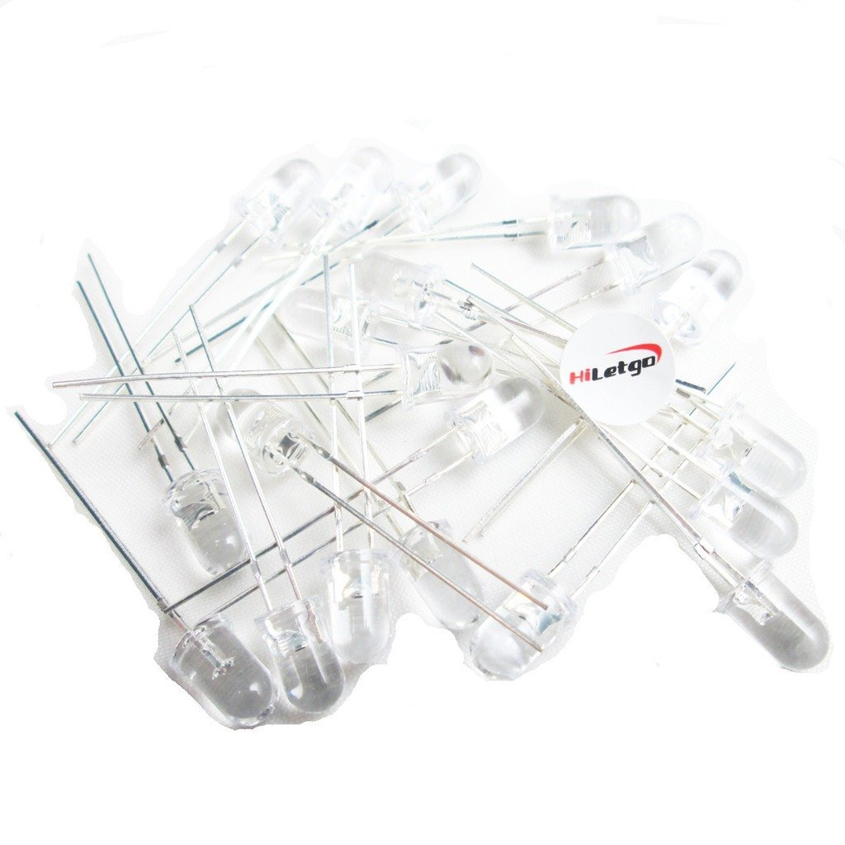
Part Selection - Photodiode
Purchased from Amazon
HiLetGo Brand
25 cents each
Active Low output
Part Number: 3-01-0591

Slide 7
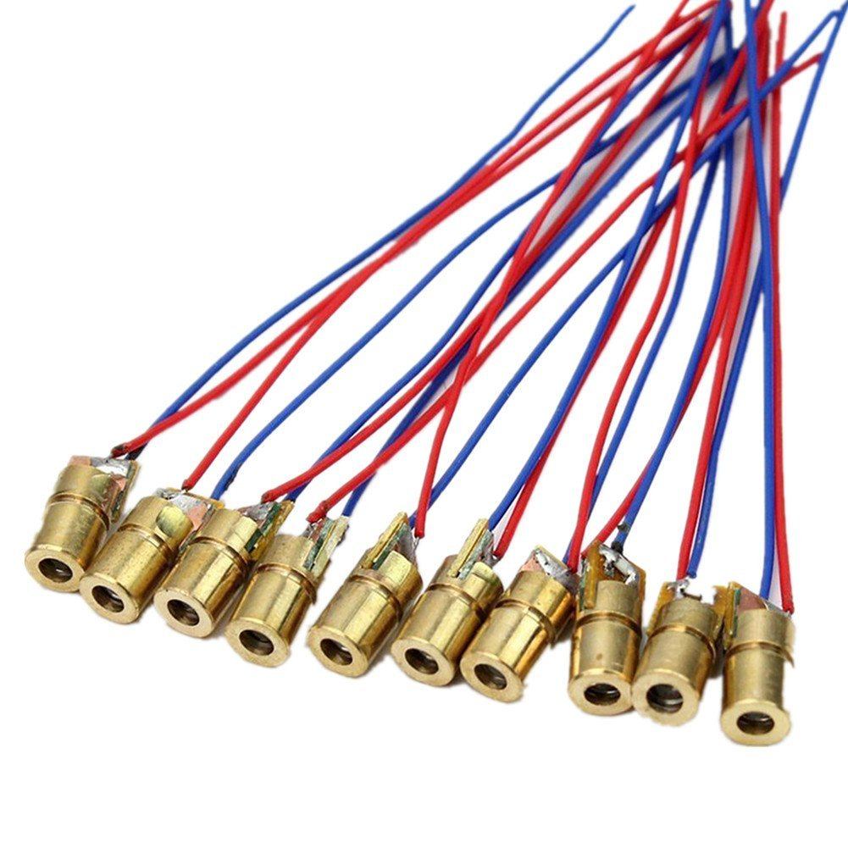
Part Selection - Lasers
Purchased from Amazon
GeeBat Brand
60 cents each
650 nm, 5V, 5mW laser dot diode
Part Number: 80-141-10

Slide 8
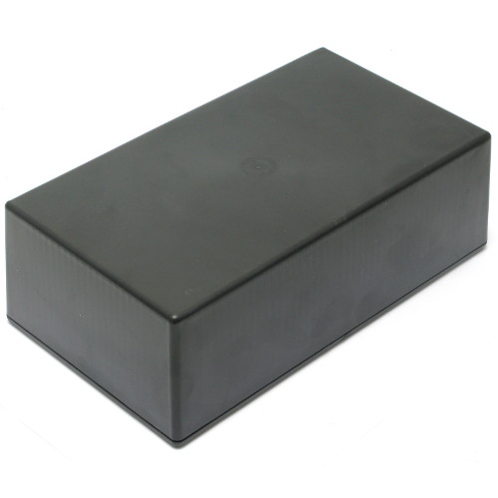
Part Selection - Housing
Purchased from Skycraft
5.25" x 3.25" x 1.6”
Drilled into sides for placement of sensor circuits and wires
$4.50 each
Part Number: SK4465

Slide 9
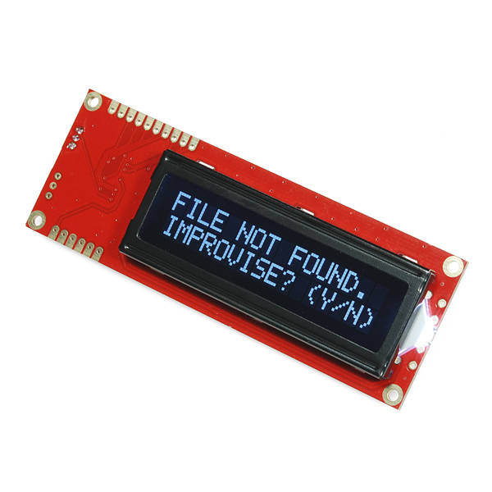
Part Selection - LCD Display
Purchased from sparkfun
Has a serial interface (not parallel), therefore requiring less GPIO pins from the MCU
Also has a backlight, so it can be used at night
Was not necessary to have fancy graphics, so we chose something inexpensive - $24
Part Number: LCD-09395

Slide 10
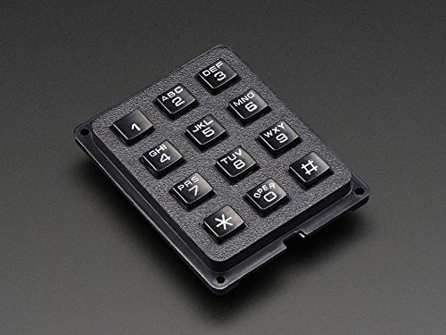
Part Selection - Keypad
3x4 numeric keypad, rather than one with alphanumeric input
Cost $3.40
Decision was largely driven by desire to reduce costs
Part was purchased at Skycraft

Slide 11
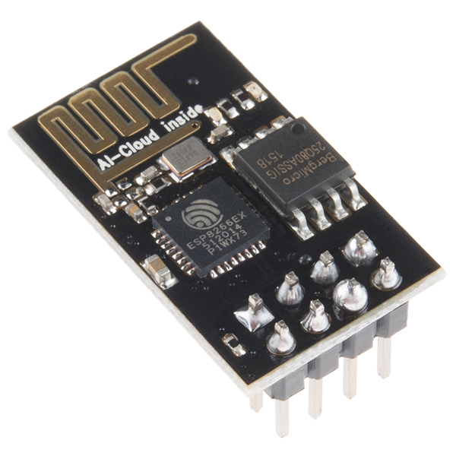
Part Selection - Network Interface
Using the ESP8266 WiFi transciever
TBD Control Brand
Very low cost - $3.50 on amazon
Uses UART interface, easing requirements from MCU
Allows flashing of custom firmware, which offloads some computation from the host microcontroller
Part Number: B01MT6T73L

Slide 12
Sensor Requirements
Accuracy - Car should trigger sensor only once as it enters or exits
False Positives - Sensors should be able to filter out false positives
Noise Resilience - Sensor should not be triggered or prevented from triggering by noise
Small Cone of Detection - Cone of Detection should be as close to 0 degrees as possible

Slide 13
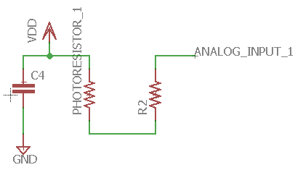
Sensors
Optical sensor system with laser and photoresistor
Voltage level of circuit driven to 5V as laser shines on it
Signal that car has entered is sent when voltage level drops to 0 V
Two sensors per lane to reduce false positives

Slide 14
Microcontroller Choice
MCU | USB | UART’s | #Pins (&GPIO) | Self Programing | Clock Speed | Cost
Rasp. Pi 3-b | Y | 0 | 40 (40) | Y | 1.2 GHz | $35
nRF52832 | N | 1 | 48 (32) | N | 64 MHz | $20
PIC32MX64 | Y | 4 | 64 (53) | N | 200 MHz | $20
PIC32MZ144 | Y | 6 | 144 (120) | N | 252 MHz | $10
MSP430F67 | N | 3 | 100 (72) | Y | 25 MHz | $7
ATMEGA328P | N | 1 | 28 | Y | 20 MHz | $2
Notes:
For our choice of microcontroller we looked at a large variety of options. We initially chose the PIC32MZ144, highlighted in blue, because of its high clock speed and relatively cheap cost. But in the development process it proved to be very finicky and hard to use and test. So after a little over half the semester went by then we changed our choice to the ATMEGA specifically the 328P. Even though the performance wouldn’t be as good, it is much cheaper: Being only $2.

Slide 15
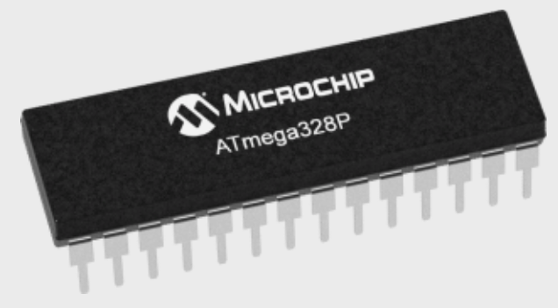
ATMEGA328P-PU
8-Bit AVR RISC-based MIPS
Max Core Clock Speed - 20 MHz
Operating Voltage 1.8 - 5.5 Volts
UART(s) - 1 (Pairs of RX and TX)
6 channel A/D converter
Number of Pins - 28
Low-Power Modes
$2.18 from Microchip Direct
Notes:
The atmega MCU we chose is widely used chip. Our specific version the 328P-PU operates using any voltages between 1.8 and 5.5 volts, one UART connection: used for the wi-fi module, 6 A/D converters: four of which are used for reading the status of the photoresistors, 28 pins, and only $2.18 from Microchip technologies.

Slide 16
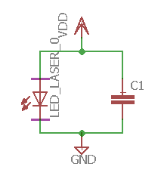
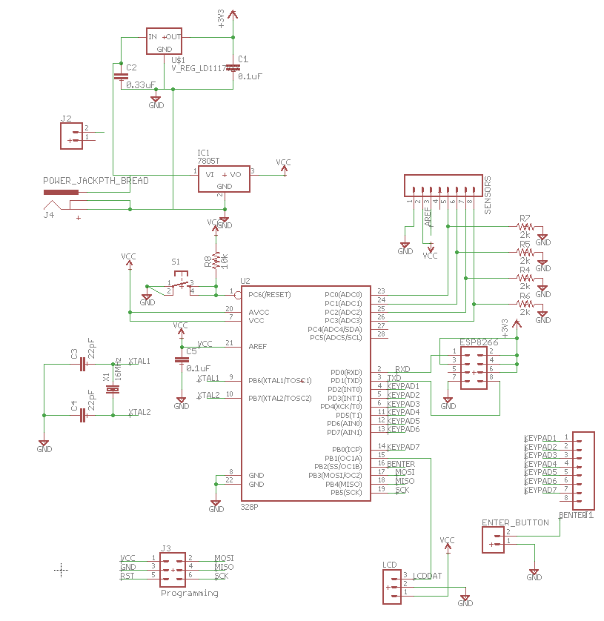
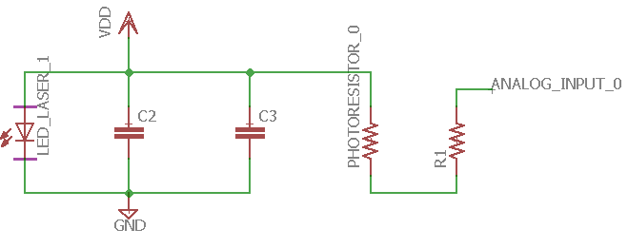
Notes:
These are our schematics in EAGLECAD. The three schematics on the left are the three different varieties of circuits used for the sensor boxes. The top being one with just a laser, the middle are ones with a laser and the photoresistor, and the bottom is one with just a phototresistor. The schematic on the right displays all the connections to the MCU and the power circuit at the top. One the top right there are the headers for the sensors, wifi module, keypad and enter button, and the LCD screen. This six pin header here is for programming the MCU when it’s attached to the PCB.

Slide 17
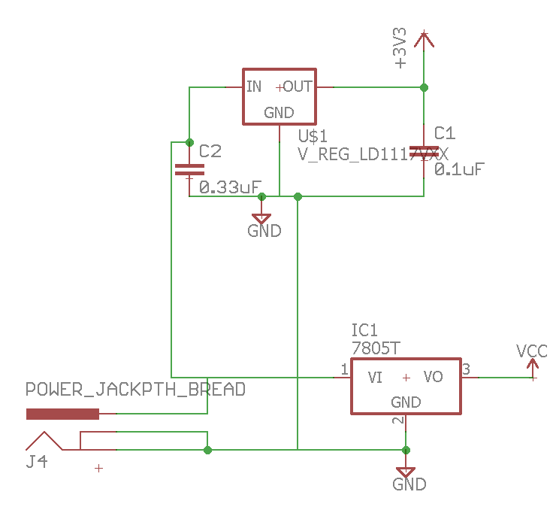
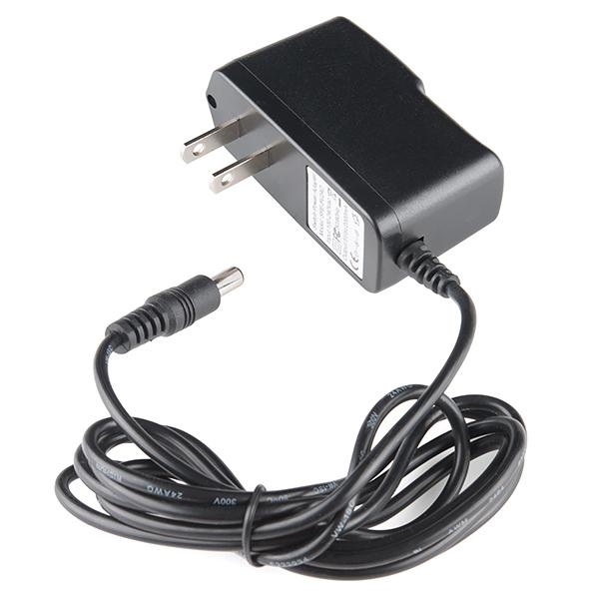
Power Supply and Voltage Regulators
Wall outlet 120V 60Hz AC to 9V DC
Two voltage regulators
5V & 3.3V
3.3V required for Wifi Module
5V for everything else
Notes:
For powering theproject we decided on a wall jack to convert the outlet AC to 9V DC. Then we have two voltage regulators to convert the 9 volts DC to 5 volts and 3.3 volts. The only thing requireing 3.3 volts is the wi-fi module, while everything else runs off of 5 volts.

Slide 18
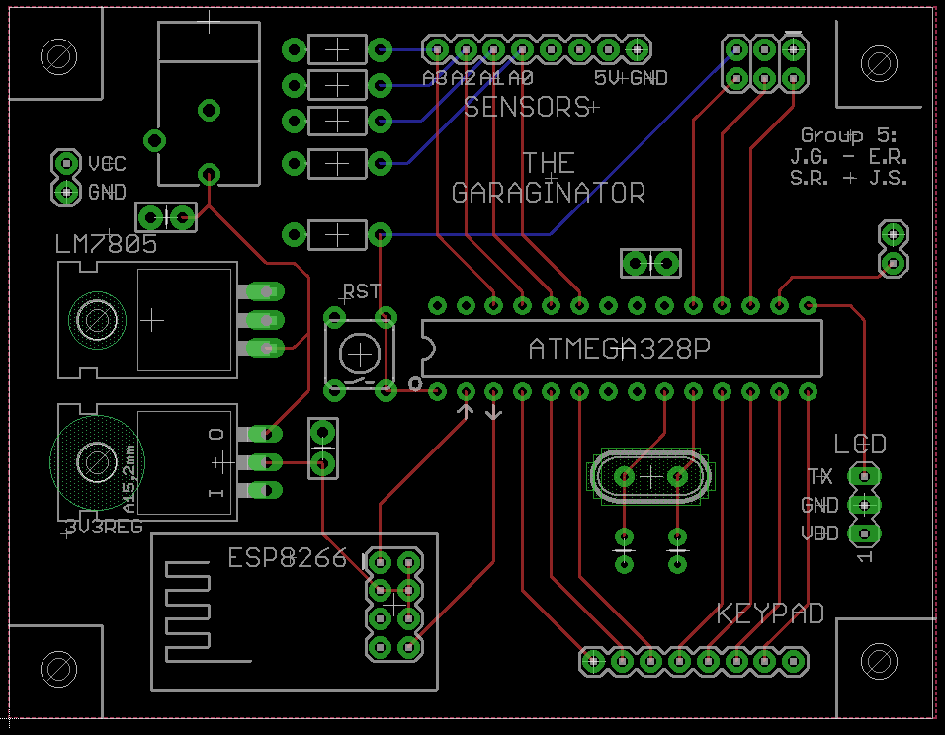
PCB Design

Slide 19
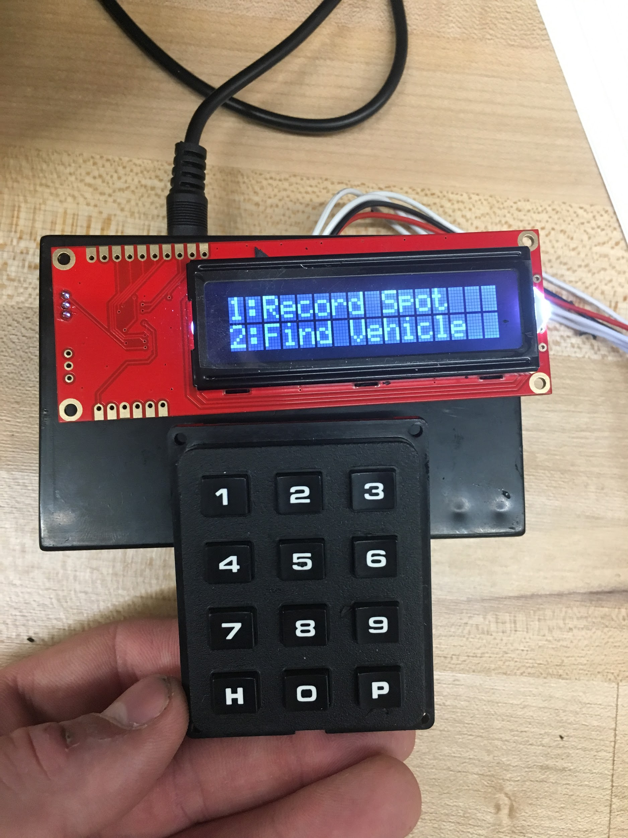
Kiosk - Overview
Houses the PCB
Allows users to input or retrieve their vehicle’s location from inside any garage
Interprets analog data from sensors
Sends amount of cars entering and exiting a garage to the backend web server

Slide 20
Kiosk - Interpreting Sensor Data
Each lane has two laser/diode pairs, to ensure that an object passing through is at least a certain length
Counters increment on the rising edge of the first pair, only if the second pair is also already broken.
This system works well for the case of cars tailgating
Laser
Diode
Laser
Diode

Slide 21
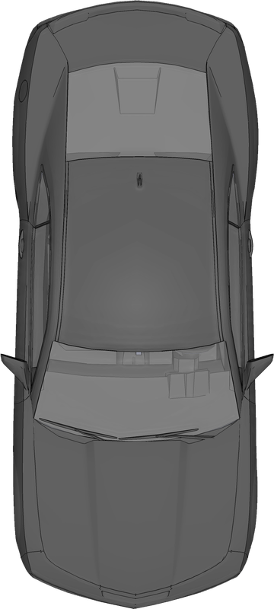
Kiosk - Interpreting Sensor Data
When a car enters the garage it will always break both lasers on the way in
Laser
Diode
Laser
Diode

Slide 22
Kiosk - Interpreting Sensor Data
When a car enters the garage it will always break both lasers on the way in
Next, the first pair will become unbroken
This is the transition where the counter gets incremented/decremented
Laser
Diode
Laser
Diode

Slide 23
Kiosk - Interpreting Sensors
Note that even if a car is tailgating extremely closely, this transition will still occur
This works as long as the cars aren’t moving so fast that there isn’t time for a sensor reading
Laser
Diode
Laser
Diode

Slide 24
Kiosk - Other Challenges
User interactions must be smooth and responsive, meaning the MCU must always be ready to accept input
Takes Sensor readings every 100 msec, and determines whether that means there is a car
Must make readings very quickly to keep user input latency low
The Kiosk must also send all this information to the web server, while taking care to avoid data races
Since there is only one data connection to the WiFi module, sensor data and parking spot data cannot be transferred simultaneously
We managed to do all this with about $5 worth of processing power

Slide 25
Kiosk - Software Design
The key was to leverage the processing capabilities of the ESP8266 module with the I/O capabilities of the ATMega
We used a command pattern to allow the ATmega to control the processing on the WiFi module.
All commands are initiated by ATMega, and consist of a single line in a format that is convenient for the receiver
Below is a rough example of the data exchange when a user is looking up where they parked
ATMega
REQ:/getSpot {“userid”:”123”,”passcode”:”9876”}
ESP8266 WiFi Module
RSP:200:GARAGE D FLOOR 2 SPOT NUM 555

Slide 26
Software Details
NodeJs is being used as our backend Server
Handles update requests when garage sensors are triggered
Used to constantly refresh the garage information table on the website
Handles data transfer of vehicle location to our garage kiosk system and website.
MySQL is the Database Management System we are using
Holds information for all garages and users
Used to store user’s vehicle location
HTML, BootStrap CSS and AngularJS used for creating frontend web page
Displays real time garage information/availability
Allows users to store and retrieve their vehicles location

Slide 27
NodeJS Description
Very good at handling a large amount of requests with ease, specifically I/O requests by using asynchronous event driven APIs.
NPM (Node Package Manager) which is a great tool for managing 3rd-party dependencies.
Lots of useful libraries such as crypto which we used to implement a sha256 login system.
We use a NodeJS MySQL plugin which allows us to pool database connections, this lets us hand a database connection to any http request that requires one.

Slide 28
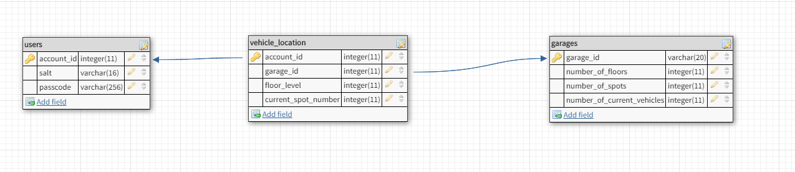
Database Tables Description
The Users table holds user id (possibly UCF ID), salt, and passcode
The Garage table holds garage information such as number of spots and floors
Vehicle location uses two foreign keys (account_id from users table which is also the primary key) and (garage_id from garages table) in order to create a unique entry in this table allowing users to “store” their location to be retrieved later.

Slide 29
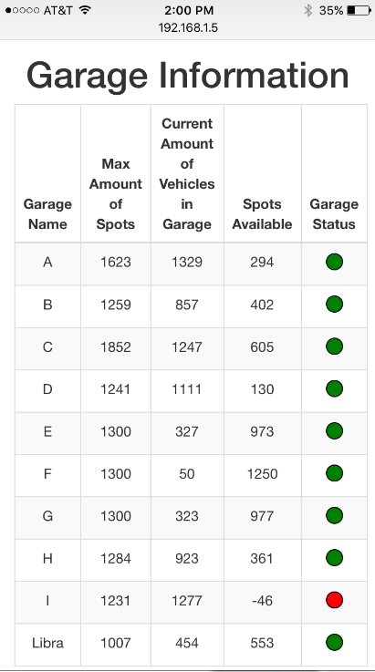
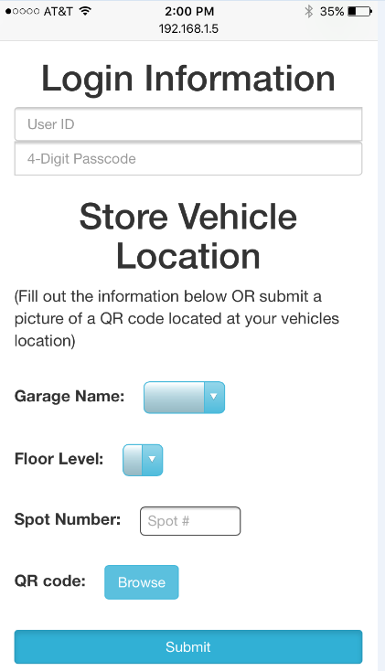
Web Application - Interface
The Garage information is immediately accessible
The garage tables update in real time
Users can store their vehicles location manually by filling out the form or they can take a picture of a QR code located at that location.
We use a JavaScript port of the ZXing QR code scanner library to read and process images sent from users to extract and decode the QR code from the images they upload.
Users can retrieve their spot if they have saved one

Slide 30
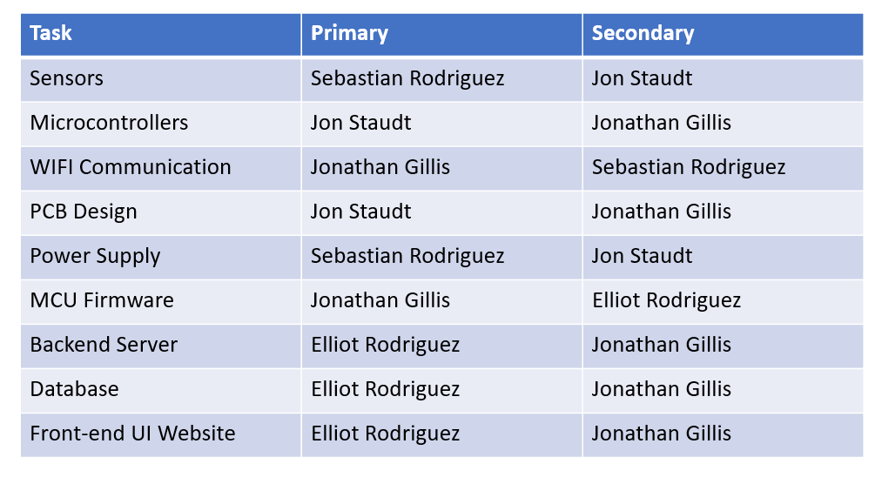
Task Allocation

Slide 31
Budget
Total Development Costs
Part | Price | # ordered
Router | $50.00 | 1
ATMEGA328P | $2.18 | 5
Pef Board | $1.50 | 10
3 x 4 Keypad | $3.50 | 1
character display | $24.95 | 1
Magnetic card reader | $12.90 | 1
PIC32MZ2048EFH144 | $9.67 | 8
Sensors - Lasers | $0.60 | 10
Sensors - PhotoDiodes | $0.25 | 20
ESP8266 Wifi module | $3.50 | 4
PCB | $0.20 | 10
Housing Units | $4.50 | 9
Breakout Board #1 | $2.60 | 4
Breakout Board #2 | $1.60 | 4
Ethernet RJ45 Jacks | $6.69 | 5
Soldering Flux Pen | $15.00 | 1
Ethernet PHY Chip KSZ8081 | $0.67 | 1
Debugger | $50.00 | 1
Total | $378.03
Per Unit Cost
Part | Price | #required in project
Perf Board | $1.50 | 6
3 x 4 Keypad | $3.50 | 1
LCD Character Display | $24.95 | 1
ATMEGA328P | $2.18 | 1
Sensors - Lasers | $0.60 | 4
Sensors - PhotoDiodes | $0.25 | 4
ESP8266 Wifi module | $3.50 | 1
PCB - Estimate | $0.20. | 1
Housing Units | $4.50 | 7
Total Unit Costs | $51.23

Slide 32
Questions?

