Slide 1
AQUA SENTINEL 3000
Group 11
Anna Baranova Computer Engineering
Brian Bisplinghoff Computer Engineering
Minh Nguyen Electrical Engineering
Zachary Schwartz Computer Engineering

Slide 2

Problem
Drowning is a major cause of death in children
Impossible to always keep track of kids at all times
Parents are always worried when they own a pool
Particularly when leaving child with babysitter

Slide 3
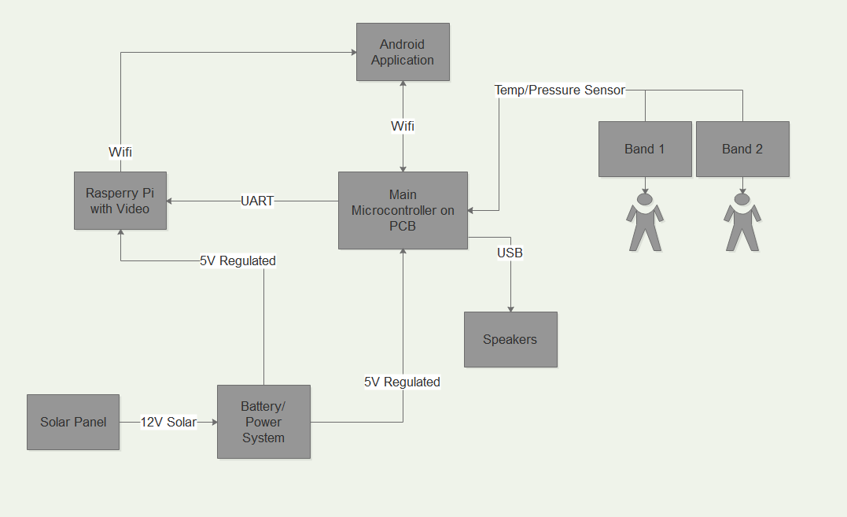
Solution
Pool monitoring system
Sits by the pool and constantly monitors
Child wears a band that will detect if they fall in
Sends alert to parents phone application to alert them
Parent then has a variety of options to respond to the situation

Slide 4
Goals and Objectives
Easy to set up by pool
Both band and sensor are waterproof
System is very responsive in alerting the parent and responding to commands sent from application
User-friendly mobile application
The wearable device is comfortable, small, and sturdy
Reliable communication between all components

Slide 5
Specifications and Requirements
Lightweight, no more than 15 pounds
Band able to withstand being submerged in 1 feet of water
WIFI connection able to sync within at least 30 meters
Able to be powered solely by sunlight and function with no light for up to 2 days
Video able to be streamed with maximum delay of 3 seconds
Cost below $100 to manufacture

Slide 6
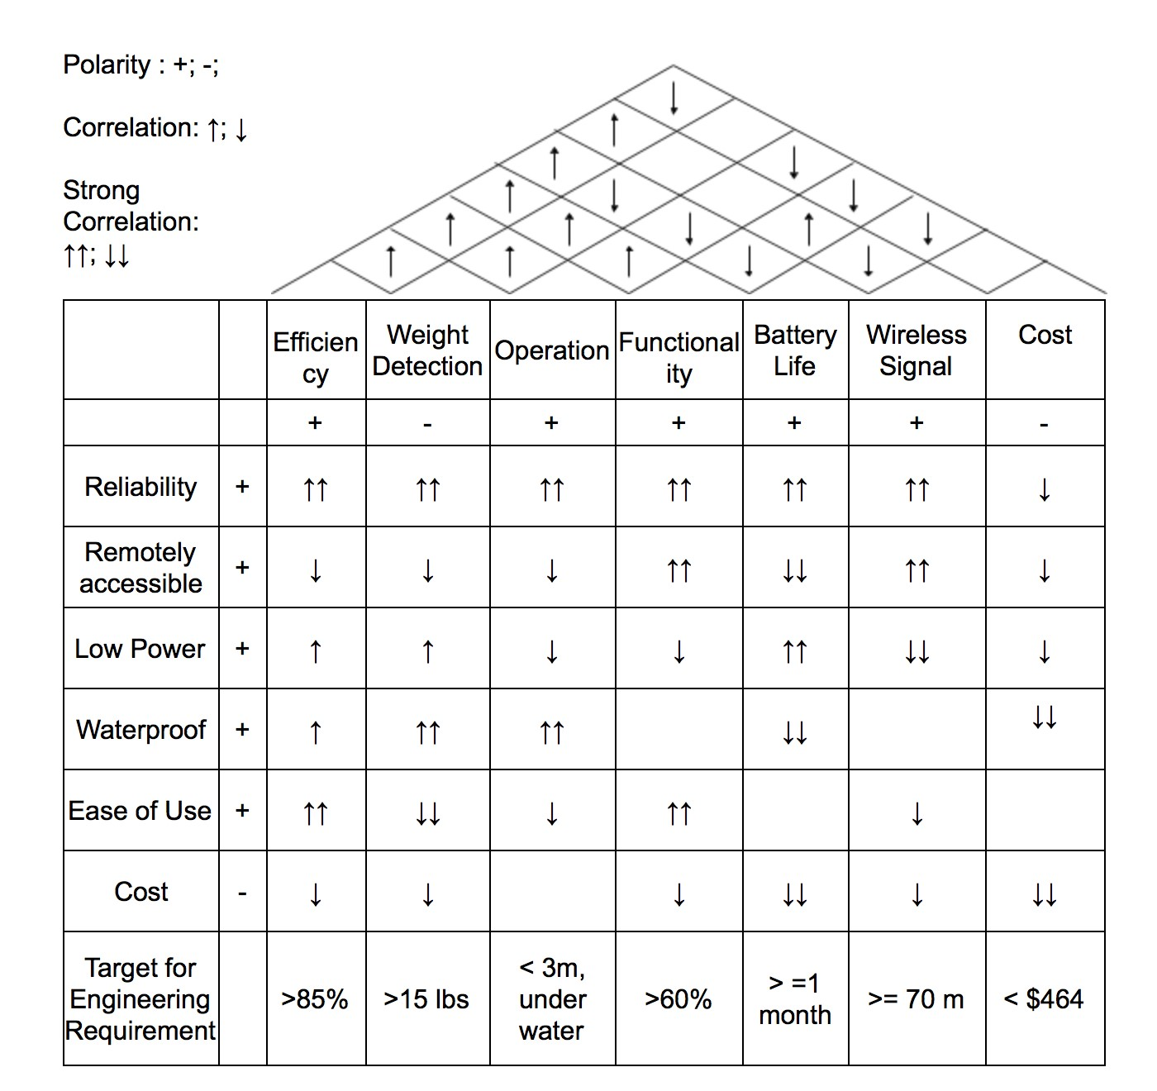
House of Quality

Slide 7
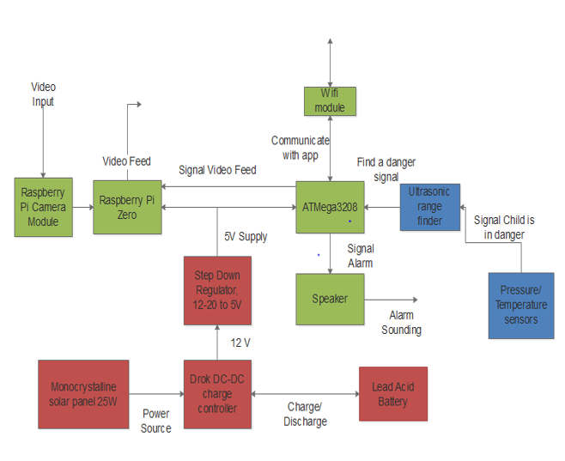
System Overview

Slide 8
Microcontroller Selection
 | MSP430G2553 | MSP430FG4618 | ATmega328 | SAM4SD32C | PIC 16F887
GPIO Count | 24 | 80 | 22 | 79 | 35
Clock Frequency | 16 MHz | 8 MHz | 1 MIPS/MHz | 120MHz | 20 MHz
RAM | 512 Bytes | 8 kB | 2 kB | 160 kB | 368 Bytes
Storage Memory | 16 kB | 116 kB | 32 kB | 2024 kB | 4 kB
ADC | 10-bit | 12-bit | 10-bit | 16-bit | 8-bit
Low power current | .5 µA | 1.3 µA | .75 µA | 30 µA | 11 µA
Cost | $2.38 | $121.18 | $1.95 | $2.16 | $8.63
Additional Consideration | Available easily with launchpad development board. | Not available except with costly board. | Arduino libraries available to supplement development. | DAC available if necessary. | Low amount of development resources

Slide 9
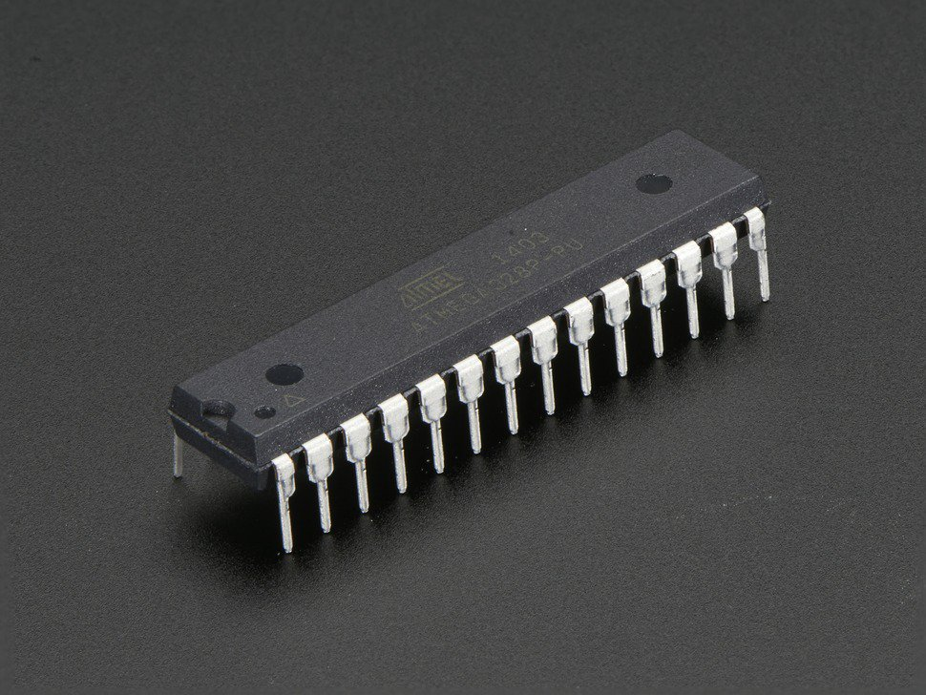
Microcontroller Selection – ATmega328
Sufficient memory and GPIO pins
10-bit ADC
Capable of low power modes with interrupts
Most development libraries of any MCU

Slide 10
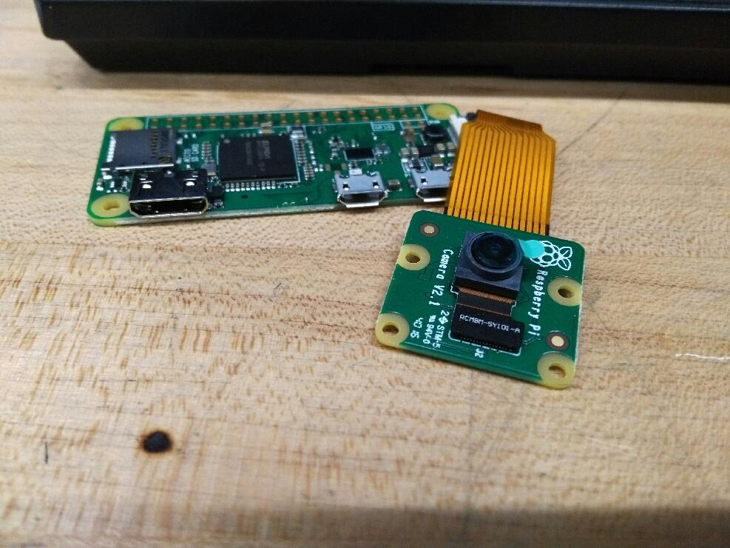
Raspberry Pi Zero
Extremely affordable at $10
Capable of video streaming
WIFI connection built in allows for easy configurability
Small enough to be compatible with the rest of system

Slide 11
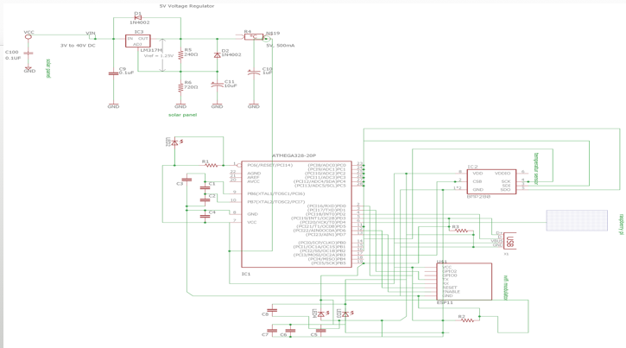

Slide 12
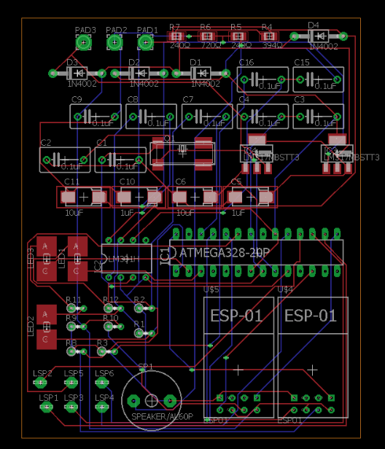
Printed Circuit Board Design

Slide 13
WiFi Selection
 | ESP8266-01 | CC3000 | HDG204 | RN-131C
WiFi Standard | 802.11 b/g/n | 802.11 b/g | 802.11 b/g | 802.11 b/g
Size | 21X11 mm | 26.22X40.45 mm | Arduino Shield 66X53 mm | Arduino Shield 66X53 mm
Interface | TTL Serial | SPI | SPI | SPI
Transmit Current | 215 mA | 350 mA | 210 mA | max 210 mA
Receive Current | 60 mA | n/a | n/a | 40 mA
Programmable | Yes | No | Yes | No
Cost, $ | 2.75 | 34.95 | 84.95 | 69.95

Slide 14
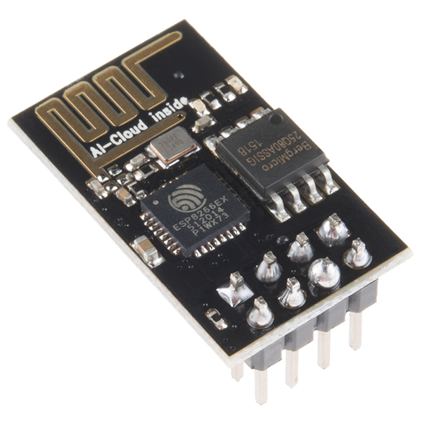
Wi-Fi Module ESP8266 is the choice
This module will be placed on wearable device and ATMega3208
Uses standard TCP/IP connection to connect to Wi-Fi
Parameter | ESP8266 Implementation
Transmit Current | 200 mA
Receive Current | 60 mA
Standby Current | .9 mA
Protocol | TCP/IP
Turnaround time | 2ms
Microcontroller Connection | SPI/UART/SDIO 2.0

Slide 15
Speaker Selection
 | USB Speakers from Adafruit | Audio DC Buzzer Siren | Piezo Buzzer PS-1240
Current Supply | About 300 mA draw at half-volume | Requires 260 mA supply | 9 mA
Connection | Requires 3.5 mm stereo jack on PCB | Hardwired onto the PCB | Hardwire onto the PCB
Frequency | 100 Hz - 18 KHz frequency response | 3 KHz | 2KHz – 10 KHz
Power | 5 V DC at max volume | 6 - 16 Voltage Range | 3 – 30 Voltage Range
Volume | Two 3 W speakers | 123 dB when operating at 12 V | 60 dB when operating at 3 V
Price, $ | 10 | 31 | 1.50

Slide 16
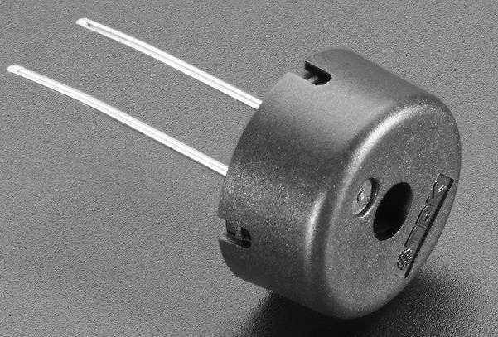
Speaker
Piezo Buzzer is best for our project because:
  Low-powered
  Lightweight
  Does not need aux input
        Using USB powered speakers would consume more power and require an aux input.

Slide 17
Camera (Raspberry Pi
Camera Module V2)
Will start recording video of pool area when parent enables the camera from the mobile application.
Stream will be viewable on mobile application.
 | Raspberry Pi Camera Module V2 ($29) | Logitech HD Webcam C525 ($33)
Connection | Connects to CSI port | Connects to USB port
Video Quality | Supports up to 1080P video | Supports up to 720P video
Compatibility | Directly compatible with the Pi which will handle our video processing. | WIll not be able to support official drivers when using with the Pi.
Frame Rate | At 720P can produce 180 fps | At 720P can produce 30 fps
CPU Consumption | Consumes less CPU power | Resource intensive
Power | Producing 1080P video draws only 250 mA | Producing 720P video draws about 400 mA

Slide 18
Ultrasonic Sensor Technology
Diffuse Mode | Retroreflective Mode | Thru-beam Mode
Transmitter and receiver in the same housing | Transmitter and receiver in the same housing | Transmitter and receiver in different housing.
Continuously emits sound wave to capture echo from object in range. | Uses retro-reflector to reflect emitted sound wave. If sound wave is not captured by receiver - there is an object between sensor and retro-reflector. | Transmitter sends sound wave and receiver captures it. When signal is lost an object is present between transmitter and receiver.
Easy to install | Easy to install | Hard to install / alignment is important
Can detect object in difficult angle | Moderate sensing distance | Longest sending distance
No reflector needed | Less expensive than thru-beam because simpler wiring | Most reliable when you have highly reflective objects
If background is close or sufficiently reflective, it is almost impossible to detect an object | May detect reflection from shiny objects | More expensive because separate light source and receiver required, more costly wiring
Used when both sides of the object cannot be accessed | General purpose sensing | Used in general purpose sensing and/or parts counting

Slide 19
Ultrasonic Sensor Comparison
 | XL-MaxSonar-EZ0 | HRLV- MaxSonar-EZ1 | HC-SR04 | RCVR 40kHZ | PING#28015
Manufacturer | MaxBotix | MaxBotix | Elecfreaks | Murata Electronics | Parallax
Price, $ | 49.95 | 34.95 | 3.95 | 6.80 | 29.99
Range Detection | Wide: Up to 2m | Wide: Up to 1.2m | Wide: up to 0.6m , beam angle 15° | beam angle 80° | beam angle 20°
Power, V | 3.3 to 5.5 | 2.5 to 5.5 | 5 | - | 5

Slide 20
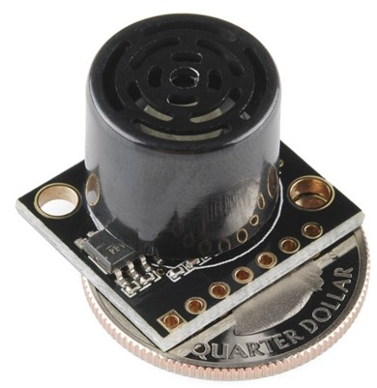
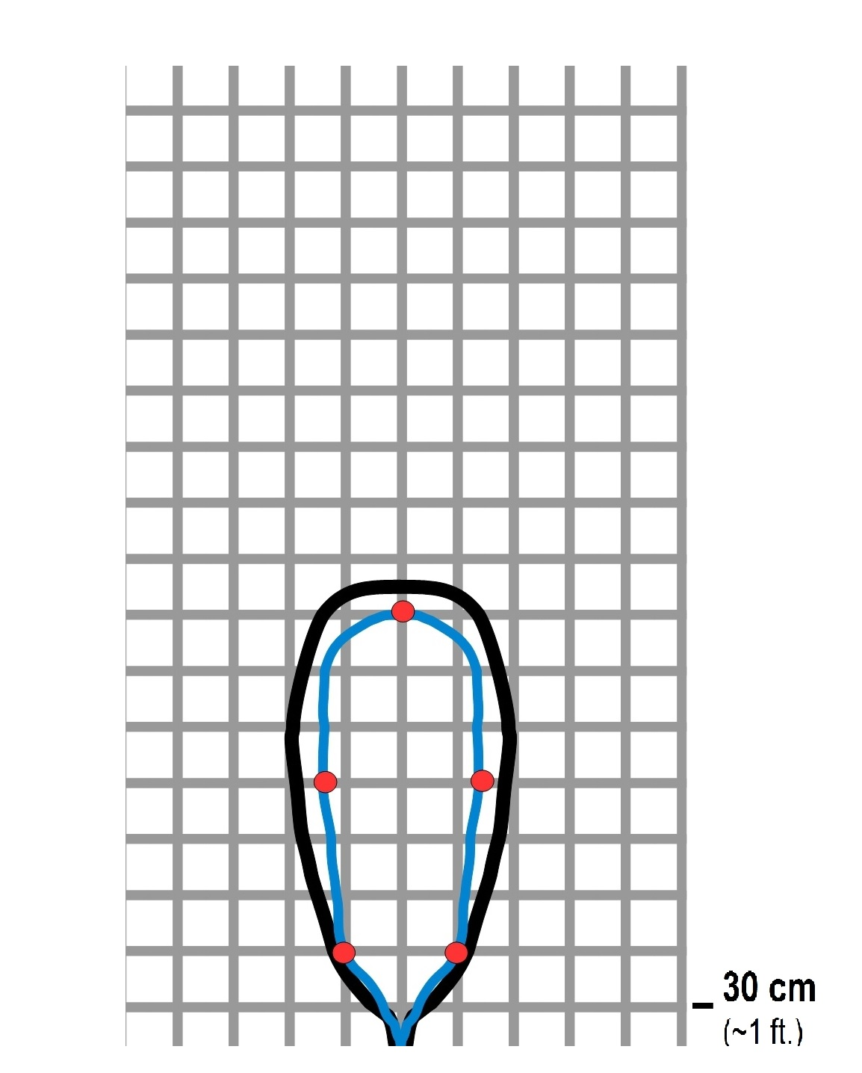
HRLV-MaxSonar-EZ1 the choice
Object proximity detection from 1-mm to 5 meters
Resolution of 1-mm
Actual operating temperature range from –40°C to +65°C
Operating voltage from 2.5V to 5.5V
Nominal current draw of 2.5mA at 3.3V, and 3.1mA at 5V
Low current draw reduces current drain for battery operation
Fast first reading after power-up eases battery requirements

Slide 21
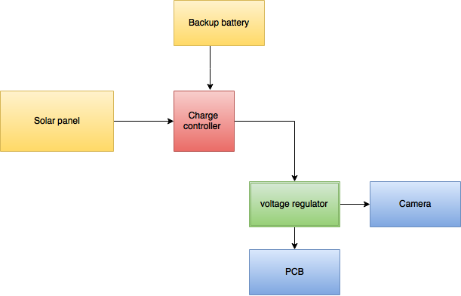
Power System Flow Diagram

Slide 22
Solar Panel Technology Comparison
 | Thin Film | Poly-Si Panels | Mono-Si Panels
Maximum Efficiency | 12% | 16% | 21%
Manufacturing method by | Depositing 1 or more layers of PV material | Fusing different crystals of Si | Single Si crystal
Degradation of Performance | Less affected by low-sunlight conditions | In low-sunlight conditions | In low-sunlight conditions
Best if used in | Standard Temperature | Moderately High Temperature | High Temperature
Cost/Watt, $ | 0.67 | 1.42 | 1,59

Slide 23
Solar Panel Comparison
 | Newpowa 25W | Komaes 50W | ALEKO 25W | PowerEco 25W
Power | 25W, max | 50W, max | 25W, max | 25W, max
Voltage at Pmax | 17.2V | 17.74V | 17.5V | 18.9V
Power Tolerance | ± 3% | ± 5% | - | ±3%
Current at Pmax | 1.45A | 2.84A | 1.35A | 1.49A
Price, $ | 39.97 | 84.99 | 34.84 | 42.00

Slide 24
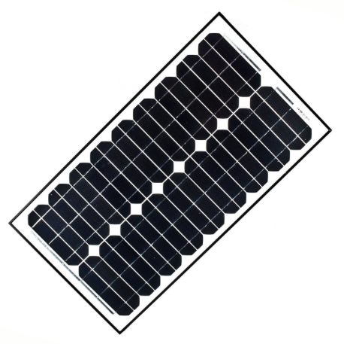
Newpowa NPA25-12 (Our Selection)
High efficiency 25W 12V Mono Solar Panel PWM 10A Charge Controller Battery Charger Kit
Temperature coefficient of Voc | -(80±10)mV/°C
Temperature coefficient of Isc | (0.065±0.015)%/ °C
Temperature coefficient of power | -(0.5±0.05)%/ °C
NOCT (Air 20°C; Sun 0.8kW/m² wind 1m/s) | 47±2°C
Operating temperature | -40°C to 85°C
Maximum system voltage | 1000V DC
Power tolerance | ± 3%

Slide 25
Battery Technology
Lead Acid | Lithium Ion | SaltWater
Most Commonly Used | Commonly Used | Not well known
Cheap cost | Flexible in Design | Pound per pound cheapest
Does not last as long | Long Lasting | Extremely Large
Need to constantly maintain | Flammable | Price starts at $800
Toxic | Non Toxic | Non Toxic

Slide 26
Battery Comparison
 | UB1222 | NPower | EXP 1270
Volts | 12 | 12 | 12
Amps | 2.2 | 18 | 7
Battery Type | AGM | AGM | AGM
Battery Chemistry | UPG sealed | Sealed Lead Acid | Sealed Lead Acid
Dimensions (LxWxH), in | 7 x 1 3/8 x 2 1/2 | 7 1/8 x3 1/16 x 6 9/16 | 5.9 x 2.5 x 3.7
Cost, $ | 19.99 | 59.99 | 24.99

Slide 27
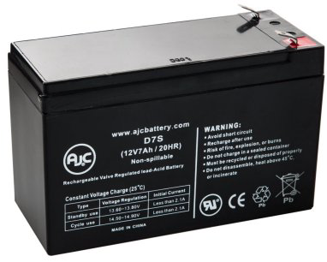
ExpertPower EXP1270 (Our Selection)
12 Volt, 7 Amp, 20 Hour, Sealed Lead Acid Battery
Protective ABS plastic battery case is resistant including shock, vibration chemicals and heat.
AGM technology to protect environment from acid spill makes it safe to operate.
Easy installation and maintenance free.

Slide 28
Voltage Regulator technology Comparison
Low DropOut | Quasi Low Dropout | Standard NPN
Requires at least voltage across (0.1 to 0.7 V) | Requires least voltage across (0.9 to 1.5 V) | Requires most voltage across ( 1.7 to 2.5 V)
Highest ground pin current (wasted current) (< 20-40 mA) | Low current (wasted current) (< 10 mA) | Lowest ground pin current (wasted current) (< 10 mA)
PNP transistor | PNP and NPN transistors | NPN (Darlington config.)
Best for battery power applications | Good use on both AC and battery powered | Best for AC powered applications

Slide 29
Voltage Regulator Comparison
 | LM317 Adjustable Regulator | DROK Voltage Regulator
Control | Harder to regulate | LCD Screen (numerical control)
Usability | Compact in size. Harder to replace | Easy to replace
Cost | Cheap $0.75 | More expensive $9.00

Slide 30
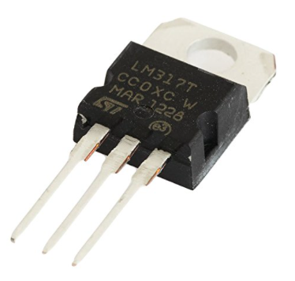
Voltage Regulator LM317 (Our Selection)
3 terminal positive voltage adjustable regulator
Output voltage range 1.25V 37V
Output current greater than 1.5A
Internal short-circuit current limiting
Thermal overload protection
Output safe-area compensation

Slide 31


Operating System (Android)
Open source and extensive resources (API support)
Simple debugging
Programmable on Windows and Mac
Easier to publish Android app than iOS app
We have more background experience in Android

Slide 32
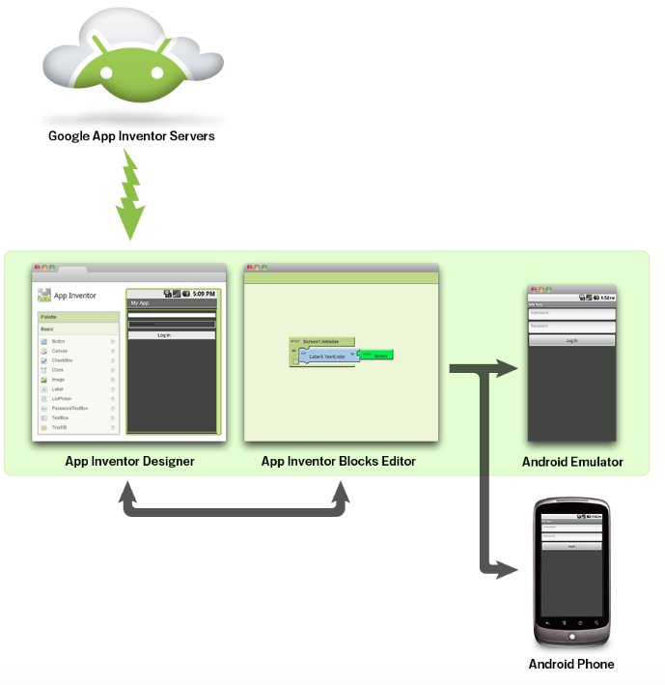
MIT App Inventor
The App Inventor for Android is an open-source web application.
Very easy to use
Real-time debugging on connected devices

Slide 33
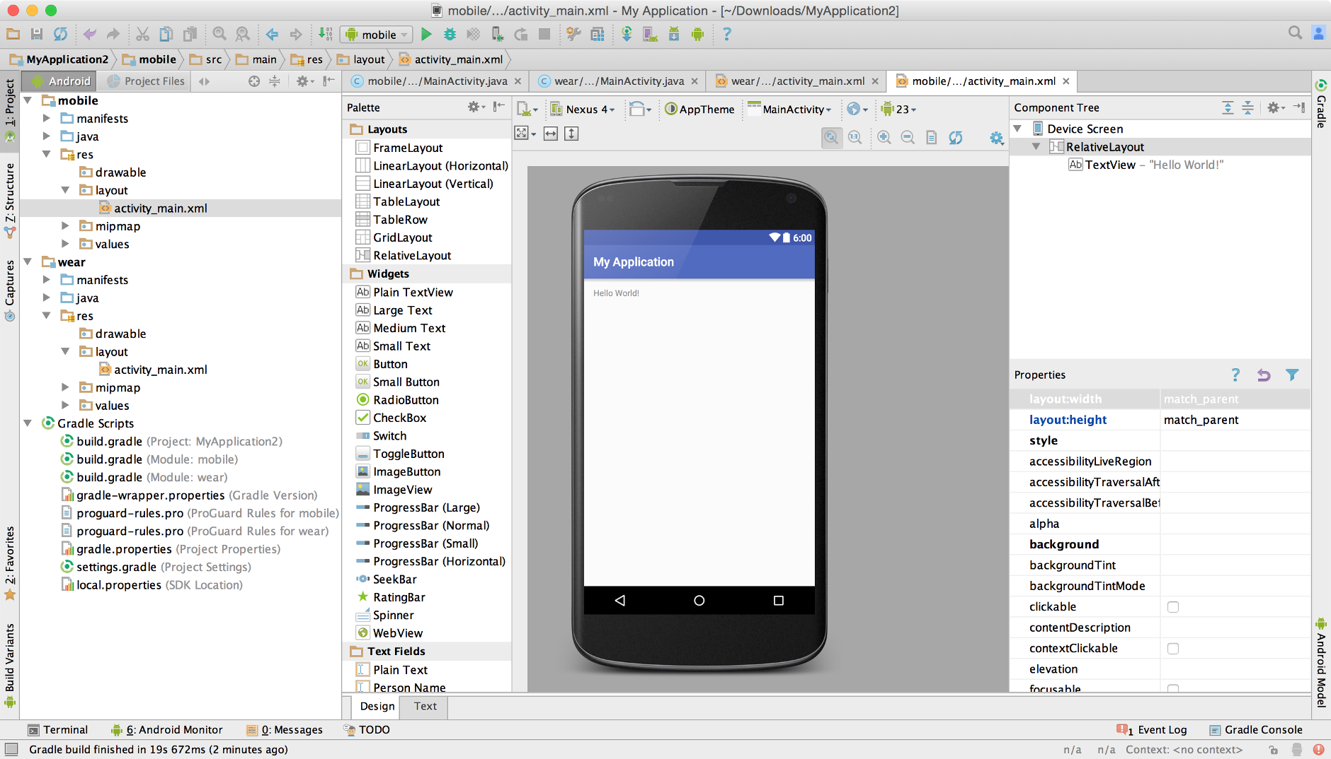
Android Studio
Official IDE for Android development.
Integrates version control tools such as GitHub
Efficient/fast emulator
Gradle-based build support

Slide 34
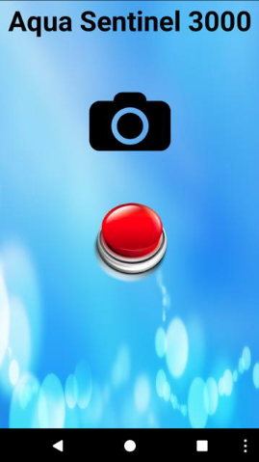
GUI
Simple and organized
Two buttons on home page:
          Camera
          Alarm
On camera page: Text box to enter IP and connect, which will launch a viewing page for the stream
On alarm page: Text box to enter IP and disable/enable buttons for the alarm.

Slide 35
App Functionality
Communicate with main main MCU
  Display connection status
  Turn alarm on/off (sends http request over the network using TCP protocol)
  Display video stream (when user types in IP to connect to it will store as string and call the IP.

Slide 36
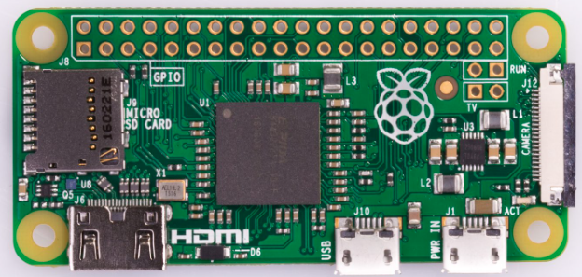
Raspberry Pi Software
The Raspberry Pi runs the MJPG Streamer API which continuously captures photos and saves the photos to a temporary folder on the Pi.
When the user enters IP on video page of mobile application, it will connect to the Pi and display the frames that are being captured and stored in the temporary folder.

Slide 37
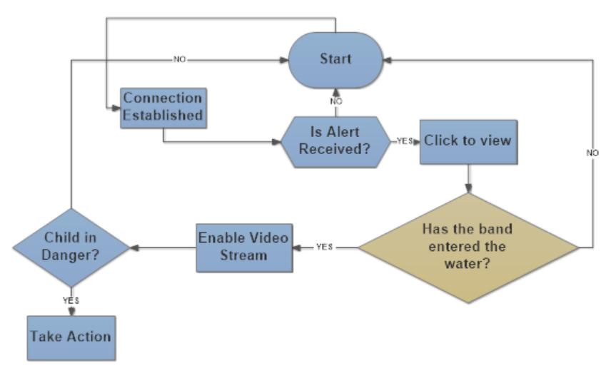
Software Flowchart

Slide 38
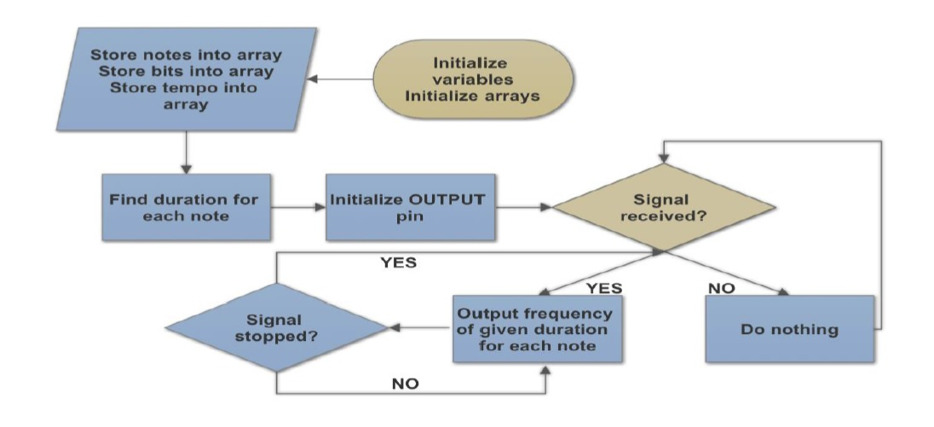
Microcontroller Code: Speaker

Slide 39
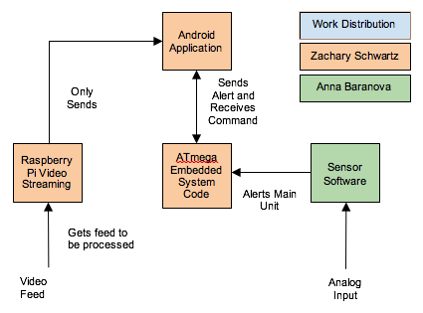
Overview: Coding Block Diagram

Slide 40
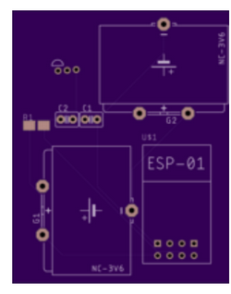
Wearable Device
Purpose is to detect object in water
Lightweight
Mobile
Independent of main unit
Triggers when temperature changes
Triggers when connection lost

Slide 41
Temperature Sensor Technology
Thermistors | Resistive temperature detectors | Thermo- couple | Infrared
resistance | resistance | thermoelectric effect | infrared rays
most accurate, sensitive | made of durable materials | measurement from distance | Measurement from distance
made of fragile materials | high cost, slower response time | difficult to calibrate, not to accurate as RTD | affected by dust, humidity, fog, rapid changes in temperature

Slide 42
Temperature Sensors Comparison
 | TMP36 | DS18B20 | MLX9061 | TD5 | PTS0603
manufacturer | Analog Devices Inc | Maxim Integrated Products | MELEXIS | Honeywell Sensing and Productivity Solutions | Vishay Beyschlag
price, $ | 1.50 | 0.85 | 15.95 | 3.03 | 2.25
size | compact | compact | compact | compact | compact
power, V | 2.7 to 5.5 | 3 to 5.5 | 5 | 10 | -
sensor type | analog | thermocouple | infrared | RTD | RTD

Slide 43
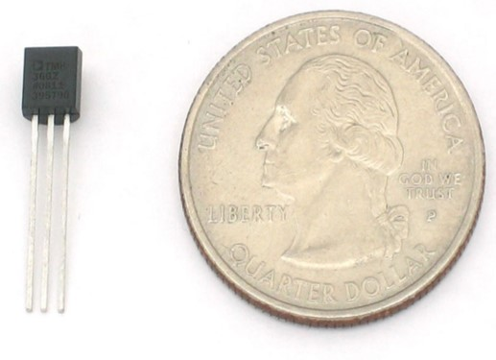
DS18B20 (Our selection)
Low voltage operation (3 V to 5.5 V)
±0.5°C accuracy over temperature
Stable with large capacitive loads
Specified −55°C to +125°C operation
Low self-heating

Slide 44
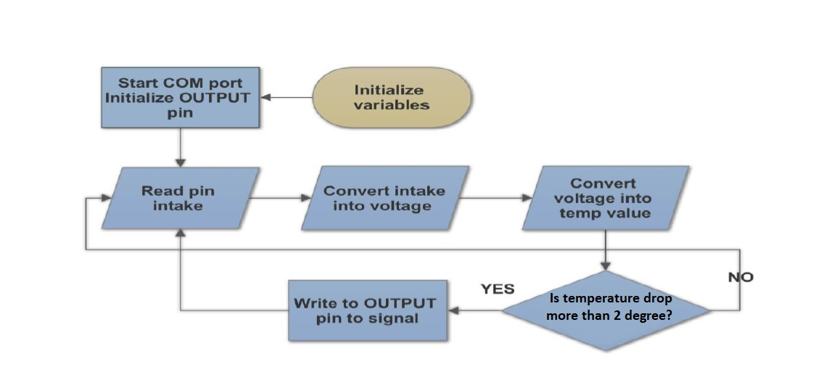
Temperature Flowchart

Slide 45
Main Housing
Dustproof of at least IP5x rating
Waterproof of at least IPx5 rating
Weather resistant
Minimal penetration depth to ensure signal can be received and transmitted

Slide 46
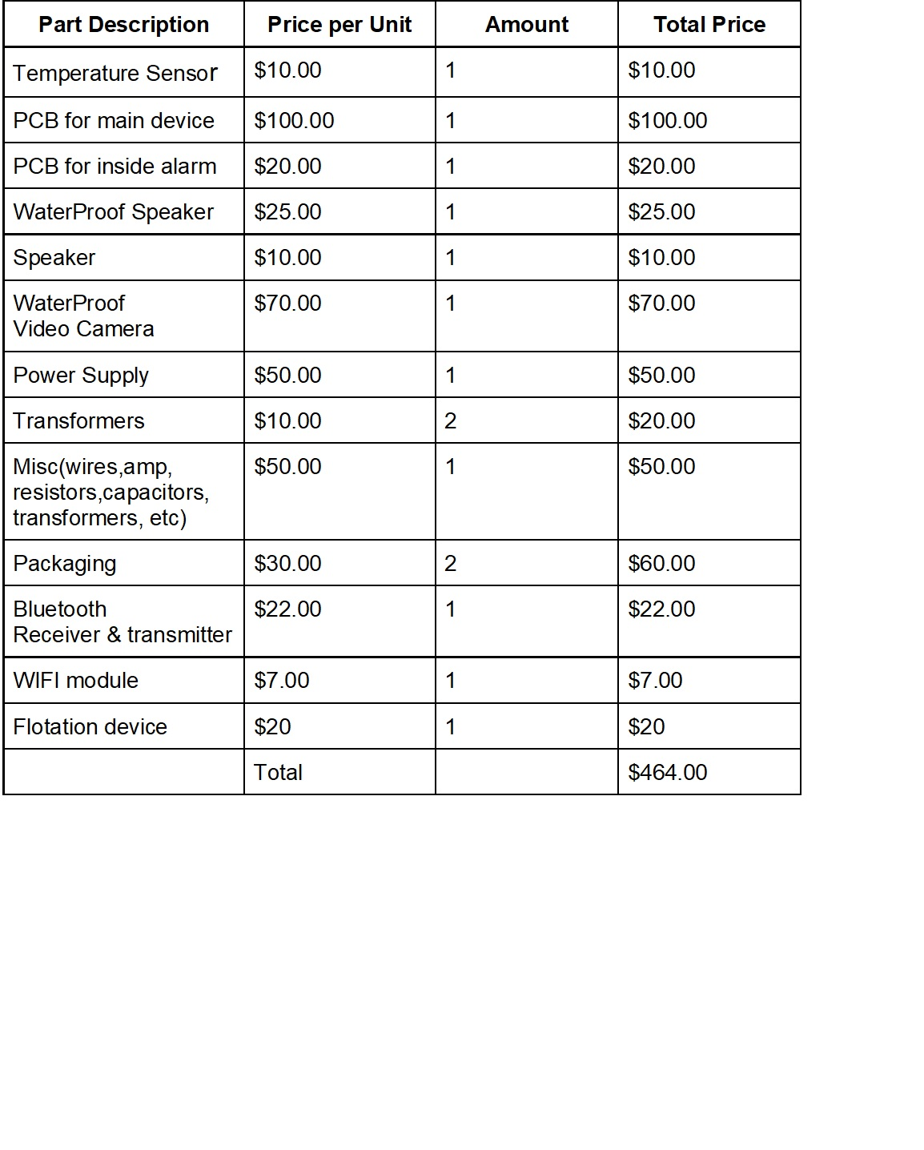
Proposed Budget

Slide 47
Parts Purchased
Item Name | Seller | Price per unit | Delivery price | Total Paid | Quantity | Purchaser
Raspberry Pi Zero w/ camera | Adafruit | 44.95 | 0 | 44.95 | 1 | Zach
USB Speakers | Adafruit | 10 | 0 | 10 | 1 | Zach
Mohoo 20A 12V/24V Charge Controller | Amazon | 10.98 | 0 | 10.98 | 1 | Brian
25 Watts Monocrystalline Newpowa Solar Panel | Amazon | 45.99 | 0 | 45.99 | 1 | Brian
ExpertPower 12V 7 Amp lead-acid Battery | Amazon | 16.99 | 0 | 16.99 | 1 | Brian
DROK Micro LED DC-DC | Amazon | 10.29 | 0 | 10.29 | 1 | Brian
Wifi Module | Amazon | 8.89 | 0 | 8.89 | 2 | Brian
Ultrasonic Range Finder HRLV-MaxSonar-EZ1 | Sparkfun | 34.95 | 9.10 | 113.95 | 3 | Anna
Pressure Sensor (Adafruit BMP280) | Adafruit | 9.95 | 14.06 | 43.91 | 3 | Anna
Temp Sensor | Adafruit | 1.50 | 0 | 4.50 | 3 | Anna
PCB #1 | OSH Park | 93.23 | 5.00 | 98.23 | 1 | Minh
PCB #2 | OSH Park | 42.55 | 0.00 | 42.55 | 1 | Minh

Slide 48
Parts Purchased. Continued
Item Name | Seller | Price per unit | Delivery price | Total Paid | Quantity | Purchaser
Voltage regulator | Mouser Elec. | 1.56 | 7.99 | 9.55 | 2 | Minh
Wearable Battery | Battery Mart | 9.95 | 8.14 | 18.09 | 1 | Minh
Silicon Rubber | Amazon | 37.26 | 0.00 | 37.26 | 1 | Anna
USB 4 Port Extension | Amazon | 7.49 | 0.00 | 7.49 | 1 | Anna
Cables, Keyboard, Mouse | Amazon | 40.47 | 0.00 | 40.47 | 1 | Anna
Housing | Walmart | 18.17 | 0.00 | 18.17 | 1 | Anna
Wifi Modules | Amazon | 14.99 | 0.00 | 14.99 | 4 | Brian
Crystals | Amazon | 6.21 | 0.00 | 6.21 | 10 | Brian
Backup Microcontrollers and holders | Amazon | 17.49 | 0.00 | 17.49 | 4 | Brian
Speakers | Amazon | 17.99 | 0.00 | 17.99 | 3 | Brian
Total Spend |  |  |  | 638.94

Slide 49
Work Division
 | Anna | Brian | Minh | Zach
Main PCB |  | secondary | primary
Portable PCB |  | primary | secondary
Mobile App | secondary |  |  | primary
Power |  | secondary | primary
Main Housing | primary |  |  | secondary
Coding | secondary | primary |  | secondary
Video Coding | primary |  |  | primary

Slide 50
Questions

