Slide 1
AQUA SENTINEL
Group 11
Anna Baranova Computer Engineering
Brian Bisplinghoff Computer Engineering
Minh Nguyen Electrical Engineering
Zachary Schwartz Computer Engineering

Slide 2
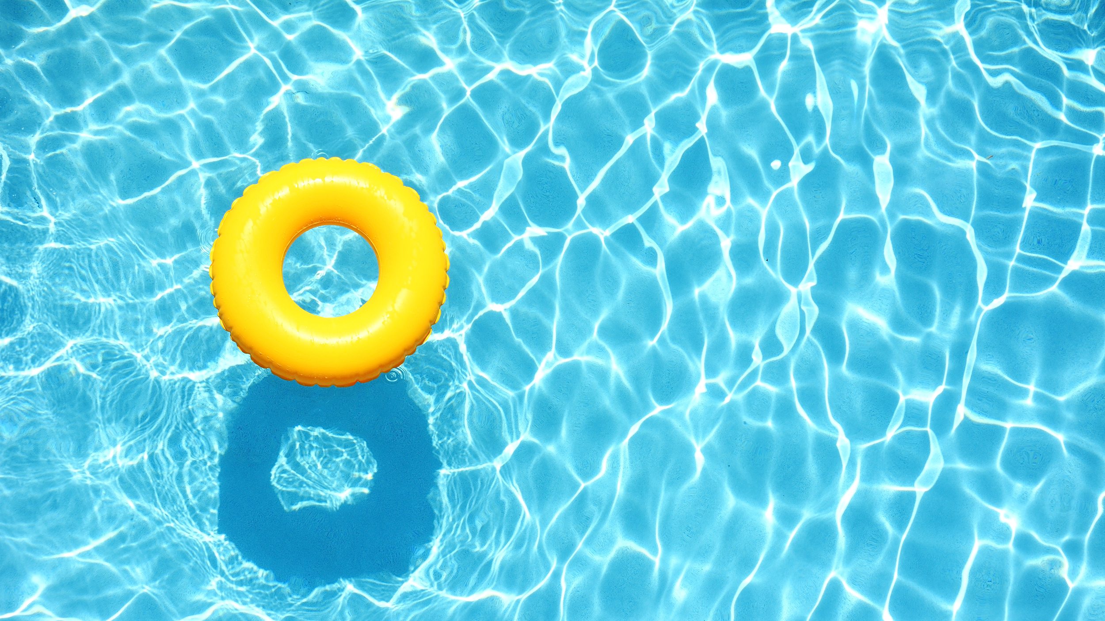
Problem
Pools are a major cause of death in children
Impossible to always keep track of kids 100%
Parents always worried when they own a pool
Particularly when leaving child with babysitter

Slide 3
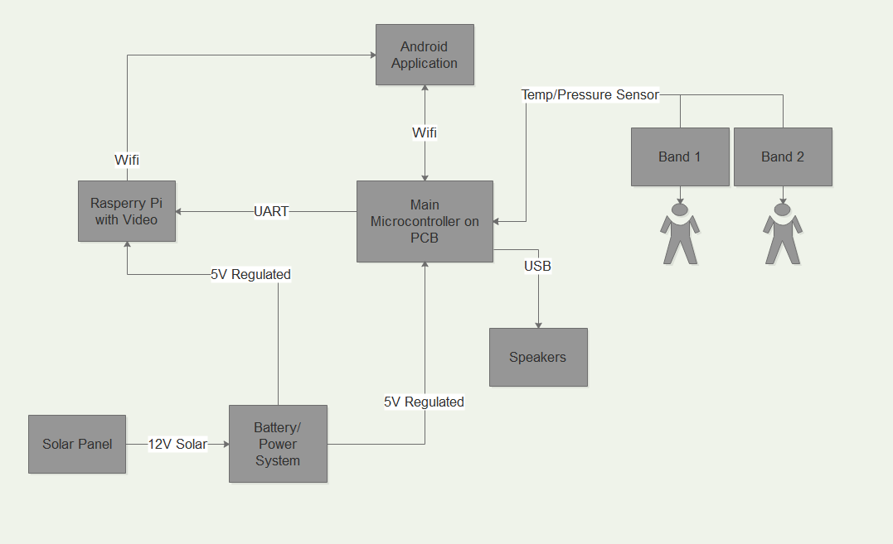
Solution
Pool monitoring system
Sits by the pool and constantly monitors
Child wears a band that will detect if they fall in
Sends alert to parents phone through application to alert them
Parent then has a variety of options to respond to the situation

Slide 4
Goals and Objectives
Easy to setup by pool
Both band and sensor water proof
System is very responsive in alerting the parent and responding to commands sent from application
User friendly mobile application
Wearable is comfortable and small, but sturdy
Communications between all components reliable

Slide 5
Specifications and Requirements
Lightweight, no more than 15 pounds
Band able with withstand being submerged in a several feet of water
WIFI connection able to sync within at least 30 meters
Able to be powered solely by sunlight and function with no light for several days
Video able to be streamed with minimal delay
Cost below $100 to manufacture
All components survive exposure to water splashing

Slide 6
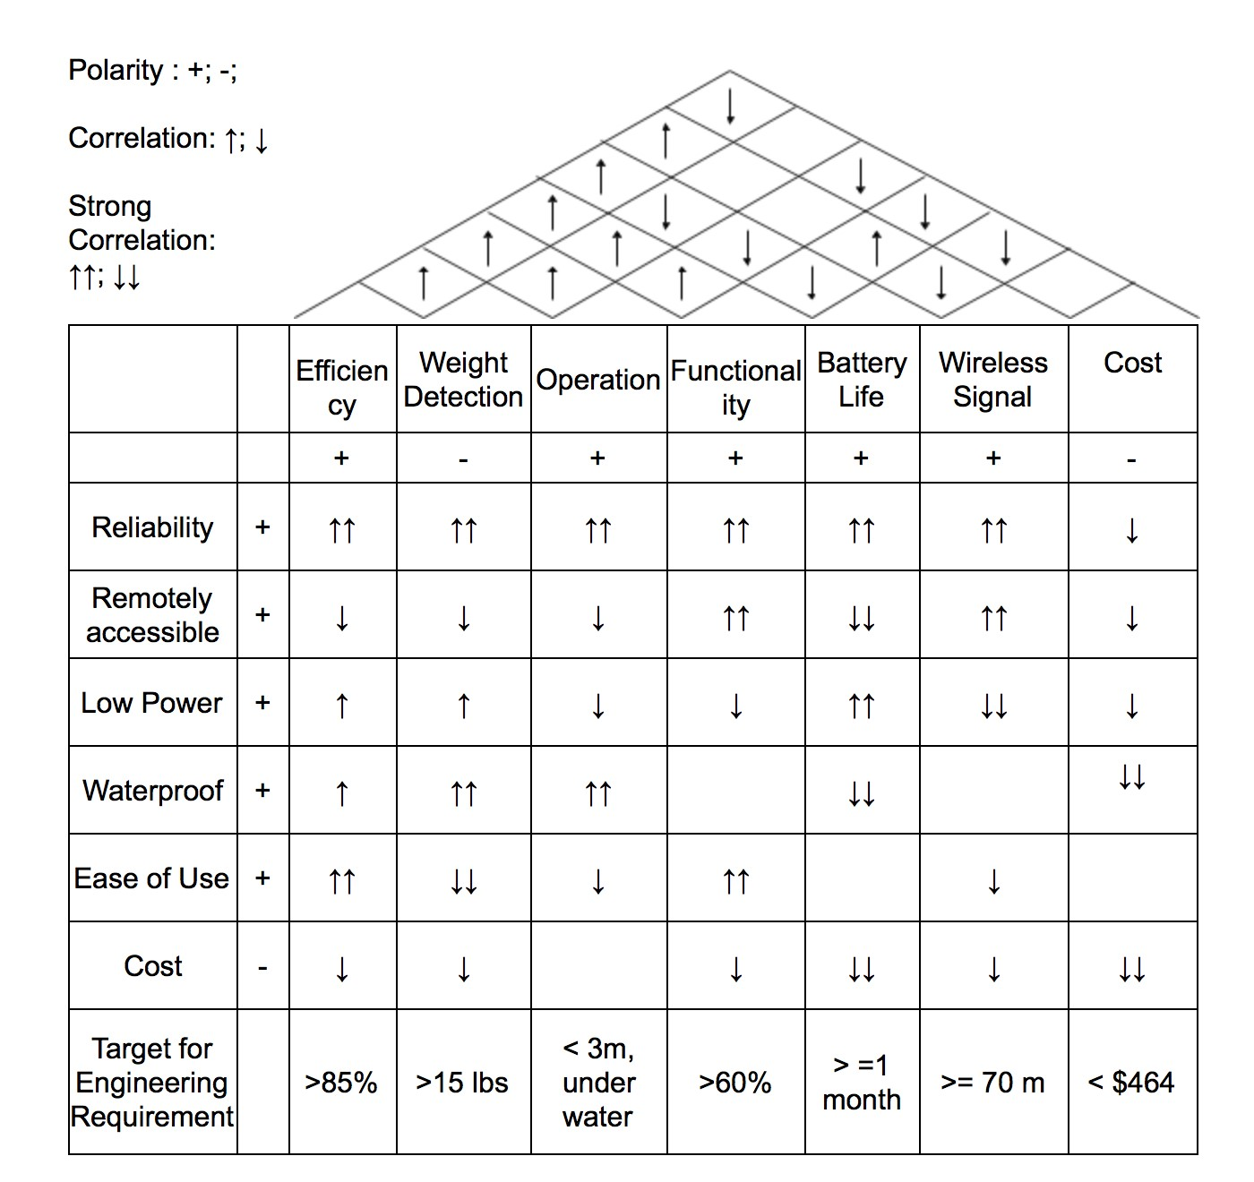
House of Quality

Slide 7
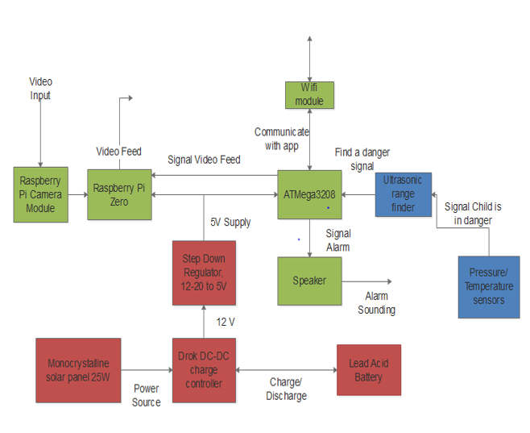
System Overview

Slide 8
Microcontroller Selection
 | MSP430G2553 | MSP430FG4618 | ATmega328 | SAM4SD32C | PIC 16F887
GPIO Count | 24 | 80 | 22 | 79 | 35
Clock Frequency | 16 MHz | 8 MHz | 1 MIPS/MHz | 120MHz | 20 MHz
RAM | 512 Bytes | 8 kB | 2 kB | 160 kB | 368 Bytes
Storage Memory | 16 kB | 116 kB | 32 kB | 2024 kB | 4 kB
ADC | 10-bit | 12-bit | 10-bit | 16-bit | 8-bit
Low power current | .5 µA | 1.3 µA | .75 µA | 30 µA | 11 µA
Cost | $2.38 | $121.18 | $1.95 | $2.16 | $8.63
Additional Consideration | Available easily with launchpad development board. | Not available except with costly board. | Arduino libraries available to supplement development. | DAC available if necessary. | Low amount of development resources

Slide 9
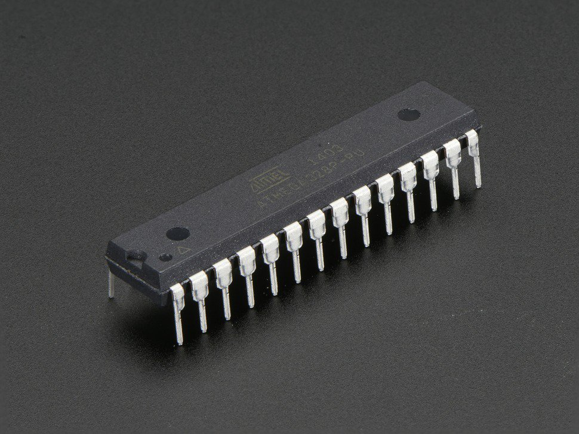
Microcontroller Selection – ATmega328
Sufficient memory and GPIO pins
10-bit ADC
Capable of low power modes with interrupts
Most development libraries of any MCU

Slide 10
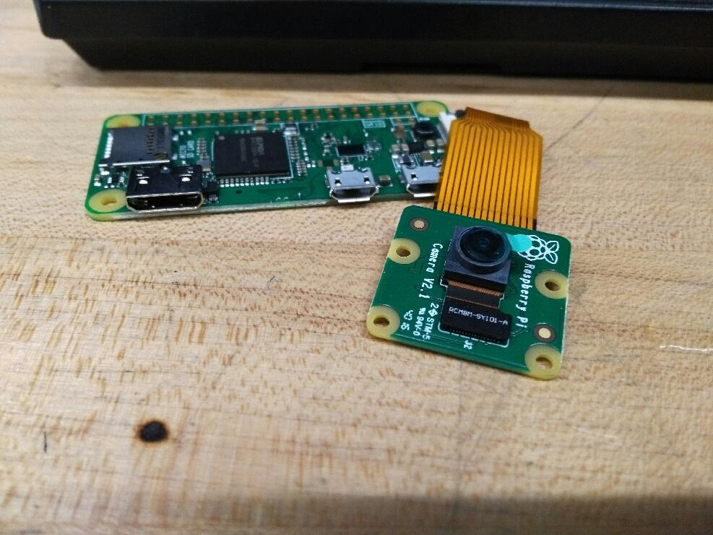
Raspberry Pi Zero
Extremely affordable at $10
Capable of video streaming
WIFI connection built in allows for easy configurability
Small enough to be compatible with the rest of system

Slide 11
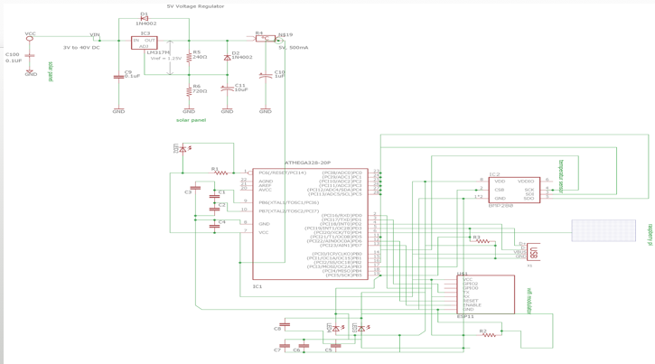

Slide 12
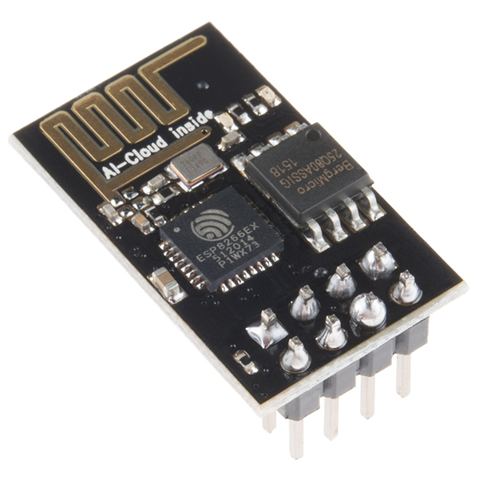
Wi-Fi Module ESP8266
This module will be placed on wearable device and ATMega3208
Uses standard TCP/IP connection to connect to Wi-Fi
Parameter | ESP8266 Implementation
Transmit Current | 200 mA
Receive Current | 60 mA
Standby Current | .9 mA
Protocol | TCP/IP
Turnaround time | 2ms
Microcontroller Connection | SPI/UART/SDIO 2.0

Slide 13
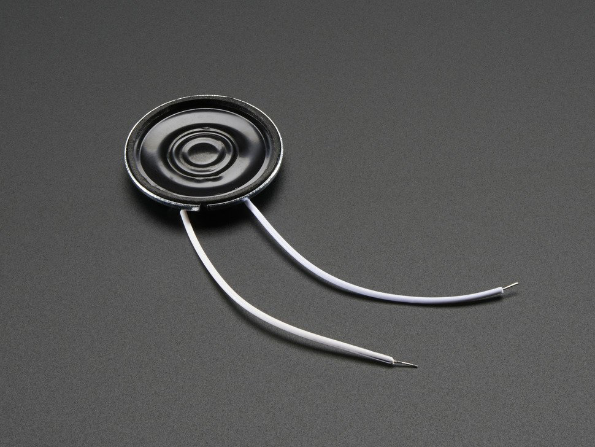
Speaker
8 ohm speaker is best option for our project because
  Low-powered
  Lightweight
  Does not need aux input
        Using USB powered speakers would consume more power and require an aux input.

Slide 14
Camera (Raspberry Pi Camera Module V2)
Will start recording video of pool area when main MCU receives signal that band enters the water.
Stream will be viewable on mobile application
Specifications | Raspberry Pi Camera Module V2 ($29) | Logitech HD Webcam C525 ($33)
Connection | Connects to CSI port | Connects to USB port
Video Quality | Supports up to 1080P video | Supports up to 720P video
Compatibility | Directly compatible with the Pi which will handle our video processing. | WIll not be able to support official drivers when using with the Pi.
Frame Rate | At 720P can produce 180 fps | At 720P can produce 30 fps
CPU Consumption | Consumes less CPU power | Resource intensive
Power | Producing 1080P video draws only 250 mA | Producing 720P video draws about 400 mA

Slide 15
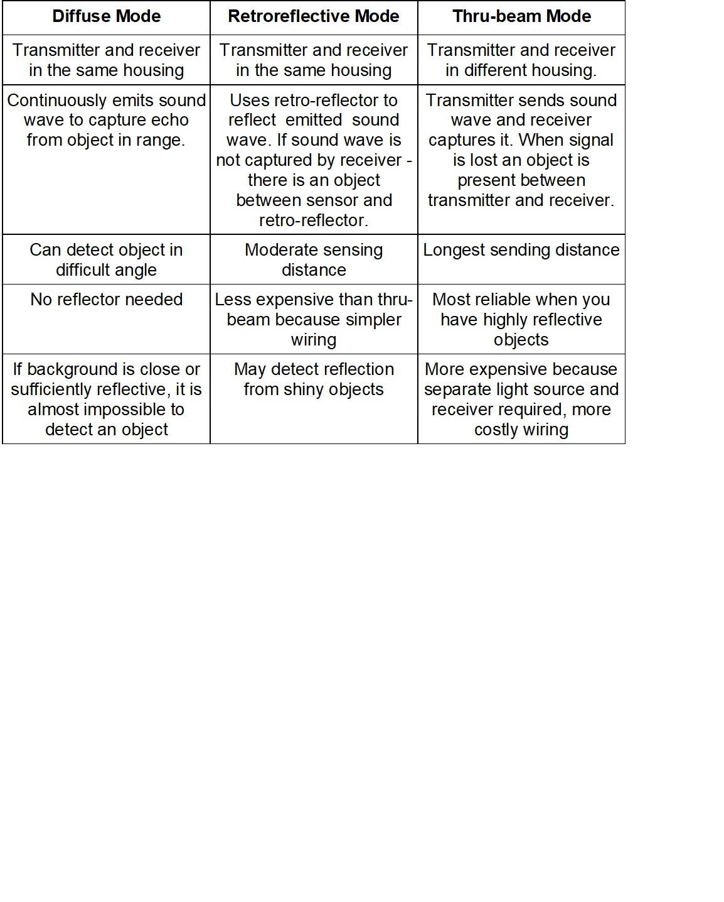
Ultrasonic Sensor Technology

Slide 16
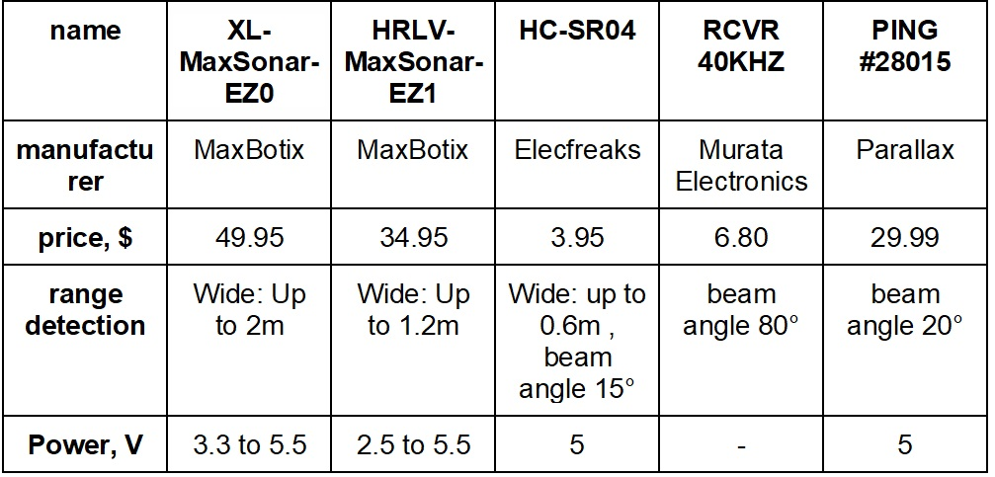
Ultrasonic Sensor Comparison

Slide 17
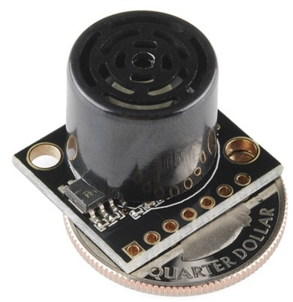
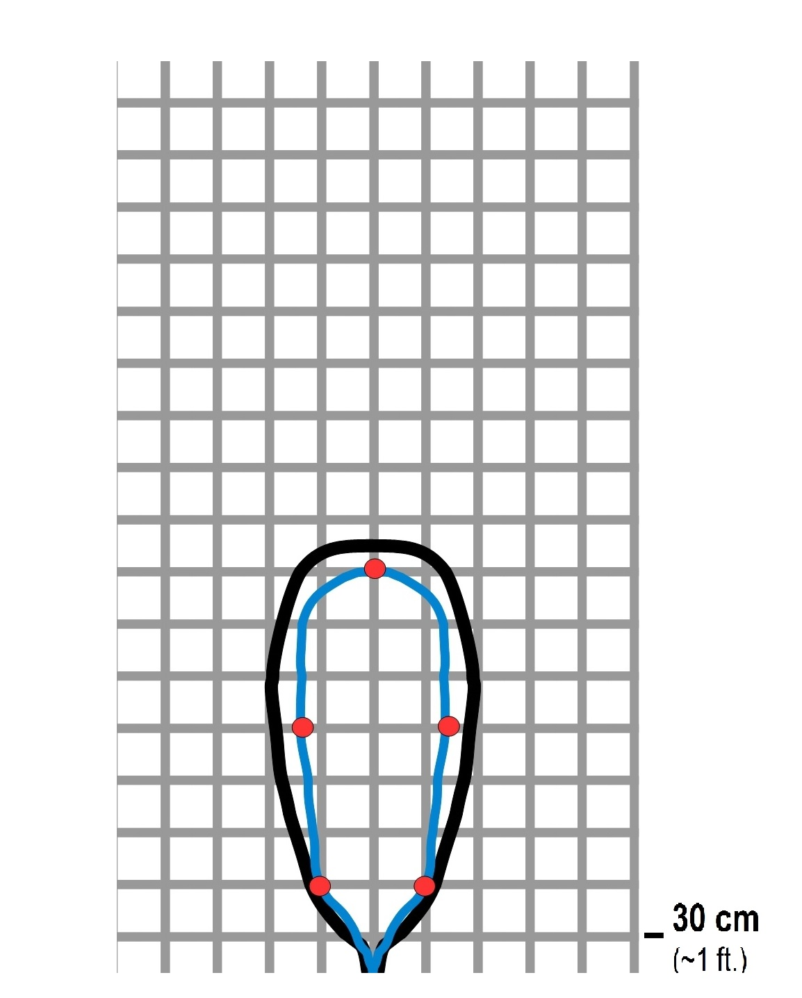
HRLV-MaxSonar-EZ1 the choice
Object proximity detection from 1-mm to 5 meters
Resolution of 1-mm
Actual operating temperature range from –40°C to +65°C
Operating voltage from 2.5V to 5.5V
Nominal current draw of 2.5mA at 3.3V, and 3.1mA at 5V
Low current draw reduces current drain for battery operation
Fast first reading after power-up eases battery requirements

Slide 18
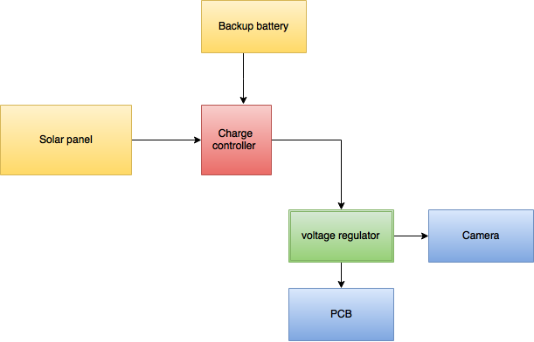
Solar Panel

Slide 19
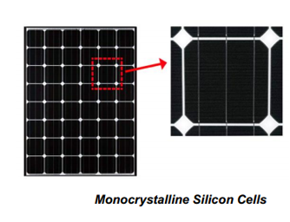
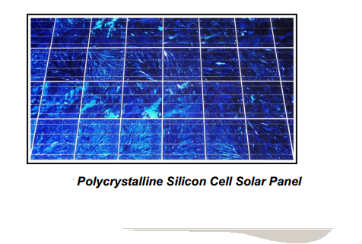
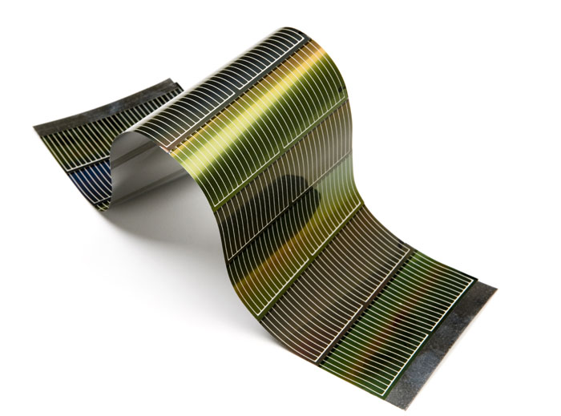
Types of Solar Panel Cell
thin film

Slide 20
Thin Film
They are created from a thin layer of non-crystalline silicon like an amorphous silicon
Extremely flexible and light
These are the cheapest of the three solar cells
Efficiency rate is around 10%
Fragile

Slide 21
MONO vs POLY
Single layers cut off a silicon ingot
          impurity that are form when
          creating a square shape
          form a cylinder ingots
Melting multiple smaller silicon crystals
Lower efficiency rate than mono
Higher efficiency rate than 20%

Slide 22
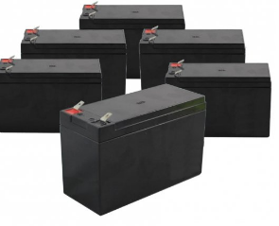
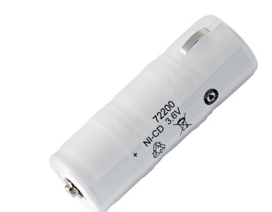
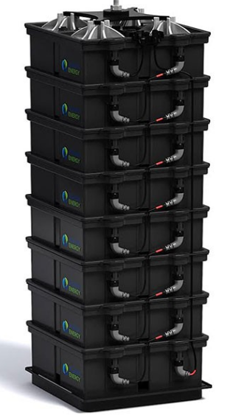
Battery
Lead-acid
Lithium Ion
Saltwater

Slide 23
Lead Acid
Most Commonly used
Cheapest
Doesn’t last as long
Constantly maintain
Toxic

Slide 24
Lithium Ion
Long Lasting
Flexible in design
Non-toxic
Flammable
Very costly

Slide 25
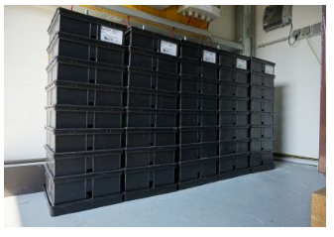
Saltwater
Pound per pound cheapest
Starts at $800
Extremely large (can power a whole building)

Slide 26
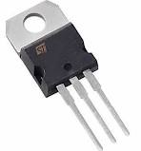
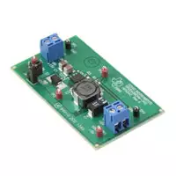
Voltage Regulator
External or Internal
External cost more but can be easily swap
Internal save space and enhanced the PCB

Slide 27


Operating System (Android)
Open source and extensive resources (API support)
Simple debugging
Programmable on Windows and Mac
Easier to publish Android app than iOS app
We have more background experience in Android

Slide 28
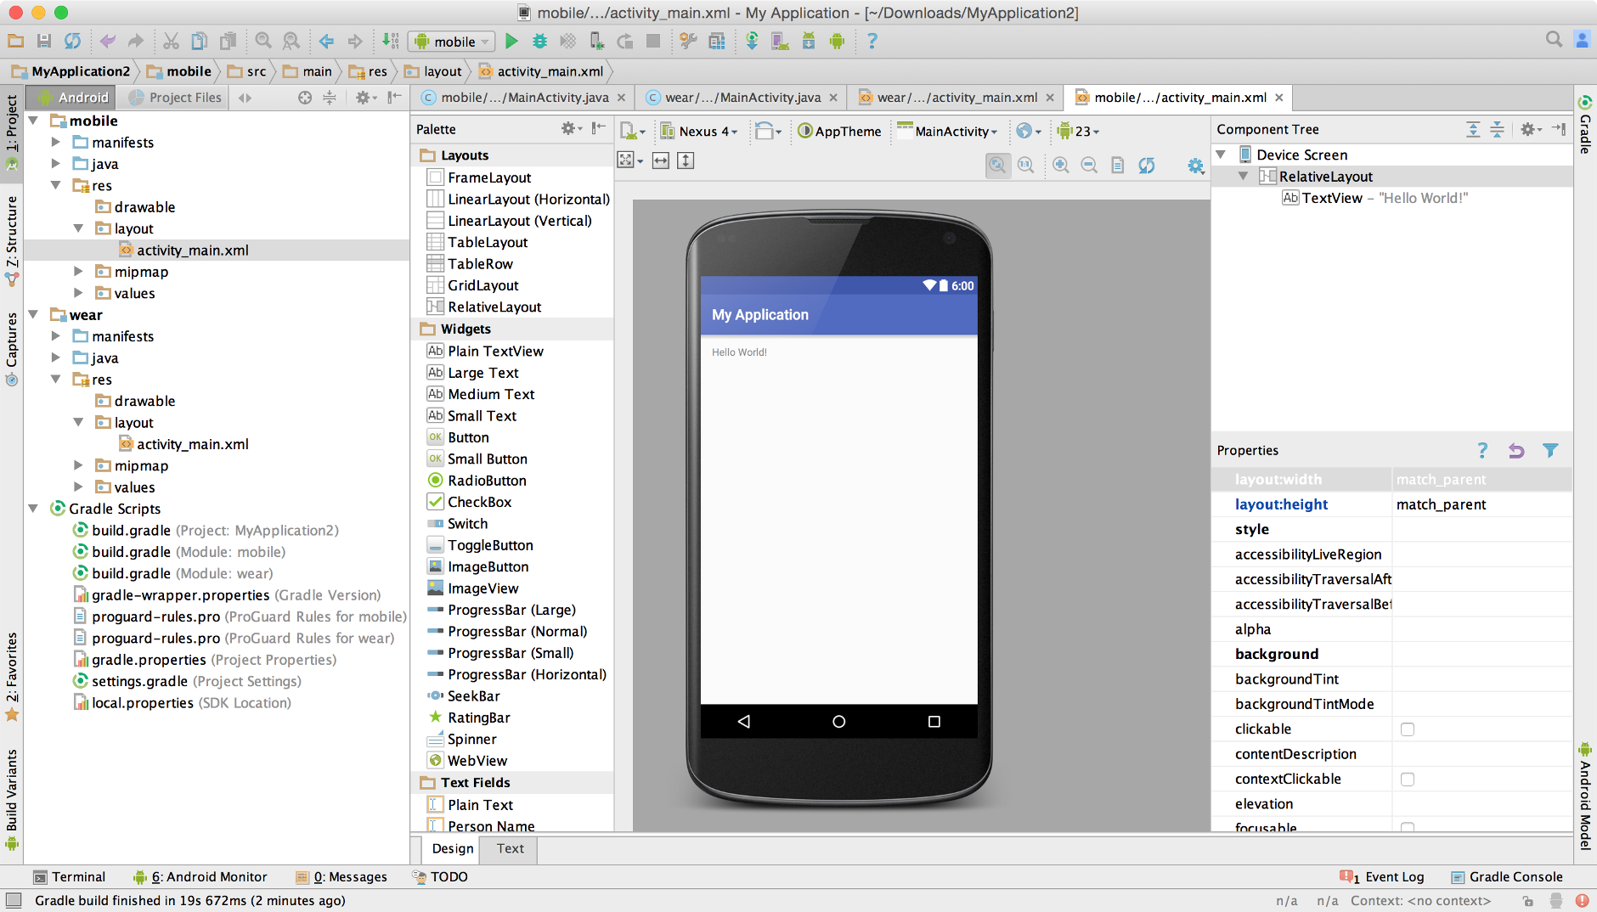
Android Studio
Official IDE for Android development.
Integrates version control tools such as GitHub
Efficient/fast emulator
Gradle-based build support

Slide 29
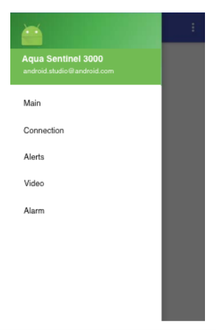
GUI
Simple and organized
Navigation drawer with labels for each core functionality
Designed using layout editor and XML

Slide 30
App Functionality
Communicate with main main MCU
  Display connection status
  Receive alert notifications
  Turn alarm on/off
  Display video stream

Slide 31
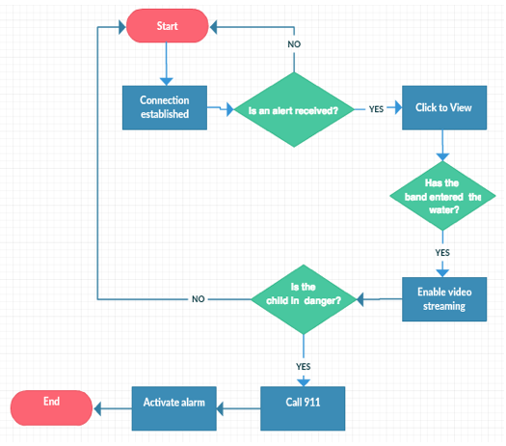
Software Flowchart

Slide 32
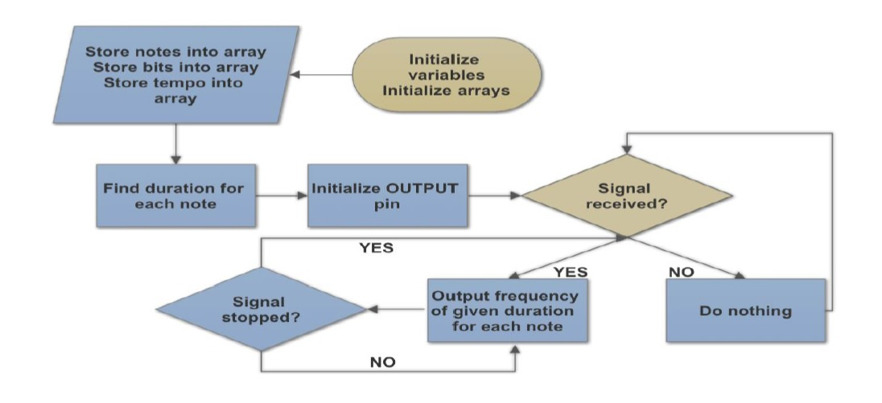
Coding Microcontroller. Speaker

Slide 33
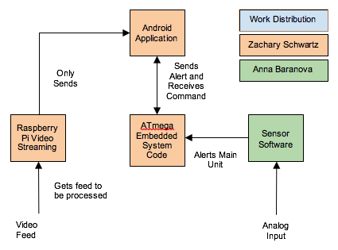
Block Diagram

Slide 34
Wearable Device
Main purpose: to recognize near drowning event
Lightweight
Mobile
Independent of main unit
Triggers when temperature changes
Triggers when connection lost

Slide 35
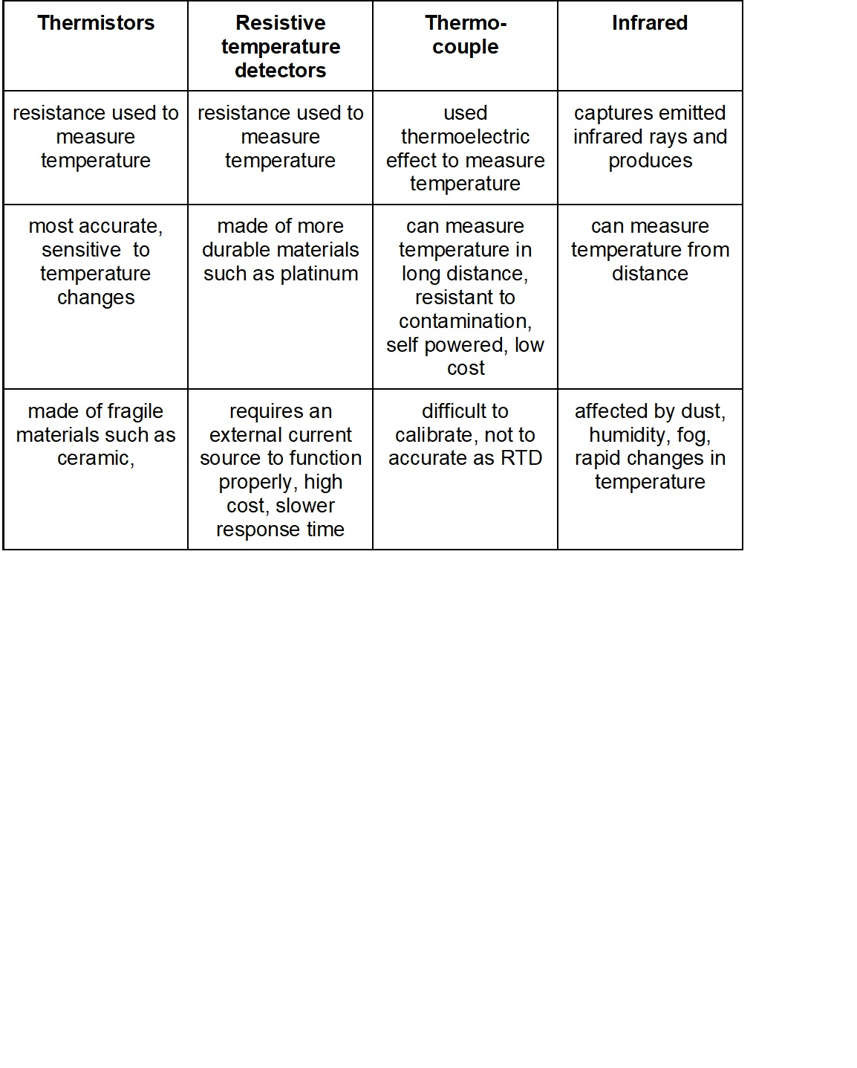
Temperature Sensor Technology

Slide 36
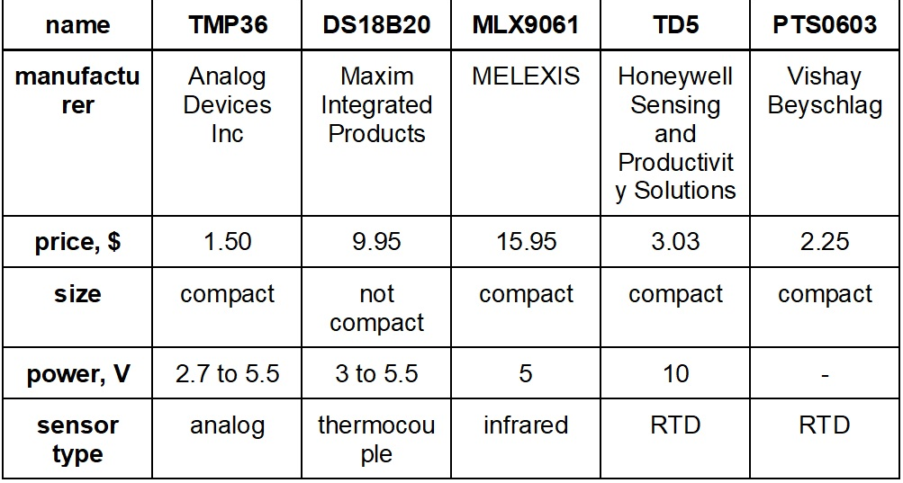
Temperature Sensors Comparison

Slide 37
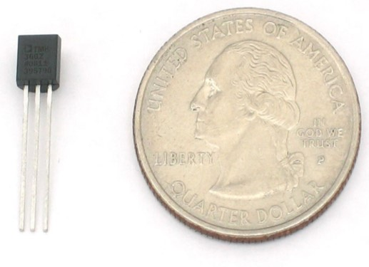
TMP36 (Our selection)
Low voltage operation (2.7 V to 5.5 V)
±2°C accuracy over temperature
Stable with large capacitive loads
Specified −40°C to +125°C operation
Less than 50 μA quiescent current
Shutdown current 0.5 μA max
Low self-heating

Slide 38
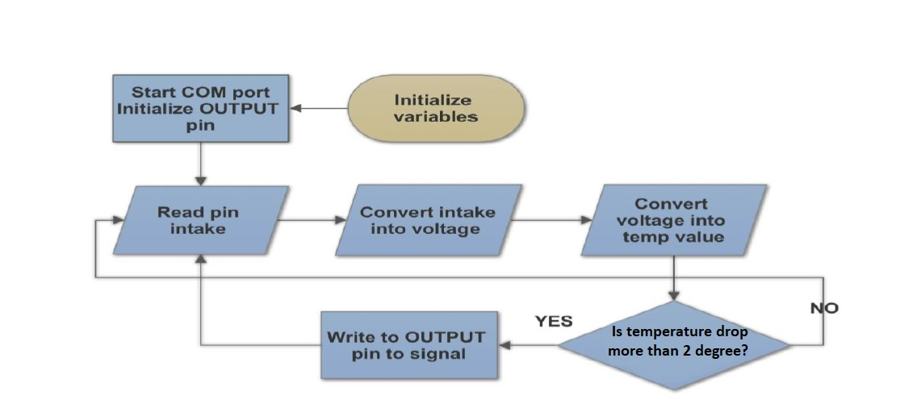
Temperature

Slide 39
Main Housing
Dust Proof of at least IP5x rating
Waterproof of at least IPx5 rating
Weather resistant
Minimal penetration depth to ensure signal can be received and transmitted

Slide 40
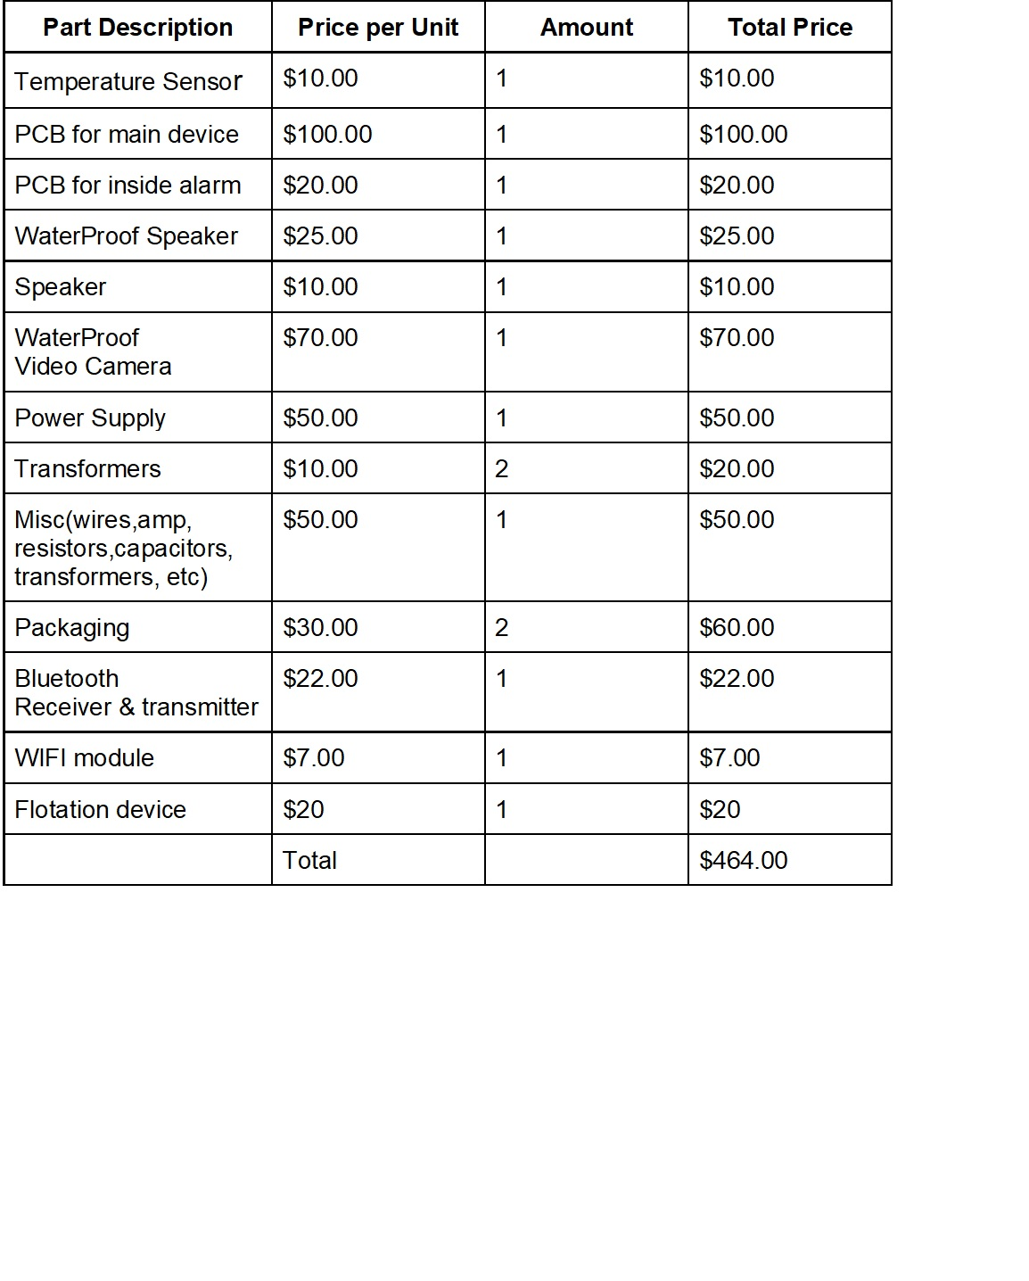
Proposed Budget

Slide 41
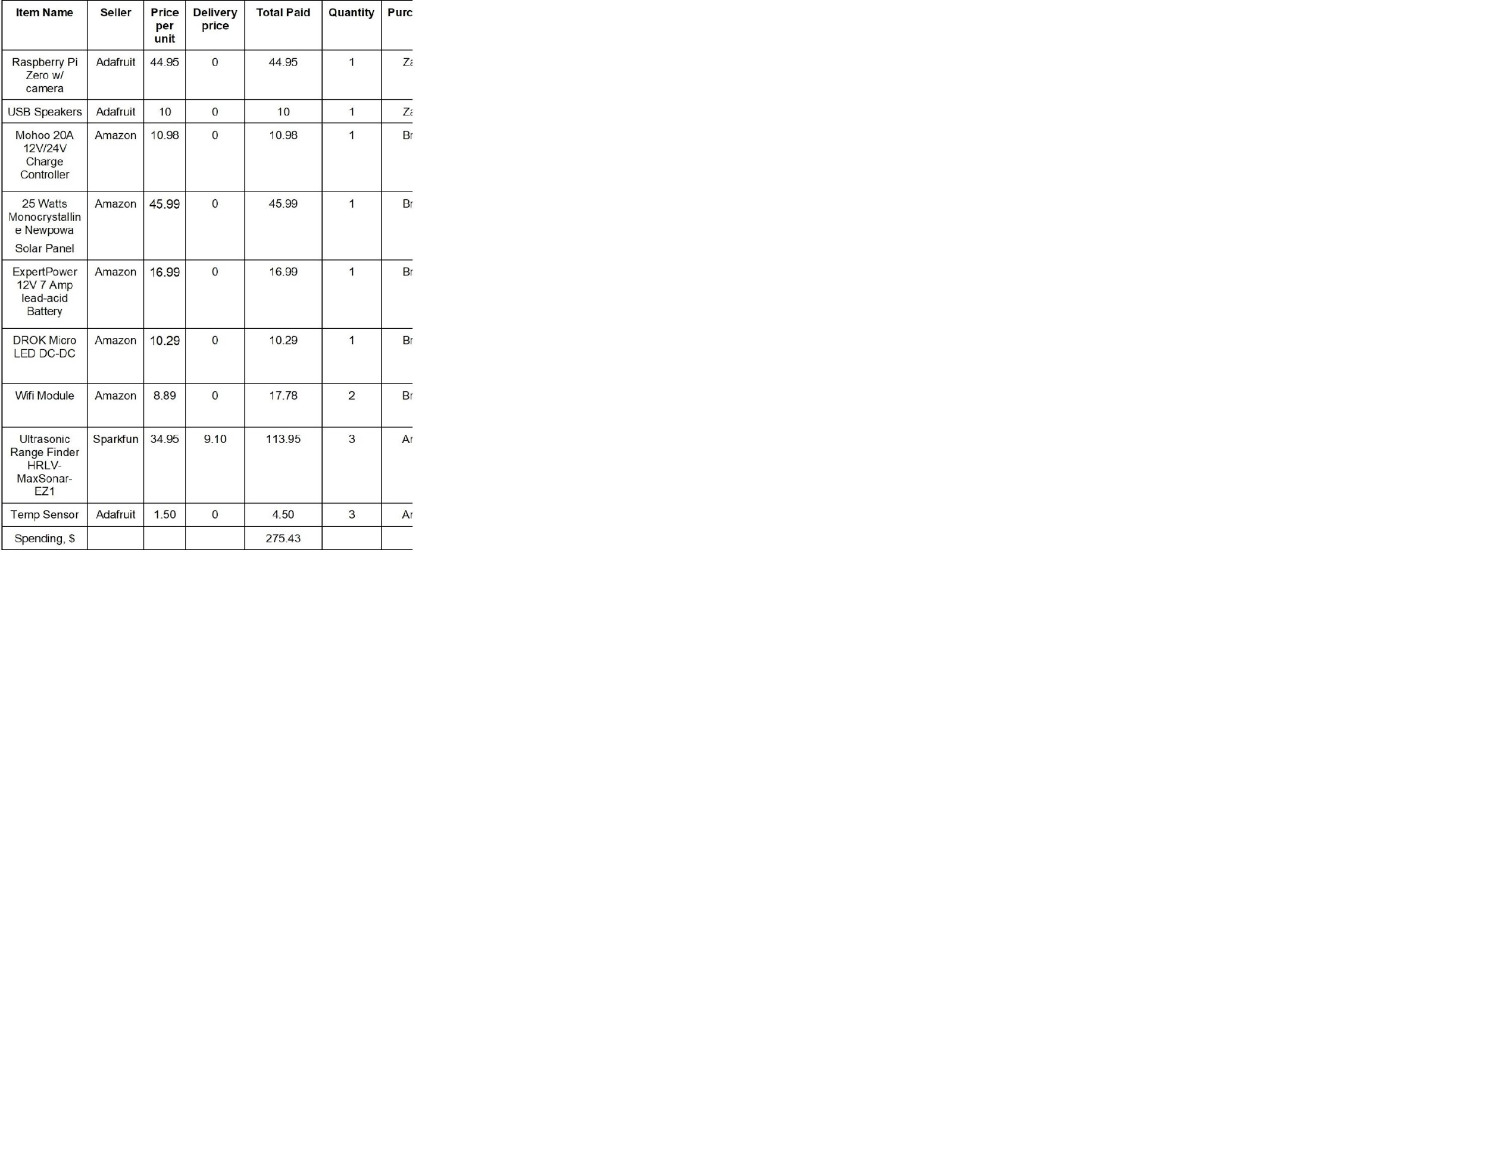
Parts Purchased

Slide 42
Work Division
 | Anna | Brian | Minh | Zach
Main PCB |  | secondary | primary
Portable PCB |  | primary | secondary
Mobile App | secondary |  |  | primary
Power |  | secondary | primary
Main Housing | primary |  |  | secondary
Coding | secondary | primary |  | secondary
Video Coding | secondary |  |  | primary

Slide 43
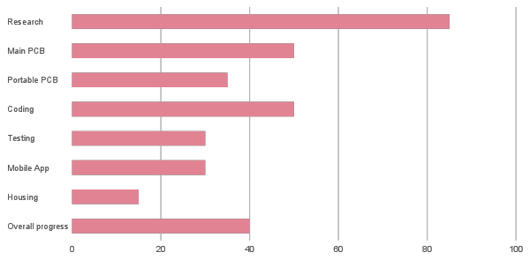
Current Progress

