Slide 1
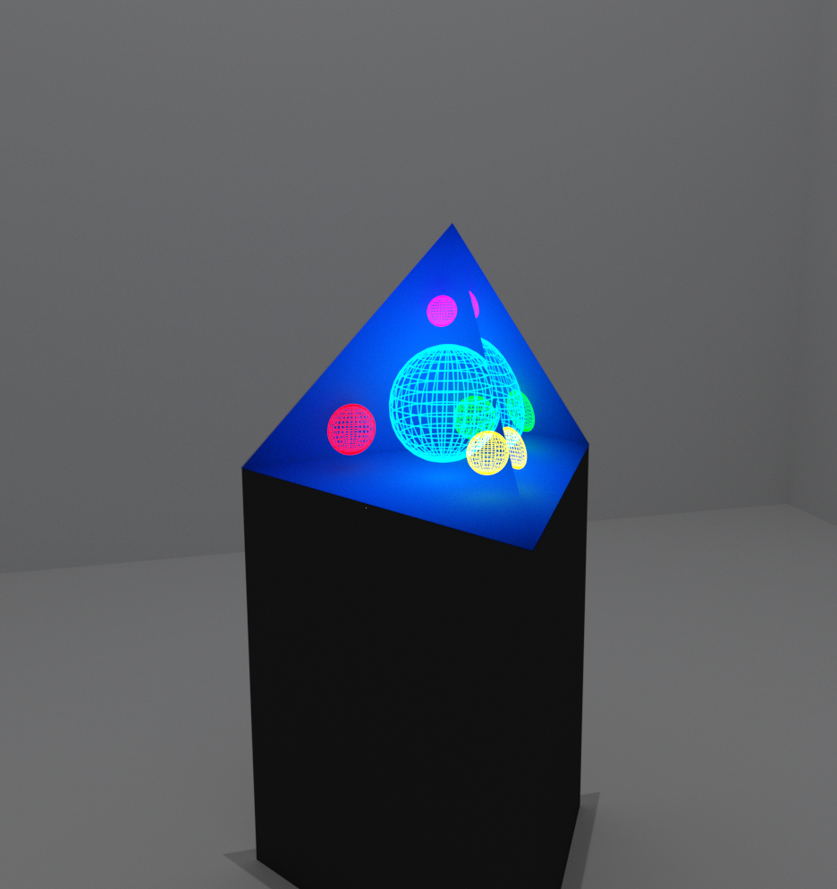
Volumetric Display
Using Head-tracking
Dane Bouchie, Cp. E.
Matthew Hosken, Cp. E.
Colburn Schacht, E. E.
Eric Smithson, Cp. E.
Group 14
Notes:
Introduce names,

Slide 2
Motivation/Background
Personal Motivation
  Practice our engineering skills by designing and building a project from start to finish
  Create something that hasn’t been “done” before
Existing systems/Inspiration
  Virtual Reality
    Designed to put into a reality, not work between realities
    Large heavy headsets hinder long term use
  Augmented Reality
    Large heavy headsets ...
    Non-Handsfree (require a phone or tablet)
    Overlaid objects that don’t change perspective with users
  Volumetric Displays
    Non-commercial
    Still in development
Notes:
(Dane)

Slide 3
Criteria & Requirements
Product Criteria
  Simulate the viewing of a 3-dimensional image within the confines of the display surface.
  Demonstrate applications
Technical Requirements
  Create a stationary stereoscopic display surface
  Track both the position of a user’s eyes with low-latency
  Develop 3D applications for the system
  Provide a way for users to interact with the system

Slide 4
Specification
The display shape will be no larger than 1 cubic meter
The display will run at a minimum of 20 frames per second refresh rate
The head tracking system will track position within a standard deviation of 1 cm
The display will have a pixel density higher than 9 dpi
The head tracking system will track within an area of at least 0.25 m²
The head tracking system will be responsive to 200 ms

Slide 6
High Level Overview

Slide 7
System Overview
Head Tracking
  Tracks user’s head movements to determine eye position
  Sends position data to application system
Application (Graphics Engine)
  Runs 3D application such as a game or design program
  Renders application graphics
  Sends display data to display
Display
  Stationary housing
  Projects stereoscopic screen on housing
  User glasses handle stereoscopy
Head Tracking
Application
(Graphics Engine)
Display (Stereoscopic Projector)

Slide 8
Component Overview
Glasses
Tracking Processor
Cameras
Projector
User
Speaker
Application & Graphics Processor
Input Controller

Slide 9
Technical Specification - Glasses

Slide 10
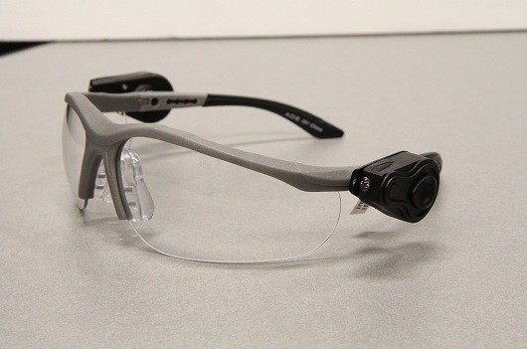
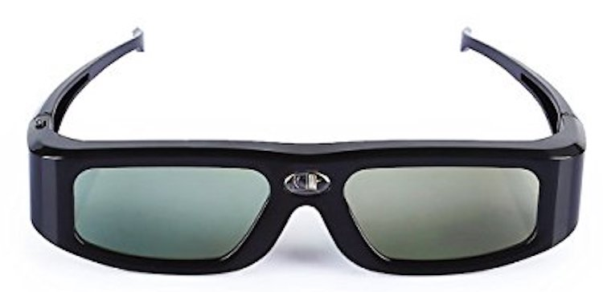
Function
Active 3D
  Process stereoscopic data
  DLP-Link
Sense and transmit IMU data
  Used in head-tracking
Provide tracking markers

Slide 11
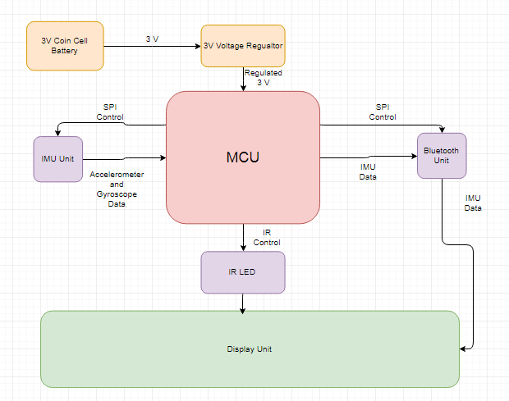
3D Glasses Design

Slide 12
Battery - Part Selection
Model # | Storage (mAh) | Depth (mm) | Est. Runtime (hrs)
CR2016 | 90 | 1.6 | 56.25
CR2025 | 162 | 2.5 | 101.25
CR2032 | 225 | 3.2 | 141
LR2025 | 40 | 2.5 | 25
LR2032 | 50 | 3.2 | 31.25
Notes:
On a side note, we might want to revisit this, like

Slide 13
MCU - Part Selection
MCU | Manufacturer | CPU (MHz) | Flash (Kb) | Low Power Modes | ADC (bit/sps)
EFM32 Gecko | Silicon Labs | 32 | 128 | 5 | 12/1M
MSP430 | T.I. | 16 | 16 | 5 | 10/200K
HT45FH3T | Holtek | 4 | 32 | 2 | 12/500K

Slide 14
IR LED - Part Selection
Part Number | Mounting Type | Forward Current (mA) | Radiant Intensity (mW/sr) | Voltage (V) | Relative Intensity at 45° | Radiance-Curren Efficiency (μV/sr)
APT1608F3C | Surface | 50 | 2.5 | 1.2 | 80% | 50
VSML3710-GS08 | Surface | 100 | 9.5 | 1.6 | 80% | 95
VSMB2020X01 | Surface | 100 | 40 | 1.35 | 5% | 400
VSMY3940X01 | Surface | 100 | 15 | 1.44 | 75% | 150
VSMB3940X01 | Surface | 100 | 13 | 1.35 | 80% | 130
LTE-R38381S-ZF-U | Surface | 1000 | 160 | 3.00 | 90% | 160
VSLY5940 | Through- hole | 100 | 600 | 1.65 | <5% | 6000
OED-EL-1L2 | Through- hole | 100 | 60 | 1.2 | -- (30°) | 600
EAILP05RDBA2 | Through- hole | 100 | 15 | 1.4 | 20% | 150
MTE9440M3A | Through-hole | 60 | -- | 1.2 | 85% | --
Notes:
Col talks while everyone admires his cool shirts. Says something like we need the brightest one that can still show brightly at an angle. Through-holes had a small wide angle intensity. The LTE part and MTE parts were high cost.

Slide 15
Internal Measurement Unit - Part Selection
Part Number | Range/ADC Precision | Accelerometer Rate (kHz) | Gyroscope Rate (kHz) | Current (mA)
LSM6DS3 | ±2/±4/±8/±16 g, ±125/±245/±500/±1000/±2000 dps @ 16-bit | 1.60 | 1.60 | 1.25
MPU-6500 | ±2/±4/±8/±16 g, ±245/±500/±1000/±2000 dps @ 16-bit | 4.00 | 8.00 | 3.4
BMI160 | ±2/±4/±8/±16 g, ±125/±245/±500/±1000/±2000 dps @ 16-bit | 1.60 | 3.20 | 0.925

Slide 16
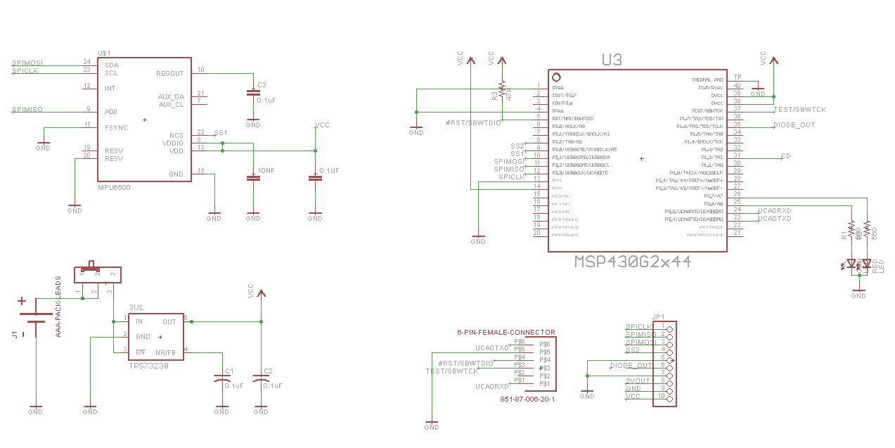
Schematic Layout

Slide 17
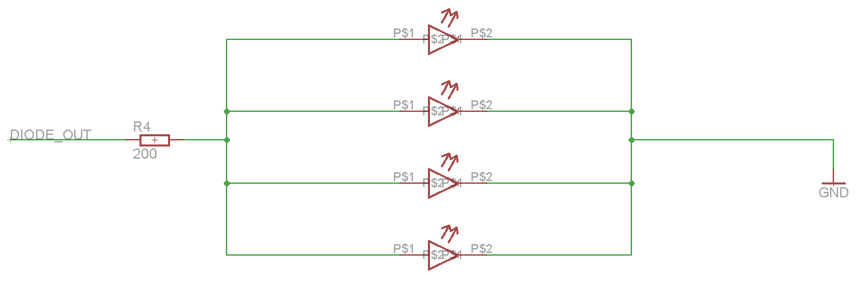
Schematic Layout (continued)

Slide 18
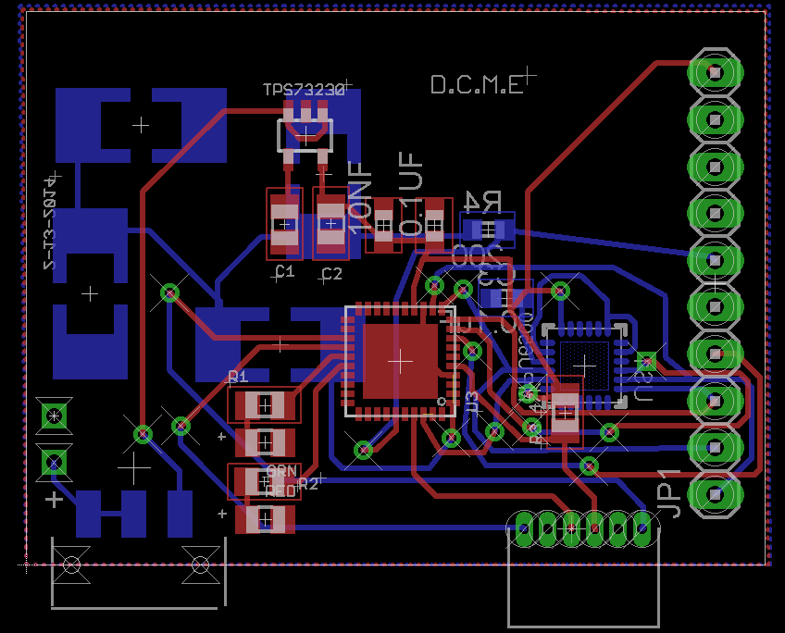
Board Layout

Slide 19
Technical Specification - Display

Slide 20
Display (Stereoscopic Projector)
3D Glasses
User
DLP Projector
Left LCD Shutter
Left Eye
HDMI
Right LCD Shutter
Right Eye
Photodiode
DLP-Link Processor

Slide 21
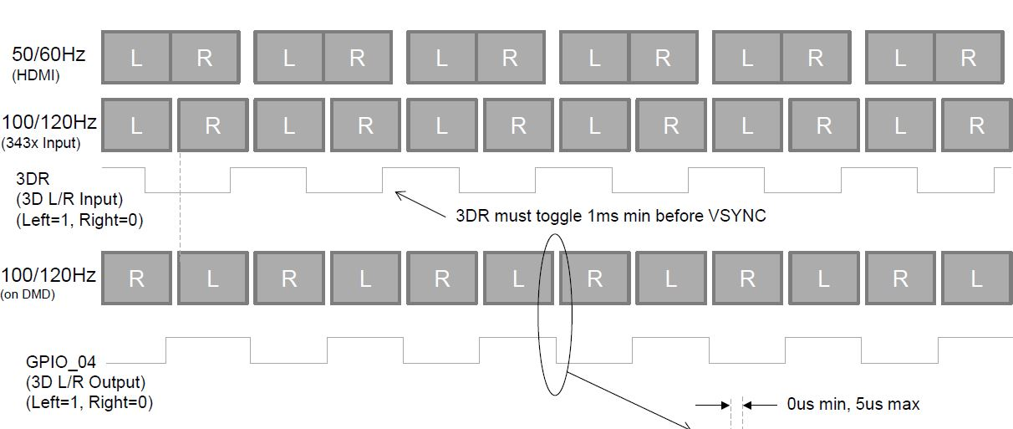
DLP-Link

Slide 22
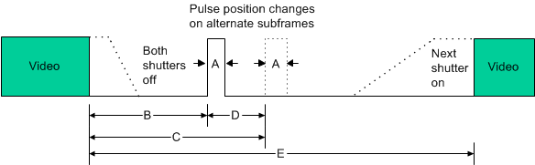
DLP-Link

Slide 23
Display - Stereoscopic Technologies
DLP Projector
  Active shutter
  High cost between $300 - $1000
  Adjustable size between 20” - 300+”
  Projected shapes
  Requires distance from screen/display surface
3D TVs
  Polarized technology
  Rectangular, landscape only
  High cost between $300 - $1000+
  Large size between 35” - 90”
3D Monitors
  Polarized technology
  Rectangular, landscape only
  Medium cost between $150-$300
  Small sizes between 20” - 30”

Slide 24
Projector - Part Selection
Optoma HD142X
  Mid-high cost ($550)
  1080p (1920 x 1080)
  3000 lumens
Optoma W331
  Mid cost ($350)
  WXGA+ (1280 x854)
  3200 lumens
Optoma GT1080
  High cost ($650)
  Short throw
  1080p (1920 x 1080)
  16ms Latency
  3000 lumens

Slide 25
Display - Housing
Considerations
  Allocate area for each user (users cannot share screens)
  Balance projector location (hiding them from the user is preferable)
  Have a camera location which has the user’s head and glasses in clear view

Slide 26
Technical Specification - Head Tracking

Slide 27
Objective
p_{glasses}
Main:
  Know position of user’s eyes
Supplementary
  Position of glasses
  + Orientation of glasses
  => Position of eyes
q_{glasses}

Slide 28
Head Tracking Technologies
Magnetic
Acoustic
Gyroscope/Accelerometer
IR Markers
Lighthouse

Slide 29
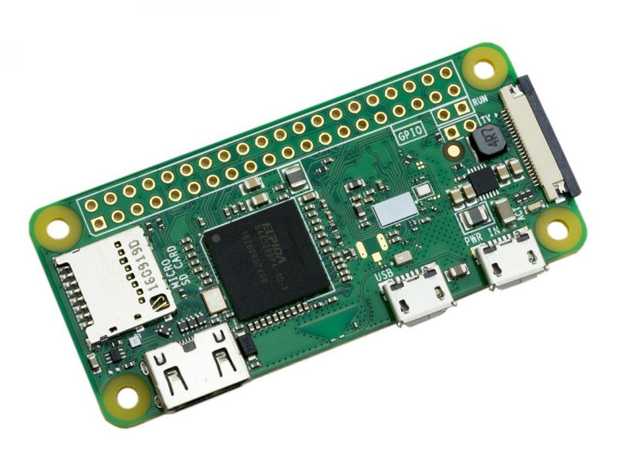
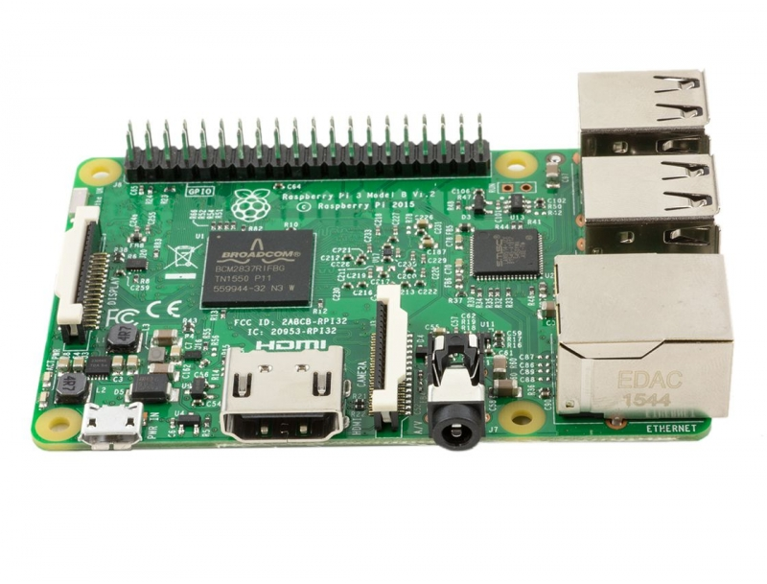
Tracking Processor
RPi Zero W
Low-cost ($15*)
High performance
  1x CPU @ 1.0 GHz
  12 x GPU @ 400 MHz
Very small form factor
Variety of Peripherals
  CSI Camera
  USB OTG
  SPI, I2C, UART
  GPIO
  Bluetooth
  WiFi
RPi 3
Mid-cost ($35)
High performance
  4x CPU @ 1.2 GHz
  12 x GPU @ 400 MHz
Small form factor
Variety of Peripherals
  CSI Camera
  SPI, I2C, UART
  GPIO
  Bluetooth
  WiFi

Slide 30
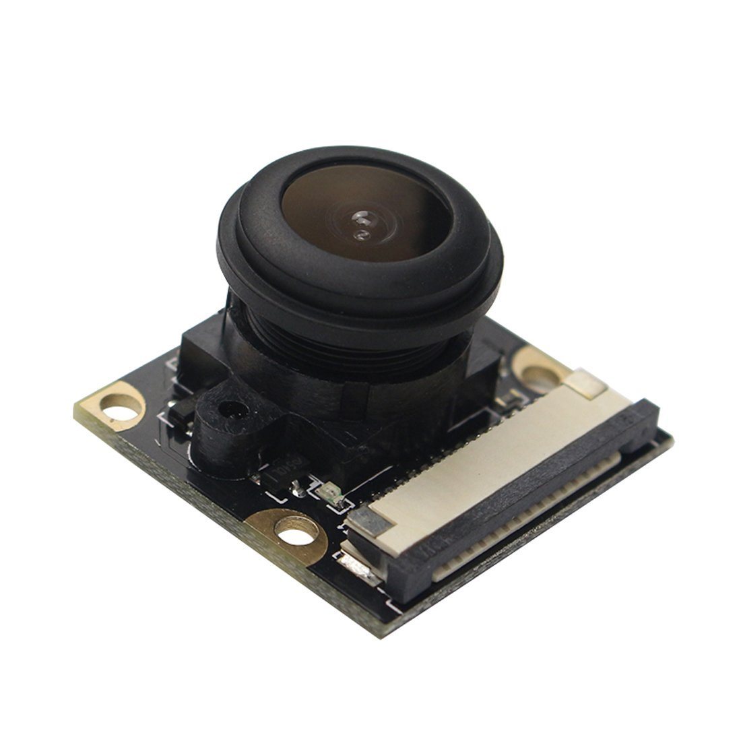
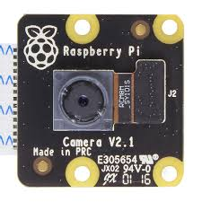
Camera
OVR5647 RPi Camera
1080p @ 30 Hz, 720p @ 60 Hz
5 MP
Low-Mid cost ($26)
OVR5647 Sensor
RPi NoIR V2
1080p @ 30 Hz, 720p @ 60 Hz
8 MP
Mid cost ($30)
Sony IMX219 Sensor

Slide 31
Camera Tracking - Challenges & Considerations
Search for pixels
Define markers
  Put pixels into groups
  Use most likely groups as trackers
Apply camera lens correction algorithm
Convert 2d coordinates into 3d space line estimate
  Affine transformation
Minimize mean-square error

Slide 32
Camera Tracking Algorithm - Optimizations
Need: RPi is slow
  1 GHz vs 62.1 Mpixels (1080p @ 30 Hz)
GPU
  VideoCore IV
  38.4 GFLOPS
  Not well documented
  Slow data transfers
  Hard to “condense” data
Look at predicted areas first

Slide 33
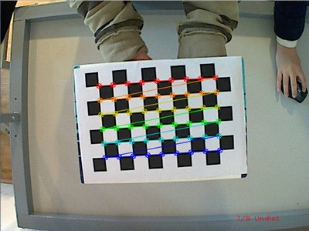
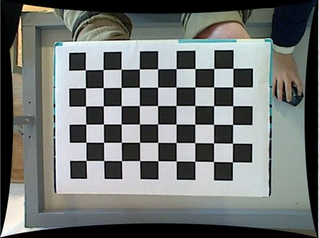
Camera Calibration
Problems:
  Camera position and rotation is not known with enough precision
  Camera lens distortion
OpenCV
  Find camera calibration distortion coefficients
  Give exact checkerboard position, find camera position and orientation
Calibration Tool
  Houses the checkerboard
  Manually triangular the distance to the center of the housing to find the checkerboard position

Slide 34
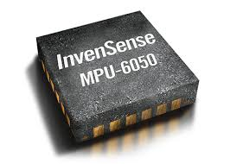
Internal Measurement Unit
Accelerometer
  2nd order position derivative
  Acceleration
Gyroscope
  1st order
  Velocity
High sampling rate @ 4kHz
Calibration:
  On startup
  Determine offset rotation by placing on flat surface and looking at accelerometer gravity vector

Slide 35
Wireless Technologies
Bluetooth
  Low-latency (1ms)
  Requires module
IrDA
  Line-of-Sight
  Short distance (1m)
  Connectionless
IR (Custom)
  Complex Hardware
  Medium - Low latency
  Connectionless
  Subject to noise
IEEE 802.11
  High Data Rate
  Requires large module
  Medium, non-deterministic latency (< 25 ms)

Slide 36
Raspberry Pi - Bluetooth HID
Based off USB HID
Low Latency, comparable to (<= 1.0 ms)
HID Reports
  Compact data
  Descriptors
    Descript data layout (sizes, offsets, etc.)
  Updates can be unsolicited transmitted (interrupt)
  Updates can be responded to from requested

Slide 37
Sensor Roles
Camera:
Absolute position & orientation
High latency
Internal Measurement Unit (IMU)
Low latency
Differential measurement
  Second order differential position (i.e. acceleration)
  First order angular position (i.e. angular velocity)
Drifting error
High frequency

Slide 38
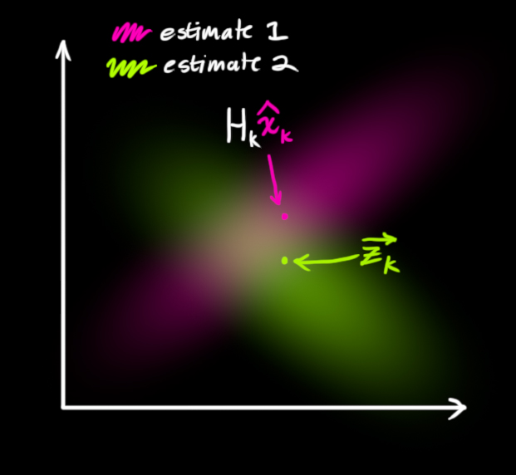
Sensor Fusion - Kalman Filter
Take estimates from sensors
Forms output by weighting:
  IMU
    Low latency data
  Camera Tracking
    Absolute, no drift error
  Prediction
    Linear equations
Updates weights based on comparison of predicted to actual

Slide 39
Latency - Compensation Need
Projector
Eye
If latency is too high, the head tracking will lag behind the user’s actual head position
  Bad effect
  Motion sickness
All components have latency
  Biggest proponents:
    Projector (~15ms)
    Usb (~3ms)
    Camera (~33ms) (Not direct)
Pre-track latency
  Before immediate position is known
Post-track latency
  Before perspective is shown to user
15ms
Renderer
3 ms
Head Tracking
33ms
Head Movements
Camera

Slide 40
Latency - Compensation Limits
Display is quantized at 60hz frames (x2 sub-frames for each eye )
Sub-frames not compensated
  Each eye has a similar perspective for consistency
  Adds unneeded complexity
Prediction accuracy limit
  Rapid movements causes failure in consistent acceleration predictions

Slide 41
Pre-Track Latency Correction/Compensation
Cause: Tracking sensors are out-of phase with track requests
Synchronization - delays movement “capture” for as long as possible
IMU:
  Tracking Processor requests IMU data, with ~2ms delay
  Tracking Processor makes request ~2ms before main track request deadline
Camera:
  Camera streams image frames at ~60hz
  Synchronize with main tracking requests
  Optical Delay
    Known constant
    Account in sensor fusion algorithm

Slide 42
Post-Track Latency Compensation
Cause: Time to render and show a frame time
Can’t correct, tracking data has already been processed
Prediction
  Known acceleration, velocity and position
  Linearly estimate and predict a small amount of time
  Assume acceleration remains constant
  Assumes user does not rapidly apply muscular force
Compensation
  Make consistent requests to the tracking system before the start of each frame
  Give a deadline that the request must be completed before rendering the next frame
  Ask the tracking system to predict the position at the time the image is shown
  Images are not instantaneous, predict the average position over the time the image is shown

Slide 43
Technical Specification - Interfacing

Slide 44
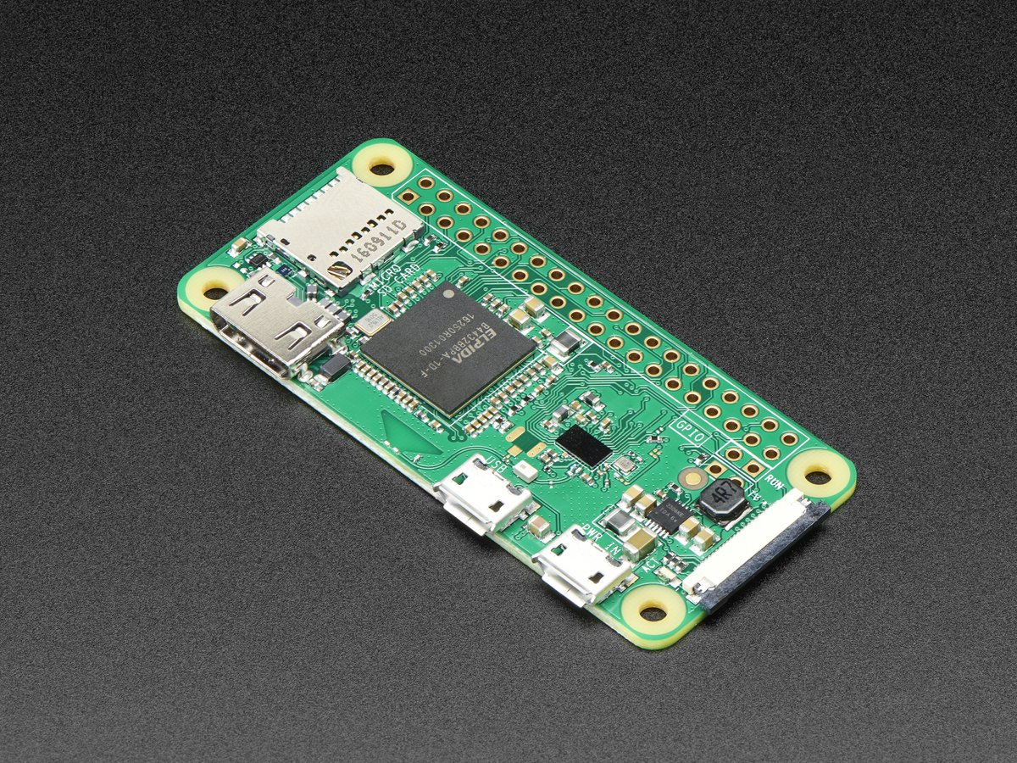
USB Interfacing (Eric)
We’re using two Raspberry Pi Zero W’s as our receivers for camera data. These Raspberry Pi’s are interfaced with the computer using USB On-The-Go.
One of them receives head tracking gyroscopic and accelerometer data from the headset and transmits all data to the computer for both devices.

Slide 45
Raspberry Pi Interfacing - SPI vs I²C
SPI
Non addressed
Simpler hardware interfacing
Lower power requirements
Less board real estate
Only supports one primary controller
No hardware acknowledgement by primary
I²C
Addressed
Multi primary/secondary
Limited to 8 bit words
Can update network with new primary/secondary configurations
We ultimately decided to go with SPI. We only have one primary/secondary relationship so it there’s no need for extra complexity. The two raspberry pi’s (one for each camera) would be connected via SPI, with the primary node also receiving bluetooth data.

Slide 46
Bluetooth Interfacing
Bluetooth Low-Energy (BLE) is a significant protocol designed for smaller devices and that use less energy. The range for BLE is 50-150m and the data rate is 1 Mbps.
We need to deliver our packets of accelerometer and gyroscope data 60 times a second (60 fps).
Max Payload: 20 B
Max (practical) Data Rate: 100 kbps
bitrate (bps) =packet size * transfer frequency
packet size = gyro data + accelerometer data = + 2B*3 + 2B*3 = 12B
transfer frequency = 60 Hz
bitrate (bps) =12B * 8b/B* 60 Hz = 5.76 kbps

Slide 47
USB Interfacing (Eric)
The Raspberry Pi Zero sends the data to the desktop computer (running windows) using USB. This is read by a USB Serial Port Monitor which is made available to other programs because the program which reads it exists within a Dynamic Link Library (DLL).
The USB reader simply listens to ports and updates variables when the most recent data becomes available.

Slide 48
Programming Language Choice - C# vs C++
Similarities
Both Object Oriented
Both Created by Microsoft
Both capable of compiling functions into a DLL
Both are strongly typed
Differences
Only Unity uses C#
Easier to interface C# DLLs with other C# programs
C# is much more like Java and therefore more familiar.
We chose to go with C# for interfacing software because of its relative ease of implementing object oriented design and ease of interfacing with Unity (unity is C#).
We explored using C++ but ultimately decided the integration and supporting libraries were not present or too difficult to use.

Slide 49
Windows DLL
We make our serial port reader methods available to Unity by compiling them into a Dynamic Link Library (DLL).
DLLs allow certain code fragments to be compiled into a single library, and to be linked to by multiple programs.
We decided to use a DLL instead of having all the code in the Unity Project because it allows for more compartmentalized abstracted code.

Slide 50
Technical Specification - Applications

Slide 51
Unity Simulation
Unity is better suited to the Camera manipulation.
Unreal engine very strict and limited.
Past Experience with Unity proving helpful.

Slide 52

Unity Stuff (Matt)

Slide 53
Angle of Attack
Head-tracking will provide what is called an angle of attack
Applied angle of attack will be the camera object itself
The ability to see multiple sides of an object without changing.

Slide 54
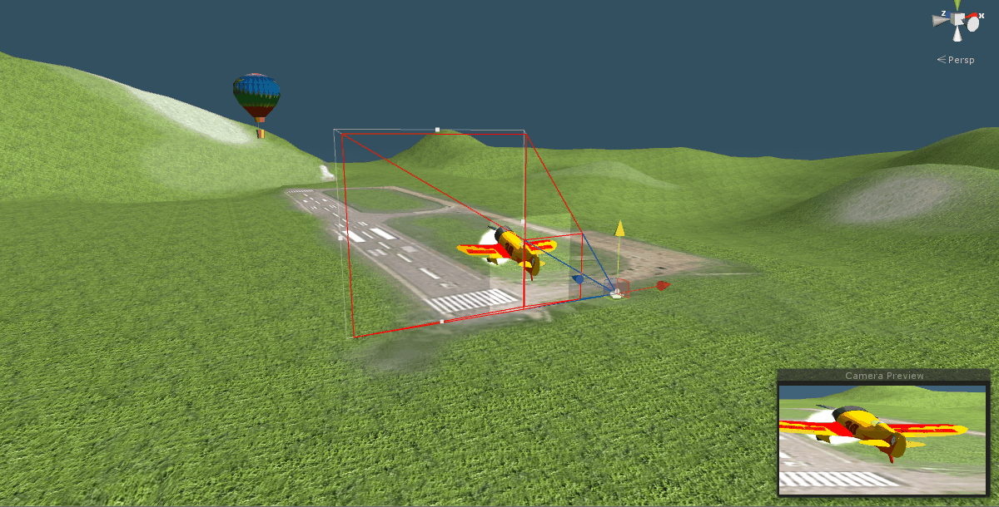

Slide 55
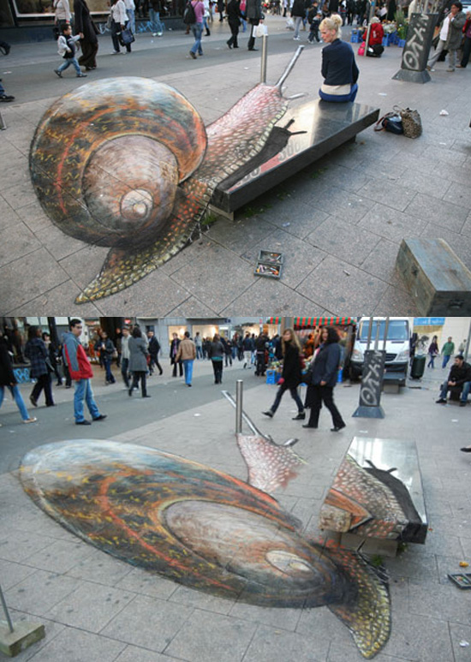
Stretching the Frame.
Angle of viewing in the real world.
Chalk art photograph
Compensates for distance between two sides of an object from the viewing aperture.

Slide 56
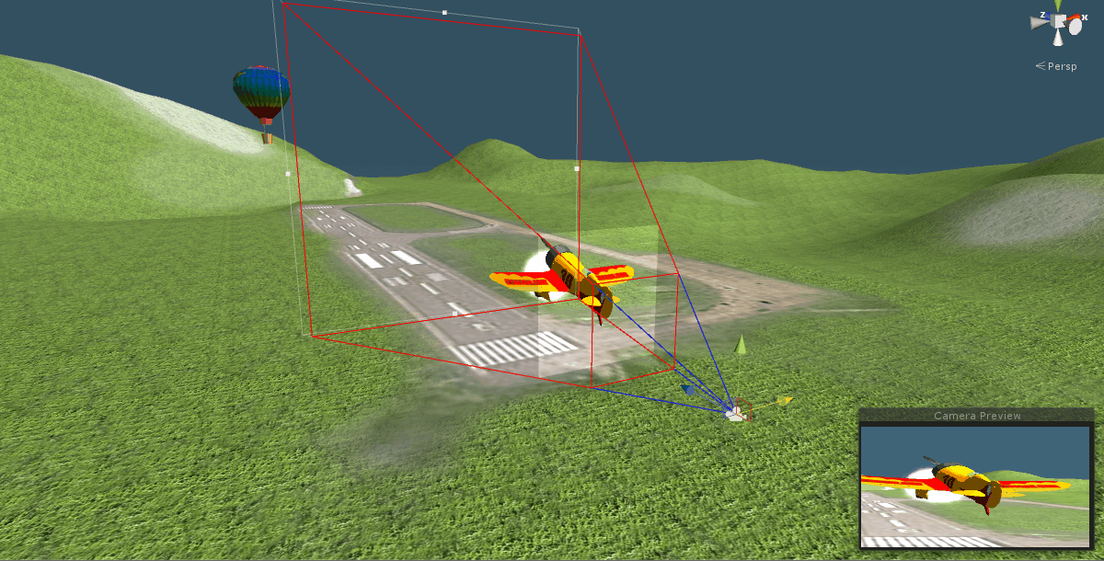

Slide 57
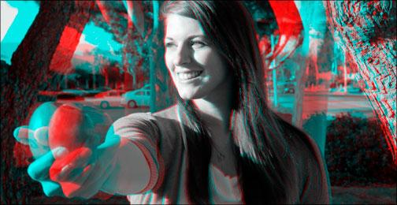
Camera Left and Camera Right
Distance between the eyes and the screen matters.
Left cam and Right cam must be pushed further apart to imply distance.
This is called Stereoscopic 3D

Slide 58
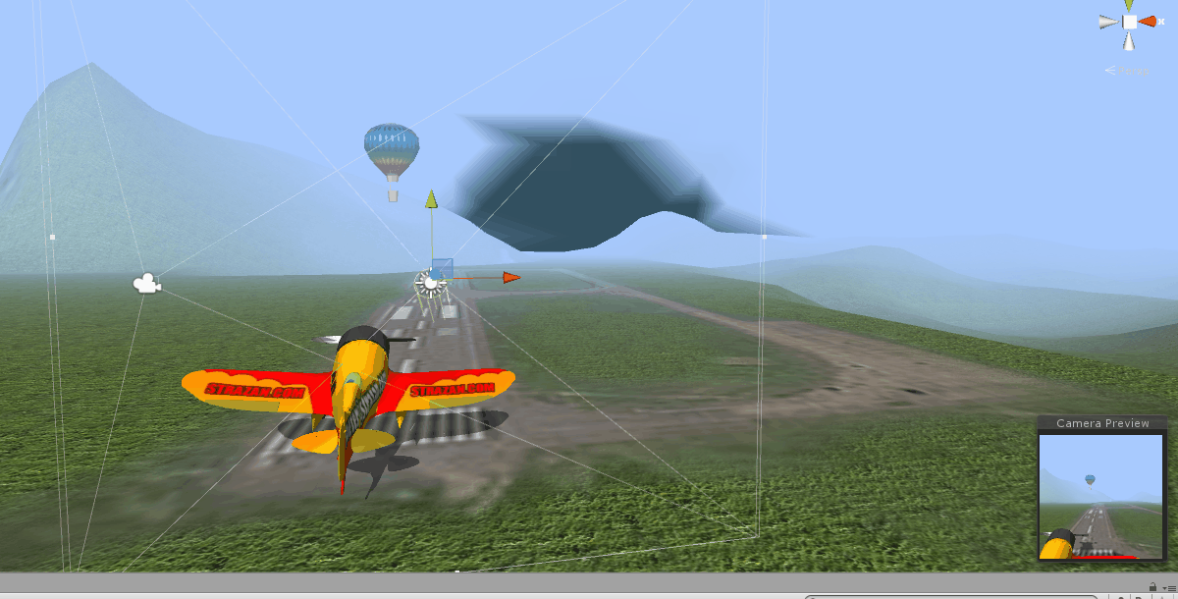

Slide 59
Stretching the frames PLURAL
In order to imply distance without creating distance, moving the frames further apart will give the correct impression
For this we can simply use cameras in the virtual world.

Slide 60
Administrative

Slide 61
Division of Labor
 | Primary | Secondary
Applications | Matt | Eric Smithson
Hardware | Col Schacht | Dane Bouchie
Interfacing | Eric Smithson | Dane Bouchie
Head-Tracking | Dane Bouchie | Eric Smithson

Slide 62
AGILE Process (Eric)
We track our progress using a trello board. Tasks are tracked across sprints as either Todo, In Progress, In Review, and finally Completed
Tasks are assigned every two weeks.
We have in person standup meetings every Wednesday in chat and every Friday in person. In these standup meetings every group member conveys the following information:
What they did since last meeting
What they are planning to do until the next meeting
What, if anything, is blocking them (i.e. something they can’t work on until someone else in the group completes a task)

Slide 63
Budget
Item | Quantity | Budget Allocation Per Item
Head Tracking Electronics (Parts) | 3 | $100
Head Tracking System Board | 3-6 | $80
Desktop System (Rendering) | 3 | $0 (Pre-owned)
Stereoscopic Integration Software | 3 | $50 (Exp.)
Base Materials | 1 | $300 (Exp.)
DLP Projector | 1 | $350
3D Glasses | 5 | $20
Budget | N/A | $3000

Slide 64
Progress
Research : 100%
Overall Design: 100%
Schematic: 100%
PCB: 100%
Embedded Software: 100%
Applications: 100%
Testing and Integration 100%
Improvements 5%

Slide 65
Improvements
Housing
3D Calibration
Performance Optimizations
Latency Optimizations
Kalman Filtering
Applications

Slide 66
DEMO

