Slide 1

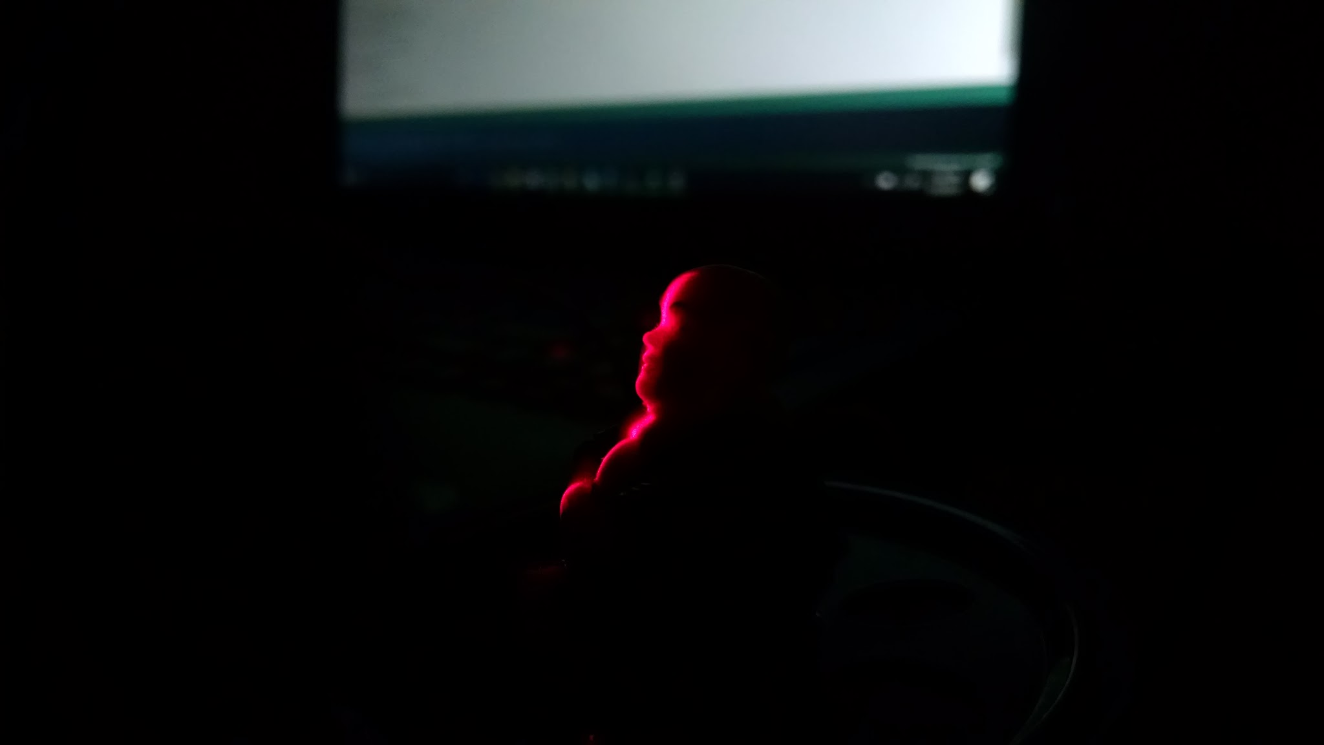
Scanner for Automated 3D Modeling of Small Objects
Group B CREOL
Cary McEwan CPE
Sommer Hilliard EE
Isaias Velez EE
Sam Benjamin PE
Notes:
Introduce ourselves first, then the project

Slide 2
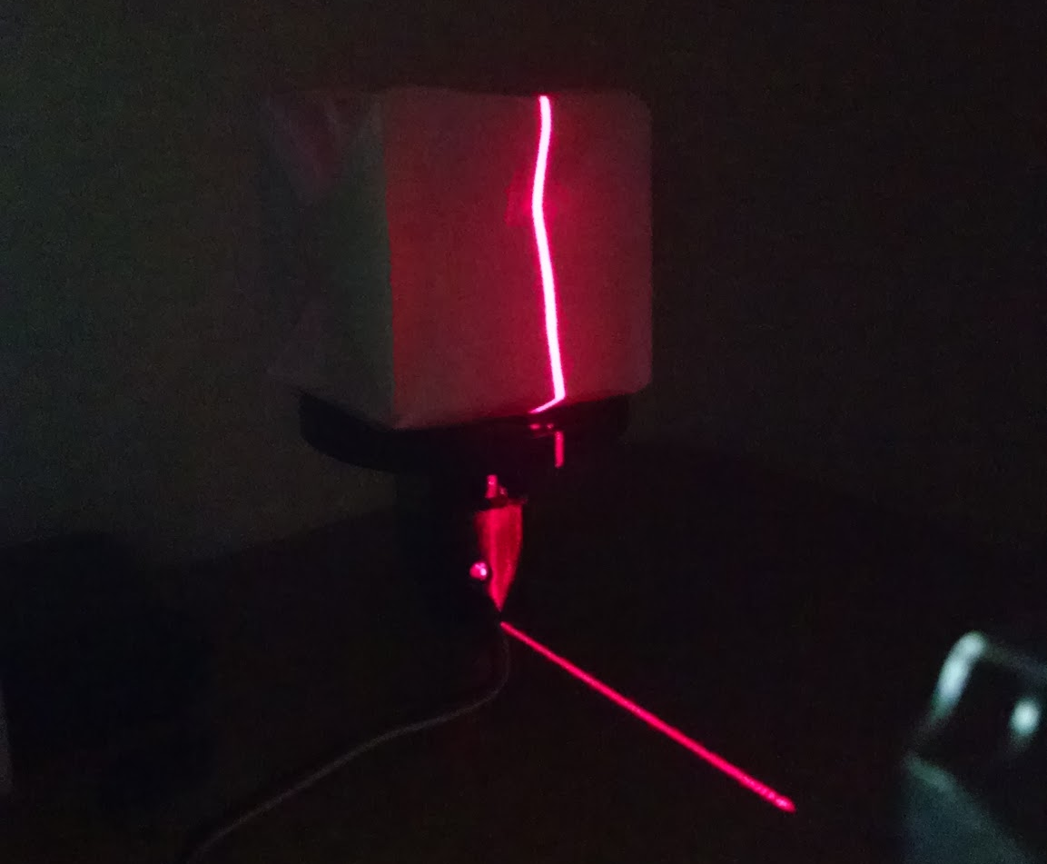
Motivations
3D printers are becoming popular, and the demand for 3D scanners isn’t far behind
3D modeling software is expensive and difficult to learn
Countless applications for hobbyists and creative types
Notes:
Sam

Slide 3
Goals & Objectives
Utility
Capable of interpreting wide range of surface geometries, reflectances
Real-time image processing via raspberry pi microcomputer
Simplicity
User-friendly touchscreen interface
Size and weight on-par with desktop 3D printers
Notes:
Sam
Two main focuses -- Utility and Simplicity.
The former refers to the range of object types which our scanner can handle. We want our design to handle as many cases as possible, from smooth reflective surfaces to rough, highly-absorbing ones. All image processing will happen on-board the device with no external software necessary

Slide 4
Specifications
Parameter | Specification
Scan Resolution | 1 mm or less
Maximum Scan Time | 5 minutes
Enclosure Dimensions | 2x2x2 feet
Weight | 20 lbs or less
Deliverable | Ready-to-print .stl file
Production Cost | $500 or less
Notes:
Sam

Slide 5
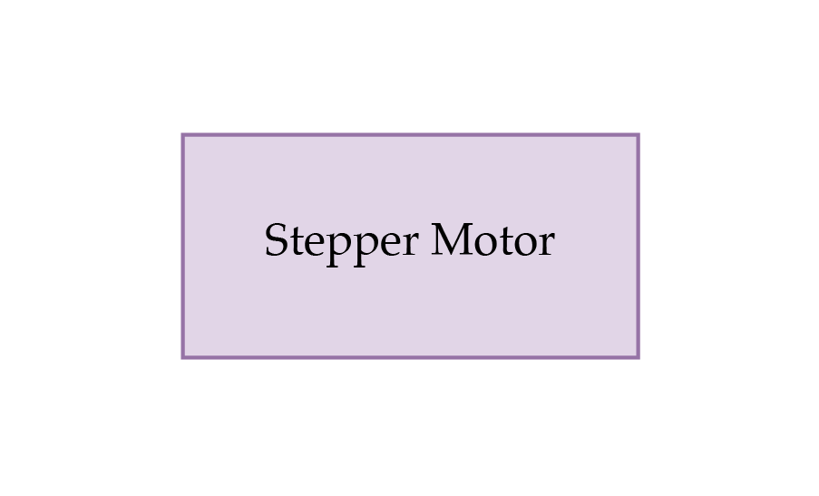
Project Block Diagram
Notes:
Isaias

Slide 6
Design Approach: Point Cloud Generation
Step 1: Imaging
Illuminate object with laser
Capture an image from a relatively large angle
Raw image data to be processed
Notes:
Sam

Slide 7
Design Approach: Point Cloud Generation
Step 2: Image Processing
Identify contour with custom CV software on raspberry pi
Reduce to a set of points whose locations are defined in 2D image space.
Processed image reduced to points
Notes:
Sam

Slide 8
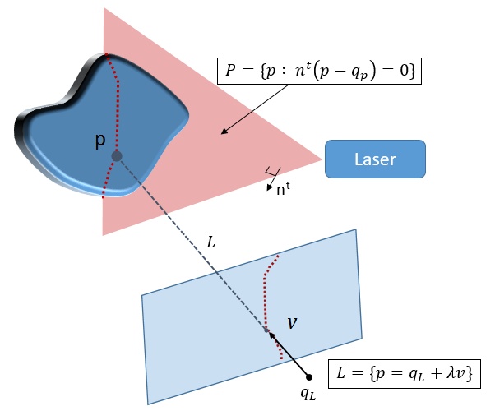
Design Approach: Point Cloud Generation
Step 3: Triangulation
For each point on the imaged contour, define a ray passing through both it and the camera’s center of projection.
Set each ray equal to the equation defining the laser’s plane of projection
Solve for x and z. The y coordinate is known because the laser is stationary
Note: p = (x,y,z)
Using triangulation to map image space to real space
Notes:
Sam

Slide 9
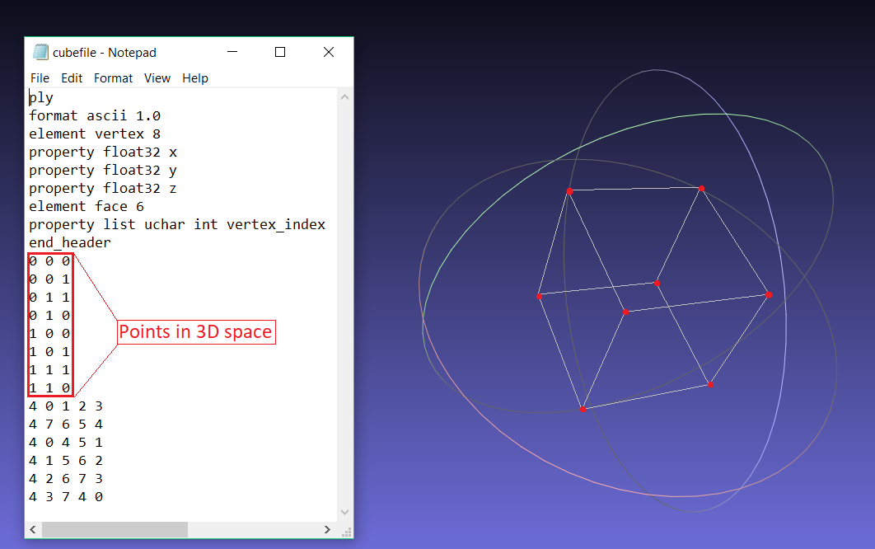
Design Approach: Point Cloud Generation
Step 4: Point Cloud Output
Write .ply file using 3D points
Begin the process of rendering as a printable .stl file
Notes:
Sam

Slide 10
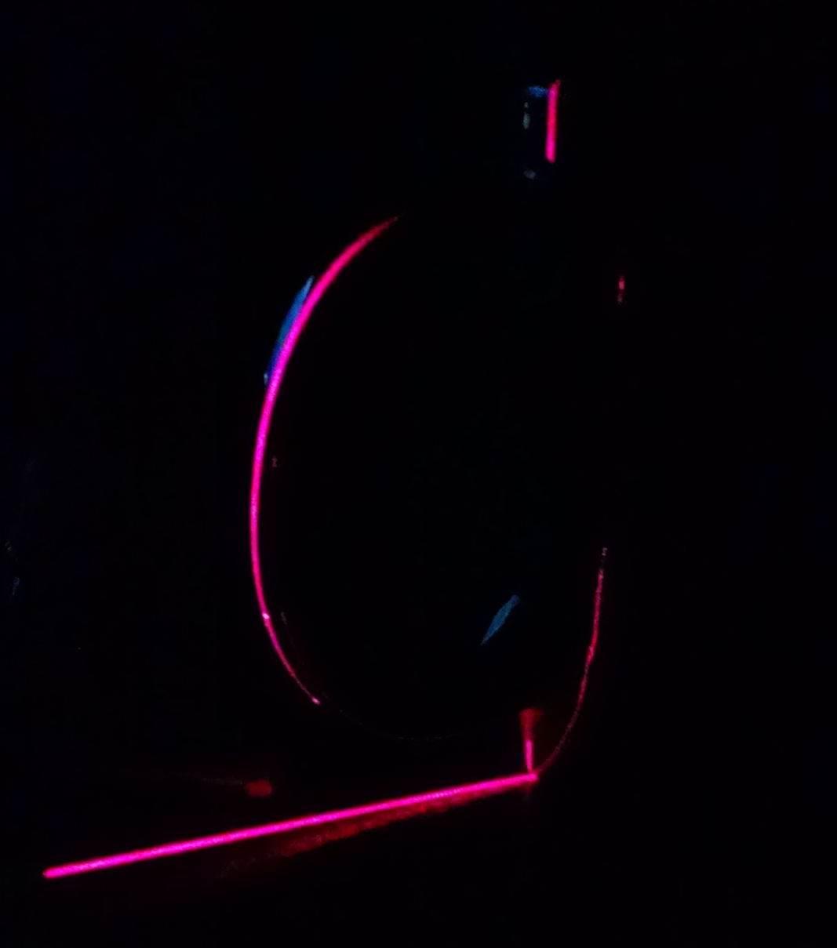
Challenges Moving Ahead
Occlusion
  Optimize camera angle
  Add a top-down laser/camera pair
Secondary Reflections
  Intensity threshold filtering
  Continuity filtering
Notes:
Sam

Slide 11
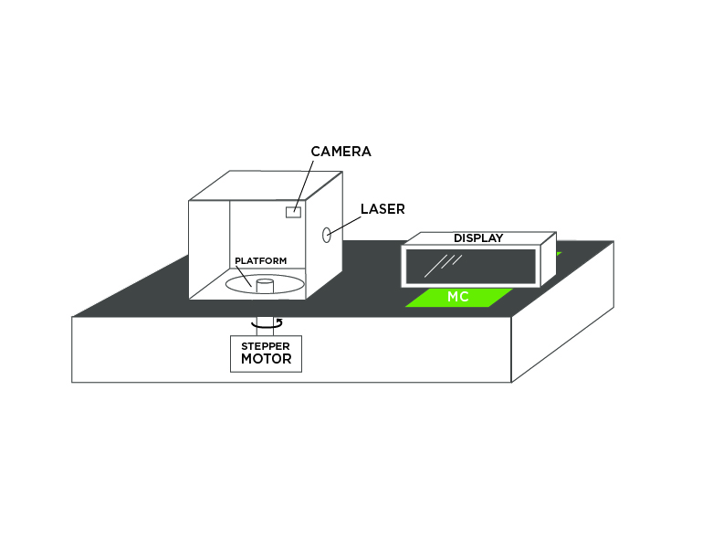
Initial Prototype Design
Chasis material is acrylic
  Lightweight
  Strength to Weight ratio
  Low cost
Notes:
Isaias

Slide 12
Container
Closed Container with black acrylic
  Reduce light pollution
  Increase contrast for laser
LED status indicator
Camera Mount
  Placed at optimized angle relative to laser
  Stability
Easy Access
Notes:
Isaias

Slide 13
Platform
Clamping system on platform
  Keep objects from shifting
  Not picked up by camera
Stepper motor to platform apparatus
  3D printed gear(s) (indirect connection)
  Direct connection of motor to platform
Low vibrational interference

Slide 14
System Enclosure
Hardware hidden inside
Stepper Apparatus under platform
Display mounted on container
Side-to-Side ventilation with mesh screen

Slide 15
Challenges and Issues
Platform, Container integration with the stepper motor
  Possible synchronization issues with gear, stepper and motor
Vibrations effects on image
  Small movements to camera/laser
  How to dampen vibration?
  Optimal steps/rev
Object centering on platform
Notes:
Isaias

Slide 16
Wireless Communication
3D Scanning System requires:
  Low power consumption
  Long battery life
  Intermittent transmissions, not constant stream.
Bluetooth Low Energy also offers an idle mode with reduced power consumption.
Bluetooth Low Energy
 | Wi-Fi Direct | Bluetooth Classic | Bluetooth Low Energy
Speed (Mbps) | 100 - 250 | 2-3 | 1
Range (ft) | 200 | 50 | 50
Battery Life | Poor | Good | Very Good
Encryption (bits) | 256 | 128 | 128
Notes:
The 3D scanning system depends on wireless communication for transmission of the point cloud file to computer, where the output can then be 3d printed. For our use, the system requires low power consumption and long battery life. Transmission speed isn’t very important as there will only be intermittent transmissions not a constant stream. As a result, we opted for Bluetooth Low Energy, also referred to as BLE. As you can see from the table, it clearly lacks the performance of Wi-Fi Direct or Bluetooth Classic, however, its extended battery life is perfect for our use, especially with an idle mode which offers an even further reduced power consumption.

Slide 17
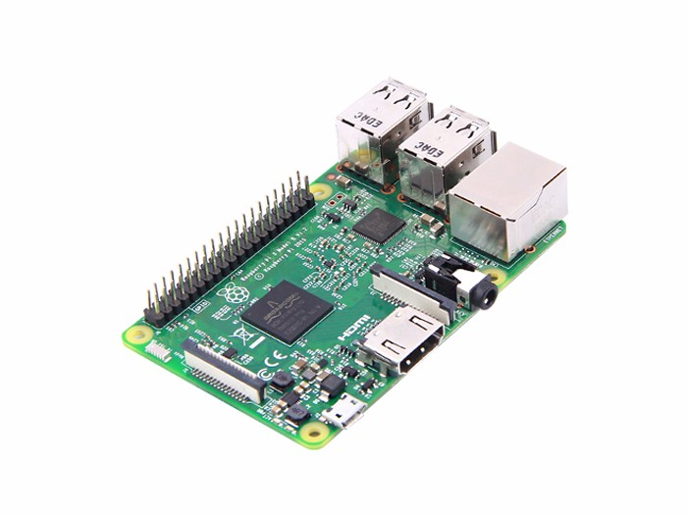
Microcontroller
1.2 GHz clock rate
40 GPIO Pins
1 GB SDRAM
Onboard HDMI
No code size limitation
Extensive developer community
Bluetooth Low Energy (BLE)
$35
Raspberry Pi 3 Model B
Notes:
Cary - For our microcontroller, or moreso embedded processing unit, we opted for the Raspberry Pi 3 Model B. Some important specs for our system include its 1.2 GHz clock rate and 1 GB SDRAM a which will be necessary for processing point cloud data while also remaining within the time constraint specified in the specification. The 40 GPIO pins allow for a ton of input/output potential. The onboard HDMI allows us to directly connect to our display and allows for features such as camera preview (which will be touched on later) as well as for the potential of on board display of the scan’s output. Some other cool features include its virtual lack of code size limitation, extensive developer community and on board support of Bluetooth Low Energy. All this for a measly $35

Slide 18
Development
Environment
Language(s): Python, C++
IDE: Pycharm, Resharper C++
OS: Linux (Raspbian)
Version Control: GitHub
Development Model: Agile
Notes:
Cary - For our software development environment, we’ll be coding primarily in Python and C++. For that we’ll be using Jetbrains’ Pycharm and Resharper C++. For those of you unfamiliar with Jetbrains’ IDE’s, I highly recommend them. They offer products for basically every language. The operating system that we’ll be using, which has long been installed on our Raspberry Pi, is Raspbian which is a distribution of Linux. This is extremely useful as there’s a ton of support available due to the amount of Raspberry Pi users that opt for this operating system. For our version control, we’ll be using the popular GitHub, just to make sure no data is loss and allow for the most efficient software development process. As a result of this, we’ve already started implementing the agile model, focusing on keeping each other updated on our existing progress and crossing off tasks as we go.

Slide 19
Device Communication
Notes:
Cary - Another extremely important function of the Raspberry Pi in our system is communicating with the other devices. As the brain of the system, the Raspberry Pi is responsible for telling the stepper motor when to step, the camera when to capture an image, etc.

Slide 20
Device Communication
RPi.GPIO Python Library
  Provides control of each of the 40 GPIO Pins
Steps taken based on rising edge clock.
Simulate this by toggling the pin from off to on.
Stepper Motor Driver
Notes:
Cary - For communicating with the stepper motor driver, we opted for the RPi.GPIO python library. This library isn’t specific to the stepper motor driver, it actually is a relatively general library that provides control of each of the 40 GPIO pins to users. The stepper motor used in our system operates on a rising edge clock. This is simulated by sending a signal of 0 to that pin and then a signal of 1. This essentially toggles it from off to on, where the step is taken at the point shown in the diagram. Though in an ideal situation, the step is taken immediately at the corner of that edge, in practice there is perhaps a nanosecond degree of delay between the transmission of the signal and the motor’s response.

Slide 21
Device Communication
PiCamera Python Library
Connected directly to camera port vs. GPIO Pin
Preview: Show user what camera sees.
Capture: Take picture.
Raspberry Pi Camera
Notes:
Cary - For handling communication with the Raspberry Pi Camera, we opted for the PiCamera Python Library. This was actually one of the major benefits of selecting the Pi Camera, this library that offers direct support. Note that we didn’t use the RPi.GPIO library because the Camera is connected directly to the camera port as opposed to a GPIO Pin. The primary functions that the library offers are a Preview which shows users what the camera sees (similarly to how one operates on a smartphone) and a capture which simply takes the picture.

Slide 22
Notes:
Cary - Communication Flowchart

Slide 23
Device Communication
Integration test consisted of:
  Rotate at 400 steps per revolution
  Capture image at each step
  NO image processing
Success: Duration of each test remains within the time constraint outlined in the specification.
Difficulty: System became unresponsive when showing camera preview.
Success/Difficulty
System Testing
Test # | Steps | Photos | Time (minutes)
1 | 400 | 400 | 3:53:02
2 | 400 | 400 | 3:52:30
Notes:
Cary - We’ve already begin conducting an end to end tests for the system. One thing we wanted to ensure was that the system was physically capable of meeting the 5 second scan time. The integration test we performed consisted of rotating the motor at 400 steps per revolution. At each step an image was taken (so a total of 400 images were captured). Note that no image processing

Slide 24
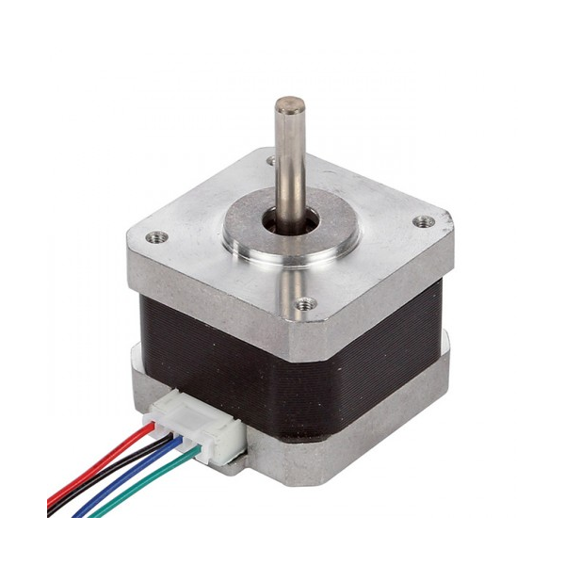
Stepper Motor
NEMA 17 Stepper Motor
2 phase
750 mA/phase
400 - 3200 steps/rev
Precise position & speed control
High low speed torque
48mm
42.3mm
Notes:
Sommer

Slide 25
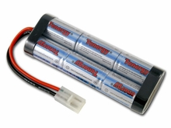
NiMh Battery
136mm
7.2V
5000mAh
Charged at rate of 2A in 200mins
Lightweight
No memory cell effect
Inexpensive
47.5mm

Slide 26
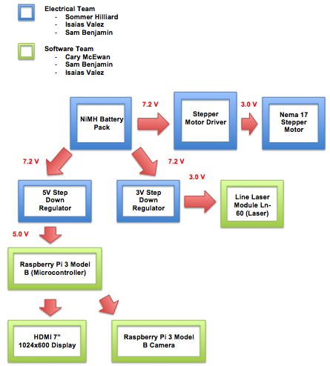
Hardware Flow Chart
Separated by electrical and software teams
Power distribution displayed

Slide 27
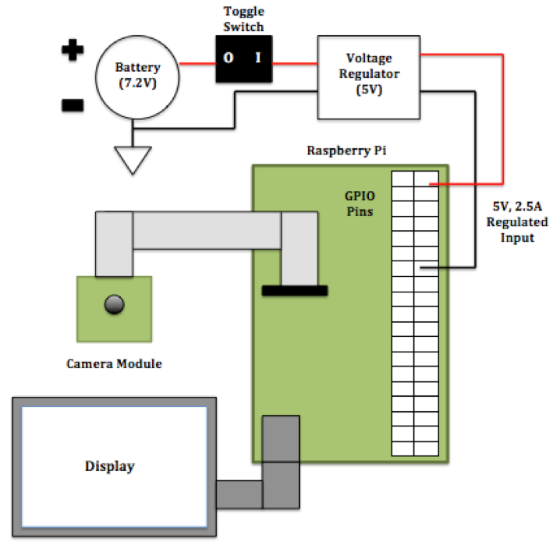
Microcontroller Subsystem
Battery
Switch
5V Switching Regulator
Raspberry Pi
Camera Module
Display

Slide 28
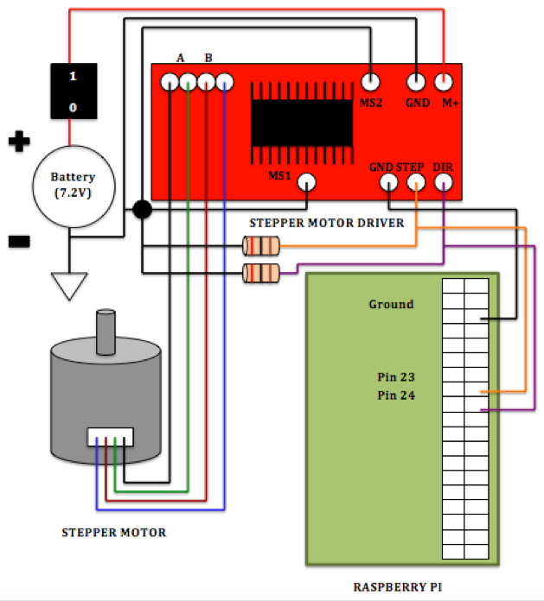
Stepper Motor Subsystem
Battery
Switch
Stepper Motor Driver
Stepper Motor
Raspberry Pi

Slide 29
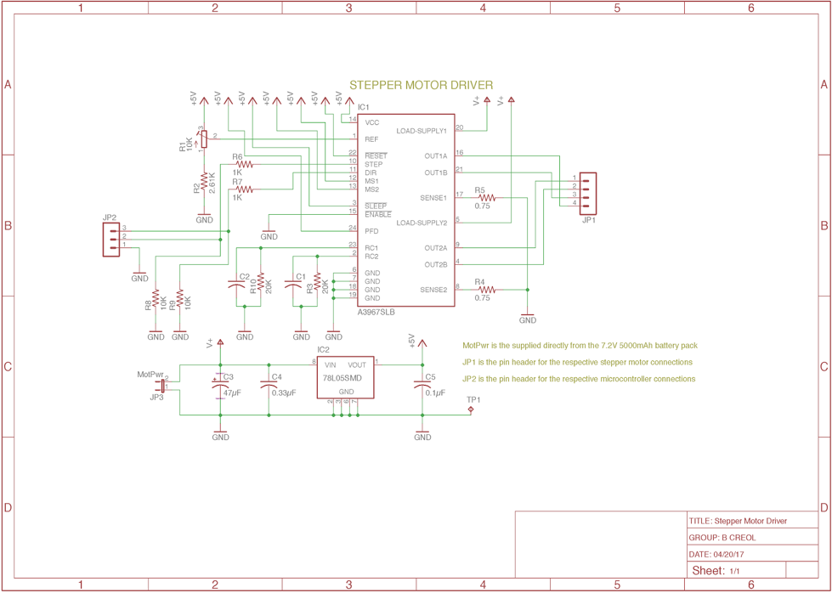
Stepper Motor Driver Schematic

Slide 30
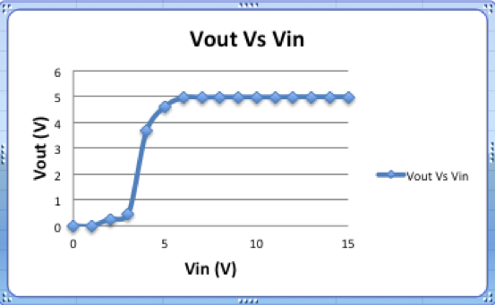
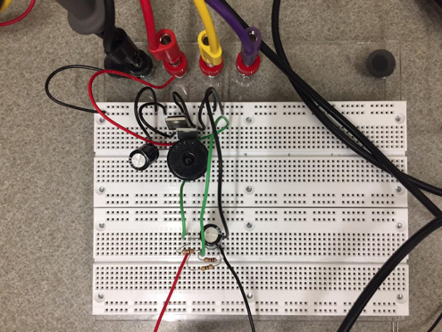
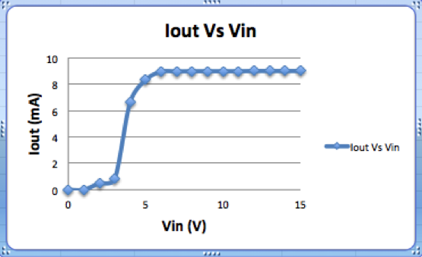
Switching Regulator Prototype
5V Switching Regulator (LM2576-ADJ)

Slide 31
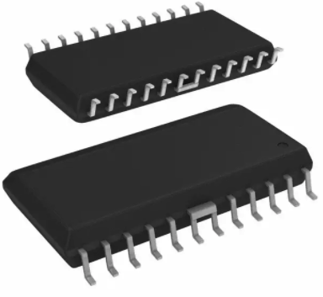
Stepper Motor Driver Chip
Allegro A3967 Microstepping Driver
10.3mm
24 pin package
Full, half, quarter, and eighth step modes
750mA, 30V output rating
Supply voltage 3.3V to 5V
15.4mm

Slide 32
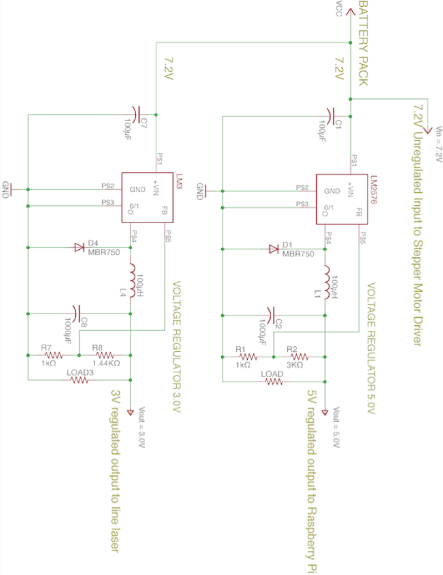
Power Management

Slide 33
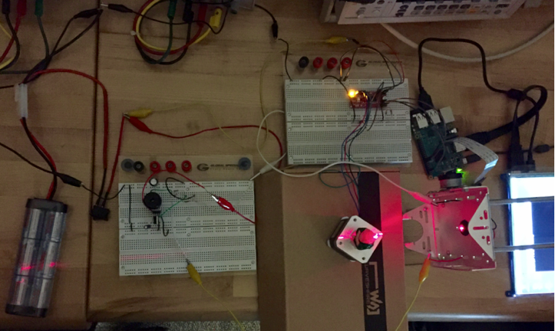
Initial Prototype Testing

Slide 34
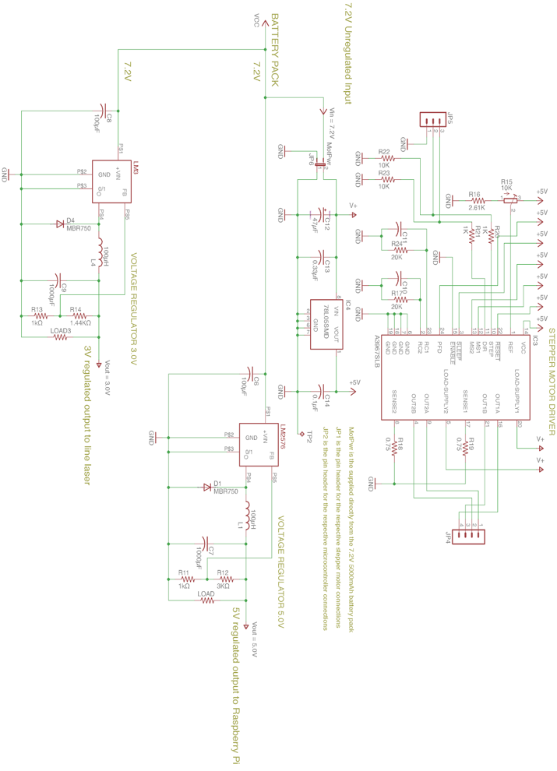
Full System Schematic

Slide 35
Budget
Description | Quantity | Price/Unit | Estimated Total
PCB | 1 | $50.00 | $50.00
Laser | 1 | $30.00 | $30.00
Camera | 1 | $30.00 | $30.00
Display | 1 | $30.00 | $30.00
Microcontroller | 1 | $20.00 | $20.00
Battery Pack | 1 | $20.00 | $20.00
Battery Charger | 1 | $30.00 | $30.00
Stepper Motor | 1 | $20.00 | $20.00
Mounting Device | 1 | $30.00 | $30.00
Total |  |  | $280.00
Note: Equal Contributions by group members for total costs of project

Slide 36
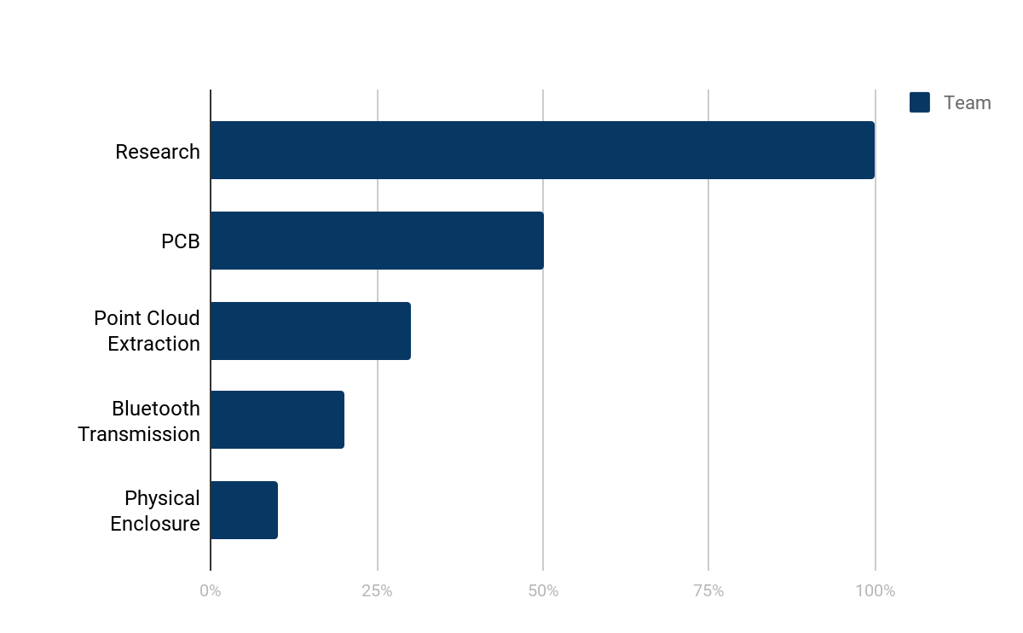
Progress
Notes:
Cary - This graph offers a visual representation of our progress to date. With the completion of senior design 1, the research phase is done and each section below covers the major components of our implementation. The PCB is at roughly 50% completion, we’ll be ordering and begin testing it shortly. Sam has made substantial progress on the point cloud extraction and the majority of what’s left it simply translating it to OpenCV. In regards to Bluetooth Transmission, I’ve began working with a library to facilitate this and now need to focus on doing so on the Raspberry Pi itself. Upon tackling most of the PCB design, we’re now turning some of our efforts to the physical enclosure, where Isais will be leading the front there.

Slide 37
What’s Next?
Finalize and order PCB
Coding point cloud extraction
Bluetooth interfacing and transmission of file
Container for system
TESTING
Notes:
Cary - What’s next?
Finalizing and order the PCB. We hope to have that done by the end of next week.
As mentioned before, translating the point cloud extraction to opencv code.
Writing the software for bluetooth interfacing and transmission of the point cloud data.
Finalizing design for the container of the system, then begin its implementation.
Most importantly, testing. We want to make sure to allocate sufficient time for testing the system and verifying that is production ready before delivery.

Slide 38
Questions?
Notes:
All

