Slide 1

Group 2
Chris Britt – Electrical Engineering
Francisco Tirado Perez – Computer Engineering
David Simoneau – Computer Engineering
Anthony Hunter Hinnant – Computer Engineering

Slide 2
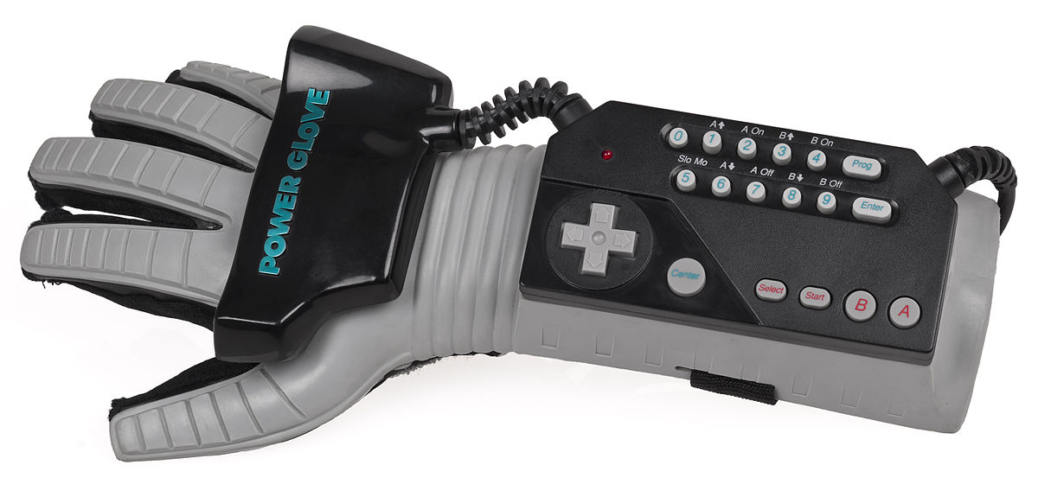
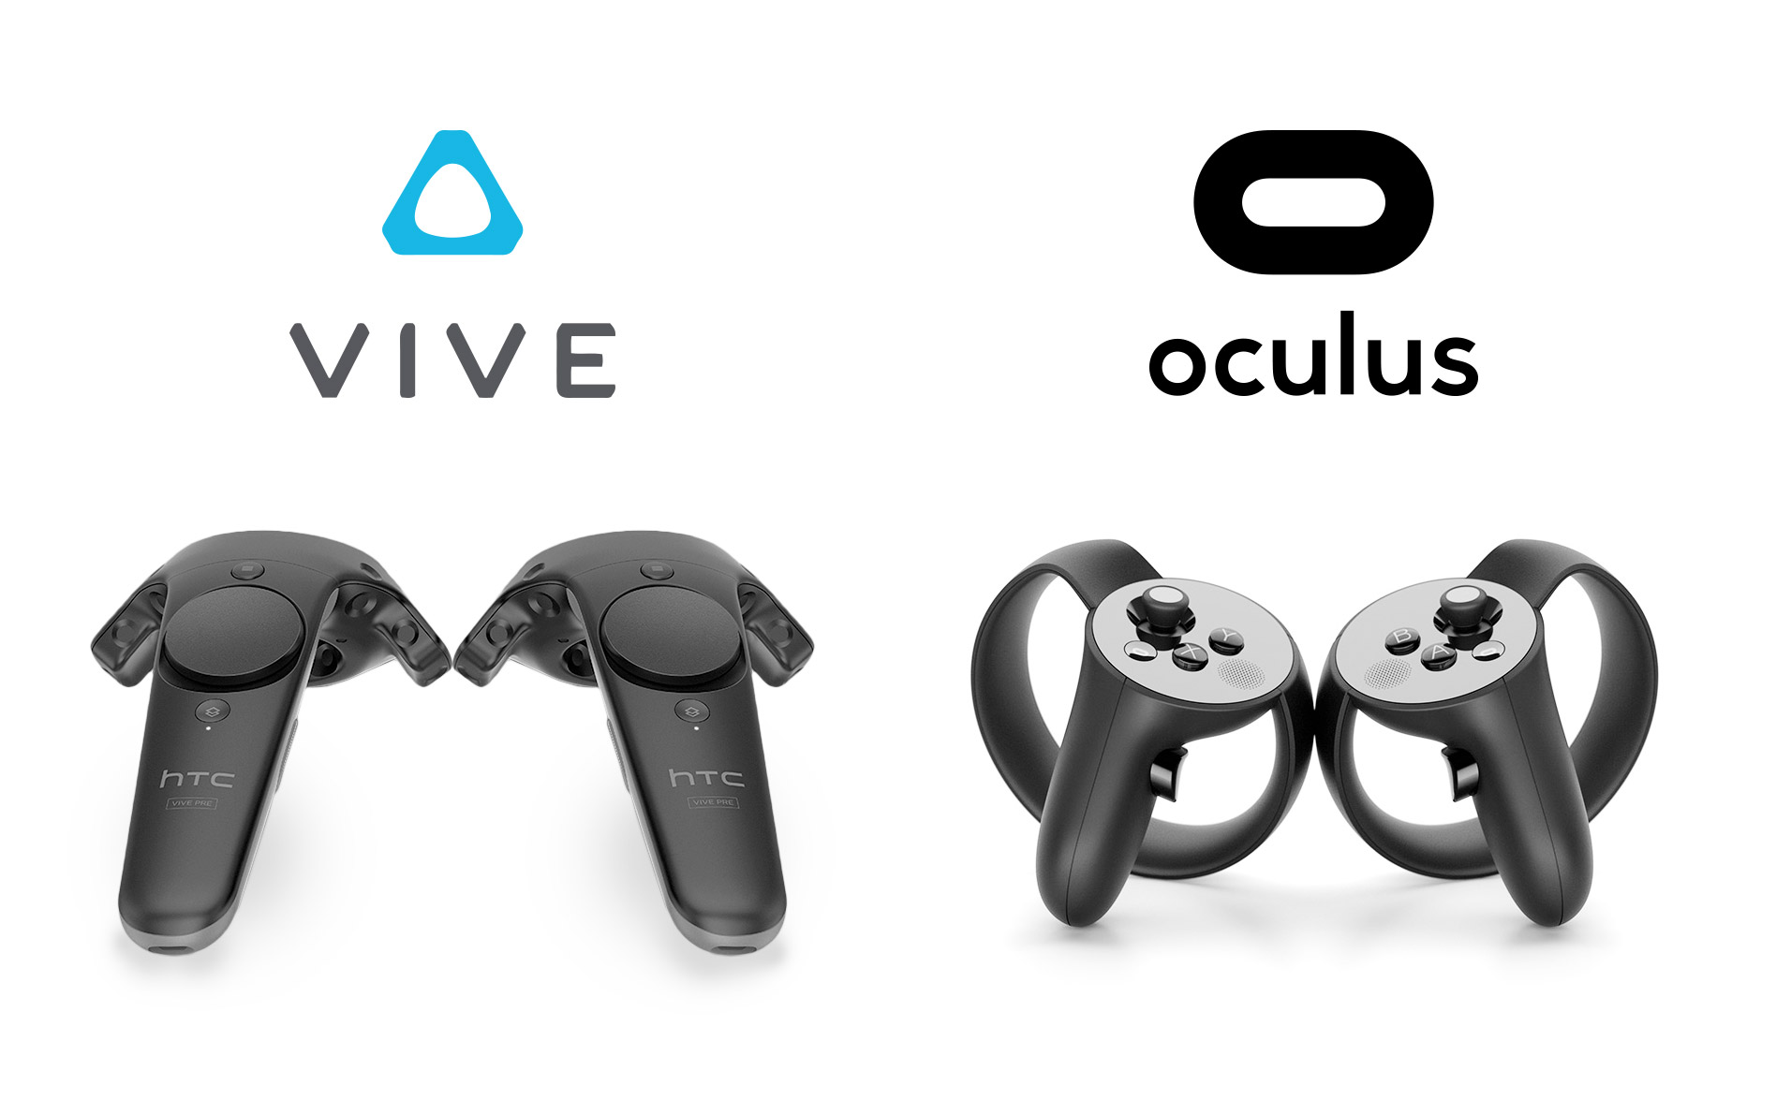
Motivation
Severe lack of open source VR controllers
Existing options are expensive, controllers, or outdated
The project is an excellent avenue to showcase practical engineering skills

Slide 3
Goals and Objectives
Enhance the virtual experience by providing touch and temperature feedback
Create a cheaper experience to current VR users
Provide a basis for simple open source hardware and software
Design a product that can be used for most VR applications

Slide 4
Specifications
General Type | Specific Type | Design Specification
Immersiveness | Frame Rate | > 30 FPS
Battery | Use Life | > 30 min
Safety | Thermal/Electrical | Reasonably Safe
Arm Strain | Weight | < 2 kgs

Slide 5
Expected Budget
Item | Quantity | Price (rough estimate)
Glove | 2 | $20
PCB Design ~ Processor Board | 4 | $150
PCB Design ~ Glove | 4 | $150
Electrical Components on PCBs | ? | $200
Bluetooth modules | 2 | $40
Peltier Devices | 10 | $50
Power Supply | 2 | $20
Vibrational Motors | 10 | $50
Gyroscope Sensor | 2 | $50
Room for Error | ? | $270
Total |  | $1000

Slide 6
Current Expenditures
Part | Description | Supplier | Amount Ordered | Cost Per Unit | Total
C0720B015F | Vibrational Motor | Digi-Key | 7 | 3.354 | 23.48
MAX6897 | IC Sequencer | Digi-Key | 3 | 1.38 | 4.14
TSV321 | Op Amp | Digi-Key | 15 | 0.494 | 7.41
NX3008CBKS | Dual Fet | Digi-Key | 25 | 0.467 | 11.53
AD5248 | Digital Potentiometer | Digi-Key | 15 | 2.525 | 37.88
TPS62823 | Power Regulator | Mouser | 3 | 1.63 | 4.89
TCA954A | I2C Mux | Mouser | 3 | 1.51 | 4.53
MMA8451 | Accelerometer Breakout | Adafruit | 2 | 10.51 | 21.02
MMA8451 | Accelerometer | Digi-Key | 0
1N4148 | Switching Diode | Digi-Key | 20 | 0.067 | 1.34
NXRT15XH103FA1B040 | Thermister | Digi-Key | 10 | 0.58 | 5.8
WP154A4SEJ3VBDZGW/CA | RGB LED | Mouser | 3 | 2.05 | 6.15
CM23-1.9 | Peltier Device | Digi-Key | 5 | 10.404 | 52.2
DRV8836 | H-bridge | Digi-Key | 5 | 1.49 | 7.45
Inductor | 470 nH Inductor | Arrow | 5 | 0.378 | 1.89
Surfance Mount to DIP converters | Various | Various |  |  | 101.8
Total |  |  |  |  | 291.51

Slide 7
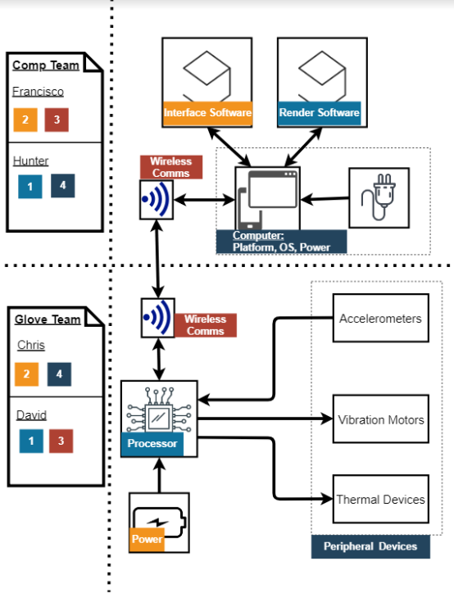
Division of Labor
Chris – Hardware
David – Embedded Systems
Francisco – Interface Driver
Hunter – Virtual Environment and API

Slide 8
Hardware Design
Christopher Benjamin Turner Britt – Primary
David Simoneau- Secondary

Slide 9
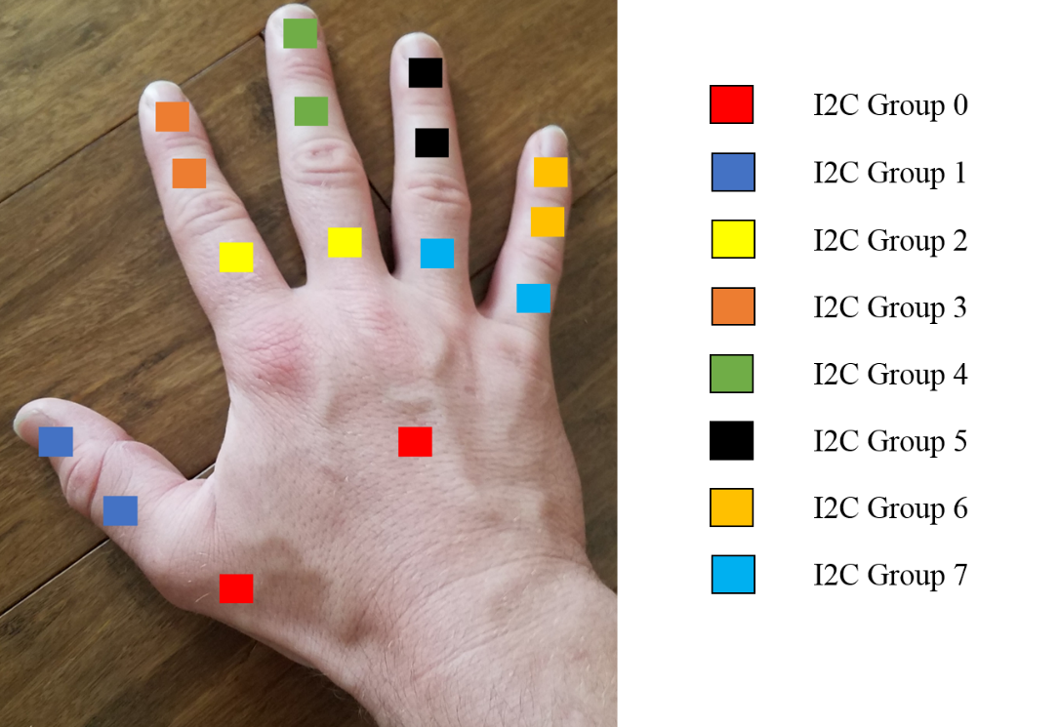
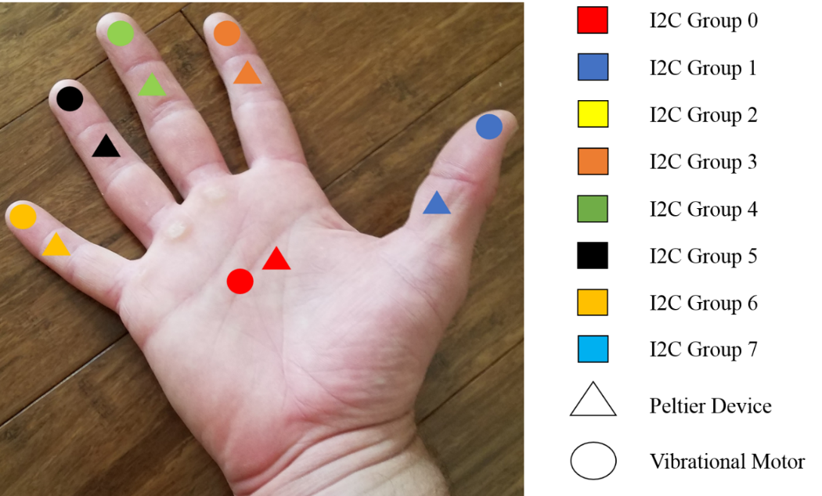
Diagram of Accelerometer Placements
Diagram of Placements of Peltier Devices and Vibrational Motors

Slide 10
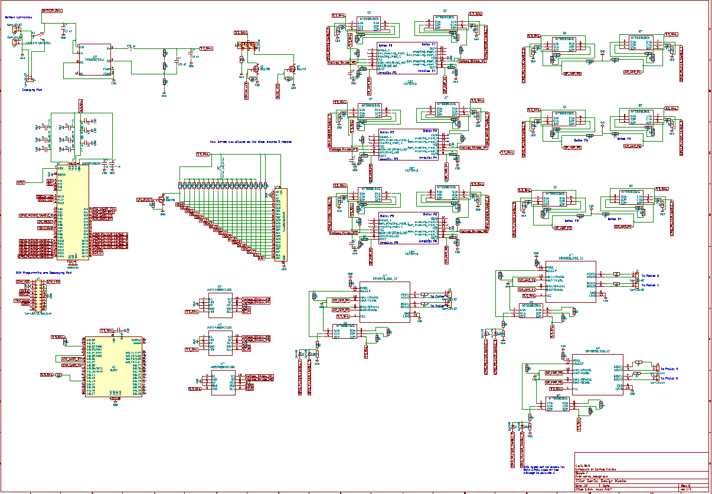

Slide 11
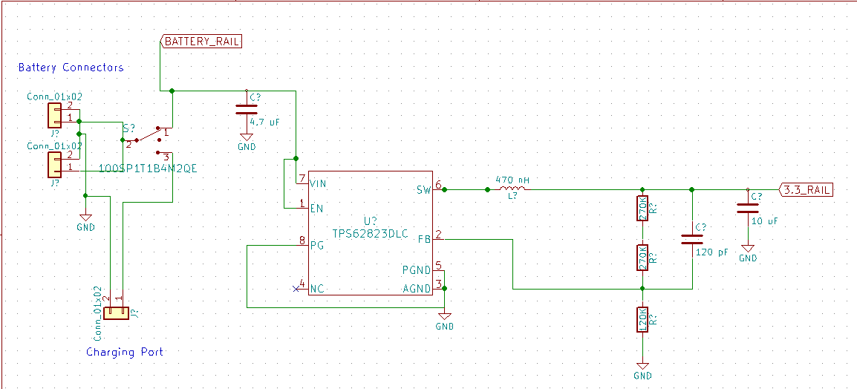
TPS62823DLC
Chosen with TI Testbench
High Efficiency Switching Reg
3.3 Volts and 3 Amps
QFN
$1.63 per Unit
ICR18650
Lithium Ion Battery
6600 mAh at 3.7V
$29.5 per Unit
69mm x 54mm x 18mm
1.25A discharge rate

Slide 12
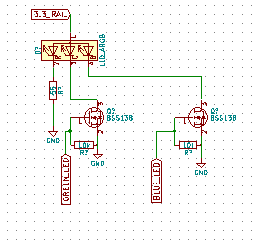
WP154A4SEJ3VBDZGW/CA
RGB Common Anode LED
2.2V Red, 3.3V Green, 3.3V Blue
$2.46 per Unit
BSS138
Switching NFET
220mA
$0.32 per Unit
SOT-23-3
Used Before

Slide 13
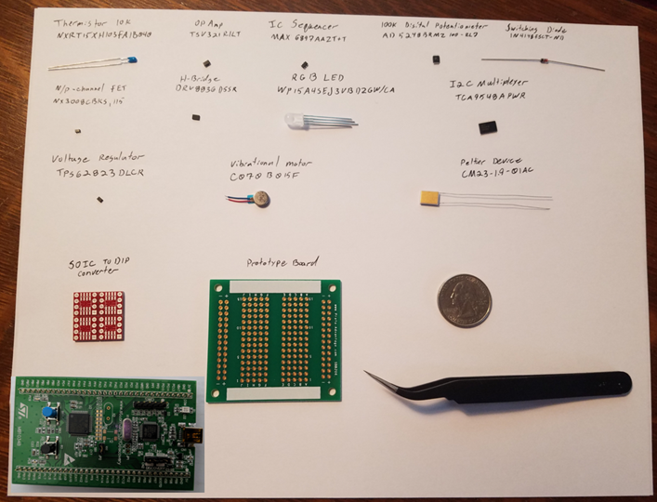
CM23-1.9-01AC
300 to 350 mA Usuable Range
1.9A Max Current
$11.08 per Unit
Cooling Not an Option

Slide 14
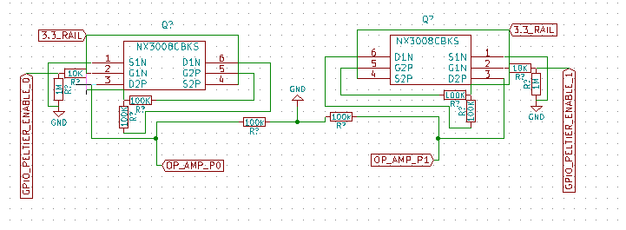
NX3008CBKSRGB
N/P Channel Dual FET
P Channel 200 mA
N channel 350 mA
Used Before
$0.467 per Unit
Used for N/P Switch to avoid 3rd State

Slide 15
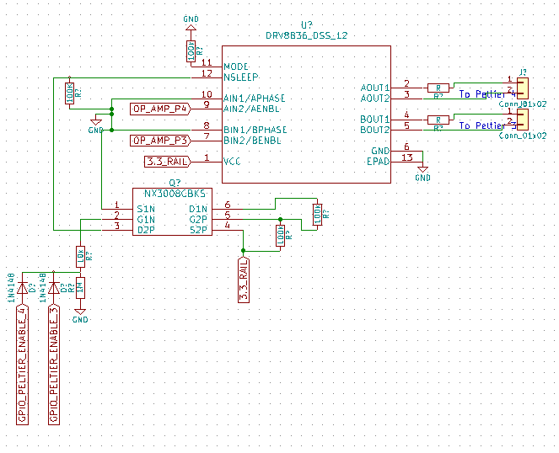
DRV8836
2 Channel Low Voltage H-Bridge
1.5 Amp Max Drive Current
Phase/Enable vs PWM
WSON 2mm x 3mm
Dedicated Sleep Pin
$1.49 per Package
3.3V Operable

Slide 16
C0720B015F
"Coin" Form ERM
3.3 Volt Operable
80 mA Max
$3.54 per Unit

Slide 17
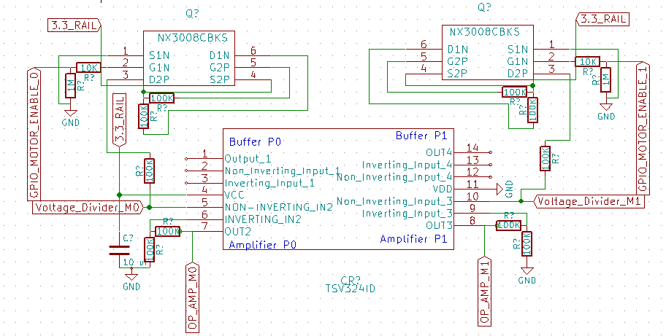
TSV321
General Purpose Rail to Rail Op Amp
80 mA Max Output Current
3.3 Operable
$0.494

Slide 18
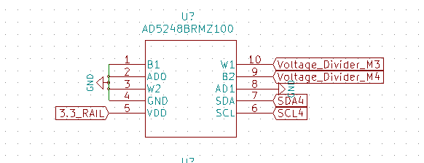
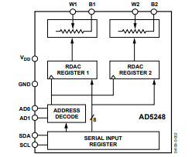
AD5248
2 Channel 256 bit I2C Potentiometer
100k Max Resistance
~50 Min Resistance
3.3V Operable
2 Addressable Pins
No Connect 3rd Terminal
10 MSOP
$2.525 per Unit

Slide 19
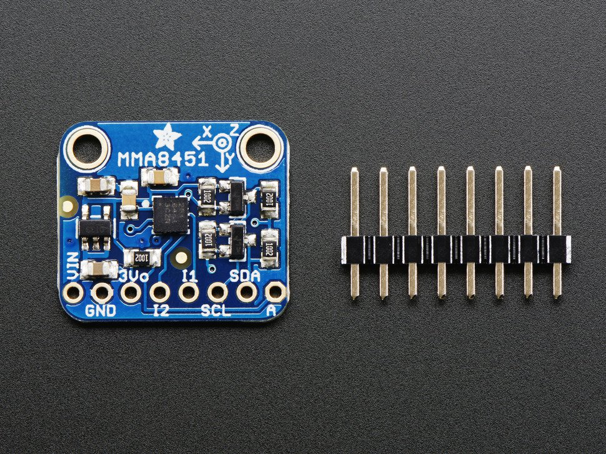
MMA8451
Triple Axis 14 Bit Accelerometer
2/4/8 Capable
3.3V Operable
I2C interface
800 Hz Data Output
2 Possible Addresses
Cheap Adafruit Breakout Board
16 Pin QFN 3mm x 3mm x 1 mm

Slide 20
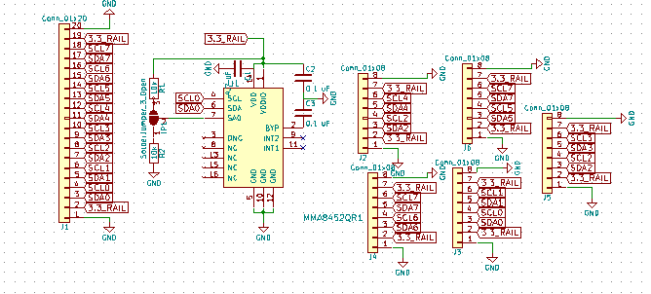
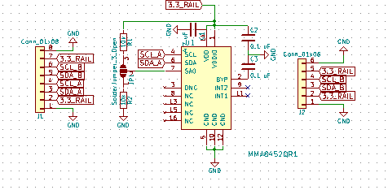
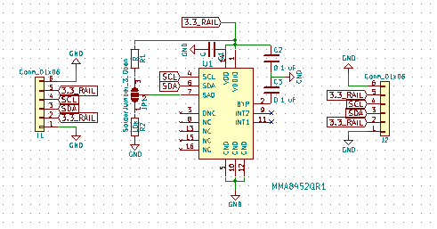
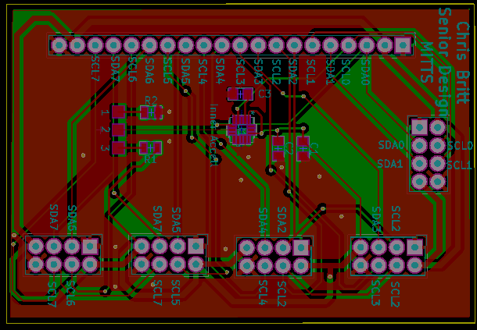
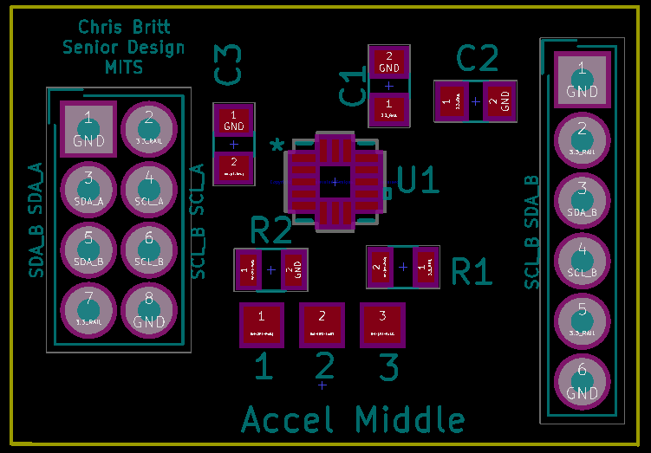
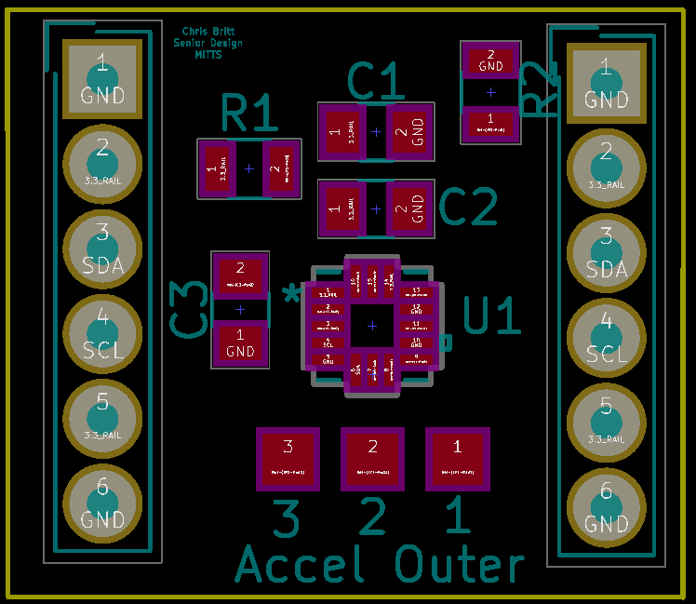
Inner
Middle
Outer
45mm x 60mm
26mm x 18mm
20mm x 17mm

Slide 21
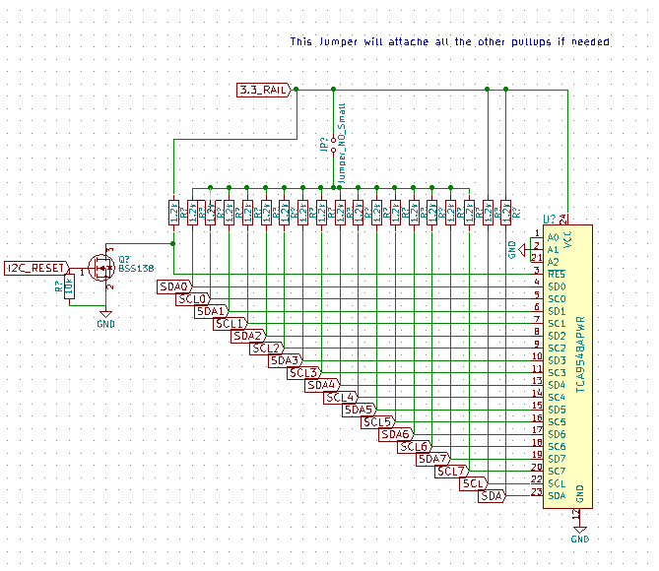
TCA9548A
1 to 8 Bidirectional I2C Switch
3.3V Operable
Adafruit Tutorial
TSSOP 24
$1.51 per Unit

Slide 22
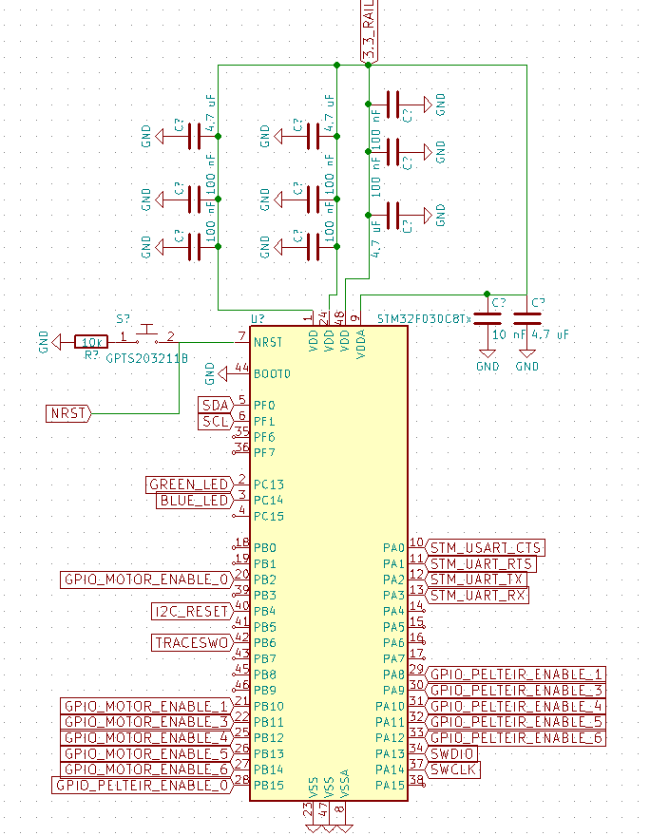
STM32F030C8 LQFP48
32 Bit
48 MHz
256 Kbytes Flash
2 I2C Channels
6 UART Channels
12 bit ADC
3.3 Operable
32 I/O Pins
Serial Wire Debug (SWD)
Internal Oscillators
Reset Pin
$2.02 per Unit

Slide 23
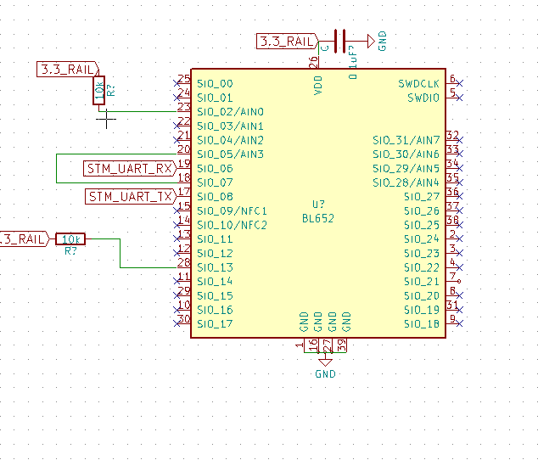
BL652
Bluetooth Module
3.3V Operable
$7.45 per Unit
VSP Mode

Slide 24
Embedded Systems
David Simoneau- Primary
Christopher Benjamin Turner Britt – Secondary

Slide 25
The Other Guys
VRGluv
Force-feedback system
Pulley-like technology
5 pounds of force

Slide 26
The Other Guys
HAPTX
Microfluidic technology
Shape, movement, texture and temperature
5 pounds of force feedback

Slide 27
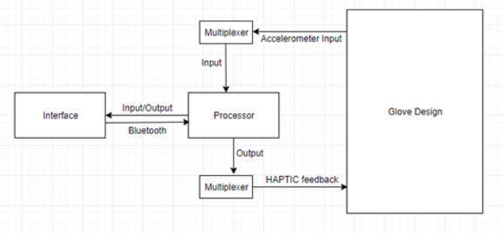
Processing Information
Handle data between sensors and software

Slide 28
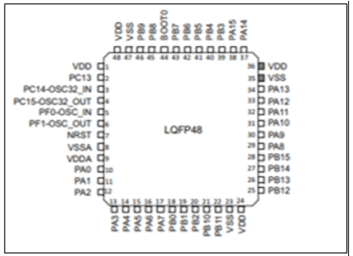
Processor Choices
ATMega
MSP430
STM32 *

Slide 29

Processor Choices Comparisons
Cheaper with more I/O

Slide 30

Processor Choices Comparisons
More memory

Slide 31

Processor Choices Comparisons
Faster

Slide 32
I2C
Using an I2C bus.
Multiplexer for polling
Device addresses minimize lines

Slide 33
Processing Information
Handle data between sensors and software

Slide 34
Wireless Communication
Infrared, satellite, radio, Bluetooth, wifi.

Slide 35
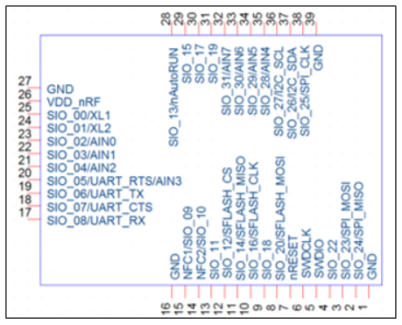
Bluetooth Module Choices
Keeping it modern. Bluetooth choices are 1.x, 2.x, 3.x, 4.x, and 5.x
RN4871-V/RM118
BL652-SC-01 *
BM62SPKS1MC2-0001AA

Slide 36
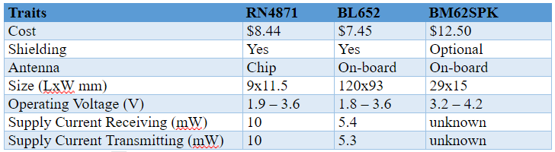
Bluetooth Comparison
Cheaper

Slide 37
Bluetooth Comparison
Cheaper
Bigger

Slide 38
Bluetooth Comparison
Cheaper
Bigger
Less Power

Slide 39
Bluetooth Regulations
This device may not cause harmful interference
device must accept any interference received, including interference that may cause undesired operation.”

Slide 40
UART
Method used with Bluetooth
Internal clocks ensure proper timing instead of clock line
HAL library handles most of specific technical details e.g start bits, stop bits, baud rate, and parity bits.

Slide 41
PCB Design
Flexible PCB?
Small and Secure

Slide 42
PCB Design Tools
KiCAD
Free
Plethora of documentation
SOLIDWORKS PCB
Better for more complex designs
DesignSpark PCB
Less documentation

Slide 43
PCB Fabrication Companies
PCBWay
Cheap and easy
4pcb
More expensive
PCBgogo
Boasts 12-24-hour production
Reliable
JLCPCB
Popular
Cheapest
Largest in China

Slide 44
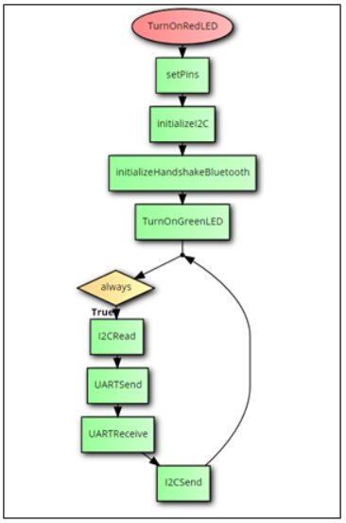
System Startup Procedure
Initialize
Loop
I2CReads
UARTSend
UARTReceive
I2CSend

Slide 45
Programming the Chip
Complexities in Datasheet
Register addresses
I2C pins and other pinouts
How to Flash
power modes

Slide 46
Configuration Utility
Francisco Tirado Perez – Primary
Anthony Hunter Hinnant - Secondary

Slide 47
Goals
System Isolation
Separate the Blender 3D environment from the Hardware Glove
Scalable
Can Coordinate multiple hardware gloves for use in the 3D environment
Debugging Platform
Aids in debugging by providing a real-time data viewing interface.

Slide 48
Development
Windows 10 Operation System
Microsoft Visual Studio 2015 Community edition
C# Programing language
C# forms API
Windows Bluetooth API

Slide 49
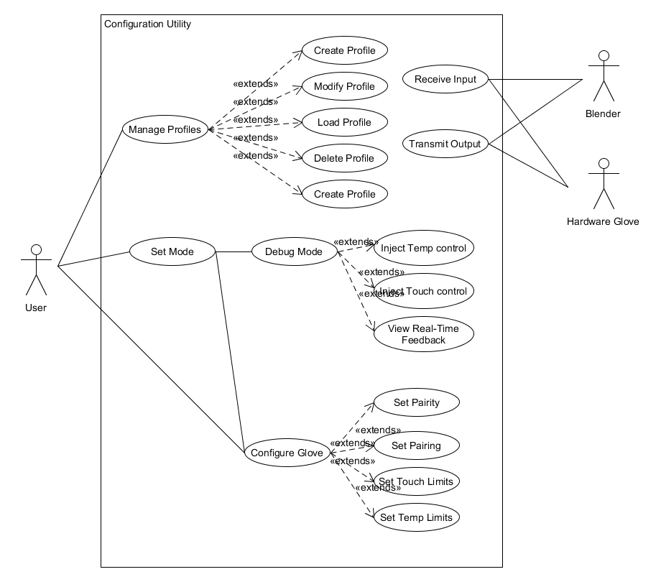
Use Case Diagram
3 Actors
User
Initiates the system
Manages stored profiles
Sets operating mode of the syste
Blender
Receives updated positional data
Provides updated sensory data
Hardware Glove
Provides Updated positional data
Receives updated sensory data

Slide 50
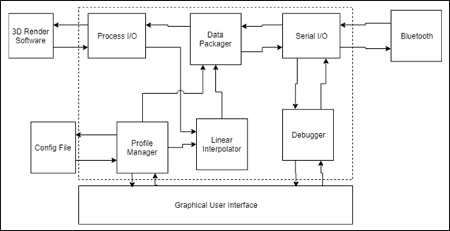
System Architecture
GUI
Visual Tool interface
Process I/O
Tool to Blender communication
Serial I/O
Tool to BlueTooth communication
Data Packager
Coordination of data
Liner Interpolator
Scaling of hardware limits
Debugger
Real-time debugging interface
Profile Manager
Persistent data storage management

Slide 51
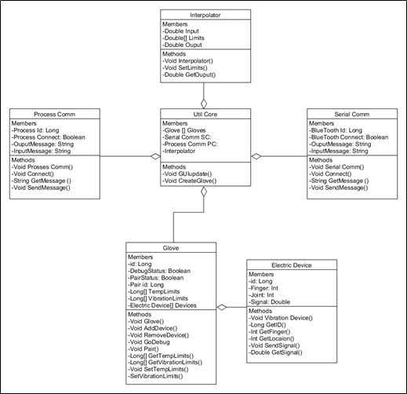
Class Diagram
Util Core
Serial Comm
Establishes Bluetooth Connection with the Hardware Glove
Process Comm
Establishes interprocess communication with Blender
Glove
Storage unit for a gloved device
Electric Device
Storage unit for an electric Device (accelerometers, Plteir, vibration motors)
Interpolator
Provides the Logic for the interpolation routines

Slide 52
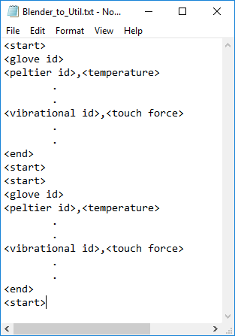
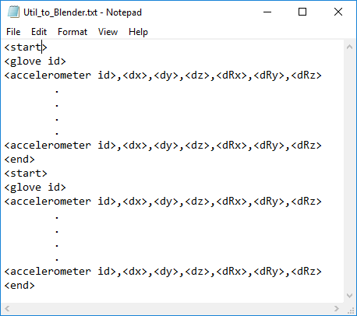
Input/Ouput Scheme
Utility <-> Blender
I/O using files
2 files
Util_to_Blender – Utility writes, Blender reads
Blender_to_Util – Blender writes, Utility reads
Utility <-> Hardware Glove
I/O Bluetooth
Utility leverages Windows Bluetooth API
Hardware Glove has a Bluetooth Module

Slide 53
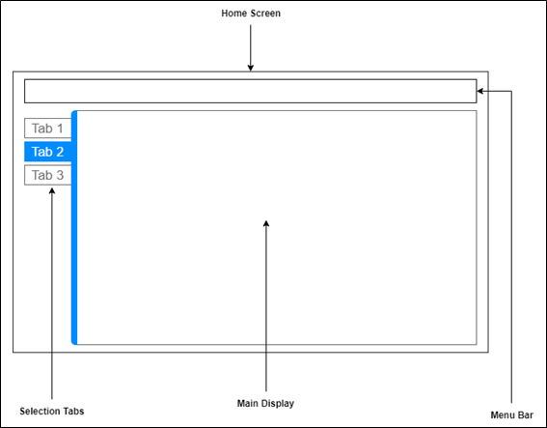
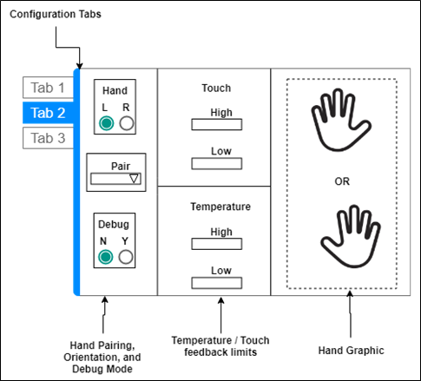
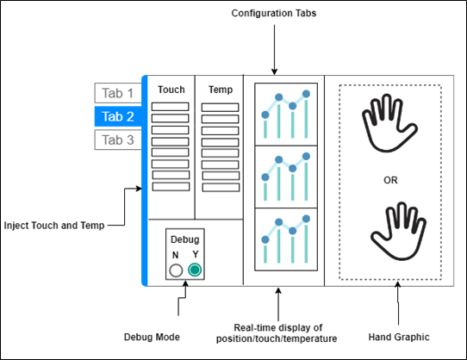
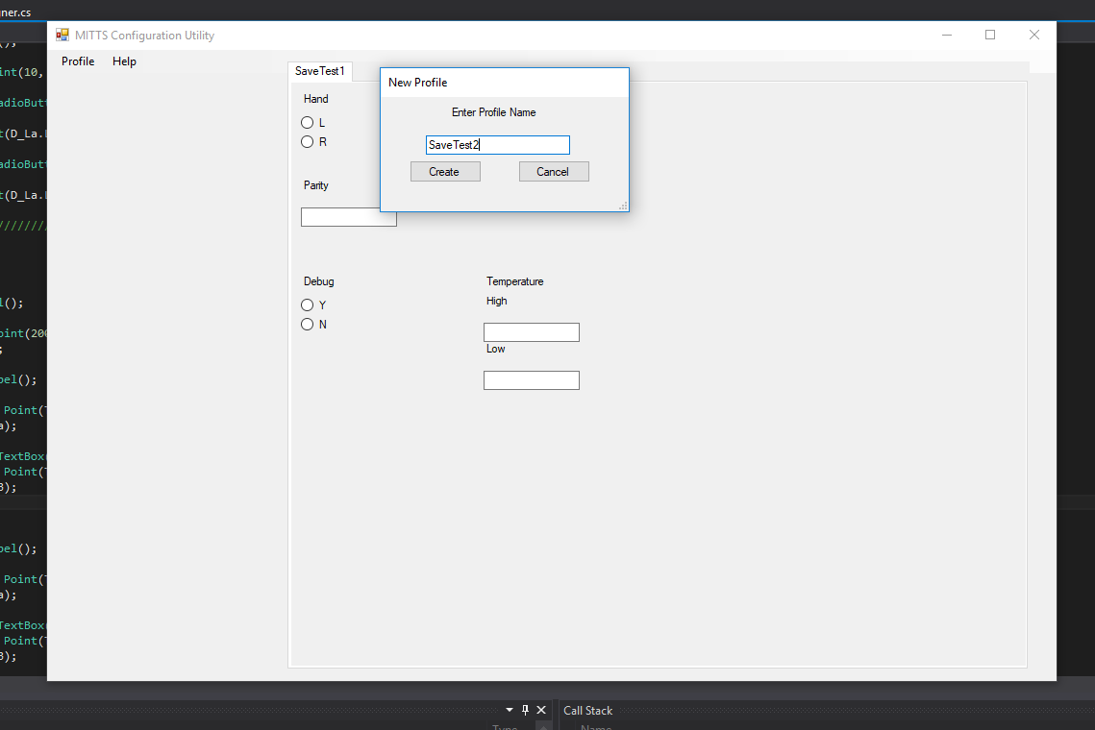
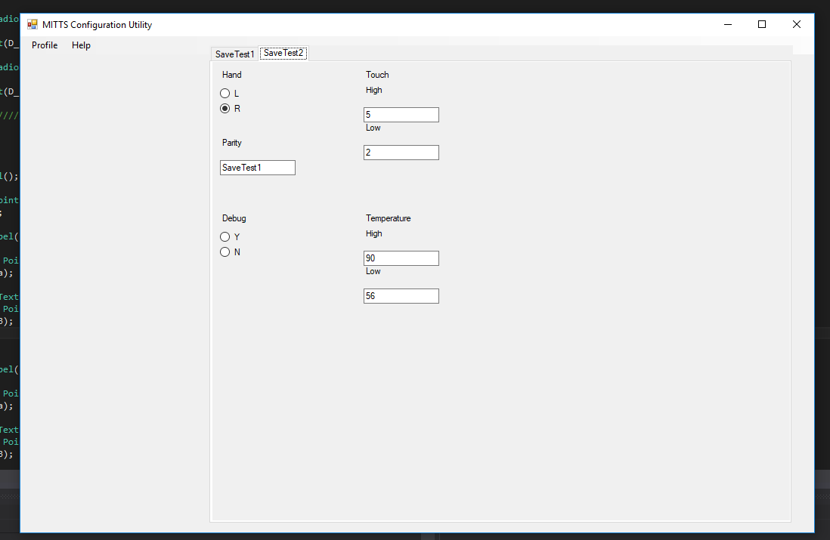
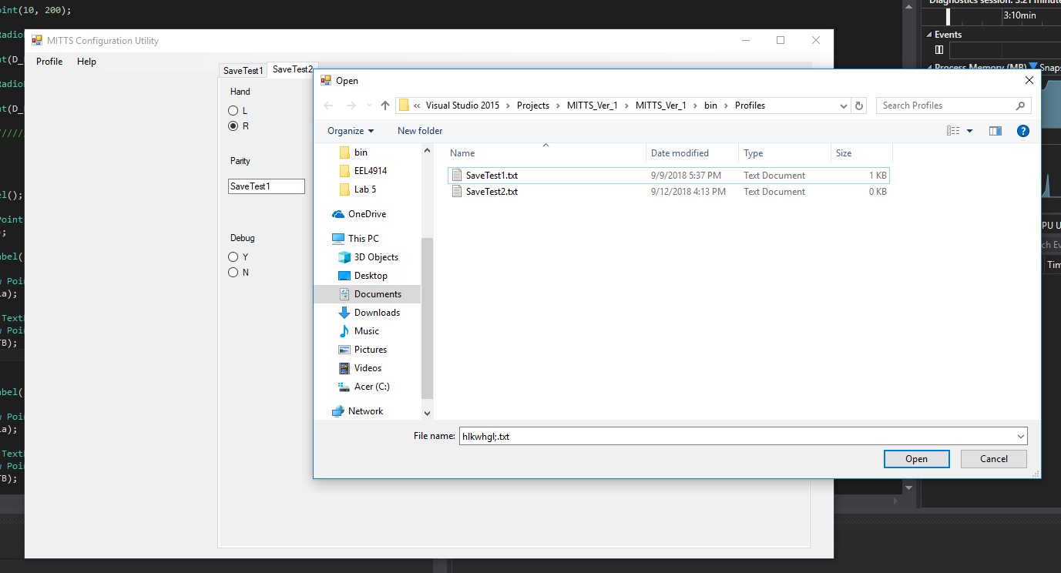
UI Design

Slide 54
Blender & 3D Environment
Anthony Hunter Hinnant - Primary
Francisco Tirado Perez – Secondary

Slide 55
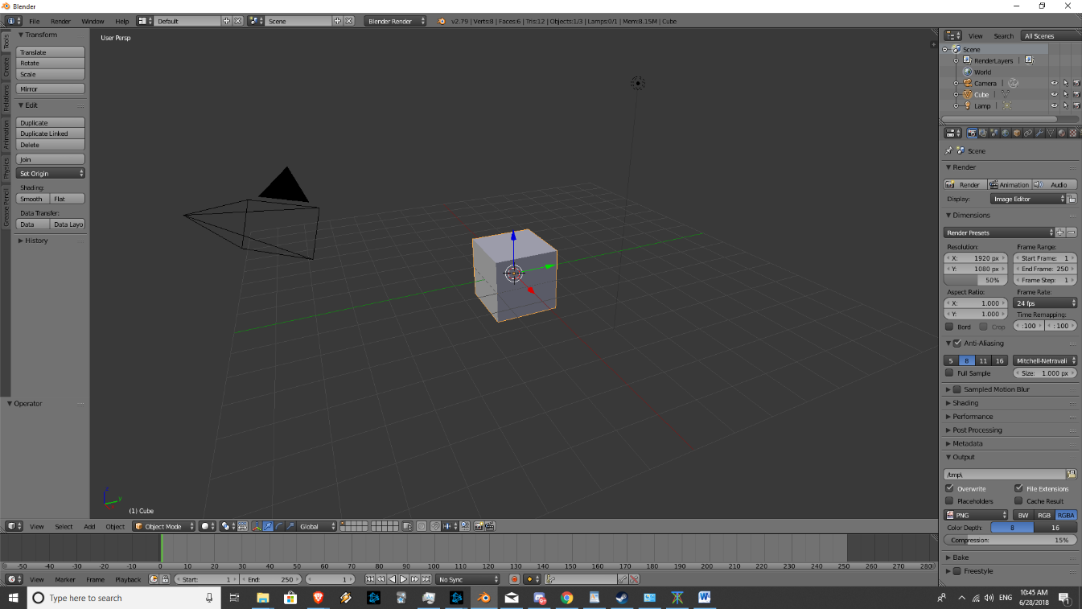
Blender
Blender is a professional open-source 3D graphics toolset used for modeling, animation, and interactive 3D applications.
Free and open source.
Flexible enough to fulfill many of our project requirements at once.

Slide 56
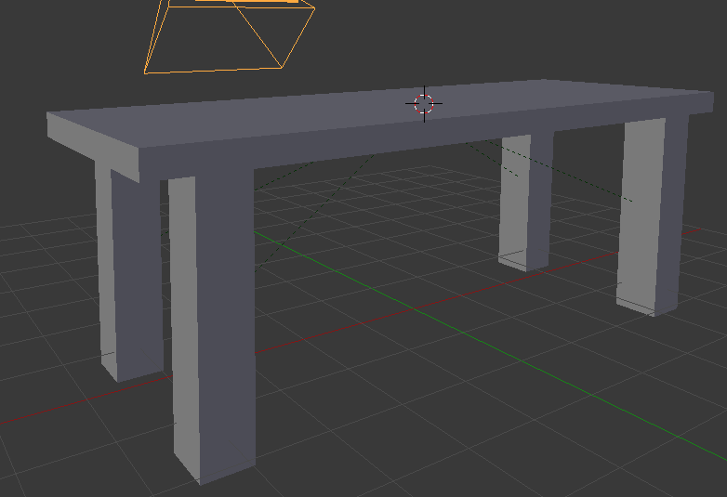
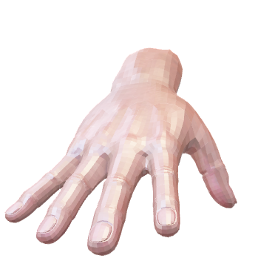
3D Modeling
Blender is used to build 3D models for our hand to interact with.
We make a table with 5 cubes, a plane for a ground, and a few other objects

Slide 57
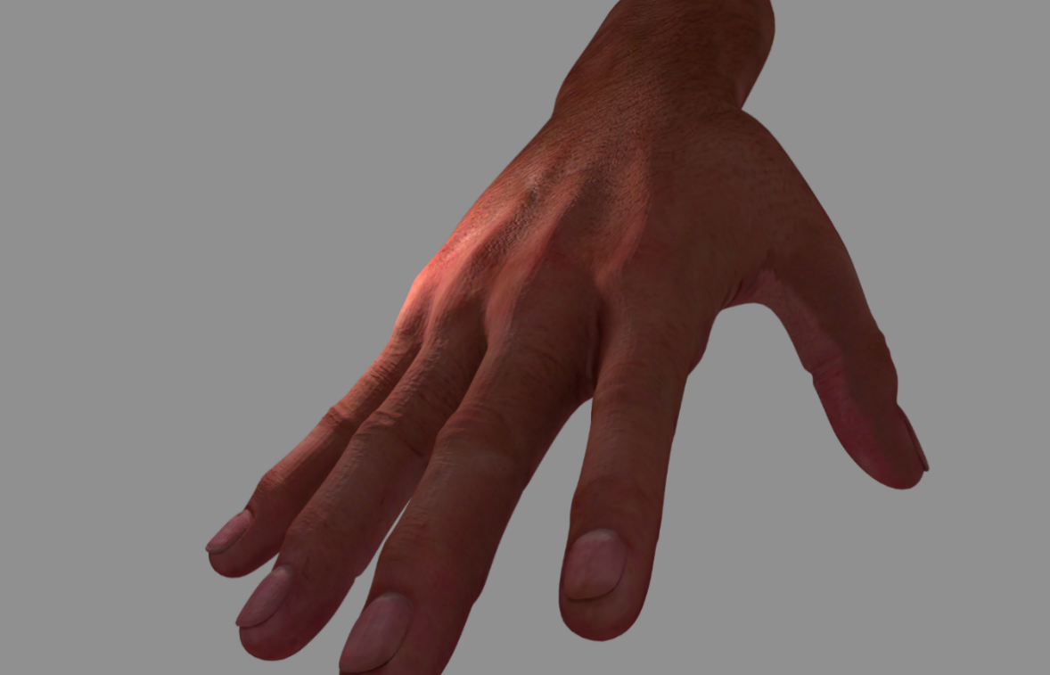
Hand
“Realistic Hand 3d model” from user “mohammadalizadeh” on free3d.com.
Textured, rigged, animating, and scripted in blender

Slide 58
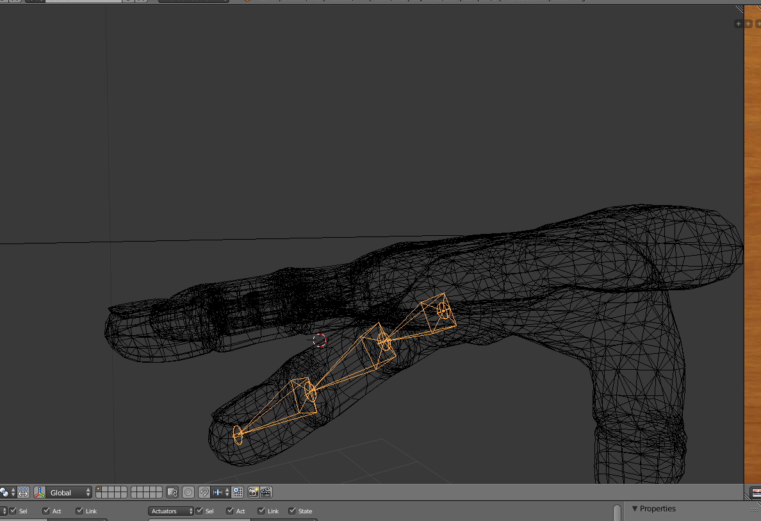
Animation & Rigging
Blender allows us to create animation skeletons to rig our models with.
This is how we set up the hand to animate and change based on the input from the dvice

Slide 59
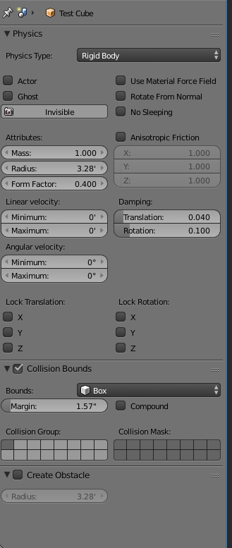
Physics
Blender has a built in physics engine that we can modify for our use
This allows us to set collision boundaries, and physics behaviors independently for each object.

Slide 60
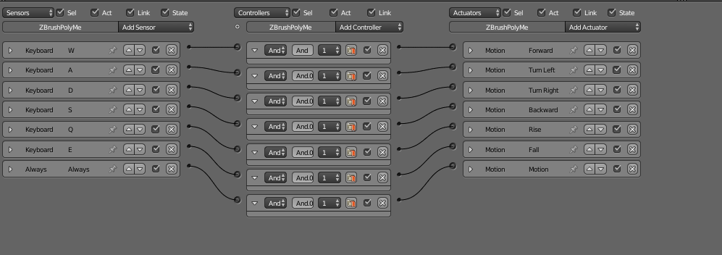
Logic Scripting
Blender incorporates logic bricks that are associated with objects, allowing us to incorporate basic scripting behaviors like camera movement and key presses.
It also allows us to associate integer properties with our objects.

Slide 61
Python Scripting
Blender allows for python scripts to be associated with objects and applications
This allows us to use scripts to perform more complex actions
This Is also how we incorporate the file i/o to communicate with the device driver

Slide 62
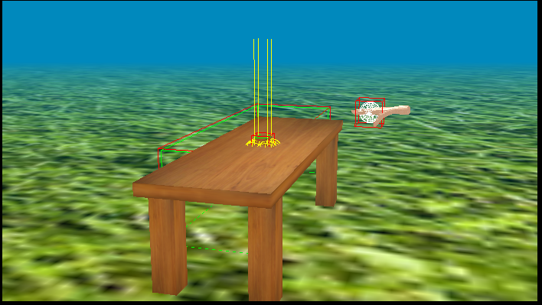
Texturing
We can edit textures on objects to give a better look.

Slide 63
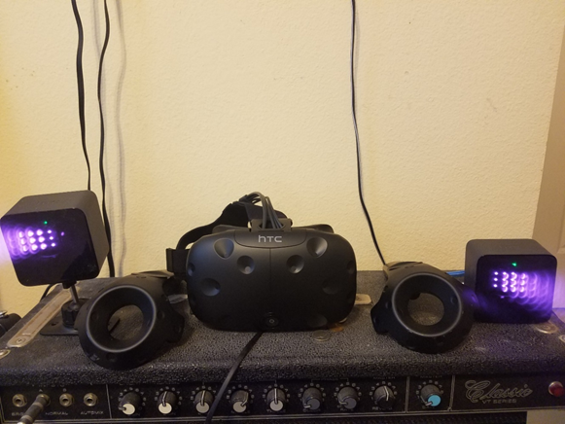
HTC Vive
The program is also made to interact with the HTC vive headset
The vive can track the users head using two beacons that come packed with it, allowing the user to see the hand relative to them

Slide 64
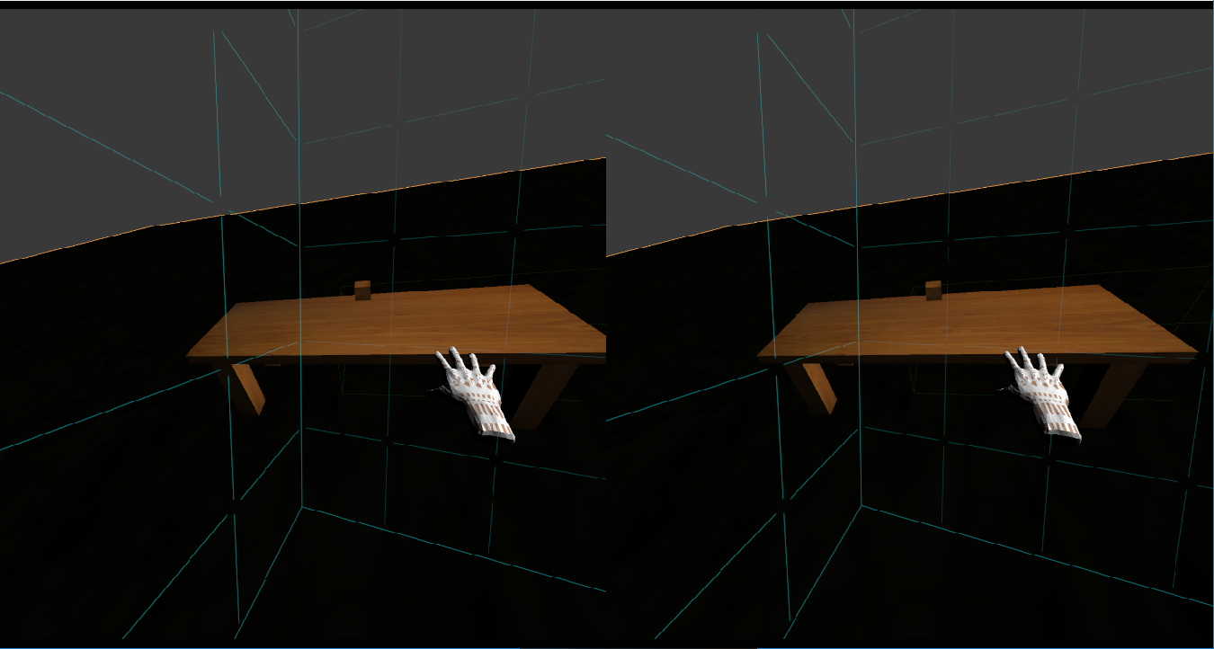
Virtual Reality
The user will be able to move the hand and interact with objects in the application with the device and virtual reality headset

Slide 65

Demonstration

Slide 67
Questions Curiosities Queries Comments

