Slide 1

Group 2
Chris Britt – Electrical Engineering
Francisco Tirado Perez – Computer Engineering
David Simoneau – Computer Engineering
Anthony Hunter Hinnant – Computer Engineering

Slide 2
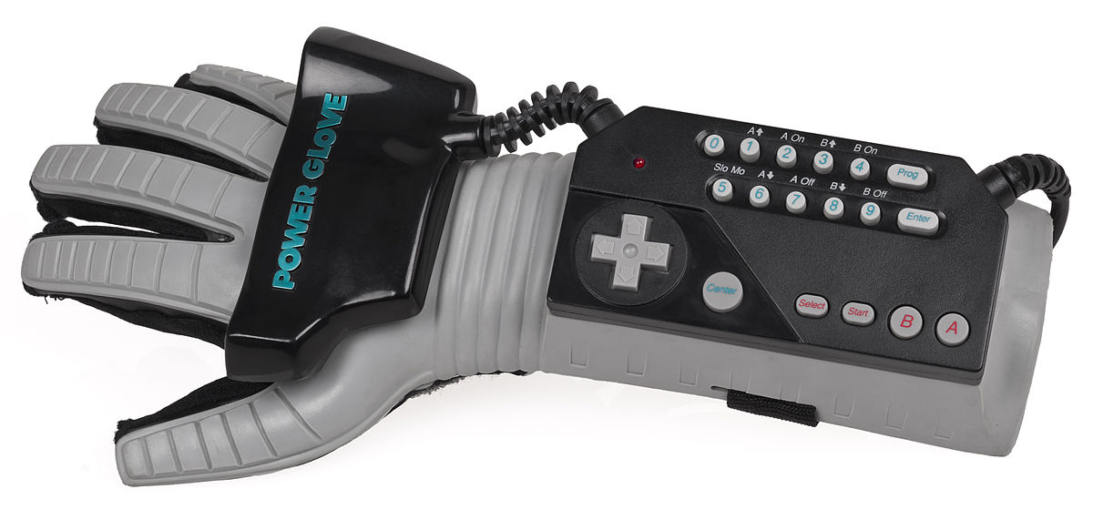
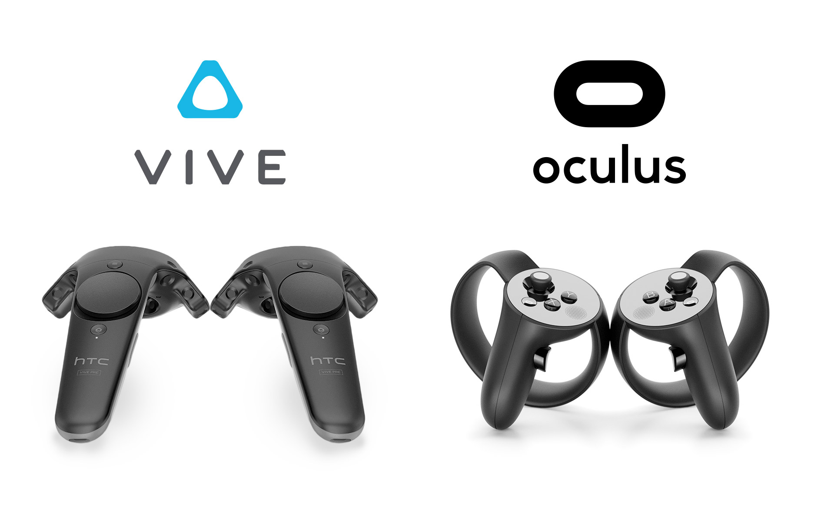
Motivation
Severe lack of open source VR controllers
Existing options are expensive, controllers, or outdated
The project is an excellent avenue to showcase practical engineering skills and challenge ourselves

Slide 3
Goals and Objectives
    Enhance the virtual experience by providing touch and temperature feedback
    Create a cheaper experience to current VR users
    Provide a basis for simple open source hardware and software
    Design a product that can be used for most VR applications

Slide 4
Specifications
General Type | Specific Type | Design Specification
Responsiveness | Frame Rate | 30 FPS (1 complete data cycle = 1 Frame)
Use Life | Battery | > 30 min
Physical Strain | Weight | < 2 kgs
Wireless | Bluetooth | LE Compatible

Slide 5
Expected Budget
Item | Quantity | Price (rough estimate)
Glove | 2 | $20
PCB Design ~ Processor Board | 4 | $150
PCB Design ~ Glove | 4 | $150
Electrical Components on PCBs | ? | $200
Bluetooth modules | 2 | $40
Peltier Devices | 10 | $50
Power Supply | 2 | $20
Vibrational Motors | 10 | $50
Room for Error |  | $320
Total |  | $1000

Slide 6
Current Expenditures
Part | Description | Supplier | Amount Ordered | Cost Per Unit | Total
C0720B015F | Vibrational Motor | Digi-Key | 7 | 3.354 | 23.48
MAX6897 | IC Sequencer | Digi-Key | 3 | 1.38 | 4.14
TSV321 | Op Amp | Digi-Key | 15 | 0.494 | 7.41
NX3008CBKS | Dual Fet | Digi-Key | 25 | 0.467 | 11.53
AD5248 | Digital Potentiometer | Digi-Key | 15 | 2.525 | 37.88
TPS62823 | Power Regulator | Mouser | 3 | 1.63 | 4.89
TCA954A | I2C Mux | Mouser | 3 | 1.51 | 4.53
MMA8451 | Accelerometer Breakout | Adafruit | 2 | 10.51 | 21.02
MMA8451 | Accelerometer | Digi-Key | 0
1N4148 | Switching Diode | Digi-Key | 20 | 0.067 | 1.34
NXRT15XH103FA1B040 | Thermister | Digi-Key | 10 | 0.58 | 5.8
WP154A4SEJ3VBDZGW/CA | RGB LED | Mouser | 3 | 2.05 | 6.15
CM23-1.9 | Peltier Device | Digi-Key | 5 | 10.404 | 52.2
DRV8836 | H-bridge | Digi-Key | 5 | 1.49 | 7.45
Inductor | 470 nH Inductor | Arrow | 5 | 0.378 | 1.89
 | Various | Various |  |  | 101.8
TPS75701KTTT | Linear Regulator | Arrow | 3 | 7.384 | 23.7
12 Ga Tamiya connectors | Battery Connectors | Amazon | pack of 5 |  | 20.38
Battery Charger |  | Battery Space |  |  | 37.5
Stencils |  | OshStencils | 4 |  | 33.13
Boards |  | OshPark |  |  | 128.15
Big Digikey order |  | digikey |  |  | 206.72
David's Stuff | Bluetooth/STM Breakout |  |  |  | 61.15
Batteries |  | digikey |  |  | 76.12
Total |  |  |  |  | 878.36

Slide 7
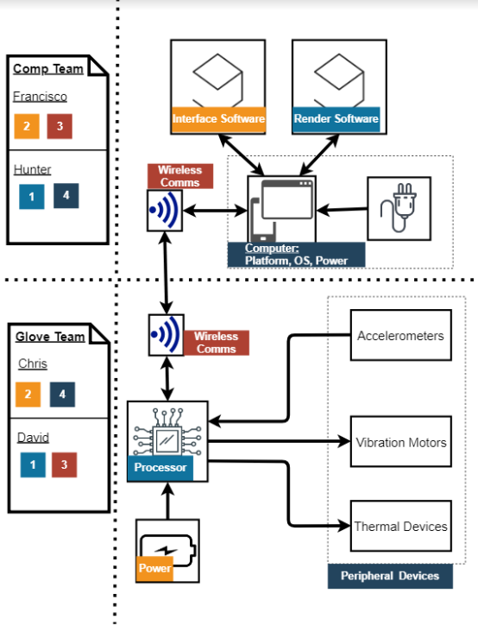
System Block Diagram
    Team Responsibilities
    Chris – Hardware
    David – Embedded Systems
    Francisco – Interface Software
    Hunter – Virtual Environment and API

Slide 8
Hardware Design
Christopher Benjamin Turner Britt – Primary
David Simoneau- Secondary

Slide 9
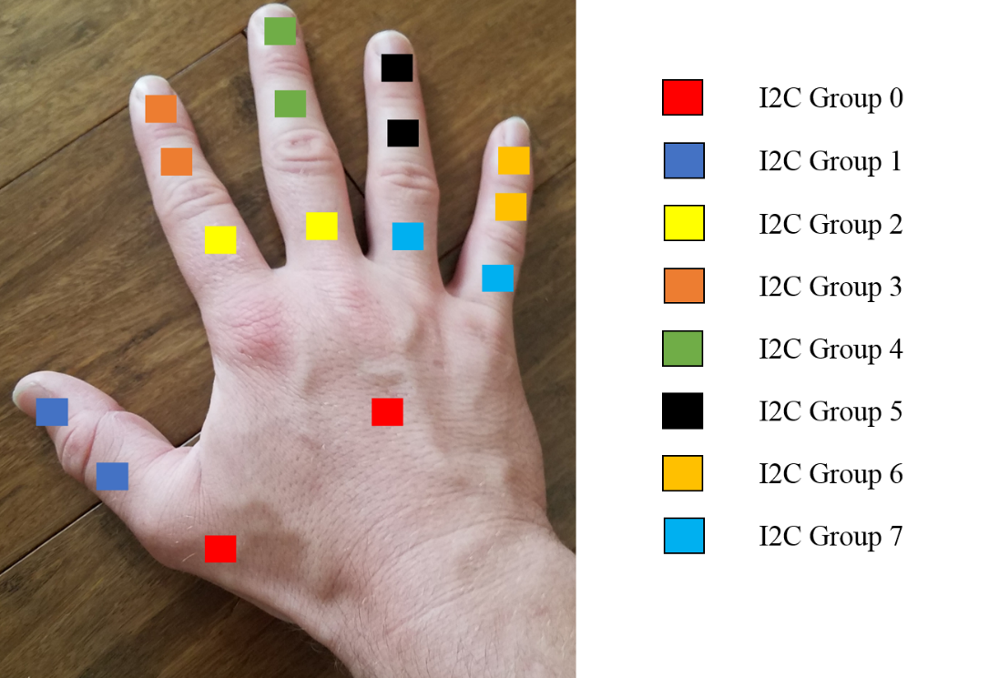
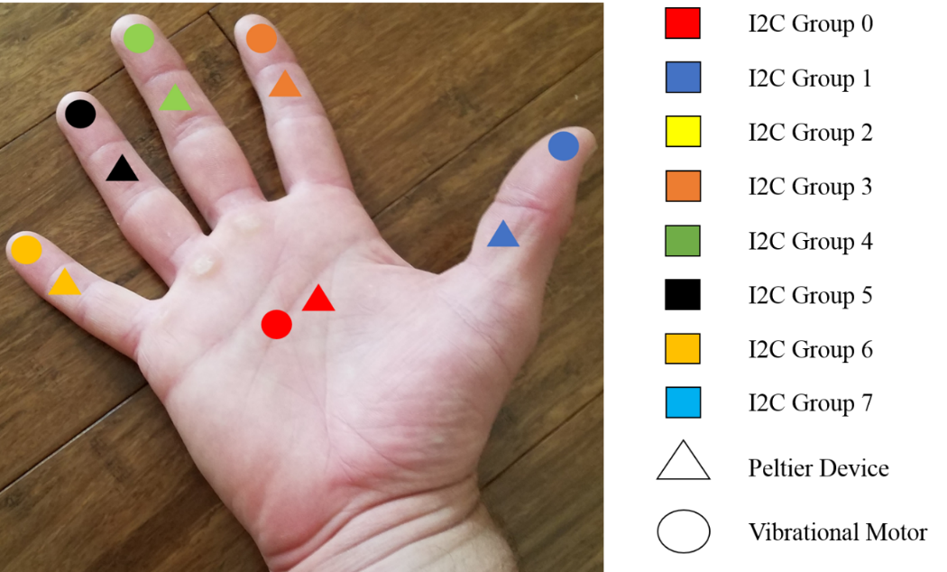
Diagram of Accelerometer Placements
Diagram of Placements of Peltier Devices and Vibrational Motors

Slide 10
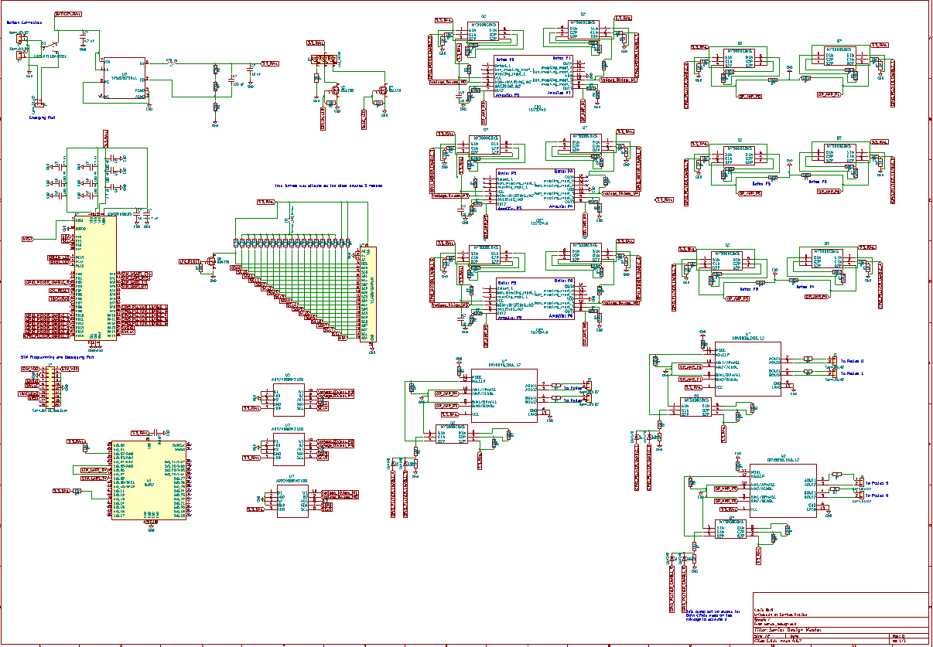

Slide 11
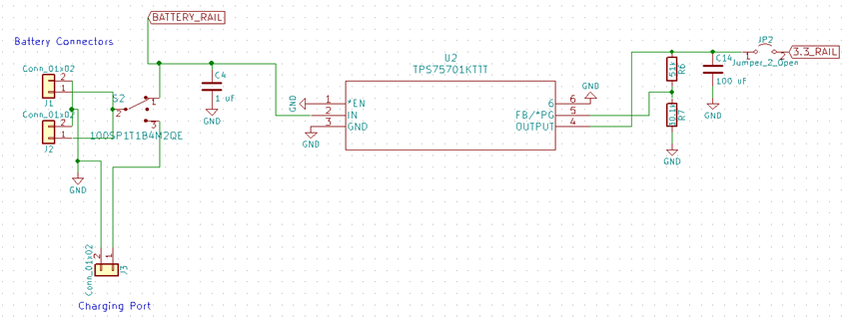
  TPS75701KTTT
  Chosen for Ease of Use after previous switching regulator failed in testing
  High Efficiency Switching Reg
  3.3 Volts and 3 Amps
  $7.97per Unit
  150 mV dropout at 3 Amps (acceptable)
ICR18650
  Lithium Ion Battery
  6600 mAh at 3.7V
  $29.5 per Unit
  69mm x 54mm x 18mm
  1.25A discharge rate

Slide 12
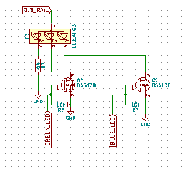
WP154A4SEJ3VBDZGW/CA
  RGB Common Anode LED
  2.2V Red, 3.3V Green, 3.3V Blue
  $2.46 per Unit
BSS138
  Switching NFET
  220mA
  $0.32 per Unit
  SOT-23-3
  Used Before

Slide 13
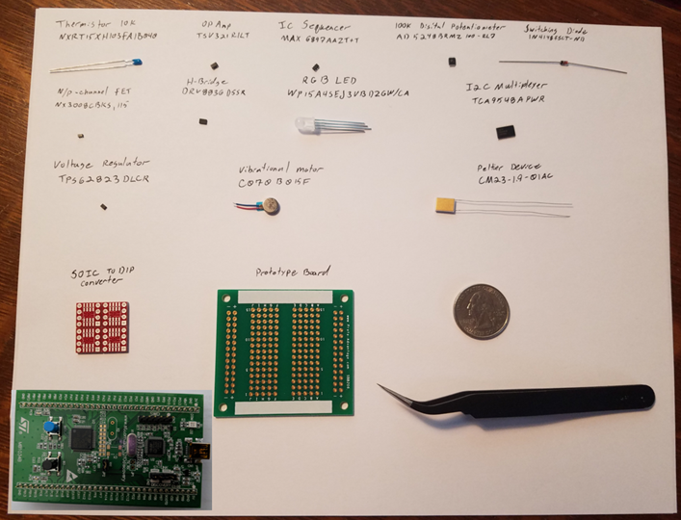
  CM23-1.9-01AC
    300 to 350 mA Usuable Range
    1.9A Max Current
    $11.08 per Unit
    Cooling Not an Option

Slide 14
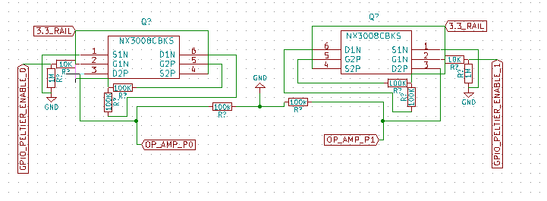
NX3008CBKSRGB
  N/P Channel Dual FET
  P Channel 200 mA
  N channel 350 mA
  Used Before
  $0.467 per Unit
  Used for N/P Switch to avoid 3rd State

Slide 15
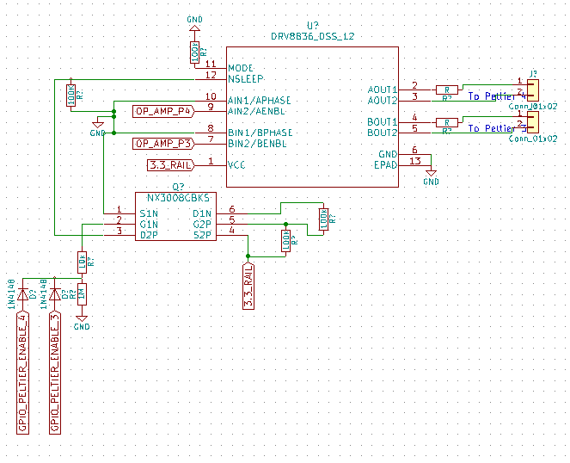
  DRV8836
    2 Channel Low Voltage H-Bridge
    1.5 Amp Max Drive Current
    Phase/Enable vs PWM
    WSON 2mm x 3mm
    Dedicated Sleep Pin
    $1.49 per Package
    3.3V Operable

Slide 16
  C0720B015F
    "Coin" Form ERM
    3.3 Volt Operable
    80 mA Max
    $3.54 per Unit

Slide 17
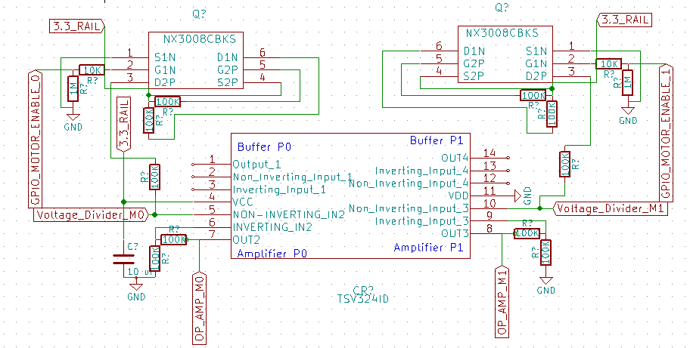
TSV321
  General Purpose Rail to Rail Op Amp
  80 mA Max Output Current
  3.3 Operable
  $0.494

Slide 18
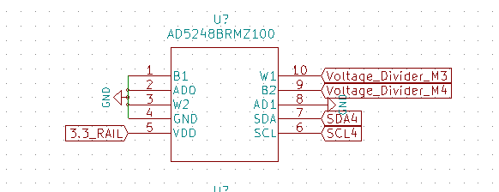
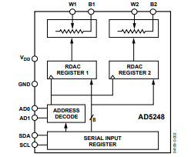
  AD5248
    2 Channel 256 bit I2C Potentiometer
    100k Max Resistance
    ~50 Min Resistance
    3.3V Operable
    2 Addressable Pins
    No Connect 3rd Terminal
    10 MSOP
    $2.525 per Unit

Slide 19
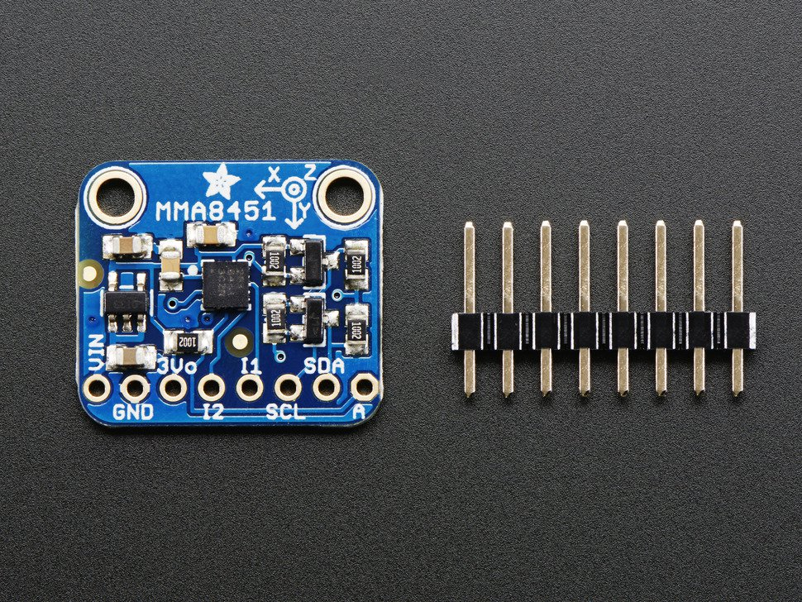
  MMA8451
    Triple Axis 14 Bit Accelerometer
    2/4/8 G Capable
    3.3V Operable
    I2C interface
    800 Hz Data Output
    2 Possible Addresses
    Cheap Adafruit Breakout Board
    16 Pin QFN 3mm x 3mm x 1 mm

Slide 20
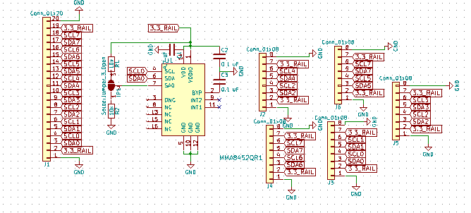
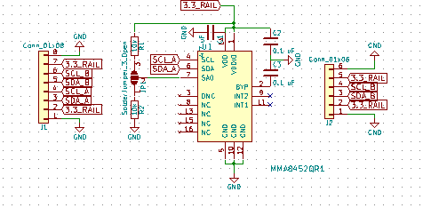
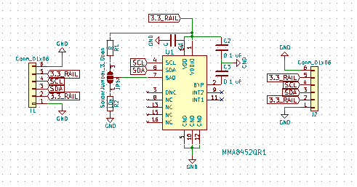
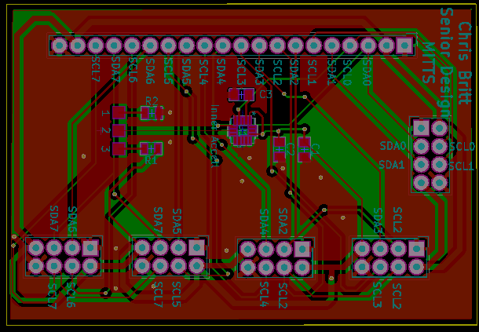
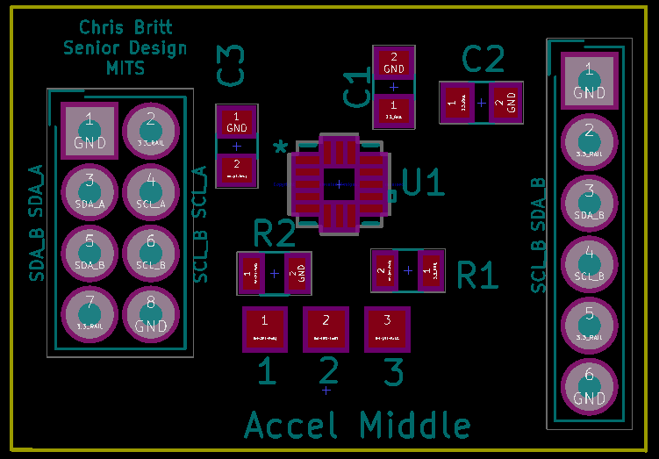
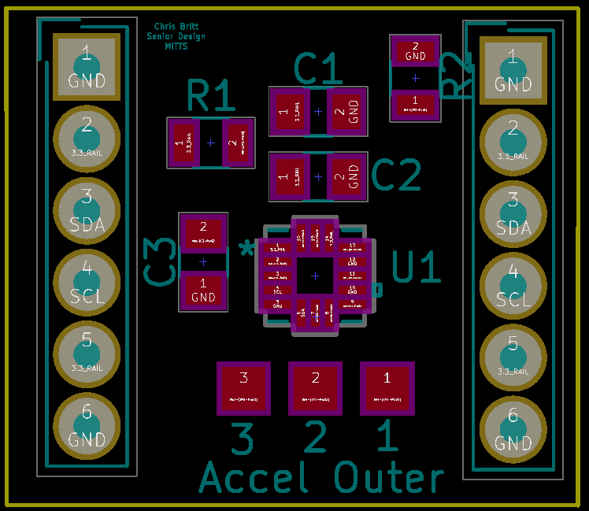
Inner
Middle
Outer
45mm x 60mm
26mm x 18mm
20mm x 17mm

Slide 21
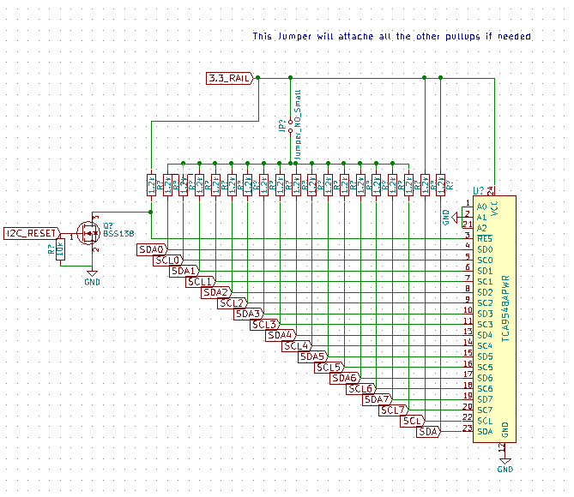
  TCA9548A
    1 to 8 Bidirectional I2C Switch
    3.3V Operable
    Adafruit Tutorial
    TSSOP 24
    $1.51 per Unit

Slide 22
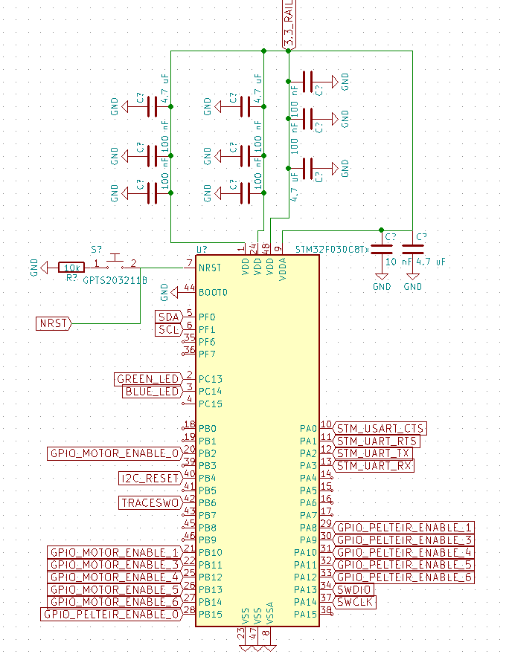
  STM32F030C8 LQFP48
    32 Bit
    48 MHz
    256 Kbytes Flash
    2 I2C Channels
    6 UART Channels
    12 bit ADC
    3.3 Operable
    32 I/O Pins
    Serial Wire Debug (SWD)
    Internal Oscillators
    Reset Pin
    $2.02 per Unit

Slide 23
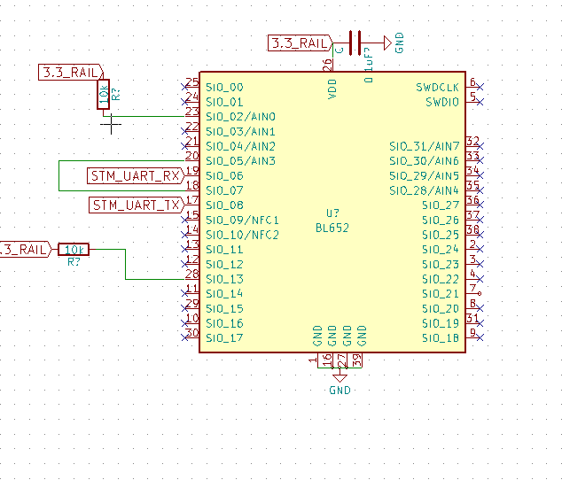
  BL652
    Bluetooth Module
    3.3V Operable
    $7.45 per Unit
    VSP Mode

Slide 24
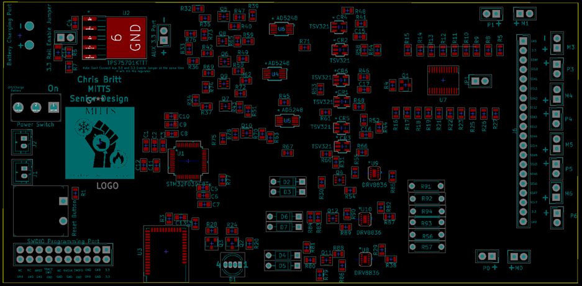
Main Pcb final product

Slide 25
Embedded Systems
David Simoneau- Primary
Christopher Benjamin Turner Britt – Secondary

Slide 26
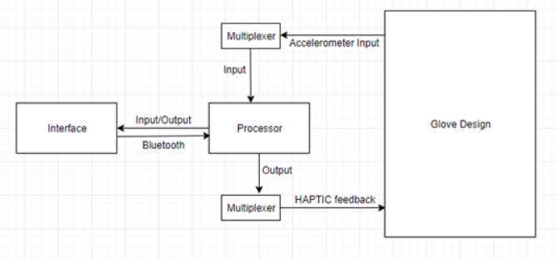
Processing Information
Handle data between sensors and software

Slide 27
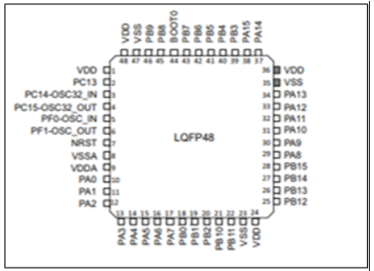
Processor Choices
ATMega
MSP430
STM32 *

Slide 28

Processor Choices Comparisons
Cheaper with more I/O

Slide 29

Processor Choices Comparisons
More memory

Slide 30

Processor Choices Comparisons
Faster

Slide 31
I2C
Using an I2C bus.
Multiplexer for polling
Device addresses minimize lines

Slide 32
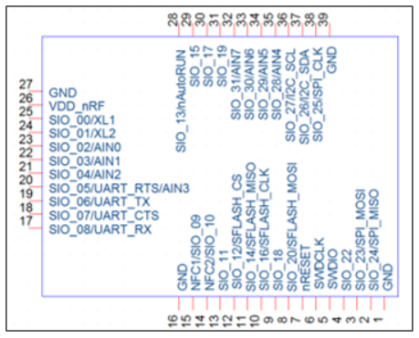
Bluetooth Module Choices
Keeping it modern. Bluetooth choices are 1.x, 2.x, 3.x, 4.x, and 5.x
RN4871-V/RM118
BL652-SC-01 *
BM62SPKS1MC2-0001AA

Slide 33
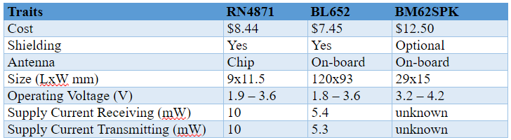
Bluetooth Comparison
Cheaper

Slide 34
Bluetooth Comparison
Cheaper
Bigger

Slide 35
Bluetooth Comparison
Cheaper
Bigger
Less Power

Slide 36
UART
Method used with Bluetooth
Internal clocks ensure proper timing instead of clock line
HAL library handles most of specific technical details e.g start bits, stop bits, baud rate, and parity bits.

Slide 37
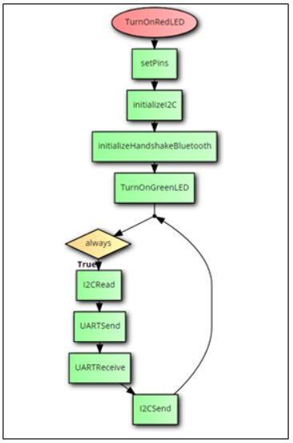
System Startup Procedure
Initialize
Loop
  I2CReads
  UARTSend
  UARTReceive
  I2CSend

Slide 38
Programming the Chip
Complexities in Datasheet
  Register addresses
  I2C pins and other pinouts
  How to Flash
  power modes

Slide 39
Configuration Utility
Francisco Tirado Perez – Primary
Anthony Hunter Hinnant - Secondary

Slide 40
Goals
System Isolation
  Separate the Virtual Environment from the Hardware Glove
Scalable
  Can Coordinate multiple hardware gloves for simultaneous use
  Supports both Classic and Low Energy Bluetooth Devices
Debugging Platform
  Aids in debugging by providing a real-time data viewing interface.

Slide 41
Development
Windows 10 Operation System
  Widely utilized
  Compatible with all software used
Microsoft Visual Studio 2015 Community edition
  No Cost
  Stable
  Resources
C# Programing language
  Multiple APIs for performing asynchronous tasks
  Windows Bluetooth API (Part of the Windows Runtime Libraries)
  Object-Oriented

Slide 42
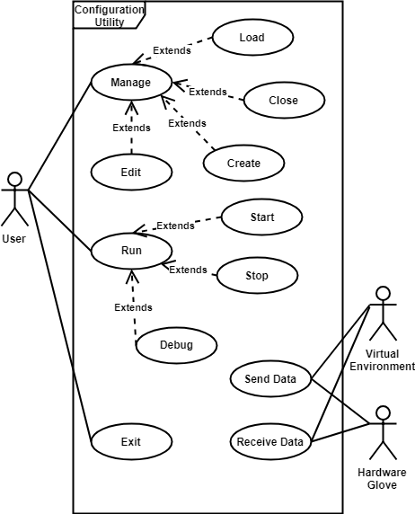
Use Case Diagram
3 Actors
  User
    Initiates the system
    Manages stored profiles
    Sets operating mode of the syste
  Virtual Environment
    Receives updated positional data
    Provides updated sensory data
  Hardware Glove
    Provides Updated positional data
    Receives updated sensory data

Slide 43
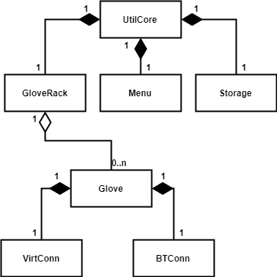
Class Diagram
Object-Oriented paradigm
  Each piece of the system is represented as a separate object, grouping logical members and methods together
  Leverage Composition and Aggregation to link the objects together
  Allows for easy of software maintenance
Scalability
  Can generate arbitrary number of Glove objects
  Each glove object handles its own communication with the rest of the complete system

Slide 44
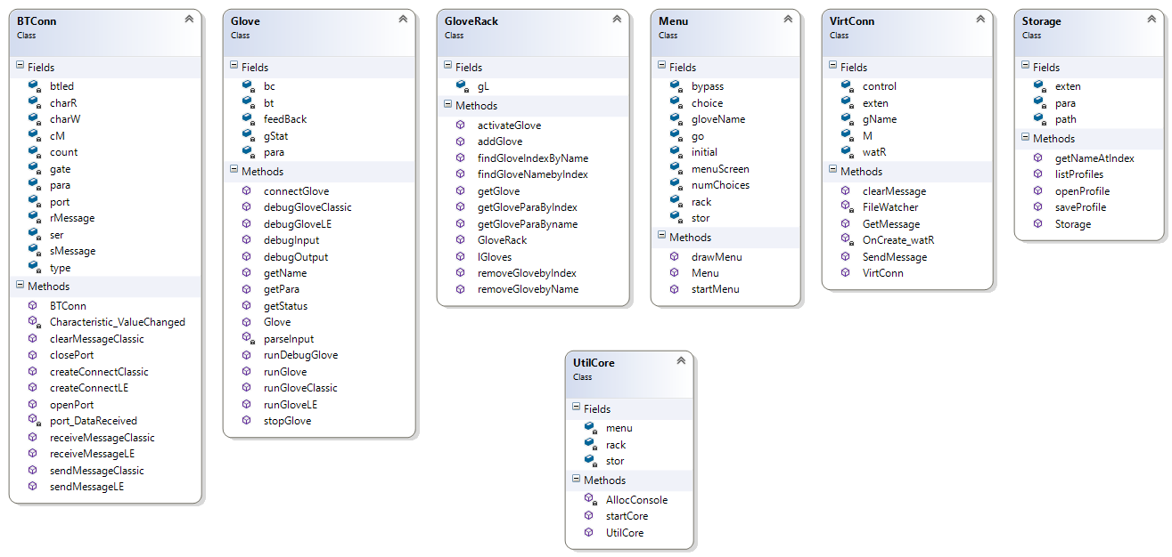
Classes

Slide 45
UtilCore
  Main Object of the Utility
  Entry Point of the processes
  Initializes a Menu, GloveRack, and Storage Object

Slide 46
Menu
  Handles the UI interface for navigating through the Utility
  Draws the UI screens
  Processes the UI actions

Slide 47
Storage
  Provides interaction with the file system.
  Handles searching, opening, and saving of glove profiles
BT_Type:LE
Glove_Name:Demo
Hand:Right
Paired:None
BT_Name:LAIRD BL652
BT_Ser_Guid:569a1101-b87f-490c-92cb-11ba5ea5167c
BT_R_Guid:569a2000-b87f-490c-92cb-11ba5ea5167c
BT_W_Guid:569a2001-b87f-490c-92cb-11ba5ea5167c
Temp_Hi:10
Temp_Lo:5
Touch_Hi:10
Touch_Lo:4
BT_Type:Classic
Glove_Name:Demo2
Hand:Right
Paired:None
BT_COM:COM4
BT_BAUD:9600
BT_Parity:None
BT_Data:8
BT_Stop:One
Temp_Hi:10
Temp_Lo:5
Touch_Hi:9
Touch_Lo:3

Slide 48
GloveRack
  Manages the dynamic List of connect and loaded hardware gloves
  Primary actions are adding, removing, and activating individual hardware gloves

Slide 49
Glove
  Main operation object of the utility
  Represents a single connected hardware glove
  Primary actions are running, stopping, and debugging the associated hardware glove

Slide 50
BTConn
  Establishes Bluetooth connection between the hardware glove and its logical representation in the Utility
  Provides both Classic and Low Energy Bluetooth I/0 protocols

Slide 51
VirtConn
  Establishes inter-process communication between the logical glove in the utility and its logical representation in the virtual environment
  Utilizes file system I/O techniques
    Monitoring
    Reading
    Writing
    Creating
    Deleting

Slide 52
Input/Output Scheme
Virtual Environment <-> Utility
Utility <-> Hardware Glove
I/O Bluetooth
  Utility leverages Windows Bluetooth API
  Hardware Glove has a Bluetooth Module
  Two types of Bluetooth
    Classic
      Bluetooth Devices mapped to comm Ports
      Serial Communication Protocols
    Low Energy
      Device interaction determined by reading and writing to Services and Characteristics
I/O using files
  2 files
    Util_to_Blender – Utility writes, Blender reads
    Blender_to_Util – Blender writes, Utility reads
  Directory Monitoring

Slide 53
Input/Output Data
Hardware Glove
  Sends - > 42 space separated angle values grouped into 14 <x, y, z> triplets.
  Receives -> 12 space separated feedback values grouped into 6 <touch, Temperature> pairs
Virtual Environment
  Receives - > 42 space separated angle values grouped into 14 <x, y, z> triplets.
  Sends -> 12 space separated feedback values grouped into 6 <touch, temperature> pairs

Slide 54
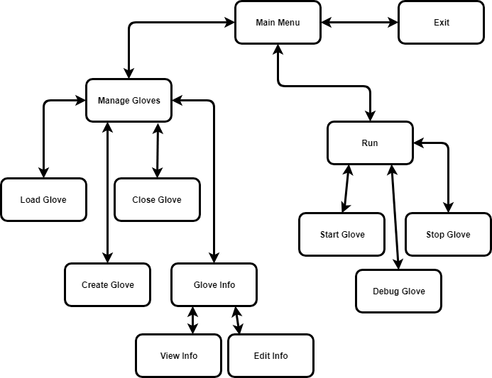
UI Design

Slide 55
UI Design
Console based ASCII User Interface
13 Major UI Screens
Navigation through numerically assigned choices both:
  Static – Menu choices always the same
  Dynamic – Menu choices variable with state of the Utility
Full featured input checking

Slide 56
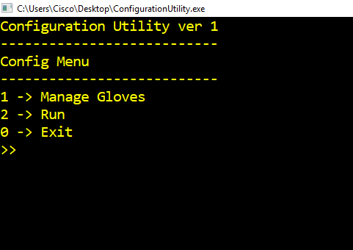
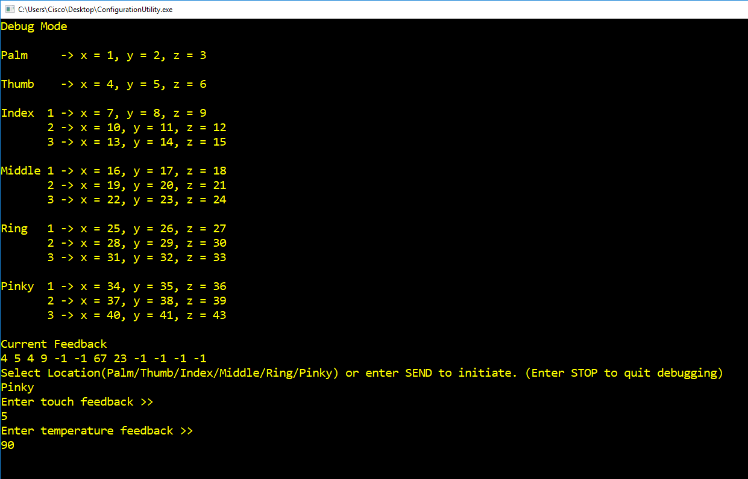
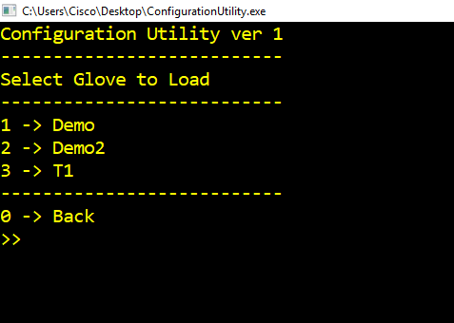
Utility Images

Slide 57
Utility Operation
Load Glove
  Reads a profile from the file system
  Creates a glove object
Start Glove
  Begins normal data transfer between hardware glove and virtual environment
  Generates sperate connection thread for asynchronous operation of the utility
Debug Glove
  Begins a debug session between a hardware glove and the utility
  Debug is a synchronous operation and control of the utility is suspended until session is completed

Slide 58
Virtual Environment
Anthony Hunter Hinnant - Primary
Francisco Tirado Perez – Secondary

Slide 59
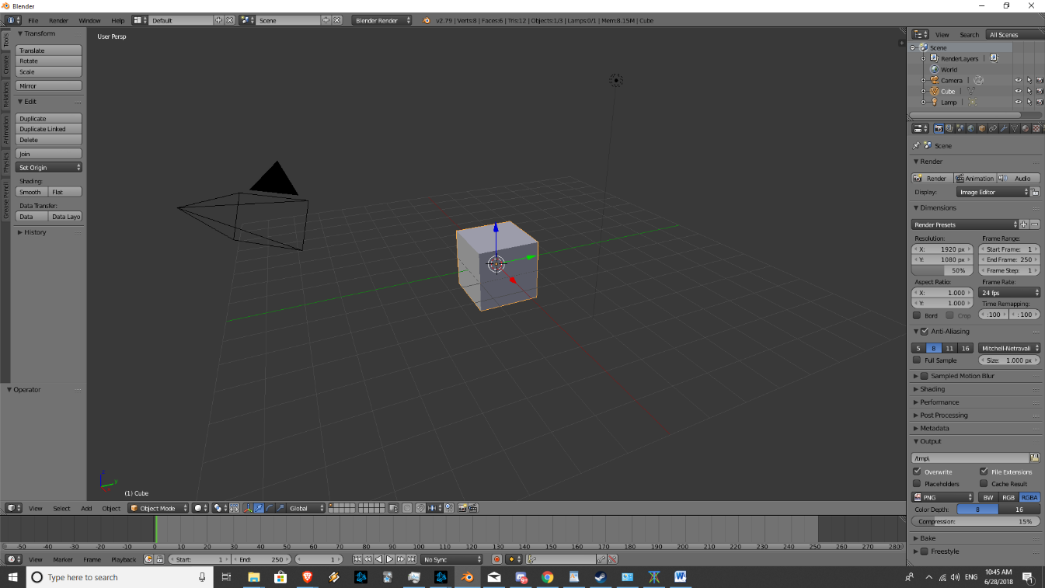
Blender & Unity
Blender is a professional open-source 3D graphics toolset used for modeling, animation, and interactive 3D applications.
Free and open source.
Flexible enough to fulfill many of our project requirements at once.
Meanwhile Unity is used to implement VR. It's a robust game engine that can use VR and is free to use for projects that make <10k a year in income.

Slide 60
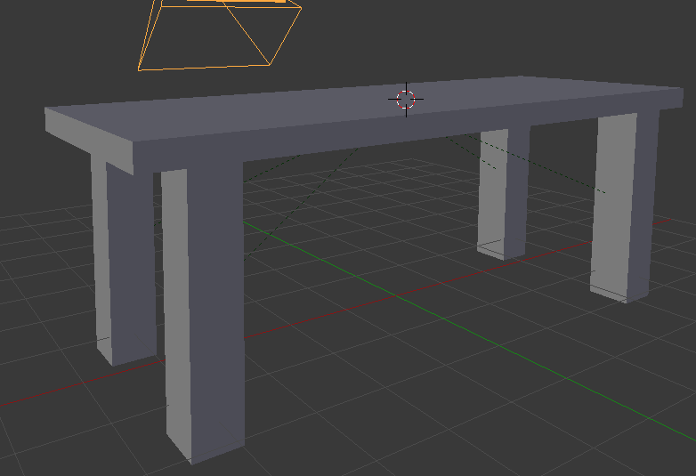
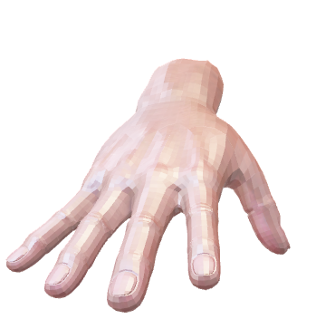
3D Modeling
Blender is used to build 3D models for our hand to interact with.
We make a table with 5 cubes, a plane for a ground, and a few other objects

Slide 61
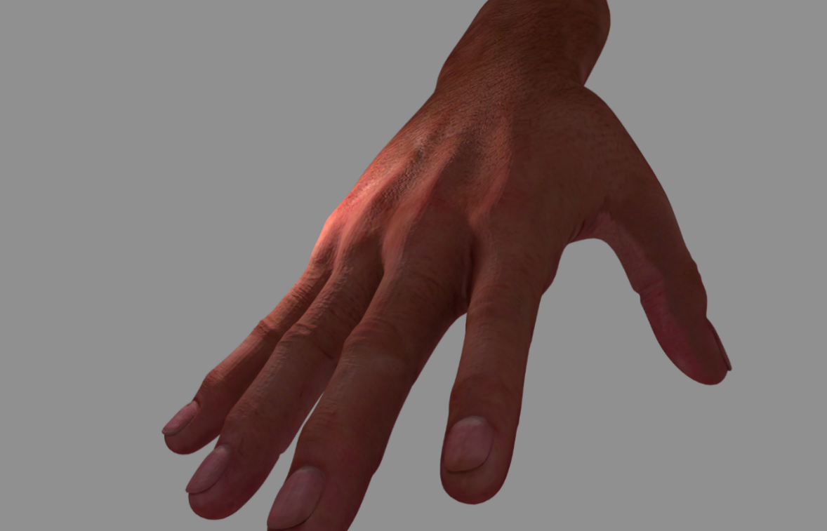
Hand
“Realistic Hand 3d model” from user “mohammadalizadeh” on free3d.com.
Textured, rigged, animating, and scripted in blender

Slide 62
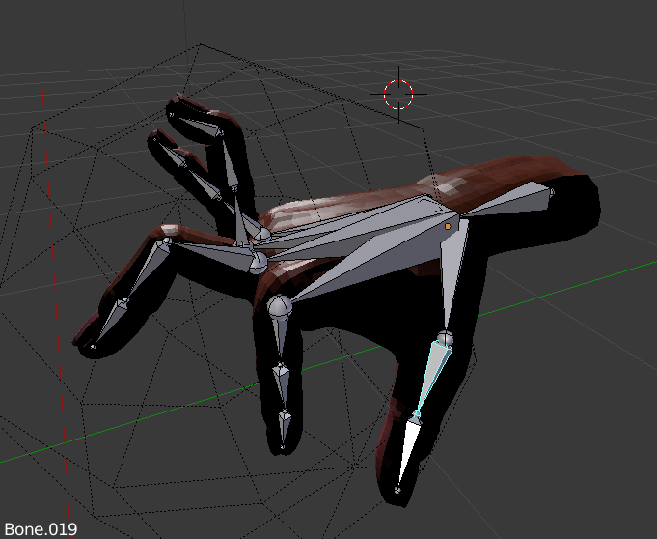
Animation & Rigging
Blender allows us to create animation skeletons to rig our models with.
This is how we set up the hand to animate and change based on the input from the dvice

Slide 63
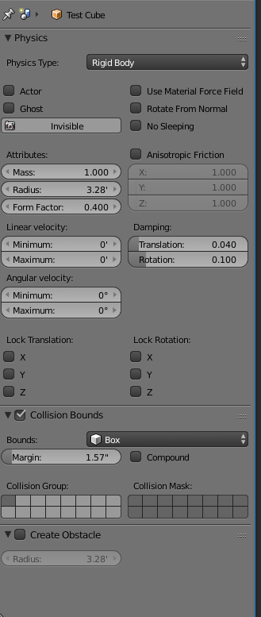
Physics
Blender has a built in physics engine that we can modify for our use
This allows us to set collision boundaries, and physics behaviors independently for each object.

Slide 64
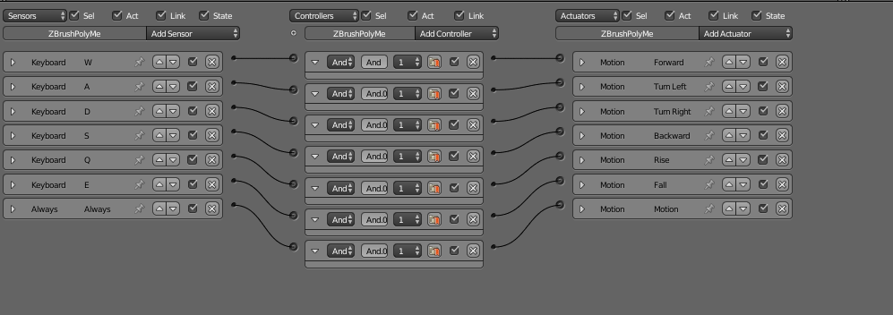
Logic Scripting
Blender incorporates logic bricks that are associated with objects, allowing us to incorporate basic scripting behaviors like camera movement and key presses.
It also allows us to associate integer and float properties with our objects.

Slide 65
Python Scripting & C#
Blender allows for python scripts to be associated with objects and applications
This allows us to use scripts to perform more complex actions
This Is also how we incorporate the file i/o to communicate with the device driver
Also used for collision detection for haptic feedback, and area detection for Peltier chips
All these functions are filled in unity with C#

Slide 66
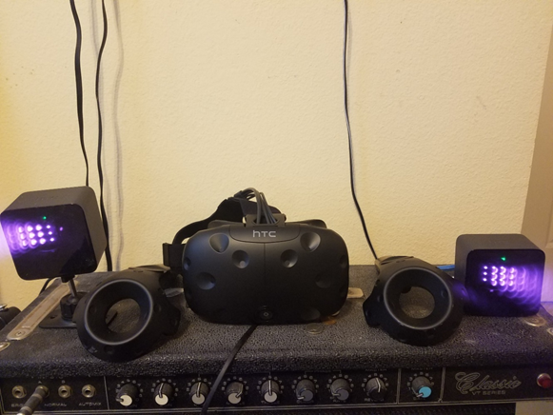
HTC Vive
The program is also made to interact with the HTC vive headset
The vive can track the users head using two beacons that come packed with it, allowing the user to see the hand relative to them

Slide 67
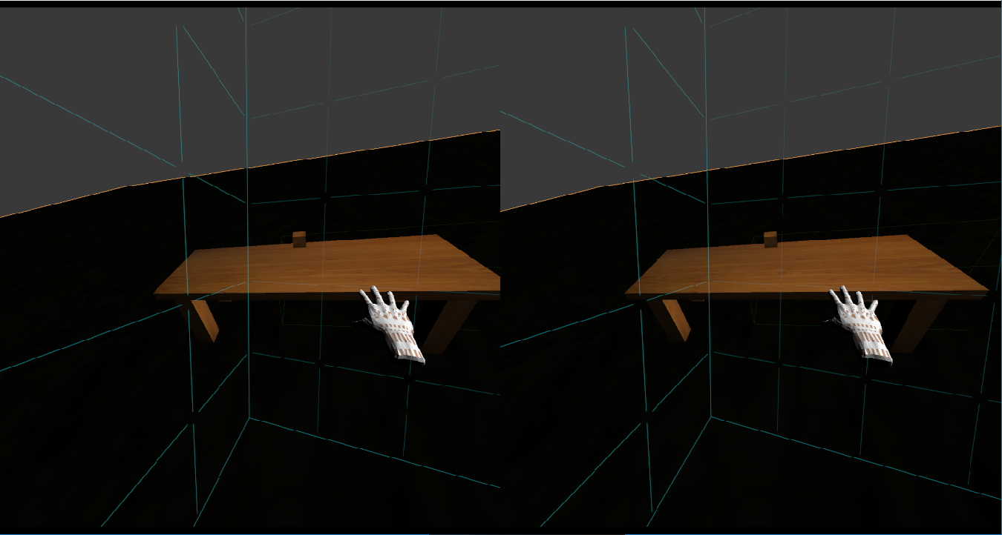
Virtual Reality
The user will be able to move the hand and interact with objects in the application with the device and virtual reality headset

Slide 68
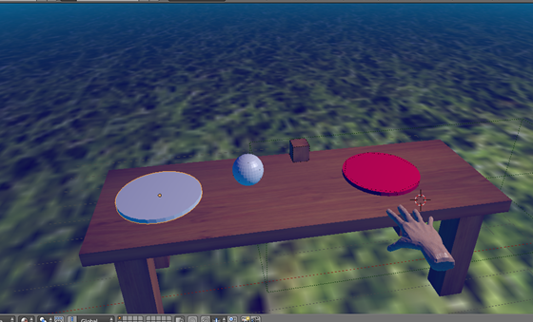
Sample of a complete virtual Environment

Slide 69
Challenges
Complexity
  14 sensor devices (accelerometers)
  2 forms of feedback devices (Peltier, vibration motors)
  2 forms of Virtual Environments (Blender, HTC VIVE)
  Data communication between 3 subsystems (2 interface points)
  Full Graphical User Interface
Experience
  Hardware
    STM32F030xx - (ARM)
    Peltier Devices
    Bluetooth LE - (Low Energy Wireless)
  Programming Languages
    C#
    Microsoft Visual Studio
  3D Graphics Software
    Blender
    Unity (HTC VIVE)

Slide 70
Demonstration
Demonstrate Main PCB Connection
Demonstrate capture of accelerometer orientation as angle measurements
Demonstrate triggering of feedback devices
Demonstrate Configuration Utility UI
Demonstrate Configuration Utility debugging interface using a Bluetooth connected phone as a hardware glove analog
Demonstrate Configuration Utility and Virtual Environment (in Blender) using a Bluetooth connected phone as a hardware glove analog
Show video of Virtual Environment utilizing Unity and HTC VIVE

Slide 71
Questions
Curiosities
Queries
Comments

Slide 72
Thank You

