Slide 1

Group 13
John McFarland
Shekh Arefen
James Johnson
Edgar Velez
Tinjac Is Not Just A Cart
Notes:
J-Mac

Slide 2
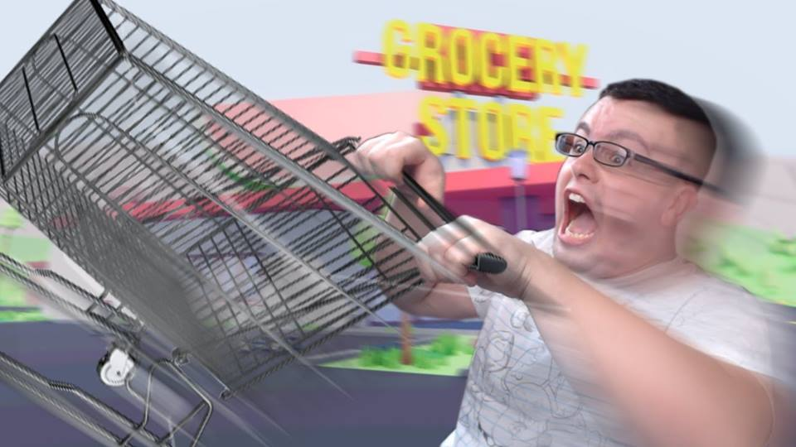
Tinjac
Autonomous shopping cart
User inputs shopping list and the cart drives to each item
Automatically calculates the shortest path
Object avoidance
Self tracking

Slide 3

Motivation
Bringing the future closer to tomorrow
To make shopping easier and a more pleasant experience, especially for older and disabled people
A device able to demonstrate all the skills learned at the University of Central Florida

Slide 4
Goals and Objectives
Saving customers time and money
A device accessible for people of all types of different walking speeds
Low technological cost
Develop a prototype that can be easily adopted
End product will have no exposed wires
Environmentally friendly power source
Cart be able to accurately know the location of the items in the store

Slide 5
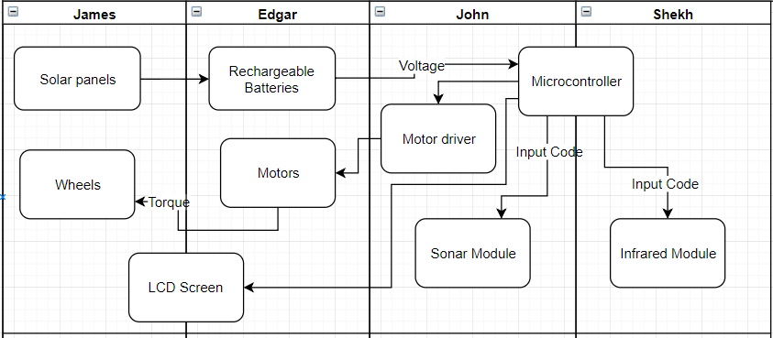
Block Diagram

Slide 6
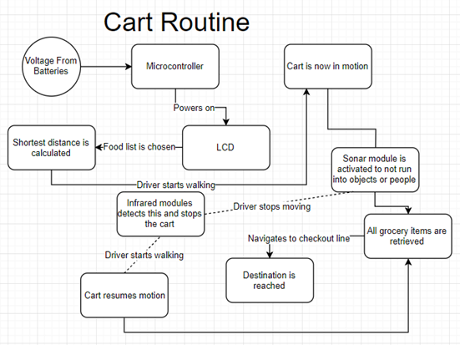

Slide 7
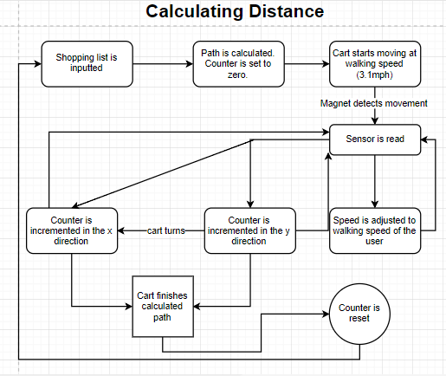

Slide 8
Core Features
Easy to use UI with the ability to add and subtract items from the shopping list even after the cart is in motion
The shopping cart has an accurate map of the store it’s in
The shopping cart is able to avoid obstacles using infrared sensors and sonar modules to adjust the speed of the cart
If the user stops walking, the cart will also stop accordingly
Rechargeable 12V power supply with a solar panel
Total cart weight is around 15 lbs
Cart should be able to hold at least 50 lbs
Dimensions are 21 by 24.5 inches, smaller than a regular cart

Slide 9
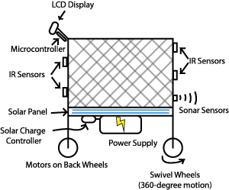

Slide 10
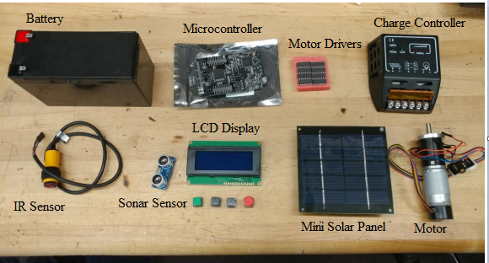

Slide 11
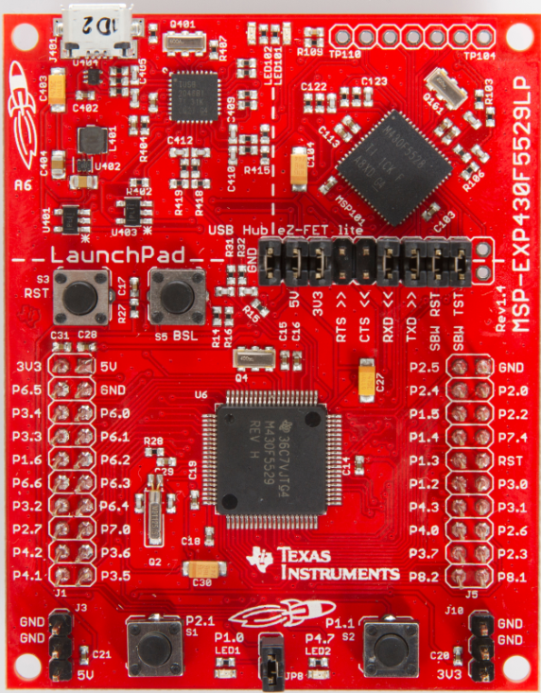
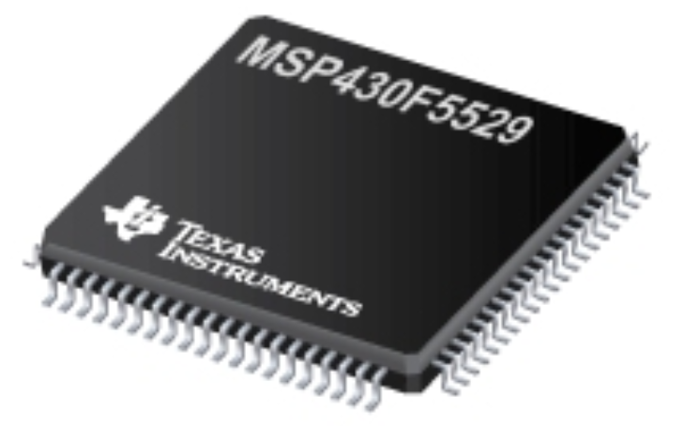
MSP-430F5529LP
Simplicity
Ease in configuring GPIO pins
3.3V
Notes:
J-Mac End

Slide 12
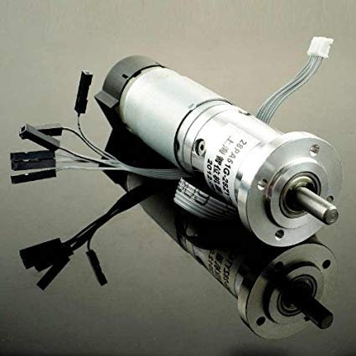
12V DC Motor 146 RPM w/Encoder
Met the requirements we initially set:
Move the cart given that it can carry a certain amount of weight.
Speed of the cart should be about the same as the average walking speed of a person.
Notes:
Eddy G

Slide 13
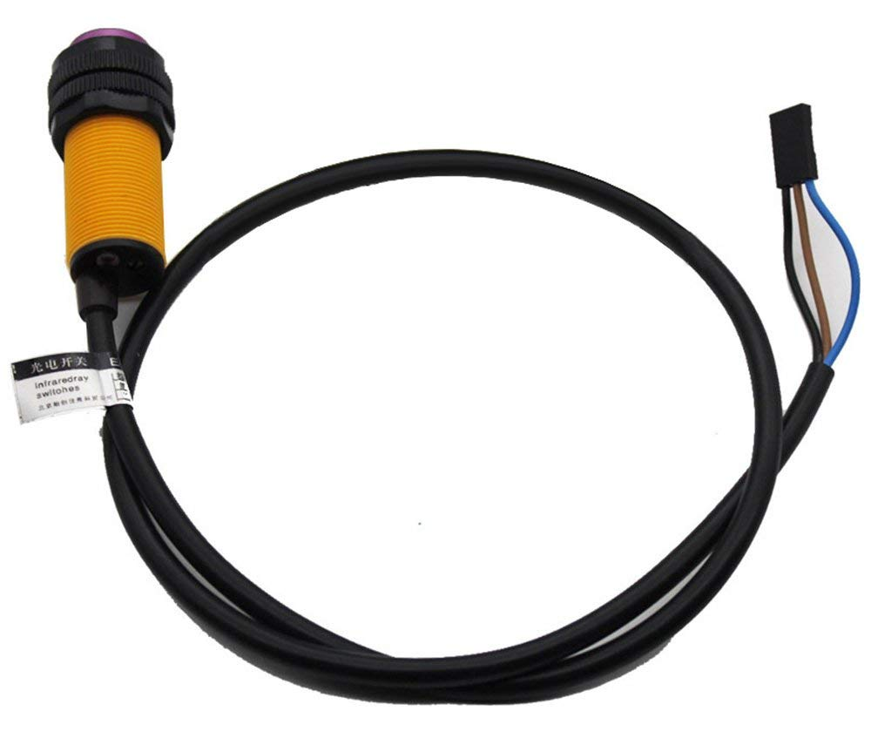
Gowoops E18-D80NK
Is used for obstacle detection and to see if the user is still following the cart
Ultimately chosen because it had the highest detection distance range (80 cm)
3.3V-5V

Slide 14
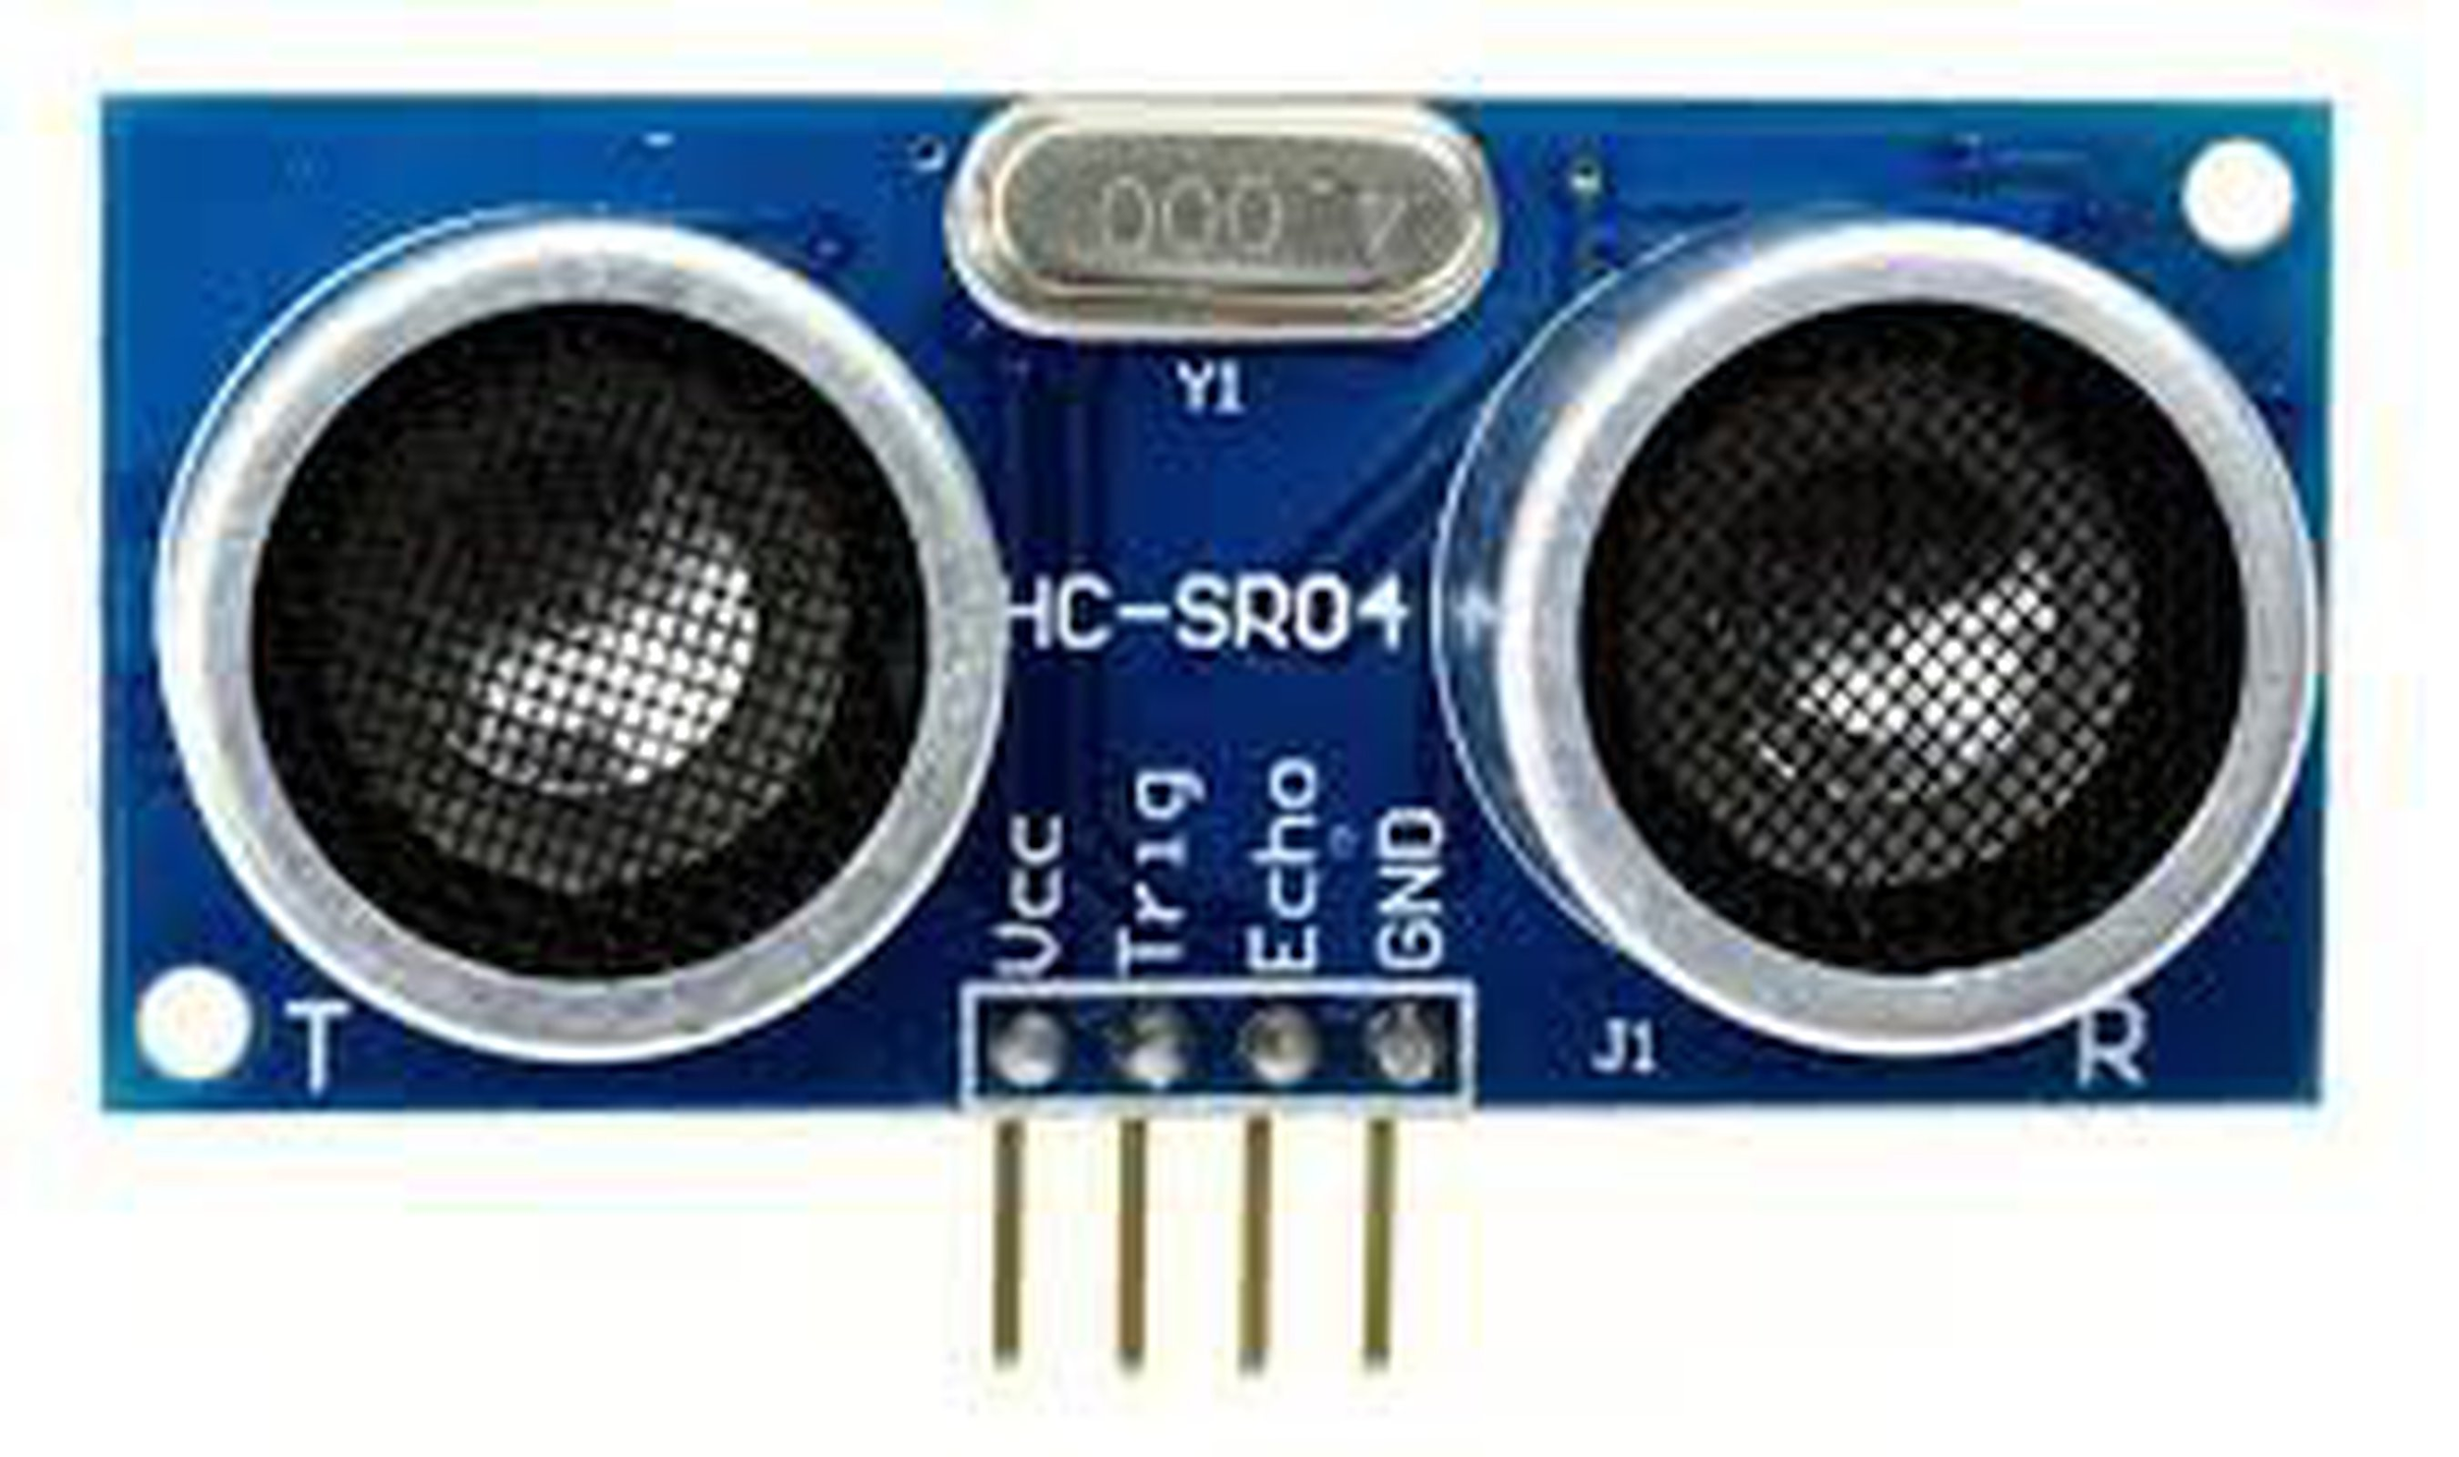
HC-SR04 Ultrasonic Sonar Module
Used for obstacle detection with a range of 400 cm
Has low power consumption so the battery can last longer
5V

Slide 15
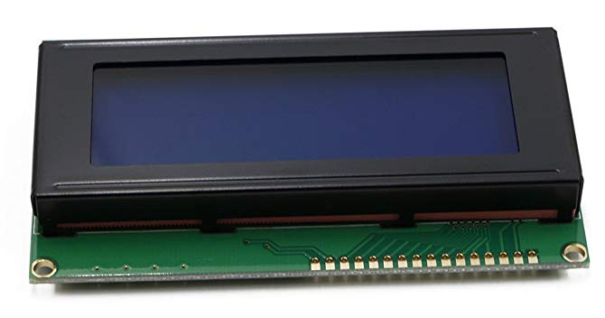
RioRand 20x4 LCD Module
LCD display has 4 lines with 20 characters each
Will mainly be used for inputting the shopping list
Can also be used to to display error messages
5V

Slide 16
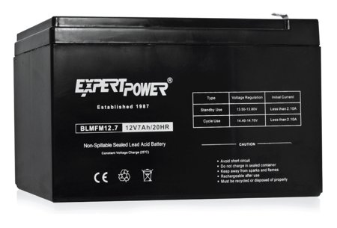
EXP1270 Rechargeable Lead Acid Battery
12 Volt, 7 amp rechargeable battery
Dimension: 5.9 x 2.5 x 3.7 inches
Weight: 4.3 lbs

Slide 17
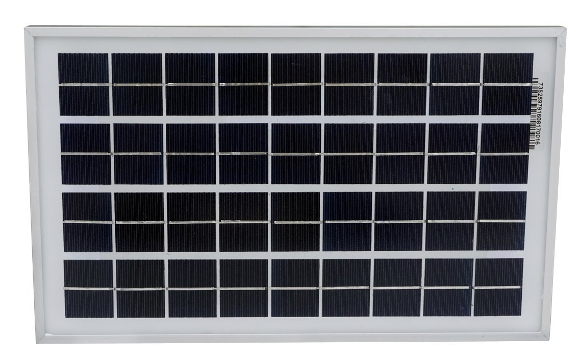
EcoWorthy Solar Panel
Water and dust proof to protect against rough weather
Corrosion resistant aluminum frame for extended outdoor use

Slide 18
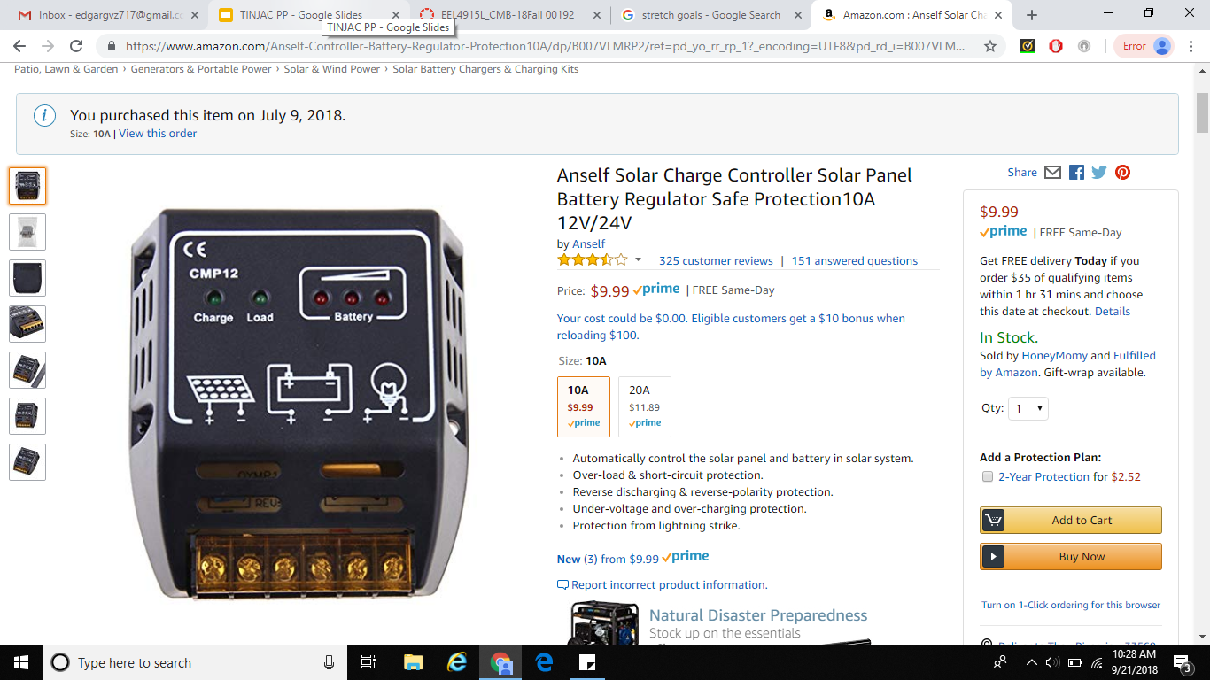
Anself Solar Charge Controller
Prevents over-loading and short-circuiting
Prevents the battery from over-charging
12-24V range, 10 A

Slide 19
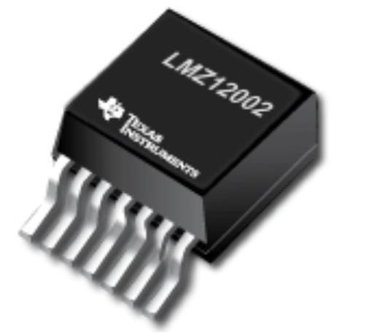
LMZ12002 Voltage Regulator
Up to 2-A Output Current.
Input Voltage Range 4.5 V to 20 V
Output Voltage Range 0.8 V to 6 V

Slide 20
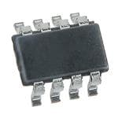
TPS563210ddf Voltage Regulator
Up to 3-A Output Current.
Output Voltage Range 11.5 V to 3.3 V

Slide 21
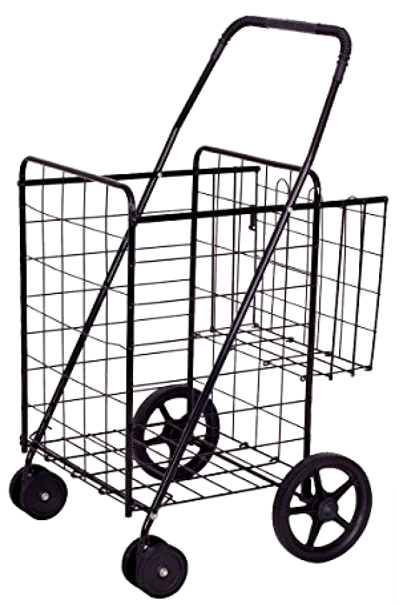
Goplus Double Basket Folding Shopping Cart
Provides additional basket, allowing more flexibility when installing our hardware components
Weighs only 13 lbs with a holding capacity of 120 lbs
Has swivel wheels, allowing the cart to travel backwards without having to worry about the front wheels
Notes:
Eddy G End (Endy G)

Slide 22
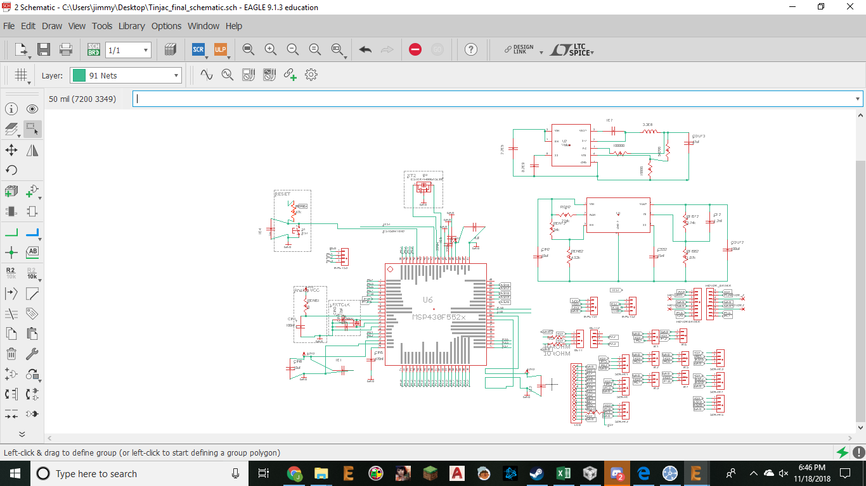
Overall Schematic
Notes:
Jimmy Start

Slide 23
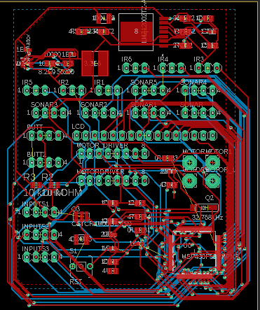
Printed Circuit Board (PCB)

Slide 24
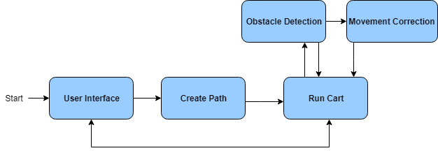
Software Design
Core Function List:
User Interface
Create Path
Run Cart
Obstacle Detection
Movement Correction
Secondary Function List:
Shopper Check
Pause Cart
Hard Reset
Emergency Stop

Slide 25

User Interface Function
Takes in user input from the different buttons that will communicate with the microcontroller
User will be able to select their grocery items and the program will proceed to the Create Path Function
Will also be able to communicate warnings/status updates with the customer

Slide 26
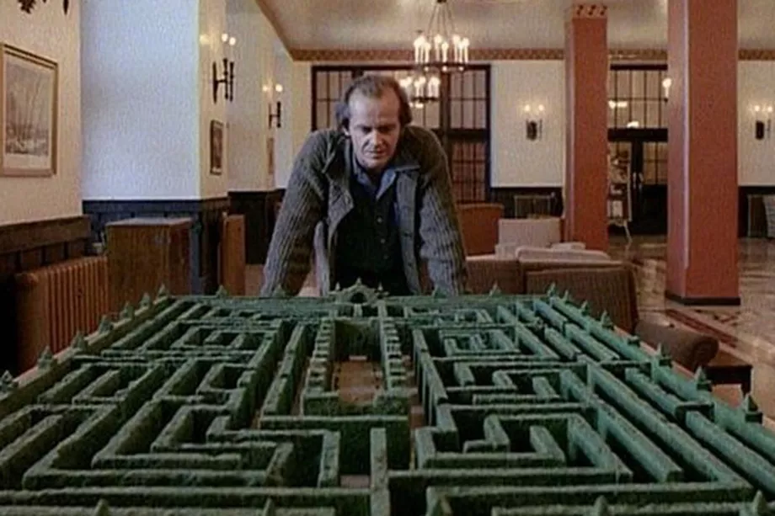
Create Path Function
Takes in the selected items, calculates the shortest path, and is passed on to the Run Cart function
References a predetermined layout of the store, with entrance and checkout locations
Will implement a modified version of Dijkstra’s algorithm to find the optimal path

Slide 27
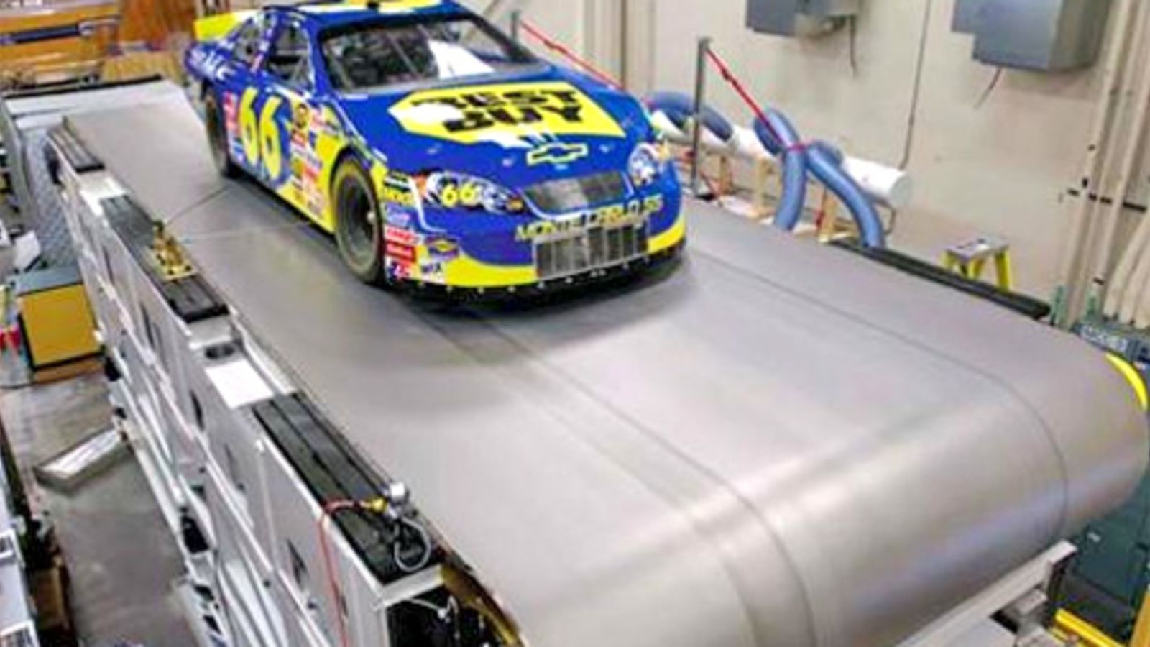
Run Cart Function
When this function is called, shopping cart moves forward while checking for any obstacles or potential collisions.
Checkpoints will be set up so that the shopper can either wait after getting an item or continue on
Once the journey is finished, the cart will head back to the starting point

Slide 28

Obstacle Detection
Will check for any potential obstacles or collisions
Works in combination with both the sonar and IR modules
When an object is detected in the path of the cart, the Movement Correction function will be called

Slide 29

Movement Correction
Once an obstacle is detected, the location of that obstacle in relation to the cart’s path will be recorded
Depending on where the obstacle lays, the cart will be triggered to move around the obstacle
The function will then calculate how much further from the original path the cart has travelled.

Slide 30
Final Software Implementation
Notes:
Eddy G Peaces again

Slide 31
Secondary Functions
Pause Cart
Pauses the cart and waits for the customer to hit the button to continue.
Important for safety.
Shopper Check
Detects when the shopper is too far away from the cart.
If they are, the cart stops, and waits for the shopper to return.
Hard Reset
Shuts down everything that Tinjac is doing, generally when errors occur.
New path generated with current location as starting point.
Emergency Stop
Serves as an emergency fail-safe.
Activated if there is a physical issue that can no longer be resolved with software.
All power is cut off except for the user interface.

Slide 32
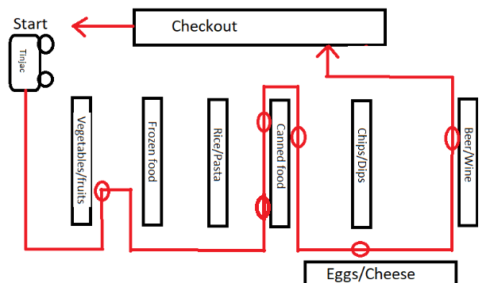
Demonstration Test
Notes:
James n his Gamez

Slide 33
Work Division
 | Power | Motors | Sensors | UI
Edgar | Primary | Secondary
James | Secondary | Primary
John |  |  | Primary | Secondary
Shekh |  |  | Secondary | Primary

Slide 34
Budget
Item Name | Quantity | Price/Part | Cost/Order
High-Torque Motor | 2 | ≈ $45 | $90
MSP 430 | 2 | ≈ $3.66 | $7.32
Compact Size Shopping Cart | 1 | ≈ $50 | $50
Solar Panel | 4 | ≈ $10 | $40
High-Capacity Rechargeable Battery | 1 | ≈ $20 | $20
Sonar Module | 2 | ≈ $4 | $8
Infrared Module | 9 | ≈ $9 | $81
L293D Motor Driver Chip | 1 | ≈ $1 | $1
Miscellaneous Wires/Gears | N/A | ≤ $10 | $10
PCB board | 10 | ≈$15 | $15
PCB parts | N/A | ≈$10 | $10
LCD Module | 1 | ≈ $10 | $10
Total: |  |  | $342.32

Slide 35
Challenges
Combining our UI code to cooperate with our sonar sensor code
PCB was printed wrong due to manufacturer
Deciding which MCU to use
Mechanical design of cart

Slide 36
End Result/Demo
See main page of website

Slide 37
Stretch Goals
An app that replaces the physical user interface
Using a button or app to call a shopping cart to your location
Alternate cart mode that follows the shopper
An item scanner on the cart
Cart can hold 100 pounds
Cart should be able to follow the shopper to their car

Slide 38
Experience Gained
Effective Collaboration/Communication
Technical writing skills
Time management
Real life setup of circuits and components
Integration of hardware + software
Notes:
Jimmy Finale

Slide 39
Questions?

