Slide 1
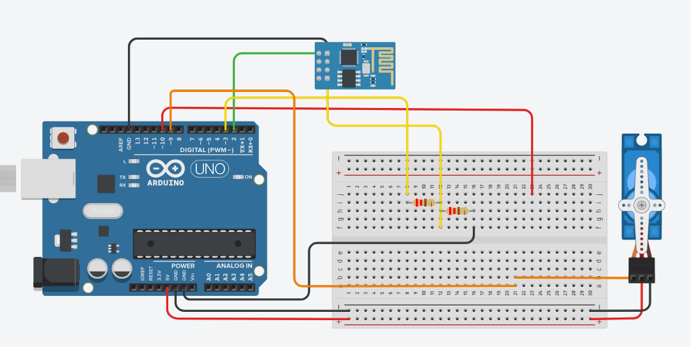
Overall Design
ESP8266-01
Arduino Uno
SG-5010
Tinker AutoCad

Slide 2
Overall Block Diagram
Peripherals
MCU
Power
Power Line:
Control Line:
9 Volt
Battery
5 Volt
Regulator
3.3 Volt
Regulator
Servo Motor
Level
Shifter
Wi-Fi
Module
MCU
Blynk

Slide 3
Power Distribution
Peripherals
MCU
Power
Power Line:
Control Line:
9 Volt
Battery
5 Volt
Regulator
3.3 Volt
Regulator
Servo Motor
Level
Shifter
Wi-Fi
Module
MCU
Blynk

Slide 4
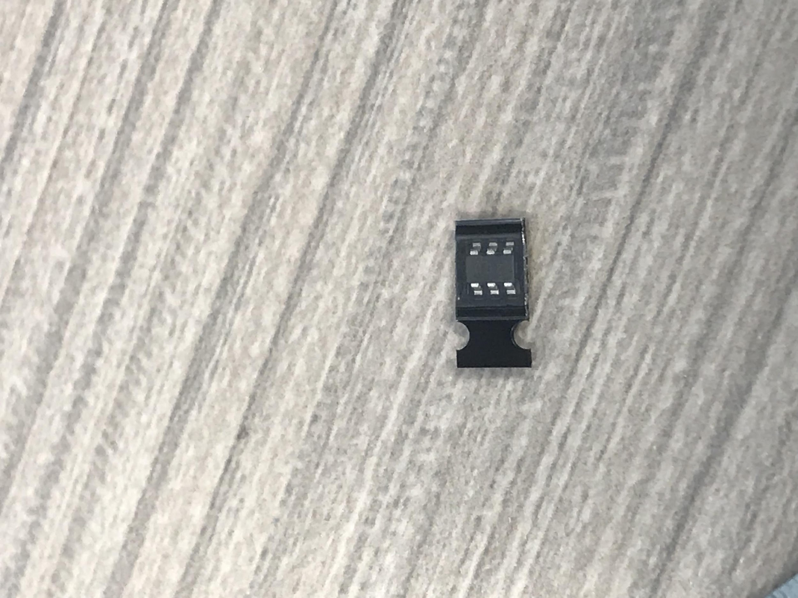
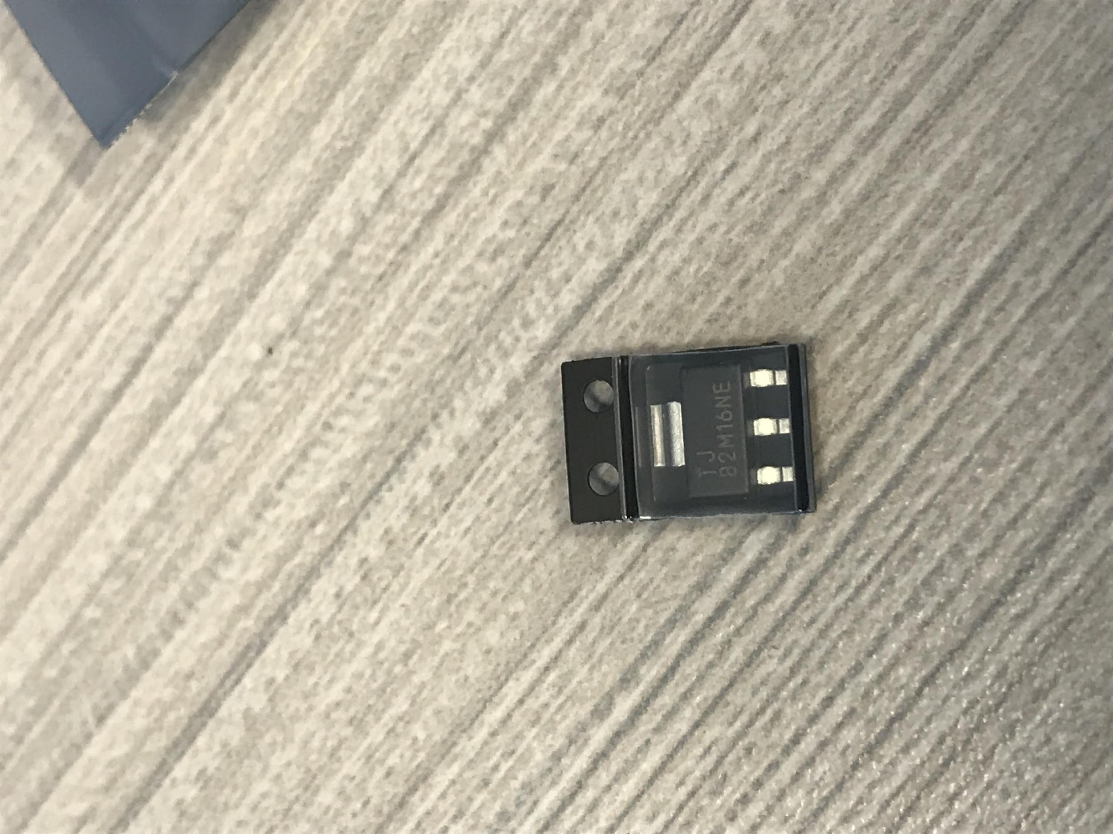
Texas Instruments Power Regulators
Purpose: Ease of usability and sufficient amount current distribution.
TI 5 Volt Buck Converter
TI 3 Volt LDO
0.120’’
0.287’’
0.120’’
0.264’’
Manufacturer | Texas Instruments (TI)
Price | $0.79
Part no. | TPS562200
No. of pins | 6
Current | 1 amperes
Manufacturer | Texas Instruments (TI)
Price | $0.20
Part no. | TLV1117LV33
No. of pins | 4
Current | 2 amperes

Slide 5
Peripheral Interface
Peripherals
MCU
Power
Power Line:
Control Line:
9 Volt
Battery
5 Volt
Regulator
3.3 Volt
Regulator
Servo Motor
Level
Shifter
Wi-Fi
Module
MCU
Blynk

Slide 6
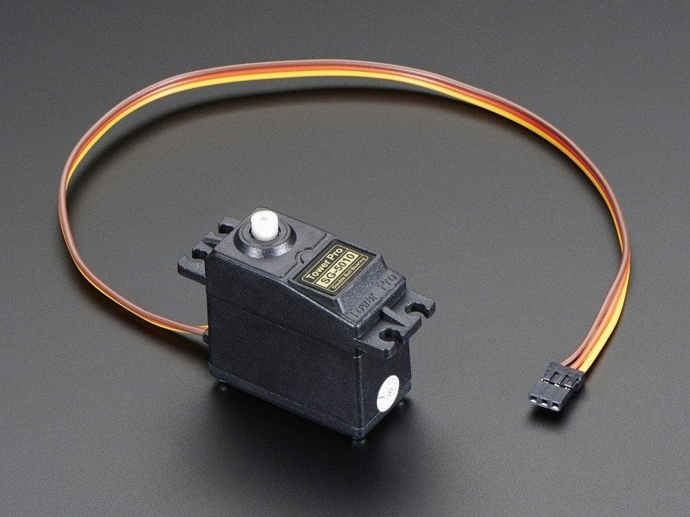
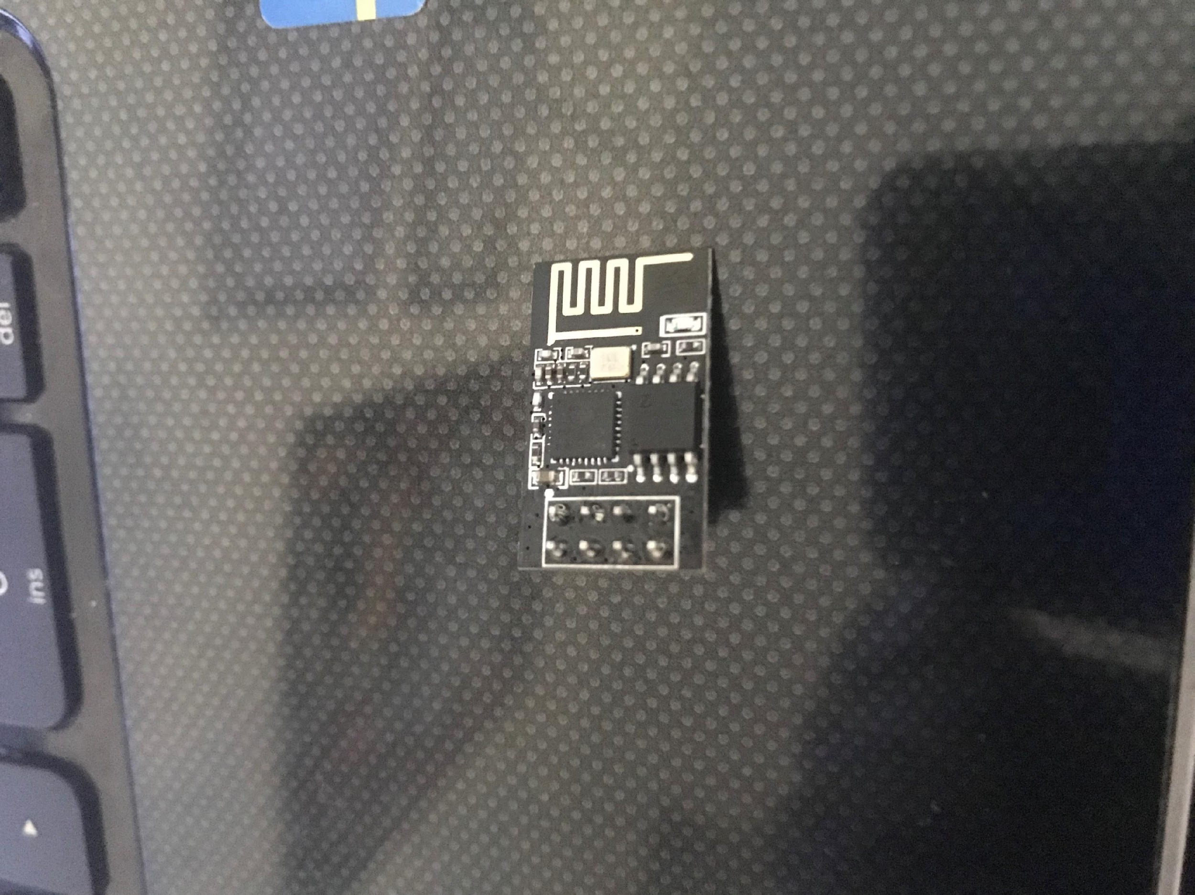
Peripherals
ESP8266-01
SG-5010
Manufacturer | ESPRESSIF
Price | $6.99
Voltage (V) | 3.3
Range (meters) | TBD
Current (mA) | 150
Manufacturer | TowerPro
Price | $6.99
Voltage (V) | 5
No. of pins | 3
Torque
Manufacturer | Atmel
Price | $2.58
Voltage (V) | 5
No. of pins | 28
Current (mA) | 20

Slide 7
Printed Circuit Board

