Slide 1

Senior Design 2018
In Home Delivery System
FABIO PARDO CPE
KARL MAMA EE
ANA GOMEZ CPE
DENA ALAWI CPE
Notes:
Ani

Slide 2


Motivation
To find a new way for people to recieve their packages and groceries more conveniently.
Time sensitive packages ex: fresh produce
Demand for in-home deliveries is increasing.
Convenience
Decrease packages theft
2
Notes:
Fabio

Slide 3
Main Goal and Objectives
Goal: To expand a commodity to the grocery delivery market by creating a reliable and trustworthy system to gives a stranger access to a home.
Objective:
To have a mobile application as the user interface of the product to the customers and drivers.
To have an integrated body camera attached to the delivery person that records from when he/she enters the home until he/she leaves.
The homeowner and the driver will have access to the video on a mobile application.
To create a lockbox that the homeowner can place onto their front door knob.
3
Notes:
Fabio

Slide 4
Primary Specifications
Component | Parameter | Design Specification
Mobile Application | Operating System | 2 Operating Systems (Android and iOS)
Mobile Application | Video Viewing | VOD
Mobile Application | Types of Account | 2 Types of Users (Customer and Employees)
Camera | Actions | Video Recording
Lockbox | Internet Connection | 65 feet
Lockbox | Security | 1 out of 2 security configurations
Lockbox | Weight | Less than 3 lbs
Lockbox | Power Consumption | Less than 7 Watts
5
Notes:
Karl

Slide 5

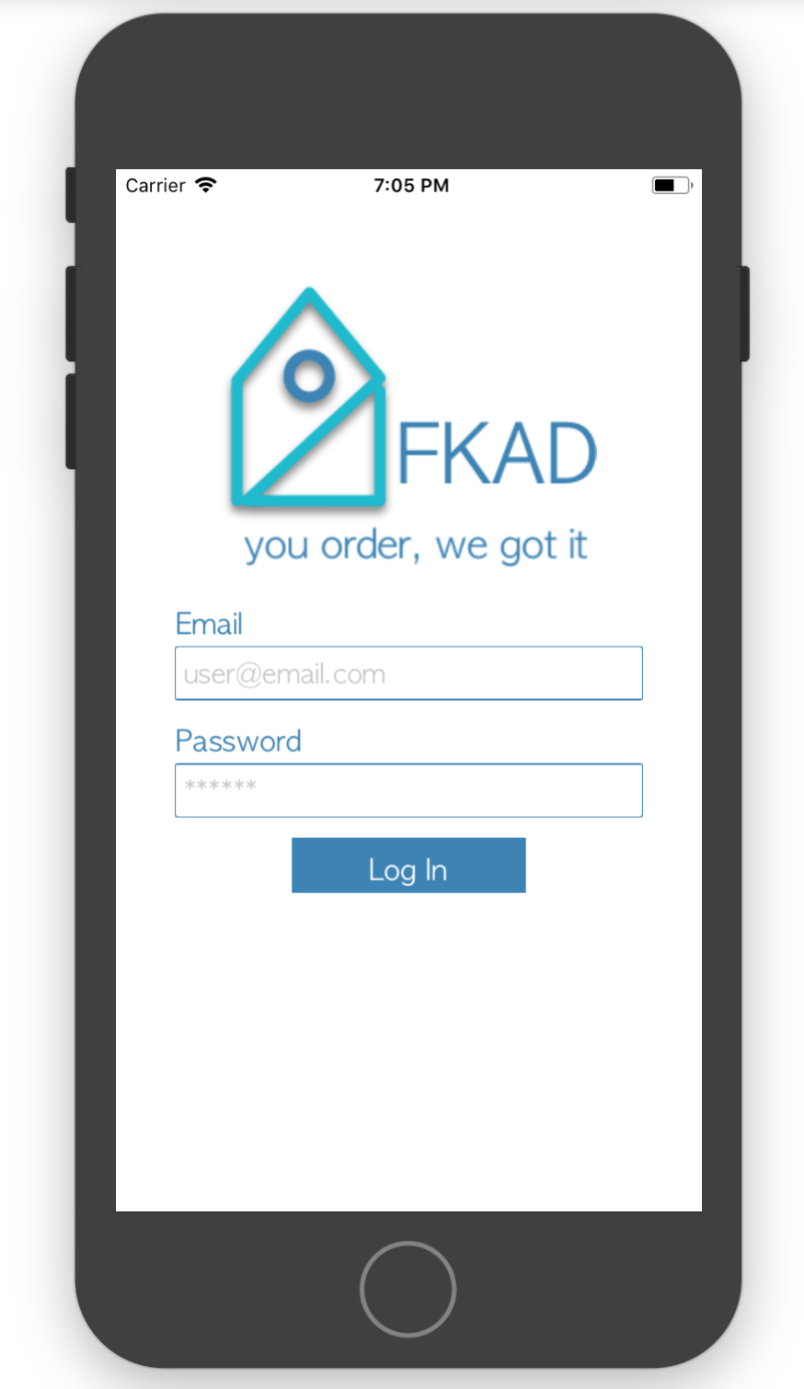

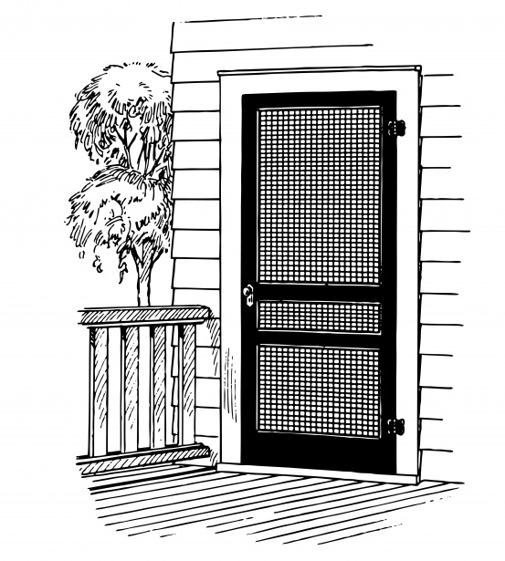


Idea
User Experience
*links Order*
Security
Employee Side
4
Notes:
Fabio

Slide 6

SOFTWARE

Slide 7
Software Block Diagram
Create new customer
Customer
Account
Mobile App & Database
Camera
KeyBox
Connect to GoPro Network
Create Order
Upload Video
Start/Stop Video
Connect to Wifi
View Video
Driver
Account
Complete Order
Get Fingerprint Access
Components
Actions
Users
8
Notes:
Ani

Slide 8
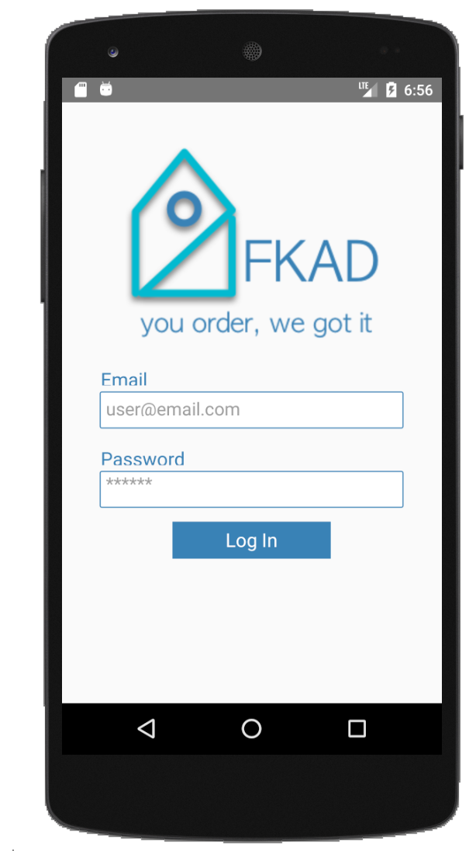

Mobile Application - User Interface
Android
iOS
Fabio & Ani - 9
Notes:
Ani
Frontend is being built by using react-native. It is a framework that can be used for Android and IOS, and lets us build cross-platform mobile apps.

Slide 9
Frontend [Tools]
Design
Implementation
Test
Sketch
React Native
XCode iOS Simulator
Android Studio's Android Simulator
10
Notes:
Ani
-we’re using IOS and anroid sim to make sure designs are standard (display issues)

Slide 10
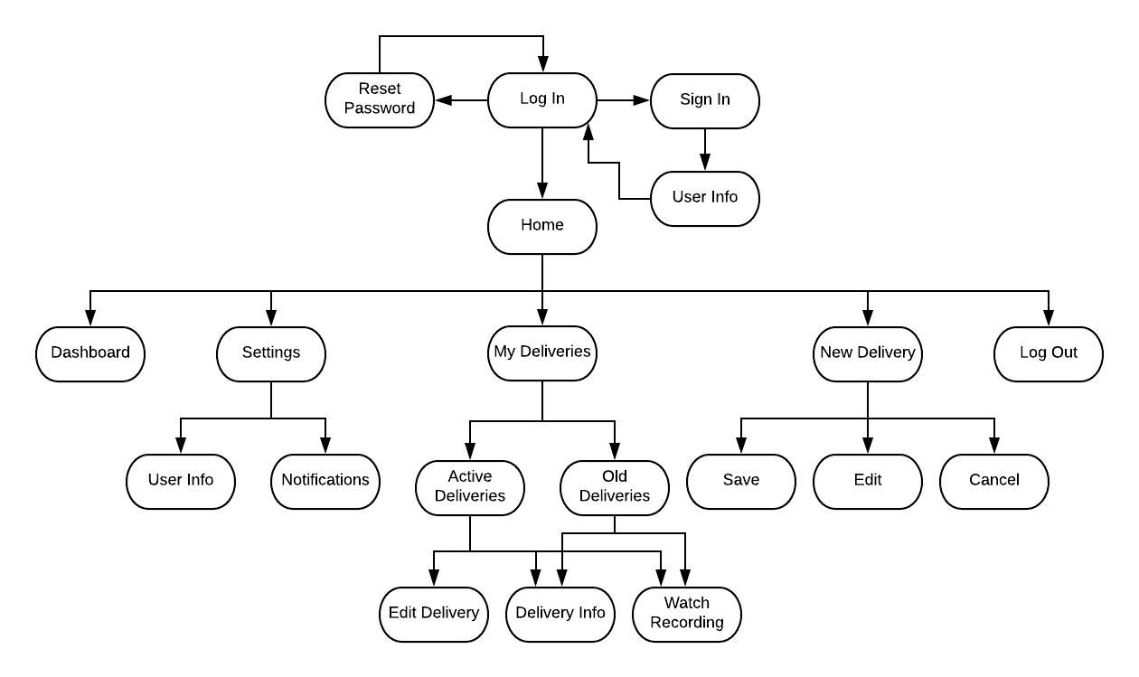
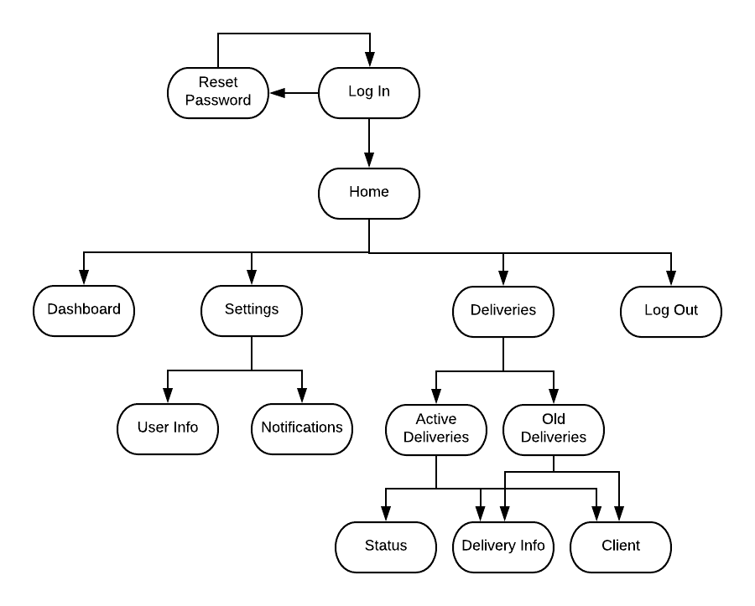
Mobile Application - Types of Account
Customer
Employee
Fabio & Ani - 11
Notes:
Ani

Slide 11
Mobile Application - Types of Account
Customer
Customer
Employee
12
Notes:
Ani

Slide 12
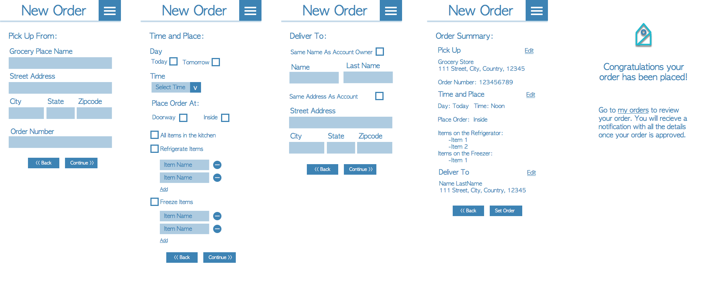
Customer - New Order UI
Ani - 13
Notes:
Ani
Not Included: Are the designs for the viewing of a live stream/onclick to view previous made deliveries.

Slide 13
Mobile Application - Types of Account
Employee
Customer
Employee
14
Notes:
Ani

Slide 14

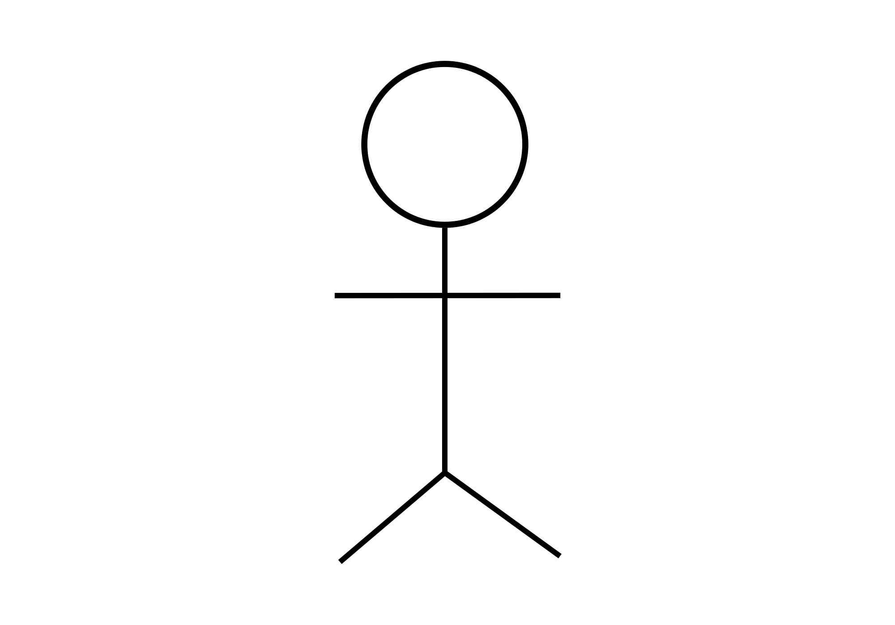
Backend [Design]
RESTful API
MOBILE APP
DATABASE
Tables
Customer
Loxbox
Employee
Order
Auth
HTTP Requests
LOCKBOX
POST
GET
PUT
DELETE
2nd Form Normalization
Dena - 15
Notes:
so the backend is designed as a Resful api with HTTP requests to support scalability and acts as a stand alone for the different components that will be using the database
its designed in 2nd normalization form database...thats why we have 5 different types of tables to avoid duplicate data

Slide 15
Backend [Tools]
Tools used at each stage
Implementation
Testing
Integration
DynamoDB
Lambda (Node JS)
API Gateway
Postman
DynamoDB
Mobile App
DynamoDB
AWS
16
Notes:
Fabio
implementation is done using AWS:
Dynamo DB service for tables
Lambda service for handling requests in Node JS
Gateway for designing the endpoints and Models
Testing …

Slide 16
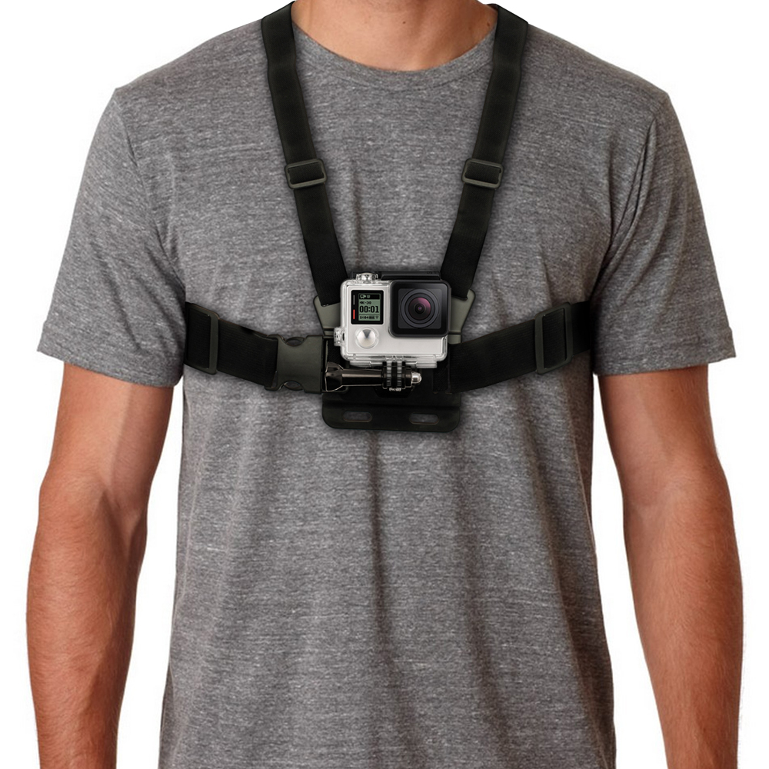
GoPro Camera Communication
Used in the project for security measures
GoPro Hero 4
Since letting a stranger into your home isn't ideal, our implementation of a GoPro body cam will allow for a more trusting experience
KonradIT’s GitHub GoPro Library allows for all functionalities necessary for the project
Open/Closing the camera shutter on door access granted
Recording the delivery in progress
Fabio & Ani - 19
Notes:
Fabio

Slide 17

YouTube API
Essential to the project for reliability
Video uploading will be used using YouTube’s API.
VODs (Videos on Demand) will be stored using this API.
Youtube API will allow for the App to give users access to certain videos.
So not everyone will be able to watch VODs
Fabio - 18
Notes:
Fabio
cut down on cost so we don’t pay for a database that handles too much data( MP4)
privacy mode

Slide 18
Connectivity with Pi
Starting
Start Recording
driver starting /ending delivery
running FKAD Service
Finger
-Print Read?
Yes
No
1-Download Media
2- Upload youtube
3-Share Video
Ending
StopRecording
Dena & Ani - 17
Notes:
Fabio

Slide 19


HARDWARE

Slide 20
Power Regulator Considerations
Effortless Implementation.
Provide sufficient amount of current (1-2 Amps).
Small footprint area.
5 Volt Regulators
Manufacturer | Device Name | Output Current (Amps) | Efficiency (%)
Texas Instruments | TPS562210A | 2 | 91
Maxim | MAX638CSA | 1 | 85
∗Texas Instruments | LM7805 | 1.5 | 55
3.3 Volt Regulators
Manufacturer | Device Name | Output Current (Amps) | Efficiency (%)
Texas Instruments | TLV1117LV | 1 | 66
ON Semiconductor | KA78R33C | 1 | 65
∗Diodes Incorporated | AX1117EH | 1 | 55
Karl-20
Notes:
Karl

Slide 21
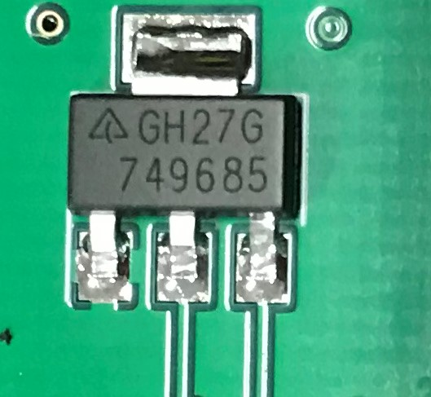
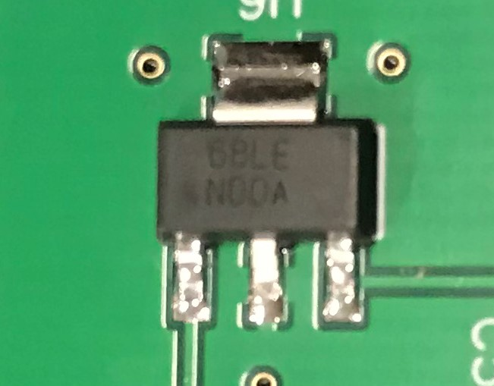
Power Regulators (Selected)
3.3 Volt LDO (AZ1117EH)
5 Volt LDO (LM7805)
0.287’’
0.146’’
0.248’’
0.264’’
Manufacturer | Diodes Incorporated
Price | $0.44
Output Current (A) | 1
Quiescent Current (mA) | 6
Efficiency (%) | 55
Manufacturer | Texas Instruments
Price | $1.36
Output Current (A) | 1.5
Quiescent Current (mA) | 6
Efficiency (%) | 55
21
Notes:
Karl

Slide 22
Peripheral Considerations
The WiFi module needed for this project has to: Communicate via UART, uncomplicated setup, and a compact design.
Manufacturer | Device Name | Voltage (V) | Supply Current (Amps) | Security
ESPRESSIF | ESP-8266-F | 3.3 | ⋍0.08 | WPA/WPA2
∗ESPRESSIF | ESP-8266-01 | 3.3 | ⋍0.08 | WPA/WPA2
The mechanism to open the lockbox has to: Consume a moderate amount of power, effortless implementation, and a considerable size.
Manufacturer | Part Name | Voltage (V) | Peak Current (Amps) | Power (Watts)
∗TowerPro | SG-5010 | 5 | ⋍0.500 | 2.5
AdaFruit | Lock-style Solenoid | 12 | ⋍0.650 | 7.8
22
Notes:
Karl

Slide 23
Peripheral Considerations (Continued)
The USB-Serial Converter is needed for this project to allow communication between the computer and our microcontroller.
This decision was based off of: Feasibility, number of components needed, and data communication speed.
Manufacturer | Part Name | Voltage (V) | Supply Current (Amps) | Clock Speed (MHz)
∗FTDI Chip | FT232R | 5 | ⋍.0.015 | 48
Texas Instruments | TUSB3410 | 3.6 | ⋍.020 | 24
MicroChip | MCP2200 | 5 | ⋍.0.015 | 12
23
Notes:
Karl

Slide 24
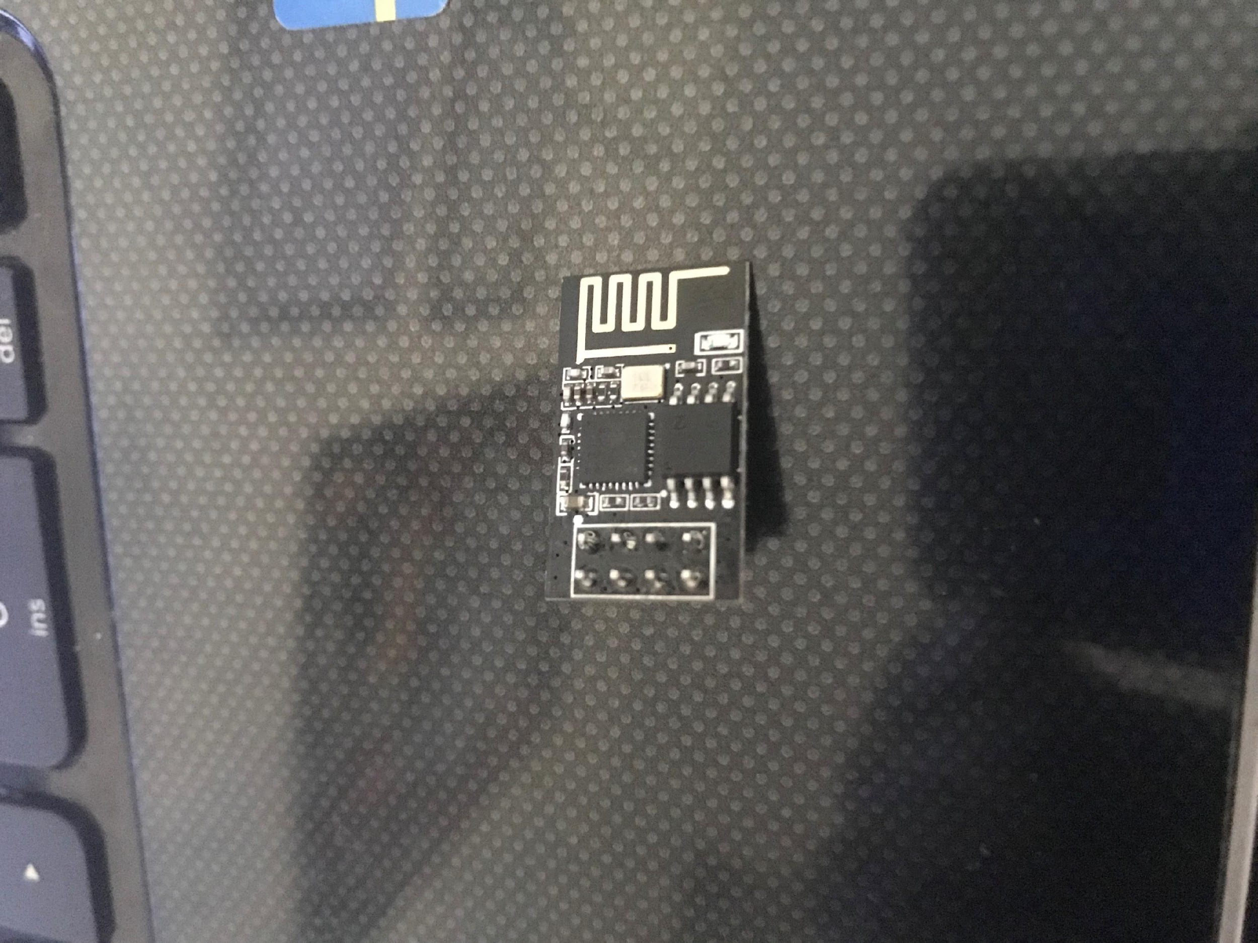
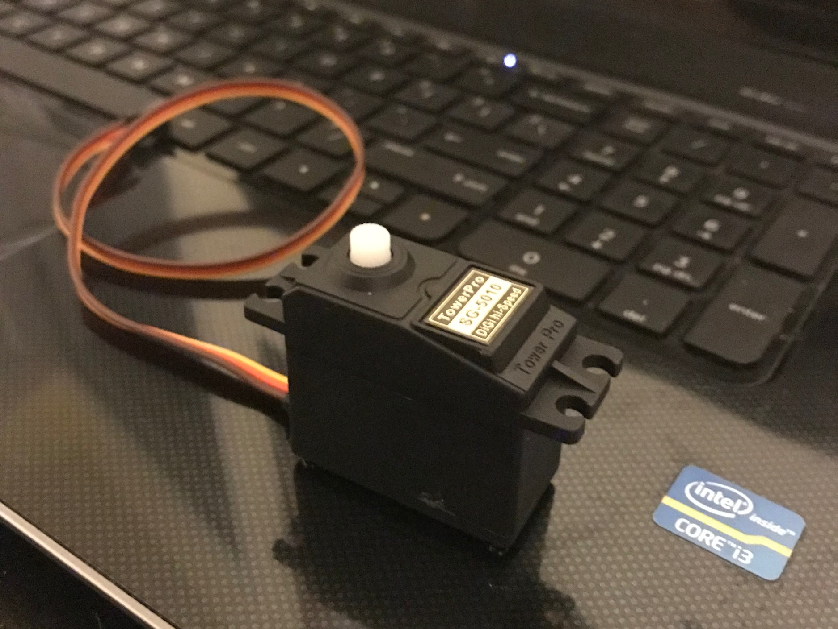
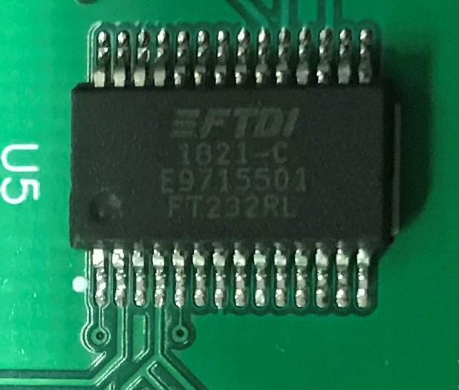
Peripherals
0.976”x0.563”
LxW
1.59”x0.807”x1.49”
LxWxH
0.406”
LXW
0.307”
WiFi Module
Servo Motor
USB-Serial
Manufacturer | ESPRESSIF
Price | $6.99
Part no. | ESP8266-01
Range (feet) | ≅65
Current (mA) | <150
Manufacturer | TowerPro
Price | $6.99
Part no. | SG-5010
No. of pins | 3
Current (Amps) | ⋍0.500
Manufacturer | FTDI Chips
Price | $4.50
Part no. | FT232RL-REEL
No. of pins | 28
Current (mA) | 15
24
Notes:
Karl

Slide 25
Microcontroller Selection
Selection Criteria:
Ease of interfacing with peripheral devices.
Multiple Universal Asynchronous Receiver-Transmitter (UART) ports (At least 2).
Large number of I/O lines.
Low Current Consumption.
Manufacturer | Part Name | Supply Voltage (Volts) | Supply Current (Amps) | Number of UART Ports
∗Atmel | ATMEGA2560-16AUR | 5 | 0.55 | 4
Atmel | ATMEGA328PB-AUR | 5 | 0.4 | 1
Texas Instruments | MSP430FR5994IPNR | 3.3 | 0.5 | 4
25
Notes:
Karl

Slide 26
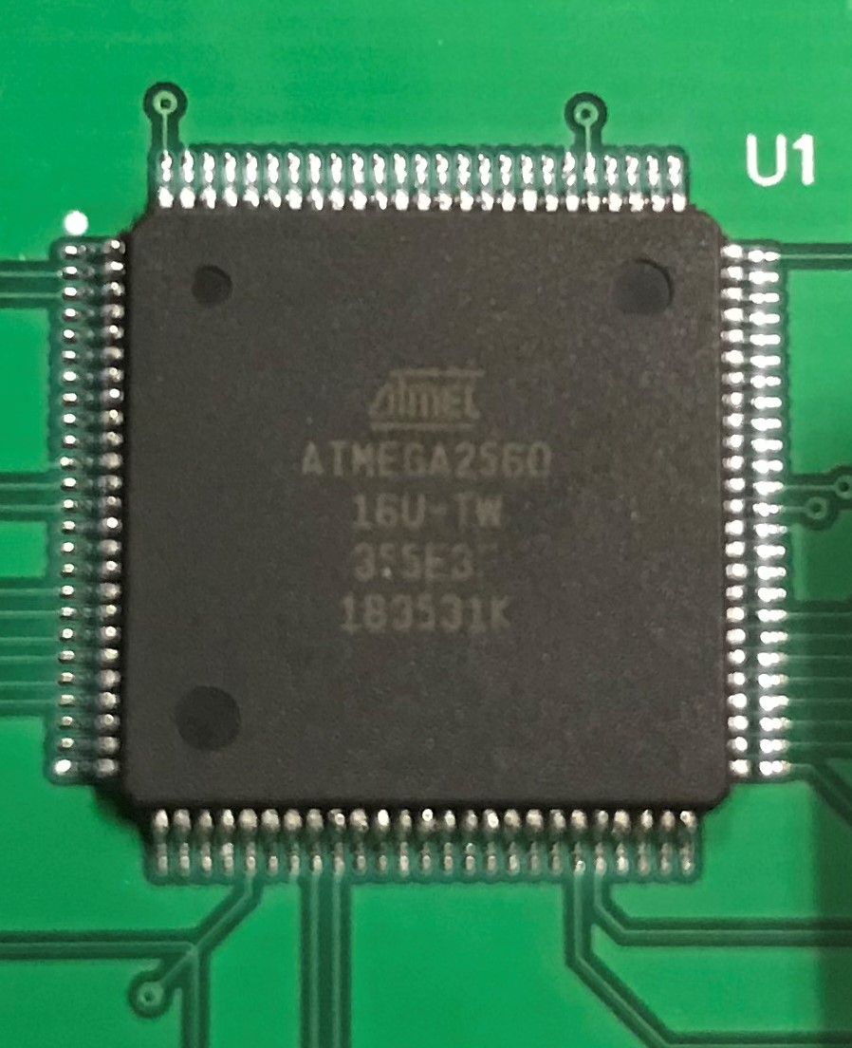
Microcontroller Selection
0.639”
The ATMEGA2560 was selected due to having:
Sufficient amount of Universal Asynchronous Receiver-Transmitter (UART) ports.
Consumes a generous amount of power, 2.75 Watts.
Numerous amount of I/O Pins.
Allows for smooth communication between peripherals.
0.639”
ATMEGA2560
Manufacturer | ATMEL
Price | $12.35
Part no. | ATMEGA2560-16AUR
No. of pins | 100
Clock Speed (MHz) | 16
Main Memory (KB) | 256
26
Notes:
Karl

Slide 27

Alkaline Battery
9 Volt Battery
4700 mAh
42.3 Wh
Low self-discharge
Long lasting device
27
Notes:
Karl

Slide 28
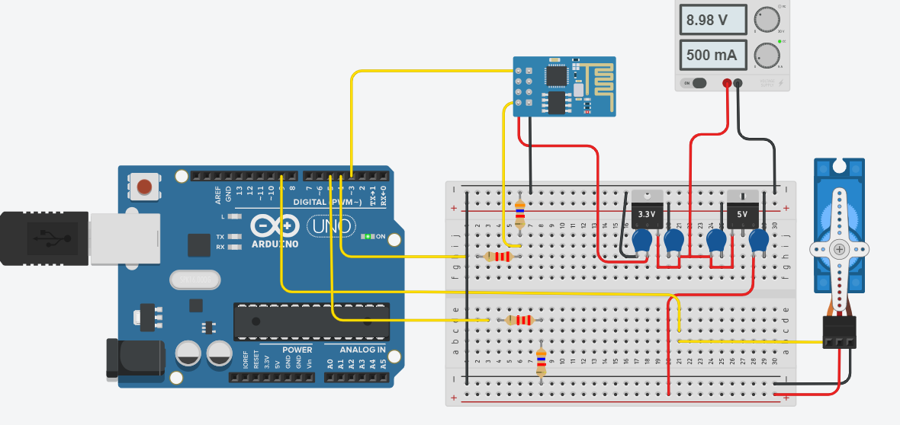
Overall Design (Breadboard)
Tinker Autocad
Communication:
Power:
Ground:
ESP8266-01 (Wi-Fi)
Fingerprint Scanner
Servo Motor
LDO
LDO
Raspberry Pi
Microcontroller
✳Low Dropout Regulators (LDO)
28
Notes:
Karl

Slide 29
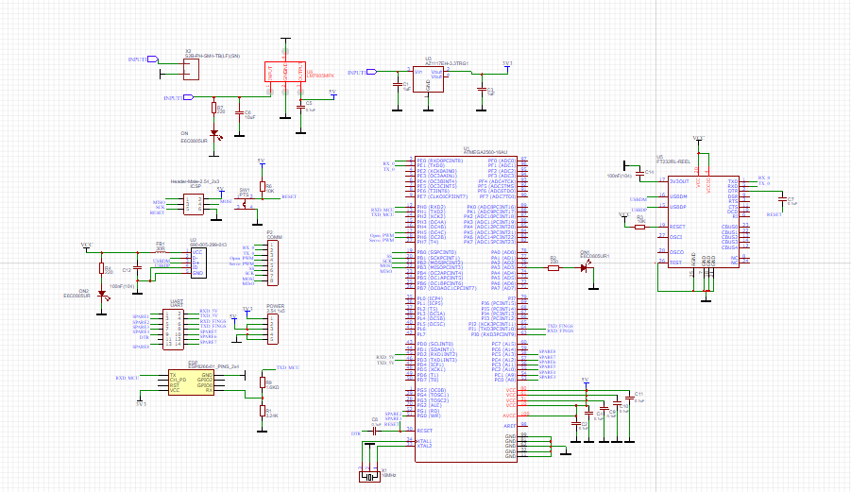
PCB Schematic
29
Notes:
Karl

Slide 30
Overall Block Diagram
5 Volt
USB Port
5 Volt
Regulator
9 Volt
Battery
3.3 Volt
Regulator
Servo Motor
Voltage
Divider
Wi-Fi
Module
MCU
USB-Serial Converter
Raspberry Pi
Extra
AdaFruit
Peripherals
MCU
Power
Power Line:
Control Line:
30
Notes:
Karl

Slide 31
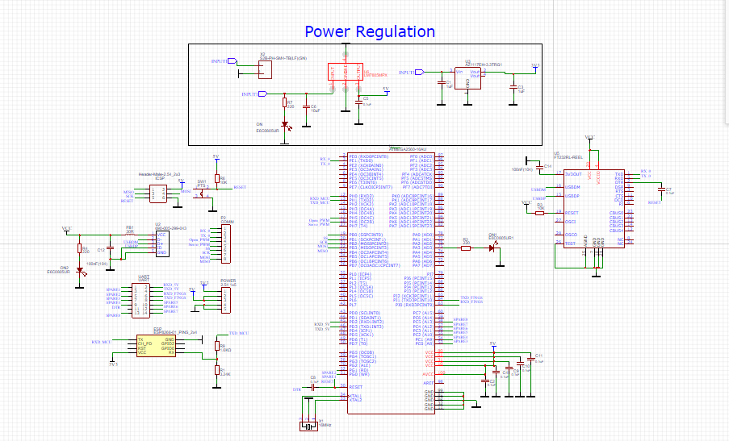
PCB Schematic
31
Notes:
Karl

Slide 32
Power Distribution
5 Volt
USB Port
5 Volt
Regulator
9 Volt
Battery
3.3 Volt
Regulator
Servo Motor
Voltage
Divider
Wi-Fi
Module
MCU
USB-Serial Converter
Raspberry Pi
Extra
AdaFruit
Peripherals
MCU
Power
Power Line:
Control Line:
32
Notes:
Karl

Slide 33
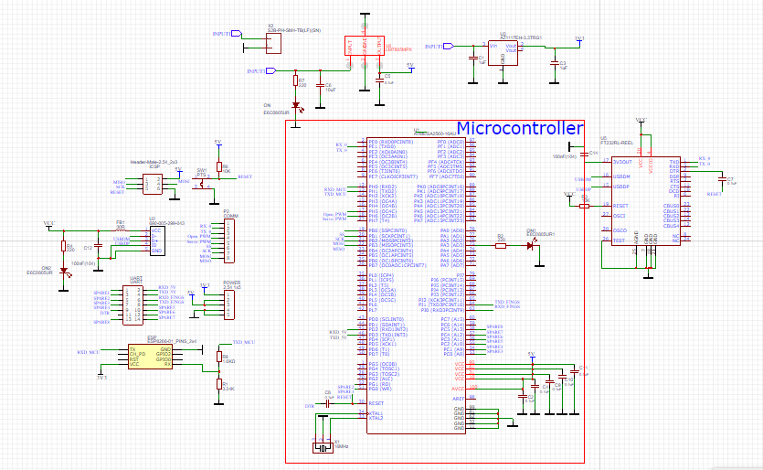
PCB Schematic
33
Notes:
Karl

Slide 34
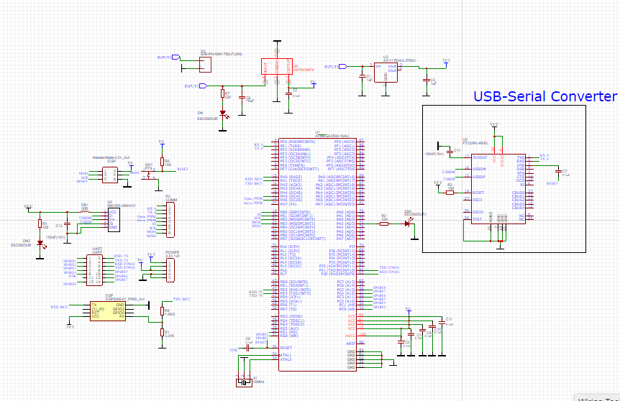
PCB Schematic
34
Notes:
Karl

Slide 35
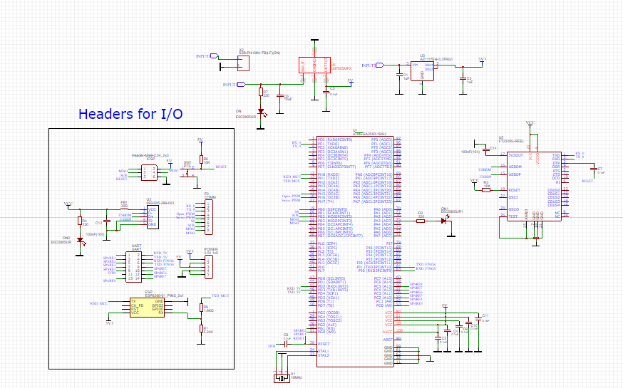
PCB Schematic
35
Notes:
Karl

Slide 36
Peripheral Interface
5 Volt
USB Port
5 Volt
Regulator
9 Volt
Battery
3.3 Volt
Regulator
Servo Motor
Voltage
Divider
Wi-Fi
Module
MCU
USB-Serial Converter
Raspberry Pi
Extra
AdaFruit
Peripherals
MCU
Power
Power Line:
Control Line:
36
Notes:
Karl

Slide 37
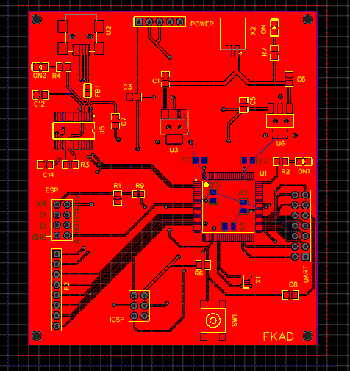
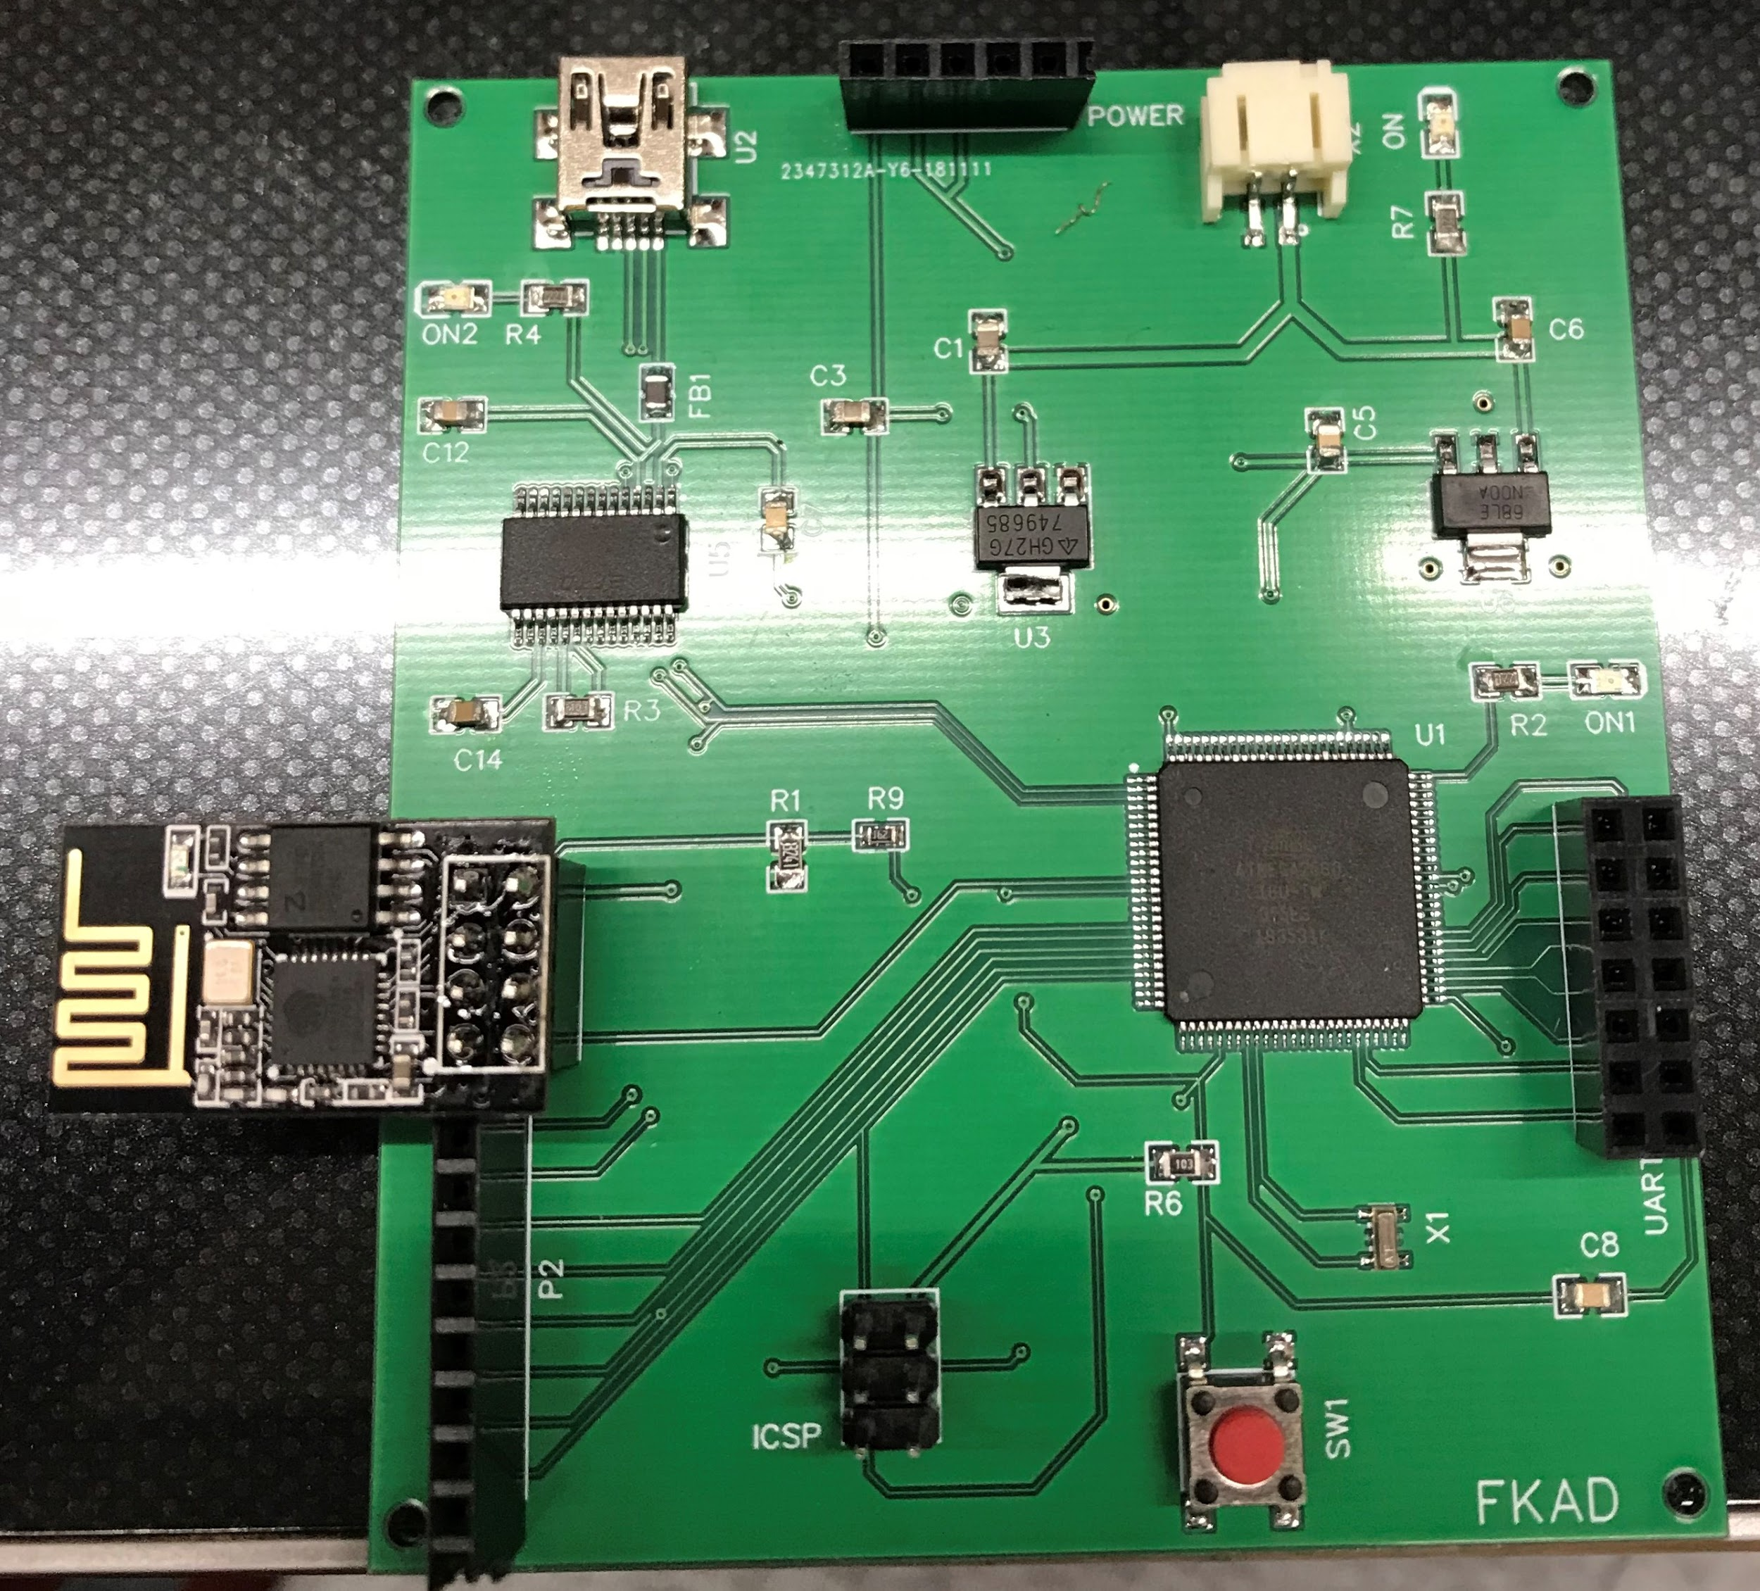
Printed Circuit Board
PCB Schematic
37
Notes:
Karl

Slide 38
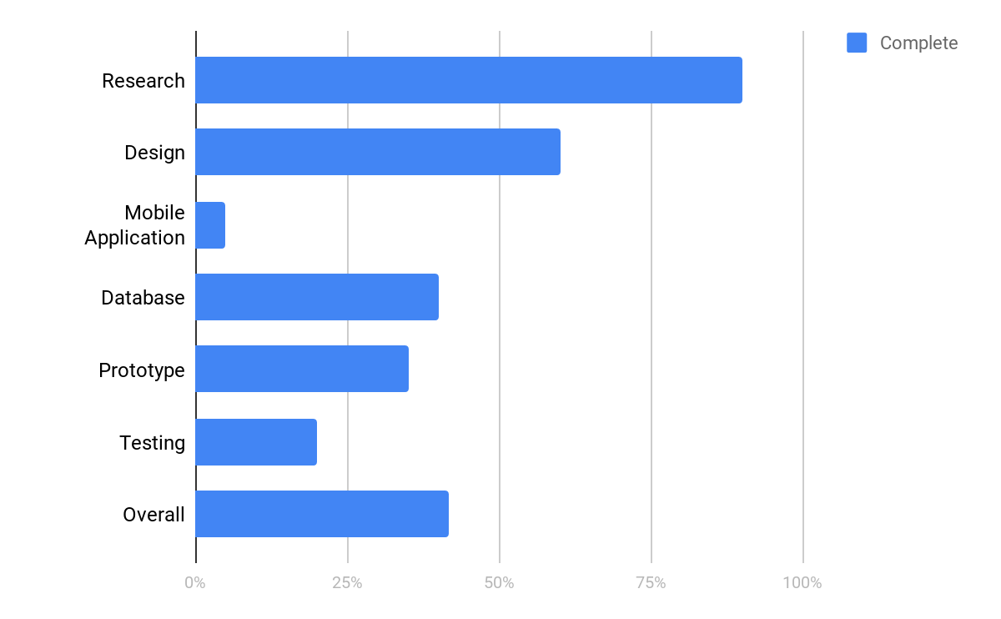
Progress
38

Slide 39
Work Distribution
Component | Ani | Dena | Karl | Fabio
FrontEnd | P |  |  | P
BackEnd | S | P |  | S
Hardware | S |  | P
Power Supply |  |  | P
Camera Communication | P | P |  | P
FingerPrint Communication |  | P | S
P | Primary
S | Secondary
39
Notes:
Ani

Slide 40
Budget [current expenses]
PCB
component | website | price
resistors, level shifting | Mouser | 8.27
MCU, resistors, capacitors, regulators, WIFI Module | LCSC | 13.11
PCB | JLCPCB (2 Boards) | 36.60
MCU, resistors, regulators, capacitors | DigiKey | 45.58
 | Total | 116.68
Prototype
component | website | price
Arduino Uno, ESP WiFi, Headers, fingerprint sensor | Adafruit | 100.7
ATMEGA4560 | Amazon | 21.99
Serial Converter | Amazon | 6.99
Breadboard Kit | Amazon | 11.99
WiFi ESP8266 | Amazon | 6.99
Servo Motor | Adafruit | 16.55
 | Total | 164.22
Total | 280.90
40
Notes:
Karl

Slide 41
Issues
Software:
◦Camera- GoPro
Hardware:
◦Fingerprint Scanner
◦WiFi Module can’t connect to UCFs WiFi (resolved)
◦Connection Header
42
Notes:
GoPro doesn’t have solid official documentation for the public. However KonradIT on github has enough documentation necessary for this project for most gopro’s released to date in python. So we’ll be using that.

Slide 42
Questions?
42

