Slide 1

SunShade
Smart-blinds appliance
Group 13
Conor Ferring, EE
Alex Rosado, CpE
Terrell Richardson, CpE
Miloud Ennemar, EE

Slide 2
Project Description
The SunShade is an internet-of-things home appliance designed for daily use, in order to create a comfortable and cost-efficient home environment.
SunShade is a cordless, solar-powered window blinds system, controlled either with the manual control pad, Alexa personal voice assistant, or the mobile application. It is capable of tilting shades, lifting or lowering blinds, or lifting or lowering a diffuser shade for enhanced environmental control, as well as numerous other technical features.

Slide 3
Features
App control - This will allow the user to adjust the up, down, and tilt blinds positions with ease, having only to lift a finger from the comfort of their homes, or from long distance.
Manual control - Some customers of existing products complain of not always wanting to use the app. For this, we will implement physical onboard buttons for direct control.
Automatic brightness control - Accounts for direction and exterior brightness to adjust the tilt of your blinds throughout the day in order to only allow a reasonable amount of natural light.
Scheduling - This will allow for users’ SunShade to protect their window-dwelling plantlife from over-exposure, as well as save the user on monthly electricity costs by limiting the effects of the sun on air conditioning usage.
Voice controlled - Amazon Echo, aka Alexa functionalities will provide a completely hands-free control for the user. Commands such as “Alexa, shades down.”,”Alexa, shades up.”, “Alexa, close shades.”, “Alexa, open shades.”

Slide 4
Goals
Create a utility for apartment-living home gardening
Create a green-energy focused home appliance
Create an energy-saving device to alleviate monthly bills
Create a product that is user-friendly
Stay within both time and budget constraints

Slide 5
Design

Slide 6
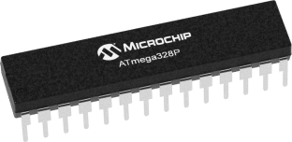
MCU
AtMega328p
CPU Speed: | 20 MIPS
Program Memory: | 32 KB
SRAM: | 2KB
Operating Voltage: | 1.8V-5.5V
Cost: | 2$ per unit

Slide 7
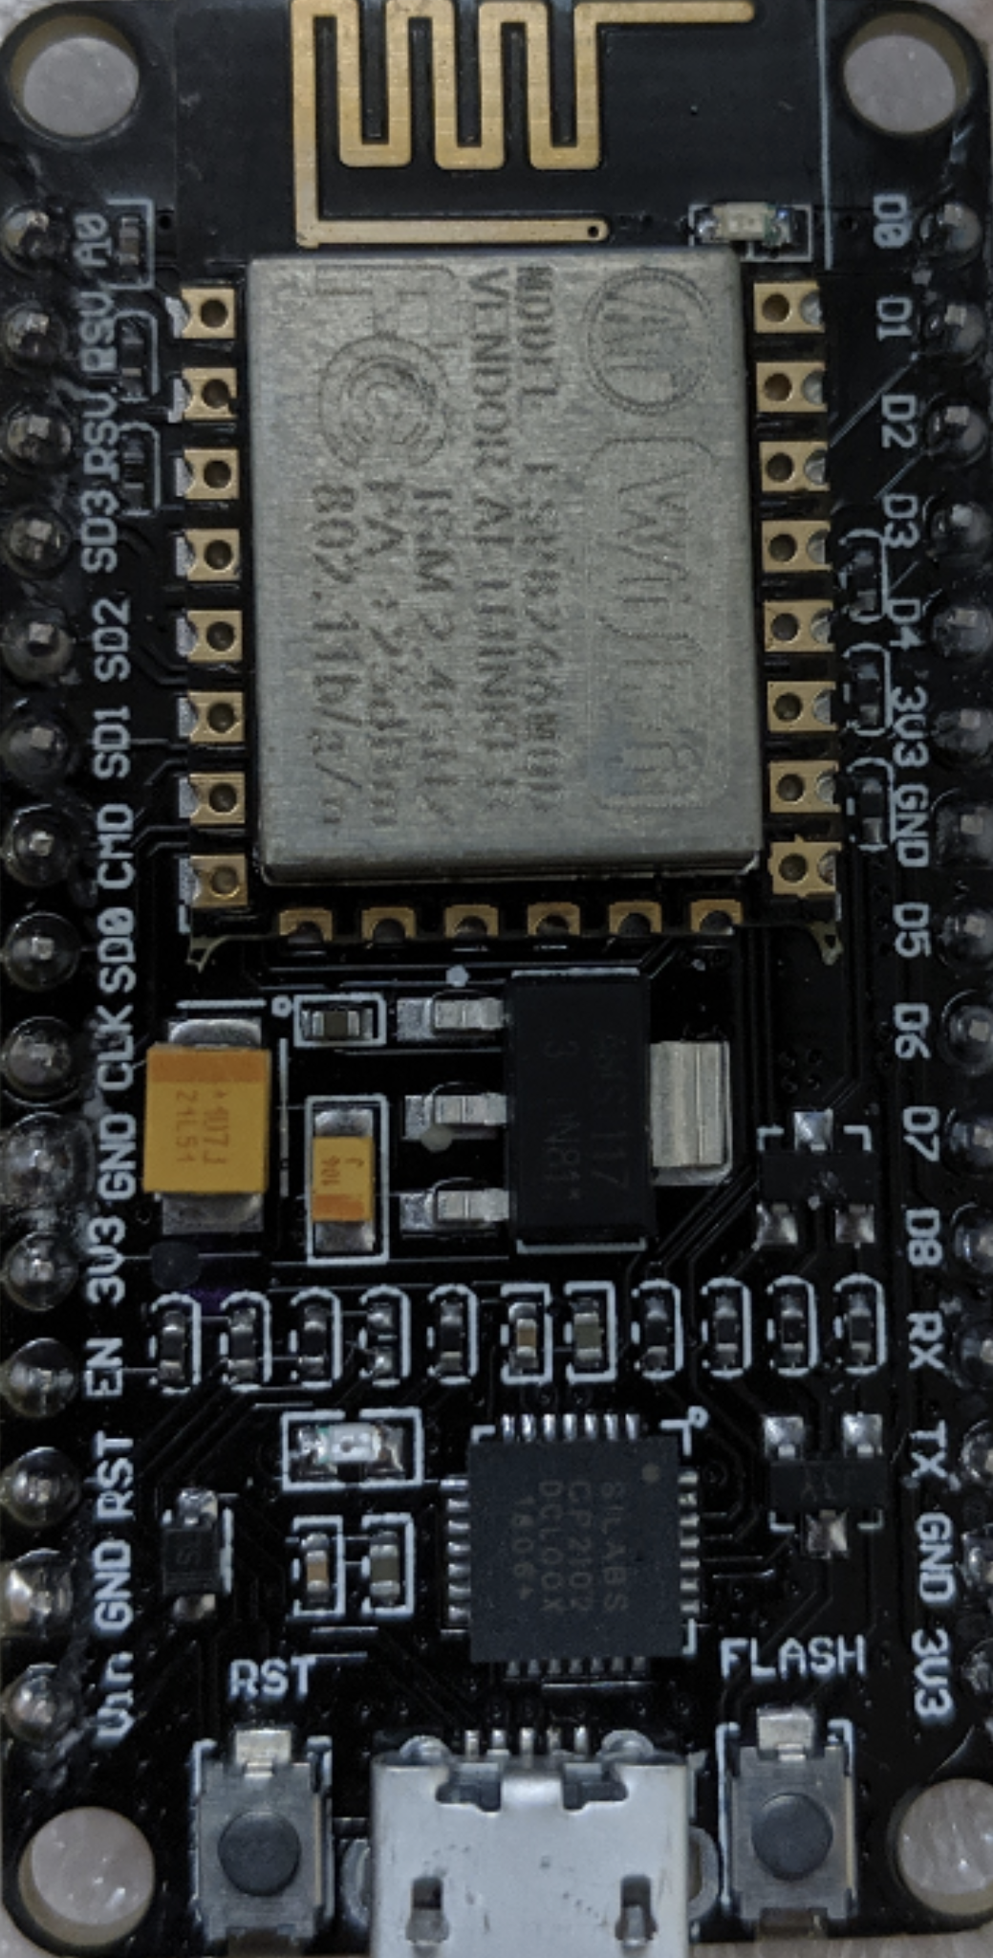
Wifi Module
ESP-12E
CPU Speed: | 80 MHz
Program Memory: | 4 MB
Operating Current: | 80 mA
Operating Voltage: | 3.3V
Cost: | 7$ per unit

Slide 8
Motors
 | 180° Servo Motor | 360° Servo Motor | DC Rollerhouse Motor
Weight: | 56 g | 55.6 g | 204 g
Operating Voltage: | 4.8 to 6V | 4.8 to 6V | 12V
Operating Current: | 500 mA | 1 A | 500 mA
Operating Speed: | .13sec/60° | .14sec/60° | 37 rpm
Stall Torque: | 11 kg-cm | 20.32 kg-cm | N/A

Slide 9
Solar Cells and Battery
Solar Cells
Type: | Monocrystalline
Power: | 2.8 W
Current: | 5.24 A
Voltage: | 0.5 V
Efficiency: | 17.64 %
Brand: | Vikocell
Cost and Vender: | 15 $ from Amazon
Battery
Type: | Li-ion 18650 INR
Capacity: | 3000mAH
Current: | 15 A
Voltage: | 3.7 V
Brand: | Samsung
Cost and Vender: | 4.73 $ from liionwholesale

Slide 10
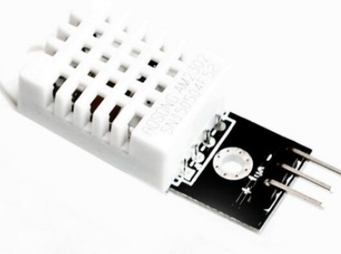
DHT22 Temperature and Humidity sensor.
Good for -40 to 80 Celsius temperature readings with ±2% accuracy.
low cost
Excellent for 0 to 100% humidity readings.
Uses only one single digital pin.

Slide 11
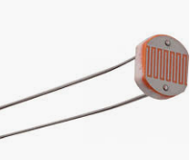
Light Dependant Resistor
Cost: $0.95
Easy to use
Depends on ambient light
 | Light Dependant Resistor | Photodiode
Accuracy | Not Guaranteed | Not Guaranteed
Range | 1 to 100 Lux | 7 Lux to 50 KLux
Uses | Used in application requires ON/OFF | Street Light

Slide 12
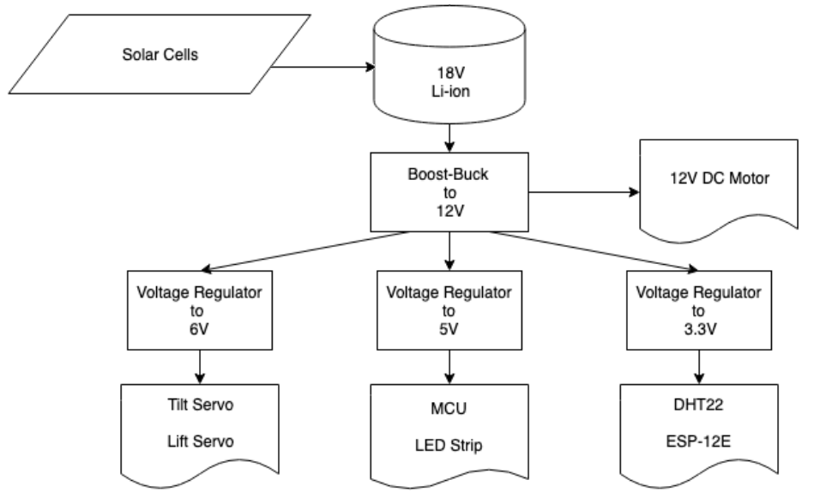
Power Diagram

Slide 13
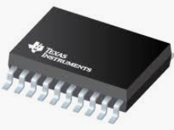
LM25118 Buck-Boost Regulator
Easy to modulate the voltage.
Maintain a regulated output voltage when the input voltage is less or greater than the output voltage
Wide range operating input voltage.
Cost: $ 4.43

Slide 14
Design | Buck-Boost Regulator | Linear Regulator
Complexity | Medium to High | Low
V-in Range | Wide | Narrow
Size | medium | small
Efficiency | High (95%) | medium
Cost | $4.95 | $1.25

Slide 15
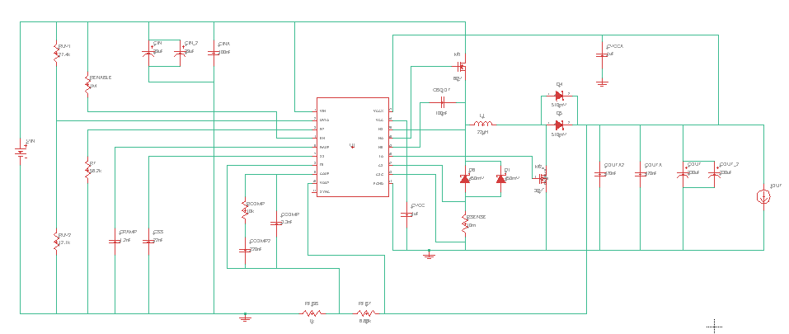
LM25118 Schematic
Buck-Boost

Slide 16
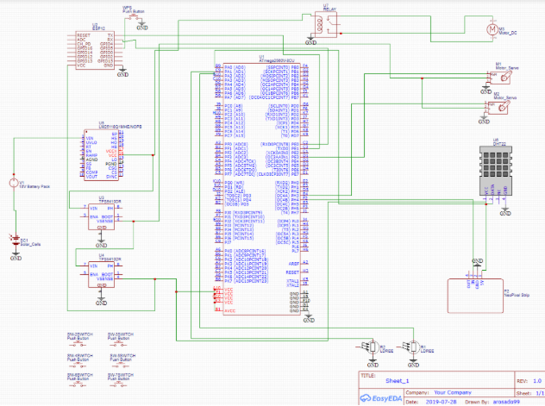
Initial Mockup Schematic

Slide 17
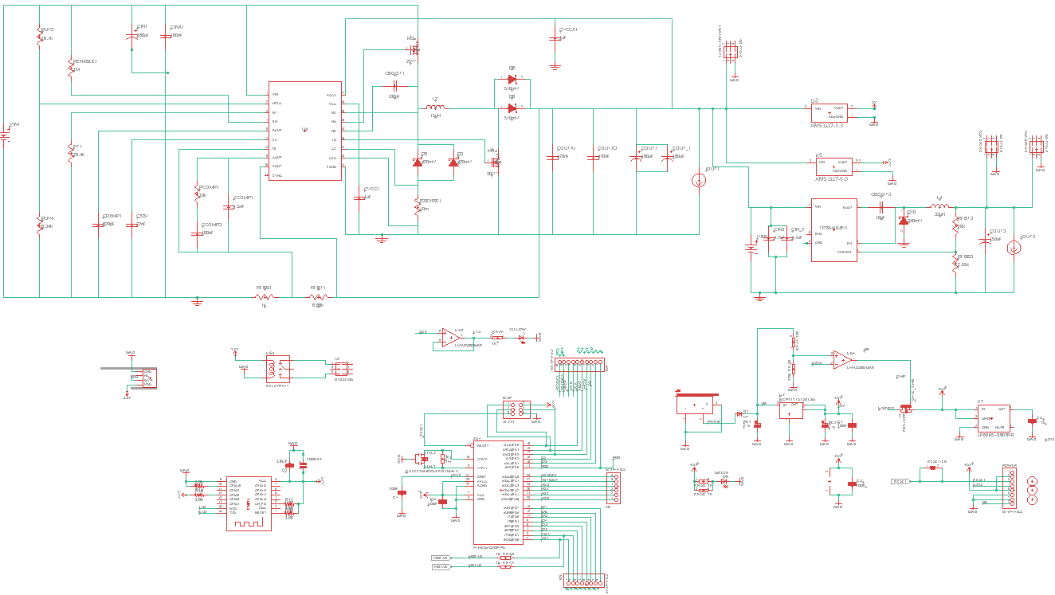
Schematic

Slide 18
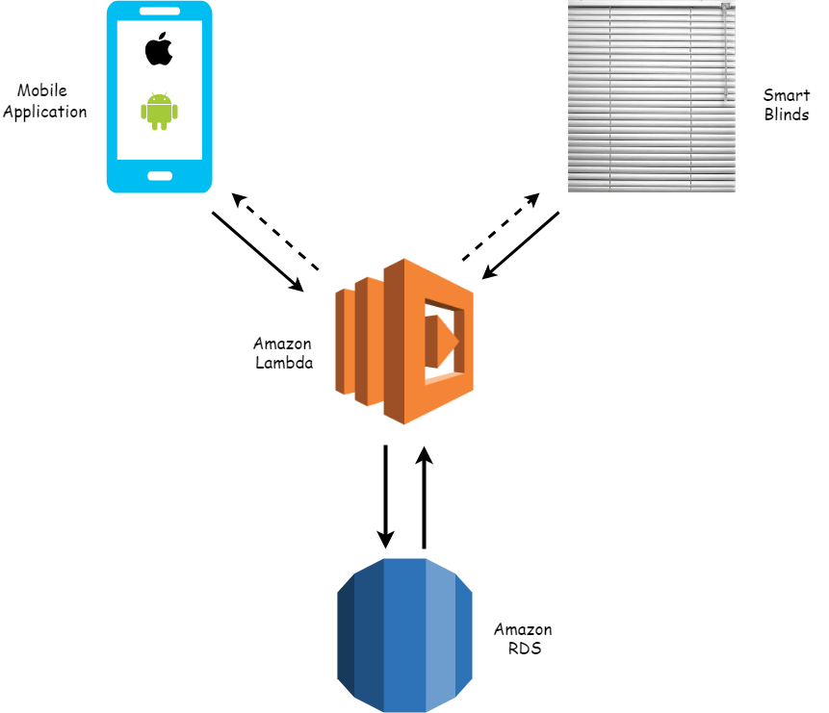
Software Design
Ensure consistent communication between blinds and user
Scalable and customizable storage
Accessible on the majority of platforms
Autonomous smart adjustments

Slide 19

React Native
Cross platform development
Supportive community and documentation
Available modules for easier development
Great knowledge and experience

Slide 20
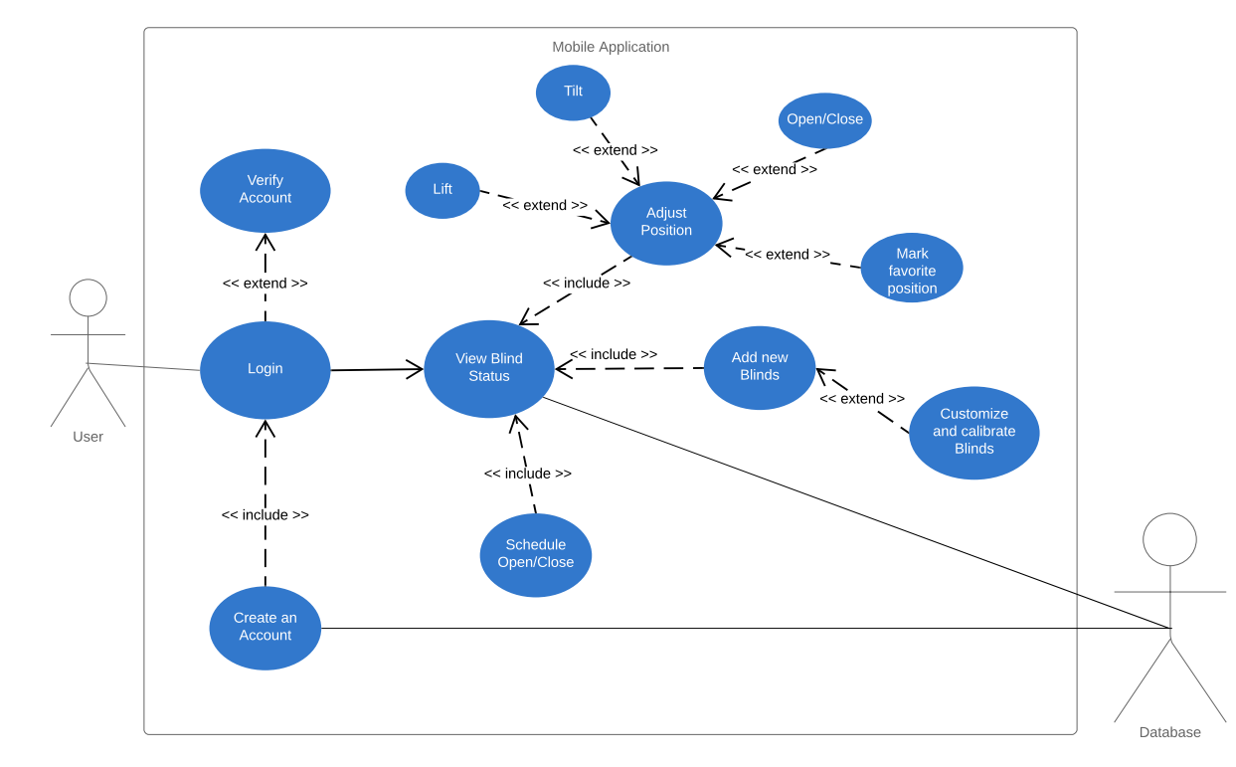

Slide 21
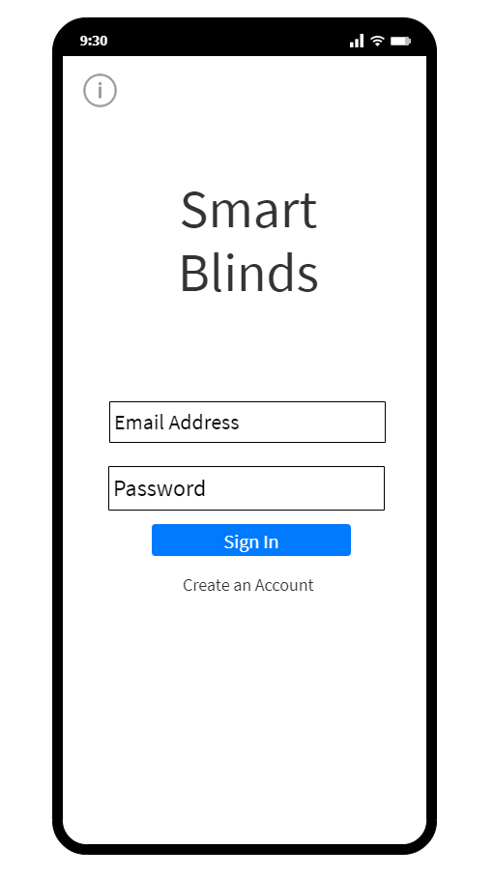
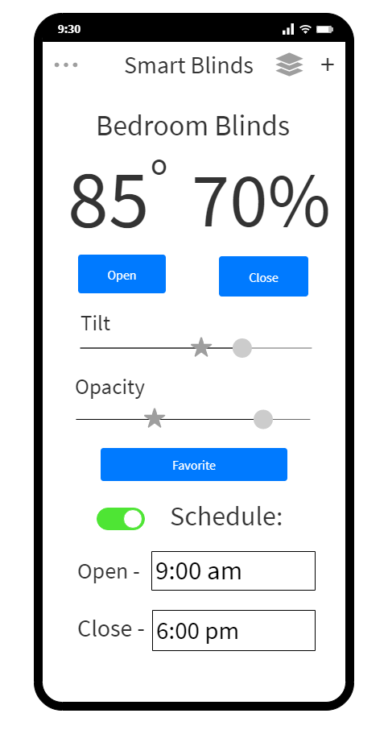
Concept
Simple and visually appealing
Easy to use
Plenty features and customizable

Slide 22
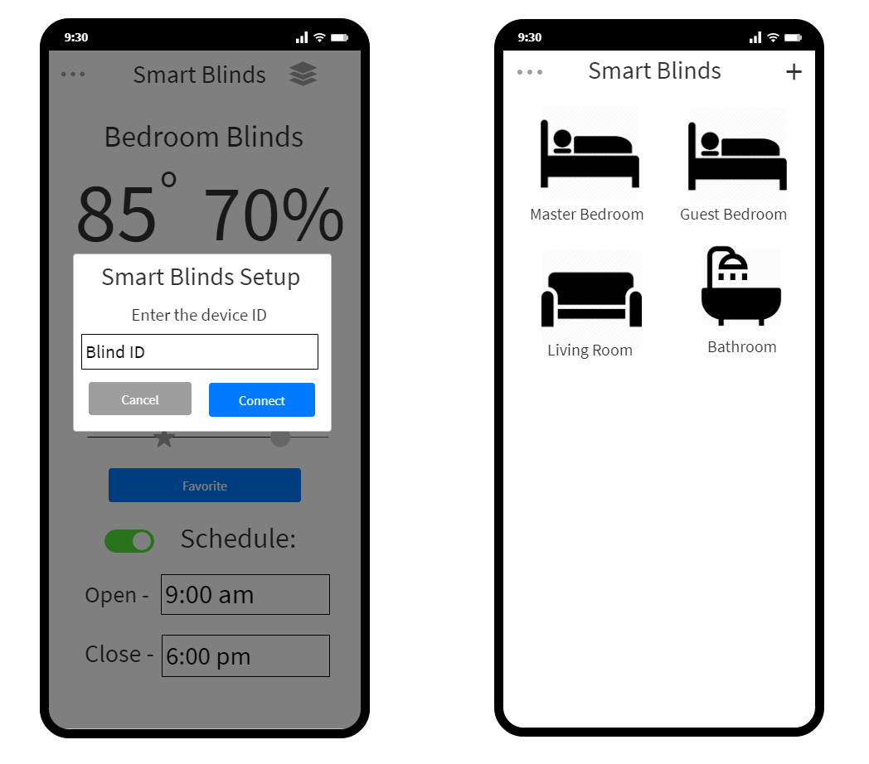

Slide 23
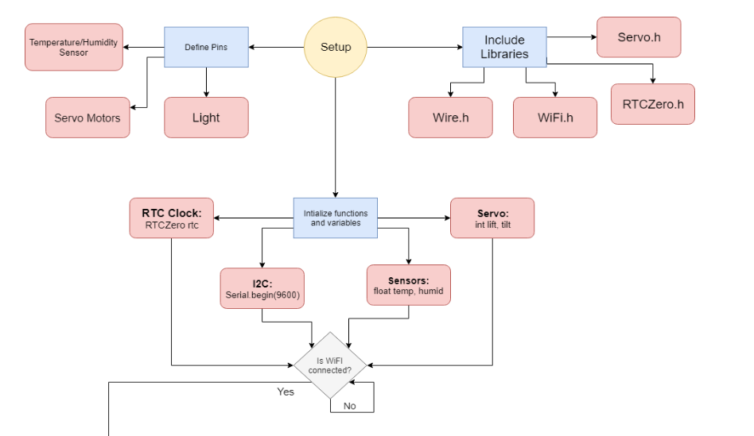
Arduino Programming
C++
Sends/receives adjustments and data from sensors
Smart adjustments based on data
Power management

Slide 24
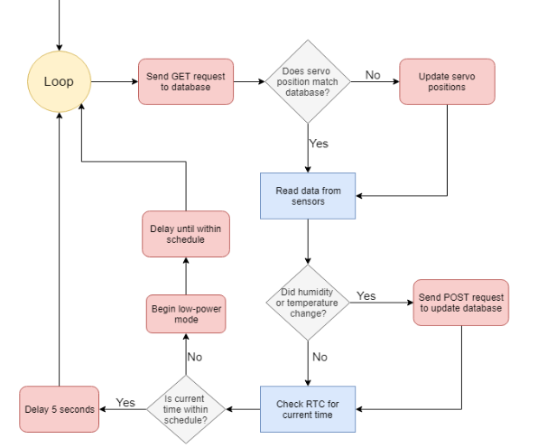

Slide 25

Amazon API Gateway & Lambda
Serverless API
Multiple language support
Simplicity & ease of use
Configurable endpoints
RESTful API

Slide 26
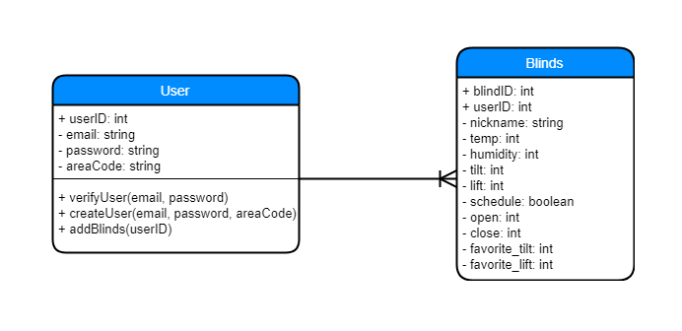
Amazon RDS
MySQL
Amazon Web Services
One to many relationship
Scalable and accessible

Slide 27
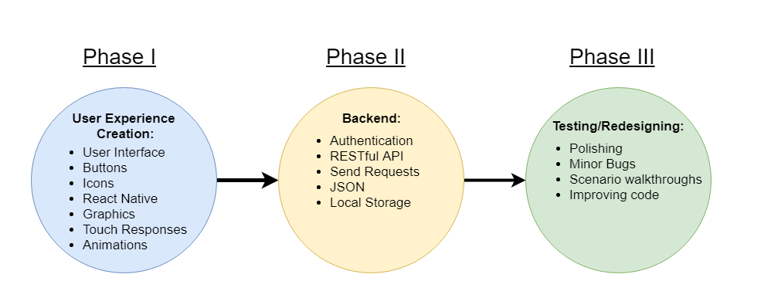
Software Development

Slide 28
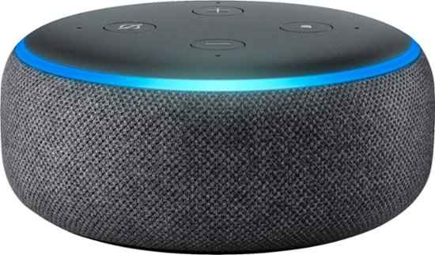
Voice Control
Will be using the Amazon Echo
Alexa Voice Service, ‘AVS’, is Amazon's very own built-in base of services built around the Echo
AVS provides the automatic speech recognition software required, along with natural language understanding, text-to-speech engines, APIs, hardware kits, software tools and all necessary documentation for such a design.
“Skill creation” is where builders can program specific voice commands and select the desired actions/reactions for their device
“Alexa, blinds closed.”

Slide 29
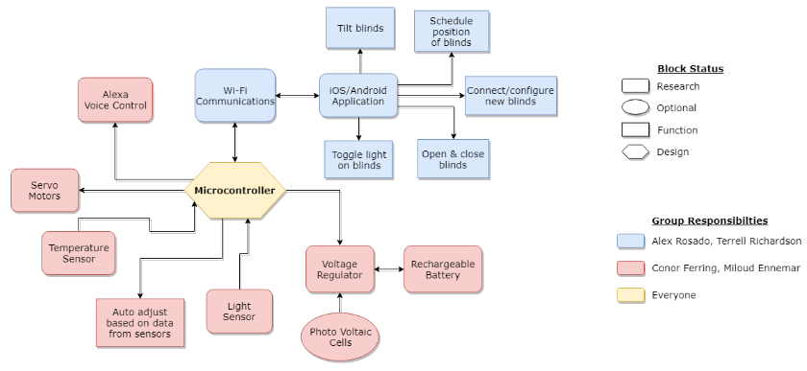
Work Distribution

Slide 30
Timeline
Components mounted: | 9/28
Prototype testing phase: | 10/1-10/8
Arduino code complete: | 10/12
Prototype complete: | 10/18
PCB Design complete, ordered: | 10/18
*MIDTERM DEMO* | 10/21-10/23
Solar power system testing phase: | 10/23-10/29
Solar power system complete: | 10/29
Application online: | 10/26
8-PAGE Conference paper DUE | 11/8
Features online: | 11/11
Alexa Compatibility complete: | 11/15
PCB Testing phase: | 10/23-11/15
Alteration, redesign phase: | 11/11 -11/18
***Project Complete*** | 11/18
Showcase | 11/21-11/22
Final Document DUE | 12/2

Slide 31
Budget = 300$
Product: | Cost:
Servo 360: | 22.79$
Servo 180: | 19.99$
DC 12V Rollerhouse motor: | 42.88$
MCU Atmega328p: | 2$
ESP 12-E | 7$
18650 LI-ION IMR cell: | 5$ per cell (8 cells)
DHT22: | 11$
Blinds: | 33.88$
Product: | Cost:
Shades: | 15$
LDR: | 5$
Solar Panel Cells: | 15$ for 10
NeoPixel LED strip: | 10.99$
Frame; | 27$
Amazon Dot | 22$
Total: | 274.53
Not included: PCB, Voltage Regulators, Prototype Board, and Misc costs.

Slide 32
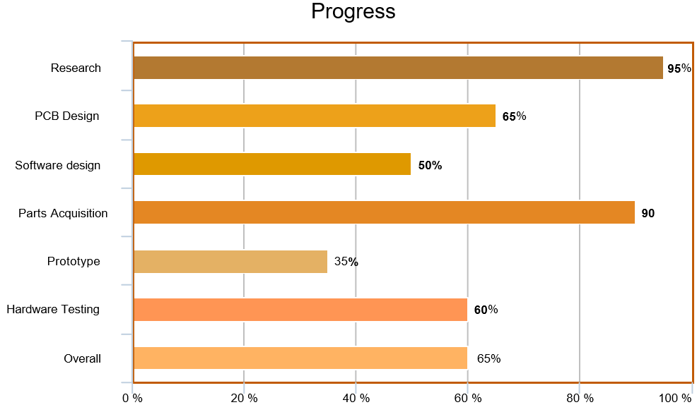

Slide 33
Issues
Mounting components to frame.
PCB design new variables to consider.
Solar-power presents unique challenges.

Slide 34
Questions

