Slide 1
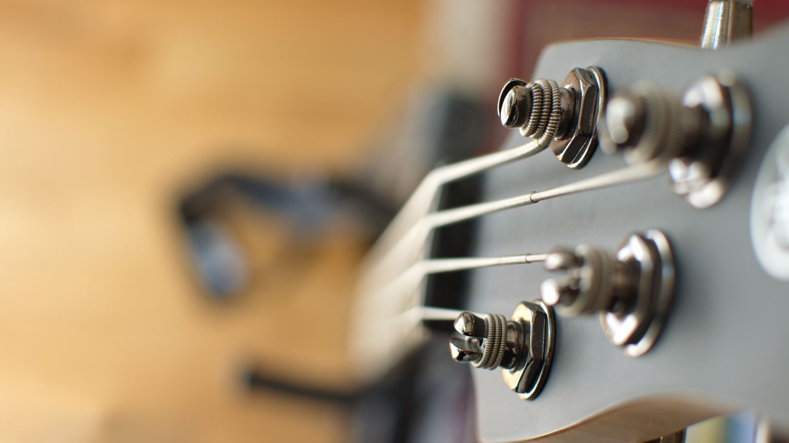
The Polyphonic
Analog-to-MIDI Converter
Group 12
Sean Dillon, EE
Andrew Obeso-Silva, CpE
Colin Smith, EE
Noah Watts, CpE

Slide 2
Contents
Introduction
  Motivation
  Objectives
  Requirements Specifications
  Block Diagrams
Hardware Design
  Power
  Preamp & filters
  Overall Schematic/PCB Design
Software Design
  MCU Overview
  ADC Driver
  Frequency Spectrum Generation
  Note Detection
  MIDI Stream & MIDI Out
  USB Driver
Budget and Spending
Progress

Slide 3
Motivation
Apply knowledge of electrical design to music technology
Create a novel device with applications for performance and studio settings using MIDI (Music Instrument Digital Interface)
No device on the market claims to perform real-time conversion of instrument signal to MIDI for multiple notes at once (polyphony).

Slide 4
Goals/Objectives
Use FFT and frequency analysis algorithms to identify multiple musical pitches at once
Accept input from ¼" cable (standard for electric instruments) or XLR3 cable (for microphones and line-out signals)
Interface with a MIDI instrument or Digital Audio Workstation (DAW) as a MIDI controller
Be compact and portable enough for use in live settings

Slide 5
Requirement Specifications
Parameter | Description | Value | Unit
Polyphony | The number of voices observed at once | 6 | Voice
MIDI Stream Latency | Target for time between reception of signal and note output | 100 | ms
Note Accuracy | The number of correct notes detected divided by the total number of notes detected | 0.8
Minimum Note Pitch | Lowest frequency detected | 82.41 | Hz

Slide 6
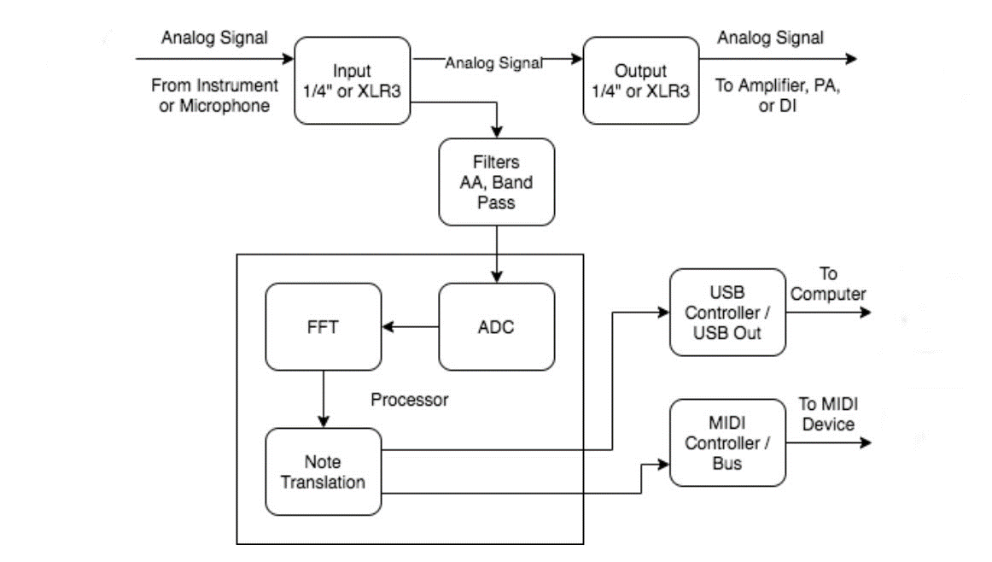
Block Diagrams

Slide 7
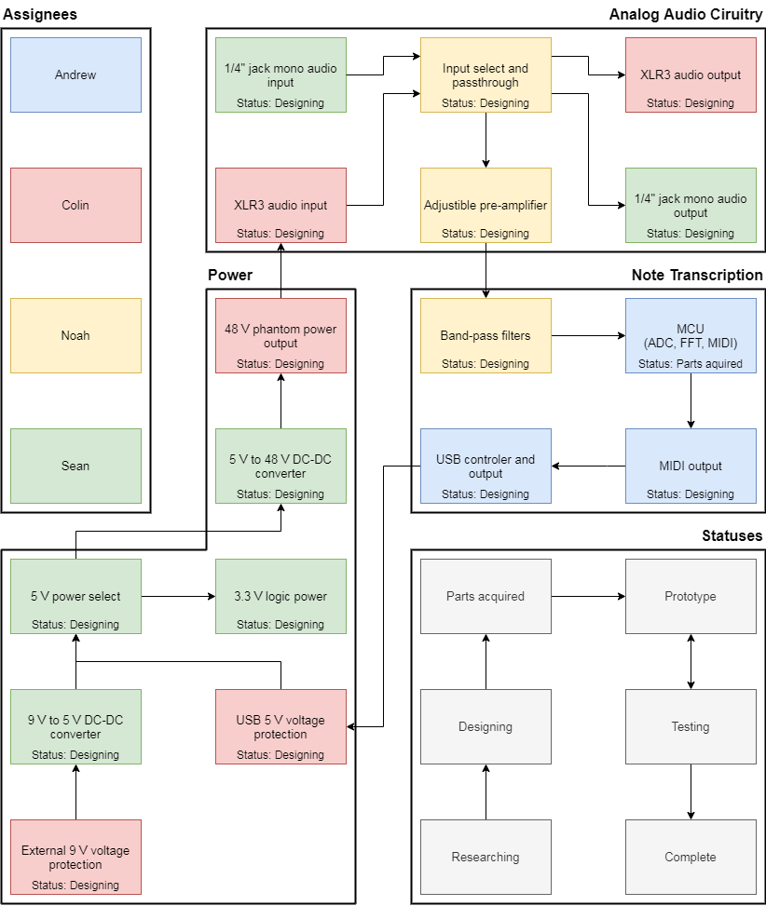
Block Diagrams
Hardware Block Diagram with division of labor

Slide 8
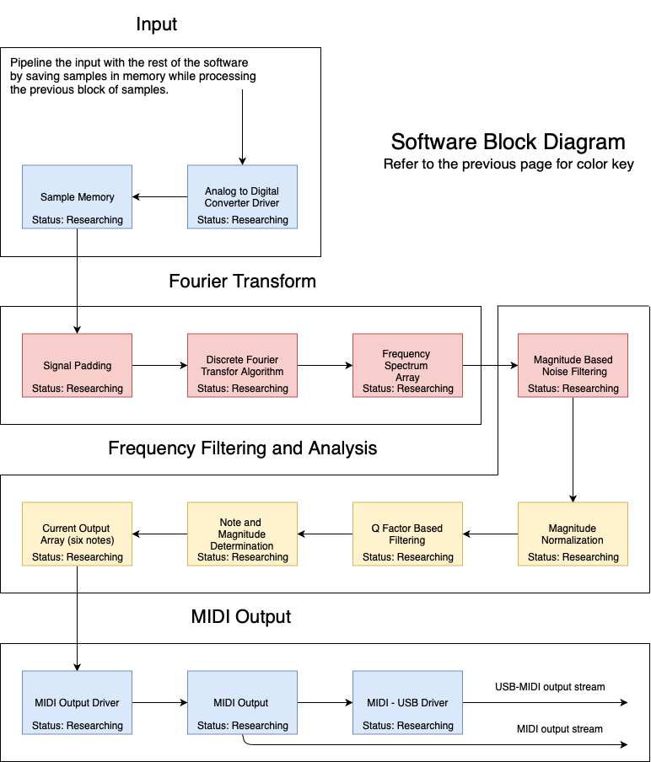
Block Diagrams
Software Block Diagram

Slide 9
Analog Preamp
Phantom Power
Buffered Pass through
Adjustable Voltage Amplifier
Clipping detection
Multistage Bandpass filter

Slide 10
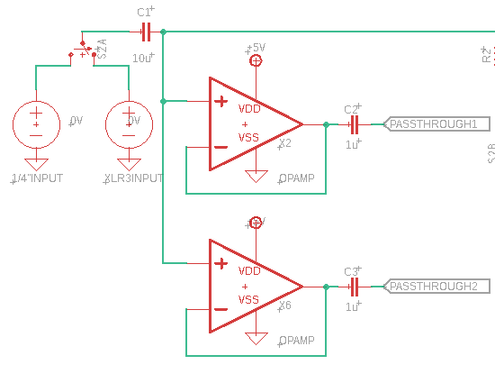
Analog Preamp
Phantom Power
  Provides 48v power to active microphones
  Balanced lines cancels out noise
Buffered Pass through
  Allows user to use the unaltered signal with other devices at the same time with a corrected impedance

Slide 11
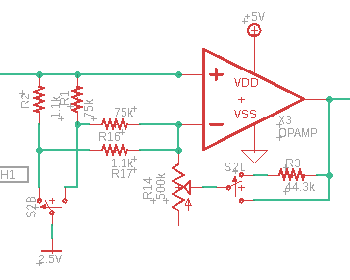
Analog Preamp
Voltage Amplifier
  Amplify signal to try and maximize ADC resolution and signal to noise ratio
  Bias the signal to center of ADC voltage range
  Potentiometer to adjust gain based on input gain
  Toggle switch to adjust voltage ranges due to differences in mic and line levels

Slide 12
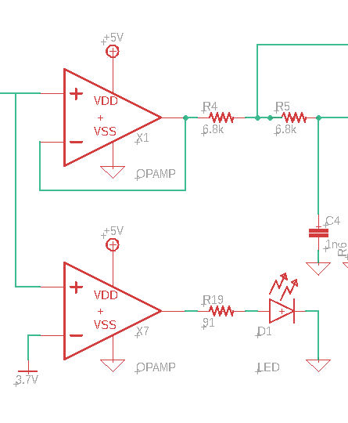
Analog Preamp
Clipping detection
  Op Amp based comparator circuit used to compare reference voltage and input voltage
  When above the reference voltage the output swings to the positive power rail due to open loop "infinite" gain
  This powers an LED indicator to show that the signal is above the level needed for the ADC input

Slide 13
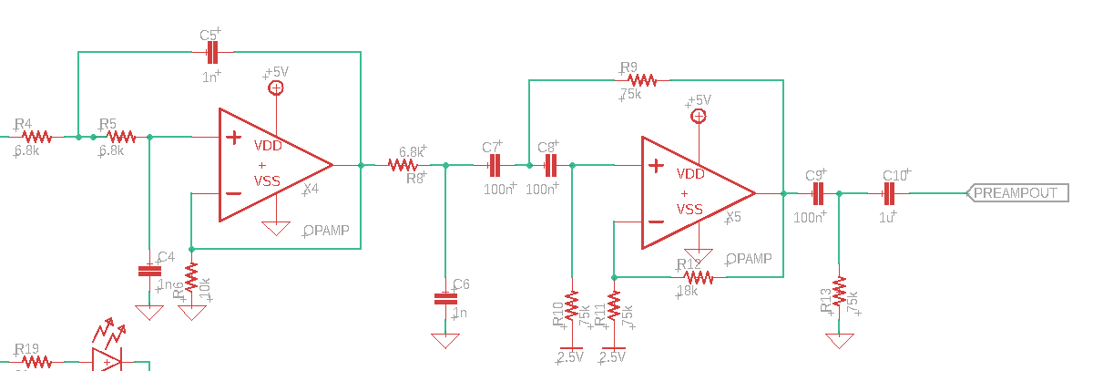
Analog Preamp
Multistage Bandpass filter
  3 Stage Butterworth low and high pass to form a bandpass filter
  Filters out extraneous low and high frequencies before the ADC

Slide 14
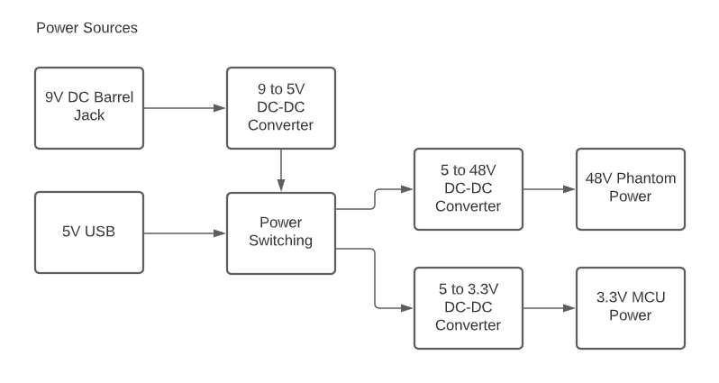
Power

Slide 15
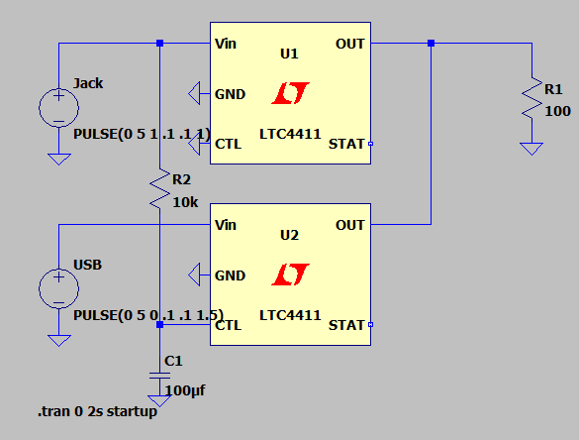
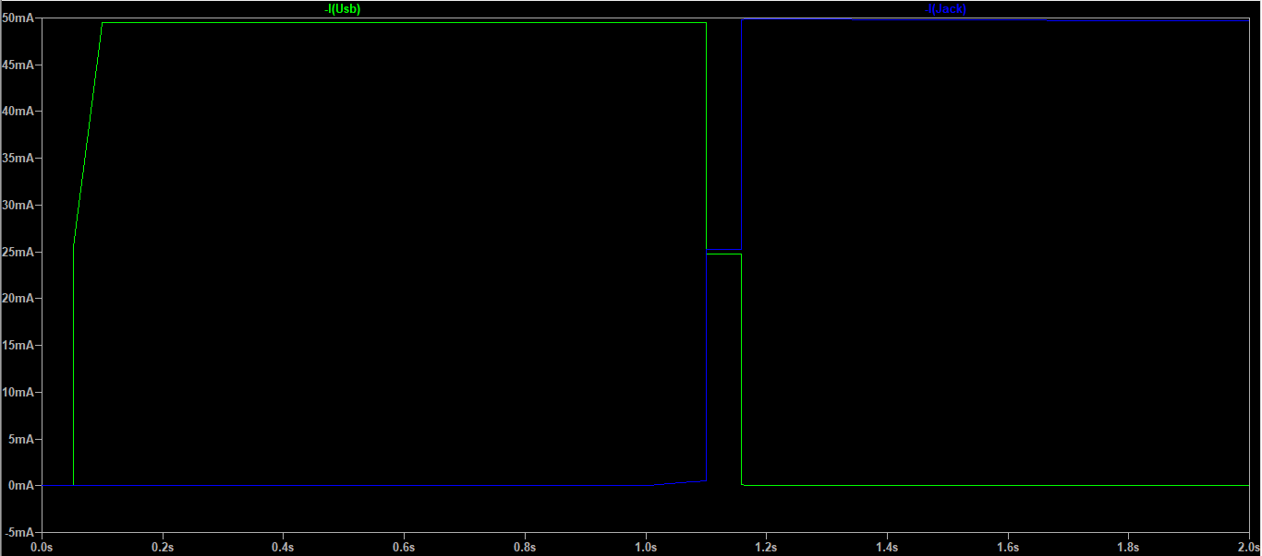
Power Switching
Power switching circuit uses two LTC4411 IC's
Prioritizes voltage from DC Barrel Jack over USB
When both sources are plugged in only the voltage from the DC Barrel Jack is used

Slide 16
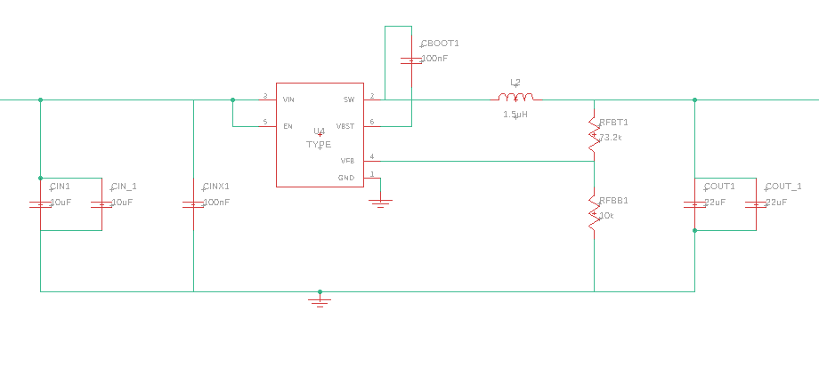
DC-DC Converters
9 to 5V DC-DC converter needed to convert 9V from DC barrel jack to 5V for general power
TPS563231 IC from Texas Instruments
All DC-DC converters designed using TI Webench Power Designer

Slide 17
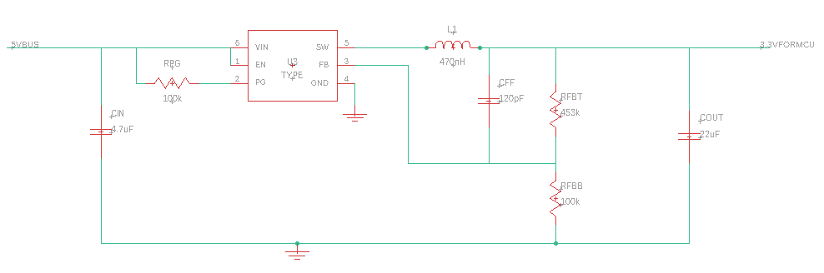
DC-DC Converters
5 to 3.3V DC-DC converter needed for 3.3V MCU Power
TPS62825 IC from Texas Instruments

Slide 18
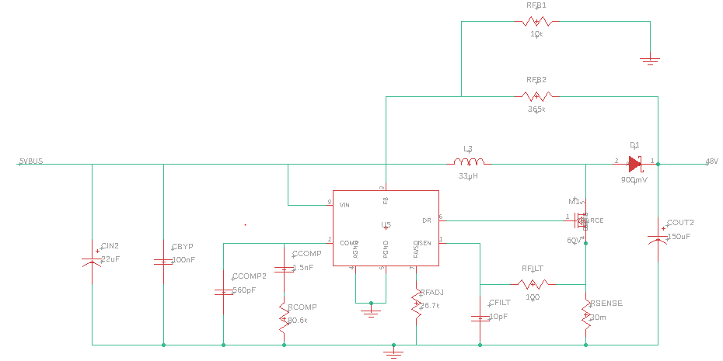
DC-DC Converters
5 to 48V DC-DC Converter needed to provide 48V phantom power to condenser microphones
LM3478 IC from Texas Instruments

Slide 19
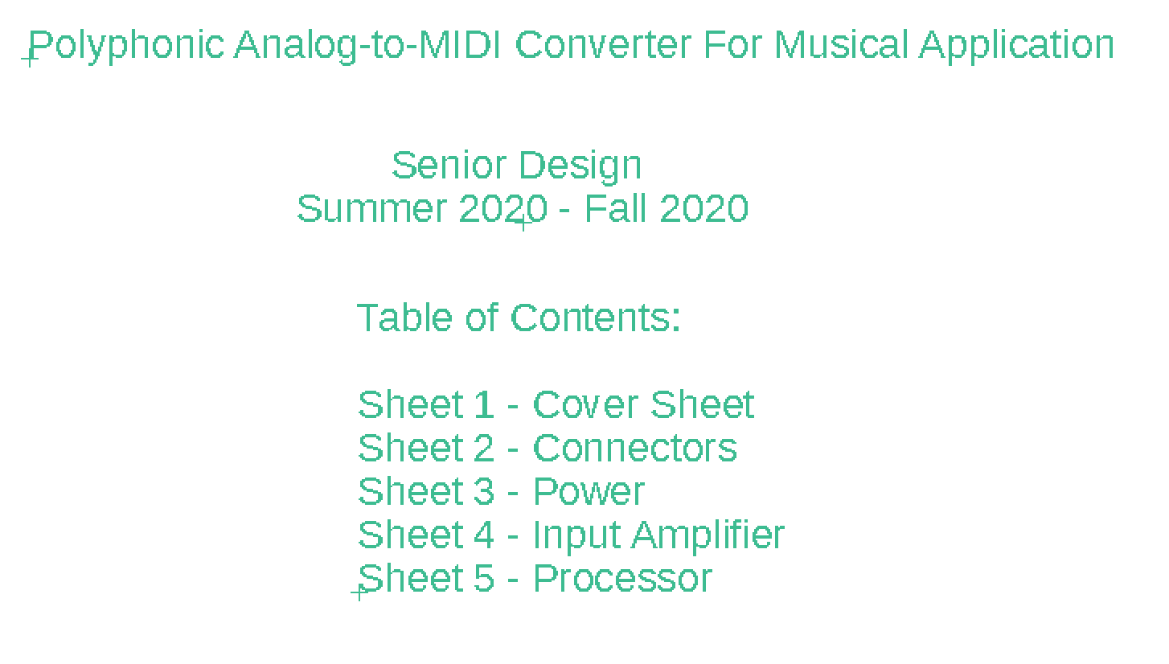
Schematic Design
All the individual pieces are assembled into one large schematic in Autodesk EAGLE.

Slide 20
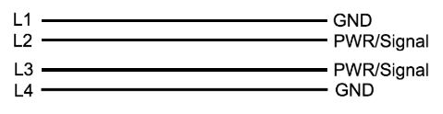
PCB Design
4 Layer board stackup
  Total thickness 1.6mm
  Greater distance between L2 and L3 than between L1 and L2 or L3 and L4
  Run traces orthogonally on L2 and L3 for reduced crosstalk
Advantages:
  Better coupling to GND planes
  Easier for signals to change layers
  Reduced crosstalk with internal signal layers

Slide 21
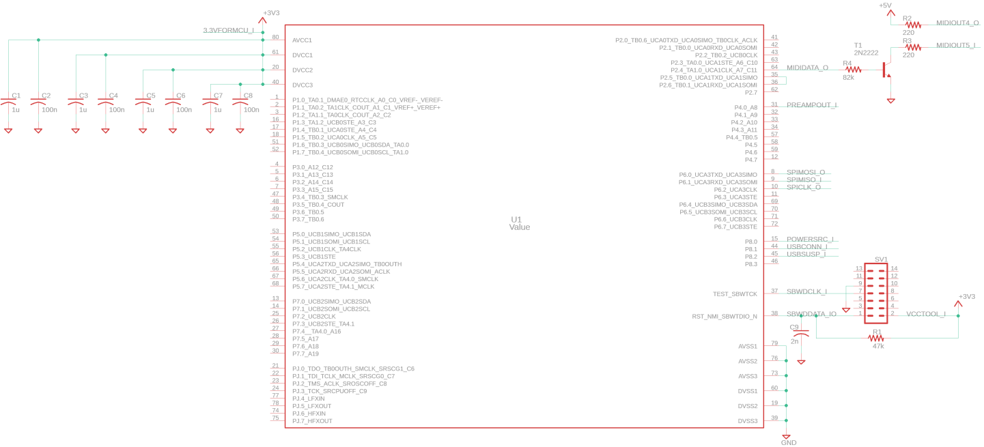
MCU Overview
TI MSP430FR5992
  Up to 16 MHz clock speed
  Familiar architecture & development environment
  Hardware acceleration for FFT and DSP operations
  Low power & low cost
  12-bit ADC with up to ~200 kHz sample rate
  UART & SPI serial interfaces
  4 kB + 4 kB of RAM

Slide 22
ADC Driver
Sampling rate of ~12.5 kHz required
  Makes Nyquist frequency ~6.2 kHz, close to note G8
  G9 is the highest note defined by General MIDI 1, but barely audible
Sample resolution of at least 8 bits
  MIDI Note Velocity (volume) is only 7 bits
ADC input is double-buffered
  Allows receiving input while performing FFT

Slide 23
Frequency Spectrum Generation
Capture frequency content of the signal using FFT
  2048-pt FFT required with ~6.2 Hz step/12.5 ksps
  Captures frequencies corresponding to notes E2 to G8
  160 ms buffer latency, 4 kB RAM!
  Needlessly high density at highest frequencies
Instead, split into 3 stages across different pitch ranges
  3rd stage: 512-pt, 40 ms
    E4 to G8
  2nd stage: 64-pt, 40 ms
    E3 to G4
    Perform FFT when buffer ½ filled
  1st stage: 64-pt, 40 ms
    E2 to G3
    Perform FFT when buffer ¼ filled

Slide 24
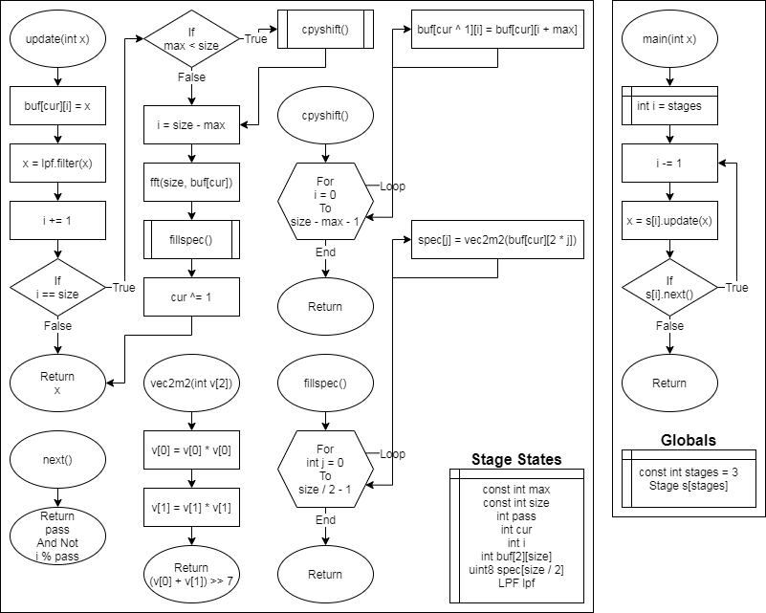
Frequency Spectrum Generation
Samples are passed through an LPF to lower stages
  Passed at a fraction of the higher stage's sampling rate
  Currently an elliptical IIR filter
  Reduce the effect of aliasing
Overall buffer period reduced to ~40 ms
  At the cost of accuracy at low frequencies
  Accuracy at high frequencies can make up for this

Slide 25
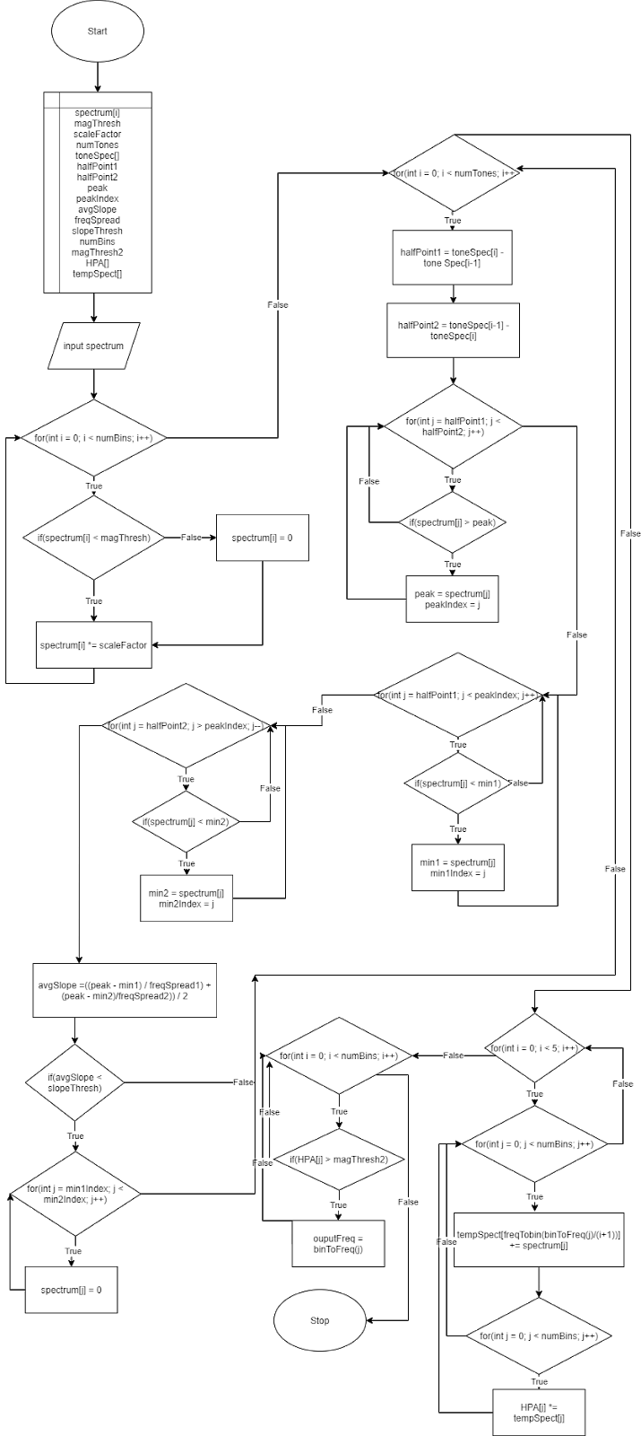
Note Detection
Magnitude based filter
Q Factor based filter
  Estimates the Q factor from the slope from the peak
Harmonic Product Spectrum
Final filter and note selection
In linear time complexity – O(n)

Slide 26
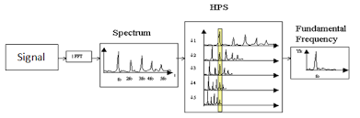
Note Detection
Harmonic Product Spectrum
  Divides frequency spectrum by harmonic multiples
  Multiplies these spectrums together to find the
  fundamental frequencies

Slide 27
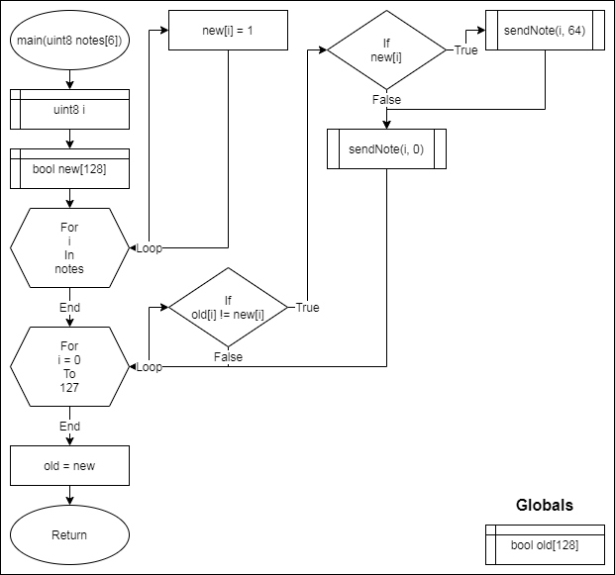
MIDI Stream and MIDI Out
These messages carry note information:
  Note On
  Note Off (optional)
  Pitch Bend (optional)
Stream consists of Status and Data bytes
  Can leave out the status byte if each subsequent message is the same type

Slide 28
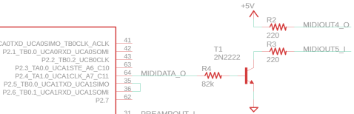
MIDI Stream and MIDI Out
Basic MIDI output physical layer implementation uses a UART, NOT gate, and a transistor
  31.25 kHz baud rate
Our implementation feeds the UART output to the MCU which outputs the inverted signal

Slide 29
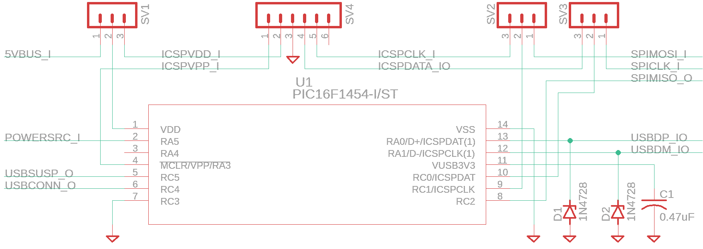
USB Driver
USB interface handled by the Microchip PIC16F1454
  Low cost, low power
  14 pins, 48 MHz clock, 1 kB RAM
  Communication between MSP430 through SPI
  Implements USB link, network, and transport layers
MIDI data is received through SPI

Slide 30
USB Driver
Implements the MIDIStreaming Interface of the USB Audio Device Class
  Wraps MIDI data stream into 4-byte packets
  Each contains 1 USB-MIDI byte, 1 status byte, and 2 data bytes
  Packets sent when requested by host

Slide 31
Budget
Money Spent so far: $120.37
Expected Budget
Component/Device | Budget
PCB | 200$
Analog-to-Digital Converter | 10$
Processor | 20$
USB cable | 2$
MIDI cable | 3$
Case | 30$
Passive components | 30$
DC-DC converters | 50$
Input/output interfaces | 30$
Voltage regulators and active components | 50$
48 V Phantom Power Output | 25$
TOTAL | 450$

Slide 32
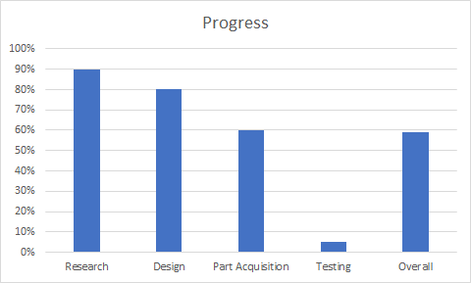
Progress

